Slide 1
SN Classification Study
Vincent Roma
SN F2F 2016

Slide 2
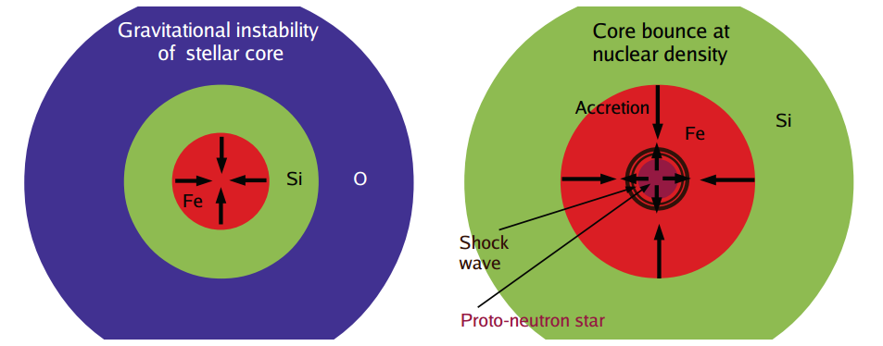
Core Collapse and Bounce

Slide 3
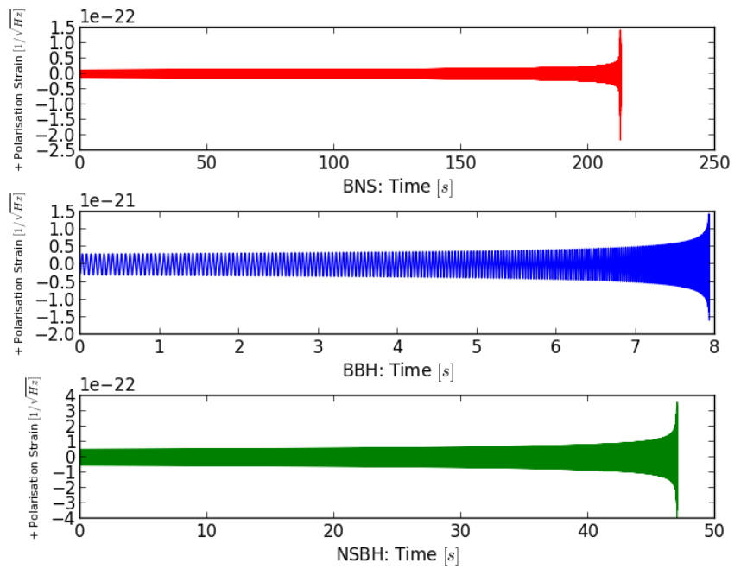
CBC Waveforms

Slide 4
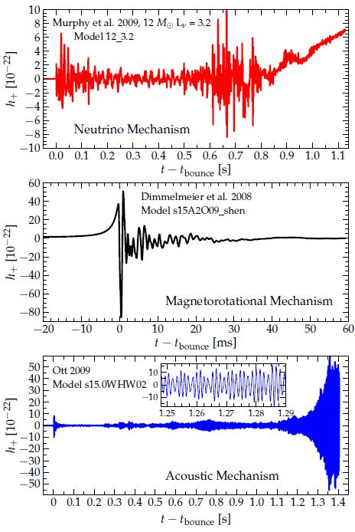

Slide 5
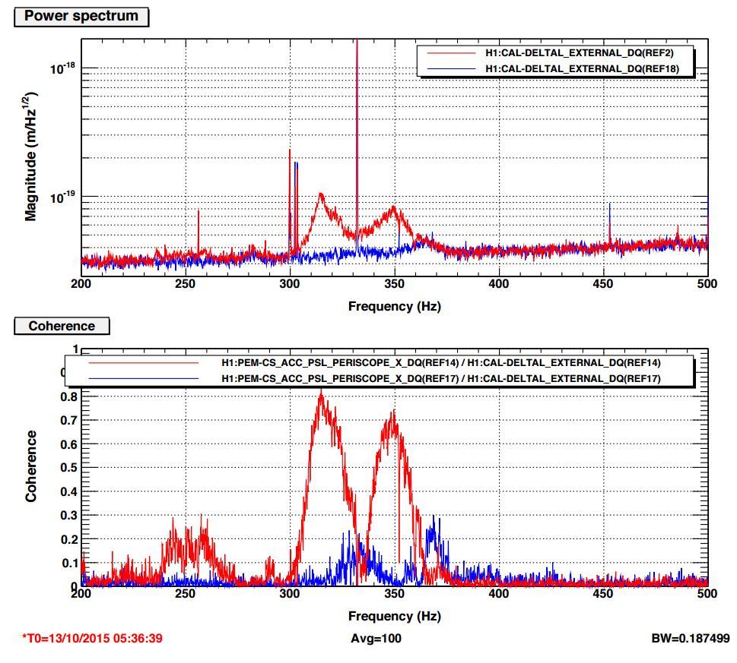
PSL Periscope Before and After Improvement

Slide 6
Preliminary Results
October 12 2015 | October 17 2015
Injected Waveform |  | Log B_{DN} (Dim PCs) |  |  | Log B_{MN} (Mur PCs)
 | .2 kpc | 2 kpc | 10 kpc | .2 kpc | 2 kpc | 10 kpc
Dim | 303311 | 232650 | 3079 | 2329 | 123 | 83 | 106490 | 76438 | 31 | 491 | -1.7 | 9.3
Mur | 385 | 241 | 2.7 | -0.4 | -0.7 | -0.5 | 244 | 161 | -1.4 | -0.6 | -2.8 | -1.0

Slide 7
Dimmelmeier Injections
Distance [kpc] | Oct 12 log B_{DM} | Oct 17 log B_{DM}
.2 | 196821 | 156212
2 | 3048 | 1838
10 | 125 | 74

Slide 8
Murphy Injections
Distance [kpc] | Oct 12 log B_{MD} | Oct 17 log B_{MD}
.2 | -141 | -80
2 | -4.1 | -0.2
10 | -2.1 | -0.5

Slide 9
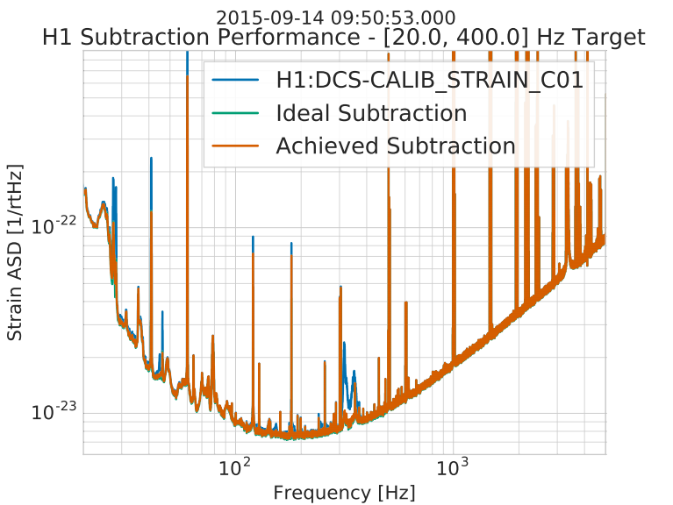
Noise Subtraction with Wiener Filtering

Slide 10
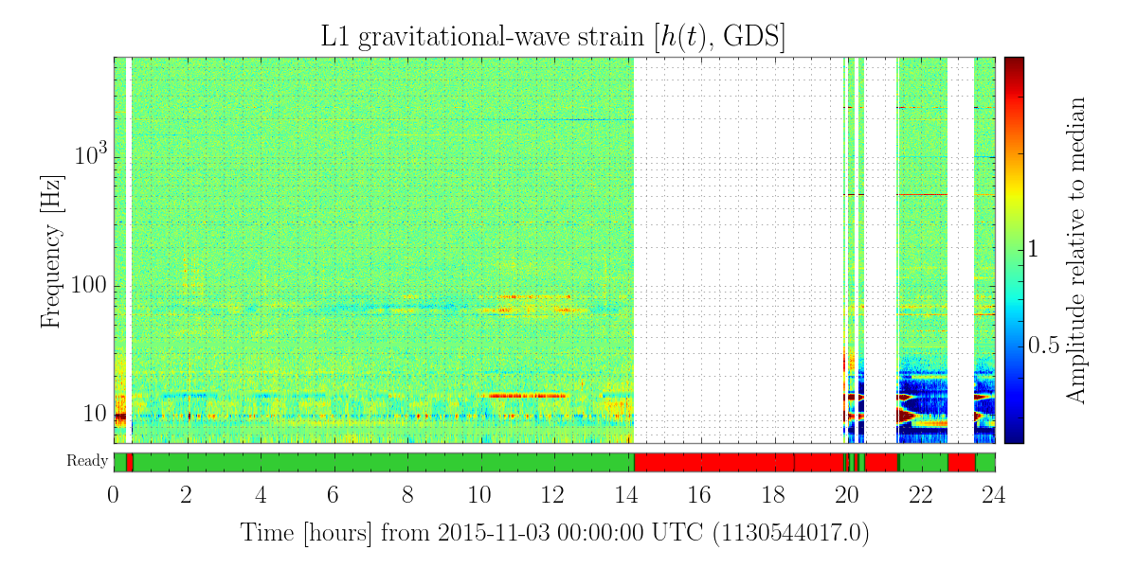
Other Environmental Noise Sources
“Noise breathing” at LLO. Mainly ~55 – 90 Hz.
Inevitable future noise sources found in O2.
Perform noise subtraction to study possible improvements to SN classification and parameter estimation.

Slide 11
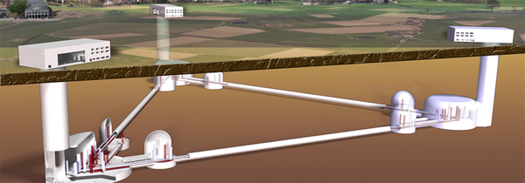
Map Out SN Waveform Classification and Parameter Estimation in Future Detectors
A+ improvements to existing LIGO interferometers
LIGO Voyager
Einstein Telescope

Slide 12
References
Core-Collapse Supernovae: Reflections and Directions - Janka, H.-Thomas et al. PTEP 2012 (2012) 01A309 arXiv:1211.1378 [astro-ph.SR]
http://www.phys.ufl.edu/ireu/IREU2013/pdf_reports/JennaKlemkowsky.pdf
McIver, Jessica, "The impact of terrestrial noise on the detectability and reconstruction of gravitational wave signals from core-collapse supernovae" (2015). Doctoral Dissertations May 2014 - current. Paper 539. http://scholarworks.umass.edu/dissertations_2/539
Logue, Josh. “Bayesian Model Selection with Graviational Waves from Supernovae” (2014). LIGO-P1400176-v1
Logue, Josh. “Inferring Core-Collapse Supernovae Physics with Gravitational Waves” (2013). LIGO-G1300650-v1
Special thanks to Jade Powell and Jess McGiver for their help.

