Slide 1
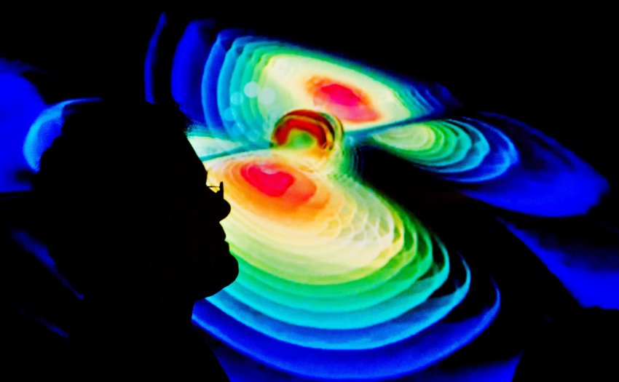

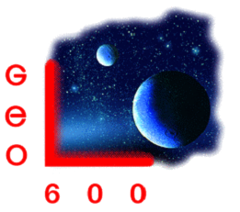

Gravitational Wave Detection
Harald Lück
on behalf of the LIGO Scientific Collaboration
Albert-Einstein-Institut (AEI) Institut für Gravitationsphysik Leibniz Universität Hannover
LIGO-G1601727.

Slide 2
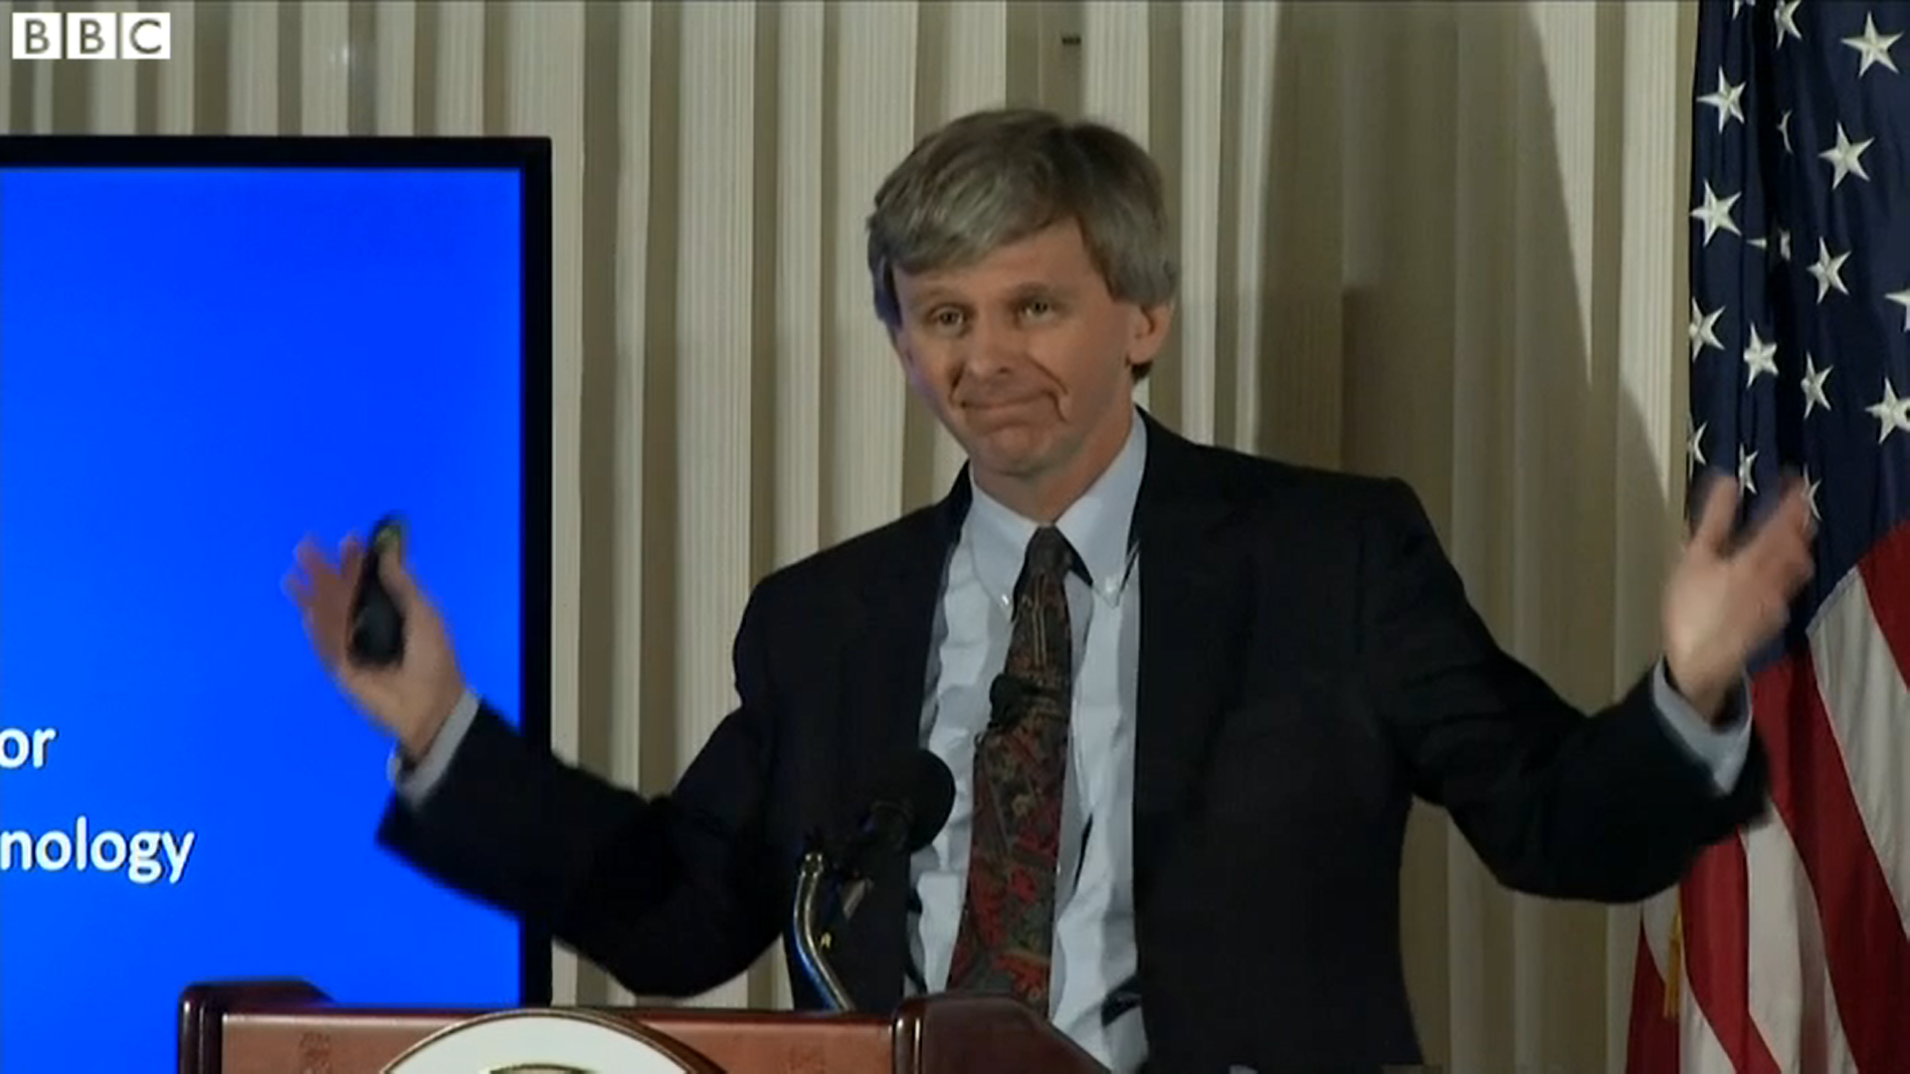
Press conference
Feb. 11th 2016
Washington D.C.
We have detected
GRAVITATIONAL WAVES !
We did it !

Slide 3
Who is WE ? → paper has 1004 authors
Phys. Rev. Lett. 116, 061102
Notes:
The detection has been made by the combined, huge effort of many people

Slide 4
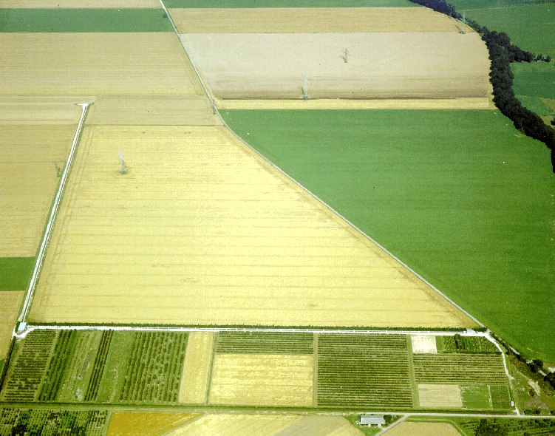
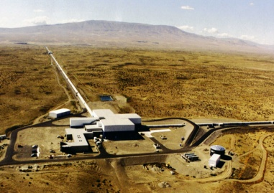


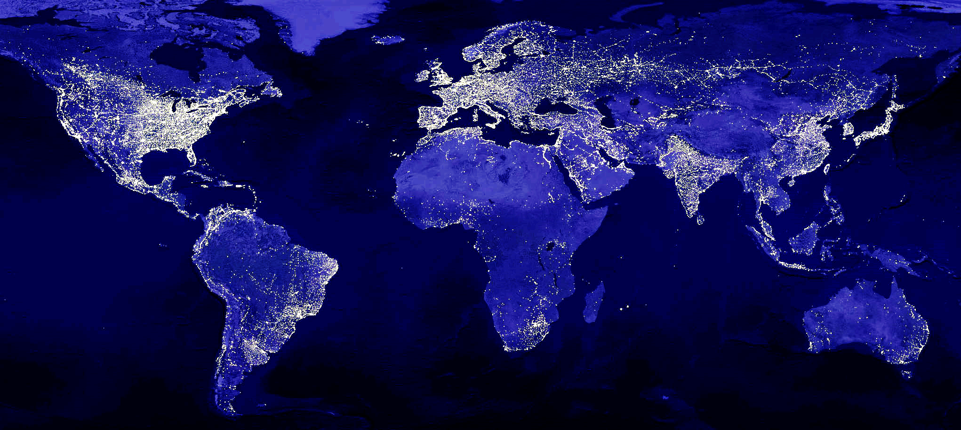
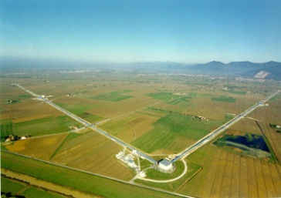
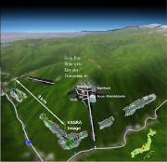


The advanced GW Network
Advanced LIGO Hanford, 2015
GEO600, 2011
Advanced LIGO
INDIA, 2014
Advanced Virgo
2016
KAGRA 2018
Advanced LIGO Livingston, 2015
Notes:
„We“ have a network of GW detectors distributed over the earth, in all stages between operational and planned.
LSC composition: (As of January 2016)
Total members: 1006 Total institutions: 83
Countries represented: 15

Slide 5
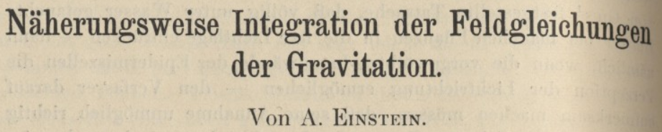
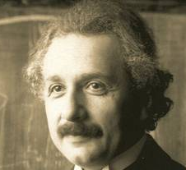
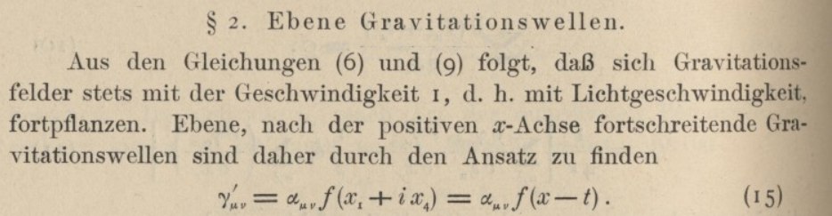
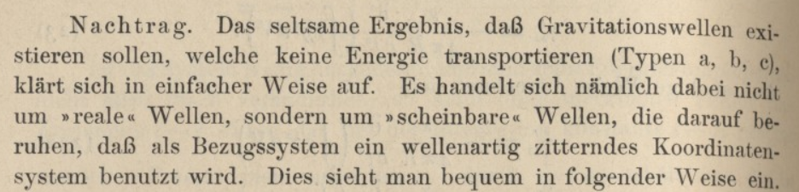
Notes:
Almost exactly 100 years ago, Einstein predicted the existence of GWs. He was rather sceptical about the existence though and revised his opinion quite a few times. Not knowing of any of the sources that we expect to detect today, he also thought that GWs are irrelevant.
Einstein in a letter to Bohr: If only it were not so damnable difficult to find rigorous solutions

Slide 6
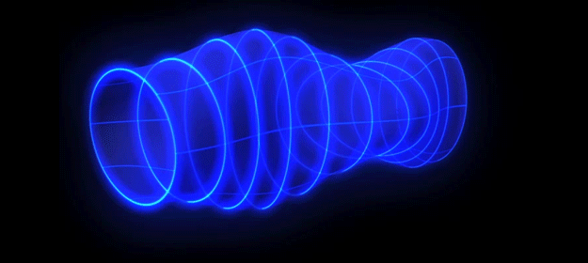
Propagating Gravitational Waves
Transversal waves in space-time travelling @ speed of light
Credit: ESA–C.Carreau
Notes:
GWs are changes of space-time curvature travelling at the speed of light. The measurable effect is tiny length changes in orthogonal directions.

Slide 7
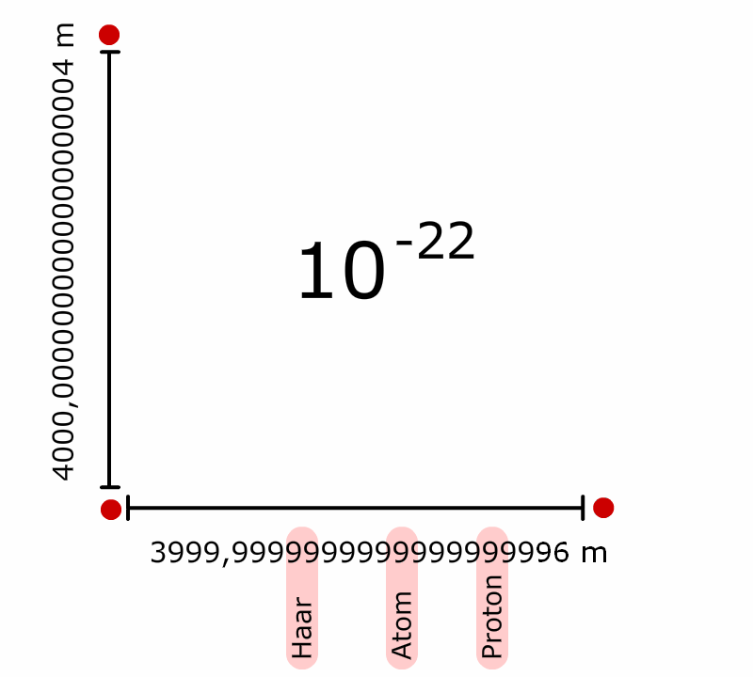
Effect of a GW
on an interferometer
of 4km length
h =
Notes:
The natural choice for detecting GWs is a Michelson interferometer. This was first proposed by two Russian scientists in the early 60’s.
1E-22 = length changes of a gravitational wave that we can just detect. The length changes are unimaginably small. The distance between earth and the sun would change by a fraction of the diameter of a hydrogen atom.

Slide 8
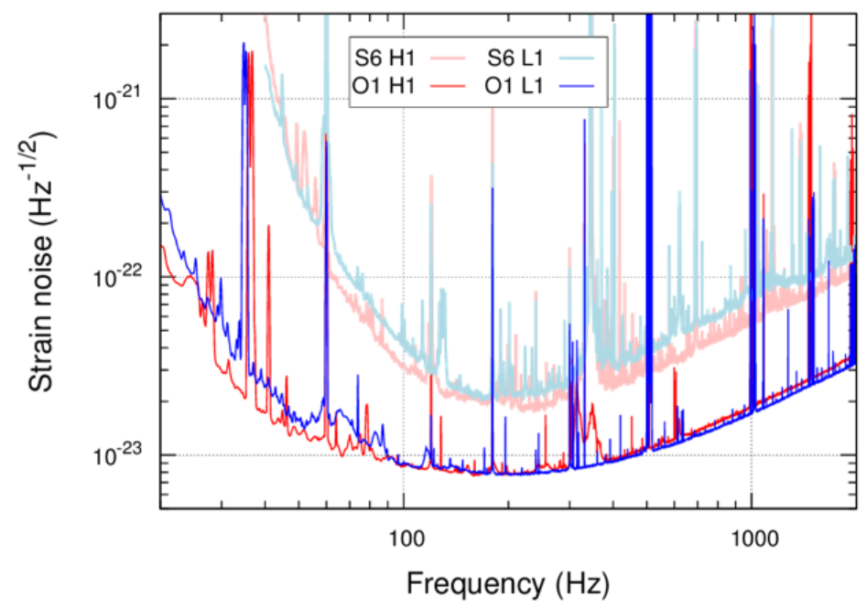
Sensitivity improvement eLIGO <-> aLIGO
Notes:
Although these changes are so small, with our gravitational wave detectors we can now measure them. This graph shows the advances from the LIGO detectors in the data runs before and after upgrading to advanced LIGO. It was especially the low frequencies, where the sensitivity increased more than tenfold, that contributed to the detection. Keep in mind that the amplitude of GWs (which is detected) decreases linearly with distance and hence an increase in sensitivity by a factor of 10 increases te volume by a factor of 1000.

Slide 9
“Observation of
Gravitational Waves from a
Binary Black Hole
Merger”
THE Detection
GW150914
14. September 2015
09:50:45 UTC
= 11:50:45 CEST
Detection of a transient signal in both
advanced LIGO
detectors

Slide 10
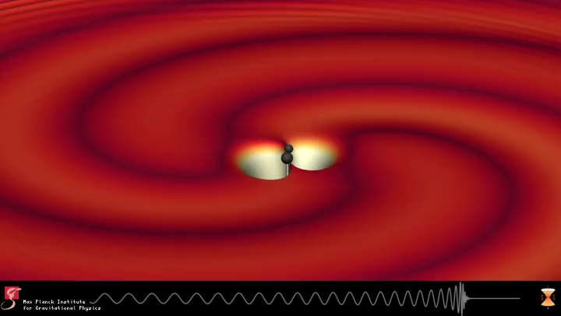
Notes:
Two black holes orbiting each other and emitting sinusoidal GW in the process. The radiation causes the system to loose energy and the BHs approach each other.

Slide 11
GW150914
Phys. Rev. Lett. 116, 061102

Slide 12
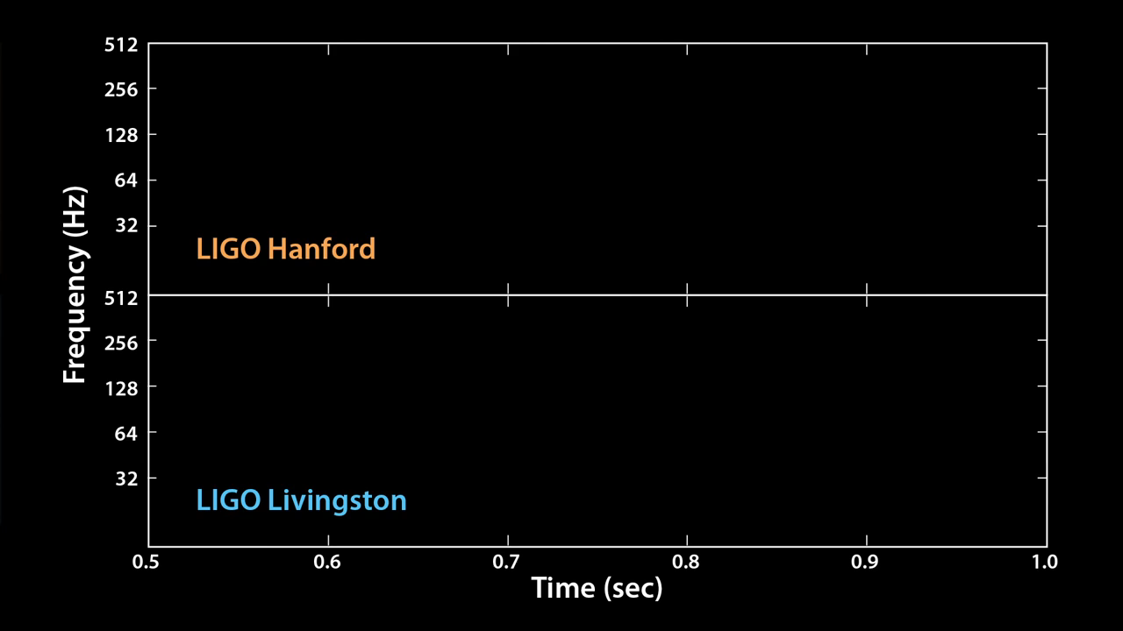
GW150914

Slide 13
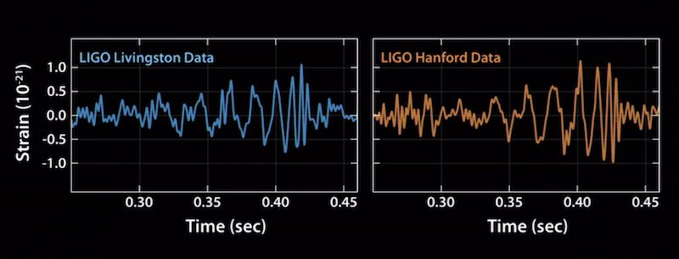
GW150914 = Binary BH
Phys. Rev. Lett. 116, 061102

Slide 14
Large template bank to determine parameters
Phys. Rev. Lett. 116, 061102

Slide 15
Phys. Rev. Lett. 116, 061102
Two black holes with 29 and 36 solar masses

Slide 16
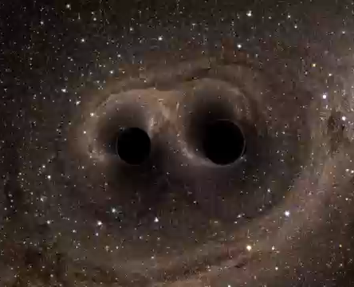
The most powerful event ever “seen”
GW150914
Before: two BHs (29 M⊙ + 36 M⊙ = 65 M⊙)
After: One BH (62 M⊙)
Within 0.2 sec 2 M⊙
were radiated off in GWs
= 4 × 10³⁰ kg (E=M c²)
3.5 × 10⁵⁶ erg / s
= 3.5 × 10⁴⁹ W
50x as much as all stars
in the universe together
Notes:
3 Msun is from infinity. It is 4.8% of the total (initial) mass of the system. In band is 3.9% (20Hz) or 3.6% (30Hz)
For comparison, the ultraluminous GRB 110918A reached a peak isotropic-equivalent luminosity of
4.7×10^^54 erg/s

Slide 17
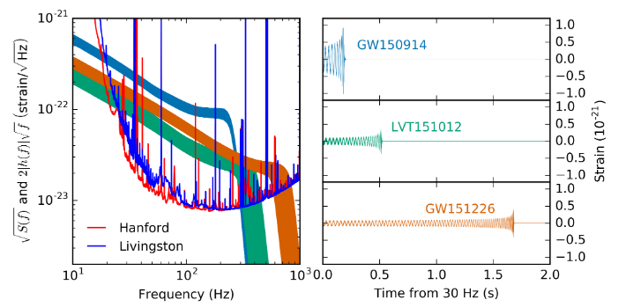
There were more Signals in O1
arXiv:1606.04856 and acc. by Phys. Rev. X;
Binary Black Hole Mergers in the first Advanced LIGO Observing Run

Slide 18
Discovery Timeline O1
Courtesy Caltech/MIT/LIGO Laboratory
Notes:
O1 data from September 12, 2015 to January 19, 2016, which
contains a total coincident analysis time of 51.5 days accumulated
when both detectors were operating in their normal
state.

Slide 19
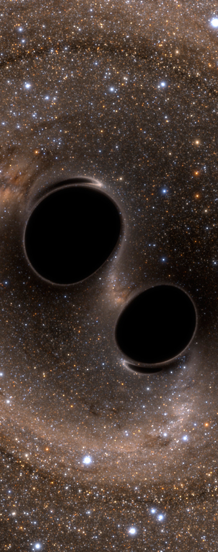
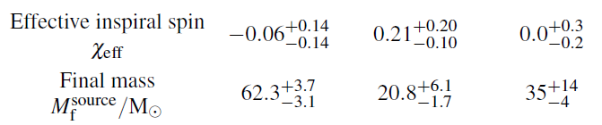
“The Three
Signals”
journals.aps.org/prl/abstract/10.1103/
PhysRevLett.116.241103,
arxiv.org/abs/1606.04856
(accepted to PRX))
arXiv:1606.04856

Slide 20
Know Stellar-Mass
Black Holes - August 2016

Slide 21
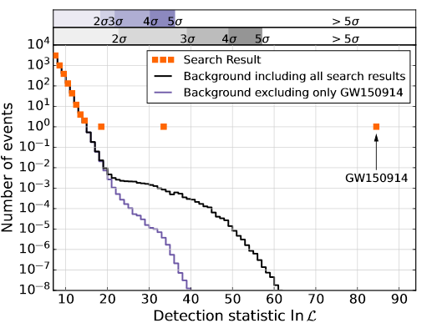
Statistics GW150914 & GW151226
False alarm rate > 1.6 My
Significance > 5.3 σ
False Alarm Probability = 7.5x 10⁻⁸
Ca. 48 d coincident time (after cleaning, vetoeing and min. lock duration filter) With 0.1 s time shift background analysis → 1.6My equiv. data
arXiv:1606.04856
Notes:
O1 data from September 12, 2015 to January 19, 2016, which contains a total coincident analysis time of 51.5 days accumulated when both detectors were operating in their normal state. … After applying this data quality process, detailed in [50], the remaining coincident analysis time in O1 is 48.6 days.
The analyses search only stretches of data longer than a minimum duration, to ensure that the detectors are operating stably. The choice is different in the two analyses and reduces the available data to 46:1 days for the PyCBC analysis and 48:3 days for the Gst-LAL analysis.

Slide 22
Anything else?
No!
LIGO records >100000 data channels
Many environmental sensors (Seismic, magnetic + elektric fields, acoustics, etc.)
  Coupling to h(t) well known

Slide 23
Sky Localisation
Image credit: LIGO (Leo Singer) /Milky Way image (Axel Mellinger)

Slide 24
The advanced GW Network
Advanced LIGO Hanford, 2015
GEO600, 2011
3000km
Advanced LIGO
INDIA, 2014
Advanced Virgo
2016
KAGRA 2018
Advanced LIGO Livingston, 2015
Notes:
„We“ have a network of GW detectors distributed over the earth, in all stages between operational and planned

Slide 25
How far away was GW150914?
1.3 billion light years away
The merger happened 1.3 Gy ago
How do we know?
Time evolution → mass of the objects
mass + time evolution → GW amplitude @ origin
h(r) = h₀ /r
h@earth = h_{observed} → distance

Slide 26
EM Follow-up observations
THE ASTROPHYSICAL JOURNAL LETTERS, 826:L13, 2016 JULY 20
Preliminary estimates of the time, significance, and sky location of the event were shared with 63 (80 now) teams of observers
covering radio, optical, near-infrared, X-ray, and gamma-ray wavelengths with ground- and space-based facilities
Alerts if FAR> < 1/month
Notes:
Timeline of observations of GW150914, separated by band and relative to the time of the GWtrigger. The top row shows GW information releases. The bottom four rows show high-energy, optical, near-infrared, and radio observations, respectively.
Optical spectroscopy and narrow-field radio observations are indicated with darker tick marks and boldface text. Table 1 reports more detailed information on the times of observations made with each instrument.
We are distributing event alerts to more than 80 EM partners. The false alarm rate threshold for sending alerts will be of the order of 1 per month. This threshold is the same as what was used in O1.
Public release of alerts is expected after a total of 4 detections. We expect the era of public alerts to occur after the end of O2 (even if we observe more than 4 events during O2). This is because switching from "private" and public alerts in the middle of an Observing Run will require a lot of preparation midrun to deal with the logistics, etc.

Slide 27
Upgrades → advanced generation
Upgrade | Parameter | Improvement
More laser power | Up to 200 W 800 kW in cavity | Shot noise
Larger Optics | ~ 40 kg | Less thermal noise
Better optics | < 0.25 ppm/cm < 0.3 nm rms | Less thermal lensing Less scattered light
Signal Recycling / RSE |  | Chose bandwidth independent from cavity buildup Tune centre frequency
Better suspensions (mainly LIGO) | Seismic isol. Glas fibres | Low frequency sensitivity Lower suspension thermal noise
Essentially all subsystems Input optics Output Mode Cleaner Electronics Auxiliary optics Thermal compensation Electrostatic Actuators |  | Less technical noise
Minor improvements
O1 → O2 (~50% Vol)
Notes:
Lots of subsystems upgraded from eLIGO to aLIGO
Many have been pioneered by GEO600 and are partly in kind contributions from the GEO collaboration, e.g. lasers and suspensions
After O1 detectors have been slightly improved reaching a slightly larger reach (ca. 80 MPc NS-NS vs 65 MPc in O1). Higher laser power and some low f improvements.

Slide 28
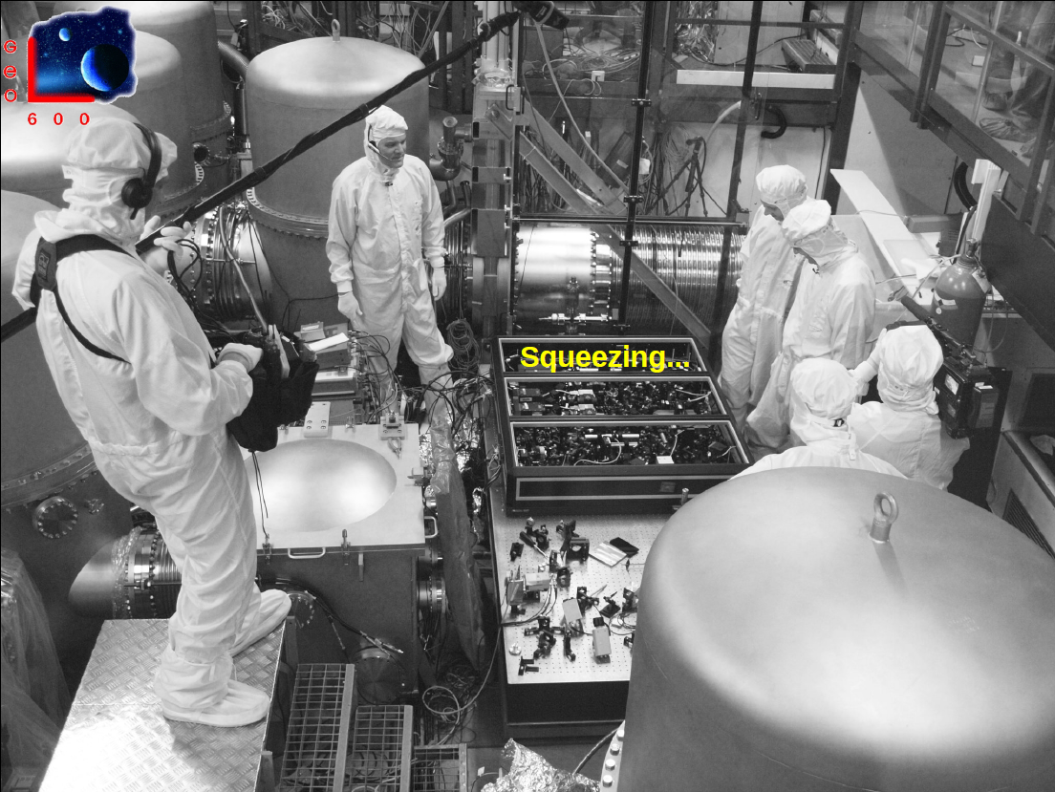
More to come

Slide 29
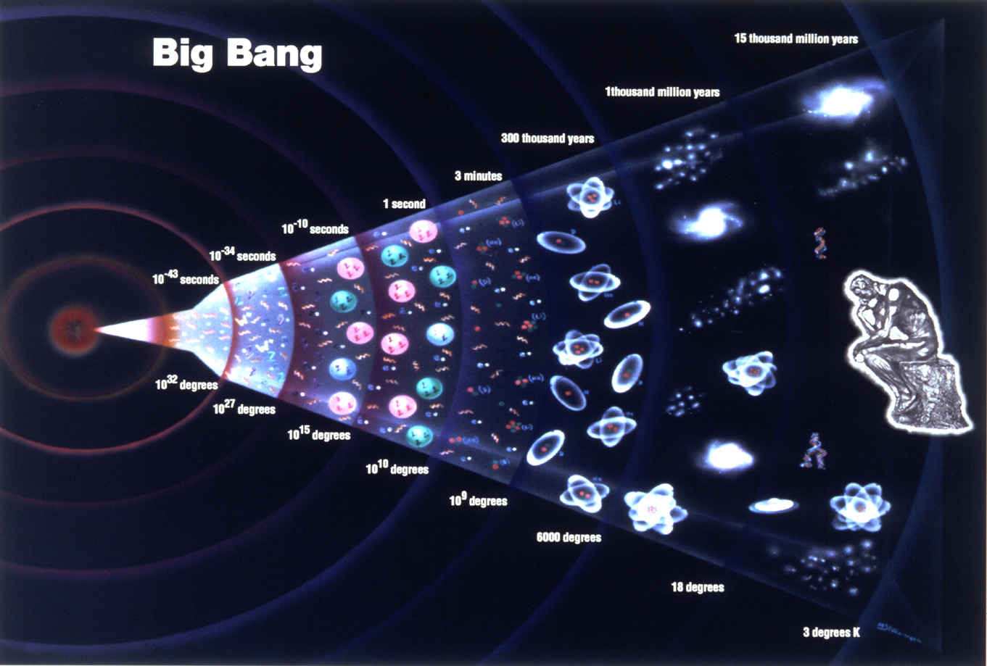
Detection is just the first step
The goal is
Gravitational Wave Astronomy
→ routinely observing regions and times which are inaccessible by other messengers
→ add info by combining GW & other messengers
Credit: universetoday.com

Slide 30
GW Spectrum
Sources
Quantum fluctuations in the early universe
Ultra massive
BH binaries in galactic centres
Ultra massive
BH swallow stellar objects
Binary systems in the milky way
Supernova
explosions
Coalescing Neutron star and Black hole systems
Fast rotating neutron stars
age of the universe
minutes
seconds
milli-
seconds
Period
years
hours
Spectrum
Frequency
Detectors
Notes:
GW cover a huge range in frequencies and wavelengths
From supermassive BH binaries to stellar mass sources and NS Eigenmodes
Requires different detector
BICEP CMB pol from Thomson scattering
Pulsar timing nHz - µHz
LISA mHz
Ground based Hz to kHz

Slide 31
Arm length ~1 Mio km
Notes:
Secured sources. Extremely high SNR.
LISA would have seen GW150914 ten years ago and predicted to the day.
Current launch date 2034. Hope to anticipate to 2028

Slide 32
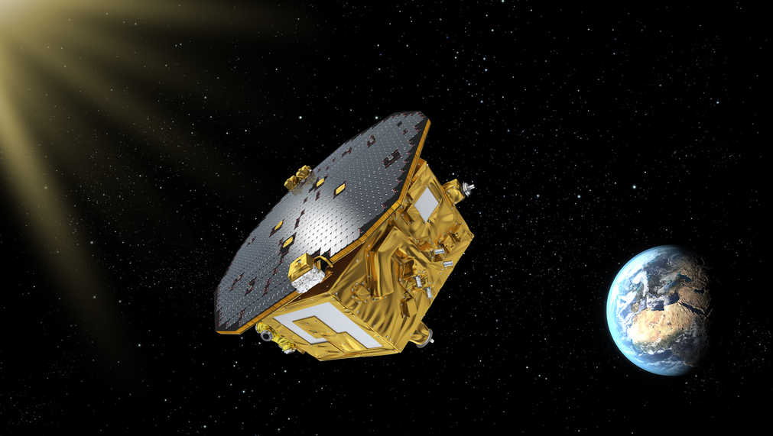
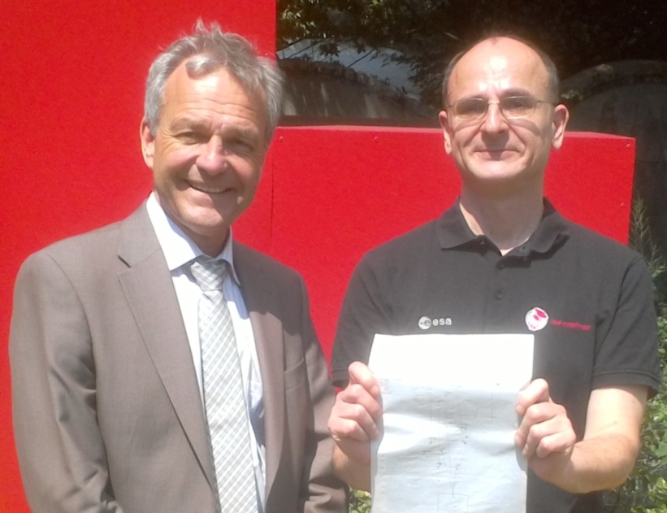
LISA and LISA Pathfinder
LISA Pathfinder results exceed expectations by orders of magnitude
Notes:
Test vital technology by compressing LISA arm into single space craft.
Launched in December. Great success so far.
In the picture: Karsten Danzmann and Gerhard Heinzel with an early hand made sketch of the LISA pathfinder readout after the press conference announcing success with LPF

Slide 33
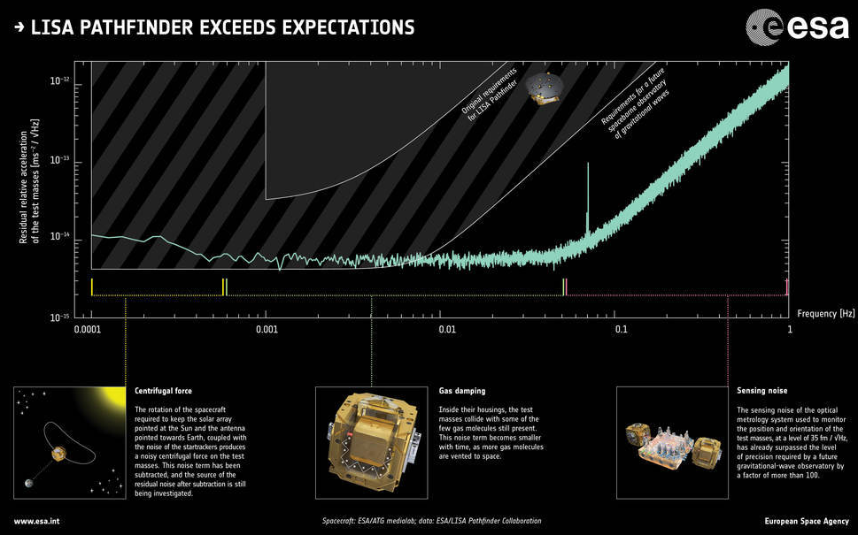
LISA und LISA Pathfinder
Notes:
LPF not only exceeds the specifications for LPF but also supersedes the requirements for LISA itself. By now the measured noise is below LISA specs over the full frequency range

Slide 34

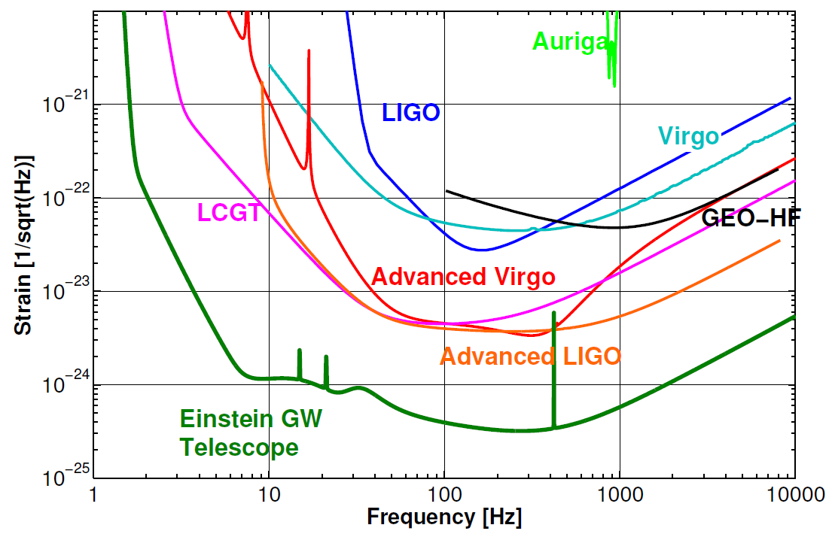
A long journey…
…on the path to routine GW astronomy
KAGRA
O1
LIGO Voyager
Cosmic Explorer
Notes:
It has been a journey of half a century and even more than two decades with the large interferometers to come to the point of detecting GWs, but we will continue on our way to routine GW astronomy.
The advanced detector will be upgraded as much as the facilities allow.
The sensitivity shown for LIGO Voyager will be close to the limits of the infrastructure and to improve further we will need new infrastructures

Slide 35
today
Credit: Michele Punturo
Notes:
O2 starting in about 5 weeks. 80% chance of seeing more than 10 events within the half year of O2 operation.

Slide 37
Sensitivities of potential LIGO upgrades

Slide 38
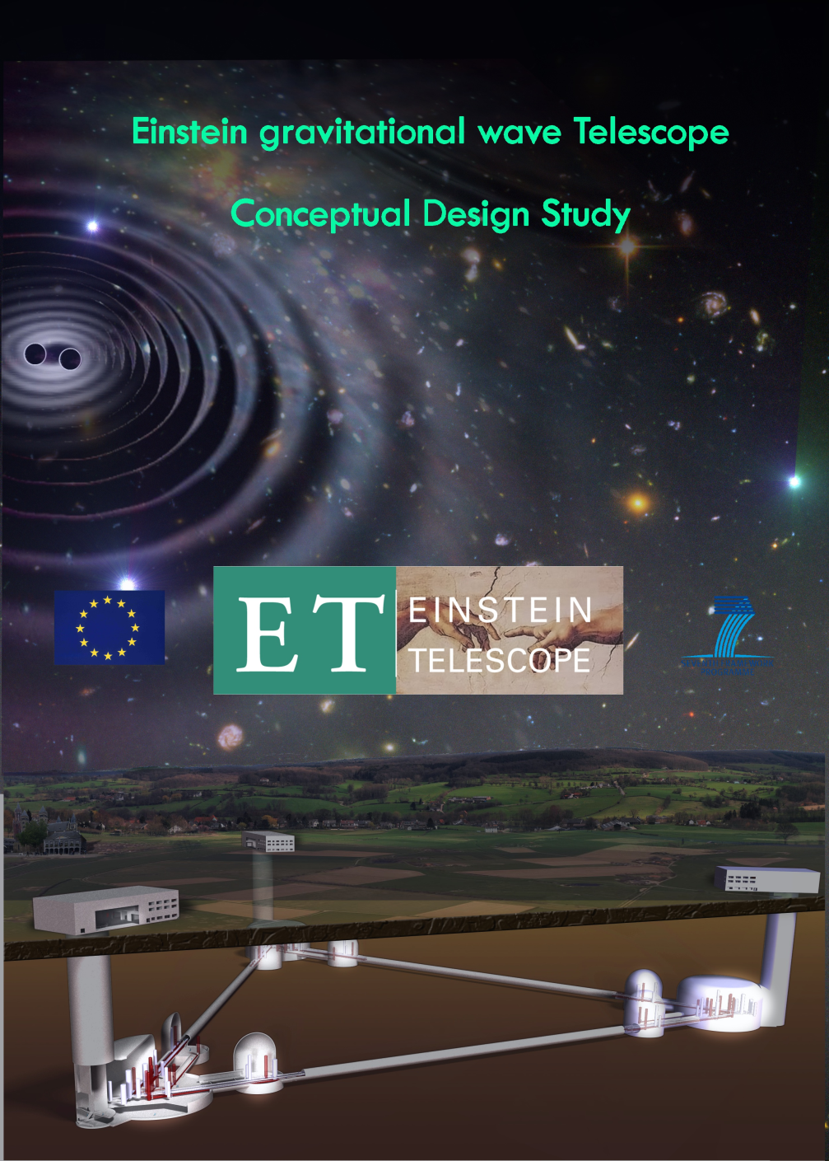
3rd Generation Gravitational Wave Observatories
Einstein Telescope Conceptual Design Study
May 2008 – May 2011
Pan European effort
Science Team = ca. 250 members
http://www.et-gw.eu/etdsdocument

Slide 39
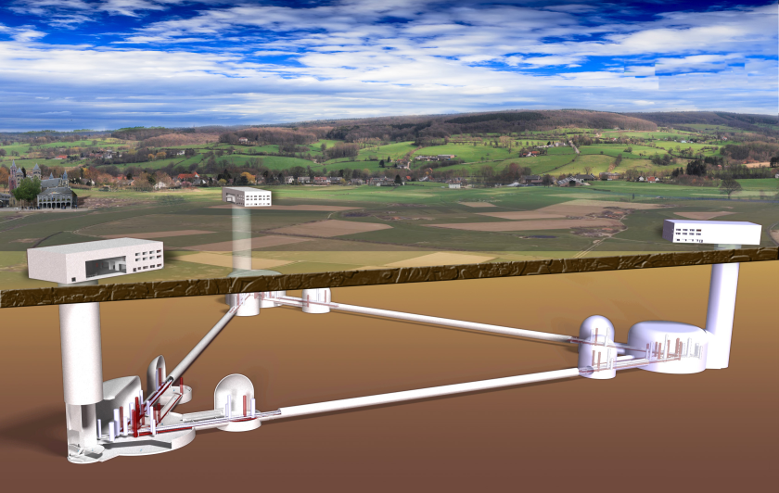
Einstein Teleskop
100 – 200m underground

Slide 40
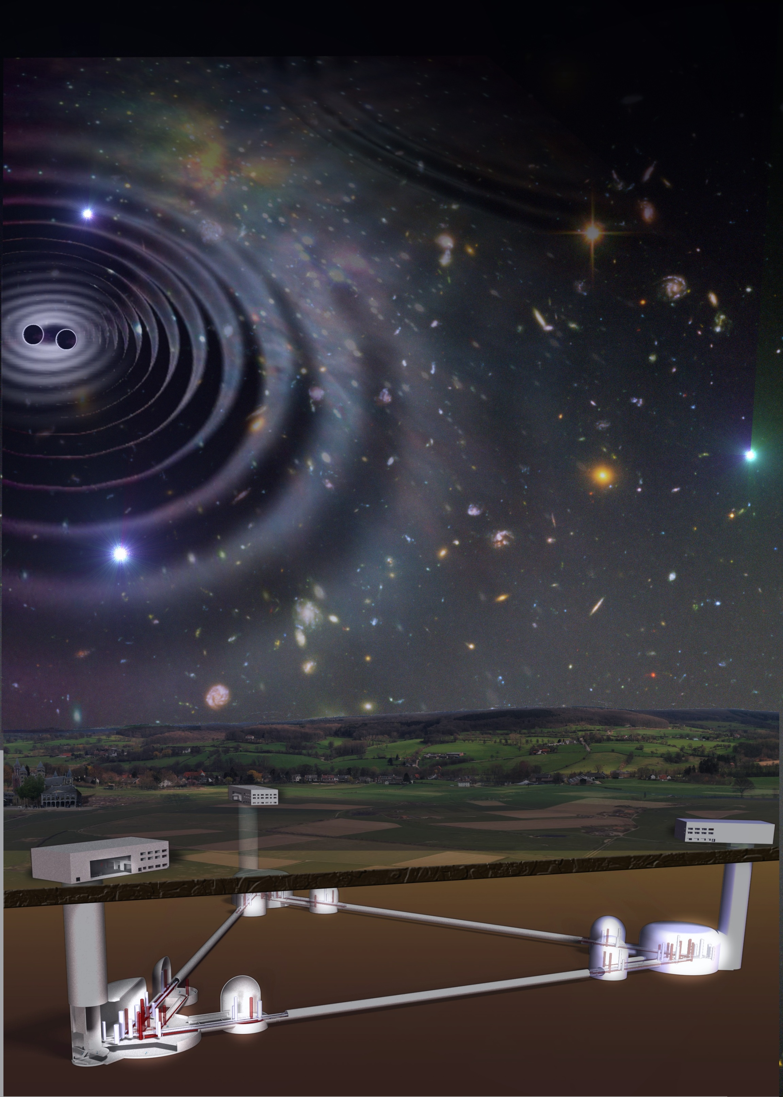
Einstein Telescope
Notes:
The next generation of gravitational wave obervatories (ET and Cosmic Explorer) will enable routine GW astronomy with frequent and also distant high SNR detections, but require a huge worldwide effort of the whole GW community.

Slide 42
4×1049 J/s peak power of source, 40 yotta yotta watt.
1×1025 meter distance to source, 10 yotta meter.
4×10^{3 meter LIGO arm length,}
^{4 kilometer.}
2×100 meter test mass suspension length, 2 meter.
1×10-6 meter ground vibration, 1 micrometer.
1×10-18 meter arm difference at peak signal, 1 attometer.
LIGO-G1600792-v1

