Slide 1
Some optical properties of hydroxide catalysis bonds
Mariëlle van Veggel on behalf
Jessica Steinlechner and Valentina Mangano and the rest of the Glasgow bonding research team

Slide 2
Contents
Introduction
How is hydroxide catalysis bonding used in the detectors
Chemistry of Hydroxide catalysis bonding (HCB)
But hydroxide catalysis bonds are invisible by eye between fused silica. This is very! Interesting. What about optical applications?
Two interesting properties
    Optical absorption
    Reflectivity
  How could this be interesting for our gravitational wave detectors?

Slide 3
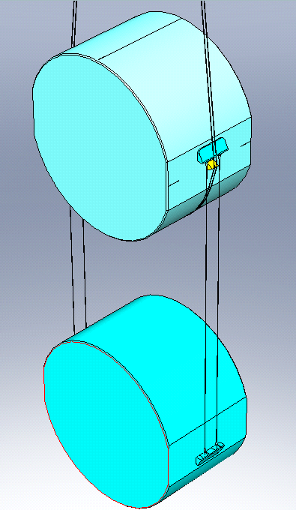
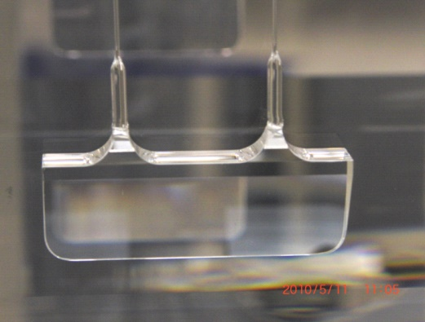
Introduction to hydroxide catalysis bonding
GEO600, aLIGO, and advanced VIRGO have quasi-monolithic test mass suspensions in fused silica which show superior thermal noise performance at room temperature
Hydroxide catalysis bonding is used in all to attach some form of interface piece to the mirror to allow attachment of the fibres (which are welded)
Steel wires
Penultimate mass
Fib
res
Attachment or ‘ear’
Weld horns
Steel wire break-off
Ear
prism
Silica fibres
End/input test mass
Ear
aLIGO monolithic mirror (ETM and ITM) suspension

Slide 4
Chemistry of hydroxide catalysis bonding
This method can create strong, durable bonds.
Chemistry of bonding between silica surfaces:
Hydration and Etching
Polymerisation
Dehydration
being released from
into the
Bonding solution with an excess of free OH⁻ ions
In aLIGO sodium silicate solution is used as the bonding solution. In advanced Virgo potassium hydroxide and sodium silicate solution is used [van Veggel & Killow, Adv. Opt. Appl., 2014].

Slide 5
Optical properties
Hydroxide catalysis bonds between fused silica components look highly transparent to the naked eye.
Optical applications could be highly interesting
e.g. fibre coupling, laser gain media, optical filters
In Glasgow we are working on two different measurements
1) Optical reflectivity of bonds
also very interesting as gives possibility of in situ measuring bond thickness
2) Optical absorption of bonds
Very much ongoing research, but we present some results here.

Slide 6
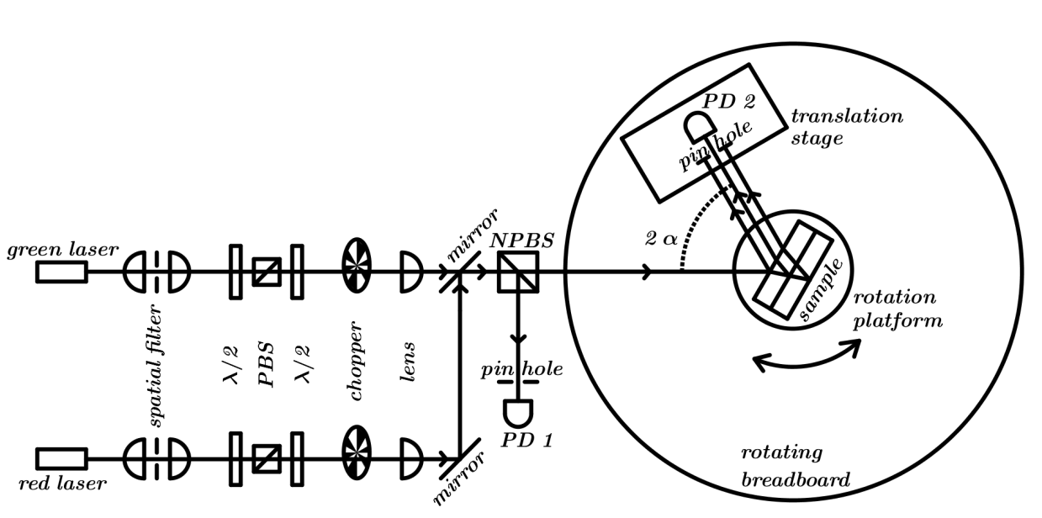
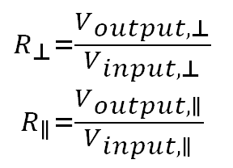
Optical reflectivity set-up

Slide 7
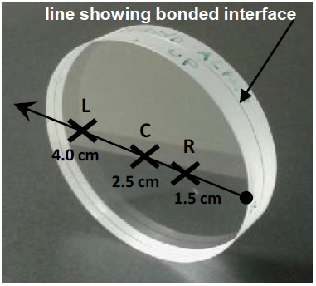
Reflectivity
Two pairs of fused silica discs
(∅50 mm, 5 mm thick, produced by Edmund optics)
Bonded using 1:6 sodium silicate solution

Slide 8


Optical reflectivity set-up
Model used is that for Fresnel reflection with thin film interference for the bond layer.
Bayesian likelihood analysis using the least squares method

Slide 9
Bond refractive index a.f.o. curing time

Slide 10
Bond thickness a.f.o. curing time

Slide 11
Conclusions reflectivity measurements
We have a non-destructive method of determining bond thickness and refractive index from reflectivity measurements
Reflectivity of 1:6 sodium silicate bond has a settling period up to the 20th day after which it gradually drops to below 10⁻⁵ after about 3 months.
The bond thickness settles as well (can vary up and down in the first 20 days), but overall drops to a constant value.
The refractive index increases over time from a value of 1.36 to 1.45 . 1.34 can be shown to be the refractive index of the solution, 1.45 approaches the refractive index of fused silica
Look at this in ‘peace and quiet’ at the poster session.
G1601717 – Valentina Mangano

Slide 12
Other reflectivity measurements
For a potassium hydroxide bond the reflectivity is immediately (within 3 days after bonding) below 10⁻⁵ and drops to a few times 10⁻⁷ after two months (analysis of this data is underway)
Measurements of sapphire substrates (C-axis along the optical axis) bonded using sodium silicate are also underway.
  Reflectivity of order 10⁻² are measured and levels remain high over curing time.
Aim to measure bond reflectivity, thickness and refractive index for
  baking at elevated temperature
  varied concentration of solution with silica substrates
  other solutions for sapphire substrates
  other substrate materials (e.g. phosphate glass, YAG)
Notes:
Reflectivity of order 10⁻² are measured and levels remain high over curing time (This is to be expected as the difference in refractive index between bond and sapphire is expected to remain high (close to 1.48 for the bond material as mostly silicates compared to 1.77)

Slide 13
Absorption of a bond between
fused silica substrates
The sample:
+ =
Fused silica substrates (Corning 7979)
(∅25 mm, 6.35 mm thick)
Bond is equivalent to a thin film
between the two substrates
Bond made using 1:6 sodium silicate solution (0.8 µl/cm²)
Notes:
That’s a typical PCI signal of a thin film (on a substrate with negligible absorption compared to the thin film).

Slide 14

Photo-thermal commonpath interferometry
Photo-thermal commonpath interferometry (PCI)
A. Alexandrovski et al. Proc. SPIE 3610, Laser Material Crystal Growth and Nonlinear Materials and Devices, 44 (May 26, 1999);
Pump beam,
1550 nm
detector
sample
Probe beam,
1620 nm
Lock-in amplifier
Notes:
We have used photo-thermal commonpath interferometry (PCI) for the absorption measurements, which is a thermally based method working as follows:
A small (35um in diameter) pump beam is absorbed. The absorption causes heating. This heating causes a change of the optical length of the substrate (due to dn/dT and thermal expansion).
A part of a much larger (and weaker) probe beam (115um in diameter) crosses the pumpbeam gets a phase shift at the place where the substrate is heated.
The interferometric phase change measured at this point is directly proportional to the absorption of the material.
The phase difference created by the pump beam within the probe beam is read out by measuring the interference between the light unaffected by the pump
and the light which has been affected by the pump. This interference has a maximum value when measured approximately one (pump) Rayleigh range from the pump waist.
The pump beam is amplitude modulated at a given frequency and a lock-in amplifier is used to recover the modulation of the interferogram at this frequency. The lock-in also provides the phase of this signal with reference to the pump modulation. This phase is determined by the diffusion of the heat from the pump absorption in the medium and by the pump beam dimensions.

Slide 15
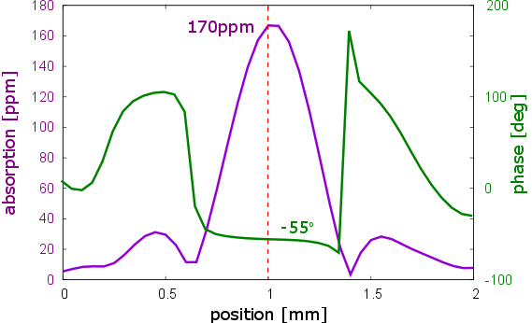
A typical PCI signal
A typical PCI signal:
This is an example measurement from the Corning 7979 bonded sample
Notes:
That’s a typical PCI signal of bond samples - on a substrate with negligible absorption compared to the thin film. The sample is moved through the crossing point of pump and probe beam. The beam crossing point is exactly on the thin film after about 1.2 mm where the signal maximizes.
(That’s not measured on our bind samples. I don’t have nice scans through the samples for these. This is just meant as a general example of a PCI measurement.)

Slide 16
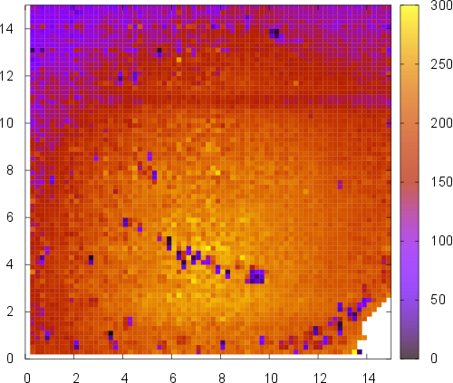
The bond absorption measurement
@ 1550 nm
Absorption [ppm]
300
14
250
12
10
200
8
Position [mm]
150
6
100
4
2
50
0
0
0
2
4
6
8
10
12
14
Position [mm]
Notes:
We have measured the absorption of the bond on a 15 mm x 15 mm big square on the bond in steps of 200um (~5500 points) and made a map of the absorption of the bond (sitting on the maximum of the plot on the last slide).

Slide 17
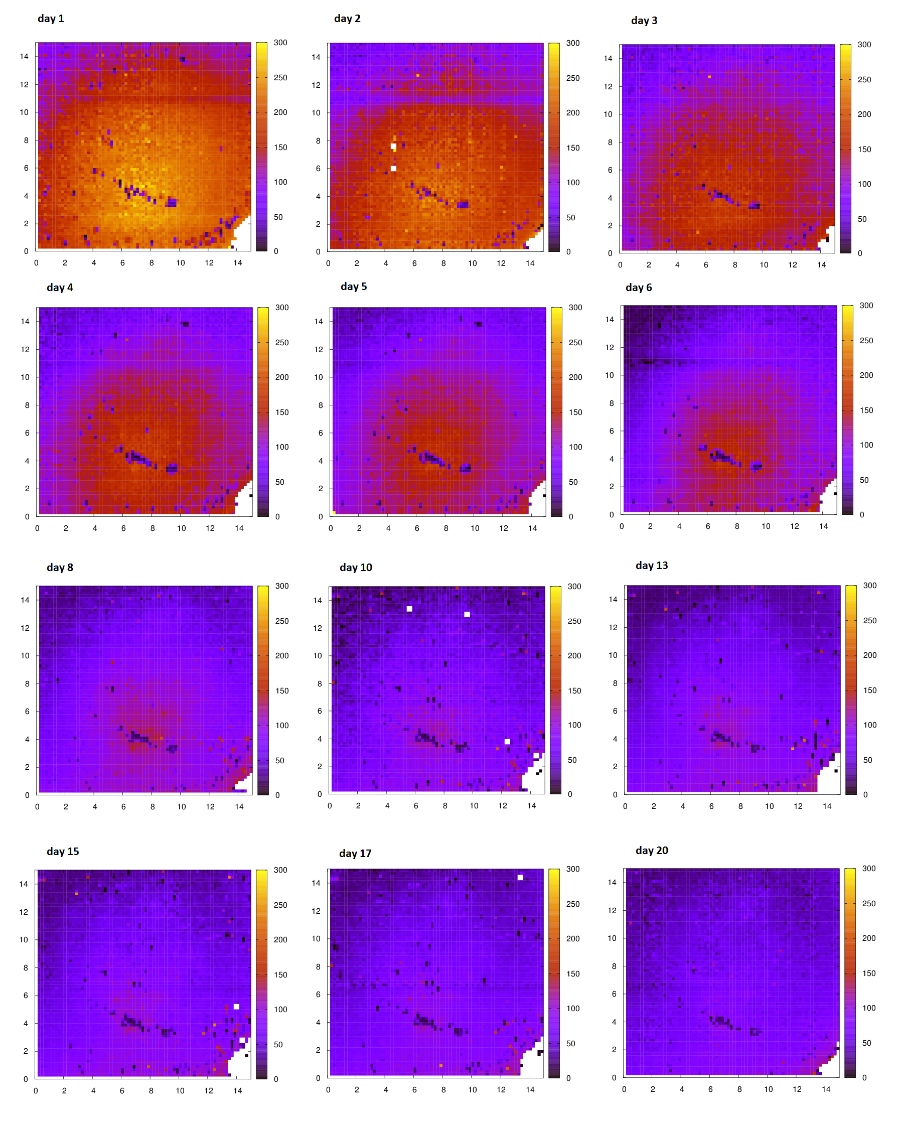
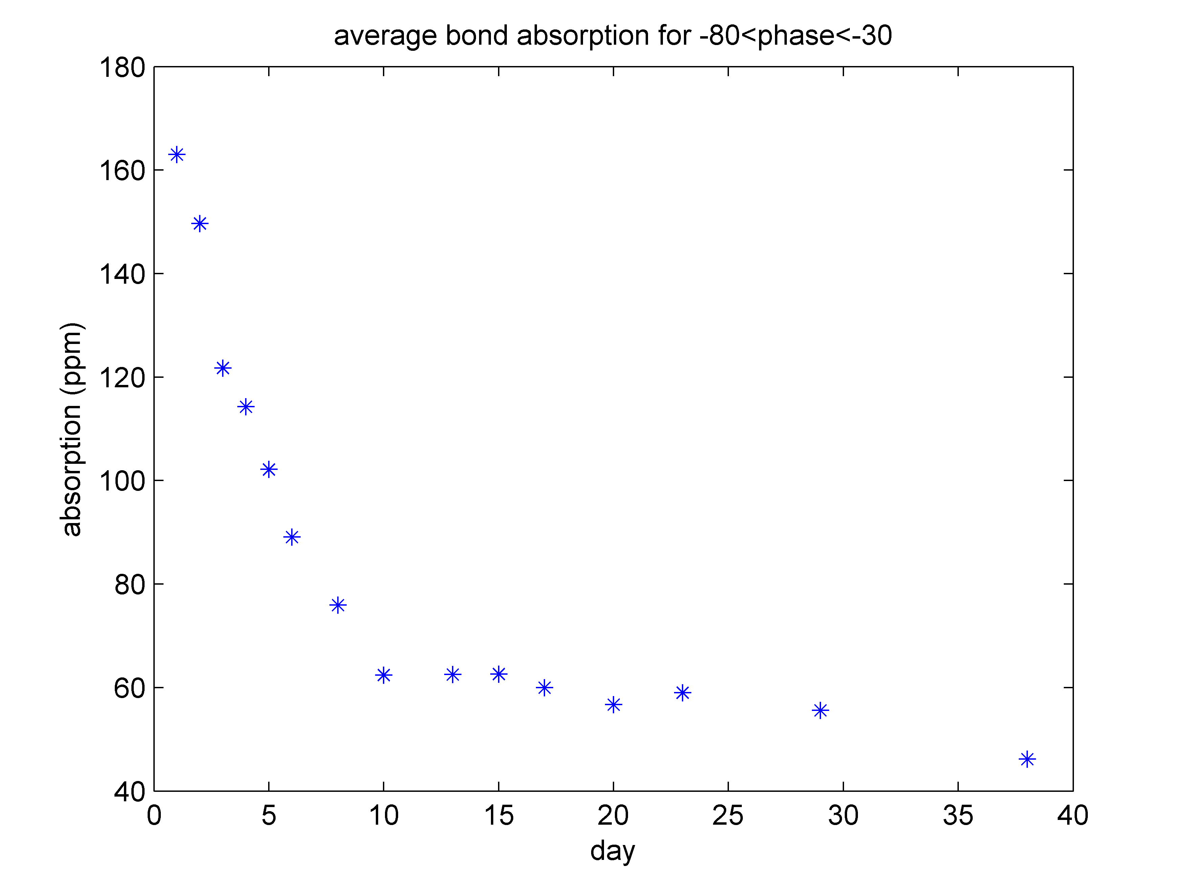
The bond absorption measurement –
time development
Day 1
Day 2
Day 3
180
Average bond absorption
Day 4
Day 5
Day 6
160
140
120
Absorption (ppm)
100
Day 8
Day 10
Day 13
80
60
40
0
5
10
15
20
25
30
35
40
Day 15
Day 17
Day 20
Curing time (days)
Absorption [ppm]
300
250
200
150
100
50
0
Notes:
We have done that over about a month time. The absorption reduces visibly.
The right plot shows the average absorption of the whole area. (For the average only points with a reasonable phase signal were used – which were most points.)

Slide 18
The bond absorption measurement –
different wavelengths
2µm
1550nm
1064nm
Notes:
The absorption at 1064nm is negligible (about 2ppm, but this was hard to see and quite noisy).
The absorption at 2um is almost exactly a factor of 5 higher than at 1550nm for the whole time.
Here we could speculate a little bit about what causes the absorption.
The two different trends (which are clearly visible on the slide before) before day 10 and from day 10 on might indicate two different absorption processes. But the constant factor between 1550nm and 2um over the complete time range rather seems to indicate the same reason causing the absorption over the whole time.
Water which drifts out of the sample might cause the absorption.
It can also be the… aehm… was it sodium or potassium in this bond? Sorry. Can never remember that. Whichever of the two things it is, it might be responsible for the absorption. Or at least responsible in combination with the water.
Possible future plans would be: Checking if the absorption changes for the other kind of bond solution (potassium/sodium), heating the sample to see it the absorption reduces faster (drying?) or if it reduced further.

Slide 19
Conclusions absorption measurements
Absorption measurements of Corning 7979 substrates bonded with 1:6 sodium silicate solution as a function of curing time (about 1 month) show
  @1550 nm a drop in absorption from 165 ppm down to 55 ppm
  @ 2 µm the absorption is 5 x higher than @ 1550 nm
  @ 1064 nm the absorption is < 2 ppm
Drop in absorption is probably dominated by the migration of water out of the bond area (evaporation)
Two different apparent mechanisms appear; cause is under investigation
Reason for baseline level is under investigation; sodium absorption??

Slide 20
How could this be interesting in GW science?
We have a non destructive measurement method to measure bond thickness which we could potentially develop further to measure bond thicknesses in actual suspensions for more accurate bond thermal noise calculations.
Interesting further afield as well…
Direct coupling of fibre optics.
Laser gain medium development.
  We want low absorption so bonds can withstand high light power levels
  We want ability to tailor reflectivity levels to optimise optical performance
Notes:
Many industrial uses, from electronic components to malleable UHV vacuum seals

Slide 21
THANK YOU!
Notes:
Many industrial uses, from electronic components to malleable UHV vacuum seals

Slide 22
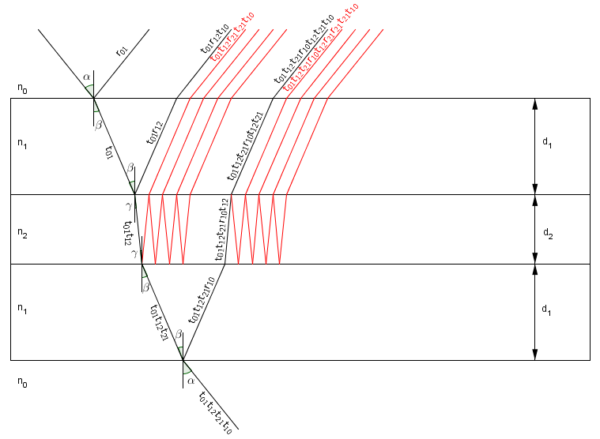


Optical reflectivity set-up
Model used is that for Fresnel reflection with thin film interference for the bond layer.
fused silica
sodium hydroxide solution
fused silica

Slide 23
Optical reflectivity set-up
The refractive index of mixed liquids can be considered proportional to the volumes of each liquid used.
Sodium silicate solution is made of Na₂O ~ 10.6% (no effect on the refractive index), SiO₂ ~ 26.5% (n_{SiO2} = 1.55) and H₂O ~ 62.9% (n_{H2O} = 1.33 ) and, therefore, the refractive index of the sodium silicate solution is: 26.5x1.55 + 62.9x1.33 = 89.4xn_{sodium} _{silicate} -> n_{sodium} _{silicate} = 1.39. The bonding solution is composed of 2 ml of sodium silicate solution and 12 ml of DI water, and its refractive index is: n_{solution} = 1.34. The value obtained is the starting point (within error) of refractive index of the bond material.

Slide 24
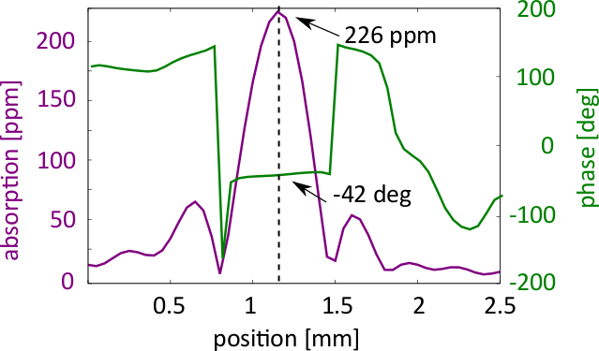
A typical PCI signal
A typical PCI signal:
This is an example from a different sample (silicon nitride) for illustration purposes
Notes:
That’s a typical PCI signal of a thin film - on a substrate with negligible absorption compared to the thin film. The sample is moved through the crossing point of pump and probe beam. The beam crossing point is exactly on the thin film after about 1.2 mm where the signal maximizes.
(That’s not measured on our bind samples. I don’t have nice scans through the samples for these. This is just meant as a general example of a PCI measurement.)

Slide 25
Photo-thermal common path interferometry
The method:
Δn
Pump beam changes refractive index of an element in the probe beam
Notes:
We have used photo-thermal commonpath interferometry (PCI) for the absorption measurements, which is a thermally based method working as follows:
A small (35um in diameter) pump beam is absorbed. The absorption causes heating. This heating causes a change of the optical length of the substrate (due to dn/dT and thermal expansion).
A part of a much larger (and weaker) probe beam (115um in diameter) crosses the pumpbeam gets a phase shift at the place where the substrate is heated.

Slide 26
Photo-thermal commonpath interferometry
We measure this phase difference by imaging the plane 1 Rayleigh range from the intersection point
(virtual detection plane)
Δn
The wavefront from this element is different from the rest of the beam
Pump beam changes refractive index of an element in the probe beam
Notes:
The phase difference created by the pump beam within the probe beam is read out by measuring the interference between the light unaffected by the pump
and the light which has been affected by the pump. This interference has a maximum value when measured approximately one (pump) Rayleigh range from the pump waist.

Slide 27
Photo-Thermal Commonpath Interferometry
Getting absorption by comparing signal to calibration substrate with known absorption
We measure this phase difference by imaging the plane 1 Rayleigh range from the intersection point
(virtual detection plane)
Δn
The wavefront from this element is different from the rest of the beam
Pump beam changes refractive index of an element in the probe beam
Notes:
The interferometric phase change measured at this point is directly proportional to the absorption of the material.

Slide 28
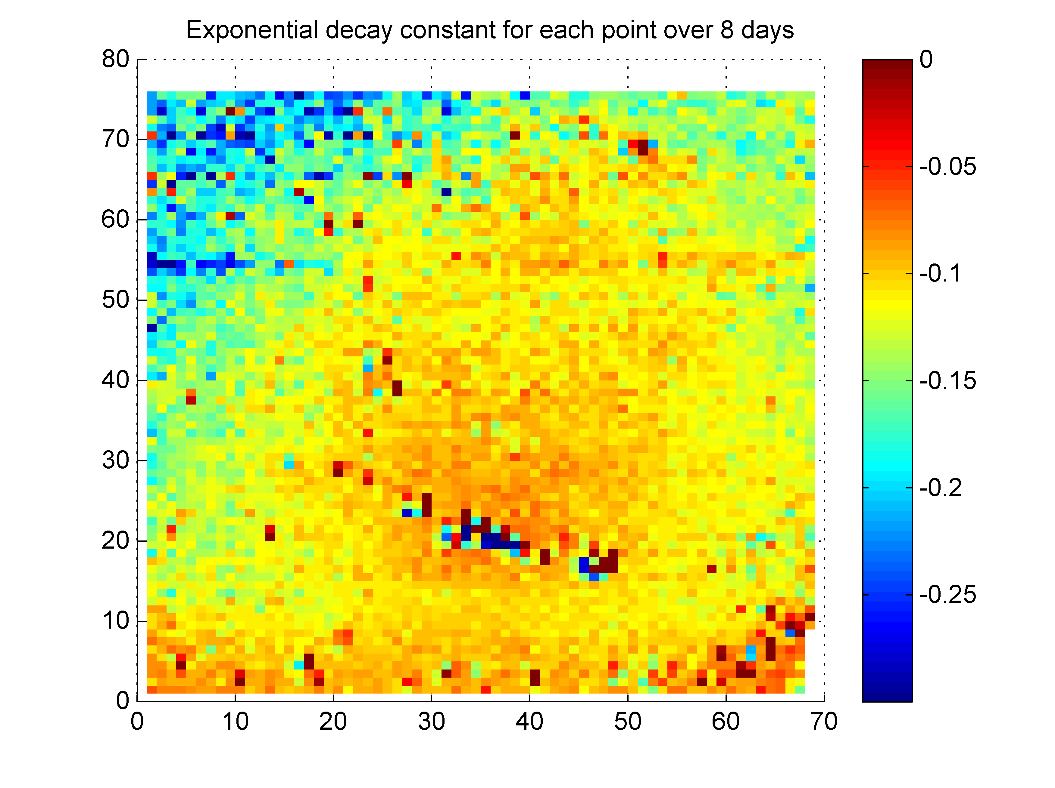
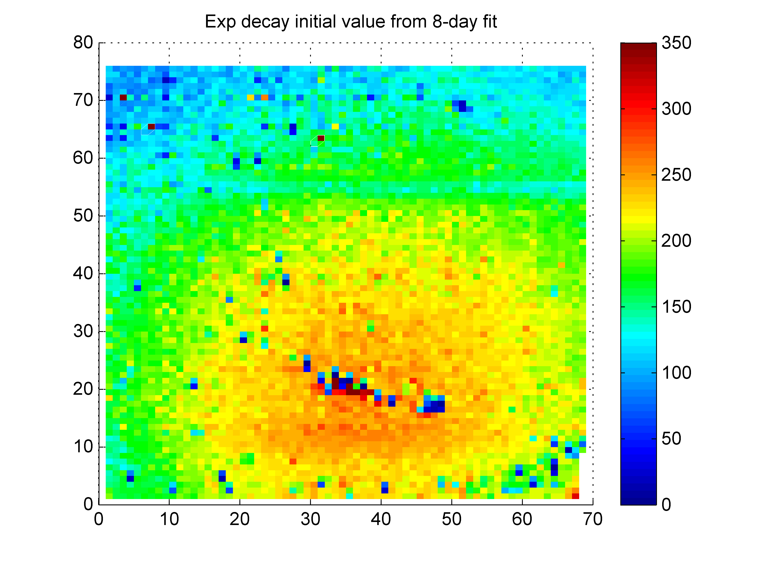
Exponential fit to each point for the first 8 days:
top: exponential decay constant
bottom: initial absorption value (in ppm)
higher initial absorption decreases slower (for most of the area)
supports assumption of absorption due to water
  higher water content close to centre of sample: water in centre drifts out slower (further away from edges)
  ???

