Slide 1
Acoustic Emissions in Metals
Searching for Crackling Noise in aLIGO Suspensions
Danielle Frostig
Mentor: Gabriele Vajente

Slide 2
Overview
Motivation
Crackling Noise
Previous Work
Microphone Calibration Experiment
Process and problems encountered
Data analysis and initial results
Conclusions and Future Work

Slide 3
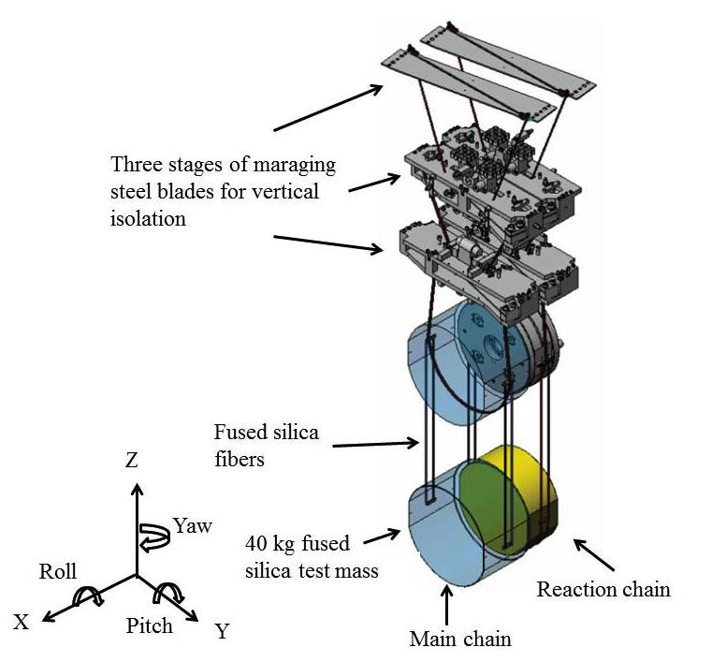
Motivation
Quadruple pendulum system with three stages of Maraging steel blades for vertical isolation
Crackling Noise
When a system responds to slowly changing external conditions with discrete energy events at higher frequencies
E.g. Earthquakes on fault lines, stock market fluctuations, a crumpling piece of paper.

Slide 4
Motivation Continued
Low frequency noise
Residual seismic motion
Up-converted to GW band
Vertical displacements couple with horizontal displacements to cause noise in the data

Slide 5
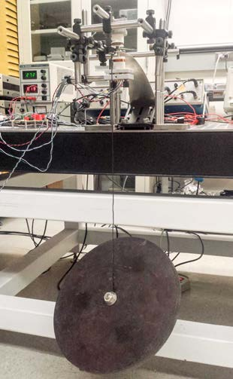
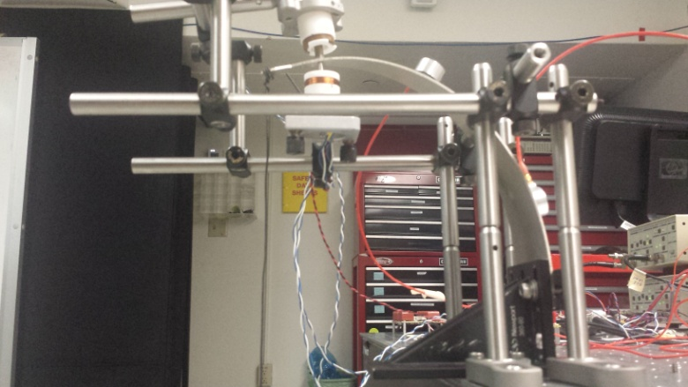
Previous Work
Maraging and high carbon steel blades loaded with 11kg and 16kg masses
Imitates aLIGO suspensions
Suspect crackling noise related to stress
Driven with a sinusoidal displacement
No difference found between on and off periods
Implies any crackling noise occurred below the noise floor

Slide 6
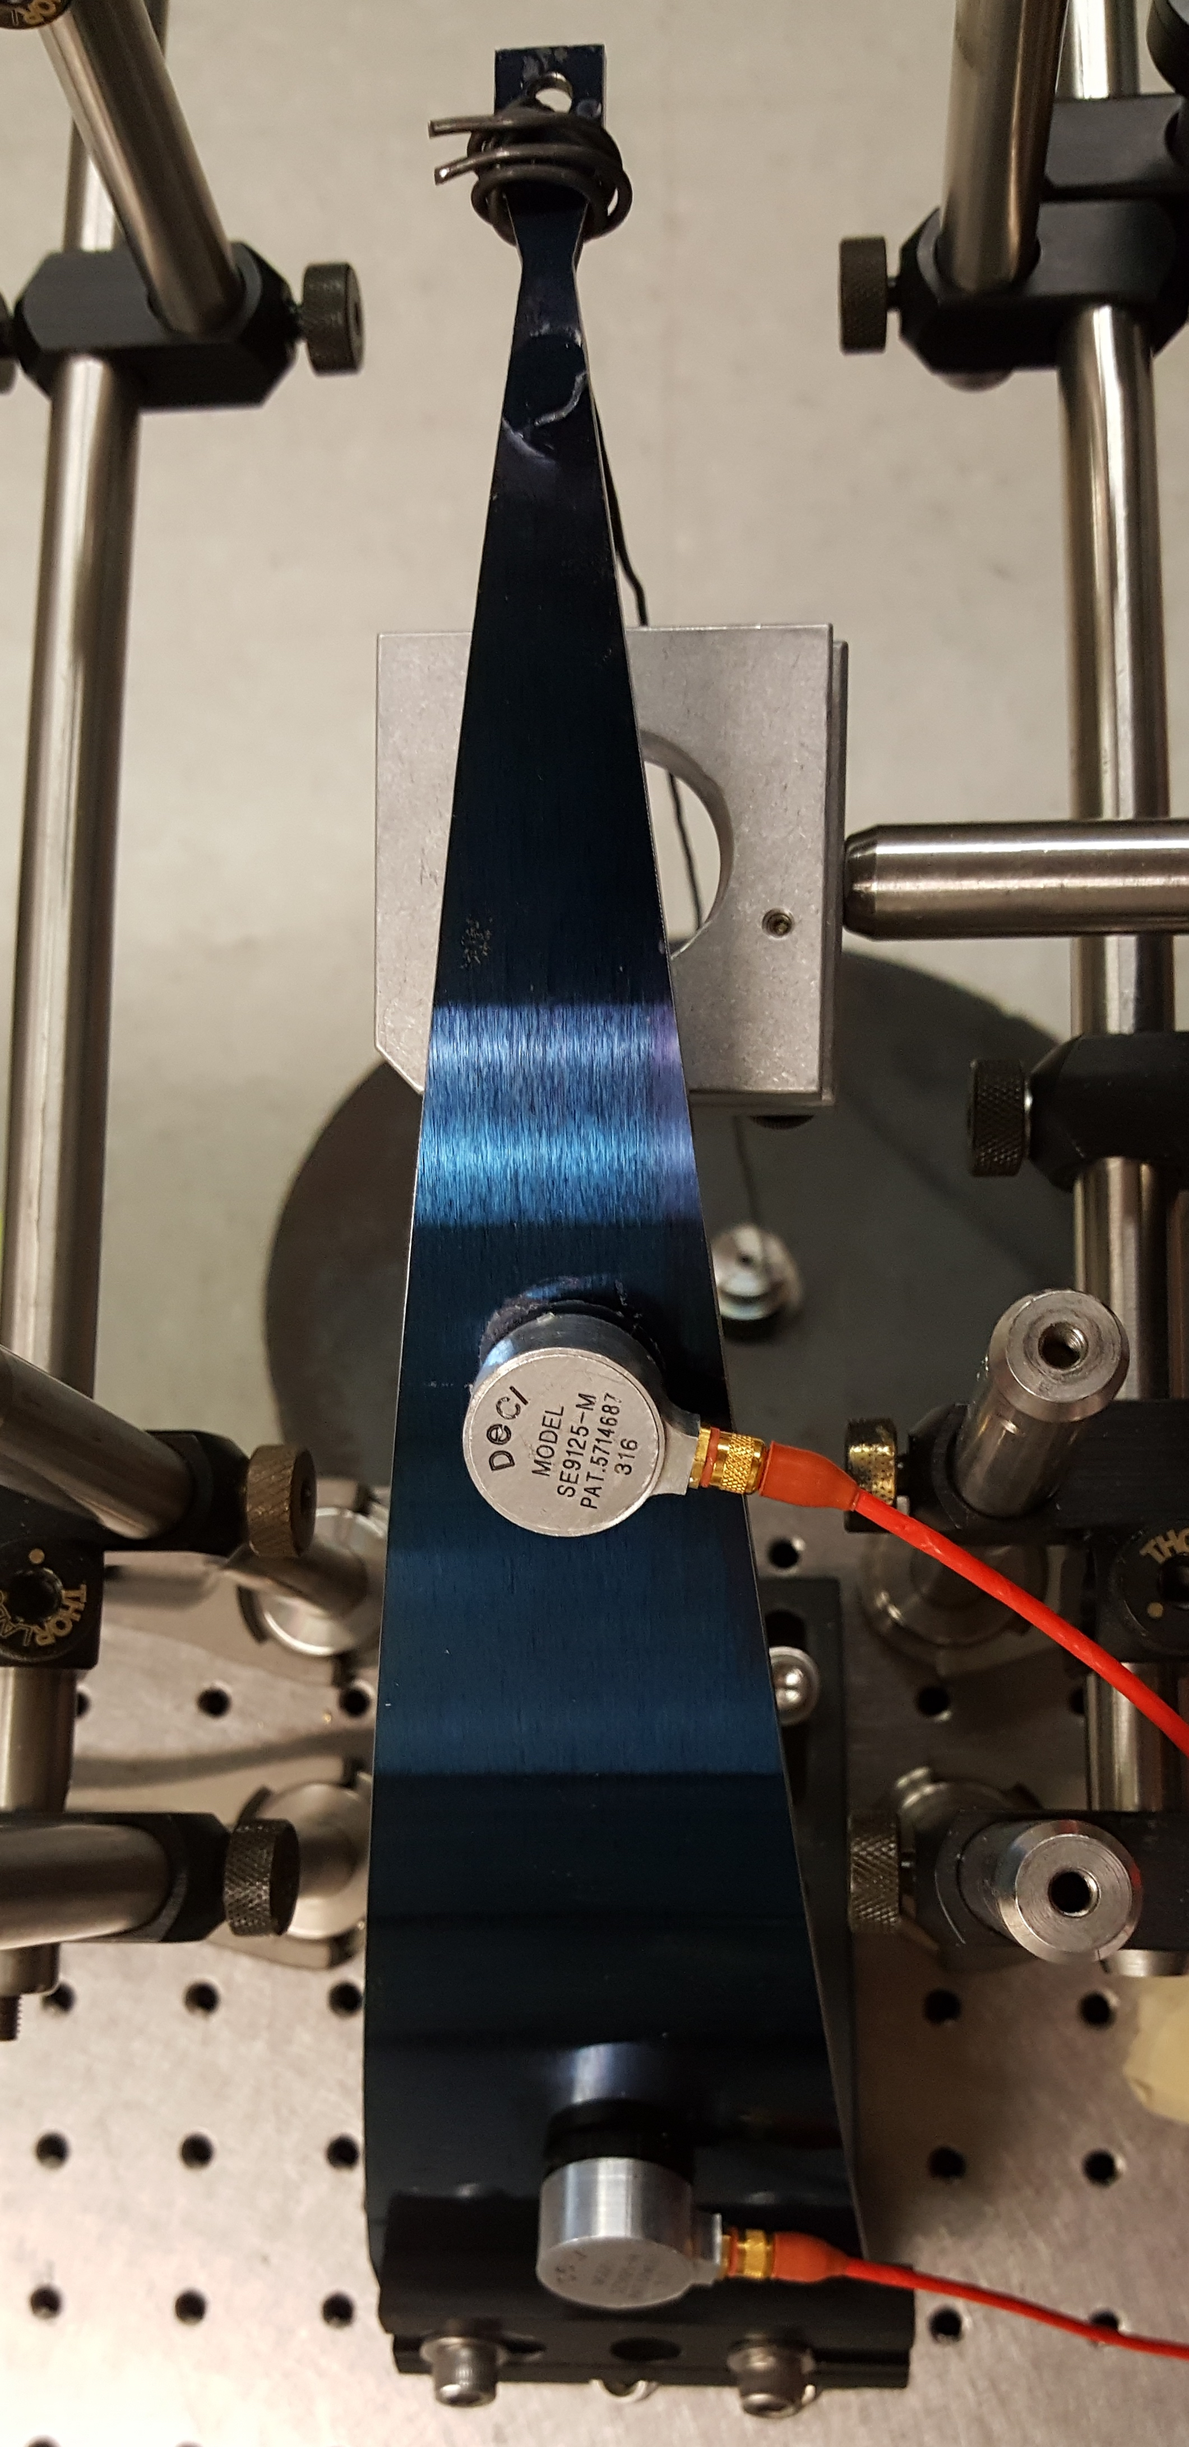
Microphone Calibration
Ultrasonic acoustic emissions microphones used to collect crackle data
We expect to detect discrete crackling events in releases of acoustic energy
If crackling noise is detected, we want to know the energy of the event.
We can calibrate the output of the microphones to energy input by a known system
E.g. a ball drop experiment

Slide 7
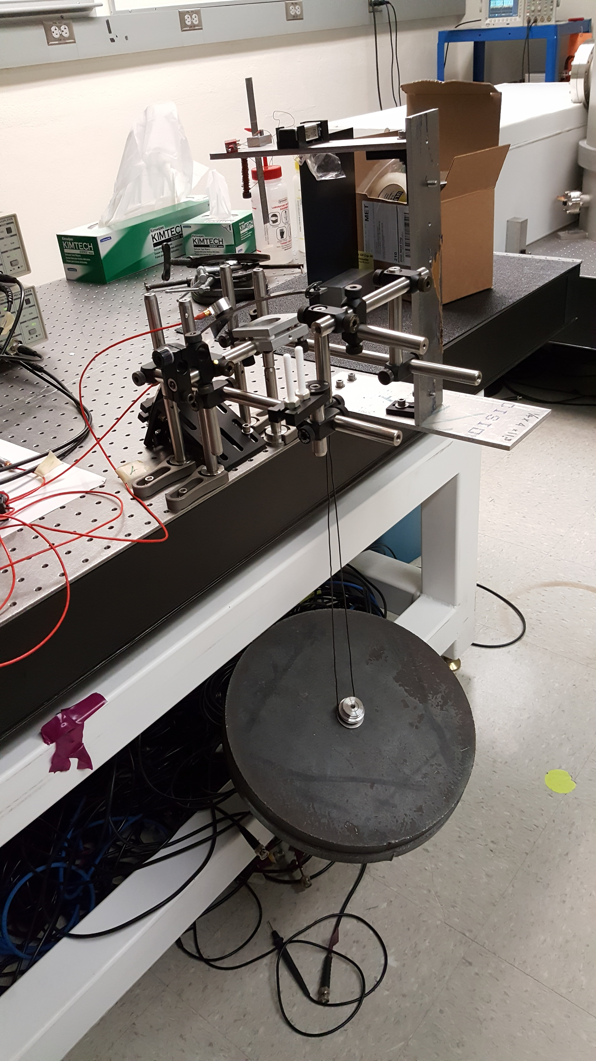
Experimental Setup

Slide 8
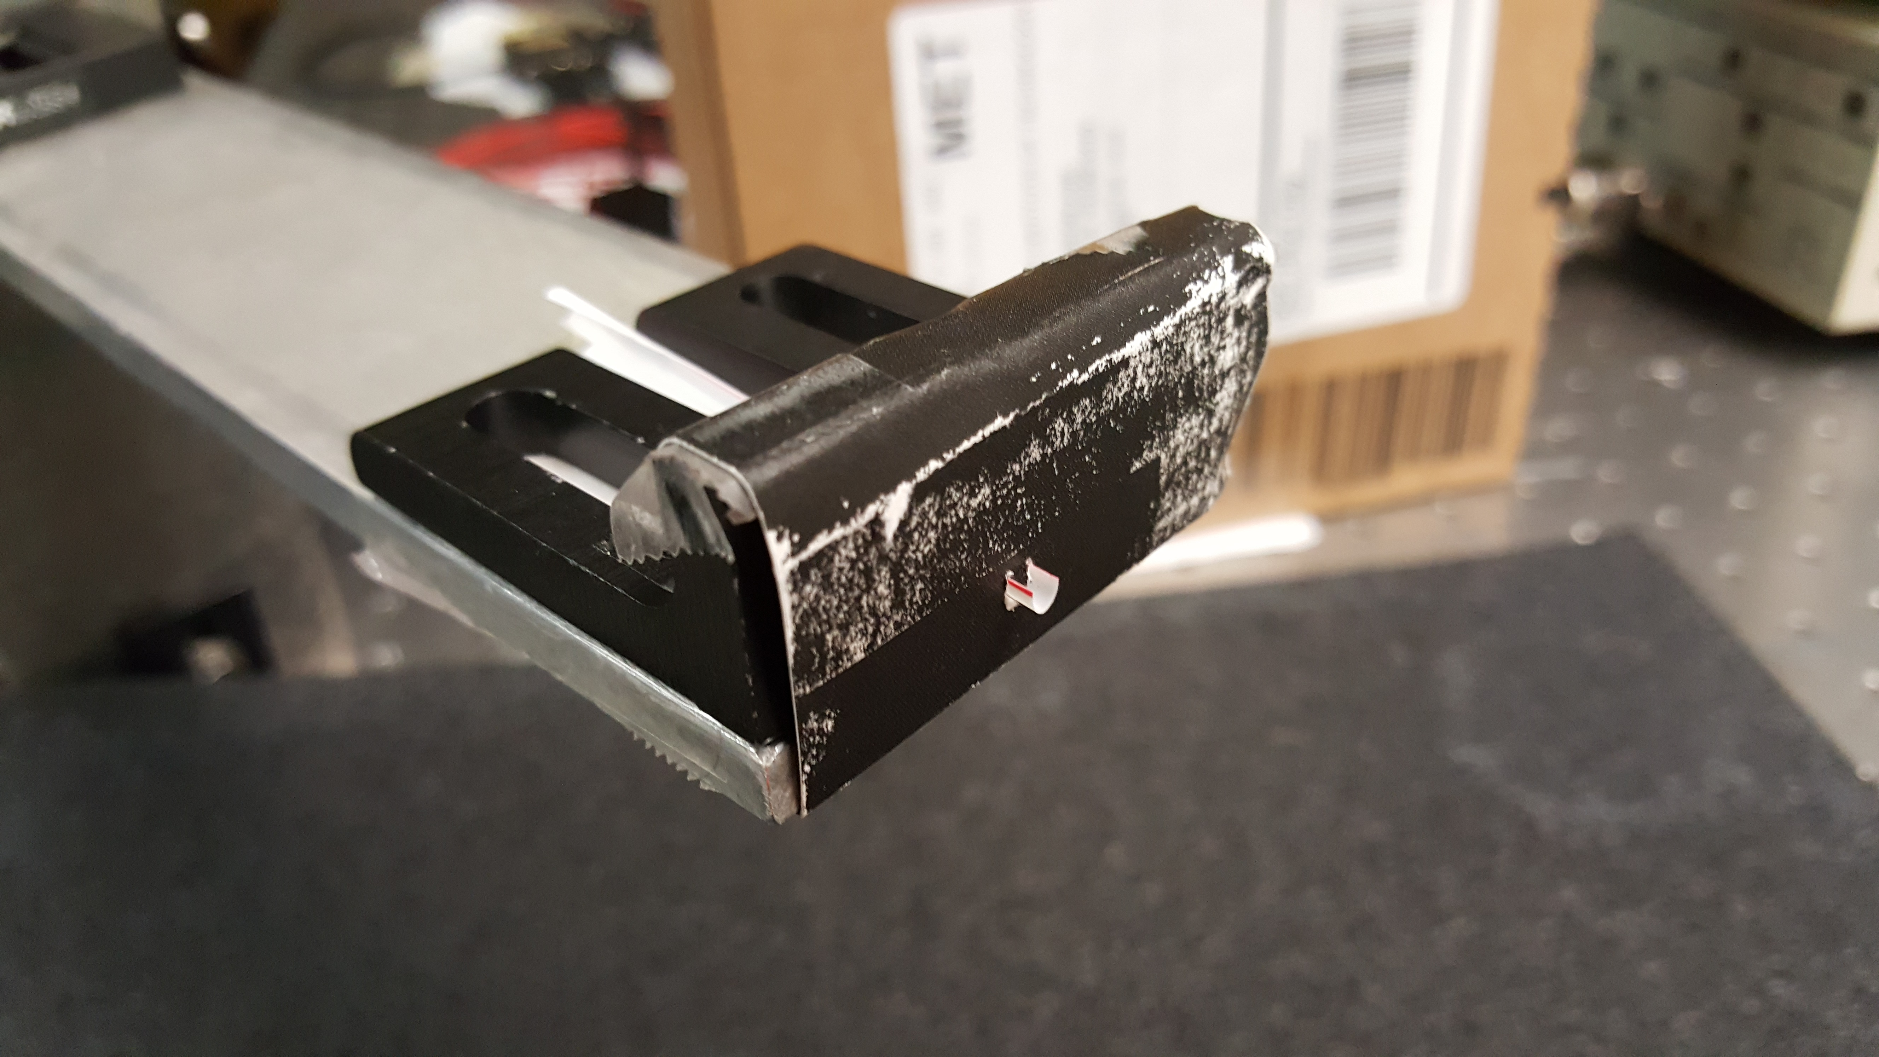
Experimental Setup
Aluminum ball release mechanism

Slide 9
Motion Tracking
Videos of ball drop experiment analyzed with MATLAB
Single object tracking based on Kalman Filtering
Script built around kalmanFilterForTracking¹ function in MATLAB
¹http://www.mathworks.com/help/vision/examples/using-kalman-filter-for-object-tracking.html

Slide 10
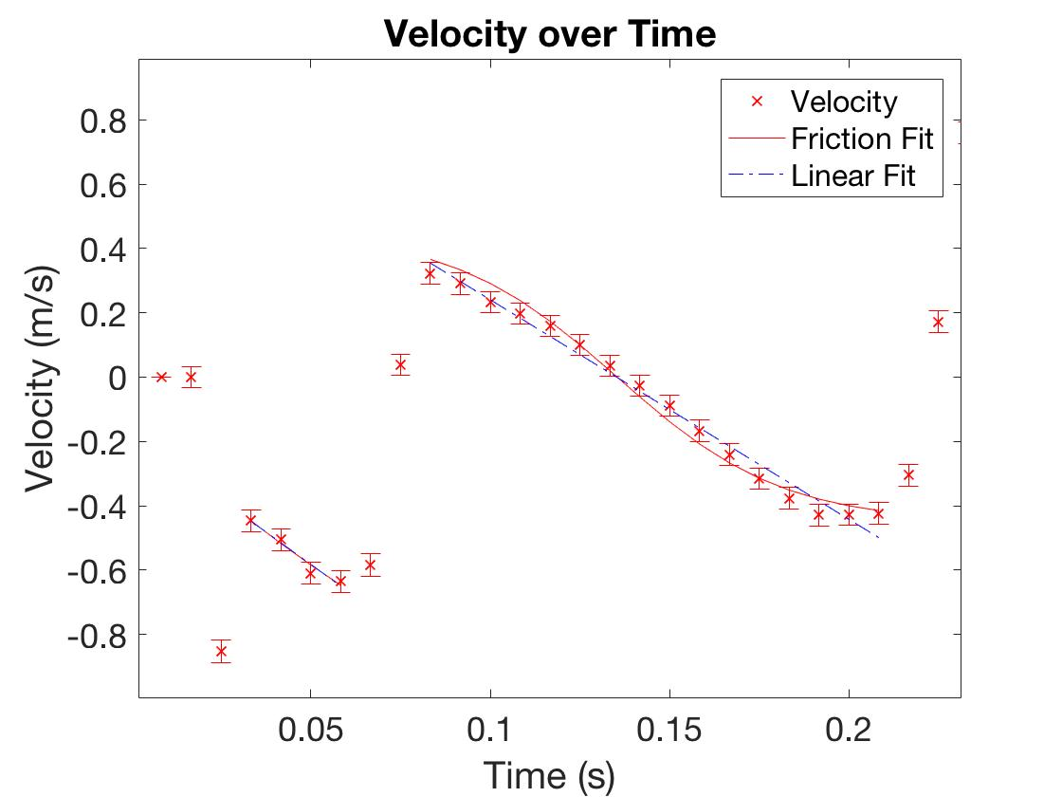
Motion Tracking
Can analyze position, velocity, and acceleration from motion.
Can obtain estimates of kinetic energy from velocity.

Slide 11
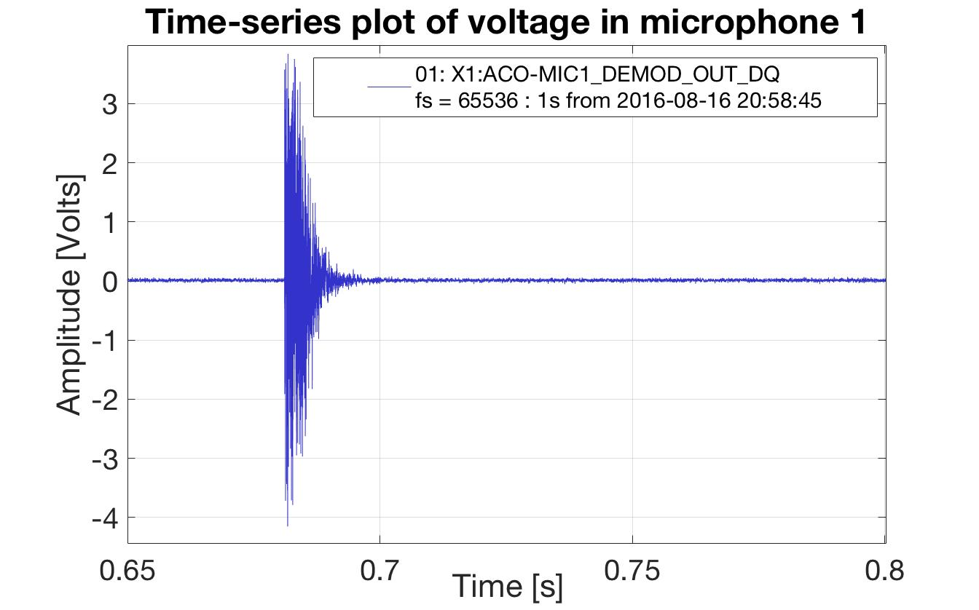
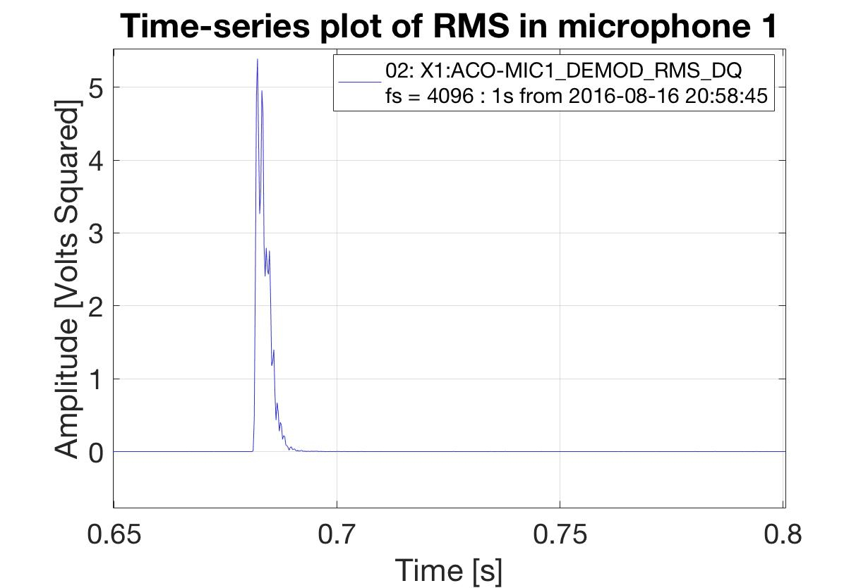
Microphone Output
The integral of an event’s root mean squared (RMS) plot gives energy recorded.

Slide 12
Summary and Future Work
Ball drop experiment and motion tracking were set up to analyze energy of a known system for microphone calibration.
Next Steps:
Correlate data to calibrate microphones
Energy was tested with variable heights, test with variable distances
Continue to run AE crackle detection experiments

Slide 13
Acknowledgements
Gabriele Vajente
Crackle and Suspension Labs
LIGO
Caltech
NSF

Slide 14
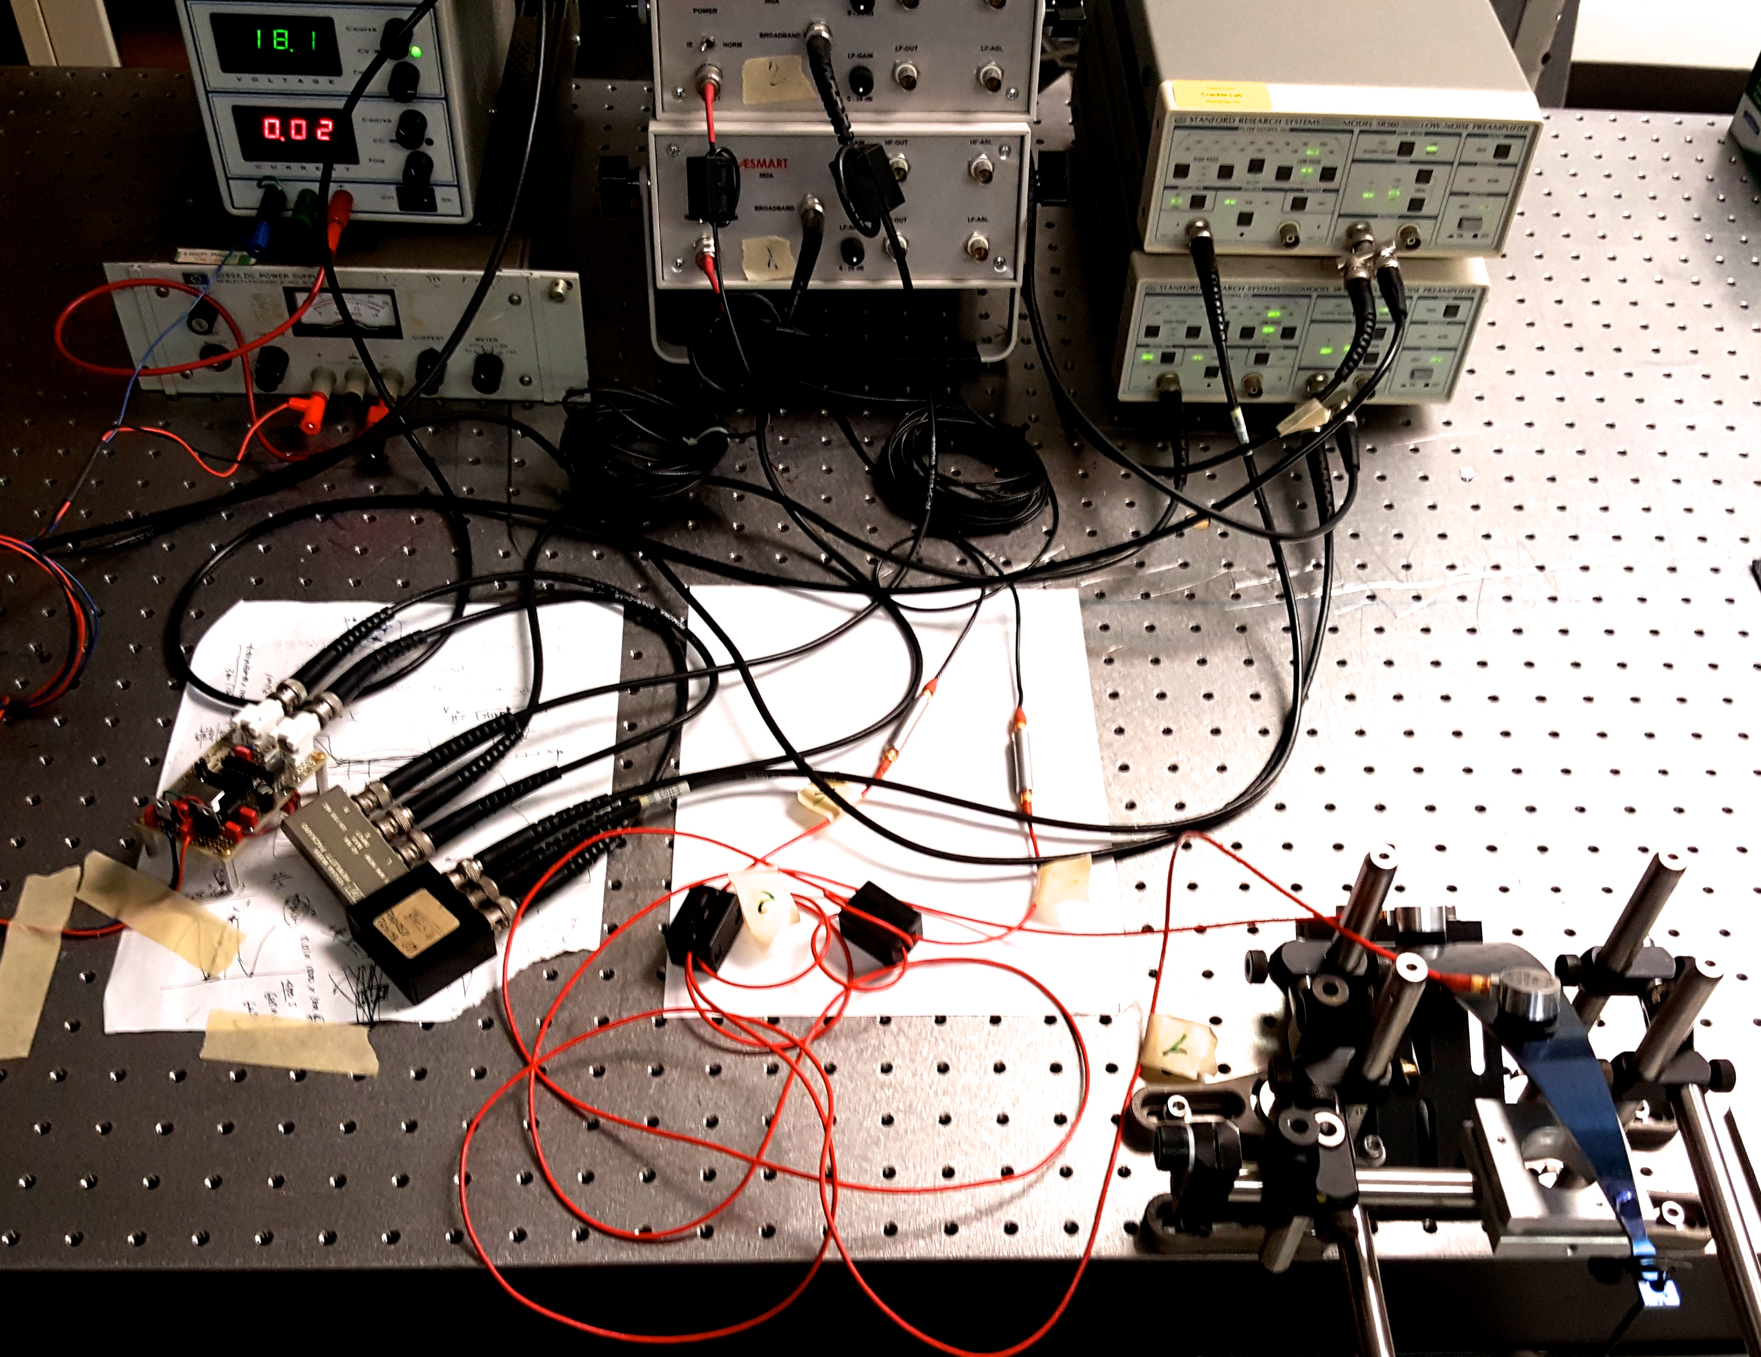
Electronic Setup

Slide 15
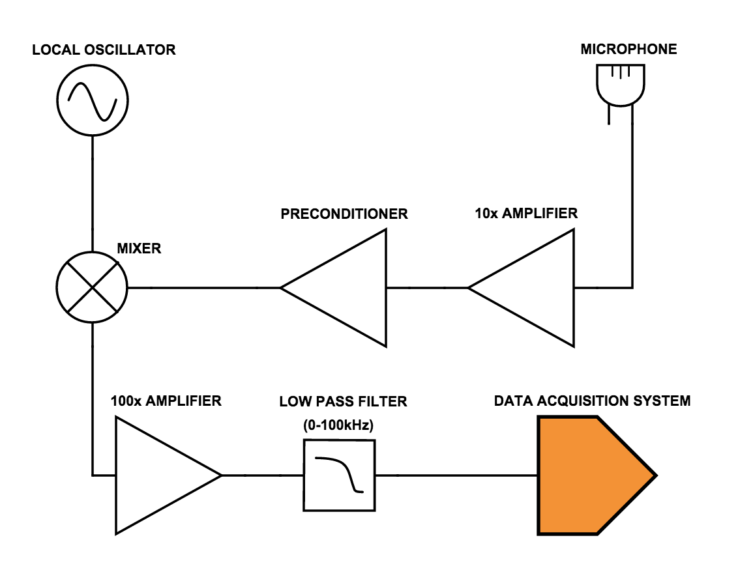
Electronic Setup

Slide 16
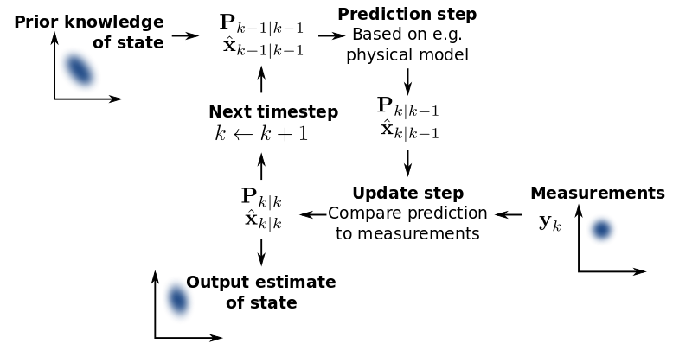
Kalman Filtering
An algorithm that uses measurements and noise to estimate unknown variables.
https://en.wikipedia.org/wiki/Kalman_filter

Slide 17
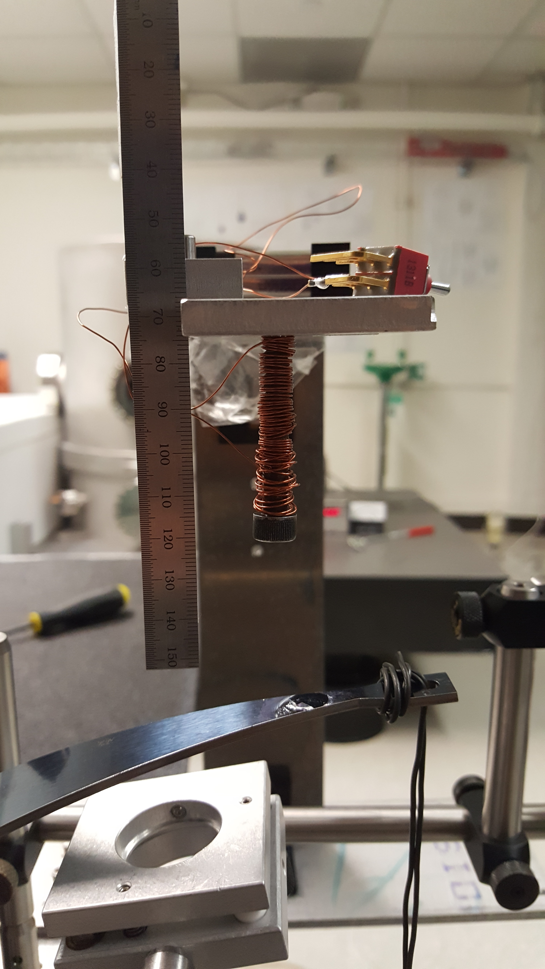
Microphone Saturation

Slide 18
Microphone Saturation

Slide 19
Maraging Steel
Maraging steels are carbon free iron-nickel alloys with additions of cobalt, molybdenum, titanium and aluminium. The term maraging is derived from the strengthening mechanism, which is transforming the alloy to martensite with subsequent age hardening.
http://www.imoa.info/molybdenum-uses/molybdenum-grade-alloy-steels-irons/maraging-steels.php

Slide 20
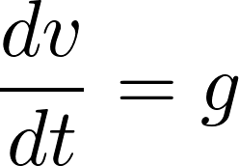
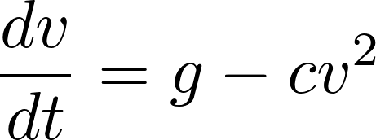
Various Fits on Velocity

