Slide 1
Micromechanical Investigations on Crackling Noise
SURF Project 2016 - California Institute of Technology - Pasadena
August 18, 2016
Riccardo Maggiore
Xiaoyue Ni
Gabriele Vajente

Slide 2
Aim and Introduction
Components of Advanced LIGO suspension system are loaded within the macroscopically elastic regime, specially about 50% of the Yield Stress.
Metals, are known to exhibit non linear deviation from a simple linear relation between strain and stress.
It has been shown that metals respond to varying external stress in a discontinuous way in this regime, exhibiting discrete releases of energy (Crackling Noise Phenomenon).
This non-trivial mechanical noise that can propagate from the maraging steel suspension blades to the test mass is a potential up-conversion noise source for the gravitational wave detector.

Slide 3
Experimental Introduction
X. Ni, "Micromechanical Investigation on Crackling Noise, Crackle Meet @Pasadena" (2016)

Slide 4
Aim and Introduction
Non-Linear Deviation from a simple linear relation
(No Theoretical Model)
Could up-convert low frequency excitations of the metals into high frequency (Audio Band) noise in their elastic regime
We have adopted a theoretical constitutive model conceived for the plastic regime and translated it into a code
This is a numerical simulation work. The first part is focused on a parametric study where I have run several simulations at a time with varying parameters.

Slide 5
Theoretical Model
$$\dot{ε}(r,t)= \frac{D_{const}}{G}τ_{tot}(r,t)$$
$$τ_{tot}(r,t)= τ_{ext}(t)+ τ_{int}(r)$$
Avalanche Condition:
$$τ_{ext}(t)=A sin⁡(ωt+ φ)$$
$$τ_{Aval}=τ_{ext}+ τ_{int} − τ_{thr}$$
$$τ_{int }\left(k\right)=−\frac{G}{π\left(1−ν\right)}ε(k)\frac{k_{x}^{2}k_{y}^{2}}{{|k|}^{2}}$$
$$τ_{Aval}>0$$
Stefanos, J., Papanikolaou, et. al. Nature 490, 517–522 (2012)
Michael Zaiser, Advances in Physics, 55:1-2, 185-245 (2006)

Slide 6
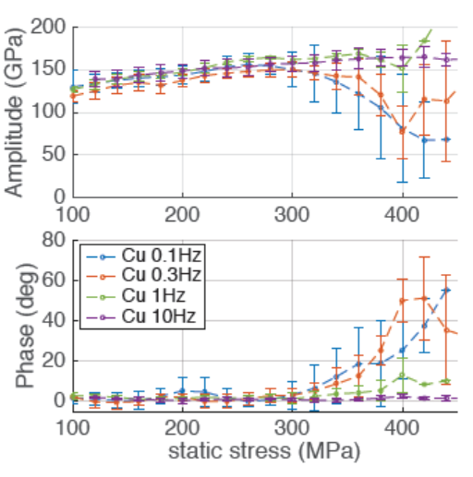
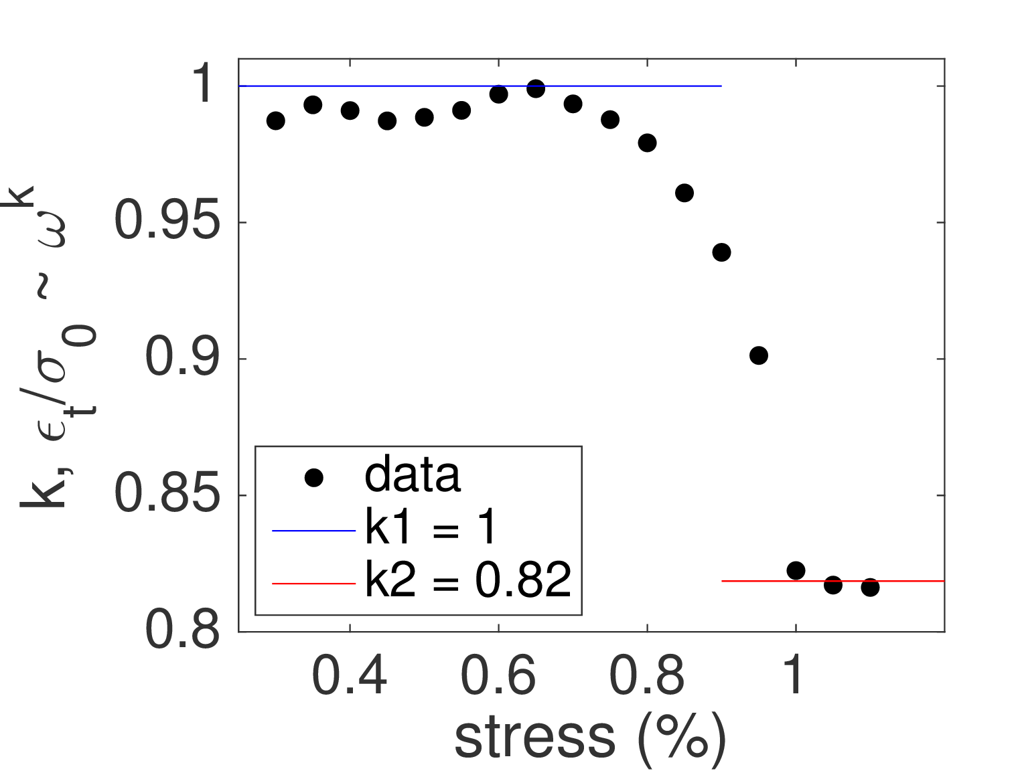
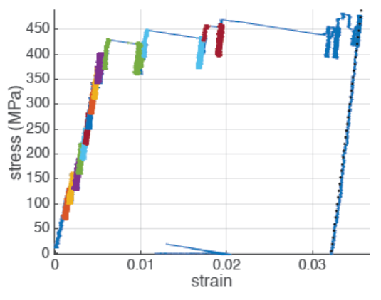
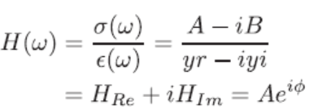
Data Analysis
Experiment
Simulation
Fixed Parameters:
$D=3.1 {10}^{−4} 1/s$
$C=3000 MPa$
Gaussian D. - $σ=1.00$

Slide 7
Parametric Study Results
Standard Fixed Parameters:
$D=5 ∙ {10}^{−2}$
$C=400.0$
Gaussian D. - $σ=0.50$

Slide 8
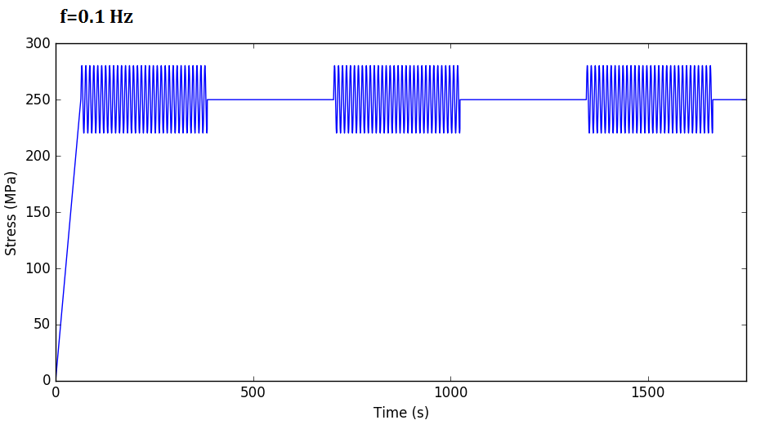
Crackling Simulation
$\tilde{σ}\left(t\right)=Re\left\{σ\left(t\right)\right\}=Acos(2πf t)$
$$ε_{1}$$
$$ε_{2}$$
$$∆ε= ε_{2} − ε_{1}$$

Slide 9
Crackling Experiment Results
Fixed Parameters:
$D=3.1 {10}^{−4} 1/s$
$C=3000 MPa$
Gaussian D. - $σ=1.00$

Slide 10
Future Work
We want to implement the crackling-noise-experiment like loading condition and carry out different frequency and amplitude driving tests at constant nominal elastic stress, for the demodulation studies of the Crackling Noise;
In order to directly apply the study in micro/nano scale to LIGO’s concern, we want to input the developed micro-mechanical simulation results for the crackling noise form into the scaling model, and predict for the crackling noise propagated to the blade tip under prescribed loading [1].
[1] G.Vajente, ”Crackling Noise: Scaling Model”, LIGO-T1600246-v2 (2016)

Slide 11
Special Thanks
Xiaoyue Ni, I want to thank you for all you have taught me. The knowledge and wisdom you have imparted upon me has been a great help and support.
Gabriele Vajente, I will always be grateful to you for your support and kindness.
Viviana Fafone, Alessio Rocchi, INFN-Virgo, for guiding me towards the right path.

