Slide 1
Temperature control of silicon mirrors in locked cavities at 123 K
Nizar Ezroura
Mentors: Christopher Wipf, Johannes Eichholz

Slide 2
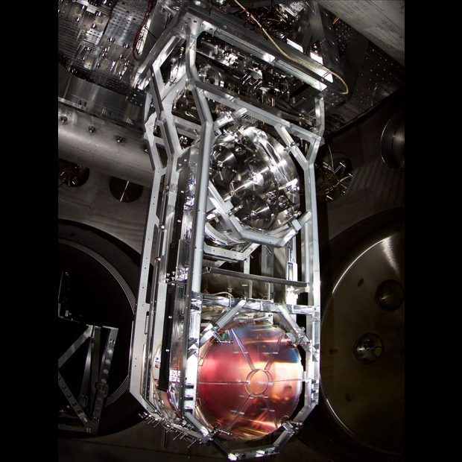
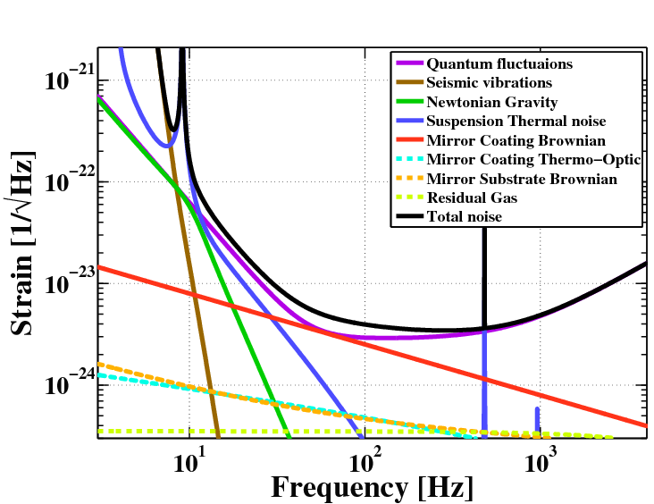
Thermal noise in test masses
One of LIGO's test masses installed in its quad suspension system [ligo.caltech.edu]
Part of the noise budget is from Brownian fluctuations. These are related to temperature and dissipation through the FDT: $S\left(f\right)∝k_{B}T⋅\underbrace{R}$
mirror dissipation term
Potential direction:
cryogenic LIGO

Slide 3
Using crystalline silicon
Using crystalline silicon at cryogenic temperatures allows to tackle two areas in the noise budget:
Brownian thermal noise: At lower temperatures, crystalline silicon is less lossy in comparison to fused silica
Quantum noise: This noise is reduced by increasing the incident laser power. However, increasing the laser power usually leads to thermal distortions in the mirrors. These can be reduced by working at around a zero-crossing of the Coefficient of Thermal Expansion (around 123 K) for crystalline silicon, whereas the CTE of fused silica doesn’t have such a point.
[C. A. Swenson, JPCRD (1983)]
Also, a zero-crossing (root) $→$ change of sign $→$ interval of control

Slide 4
Using optical cavities
[2physics.com]
4” long (a short cavity yields a higher $dω_{N}$ for a given $dL$ as resonance condition $ω_{N}=N\frac{c}{2L}$ implies: $dω_{N}=−ω_{N}\frac{dL}{L}$ )
Two curved mirrors
Mirror coatings adapted for a 1550 nm laser
(another material advantage: crystalline silicon is less absorptive in that $λ$ range)

Slide 5
Overview of the project
Locking the 1550 nm laser to a cavity: for that, the experimental setup for a frequency stabilization scheme has been set up
Temperature modulation: Using an incident low-power laser to supply a sinusoidally-changing amount of heating

Slide 6
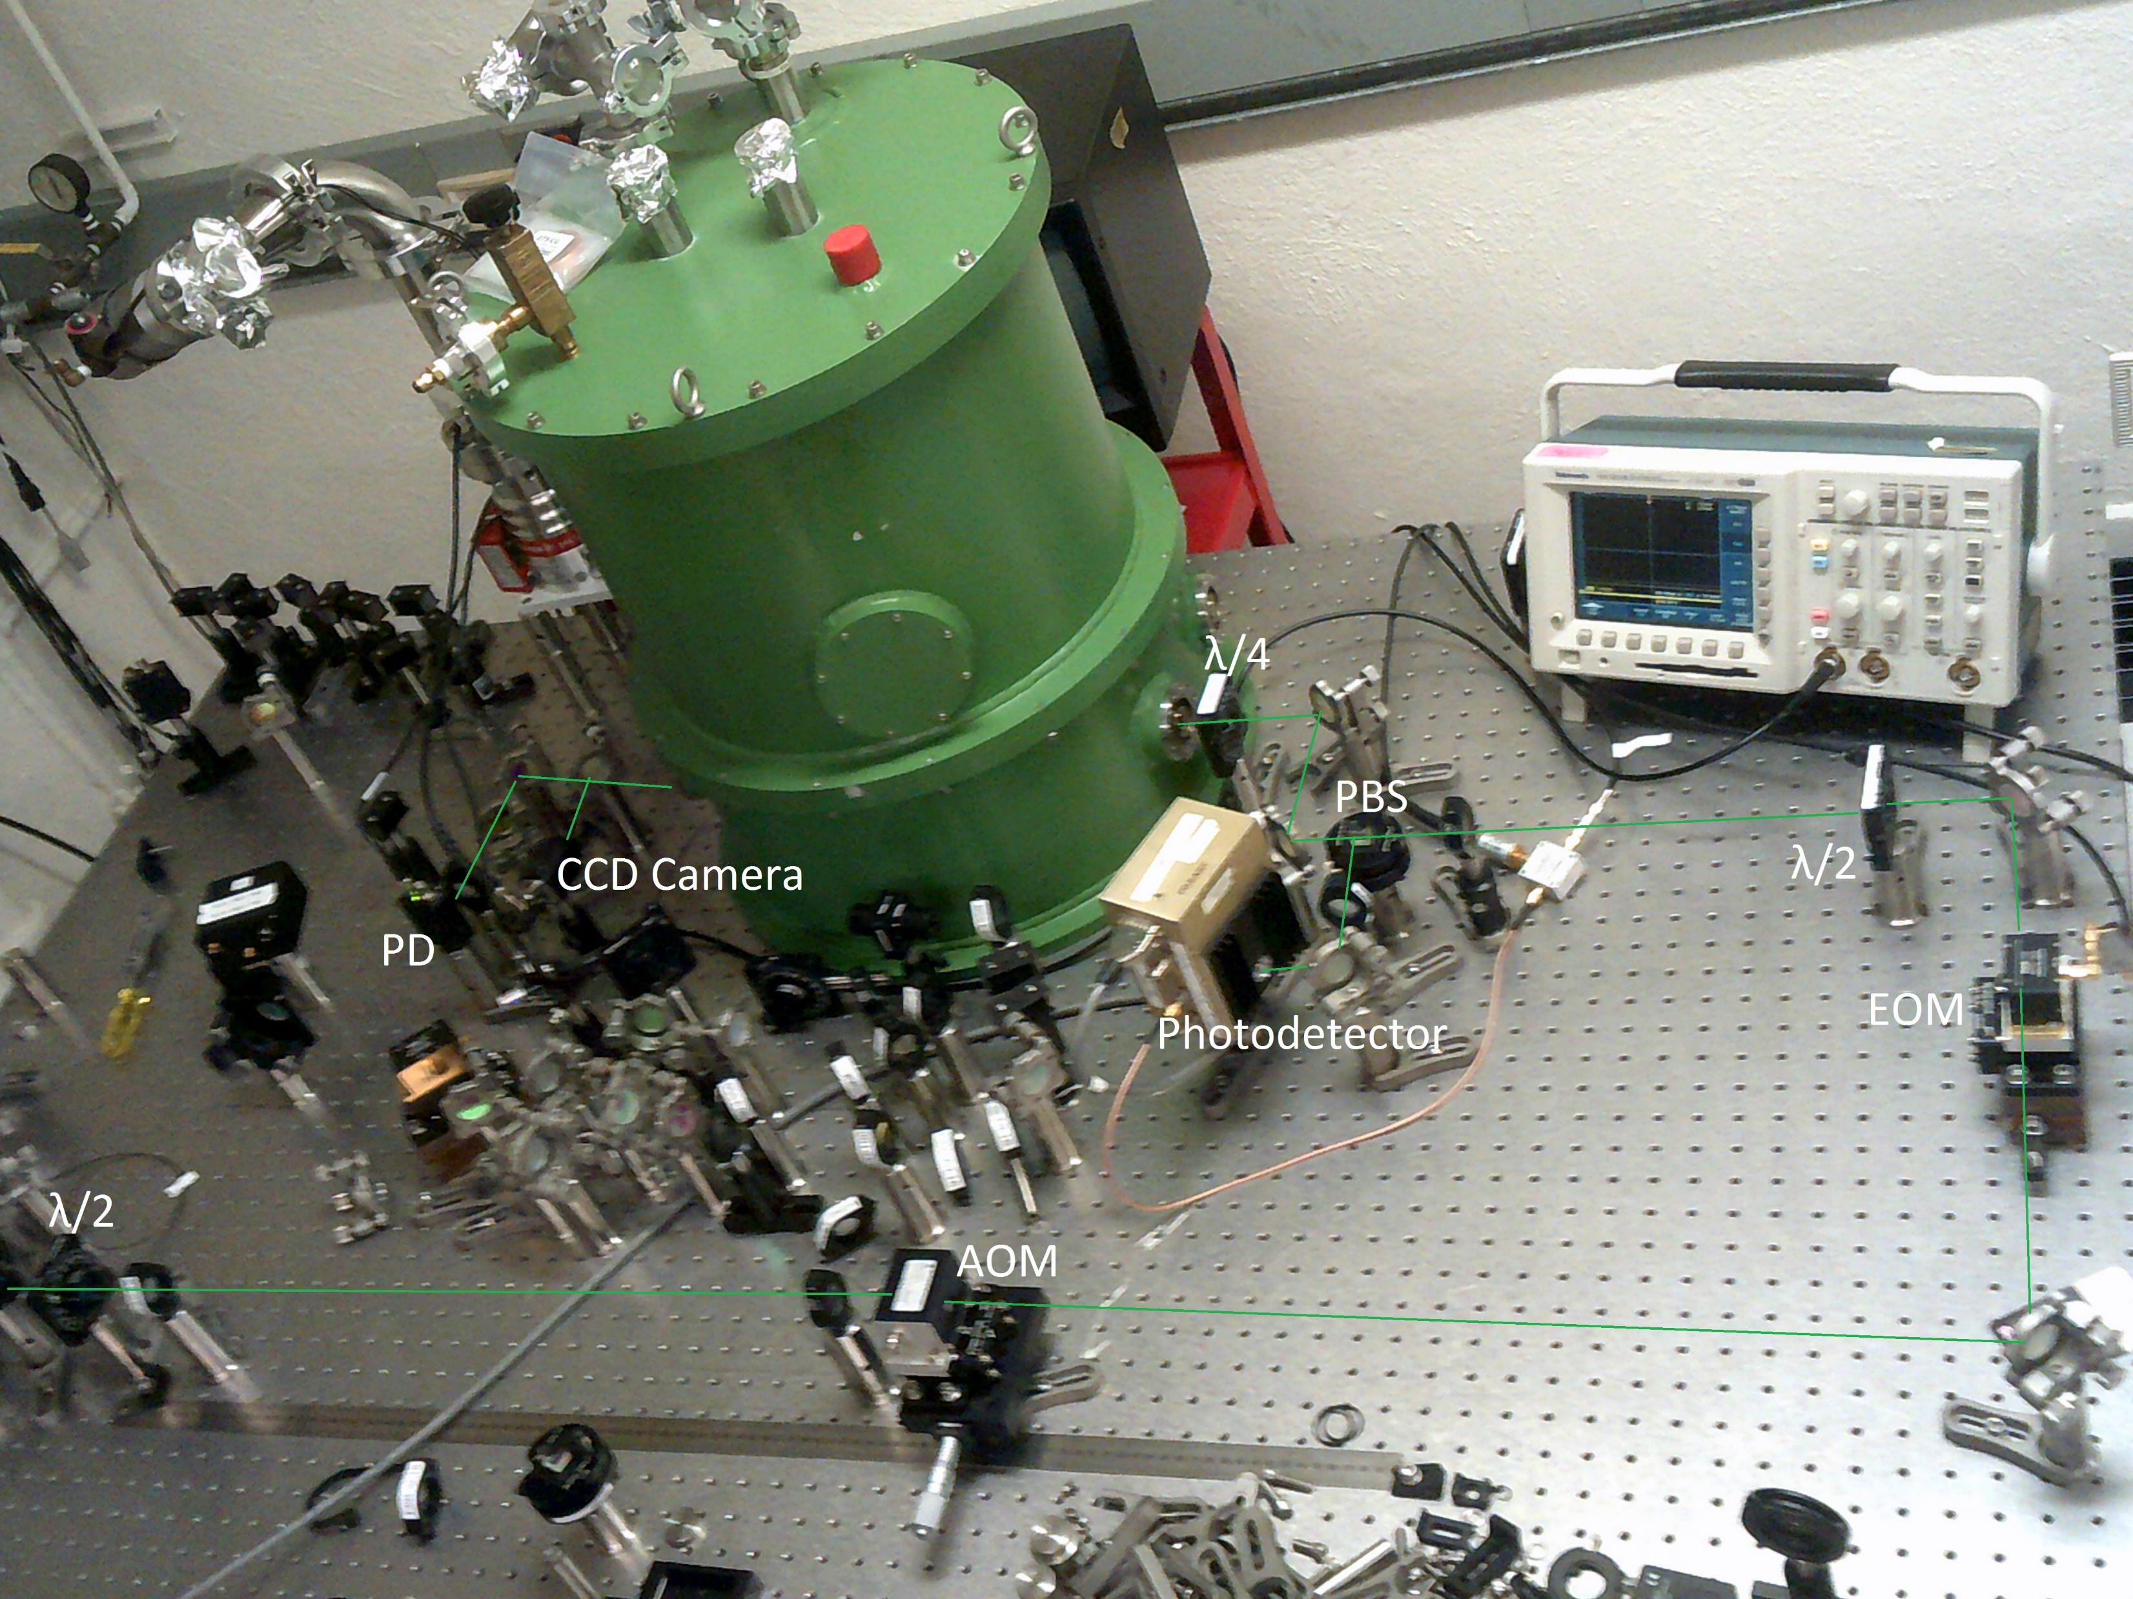
Locking a laser to a cavity
What are all of these devices scattered across the laser path?
$→$ Gaussian beam parameters
$→$ PDH (Pound-Drever-Hall) frequency stabilization technique

Slide 7
Gaussian beams
A Gaussian beam means that the beam intensity at each cross-section follows a Gaussian profile of characteristic width w(z)
This width diverges with beam path length z (with a minimum of $w_{0}:$ the waist) unless it encounters a lens or any other optical element (e.g. optical cavity)
As an optical cavity can only support specific laser beam modes, the beam has to be adapted to the target cavity: mode-matching
[en.wikipedia.org/wiki/Gaussian_beam]

Slide 8
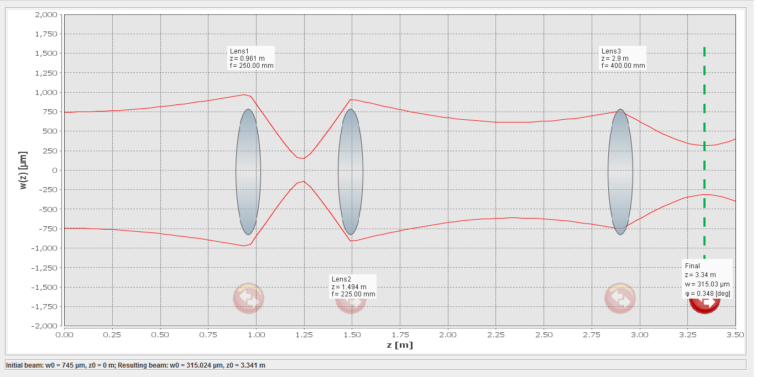
Example of mode-matching calculation:
For a target waist of $315 μm$, at $\sim 3.34 m$

Slide 9
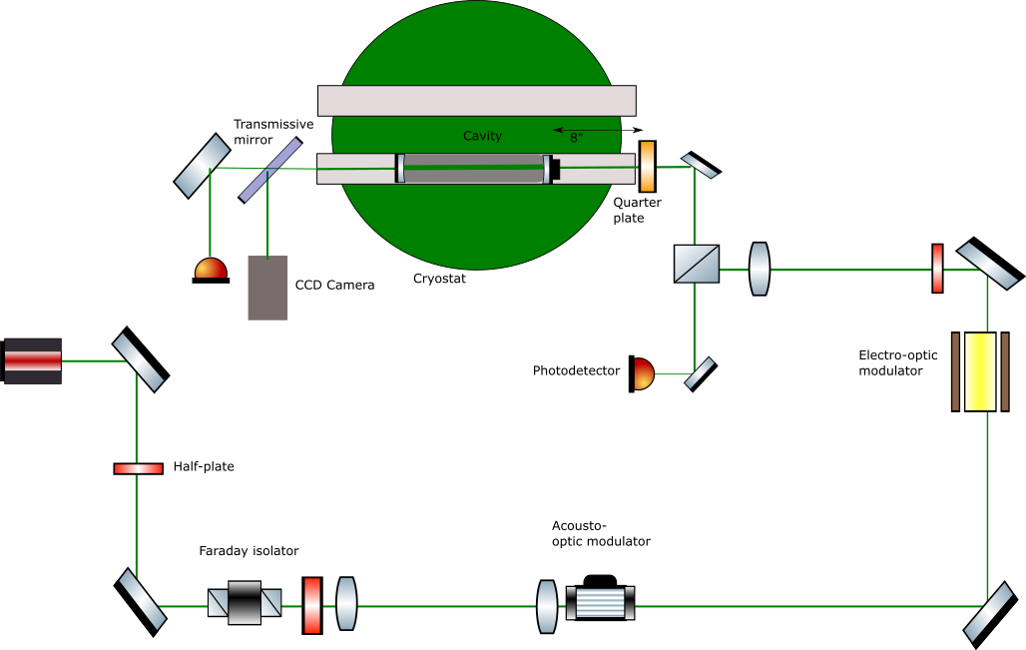
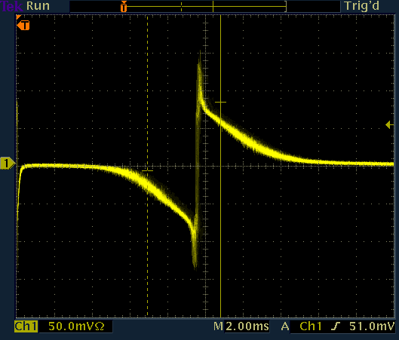
PDH frequency stabilization technique
It relies on generating sidebands around a resonant frequency $→$ spectrum contains $ω \& ω±Ω$
$e^{iωt}→e^{i(ωt+ β\sin{Ωt})}$ $→$ spectrum contains $ω \& ω±Ω$
These sidebands yield an error signal around resonance $→$ implementation of a feedback control system
Antisymmetric !

Slide 10
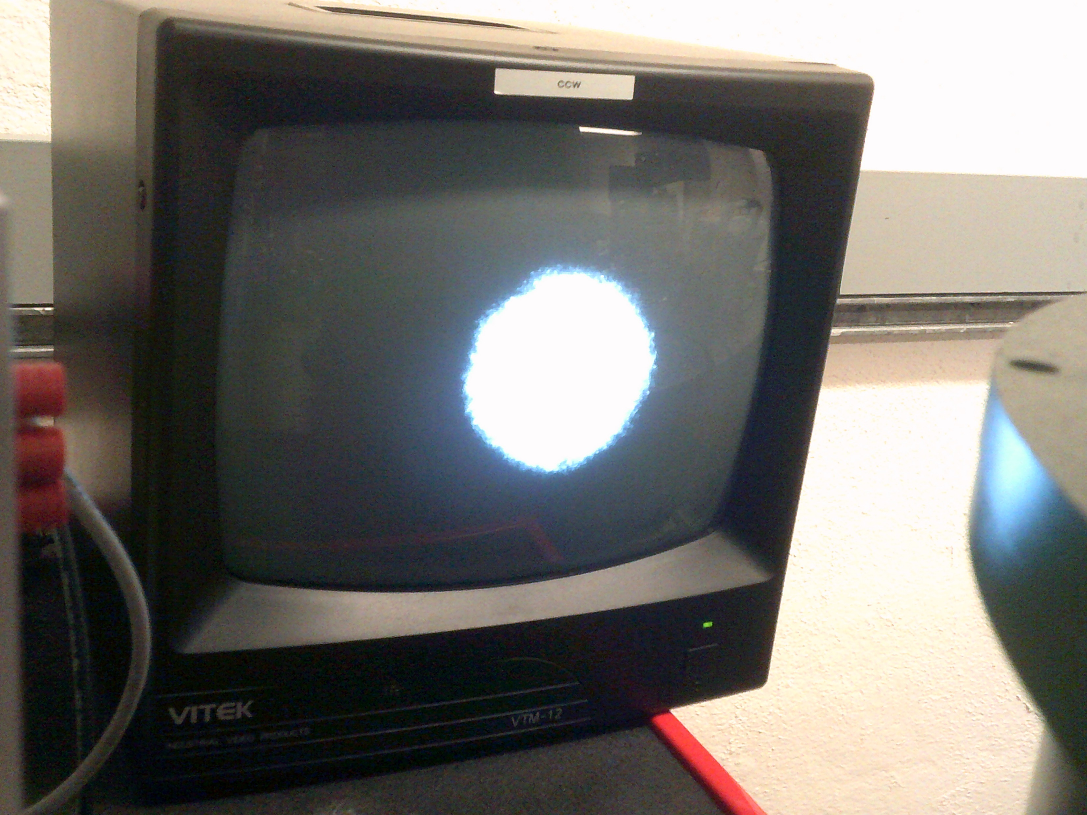
PDH frequency stabilization technique
Observing a resonance
in the cavity

Slide 11
Temperature modulation
The principle of temperature modulation is supplying an amount of heating to the cavity at some modulation frequency $f_{m}$
The method used here is to direct a laser pointer beam at the silicon substrate inside the cryostat
This can be tested at ambient room temperature and later with the cavity held at $\sim 123 K$, with the help of a detection method

Slide 12
Temperature modulation (cont.)
To detect a trace of this incident light at the frequency $f_{m}$, we first obtained a beat note between the main laser and another laser locked to a reference cavity. This beat note $Δf$ would wobble in time at the frequency $f_{m}$, which could be read out from a spectrum analyser.
Modulation peak at $f_{m}=10Hz$

Slide 13
Conclusion and future steps
What has been done?
> Modematching the laser at the desired waist setting, and setting up a PDH feedback loop for frequency stabilization.
> Implementing temperature modulation at room temperature
What will be done?
> Cooling the cryostat at the desired 123 K temperature and setting up a temperature modulation feedback loop.
> Find a better heat source (a laser with higher power, rather than the commercial laser pointer for now).

Slide 14
Acknowledgements
My mentors: Christopher Wipf and Johannes Eichholz
LIGO
California Institute of Technology
National Science Foundation

