Slide 1
Seismometer Isolation for Noise Cancellation at 40m Lab
LIGO SURF 2016
Aakash Patil
Mentors: Gautam Venugopalan, Koji Arai, Rana Adhikari
California Institute of Technology LIGO Project, MS 18 - 34 Pasadena, CA 91125. E - mail: info@ligo.caltech.edu

Slide 2
Overview
Motivation & Objectives
Experimental Setup
Preliminary Results
Future Work
Summary

Slide 3
Motivation & Objectives
To improve seismometer’s sensitivity at low frequencies
To develop enclosure for the seismometer at the LIGO 40m lab
To protect seismometer from environmental fluctuations which include thermal and electromagnetic fluctuations.

Slide 4
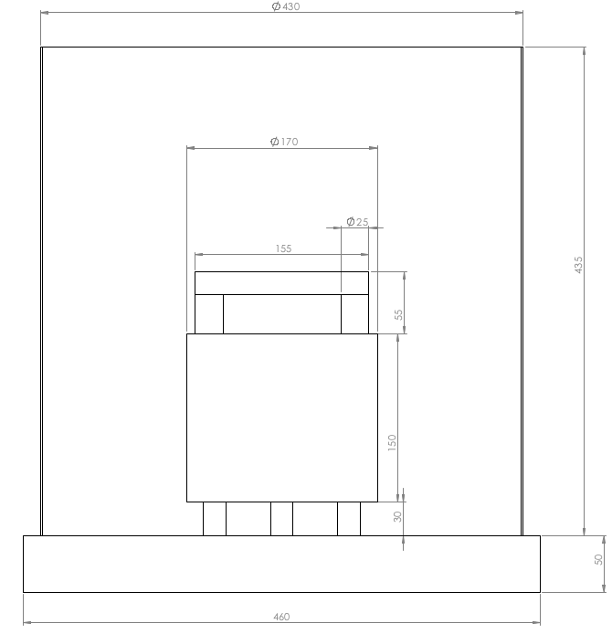
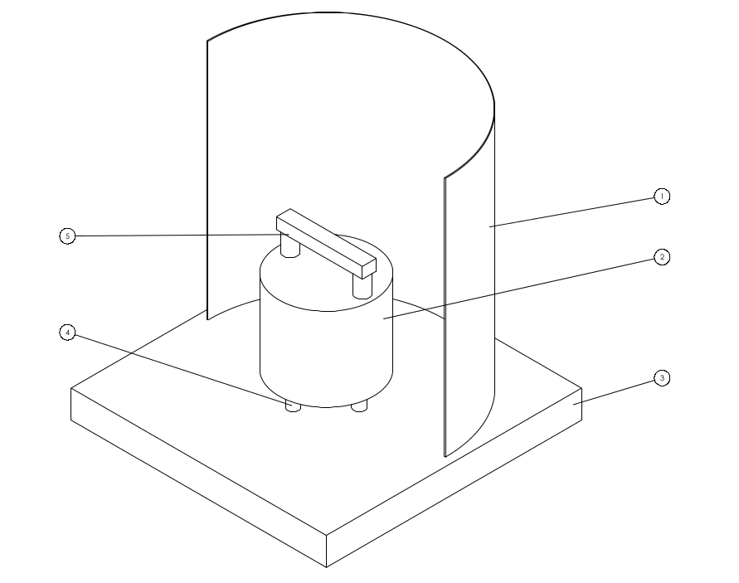
Seismometer & Enclosure
Enclosure
Seismometer

Slide 5
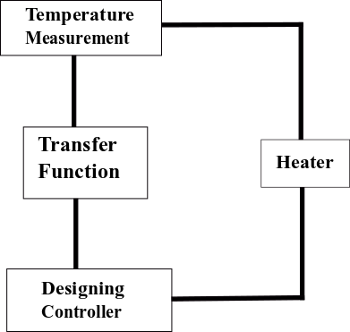
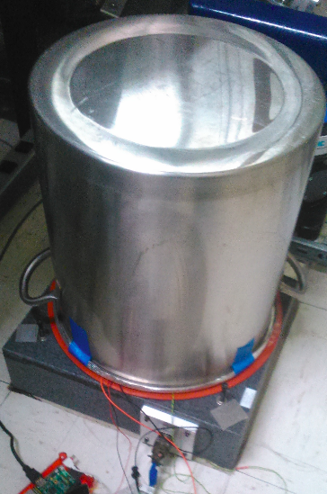
Experimental Objectives

Slide 6
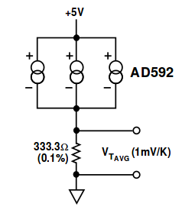
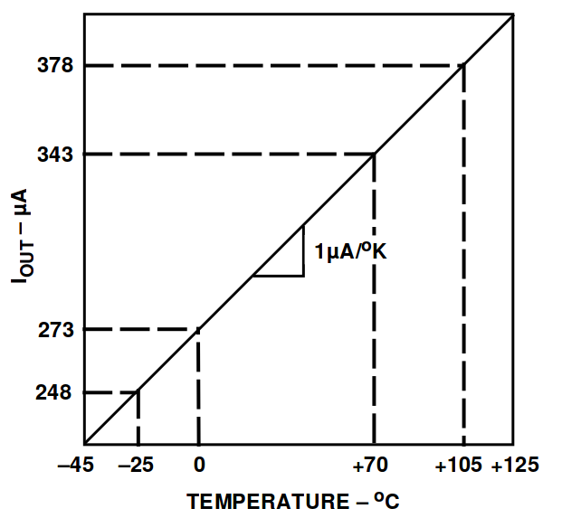
Temperature Measurement
AD592 CZ Temperature Transducer output current ∝ absolute temperature
Notes:
Talk about- single supply voltage 4 to 30V -no need of constant current source, accuracy 0.5 C at 25 C , minimal self heating, linearity 0.15C from 0 to 70C.

Slide 7
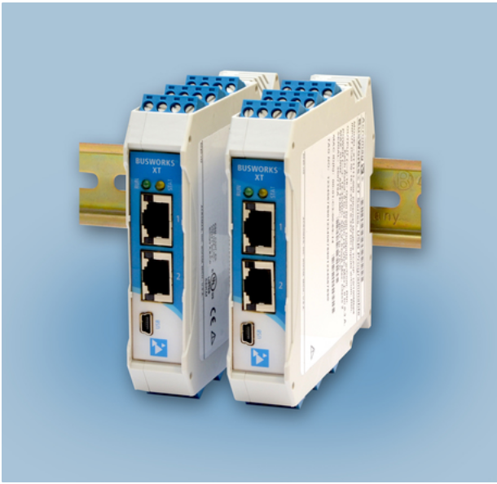
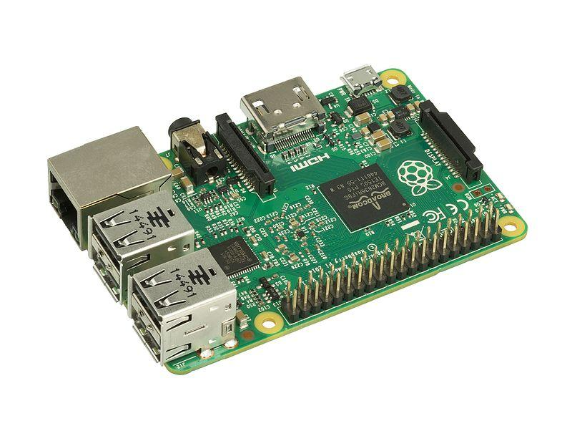
Acquiring Data
Acromag Busworks I/O Card RPi Model B GPIO- Multipurpose
Notes:
Acromag- Ethernet PLC’s RpiGPIO- General-purpose input/output pins with addon 16bit ADC by adafruit

Slide 8
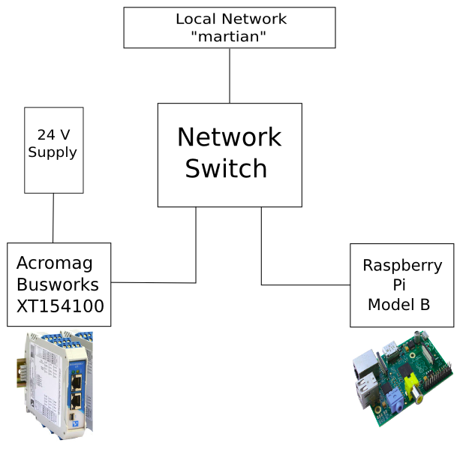
Acromag
Data I/O Future Plans at LIGO 40m
Experimental Physics and Industrial Control System by ANL
Configure as described by Aidan ATFW iki ⇓ Compile and install modules for linux-arm from source by LLO CDS ⇓ Create and test daq command and database
Notes:
Open Source libraries and tools developed to create distributed soft real-time control systems for particle accelerators, telescopes and other large scientific experiments. REMEMBER- ANL= “ARGONNE” NAT LAB.. Ask Gautam- LLO CDS?

Slide 9
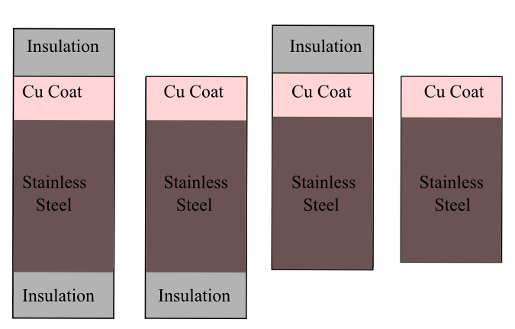
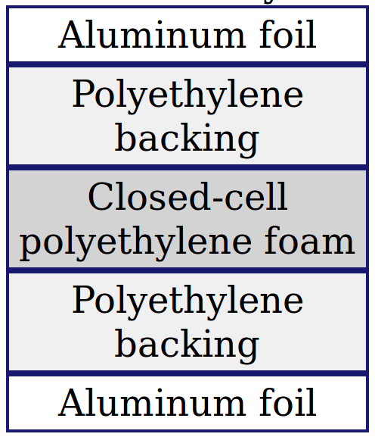
Seismometer Enclosure
Combinations Insulation
INSIDE
5 mm
OUTSIDE
Notes:
Prodex pro 5mm insulation \http://www.insulation4less.com/images/file/Prodex%20Technical%20brochure%20AD5.pdf

Slide 10
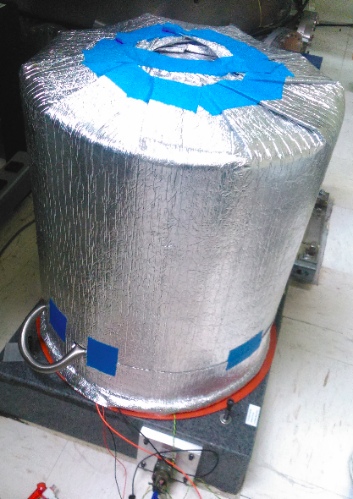
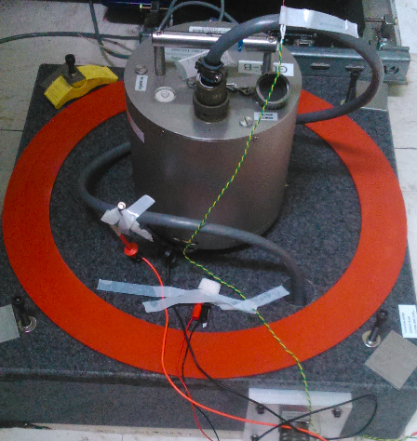
Seismometer & Enclosure

Slide 11
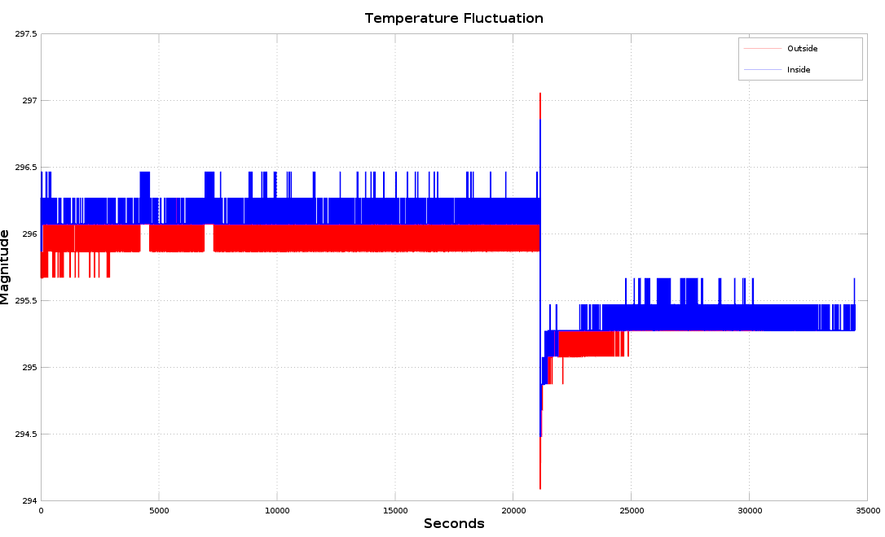
Temperature Measurement

Slide 12
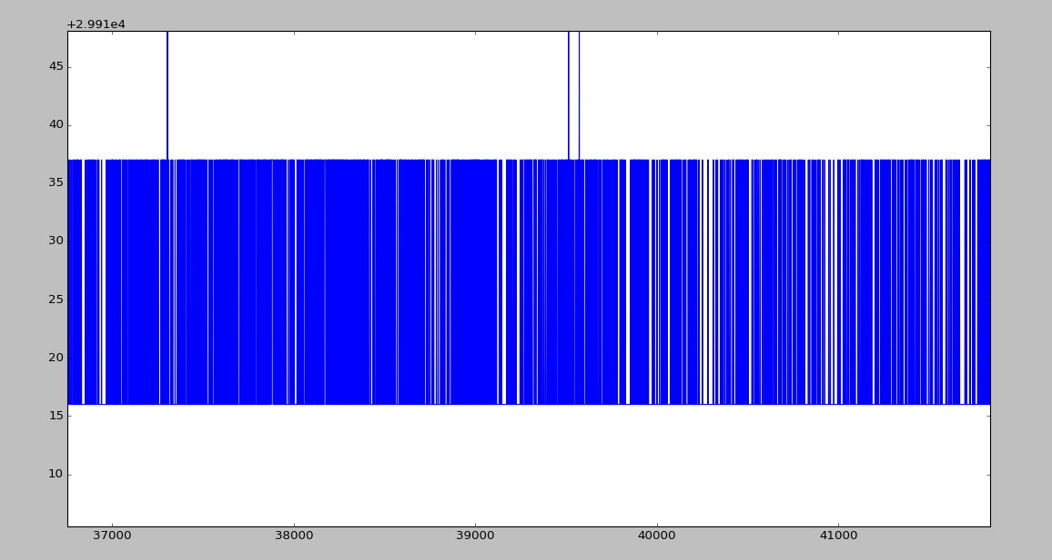
ADC Noise

Slide 13
Future Work
Acromag setup
Measure actual transfer function
Design a temperature controller
Characterisation of heater
Enclosure clamping
Connections to single seismometer wire.

Slide 14
Summary
Insulation is applied to the enclosure.
Problems in using RPi ADC have been identified.
Acromag Busworks I/O cards are NOT successfully installed and some problems remain to be solved.

Slide 15
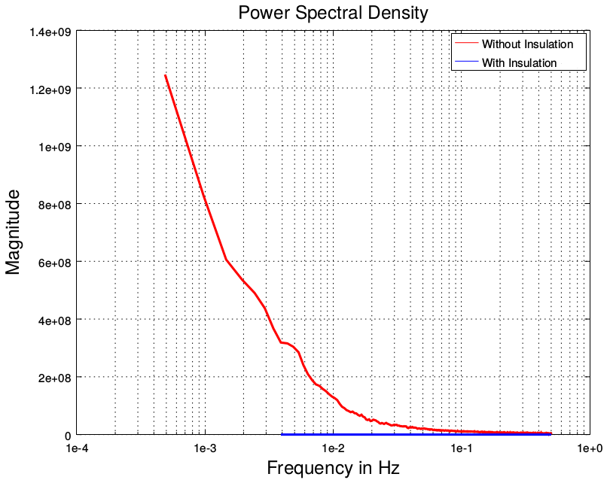
Insulated and Uninsulated Enclosure
PSD Plot
Notes:
found using Welch's overlapped segment averaging estimator pwelch-octave

Slide 16
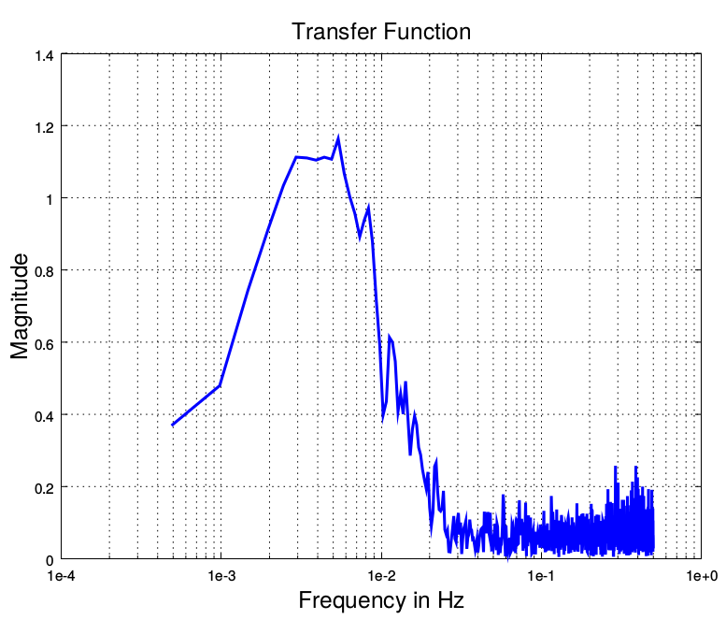
For Existing Enclosure
Temperature Fluctuation Transfer Function Plot
Notes:
To Gautam, I will also add a link to pdf to every plot just in case someone asks me to zoom in on certain area.

Slide 17
For Existing Enclosure
Temperature Fluctuation Coherence Plot
Notes:
To Gautam, I will also add a link to pdf to every plot just in case someone asks me to zoom in on certain area.

Slide 18
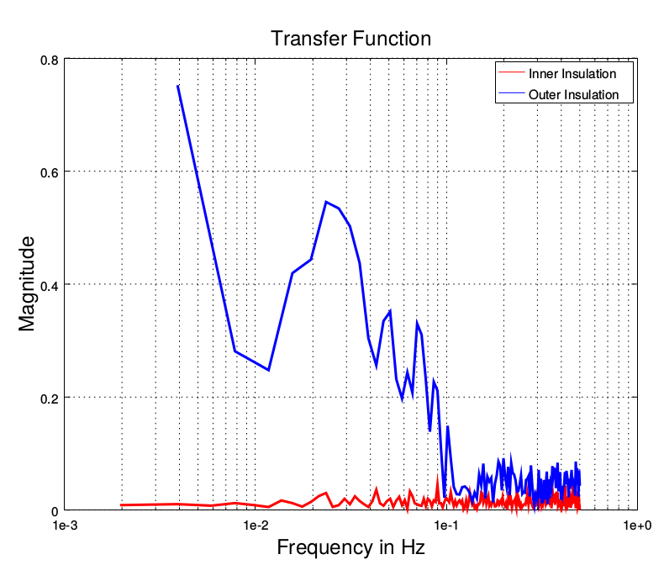
For Enclosure with One Sided insulation
Superimposed Temperature Fluctuation Transfer Function Plot for insulation on inside and outside
Notes:
To Gautam, I will also add a link to pdf to every plot just in case someone asks me to zoom in on certain area.

Slide 19
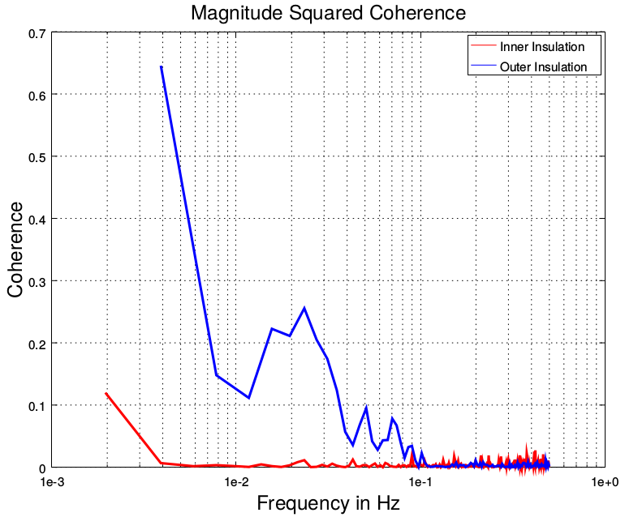
For Enclosure with One Sided insulation
Superimposed Temperature Fluctuation Coherence Plot for insulation on inside and outside
Notes:
To Gautam, I will also add a link to pdf to every plot just in case someone asks me to zoom in on certain area.

Slide 20
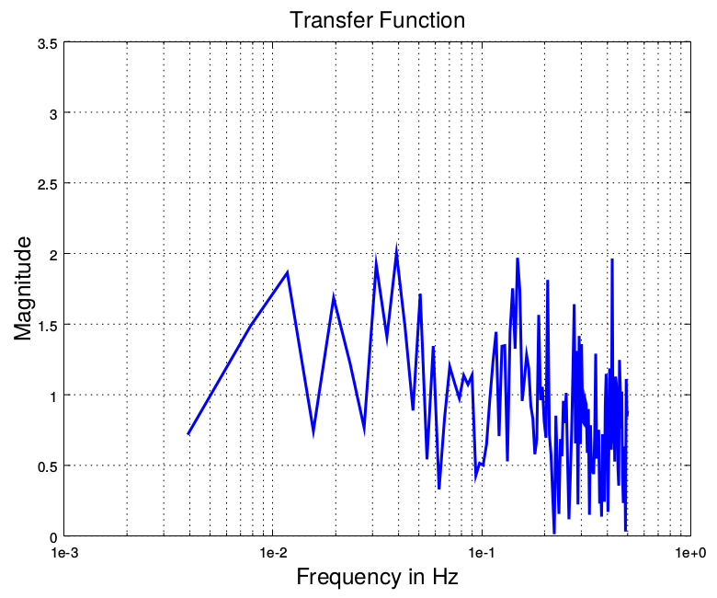
For Enclosure with Two Sided Insulation
Temperature Fluctuation Transfer Function Plot

Slide 21
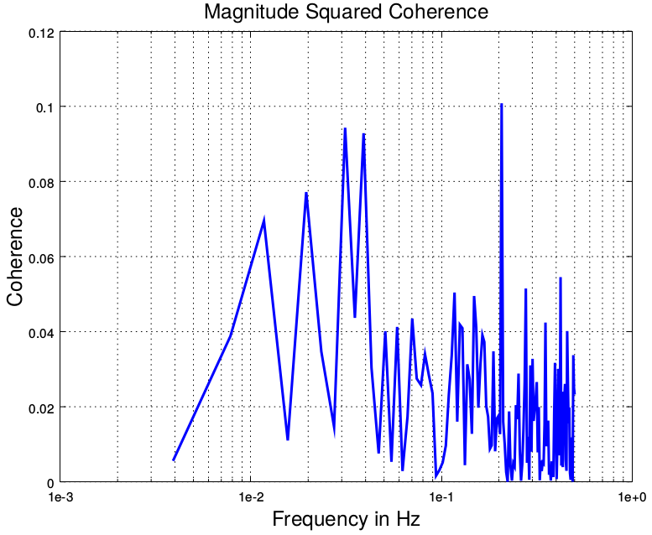
For Enclosure with Two Sided Insulation
Temperature Fluctuation Coherence Plot
Notes:
To Gautam, I will also add a link to pdf to every plot just in case someone asks me to zoom in on certain area.

Slide 22
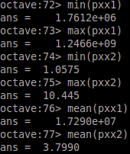
PSD Data

Slide 23
Data
strength of association between two series or power transfer between input and output of a linear system. For an ideal constant parameter linear system with a single input and single output , the coherence will be equal to one.

