Slide 1
Searching for Gravitational Waves from the Coalescence of High Mass Black Hole Binaries
LIGO SURF 2016 Final Presentation August 18, 2016 Ka-Lok (Rico), Lo Department of Physics, The Chinese University of Hong Kong Mentors: Surabhi Sachdev, Kent Blackburn, and Alan Weinstein
LIGO Laboratory, California Institute of Technology

Slide 2
Overview
Introduction
Tuning Search Parameter: f_{min}
h(t) Gating
Other Projects
Acknowledgement
Reference
Q&A
Notes:
Don’t go over the overview
Just mention: “Here’s the overview of the presentation”

Slide 3
Introduction
Background
Searching for Gravitational Waves
Matched Filtering
gstlal: the search pipeline
Objectives of the research project

Slide 4
Searching for Gravitational Waves
Amplitude of GW is small (10⁻²¹ to 10⁻²⁸)
Even worse, the detector is noisy
Impossible to detect one by naked eye
Need a more reliable and systematic way to search for GWs (proper data analysis)
Band-passed h(t)
Best-matching template
Figure taken from [1]

Slide 5
Matched Filtering
A powerful technique to search for a signal from a noisy data if we know what we are looking for
Procedures:
Figure out the expected waveforms (a lot of physics!)
Generate many of those expected waveforms (templates), forming a template bank
Slide a template across the signal and compare the ‘similarity’
Find peak of the matched filter responses
Repeat Step 3 and 4 for all the templates in the bank
Find coincident triggers (found in both H1 and L1)
Template bank defines the parameter space (masses and spins) covered by a search

Slide 6
Matched Filtering: Definition of SNR
Q: How can one quantify the similarity between the template and signal?
A: Compute the Signal-to-Noise Ratio (SNR)
Suppose we are filtering the data with some normalized templates
Matched filtering response to
Matched filtering response to
Power Spectral Density of Noise
Notes:
* It seems that everyone knows what SNR is*

Slide 7
gstlal: the search pipeline
Low Latency (on-line) search pipeline for compact binary coalescences (CBC)
EM Follow-up made possible (e.g. X ray, Visible light, Radio wave emitted from BNS merger)
Average latency ~ 1 minute (median latency)
Can be operated in either on-line or off-line mode
Based on matched filtering and detector network coincidence

Slide 8
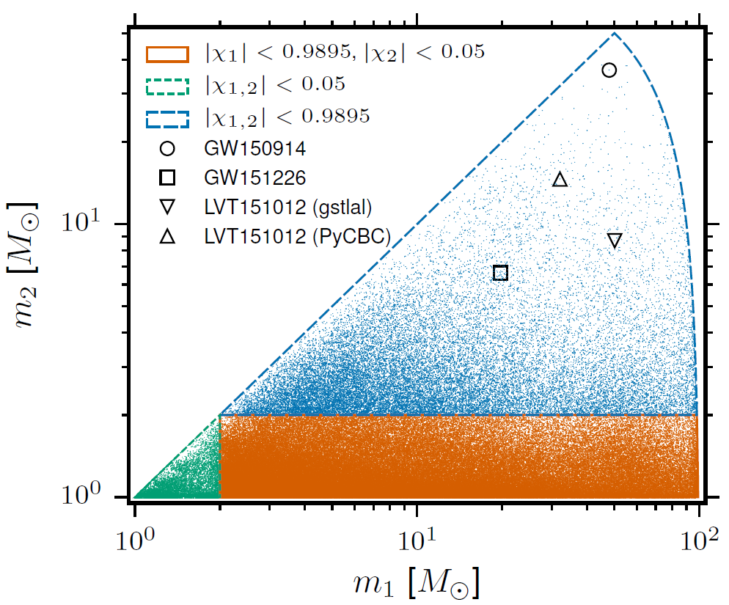
Parameter Space Covered by gstlal (uberbank)
Currently
Assumed component spins aligned with orbital angular momentum (no precession)
Figure taken from [3]
Notes:
*Remind the audience that the figure is in log scale!)

Slide 9
Objectives of this project
In short: optimizing the search
More specific:
Expanding the parameter space to cover Intermediate Mass Black Hole (IMBH) region
But there are a lot more to consider

Slide 10
What can possibly go wrong?
For instance:
Change in sensitivity for different astrophysical sources
Change in performance and extra computational costs (important for real-time GW detections)
Ensuring high mass templates are sensible
Compatibility of existing codes
We want (or try) to answer them!

Slide 11
Tuning Search Parameter: f_{min}
Motivation: Why do we need to tune f_{min}?
Results
20 Hz vs. 30 Hz
15 Hz vs. 30 Hz
15 Hz vs. 20 Hz
Notes:
Choice of fmin impacts sensitivity and computation cost

Slide 12
Observing GW Signals from IMBH
Higher the mass of the binary system, lower the ring-down frequency
is the total mass and is the reduced Kerr spin parameter
For a binary system with and , the ring-down frequency is approximately 19.8 Hz

Slide 13
Observing GW Signals from IMBH
Lower the starting frequency in order to observe them
Uberbank: 30 Hz
IMBH: 15 Hz
IMBH search was separated from the uberbank search and done off-line
Challenge: Combining the IMBH bank with the uberbank for on-line detection
So we may detect more signals during on-line search
Q: Should we lower the starting frequency to 15 Hz altogether?
A: Calculate SNR that compares injections with themselves

Slide 14
SNR Calculation
A: Calculate the optimal SNR to see how much SNR we may gain/lose
Optimal SNR: comparing the injections with themselves weighted by PSD
‘Actual’ SNR: comparing the data (with noise) with the templates (may not match exactly!)
We only have discrete number of templates in the bank
Plot the fractional change in optimal SNR with chirp mass

Slide 15
Result: 20 Hz vs. 30 Hz

Slide 16
Result: 15 Hz vs. 30 Hz

Slide 17
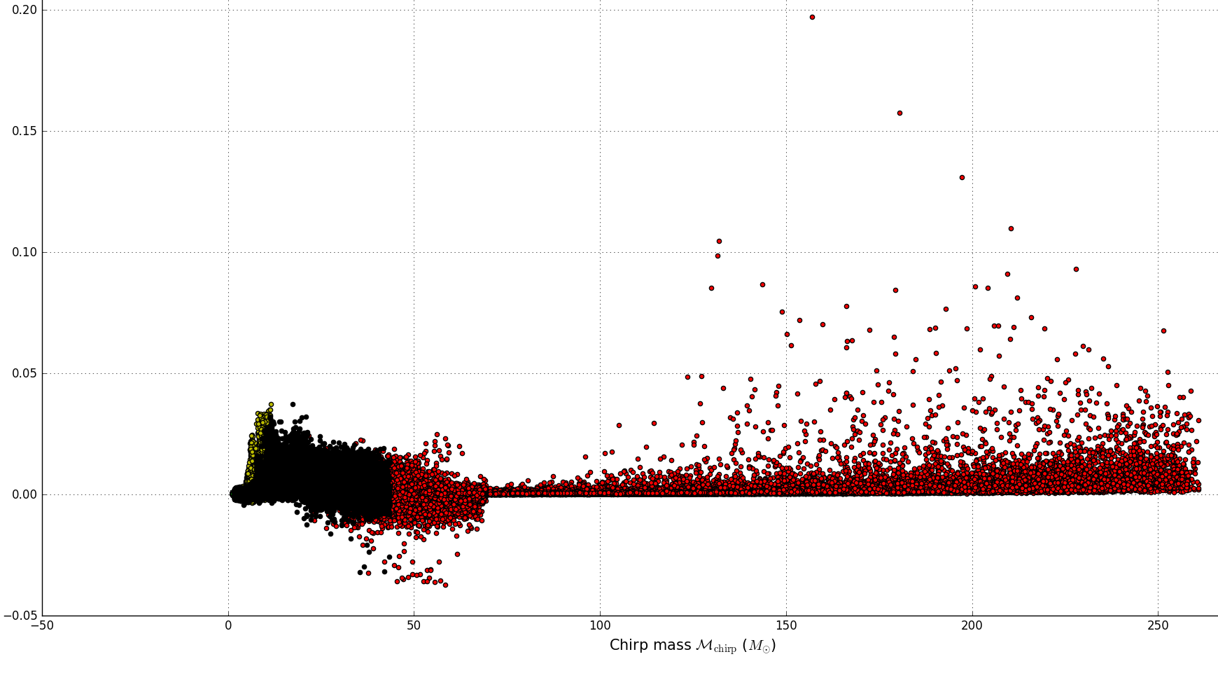
Result: 15 Hz vs. 20 Hz

Slide 18
Conclusions from the plots
A significant increase in SNR starting from
Worth lowering the starting frequency in order to get the extra SNR
Smaller change when further lowering the starting frequency from 20 Hz to 15 Hz
Will not add many computational costs for high mass region since there are fewer templates
Not significant change in SNR for lower mass region
Lowering the starting frequency in this region will add a lot more costs
But we only get a tiny increase in SNR!
Not worth it!
Notes:
Lower the starting frequency in the high mass region from 30 Hz to 15 Hz

Slide 19
Future work
We have modified gstlal codes to accept two different starting frequencies for different regions of chirp mass (within a SVD sub-bank)
Test our implementation with actual template bank to see the increase in SNR
Notes:
Chop up the bank into 250 sub banks (for background estimation and better SVD☺)
Choose different f_min for each bank

Slide 20
h(t) Gating
Motivation: Why do we need h(t) gating?
Problems with the current h(t) gating scheme
Linear scale with chirp mass of threshold value

Slide 21
Why do we need h(t) gating?
Glitches: Short transient instrumental noise fluctuations
Glitches may cause the filters to have unreasonably large response
For off-line searches: vetoes files for data quality
Veto seconds of data that contain instrumental glitches
During on-line mode: no vetoes available
Figure taken from [4]
Notes:
Vetoes seconds of data that contain instrumental glitches

Slide 22
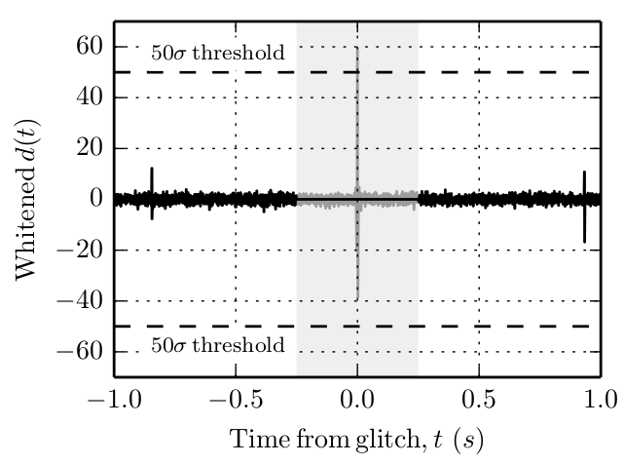
Current h(t) Gating Scheme
Specify a h(t) gating threshold value in advance (before running the search)
Filter response greater than or equal to the threshold value not likely from the astrophysical sources we are looking for
Currently chosen as
Lowest value before start missing
injections in high mass region
Replace data with 0’s
Figure taken from [2]
Notes:
Lower threshold : start missing signals in high mass region
50 is the lowest we can use

Slide 23
Problems with IMBH GW Signals
Loud in amplitude
Short in time
Easily mimicked by glitches
Likely to have a higher SNR
May be ‘gated-out’ by the current h(t) gating scheme
Blip glitch
Figure taken from [4]
IMBH Waveform

Slide 24
Naïve Solution
Naively, we can increase the threshold value so that we can detect IMBH signals
But this will allow more noise in our search
Also cause more false alarm triggers!
Because we are allowing more glitches, which can mimic actual GW signals easily

Slide 25
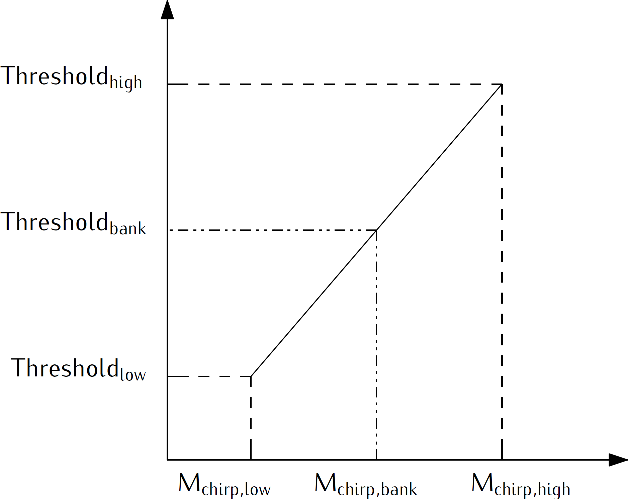
Linear Gating Scheme
Different threshold values for different chirp masses
Specify a linear scale in advance
Calculate the ‘appropriate’ threshold value for sub-banks with different masses according to the scale

Slide 26
Testing Linear Gating Scheme
Ran two gstlal off-line runs:
Default gating (one threshold value for all masses), without vetoes (to simulate the situation of on-line searches)
Linear gating, without vetoes
Template bank used: uberbank
Starting frequency: 30 Hz
Search duration: 3 days
Linear scale used:
M_{chirp, low} = 0.8; Threshold_{low} = 12.0
M_{chirp, high} = 45.0; Threshold_{high} = 100.0
Chirp mass is in the unit of solar mass

Slide 27
Results
Default gating, without vetoes
Linear gating, without vetoes
Noise removed with linear gating
All injections recovered in default gating run were also recovered in linear gating run
Notes:
* Change the scale of the plot on the left once NEMO is back*

Slide 28
Conclusions from testing runs
With linear gating scheme, we managed to
Reduce noise
Clean the data in absence of vetoes
Recover the same set of injections as compared with the default gating scheme
At least doing as good as the default scheme

Slide 29
Future Work
Short term:
Exploring different linear scales to get optimal results
Exploring different scales (e.g. Quadratic?)
Re-running with a longer search duration (exposed to more noise)
Re-running with more (software) injections
Re-running with a combined bank (uberbank + IMBH bank)
Long term:
Applying different threshold values to each template rather than to each sub-bank

Slide 30
Other Projects: Optimizing Bank Splitting Algorithms
Bank splitting:
Divide the bank into ‘split-banks’
Put 5 split-banks together to form a SVD sub-bank and perform SVD on each sub-bank
Bank splitting algorithm is
Essential for SVD compression efficiency
SVD reduces the no. of effective filters required for the search
Finish the search quicker
Essential for Background Estimation
In progress

Slide 31
Acknowledgement and Reference

Slide 32
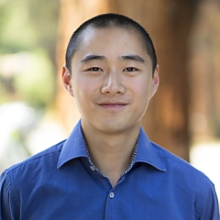
Acknowledgement
My sincere gratitude to
Mentors:
Surabhi Sachdev
Kent Blackburn
Alan Weinstein
Tjonnie Li @ CUHK GW Group
LIGO Laboratory
LIGO SURF Program and Caltech SFP Office
Leonard E Parker Center for Gravitation, Cosmology and Astrophysics @ University of Wisconsin–Milwaukee

Slide 33
Acknowledgement
This summer research would not be possible without
National Science Foundation (NSF)
Charles K. Kao Research Exchange Scholarship
CN YANG Research Exchange Scholarship
Department of Physics, CUHK
M.C. Chu from CUHK

Slide 34
Reference
[1]: The LIGO Scientific Collaboration, the Virgo Collaboration, B. P. Abbott, R. Abbott, T. D. Abbott, M. R. Abernathy, F. Acernese, K. Ackley, C. Adams, T. Adams, and et al. (LIGO Scientific Collaboration and Virgo Collaboration), Phys. Rev. Lett. 116, 241103 (2016).
[2]: C. Messick, K. Blackburn, P. Brady, P. Brockill, K. Cannon, R. Cariou, S. Caudill, S. J. Chamberlin, J. D. E. Creighton, R. Everett, C. Hanna, D. Keppel, R. N. Lang, T. G. F. Li, D. Meacher, A. Nielsen, C. Pankow, S. Privitera, H. Qi, S. Sachdev, L. Sadeghian, L. Singer, E. G. Thomas, L. Wade, M. Wade, A. Weinstein, and K. Wiesner, ArXiv e-prints (2016), arXiv:1604.04324 [astro-ph.IM].
[3]: The LIGO Scientific Collaboration, the Virgo Collaboration, B. P. Abbott, R. Abbott, T. D. Abbott, M. R. Abernathy, F. Acernese, K. Ackley, C. Adams, T. Adams, and et al., ArXiv e-prints (2016), arXiv:1606.04856 [gr-qc].
[4]: The LIGO Scientific Collaboration, the Virgo Collaboration, B. P. Abbott, R. Abbott, T. D. Abbott, M. R. Abernathy, F. Acernese, K. Ackley, C. Adams, T. Adams, and et al., ArXiv e-prints (2016), arXiv:1602.03844 [gr-qc].

Slide 35
Q&A

Slide 36
Thank you!

Slide 37
Backup slides

Slide 38
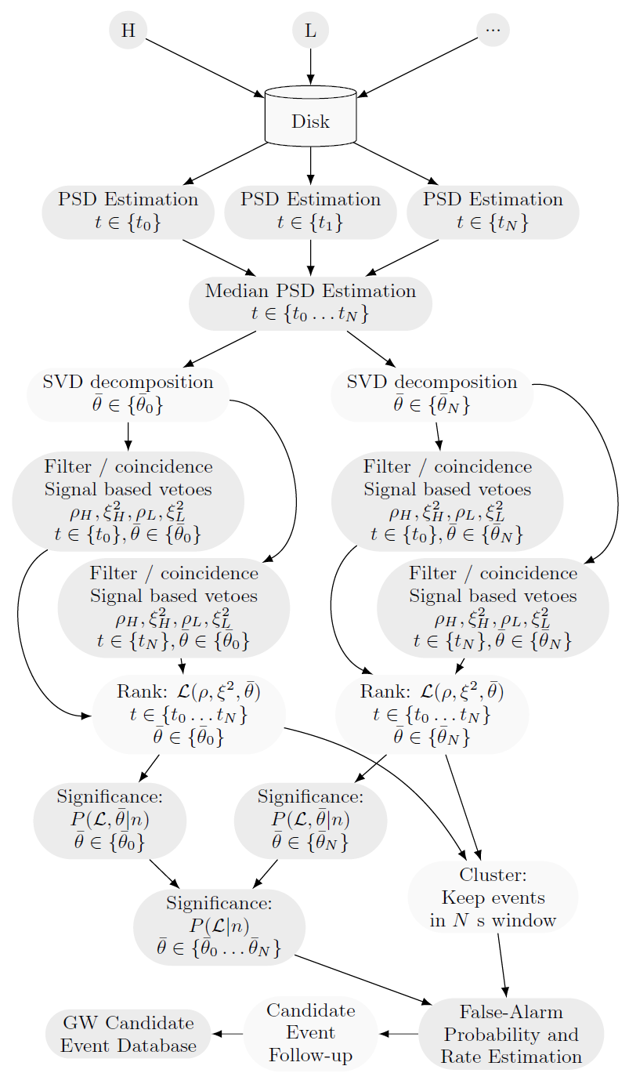
Flow Chart of gstlal
Data h(t)
Estimate Power Spectral Density (PSD)
Singular Value Decomposition (SVD) on templates
Matched Filtering
SNR > 4?
No
No further treatment
Yes
Found in both H1&L1?
No: Single Trigger
Single Trigger: Estimate Background
Yes: Coincident Triggers
Calculate ranking statistic of the candidate
Calculate False Alarm Rate (FAR) and Probability (FAP)
Figure taken from [2]

Slide 39
Bank Splitting
Motivation: Why do we need to split the template bank?
Different ways of splitting the bank
Default
Sort by chirp time
Output rows sort by chirp time
Notes:
Optimizing bank splitting algorithms

Slide 40
Singular Value Decomposition (SVD)
One of the techniques adopted by gstlal to speed up the search
Reduce the number of ‘effective’ filters required for the search
Decompose any matrix into three matrices
Where are orthogonal matrices forming the singular vectors and
are called singular values and are ordered in descending order

Slide 41
Lower Rank Matrix Approximation (LRMA) using SVD
We can express the matrix as a summation of singular values and the singular vectors
To approximate A with a lower-rank matrix M (where rank(M) = k), the best you can do is to use
Meaning that the best LRMA is truncating the summation
with

Slide 42
Performing SVD on Templates
A template is essentially a time series of numbers
Sampling the ‘simulated signal’ at certain frequency
Can be put in the form of matrix easily
When performing SVD, we put many (~1000) templates together in a matrix
Therefore m is the number of samples in each template and n is the number of templates in a SVD sub-bank
Most SVD algorithms require that
Each column is a template

Slide 43
Splitting Template Bank
As a result, the way we put templates together in a sub-bank is crucial
Affect the compression effect of SVD and hence the performance of the pipeline
Affect the sensitivity of the search since matched filtering jobs are done for each SVD sub-bank for each reference PSD
Default bank splitter: first bin templates by χ_{eff} (effective spin parameter) then sorting templates by chirp mass within each bin
Trying to put similar waveforms together in a split bank
Group a number of templates in a split-bank
Each SVD bank consists of 5 split-banks

Slide 44
Template Bank
M = 1.23
χ = 0.4
M = 3.62
χ = -0.5
M = 15.6
χ = 0.7
M = 30.4
χ = 0.1
M = 47.7
χ = -0.3
M = 4.76
χ = -0.2
M = 36.6
χ = -0.1
M = 2.96
χ = 0.0
M = 7.7
χ = 0.6
M = 68.9
χ = -0.9
M = 4.87
χ = -0.4
M = 1.69
χ = 0.8
M stands for chirp mass with the unit of solar mass
Χ stands for the dimensionless effective spin parameter

Slide 45
Step 1: Binning By χ_{eff}
M = 1.23
χ = 0.4
M = 3.62
χ = -0.5
M = 15.6
χ = 0.7
M = 30.4
χ = 0.1
M = 47.7
χ = -0.3
M = 4.76
χ = -0.2
M = 36.6
χ = -0.1
M = 2.96
χ = 0.0
M = 7.7
χ = 0.6
M = 68.9
χ = -0.9
M = 4.87
χ = -0.4
M = 1.69
χ = 0.8

Slide 46
Step 1: Binning By χ_{eff}
A χ bin
M = 1.23
χ = 0.4
M = 7.7
χ = 0.6
M = 15.6
χ = 0.7
M = 1.69
χ = 0.8
M = 4.76
χ = -0.2
M = 36.6
χ = -0.1
M = 2.96
χ = 0.0
M = 30.4
χ = 0.1
M = 68.9
χ = -0.9
M = 3.62
χ = -0.5
M = 4.87
χ = -0.4
M = 47.7
χ = -0.3

Slide 47
Step 2: Sorting By M_{chirp}
M = 1.23
χ = 0.4
M = 7.7
χ = 0.6
M = 15.6
χ = 0.7
M = 1.69
χ = 0.8
M = 4.76
χ = -0.2
M = 36.6
χ = -0.1
M = 2.96
χ = 0.0
M = 30.4
χ = 0.1
M = 68.9
χ = -0.9
M = 3.62
χ = -0.5
M = 4.87
χ = -0.4
M = 47.7
χ = -0.3

Slide 48
Step 2: Sorting By M_{chirp}
M = 1.23
χ = 0.4
M = 1.69
χ = 0.8
M = 7.7
χ = 0.6
M = 15.6
χ = 0.7
M = 2.96
χ = 0.0
M = 4.76
χ = -0.2
M = 30.4
χ = 0.1
M = 36.6
χ = -0.1
M = 3.62
χ = -0.5
M = 4.87
χ = -0.4
M = 47.7
χ = -0.3
M = 68.9
χ = -0.9

Slide 49
Step 2: Sorting By M_{chirp}
M = 1.23
χ = 0.4
M = 1.69
χ = 0.8
M = 7.7
χ = 0.6
M = 15.6
χ = 0.7
M = 2.96
χ = 0.0
M = 4.76
χ = -0.2
M = 30.4
χ = 0.1
M = 36.6
χ = -0.1
M = 3.62
χ = -0.5
M = 4.87
χ = -0.4
M = 47.7
χ = -0.3
M = 68.9
χ = -0.9
A split bank

Slide 50
Output of bank splitter: split-banks
M = 1.23
χ = 0.4
M = 1.69
χ = 0.8
M = 7.7
χ = 0.6
M = 15.6
χ = 0.7
0
3
M = 2.96
χ = 0.0
M = 4.76
χ = -0.2
M = 30.4
χ = 0.1
M = 36.6
χ = -0.1
1
4
M = 3.62
χ = -0.5
M = 4.87
χ = -0.4
M = 47.7
χ = -0.3
M = 68.9
χ = -0.9
2
5

Slide 51
New Proposals for Bank Splitter
Proposal I: Sort by chirp time only
We expect that the distribution of the time required to complete the matched filtering will be more dispersed
Proposal II: Sub-banks sort by the chirp time of their first template
Since each SVD bank comprises of 5 split banks, we are sort of putting similar templates together
Chirp time of a template is estimated by SEOBNRv2DoubleSpinChirpTime function implemented in lalsimulation
Notes:
Chirp mass: a good criterion how templates match with each other for inspiral only region
Chirp time: a good criterion how templates match with each other for IMR (Inspiral-Merger-Ringdown) region

Slide 52
Comparing bank splitters
There are mainly two criteria:
Speed of matched filtering jobs
Sensitivity of the search
We can compare bank splitters by looking at
For speed:
Flopulator (FLOP Calculator)
Calculate the number of Floating Point Operations needed for the filtering jobs WITHOUT actually doing them
gstlal_inspiral time
Measuring the actual time required to finish the filtering jobs
For sensitivity:
Range
How far can we detect a GW signal

Slide 53
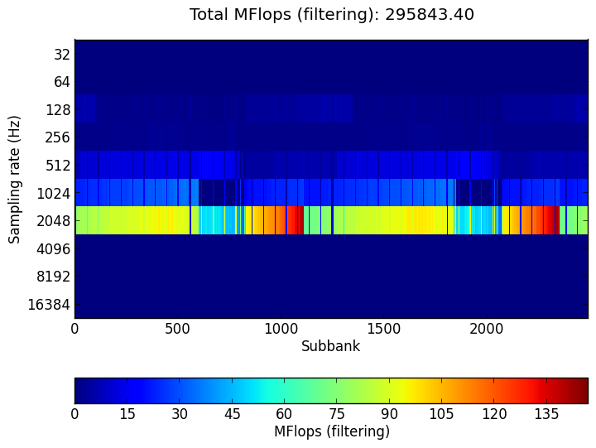
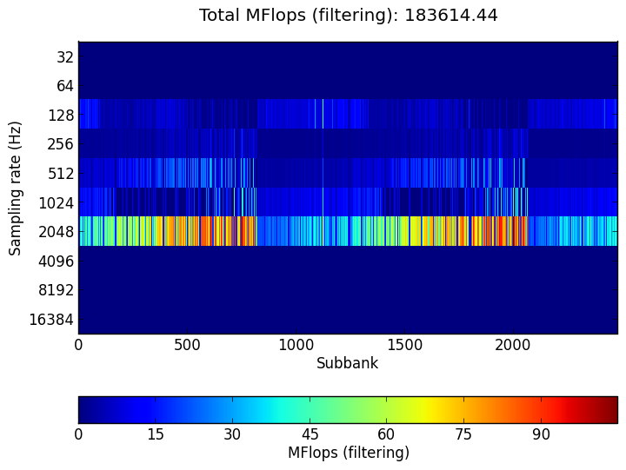
Results: Flopulator output
Default
Proposal I
Proposal II

Slide 54
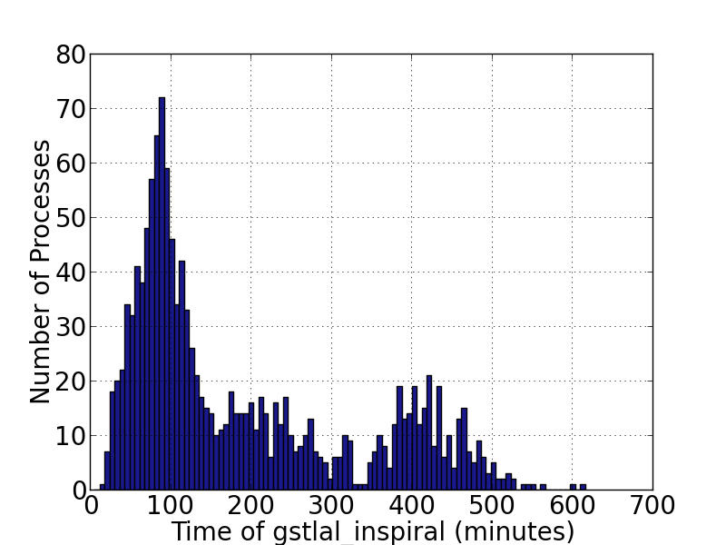
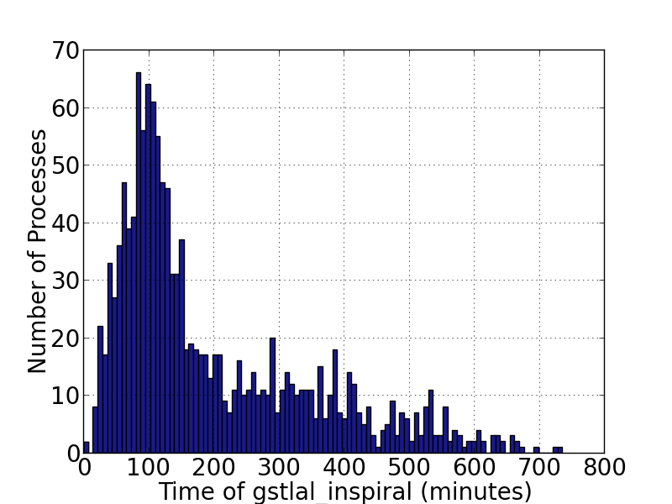
Results: gstlal_inspiral Time
Default
Proposal I
Proposal II

Slide 55
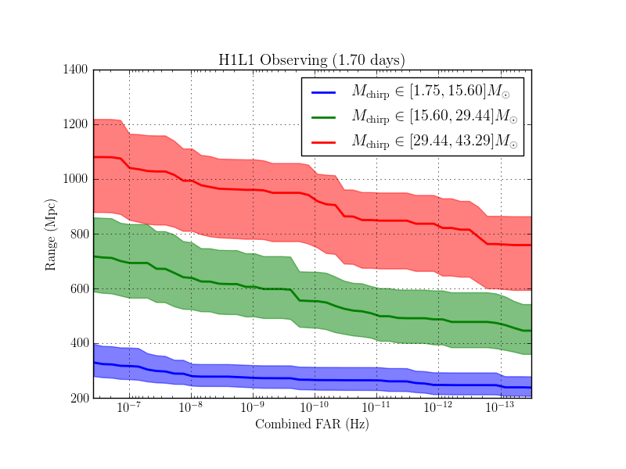
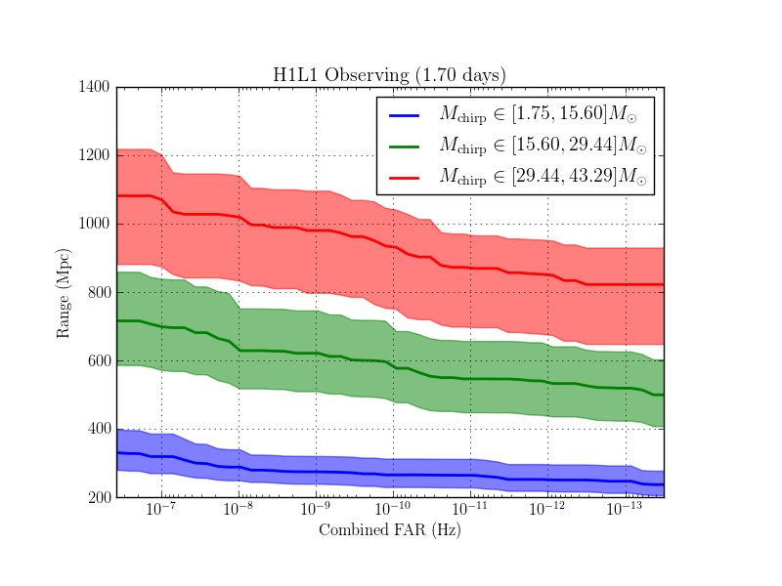
Results: Range
Default
Proposal I
Proposal II

Slide 56
Quick Summary on Bank Splitting
Put templates with similar chirp time together and form a split bank for SVD
Chirp time is a good criterion about how templates match with each other for Inspiral-Merger-Ringdown region
As compared with the default bank splitter, chirp time bank splitter:
The greatest time required to complete matched filtering (in gstlal_inspiral) is lower
Higher total FLOPS required for matched filtering predicted by Flopulator (FLOP calculator)
Same sensitivity (within the error)

Slide 57
Quick Summary on Bank Splitting
There is another group working on bank splitting as well (Leslie Wade @ Kenyon College)
Because of a bug, they group templates randomly instead of chirp time
A better sensitivity is observed
This raises two concerns
The current standard of comparing binning methods is flawed
Current ranking statistic is flawed because we have been assuming that grouping unlike templates will only decrease the sensitivity

