Slide 1
Intro to Controls and the new Controls Working Group
Brett Shapiro
31 August 2016
LAAC Session
LVC Glasgow Scotland

Slide 2

Many other controls tutorials
G1600726 - Intro to Control Theory for LIGO People (3 separate lectures)
G1601417 - SURF lectures: Introduction to controls
G1600525 - Introduction to controls in LIGO
G1400557 - State-Space Methods for Feedback Control
G1400102 - Introduction to State Space Control Techniques
- This list may not be exhaustive

Slide 3
Outline
Controls tutorial
  Feedback control signal flow
  Transfer function models
  Feedback stability
Control System Working Group (CSWG)
Notes:
In the first part, we’re going to talk about the basics of control. So I’m going to assume no prior knowledge of feedback systems.
At the end, I’ll introduce our new controls working group.

Slide 4
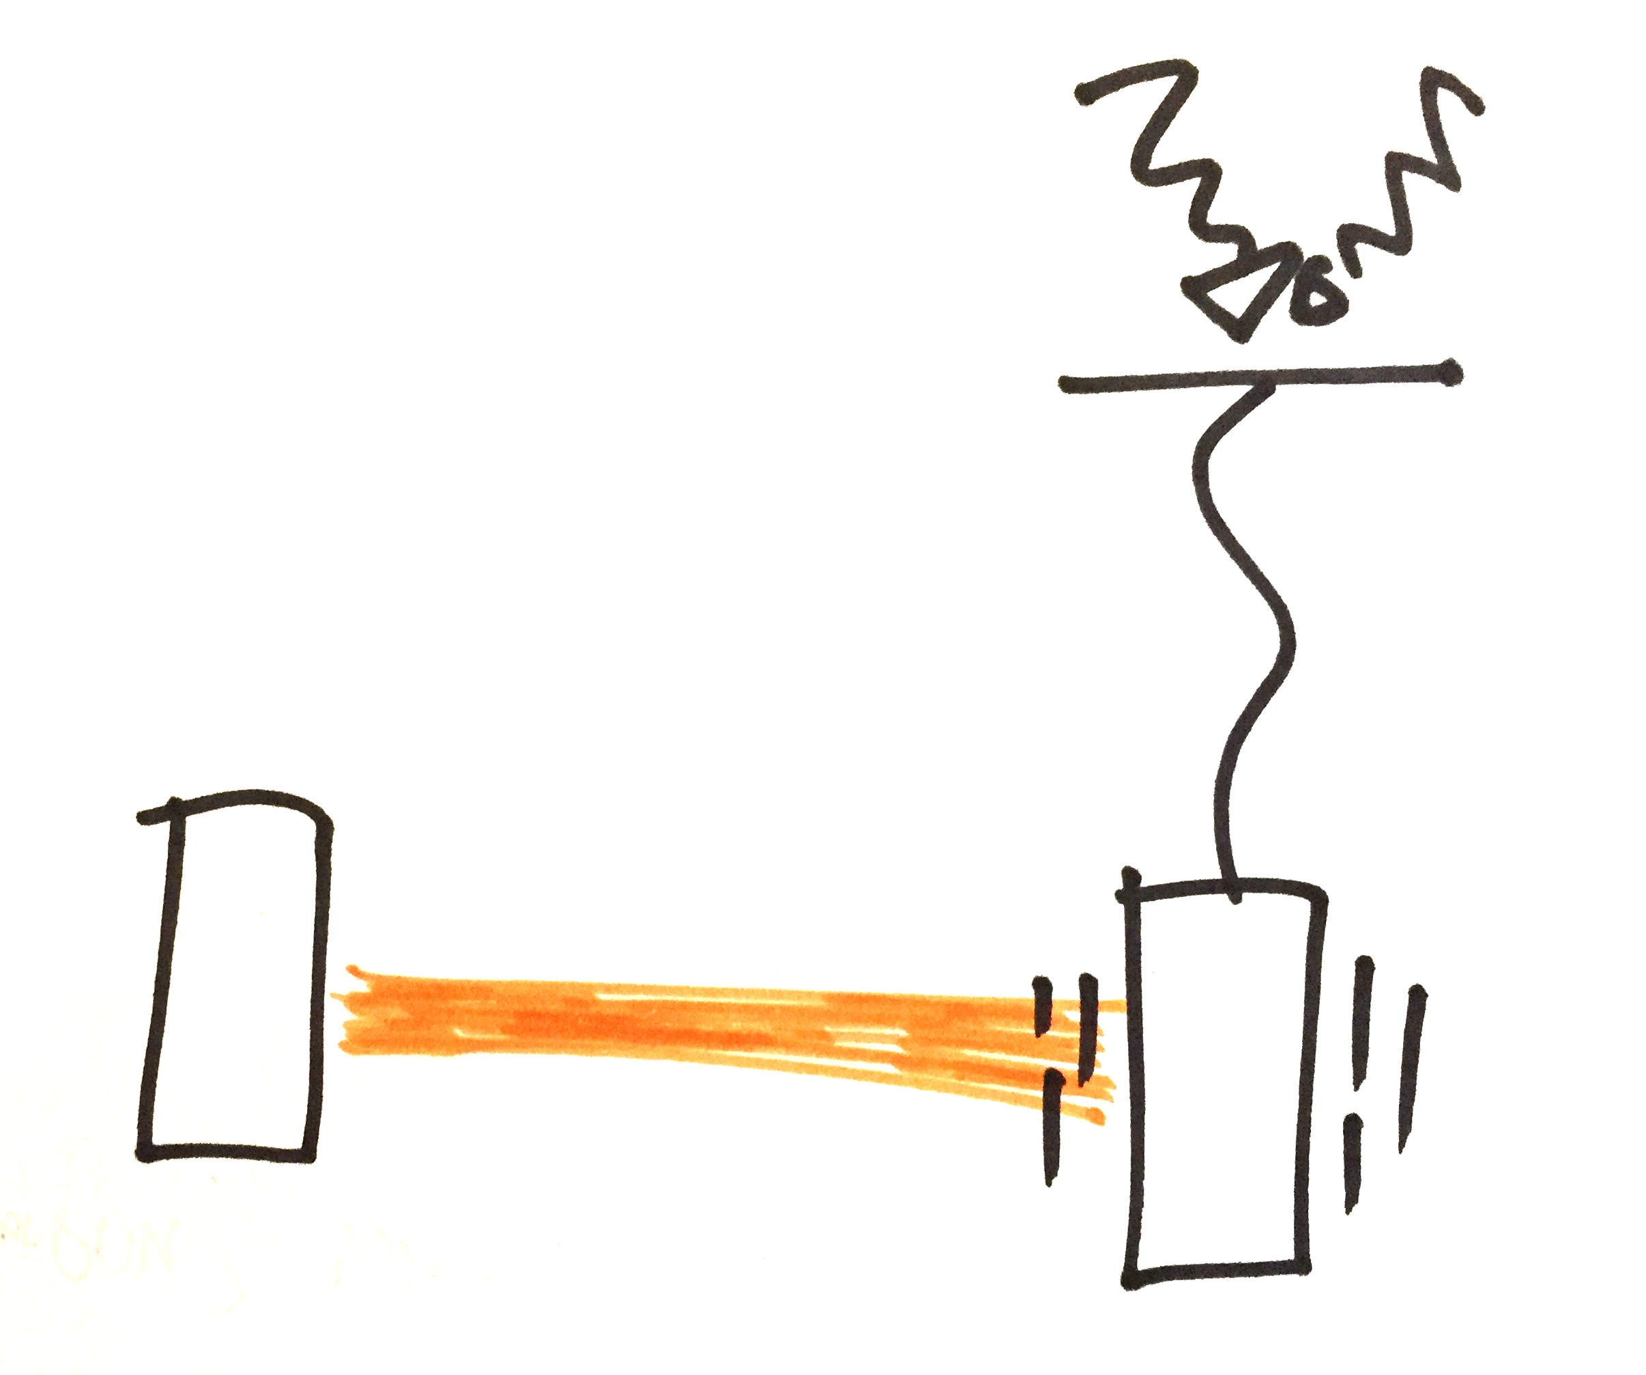
Why we need control
The ground moves and disturbs our mirrors.
We use control to keep the cavity lengths fixed and the mirrors aligned
Fabry-Perot cavity
Ref G1600525
Notes:
We need control because we need our cavity lengths constant to within some tiny fraction of the laser wavelength and for the mirrors to be pointing at each other within some tiny angular tolerance
But the ground is always trying to move them more than this…by many orders of magnitude.

Slide 5
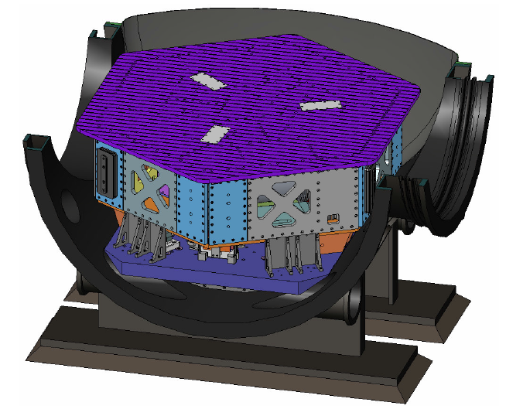
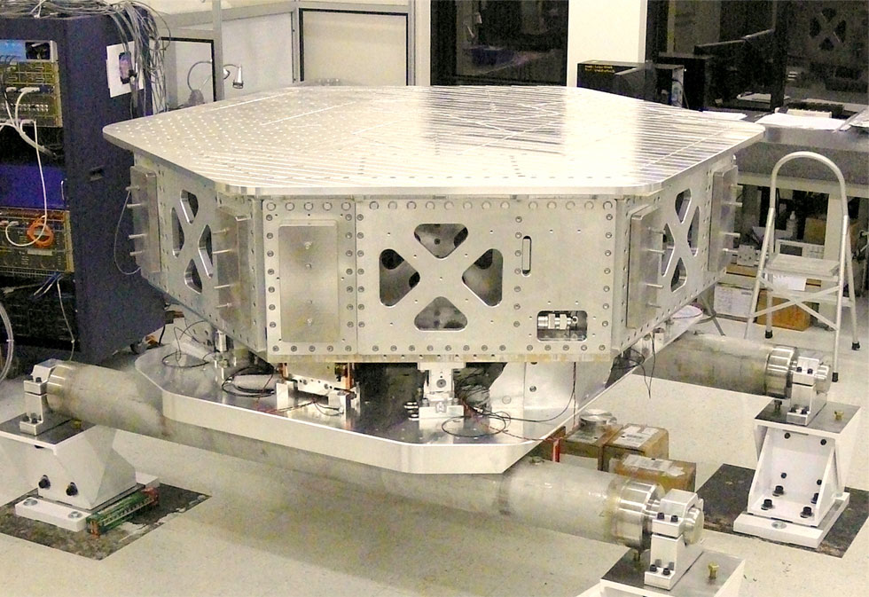
HAM-ISI Example
CAD model of HAM-ISI in a HAM chamber
Photo of a HAM-ISI
Credit: HPD
Notes:
In this talk I’m going to follow the example of the HAM-ISI, pictured here.

Slide 6
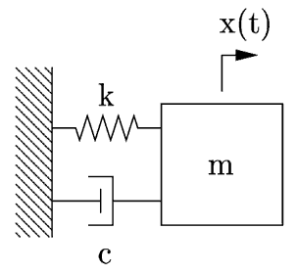
HAM-ISI Example
Model:
single DOF mass-spring-damper system
Photo of a HAM-ISI
Credit: HPD
Physical parameters used in these slides: k = 250,000 N/m, m = 1900 kg, c = 870 N/(m/s)
Values adapted from G070156, slides 55 & 63: m = mu, k = kzztot, c was chosen to match measured data
Notes:
The HAM-ISI is a nice example because it is just a single stage. You can model it is a simple mass-spring-damper system. It is simple enough in fact you can often focus on one degree of freedom (DOF) at a time. So we’ll just assume here that the HAM-ISI is a single DOF damped mass-spring system.

Slide 7
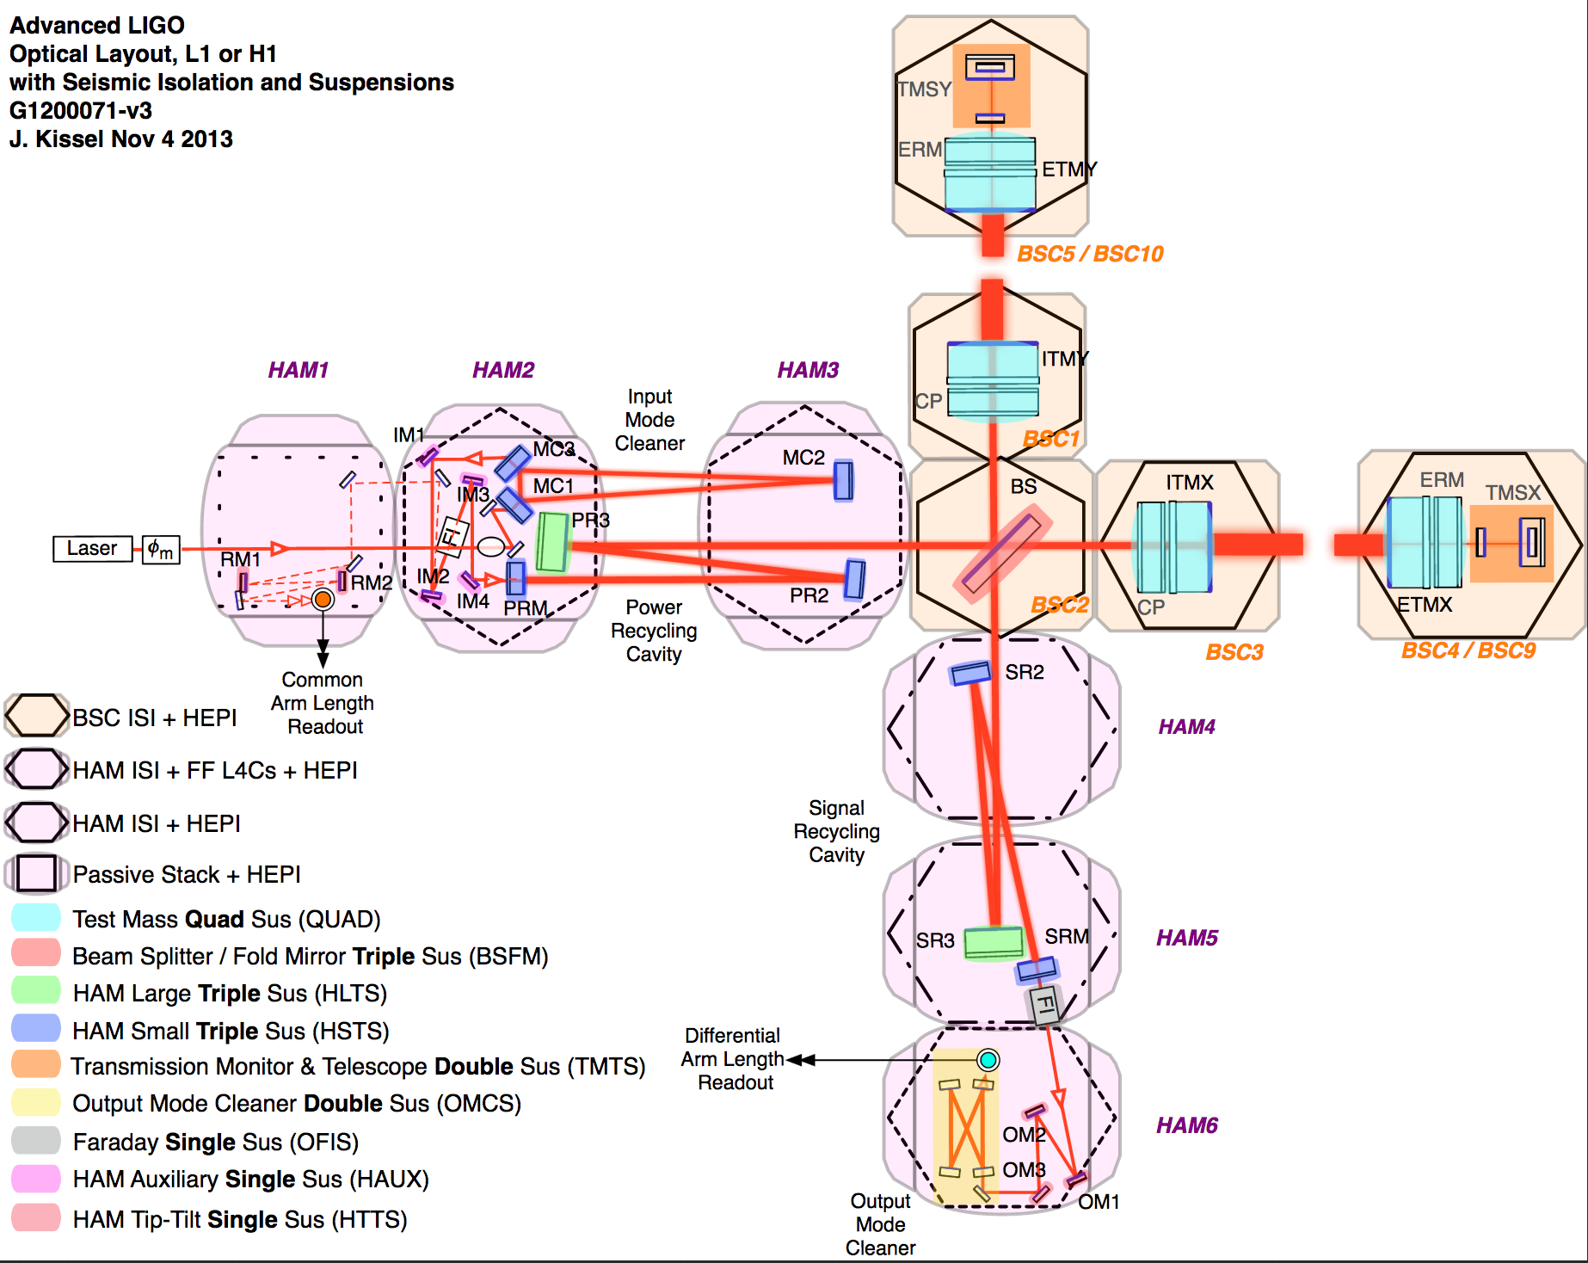
Notes:
For some context, all optics that aren’t test masses or beam splitters sit on top of a HAM-ISI. In the aLIGO optical layout here, the purple chambers are the HAMs, the tan ones are the BSCs.

Slide 8
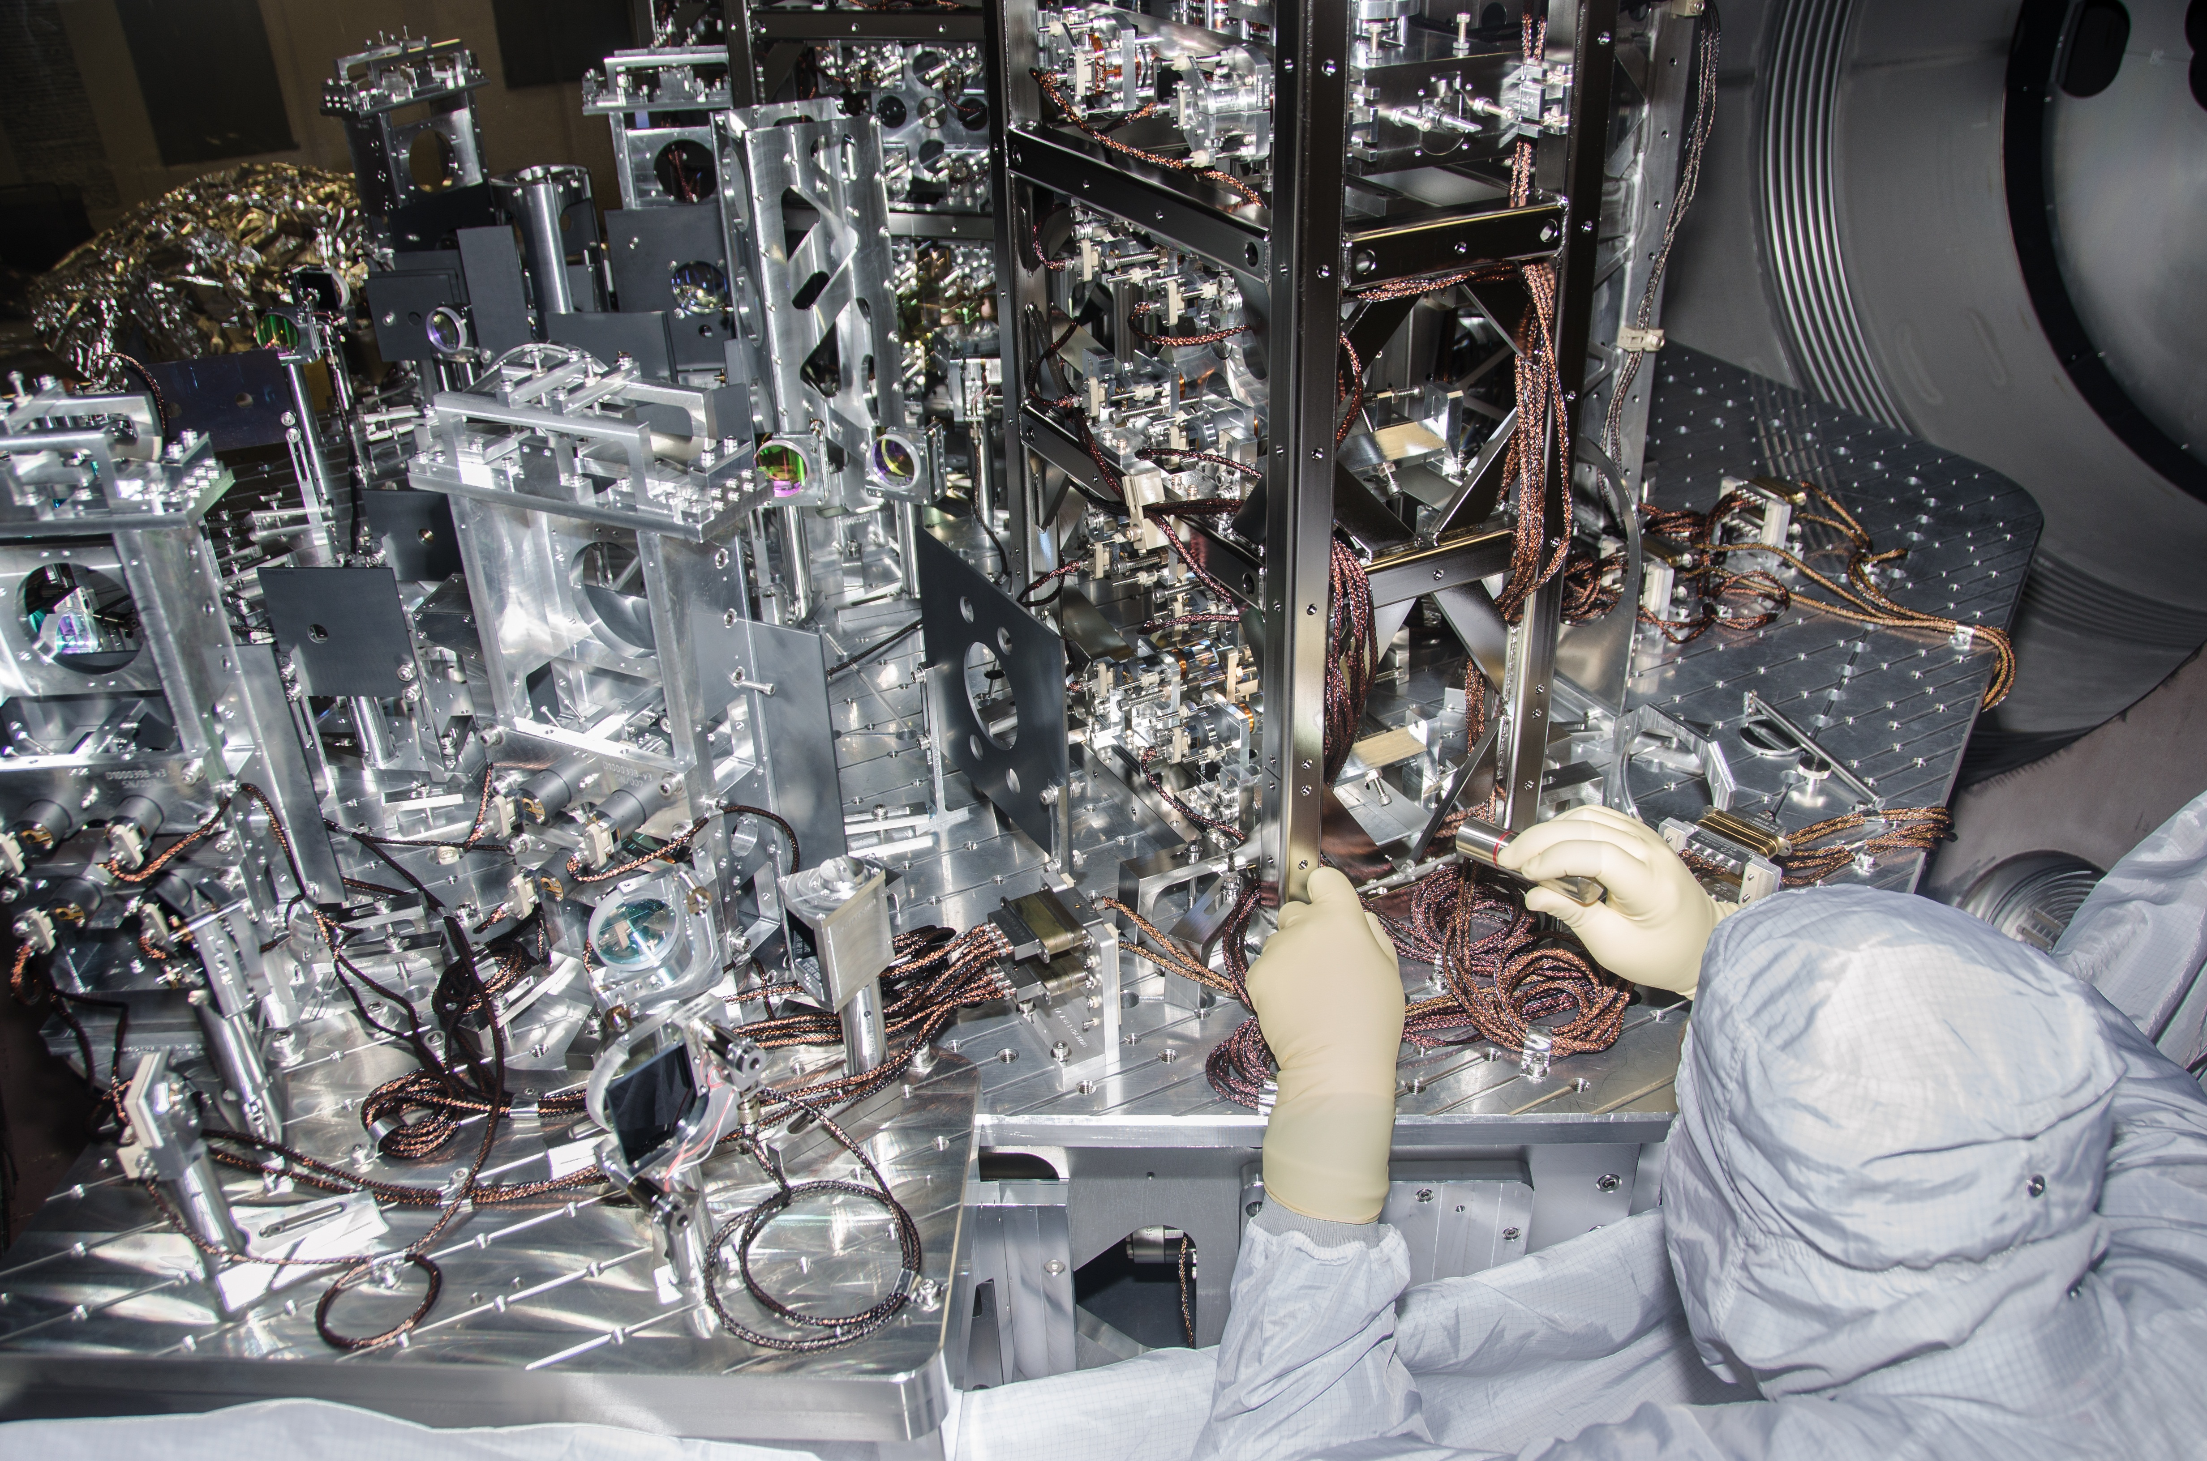
Notes:
HAM2 in particular is loaded will stuff, here’s a picture of all the optics in that chamber.
To keep all those optics well isolated and aligned, our goal is to actively control the ISI to 1) not move, 2) and to sit at the right location.

Slide 9
Feedback loop block diagram
Current
position
HAM-ISI
Position sensor
Current position
Desired position
Notes:
To illustrate the control we need, I have the start of a block diagram here showing the HAM-ISI being disturbed by some ground displacement, and then we have a sensor that measures the ISI’s displacement. The cartoon in the corner summarizes the problem where we want the ISI to be in some desired position, be in reality it is someplace else.

Slide 10
Feedback loop block diagram
Desired
position
Current
position
HAM-ISI
+
-
Position sensor
Current position
Desired position
Notes:
To bring it back to the desired position, we first calculate how far away it is by finding the difference between the desired and current positions.

Slide 11
Feedback loop block diagram
Desired
position
Current
position
HAM-ISI
+
-
Position sensor
+
Current position
Desired position
Notes:
This signal will be contaminated by some about of sensor noise.
But, assuming the noise is small enough…

Slide 12
Feedback loop block diagram
Desired
position
Current
position
Actuator
HAM-ISI
+
+
-
Position sensor
+
Current position
Desired position
Notes:
what we’d like to do is send that difference signal to the ISI’s actuators to push it back to the right place. So if the sensor signal is to small, we push with the actuator to make it bigger, if it is to big we push the other way to make it smaller.

Slide 13
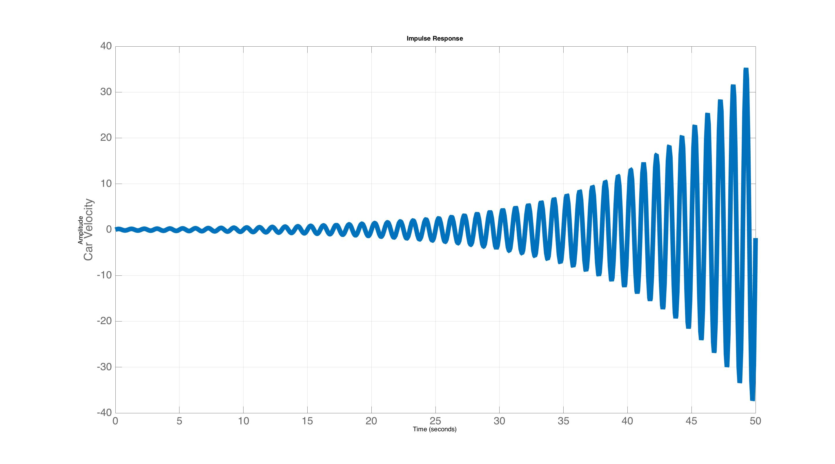
Feedback loop block diagram
Desired
position
Current
position
Actuator
HAM-ISI
+
+
-
Position sensor
+
Current position
Desired position
In general unstable!
Notes:
Unfortunately, it is almost never this simple however. In general, the dynamics of the ISI, or whatever the system, will cause this loop to be unstable. You can think of it this way, that the HAM-ISI has some differential equation, and that differential equation changes when you close that loop. That closed loop differential equation will either exponentially decay to zero, or exponentially approach infinite.

Slide 14
Feedback loop block diagram
Desired
position
Current
position
Control
Actuator
HAM-ISI
+
+
-
Position sensor
+
Current position
Desired position
Stabilize with the addition of a control filter
Also gives you parameters to tune the response
Notes:
To avoid these issues we always include a control filter in the loop. The control filter modifies the differential equation in such a way that you get a desirable closed loop response. This allows the loop to be stable, but also, equally important: the controller gives you a place to tune the response so the loop isn’t just stable, but responds in a desirable way (avoids oscillations, offsets, etc).

Slide 15
Transfer functions
Used for modeling each block in the loop
Notes:
So now let’s take a look at transfer functions, since these are the most common way we model our systems.

Slide 16
Feedback loop block diagram
Desired
position
Current
position
Control
Actuator
HAM-ISI
+
+
-
Position sensor
+
Each block has a model associated with it.
-typically represented a as transfer function
Notes:
Each block in the loop has its own transfer function.

Slide 17
Feedback loop block diagram
Desired
position
Current
position
Control
Actuator
HAM-ISI
+
+
-
Position sensor
+
Each block has a model associated with it.
-typically represented a as transfer function
Notes:
If we plot the HAM-ISI’s transfer function for example, it looks like …

Slide 18
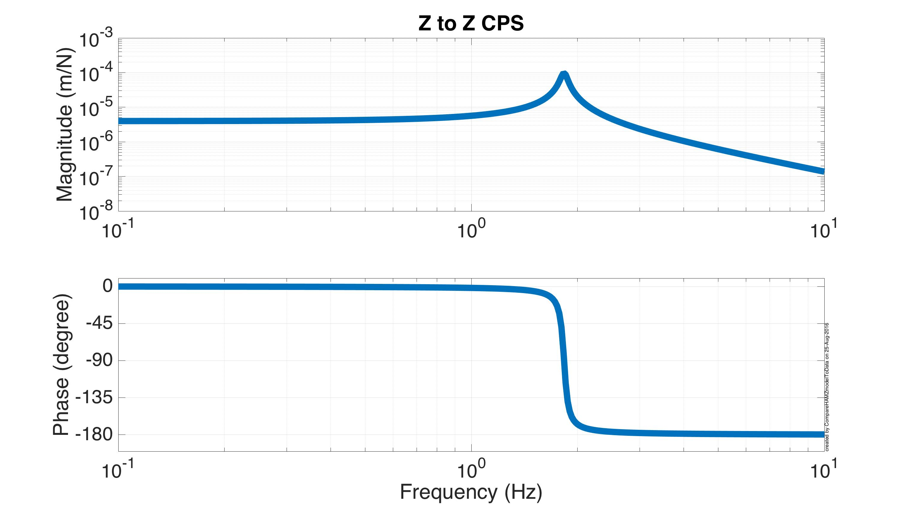
Feedback loop block diagram
Desired
position
Current
position
Control
Actuator
HAM-ISI
+
+
-
Position sensor
+
Each block has a model associated with it.
-typically represented a as transfer function
Notes:
…this.

Slide 19
System models: Transfer Functions
Bode plot of the x/f transfer function
Notes:
Zooming in on that. This particular type of plot is called a bode plot. The horizontal axis is frequency. The top half shows magnitude, and we see that the units are m/N because, this is the transfer function from the actuator force to its displacement. The bottom phase, which is almost always shown in units of degrees. What this plot means is that if we drive the actuators with a sine wave at particular frequency we’ll get this many meters for every Newton, and then we’ll have this much phase between the actuator force and ISI displacement,

Slide 20
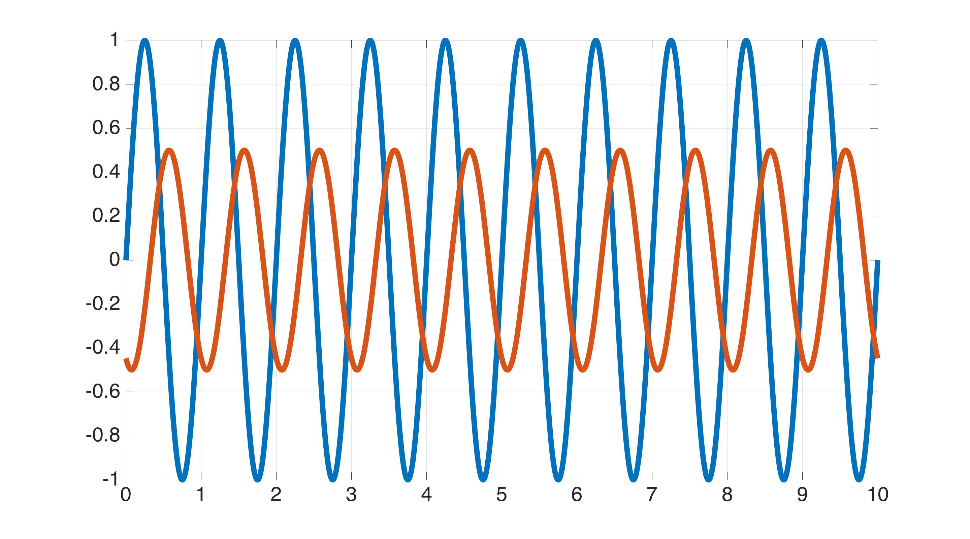
TF input/output relationship
1 Hz Excitation
Actuator signal
Signal Value
Displacement signal
Time
Notes:
So, actually here is a plot of that. Note, that if the system is linear, the displacement signal will have exactly the same frequency as the excitation signal. The amplitudes may be different, which is captured by the Bode magnitude plot, and the phase might be different, which is captured by the Bode phase plot. But the frequencies will always be the same, unless some nonlinear process is going on, which we work very hard to avoid. Because if you think linear control systems are confusing, you really won’t like nonlinear control.

Slide 21
System models: Transfer Functions
Bode plot of the x/f transfer function
Notes:
One of the nice features of linearity, is it makes the TF easy to measure. All you have to do is capture that magnitude and phase relationship at multiple frequencies…

Slide 22
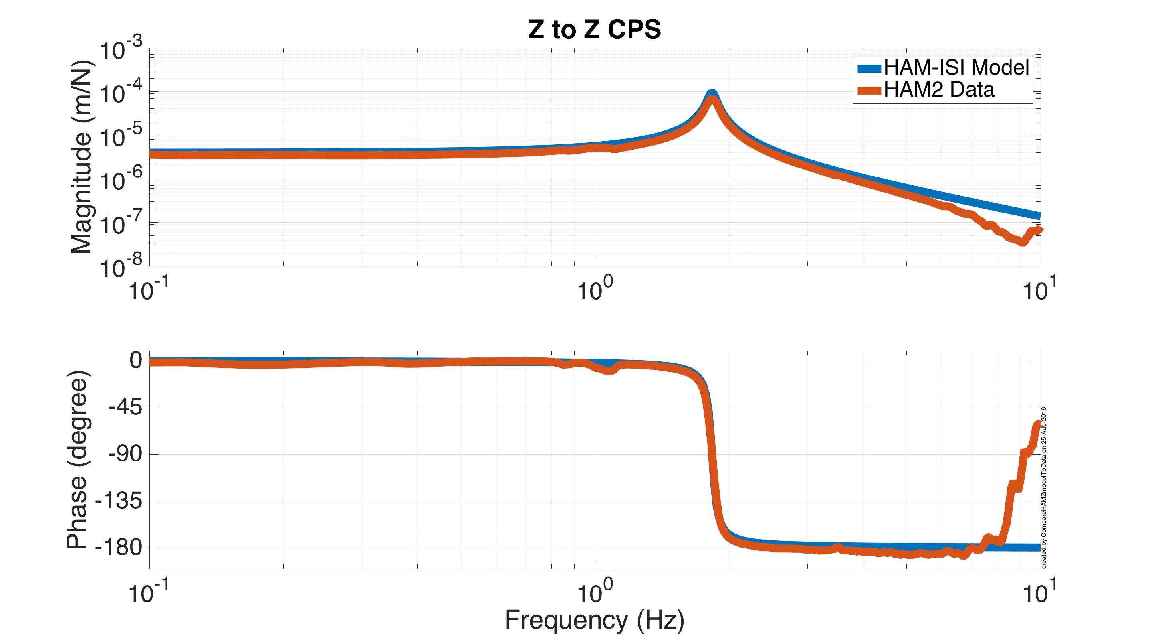
System models: Transfer Functions
Bode plot of the x/f transfer function
Notes:
…and then you can identify what the transfer function is. Here in red is the measured ISI TF on top of the model in blue. Here they match pretty well because the measured TF was used to update the model.

Slide 23
System models: Transfer Functions
Bode plot of the x/f transfer function
Transfer function equation
(Laplace transform of diff. equ.)
where
Notes:
In equation form, that model transfer function looks like this, where s is the imaginary number time 2*pi*frequency (in Hz). m is the mass, c is the damping, and k is the spring stiffness.
Note also, that the transfer function equation is in the laplace domain, while the bode plot is the fourier domain, because s=i*2*pi*frequency converts laplace to fourier.

Slide 24
What determines the TF?
Time Domain
Differential equation
Frequency Domain
Transfer function
Laplace Transform
Replace all time derivatives with s
Notes:
And that equation is just the Laplace transform of the differential equation. To get the Laplace transform all you so is replace every time derivative with an s.

Slide 25
What determines the TF?
Transfer function
Roots of polynomial –> poles
Notes:
The roots of the polynomial in the denominator have a special status. Those roots are known as the poles. For mechanical systems, these poles come in complex conjugate pairs, because each inertia term contributes an s^2.

Slide 26
What determines the TF?
Transfer function
Roots of polynomial –> poles
The poles are the system time constants
Solution to the differential equation
Notes:
The physical interpretation of the poles is that they are the time constants in the solution to the differential equation.

Slide 27
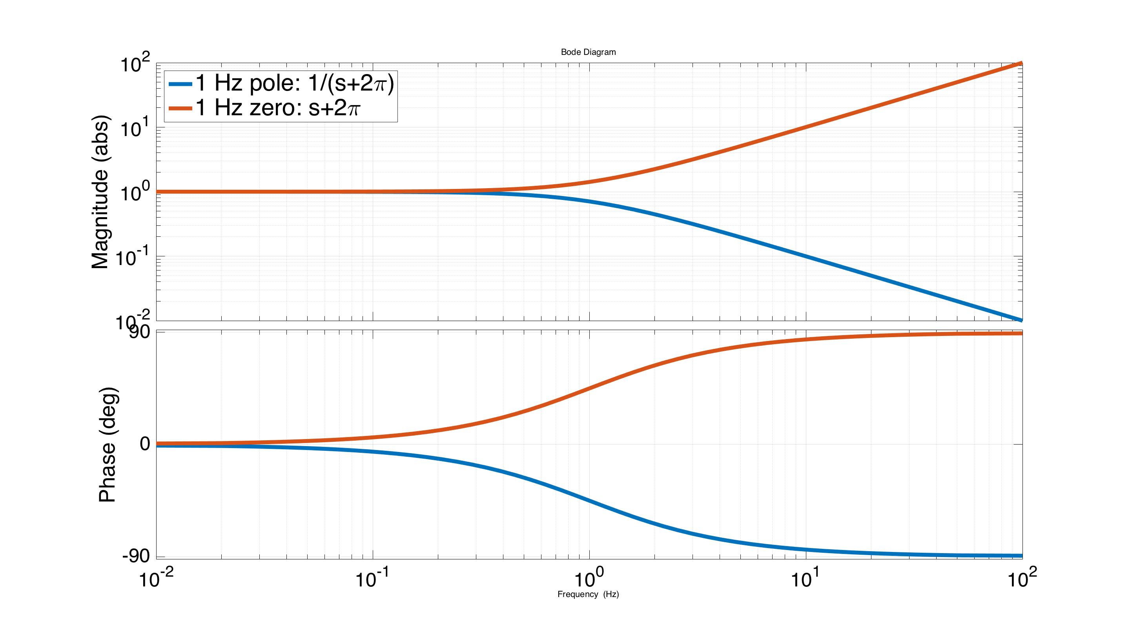
Control design: poles and zeros
Recall:
to generate the bode plot
LHP Poles: -90 deg phase, 1/f mag
LHP Zeros: +90 deg phase, f mag
Notes:
Before beginning the feedback design example, it is useful to look at a bode plot of a single zero, in red, and pole, in blue. Here both are set to 1 Hz. Note that the zero magnitude increases linearly with frequency, and the phase transitions to +90 degrees. The pole is the exact opposite. The magnitude is inversely proportional to frequency, and the phase goes to -90 degrees. (you can kind of think of the zeros and poles‘turning on’ as you move past them in frequency) For complex airs of poles and zeros, see the backup slides.
For the case of non-causal filters, we would have more zeros than poles, which means to magnitude would increase up to infinity at infinite frequency, with positive phase. This means the filter output would occur before the input. In realtime clearly this can’t happen. Non-realtime filters, for offline data processing, can have more zeros than poles.

Slide 28
System models: Transfer Functions
Bode plot of the x/f transfer function
1.8 Hz
Complex pole pair
Notes:
When you have a complex pair of poles, like in mechanical systems, it manifest as a resonant frequency.

Slide 29
System models: Transfer Functions
Bode plot of the x/f transfer function
1.8 Hz
Complex pole pair
Notes:
The frequency of the resonance is the magnitude of the pole (divided by 2*pi for units of Hz).

Slide 30
System models: Transfer Functions
Bode plot of the x/f transfer function
1.8 Hz
Complex pole pair
Notes:
The Q, or Quality factor, which measures how tall and sharp the resonance is, is given by the inverse of the damping ratio, where the damping ratio is determined by the pole angle in the complex plane.

Slide 31
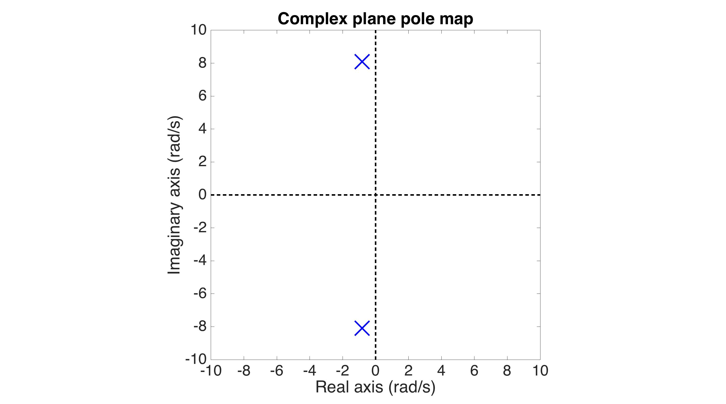
Poles in the complex plane
Conjugate pair
Notes:
While these equations are nice, I like to actually visualize this in the complex plane. So here we have our conjugate pair. The horizontal axis is the real part, the vertical the imaginary.

Slide 32
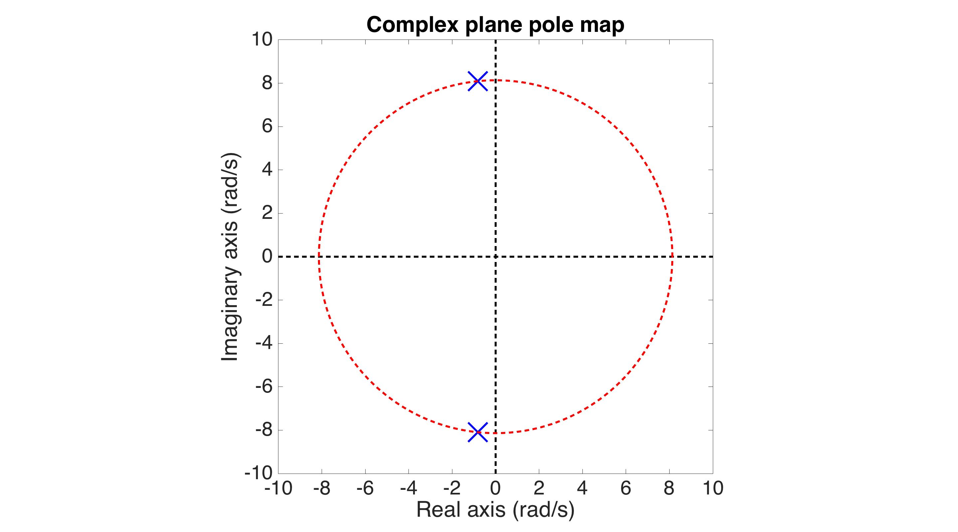
Poles in the complex plane
Radius = natural frequency
Notes:
The radius of the circle passing through the them tells you their frequency.

Slide 33
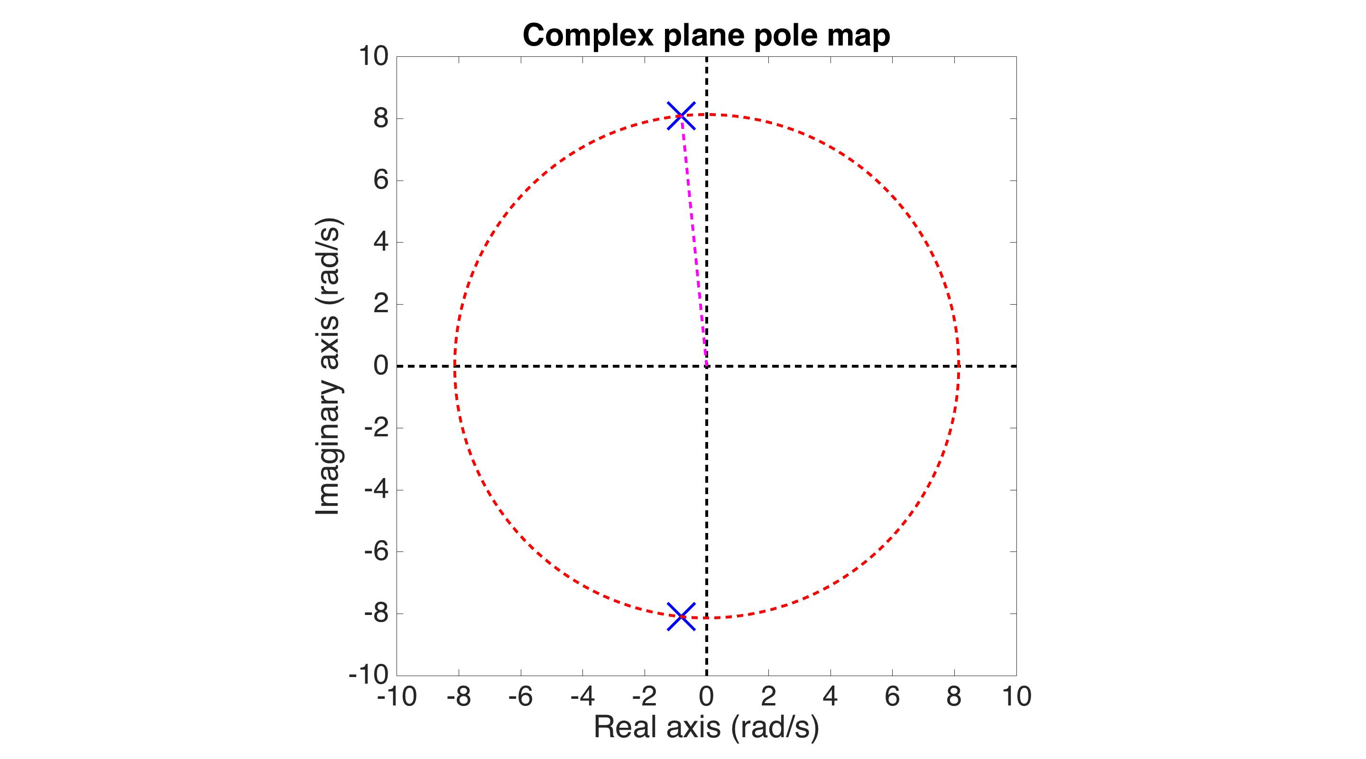
Poles in the complex plane
Radius = natural frequency
sin(angle)= damping ratio
Q = 1/(2*damping ratio)
Notes:
The angle they make with the imaginary axis is the damping. Specifically, the damping ratio is the sine of the angle. The Quality factor is 1 / (2 * sin(angle) ).

Slide 34
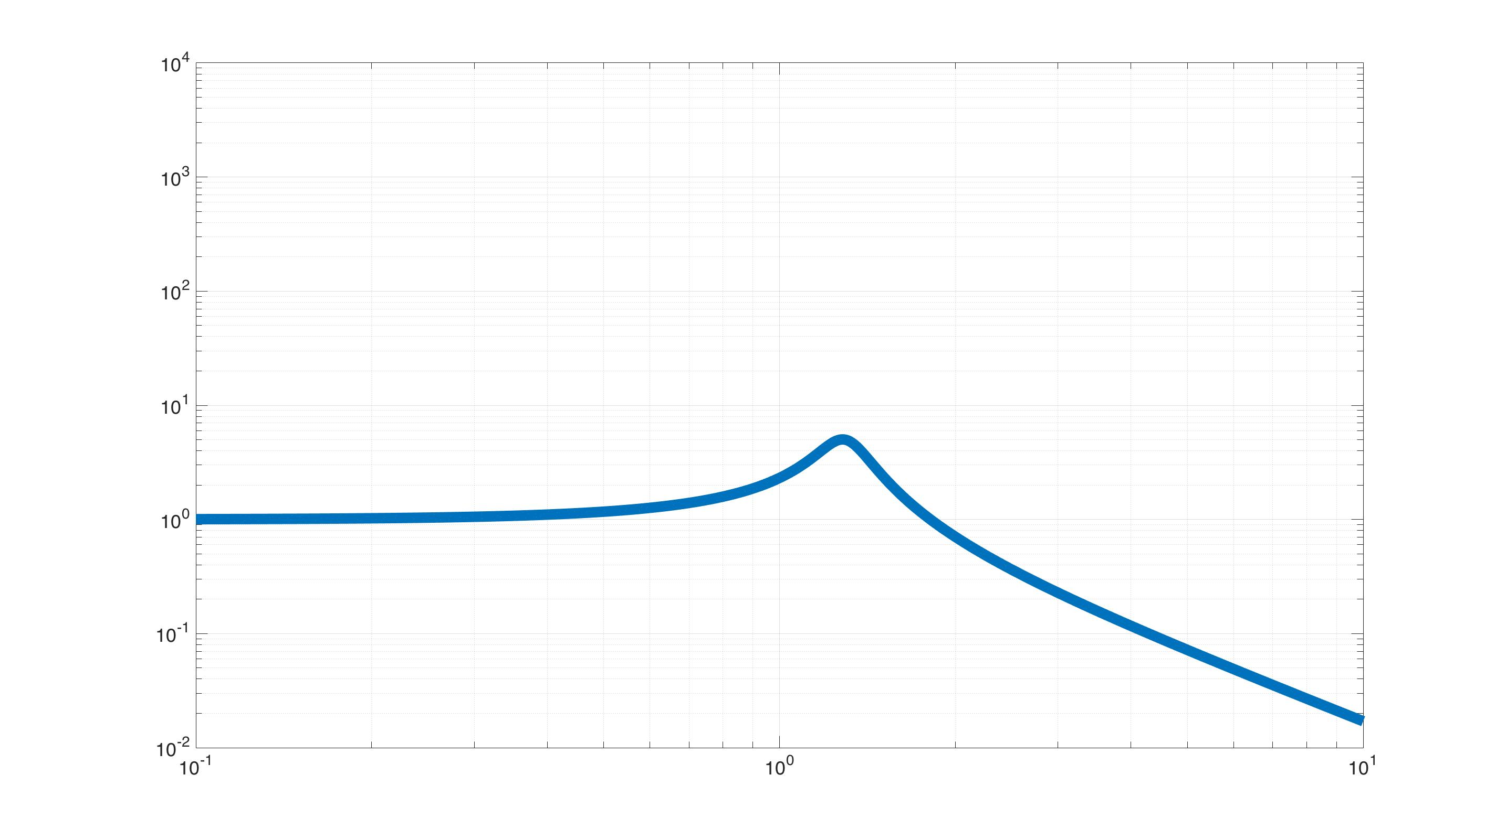
Poles in the complex plane
Transfer Function
Frequency
Notes:
Here the relation between damping and angle is clear, because if we rotate the poles towards the imaginary axis,…

Slide 35
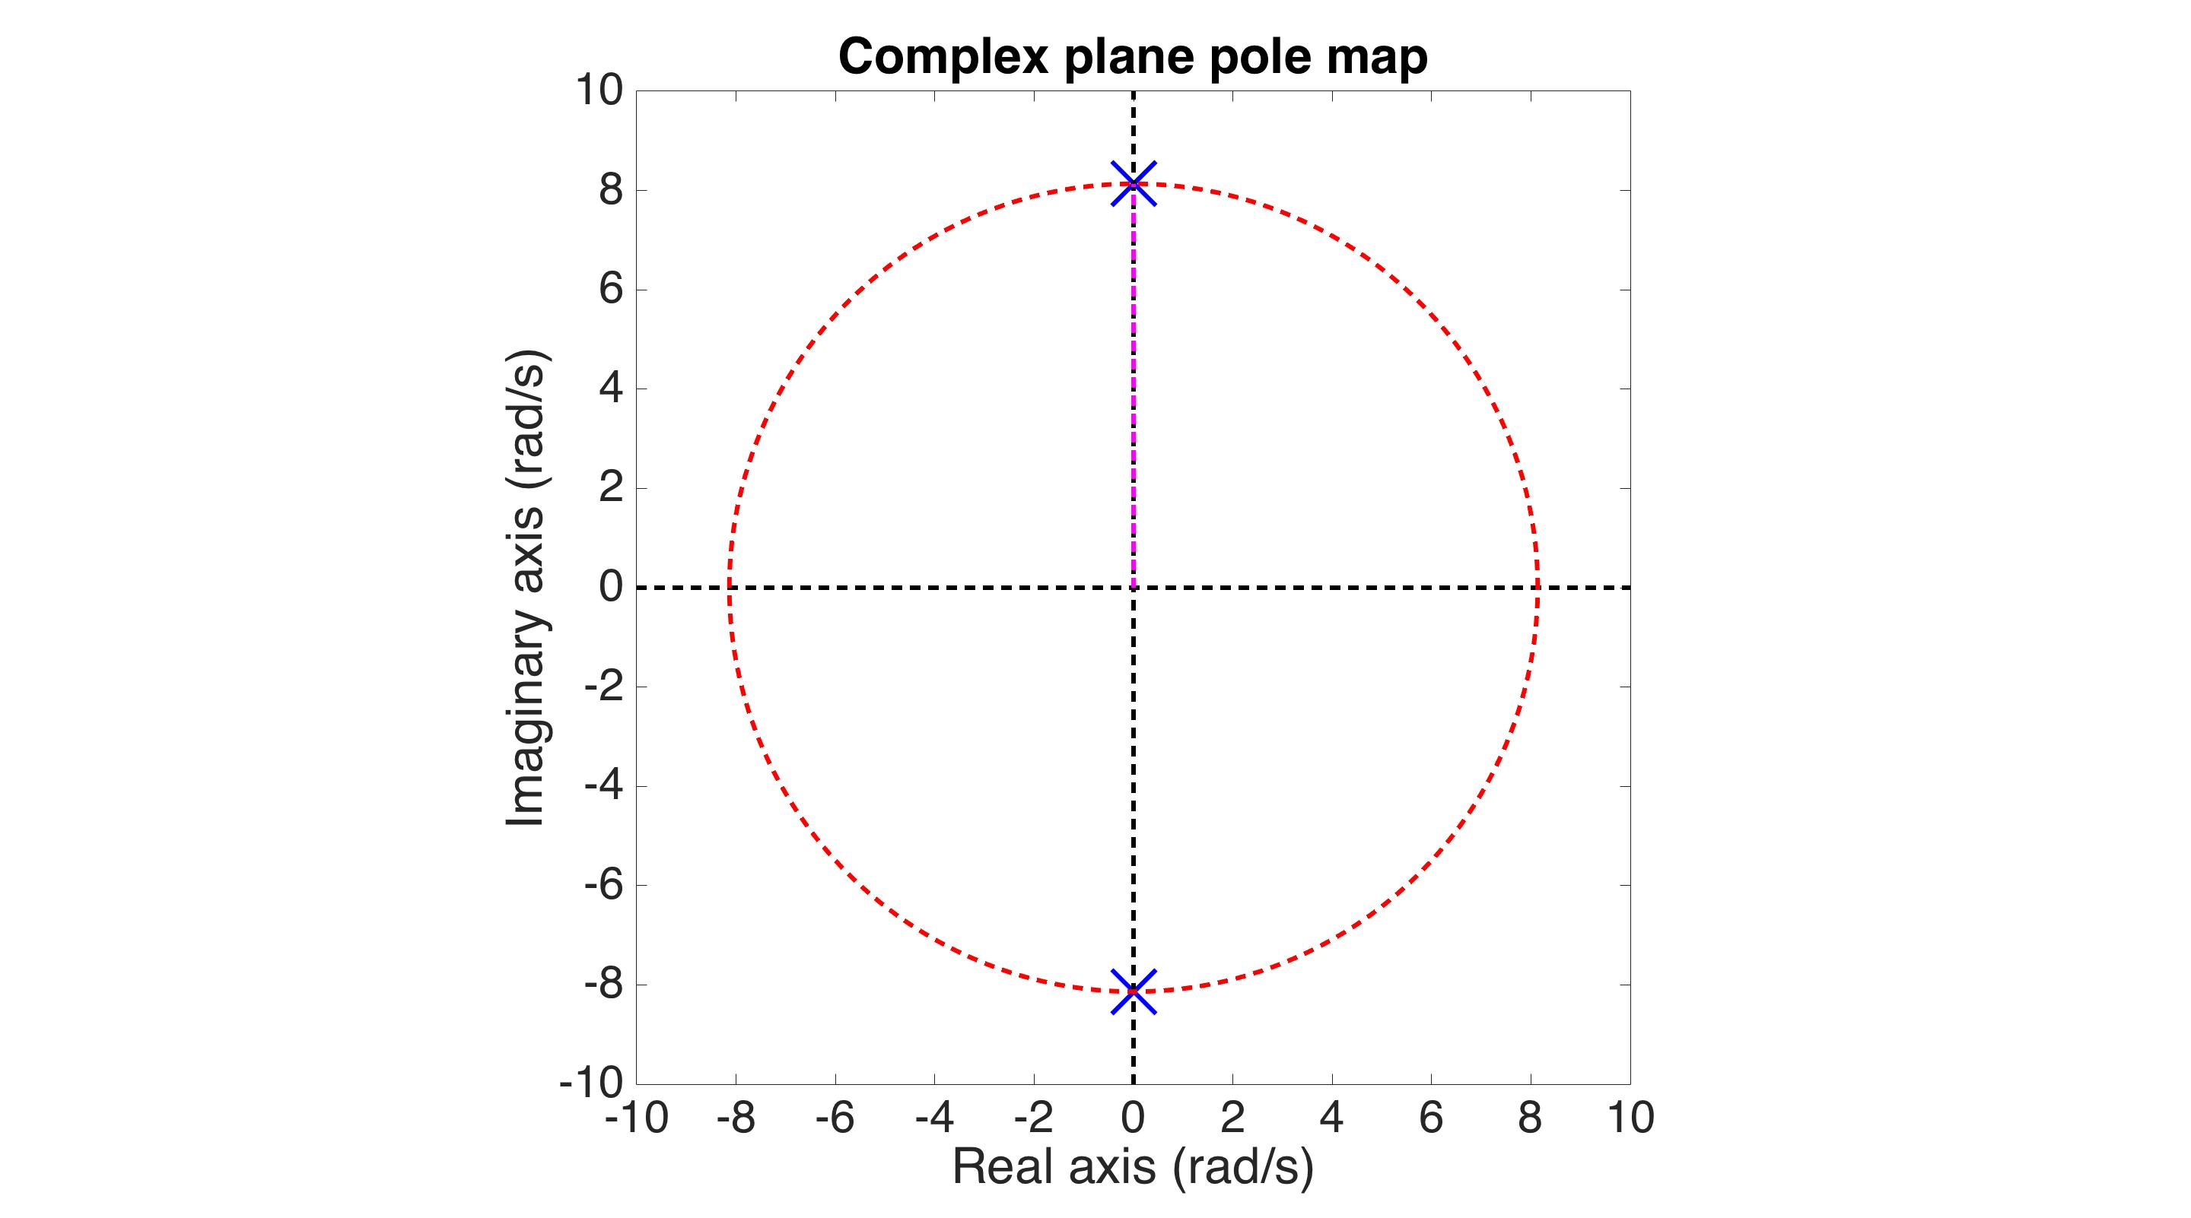
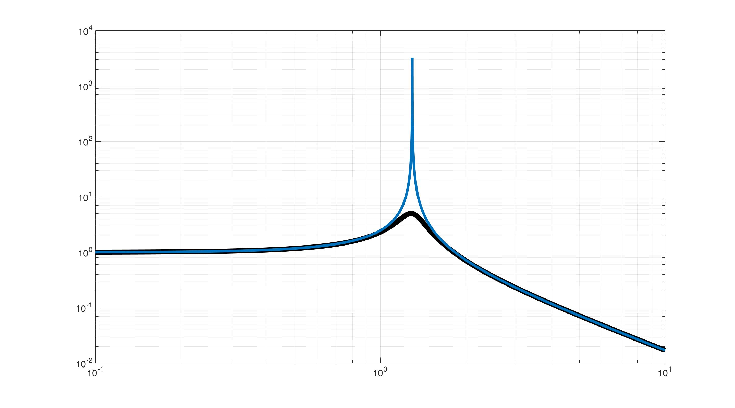
Poles in the complex plane
Transfer Function
Frequency
Notes:
, you’ll see the resonant peak get a lot taller and sharper.

Slide 36
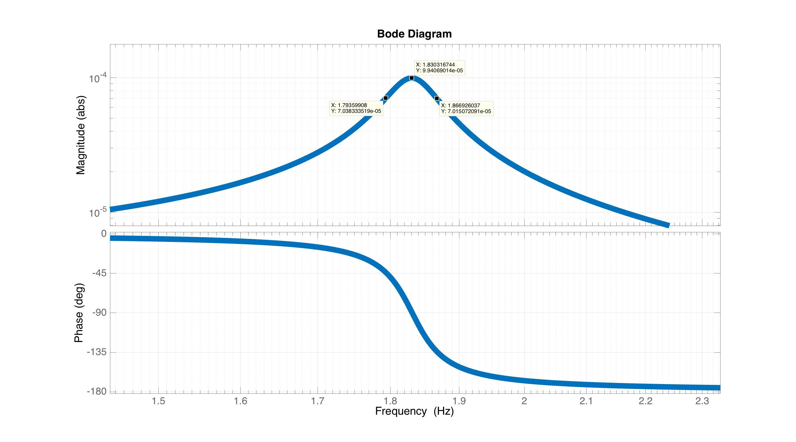
Resonance Quality (Q) factor
Notes:
Just for reference, one measure of Q, that quantifies how tall and skinny the peak is, is the ratio of the peak frequency to its width, where the width is defined at 1/sqrt(2) of the peak magnitude.

Slide 37
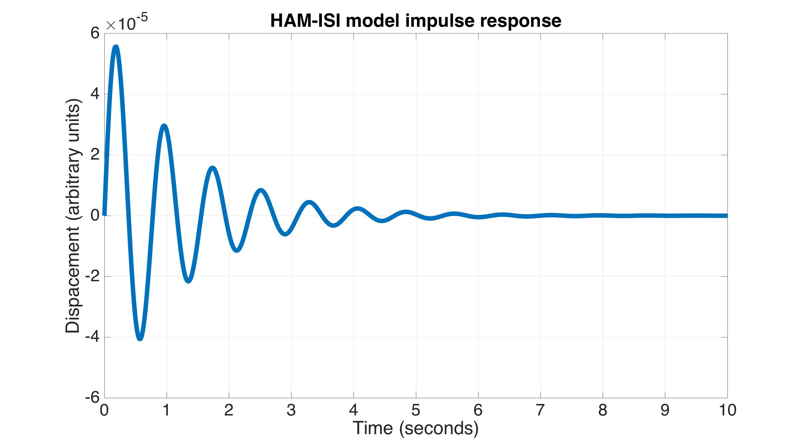
Resonance Quality (Q) factor
Can also measure Q by the ringdown time constant
Signal y (arbitrary units)
Time t (seconds)

Slide 38
Feedback Stability

Slide 39
Feedback loop block diagram
Desired
position
Current
position
Control
Actuator
HAM-ISI
+
+
-
Position sensor
+
Notes:
To look at feedback stability, let’s return to our block diagram.

Slide 40
Feedback loop block diagram
Desired
position
Current
position
C
A
H
+
+
-
S
+
Notes:
To keep the notation simple, I’m going to represent the TF of each block with a capital letter.

Slide 41
Feedback loop block diagram
Desired
position
Current
position
C
A
H
+
+
-
S
+
Seismic noise transmission
Notes:
You can show, with just a little algebra, that the closed loop transfer function from seismic noise to ISI displacement is this.

Slide 42
Feedback loop block diagram
Desired
position
Current
position
C
A
H
+
+
-
S
+
Loop gain transfer function
Seismic noise transmission
Notes:
This transfer function in the denominator is very important. It is called the loop gain, or open loop, transfer function. It is simply the product of all the blocks in the loop.

Slide 43
Feedback loop block diagram
Desired
position
Current
position
C
A
H
+
+
-
S
+
Loop gain transfer function
CAHS = -1= bad
Seismic noise transmission
Notes:
Note, that it is immediately obvious that stability will have something to do with keeping the loop gain transfer function away from the -1 point. Because that would give us a zero in the denominator, making the response go to infinite.

Slide 44
Feedback loop block diagram
Desired
position
Current
position
C
A
H
+
+
-
S
+
Seismic noise transmission
Sensor noise transmission
Notes:
Similarly, we can write down the closed loop TF for the sensor noise to displacement. Note, that the denominator is the same for both. In fact, all closed loop TFs for this loop will have the same denominator. Thus, to sudy stability all we need to do is look at how the loop gain approaches the -1 point.
It is meanignful also that the numerators are different. Not for stability, but for performance. For seismic noise, we want to make the loop gain as large as possible. But if we do that, we’ll cause the ISI to follow sensor noise (assuming the sensor TF S=1). Maybe that is OK in some cases, but not all.

Slide 45
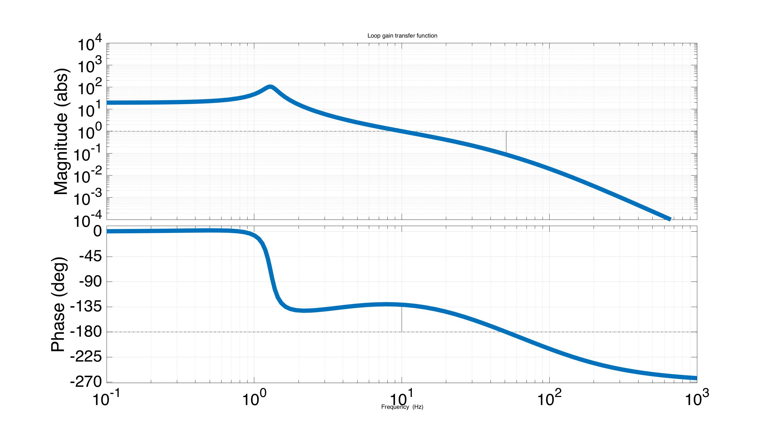
Ex. Loop Gain TF: CAHS
Matlab for control filter: C = zpk(-2*pi*3.33,-2*pi*[30;100],1.4e+10)
Notes:
Here is a Bode plot of an example loop gain for a particular control filter design. The loop gain is larger than 1 at low frequencies to suppress seismic noise, and small how at frequencies to avoid amplifying the sensor noise.

Slide 46
Ex. Loop Gain TF: CAHS
Unity crossing
-180 crossing
Matlab for control filter: C = zpk(-2*pi*3.33,-2*pi*[30;100],1.4e+10)
Notes:
Now let’s see how close it approaches to the unstable -1 point. Note, -1 is equal to a magnitude of 1 and phase of +-180 degrees. Here, when the magnitude is 1, the phase is about -135. Then, when the phase reaches -180, the gain is about 0.1.

Slide 47
Ex. Loop Gain TF: CAHS
Unity crossing
-180 crossing
It never hits -1. Is it stable?
Matlab for control filter: C = zpk(-2*pi*3.33,-2*pi*[30;100],1.4e+10)
Notes:
So we’re 45 degrees away from -1 at one point, and an order of magnitude at the other. Is it stable?

Slide 48
Ex. Loop Gain TF: CAHS
Unity crossing
-180 crossing
It never hits -1. Is it stable? YES!!!
Matlab for control filter: C = zpk(-2*pi*3.33,-2*pi*[30;100],1.4e+10)
Notes:
Indeed, it is in this case.

Slide 49
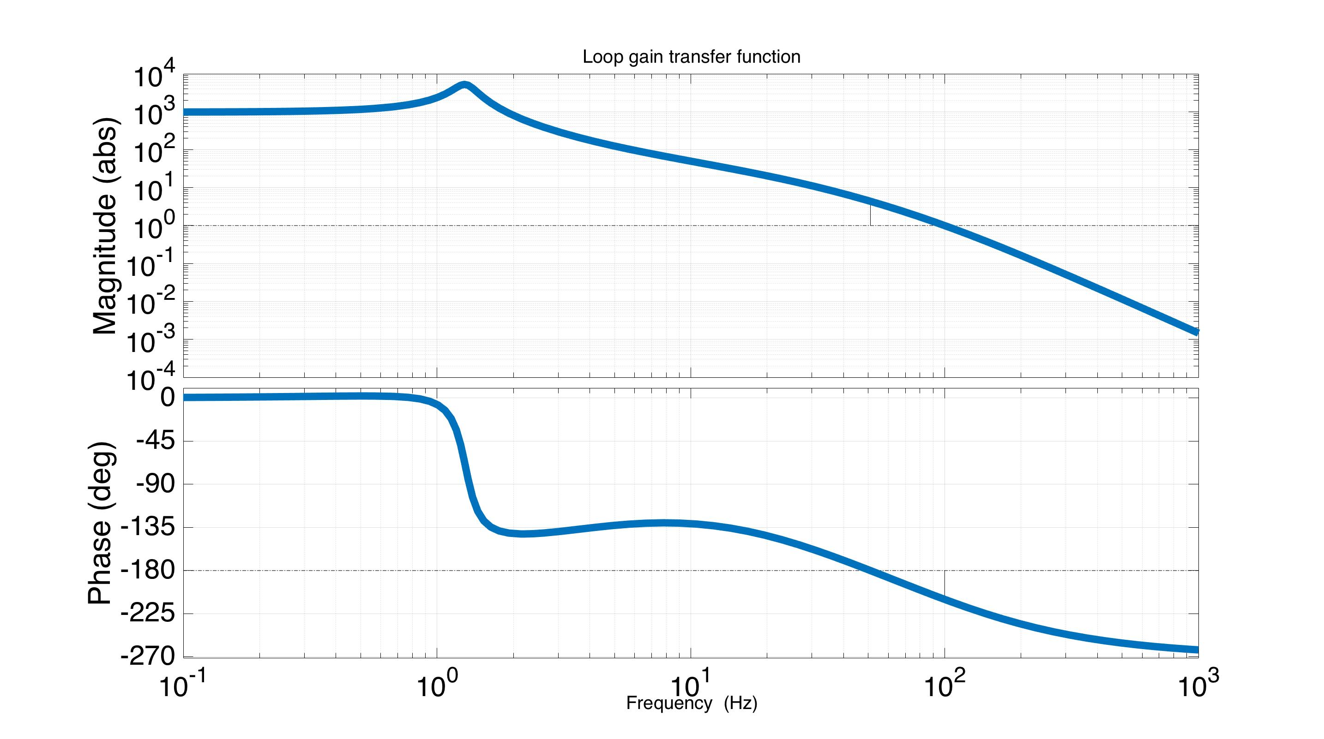
Ex. Loop Gain TF: 50*CAHS
Unity crossing
-180 crossing
It never hits -1. Is it stable?
Matlab for control filter: C = zpk(-2*pi*3.33,-2*pi*[30;100],7.0e+11)
Notes:
Now, let’s say we want to increase the loop gain more, to better suppress the seismic noise. This loop is exactly the same, but with 50 times more gain. When it crosses unity magnitude, the phase is about -220. When it crosses -180, the magnitude is about 10. As before, we never actually pass through -1. Is this loop stable?

Slide 50
Ex. Loop Gain TF: 50*CAHS
Unity crossing
-180 crossing
It never hits -1. Is it stable? NO!
Matlab for control filter: C = zpk(-2*pi*3.33,-2*pi*[30;100],7.0e+11)
Notes:
No, it isn’t. Controls is unfortunately not that simple. It is not just about avoiding -1, but how you approach -1. The mathematical proof for this is rather abstract, but has to do encirclements of the -1 point. I’m not going to talk about it. If you want to know the details, I have some references to a couple text books. In practice, all you need to know is to not cross +- 180 degrees until the magnitude is below unity.

Slide 51
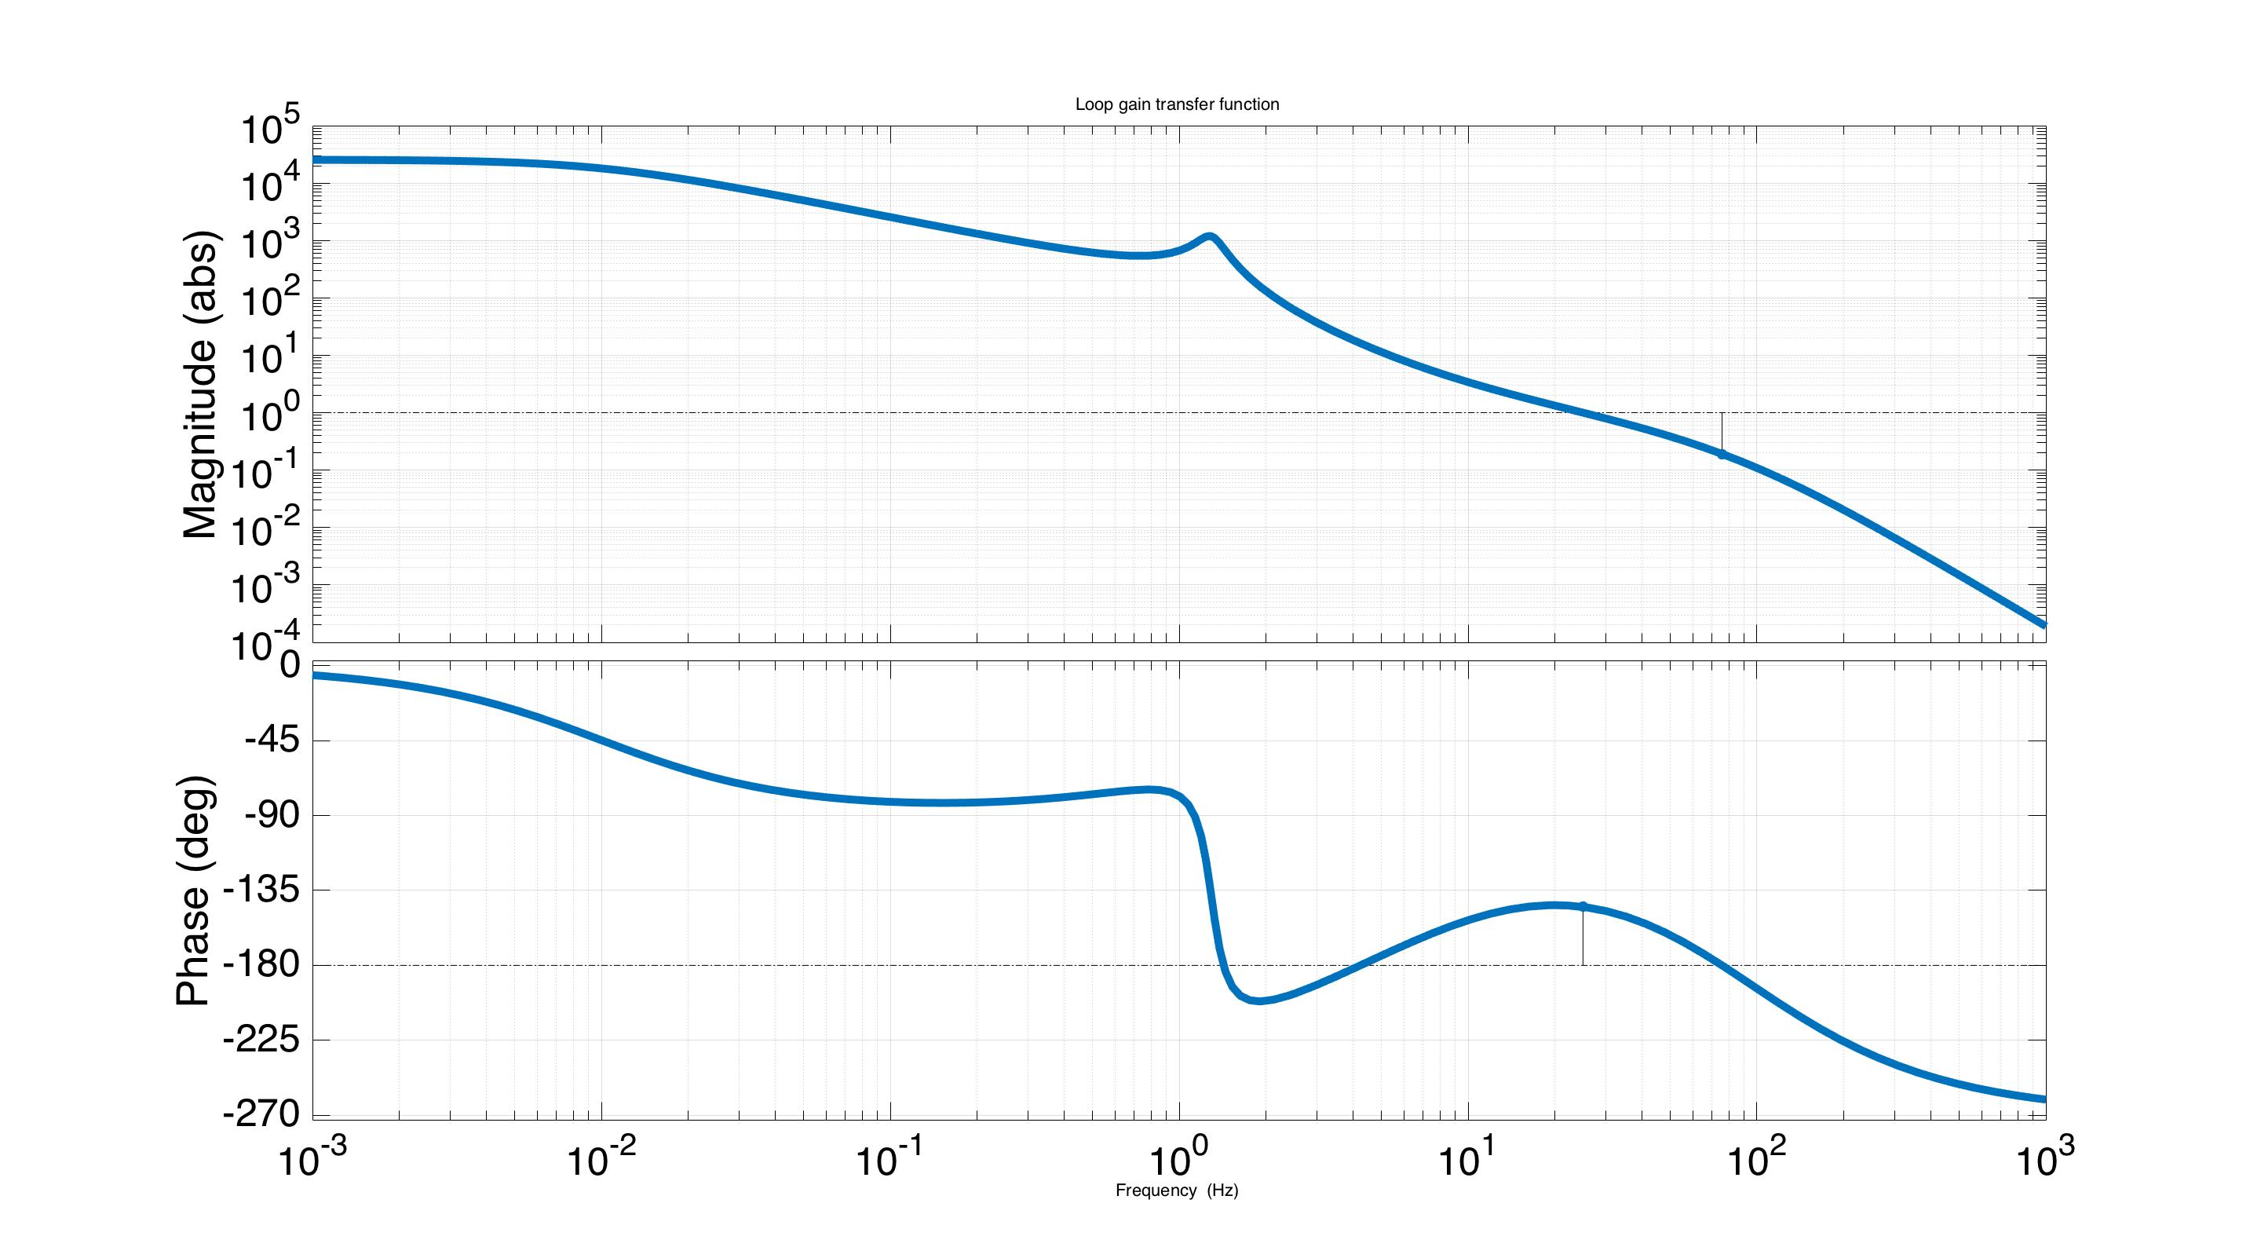
Another Loop Gain Example
Multiple 180º crossings. Stable?
Crosses -180, but still stable
because it is before the unity gain
frequency
-180
Matlab for control filter: C = zpk(-2*pi*[2,25/3],-2*pi*[0.01,25*3,100],9.1e10)

Slide 52
Another Loop Gain Example
Multiple 180º crossings. Stable? Yes!
Crosses -180, but still stable
because it is before the unity gain
frequency
-180
Matlab for control filter: C = zpk(-2*pi*[2,25/3],-2*pi*[0.01,25*3,100],9.1e10)
Notes:
It is stable, because the phase can do whatever you like, as long as it comes back with +-180 degrees before you cross unity.

Slide 53
This is Stable!?
Quad SUS modal damping simulation
unity gain
-180
+180
-180
+180
-180
Notes:
So I have here an example modal damping loop gain. This isn’t something you usually bother to look at with MC designs, but I think here it is informative to look at it just to make a point. (For the MIMO case the concept of loop gain breaks down. This example is applied to a SISO case to make the point.)
Because everyone knows that for stable control the phase must stay within +-180 degrees. This is one of the first things you learn when learning to design loops. But look at this thing, it crosses 180 like 4 times, yet it is still stable! Actually, what we learned isn’t completely true. Modern control algorithms know better because the physics of stability are built into them.

Slide 54
This is Stable!?
Quad SUS modal damping simulation
unity gain
> 1 region
-180
+180
-180
+180
-180

Slide 55
This is Stable!?
Quad SUS modal damping simulation
unity gain
> 1 region
±180º crossing
-180
+180
-180
+180
-180
Notes:
It turns out you can cross 180 as many times as you want, provided that the magnitude is less than 1 each time. Actually, there are more subtleties than that, but that just reinforces my point.
So modern control, and optimal control in general, is one way of avoiding artificial constraints that we might impose on our systems. Sometimes we aren’t aware we are doing so as in this case, and sometimes we are, just because we need to simplify them so that we can get our heads around the problem. An example is the ISI control. I don’t want to suggest we should use MC on the ISI, I don’t know the answer to that. I am just using it as an example of a system where we use a bunch of SISO loops loop to control a 12X12 MIMO system, just so it is tractable. In doing so we’re missing out on taking advantage of the couplings between the DOFs that comes naturally to MC algorithms. Another example is the suspension damping, which is why modal damping has the potential to damp more efficiently.

Slide 56
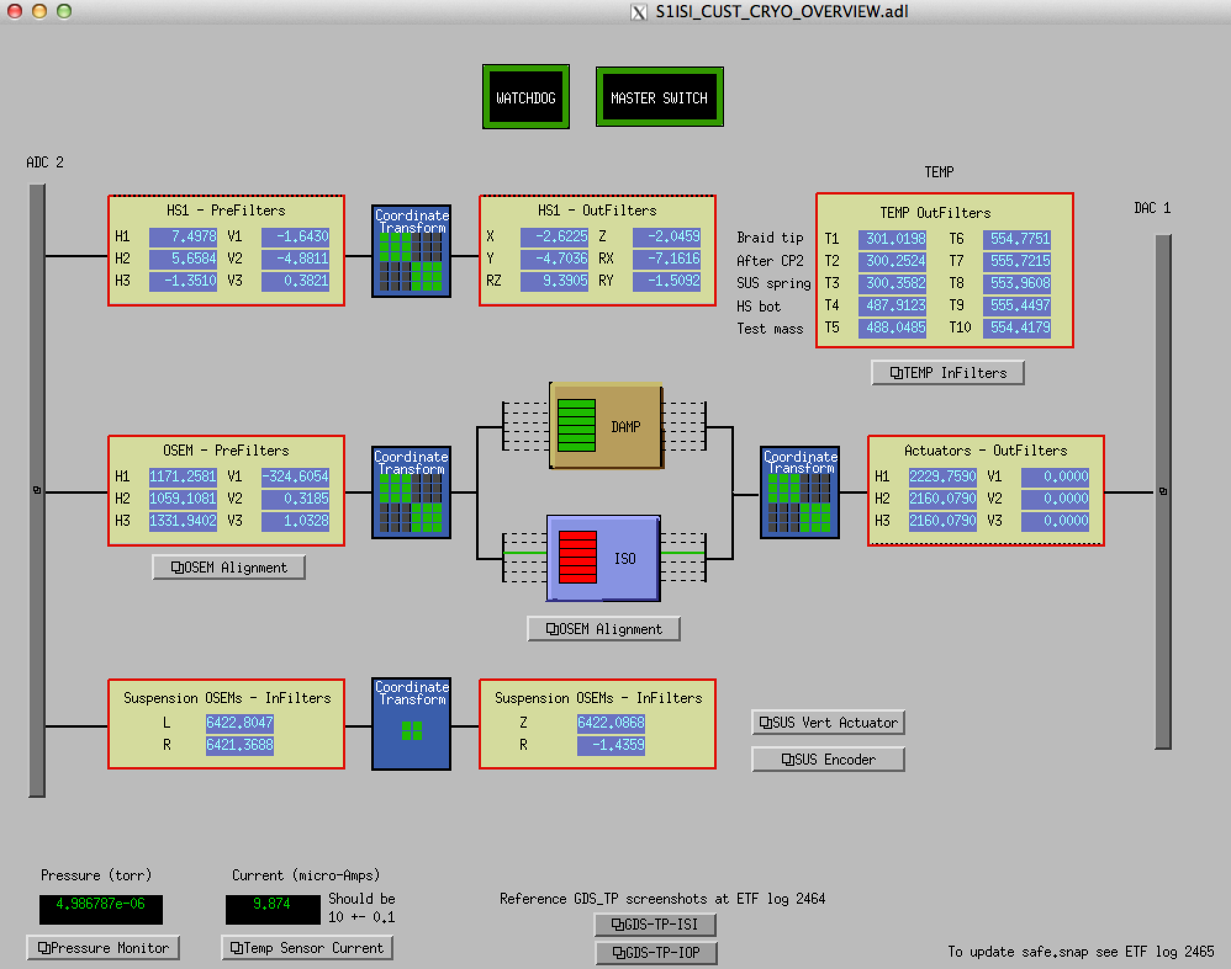
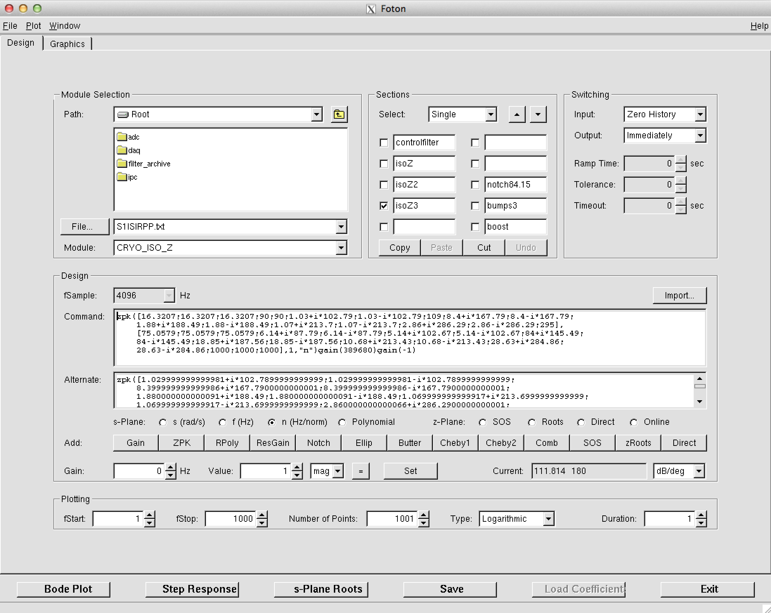
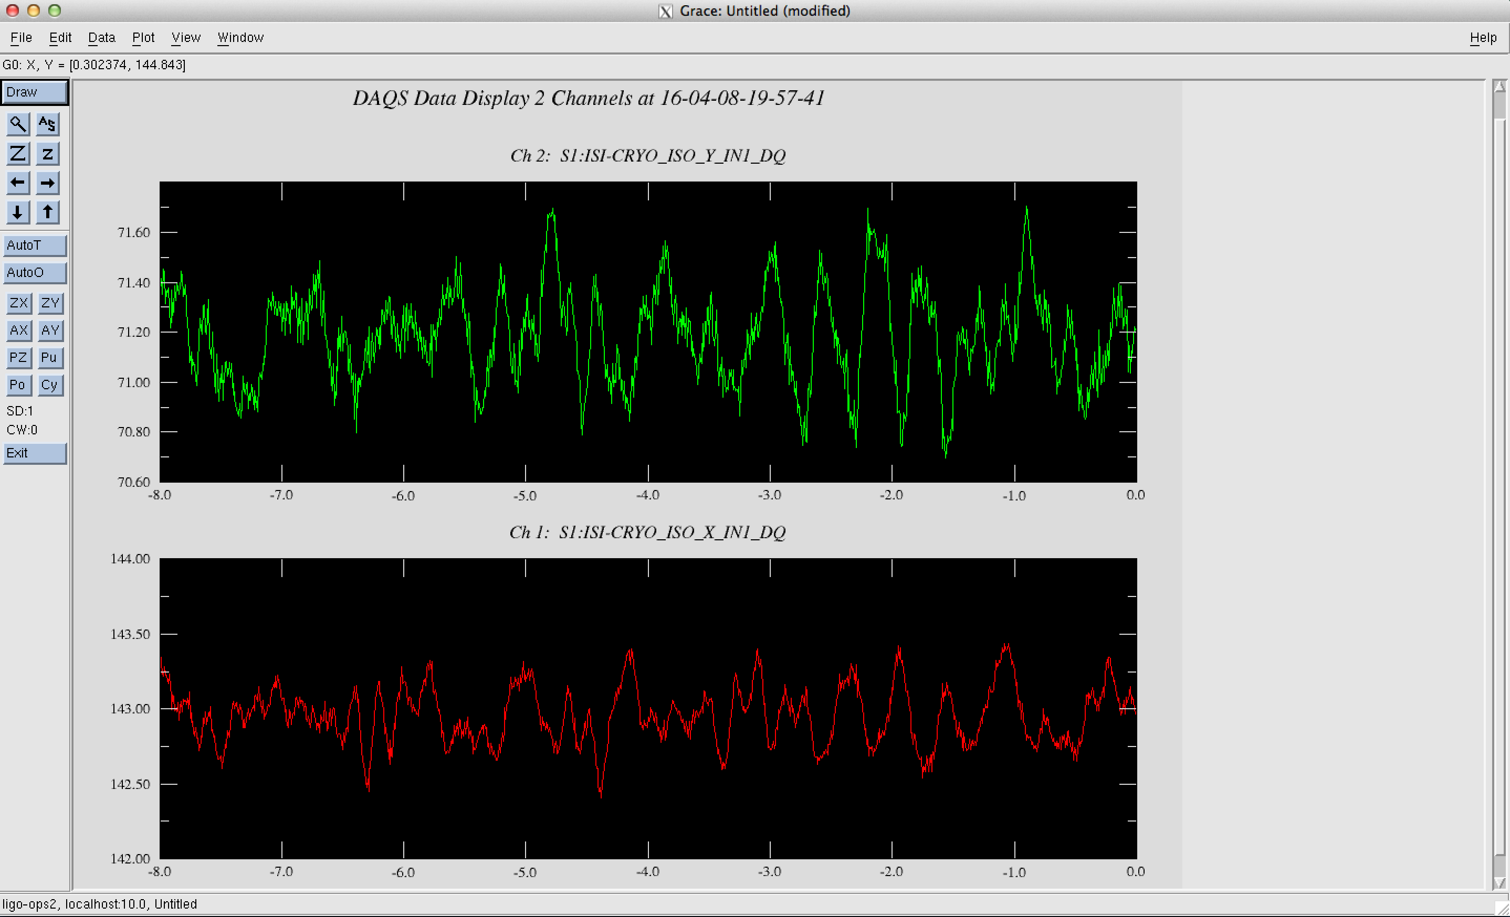
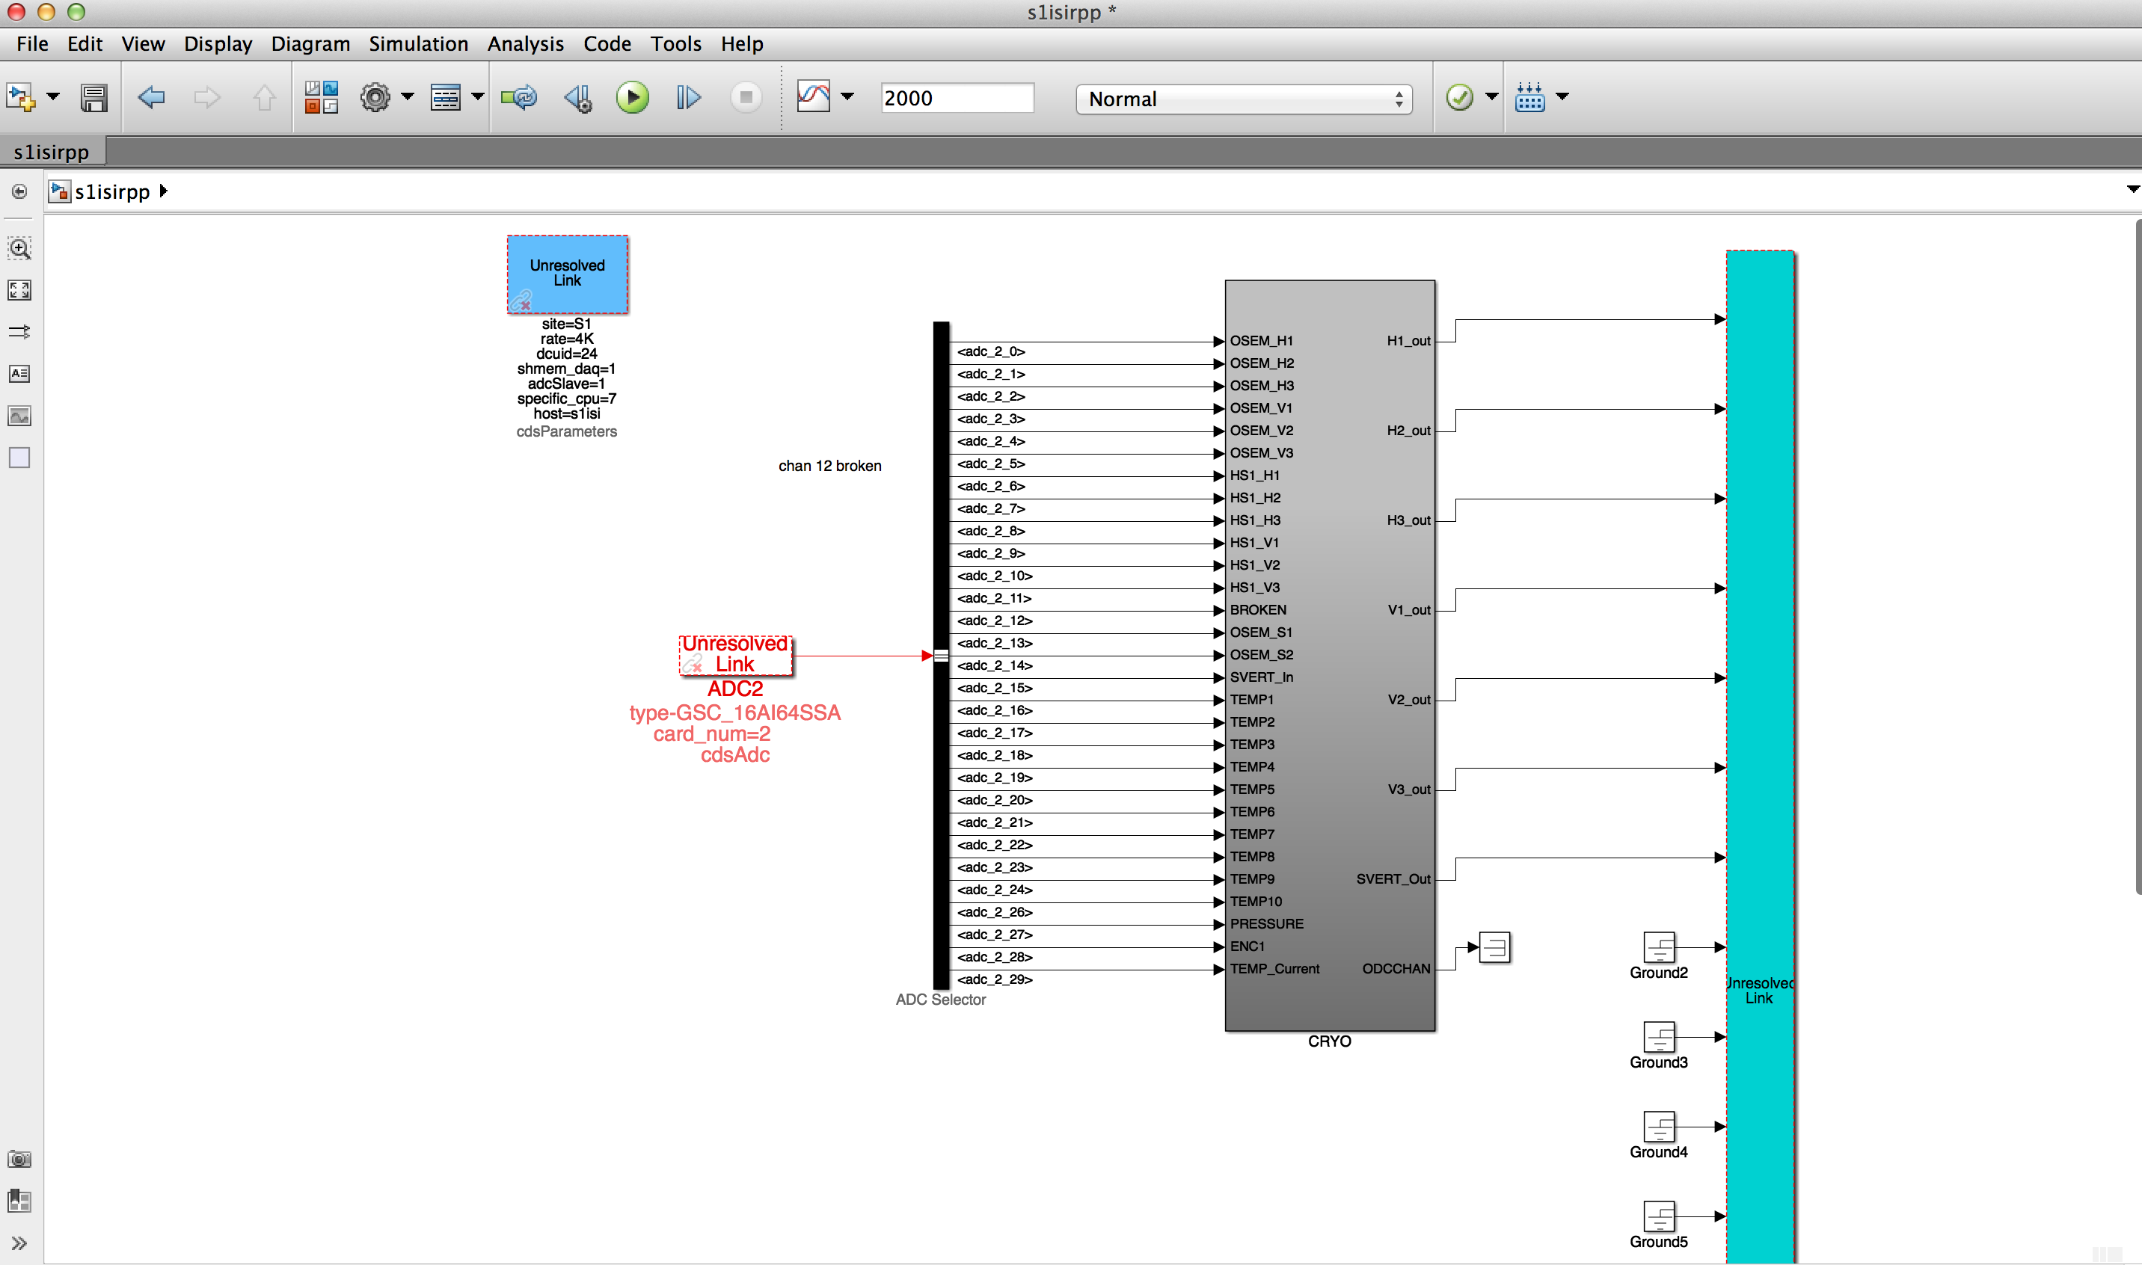
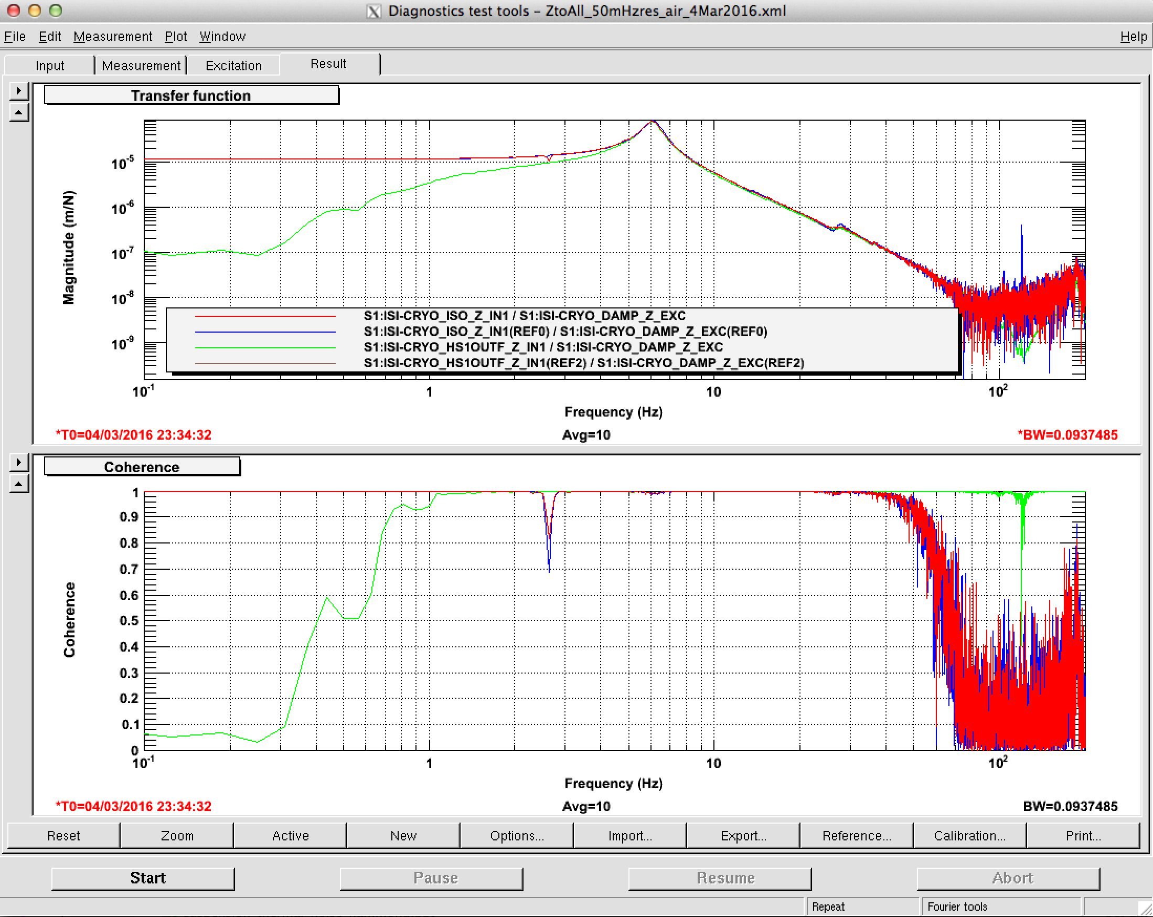
MEDM – user interface screens
Foton – install filters
Dataviewer –
realtime signals
DTT - measurements
Matlab – realtime code
Notes:
To implement our controls at the sites, we have many software tools to help us out. I’m not going to get into these either, but many of you no doubt are already familiar with these.

Slide 57
Controls text books
Digital Control of Dynamic Systems, 3rd Ed. Franklin, Powell, and Workman.
  Main focus is on the control of digitally sampled systems, but also has a good review of continuous control, system identification, optimal control, and nonlinear systems.
Modern Control Engineering, 5th Ed. Ogata
  Standard introductory text to control
Notes:
If you want to learn more about controls, here are a couple of text books that I used in the classes I took. I think they are pretty good.

Slide 58
Control System Working Group (CSWG)
See G1601671

Slide 59
Control System Working Group (CSWG)
Formally organized at the March 2016 LVC
Group charter at M1600033
Chair: Dennis Coyne.
Deputy co-chairs: Brett Shapiro, Robert Ward.

Slide 60
CSWG Role
The CSWG is unique among working groups
Feedback control is used by many of the other instrument science working groups.
It’s relevance is demonstrated through application to the other working groups.

Slide 61
CSWG Role
Support of other groups
  training references: G1600726, G1601640, G1601417, G1600525, G1400557, G1400102
  support of particular problem areas
  review the applicability of new controls techniques
Research into advanced techniques
  Machine learning
  Feedback optimization (automated design)
  etc

Slide 62
5 current focus areas identified
5 problem/focus areas identified to support CSWG’s role
Get involved in these focus areas!
  IFO lock maintenance with machine learning
  Test mass length-to-angle decoupling
  Feedback optimization
  Transfer function fitting algorithms
  IFO earthquake robustness

Slide 63

Additional Focus Areas?
The CSWG is not restricted to these 5 areas
Please suggest any other areas the CSWG should prioritize

Slide 64
A Global Working Group
Reference LIGO-G1600275

Slide 65
Meetings
Bi-monthly Teamspeak meetings
US-western hemisphere: 1st Fri of the month, 9am US-PT (6pm CET, 9:30pm IST)
US-eastern hemisphere: 3rd US Thu of the month, 4pm US-PT (Fri 9am AET, 8am JST, 4:30am IST)

Slide 66
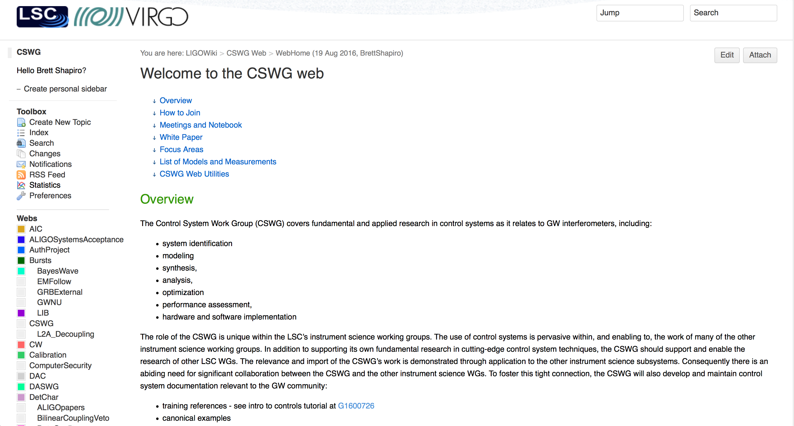
CSWG Wiki
https://wiki.ligo.org/viewauth/CSWG/WebHome

Slide 67
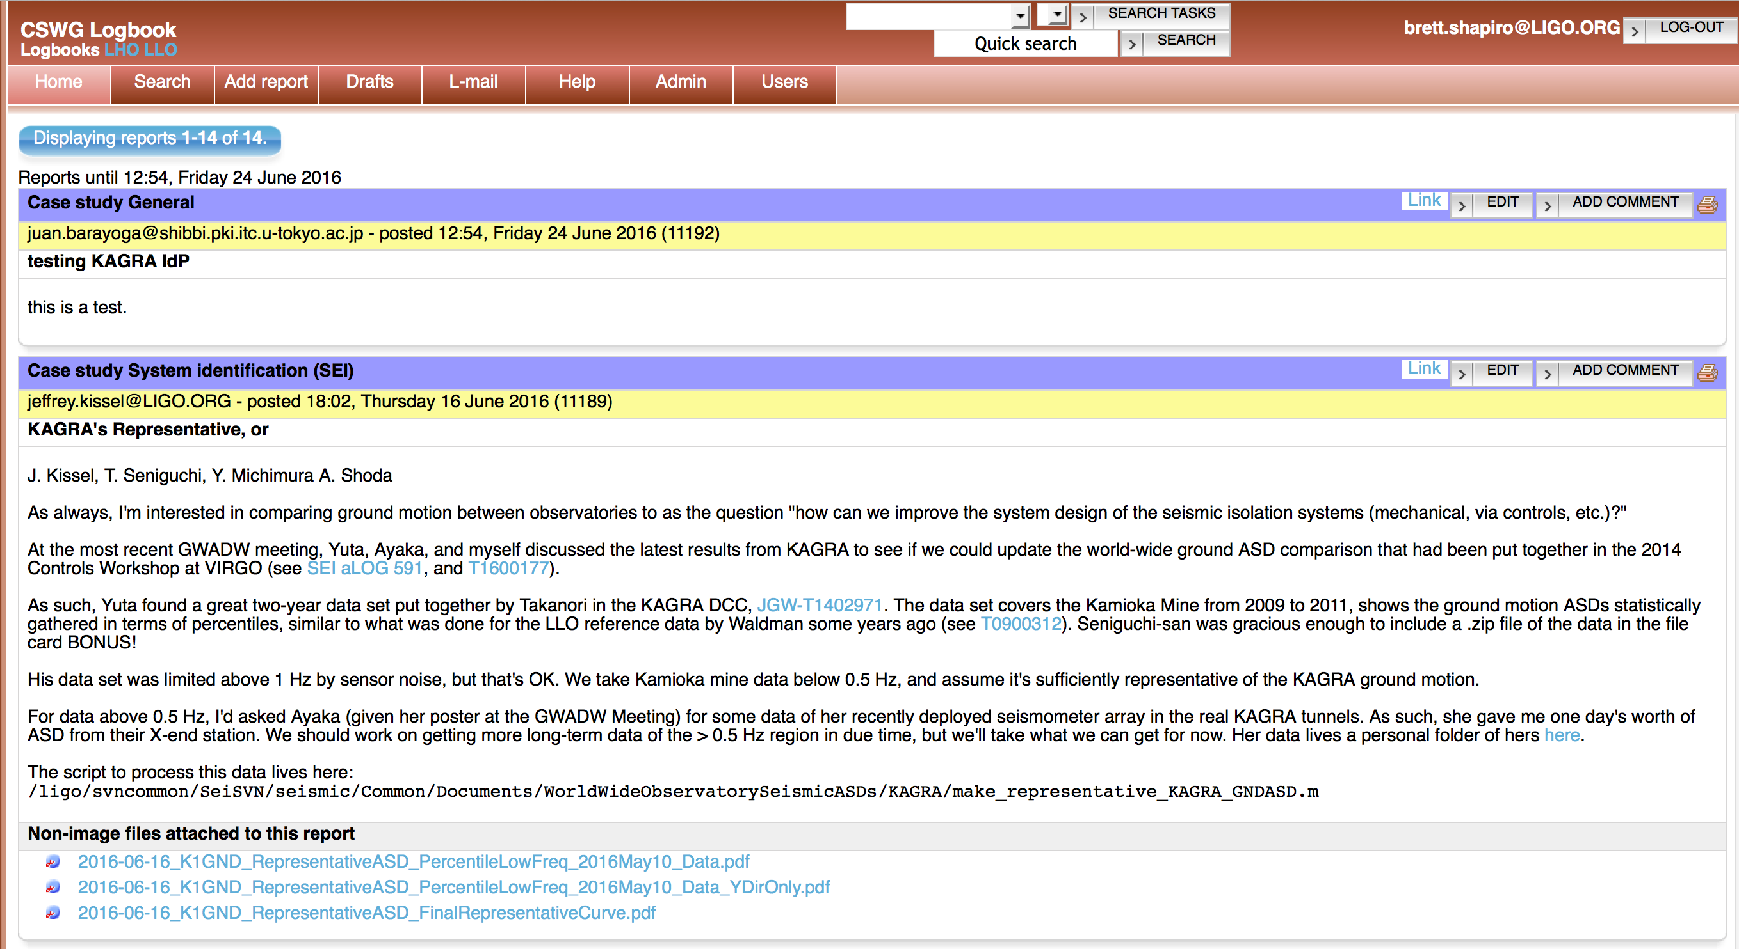
CSWG tools
alog
https://alog.ligo-la.caltech.edu/CSWG/
Mailing list: cswg@sympa.ligo.org
Sign up at https://grouper.ligo.org/mailinglists/cswg
Teamspeak channel: CSWG

Slide 68

We Need You!
Many areas where work is needed
Get involved!
Students encouraged to take a controls course
GW interferometers don’t work without controls!
Credit: http://einsteinpostdocs.info/

Slide 69
Extra Slides

Slide 70
Control design: poles and zeros
Recall:
to generate the bode plot
for bode plot
LHP Poles: -90 deg phase, 1/f mag
LHP Zeros: +90 deg phase, f mag
Note, don’t ever use these unless you have a really good reason:
RHP Poles: +90 deg phase, 1/f mag (unstable)
RHP Zeros: -90 deg phase, f mag (stable, but usually make feedback less stable)
Notes:
Note, these zero and pole properties are only valid for left half plane (LHP) poles and zeros. Right half plane (RHP) poles and zeros have the reverse phase characteristics (poles -> +90 phase, zeros -90 phase). It is best to avoid using either of these unless you have a really good reason. RHP poles are naturally unstable. RHP zeros are actually stable, however, they tend to make feedback less stable (because of their negative phase). RHP poles are zeros are not completely useless it turns out, but you should have a good reason for using them. For example, sometimes the only way to stabilize an unstable plant is to use RHP poles. This is a bit weird because it means you’re using an unstable controller to stabilize an unstable plant. In any case, nearly all our LIGO plants are stable (exceptions being some modes of the optics under high laser power, due to coupling to radiation pressure).

Slide 71

5 current focus areas identified
Machine Learning for lock maintenance
  Leader - Rob Ward
  Use an algorithm to ‘learn’ the best way to maintain lock
  See example of acquiring a Bose-Einstein condensate
  P. B. Wigley, et al. Fast machine-learning online optimization of ultra-cold-atom experiments. Scientific Reports, 2016; 6: 25890
Test mass control
Test mass

Slide 72
5 current focus areas identified
Length to angle decoupling
Leader – TBD
Separate the problems of controlling cavity length and alignment. Alignment control is currently suboptimal and contributing noise to the IFO.
Length control drive
Test mass

Slide 73
5 current focus areas identified
3) FB optimization (esp. applied to angular controls)
Leader – TBD
Collaboration with UC Berkeley and Google
Cost function
Control Filter
Optimization Algorithm:
Monte carlo, particle swarm, gradient descent, etc
Cost
Magnitude
Parameters
e.g. filter poles and zeros
Frequency

Slide 74
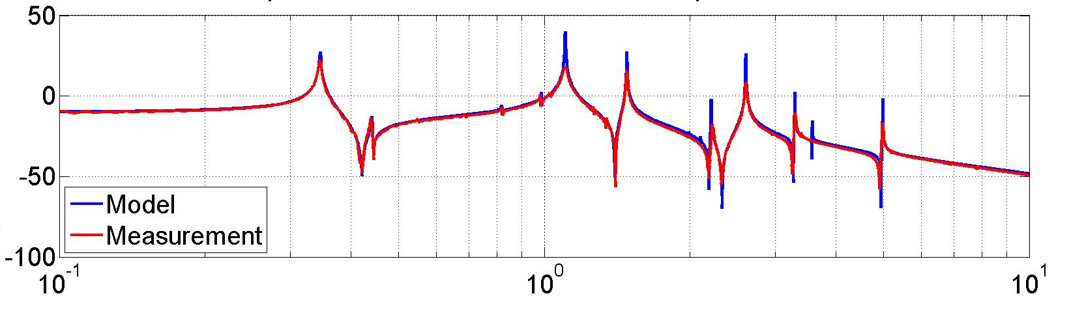
5 current focus areas identified
4) Transfer function fitting algorithms
Leader – TBD
Motivation: G1601173 - Hopes and Dreams: One TF Fitting Program to Rule Them All
Various tools exist: vectfit, n4sid, etc. How to best apply them? Do we need something new?
Part of a more general topic of experiment design and system identification
Quad Pitch TF Fit
Model
rad/Nm (dB)
Measurement
Frequency (Hz)

Slide 75
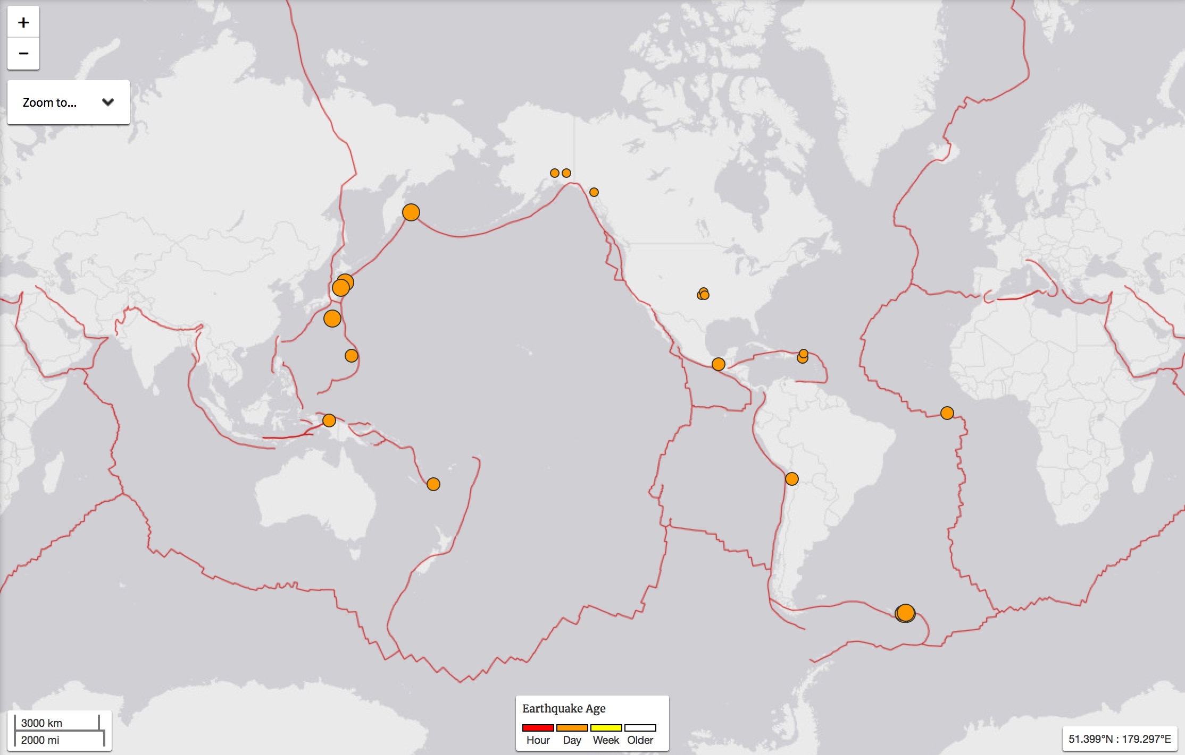
5 current focus areas identified
5) IFO robust configuration for earthquakes
Leader – Sebastien Biscans
We already receive early warnings. How best to configure the IFO to not loose lock?
Earthquake map – 22 August 2016
USGS

Slide 76
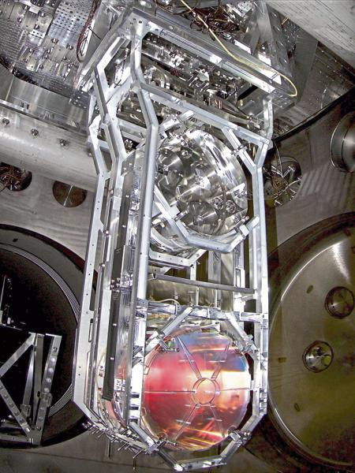
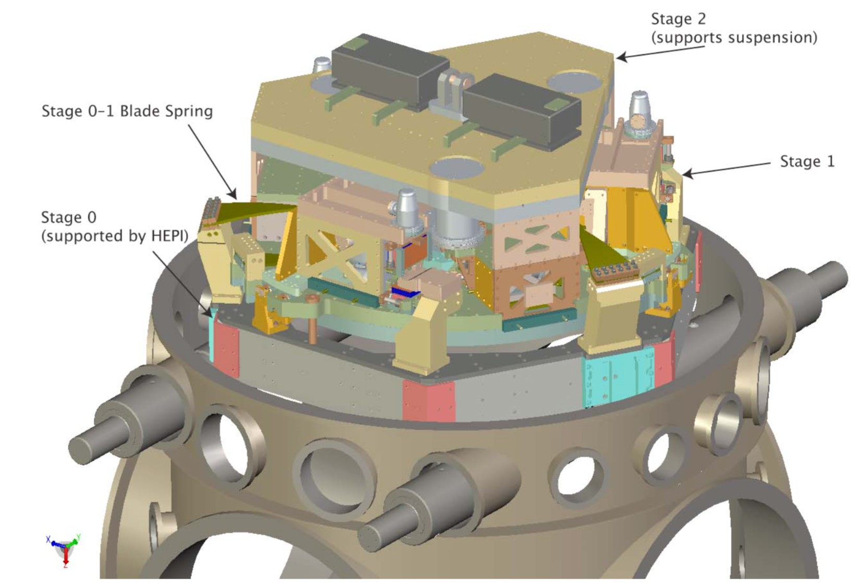
Control Loops Everywhere
Cavity lengths
Angular motion of all mirrors
Motion of the input beam
Laser power and frequency
Multi-degree of freedom control of the seismic isolation systems (ISIs) and suspensions
Adapted from G160525

Slide 77
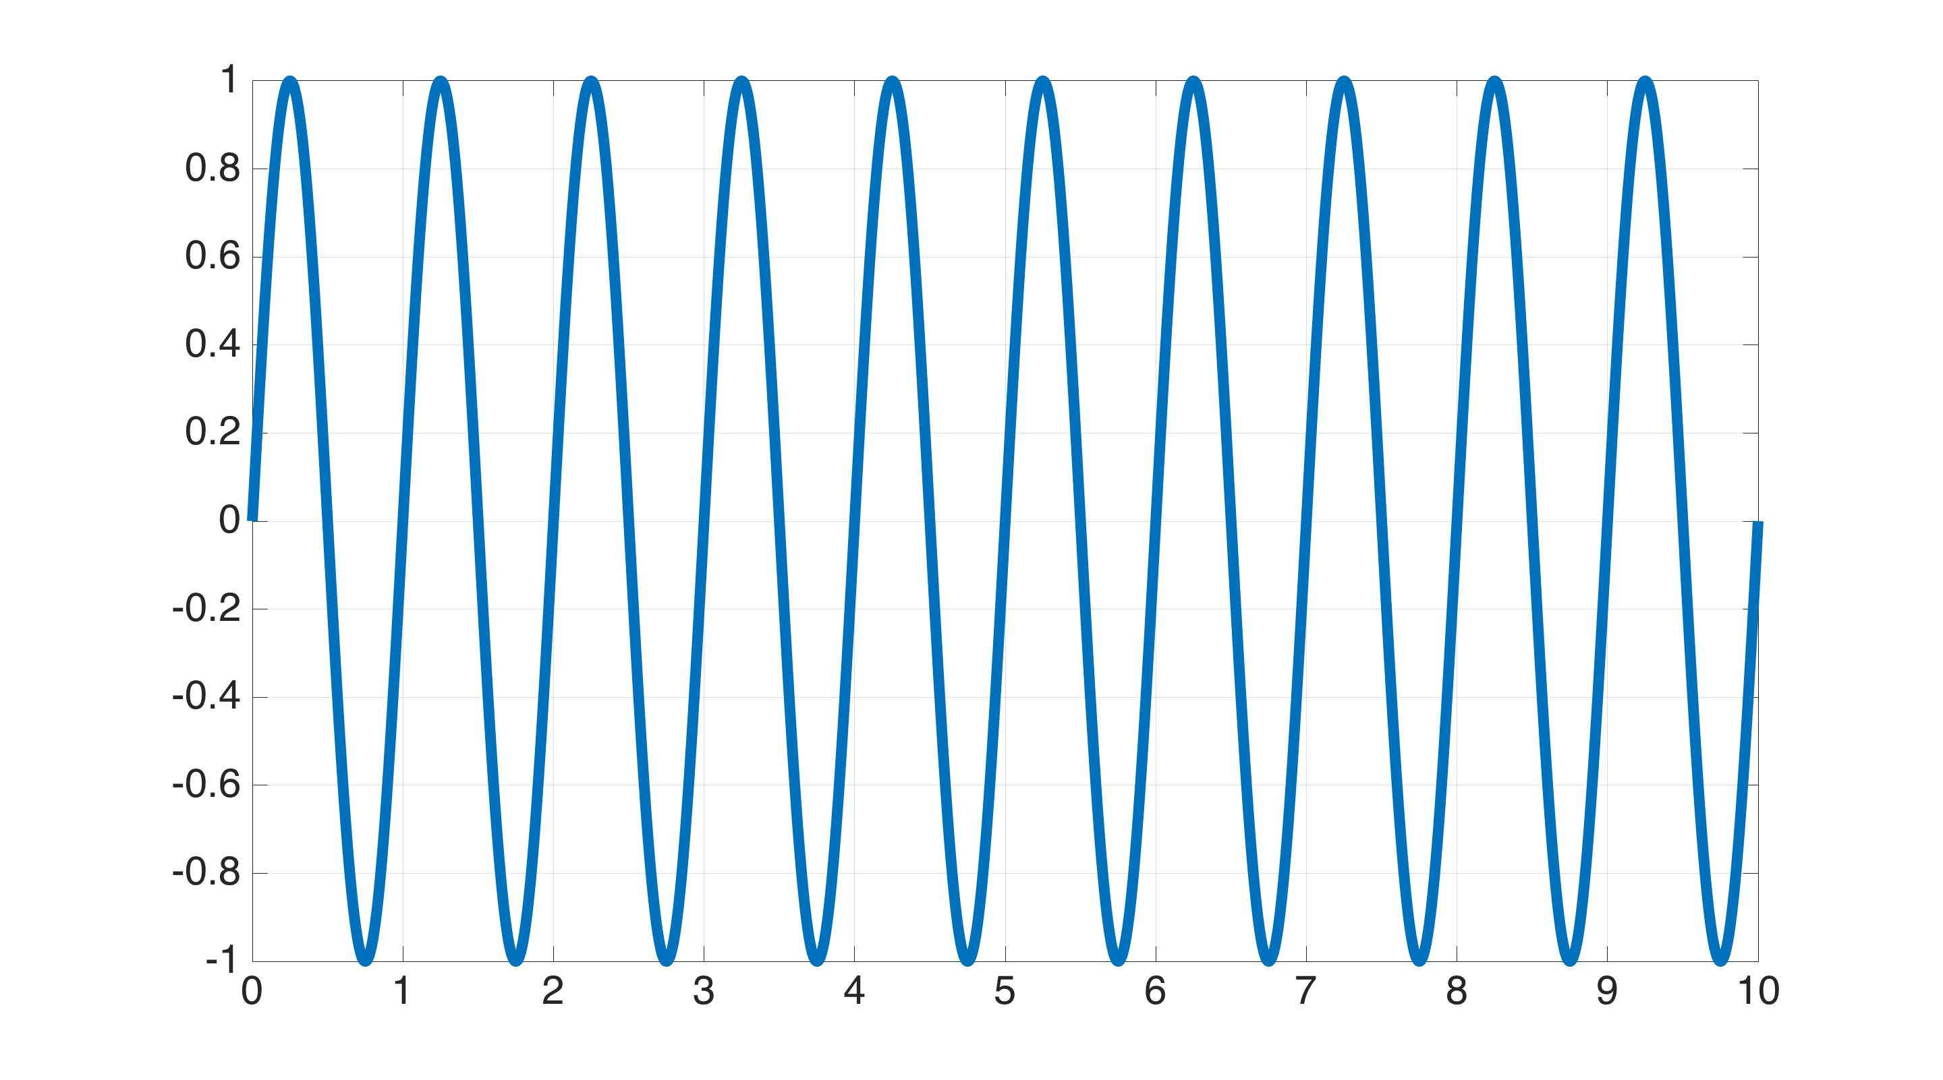
What TFs mean?
1 Hz Excitation
Excitation signal
Signal Value
Time

Slide 78
What TFs mean?
1 Hz Excitation
Excitation signal
Signal Value
Output signal
Time

Slide 79
What TFs mean?
1 Hz Excitation
Excitation signal
TF magnitude = Amplitude ratio
Signal Value
Output signal
Time

Slide 80
What TFs mean?
1 Hz Excitation
Excitation signal
TF magnitude = Amplitude ratio
Signal Value
Output signal
TF phase = (time delay) *frequency*(360 degrees)
Time

