Slide 1
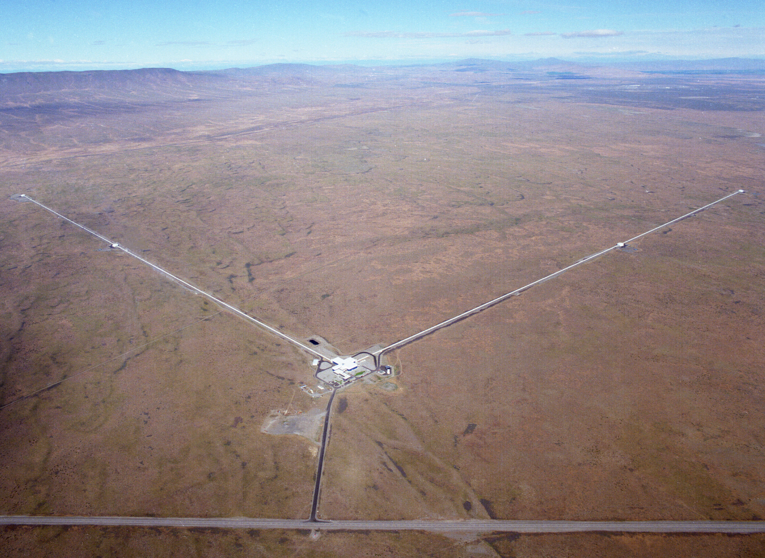
Cries from the Cosmos: LIGO Observes the Most Extreme Phenomena in Our Universe
Fred Raab, for the LIGO Scientific Collaboration and the Virgo Collaboration

Slide 2
This is a story of discovery, written in the “spacequakes” created by the births and deaths of black holes. It is a story predicted a century ago. Learning how to read this story took half a century. The story was read first by a village of scientists spanning the globe, who then shared it with the rest of the world.

Slide 3
The stage for this story is space and time.

Slide 4
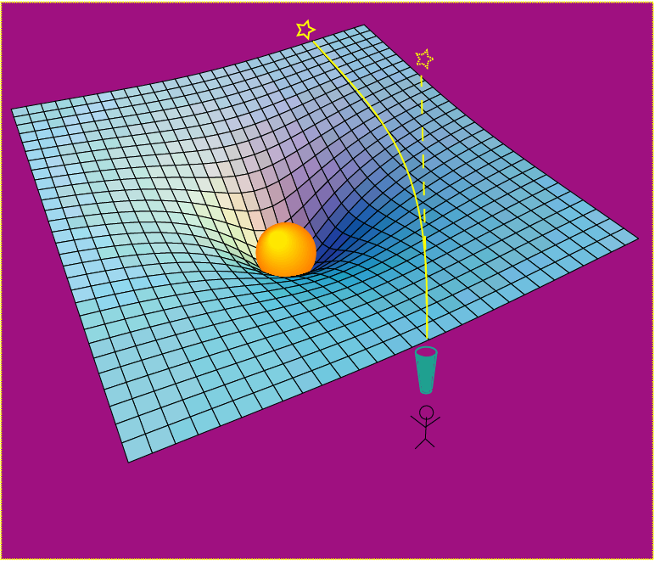
Einstein’s General Relativity re-wrote the rules of space and time
Rendering of space stirred by two orbiting black holes
A massive object shifts apparent position of a star
Empty space and time are things, with real physical properties. Space has a shape, a stiffness and a maximum speed for information transfer.

Slide 5
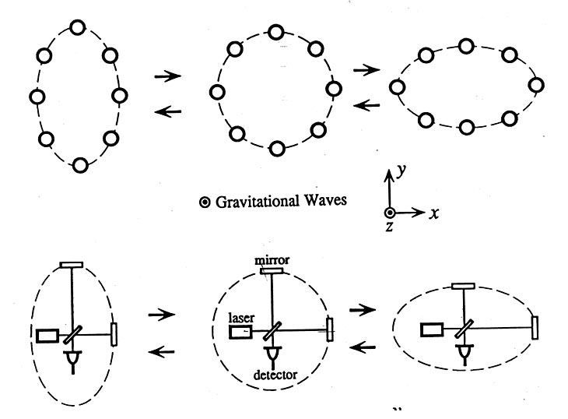
Basic idea is simple
GW amplitude h = (R_{x}-R_{y})/R
Spatial asymmetry induces relative phase shifts on light in arms

Slide 6
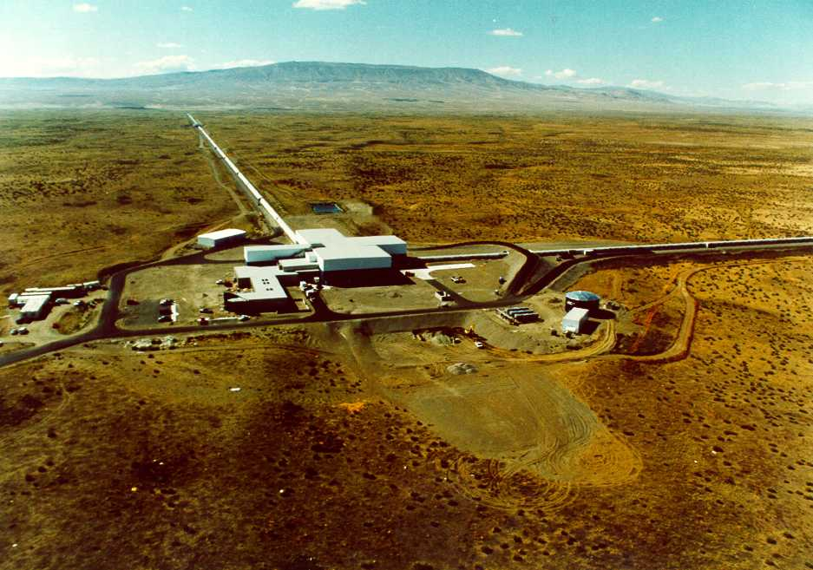
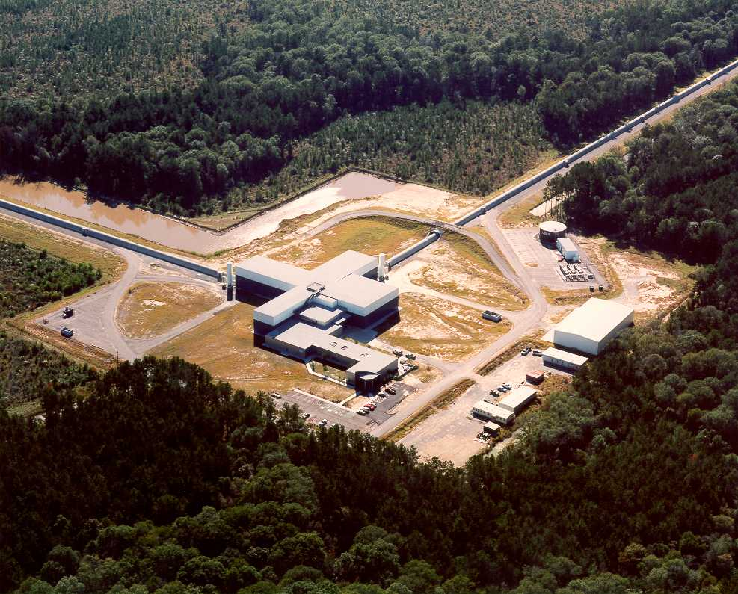
The Laser Interferometer
Gravitational-Wave Observatory
LIGO (Washington)
LIGO (Louisiana)
Brought to you by the National Science Foundation; operated by Caltech and MIT; the research focus for more than 1000 LIGO Scientific Collaboration members worldwide.

Slide 7
The actors are monster objects called “black holes” which became locked in a death spiral and died in an event of unimaginable violence.

Slide 8
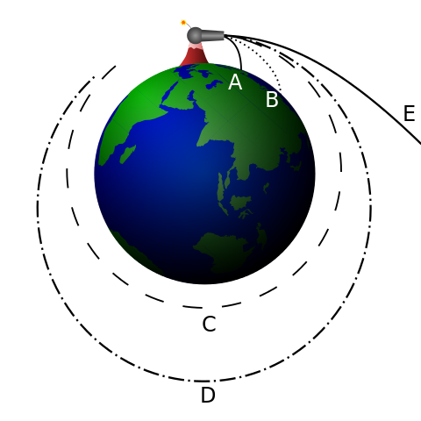
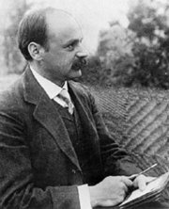
Schwarzschild Black Hole
Escape Velocity
Schwarzschild Radius
Object Schwarzschild Radius
Earth 1 cm (size of marble)
Sun 3 km (2 miles)‏
Newton’s Cannonball
Credit: Brian Brondel
Diameter of a 60 solar-mass black hole is equivalent to the distance between Yakima and Walla Walla.
Karl Schwarzschild
LIGO-G0900422-v1
Notes:
8
8

Slide 9
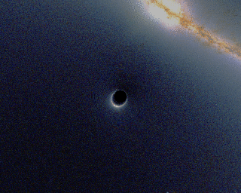
Illustration of How a Black Hole Distorts Background Light
https://en.wikipedia.org/wiki/File:BlackHole_Lensing.gif

Slide 10
The story starts a long time ago in a part of our universe far, far away…
Notes:
10
10

Slide 11
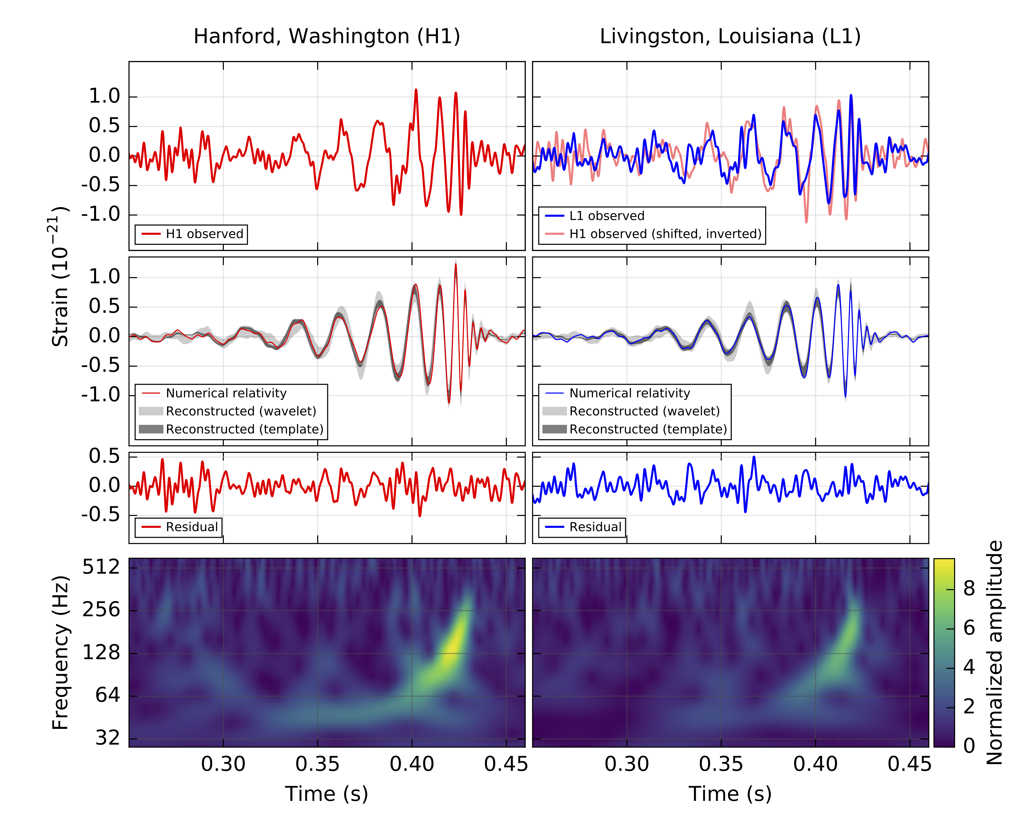
Observed on Sep 14, 2015
PRL 116, 061102 (2016)

Slide 13
A signal from a binary black hole merger
PRL 116, 061102 (2016)

Slide 14
A signal from a binary black hole merger

Slide 15
Long, long ago? Far, far away?
This event occurred more than a billion years ago and the “spacequake”, known as a gravitational wave traveled at the speed of light for all that time.
At that time, life on Earth consisted of only single-cell creatures.
We can explore distances using light, which travels at a speed of one foot per nanosecond.
Since we are exploring the night sky later tonight, let’s use some of the things we see in the day or night-time sky.

Slide 16
Astronomical distances
Astronomical distances are inconveniently large to measure in meters, so we often give distance as the length of time it takes light to cross that distance.
David & Fred Raab
For example, it takes light about 1.3 seconds to travel the distance from Earth to Moon, so we say the Moon is 1.3 light-sec from Earth.

Slide 17
Distance to the Sun
The Sun is 8.3 light-minutes away; first estimated by the Danish mathematician and astronomer Olaf Roemer 1675.
Jupiter
Roemer realized that errors between Cassini’s estimates of eclipses of Jupiter’s moons and observations were caused by time it takes light to cross Earth’s orbit.
Earth
Sun
Jupiter is 35-52 light-minutes from Earth.

Slide 18
Distances to stars visible to naked eye…
Vega is 25 light-years away; light you see tonight left Vega during Earth year 1991
The Dow Jones Industrial Average closes above 3,000 for the first time ever, at 3,004.46.
The Cold War ends as President of the Soviet Union, Mikhail Gorbachev, resigns and the Soviet Union dissolves.
The LIGO Construction proposal does not get funded. (It got funded the following year.
Double-Double is 160 light-years away; light you see tonight left in Earth year 1856
Russia signs Peace of Paris, ending the Crimean War.
Republican Party opens its 1st national convention in Philadelphia.
James Buchanan becomes 15th U.S. President.

Slide 19
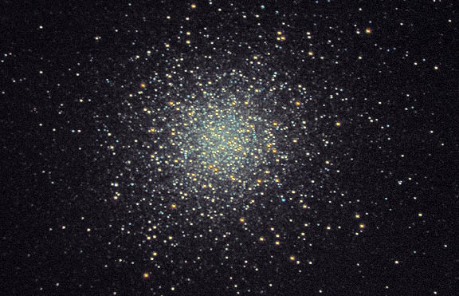
Globular Clusters are even farther away, but still in our own Milky Way galaxy
Globular cluster M13 is 21,000 light years away; light you see tonight has been traveling since a time on Earth that giant sloth, dire wolves and sabertooths were drowning in the LaBrea tar pits.
M13 from utahskies.org
Globular clusters are dense, spherical collections of stars in the spherical halo surrounding our galaxy, outside the main disk containing most stars and nebulae. Typical globular clusters contain hundreds of thousands to millions of stars and are tens of thousands of light-years from our solar system.

Slide 20
Galaxies are much further away…
You should be just barely able to see M31, the Andromeda Galaxy, with your naked eye tonight; it is the furthest object that the naked eye can detect at 2.3 million light-years from Earth. With hundreds of billions of stars it puts out enough light to be seen in dark skies at such great distance.
Light you see from M31 tonight has been traveling from M31 since Astralopithecus and Homo Habilis roamed the Earth.
M31 is our closest large galaxy. In the volume that we can see systems like GW150914, there are more than 5 million galaxies.

Slide 21
This first gravitational wave discovery was named GW150914:
Event type = gravitational wave
Detection year = 2015
Detection month = 09 = September
Detection day = 14
This was the most energetic event ever detected by humans, converting a mass equivalent to a million Earths into gravitational-wave energy.
For a few tenths of a second the power in this gravitational wave was 50 times greater than the total power output of all the stars in the universe.
But there were more discoveries to come…

Slide 22
Discovery Timeline – Advanced LIGO’s 1st Observations
Courtesy Caltech/MIT/LIGO Laboratory

Slide 23
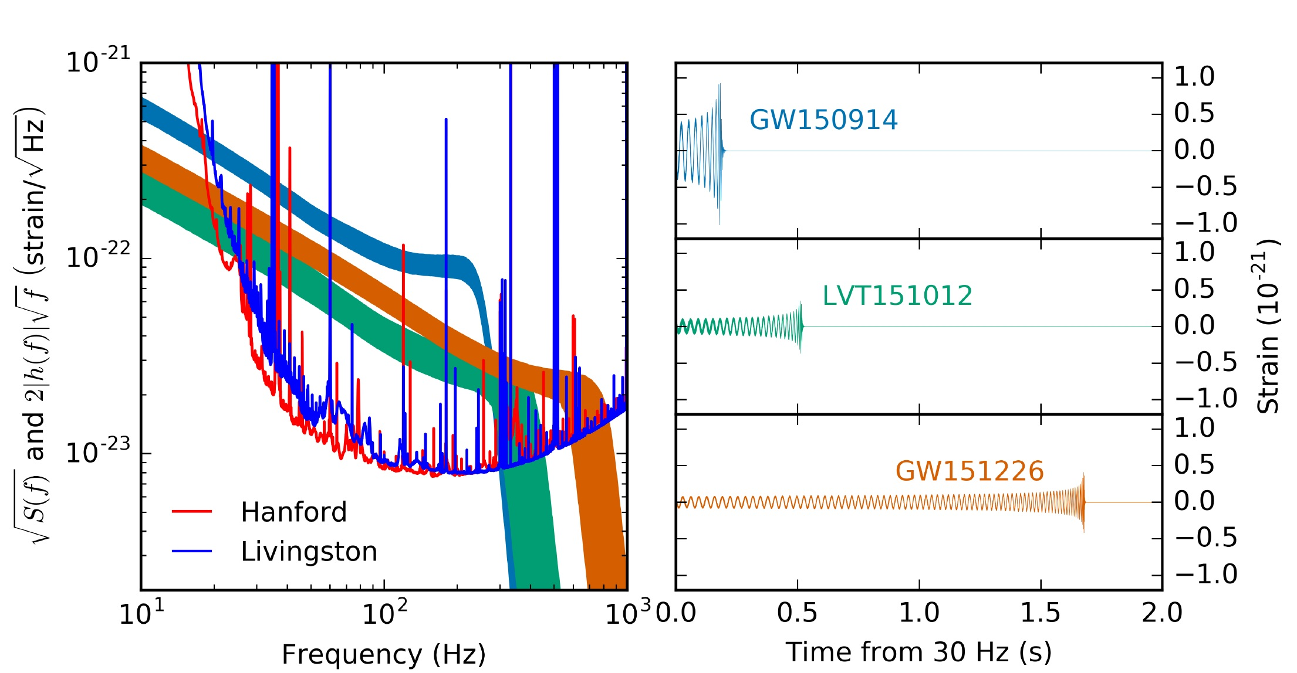
Advanced LIGO’s First Observations
ArViv:1606.04856; see also PRL 116, 241103 (2016) for GW151226.

Slide 24
Known Stellar-Mass Black Holes – June 2016
Courtesy Caltech/MIT/LIGO Laboratory

Slide 25
What will be the legacy of LIGO discoveries?
Attempts in the 19th century to explain why the sky is blue, sunsets red and clouds white led to the 20th century economy:
Atomic and nuclear physics and modern materials
Modern chemical and pharmaceutical industries
Modern electronics and computer industries
Unraveling the structure of DNA and other bio-molecules, leading to modern biochemistry and gene therapy
Development of almost all medical diagnostic machines
Also a new phrase, “Blue-sky research”
LIGO discoveries likely will revolutionize our understanding of space, time, matter and energy, as well as redefine what people can imagine and build

Slide 26
Credit: NASA

Slide 27
Summary
The 1st observing run of LIGO’s 2nd-generation detectors have initiated Gravitational-Wave Astronomy.
We have seen the annihilations and the births of black holes for the first time.
General Relativity provides a powerful framework from Earth-bound physics to mergers of stellar mass black holes at velocities near the speed of light.
Black Hole Binaries exist and merge hourly somewhere in the universe
An emerging international network of detectors soon will provide more accurate positions of sources to enable EM follow-ups of GW events.
It is possible to develop more powerful generations of detectors and there is much physics still to be harvested from their observations.

