Slide 1
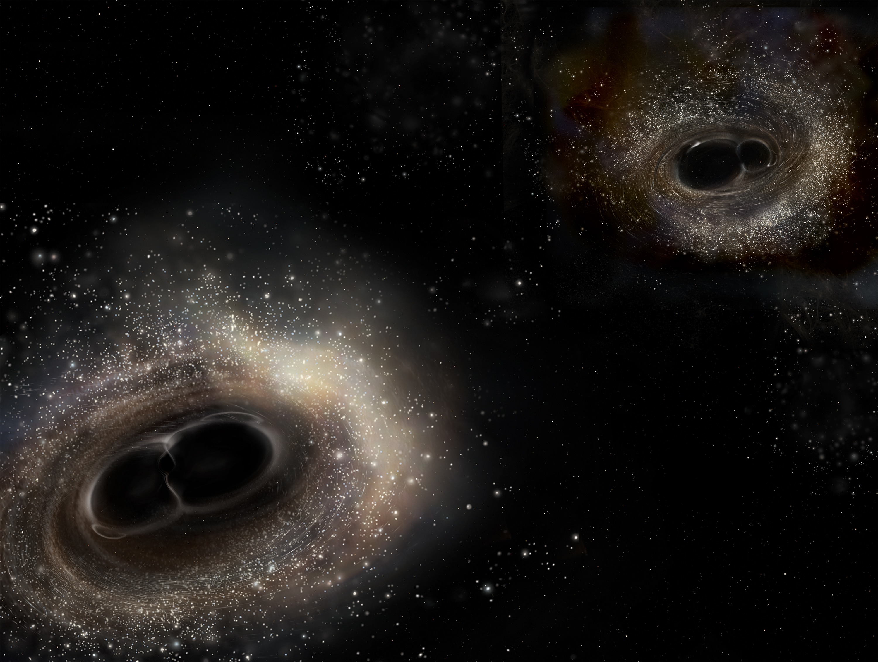
What Can We Learn From Gravitational Waves?
Tiffany Summerscales
Andrews University
On behalf of the LSC
Image Credit: LIGO/A. Simonnet

Slide 2
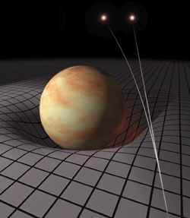
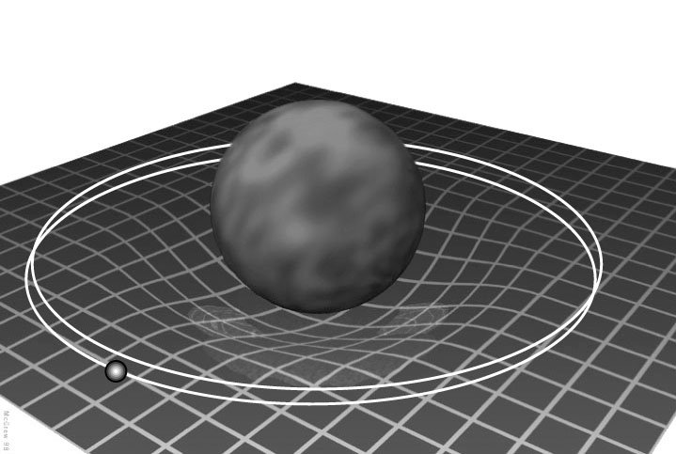
What is a Gravitational Wave?
Space tells matter how to move.
Matter tells space how to curve.
– John A. Wheeler
http://preposterousuniverse.com/spacetimeandgeometry/covercrop.jpg
http://zebu.uoregon.edu/ph121/hb/amy/merc.jpg

Slide 3
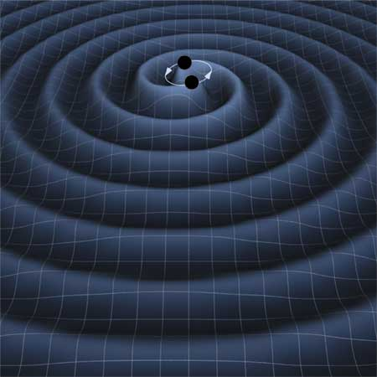
What is a Gravitational Wave?
Change in matter distribution = Change in curvature
Propagating change in curvature = A Gravitational Wave
http://lisa.jpl.nasa.gov/gallery/binary-wave.html

Slide 4
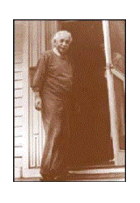
What is a Gravitational Wave?
Animation from http://www.ligo-la-caltech.edu/Posters/index.php

Slide 5
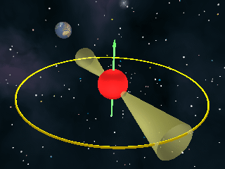
How Do We Know Gravitational Waves Exist?
http://nobelprize.org/nobel_prizes/physics/laureates/1993
http://www.jb.man.ac.uk/news/neutronstar/neutronstar.gif
Hulse
Taylor
In 1974, Russell Hulse and Joseph Taylor discover a new pulsar

Slide 6
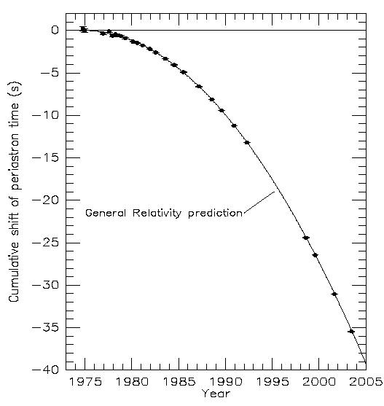
The Hulse-Taylor Binary Pulsar
http://arxiv.org/abs/astro-ph/0407149
http://www.atnf.csiro.au/news/press/neutron_binary/

Slide 7
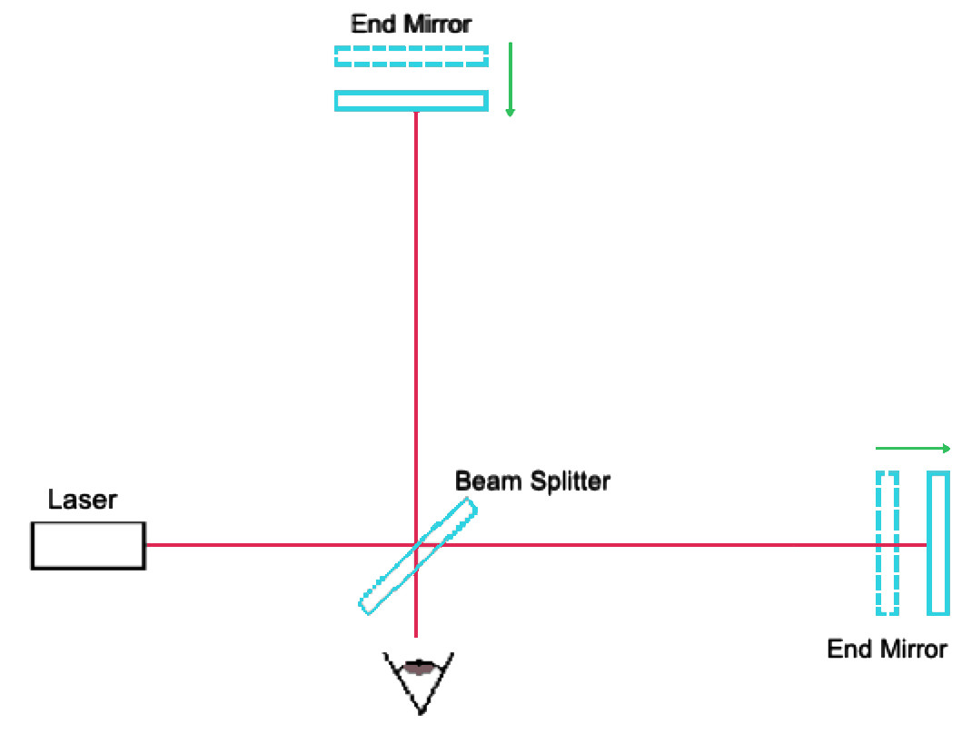
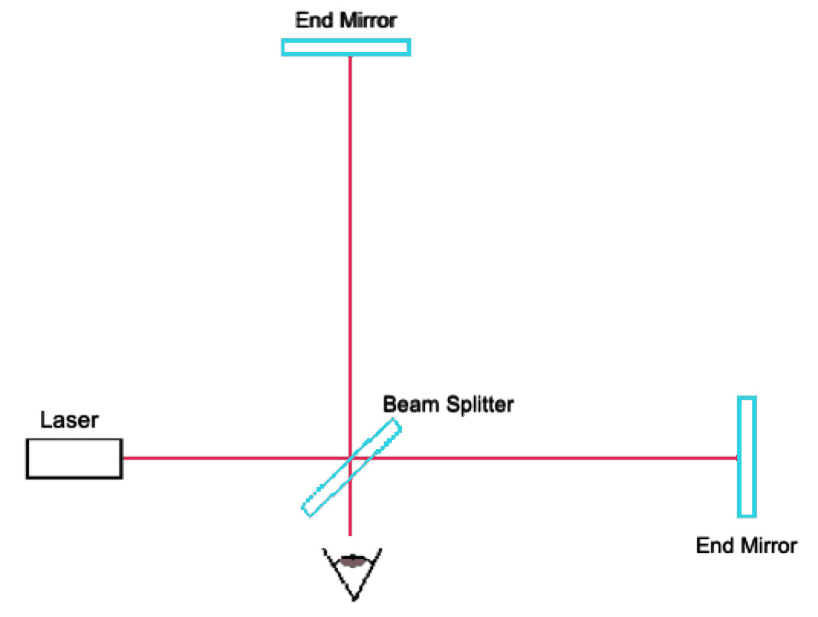
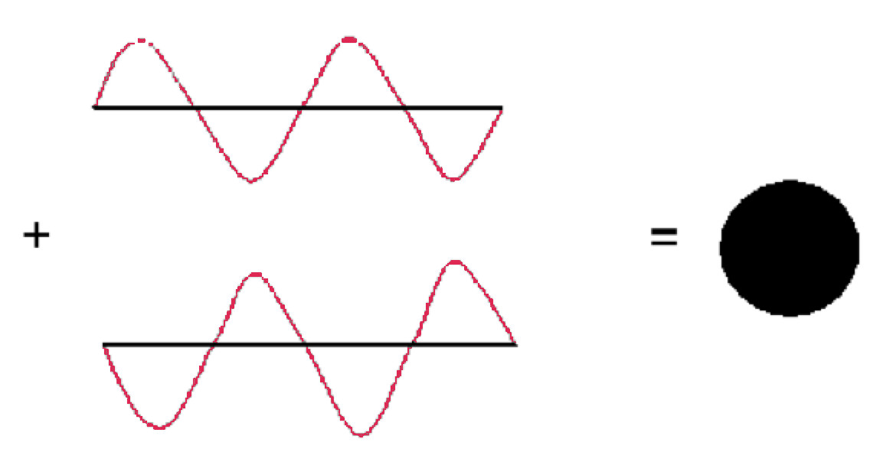
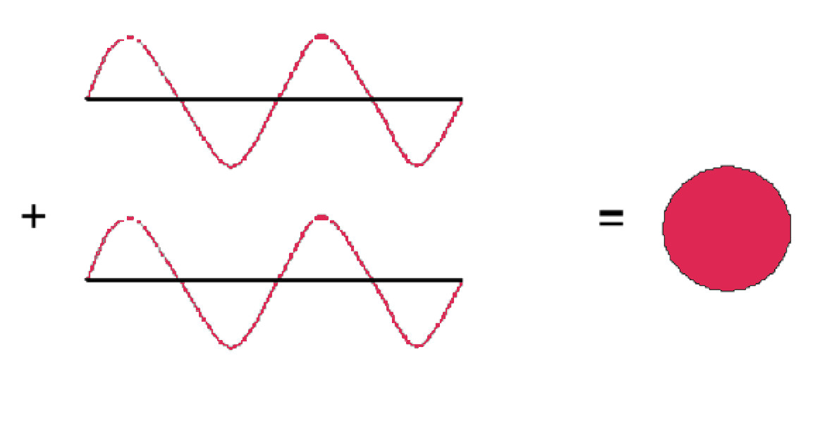
LIGO and Interferometry
Interferometry

Slide 8
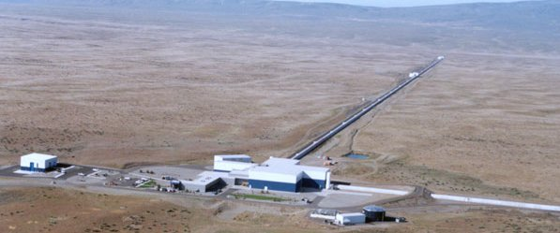
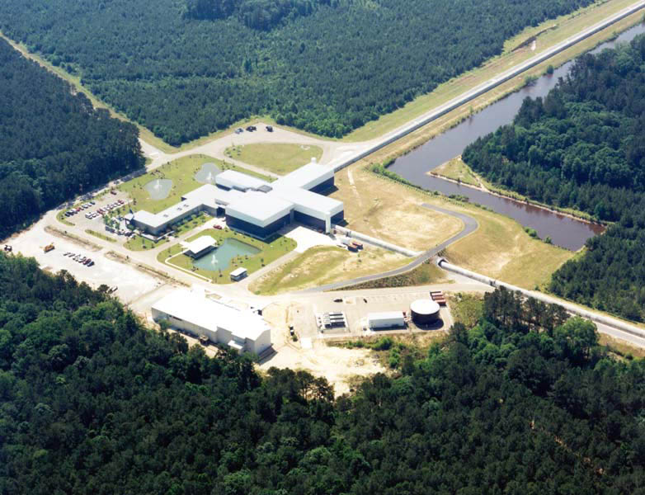
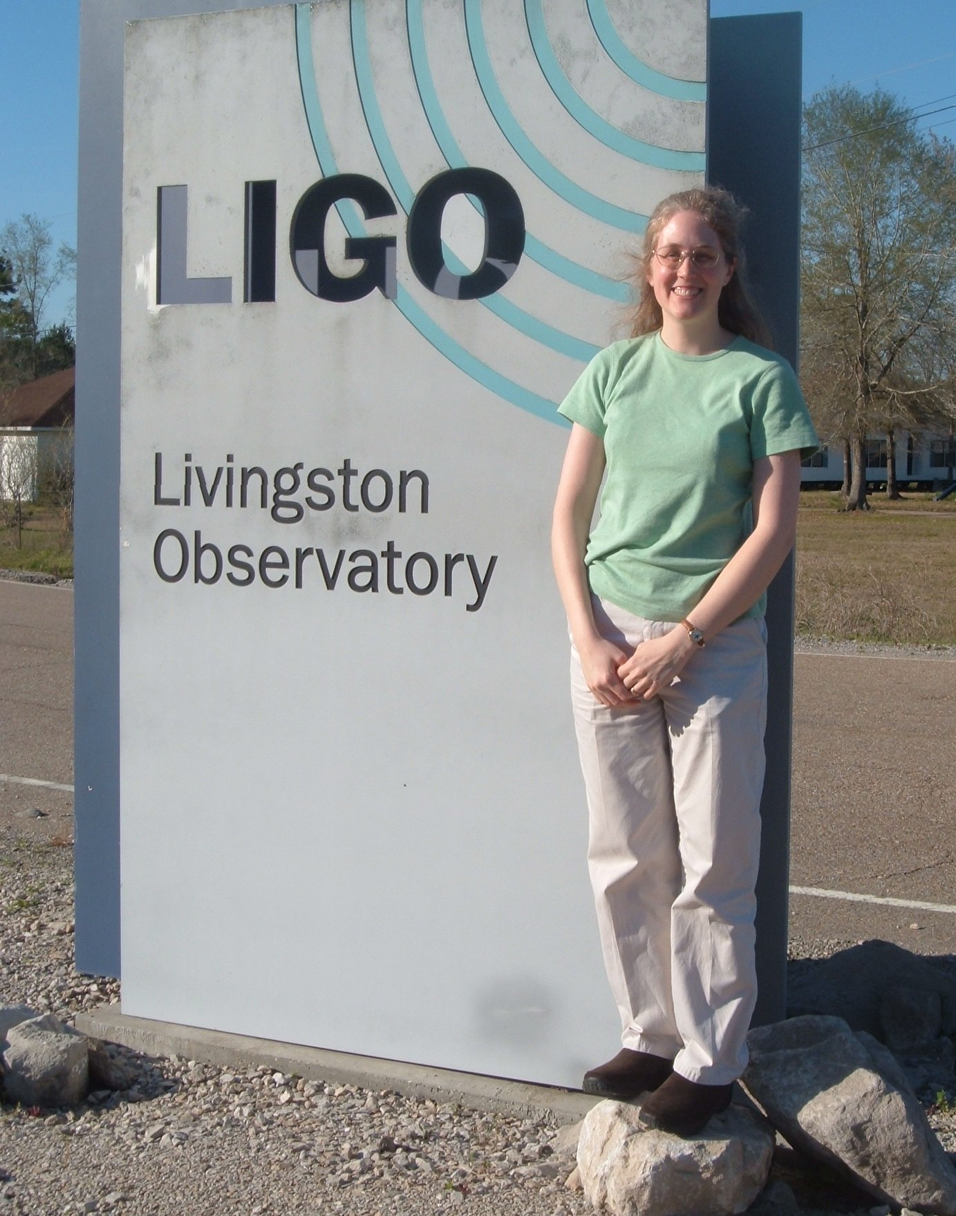
How Do We Detect Gravitational Waves?
Image Credit: LIGO Lab

Slide 9
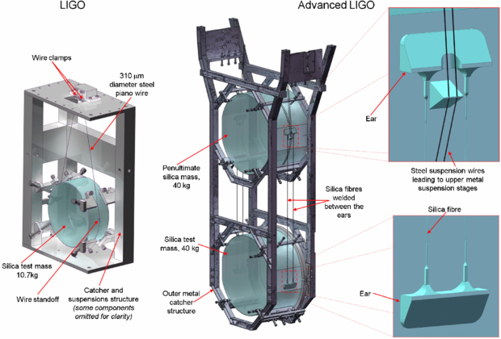
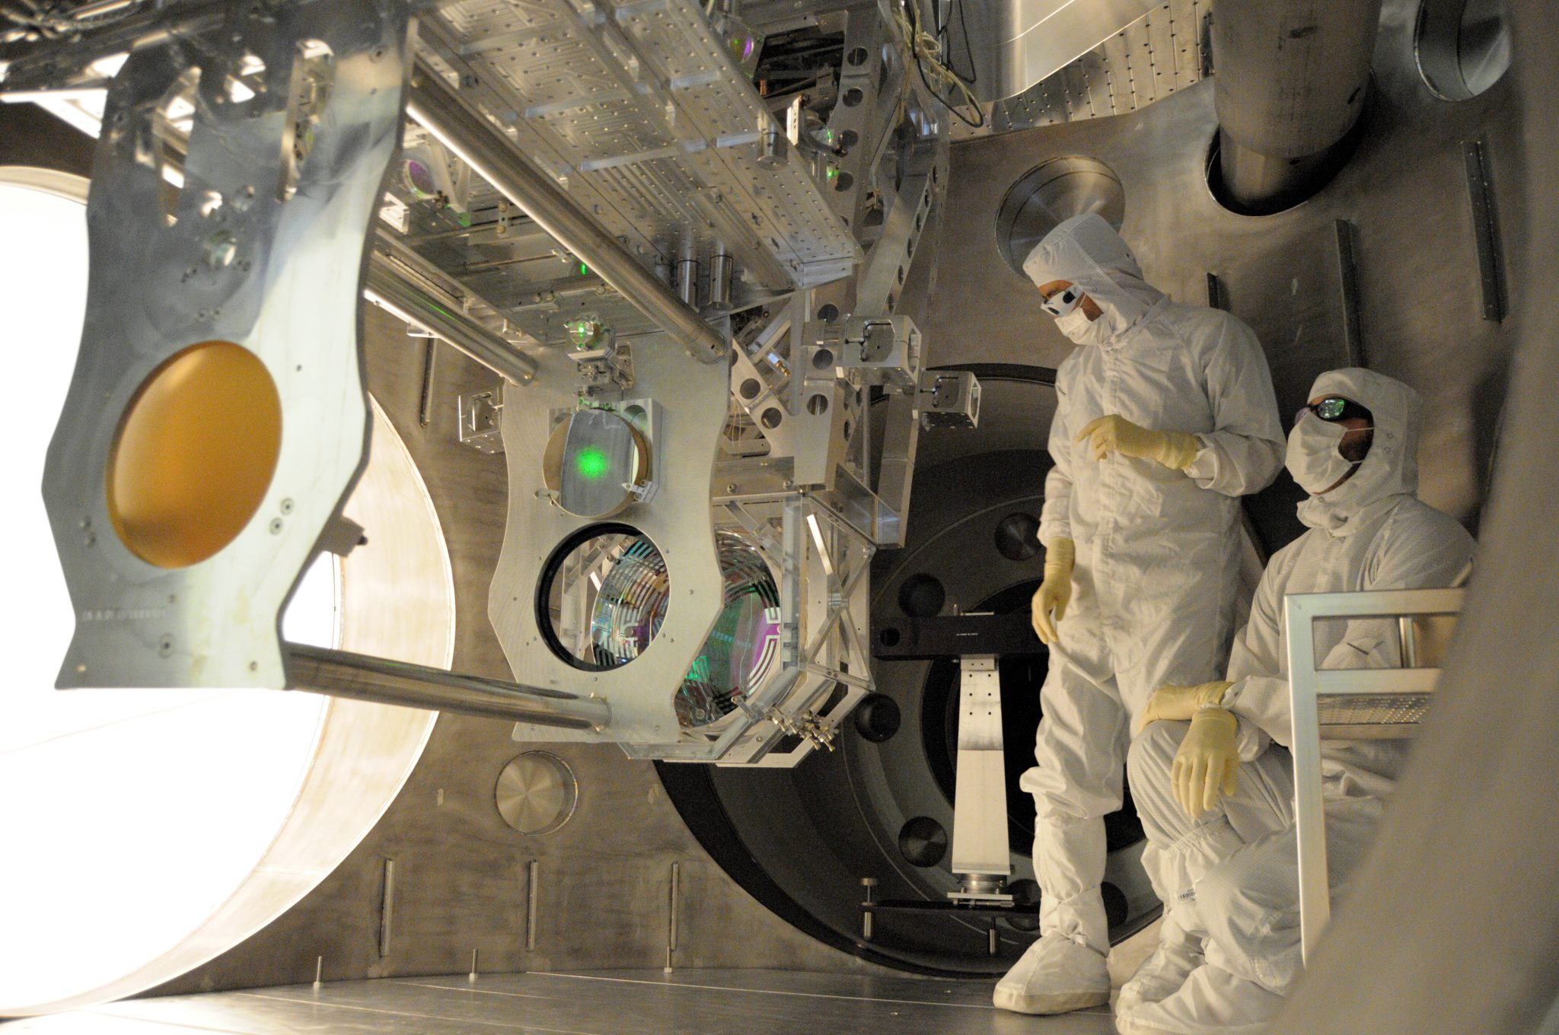
iLIGO → aLIGO
Image Credit: LIGO
Class. Quantum. Grav. 29 (2012) 035003
Initial detectors (2002 – 2010)
Upgrades
Laser 4.5 W to 125 W
Mirrors 25 cm diameter, 10.7 kg to 34 cm, 40 kg
More sophisticated suspensions

Slide 10
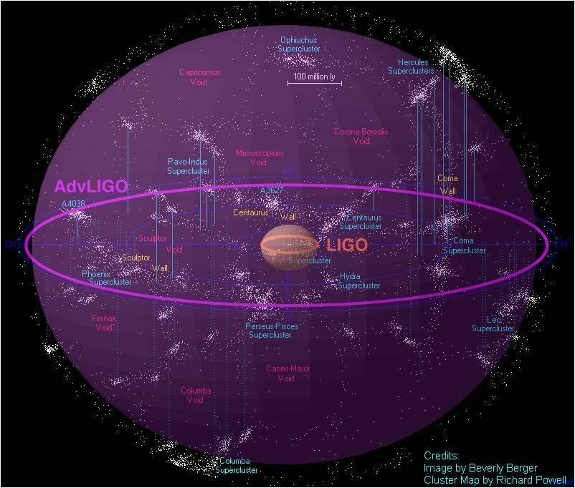
iLIGO → aLIGO

Slide 11
A Network of Gravitational Wave Detectors
Image Credit: LIGO

Slide 12
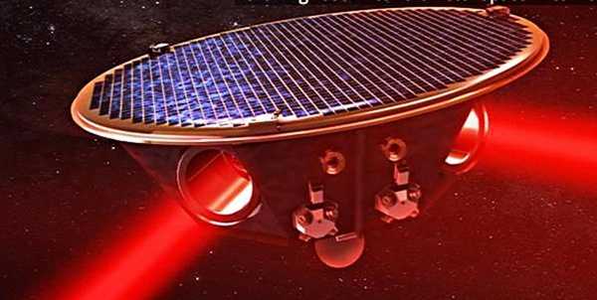
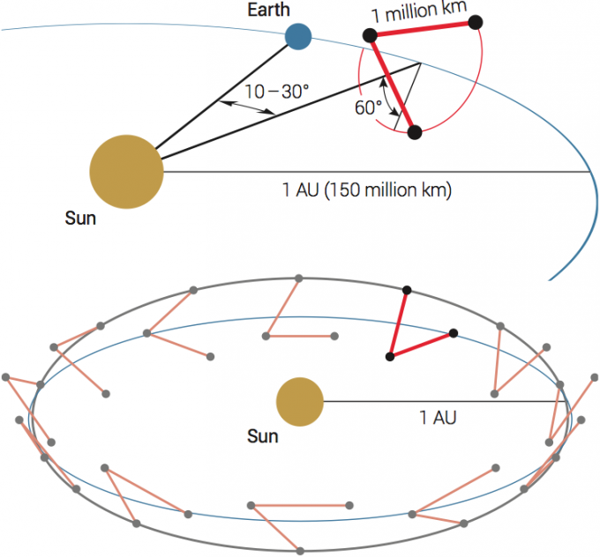
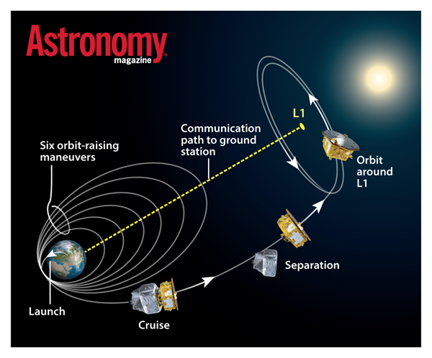
Laser Interferometer Space Antenna
Image Credit: eLISA
Image Credit: eLISA

Slide 13
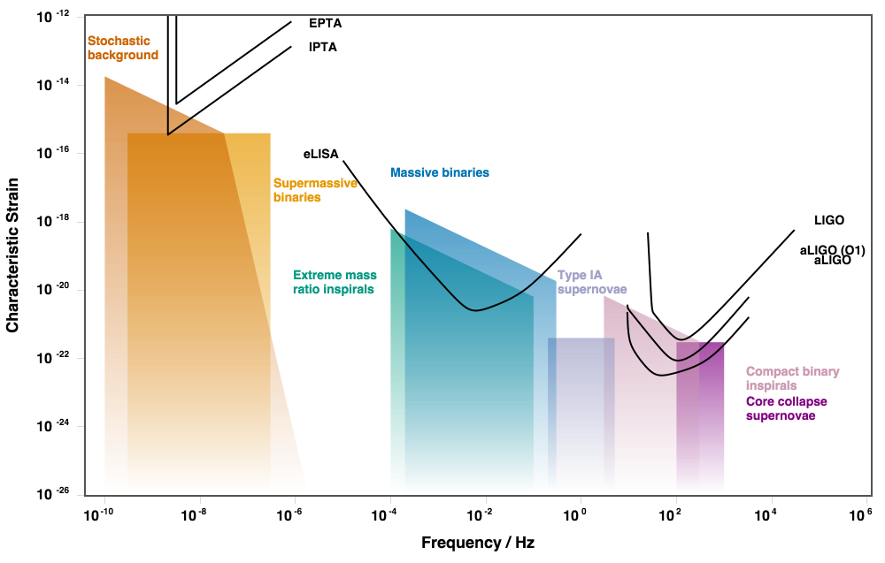
Laser Interferometer Space Antenna
Image from http://rhcole.com/apps/GWplotter

Slide 14
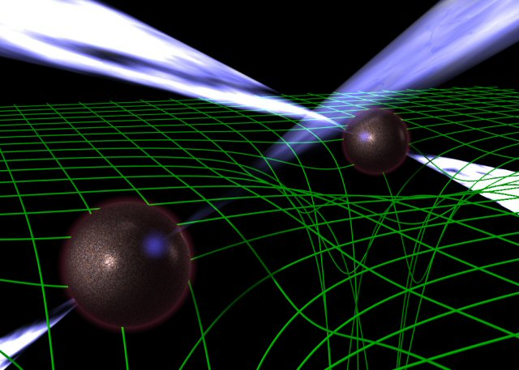
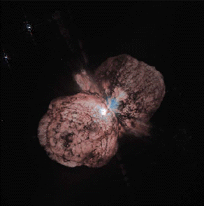
Target Sources
Binary neutron star inspirals and binary black hole inspirals
Spinning neutron stars
Bursts from supernovae etc
Stochastic background from indistinguishable sources and/or the creation of the universe
http://hubblesite.org/gallery/album/entire_collection/pr1996023a/
http://www.jb.man.ac.uk/research/pulsar/doublepulsarcd/

Slide 15
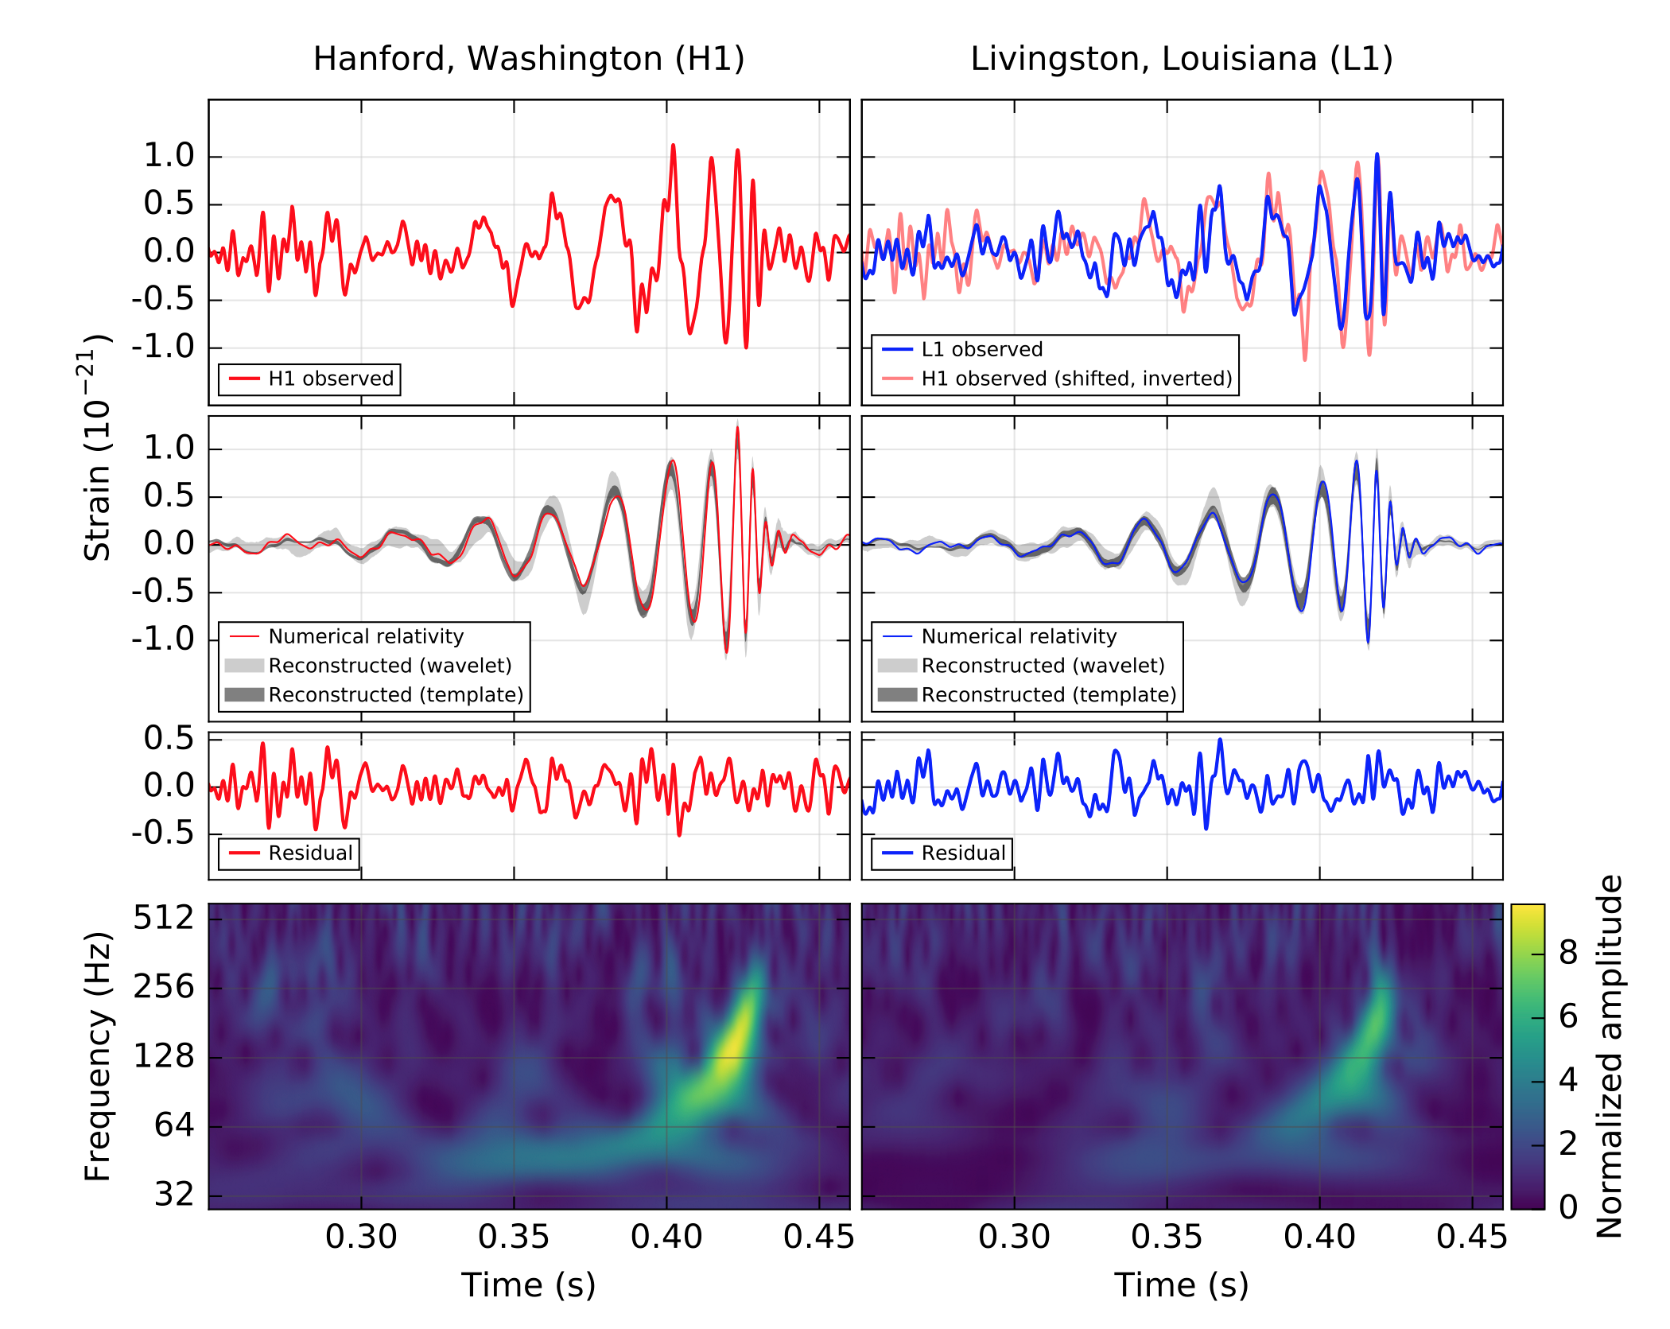
GW150914: Discovery!
Image Credit: LIGO from B.P. Abbott et al Phys. Rev. Lett. 116 (2016) 061102

Slide 16
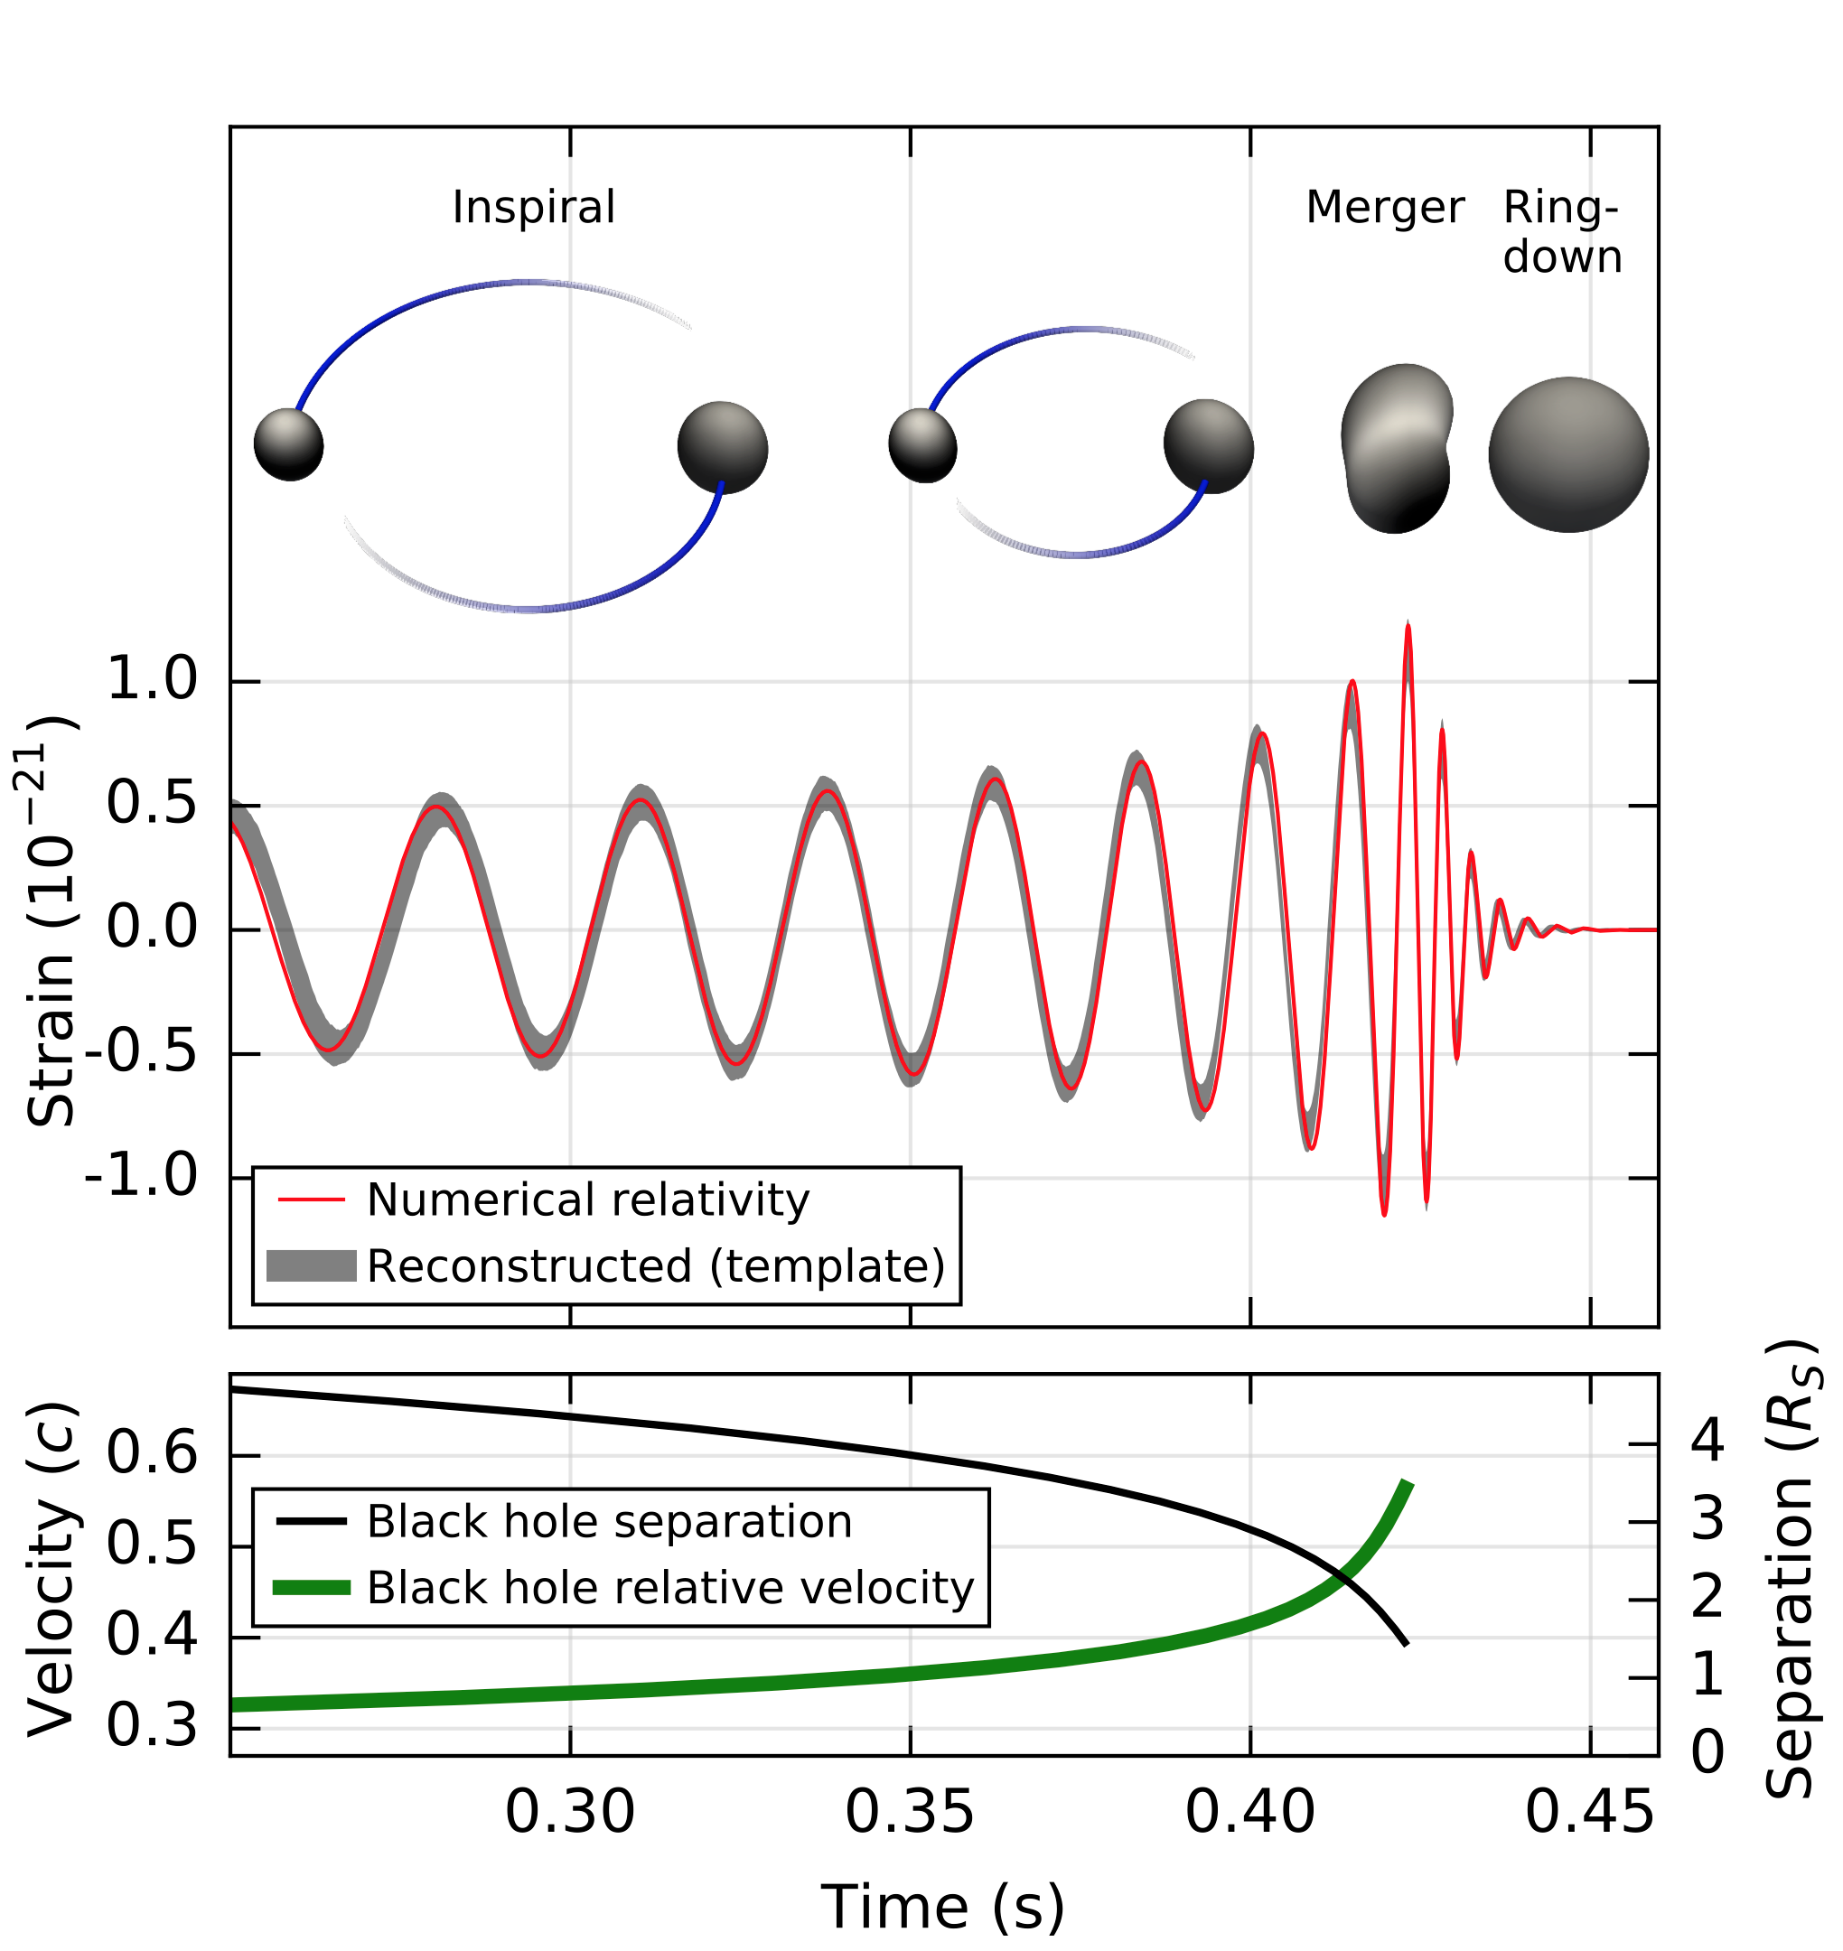
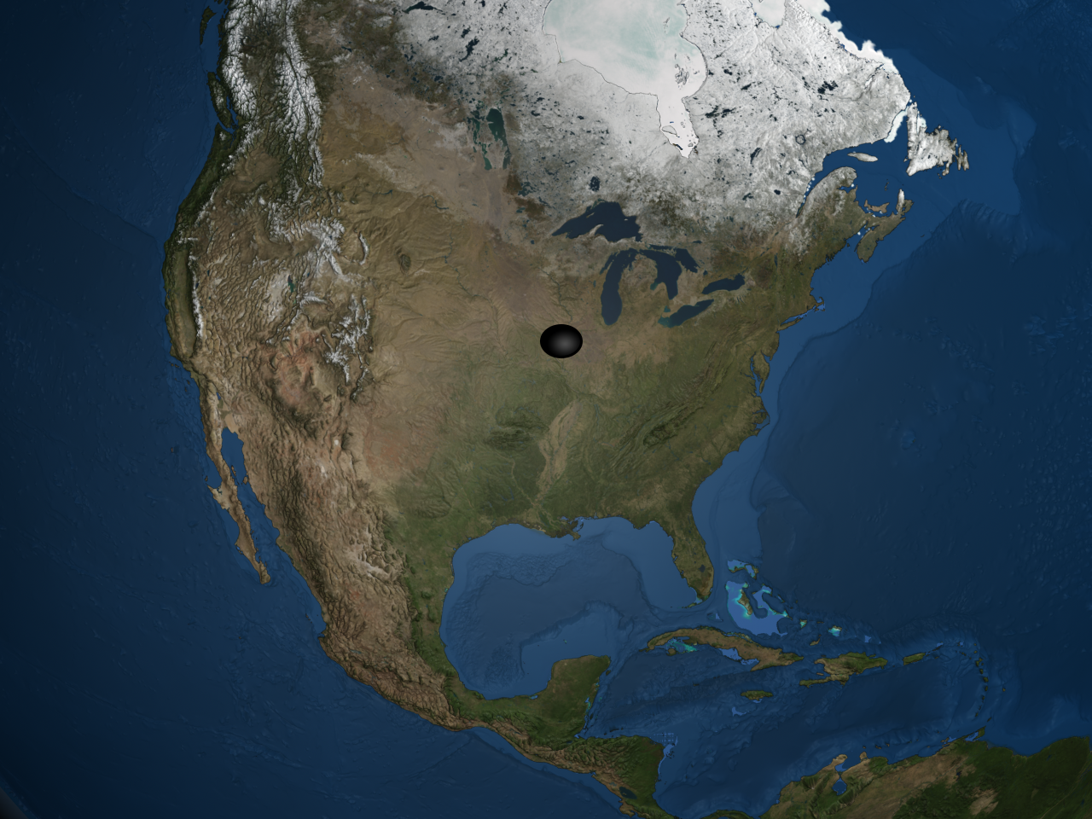
GW150914: What did LIGO See?
Binary Black Hole Inspiral
29 M + 36 M = 62 M
1.3 billion light years away
Image Credit: LIGO from B.P. Abbott et al Phys. Rev. Lett. 116 (2016) 061102

Slide 17
GW150914: What did LIGO See?
Movie Credit: LIGO

Slide 18
The Music of the Spheres
Movie Credit: LIGO

Slide 19
Encore!
Image Credit: LIGO

Slide 20
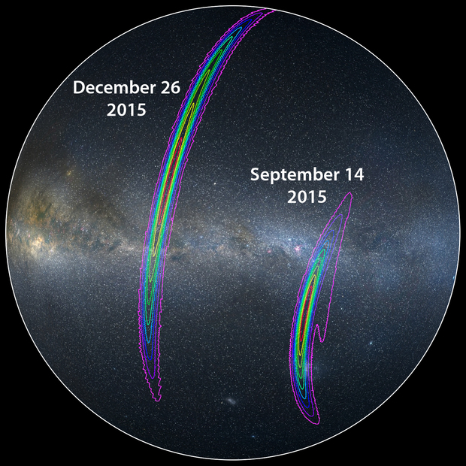
Encore!
Image Credit: LIGO/Axel Mellinger

Slide 21
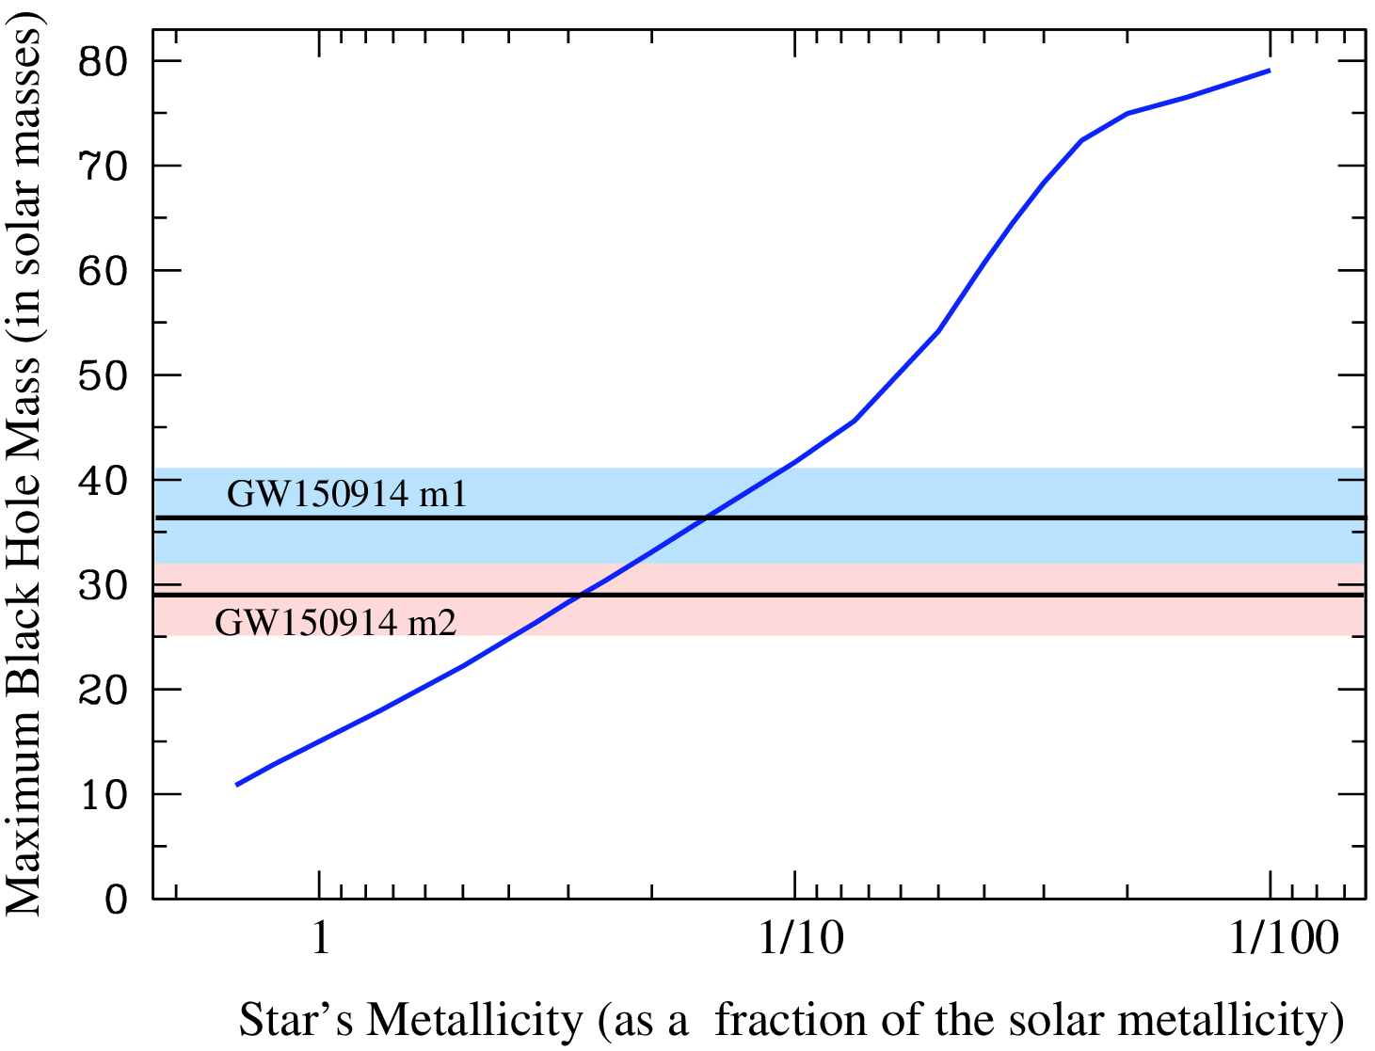
What Did We Learn?
Weak Wind
Image Credit: LIGO
Image from https://dcc.ligo.org/LIGO-P1500262

Slide 22
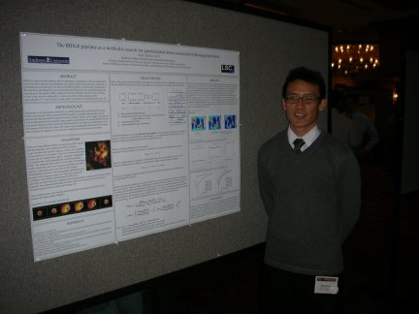
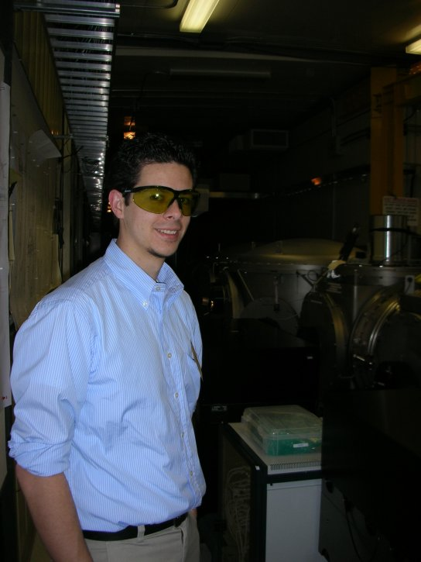
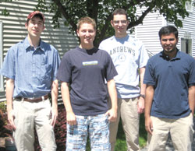
LIGO @ Andrews

Slide 23
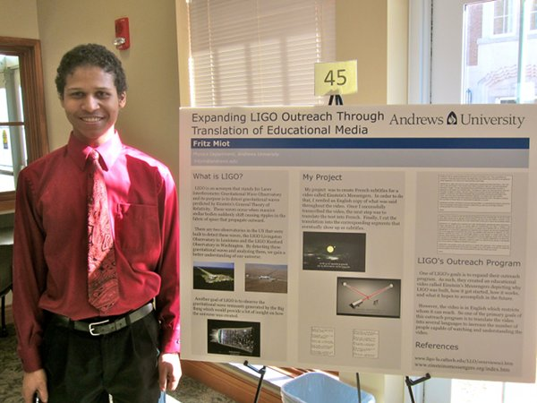
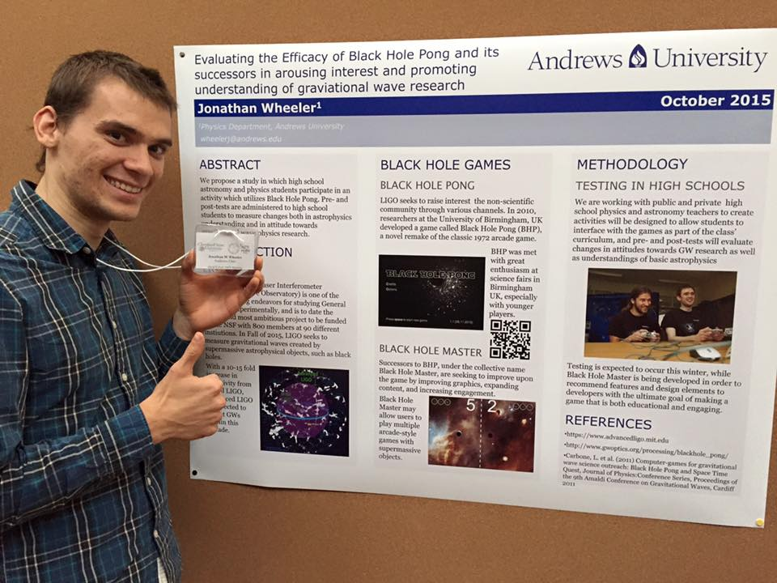
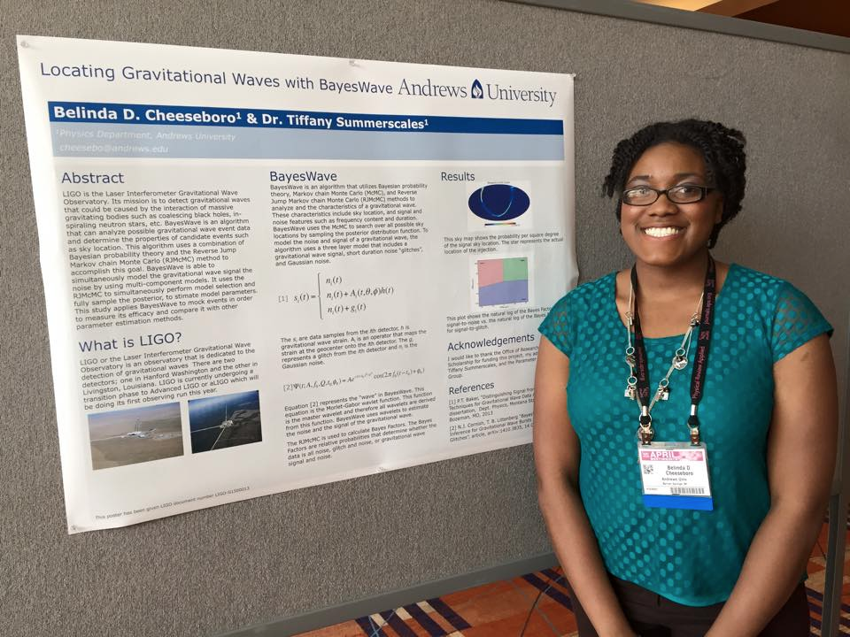
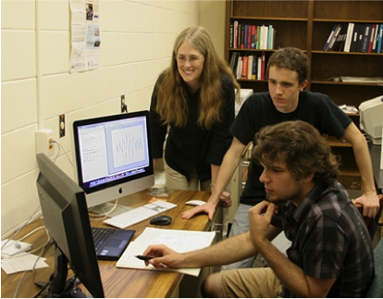
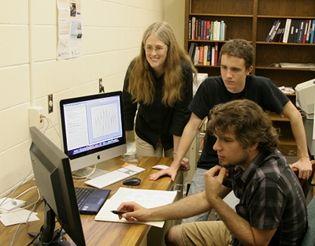
LIGO @ Andrews

Slide 24
Learn More About It!
Join the Search for Gravitational Waves
Einstein@Home http://einstein.phys.uwm.edu/
Help Improve the Detectors
Zooniverse Gravity Spy https://www.zooniverse.org/projects/zooniverse/gravity-spy/
Learn More about LIGO
LIGO website http://www.ligo.org
Einstein’s Unfinished Symphony by Marcia Bartusiak

