Slide 1
Elements in the strategy for the future of ground based gravitational wave research
R. Weiss
Dawn II Meeting
Georgia Institute of Technology
July 8. 2016

Slide 2
The elements of the program
Strong observing program
Known and predicted sources
The dark sky and unexpected sources
The known sky in new ways
The correlations with E&M and particle astronomy
Strong technical development program
Unique relation of the science to the sensitivity
Instruments operating at the limit of technology
Strong analysis program

Slide 3
An example science evolution
Black holes
Distribution of masses and spins vs z and astrophysical setting
Origins
collapse of ordinary stars
product of the first stars
dynamical formation
Primordial
Precision tests of GR
Cosmology with black holes
Cosmic metric and derivatives
H and w with different systematics
Large scale structure of the universe
Consistency of cosmological parameters

Slide 4
Possible future of ground based work
Near term 5-10 years
Operating costs: LIGO lab $40M/yr , LSC $10M/yr
New detector components in 4km facilities ~$30M -$100M
Longer term > 10 years
Refurbishment of 4km facilities ?? 25 year lifetime
New facilities allowing improved sensitivity
Longer 40km L and or buried triangle ~ $1B

Slide 5
Science politics
What disciplines are interested in the science
Astronomy: populations, evolution, specific systems, supernova, cosmology
Physics: Strong field GR tests in understandable systems, gravitation on large scales, consistency of cosmological solutions, nuclear physics: equations of state , r process heavy element formation, supernova, wave kinematics
Would gravitational wave research be a priority for either discipline? Enough for $1B?

Slide 6
Strategies
Require a reputable scientific group (not only in GW research) to establish priorities for the science.
Example: the Sessler-McDaniel panel in 1986
If astronomy: need to be part of Decadal Study in 2020 (begins in 2018)
CMB, pulsar timing and space based are in Decadal
Ground based would be competing with many large projects
Astronomy is already having trouble supporting the operations of its facilities
If Physics: no longer Decadal Studies, does not fit into HEPAP
Need a NRC panel to review the field in late 2017 or early 2018
Full spectrum: CMB, pulsar timing, space based, ground based
Both physics and astronomy representatives
Scientists (not all in our field) to evaluate the importance of our science, the technology and costs
Why a NRC panel
Need the authority of the NAS to convince congress
Useful in the approach to private donors

Slide 7
What needs to be done
Establish the charter for such a panel
Prepare the science case for successive sensitivity improvements by factors of ~3 indicating where the breakpoints are demanding new facilities
Indicate broadly the technical changes associated with increments in sensitivity
Estimate approximate costs and schedules for the sensitivity improvements

Slide 8
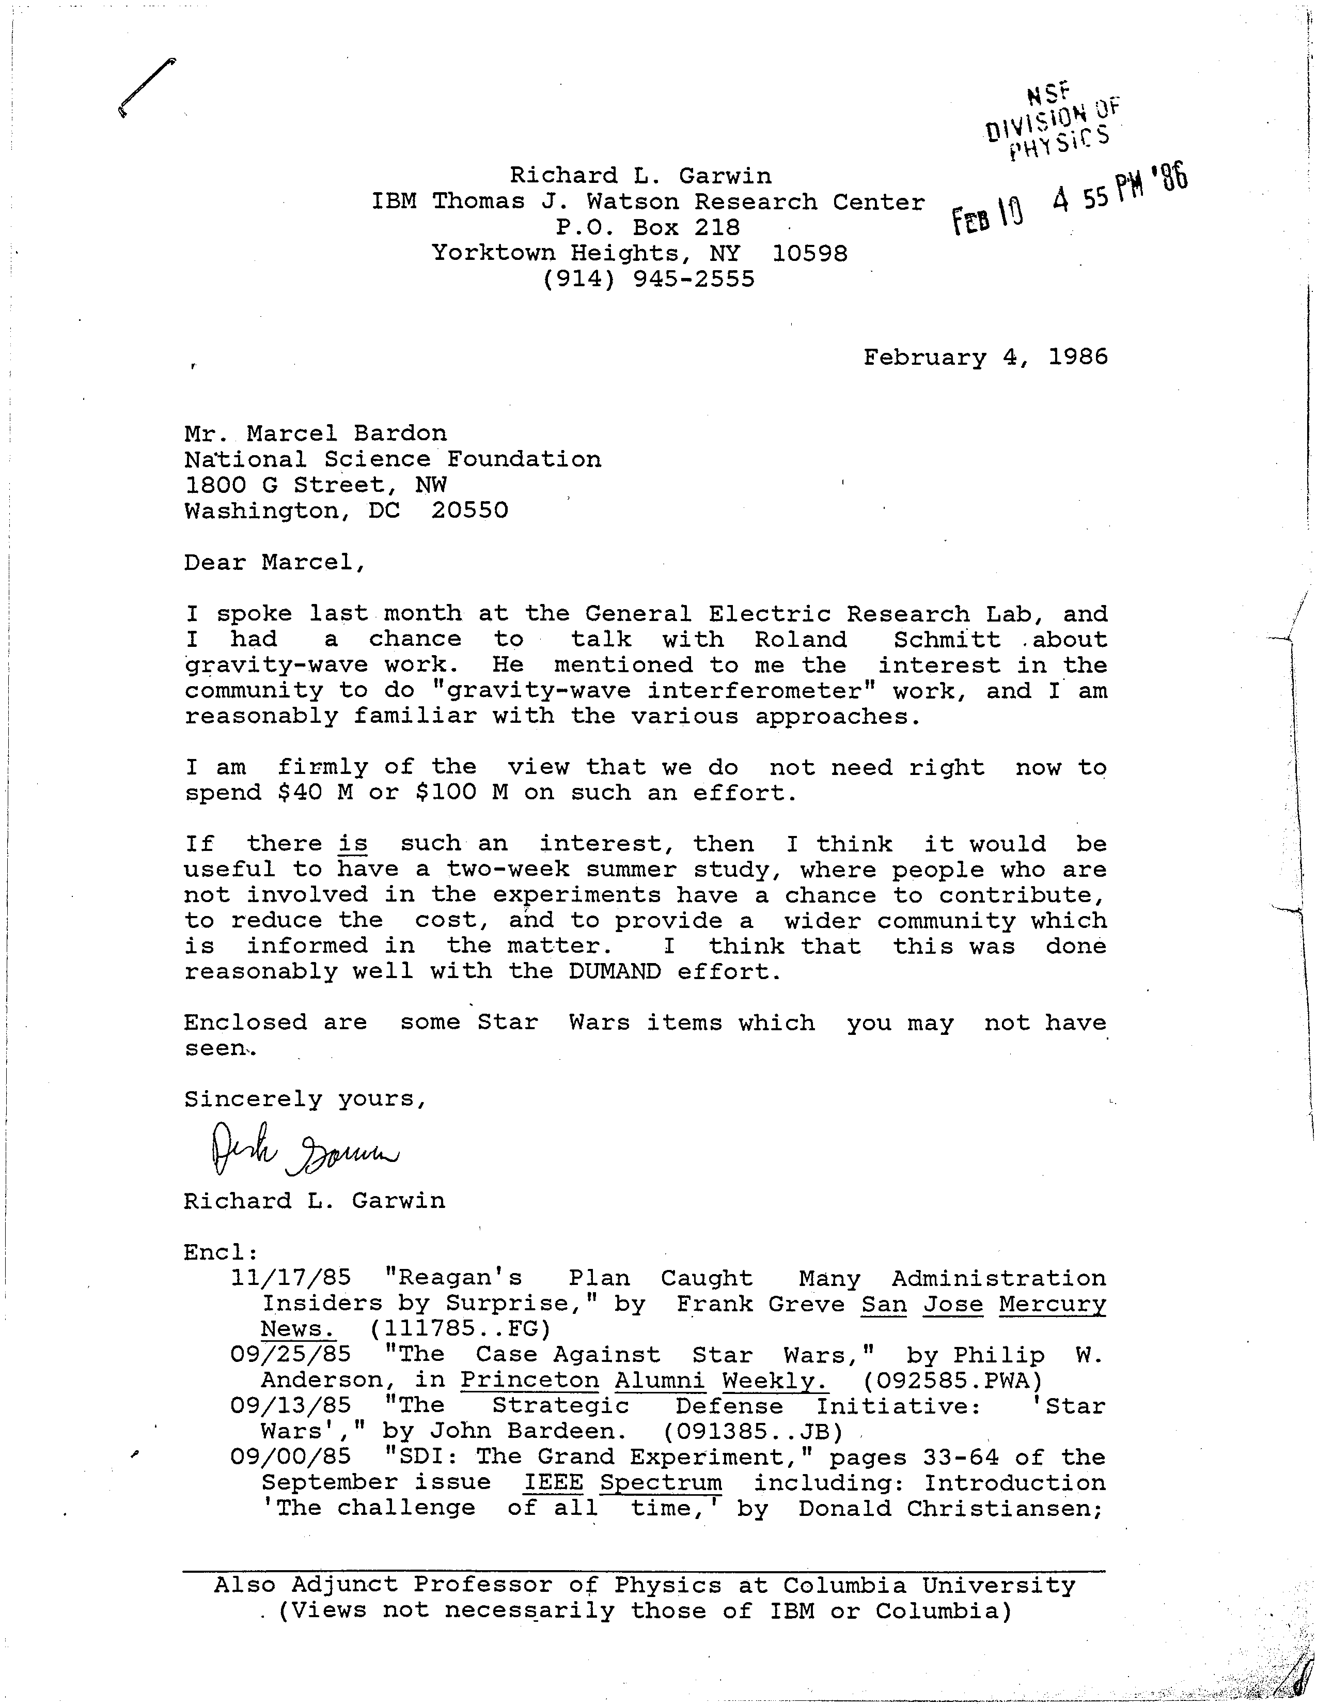

Slide 9
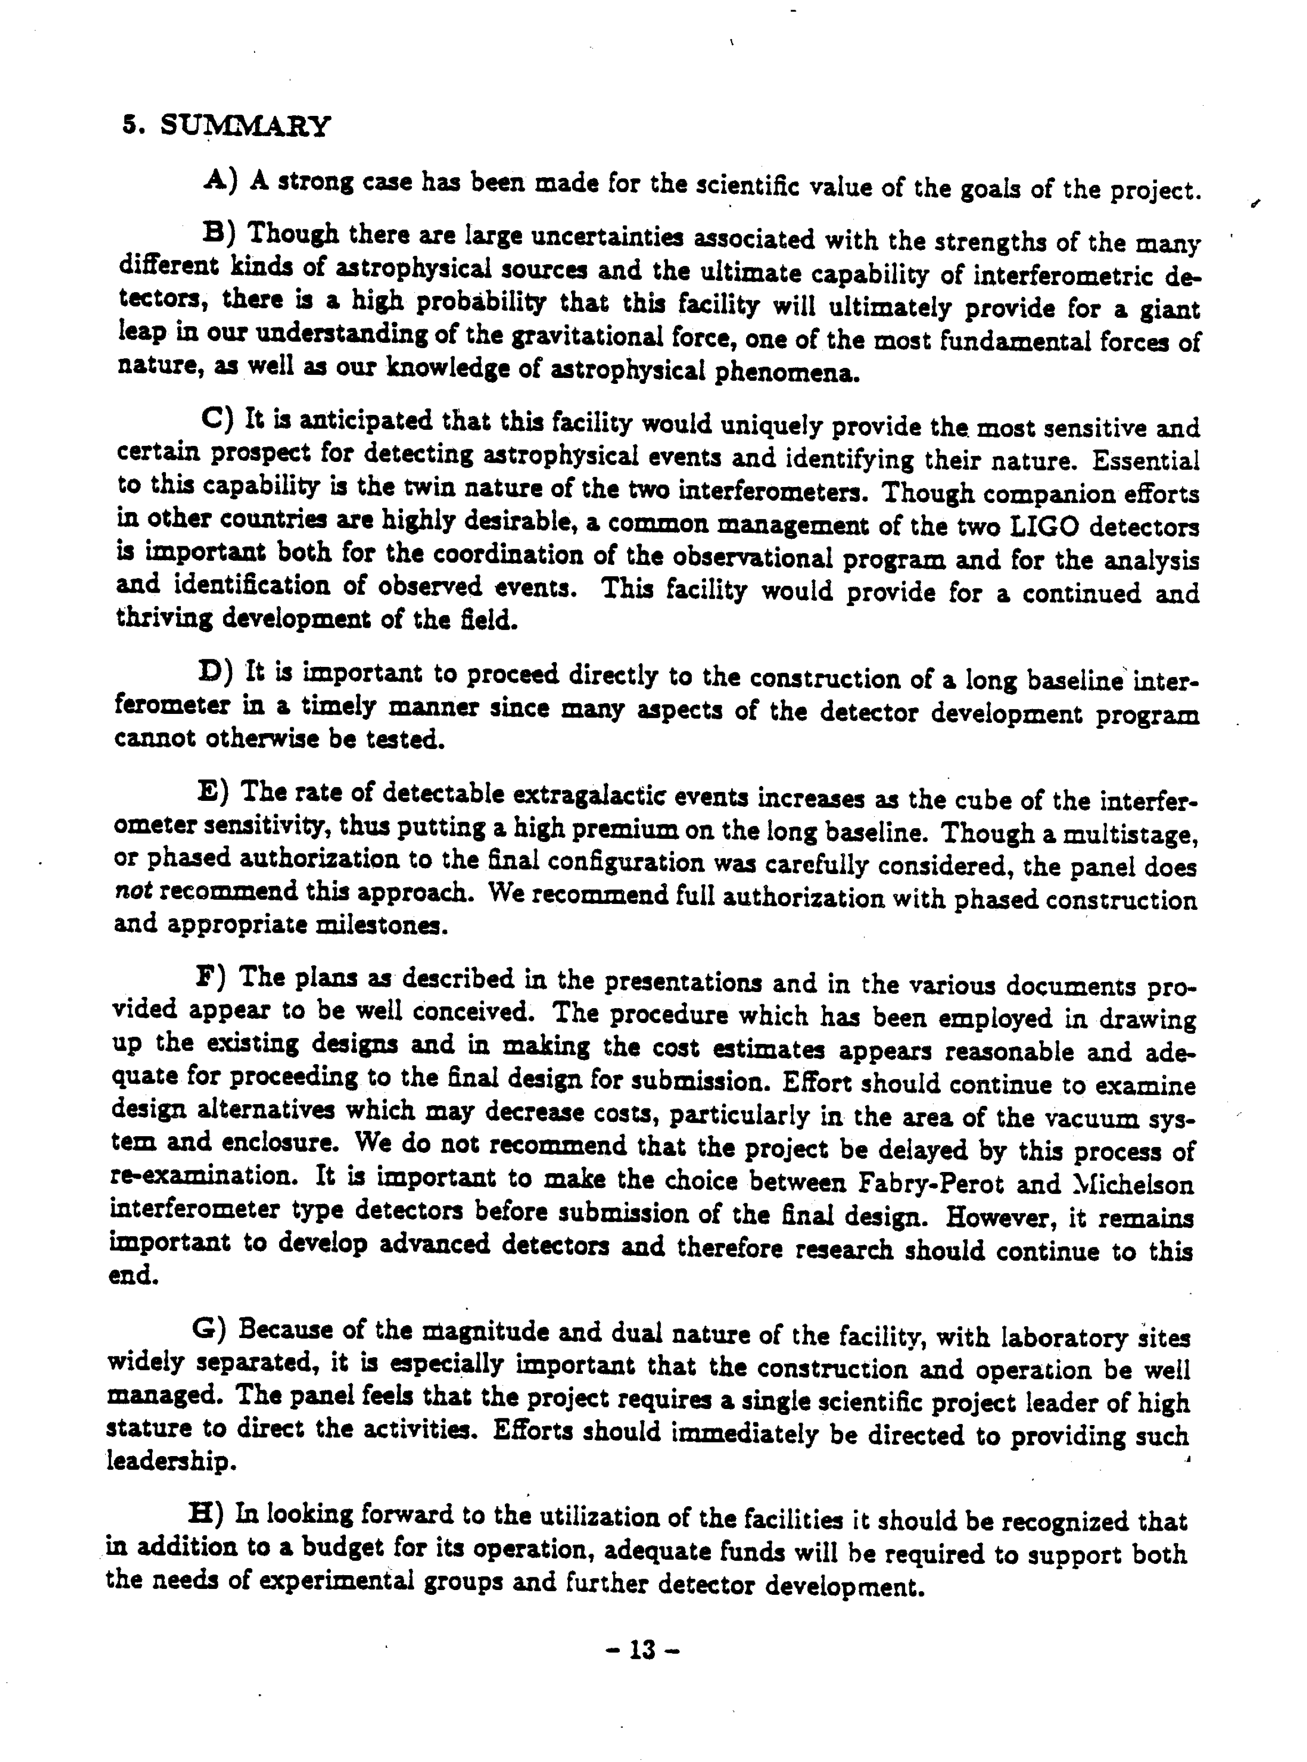
Report to the NSF
Panel on interferometric observatories for
Gravitational waves January 1987

Slide 10
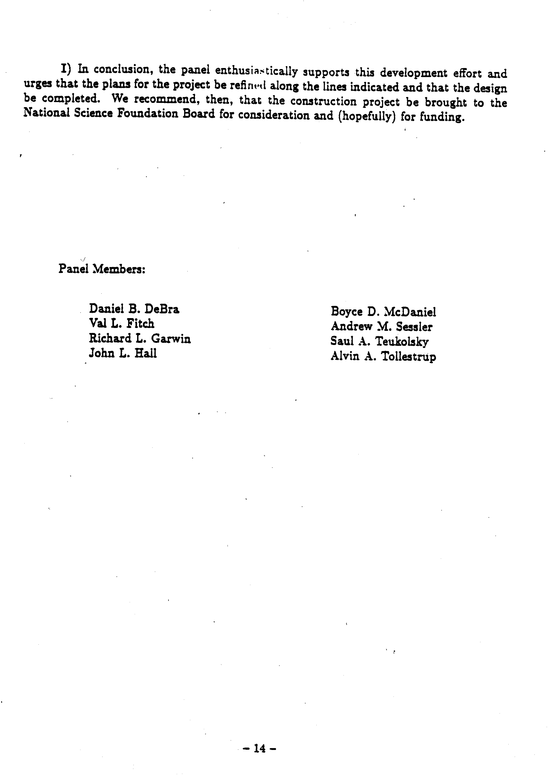
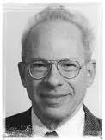
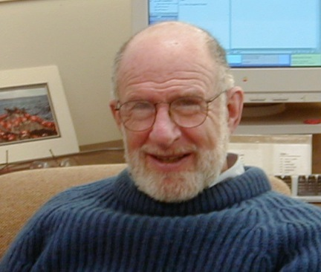
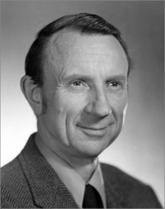
A. Sessler
B. McDaniel
R. Garwin

Slide 11
A. Sessler
B. McDaniel
R. Garwin

Slide 12
