Slide 1

Post-detection GW Astrophysics: What We Know and Don't Know About the GW Sky
(But Really Want To!)
Salvatore Vitale
MIT
DAWN workshop
Atlanta, July 7 2016

Slide 2
Post detection era
We need to plan asap for the future of ground-based GW detectors
What (astro)physical questions have we answered in O1 ?
What are the open questions?
  What questions require a significant upgrade?
  What questions require new facilities?
  How many detectors should we have online, and under which conditions?

Slide 3
What did we learn in O1 – BH masses
We measured BH masses directly
BHs can have masses much larger than what found with EM (<~ 15M)
Implications for metallicity and winds strength in the progenitors
1606.04856

Slide 4
What did we learn in O1 – BH spins
We measured BH spins directly
Spins for BBH hard to measure due to mass ratio close to 1
GW151226 had a least a BH with non-zero spin
No much can be said about spin orientation
1606.04856

Slide 5
What did we learn in O1 - general relativity
The two events allowed for the firsts tests of GR in a strong field dynamical regime
Still not a precise test. Will require more events
1606.04856

Slide 6
What did we not learn about BHs
Mass and spin distribution
Could not exclude exotic objects (instead of BHs)
Could not pinpoint to the astrophysical formation channel of the systems
Did not probe cosmological distances
Did not see effects of spin precession
Did not see EM counterpart (if any was present…)
To address these will take more time, or more detectors, or new detectors

Slide 7
Further ahead…
Cosmic history
  When did seed black holes form, how heavy were they and how did they grow?
  What is the geometry, topology and dynamics of large scale structure in the Universe?
  Did CBC produce most of the metals in the Universe?
Extreme matter
  What are the equation of state and internal structure of neutron stars?
  How fast can black holes spin and how big can they get?
  How do supernovae explode?
  How do CBC form, and are they progenitors of short GRBs?
Extreme gravity
  Can we test the no hair theorem?
  Can we probe the space-time around the horizon?
  Is general relativity correct?

Slide 8
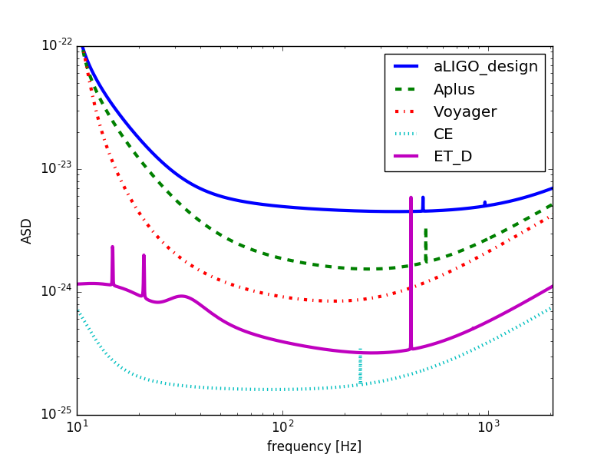
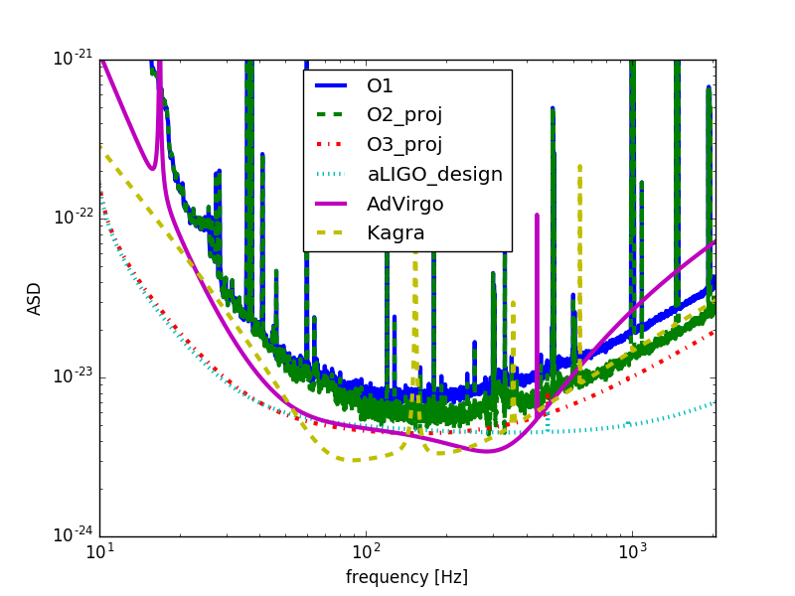
Further ahead…
A+, New facilities
2 G detectors

Slide 9
CBC formation channels
The two most likely formation patterns for CBCs are:
  Common envelope. The two objects were in a binary system from the very beginning -> aligned spins
  Dynamical capture. The two objects were born independently, then met and formed a bound system -> isotropic spins
If both channels happen, we can estimate the relative ratio
10% uncertainty with 200 events
1503.04307
Can be done starting in O2

Slide 10
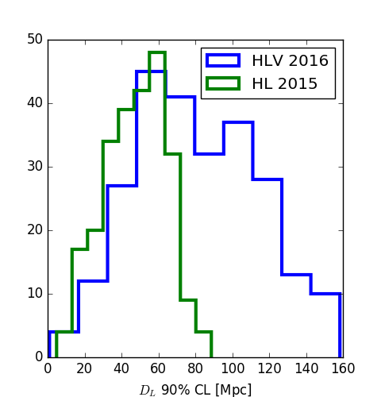

Intrinsic masses
What we measure with GW are the redshifted masses
$$m_{det}=\left(1+z\right)m_{source}$$
GWs do not provide z, but luminosity distance
In absence of EM counterpart, we need to calculate z by assuming a cosmology
Uncertainties in distance will thus propagate to source masses
Do we measure distances better with 3 detectors? No!
Data from 1404.5623
Can be done starting in O2

Slide 11
Neutron stars – equation of state
0911.3535
CBC detections can be used to measure the equation of state of neutron stars
EOS ranking could be done with second generation detectors if rate is high
  Could exclude some extreme EOS
EOS measurement will likely will happen when new facilities are online
  Large collection of quiet events
  Occasional loud events
O3 or later

Slide 12
Continuous wave sources
Spinning neutron stars can have ellipticity and emit GWs
  Their amplitude strongly depends on EOS
A detection would provide the quadrupole moment
  Ellipticity (requires EOS)
  Differential rotation in the core
Spin-down limit already beaten for a few pulsars
  Will improve in the next science runs
  Could exclude some EOS
Detection could happen any time from O2 on, depending on EOS (note: O1 analysis not yet concluded!)
O2 or later

Slide 13
Core-collapse supernovae
Huge potential impact on nuclear physics and astrophysics
  Explosion mechanism
GW rate and waveform very uncertain
In many models, only galactic SNe would be detectable by 2G
  Rate of ~1/century
Third generation detectors could bring this up to ~few/year
Until new facilities are online, it really boils down to luck…
O2 or later
1511.02836

Slide 14
Stochastic background
The stochastic background made of all unresolvable BBH could be detectable already with 2G detectors
Study of the stochastic signal can potentially help assessing metallicity, delay time and start formation rate of underlying population
  Requires new facilities
Background from inflation is a more ambitious goa
O4 for detection
A+ or new facilities for science
1602.03847

Slide 15
Summary
Note: some of the searches in O1 data are not finished yet!
 | BNS | NSBH | BBH
Detection | >= O2 | >= O2 | 😀
Rates | >= O3 | >= O3 | >= O2
Mass distribution | >= O3 | >= O3 | Decent in O2
Spin distribution | >= O3 | >= O3 | >= O2
Formation channels | >= O3 | >= O3 | >= O2
EOS | > O3, A+, NF | > O3, A+, NF | ??
EM connection | > O3 | > O3 | O2 w/ Virgo?
Detection at z>1 | NF | NF | O3
Tests of GR | >=O2 | >=O2 | 😅
 | CC SNe | Other bursts
Detection | O2 - NF | O2- NF
Mechanism | From 1st detection | ??
Mass→ GW efficiency | From 1st detection | ??
 | BBH bgd | Primordial bgd
Detection | O4, A+, NF | >>> NF
Population studies | A+, NF | Not Relevant
 | Targeted CW | Blind CW
Detection | O2 – NF | O2 – NF
Ellipticity/EOS | From 1st detection | From 1st detection
Population studies | Not relevant | A+, NF
NF= new facilities (CE, ET)

Slide 16
Acknowledge very useful discussions with B. Sathyaprakash, S. Fairhurst, R. Adhikari, M. Evans, D. Sigg, M. Zucker, C. Palomba, M. Zanolin, Y. Chen

