Slide 1
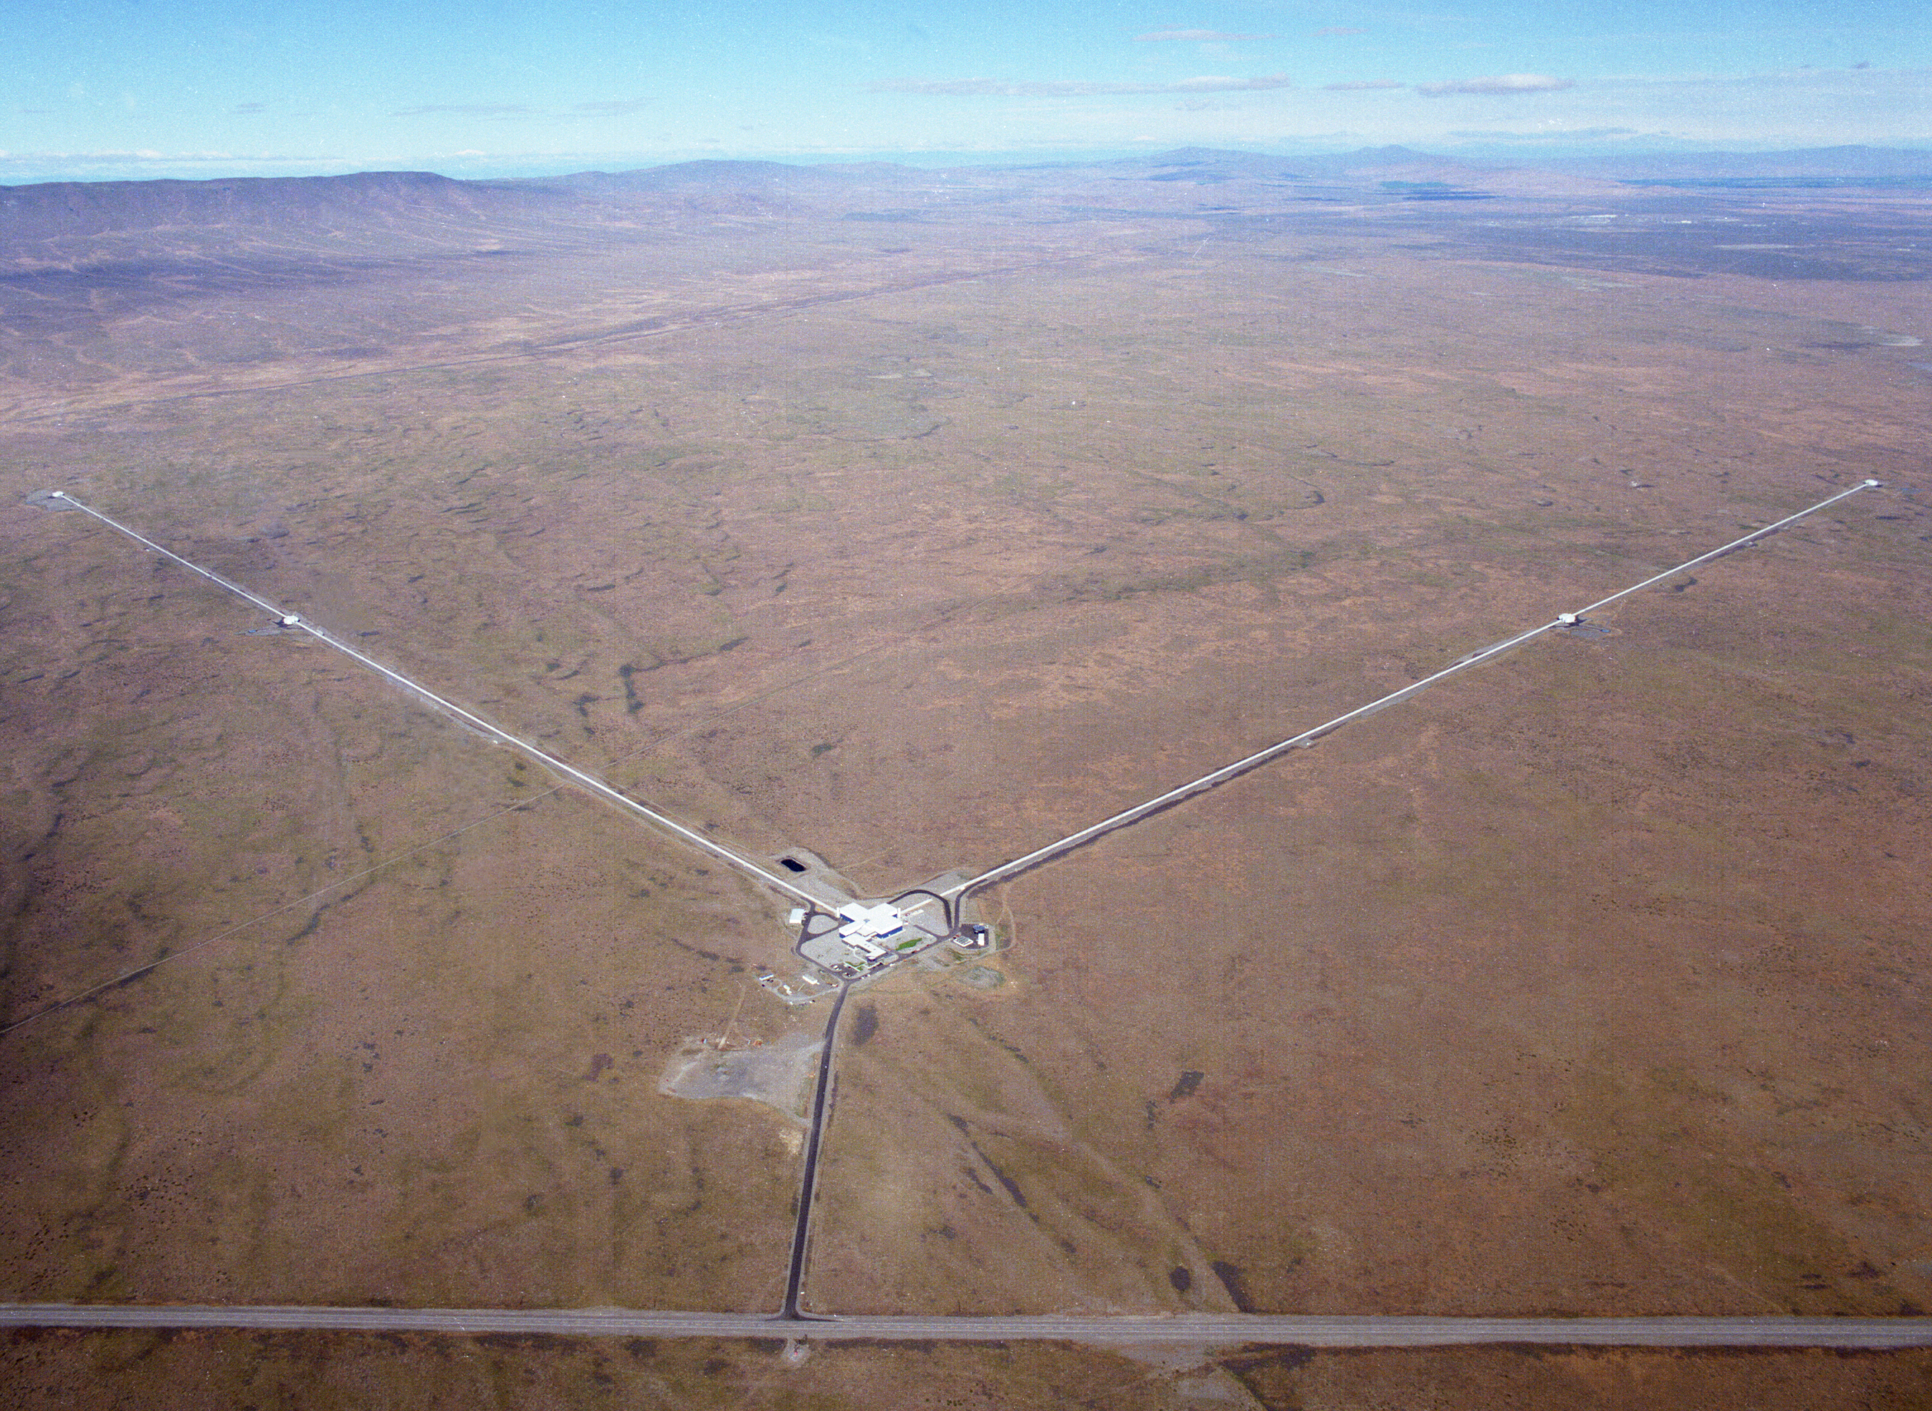
The Birth of Gravitational-Wave Astronomy
Fred Raab, for the LIGO Laboratory and the LIGO Scientific Collaboration
13-Jul-16

Slide 2
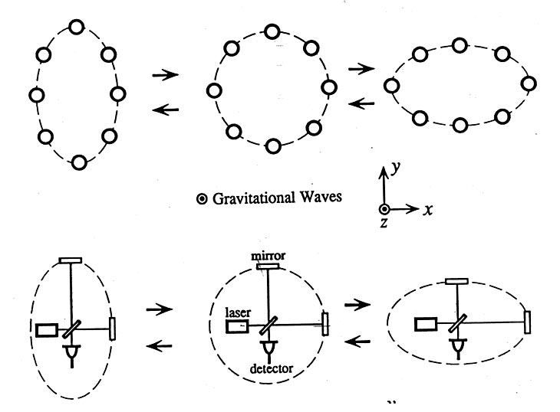
Basic idea is simple
GW amplitude h = (R_{x}-R_{y})/R
Spatial asymmetry induces relative phase shifts on light in arms

Slide 3
Noise cartoon
R. Adhikari

Slide 4
Discovery Timeline – Advanced LIGO’s 1st Observations
Courtesy Caltech/MIT/LIGO Laboratory

Slide 5
Known Stellar-Mass Black Holes – June 2016
Courtesy Caltech/MIT/LIGO Laboratory

Slide 6
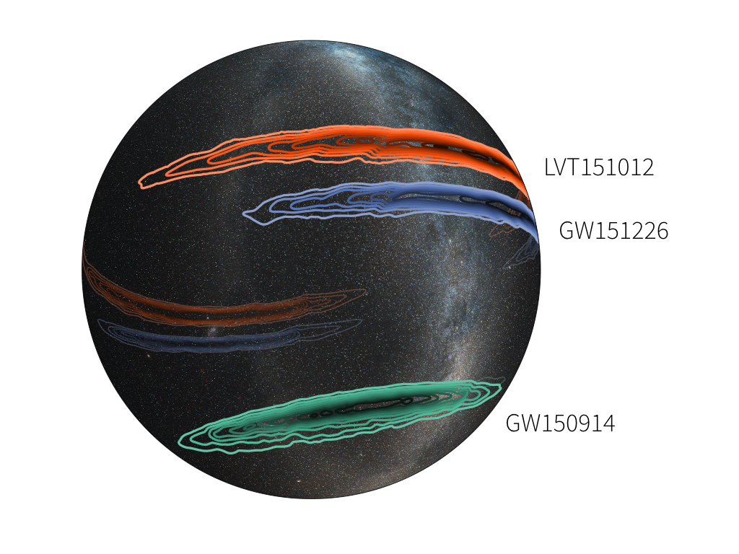
Sky Localization Is Poor With Only Two Detectors
Image credit: LIGO (Leo Singer) /Milky Way image (Axel Mellinger)

Slide 7
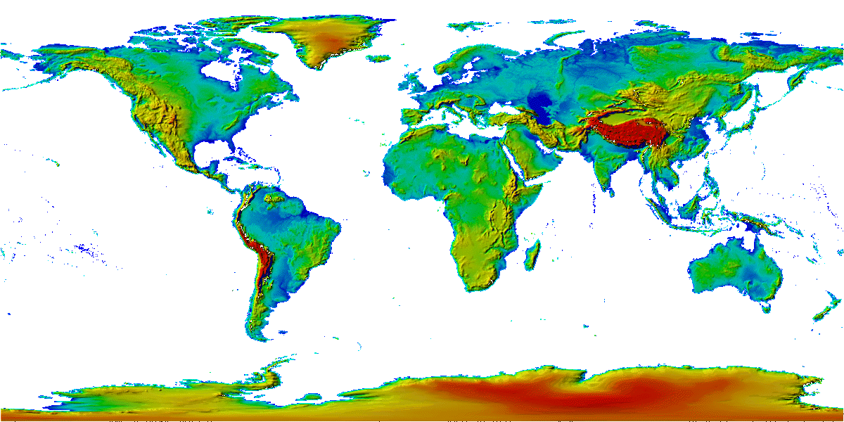
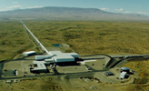
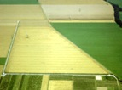
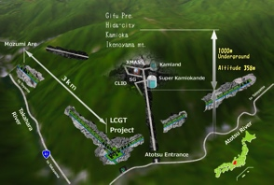
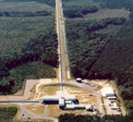
The advanced GW detector network:
2015-2025
Advanced LIGO
Hanford
2015
GEO600 (HF)
2011
KAGRA
2018?
Advanced LIGO
Livingston
2015
Advanced
Virgo
2016
LIGO-India
2024
7
7

Slide 8
Initial S6 / Advanced O1 Design / A+ Upgrade
~3 x the sensitivity made the difference
And we can go beyond
~3 x to go!

Slide 9
Credit: NASA

Slide 10
Summary
1st observing run of LIGO’s 2nd-generation detectors have initiated Gravitational-Wave Astronomy.
General Relativity provides a powerful framework from Earth-bound physics to mergers of stellar mass black holes at velocities near the speed of light.
Black Hole Binaries exist and merge hourly somewhere in the universe
An emerging international network of detectors soon will provide more accurate positions of sources to enable EM follow-ups of GW events.
There is still room within the laws of physics to develop more powerful generations of detectors and much physics still to be harvested from their observations.

