Slide 1
Reaching the Advanced LIGO Detector Design Sensitivity
July 7, 2016
Daniel Sigg
LIGO Hanford Observatory

Slide 2
Plan
Interleave commissioning with observation runs
  Shorter runs at the beginning
Work in stages
  O1: ~3 months, we could get lucky
  O2: ~6 months run at ~100 Mpc
  O3: long run at ~150 Mpc
Commissioning:
  After O1: Increase power to 50W+
  After O2: Increase power to 100W+ (or squeezing)
were

Slide 3
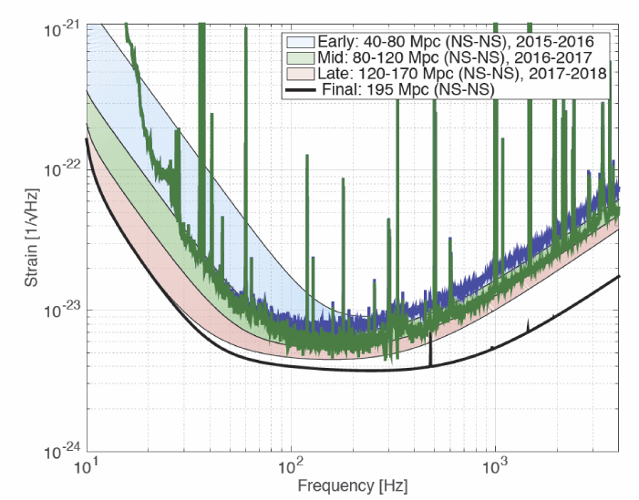
Sensitivity Goals for Early Runs
O1
O2 projection with 50 W laser power

Slide 4
Major Challenges
Understand and suppress low frequency noise
  Alignment noise
  Auxiliary degrees-of-freedom
  Unknown noise sources and unknown coupling mechanism
Increase power from ~25W (O1) to ~150W
  Thermal lensing and thermal compensation
  Control alignment instabilities w/o degrading noise
  Control parametric instabilities

Slide 5
In Detail:
Post O1 Commissioning
Double the laser power: 25 W → 50 W
  Requires activating High Power Oscillator stage
  Currently at 40W at LHO
  LLO: Plagued by laser problems
Diagnose and reduce low-frequency noise
Diagnose and reduce other instrumental artifacts
  transient noises and spectral lines observed in O1
Improve uptime
  Work on robustness & stability

Slide 6
Timeline between O1 & O2

Slide 7
L1: In-vacuum work for O2
Sensitivity
  Faraday isolator, high QE photodetectors
  Passive dampers for HAM seismic isolator components
  Stray light baffles
Laser Power Increase
  Thermal compensation in signal recycling cavity
Robustness
  Passive tuned dampers for test mass suspension modes

Slide 8
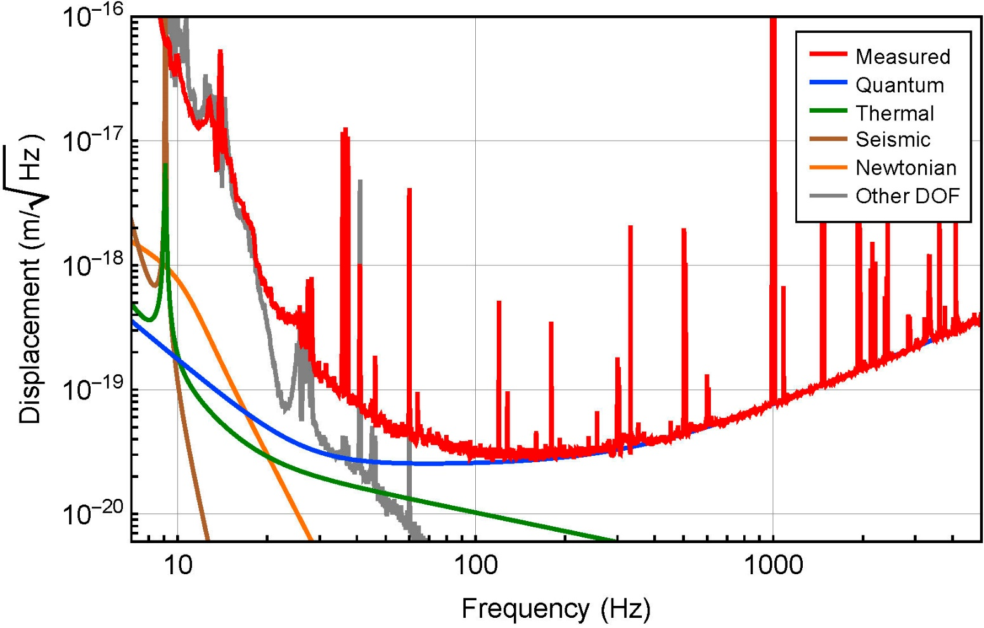
Low Frequency Noise
Some of it is explained
Mystery noise(s)

Slide 9
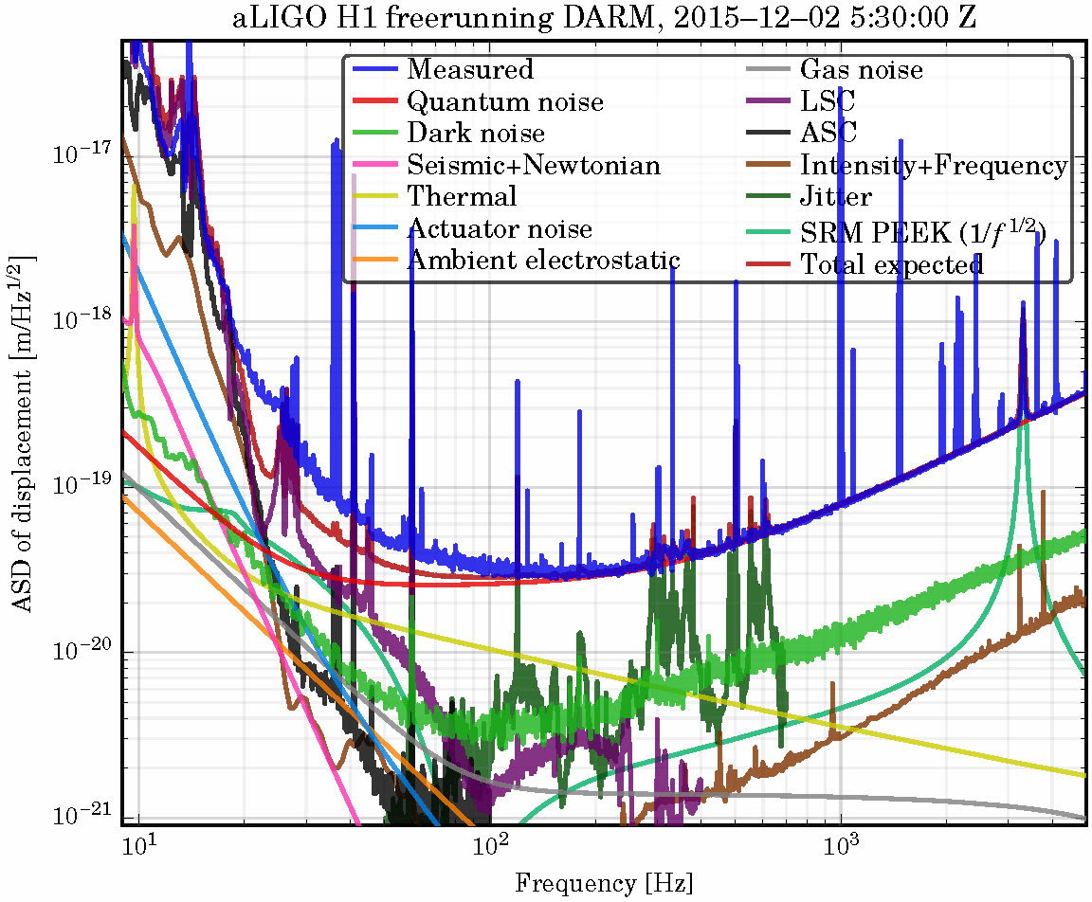
Updated Noise Budget

Slide 10
In Detail:
Post O2 Commissioning
Replace end test masses and end reaction masses
  Fix 532nm coating error → should help with robust locking
  Fix phase ripple that scatters light
  Reduce squeezed film damping with new annular ERM
Replace Compensation Plate on H1 (a la L1)
Test mass Suspension mode dampers for H1
  Dampers for triple suspensions in development
Uptime → Robustness
  Improve wind mitigation at LHO (tilt sensors, wind fences)
Acoustic mode dampers for test masses
  3rd technique for Parametric Instability mitigation; still in development

Slide 11
Squeezed Light Injection:
Post O2/O3
Squeezed light source with in-vac OPO currently in development
  Provide 3-5 dB of quantum noise reduction at high frequencies & corresponding increase in radiation pressure noise
  Planning to make this an option for post-O2
Addition of filter cavity would limit the low-frequency noise increase
  Short filter cavity: ‘do no harm’
  In development for testing at MIT-LASTI
  Planning this as a post-O3 option

Slide 12
Summary
Sensitivity of initial detectors was surpassed quickly
Successful O1 run and first GW detection
  There is now more incentive to run
Explanation for low frequency noise is elusive
High power operations hampered by laser problems
Improvements in seismic
  High wind & high µseis problem at LHO: tilt meters were installed
Major vent at LLO: fix Faraday, ITM comp, BS baffle, etc.
Ready for O2 in September of this year

Slide 13
Mystery Low Frequency Noise (1)
What’s known:
  Possible explanation at lower end, but not at 80 Hz
  Similar level between H1 and L1
  L1 shows additional bumps (maybe due to scattering)
  Relatively stationary
  To reach above 100Mpc NS inspiral range we need both
    Reduce this noise and
    Higher laser power to reduce shot noise
Unknown:
  What causes it
  Single or multiple sources
  Exact spectral shape (not enough exposed, but not flat)

Slide 14
Mystery Low Frequency Noise (2)
It ain’t:
  ETM/ITM coating thermal or SUS thermal
  Just scattering (too stationary)
  Suspension drive electronics
  Electric charge
  Sensing noise
  Laser noise (frequency, intensity, RFAM)
  Beam jitter
  Angular control noise
  Up-conversion
  Beamsplitter motion
  OMC related
  PEM related such as acoustic, seismic, magnetic, …

Slide 15
Mystery Low Frequency Noise (3)
Still out there:
  Scattering (not completely ruled out)
  Squeezed film damping
  Mechanical interference
  Anything in the SRC such as ITM/BS AR coatings

