Slide 1
Getting an A+ :
Enhancing Advanced LIGO
LIGO-DAWN Workshop II
Georgia Tech
7 July, 2016
M. E. Zucker
LIGO Laboratory

Slide 2
Topics for today
Context and motivation
Our target
What will it look like ?
How long will it take ?
How much it will cost ?
Summary

Slide 3
Set the stage: Where we expect to be
O2 and O3 will yield many BBH detections by late 2018
  BNS and other important astrophysical targets may remain elusive, or too rare for full exploitation
L1 and H1 should reach design sensitivity by mid-2019
  At this point, observational horizons freeze at limits set by aLIGO technology
“Next-generation” detectors optimistically ready no earlier than end of next decade
  And only with immediate funding commitments

Slide 4
aLIGO operating at full power
Laser Power: 125.00 Watt
SRM Detuning: 0.00 degree
SRM transmission: 0.3500
ITM transmission: 0.0140
PRM transmission: 0.0300
Finesse: 446.41
Power Recycling Factor: 40.54
Arm power: 710.81 kW
Power on beam splitter: 5.07 kW
Thermal load on ITM: 0.385 W
Thermal load on BS: 0.051 W
BNS range: 191.04 Mpc (comoving)
BNS horizon: 436.32 Mpc (comoving)
BNS reach: 272.08 Mpc (comoving)
BBH range: 1.37 Gpc (comoving, z = 0.3)
BBH horizon: 3.24 Gpc (comoving, z = 0.9)
BBH reach: 2.12 Gpc (comoving, z = 0.5)
Stochastic Omega: 2.42e-09

Slide 5
What can we do?
aLIGO design is limited by quantum noise at high and at low frequencies
Mid-band (the “bucket”) limited by Brownian thermal noise in mirror coatings
We’ve learned a lot on both fronts since aLIGO designs were frozen
We’ve also learned much about the detectors by commissioning and operating them
We now have a lot of capable, well-proven technology in our toolkit
These afford a realistic prospect to improve aLIGO sensitivity at all frequencies*
*LIGO-P1400164

Slide 6
Concept Roadmap
(adapted from G1401081)
Ultimate (ET, CX)
New Facility
Si, Cryo, 2 µm
Voyager – Current Facility
Coatings, squeezing
A+
Advanced LIGO
Color Code:
Simulation
Installation
Experiment
Commissioning
you are here
Design
Data
time

Slide 7
A+
An incremental upgrade to aLIGO that leverages existing technology and infrastructure, with minimal new investment and moderate risk
Target: factor of 1.7* increase in range over aLIGO
About a factor of 5 greater event rate
Stepping stone to future 3G detector technologies
Link to future GW astrophysics and cosmology
Could be observing within < 6.5 years (mid-2022)
  with prompt funding (FY’19 or earlier)
“Scientific breakeven” within 1/2 year of operation
Incremental cost: a small fraction of aLIGO
*BBH 20/20 M: 1.64x
*BNS 1.4/1.4 M: 1.85x

Slide 8
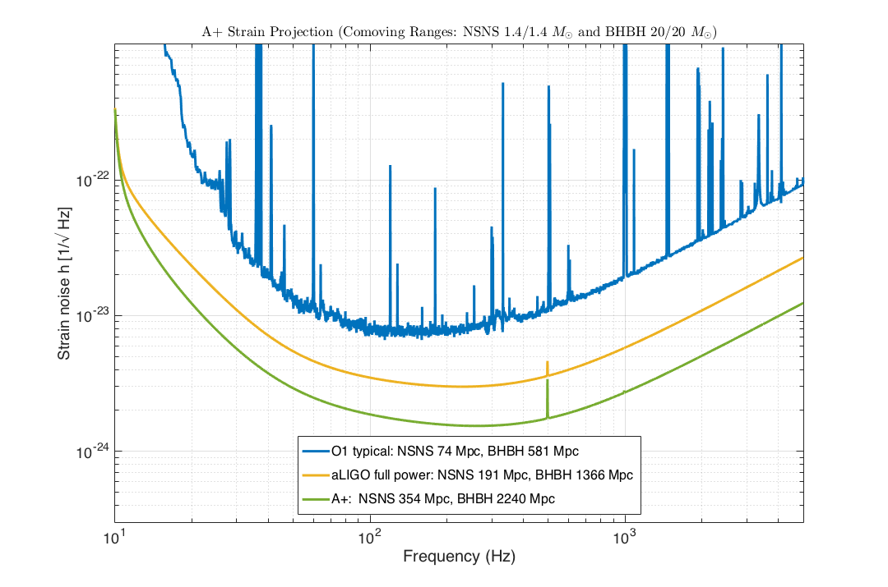
A+ Strain Sensitivity Projection
A+ key parameters:
12dB injected squeezing
15% readout loss
100 m filter cavity
20 ppm RT FC loss
CTN half of aLIGO
LIGO-G1600769-v5

Slide 9
Coating Thermal Noise (CTN) Reduction
Existing dielectric coatings have excess mechanical dissipation, leading to Brownian thermal noise
Recent LSC Coatings working group results point to reduced loss through modified deposition and/or composition
  Elevated-temperature, ion assisted or low-rate deposition
  Trinary (hybrid layer) designs
Each requires investment (NRE) in ‘nonstandard’ industrial capacity (LIGO requirements are special)
We anticipate a factor of 4 lower dissipation, for a factor of 2 reduction in strain noise

Slide 10
A+ Coatings Plan
Current R&D on small samples will inform a new A+ Coating Pathfinder development program, which we propose to launch in 1.5 years (FY2018)
Will spin up industrial vendor(s) to demonstrate full-aperture coatings with new low-dissipation process
  Requires tooling, chamber and process investments
In parallel,we’ll repolish spare aLIGO ITM and ETM optics
  (+ buy a few additional spares)
  Metrology, QA, lab infrastructure, suspensions, tooling, procedures, etc. all identical to aLIGO installation
Begin production coating with new process early 2020
  Expect production rate similar to aLIGO
Low-CTN test masses ready for installation early 2021

Slide 11
Quantum Noise Reduction:
Frequency-Dependent Squeezing
Expect squeezed light injection, now in preparation, to be operating by 2019
Effective substitute or assist for high-power operation
  Phase squeezing at HF causes amplitude anti-squeezing (radiation pressure) at LF
  Added radiation pressure increasingly bothersome as other LF noise is improved; forces trade
Solution: Frequency-dependent squeezing (FDS)
NOTE: FDS is key to planned future detectors (Voyager, ET, CX, etc.)

Slide 12
Frequency-Dependent Squeezing
Optical “filter cavity” (FC)
Rotates squeezing phase to both improve radiation pressure at LF and phase noise at HF
Low-loss, high finesse cavity with bandwidth ~100 Hz
Sensitive to optical losses, scattering and mirror motion
Requires L_{FC} ~ 100 m
Requires high-quality FC mirrors
Requires seismic isolation and quiet mirror suspension

Slide 13
FDS demonstration with 2m filter cavity
Oelker et al, LIGO-P1500062
16m FC FDS test is now in progress at MIT LASTI (LIGO-E1600058)
Potential option to install 16m FC on H1 and L1 after O3 as an interim stopgap, if required

Slide 14
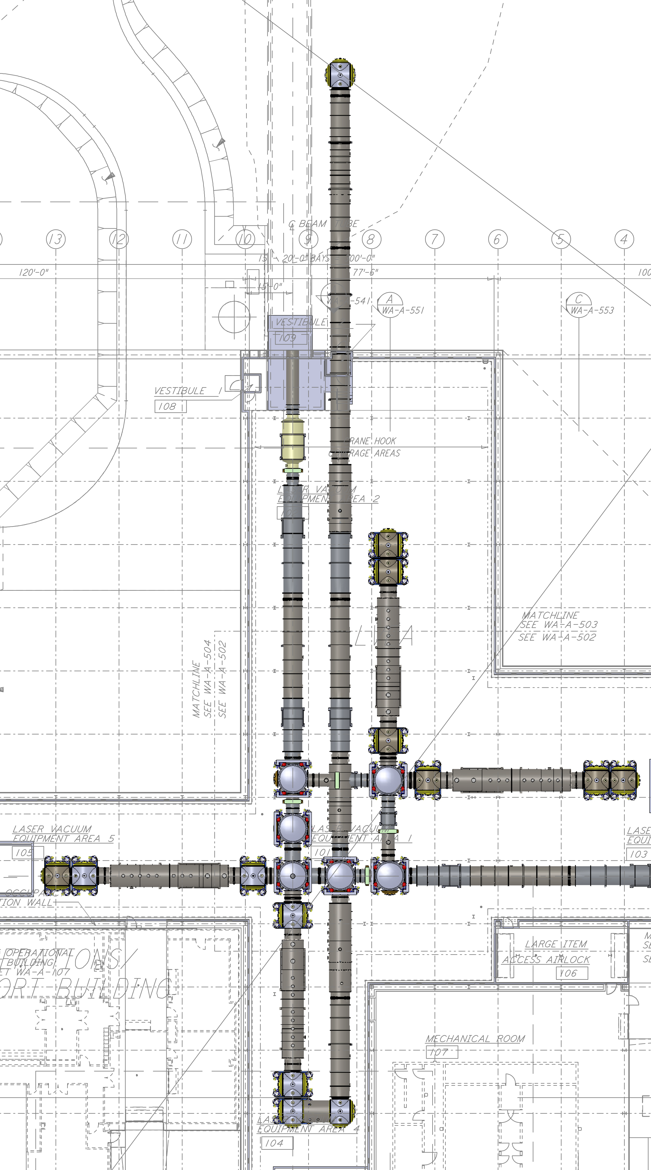
100m Filter Cavity
Facility Layout Concept
Hanford corner station
New LVEA lab annex
Recycle four H2 HAM vacuum chambers
(ship 2 ➔ LLO)
Small (250 mm) FC beamtube
FC beam penetrates ITMx chamber
25m x 6m lab extension/annex alongside existing Y tube enclosure
New 250 mm Φ beam tube
Surplus H2 HAM chambers

Slide 15
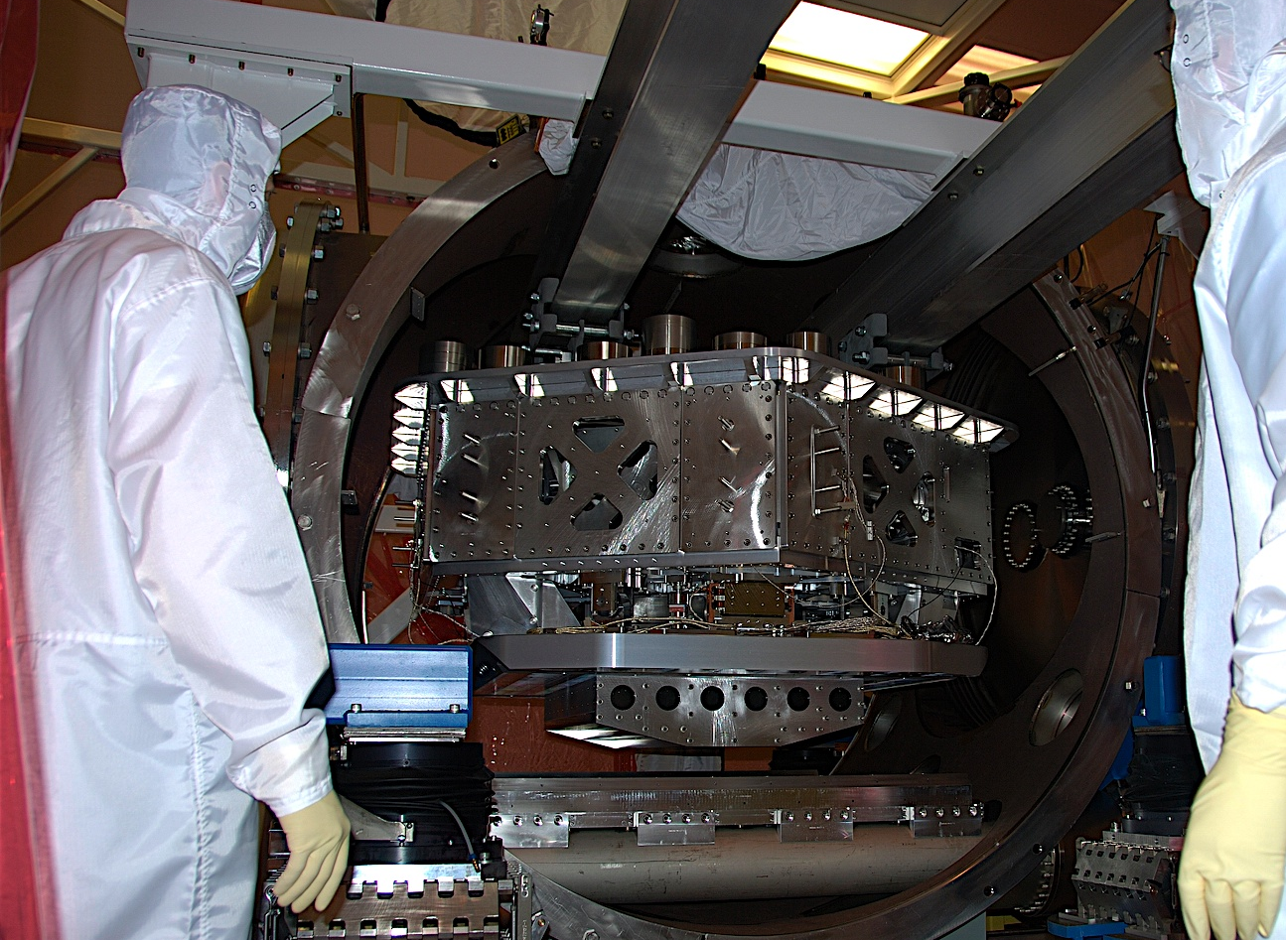
A+ filter cavity mirror suspension & seismic isolation
L1 ISI 1/31/08
aLIGO HAM Small Triple Suspension (HSTS)
aLIGO HAM Internal Seismic Isolator (HAM-ISI)
Notes:
HAM ISI insertion in HAM6 at Livingston with guidance from Jeff Kissel (LSU, left) and Brian O’Reilly (LLO, right). March 2008.

Slide 16
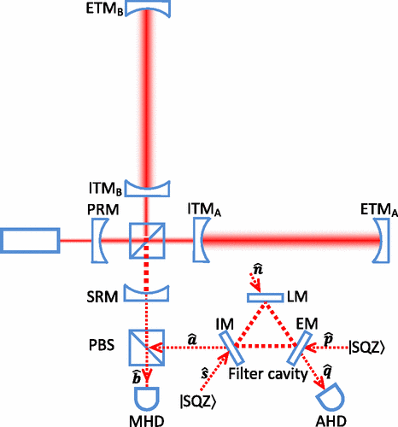
A+ Quantum Noise Optimization:
Optical Loss Reduction
Output losses degrade squeezing benefit
Aim to reduce output losses from ~ 25% to <10%
Lossy aLIGO components will be replaced
An enlarged main beam splitter will reduce aperture losses (LIGO-T1400296)
Active mode matching will improve coupling losses
(LIGO-T1500188)
graphic credit: Khalili et al., Phys. Rev. D 80, 042006

Slide 17
Balanced homodyne readout
Reduced dark-port loss
Improved backscatter immunity
Reduced LO noise sensitivity
Improved phase tuning flexibility
Enhanced readout dynamic range
LIGO-P1300184

Slide 18
Projected A+ Upgrade Cost (H1 and L1)
Category⁺ | ROM Estimate (FY’17k$)*
Core optic coating pathfinder | 3,546
Core optic production | 4,266
FC facility mods | 1,023
FC vacuum | 1,761
FC seismic isolation | 4,728
FC suspensions | 990
Balanced homodyne readout | 339
Sensing & control | 214
Other equipment | 601
Labor | 5,648
Contingency (25%) | 5,779
Total | 28,896
⁺Color code:
scaled from aLIGO
new engineering
PRELIMINARY
Challenge: Exceeds nominal NSF Physics Division “Mid-Scale Project” guideline, but well below MREFC threshold
*6/30/2016 rollup; aL labor scaling, no indirect

Slide 19
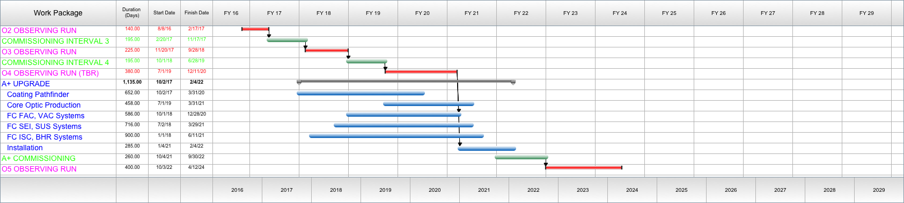
Simplified Schedule*
*FY18 funding start; 5y POP; LIGO-P1200087-v32 observing scenario
PRELIMINARY
Under (mostly) conservative assumptions, supports installation start @ 2QFY21
Installation, commissioning times scaled from ‘comparable’ aLIGO experience
Goal: coincidence operation (@improved sensitivity) by end of calendar 2022

Slide 20
Risks and decision points
Low-CTN coating process not ready in time?
  Can decouple & delay TM replacement
  Requires 2 installation phases; but intermediate enhanced performance is available for observing, in between
Problems commissioning new FC and readout?
  Can quickly and seamlessly revert to baseline aLIGO configuration while problems are diagnosed and resolved
Unforeseen obstacle to aL design sensitivity?
  Impact and reaction depends on nature of the problem
  Precedent shows many such obstacles are mitigated by upgrades, or by opportunities they present (e.g., HEPI, TCS, eLIGO, etc.)
  Improvements at the cutting edge take time and preparation. We have always needed to anticipate success, or find ourselves unprepared for it.

Slide 21
Summary
Our newborn science will continue to be sensitivity driven for the foreseeable future
Whenever we can devise a clear plan to better sensitivity, it is our duty to look beyond the current horizon
A+ is such a plan, and now is the time

Slide 22
Extra slides

Slide 23
Squeezed light injection*
OPO on suspended platform
Vacuum Optical Parametric Oscillator (VOPO)
* Not part of A+; this should already be in operation by mid-2019

Slide 24
Dark Port Loss Budget
If we injected squeezing in aLIGO today, we would endure 25% loss from known sources.
Most can be eliminated by installing better optical components that are now available, plus adaptive mode matching techniques we’re developing in the lab.

Slide 25
Added Opportunity: Newtonian Gravity Gradient Noise Cancellation
Local density gradients may limit A+ during high seismicity, and will routinely affect 3rd generation successors
Can be mitigated by modeling & subtracting local gravity fluctuations
Prototype array now in preparation at LHO
(LIGO-P1600146)

Slide 26
aLIGO operating at full power
Laser Power: 125.00 Watt
SRM Detuning: 0.00 degree
SRM transmission: 0.3500
ITM transmission: 0.0140
PRM transmission: 0.0300
Finesse: 446.41
Power Recycling Factor: 40.54
Arm power: 710.81 kW
Power on beam splitter: 5.07 kW
Thermal load on ITM: 0.385 W
Thermal load on BS: 0.051 W
BNS range: 191.04 Mpc (comoving)
BNS horizon: 436.32 Mpc (comoving)
BNS reach: 272.08 Mpc (comoving)
BBH range: 1.37 Gpc (comoving, z = 0.3)
BBH horizon: 3.24 Gpc (comoving, z = 0.9)
BBH reach: 2.12 Gpc (comoving, z = 0.5)
Stochastic Omega: 2.42e-09

Slide 27
..plus squeezing with
~100m scale filter cavity
Laser Power: 125.00 Watt
SRM Detuning: 0.00 degree
SRM transmission: 0.3500
ITM transmission: 0.0140
PRM transmission: 0.0300
Finesse: 446.41
Power Recycling Factor: 40.54
Arm power: 710.81 kW
Power on beam splitter: 5.07 kW
Thermal load on ITM: 0.385 W
Thermal load on BS: 0.051 W
BNS range: 258.72 Mpc (comoving)
BNS horizon: 592.49 Mpc (comoving)
BNS reach: 370.29 Mpc (comoving)
BBH range: 1.74 Gpc (comoving, z = 0.4)
BBH horizon: 4.14 Gpc (comoving, z = 1.3)
BBH reach: 2.77 Gpc (comoving, z = 0.8)
Stochastic Omega: 9.32e-10

Slide 28
..plus coating thermal noise reduction
Laser Power: 125.00 Watt
SRM Detuning: 0.00 degree
SRM transmission: 0.3500
ITM transmission: 0.0140
PRM transmission: 0.0300
Finesse: 446.41
Power Recycling Factor: 40.54
Arm power: 710.81 kW
Power on beam splitter: 5.07 kW
Thermal load on ITM: 0.385 W
Thermal load on BS: 0.051 W
BNS range: 354.06 Mpc (comoving)
BNS horizon: 814.04 Mpc (comoving)
BNS reach: 510.28 Mpc (comoving)
BBH range: 2.24 Gpc (comoving, z = 0.6)
BBH horizon: 5395.58 Mpc (comoving, z = 2.1)
BBH reach: 3700.64 Mpc (comoving, z = 1.1)
Stochastic Omega: 6.78e-10

