Slide 1
Gravitational wave detection with laser interferometers
LIGO-G1601395-v1
Koji Arai – LIGO Laboratory / Caltech

Slide 2
Introduction

Slide 3
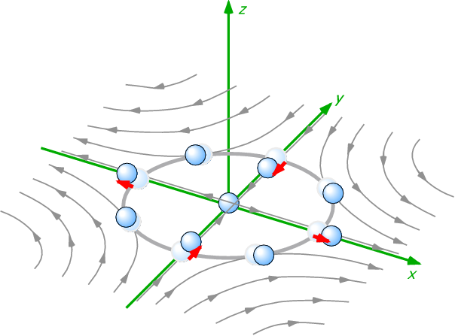
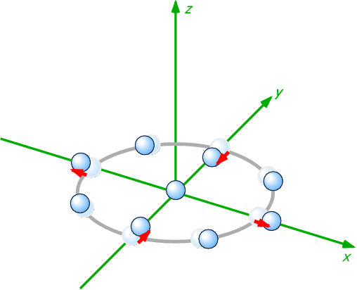
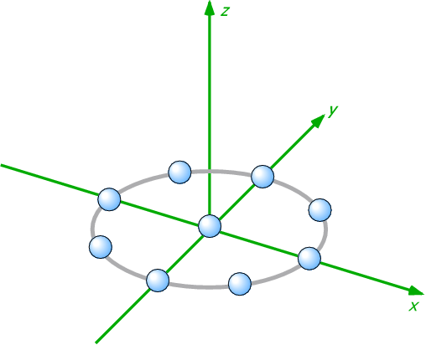
Gravitational wave
General Relativity
  Gravity = Spacetime curvature
  Gravitational wave = Wave of spacetime curvature
Gravitational waves
  Generated by motion of massive objects
  Propagates with speed of light
  Cause quadrupole deformation
  of the spacetime
  Measure strain between
  free masses to detect GWs
GW
Free mass

Slide 4
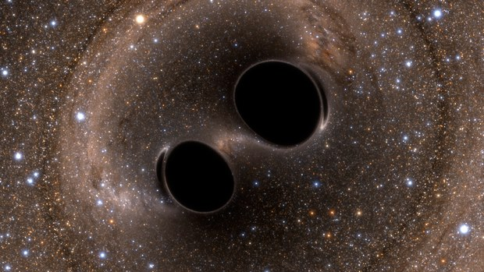
GW: Generation, Propagation, and Detection
Generation:
Change of quadrupole moment
Post-newtonian, NR
1/R
Propagation:
wave equation of
the spacetime metric
Detection:
Quadrupolar “displacement” of the masses

Slide 5
GW Detection
Measure strain between free masses
GW
free
mass
free
mass

Slide 6
GW Detection
Measure strain between free masses
  GW does not appear in the local motion
  Changes optical distance between the masses
Longer the baseline, the bigeer change
  (displacement dx) = (Strain h) x (baseline L)
We need to measure phase of the laser light
=> use “laser interferometry”
GW
L->L(1+dh)

Slide 7
Quadrupole nature of GWs
Differential motion => Michelson interferometer
Longer baseline
-> bigger change
  (displacement dx) = (Strain h) x (baseline L)
Need to measure phase of the laser light
=> use “laser interferometry”

Slide 8
GW telescope?
A continuous signal stream from an interferometer
Fixed on the ground, can not be directed
Poor directivity
=> More like an antenna

Slide 9
GW telescope?
A continuous signal stream from an interferometer
GWs and noises: in principle, indistinguishable
=> Anything we detect is GW
Reduce noises!
  Obs. distance is inv-proportional to noise level
  x10 better => x10 farther => x1000 more galaxies

Slide 10
Actual GW detector
4km FP arm cavities
Mode
Cleaner
Vacuum Envelope
Seismic Attenuation
Recycling
Mirrors
Analog Electronics
Digital Control
Mirror Suspension
(Quad Pendulum)
High
Power Laser
Data Analysis
Signal
Readout
Scheme
Data Storage
Mirror & Coating
Fused Silica fiber

Slide 11
Components of the interferometer
3 elements of a GW detector
  Mechanics
  Optics
  Electronics

Slide 12
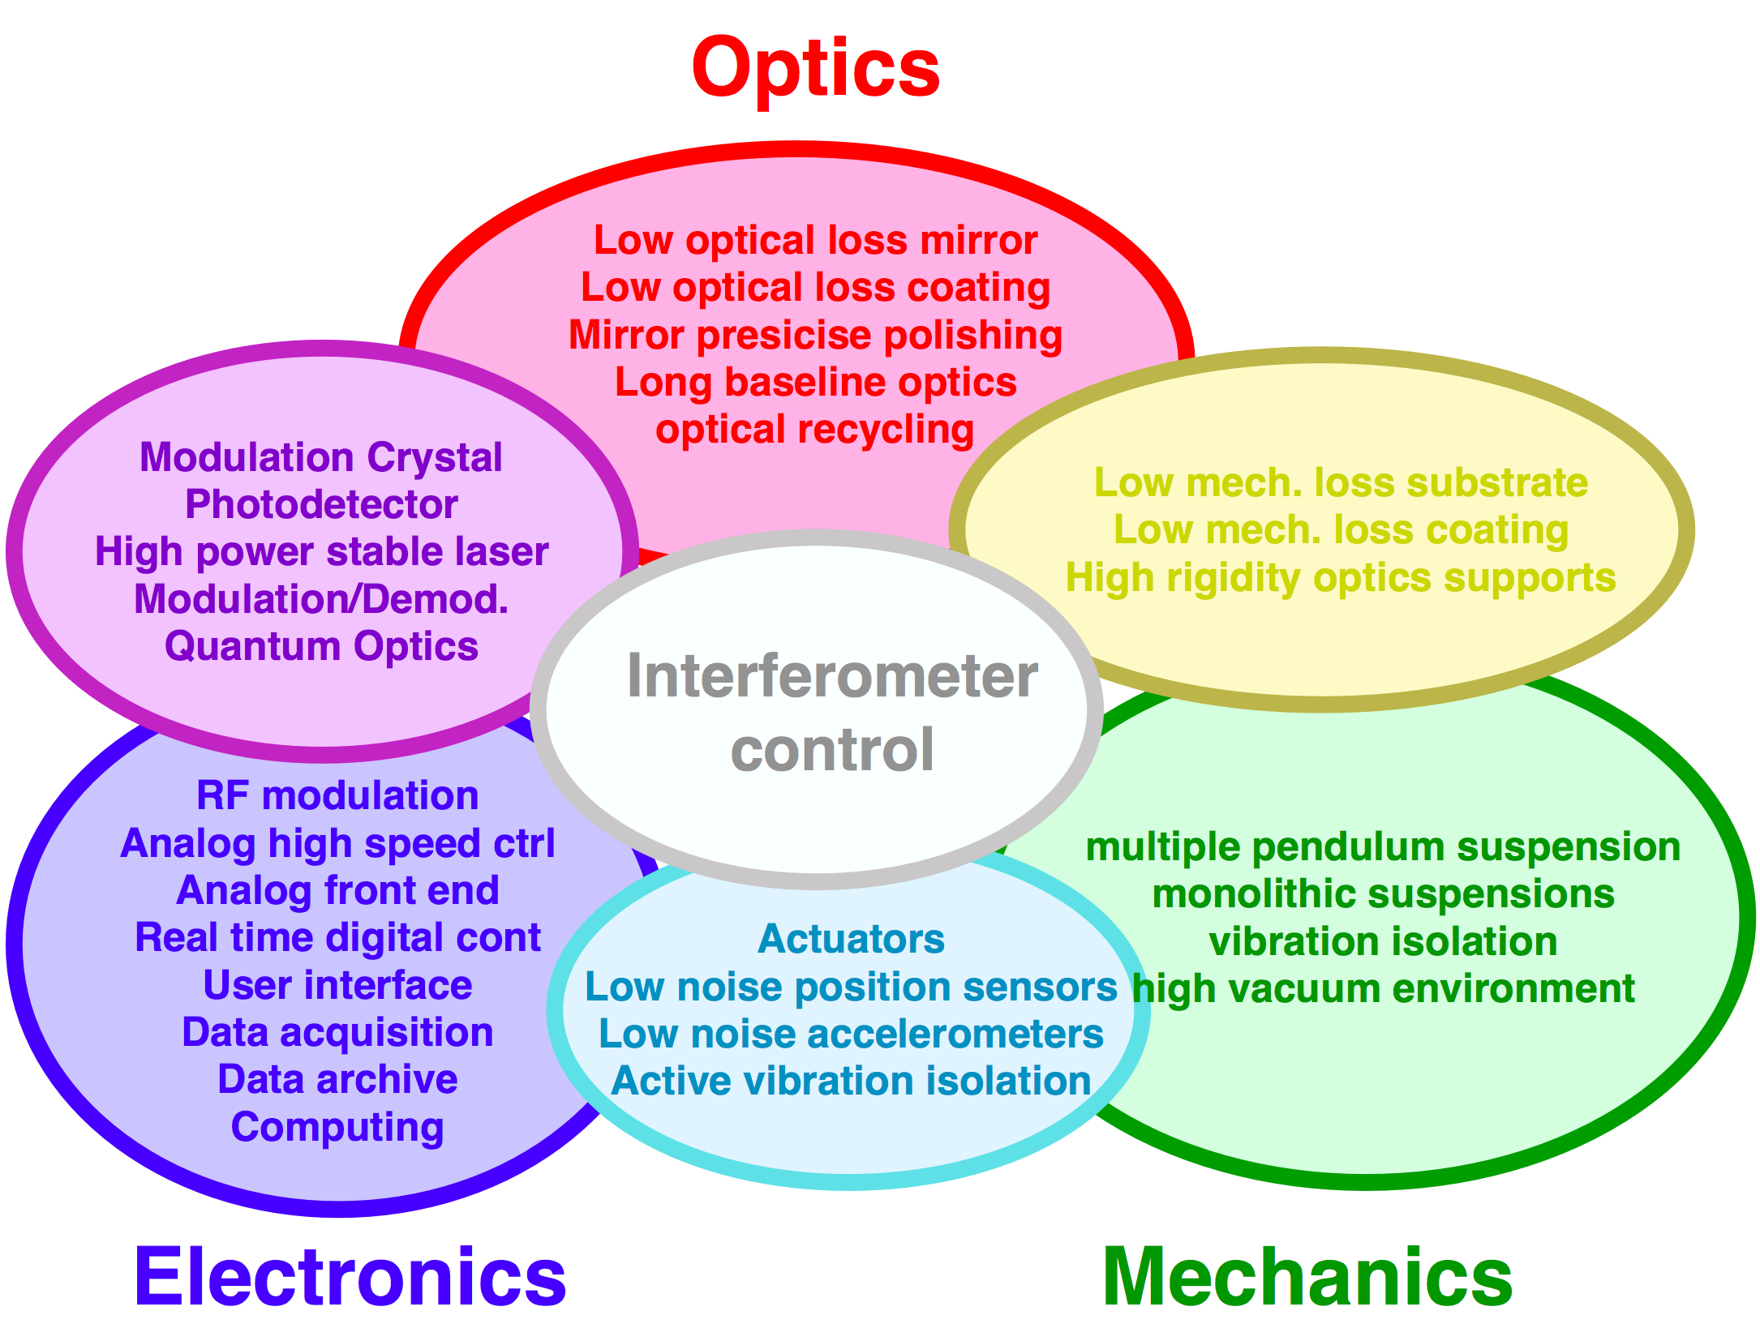
Components of the interferometer
3 elements of a GW detector
  Mechanics
  Optics
  Electronics

Slide 13
Sensitivity and noise
Sensitivity (=noise level) of Advanced LIGO
Design

Slide 14
Sensitivity and noise
Sensitivity (=noise level) of Advanced LIGO
Current sensitivity
h= 8x10⁻²⁴ /rtHz

Slide 15
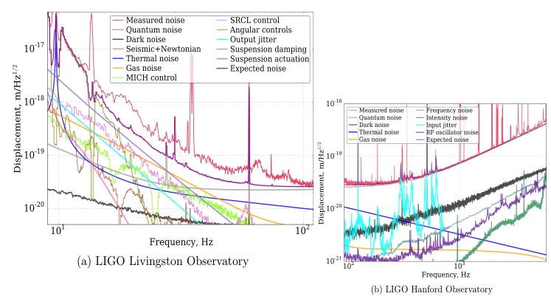
Sensitivity and noise
Sensitivity (=noise level) of Advanced LIGO
Noise budget
h= 2x10⁻²³ /rtHz

Slide 16
Optical configurations of laser interferometer GW detectors

Slide 17
Introduction ~ Interferometer?
Interferometry
  Utilize characteristic of a Michelson
  interferometer as a length comparator
Michelson
Interferometer
In reality...
Fabry-Perot cavity
Advanced LIGO
Dual-Recycled Fabry-Perot Michelson Interferometer
No worries: It’s just a combination of MI and FPs

Slide 18
Michelson interferometer
Light intensity at the output port
  Difference of the electric fields from the arms
  Output intensity is sensitive
  to the differential phase

Slide 19
Michelson interferometer
Frequency response of the Michelson to GWs
Frequency response
of the Michelson interferometer
Ω: optical angular frequency, λ_{OPT} laser wavelength
ω: angular frequency of GW, λ_{GW} wavelength of GW
Jean-Yves Vinet,et al
Phys. Rev. D 38, 433 (1988)

Slide 20
Michelson interferometer
Frequency response of the Michelson to GWs
Cut off freq
longer -> lower
DC Response
longer -> larger
Notch freq
f = n c / (2 L)
  Michelson arm length optimized for 1kHz GW
  -> 75km, too long!

Slide 21
Fabry-Perot optical resonator
Storing light in an optical cavity
  Field equations
Very fast phase response

Slide 22
Fabry-Perot optical resonator
Storing light in an optical cavity
Finesse
Cutoff freq “Cavity pole”
DC Response
amplification
  1. FP increases stored power in the arm
  2. FP increases accumulation time of the signal
  => Above the roll-off, increasing F does not improve the response

Slide 23
Fabry-Perot Michelson Interferometer
Differential nature of the Michelson
+ Longer photon storage time of Fabry-Perot cavities
= Fabry-Perot Michelson Interferometer
Basic form of the modern interferometer GW detector

Slide 24
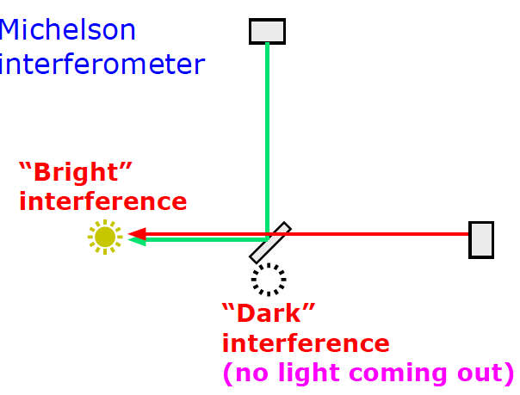
Optical Recycling Technique
Power recycling
  When the Michelson interferometer is operated
  at a “dark fringe”, most of the light goes back to the laser side

Slide 25
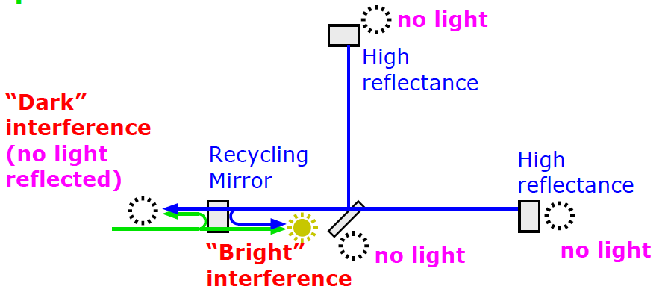
Optical Recycling Technique
Power recycling
  Let’s reuse the reflected light
  Place a mirror in front of the interferometer
  to form a cavity with the Michelson (compound mirror)
  “Power Recycling Mirror”
  The internal light power is increased
  = equivalent to the increase of the input laser power
compound mirror

Slide 26
Optical Recycling Technique
Power recycling
  BTW, all the output ports are made dark.
  Where does the light go?
  In the ideal power recycling, all input power is internally
  consumed via optical losses (absorption & scattering)

Slide 27
Optical Recycling Technique
Power-recycled Fabry-Perot Michelson Interferometer
  Internal light power in the arms is increased
From the laser side /
common arm length change
It looks like a three mirror caivty
= high finesse cavity
For the differential motion (=GW)
It looks like just an arm cavity

Slide 28
Optical Recycling Technique
Dual-recycled Fabry-Perot Michelson Interferometer
  Another mirror is added at the dark port
  “Signal Recycling Mirror”
  Dual recycling allows us to set different storage times
  for common and differential modes
Common mode
= high finesse three mirror cavity
Differential mode (=GW)
= low (or high) finesse three mirror cavity

Slide 29
To tuned or not to tune
Bandwidth of the detector can be changed
  by changing the resonant phase of the signal recycling cavity (SRC)
Optimize the curve depending on the noise shape
Dynamic signal tracking
Signals: resonant in SRC
(Resonant Sideband Extraction)
Signals: anti-resonant in SRC
(Signal Recycling)

Slide 30
Signal Readout
Interferometer response is nonlinear
How do you read the GW signal (and other signals)?
=> Signal readout scheme

Slide 31
Signal Readout
Signal readout scheme
RF phase modulation / demodulation
or DC Readout

Slide 32
Signal Readout
RF Readout and DC Readout
DC Readout is good for GW channel
  removes nonstationary shot noise
  mitigates technical noises associated with the RF sidebands

Slide 33
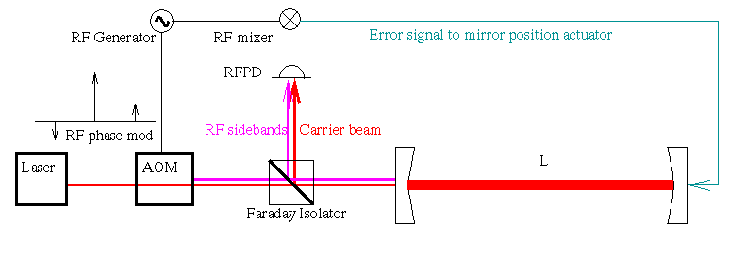
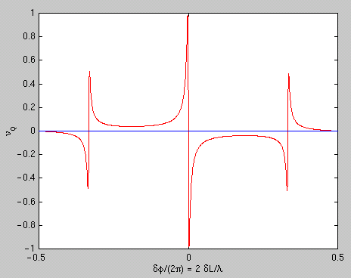
Pound-Drever-Hall technique (PDH)
RF signal readout scheme for cavities
  Phase modulation -> RF optical sidebands
  Reflected beam -> detected / demodulated
V
Laser
Electro-Optic
Modulator
Faraday
Isolator
or
Pick-off mirror
dL or f

Slide 34
Summary
Optical phase measurement => Interferometry
Michelson interferometer: requires too long arm
Fabry-Perot arm: longer light storage time
Optical recycling technique:
- more power in the arms
- allows us to taylor the detector response to GW signals
Optical read-out schemes

Slide 35
Advanced topics
Angular & frequency response of an interferometer
  Up to this point GWs from the zenith was assumed.
  What is the response to GWs with an arbitrary angle?
  What is the frequency response of the detector for such GWs?
  Draw an arbitrary optical path.
  What is the angular and frequency
  response of such a path?
  Can we use numerical “optimization”
  for certain criteria?
  e.g.
  better sky coverage, directive beaming,
  for certain source frequency, etc…
GW
GW
GW

Slide 36
Advanced topics
Angular & frequency response of an interferometer
  R. Schilling, Class. Quantum Grav. 14 (1997) 1513-1519

Slide 37
Noises in Gravitational Wave Detectors

Slide 38
Introduction ~ Noise?
GW detection
Data stream of differential arm strain
Once recorded:
Signals and noises are indistinguishable
What we can do is to catch “likely” features
Reduce any kind of noises!

Slide 39
Introduction ~ Noise?
Time domain vs frequency domain
Noise
Reduction
Time domain: transient noises
Frequency domain: stationary noises

Slide 40
Introduction ~ Noise?
Power Spectral Density (PSD)
Double sided PSD (-Infinity < f < Infinity)
Single sided PSD (0 <= f < Infinity)
[x_{unit}² / Hz]
Linearized PSD:
[x_{unit}/ sqrtHz]

Slide 41
Introduction ~ Noise?
Parseval’s Theorem for signal RMS and PSD
Root Mean of x(t):
average signal power density (per sec)
(cf. variance, std deviation)
PSD Sx(f):
power density per frequency (per sec)

Slide 42
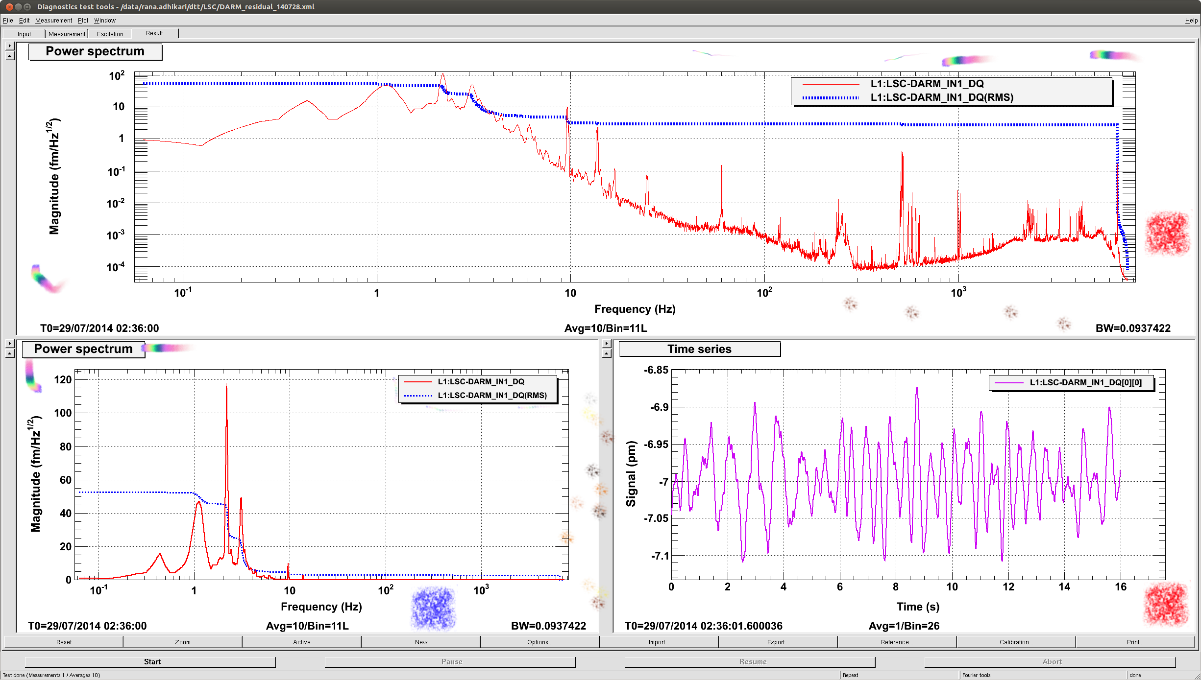
Introduction ~ Noise?
Example
PSD [fm/sqrtHz] in log-log scale, RMS [fm] ~ 50fm = 0.05pm
PSD [fm/sqrtHz] in log-lin scale
RMS [fm]
Time series [pm]

Slide 43
Noise categories
3 fundamentals of the GW detector
Mechanics -> Displacement noises
Optics -> Optical noises
Electronics -> Electrical noises
Displacement
Optical
Optical
Displacement
Electrical
Electrical
Electrical

Slide 44
Sensitivity and noise
Sensitivity (=noise level) of Advanced LIGO
Noise budget
Laser shot noise
Laser radiation pressure noise
Thermal noise
Seismic noise
Laser intensity /frequency noise
Electronics noise
Digitization noise
Angular control noise
......
h= 2x10⁻²³ /rtHz

Slide 45
Displacement noises

Slide 46
Displacement noise
Mechanical displacement sensed
by a laser interferometer
The longer the arm length,
the smaller the strain noise
  Seismic noise
  Thermal noise
  Newtonian Gravity noise

Slide 47
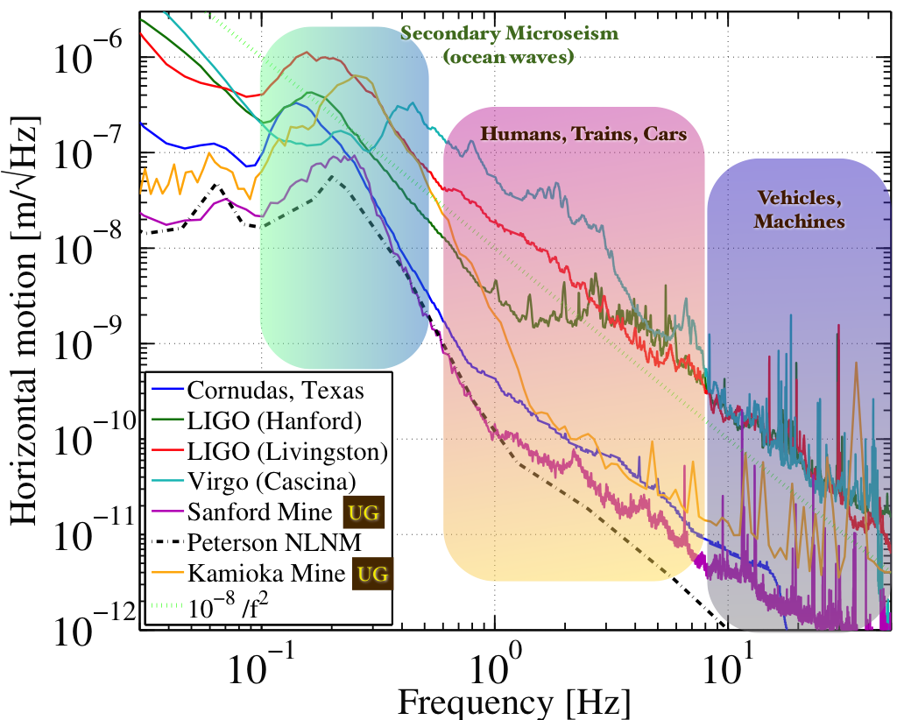
Displacement noise
Seismic noise
  Even when there is no noticeable earth quake…
Target
disp. noise
10⁻²⁰m/rtHz
http://link.aps.org/doi/10.1103/RevModPhys.86.121 (http://arxiv.org/abs/1305.5188)

Slide 48
Displacement noise
Vibration isolation ~ utilize a harmonic oscillator
  A harmonic oscillator provides vibration isolation
  above its resonant frequency
w0=1Hz
|x/X|~1/1000@30Hz

Slide 49
Displacement noise
How to get more isolation?
Damping
Lower the peak height
Multi stage
Steeper isolation curve
Lower resonant freq
Better isolation
f ⁻⁴
f ⁻²
Worse isolation
More peaks
Complex to realize
In practice: employ combination of these measures

Slide 50
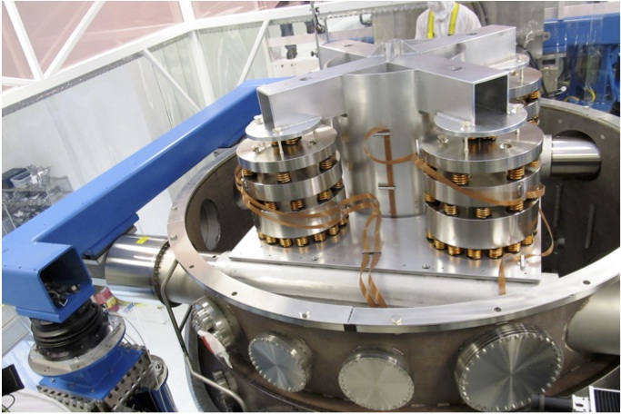
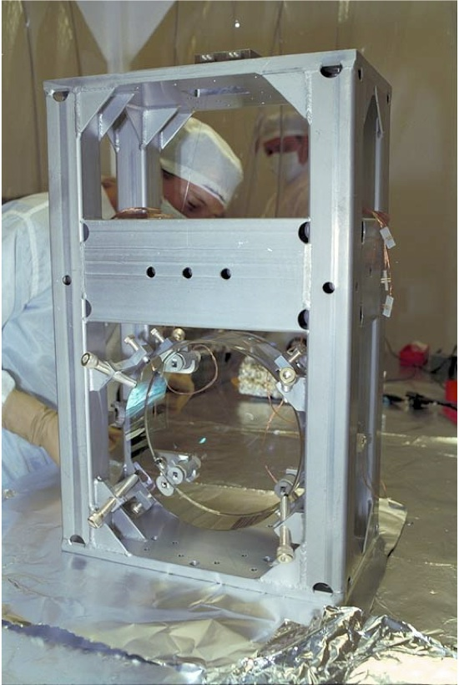
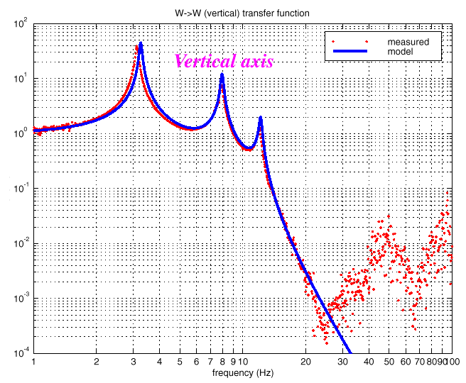
Displacement noise
iLIGO vibration isolation
Hydraulic active isolation / Isolation stack / Single Pendulum

Slide 51
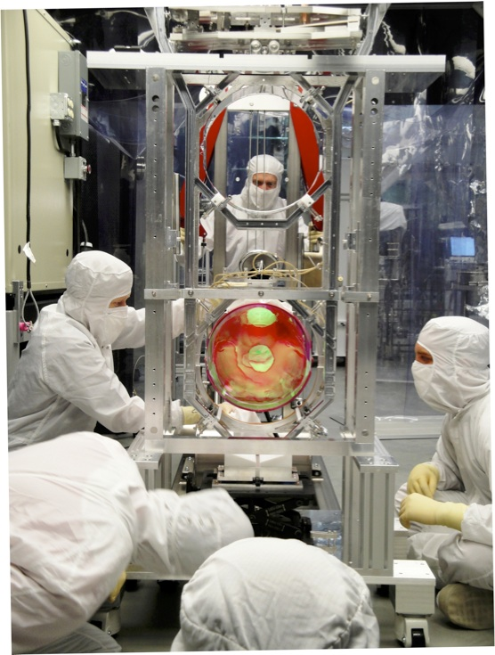
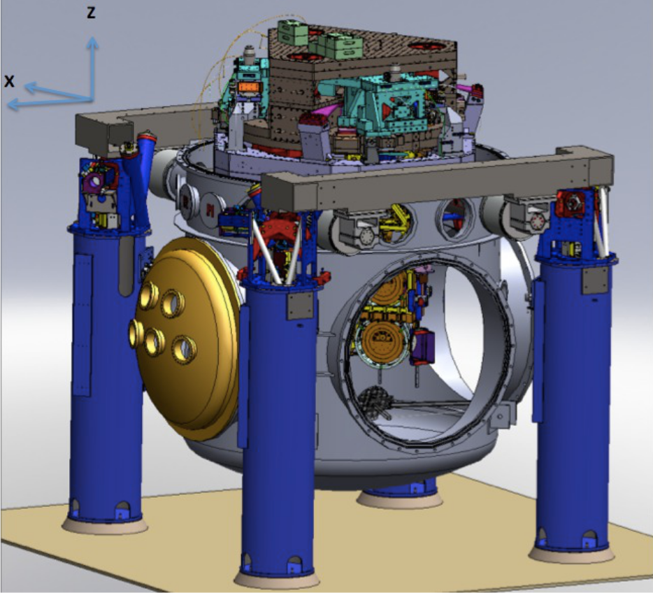
Displacement noise
aLIGO vibration isolation
Hydraulic active isolation / Invacuum Active Isolation Platforms / Multiple Pendulum

Slide 52
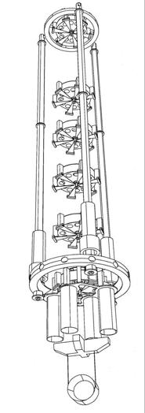
Displacement noise
Virgo: super attenuator
  8m high
  9 stages in horizontal
  6 stages in vertical
8m

Slide 53
Displacement noise
http://link.aps.org/doi/10.1103/RevModPhys.86.121 (http://arxiv.org/abs/1305.5188)

Slide 54
Displacement noise
Question:
n-stage multiple pendulum with fixed height of H
How many stages n do we need to realize
the vibration isolation of A at frequency of f?
For a given A what is the minimum f, we can
realize by increasing n?
(Mass distribution)
  For equal m for each stage
  or
  For arbitrary mass m_{i} and length h_{i}

Slide 55
Displacement noise
Thermal noise:
System in thermal equilibrium
  the system can dissipate its energy to the heat bath
  the system is thermally excited by thermal fluctuation
Mechanical thermal noises
  suspension thermal noise
  mirror substrate thermal noise
  mirror coating thermal noise

Slide 56


Displacement noise
Fluctuation Dissipation Theorem
Friction: interaction with “bath” = huge number of d.o.f.
Fluctuation force: produced by huge number of d.o.f.
Dissipation and fluctuation have certain relationship
system description (Langevin equation)
q: generalized coordinate m: generalized mass
R: friction (dissipation)
F: internal force (restoring force, etc)
F’(t): fluctuating force from heat bath
Power spectrum density (PSD) of the fluctuation force

Slide 57

Displacement noise
Transfer function approach
Equivalently, the fluctuation of the system can be obtained from the response of the system
where Z(w) and H(w) are the impedance and
force-to-displacement transfer function of the system

Slide 58
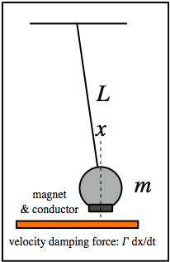


Displacement noise
Question:
- Velocity damping of a pendulum
- Structure damping
loss angle: 0 < 𝜙 ≪ 1
- How anti-spring changes the thermal noise spectrum?
anti-spring parameter: 0<𝛼<1

Slide 59

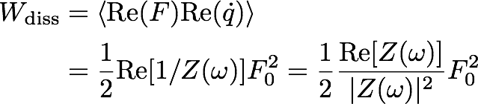
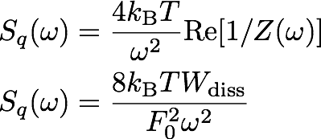
Displacement noise
In some cases, calculating the system response is complicated (e.g. deformation of an elastic body)
Systems response (impedance) at a certain freq:
Average rate of energy disspation
We don’t need to
know Z(w)!

Slide 60
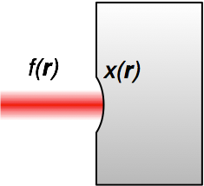


Displacement noise
Sensing of the mirror surface deformation with a laser beam (with intensity profile of f(r))
Apply periodic pressure with profile of f(r)
This induces deformation of x(r) which is different
from our sensing profile of f(r), but that’s OK
Calculate the rate of dissipation Wdiss
analytically, using FEA, or etc
Put this into the formula
We don’t need to
know Z(w)!
Y. Levin PRD 57, 659-663 (1998)

Slide 61
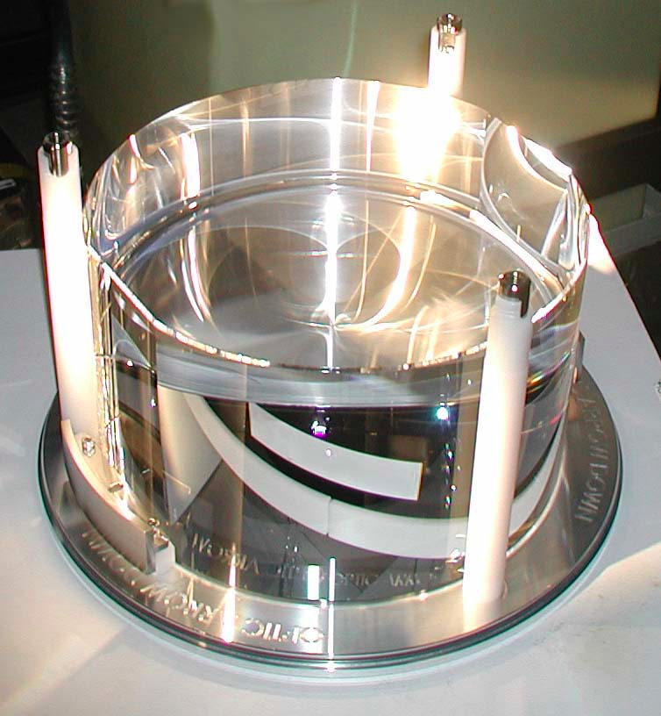
Displacement noise
Mirror substrate thermal noise
  Brownian motion
  Mechanical loss associated
  with the internal friction
  ⬄Thermally excited body modes
  Optical coating (high mechanical loss)
  will be limiting noise source in aLIGO
  Thermo elastic noise
  Elastic strain & thermal expansion coefficient
  => cause heat distribution & flow in the substrate
  ⬄Temperature fluctuation causes mirror displacement
  Thermo-refractive noise
  ⬄Temp. fluctuation causes fluctuation of refractive index
We don’t need to
know Z(w)!

Slide 62
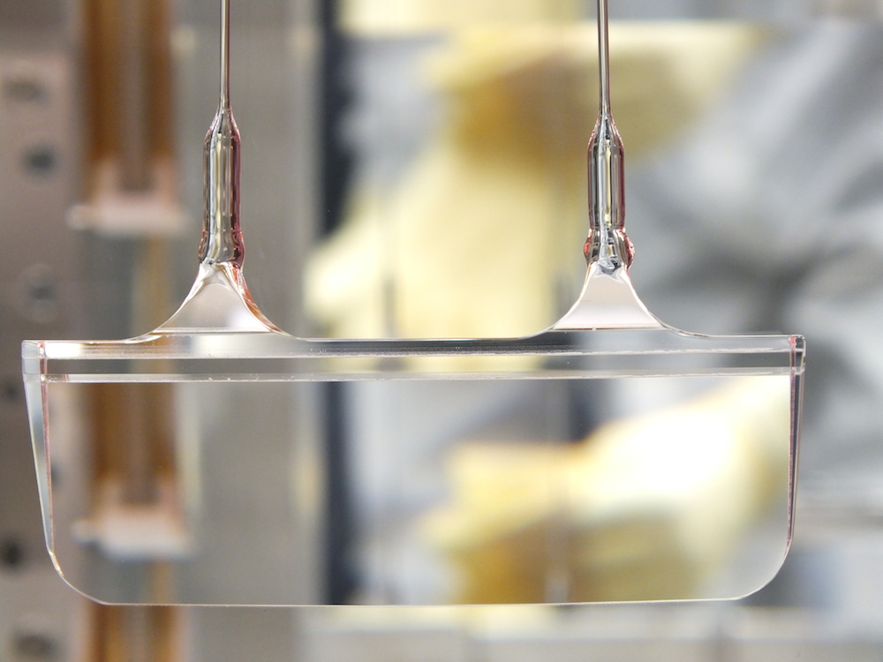
Displacement noise
Suspension thermal noise
  Brownian motion
  Mechanical loss of the suspension fiber
  ⬄Thermally excited pendulum modes
  Thermo elastic noise
  Elastic strain of the fiber & thermal expansion coefficient
  => cause heat distribution & flow in the fiber
  ⬄Temperature fluctuation causes mirror motion
<- Monolithic suspension
for high pendulum Q
We don’t need to
know Z(w)!

Slide 63
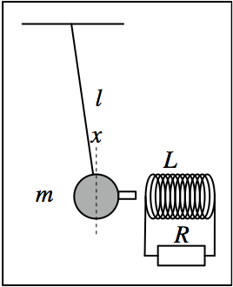
Displacement noise
Question
  Induced current damping (electro-mechanical system)
  1. How does the Q factor of the system depend on R?
  2. How much is the thermal noise displacement of the mass?
  3. How does the thermal noise of the resister shakes the mass?
  4. How are the above questions with a capacitive coupling
  instead of the coil?
  Cold damping
  1. If the resister is cooled, how does
  the thermal noise motion change?
  2. Is the pendulum actually cooled?
  Down to what temperature?
  3. How fast the pendulum recovers the
  original temperature once R is returned
  to the room temp.?
We don’t need to
know Z(w)!

Slide 64
Displacement noise
Newtonian Gravity noise
  Mass density fluctuations around the test masses
  => test mass motion via gravitational coupling
  Dominant source of Newtonian noise
  = Seismic surface wave
  Mitigation
  1) Going to quiet place (underground)
  2) Feedforward subtraction
  3) Passive reduction by shaping
  local topography
NN
aLIGO
sensitivity
J Driggers, et al, PRD 86, 102001 (2012)
J Harms, et al, Class. Quantum Grav. 31 185011 (2014)

Slide 65
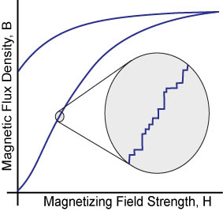
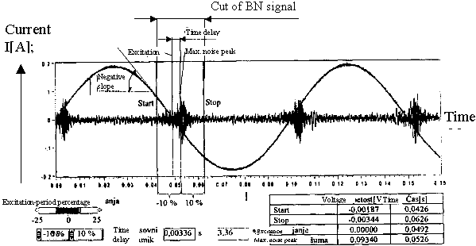
Displacement noise
Mechanical upconversion noise
  Large low frequency (f < 1Hz) motion
  => upconverted to 10~100Hz motion via nonliner processes
  Barkhausen noise
  => low freq mirror actuation cause BH noise and upconversion
  Select better magnet materials (e.g. SmCo)
https://www.nde-ed.org/

Slide 66
Optical noises

Slide 67
Optical noises
Noises that contaminate the readout signal
  Quantum noises (shot noise, radiation pressure noise)
  Laser technical noises (frequency/intensity noise)
  Modulation noises
  Scattered light noise
Optical
Optical

Slide 68
Optical noises
Quantum noises: Shot noise
  Noise due to photon counting statistics
  N detected photon => standard deviation √N
  Increasing the incident power P_{in},
  => The shot noise is increased by √P_{in}
  => The signal amplitude is increased by P_{in}
  In total, the signal-to-noise ratio is improved by

Slide 69
Optical noises
Quantum noises: Shot noise
  Photon shot noise associated with photodetection
  Michelson interferometer
  Michelson response (@DC)
  i_{DC} : DC Photocurrent
  η : PD Quantum Efficiency
  ν : Optical Frequency
at the limit of d𝜙->0
Michelson
Strain Sensitivity
Shot-noise limit of the Michelson phase sensitivity
  1.3x10⁻²⁰ 1/sqrtHz
  @1W, 1064nm, 4km

Slide 70
Optical noises
Supplemental slide ~ Shot noise derivation

Slide 71
Optical noises
Quantum noises ~ Radiation pressure noise
  Photon number fluctuation in the arm cavity
  => Fluctuation of the back action force
  Quantum noise of the input laser
  => Common noise for two arms
  => cancelled and does not appear in the signal
  Vacuum fluctuation injected
  from the dark port
  => Differentially power fluctuation
  => Cause the noise in the GW signal

Slide 72
Optical noises
Quantum noises
  Standard Quantum Limit (SQL)
- Trade-off Between Shot Noise and Radiation-Pressure Noise
- Uncertainty of the test mass position due to observation

Slide 73
Optical noises
Laser frequency noise
  Laser wavelength (λ = c / ν)
  = reference for the displacement measurement
  Optical phase 𝜙 = 2 pi ν L / c
  d𝜙 = 2 pi / c (L dν + ν dL) <= indistinguishable
  dL/L target 10⁻²⁴
  => dν = 10⁻²⁴ x 300 THz (1064nmYAG laser)
  = 3 x 10⁻¹⁰ Hz/rtHz

Slide 74
Optical noises
Laser frequency noise
  Target: dν_{eff} = 3 x 10⁻¹⁰ Hz/rtHz
  Laser stability
  dν = 10~100 Hz/rtHz @100Hz
iLIGO
3-stage cascaded
laser frequency stabilization
  Michelson’s differential sensitivity provides
  Frequency noise cancellation of 1/100~1/1000
  “Common Mode Rejection”

Slide 75
Optical noises
Laser intensity noise
  Relative Intensity Noise (RIN): dP/P
  Sensor output V = P x
  => dV = P dx + x dP <= indistinguishable
  Requirement: RIN = 10⁻⁹ 1/√Hz
  x_{ofs}=10e-12 (DC Readout)
  => dx=1e-20 m/√Hz

Slide 76
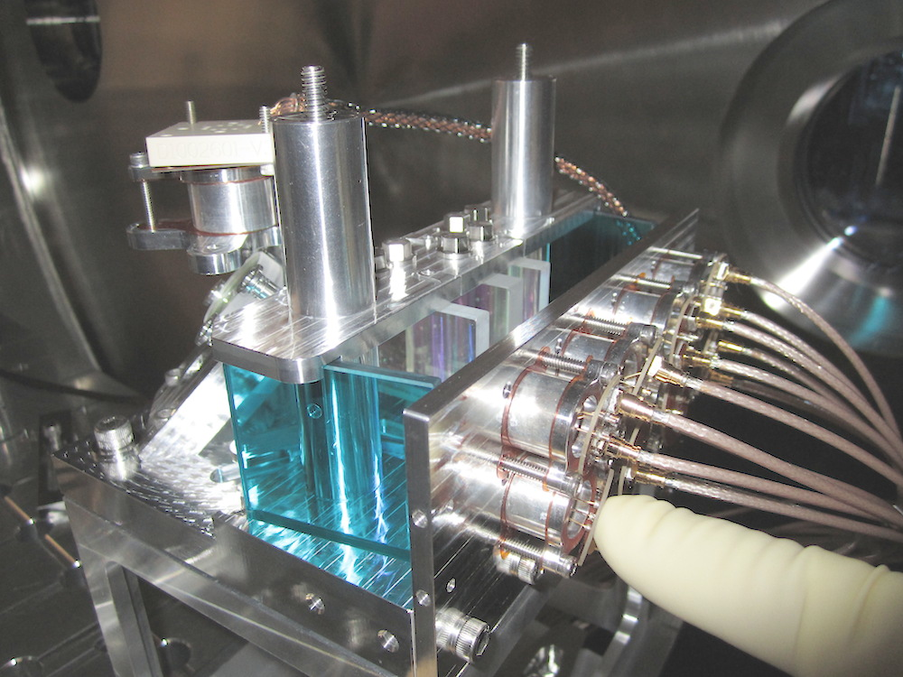
Optical noises
Laser intensity noise ~ intensity stabiliaztion
  Requirement: RIN = 10⁻⁹ 1/√Hz
  2-stage cascaded intensity stabilization control
  Challenge: requires 300mA of photodetection
  Shot noise limited RIN
  In-vacuum 8-branch
  Photodiode array
P. Kwee et al,
Optics Express 20 10617-10634 (2012)

Slide 77
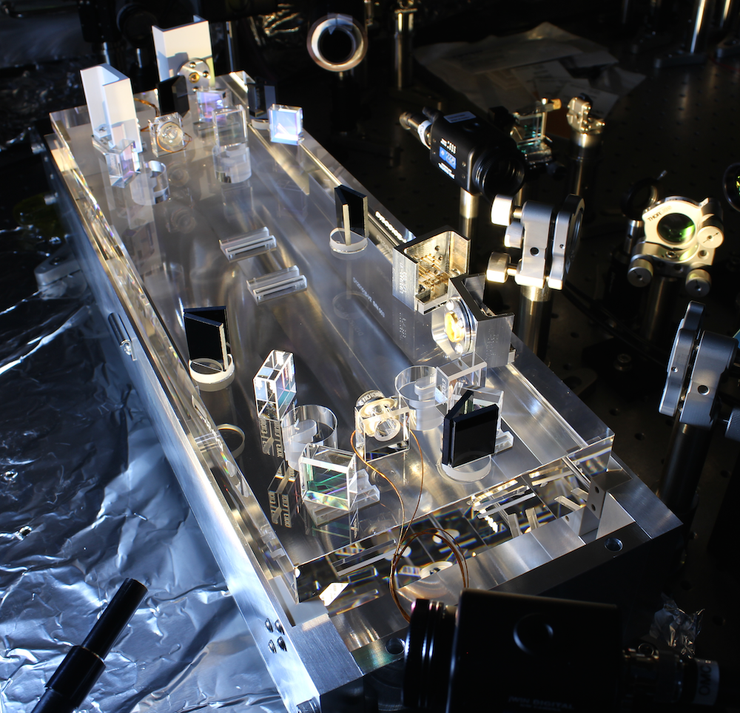
Optical noises
Modulation noises
  RF Residual Amplitude Modulation
  Modulation Oscillator Phase Noise
  Modulation Oscillator Amplitude Noise
Produce noise sidebands on the modulation sidebands
Mitigation
  For the GW signal:
  Use DC readout and eliminate them
  by an “output mode cleaner cavity”
J. Camp et al JOSA A 17 120-128 (2000)

Slide 78
Optical noises
Scattered light noise
  Scattered light recouples to the interferometer beam
  with an arbitrary phase
  => causes amplitude and phase fluctuation
  Two effects:
  1. Small motion regime: linear coupling of the phase fluctuation
  2. Large motion regime: low freq large motion of the scattering object => upconversion via fringe wrapping
  Mitigation
    Reduce scattered light
    Vibration isolation
    of the scattering object

Slide 79
Electrical noises

Slide 80
Electrical noises
General rules for electrical noises
  Electrical noise in photo detection
  Digitization noise (ADC/DAC) / Aliasing
Control noise
Actuator noise

Slide 81
General rules for electrical noises
Low noise amplification at the beginning
Give necessary gain as early as possible
Don’t attenuate (and amplify again)
input noise: v1
input noise: v2
output noise Vout:
Sqrt[(v1 G1 G2)²+(V2 G2) ²]
Signal
Gain G1
Gain G2
Input equivalent noise
Vout / (G1 G2)
= Sqrt[v1²+(v2/G1) ²]
output noise: v1 G1
Lessons
  The input referred noise is determined by v1
  It won’t become better by the later stages
  If G1 is big enough, we can ignore the noise of later stages

Slide 82
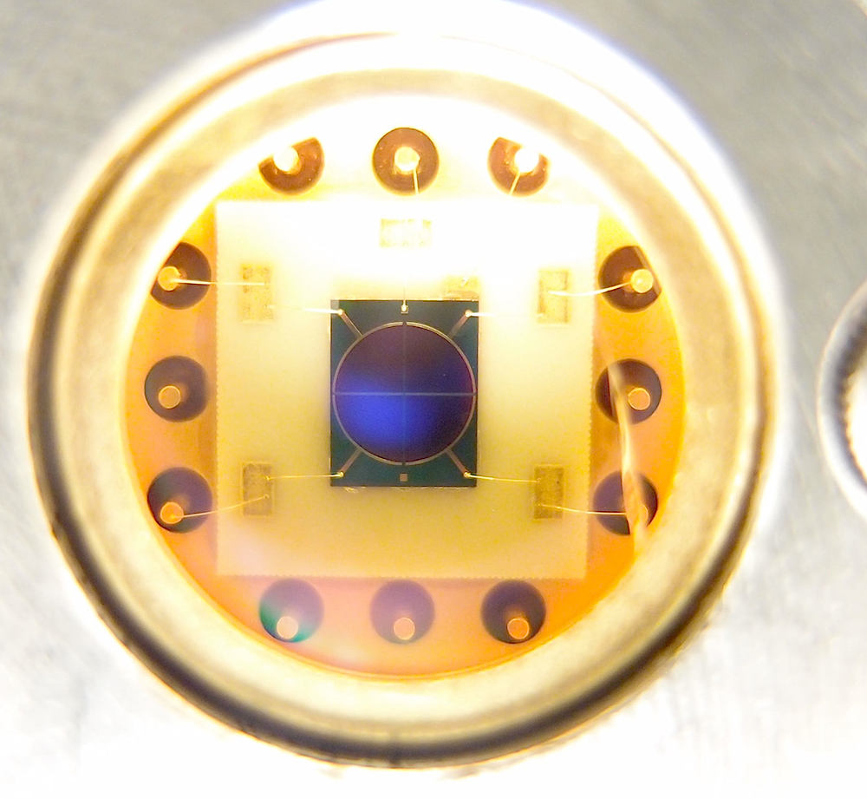
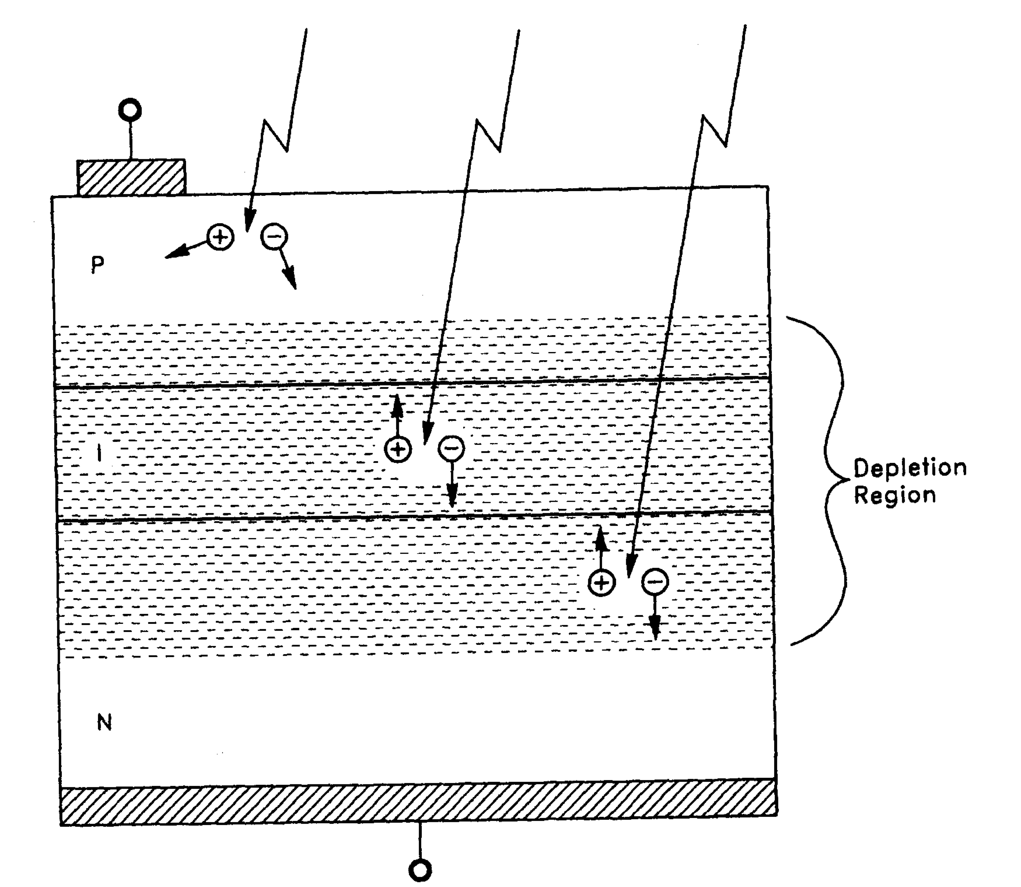
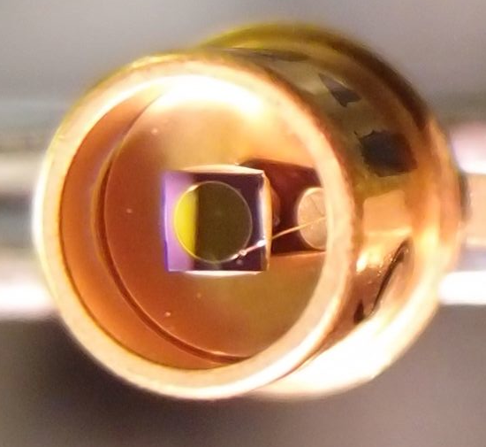
Noise in photodetectors
Photodiodes
  PIN photodiodes
  (InGaAs for near IR, Si for visible)
    Good linearity
    Low noise
    High Quantum Efficiency (>90%)
InGaAs Quadrant PD
(𝜙3mm)
Anode
InGaAs PD (𝜙1mm)
P-layer
I-layer
N-layer
Photocurrent
Cathode
“Photodiode Amplifiers”, J. Graeme (McGrawHill 1995)

Slide 83
Noise in photodetectors
Photodetectors are the first electrical block
of the control chains
  It is important to have
  low input-referred current noise
Photo detection
  AF (Audio Frequency 0~100kHz)
    Prenty of light (photocurrent ~mA)
    Not a big electrical issue
  RF (Radio Frequency 10~200MHz)
    Large diode aperture -> high RF noise
    Need careful consideration

Slide 84
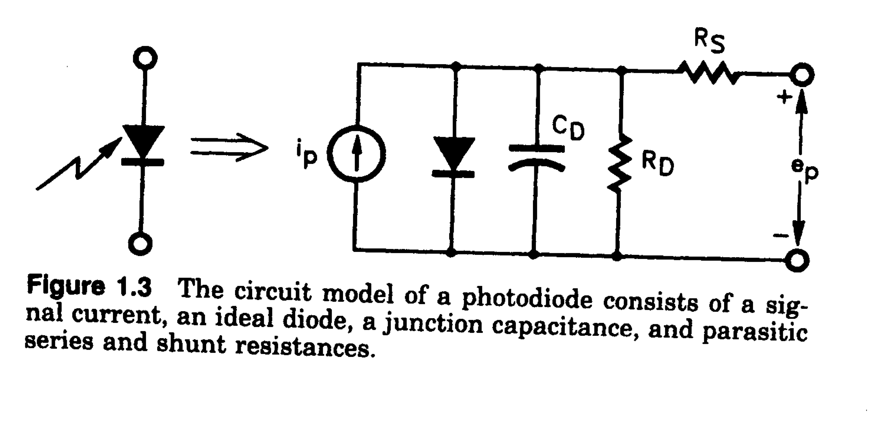
Noise in photodetectors
Noise in photodiodes
  Photodiode equivalent circuit
    Shunt Capacitance R_{D} (~100MΩ) Usually not a problem
    Junction Capacitance C_{D} (1pF~1nF)
    Series Resistance R_{S} (1Ω~100Ω)
input referred noise current
  The diode aperture size needs to be ~mm => Cd tends to be big.
  2mm InGaAs PD: Rs~10Ω, Cd~100pF
  => i_Rs = 20 pA/sqrtHz @100MHz
  (equivalent to the shot noise of 1mA light ~ 1.3mW@1064nm)

Slide 85
Analog/Digital interface
Restriction of signal digitization
  Voltage quantization: quantization noise
  => limited dynamic range
  => Requires whitening/dewhitening filters
  Temporally discrete sampling: aliasing problem
  => limited signal bandwidth
  => Requires anti-aliasing (AA) / anti-imaging (AI) filters
  Typical signal chain

Slide 86
Digitization (Quantization) noise
Analog signals (~+/-10V) -> Digital signal
  Digitized to a discrete N bit integer number
  Quantization causes a white noise
  e.g. +/-10V 16bit => Δ = 0.3mV => Vn ~ 100 μV/sqrtHz
  cf. Input noise of a typical analog circuit 10nV/sqrtHz
quantization error
quantization
http://www.analog.com/static/imported-files/tutorials/MT-229.pdf

Slide 87
Digitization (Quantization) noise
Whitening
  Amplify a signal in the freq band where the signal is weak
Dewhitening
  Amplify a signal in the freq band where the signal is weak

Slide 88
Control induced noise
Noise couplings from auxiliary loops
  e.g. Angle control feedback
  -> noise injection to the GW channel
  Mitigation
  1) Make the coupling smaller
  2) Make the noise itself smaller
  3) Limit the control bandwidth of the aux loop

Slide 89
Actuator noise
Actuator noise appears in the GW signal
as an external disturbance
  Mitigation
  1) Make the noise itself smaller
  2) Make the actuator response smaller
  We need to keep sufficient actuator strength
  for lock acquisition
  => Transition to a low-noise mode after achieving lock

Slide 90
Summary

Slide 91
Summary
Summary
  There are such large number of noises
  They are quite omnidisciplinary
  Even only one noise can ruin our GW detection
  GW detection will be achieved by
    Careful design / knowledge / experience
    Logical, but inspirational trouble shooting
  Noise “hunting”

