Slide 1
David Reitze Executive Director LIGO Laboratory
LIGO-G1601389-v1

Slide 2
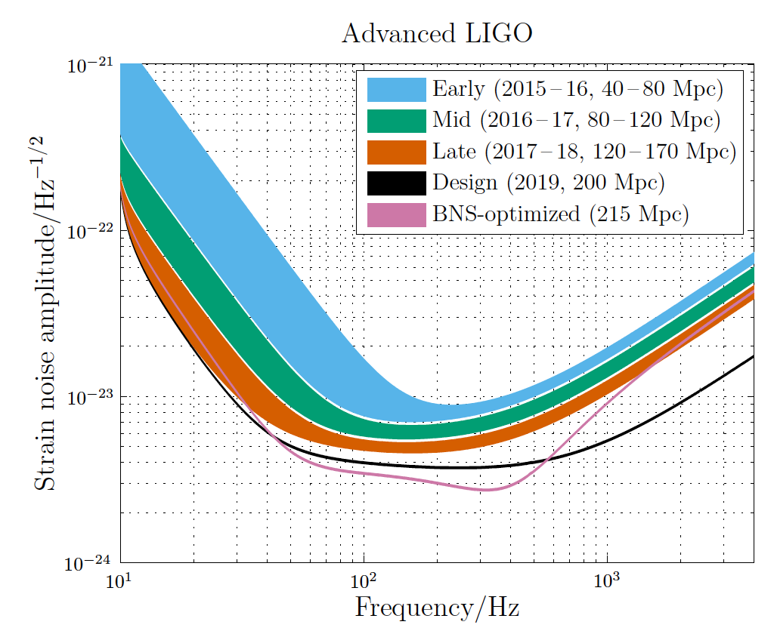
Advanced LIGO’s Second Observing Run
Advanced LIGO’s second run will begin in the Fall 2016; a six month duration run
We will see a 15% – 25% improvement in sensitivity performance over LIGO’s first observing run
This will result in an increase in the rate of events detected by 1.5 to 2 times

Slide 3
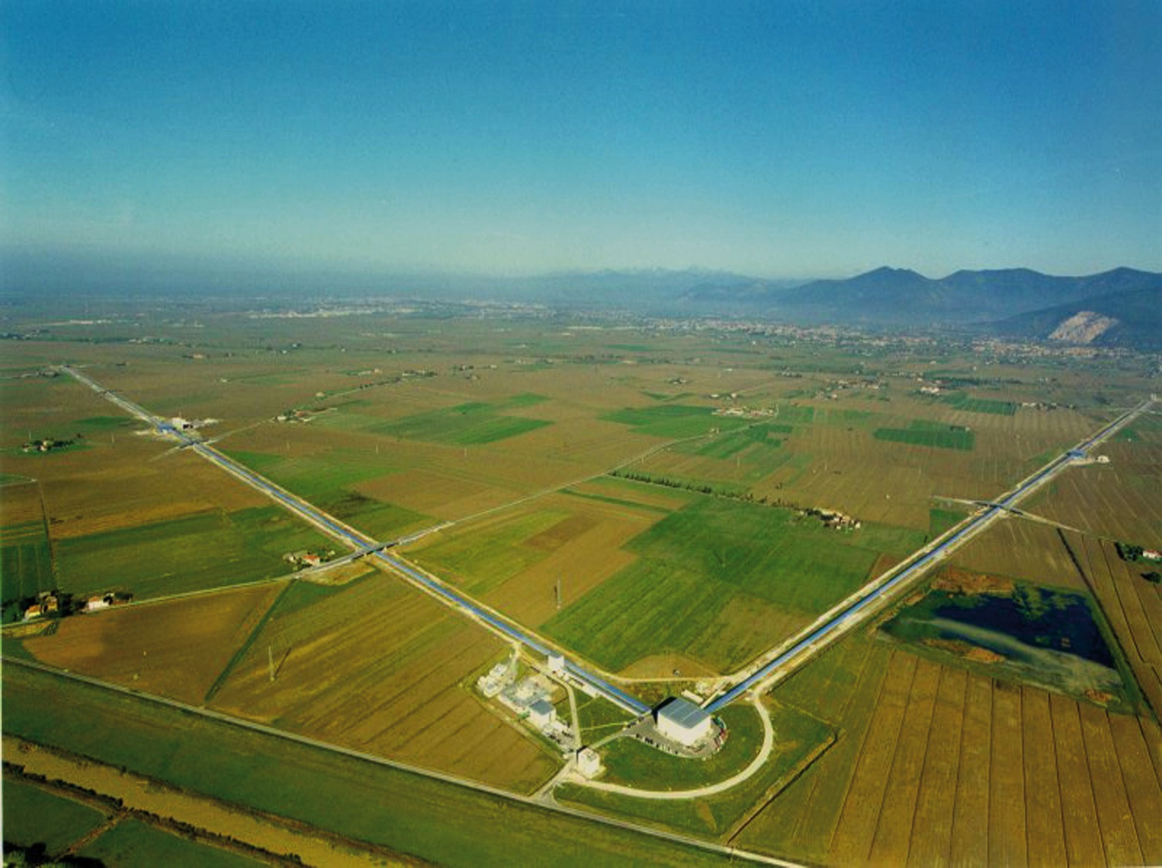
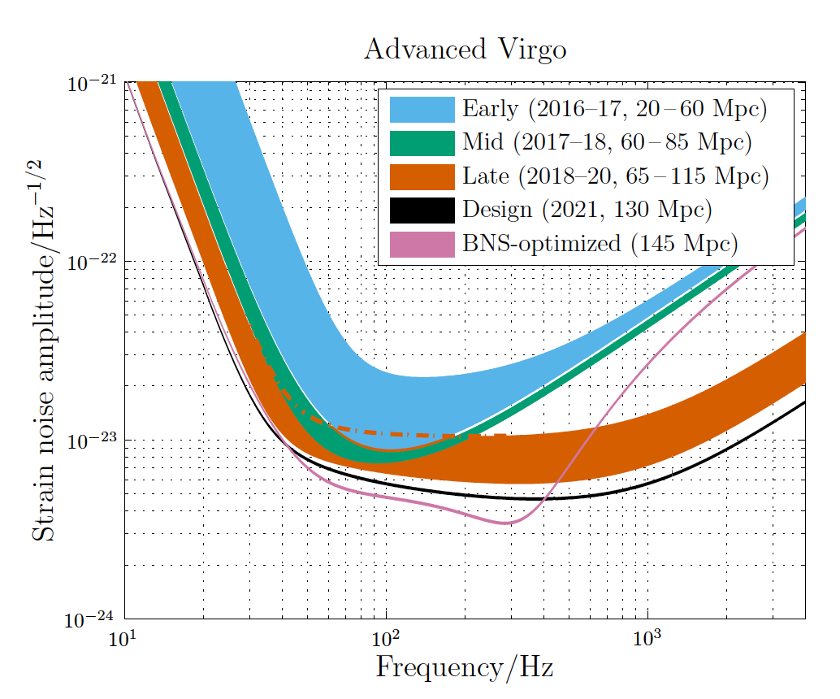
The Virgo Detector

Slide 4
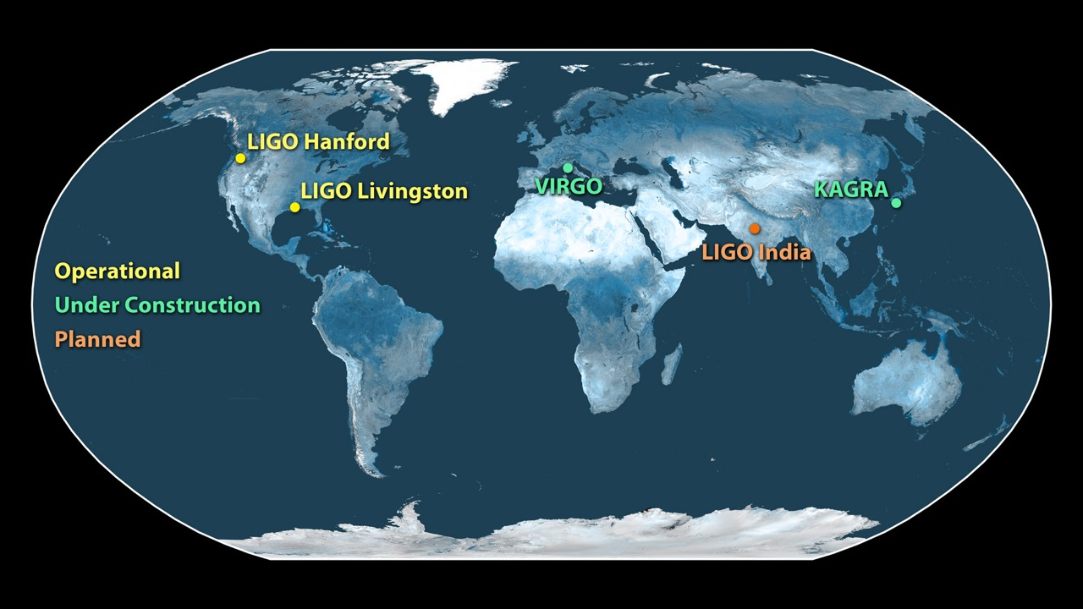
The Future Global Network of Gravitational Wave Observatories

Slide 5
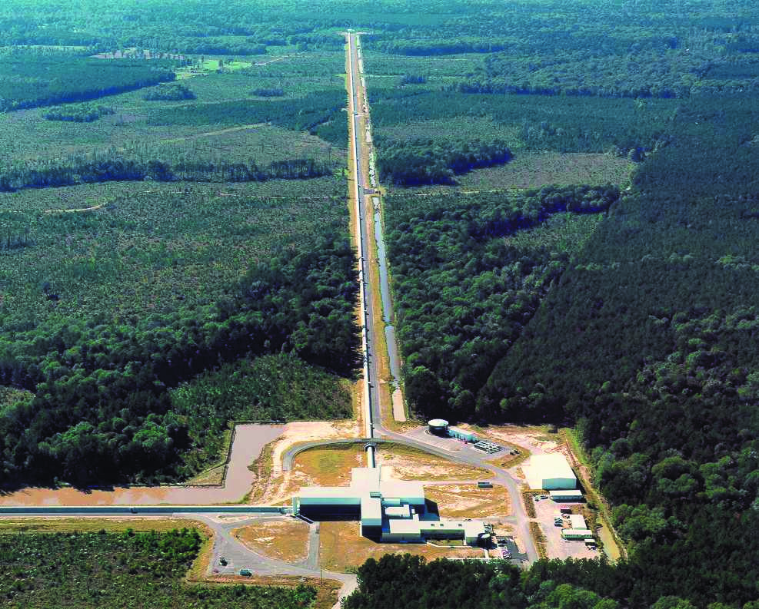
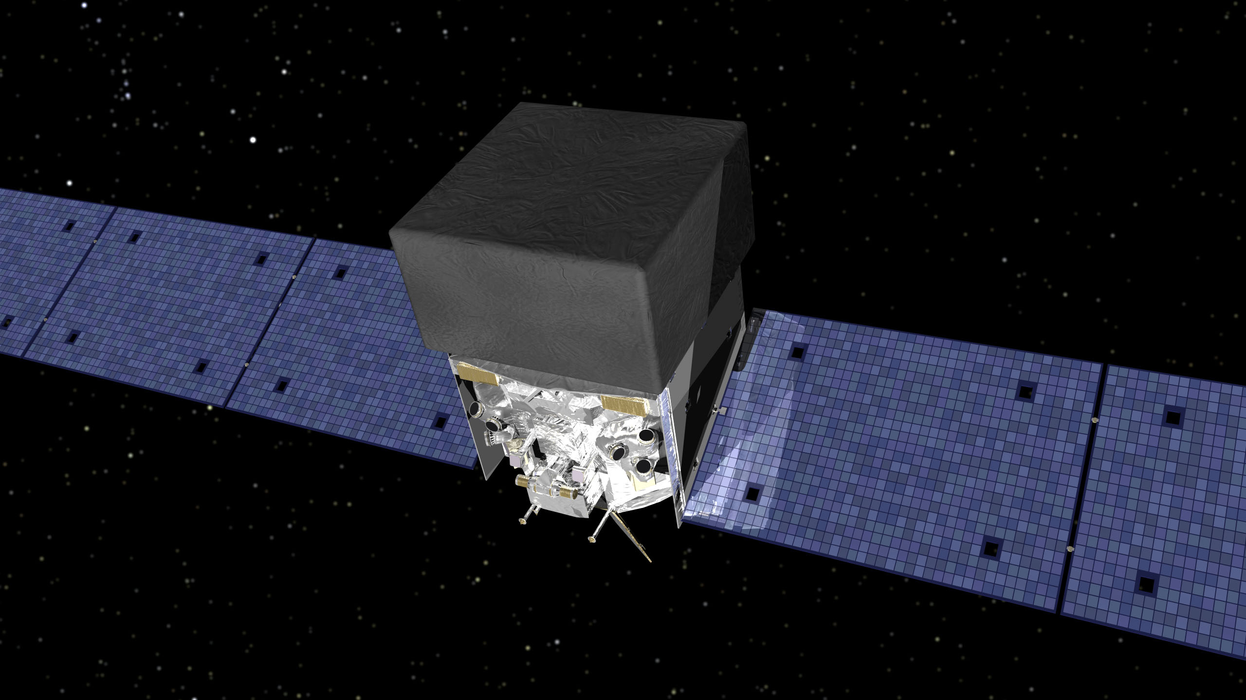
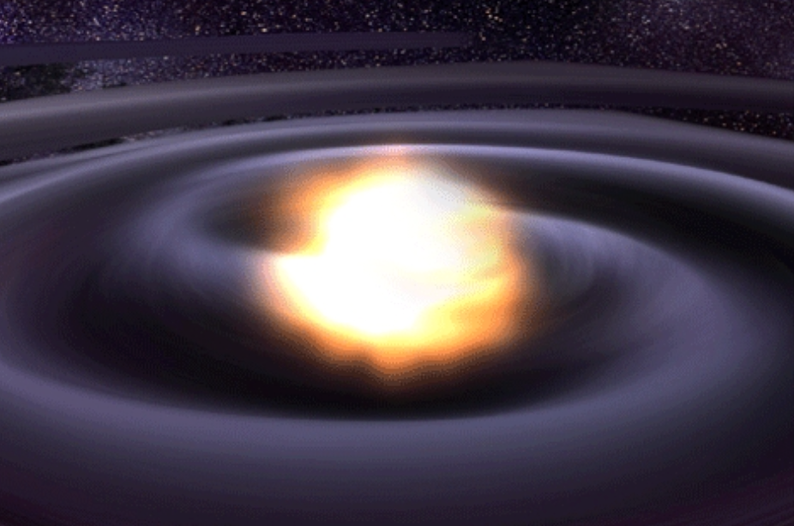
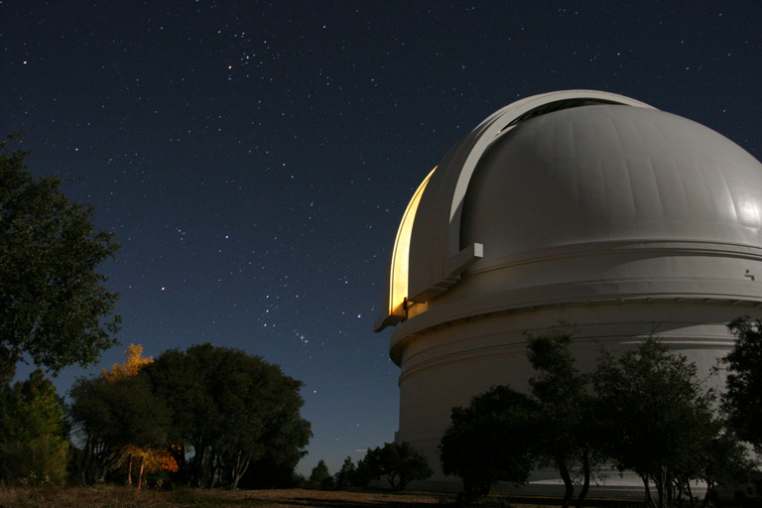
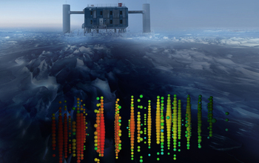
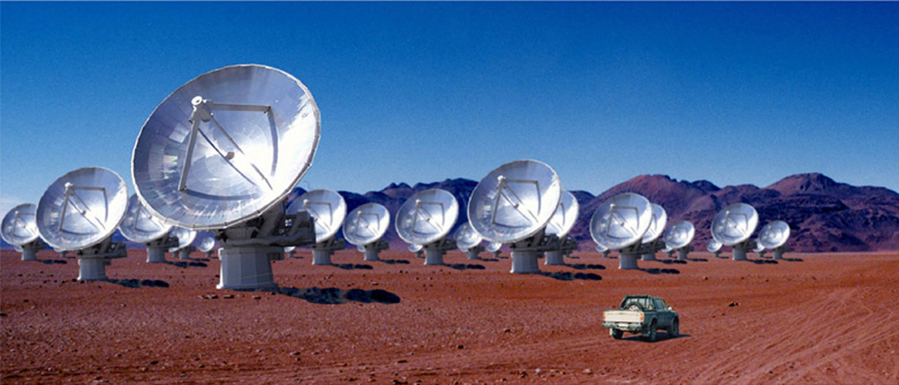
Multi-messenger Astronomy with Gravitational Waves
Binary Neutron Star Merger
X-rays/Gamma-rays
Gravitational Waves
Visible/Infrared Light
Neutrinos
Radio Waves

Slide 6
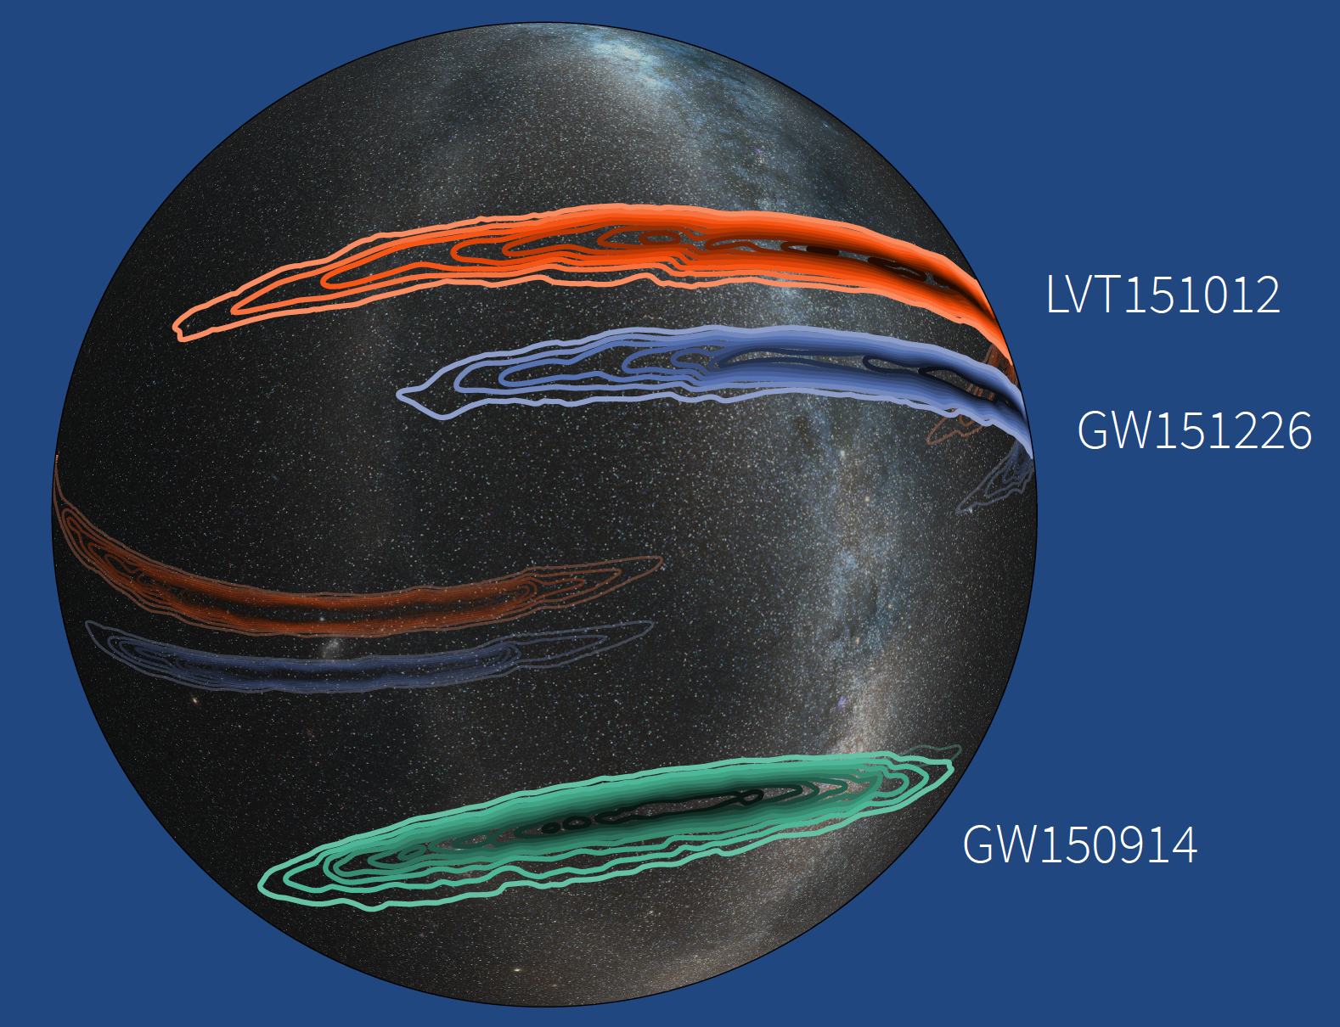
Sky Locations of Gravitational-wave Events GW150914, GW151226 and Candidate LVT151012

Slide 7
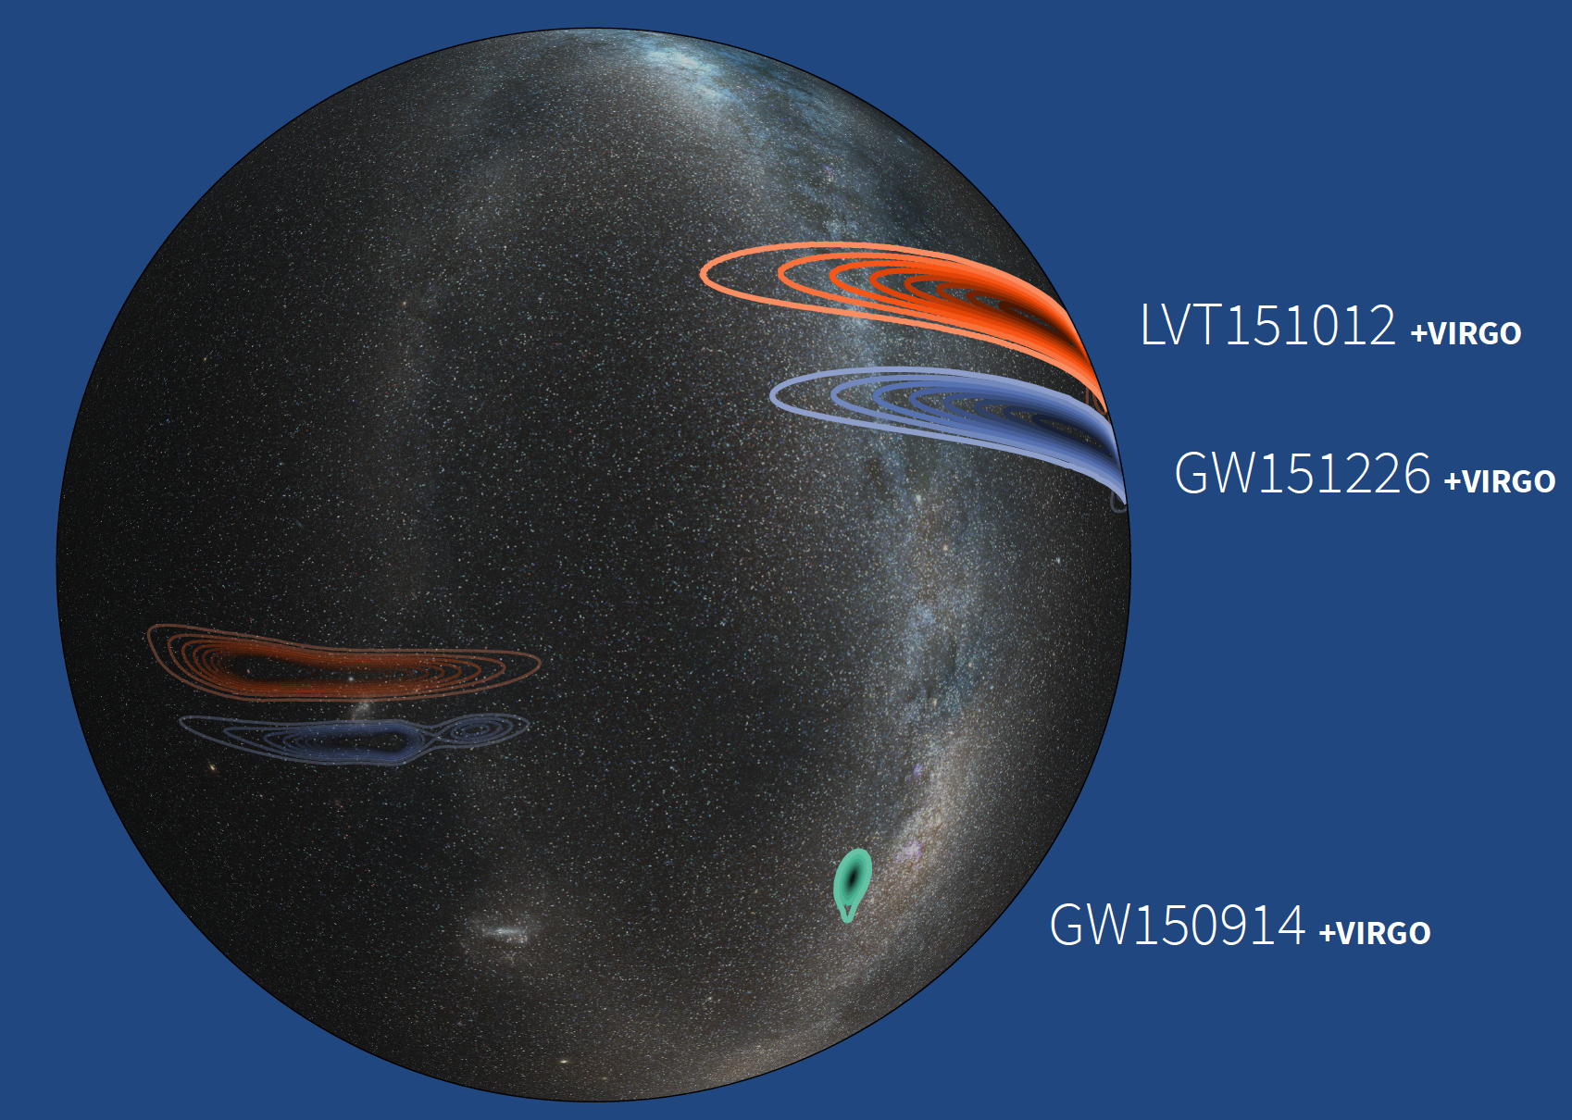
Simulated Sky Locations of O1 Events and Candidate Including the Virgo Interferometer

Slide 8
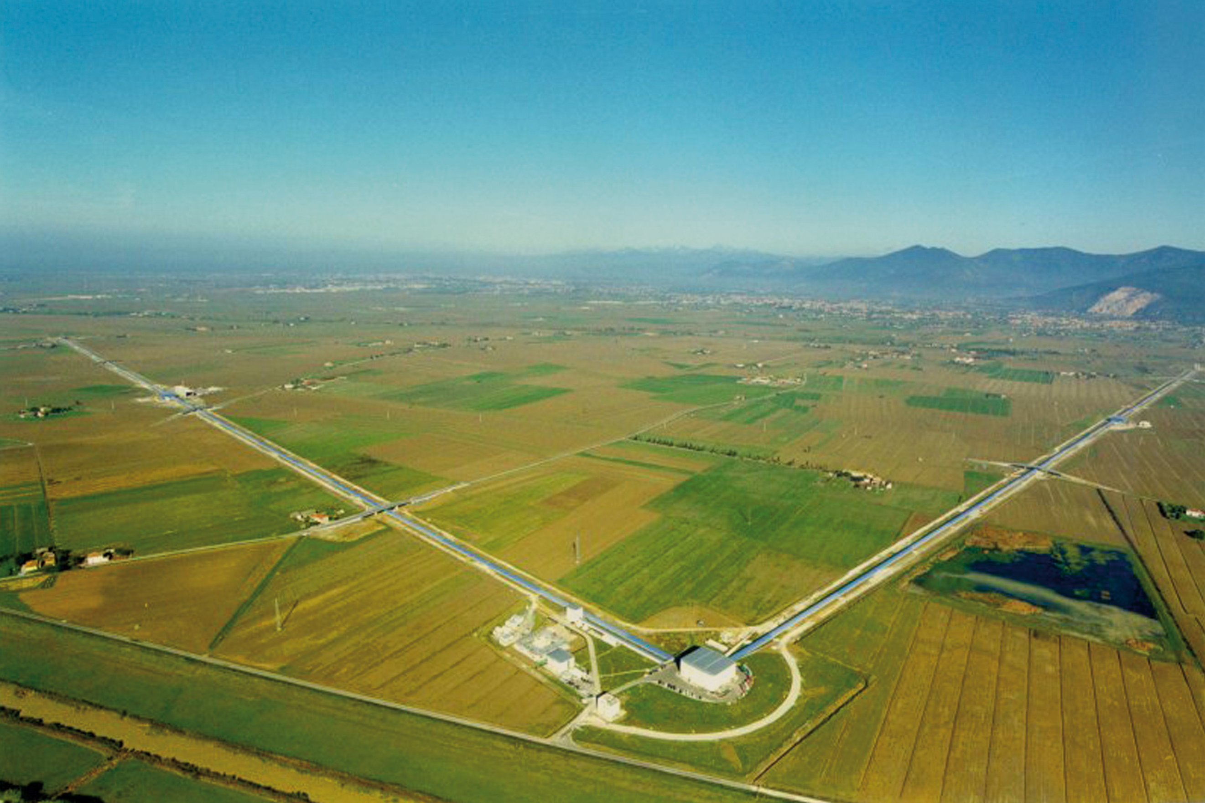
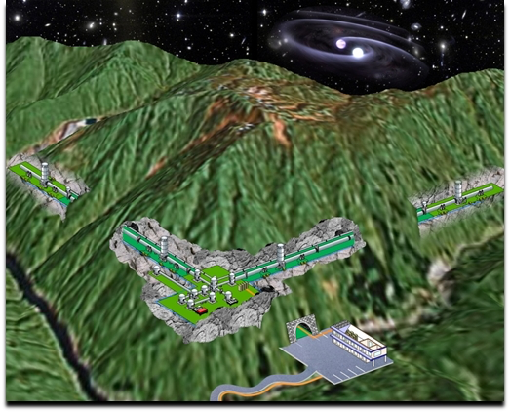
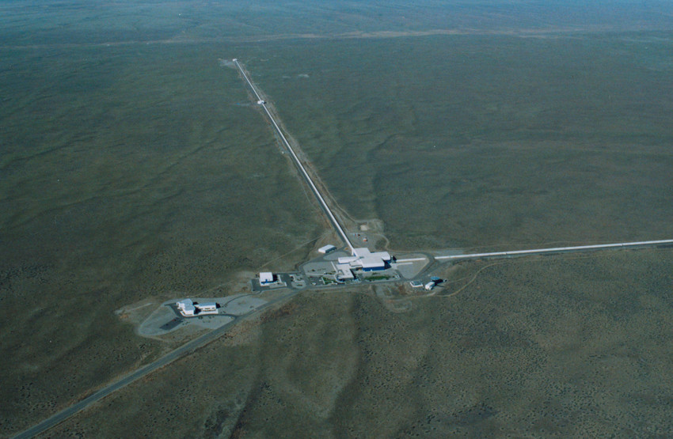
LIGO Livingston
USA
Virgo
Italy
LIGO-India
India
LIGO Hanford
USA
KAGRA
Japan

