Slide 1
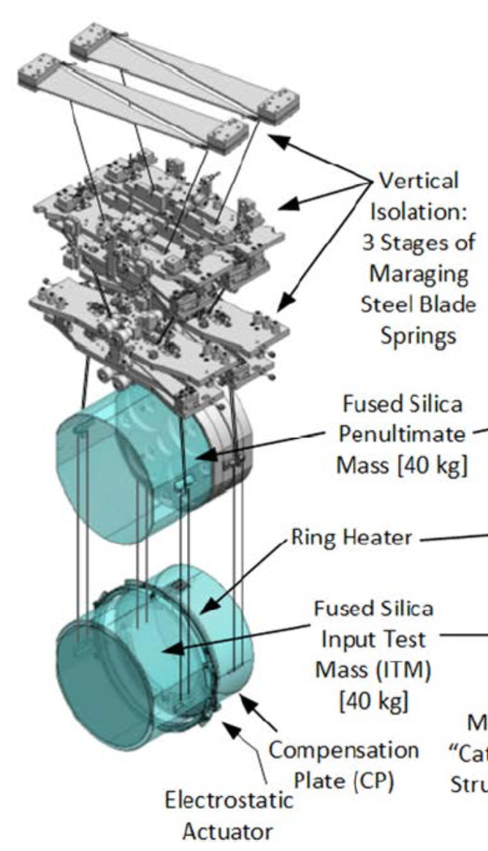
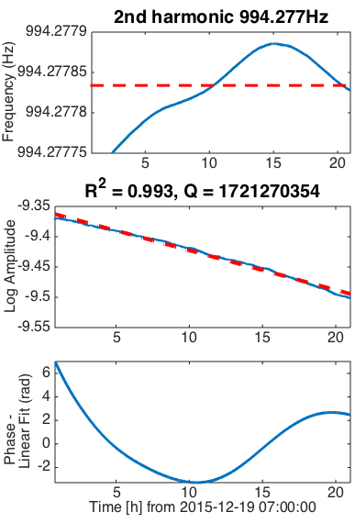
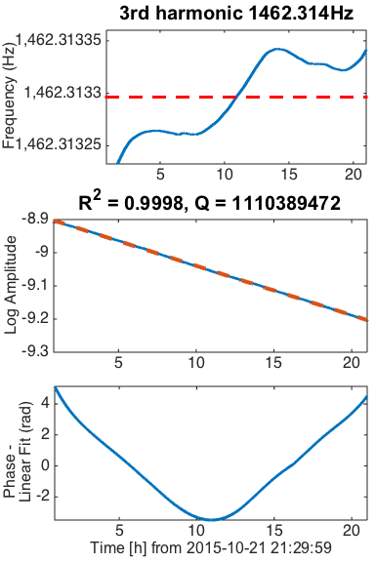
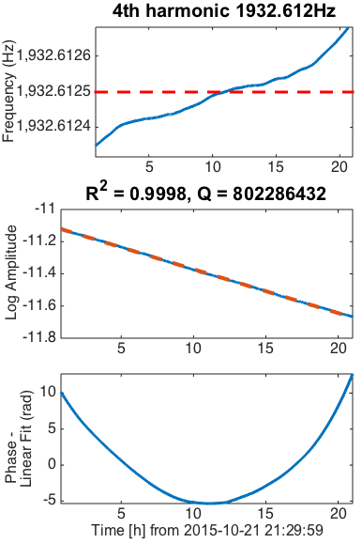
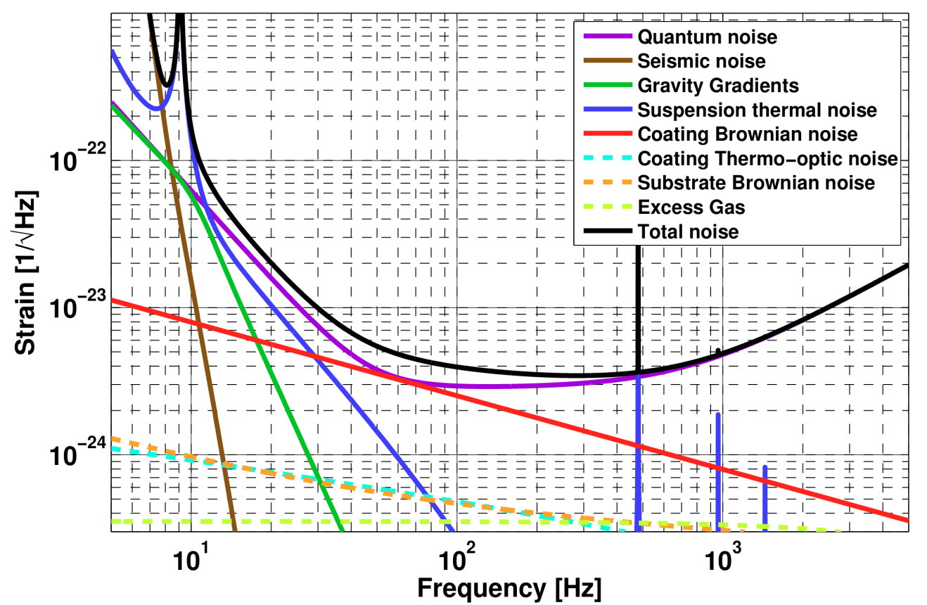
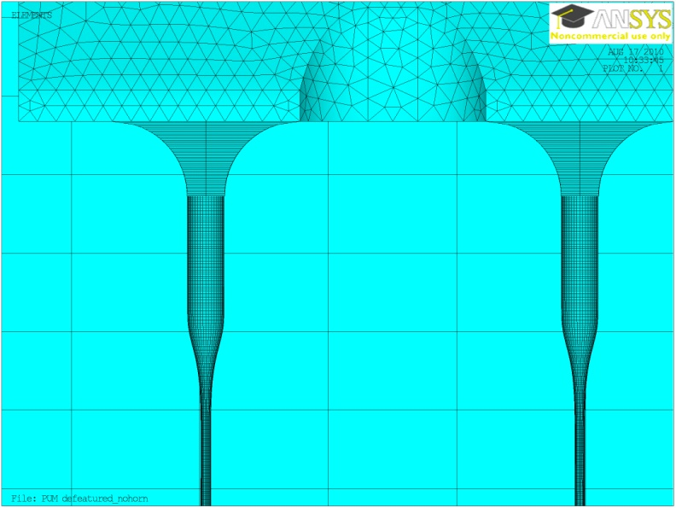
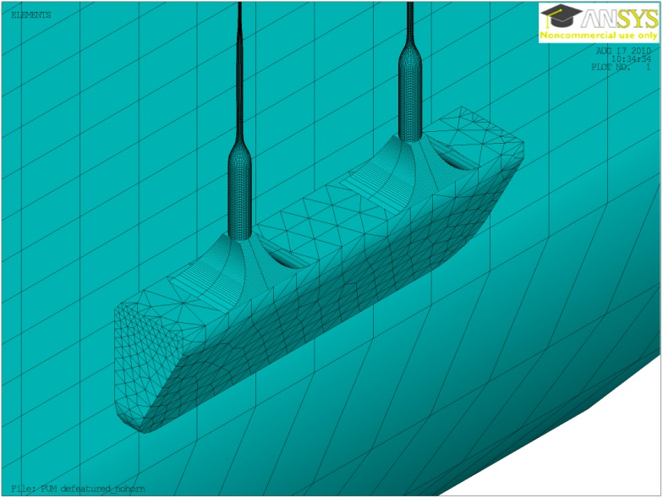
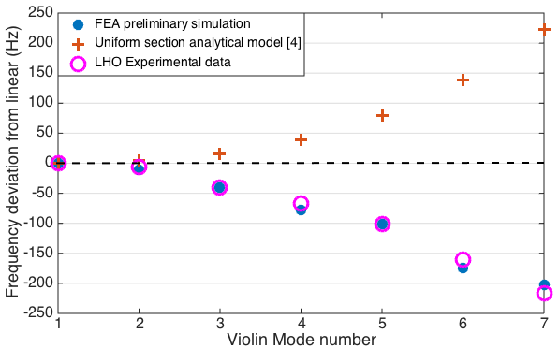
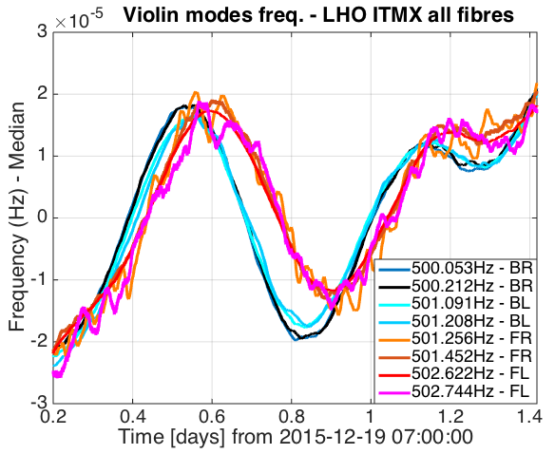
Characterisation of the aLIGO monolithic suspensions
B. Sorazu, A. Cumming, G. Hammond, A. Bell, K. A. Strain, Jim Hough, Sheila Rowan
Institute for Gravitational Research, SUPA, University of Glasgow, Glasgow, G12 8QQ, UK
Introduction
Q-factors of multiple harmonics of the violin modes
Suspension thermal noise is an important low frequency noise source between 10 and 30 Hz in the Advanced LIGO (aLIGO) detectors. At Glasgow we are working to enhance the characterization of the aLIGO detector’s monolithic suspensions, prototyped in 2010 [1] and installed between 2011-2015, to better understand the aLIGO detectors low frequency noise performance.
The Q-factors of the QUAD violin modes are ≈10⁹ (1 week decay time). Ringing up multiple modes may provide a better constraint on the different mechanical loss terms, ultimately providing separate characterisation of each individual installed suspension.
aLIGO design sensitivity
Figure 1: (Left) aLIGO QUAD suspension including reaction chain (monolithic stage in blue at front). (Right) aLIGO design sensitivity showing fundamental noise contributions (suspension thermal noise in dark blue).
Figure 3: Q measurement of the 2nd (left), 3rd (middle horizontally) and 4th (right) harmonics of violin modes associated with the LHO ITMX suspension. (Top) represents the tracked frequency in blue with the median in red. (Middle vertically) Logarithmic decay of their amplitude in blue with the linear fit in red – R² is the goodness of fit. (Bottom) represents the phase variation of the resonances after linear fit removal.
Monitoring violin modes of the QUAD suspensions
FEA modelling of aLIGO fibre profiles
Ear horn modelled as part of fibre with rectangular section
The QUAD monolithic suspensions are made of fused silica (low mechanical loss) to minimize suspension thermal noise in detection bandwidth. Consequently violin modes of suspension fibres have extremely high Q-factors [1]. The repeatability of the fibre manufacture and the welding process causes equivalent resonances of different fibres to have low spread in frequency (0.05Hz). These factors make it difficult to monitor each mode separately.
After evaluating different methods, we found the line tracker iWave [2] to be suitable, after conditioning of the data and tuning of parameters. iWave is based on IIR filters of complex coefficients with a transfer function that resembles a damped oscillator of controllable frequency and Q. Here it is configured as a digital PLL that locks to each violin mode in real time.
During locks of between 20 and 35 hours, when the violin modes damping filters were off, we tracked frequency, amplitude and phase variations of all the modes for one of the suspensions at the Hanford aLIGO detector. This enabled the measurement of real time frequency variations of the violin modes (fig. 2); and Q-factors of multiple harmonics (fig. 3).
Preliminary FEA modelling of the actual fibre profiles, measured during installation of the LHO ITMX suspension (end of March 2014), has been used to predict the observed departure of the frequencies of the violin mode harmonics from whole multiples of the fundamental (“inharmonicity”).
For uniform wires the inharmonicity is above the corresponding integer multiple of the mode fundamental frequency [3,4].
Real fibre geometry (from profiled fibre)
Real ear geometry
Figure 4: ANSYS FEA model of the ITMX suspen- sion, using real fibre profiles during installation.
However the inharmonicity observed on shaped fibres (with neck, stock and weld, in addition to the thin section of the fibre) is below the corresponding multiple of the fundamental frequency.
Frequency variations possibly due to pitch and temperature sensitivity
Analytical model is above the linear (exaggerated by a factor of 100 for clarity)
Linear
FEA model and measured values in good agreement and below the linear
Figure 5: Preliminary FEA modelling of fibre profiles (weld shapes to be included in the future), predicts the inharmonicity observed on the LHO ITM monolithic suspension fibres. The FEA model values (in blue) are in good agreement with the measured values (in magenta) averaged over all 8 ITM fibres. We believe the inharmonicity trend observed on the FEA and measured values is dominated by the physical shape of the ends of the fibres (work is ongoing).
Figure 2: Frequency variations of LHO ITMX violin modes. Further studies are ongoing, our hypothesis is that this is due to temperature changes of ~0.05 degrees. The phase difference between modes of the back and front fibres may be due to suspension pitch sensitivity.
Future work
Using the above analysis techniques for the lower glass stage of the suspension, in the future we shall compare the measured violin mode Q values with detailed FEA modelling of the aLIGO monolithic suspensions. This information will help to better understand the aLIGO detector’s low frequency noise performance, the coupling to environmental factors such as temperature, and potential for future upgrades, where detailed knowledge of loss processes in suspensions is vital.
Acknowledgement
We would like to thank Ed Daw, Brett Shapiro, Alastair Heptonstall, and other LSC colleagues for their discussions.
[1] Cumming A., et. al. Class. Quantum Grav. 29, 2012
[2] iWave, created by Ed Daw (University of Sheffield). Private communication.
[3] Gonzalez G. and Saulson P. , J. Acoust. Soc. Am. 96,1994
[4] Barton M. LIGO-T1300876, 2015
Institute for Gravitational Research, SUPA, University of Glasgow, Glasgow, G12 8QQ
LIGO-G1601163
University of Glasgow, charity number SC004401

