Slide 1
Heterogeneous Detector Networks Sky Localization with 3G Detectors
May 26, 2016
Daniel Sigg LIGO Hanford Observatory

Slide 2
Issue
Sky localization is vital
EM counter parts (maybe)
Full waveform reconstruction
Distance determination (z goes into source frame mass)
Full Sky Coverage
Advanced detectors:
Network with 4-5 detectors of similar sensitivity
Sky localization by triangulation
3G detectors:
Network probably much smaller
Sky localization by polarization?
Heterogeneous network with Advanced detectors?

Slide 3
Basics
Inverse problem solved: Gürsel, Tinto 1989
Requires 3 detectors: not collinear, not coplanar (can be collocated)
For example: 3 L’s randomly on Earth, or 1 Δ & 1 L, or 2 Δ’s
With similar detectors combined SNR matters (detector null fine)
Sky location by polarization and antenna pattern
Triangulation:
Need 3 facilities minimum
Base length matters & high frequency signals give better timing
Tends to be superior (on Earth approx. factor of 10 in angle)
SNR of worst detector determines resolution (detector null bad)
Monte Carlo code combines both methods

Slide 4
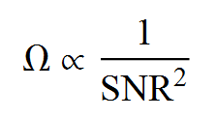
Advanced Detector Network
Low SNR events dominate in plot!
Klimenko,Vedovato

Slide 5
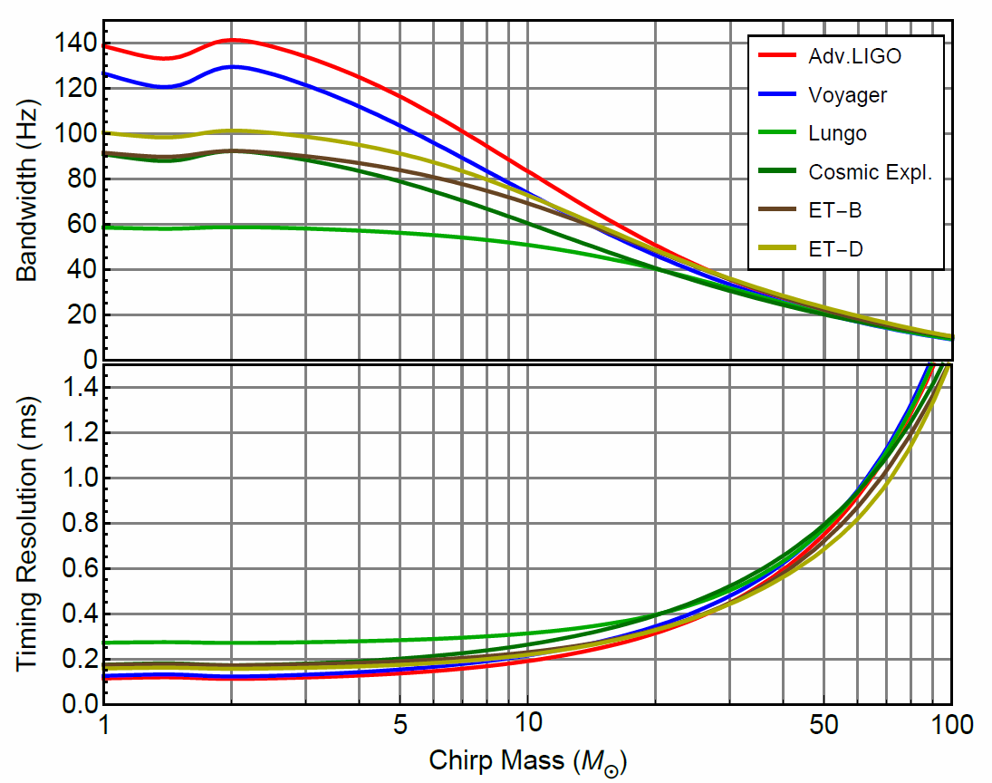
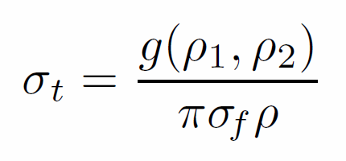
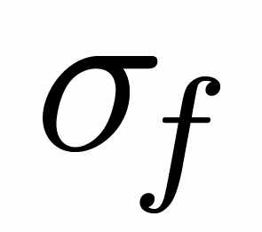
Triangulation Error
Time Resolution
Fairhurst
Effective Bandwidth

Slide 6
Heterogeneous Networks
1-2 3G detector facilities + advanced detectors
Cut on high SNR events in 3G detector
Solid angle reduction (SNR 3G/AD ~ 10)
Add one 3G facility: ~2
Add two 3G facilities: ~10
Three 3G facilities: ~70 (due to reduced bandwidth)
Will allow for distance measurements
Two 3G facilities on their own?

Slide 7
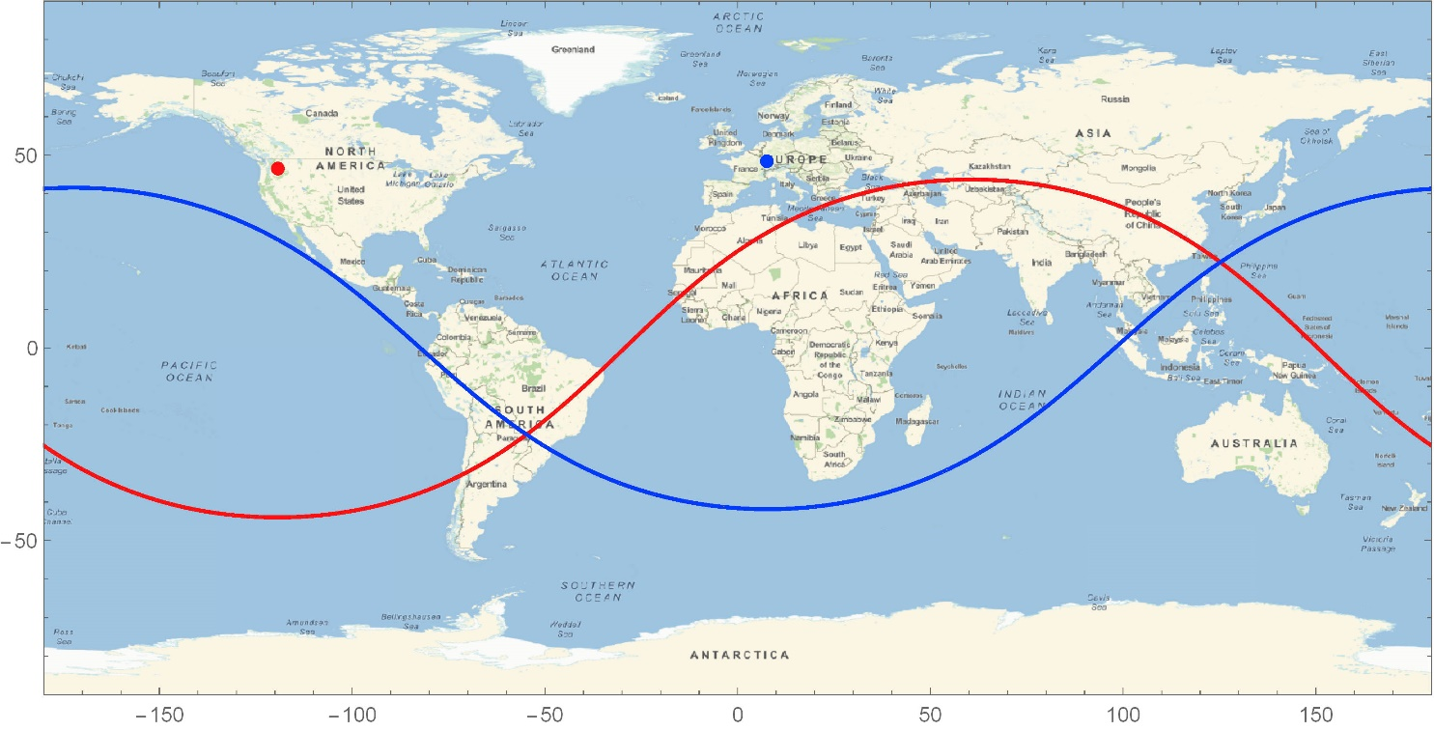
Double Trigon Configuration
Measure both polarization at both observatories
Try to locate 90$°$ apart on Earth
Detector normals:
$\left(\begin{matrix}+1 \\ 0 \\ +1\end{matrix}\right)$
$\left(\begin{matrix}+1 \\ 0 \\ −1\end{matrix}\right)$

Slide 8
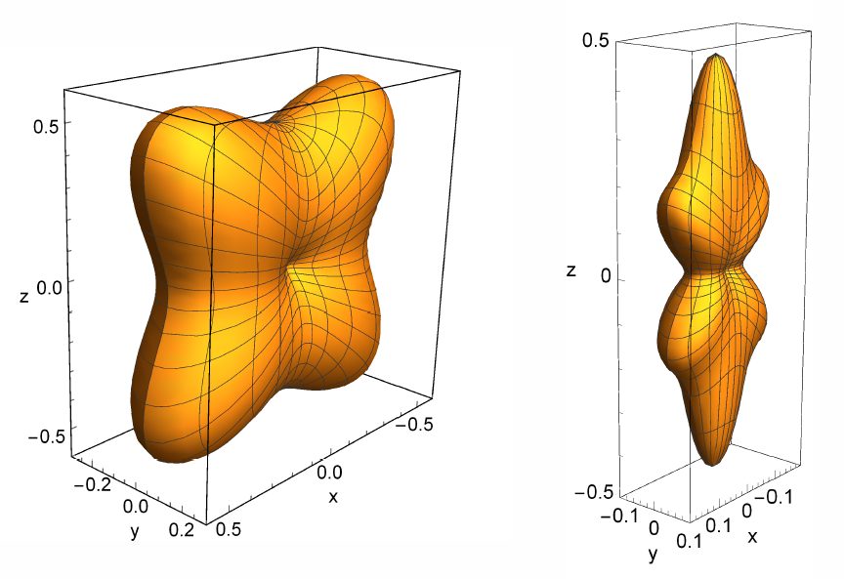
Solid angle for SNR 100 events (BW 50Hz)
Polarization alone
Polarization & Timing

Slide 9
Open Questions
How important is accurate sky localization?
Is the sky localization of the advanced detector network good enough for 3G physics?
If not, need more than one 3G facility
How important is full sky coverage?
If you can see all binary inspiral events, you can subtract/veto them from the stochastic background!
How many facilities can we afford?
Trade off: 3 L’s vs 2 Δ’s ?
Need MC code simulations

