Slide 1
Third Interferometer aka 3rd IFO Storage I. Main Presentation
NSF Review June 2016
v7
Fred Raab, Calum Torrie
and Nichole Washington
Please note while all links in this document may not click through to available DCC links, all links (not directly available) can be accessed via the related documents from the DCC page of this document i.e. at https://dcc.ligo.org/LIGO-G1601083/public.

Slide 2
Summary of talk contents
The past
Acceptance & Deliverables
The Present
Transition between aLIGO→Operations
Review of Acceptance, Initial Walkthrough & Fault Report System, FRS
3rd IFO Storage & Security / “lock down”
FAMIS Inspection & Maintenance Schedule
Component Request Log
Next
3rd IFO Modifications/Change Control (Development Effort)
The Future
3rd Physical Inventory Tracking
Physical Inventory “Stock-taking”
And then
Shipping to India …

Slide 3
Acceptance & Deliverables
Acceptance Review
15 sub-systems reviewed [out of 15]
Product reviewed and received
3rd IFO Acceptance and Punch-list
14th Sept 2015: 3rd IFO Acceptance documentation was submitted (Calum Torrie and Jodi Fauver) for approval by Systems Engineer (Dennis Coyne).
15th Sept 2015: Confirmation of no issues or bugs for transfer to existing “bug-lists”.
16th Sept 2015: Signoff and acceptance complete.
Refer to Documentation
3rd IFO Long-Term Storage Acceptance and Punchlist, LIGO-M1300164 [Approved]
This document provides information on the status of 3rd IFO (aka H2/India) storage at the end of the aLIGO project. At the time of close-out all sub-systems have completed handover to 3rd IFO. As part of the hand-over it is noted that a full integration of all of the parts lists and bill of materials into one system did not occur. This will be passed to Operations as a recommendation.

Slide 4
Transition between aLIGO→Operations
Hand-off to Ops staff
Includes all 3IFO storage plan responsibilities identified in E1300001 and in subsystem storage documentation
Storage – Security - Routine inspections and maintenance - Inventory tracking - Component modifications/change control
aLIGO Project was responsible for 3rd IFO components until formal acceptance → Upon acceptance of 3rd interferometer, custodianship became the responsibility of LIGO Lab Operations
Run by Operations (Fred Raab), supported by systems engineering (Dennis Coyne/Calum Torrie), oversight from business/property management (Hannah Hansen/Nichole Washington), assigned support by subsystem custodians
Ops subsystem / custodial responsibilities
Storage & security “lock down”, LIGO-E1600178: WASP Database Spreadsheet
Routine inspections and maintenance, LIGO-E1300001: Long Term Storage Plan for the Components of the Third Advanced LIGO Interferometer
Check out & request tracking, LIGO-F1500003: Third IFO Component Request Form and Procedure, LIGO-E1500229: Third IFO Component Request Log
Component modifications/change and more importantly development / upgrade effort
Inventory tracking, LIGO-E1300044: Top Level 3rd IFO BOM (work in progress), LIGO-E1300001: Long Term Storage Plan for the Components of the Third Advanced LIGO Interferometer LIGO-E1600122: 3rd IFO Sub-System Template for Inventory
Shipping

Slide 5
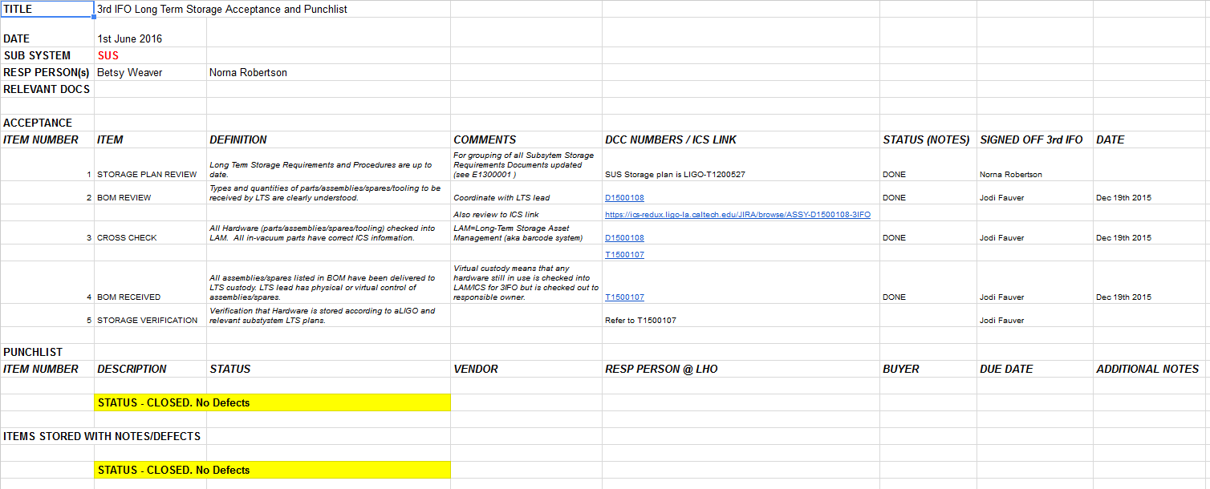
Operations effort – Review of “Acceptance & Deliverables”
June 2016: As part of Operations effort the team reviewed Storage Acceptance and Punchlist.
Each tab has verified bill of materials from each sub-system, which will be used as part of Inventory Control System (ICS) data collection and physical inventory (see later in talk)
Example page from 3rd IFO Long-Term Storage Acceptance and Punchlist, LIGO-M1300164 -v10 (SUS)

Slide 6
Initial Walk through &
Fault Report System, FRS
Initial Walk-through
March 2016 - 6 month after acceptance scheduled an initial walk-through of storage
Requirements for inspection and maintanance
Building and room requirements
Environmentally controlled containers and cabinets
Inventory and access controls
Change control and defect tracking
Routine monitoring and inspection
LIGO-E1600178: WASP Database Spreadsheet
Familiarization by new team of (Container level) Database of all items stored
LIGO FRS
The new LIGO Fault Reporting System (FRS) is being used to track and resolve issues associated with the 3rd IFO Storage
9 issues have been highlighted, 5 are resolved and 4 are pending
These range from storage condition e.g. finalizing wrapping and positioning on shelf to labelling of product on pallet, example: -
Issue - Incomplete maintenance schedule documentation
Resolution - All maintenance schedules are now documented on FAMIS
Notes:
Planning full Stock-take and walkthrough (see later)

Slide 7
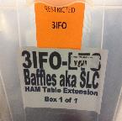
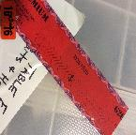
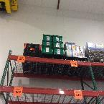
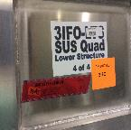
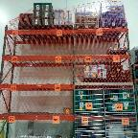
3rd IFO Storage & Security
[now]
Inventory of Stored Containers
Record Types of Storage Units (Custodian & FLS Crew)
Components, Containers, Crates, Pallets
Record Identifying Information (Custodian & FLS Crew)
Review (Property Manager)
BOM, Label, Lock, Record Number
Record Location (Custodian & FLS Crew)
Building, Room, Cabinet, Shelf
Record Data (Custodian with input from Property Manager)
Database E1600178

Slide 8
FAMIS Inspection & Maintenance Schedules [now]
The following schedules are currently in FAMIS recording all inspections and maintenance.
3rd IFO Building walk-through [weekly]
Inspect for access violation, pest or insect intrusion, water/moisture problems etc.
3rd IFO Environmental Controlled Container Inspection [Monthly]
Inspect all sealed storage containers that include either dry nitrogen or desiccant for mechanical damage, exposure to ambient air, saturation of desiccants or other problems.
3rd IFO Equipment Inspection [Monthly]
Inspect stored equipment for signs of unauthorized access, damage or other problems that indicate the integrity has been compromised.
3rd IFO Property Inspection [Annual]
1st inventory and check against the master 3IFO BOM, in planning.
If seals are intact this will verify that the contents are intact.

Slide 9
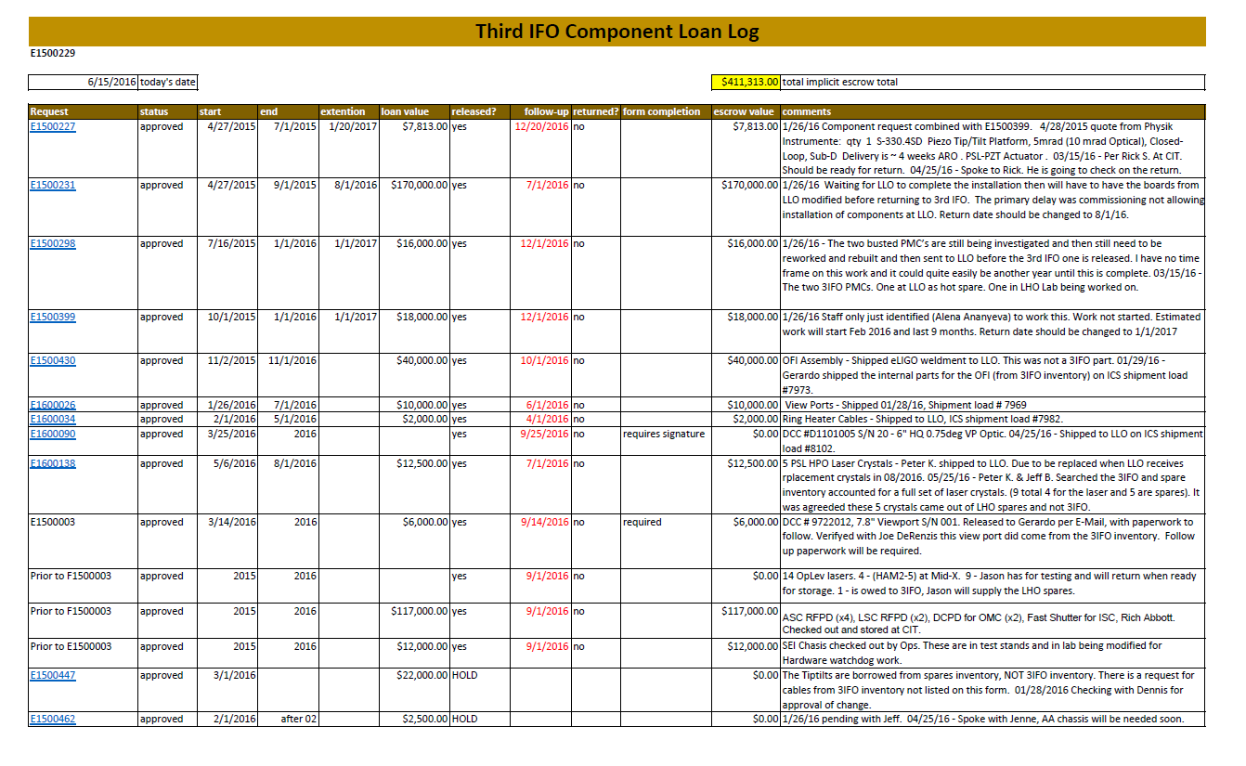
Request Log
LIGO-E1500229: Third IFO Component Request Log
A log of all (approved and rejected) requests for loan of Third Interferometer (IFO) Component Requests
17 approved (including handover from acceptance)
$410k total implicit escrow total [75% is two line items, highlighted below]
Extract from Log on 15th June 2016

Slide 10
3rd IFO Modifications/Change Control
(Development Effort) [coming soon 1-2 months]
Examples:
SR3 Actuator.
Test Mass Bounce and Roll Mode Dampers
Test Mass non-magnetic blade dampers
Modifications & Change Control (Systems Engineering)
Lock down (Custodian)
Record (Custodian)
Review
(Property Manager)
Receive (Custodian)
Development Effort /
Upgrades

Slide 11
3rd Physical Inventory Tracking
[later 6-12 months]
ICS vs Physical Components (Custodian)
FRS Issue Reporting (All)
FAMIS Work Assignment (All)
Audit & Report
(Property Manager)
Inventory Control System (ICS) data will be verified for record accuracy prior to physical inventory [using BOM’s supplied by sub-systems as initial input]
At this point an overall “storage state” BOM will be created LIGO-E1300044: Top Level 3rd IFO BOM (work in progress)

Slide 12
Workflow for 3rd IFO Inventory Database
[later 6-12 months]
ICS
NO
Fill out BOM
E1600122
ICS Storage Loads
Storage-xxxx
Review
Assembled
top level
Kitted
components
Update
YES
Review
Partial Assembly
sub assembly
Workflow planned for team that will work on Inventory Database using LIGO’s Inventory Control System (ICS).

Slide 13
Physical Inventory “Stock-taking” (Annual)
Even though we have confidence in the Acceptance process (Sept 2015) and in the Check-out procedure, a “stock-taking” is planned
Physical verification of the condition of items in storage plan valid?
Physical verification of the quantities of items in storage check out procedure, working?
Support our plan to consolidate the storage database using Google Docs, see LIGO-E1600122 below via the LIGO Inventory Control System (ICS)
Match & update the storage condition to the Bill of Materials (BOM)
LIGO-E1300044: Top Level 3rd IFO BOM (pending)

Slide 14
Final Check-out: Shipping of H2 Components [much later, few years]
LIGO Laboratory shares responsibility with partner for shipping 3rd interferometer components overseas
India is responsible for all costs associated with shipping except LIGO staff time as presented below
LIGO Lab primary responsibilities
Preparation and execution of export licenses
NB: all components covered under Export Administration Regulations (dual use)
Check-out and final inspection of H2 components
Partner primary responsibilities
Design and manufacture of shipping containers
Develop crating procedures
Providing clean/secure storage
Identify best shipment methods
Joint responsibilities
Component and assembly packing
LIGO Lab provides oversight on all partner activities

Slide 15
H2 Component Shipping: Logistics
LIGO shipment readiness review required before shipment is authorized. Must pass certification checklist:
Final inspection: component/assembly complete and in proper condition
Shipping container design approved; shipping container(s) ready and available
Receiving area ready (matches LIGO storage requirements); receiving team trained and certified in proper handling
Documents ready (‘traveler’, export license)
We will adopt Advanced LIGO component shipping containers where possible
Designs have been ‘battle-tested’ during aLIGO
Some new containers will be designed as needed for components assembled at LIGO sites
LIGO Lab Operations caretaker is responsible for overseeing packing and shipping all subsystems

Slide 16
Summary of talk contents
The past
Acceptance & Deliverables
The Present
Transition between aLIGO→Operations
Review of Acceptance, Initial Walkthrough & Fault Report System, FRS
3rd IFO Storage & Security / “lock down”
FAMIS Inspection & Maintenance Schedule
Component Request Log
Next
3rd IFO Modifications/Change Control (Development Effort)
The Future
3rd Physical Inventory Tracking
Physical Inventory “Stock-taking”
And then
Shipping to India …
Progress
All areas covered in talk

Slide 17
Third Interferometer aka 3rd IFO Storage
II. Response to Recommendations from NSF Storage Review
NSF Review June 2016
v7
Please note while all links in this document may not click through to available DCC links, all links (not directly available) can be accessed via the related documents from the DCC page of this document i.e. at https://dcc.ligo.org/LIGO-G1601083/public.

Slide 18
Review of the Long Term Storage Plan For the National Science Foundation April 9, 2013 Final Report
Question #1
Please advise NSF on the appropriateness of LIGO's proposed plans to store the in-vacuum components of the second Hanford interferometer for a nominal 3-5 year period. Please advise NSF of any best practices or sources of expertise used elsewhere to store approximately similar components that may be of assistance to LIGO in further planning.
Panel Response: The storage plans for in-vacuum components is appropriate with the exception of the omission of optical witness samples where high value/long lead optical assemblies and suspension systems would benefit from independent monitoring.
LIGO Response: Clean 4” silicon wafers placed in storage location, for future analysis. Equivalent to those used in LIGO chambers

Slide 19
Review of the Long Term Storage Plan For the National Science Foundation April 9, 2013 Final Report
Question #3
Please advise NSF on the appropriateness of LIGO's plans to inventory the stored items, including: Plans to uniquely identify and track the location of stored items and materials. Plans to maintain data and metadata pertaining to the stored items that may be required during their later use, as well as plans to maintain adequately documented software, software parameters, changes or other stored hardware-specific information. Plans for inventory control, security, and safety during storage. Plans for environmental control and environmental monitoring during storage.
Panel Response The review panel feels that LIGO’s plans are appropriate for the proper tracking of stored items. Inventoried items are tracked with a computer program called ICS (for Inventory Control System) that provides deep documentation. Software is under configuration control and is shared among LIGO sites. Plans for inventory control, security and safety are sufficient as containers are numbered and inventoried. Containers will be clearly marked and have paper copies of the container’s contents including engineering drawings. The plan calls for locks and tamper evident seals. Containers without locks will be stored in locked, limited access rooms. Stored items for a 3rd IFO are not to be co-mingled with other LIGO components and 3rd IFO components cannot be used for other purposes without senior management approval and a plan for component replacement. The areas designated for 3rd IFO storage seem adequately safe from natural and man-made hazards like weather and power failures. All the stored equipment will be maintained indoors in clean temperature and humidity controlled rooms. Storage areas will be inspected periodically (weekly) for evidence of environment variations or pest control issues. The review panel recommends that LIGO verify that software, data and documentation is duplicated at a back- up server at a different location.
LIGO Response: Containers are clearly marked and include paper copies of contents and DCC numbers of all drawings. All drawings are on the DCC and searchable with DCC number.
LIGO Response: Key documentation (except full inventory) now on our Document Control Center (DCC) which is backed up. Working on getting all of the inventory into the LIGO Inventory Control System (ICS) which is also backed up.

Slide 20
Review of the Long Term Storage Plan For the National Science Foundation April 9, 2013 Final Report
# Question #5 (only sections with actions listed)
Given the approach that LIGO plans for the storage: Are any of the stored assemblies, any of their component parts, or their storage containers expected to exhibit performance capabilities that degrade with time in storage? If yes, why?
Panel Response From the information reviewed and discussed with the Project, there were no systems or components that are expected to exhibit degradation over the 3-5 years planned for storage. With respect to the storage containers, many of the systems are currently in temporary storage and the planned storage containers have not been fabricated yet. The main concerns on the storage containers have to do with the plans and procedures for dry nitrogen purge, use of optical witness samples, desiccants and humidity strip indicators.
LIGO Response: All items are now in the long term storage containers, refer to main talk and in particlaur to slide on Long Term Storage and associated documents. LIGO’s FAMIS (refer to main talk) is the tool now utlilized for the tracking of the Nitrogen and desiccant levels.
Question #5 (only sections with actions listed)
What assemblies or components will require retesting, re-characterization or recalibration after storage or will this be required for all stored items? How was or is this to be determined? Are any special facilities, instruments or fixtures required?
Panel Response The panel recommends that the Project consider the pros and cons of performing retesting (functional or performance) on any of the stored systems. They should consult with the provider of the system, subsystem, or component as to the benefits of performing any testing prior to shipping. In many cases (like the PSL), the advantages of performing one final system test may be outweighed by the risks of damage or contamination from unpacking, testing, and repacking.
LIGO Response: On review internally by LIGO the re-testing was considered not required.

Slide 21
Third Interferometer aka 3rd IFO Storage
III. Supplemental Slides
NSF Review June 2016
v7
Please note while all links in this document may not click through to available DCC links, all links (not directly available) can be accessed via the related documents from the DCC page of this document i.e. at https://dcc.ligo.org/LIGO-G1601083/public.

Slide 22
Bill of Materials (BOM)
The detector drawings and BOMs are hierarchically linked in the SolidWorks vault,
and in the LIGO Document Control Center (DCC). BOMs are embedded
in the assembly and sub-assembly drawings (and of course within the
SolidWorks CAD files). In addition, we provide BOMs at the chamber
assembly level as separate documents. The chamber-level BOMs (for LLO)
are as follows:
E1101163 BSC1 L Top Level Chamber Assembly BOM
E1101164 BSC2-L Top Level Chamber Assembly BOM
E1101165 BSC3 L Top Level Chamber Assembly BOM
E1201084 BSC4 L Top Level Chamber Assembly BOM
E1300289 BSC5 L Top Level Chamber Assembly BOM
E1200569 HAM1-L Top Level Chamber Assembly BOM
E1100820 HAM2-L Top Level Chamber Assembly BOM
E1100818 HAM3-L Top Level Chamber Assembly BOM
E1101158 HAM4-L Top Level Chamber Assembly BOM
E1101159 HAM5-L Top Level Chamber Assembly BOM
E1101160 HAM6-L Top Level Chamber Assembly BOM
All of these are publically available either directly or by paging down from D0901491 which is a related document at: - https://dcc.ligo.org/LIGO-G1601083/public.

Slide 23
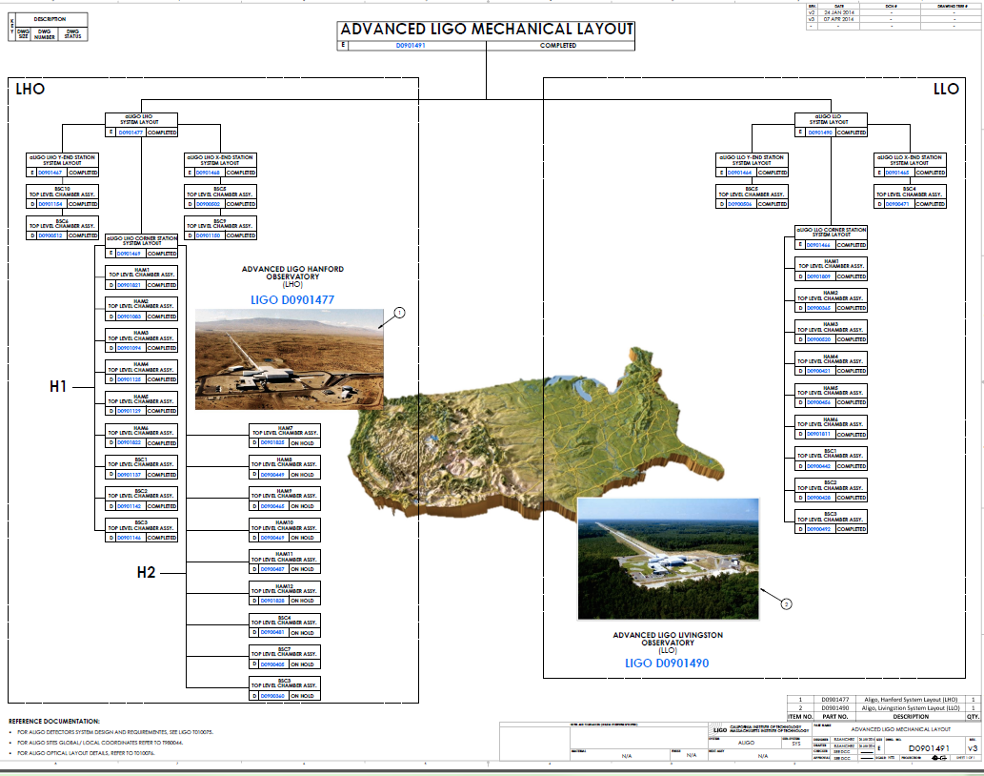
Bill of Materials (BOM)

Slide 24
Bill of Materials (BOM)
One can path to the detector drawings (from top-level assemblies, to lower-level
assemblies and down to the piece part level) by starting at the root document.
For example (to 6th level only):
LIGO-D0901491: aLIGO, Mechanical Layout LIGO-D0901490: aLIGO LIVINGSTON SYSTEM LAYOUT LIGO-D0901464: aLIGO Systems Layout LLO Y-End Station LIGO-D0900506: aLIGO Systems BSC5-L1, Top Level Chamber Assembly LIGO-E1300289: BSC5 L Top Level Chamber Assembly BOM LIGO-D0900507: AdvLIGO VE BSC5-L1, Vaccuum Equipment Assembly LIGO-D0900516: AdvLIGO SEI BSC5-L1, XYZ Local CS for ISI Table LIGO-D0901182: aLIGO, SEI, BSC-ISI, Top Assembly LIGO-D0900517: AdvLIGO SUS BSC5-L1, XYZ Local CS for ETMY LIGO-D0901346: Advanced LIGO Quadruple Suspension Assembly ETC. LIGO-D070056: Advanced LIGO, SUS, Quad N-PType, Quad Dog Clamp LIGO-D1003190: aLIGO SUS BSC Shorter Dog Clamp LIGO-D1100785: SUS Nitronic Flat Washers LIGO-D1002424: aLIGO, SUS, VIBRATION ABSORBER, 5LB VERTICAL WITH O-RINGS LIGO-D0900436: AdvLIGO SUS BSC5-L1, XYZ Local for ETM Tel Assy ETC LIGO-D1201071: AdvLIGO BSC5-L1 ISI Table, Payload & Suspended Mass Assembly LIGO-D1200677: AdvLIGO SUS BSC5-L1, XYZ Local CS for SLC Arm Cavity Baffle ETC LIGO-D1200111: CABLE HARNESS ROUTING CONFIGURATION, LBSC5 / WBSC10 LIGO-D1000513: HEPI ASSEMBLY, BSC aLIGO ETC LIGO-D1003092: Flange Layout – L1 Beam Splitter Chamber 5 (BSC5) ETMY LIGO-E1000337: AdvLIGO Detailed Mass Properties-CG Report BSC Tables (LLO) LIGO-D0901465: aLIGO Systems Layout LLO X-End Station ETC LIGO-D0901466: aLIGO Systems Layout LLO Corner Station ETC
All of these are publically available either directly or by paging down from D0901491 which is a related document at: - https://dcc.ligo.org/LIGO-G1601083/public.

Slide 25
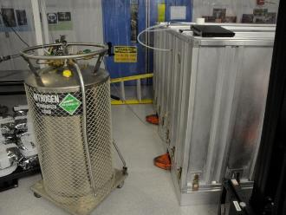
General Storage Requirements
Several types of packaged interferometer components:
Shipping crates – protected internally from contamination, but with outside housing incompatible with clean areas
Storage containers
“In air” parts are destined to function inside the clean area that houses the interferometers, but outside the vacuum system
“In Vacuum” parts: Items intended for permanent in-vacuum service (Class A) or tooling that touches in-vacuum parts (Class B) are fabricated, cleaned, baked, and packaged according to specific and stringent protocols.
Class A and Class B parts must be stored in clean space, some of them under dry nitrogen (N2) purge (or vacuum) to avoid humidity impacts.

Slide 26
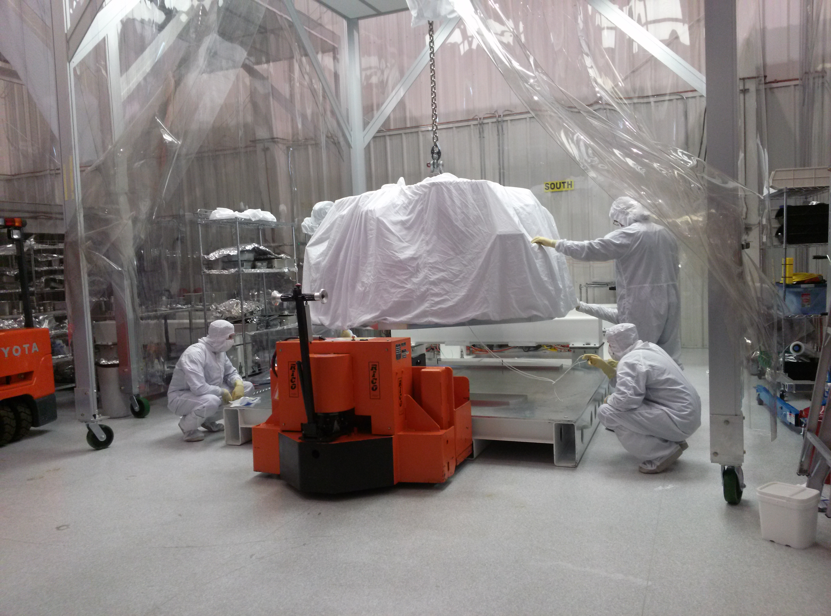
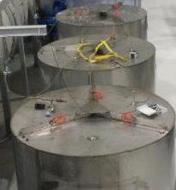
Storage
Venues arranged according to general storage condition requirements, LIGO-E1300001: Long Term Storage Plan for the Components of the Third Advanced LIGO Interferometer
Temperature range: 72F +/- 3.5F
Humidity range: 20-70% relative humidity (RH)
Cleanliness
Assignment of 3IFO Storage venue is further refined using each sub-system’s specific humidity control requirements
REF: Technical Progress-3IFO for NSF Review 2015 https://dcc.ligo.org/LIGO-G1500720

Slide 27
Storage Requirements
LIGO-E1300001: Long Term Storage Plan for the Components of the Third Advanced LIGO Interferometer
The purpose of this document is to define the requirements and top-level plans for Long Term Storage (LTS) of the Advanced LIGO (aLIGO) Third Interferometer (3rd IFO) components . Detailed storage plans are defined in documentation referenced in the following sections.
It should be noted that all components of the 3rd IFO are to be stored in LIGO facilities at the LIGO Hanford Observatory (LHO), under LIGO oversight/security and within clean and environmentally controlled spaces.
There are very few items which require special consideration for long term storage. In addition all of these 3rd IFO components will be tracked and controlled using the same procedures and inventory control system used for the components of the other two aLIGO interferometers.
LIGO-T1200527: Suspension (SUS) Long Term Storage for the 3rd aLIGO Interferometer
LIGO-T1200549: Seismic Isolation (SEI) Long Term Storage for the 3rd aLIGO Interferometer
LIGO-T1200557: Pre-Stabilized Laser (PSL) Long Term Storage for the Third aLIGO Interferometer
LIGO-T1200567: Input Optics (IO) Long Term Storage for the 3rd aLIGO Interferometer
LIGO-T1300027: Interferometer Sensing and Control (ISC) Long Term Storage for the 3rd aLIGO Int
LIGO-T1300016: Core Optics Components (COC) Long Term Storage for the 3rd aLIGO Interferometer
LIGO-T1300010: Facilities Modifications and Tooling (FMP) Long Term Storage for the 3rd aLIGO Int
LIGO-T1300002: Control and Data Systems (CDS) Long Term Storage for the 3rd aLIGO Interferometer
LIGO-T1300006: Stray Light Control (SLC) Long Term Storage for the 3rd aLIGO Interferometer
LIGO-T1300003: Thermal Compensation System (TCS) Long Term Storage
LIGO-T1200558: Optical Lever (OpLev) Long Term Storage for the 3rd aLIGO Interferometer
LIGO-T1300011: Initial Alignment System (IAS) Long Term Storage for the 3rd aLIGO Interferometer
LIGO-T1300012: Photon Calibrator (PhCal) Long Term Storage for the 3rd aLIGO Interferometer
LIGO-T1300007: Transmission Monitor SUS (TMS) Long Term Storage (LTS) for the 3rd IFO and LIGO LTS
LIGO-T1300006: Stray Light Control (SLC) Long Term Storage for the 3rd aLIGO Interferometer

Slide 28
3rd IFO Inspections & Maintenance
[now]
FAMIS Schedules
(Property Manager)
Physical Inspections (FLS Crew)
FRS Maintenance Reporting
(FLS Crew)
FAMIS Maintenance Assignment
(Custodian)
Review
(Property Manager)

Slide 29
3rd IFO Check Out & Request Tracking
[now]
Approve
(Systems Engineering)
Locate, Release & Document
(Custodian)*
Monitor Return
(Property Manager)
Receive, Lock Down & Record
(Custodian)*
Review
(Property Manager)
Submit
(Requestor)*
Completion of E1500003
Recorded on E1500229
Physical components from storage
Review of E1500229
Physical components to storage
Trust and verify
and documented on E1500229
and documented on E1500229
* Acting on-site property custodian Jeff Bartlett available for guidance / support here

Slide 30
Check Out Procedure
LIGO-F1500003: Third IFO Component Request Form and Procedure
This form is to be completed and submitted for approval by Systems Engineering for any loan or use of a Third Interferometer (IFO) component.
Procedure
The requester/borrower reserves an E-number from the DCC, completes the form above, uploads the completed form, and requests the System Engineer to review via the DCC electronic approval.
The System Engineer considers and dispositions the request: a. consults with the LTS Manager and/or requests clarification from the requester, as needed. b. If deemed warranted (e.g. high risk, high replacement cost, etc. ), the System Engineer may request TRB and/or OMT review and approval.
If rejected, the System Engineer explains the reason for rejection above and marks the request “rejected” in the “notes and changes” metadata field in the DCC, and informs the requester.
If approved, the System Eng.:a. indicates any caveats above & marks the request “approved” or “approved with caveats” in the “notes and changes” metadata field in the DCC, and informs the requester and the LTS mgr. b. adds the approved loan to the Third IFO Request Log E1500229, and updates the total loan value c. informs the LIGO Business Mgr. of the implicit escrow amount if/when the total loan value exceeds $50K

Slide 31
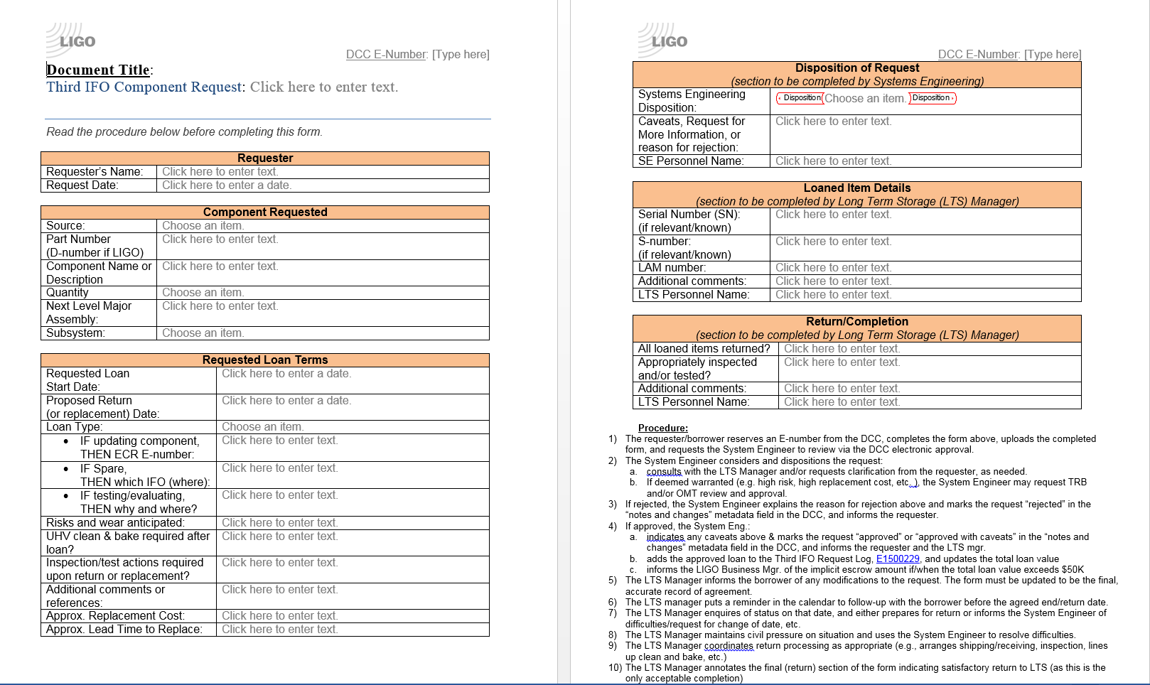
Check out Procedure
Managed by Jeff Bartlett (operator) at LHO

Slide 32
aLIGO Project Responsibilities
3rd IFO storage protocols established by aLIGO Project
Storage
Security
Routine inspections and maintenance
Inventory tracking
Component modifications/change control
aLIGO Project was responsible for 3rd IFO components until formal acceptance → Upon acceptance of 3rd interferometer, custodianship became the responsibility of LIGO Lab Operations
Ref: 3rd IFO Long-Term Storage Acceptance and Punchlist https://dcc.ligo.org/LIGO-M1300164
Procedures/protocols (E1300001) established by aLIGO Project to be adopted by Operations

Slide 33
Sub-System Custodian List
E1300001 Section Subsystems Primary Secondary Tertiary Notes
7.1 Suspensions (SUS) Betsy Travis Jeff
7.2 Seismic Isolation (SEI) Hugh Jim TJ
7.3 Pre-stablized Laser (PSL) Peter Jason Ed Jeff (Chillers)
7.4.1 Stray Light Control (SLC) Gerardo Betsy TJ
7.4.1 Viewports (VP) Gerardo Joe D Kyle? 7.4.2 Transmission Monitor Suspension (TMS) - SUS Jeff Betsy
7.4.2 Transmission Monitor Suspension (TMS) - ISC Corey Keita
7.4.3 Thermal Compensation System (TCS) - In Vac Betsy Nutsinee
7.4.3 Thermal Compensation System (TCS) - In Air Jason Nutsinee
7.4.4 Optical Lever (OpLev) Jason Ed TJ
7.4.5 Photon Calibrator (PCal) Rick Travis
7.4.6 Initial Alignment System (IAS) Jason Hugh Updated 2nd June
7.5 Input Optics (IO) Cheryl Corey Betsy
7.6 Core Optics Components (COC) Betsy Gerardo Travis
7.7 Interferometer Sensing & Controls (ISC) Corey Keita TJ
7.8 Data Acquisition, Diagnostics, Networking & Supervisory Control (DAQ) Richard Filliberto Dave B 7.9 Installation & System Test and Facility Modifications & Preparation (INS/FMP) Travis Betsy Jeff Jeff (assem tooling)
FLS Crew Bubba

