Slide 1
VOPO Injection Bench Assembly FEA
LIGO MIT Lab
Fernandez Galiana, Alvaro

Slide 2
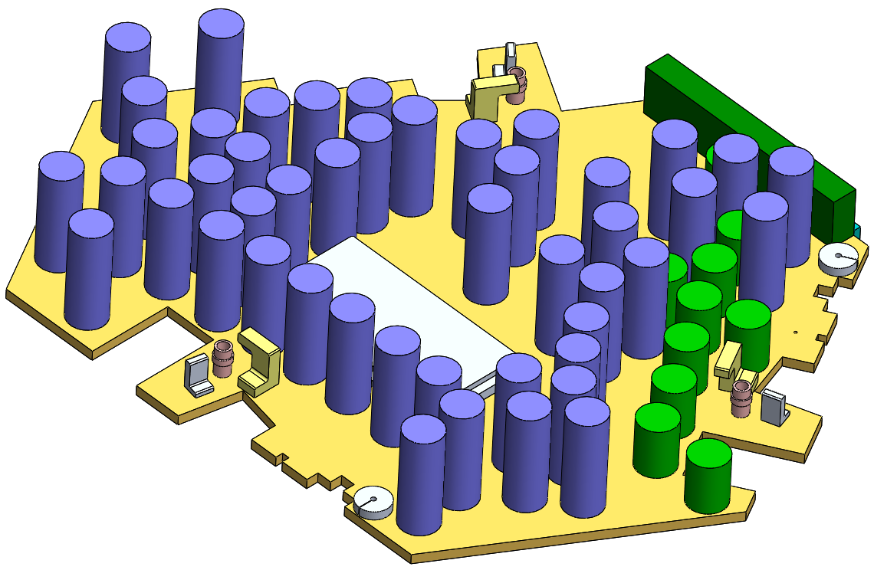
Injection Bench Assembly Components
D1500275 VOPO Injection Bench TO FEA (13.61kg)
Increased to balance
Clamps and Stops (0.25 kg)
TOTAL: 37.37 kg
Optics (15.67 kg)
Dummy masses (7.84 kg)

Slide 3
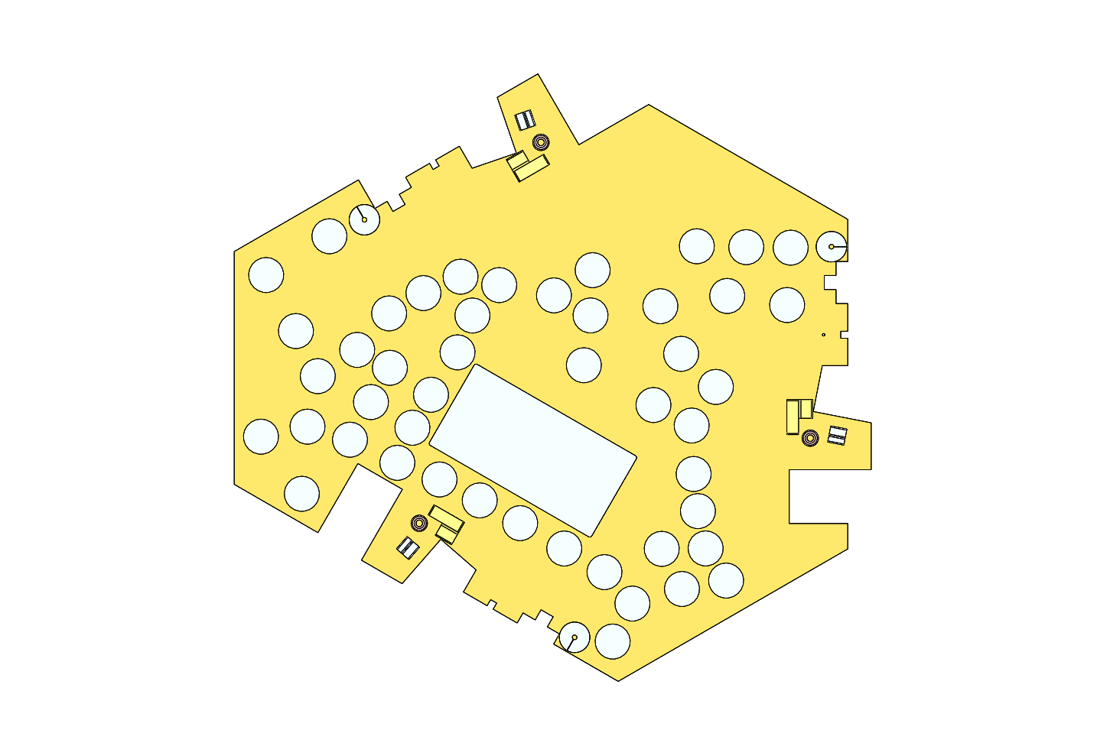
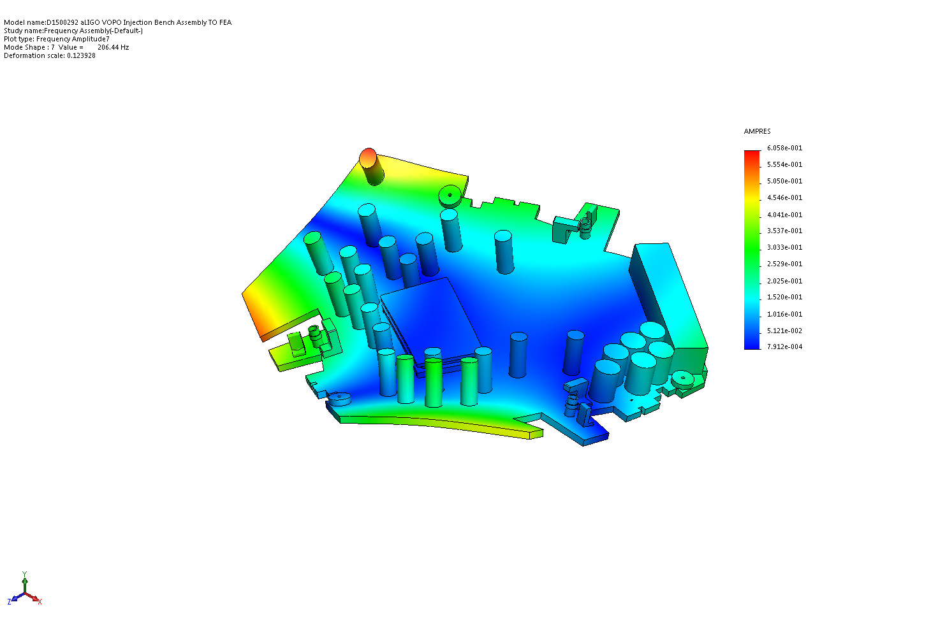
Assembly Design Drivers
Center of Mass in the Geometric Center
First frequency as high as possible (min 150 Hz)

Slide 4
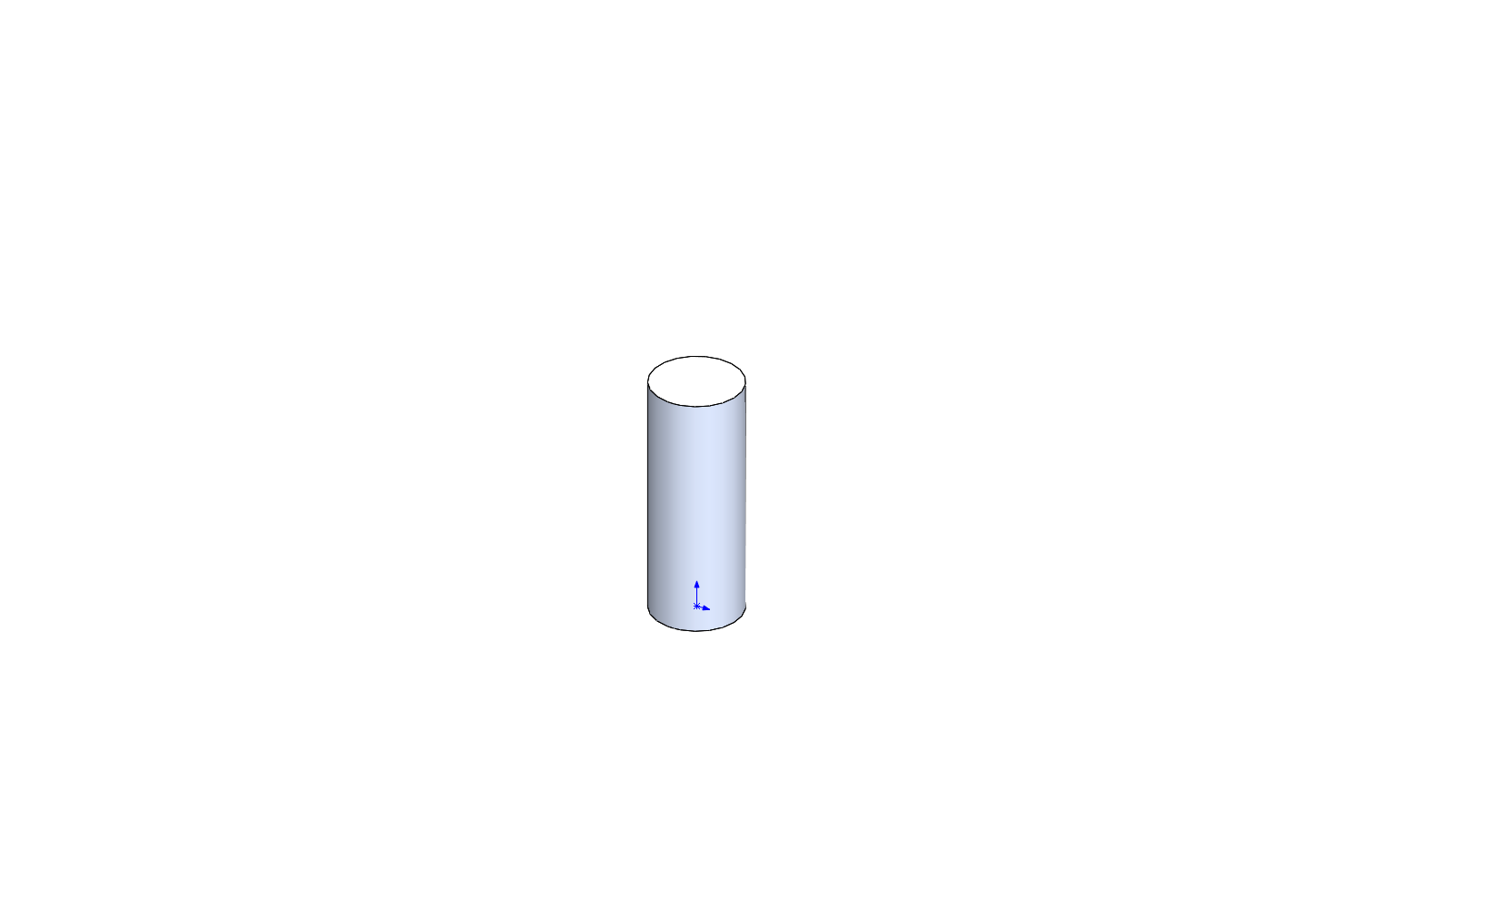
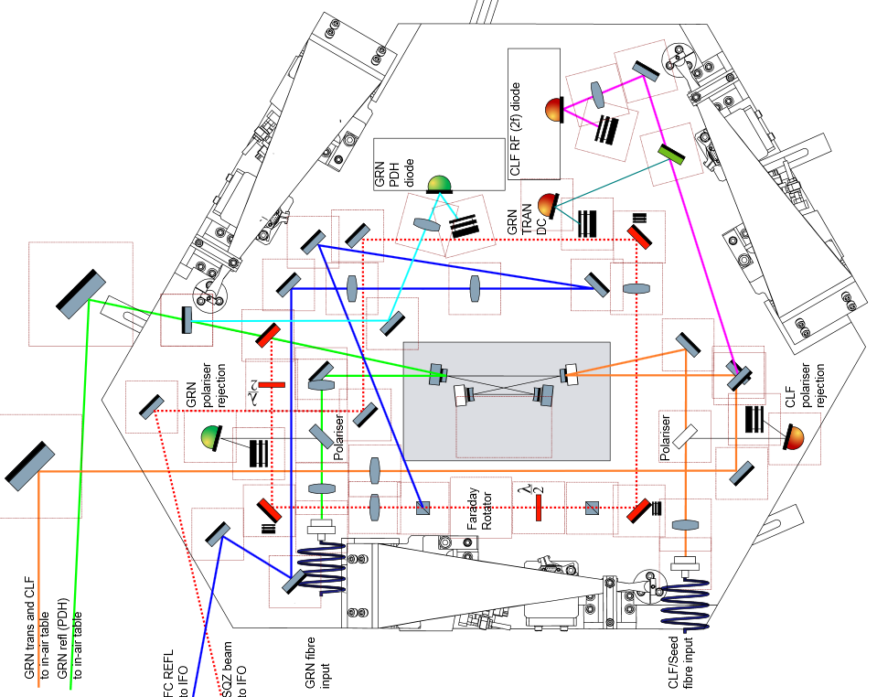
Optics Layout
Optics: 313 g each
Real Optics Layout
Dummy Optics Layout

Slide 5
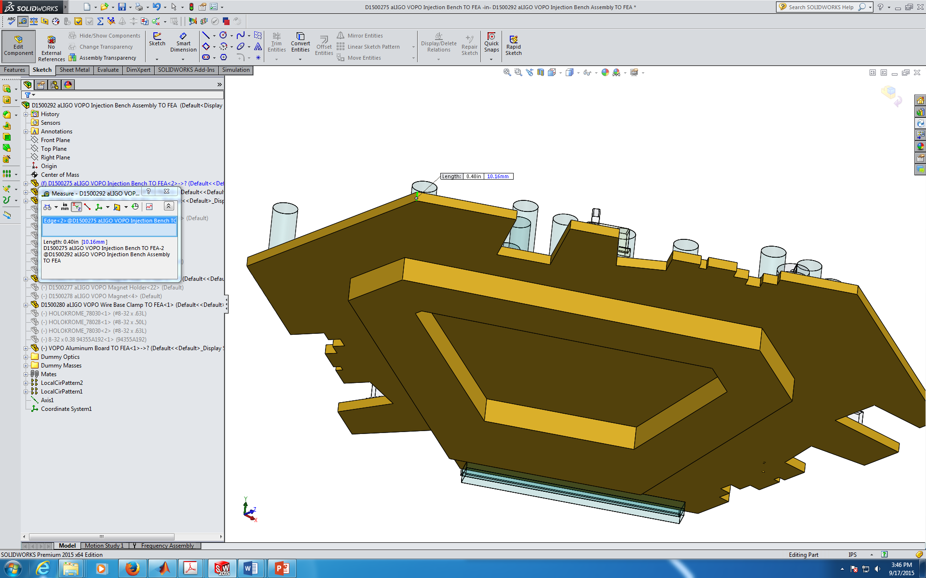
Bench Geometry
No symmetry to partially compensate optics mass
Injection Bench Thickness

Slide 6
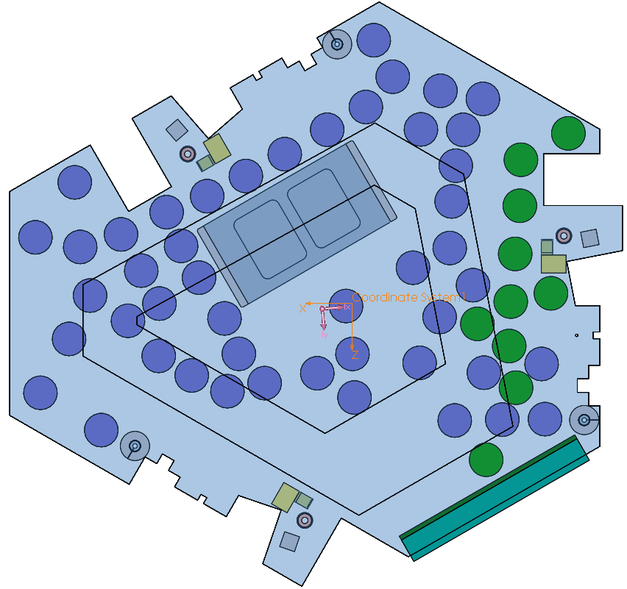
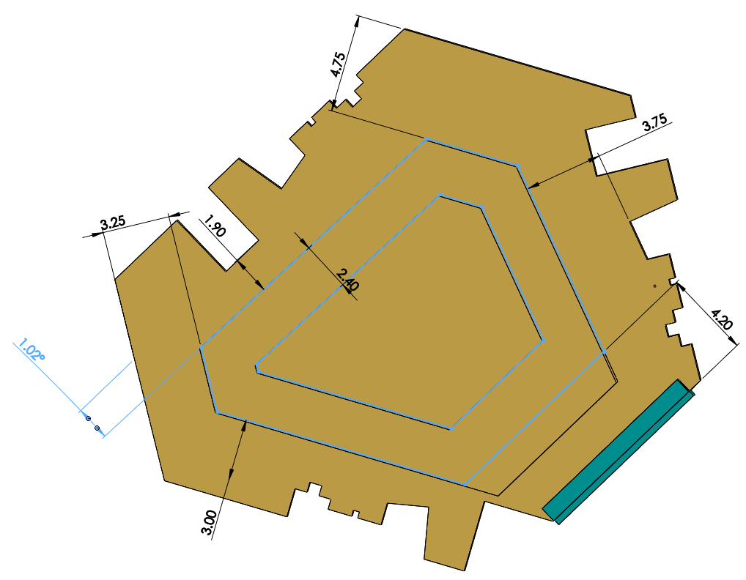
Bench Geometry
No symmetry to partially compensate optics mass
Injection Bench Bottom Geometry
Injection Bench Center of Mass

Slide 7
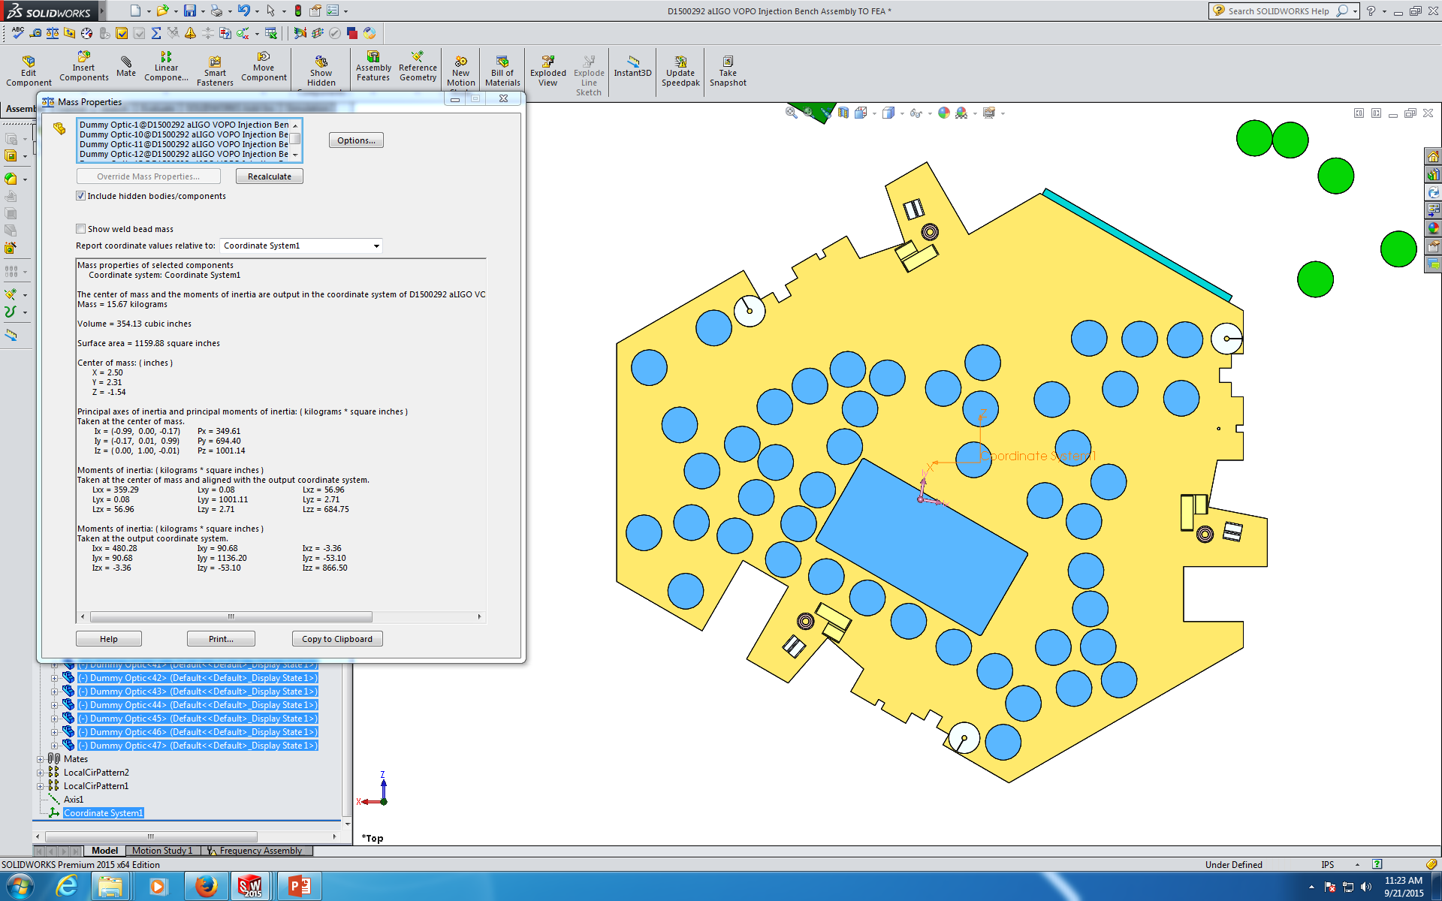
Center of Mass
Geometric Center
Optics
Center of Mass

Slide 8
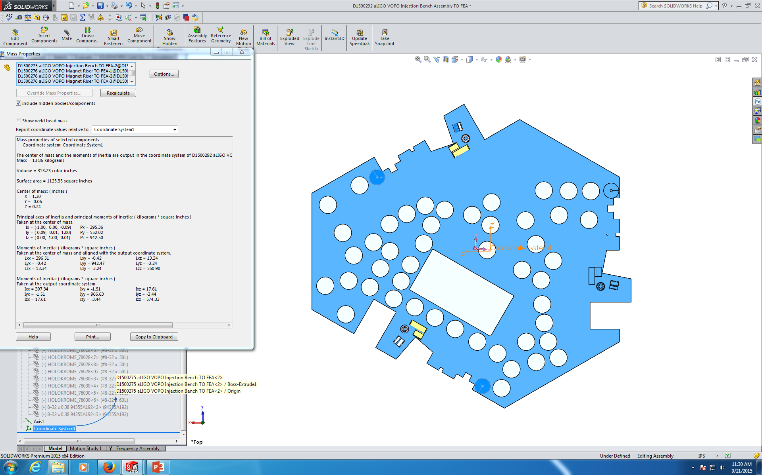
Center of Mass
Geometric Center
Injection Bench + Clamps
Center of Mass

Slide 9
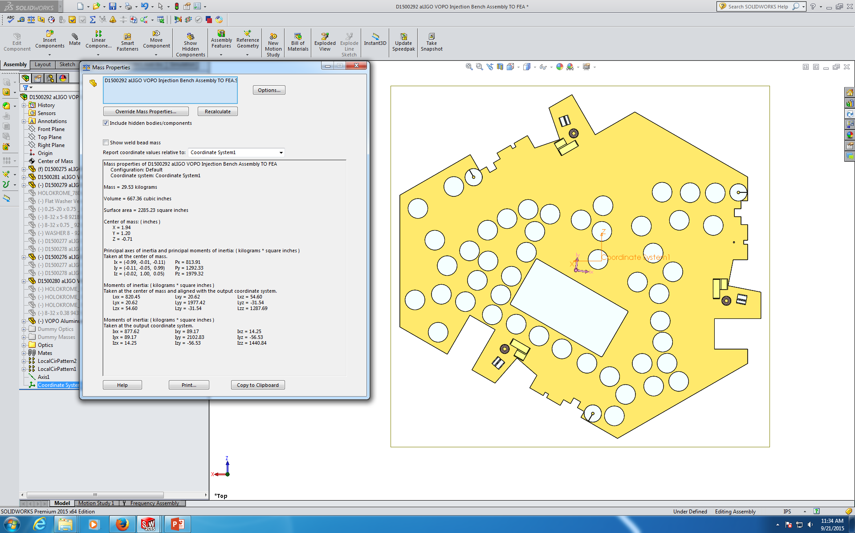
Center of Mass
Geometric Center
Without balancing masses
Center of Mass

Slide 10
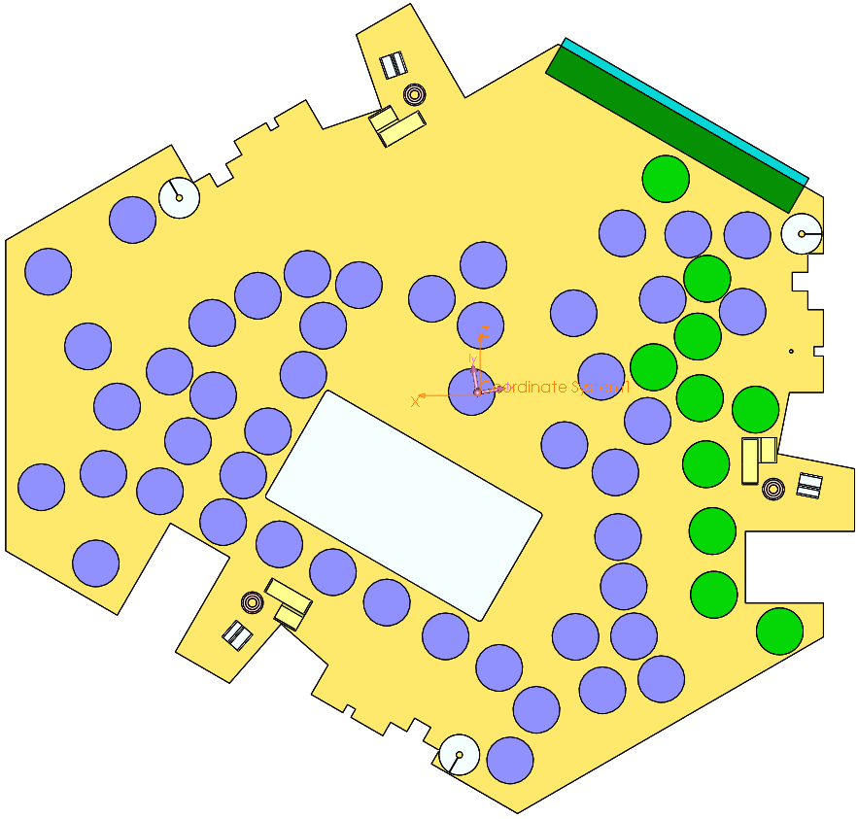
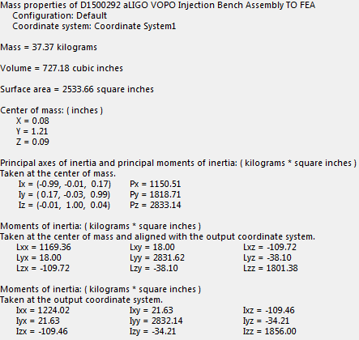
Center of Mass
Geometric Center
With balancing masses
Center of Mass

Slide 11
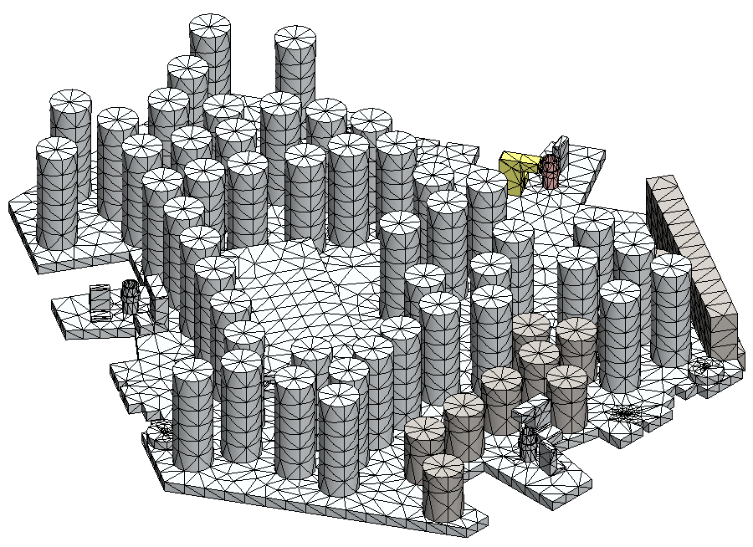
FEA
Using SW Simulation with bonded contacts

Slide 12
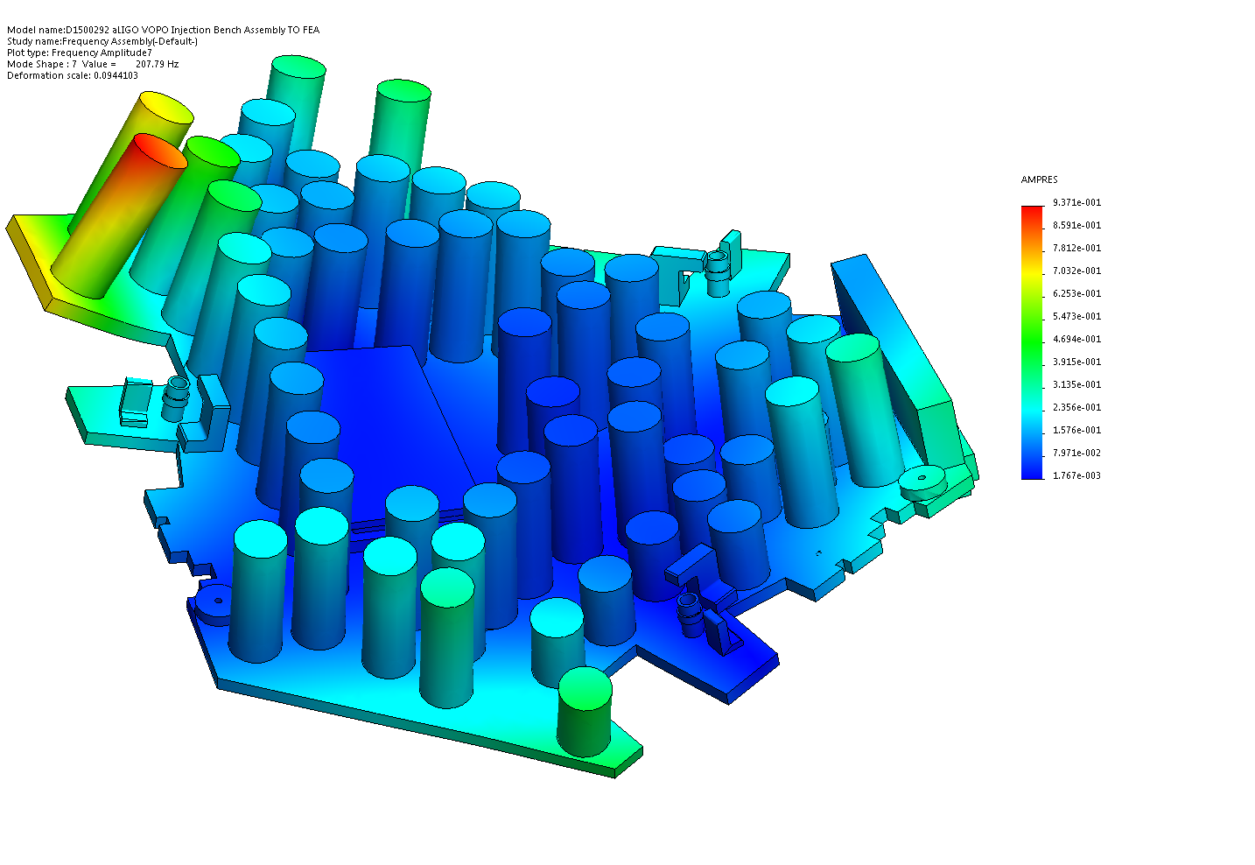
FEA Results

Slide 13
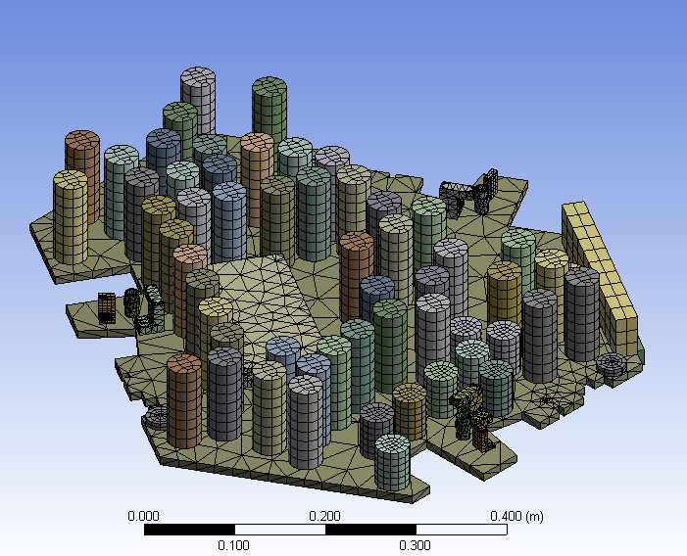
FEA
Using ANSYS with bonded contacts

Slide 14
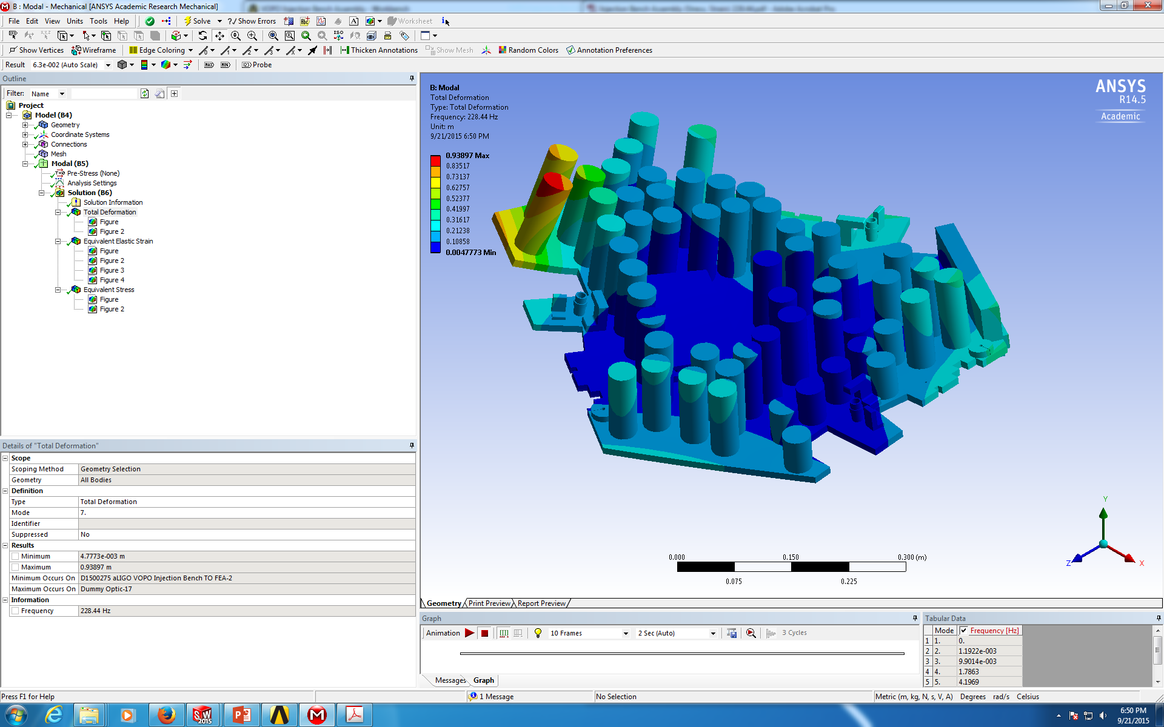
FEA Results
Deformation

Slide 15
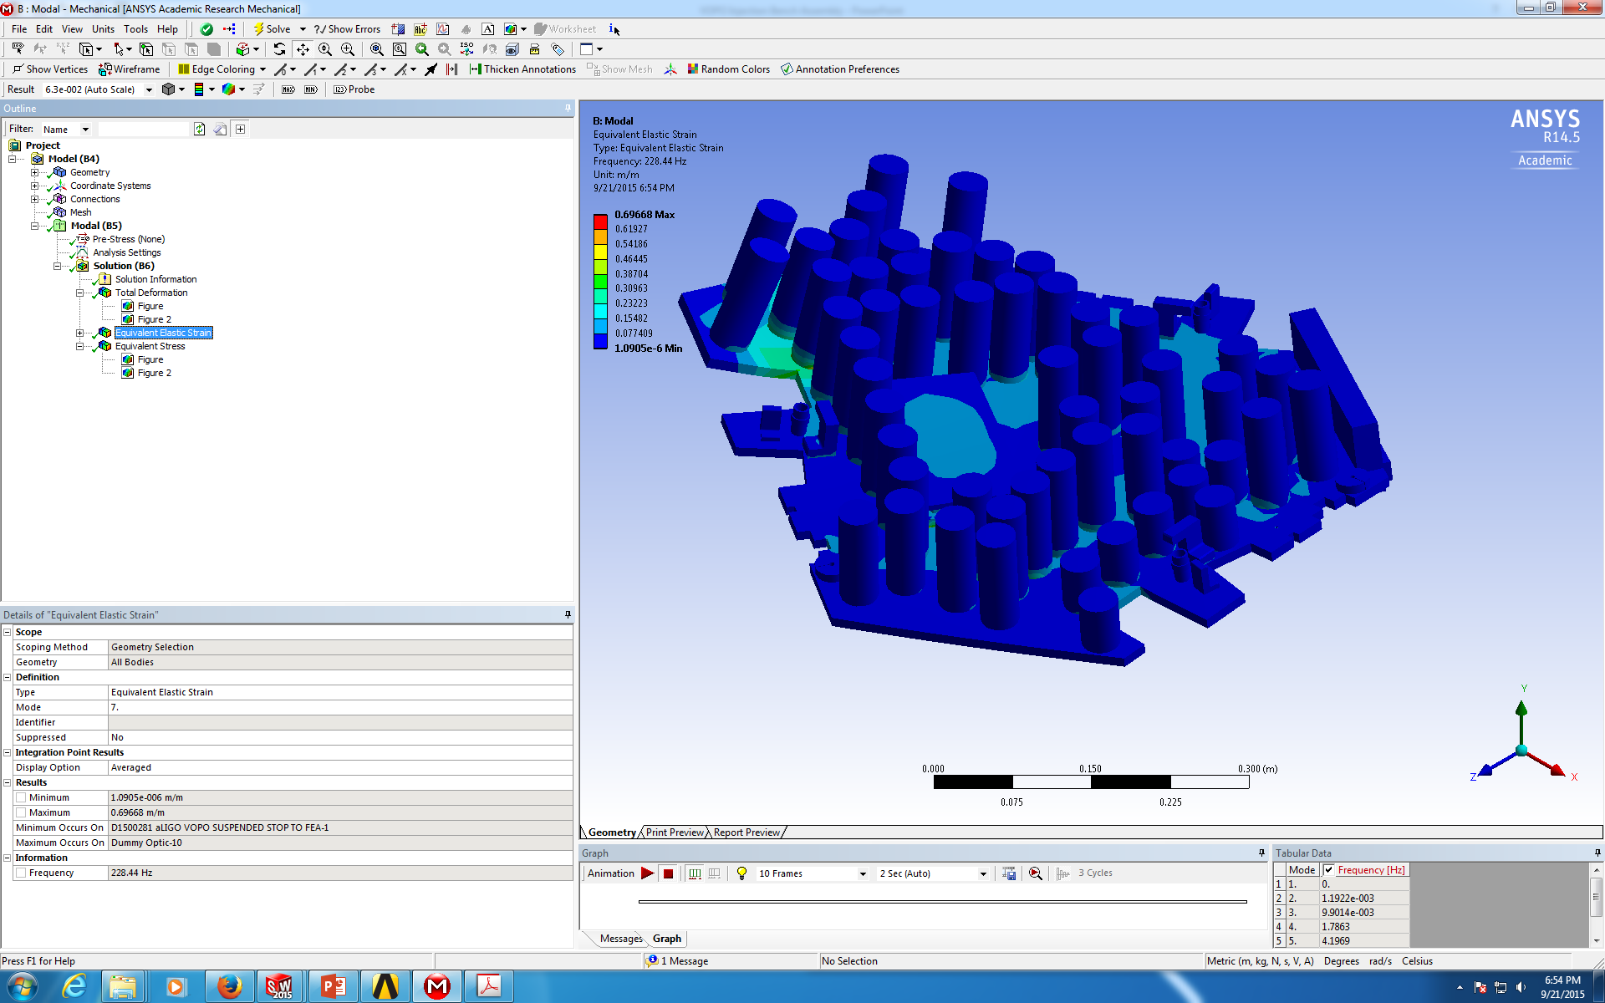
FEA Results
Strain

Slide 16

FEA Results
Stress

Slide 17
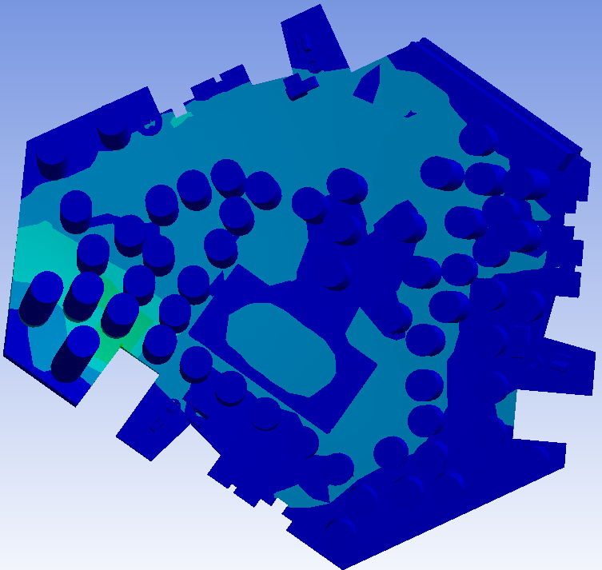
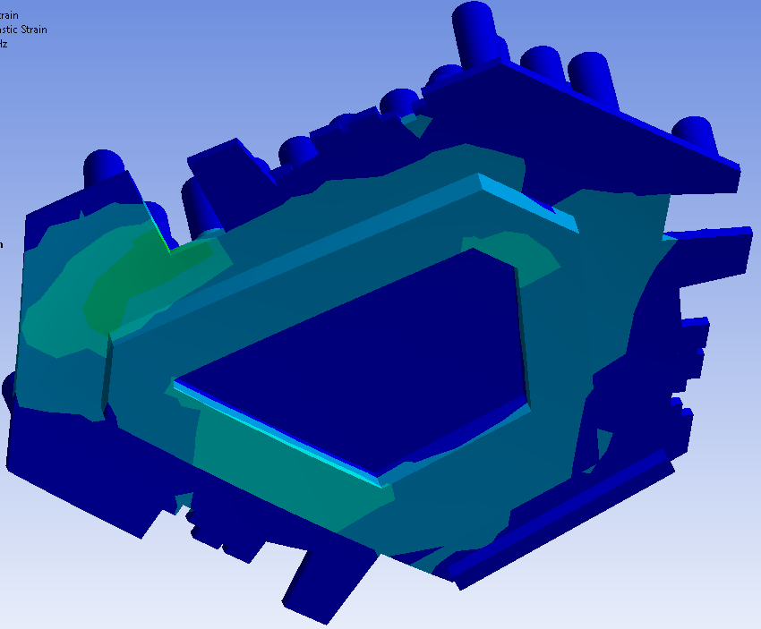
Global Results
First Resonance Frequency:
Areas to be reinforced (Strain plot)

Slide 18
Work to be done
Refine the Dummy Mass models
Work on the Dummy Mass attachment
Refine the whole model with the real optics layout
Reinforce the areas with more Strain

Slide 19
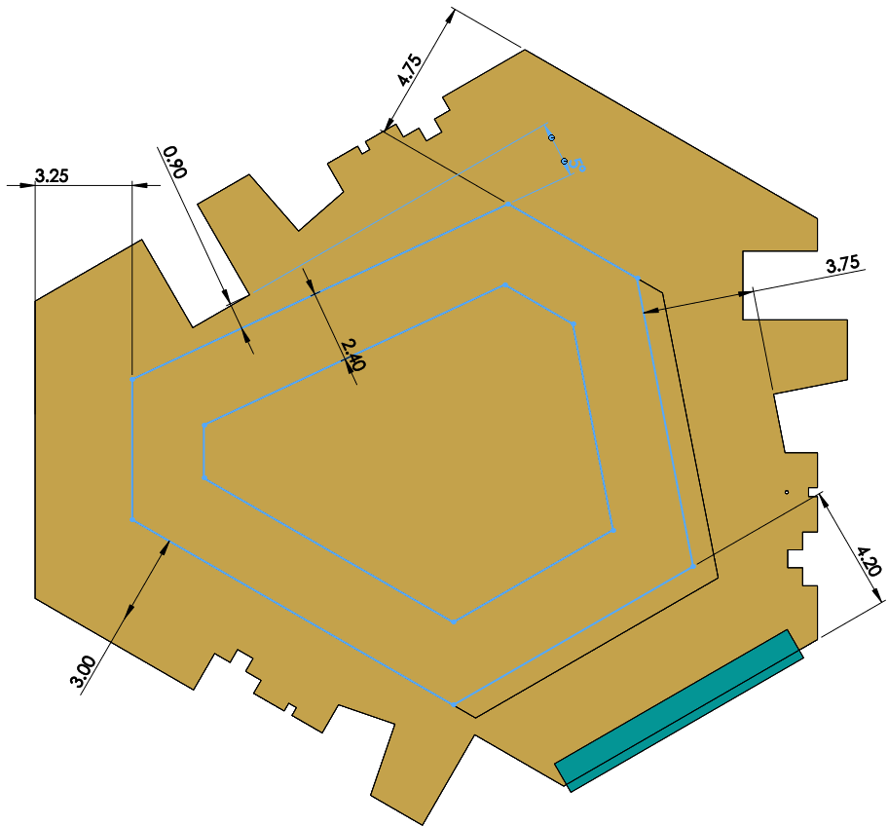
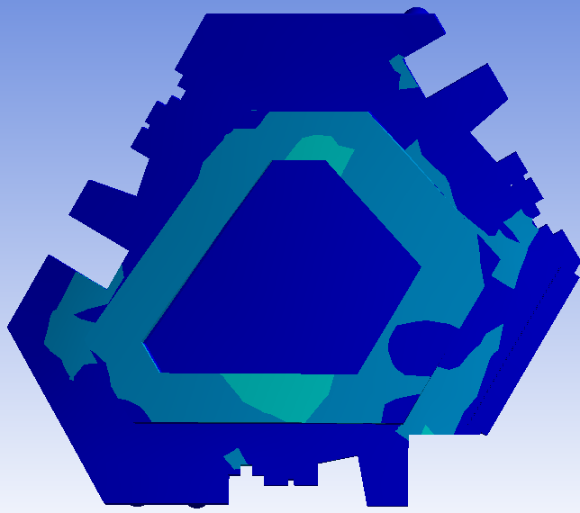
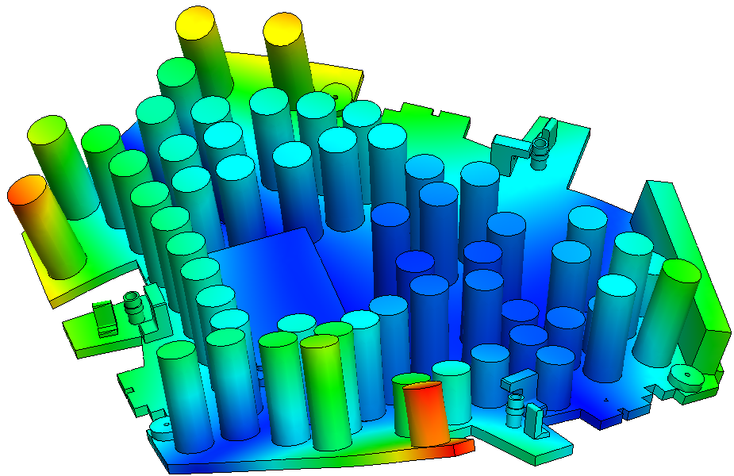
Last Version
Modal Analysis
Weight: 13.78kg
ANSYS: 239.31 Hz
SW: 217.87.31 Hz

Slide 20
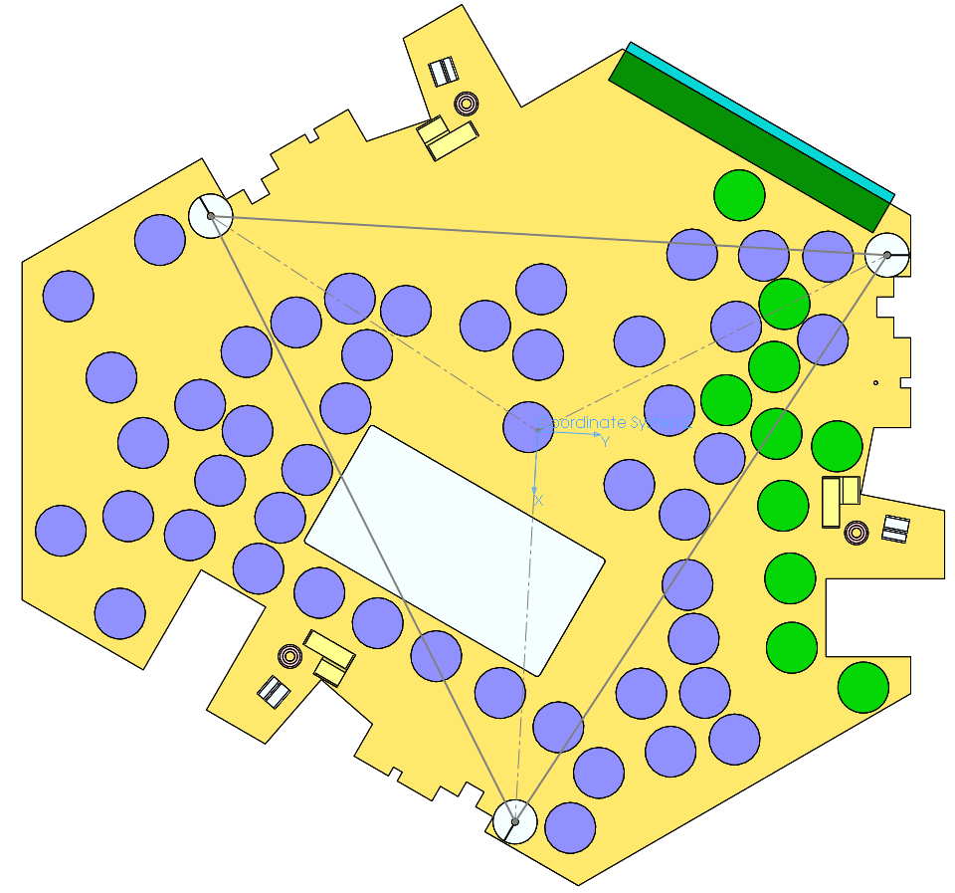
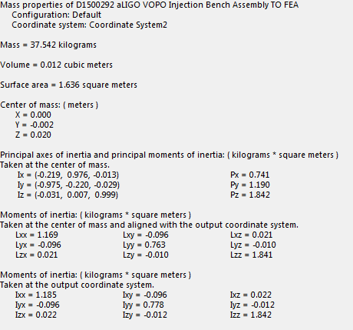
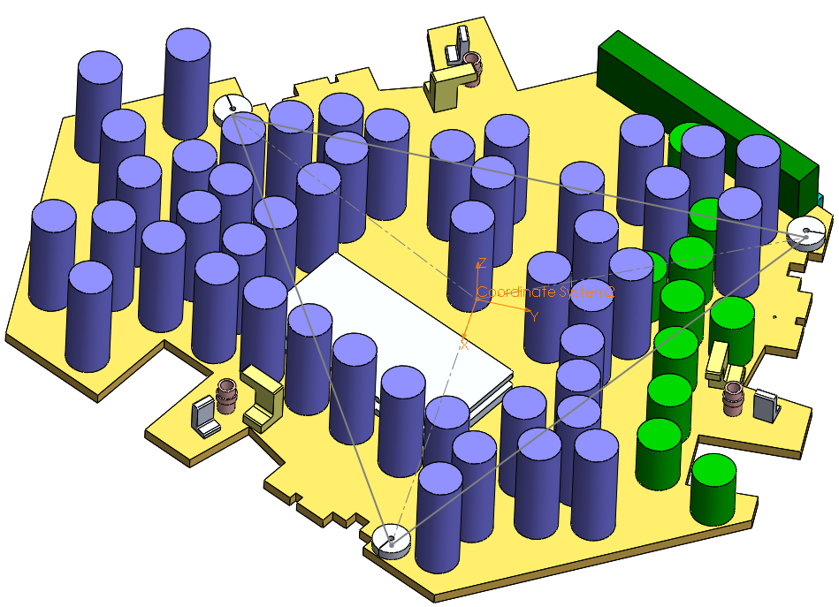
Last Version
Mechanical Properties

Slide 21
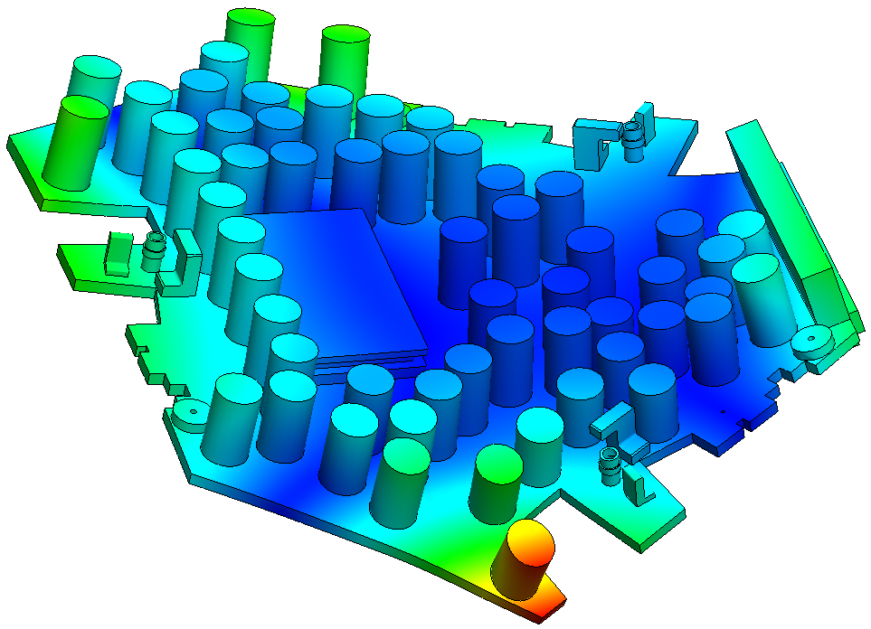
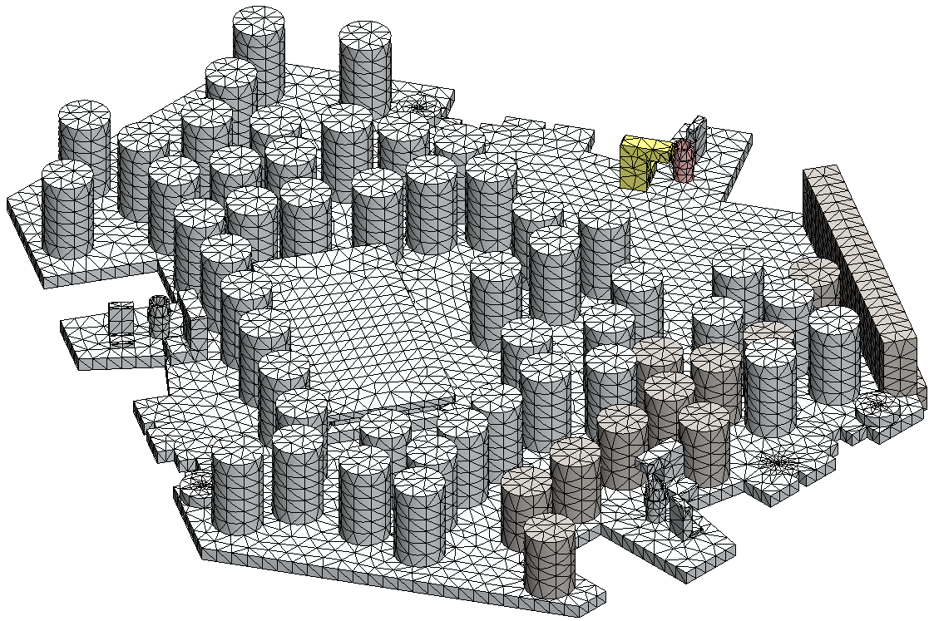
Last Version
Difference Continuous vs. Contact
COMPATIBLE
f = 224.96 Hz

Slide 22
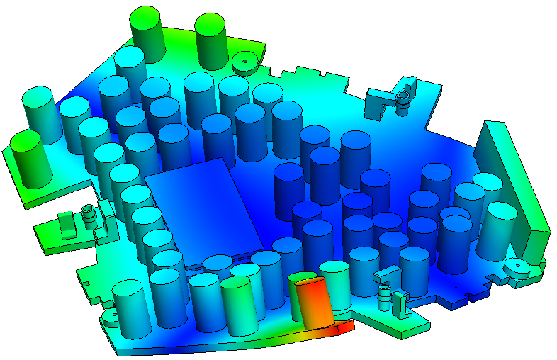
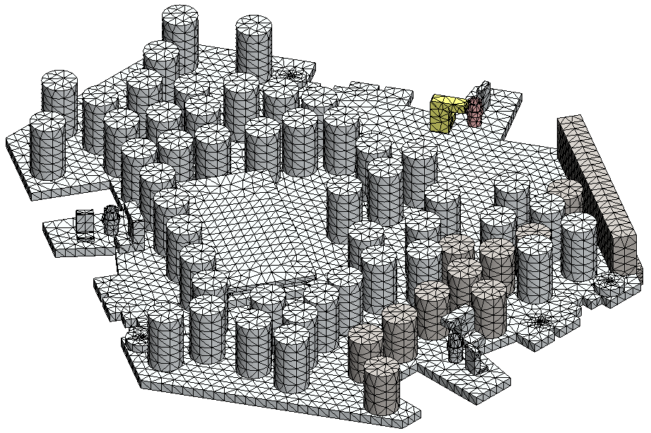
Last Version
Difference Compatible vs. Incompatible Mash
INCOMPATIBLE
f = 224.66 Hz

Slide 23



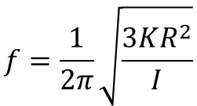


Last Version
YAW Frequency Calculation
K θ R
$$I\ddot{θ}=−3 R KRθ$$
θ R
$$\ddot{θ}+\frac{3KR^{2}}{I}θ=0$$
θ R
K θ R
R
R
θ
I_{ZZ}
$$ω^{2}=\frac{3KR^{2}}{I}$$
R
$$f=\frac{1}{2π}\sqrt{\frac{3KR^{2}}{I}}$$
K θ R
θ R
$$K=Kxx=1004.3 N/m$$
I_{ZZ} = 1.842 kg m²
$$f_{YAW}=1.878 Hz$$
R = 0.293 m

Slide 24
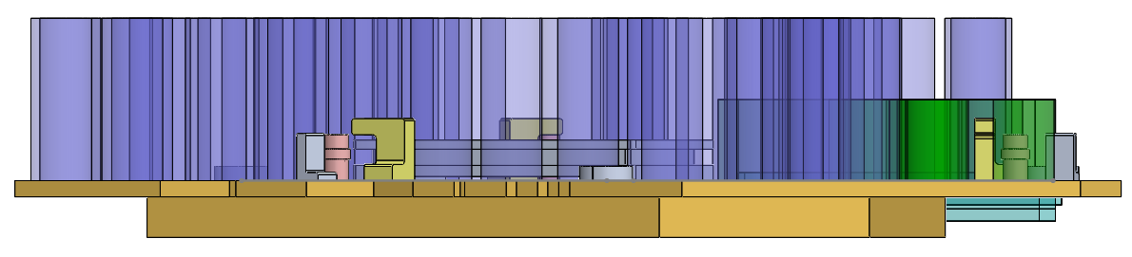




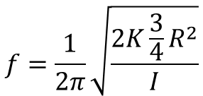


Last Version
PITCH Frequency Calculation
$$I\ddot{γ}=−2 d Kdγ$$
$$\ddot{γ}+\frac{2Kd^{2}}{I}γ=0$$
ψ d
K ψ d
ψ d
$$ω^{2}=\frac{2Kd^{2}}{I}$$
d
ψ
d
I_{XX}
$$f=\frac{1}{2π}\sqrt{\frac{2K{\frac{3}{4}R}^{2}}{I}}$$
K ψ d
I_{XX} = 1.185 kg m²
$$K=Kzz=\text{1443.0 }N/m$$
$$d=R cos⁡(30°)$$
d = 0.254 m
$$f_{PITCH}=1.9862Hz$$

Slide 25
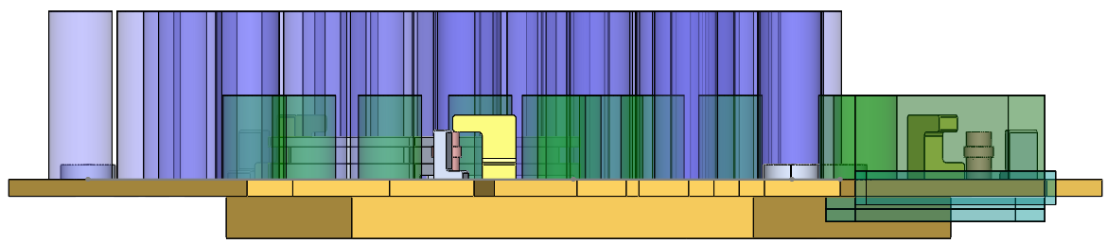

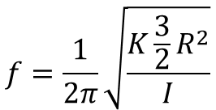





Last Version
ROLL Frequency Calculation
$I\ddot{φ}=−2 d_{2} Kd_{2}φ−d_{1}Kd_{1}$ $φ$
$$\ddot{φ}+\frac{K{{(2d}_{2}}^{2}+{d_{1}}^{2})}{I}φ=0$$
K φ d1
2 φ d2
$$ω^{2}=\frac{K{{(2d}_{2}}^{2}+{d_{1}}^{2})}{I}$$
φ d1
φ
$$f=\frac{1}{2π}\sqrt{\frac{K{\frac{3}{2}R}^{2}}{I}}$$
d1
I_{YY}
d2
2 K φ d2
I_{YY} = 1.185 kg m²
$$K=Kzz=\text{1443.0 }N/m$$
$$d_{1}=R$$
$$f_{ROLL}=2.4513 Hz$$
$$d_{2}=R sin(30°)$$

Slide 26
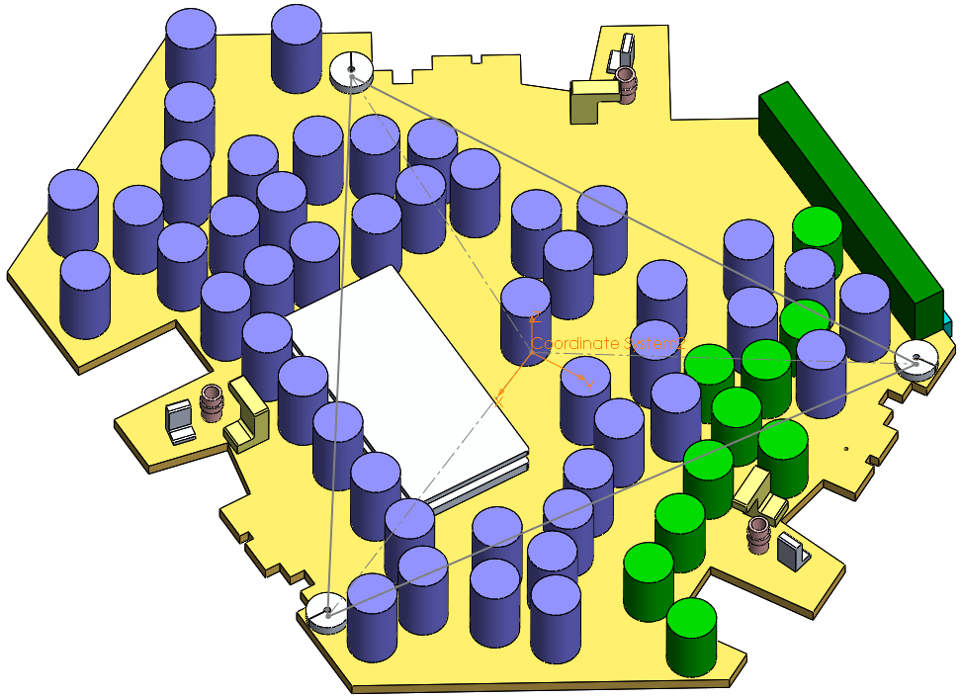
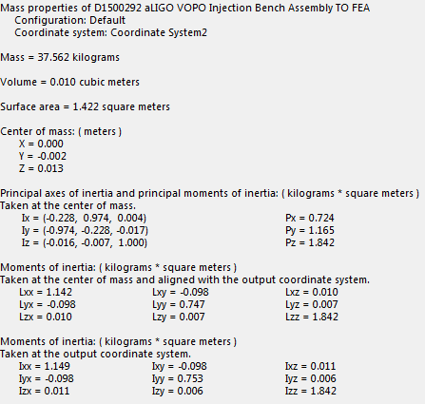
Last Version
Proper calculation

Slide 27
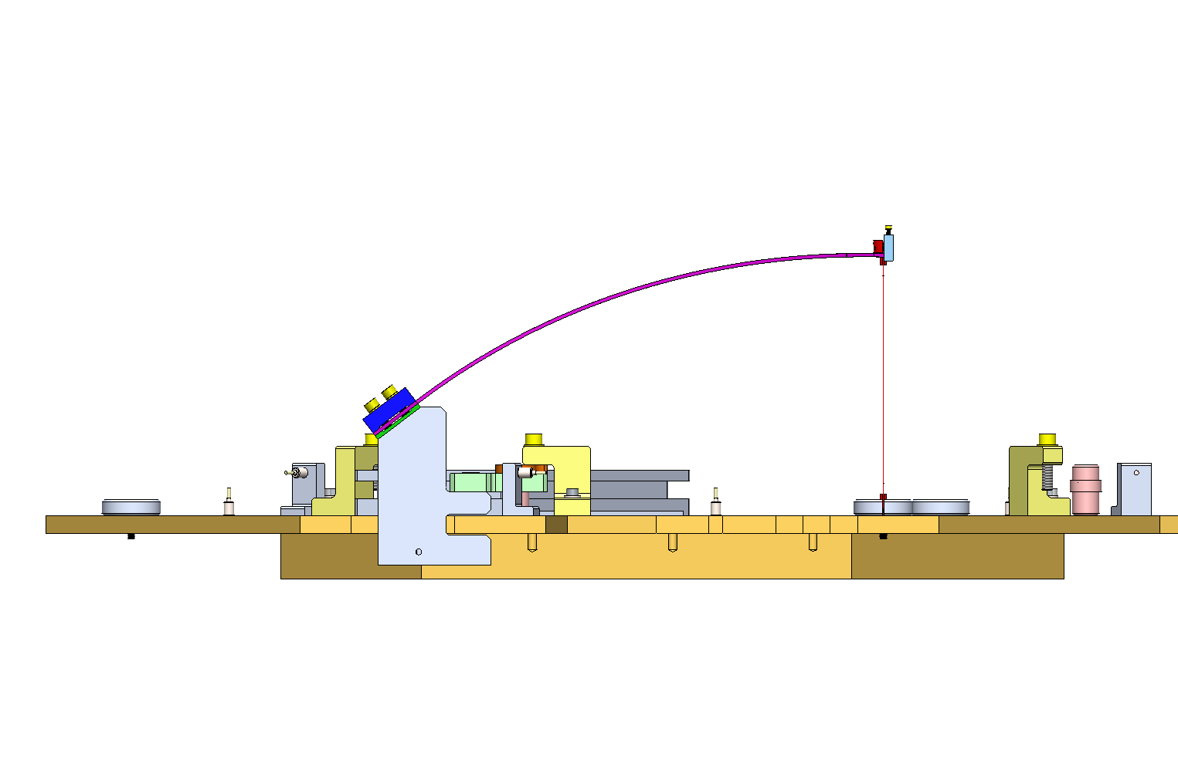
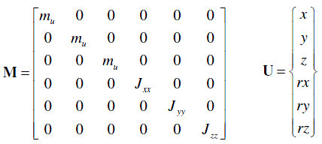


Last Version
Proper calculation
CoG
b
ZMP
a
a = 10.1596 + 3.4117 = 13.5713 mm
b = 7.035 mm
h_{f}= b – a = -6.5363 mm
$$M\ddot{U}+KU=0$$

Slide 28
Last Version
Proper calculation: AssemblyFrequencies.m
CoG
b
ZMP
a
a = 12.05 + 3.14 = 15.19 mm
b = 7.035 mm
h_{f}= b – a = -2.19 mm
$$M\ddot{U}+KU=0$$

Slide 29
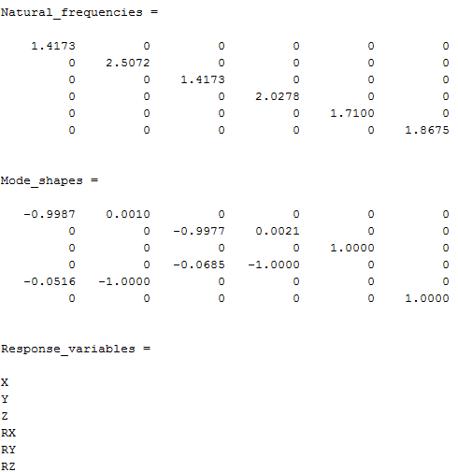
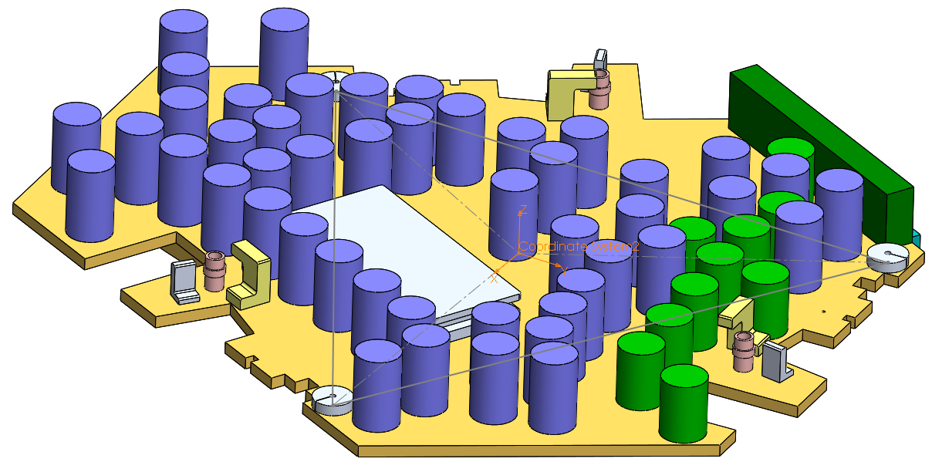




Last Version
Proper calculation
$$M\ddot{U}+KU=0$$
$$\ddot{U}+{[M}^{−1}K]U=0$$
$$ω^{2}=eigenvalue(M^{−1}K)$$
$$f=\frac{2}{2π}\sqrt{eigenvalue(M^{−1}K) }$$
AssemblyFrequencies.m

Slide 30
Last Version
Assembly Frequencies
Yaw (Rz)
Z
X
Y
Roll (RX)
Pitch (RY)

Slide 31
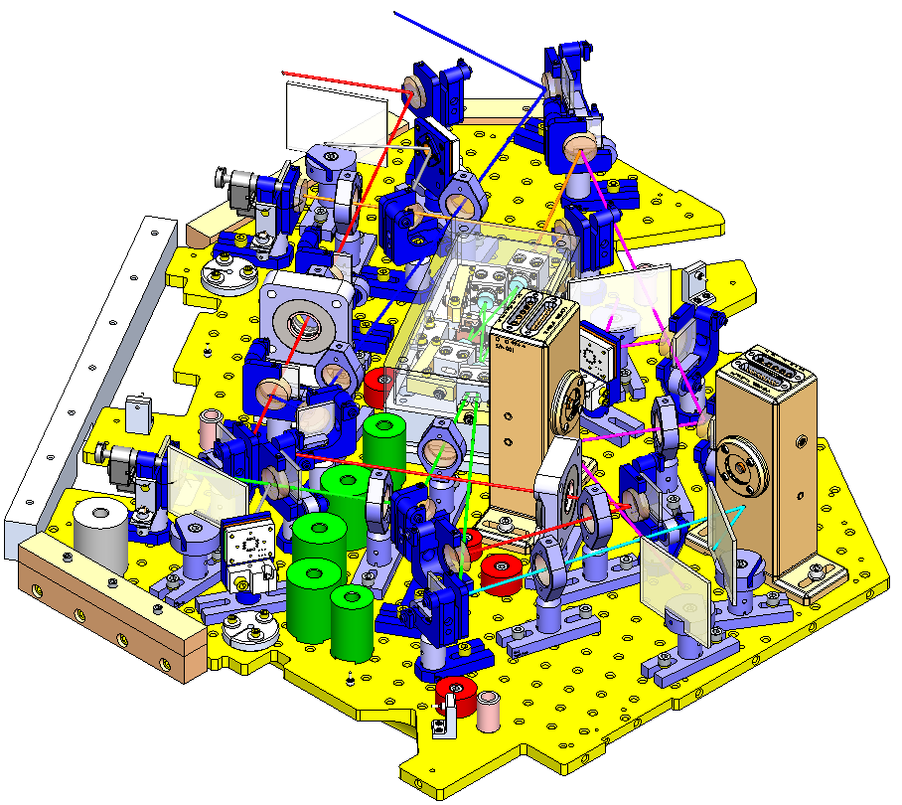
Z
X
Yaw (Rz)
Roll (RX)
Pitch (RY)
Y

Slide 32
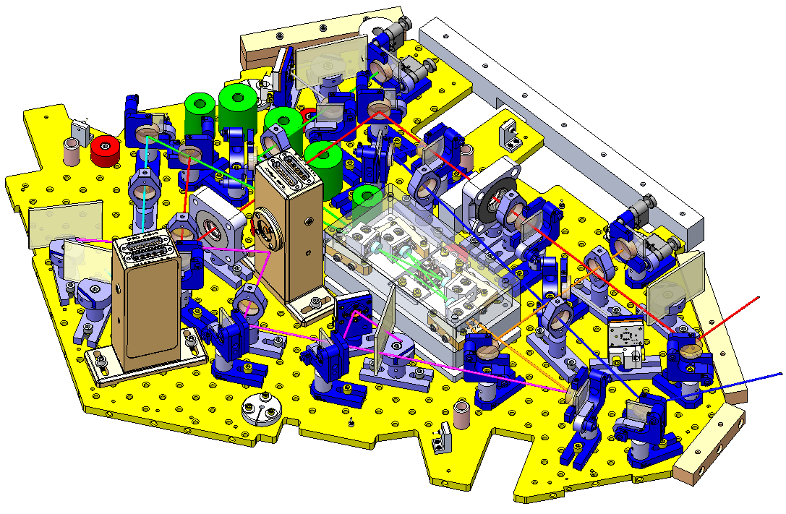
Z
Yaw (Rz)
Y
Pitch (RY)
Roll (RX)
X

Slide 33
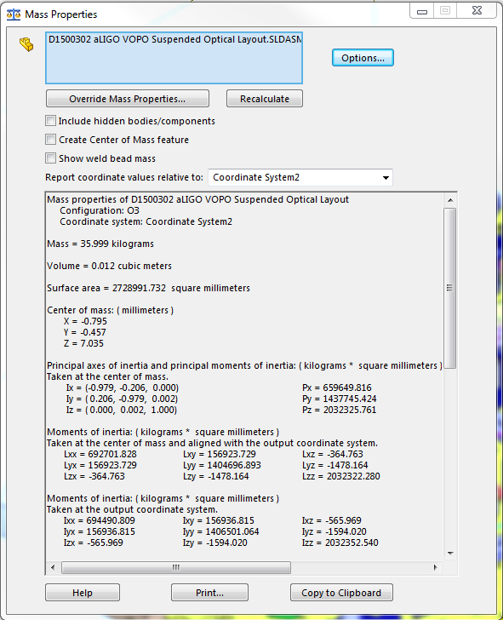
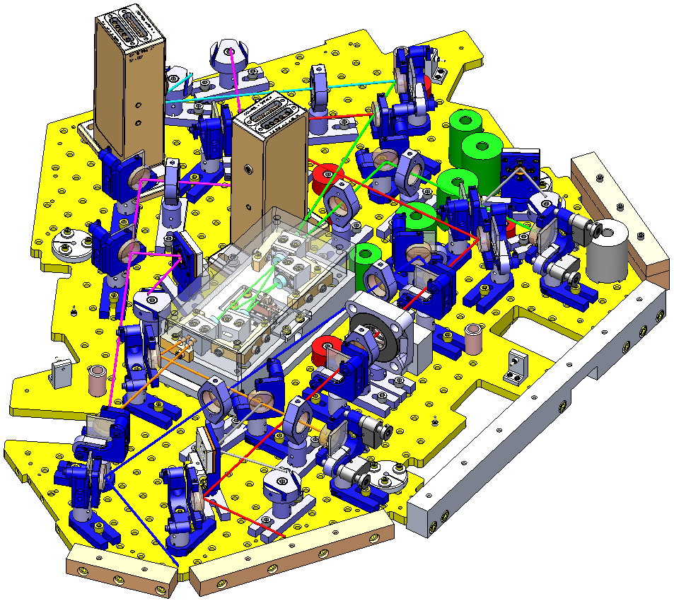
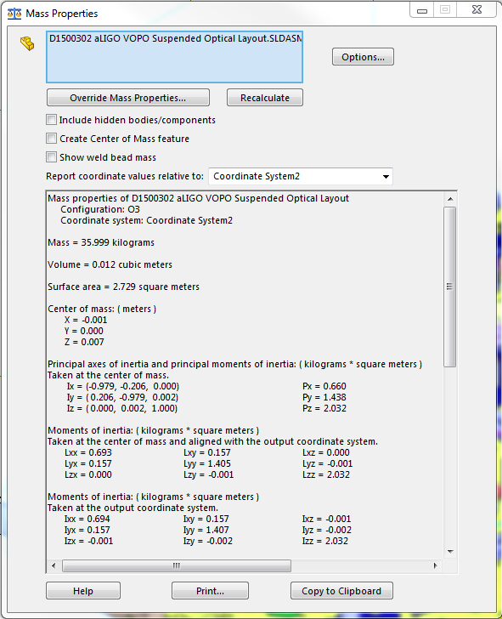
Z
Yaw (Rz)
Y
Pitch (RY)
X
Roll (RX)

Slide 34
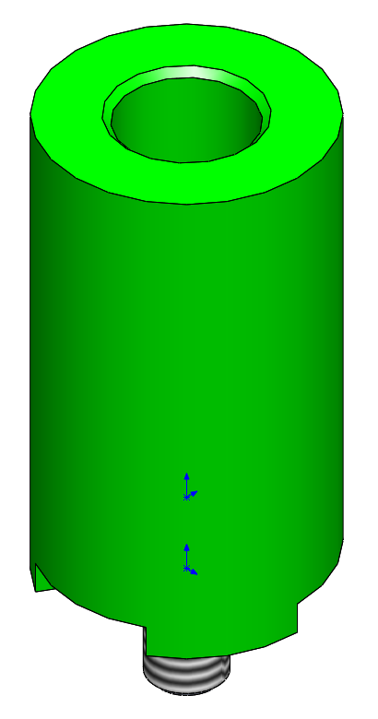
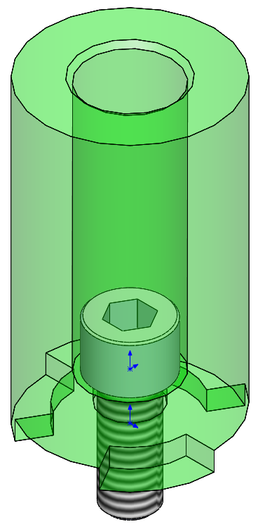
Balancing Masses
Masses in a high range of values
  25g
  53g
  76g
  100g (x2)
  146g
  200g
  245g
  252g
  302g
  402g
  413g
  507g
  610g
Maximum height = 2 in (-0.5in beam plane)
Holo-Kromme SHCS ¼”-20 x 0.625: 6g

Slide 35




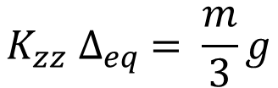

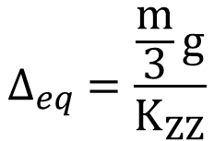
Balancing Masses
Minimum Mass Range Calculation
  “Perfect” alignment without extra mass addition/removal
$$K_{zz} ∆_{eq} = \frac{m}{3}g$$
$$∆_{eq} =\frac{\frac{m}{3}g}{K_{ZZ}}$$
Equilibrium 1 blade
$$K_{ZZ} ∆_{eq}$$
Z = 0
$$K_{zz}=1443\frac{N}{m}$$
$$m=37.5 kg$$
$$\frac{m}{3}g=122.625 N$$
$$∆_{eq} =84.98 mm$$

Slide 36







Balancing Masses
Minimum Mass Range Calculation
  Case where height adjustment is required
NOTE: Additional mass is added to adjust the height to the desired position
Error Case
$$K_{ZZ} (∆_{eq}−Error)$$
$$K_{ZZ} (∆_{eq})$$
Z = Error
Z = 0
$$\frac{m}{3}g=122.625 N$$
$$\frac{m+m_{added}}{3}g$$
$$K_{zz}(∆_{eq}−Error) = \frac{m}{3}g$$
$$m_{added}=\frac{K_{ZZ }Error}{ g}$$
$$K_{zz} ∆_{eq} = \frac{m+m_{added}}{3}g$$
NOTE: The final balancing will be made using screws and washers as they are about the desired weight

Slide 37
Balancing Masses
Beam
2.5”
Injection Bench Top
4”
Base Plate

Slide 38
VOPO Injection Bench Assembly FEA II
LIGO MIT Lab
Matichard, Fabrice
Fernandez Galiana, Alvaro

Slide 39

Global Results
First Resonance Frequency:

Slide 40



Global Results
First Resonance Frequency:
$f=$248.87 Hz

Slide 41




Global Results
First Resonance Frequency:
$f=$256.94 Hz

Slide 42

Z
X
Yaw (Rz)
Roll (RX)
Pitch (RY)
Y

Slide 43

Z
Yaw (Rz)
Y
Pitch (RY)
Roll (RX)
X

Slide 44


X
X
Y
Y

Slide 45

Last Version
Proper calculation
CoG
b
ZMP
a
a = 10.1596 + 3.4117 = 13.5713 mm
b = 7.035 mm
h_{f}= b – a = -6.5363 mm
ZMP = 3.4117mm
$$M\ddot{U}+KU=0$$

Slide 46


Last Version
Proper calculation
CoG
b
ZMP
a
a = 10.1596 + 3.4117 = 13.5713 mm
b = 7.035 mm
h_{f}= b – a = -6.5363 mm
ZMP = 3.4117mm
$$M\ddot{U}+KU=0$$

Slide 47

Last Version
Proper calculation
CoG
b
ZMP
a
a = 10.1596 + 3.4117 = 13.5713 mm
b = 7.035 mm
h_{f}= b – a = -6.5363 mm
ZMP = 3.4117mm
$$M\ddot{U}+KU=0$$

Slide 48

Last Version
Proper calculation
$$M\ddot{U}+KU=0$$
$$\ddot{U}+{[M}^{−1}K]U=0$$
$$ω^{2}=eigenvalue(M^{−1}K)$$
$$f=\frac{2}{2π}\sqrt{eigenvalue(M^{−1}K) }$$
AssemblyFrequencies.m

Slide 49
Z
Yaw (Rz)
Y
Pitch (RY)
X
Roll (RX)

Slide 50
Excitation response

Slide 51
Excitation response

Slide 52
Balancing Masses
Masses in a high range of values
  25g
  53g
  76g
  100g (x2)
  146g
  200g
  245g
  252g
  302g
  402g
  413g
  507g
  610g
Maximum height = 2 in (-0.5in beam plane)
Holo-Kromme SHCS ¼”-20 x 0.625: 6g

Slide 53



Balancing Masses
Minimum Mass Range Calculation
  “Perfect” alignment without extra mass addition/removal
$$K_{zz} ∆_{eq} = \frac{m}{3}g$$
$$∆_{eq} =\frac{\frac{m}{3}g}{K_{ZZ}}$$
Equilibrium 1 blade
$$K_{ZZ} ∆_{eq}$$
Z = 0
$$K_{zz}=1255.1\frac{N}{m}$$
$$m=36 kg$$
$$\frac{m}{3}g=122.625 N$$
$$∆_{eq} =93.79 mm$$

Slide 54

Balancing Masses
Minimum Mass Range Calculation
  Case where height adjustment is required
NOTE: Additional mass is added to adjust the height to the desired position
Error Case
$$K_{ZZ} (∆_{eq}−Error)$$
$$K_{ZZ} (∆_{eq})$$
Z = Error
Z = 0
$$\frac{m}{3}g=39.24 N$$
$$\frac{m+m_{added}}{3}g$$
$$K_{zz}(∆_{eq}−Error) = \frac{m}{3}g$$
$$m_{added}=\frac{K_{ZZ }Error}{ g}$$
$$K_{zz} ∆_{eq} = \frac{m+m_{added}}{3}g$$
NOTE: The final balancing will be made using screws and washers as they are about the desired weight

