Slide 1
VOPO HAM 5 & HAM 6 Layout
LIGO MIT Lab
Barsotti, Lisa
Matichard, Fabrice
Miller, John
Fernandez Galiana, Alvaro

Slide 2
Optical Layout
2 different layouts:
O3 Squeezer model with filter cavity + RFPD in Vacuum
O2 Squeezer model (early squeezing)

Slide 3
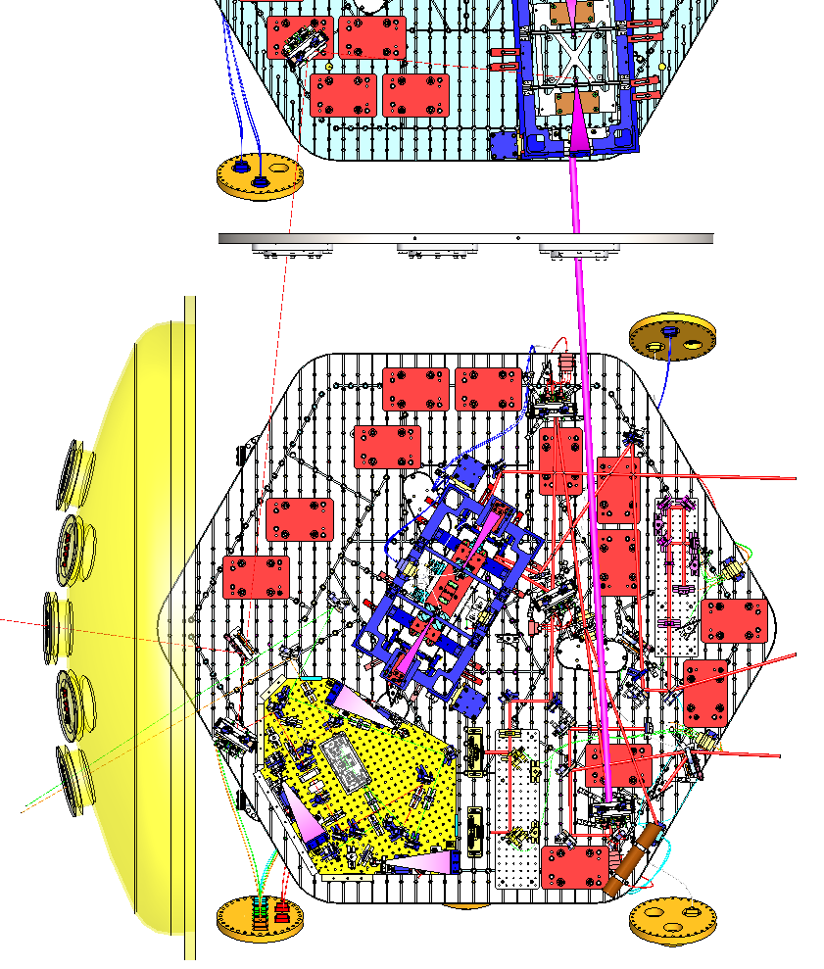
O2 LAYOUT
Faraday
HAM 5 & HAM 6 LAYOUT FOR O2
NO Filter Cavity
RFPD in Air
To be added:
VOPO Suspension (x1)
Tip-Tilt (x1)
2” Mirror (x2)
Beam Splitter (x1)
VOPO

Slide 4
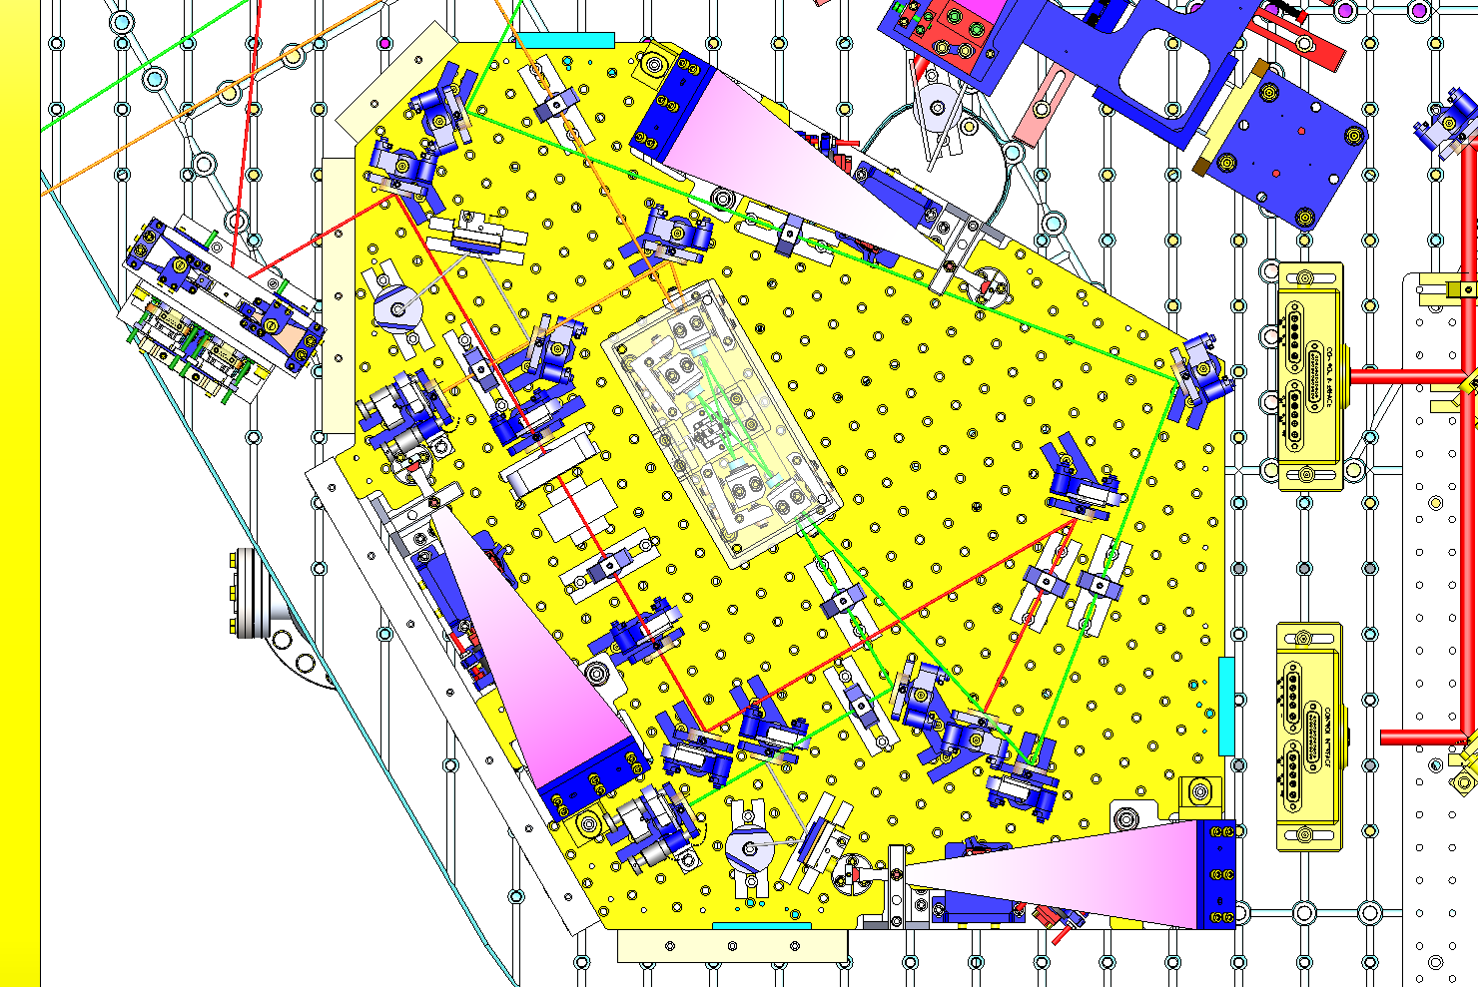
O2 LAYOUT
Injection Bench O2
Green Beam: 532 nm
Orange Beam: 1064 nm
Red Beam: SQZ

Slide 5
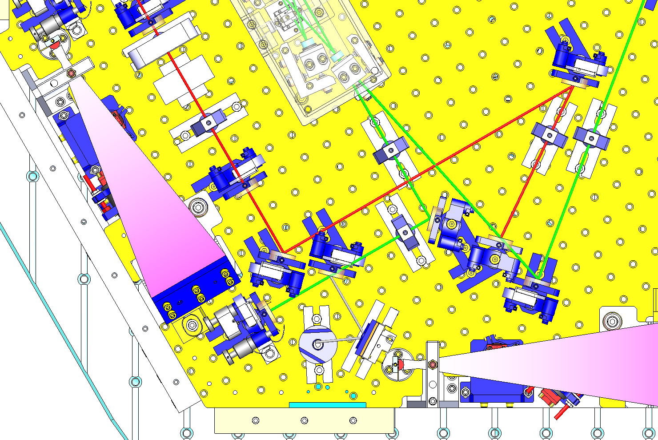
O2 LAYOUT
Injection Bench O2
C
Green Beam:
A = 0.149 m
B = 0.106 m
C = 0.10862 m
D =
Fiber-Lens1: 0.149
Fiber-Lens 2: 0.255
Fiber-Cavity: 0.36362
B
D
A

Slide 6
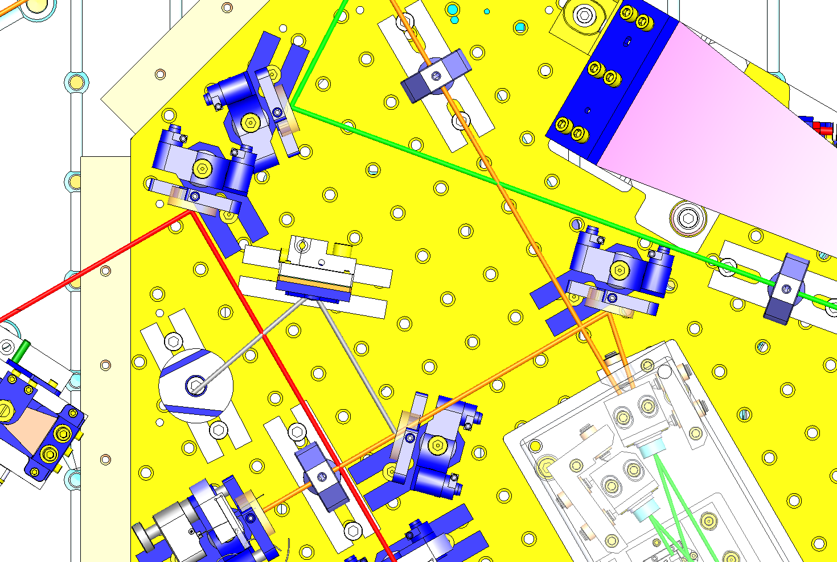
O2 LAYOUT
Injection Bench O2
Orange Beam:
A = 0.030 m
B = 0.250 m
Fiber-Lens1: 0.030 m
Fiber-Cavity: 0.280 m
B
A

Slide 7
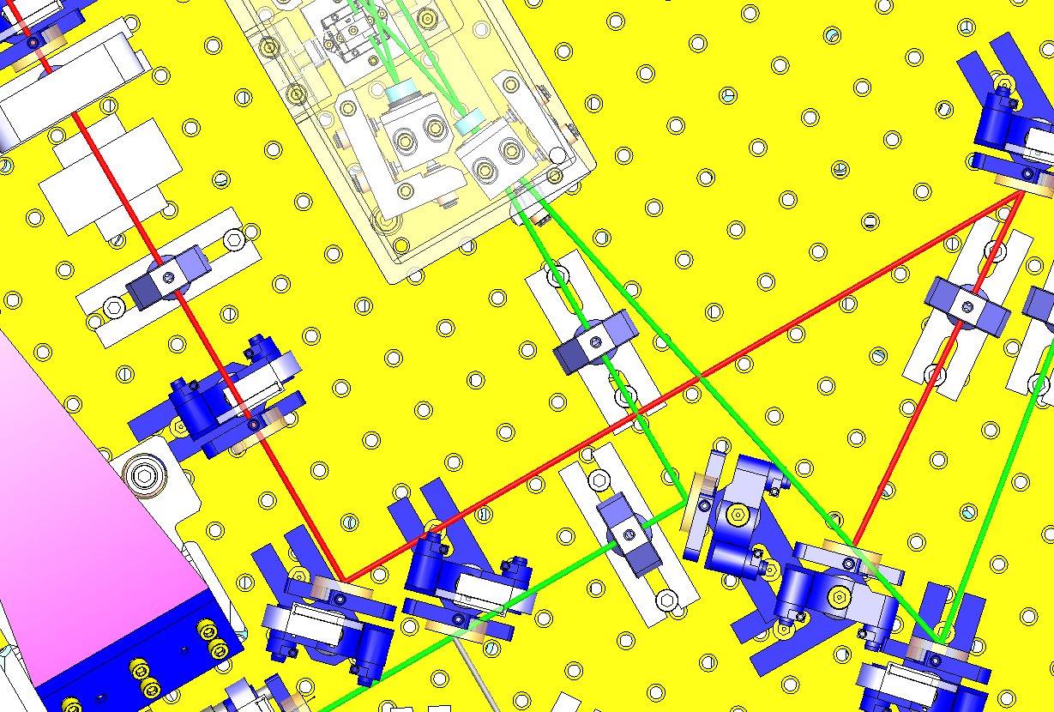
O2 LAYOUT
Injection Bench O2
SQZ Beam:
A = 0.346m
B = 0.534m
C = 67.50° (33.75° incidence)
Cavity-Lens1: 0.346m
Cavity-Lens 2: 0.880 m
C
B
A

Slide 8
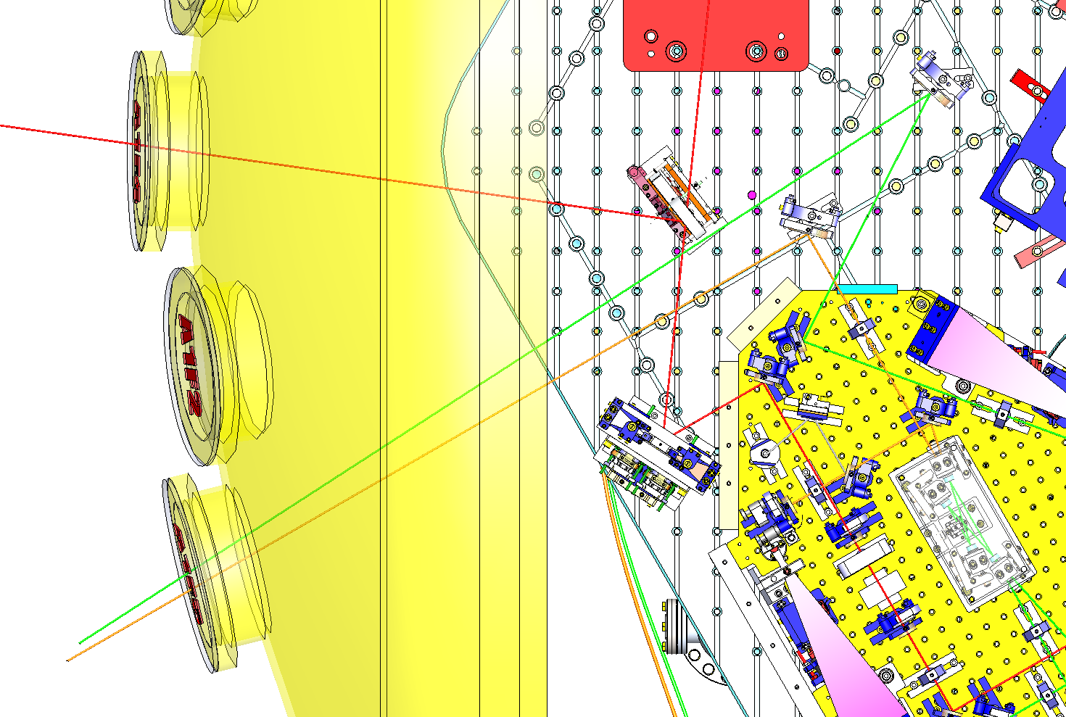
O2 LAYOUT
HAM 6 O2
E
HAM 6 Beam:
A = 90° (45° incidence)
B = 54° (27° incidence)
C = 92° (46° incidence)
D = 90° (45° incidence)
E = 32° (16° incidence)
C
D
B
A

Slide 9
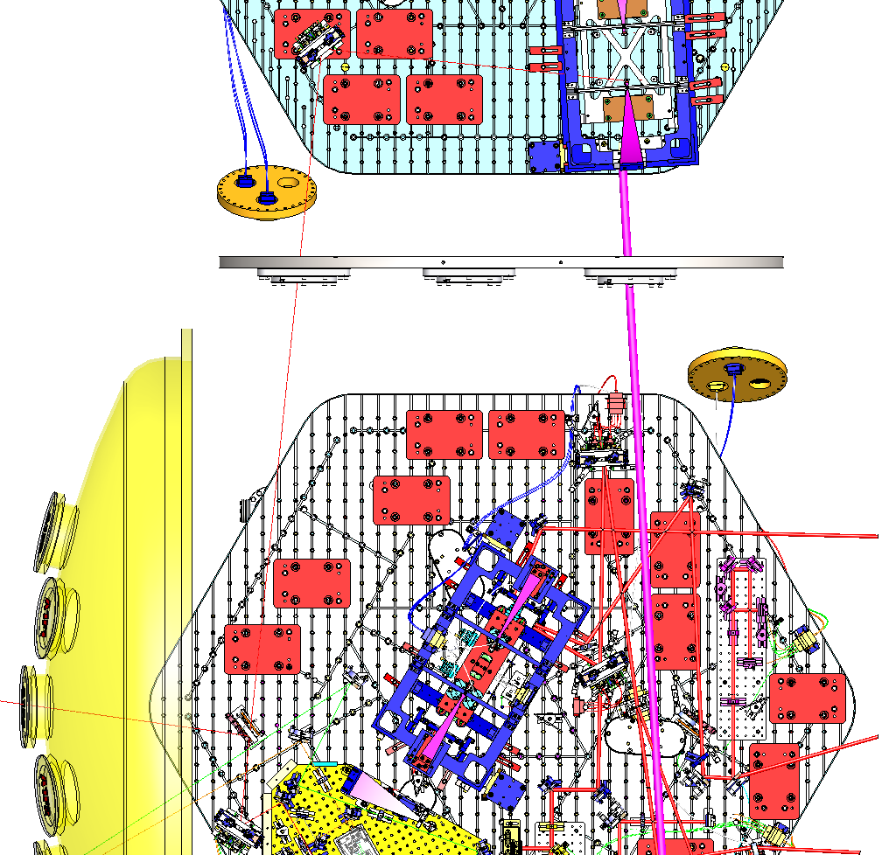
O2 LAYOUT
HAM 5 & 6 O2 Layout
SQZ Beam (Red):
Cavity Out – Faraday : 4.7146m

Slide 10
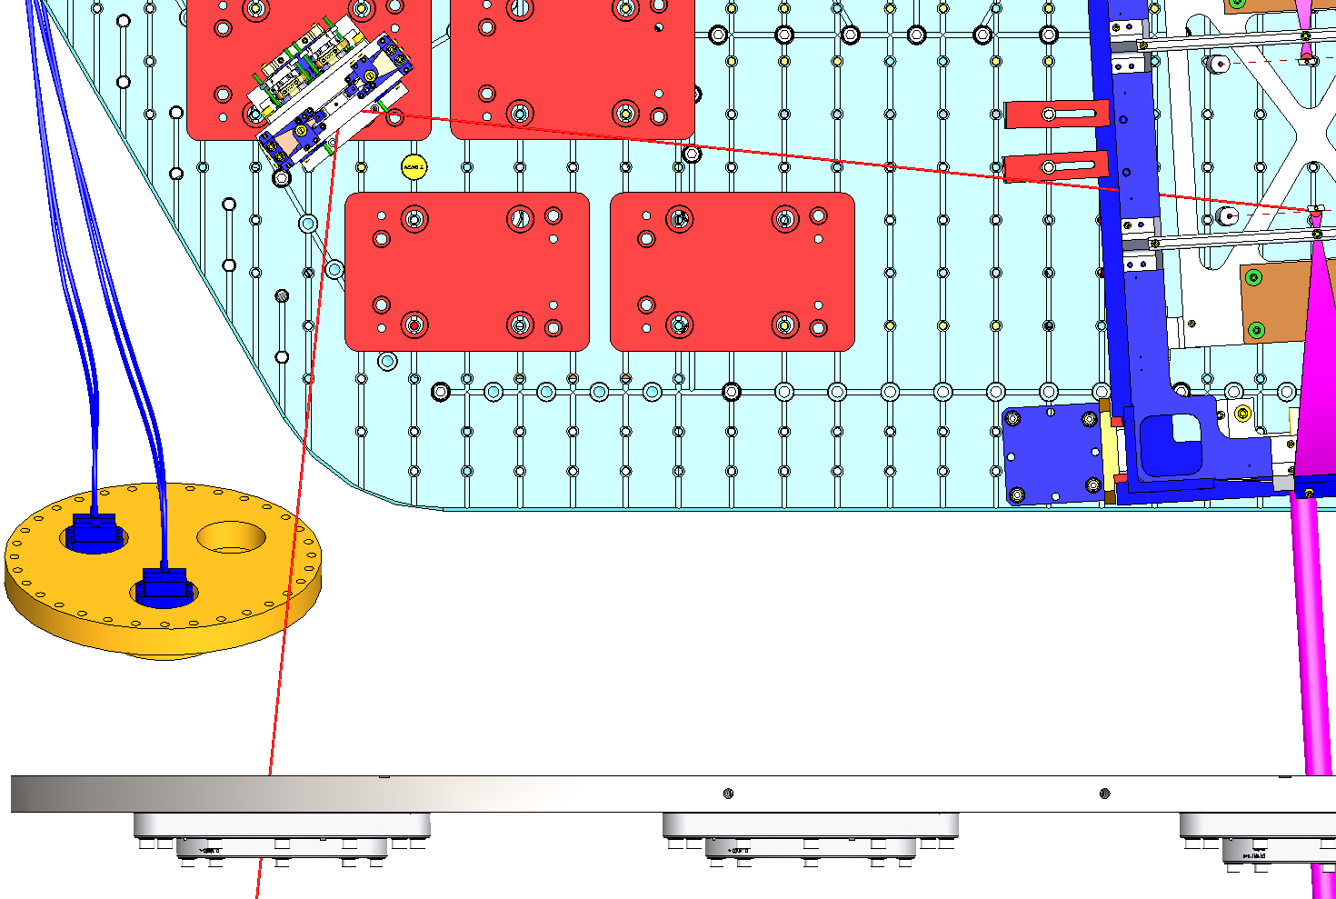
O2 LAYOUT
HAM 5 O2 Layout
A
HAM 5 SQZ Beam:
A = 90°

Slide 11
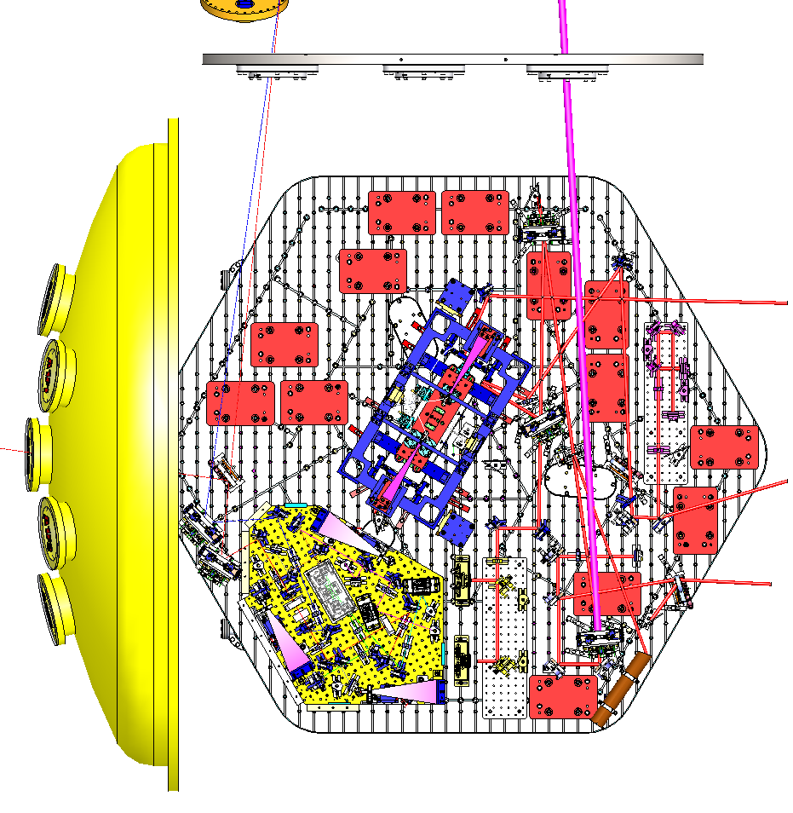
O3 LAYOUT
HAM 6 O3
Filter Cavity
RFPD in Vacuum
To be added (from O2):
Tip-Tilt (x1)
To be removed (from O2):
2” Mirror (x2)

Slide 12
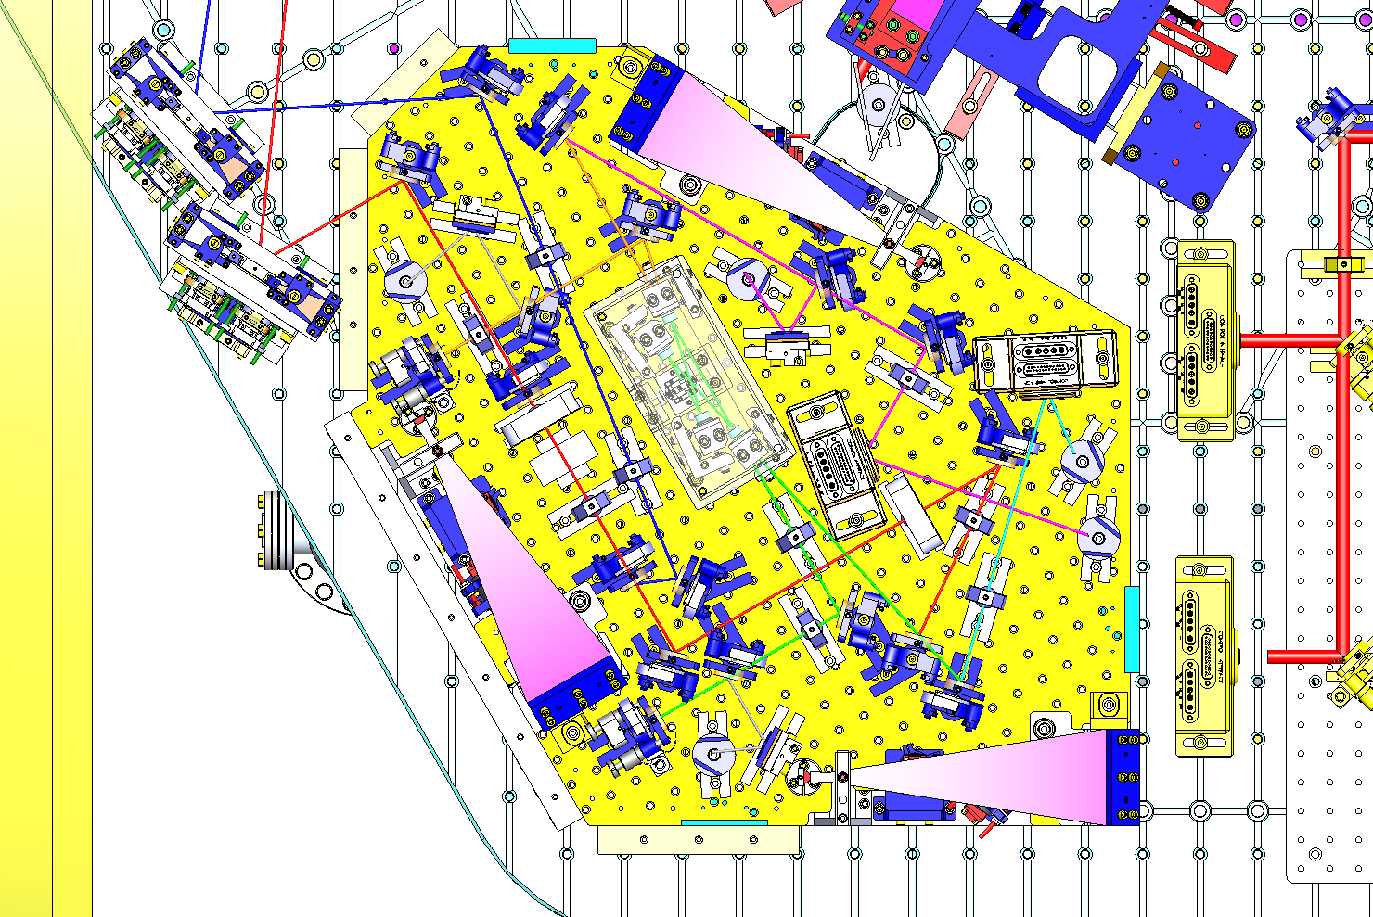
O3 LAYOUT
Injection Bench O3
Green Beam: 532 nm
Orange Beam: 1064 nm
Red Beam: SQZ
Blue Beam: FC to IF

Slide 13
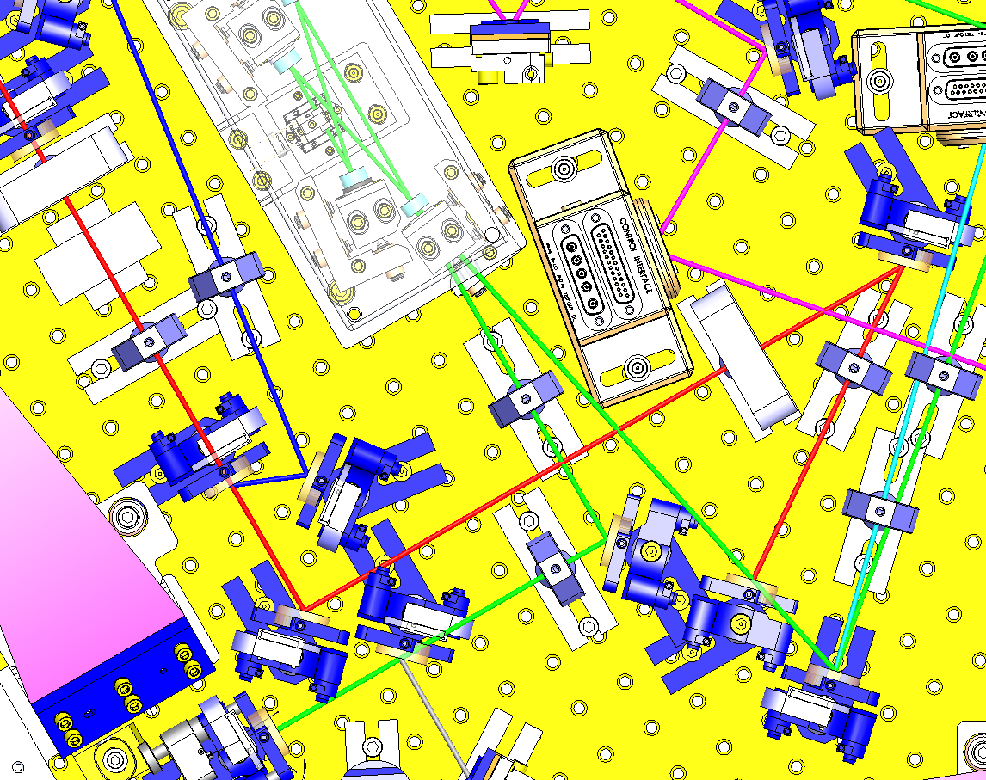
O3 LAYOUT
Injection Bench O3
Orange Beam:
Same as O2
Pink Beam:
RFPD in Vacuum

Slide 14
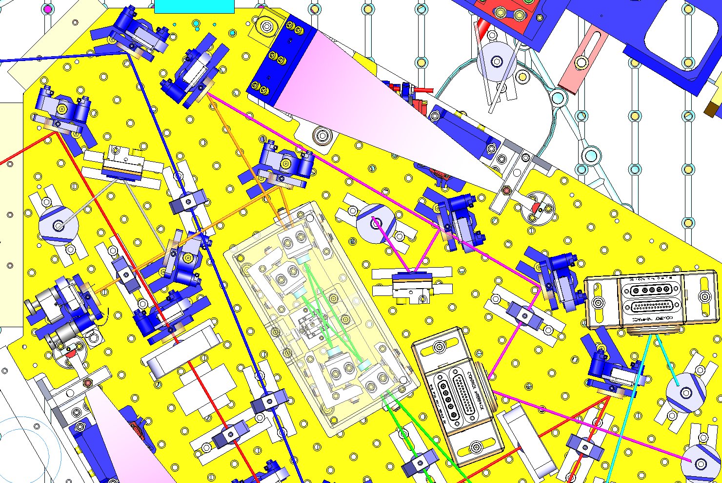
O3 LAYOUT
Injection Bench O3
Blue Beam:
RFPD in Vacuum

Slide 15
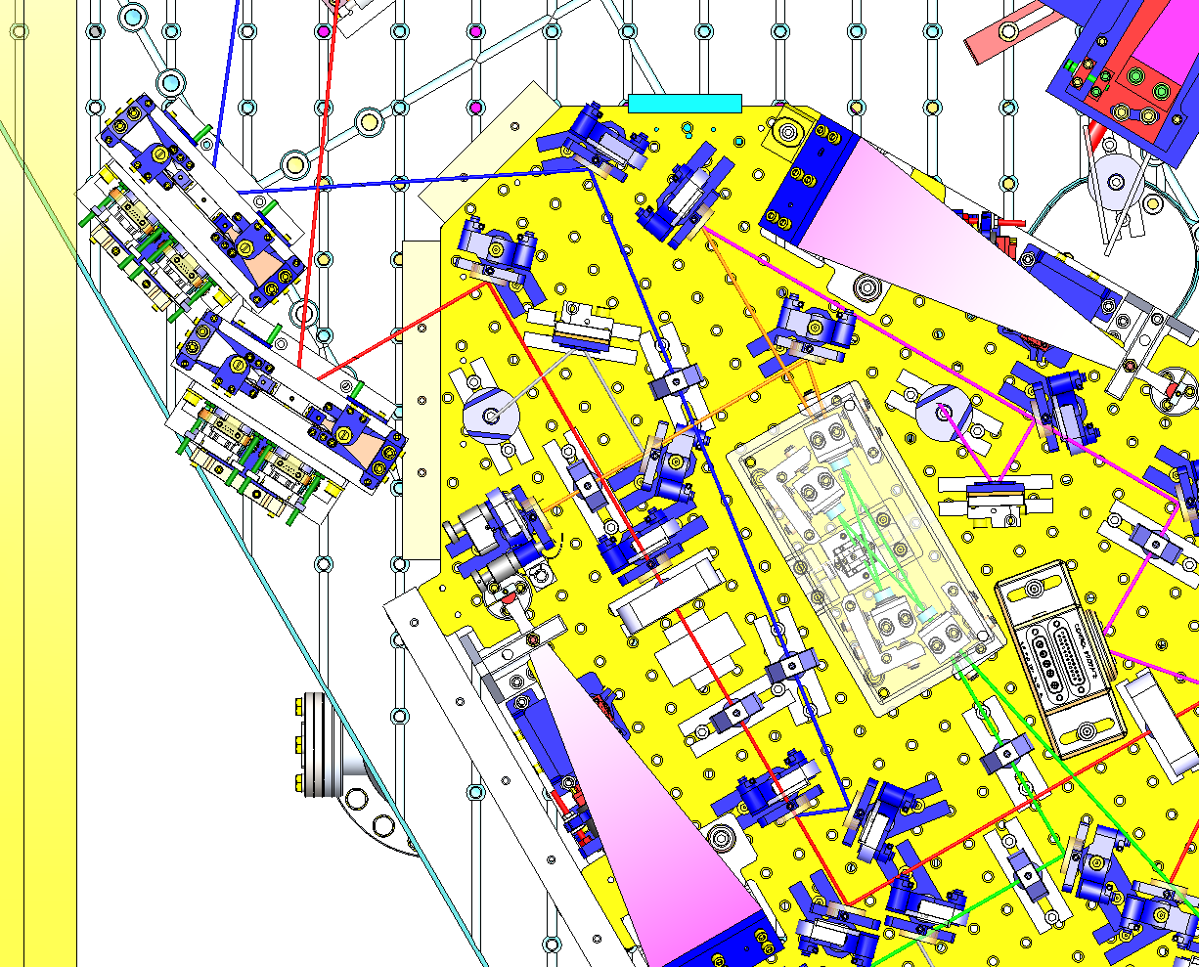
O3 LAYOUT
Injection Bench + HAM 6 O3
C
B
SQZ (red) Beam:
Same as O2
FC (Blue) Beam:
A = 75.82° (37.91° incidence)
B = 108.36° (54.18° incidence)
C = 78° (39° incidence)
A

Slide 16
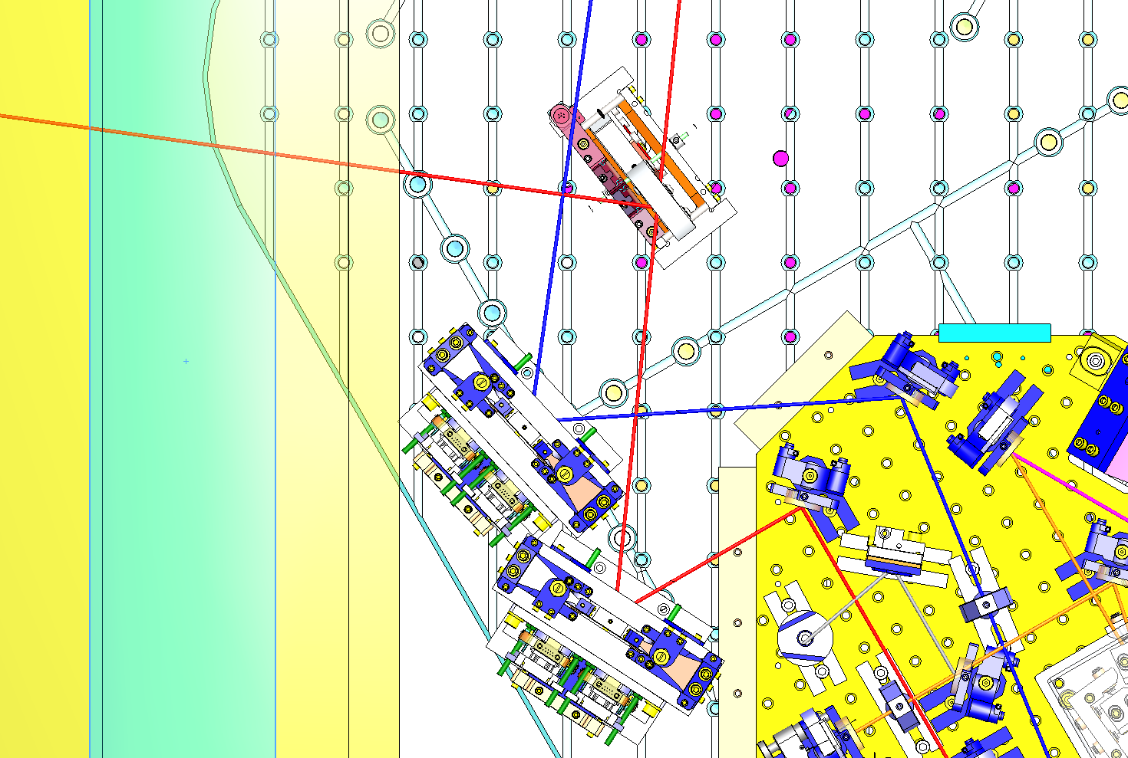
O3 LAYOUT
HAM 6 O3

Slide 17
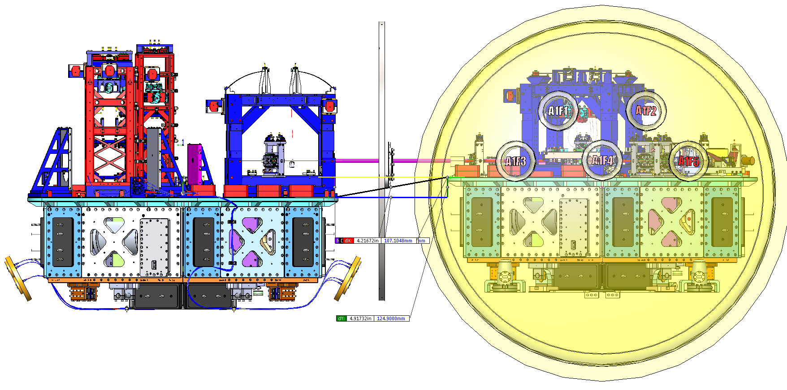
HEIGHT “PROBLEM”
Height difference Ham 5 - 6
Height difference: 4.91732 in (124.9mm)

Slide 18
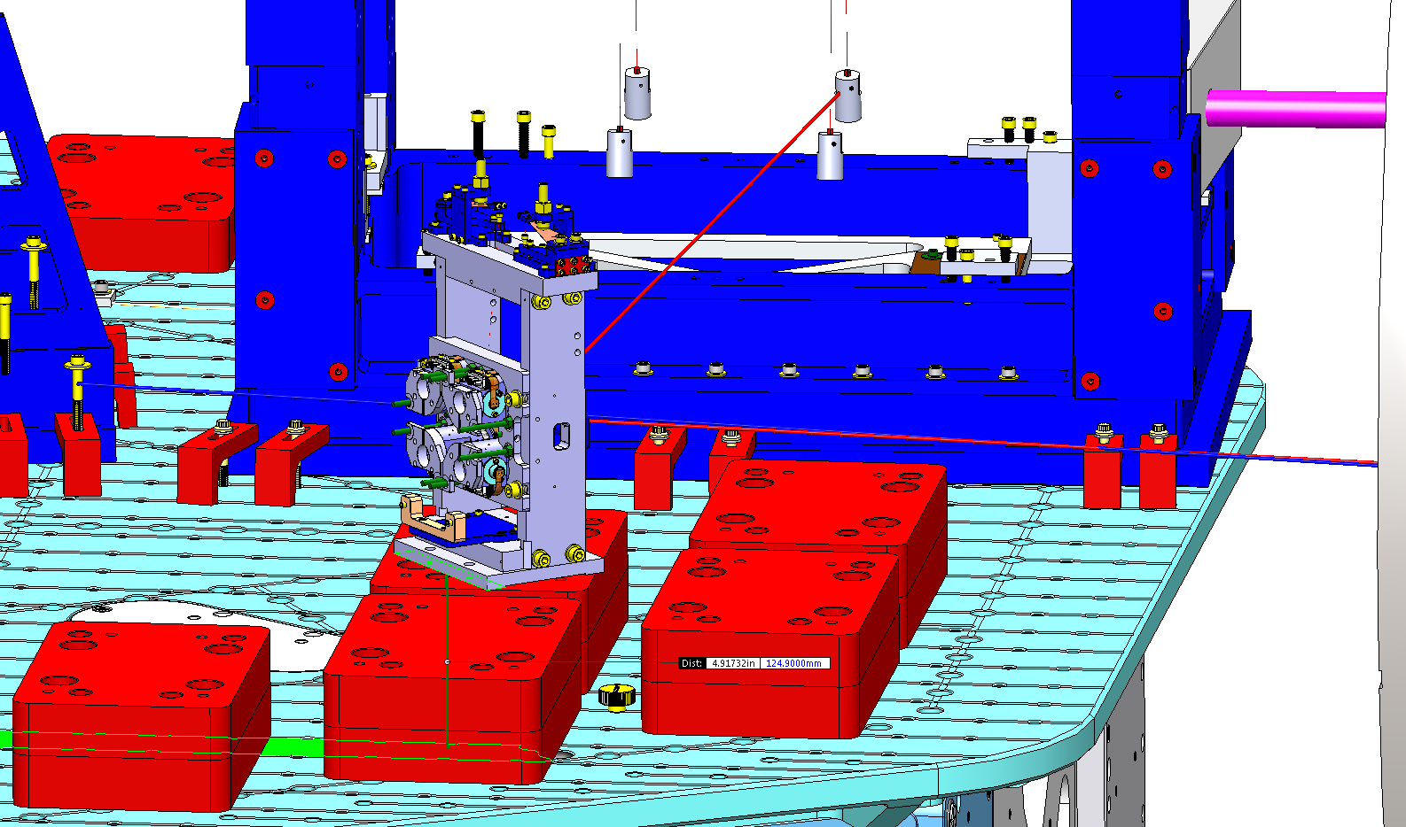
HEIGHT “PROBLEM”
Height difference Ham 5 - 6
NOTA: A 124.9mm high Aluminum base will have to be designed in order to raise the Tip-Tilt in Ham 5

