Slide 1
Opening the Gravitational Wave Window on the Universe
Peter R. Saulson
Martin A. Pomerantz ‘37 Professor of Physics Syracuse University

Slide 2
Facts about the new LIGO gravitational wave observatory
On 14 September 2015, LIGO heard the collision of two black holes by receiving their gravitational waves.
The two black holes were each about 30 times more massive than our Sun.
They spun around each other several times in the last few tenths of a second before they collided.
This happened 1.3 billion light years away, 1.3 billion years ago.

Slide 3
Questions that you might have
What is a black hole?
What is a gravitational wave?
What is LIGO? How does it work to detect gravitational waves?
What did LIGO find?
What kind of imaging can we do?

Slide 4
What is a black hole?
If enough matter is placed into a small enough place, its gravity is so strong that nothing can escape from it, not even light. It then becomes invisible – a black hole.
If all of the matter of the Earth were squeezed into a ball 2.5 cm in diameter, it would be a black hole.
To make the Sun a black hole, squeeze it into 6.5 km in diameter. (Its actual diameter is 1.4 million km.)

Slide 5
What is a gravitational wave?
A gravitational wave is a ripple in space itself.
Gravitational waves travel at the speed of light.
They are made when large masses (like large stars that have turned into black holes) move at close to the speed of light.

Slide 6
Here’s how two black holes generate gravitational waves

Slide 7
What is a gravitational wave, anyway?
And, can that understanding suggest a way to detect them?

Slide 8
A set of free test charges

Slide 9
Electromagnetic wave moves charged test bodies

Slide 10
A set of freely-falling test masses

Slide 11
A grav wave distorts set of test masses in a quadrupolar pattern

Slide 12
Gravitational wave “strain” pattern
Effect is transverse to the direction of propagation.
Strain amplitude: h = 2 ΔL/L
The effect is bigger over longer baselines.

Slide 13
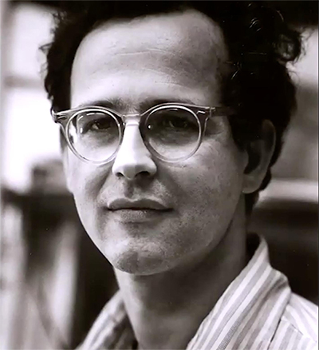
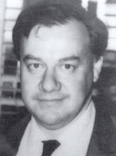
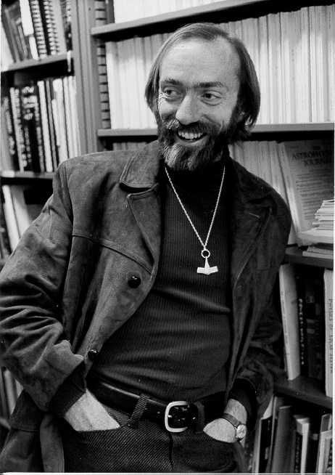
Founders of LIGO ca. 1972
LIGO’s co-inventors in the 1970s: Experimenters Rainer Weiss (MIT) and
Ronald Drever (Glasgow, then Caltech), and theorist Kip Thorne (Caltech).

Slide 14
Let’s invent a gravitational wave detector
In principle, there’s no limit to how far apart we can put our test masses.
We’ve put ours 4 km apart.

Slide 15
How LIGO Works Credit: LIGO/T. Pile

Slide 16
Strain vs. time records the history of system that made the wave
B. P. Abbott et al. (LIGO Scientific Collaboration and Virgo Collaboration)
Phys. Rev. Lett. 116, 061102

Slide 17
Orbital periods of stellar-mass binaries are in the audio band!

Slide 18
Antenna pattern

Slide 19
LIGO as an imaging device
Credit: LIGO/ Axel Mellinger

Slide 20
Localization by triangulation
Benjamin P. Abbott et al. (LIGO Scientific Collaboration and Virgo Collaboration),
"Prospects for Observing and Localizing Gravitational-Wave Transients with Advanced LIGO and Advanced Virgo",
Living Rev. Relativity 19, (2016)

Slide 21
Improved localization via: signal ratios, more detectors
Benjamin P. Abbott et al. (LIGO Scientific Collaboration and Virgo Collaboration),
"Prospects for Observing and Localizing Gravitational-Wave Transients with Advanced LIGO and Advanced Virgo",
Living Rev. Relativity 19, (2016)

Slide 22
Gravitational waves: new physics, new astronomy
Embody gravity’s obedience to the principle “no signal faster than light”
Are made when large masses orbit at relativistic speeds
Travel through otherwise opaque matter
Can be generated by pure spacetime
Black holes
Early universe fluctuations
Can’t be made by any conceivable artificial source, but are a great new tool for astronomy

Slide 23
What does it take to build a gravitational wave detector?
We’ll need:
A set of free test masses, far apart,
A means to measure their relative motion, and
Isolation of the masses from other causes of motion.
Here’s the challenge:
Best astrophysical estimates predict fractional separation changes of only 1 part in 10²¹, or less.
If test masses are separated by 4 km, that means a length change less than 10⁻¹⁸ m!

Slide 24
How small is 10⁻¹⁸ m?
Diameter of human hair: 10⁻⁵ m
Diameter of atom: 10⁻¹⁰ m
Diameter of atomic nucleus: 10⁻¹⁴ m
Diameter of proton: 10⁻¹⁵ m
To succeed, we need to discern length changes 1,000 times smaller than a proton.
We can do it!

Slide 25
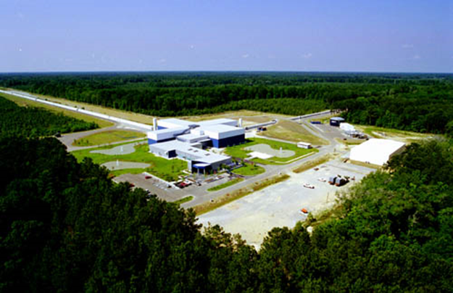
LIGO’s two sites observed from 2005 to 2010, then upgraded.
LIGO Hanford Observatory, WA
LIGO Livingston Observatory, LA
Advanced LIGO will eventually have 10 times the sensitivity of initial LIGO. Last fall, when we were “halfway there”, we made our first observing run.

Slide 26
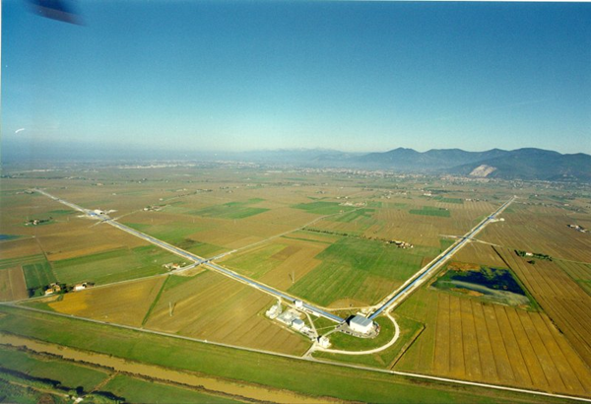
Our partners, GEO and Virgo
GEO, 600 m arms, near Hannover
Virgo, 3 km arms, near Pisa

Slide 27
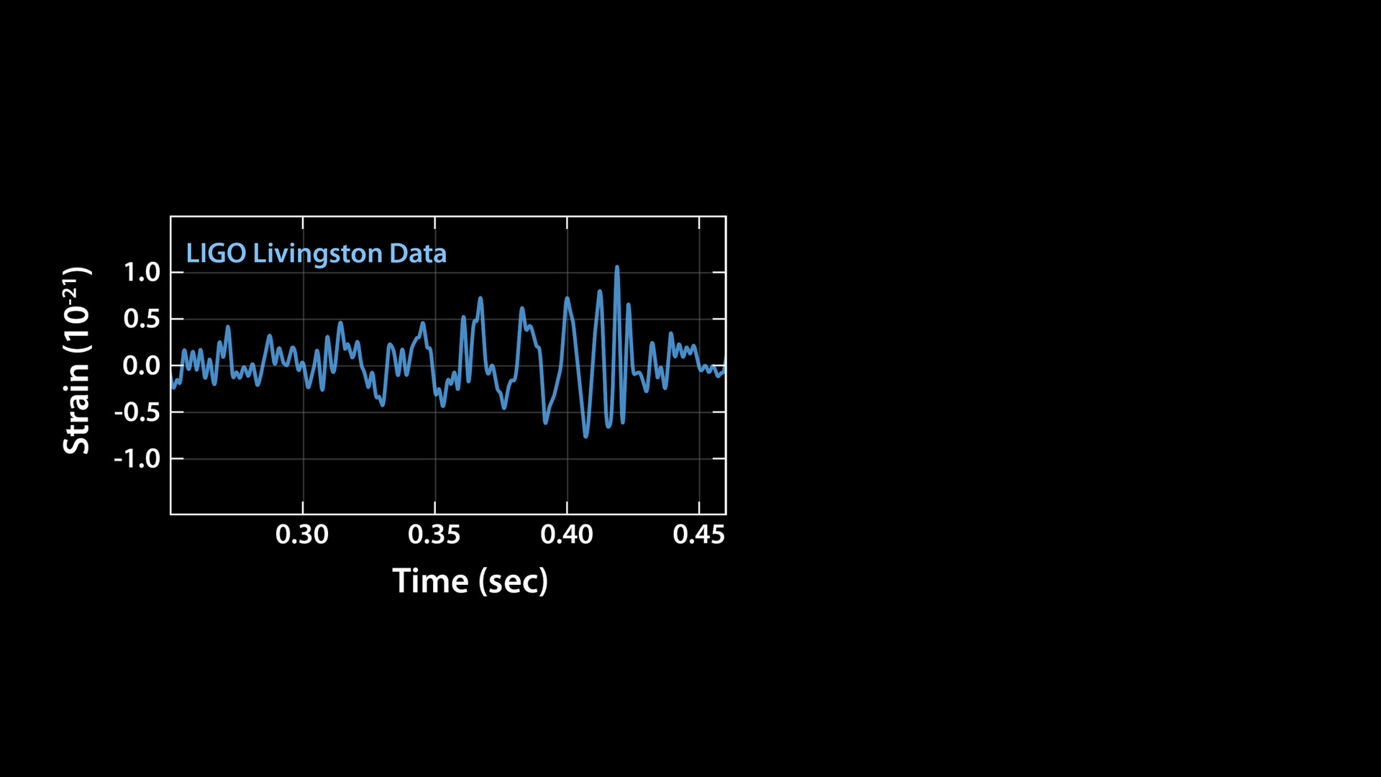
2015 Sept 14 09:50:45 UTC

Slide 28
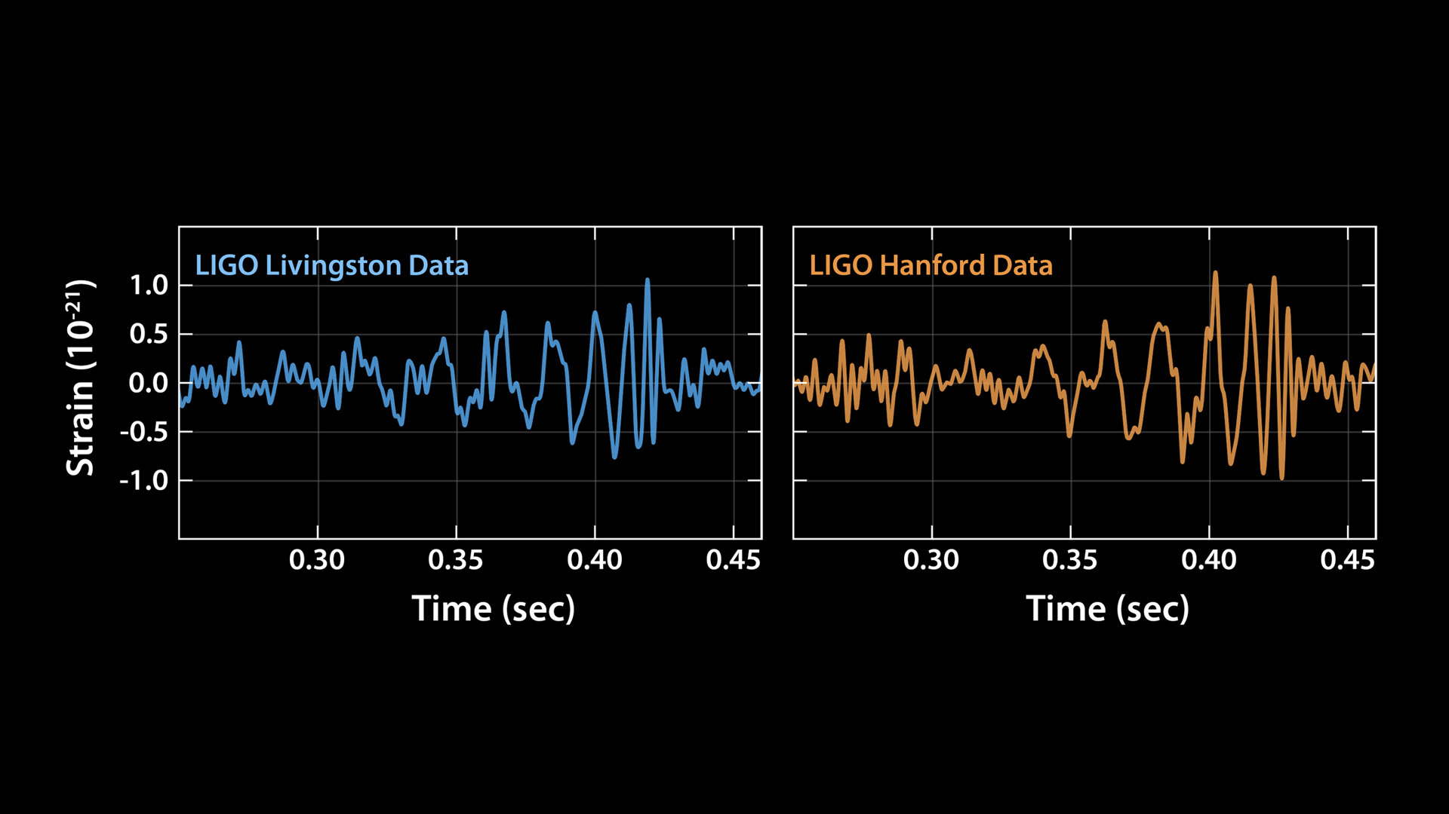
2015 Sept 14 09:50:45 UTC

Slide 29
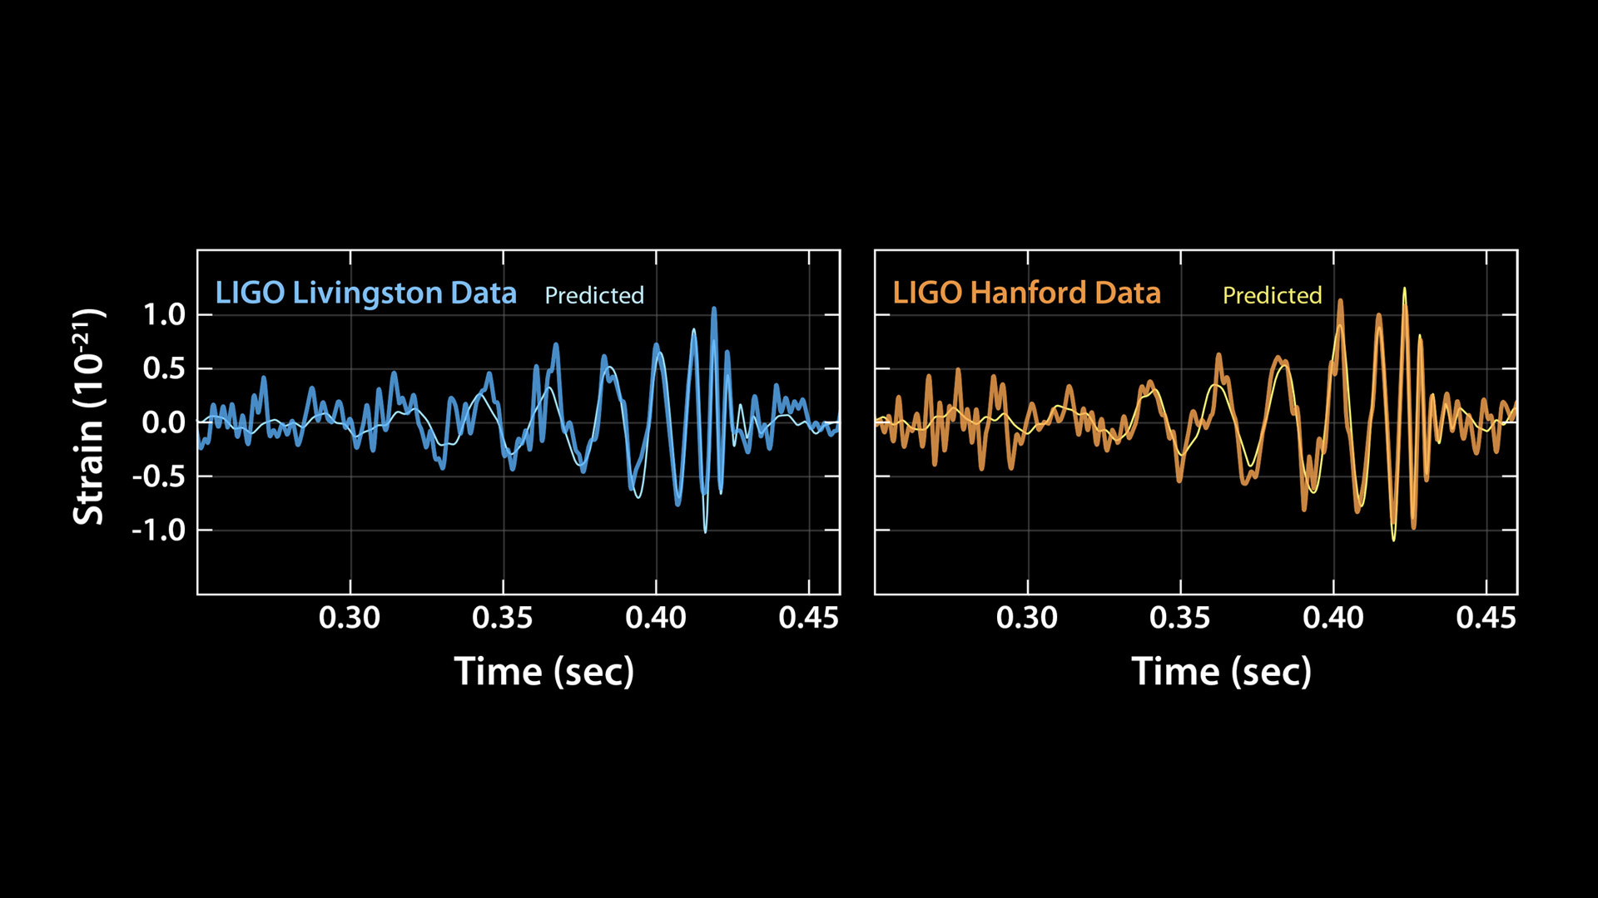
2015 Sept 14 09:50:45 UTC

Slide 30
Listen to the signal

Slide 31
The gravitational wave future is bright!
LIGO plans to start its next observing run within a few months. During that period, we hope to be joined by Virgo.
We ought to find more binary black holes.
Someday soon, perhaps also binary neutron stars, or even more exotic objects.
Stay tuned!

