Slide 1
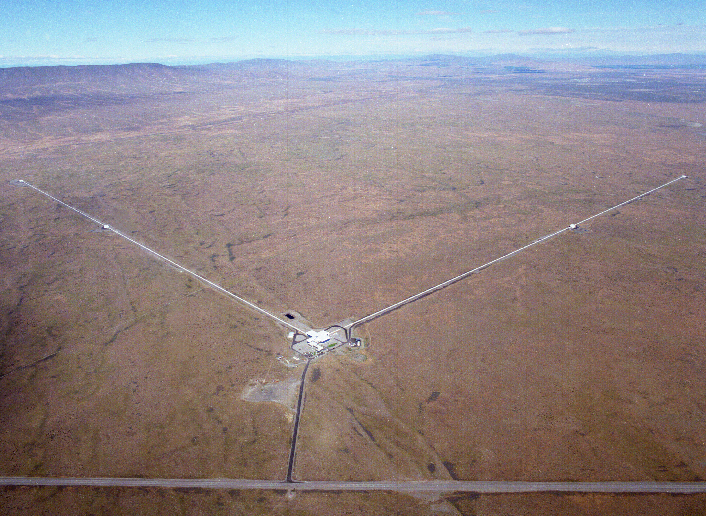
Introduction to Gravitational-Wave Astronomy – Teacher Edition
Fred Raab,
for the LIGO Laboratory and the LIGO Scientific Collaboration
16-Jul-18

Slide 2
Outline
My talk today
  Basics of General Relativity and Gravitational Waves
  Sources of Gravitational Waves
  Detectors of Gravitational Waves
  Some history
  International Network of Terrestrial GW Detectors
  The future

Slide 3
Basics of General Relativity and Gravitational Waves
Wherein it is realized that space and time are things whose properties are manifested by phenomena that we collectively refer to as “gravity”.

Slide 4
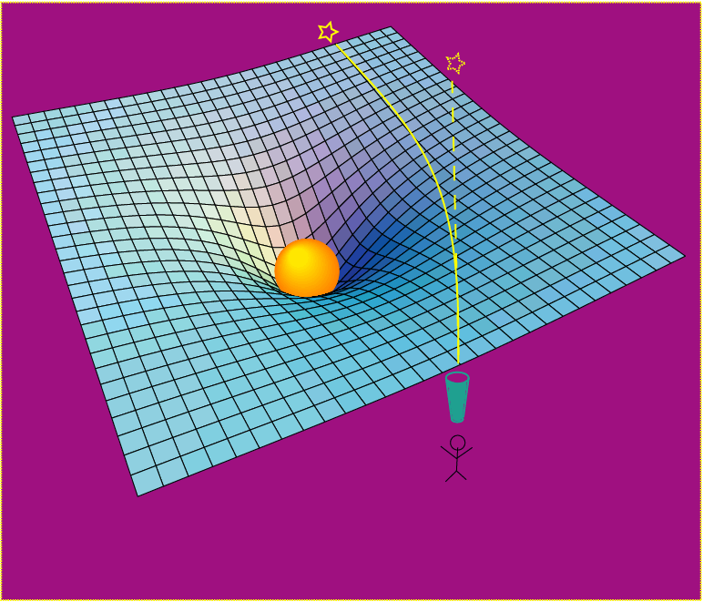
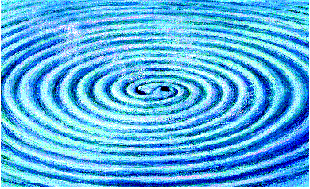
Einstein’s General Relativity re-wrote the rules of space and time
Rendering of space stirred by two orbiting black holes
A massive object shifts apparent position of a star
Empty space and time are things, with real physical properties. Space has a shape, a stiffness and a maximum speed for information transfer.

Slide 5
The problem with checking relativity in Einstein’s time
A figure of merit for manifesting relativistic effects is v/c.
In Einstein’s time, there was not a lot of v/c available to observe and rulers and clocks were poor.
  v/c for a locomotive is approximately 10⁻⁷
  Ruling engines could get down to micron resolution (10⁻⁶ m)
  Clocks could keep time to a second per day
Today
  v/c reached 0.5 for GW150914
  LIGO resolution is approximately 10⁻²⁰ m
  Clocks keep time to a second per 300 million years

Slide 6
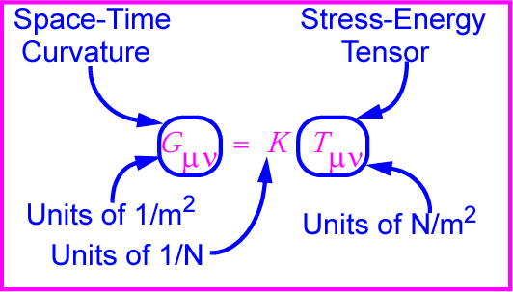
Gravitational waves: hard to find because space-time is stiff!
K ~ 10⁻⁴⁴ N⁻¹
⇒ Wave can carry huge energy with miniscule amplitude!

Slide 7
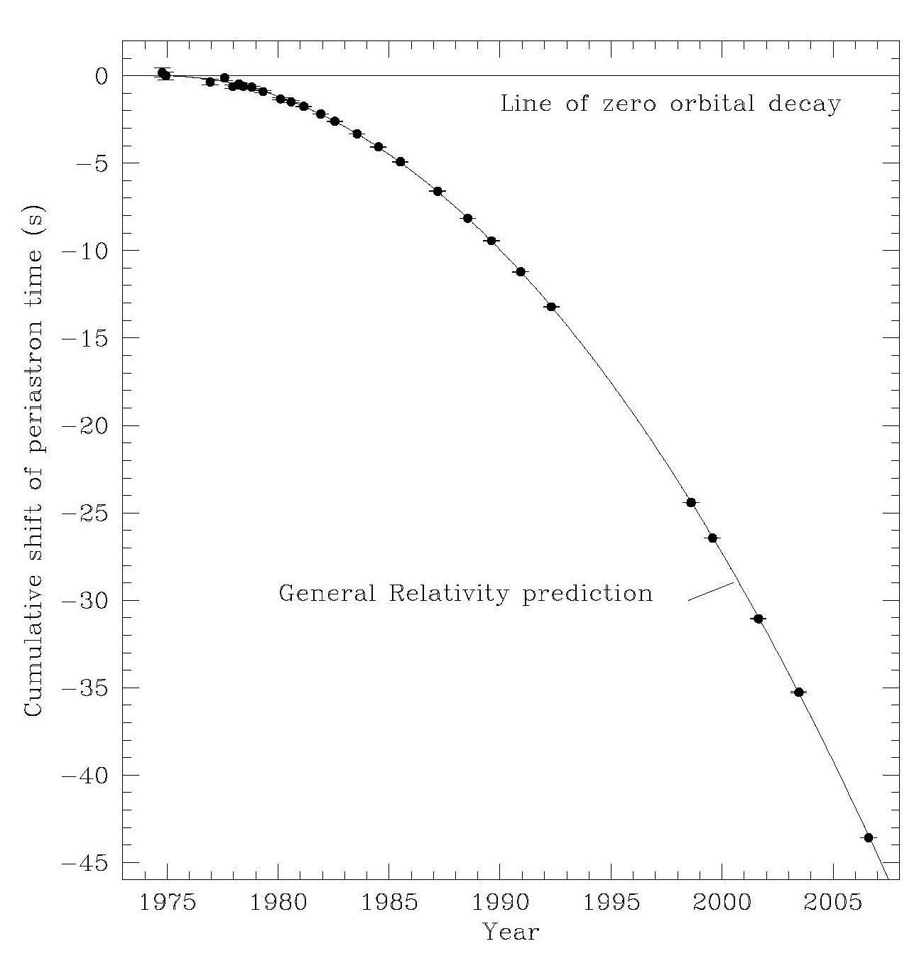
Gravitational Waves hard to find, but known to exist
Neutron Binary System – Hulse & Taylor
PSR 1913 + 16 -- Timing of pulsars
Emission of gravitational waves
•
17 / sec
•
~ 8 hr
Neutron Binary System
separated by 10⁶ miles
m₁ = 1.4m; m₂ = 1.36m; ε = 0.617
Prediction from general relativity
spiral in by 3 mm/orbit
rate of change orbital period
Taylor and Weisberg

Slide 8
Sources of Gravitational Waves
Accelerating Quadrupole Mass Moments

Slide 9

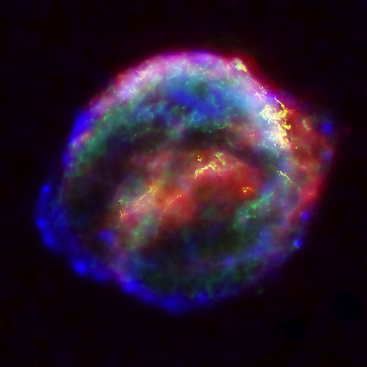

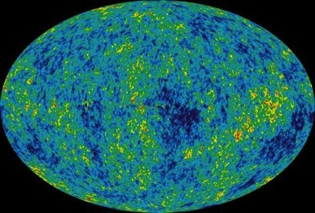
Astrophysical Sources of Gravitational Waves
Coalescing Compact Binary Systems: Neutron Star-NS, Black Hole-NS, BH-BH
- Strong emitters, well-modeled,
- (effectively) transient
Asymmetric Core Collapse Supernovae
- Weak emitters, not well-modeled (‘bursts’), transient
Credit: Chandra X-ray Observatory
Credit: AEI, CCT, LSU
Cosmic Gravitational-wave Background
- Residue of the Big Bang
- Long duration, stochastic background
Spinning neutron stars
- (nearly) monotonic waveform
- Long duration
NASA/WMAP Science Team
Casey Reed, Penn State
Notes:
LIGO is designed to be an observatory, not a one-off proof that GWs exist. What do we look for?
There are number of predicted astrophysical sources of gravitational radiation, and most of them involve cataclysmic events.
Binary systems – NSs and BHs, most likely source, theoretically well understood with known waveforms
Bursts – GW emissions that are not well modeled or understood. These include asymmetrically core collapse supernova, cosmic strings, and perhaps unknown sources
The residual GW background
Continuously emitting sources such as spinning neutron stars, which have a pure monotone emission.

Slide 10
Frequency-Time
Characteristics of GW Sources
time
Ringdowns
Broadband Background
Bursts
frequency
CW (quasi-periodic)
Chirps
Earth’s orbit
Earth’s rotation
frequency
frequency
time
time

Slide 11
Detectors of Gravitational Waves
No Law of Physics Forbids Them

Slide 12
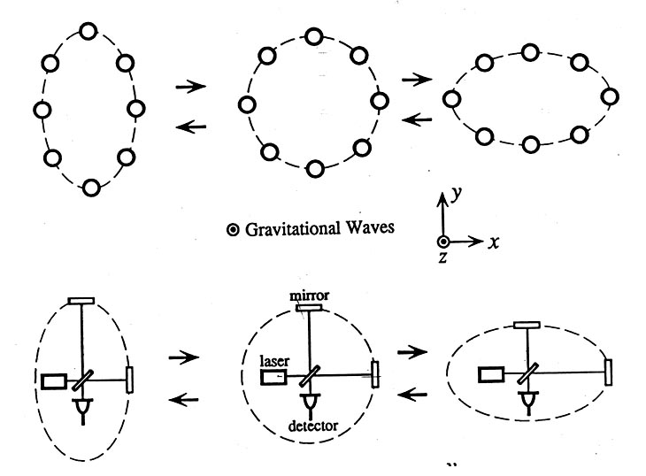
Basic idea is simple
GW amplitude h = (R_{x}-R_{y})/R
Spatial asymmetry induces relative phase shifts on light in arms

Slide 13
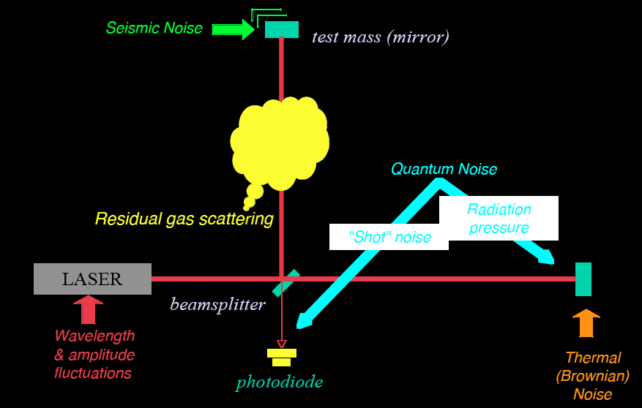
Noise cartoon
R. Adhikari

Slide 14
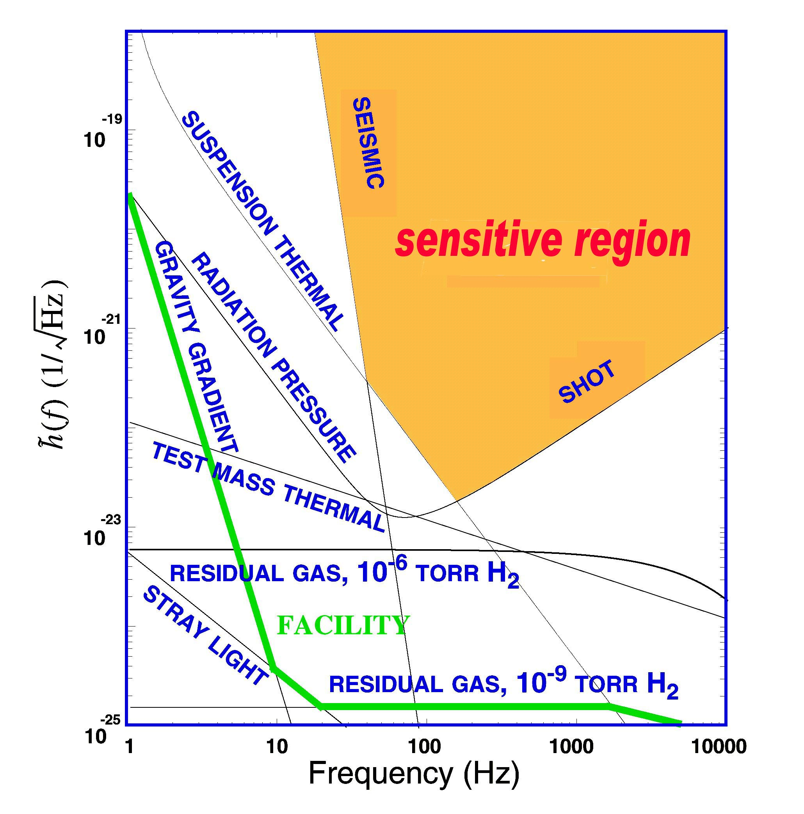
What Limits Sensitivity of Interferometers?
DESIGN
Seismic noise & vibration limit at low frequencies
Atomic vibrations (Thermal Noise) inside components limit at mid frequencies
Quantum nature of light (Shot Noise) limits at high frequencies
Myriad details of the lasers, electronics, etc., can make problems above these levels
COMMISSIONING

Slide 15

Optical configuration
Complete detector description in Class. Quantum Grav. 32 (2015) 074001

Slide 16

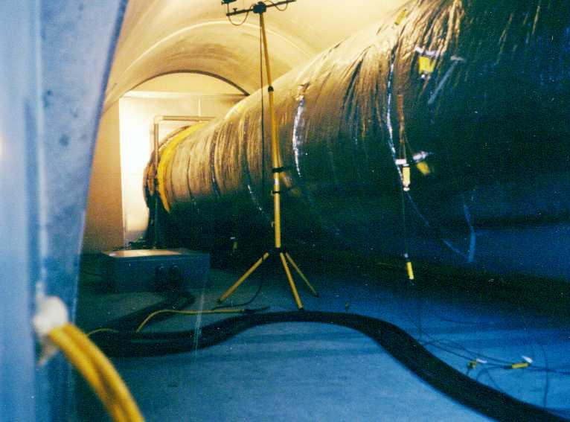
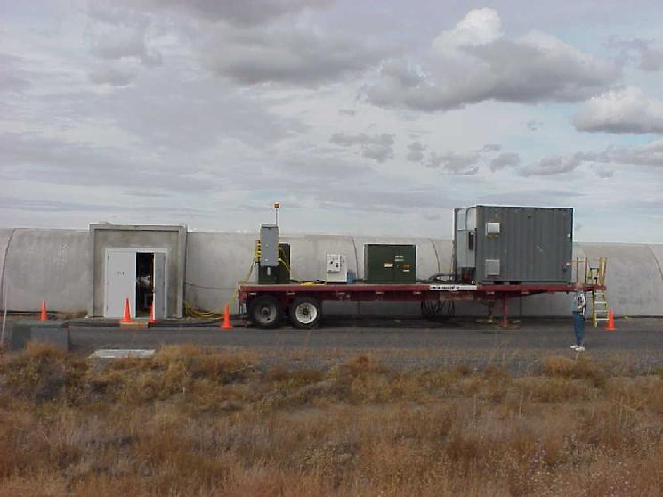
Evacuated Beam Tubes Provide Clear Path for Light
P< 10⁻⁹ Torr
Portable power supply for bakeout

Slide 17
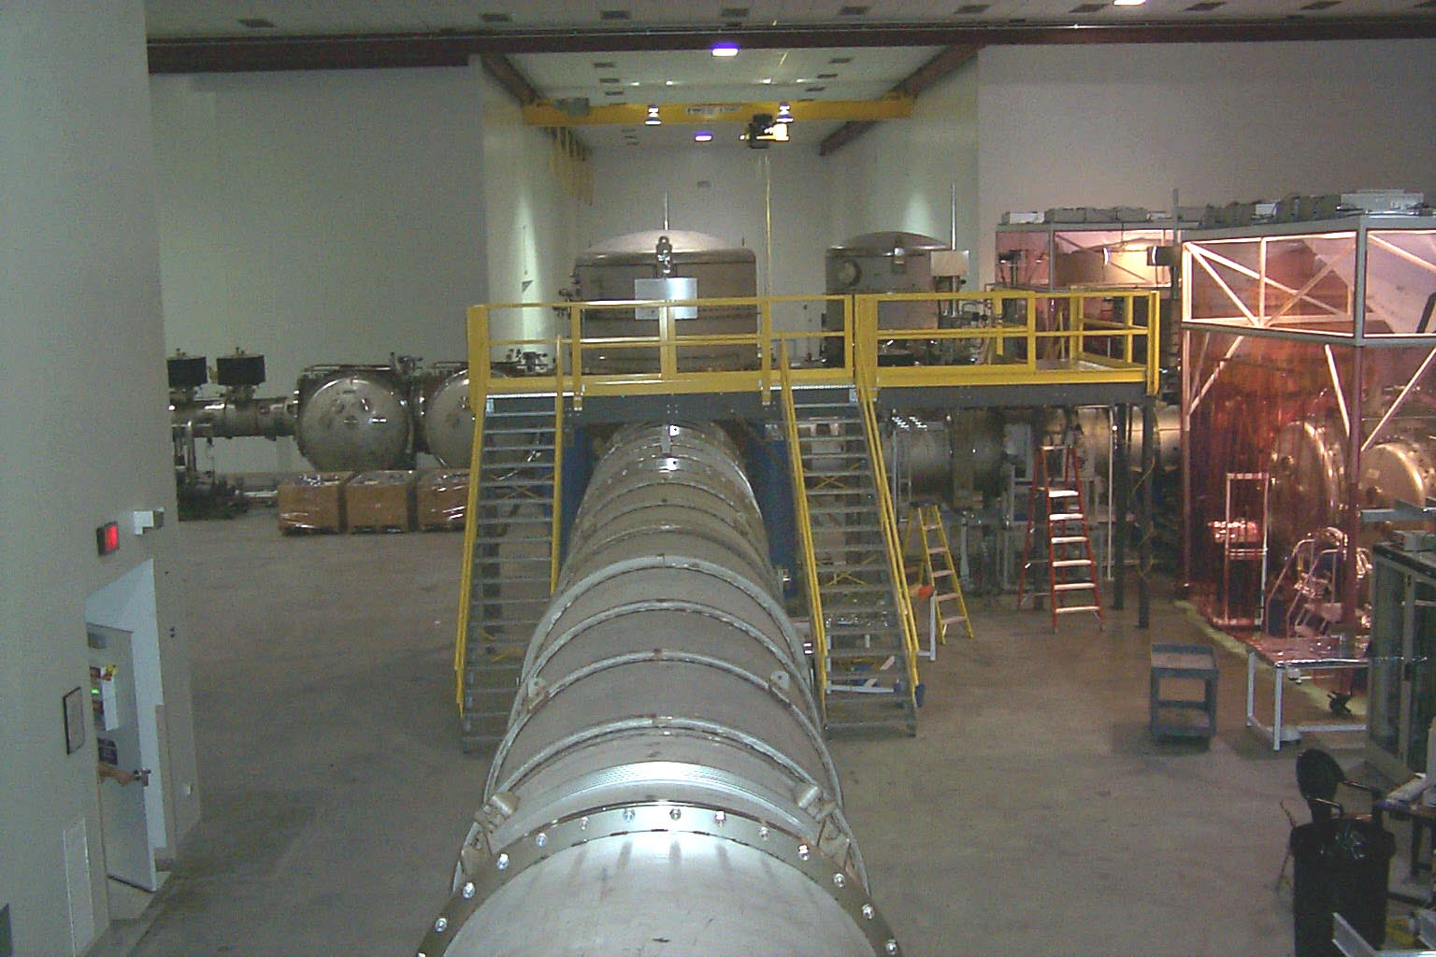
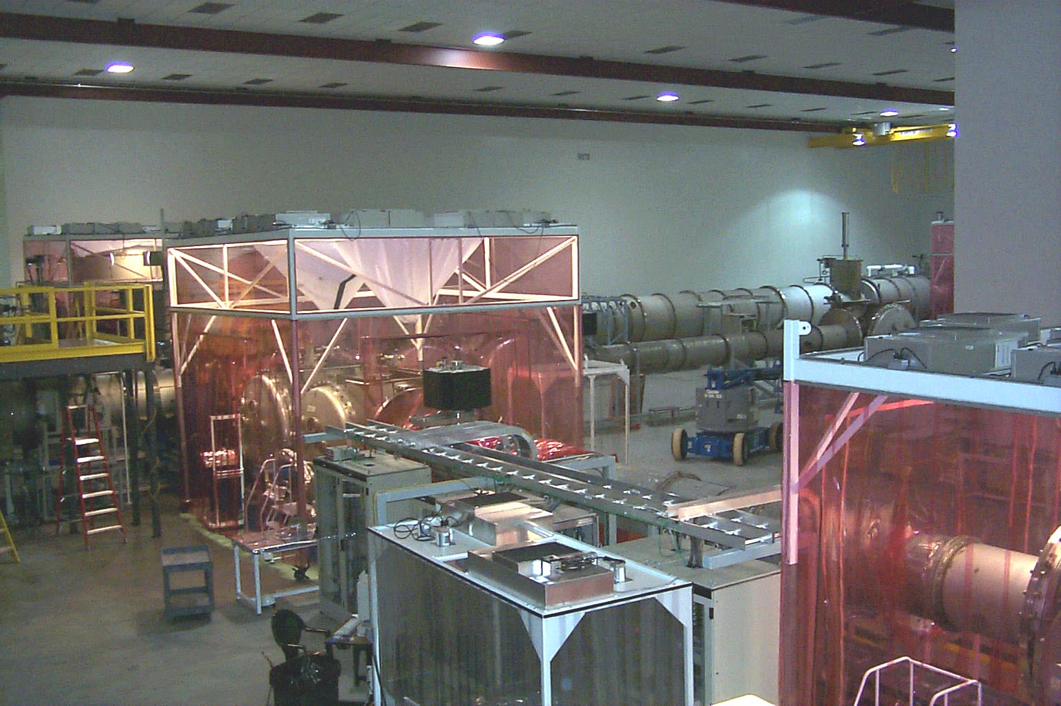
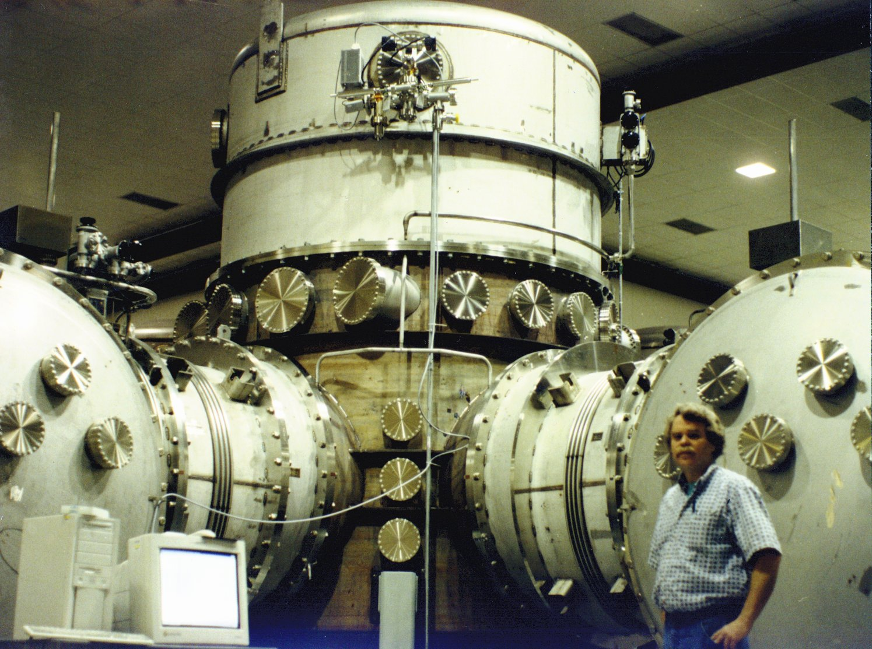
Vacuum Chambers Provide Quiet Homes for Mirrors
View inside Corner Station
Standing at vertex beam splitter

Slide 18
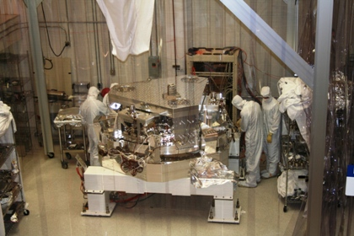
BSC Internal Seismic Isolator

Slide 19
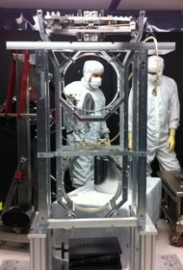
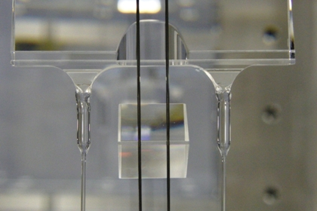
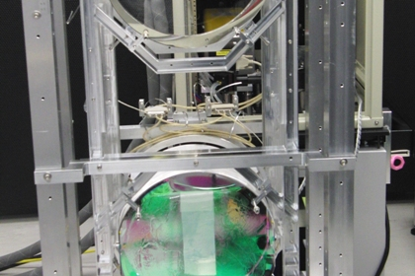
Advanced LIGO Monolithic Suspension

Slide 20
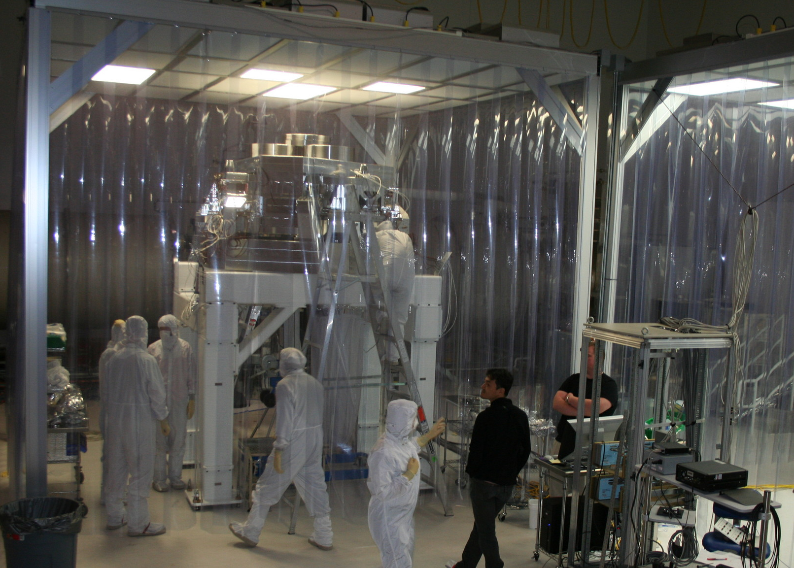
Advanced LIGO installation in progress
17-Aug-11

Slide 21
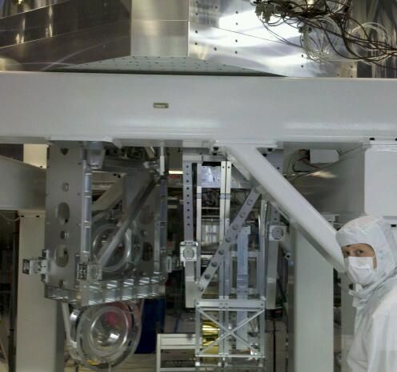
Putting it together:
Seismic & Suspension & Optics
Seismic isolation
Test mass suspension
Folding mirror suspension

Slide 22
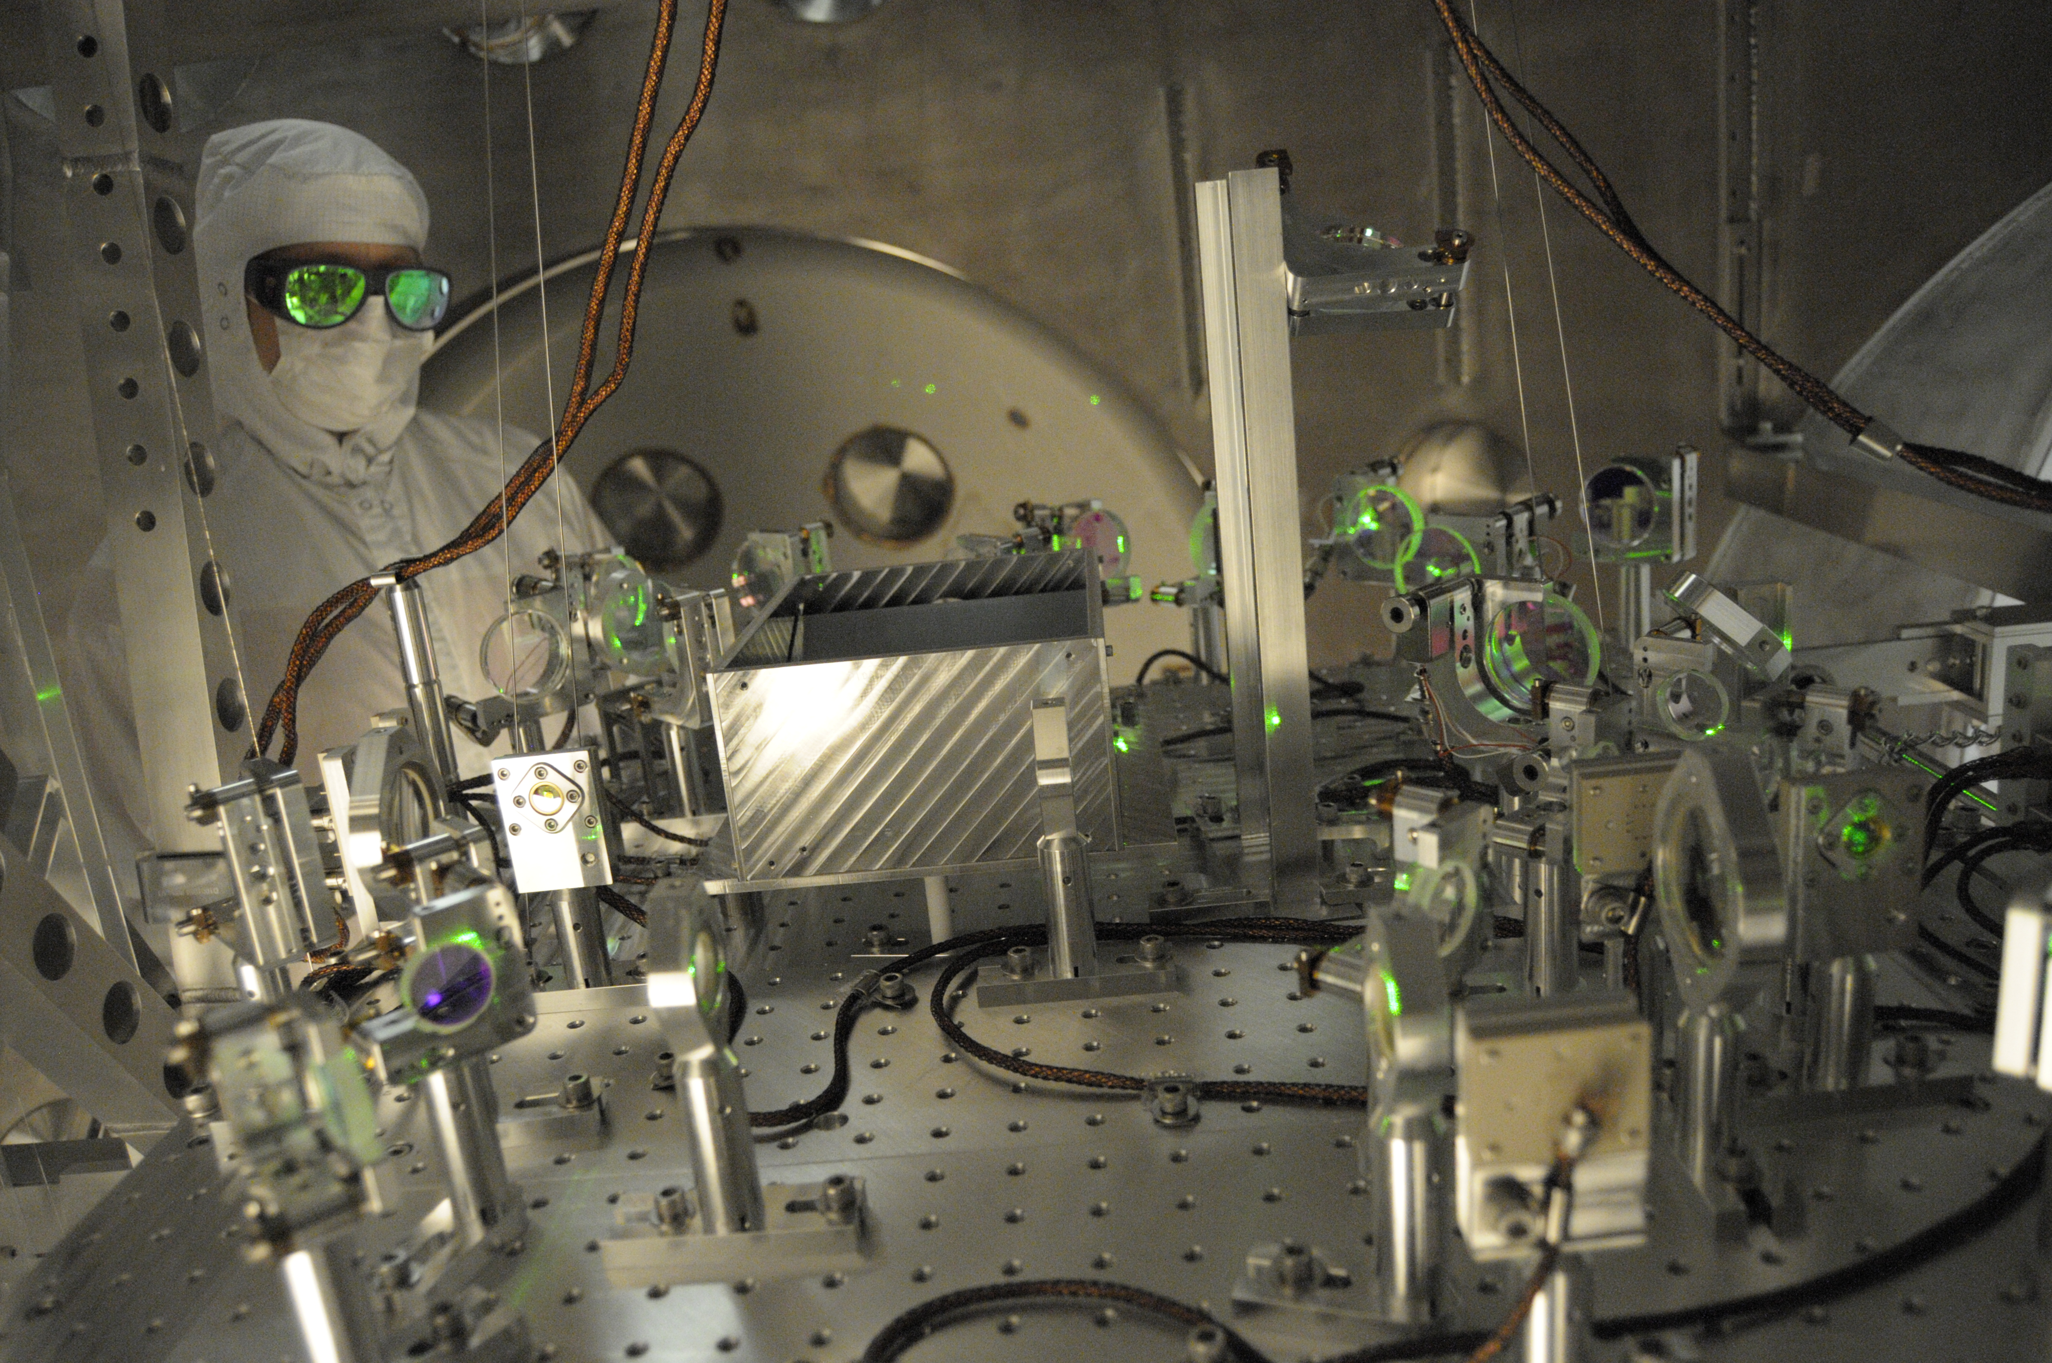
Lock Acquisition: Arm Locking Subsystem

Slide 23
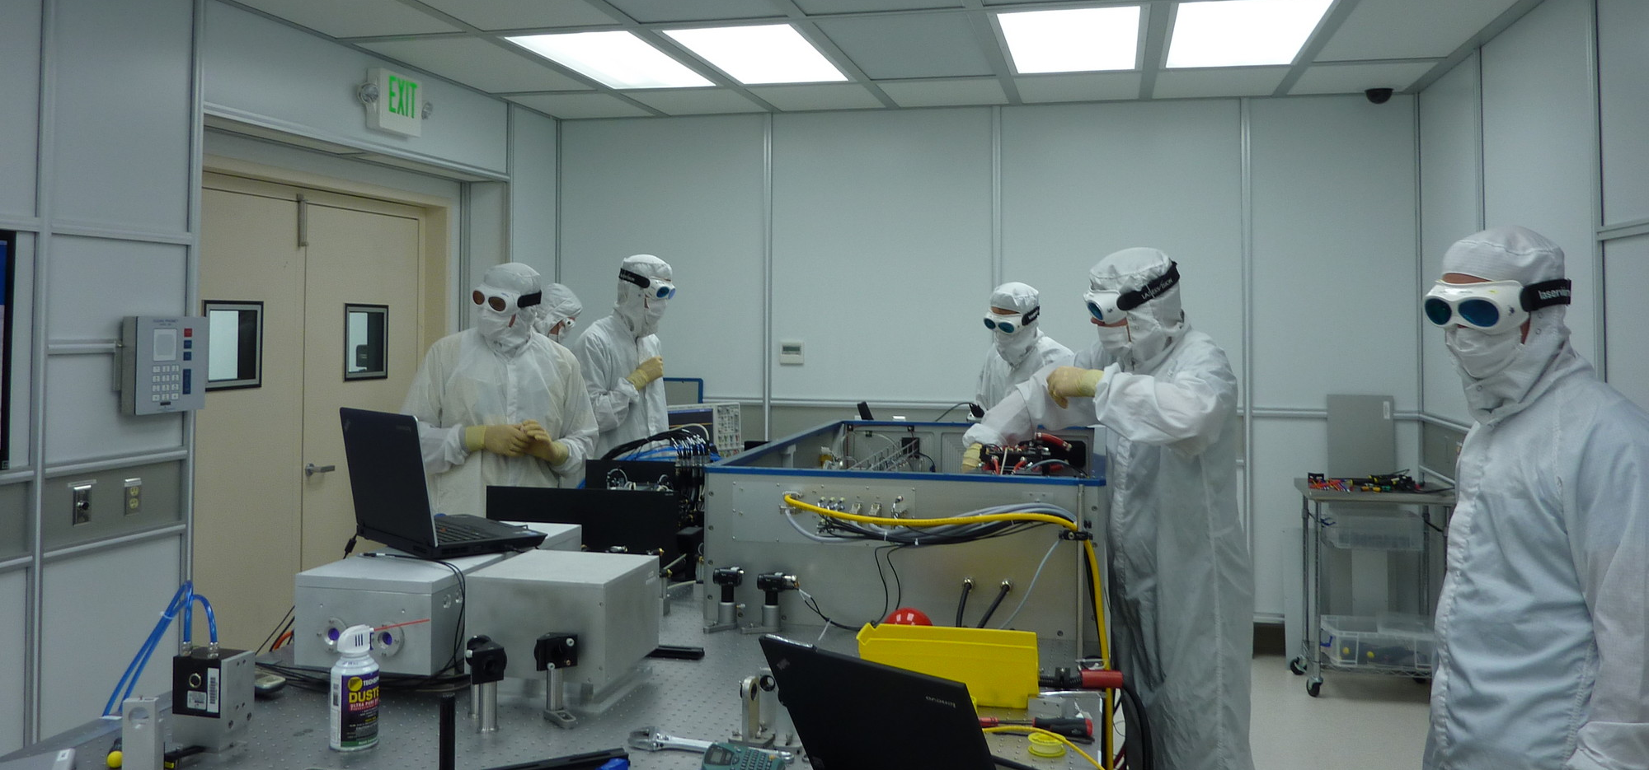
aLIGO Pre-stabilized laser

Slide 24
Principal noise terms

Slide 25
Some History

Slide 26
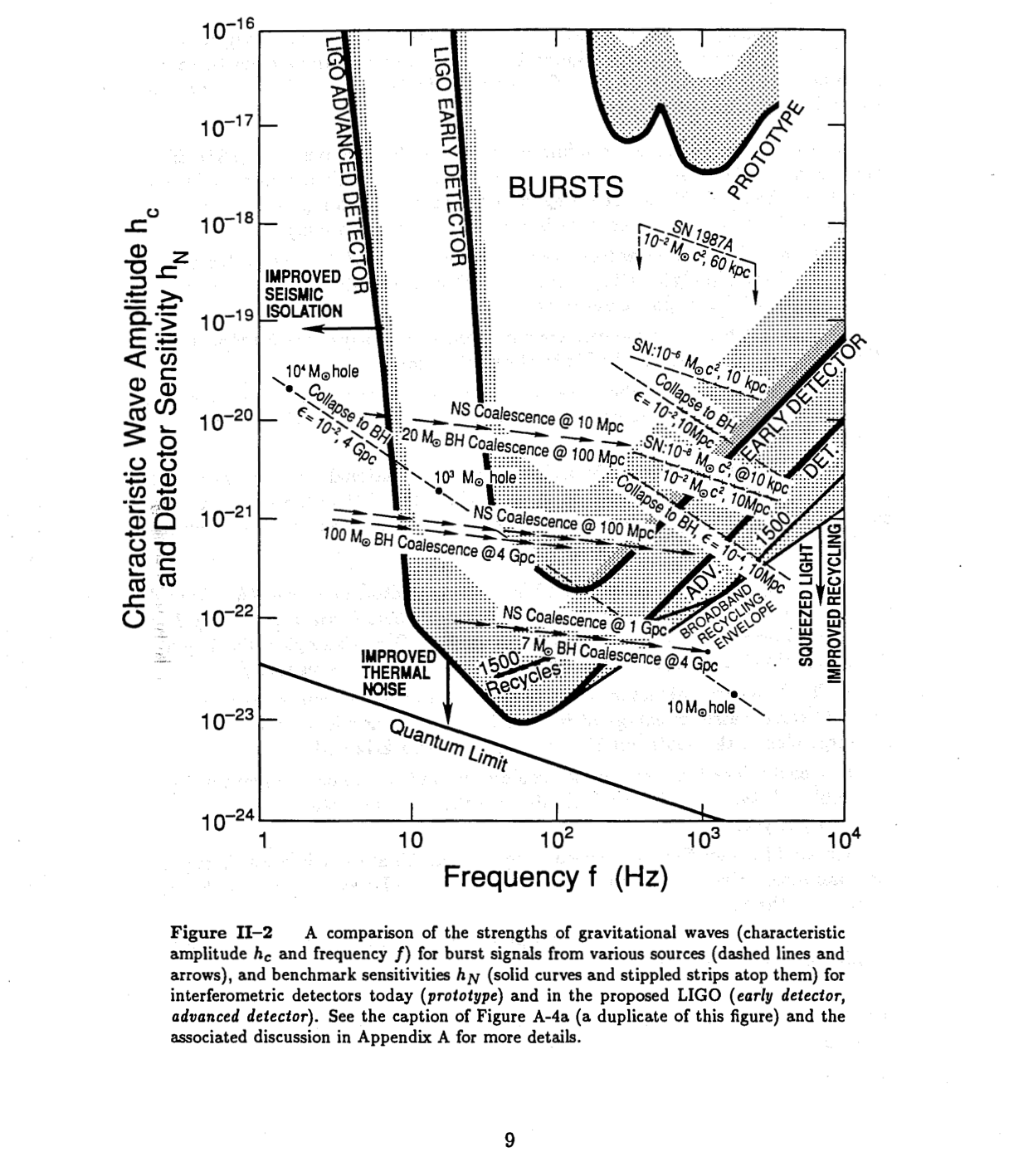
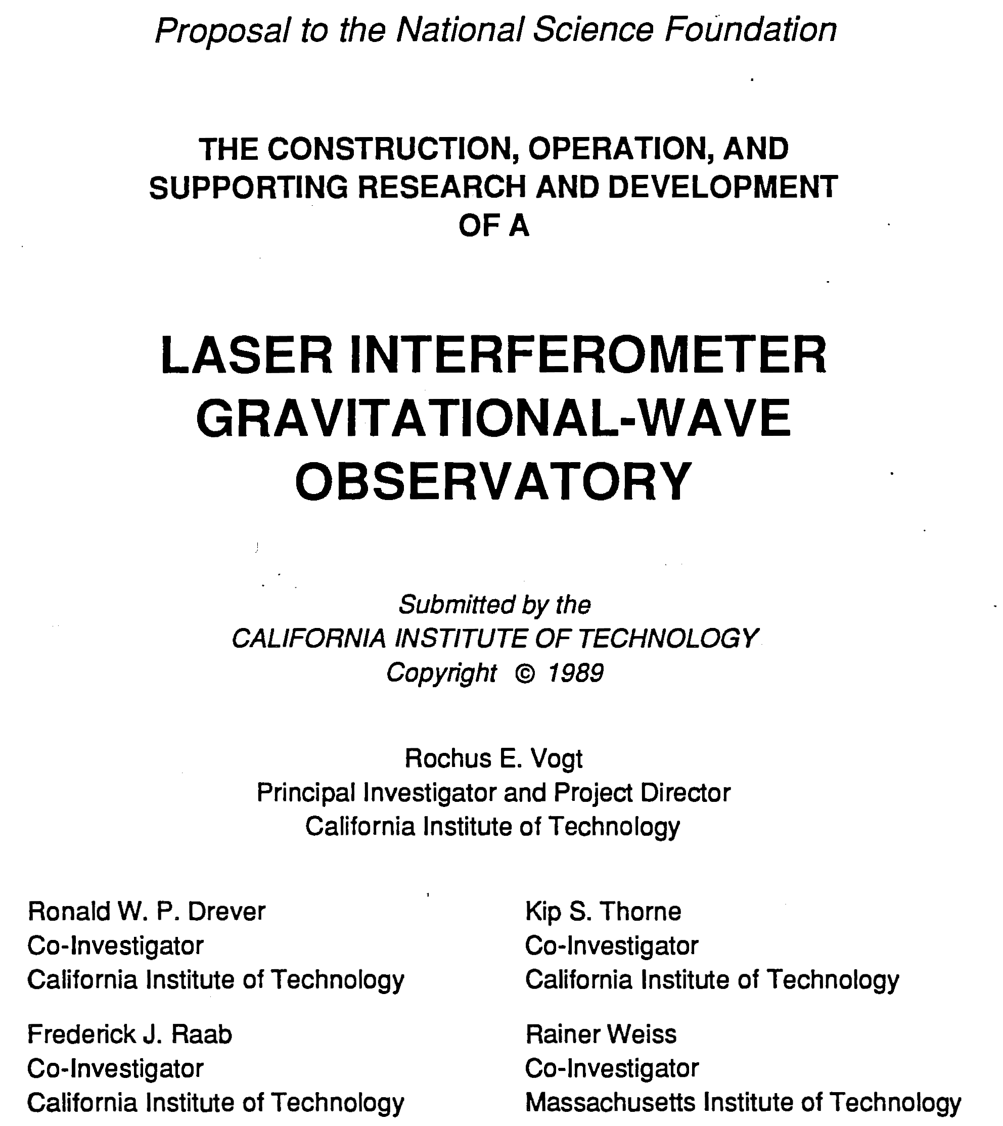
Strategy: Build a Facility That Can House Evolving Generations of More Powerful Detectors

Slide 27

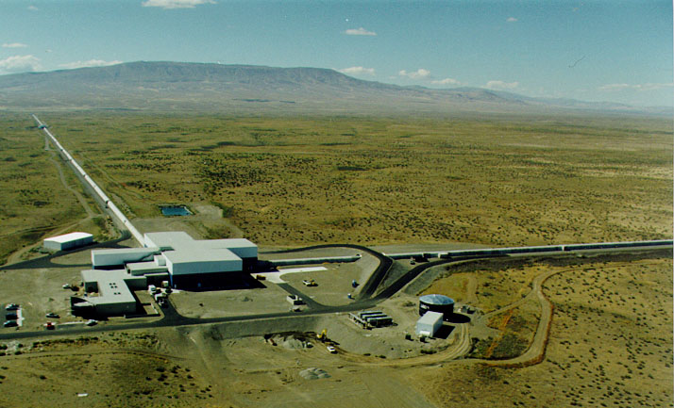




The Laser Interferometer Gravitational-wave Observatory
LIGO Observatories constructed from 1994-2000
LSC created 1997
Initial LIGO operated from 2002-2010
Advanced LIGO 2015
Hanford, WA
Advanced LIGO detectors:
Livingston, LA

Slide 28





















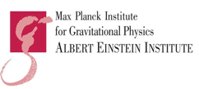


























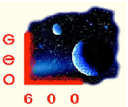




























LIGO Scientific Collaboration
~ 1000 members ~ 80 institutions, 16 countries

Slide 29
First Direct Detection of Gravitational Waves
Opening a New Window on the Universe

Slide 30
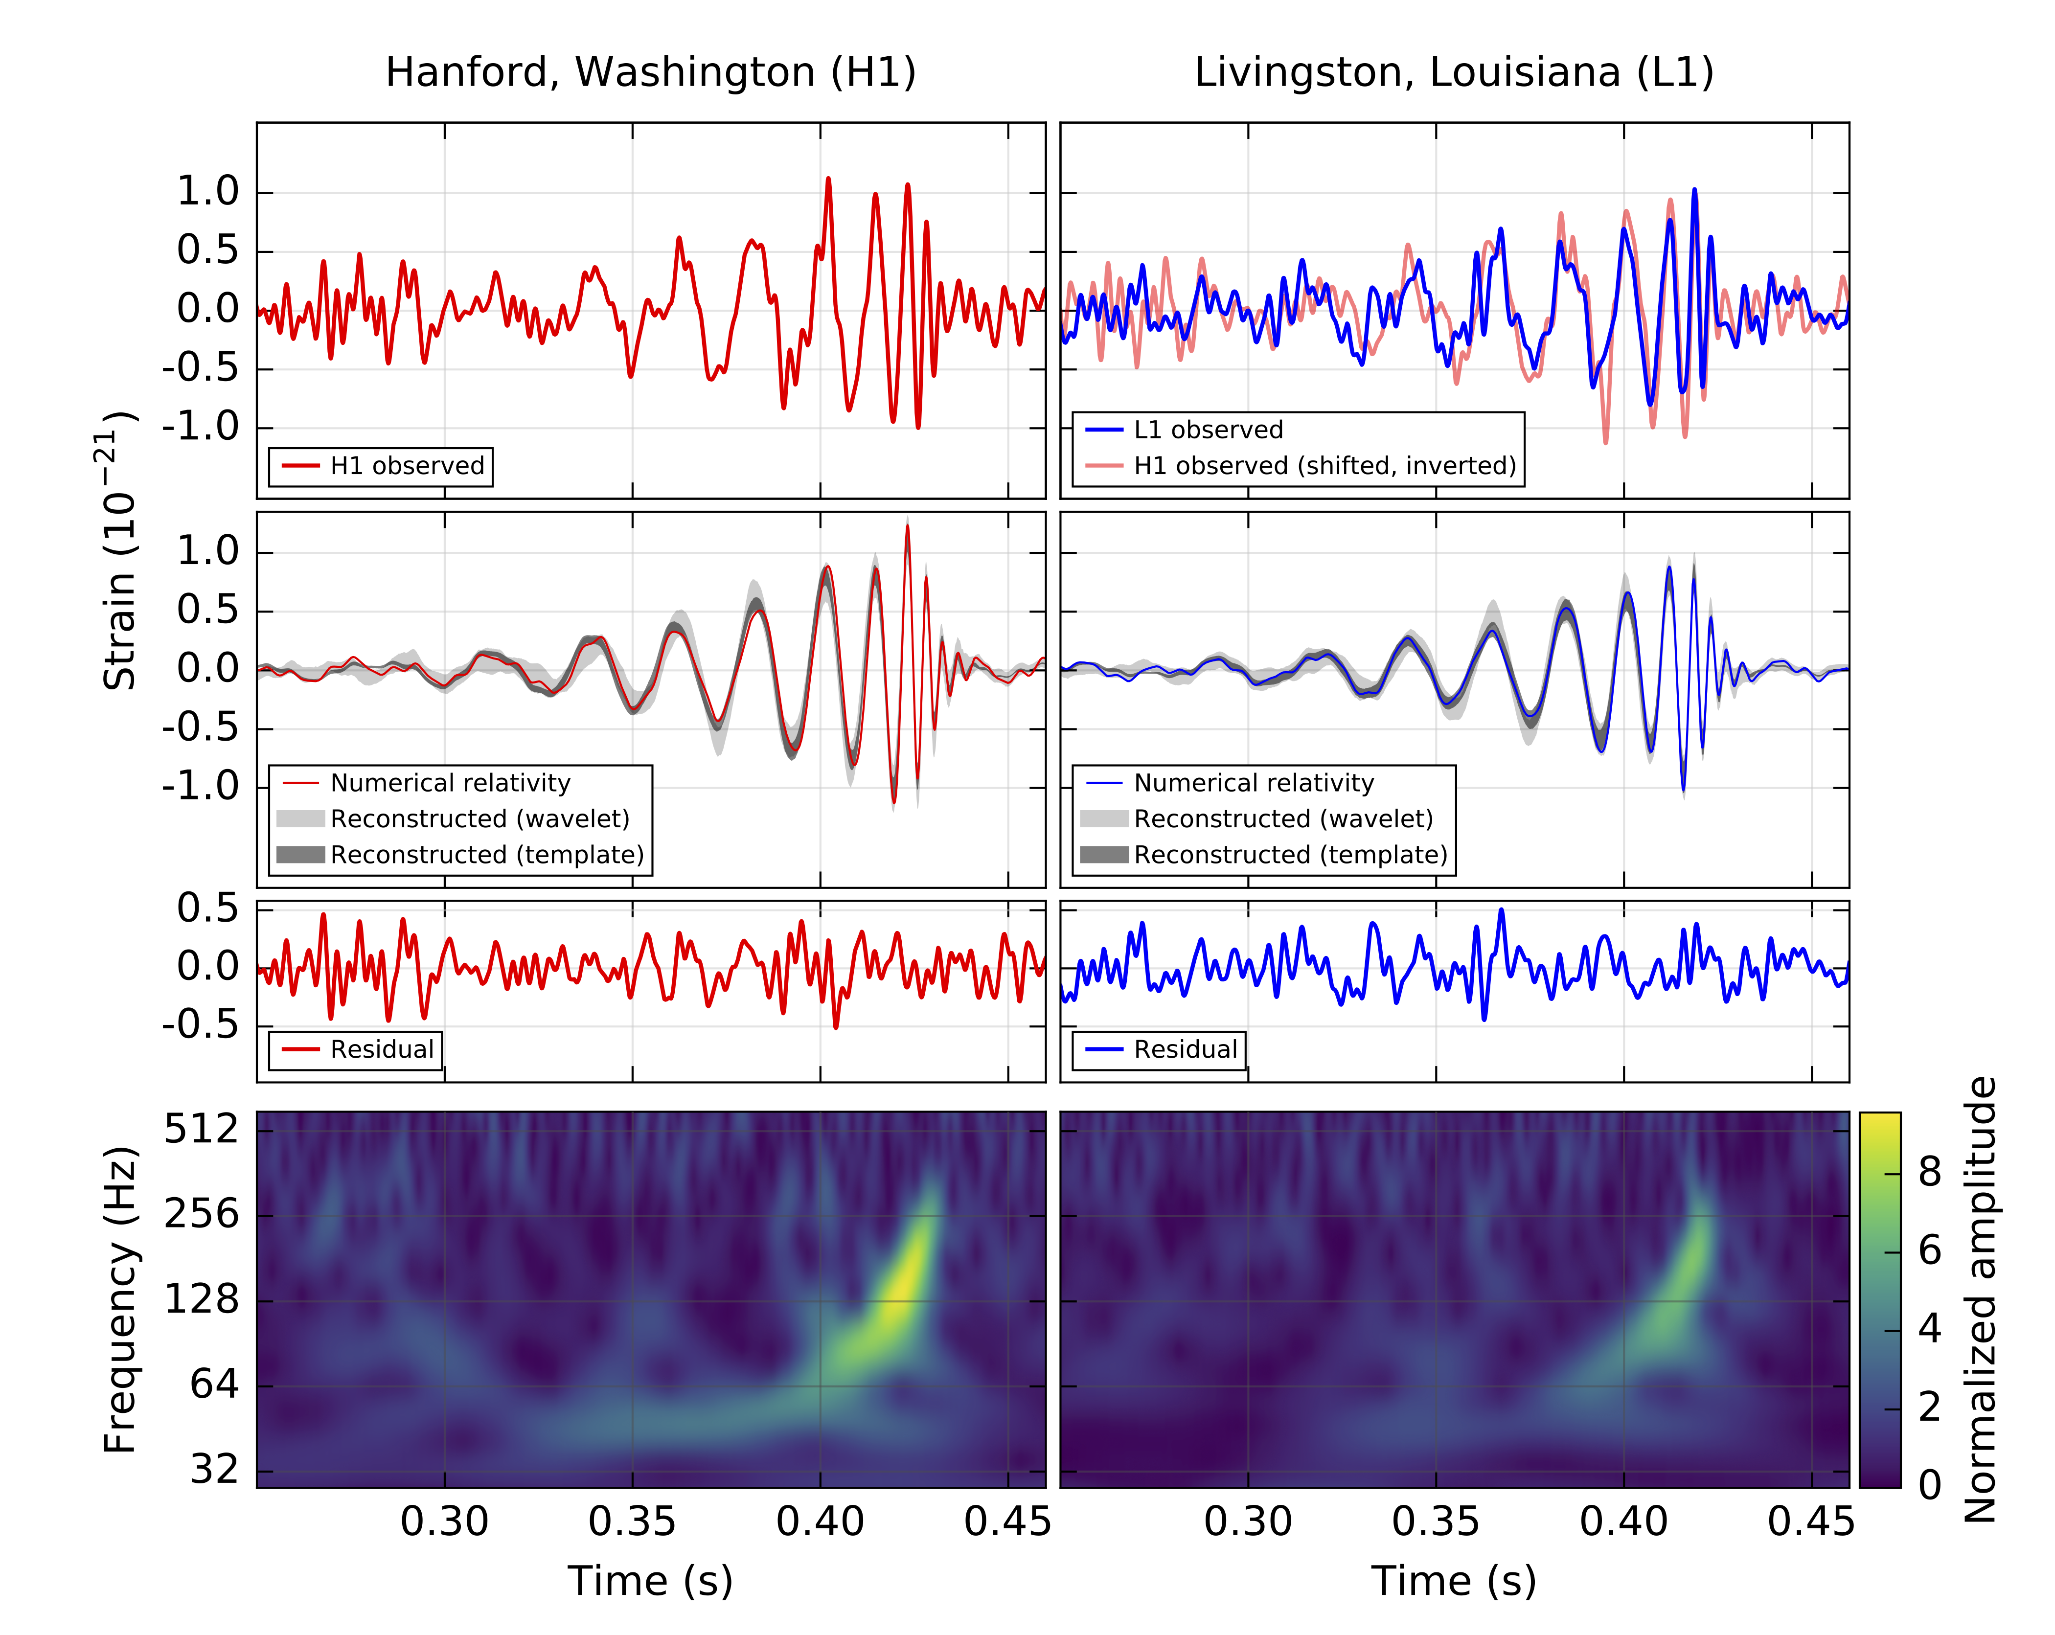
GW150914: What was observed?
B. P. Abbott et al., Phys. Rev. Lett. 116, 061102

Slide 31
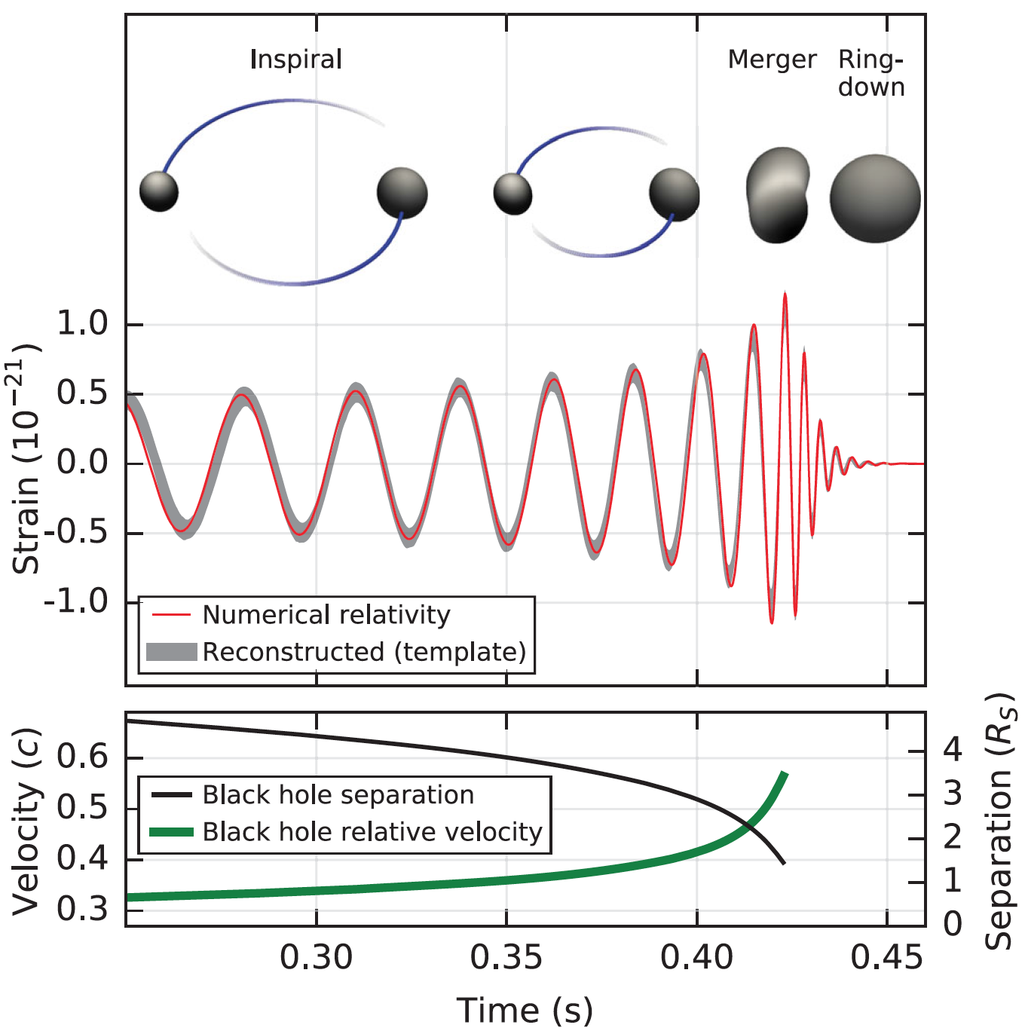
What can we learn from h(t)?
Phase evolution gives chirp mass and aligned components of spin
B. P. Abbott et al. (LIGO Scientific Collaboration and Virgo Collaboration), Observation of Gravitational Waves from a Binary Black Hole Merger, Phys. Rev. Lett. 116, 061102 (2016)
Ringdown frequency and Q
give mass and spin
of final black hole
Modulation of amplitude gives nonaligned spin components
Highest frequency gives sizes of objects just before merger.

Slide 32
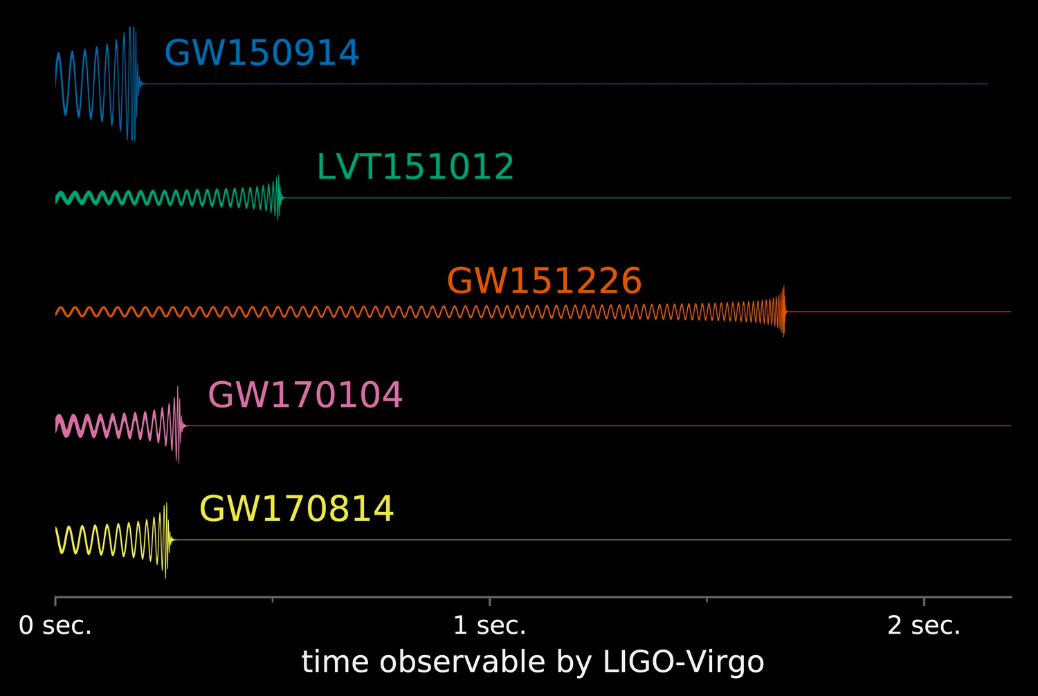
Comparison of GW Waveforms from BBHs (Sep 2017)
LIGO/Caltech/MIT/LSC

Slide 33
Multi-Messenger Astronomy
These first observations of dynamic extreme spacetimes with BBHs show us that GR is reasonably accurate in this regime and can be used as a tool for examining and interpreting extreme states of matter.
There are a rich collection of sources still to be examined!

Slide 34
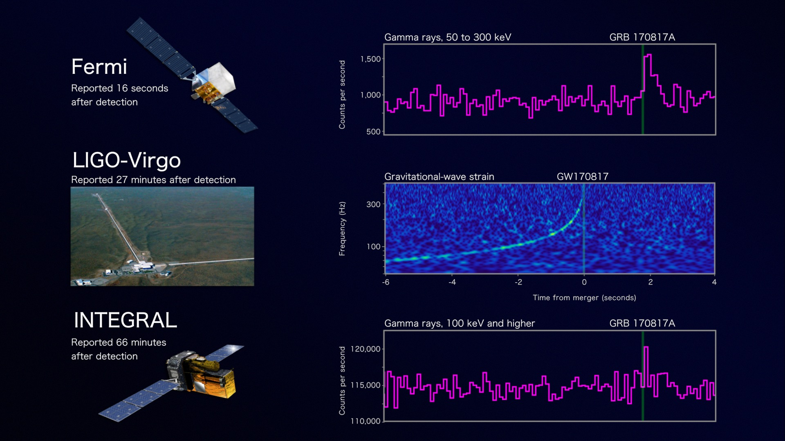
Onto the study of the most extreme states of matter
Credit: NASA's Goddard Space Flight Center, Caltech/MIT/LIGO Lab and ESA

Slide 35
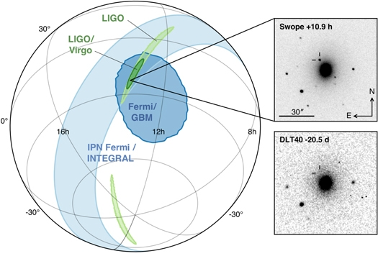
LIGO-Virgo network localization enables discovery of optical counterpart
Figure 1 from Multi-messenger Observations of a Binary Neutron Star Merger
B. P. Abbott et al. 2017 ApJL 848 L12 doi:10.3847/2041-8213/aa91c9

Slide 36
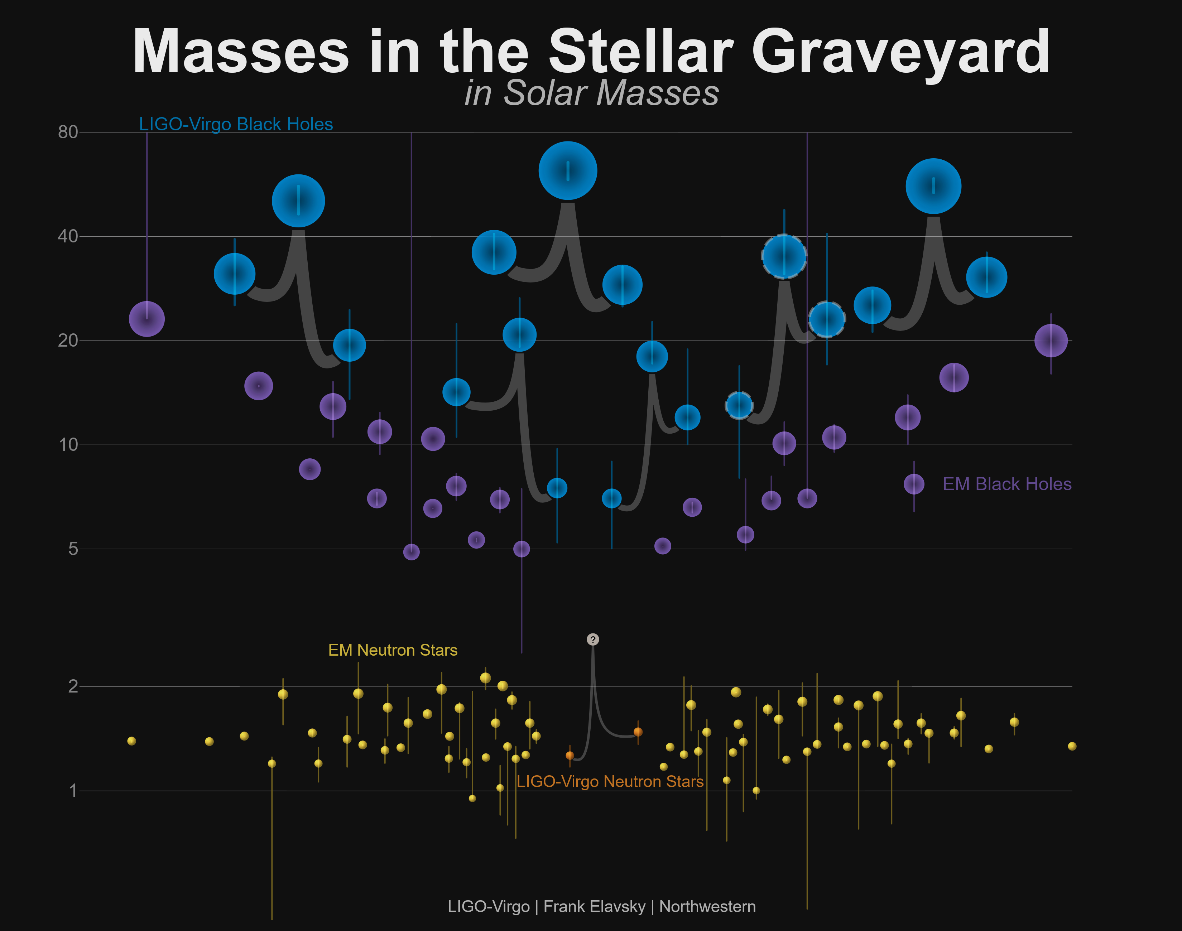
Known Masses of Stellar Remnants – Dec 2017
Non-LIGO Data Sources: Neutron Stars: http://xtreme.as.arizona.edu/NeutronStars/data/pulsar_masses.dat
Black Holes: https://stellarcollapse.org/sites/default/files/table.pdf |
LIGO-Virgo Data: https://losc.ligo.org/events/

Slide 37


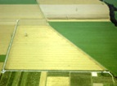

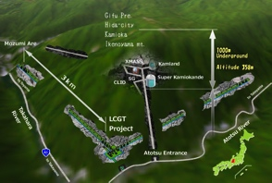



The advanced GW detector network:
2015-2025
Advanced LIGO
Hanford
2015
GEO600 (HF)
2011
KAGRA
2020
Advanced LIGO
Livingston
2015
Advanced
Virgo
2017
LIGO-India
2024
37
37

Slide 38
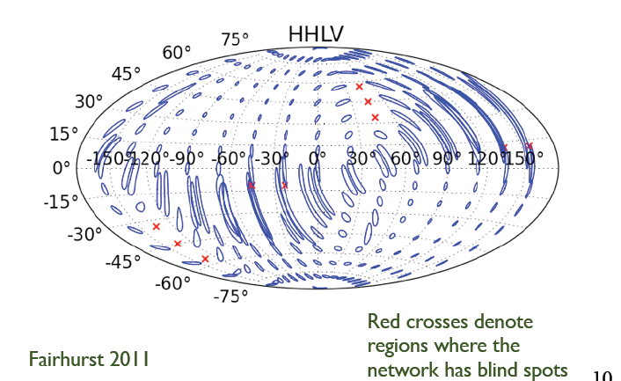
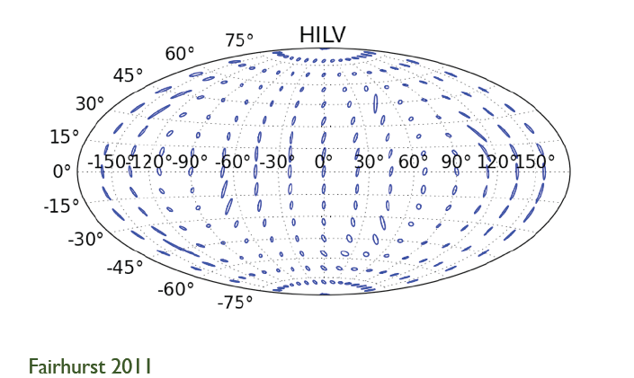
The compelling case for LIGO-India is Multi-Messenger Astronomy
LIGO+Virgo only
LIGO+Virgo+LIGO-India
It is rare for the birth of a new field of astrophysics to be pinpointed to a singular event. …One thing is certain, however: 2017 August 17 will always be remembered as the singular moment when multi-messenger GW–EM astronomy was born. - Edo Berger, Focus on the Electromagnetic Counterpart of the Neutron Star Binary Merger GW170817, ApJL 848.

Slide 39
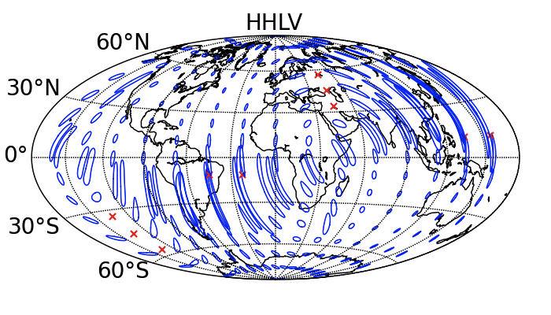
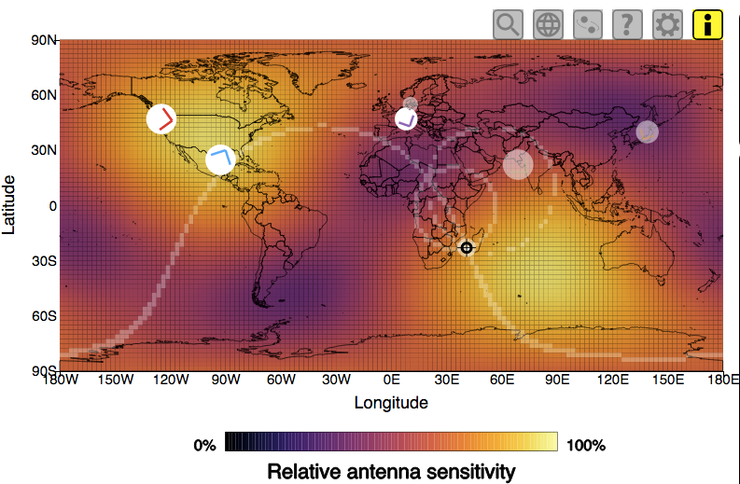
GW170817 Landed in a Good Region of Sky When 3 Detectors Were Up
S. Fairhurst - P1200054
Visualization courtesy of Chris North

Slide 41
Science drives Requirements
Stellar Evolution at High Red-Shift: Black Holes from the first stars (Population III)
  Reach z>~10
  At least moderate GW luminosity distance precision
Independent Cosmology and the Dark Energy Equation of State
  Needs precision GW luminosity distance and localization for EM follow-ups (for redshift)
Checking GR in extreme regime
  High SNR needed
  GW luminosity distance and localization not essential

Slide 42
Advanced LIGO upgrade path
Advanced LIGO is limited by
quantum noise & coating thermal noise
Squeezed vacuum to reduce quantum noise
Options for thermal noise:
  Better coatings
  Cryogenic operation
  Longer arms (new facility)

Slide 43
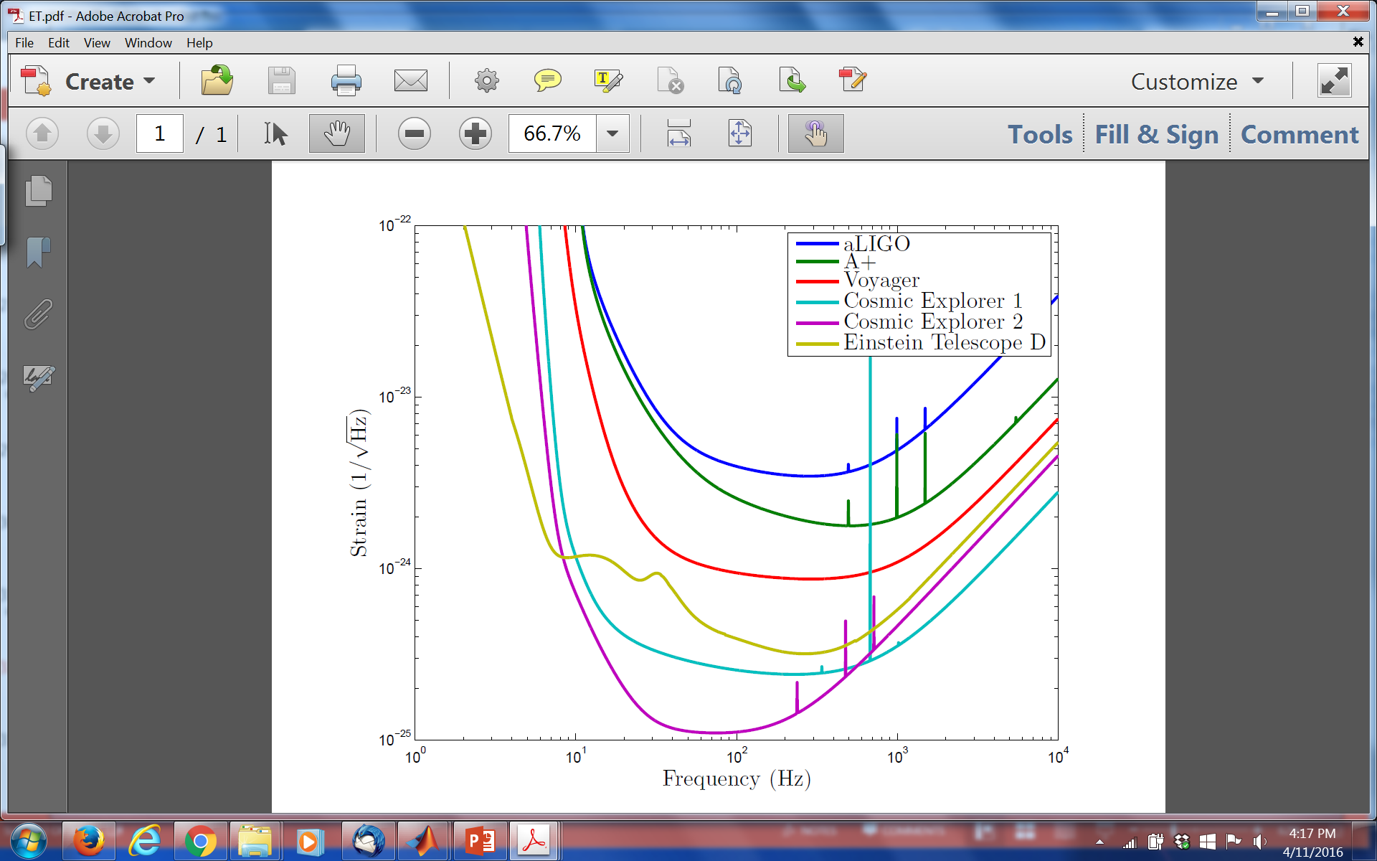
Upgrade possibilities

Slide 44
Summary
GW150914 initiates Gravitational-Wave Astronomy.
General Relativity provides a powerful framework from Earth-bound physics to mergers of stellar mass black holes at velocities near the speed of light.
An emerging international network of detectors will provide more accurate positions of sources to enable EM follow-ups of GW events and improved polarization information.
There is still room within the laws of physics to develop more powerful generations of detectors.

Slide 45
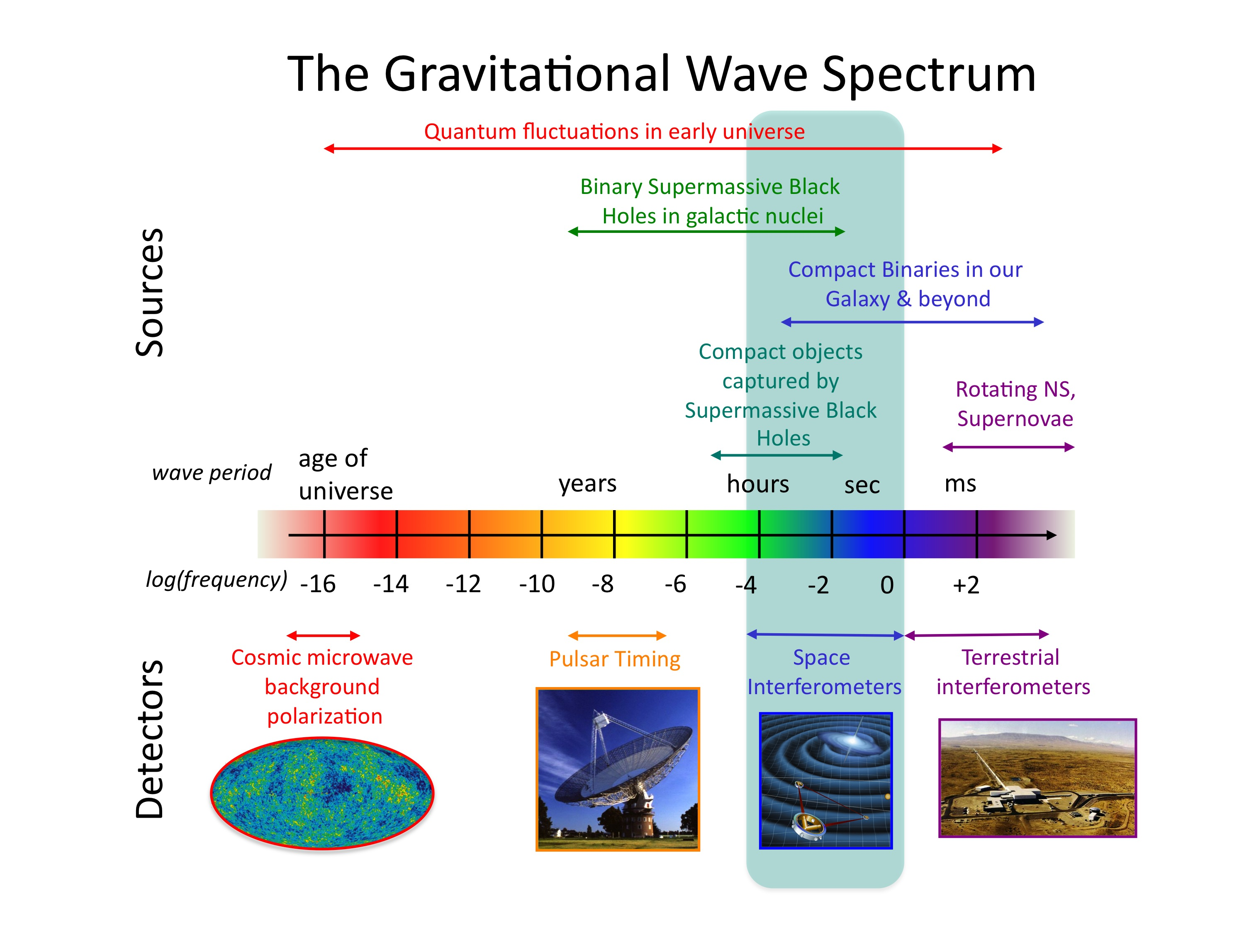
Credit: NASA

