Slide 1
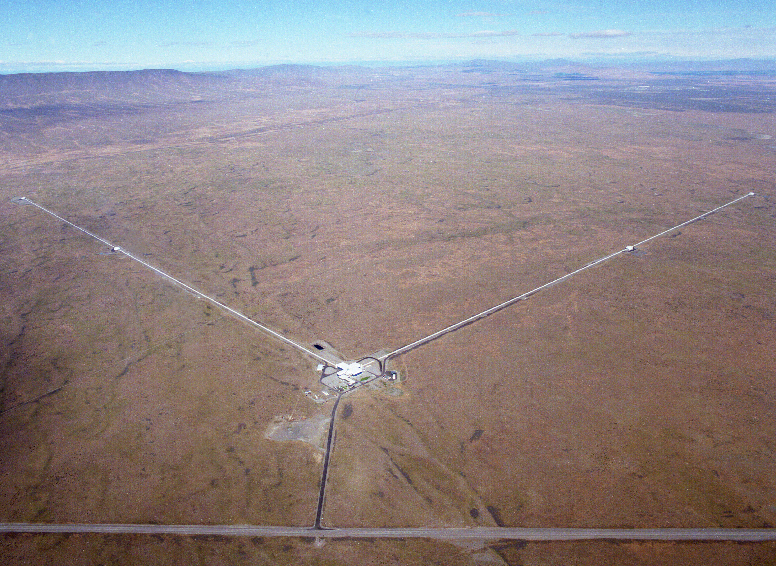
Introduction to Gravitational-Wave Astronomy
Fred Raab,
for the LIGO Laboratory and the LIGO Scientific Collaboration
27-Apr-16

Slide 2
Outline
My talk today
  Basics of General Relativity and Gravitational Waves
  Sources of Gravitational Waves
  Detectors of Gravitational Waves
  Some history
  International Network of Terrestrial GW Detectors
  Future detectors
Mike Landry’s talk next week
  Advanced LIGO Detector
  First Direct Detection of Gravitational Waves

Slide 3
Basics of General Relativity and Gravitational Waves
Wherein it is realized that space and time are things whose properties are manifested by phenomena that we collectively refer to as “gravity”.

Slide 4

Special Relativity and the Case of the Missing Sun
Notes:
Suppose that an instant before time T=0, the Sun would disappear. What would happen to the orbit of Earth? Most people would expect Earth to immediately hurtle out into space, since the gravitational pull of the sun would no longer hold it. But special relativity says that information cannot travel faster than light. So Earth would continue to orbit the Sun that we can see is no longer there until folks on Earth see the Sun disappear. Right near the edge of the vanished Sun, its gravity disappears right away. Later and later its gravity disappears farther and farther away until it eventually (at T = 8 min 20 sec) it disappears at Earth. That front of disapearing gravity is the gravity wave front.

Slide 5
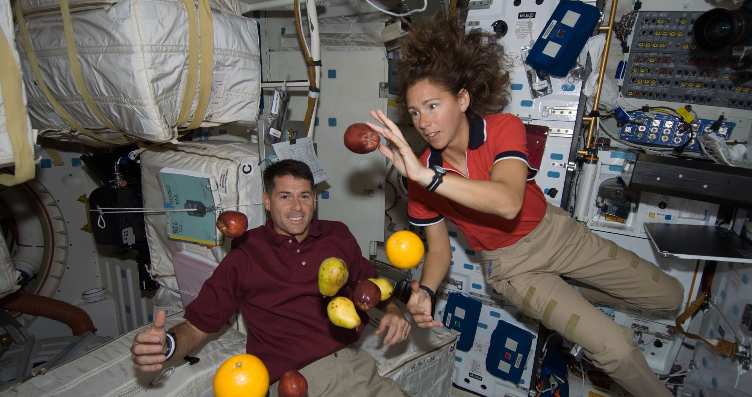
Free fall is weightless

Slide 6
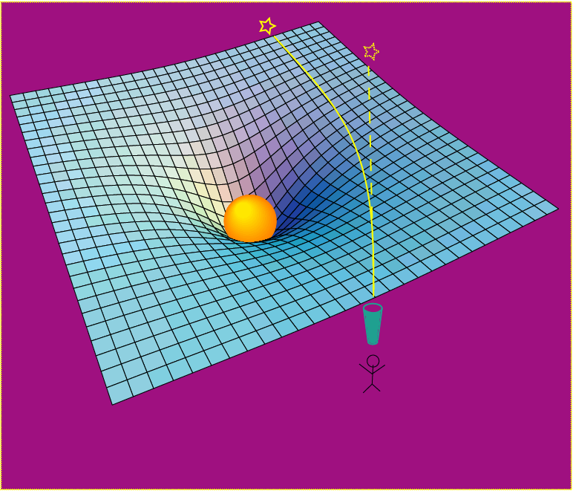
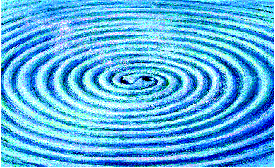
Einstein’s General Relativity re-wrote the rules of space and time
Rendering of space stirred by two orbiting black holes
A massive object shifts apparent position of a star
Empty space and time are things, with real physical properties. Space has a shape, a stiffness and a maximum speed for information transfer.

Slide 7
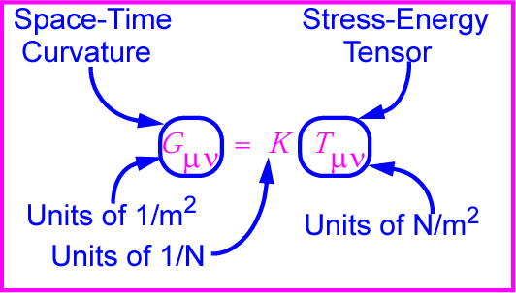
Gravitational waves: hard to find because space-time is stiff!
K ~ 10⁻⁴⁴ N⁻¹
⇒ Wave can carry huge energy with miniscule amplitude!

Slide 8
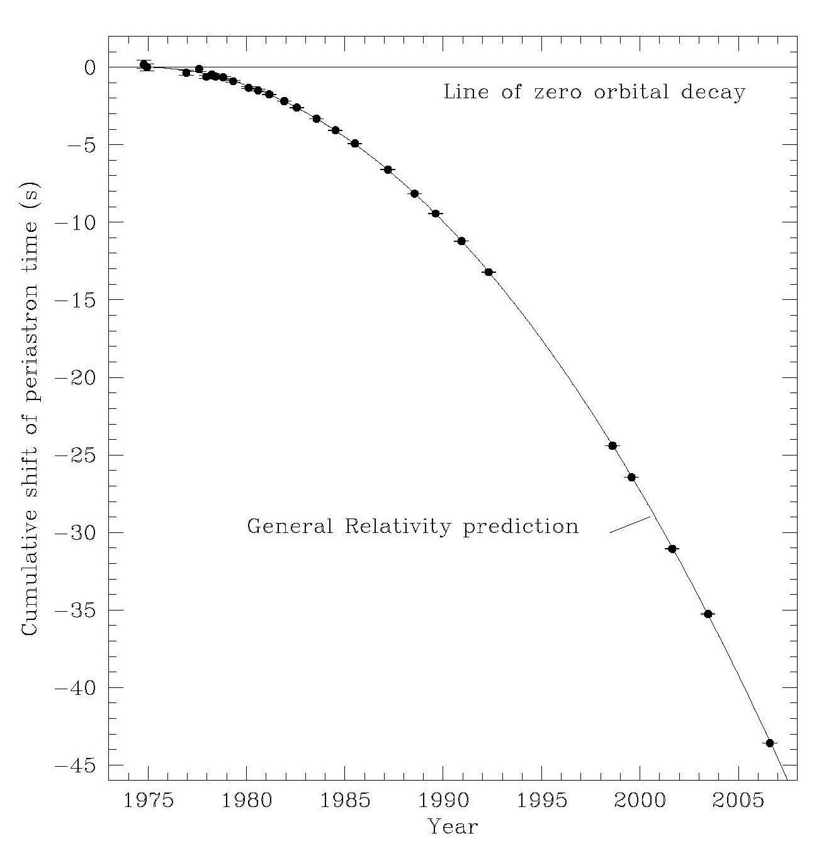
Gravitational Waves hard to find, but known to exist
Neutron Binary System – Hulse & Taylor
PSR 1913 + 16 -- Timing of pulsars
Emission of gravitational waves
•
17 / sec
•
~ 8 hr
Neutron Binary System
separated by 10⁶ miles
m₁ = 1.4m; m₂ = 1.36m; ε = 0.617
Prediction from general relativity
spiral in by 3 mm/orbit
rate of change orbital period
Taylor and Weisberg

Slide 9
Sources of Gravitational Waves
Accelerating Quadrupole Mass Moments

Slide 10

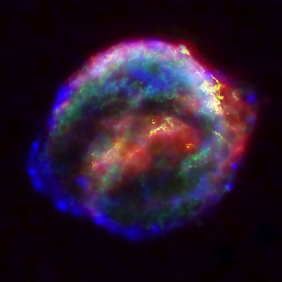

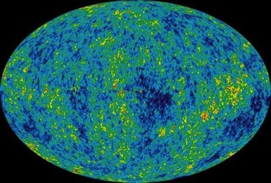
Astrophysical Sources of Gravitational Waves
Coalescing Compact Binary Systems: Neutron Star-NS, Black Hole-NS, BH-BH
- Strong emitters, well-modeled,
- (effectively) transient
Asymmetric Core Collapse Supernovae
- Weak emitters, not well-modeled (‘bursts’), transient
Credit: Chandra X-ray Observatory
Credit: AEI, CCT, LSU
Cosmic Gravitational-wave Background
- Residue of the Big Bang
- Long duration, stochastic background
Spinning neutron stars
- (nearly) monotonic waveform
- Long duration
NASA/WMAP Science Team
Casey Reed, Penn State
Notes:
LIGO is designed to be an observatory, not a one-off proof that GWs exist. What do we look for?
There are number of predicted astrophysical sources of gravitational radiation, and most of them involve cataclysmic events.
Binary systems – NSs and BHs, most likely source, theoretically well understood with known waveforms
Bursts – GW emissions that are not well modeled or understood. These include asymmetrically core collapse supernova, cosmic strings, and perhaps unknown sources
The residual GW background
Continuously emitting sources such as spinning neutron stars, which have a pure monotone emission.

Slide 11
Frequency-Time
Characteristics of GW Sources
time
Ringdowns
Broadband Background
Bursts
frequency
CW (quasi-periodic)
Chirps
Earth’s orbit
Earth’s rotation
frequency
frequency
time
time

Slide 12
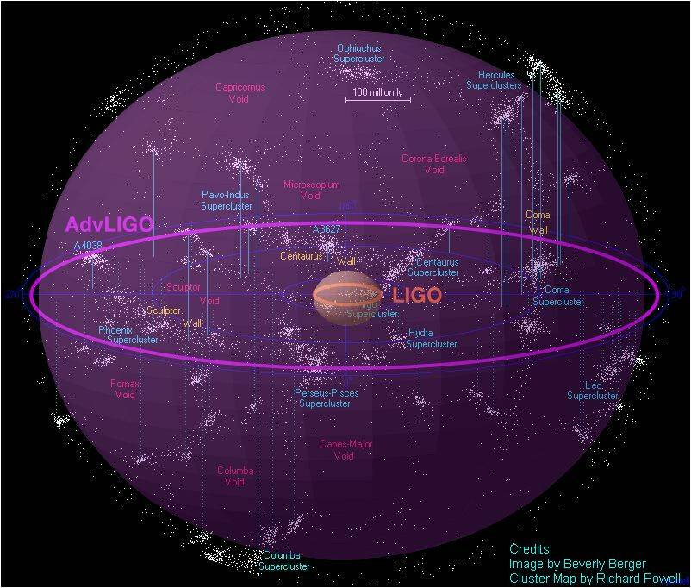
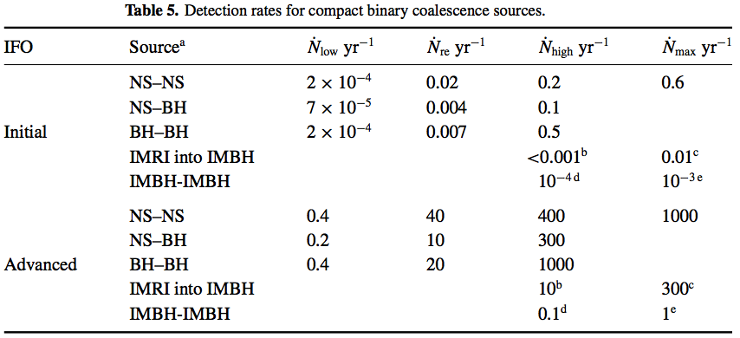
Expected event rates
Binary neutron stars
Initial LIGO reach: 15Mpc; rate ~ 1/50yrs
Advanced LIGO ~ 200Mpc
‘Realistic’ rate ~ 40 events/yr
Rates paper: Class. Quant. Grav,
27 (2010) 173001
Notes:
From i) observations of double neutron stars in our galaxy, and
ii) Population synthesis modeling.
Suffers from small sample size, and the assumption the sample is representative
Suffers from unknowns like birth velocities, companion mass distribution etc

Slide 13
Detectors of Gravitational Waves
No Law of Physics Forbids Them

Slide 14
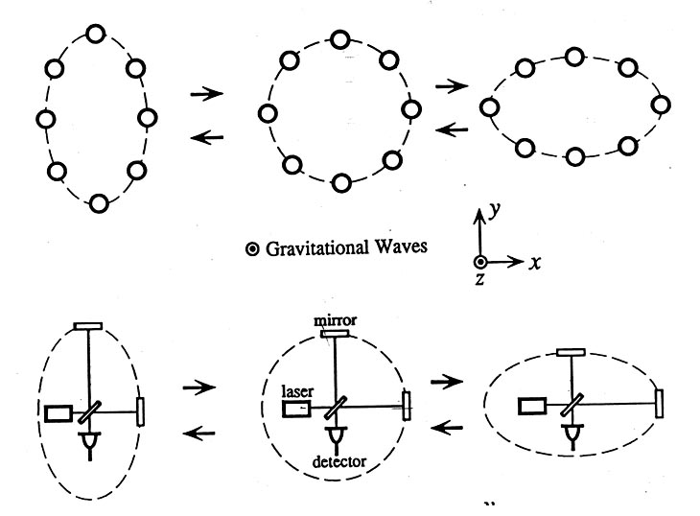
Basic idea is simple
GW amplitude h = (R_{x}-R_{y})/R
Spatial asymmetry induces relative phase shifts on light in arms

Slide 15
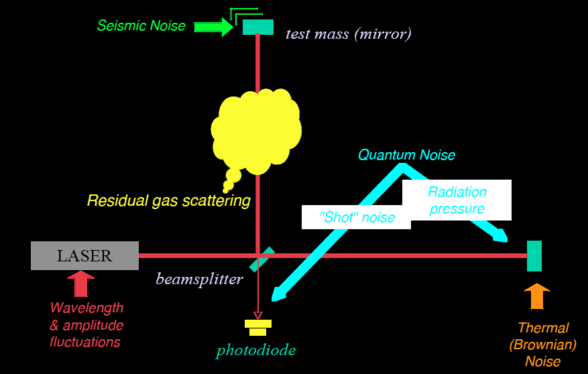
Noise cartoon
R. Adhikari

Slide 16
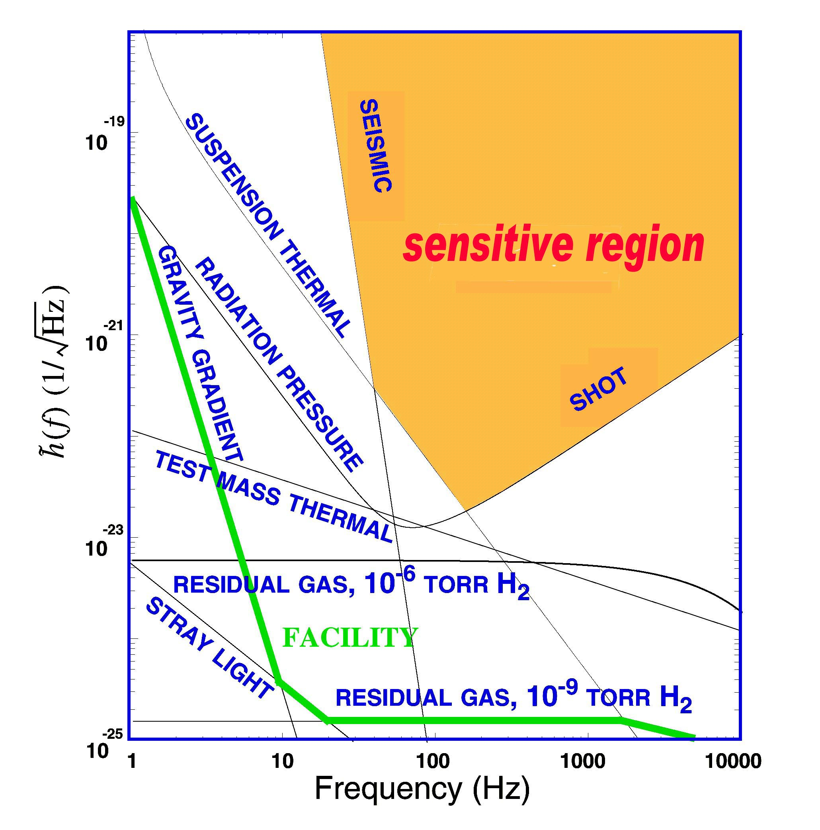
What Limits Sensitivity of Interferometers?
DESIGN
Seismic noise & vibration limit at low frequencies
Atomic vibrations (Thermal Noise) inside components limit at mid frequencies
Quantum nature of light (Shot Noise) limits at high frequencies
Myriad details of the lasers, electronics, etc., can make problems above these levels
COMMISSIONING

Slide 17

Optical configuration
Complete detector description in Class. Quantum Grav. 32 (2015) 074001

Slide 18
Principal noise terms

Slide 19
Some History

Slide 20
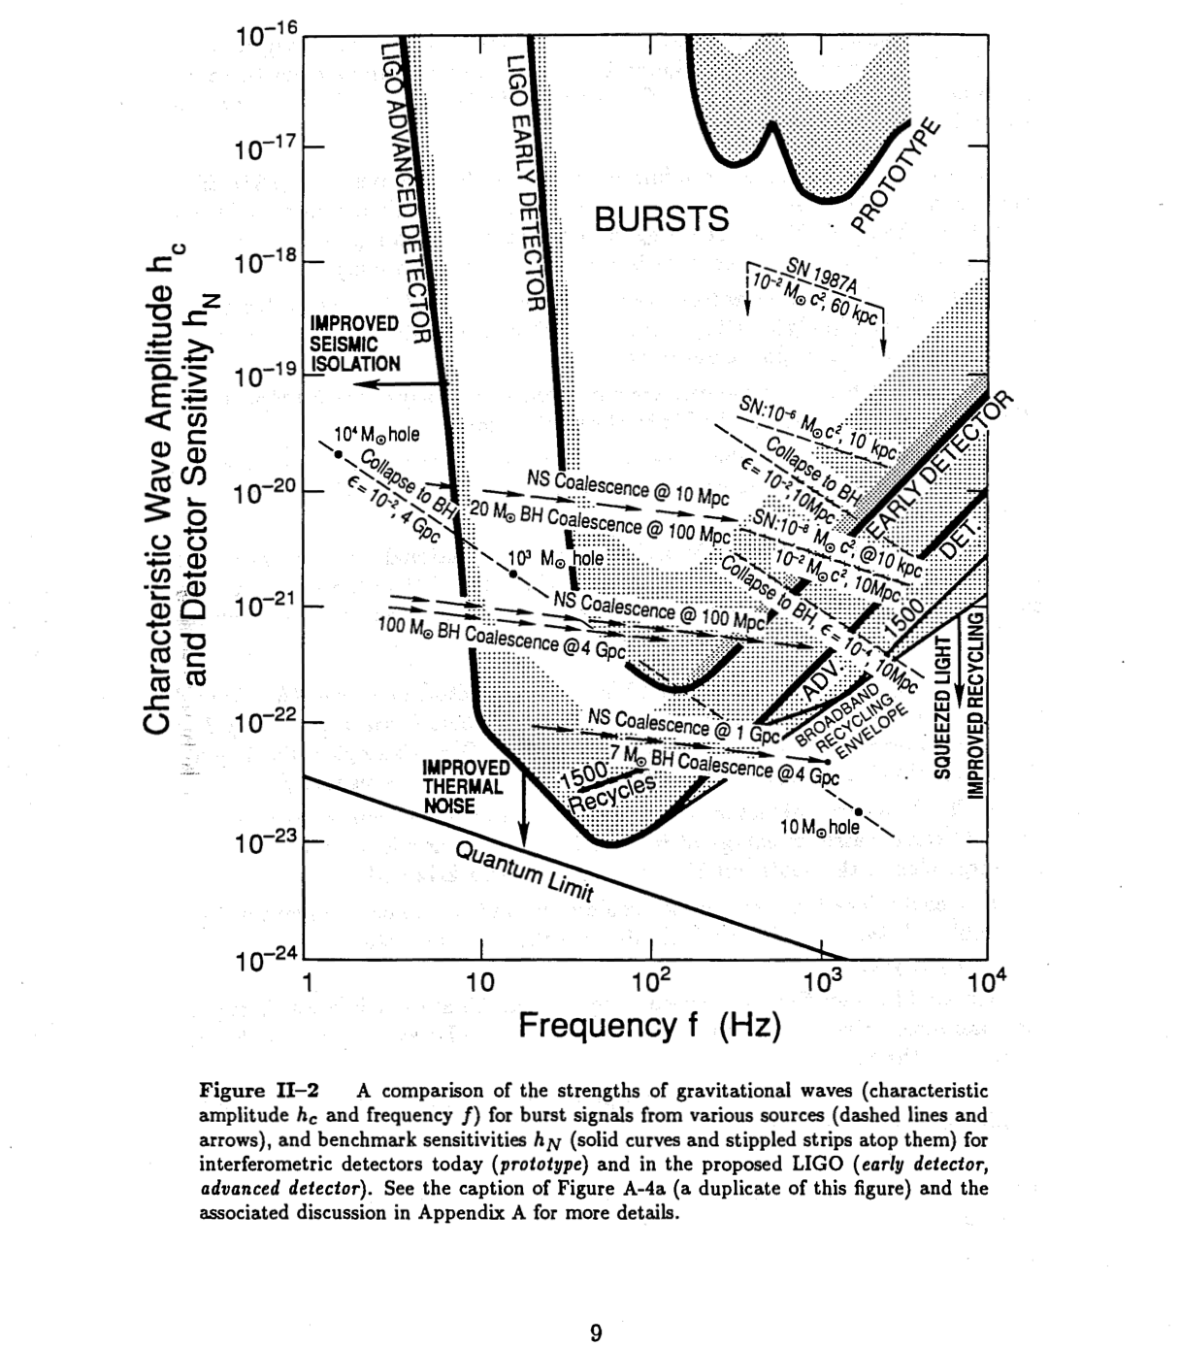
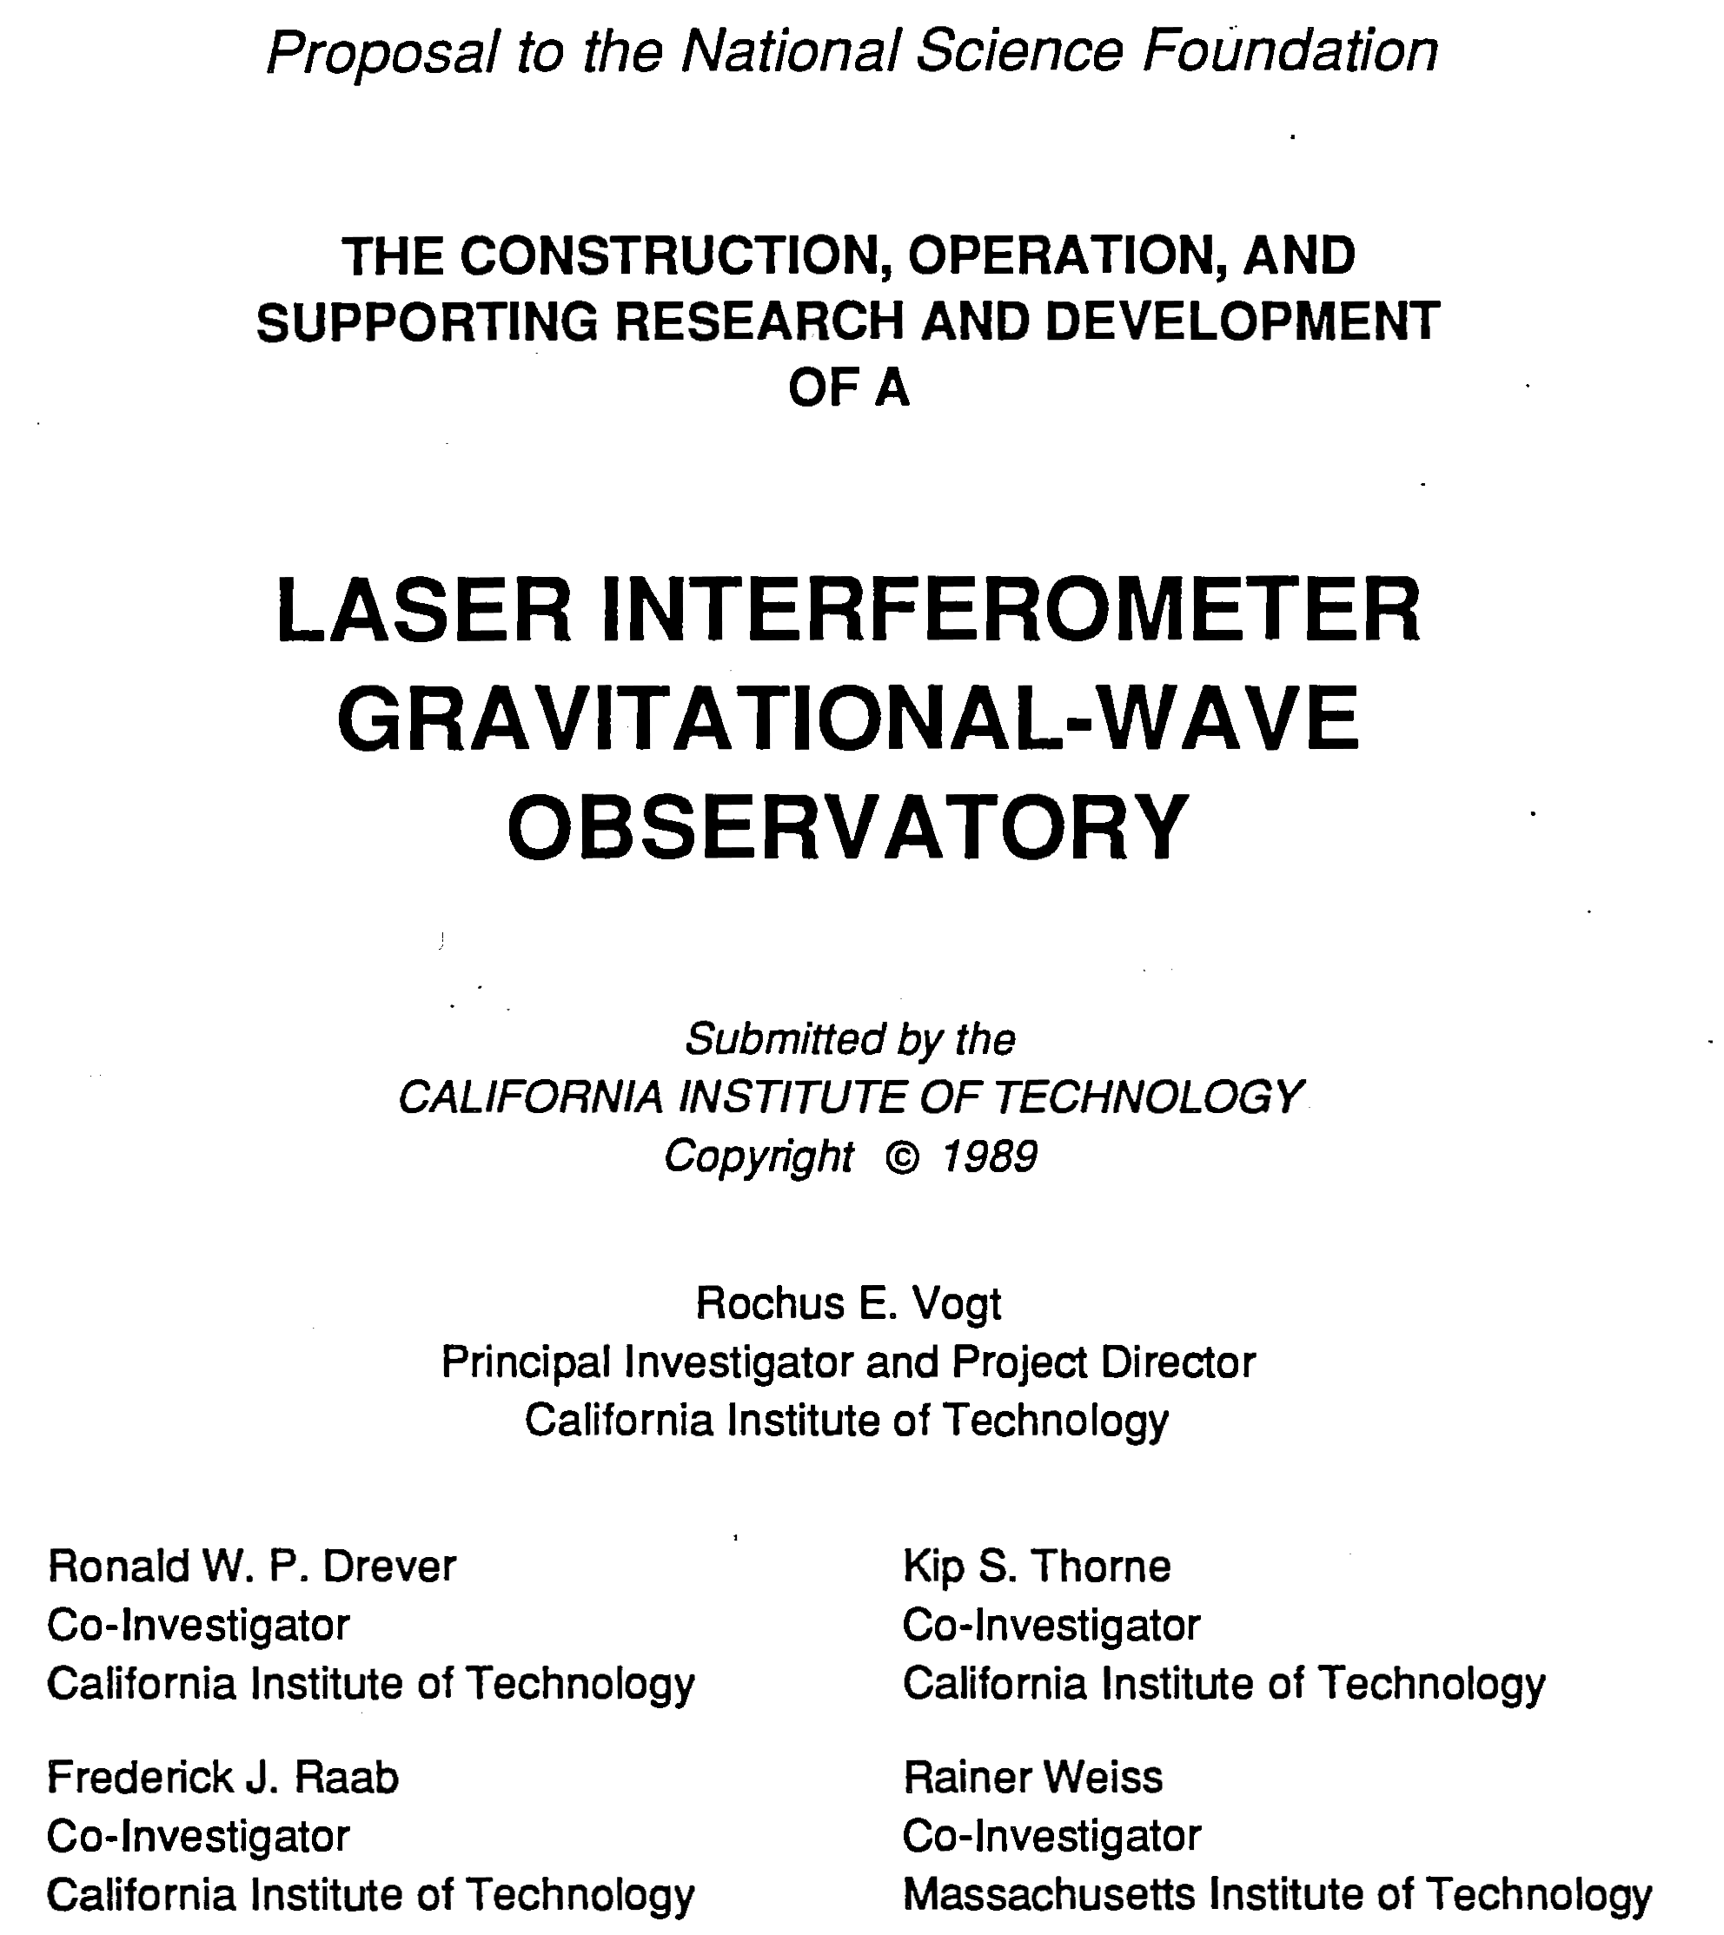
Strategy: Build a Facility That Can House Evolving Generations of More Powerful Detectors

Slide 21

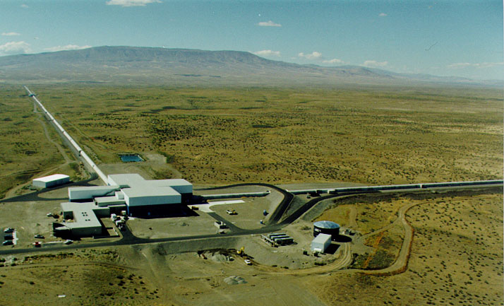




The Laser Interferometer Gravitational-wave Observatory
LIGO Observatories constructed from 1994-2000
LSC created 1997
Initial LIGO operated from 2002-2010
Advanced LIGO 2015
Hanford, WA
Advanced LIGO detectors:
Livingston, LA

Slide 22

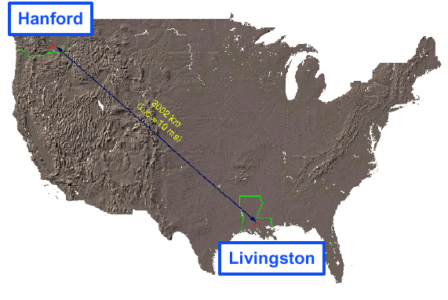
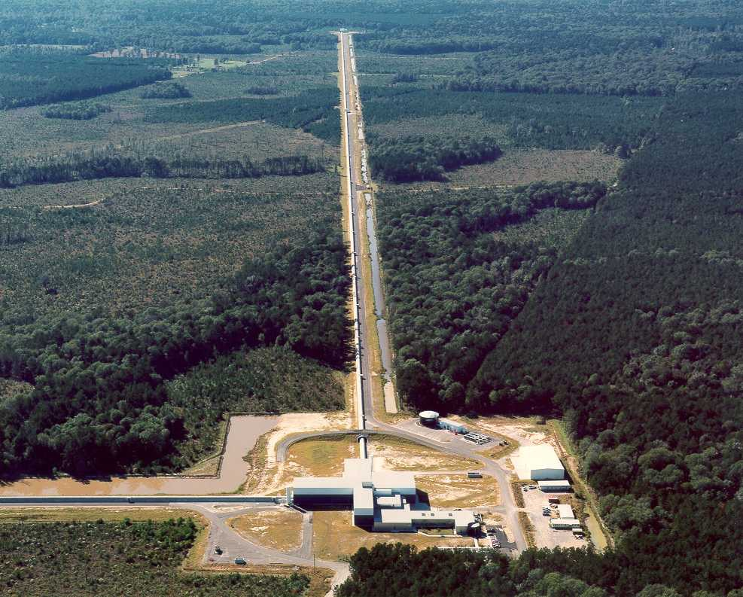
LIGO Laboratory
Mission: Observe gravitational wave sources; operate the LIGO facilities; instrument science and technology; scientific education and public outreach.
~200 scientists, engineers and staff; includes physicists working on instrument science and data analysis.
MIT
Caltech
LIGO Livingston
Notes:
LIGO is actually two observatories.
Describe parameters
Emphasize that the arms are in ultra high vacuum. 8 km of steel 1.2 m dia beam tubes at each site
Separate observatories allow for coincidence detection – since the detectors see uncorrelated noise, only a true gravitational wave would appear on all the interferometers with the correct amplitude.
Emphasize that the LIGO Observatories were designed and are operated by Caltech and MIT

Slide 23
First Direct Detection of Gravitational Waves
Opening a New Window on the Universe

Slide 24
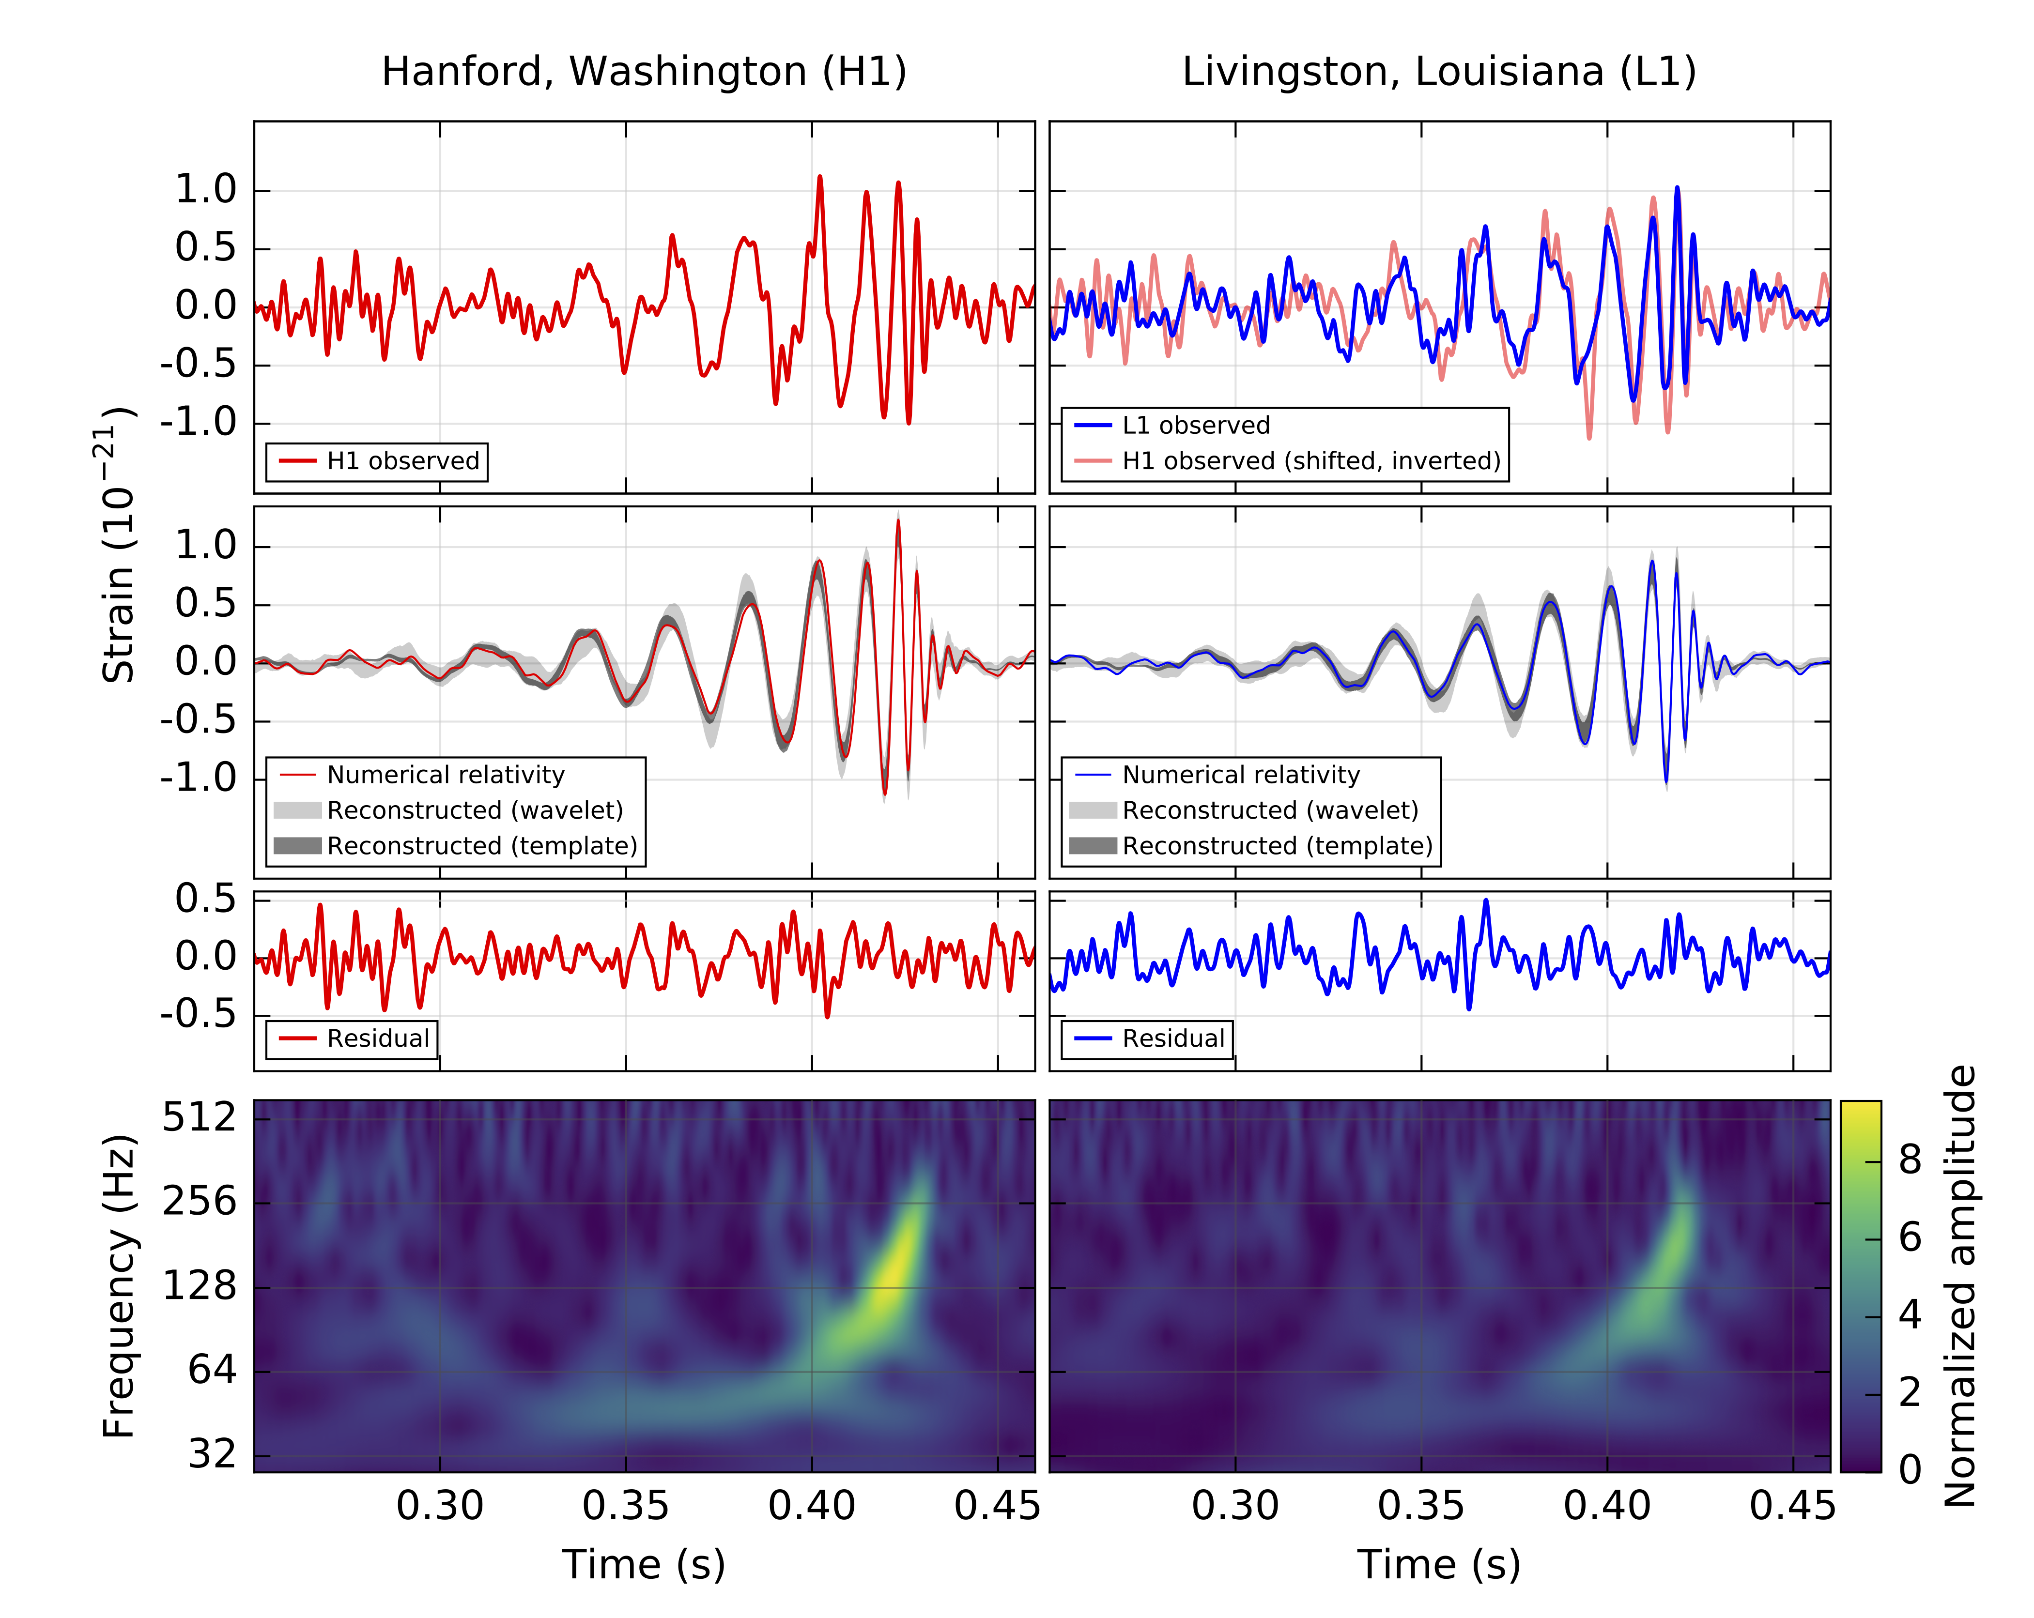
GW150914: What was observed?
B. P. Abbott et al., Phys. Rev. Lett. 116, 061102

Slide 25
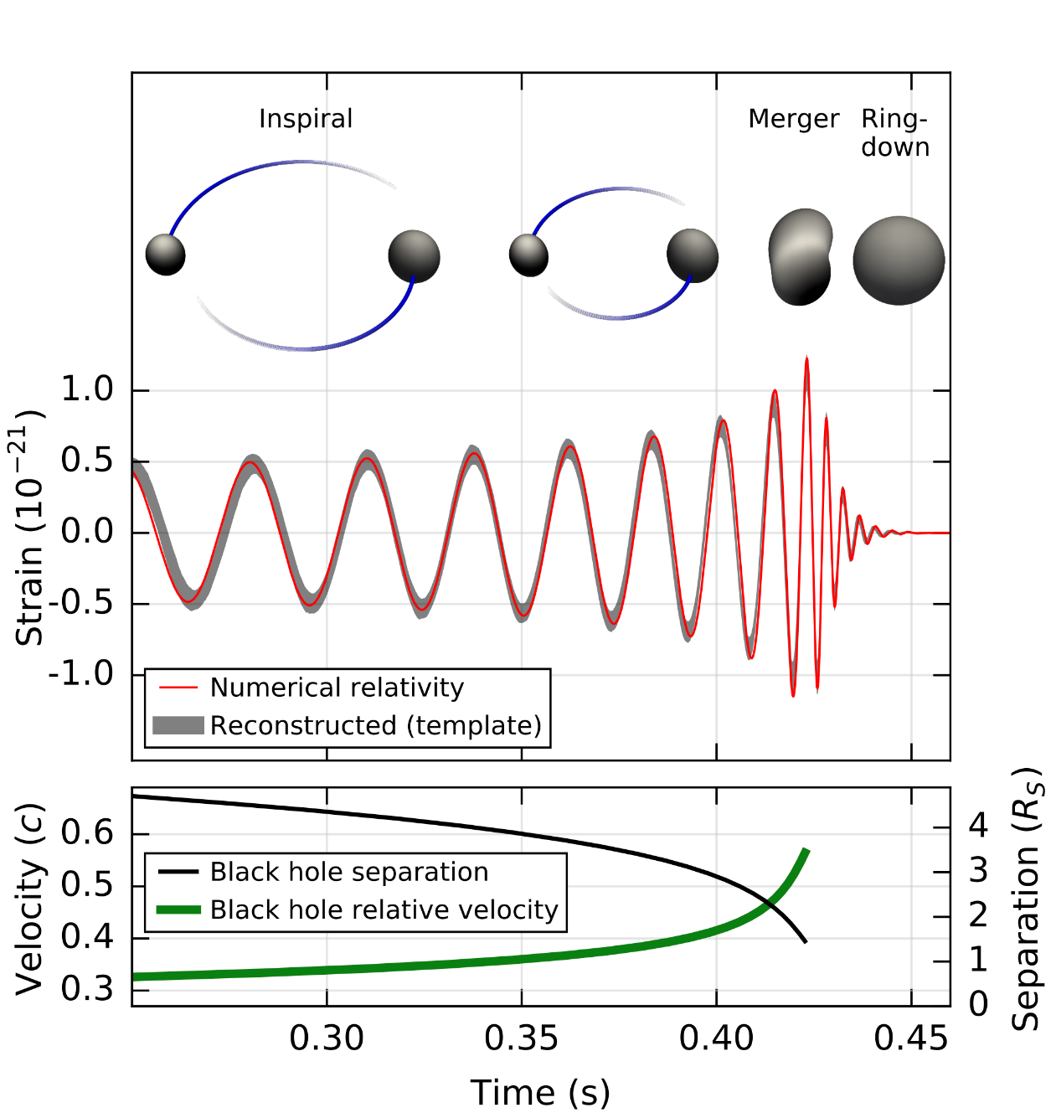
A signal from a binary black hole merger
B. P. Abbott et al., Phys. Rev. Lett. 116, 061102

Slide 26
But what have you done for us lately?
Emphasis on the O in LIGO:
  More BBHs
  Better location information
  New sources like BS-NS and NS-NS
  Better throughput, from online triggers to released skymaps to submitted papers
Our collaboration is focusing on the phase transition brought on by first detection.
The quality and number of available detectors is key
  More detectors to form a global array are needed for many science objectives
  Current facilities can be upgraded
  New facilities can achieve factor of x10 and more beyond ALIGO design

Slide 27
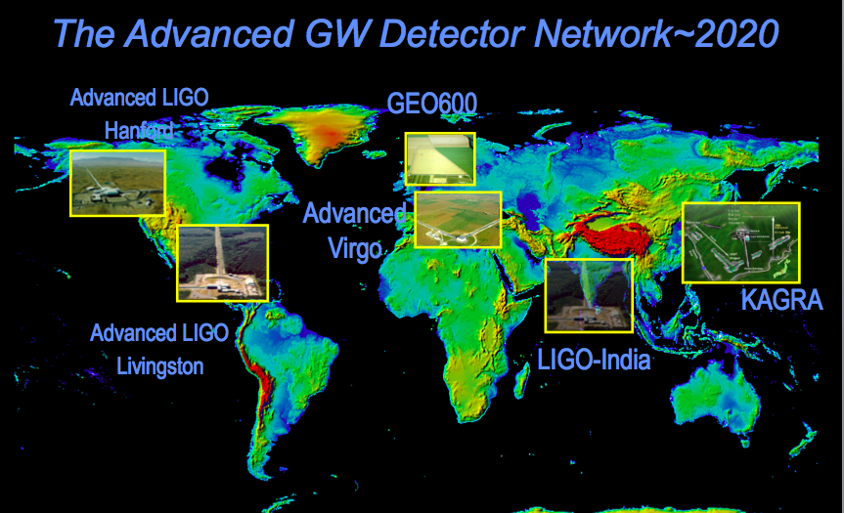
LIGO leads but it’s not alone:
The global gravitational wave array
LIGO-G1600919
2016 APS April meeting, Salt Lake City
/ 23

Slide 28
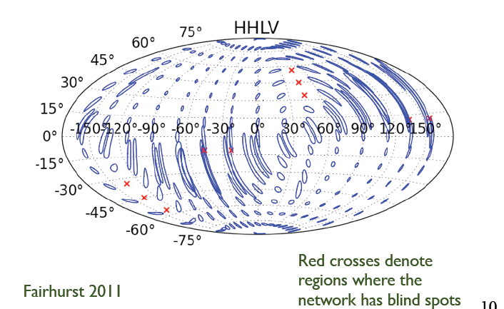
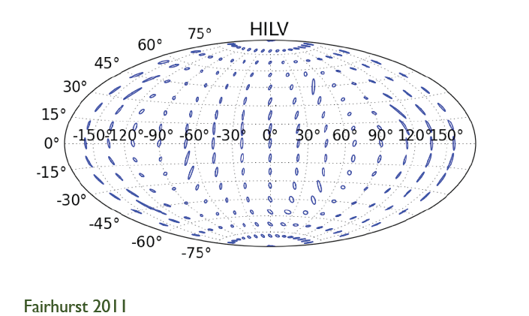
Location, location, location…
EM follow-ups are greatly facilitated by improving GW source location
This requires a worldwide network of GW detectors operating at comparable sensitivities
Error ellipses with 2 US sites + Virgo
Error ellipses with 2 US sites + Virgo + India
B.P. Abbott, et al., Living Rev. Relativity, 19, (2016), 1

Slide 29
Initial S6 / Advanced O1
Design / A+ Upgrade
~3 x the sensitivity
made the difference
And we can
go beyond
~3 x to go!

Slide 30
Science drives Requirements
Stellar Evolution at High Red-Shift: Black Holes from the first stars (Population III)
  Reach z>~10
  At least moderate GW luminosity distance precision
Independent Cosmology and the Dark Energy Equation of State
  Needs precision GW luminosity distance and localization for EM follow-ups (for redshift)
Checking GR in extreme regime
  High SNR needed
  GW luminosity distance and localization not essential

Slide 31
Advanced LIGO upgrade path
Advanced LIGO is limited by
quantum noise & coating thermal noise
Squeezed vacuum to reduce quantum noise
Options for thermal noise:
  Better coatings
  Cryogenic operation
  Longer arms (new facility)

Slide 32
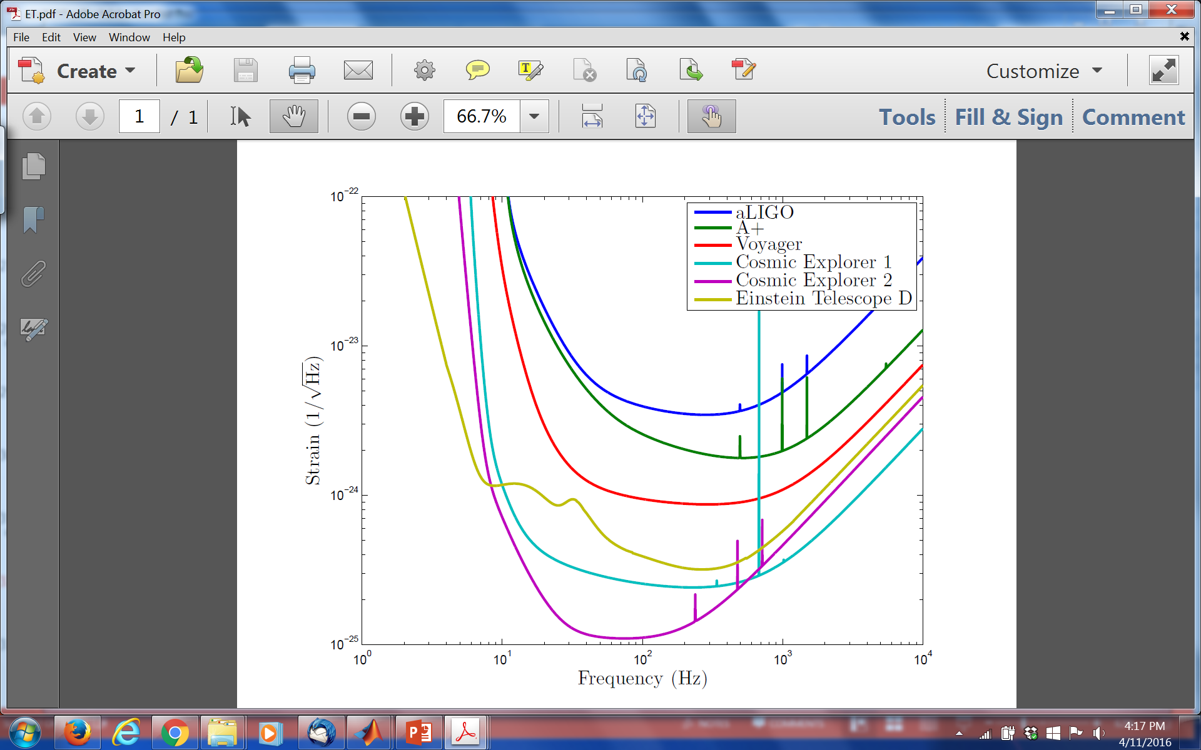
Upgrade possibilities

Slide 33
Summary
GW150914 initiates Gravitational-Wave Astronomy.
General Relativity provides an powerful framework from Earth-bound physics to mergers of stellar mass black holes at velocities near the speed of light.
An emerging international network of detectors will provide more accurate positions of sources to enable EM follow-ups of GW events.
There is still room within the laws of physics to develop more powerful generations of detectors.

Slide 34
Advanced LIGO timeline

