Slide 1

An overview of the control layers in LIGO 4km interferometers, F. Matichard, ASPE 2016
An overview of the control layers in LIGO 4km interferometers
F. Matichard^{1,2}, D. Martynov¹, B. Shapiro³, J. Rollins², D. Coyne²
¹ MIT, Cambridge, MA
² Caltech, Pasadena, CA
³ Stanford University, Stanford, CA
fabrice@ligo.mit.edu

Slide 2
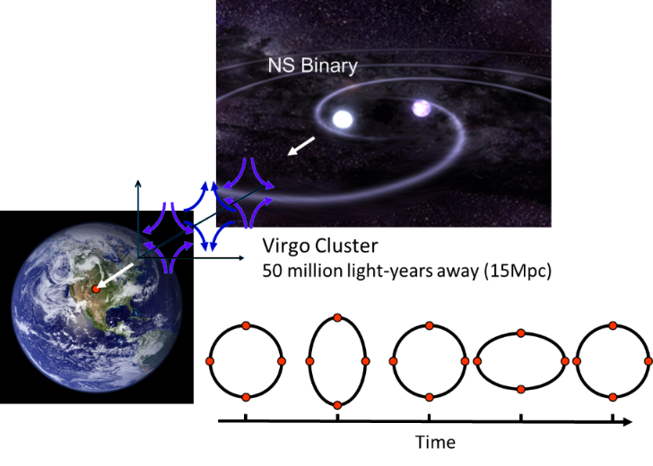
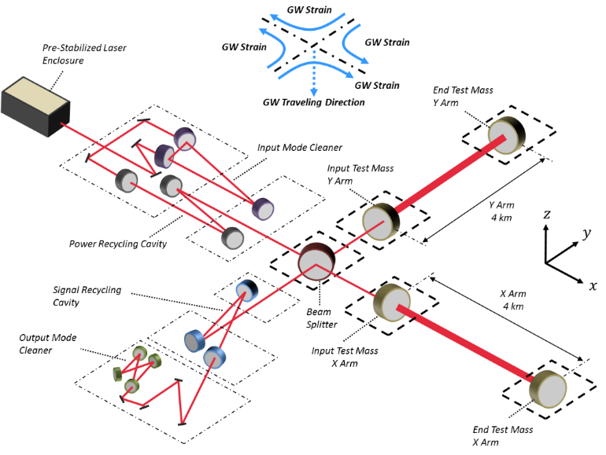

An overview of the control layers in LIGO 4km interferometers, F. Matichard, ASPE 2016
Advanced LIGO detectors
Hundreds of servo systems to isolate the optics and control the interferometer.
$${10}^{−18} m$$
Sub-systems and System controls

Slide 3
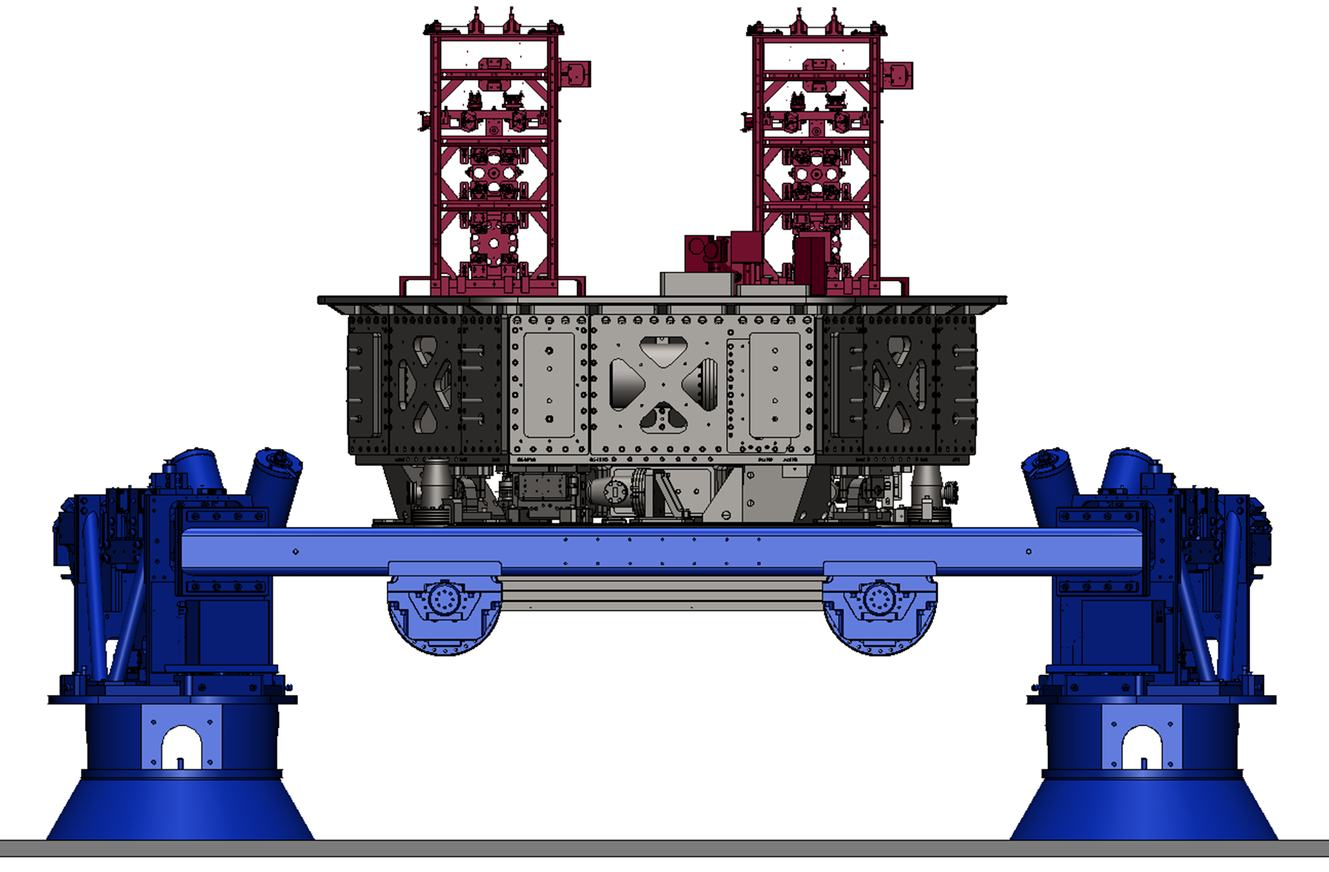
An overview of the control layers in LIGO 4km interferometers, F. Matichard, ASPE 2016
Seismic Isolation
Multi-stage pendulums
Active inertial isolators

Slide 4



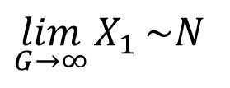



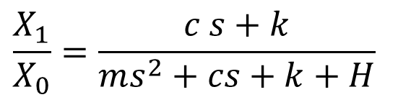




An overview of the control layers in LIGO 4km interferometers, F. Matichard, ASPE 2016
Active inertial control
Suspended platform
Inertial Sensors
$$F$$
Control Force
$$z_{1}$$
$$θ_{1}$$
$$x_{0}$$
$$x_{1}$$
$$x_{1}$$
$$z_{0}$$
$$θ_{0}$$
$$F=−H (X_{1}+N)$$
$$x_{0}$$
$$\frac{X_{1}}{X_{0}}=\frac{c s+k}{ms^{2}+cs+k+H}$$
Support Structure
$$\lim_{G→∞}{X_{1}}\sim N$$

Slide 5
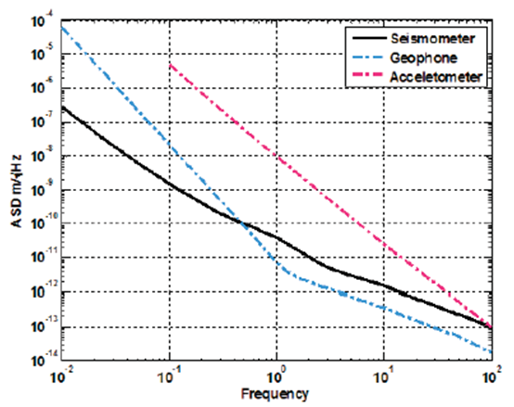
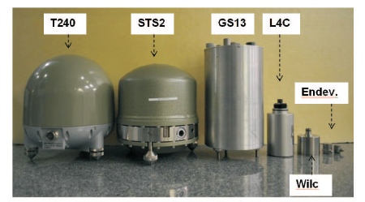
An overview of the control layers in LIGO 4km interferometers, F. Matichard, ASPE 2016
Inertial Sensors Noise

Slide 6
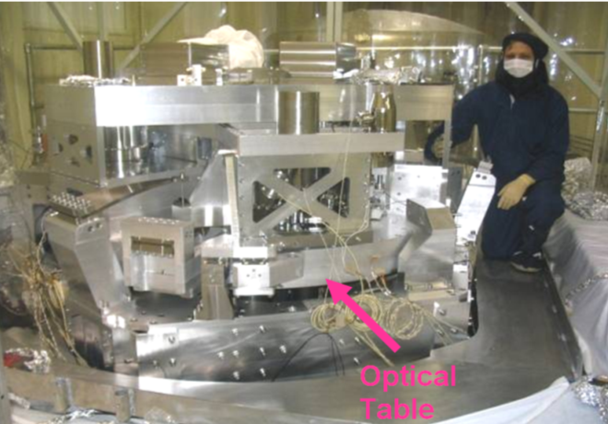
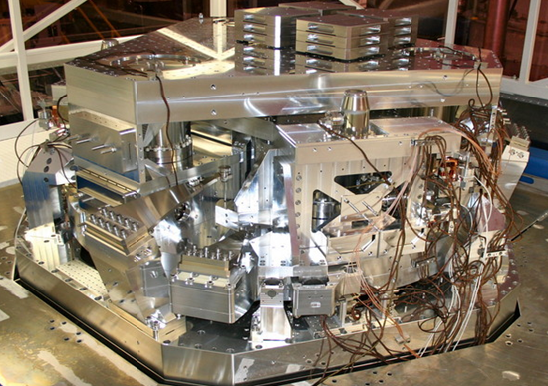
An overview of the control layers in LIGO 4km interferometers, F. Matichard, ASPE 2016
Bandwidth
Prototype
Compensator was made of 104 poles and zeros.
Final Design
22 poles and zeros

Slide 7














An overview of the control layers in LIGO 4km interferometers, F. Matichard, ASPE 2016
Control Scheme
Input Motion
Output Motion
$${ X}_{0}$$
$$P_{S}$$
Control Force
-
+
$$X_{1}$$
$$F$$
+
+
$$P_{F}$$
$$C_{FF}$$
+
-
$$H$$
$$U_{a}$$
+
Feedforward
+
+
$$N_{a}$$
$$C_{FB}$$
+
+
$$U_{r}$$
+
$$H_{SC}$$
$$L$$
$$N_{r}$$
+
+
Feedback
Sensor Correction
$$〈{X_{1}}^{2}〉= {\left|\frac{P_{s }+L {C P}_{F } }{1+C P_{F }}\right|}^{2}〈{X_{0}}^{2}〉+ {\left|\frac{H {C P}_{F } }{1+C P_{F }}\right|}^{2}〈{N_{a}}^{2}〉+ {\left|\frac{L {C P}_{F } }{1+C P_{F }}\right|}^{2}〈{N_{r}}^{2}〉$$

Slide 8

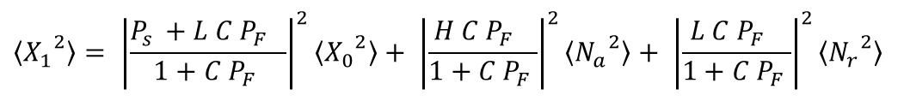

An overview of the control layers in LIGO 4km interferometers, F. Matichard, ASPE 2016
Ouput Motion
Input Motion
Inertial sensor noise
Relative sensor noise
$$〈{X_{1}}^{2}〉= {\left|\frac{P_{s }+L {C P}_{F } }{1+C P_{F }}\right|}^{2}〈{X_{0}}^{2}〉+ {\left|\frac{H {C P}_{F } }{1+C P_{F }}\right|}^{2}〈{N_{a}}^{2}〉+ {\left|\frac{L {C P}_{F } }{1+C P_{F }}\right|}^{2}〈{N_{r}}^{2}〉$$
Complementary filters:
$$L+H=1$$
High loop gain:
$$C P_{F }→∞$$
Residual motion:
$$〈{X_{1}}^{2}〉\sim {\left|L\right|}^{2}〈{X_{0}}^{2}〉+ {\left|H\right|}^{2}〈{N_{a}}^{2}〉+ {\left|L\right|}^{2}〈{N_{r}}^{2}〉$$

Slide 9
An overview of the control layers in LIGO 4km interferometers, F. Matichard, ASPE 2016
Performance
Ground
Requirements
Advanced LIGO two-stage twelve-axis vibration isolation and positioning platform. Part 1: Design and production overview
Precision Engineering 40 (2015): 273-286.
Advanced LIGO two-stage twelve-axis vibration isolation and positioning platform. Part 2: Experimental investigation and tests results. Precision engineering 40 (2015): 287-297.

Slide 10
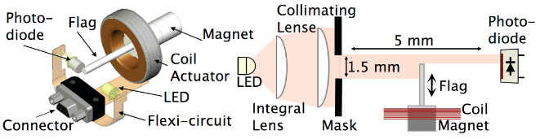
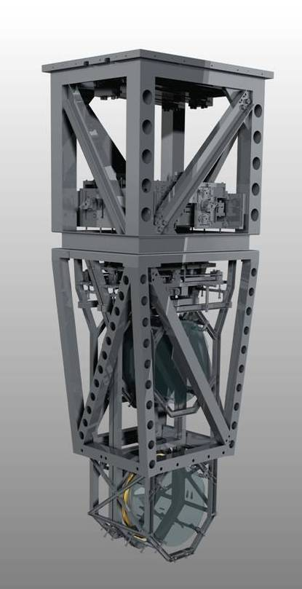
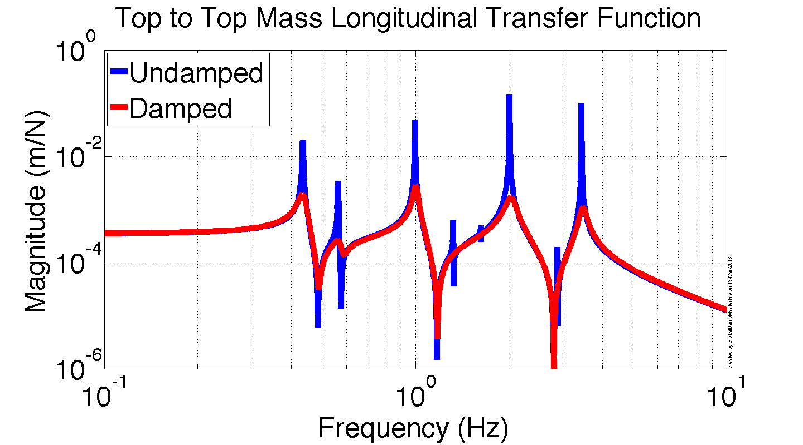
An overview of the control layers in LIGO 4km interferometers, F. Matichard, ASPE 2016
Suspension controls
Reaction Chain
Main (test) Chain

Slide 11

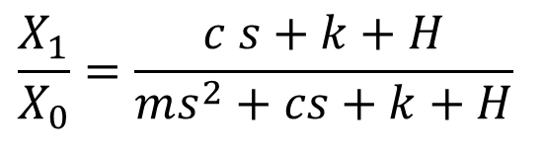



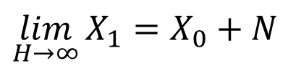
An overview of the control layers in LIGO 4km interferometers, F. Matichard, ASPE 2016
Suspension damping feedback
sensor noise
$$F$$
[m]
Damping feedback filter
+
[N]
$$x_{0}$$
$$x_{1}$$
$$F=−H (X_{1}−X_{0}+N)$$
$$\frac{X_{1}}{X_{0}}=\frac{c s+k+H}{ms^{2}+cs+k+H}$$
$$\lim_{H→∞}{X_{1}}=X_{0}+N$$

Slide 12
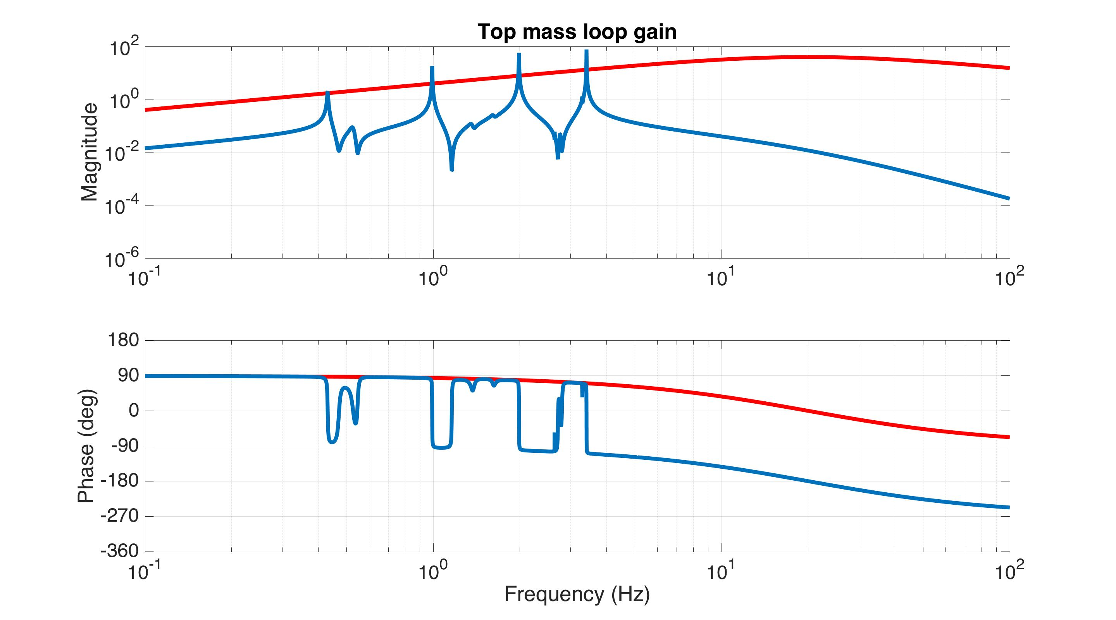
Simple Damping Loop
An overview of the control layers in LIGO 4km interferometers, F. Matichard, ASPE 2016
Control filter
Loop gain

Slide 13
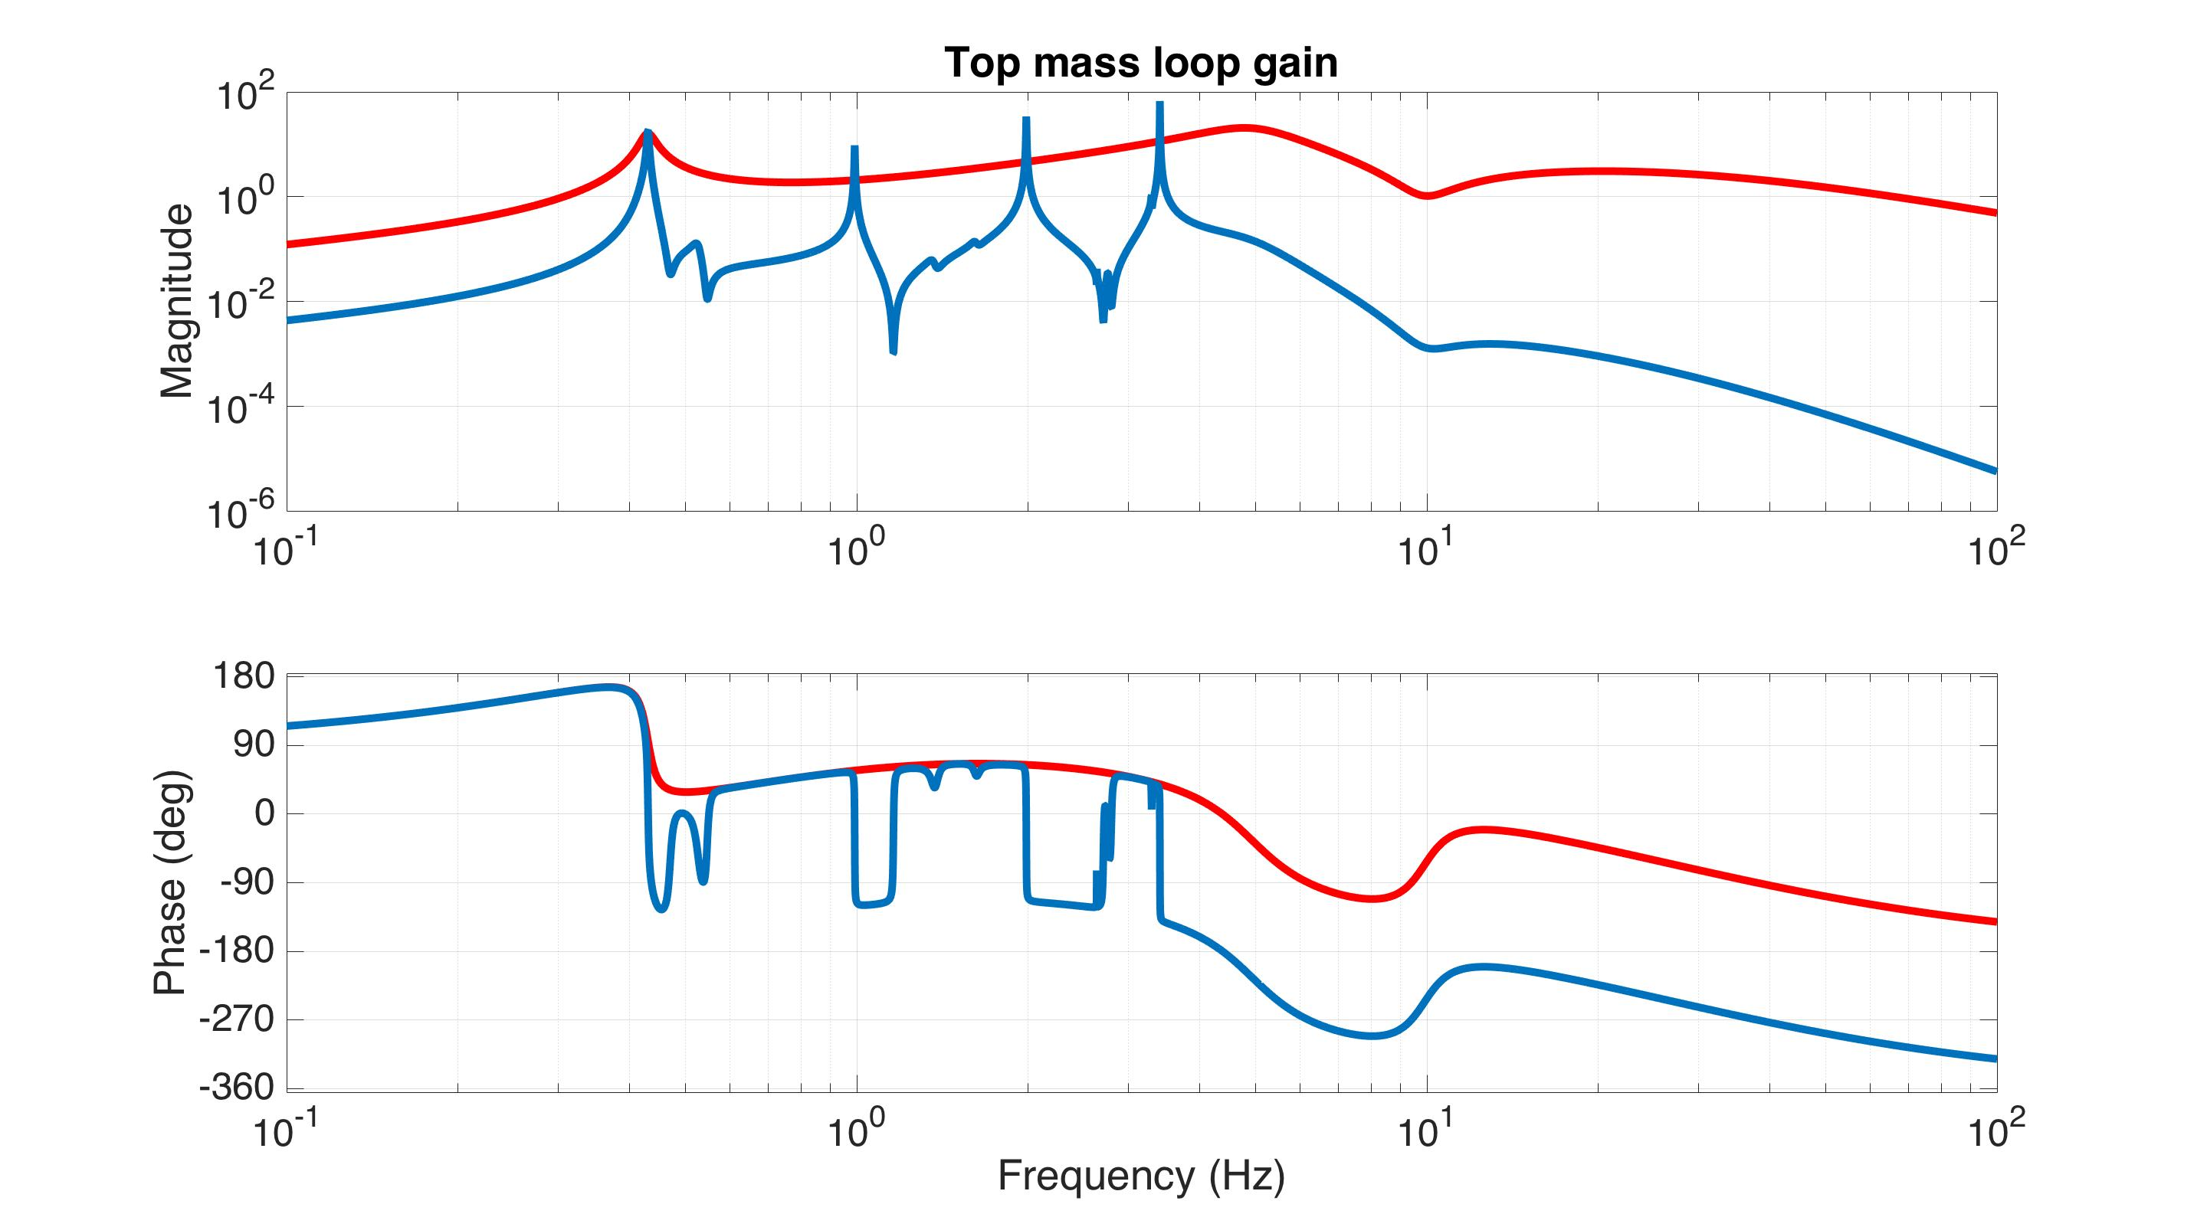
Low Noise Loop
An overview of the control layers in LIGO 4km interferometers, F. Matichard, ASPE 2016
Control filter
Loop gain

Slide 14
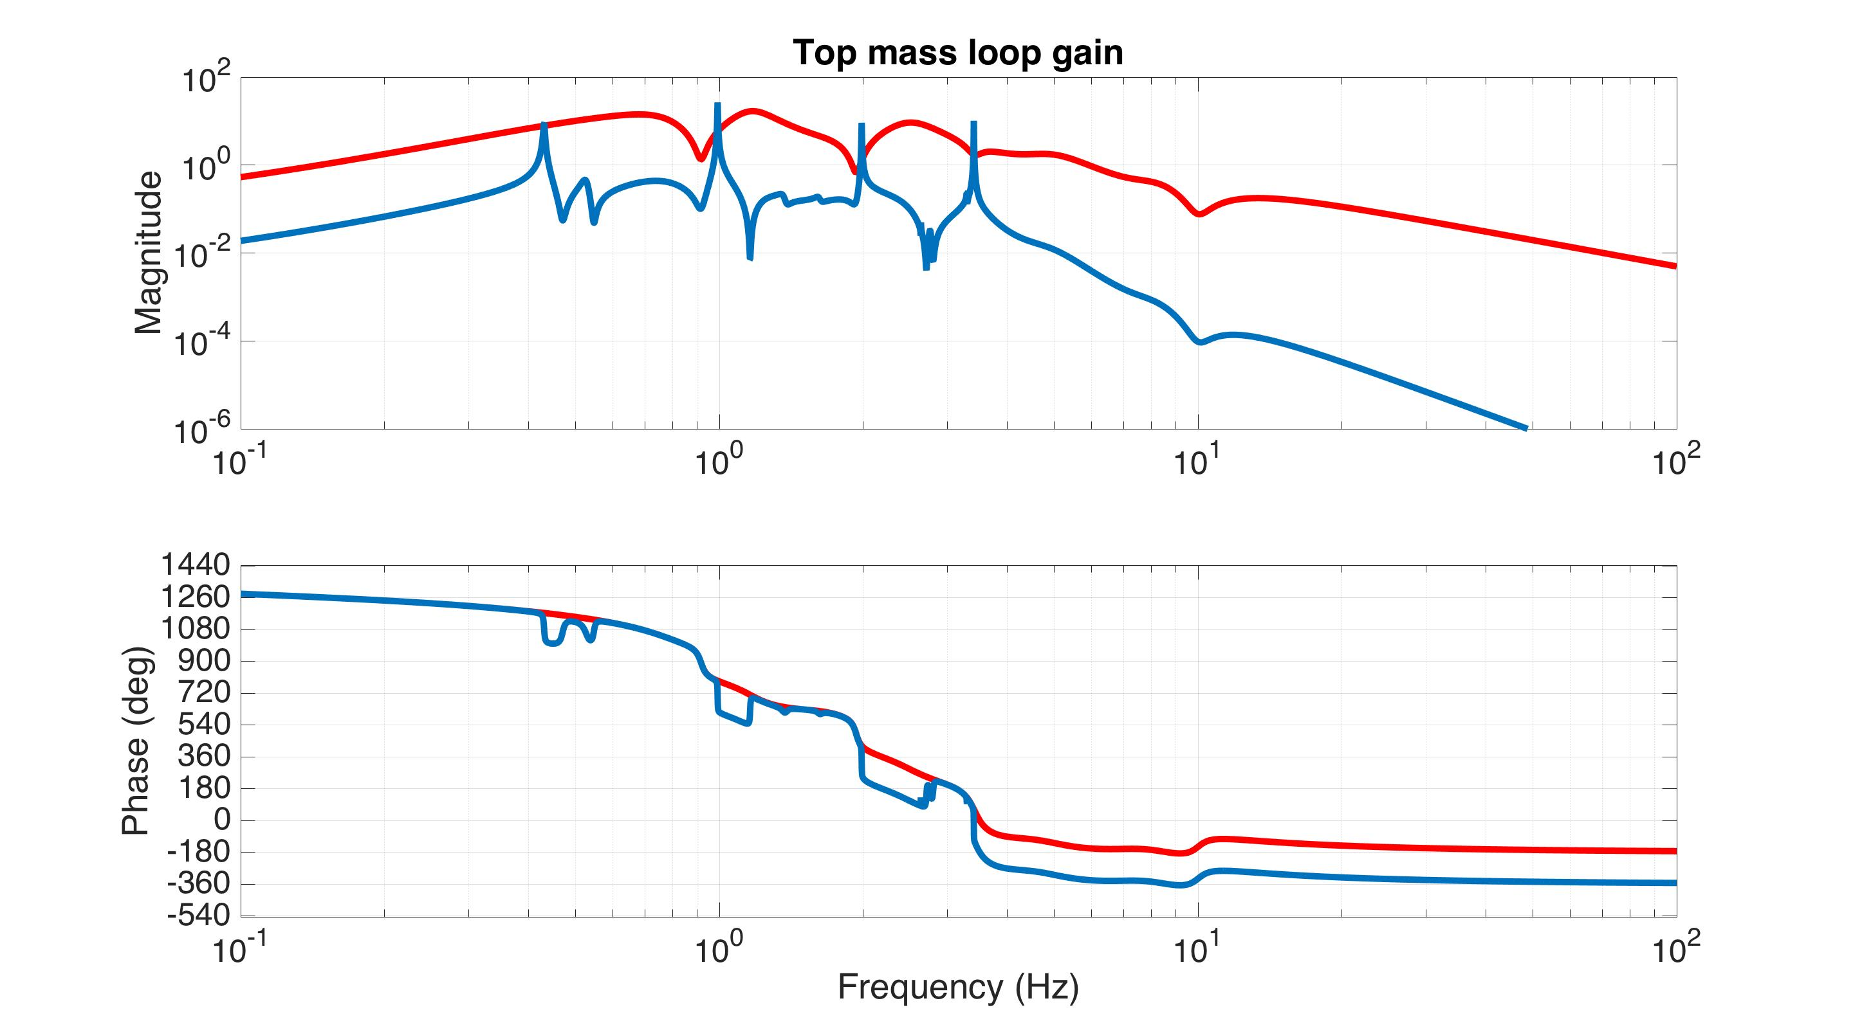
Modal Damping Loop
An overview of the control layers in LIGO 4km interferometers, F. Matichard, ASPE 2016
Control filter
Loop gain

Slide 15
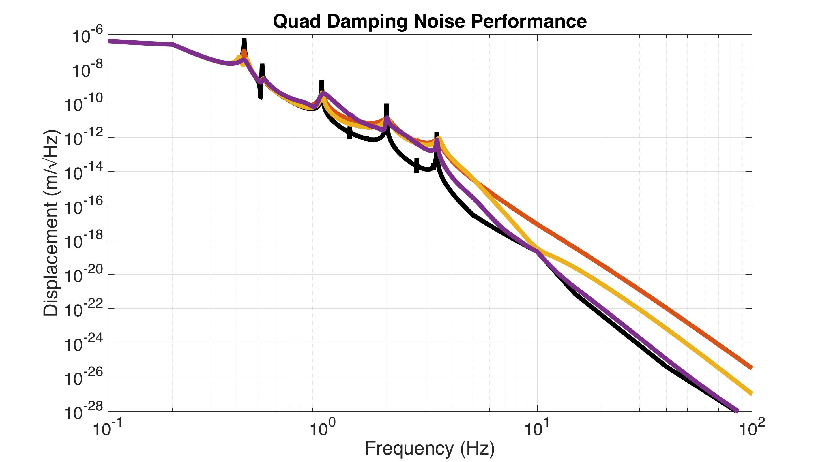
Damping Noise Performance
An overview of the control layers in LIGO 4km interferometers, F. Matichard, ASPE 2016
Simple damping
Low noise damping
No damping
Modal damping

Slide 16
An overview of the control layers in LIGO 4km interferometers, F. Matichard, ASPE 2016
Lock acquisition
Pre-Stabilized Laser
Laser
Input Mode Cleaner
From free swinging uncontrolled state to fully locked
Y arm
Power Recycling Cavity
Signal Recycling Cavity
Output Mode Cleaner
X arm

Slide 17
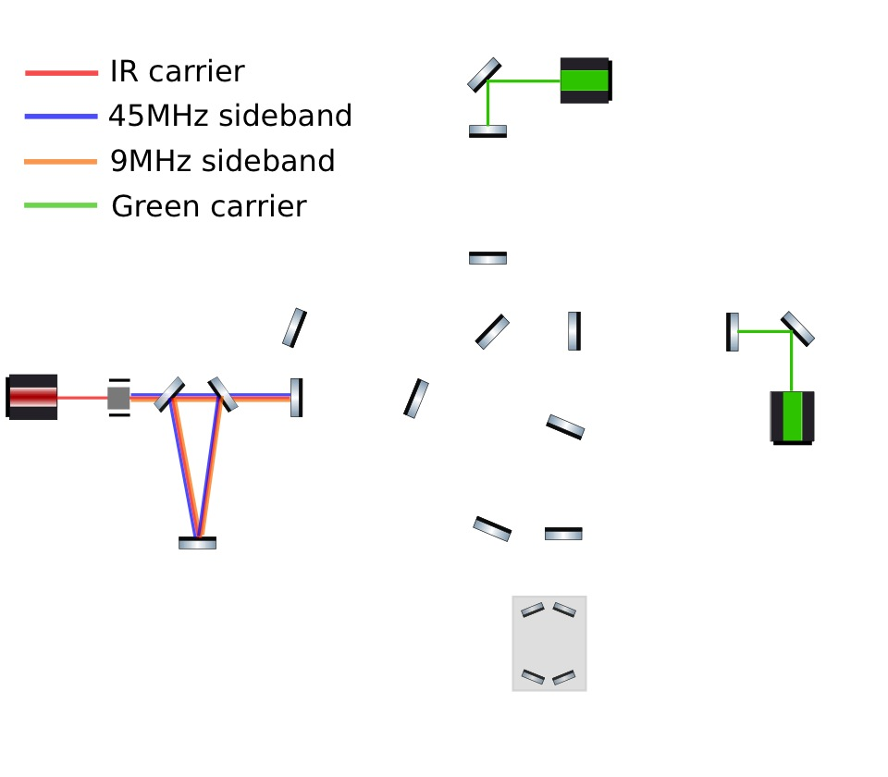
An overview of the control layers in LIGO 4km interferometers, F. Matichard, ASPE 2016
Lock acquisition
PSL+IMC
ALS
Y-END
DRMI
CORNER
X-END
CARM offset reduction
PSL+IMC
Angular controls
OMC
DC readout

Slide 18
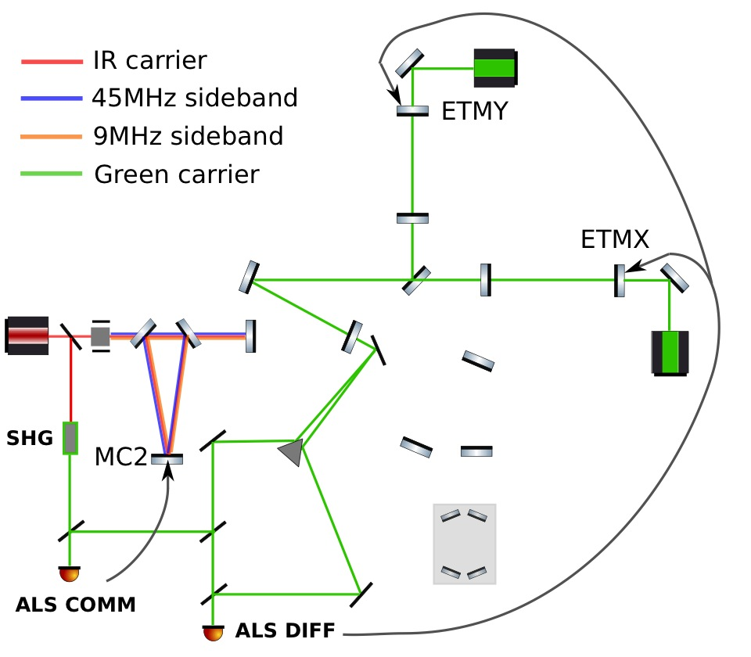
An overview of the control layers in LIGO 4km interferometers, F. Matichard, ASPE 2016
Lock acquisition
PSL+IMC
ALS
DRMI
CARM offset reduction
Angular controls
DC readout

Slide 19
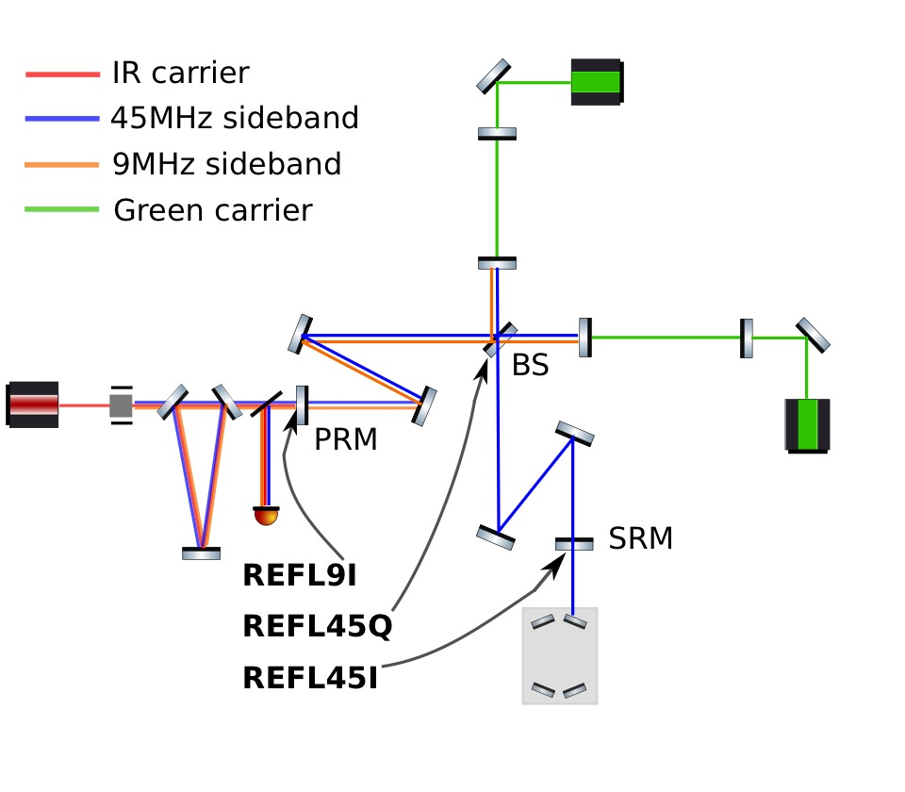
An overview of the control layers in LIGO 4km interferometers, F. Matichard, ASPE 2016
Lock acquisition
PSL+IMC
ALS
DRMI
CARM offset reduction
Angular controls
DC readout

Slide 20
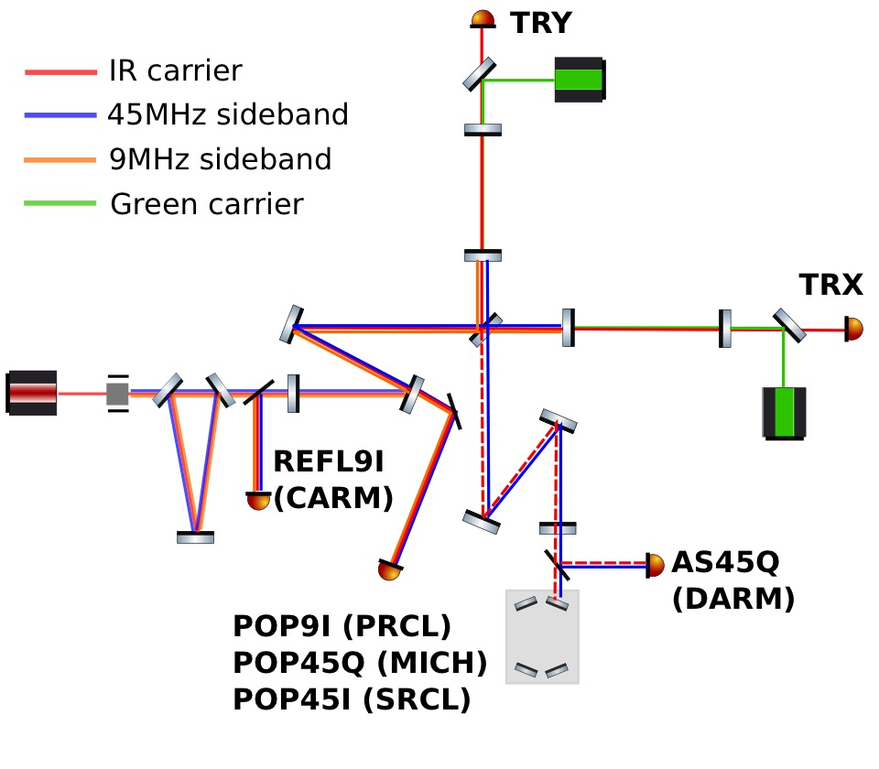
An overview of the control layers in LIGO 4km interferometers, F. Matichard, ASPE 2016
Lock acquisition
PSL+IMC
ALS
DRMI
CARM offset reduction
Angular controls
DC readout

Slide 21
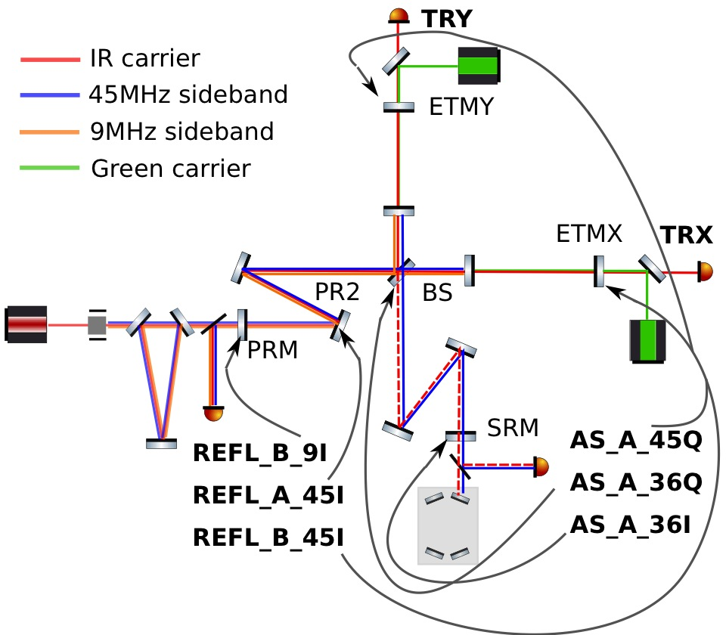
An overview of the control layers in LIGO 4km interferometers, F. Matichard, ASPE 2016
Lock acquisition
PSL+IMC
ALS
DRMI
CARM offset reduction
Angular controls
DC readout

Slide 22
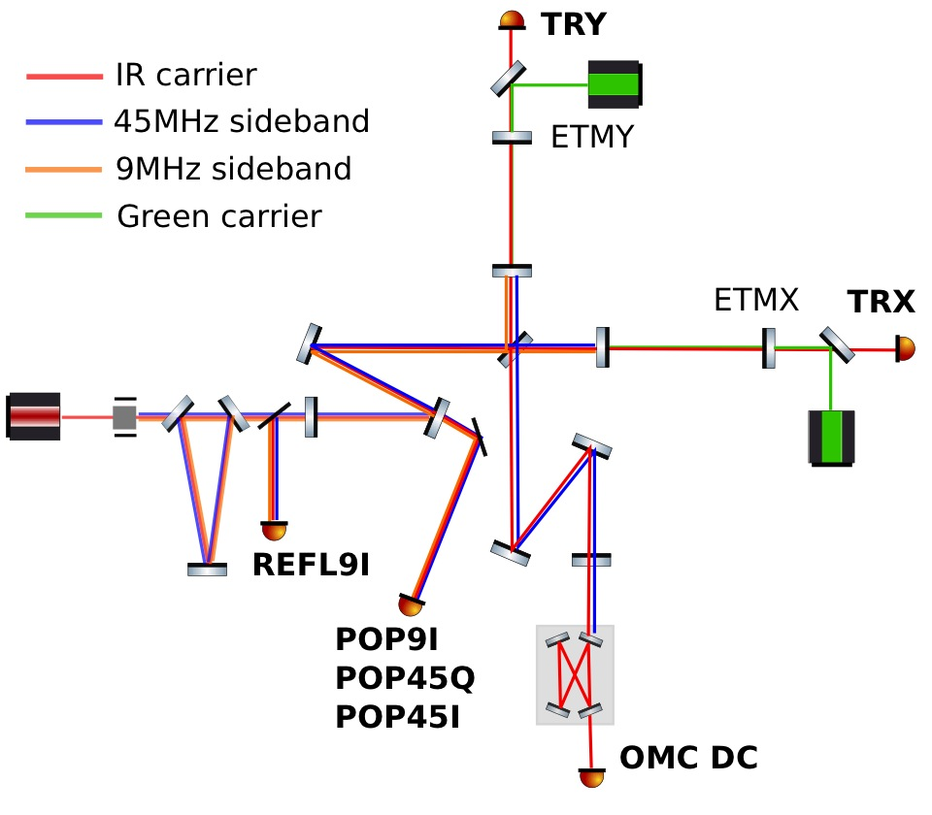
An overview of the control layers in LIGO 4km interferometers, F. Matichard, ASPE 2016
Lock acquisition
PSL+IMC
ALS
DRMI
CARM offset reduction
Angular controls
DC readout

Slide 23
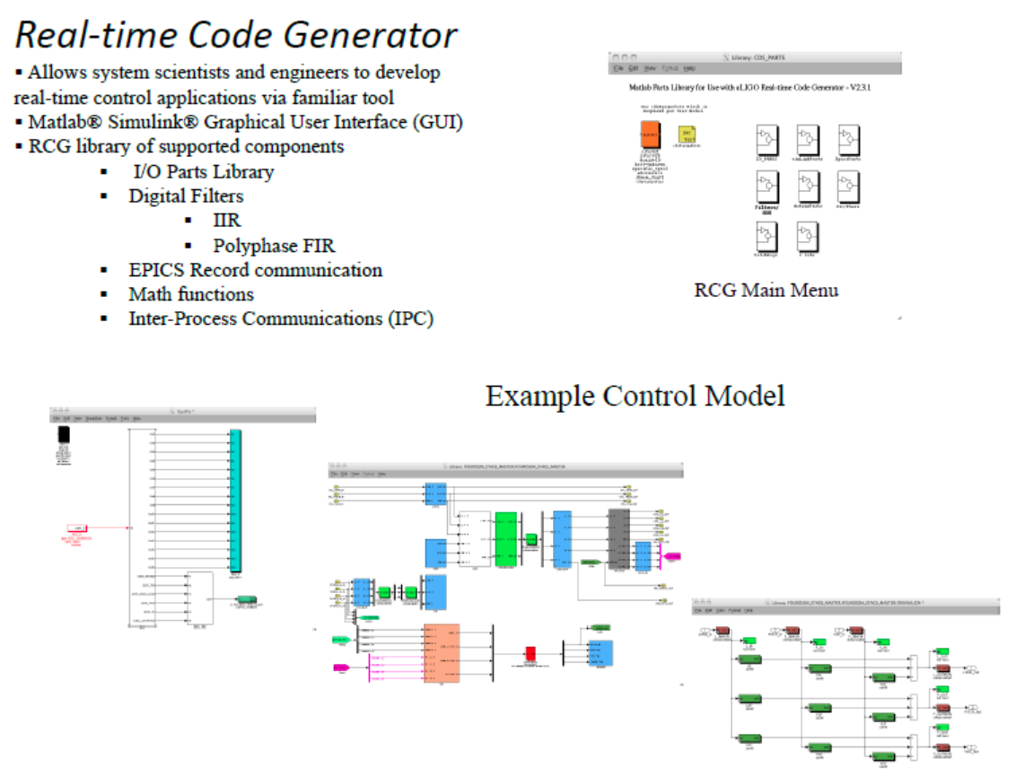
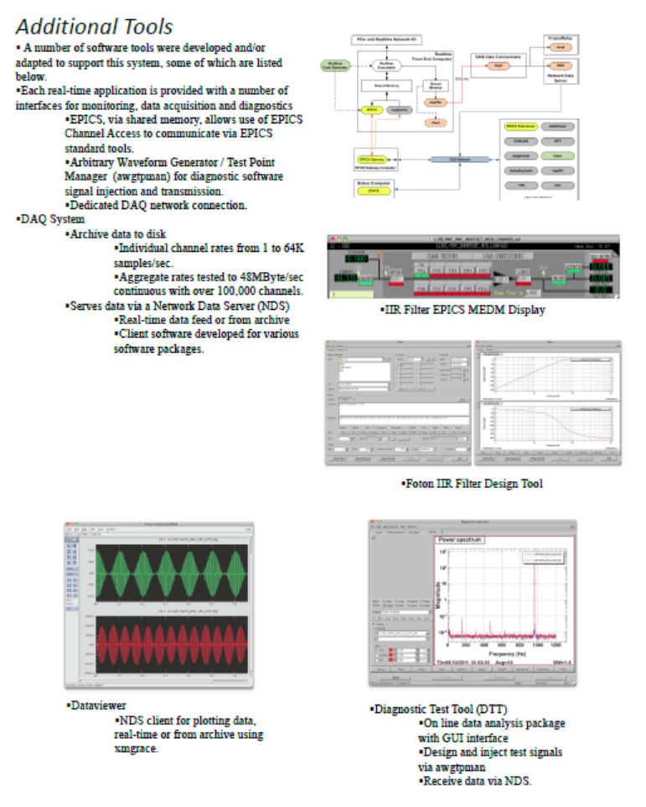
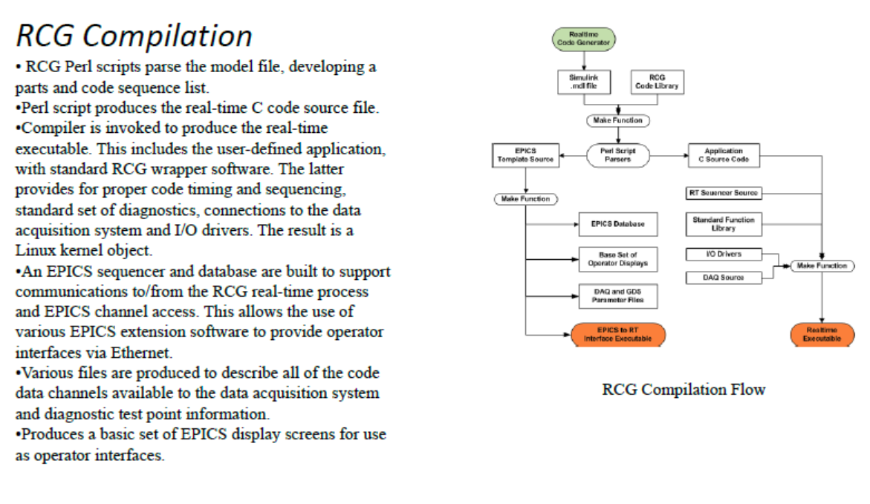
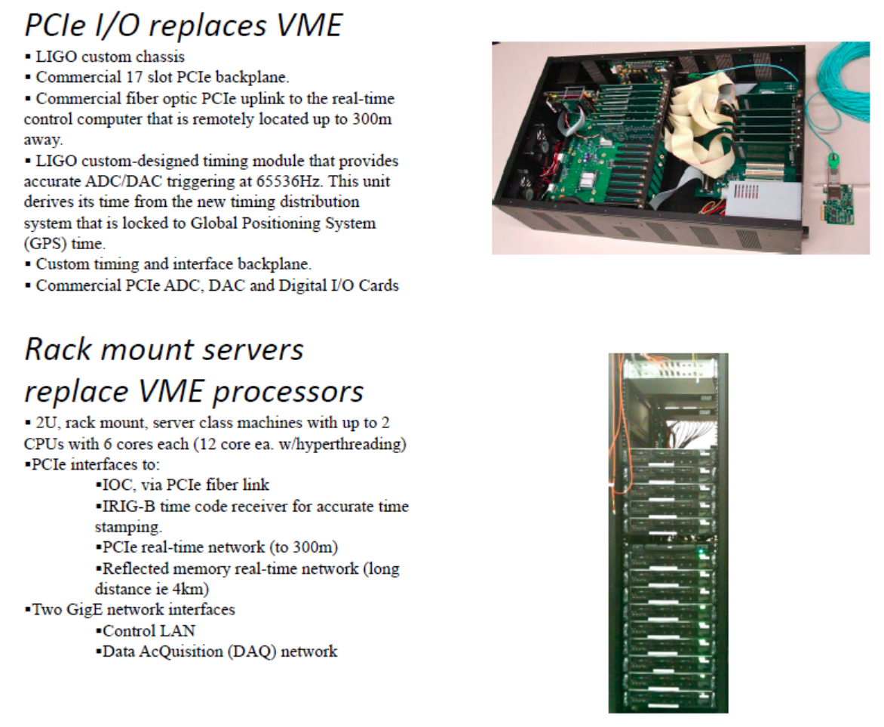
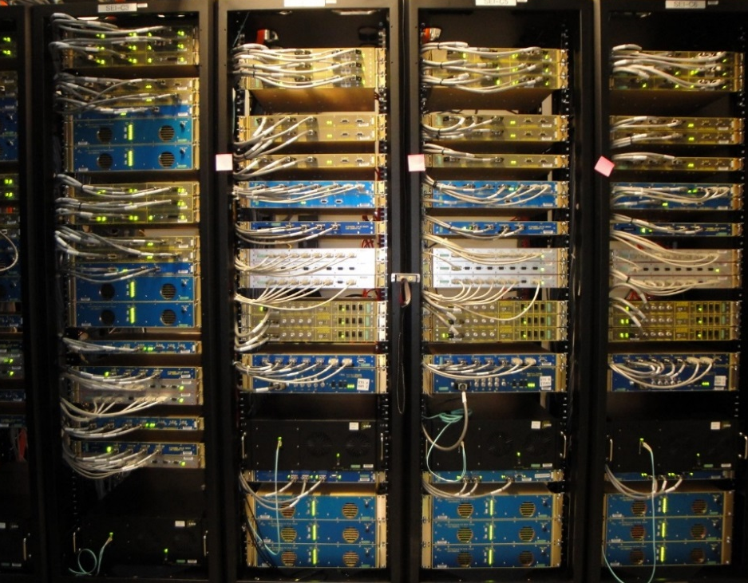
An overview of the control layers in LIGO 4km interferometers, F. Matichard, ASPE 2016
Control and Data Acquisition System

Slide 24
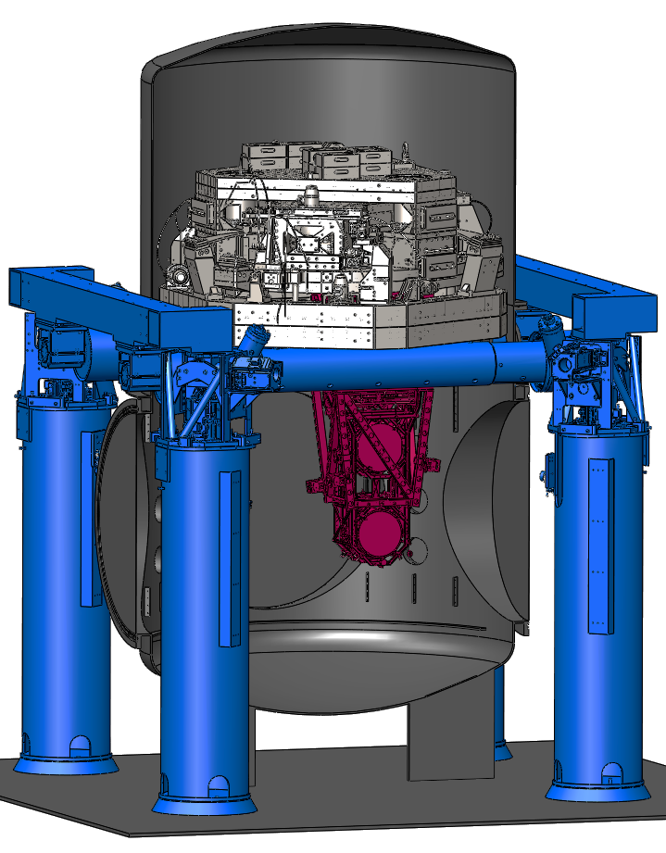
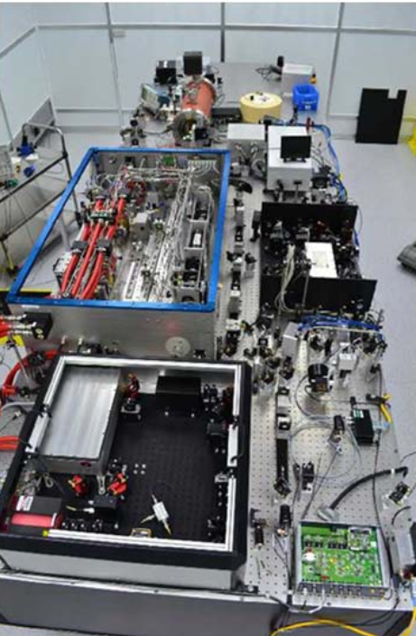
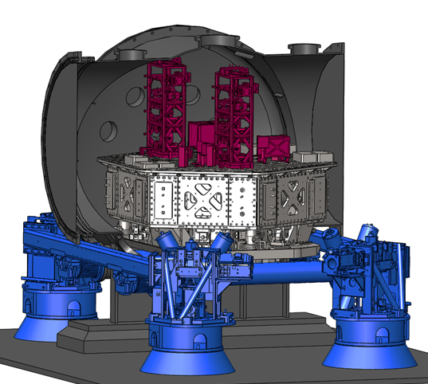
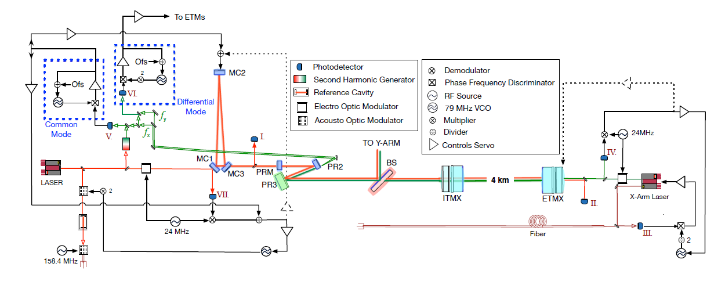
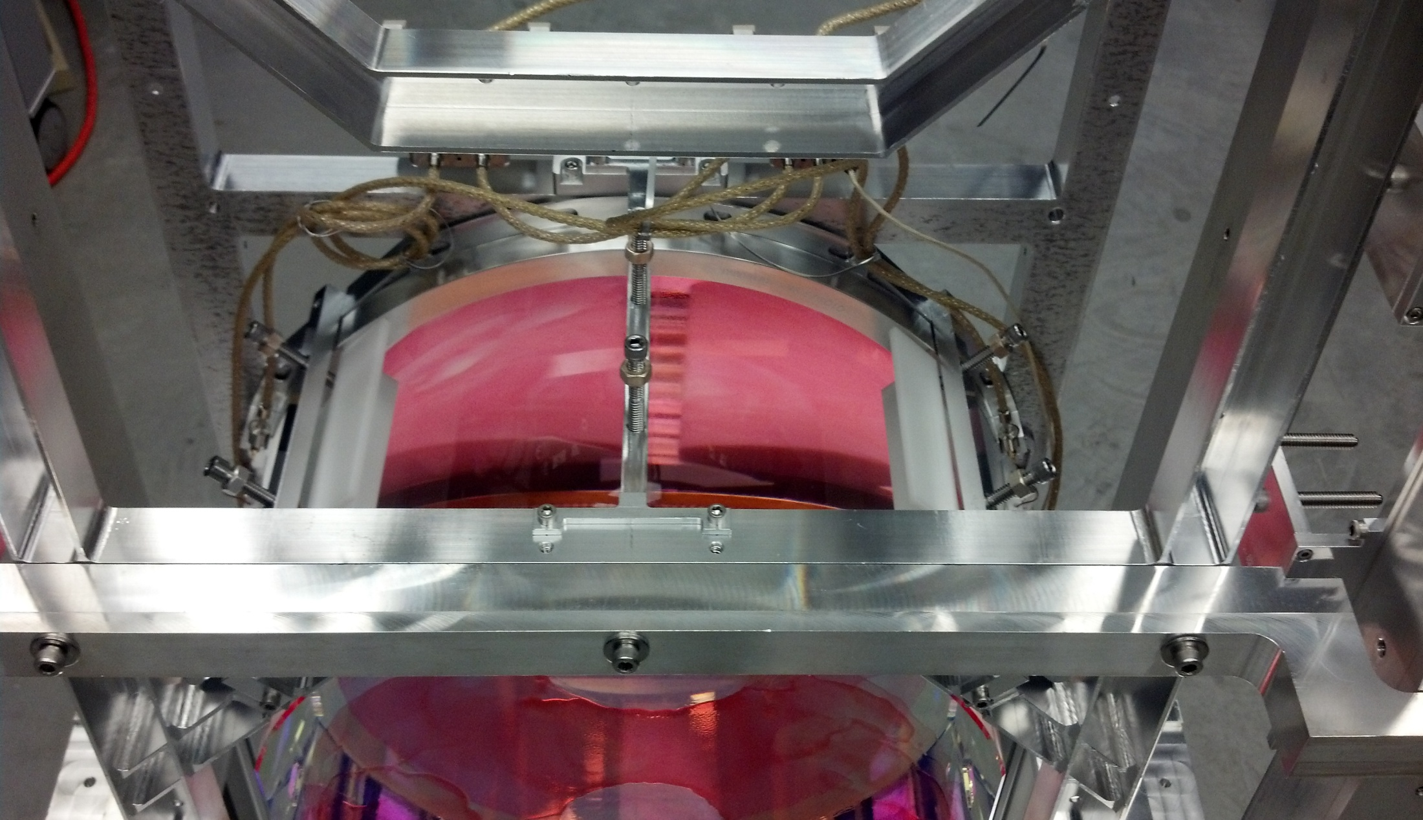
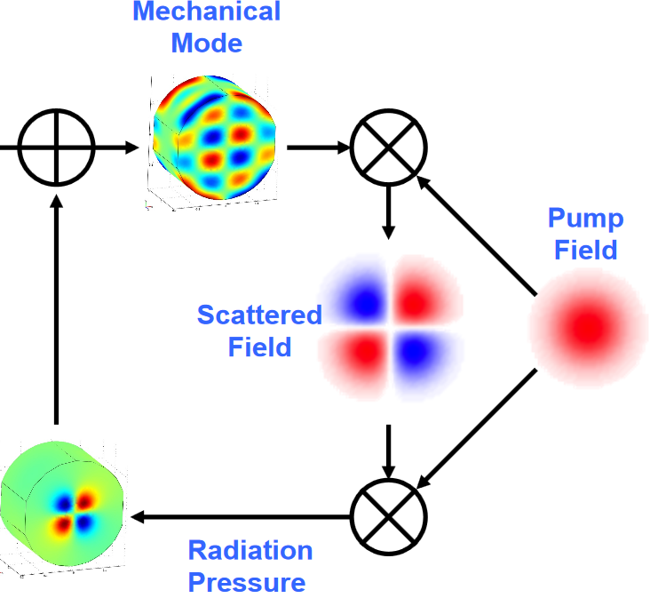
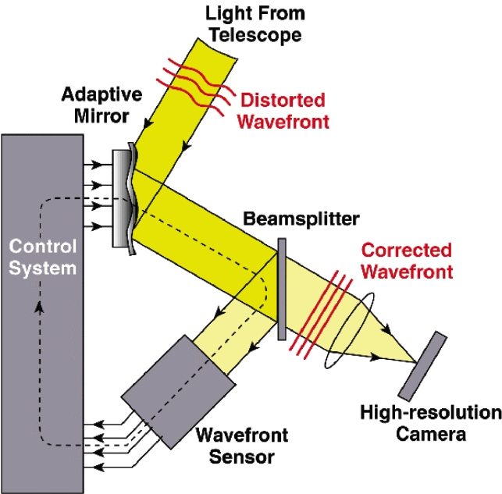
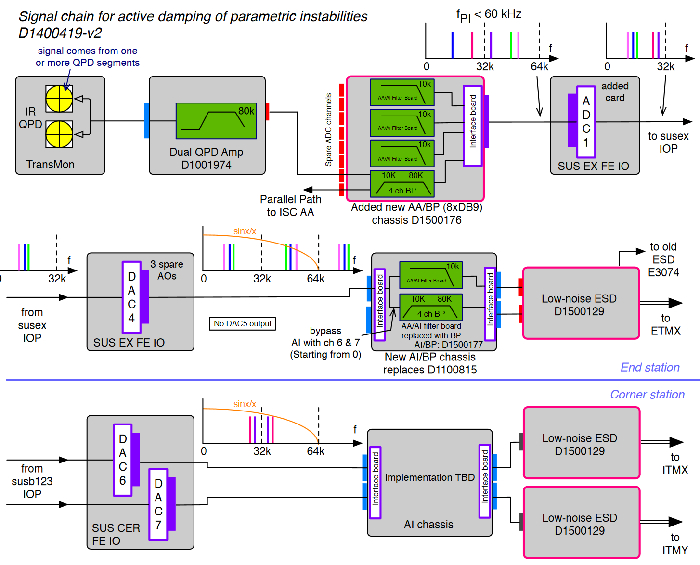
An overview of the control layers in LIGO 4km interferometers, F. Matichard, ASPE 2016
Laser
System Supervisory

Slide 25
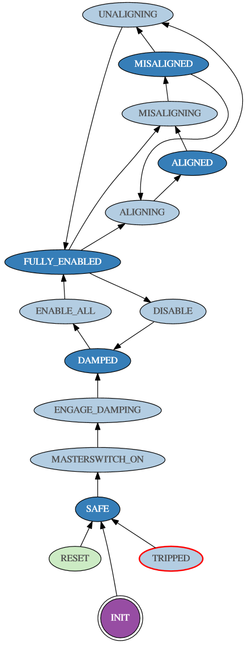
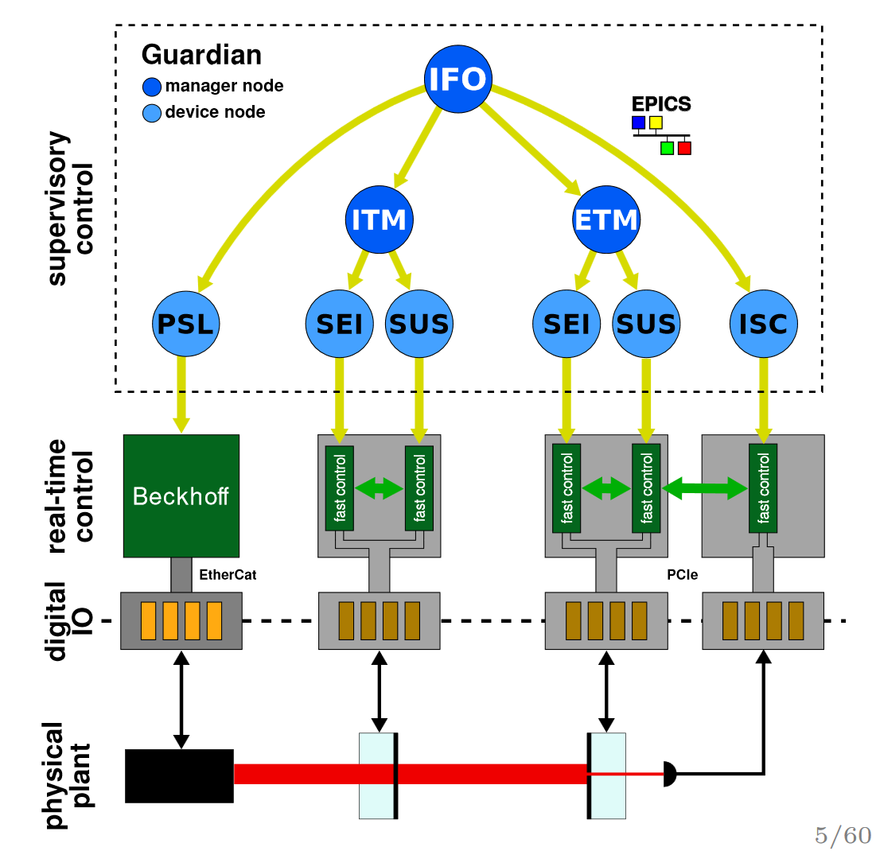
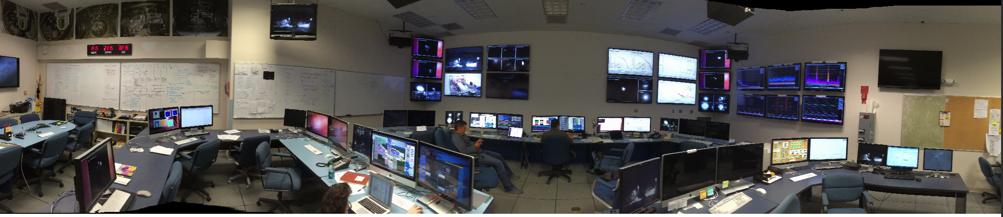
An overview of the control layers in LIGO 4km interferometers, F. Matichard, ASPE 2016
Guardian:
Hierarchical, distributed, state machine
Individual automation nodes oversee well defined sub-domains of the full system
Each node is a separate
Daemon process
State graphs
describe the accessible states of the system, and the allowable transitions between states
Operator

Slide 26
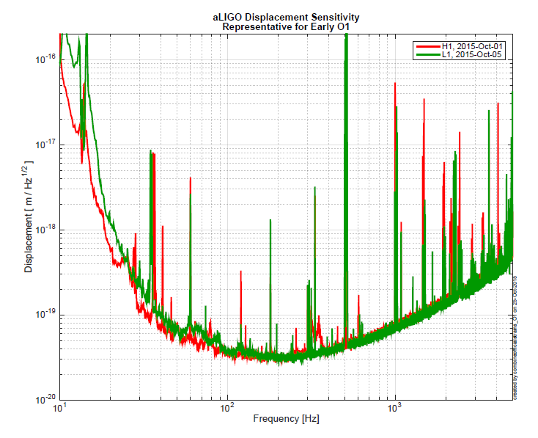
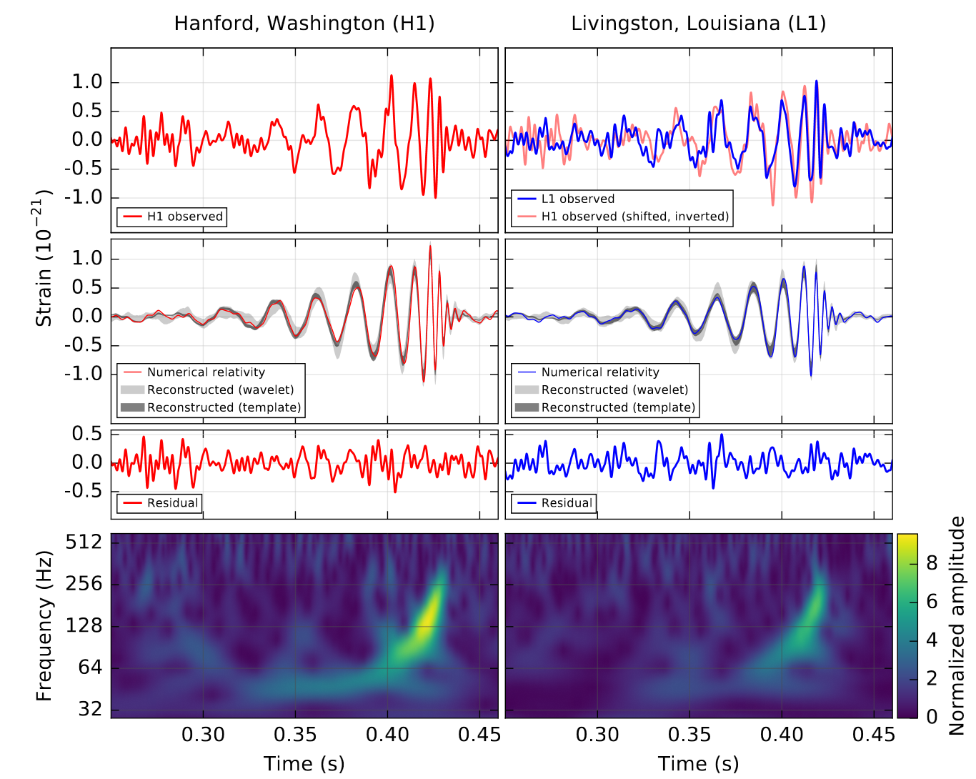
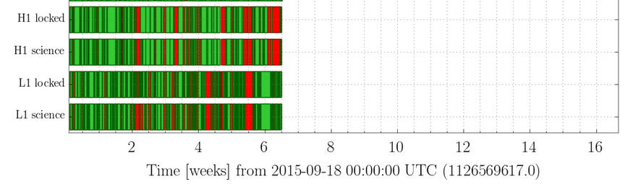
An overview of the control layers in LIGO 4km interferometers, F. Matichard, ASPE 2016
Sensitivity
Detection
Duty-Cycle
Abbott, B. P., et al. "Observation of gravitational waves from a binary black hole merger." Physical review letters 116.6 (2016): 061102.

