Slide 1
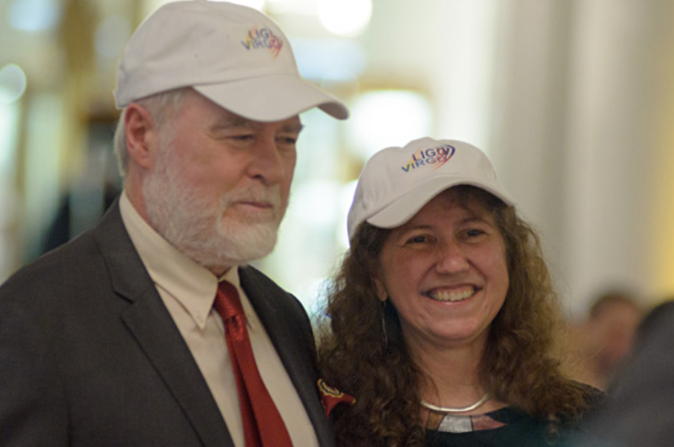
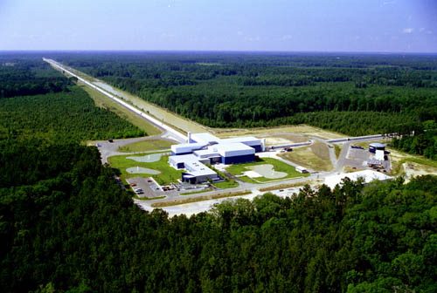


LIGO, gravitational waves and me: a wonderful life in physics with more to come!
Gabriela González,
Louisiana State University
Jan 18, 2014

Slide 2

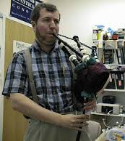




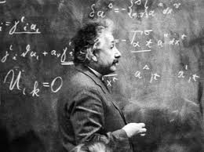


School and college in Argentina

Slide 3
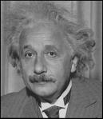
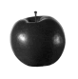
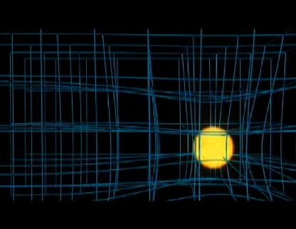
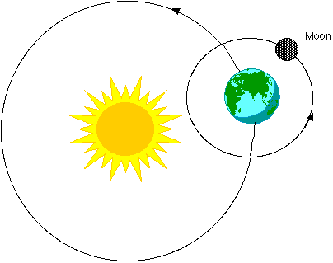
Einstein’s gravity
When masses move, they wrinkle the space time fabric, making other masses move…
Explains just as well as Newton’s why things fall and planetary motion…
sciencebulletins.amnh.org

Slide 4
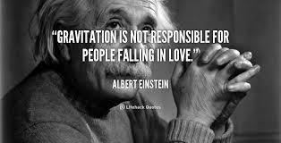
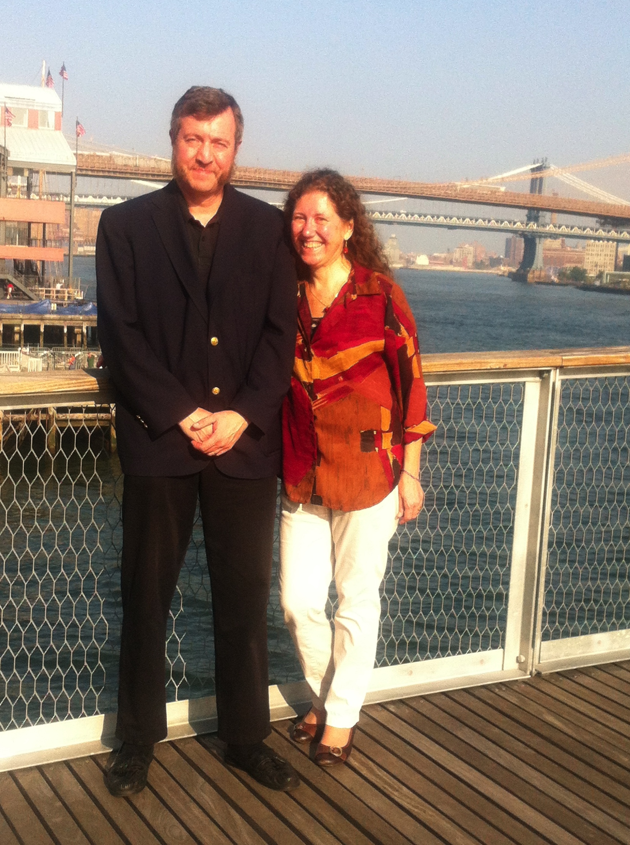
Proving Einstein wrong…

Slide 5
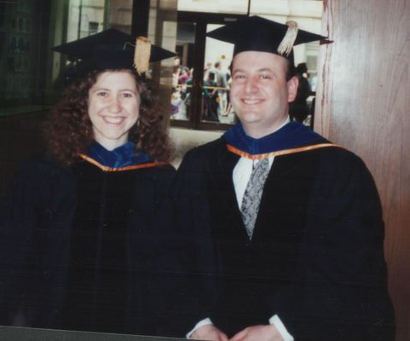
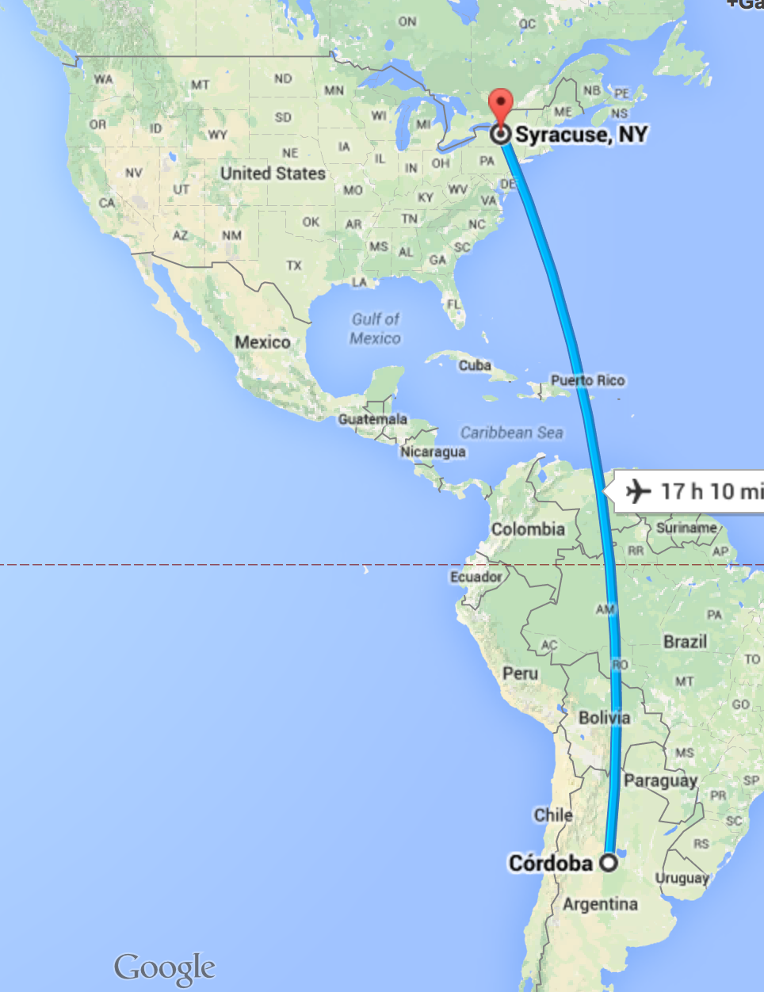
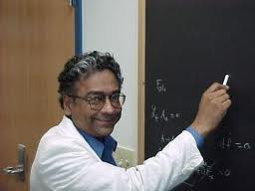
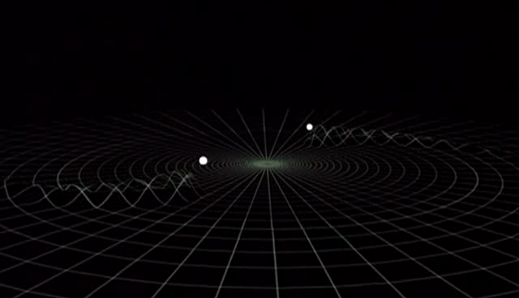
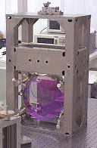
Moving to US, PhD, LIGO

Slide 6
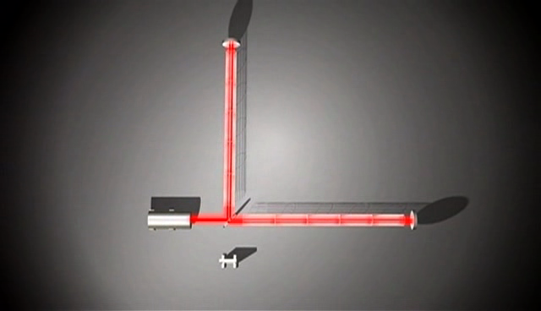
Moving to US, PhD, LIGO

Slide 7
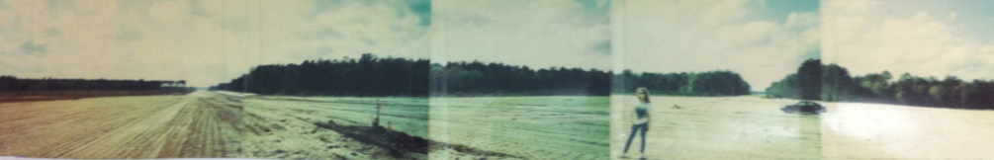
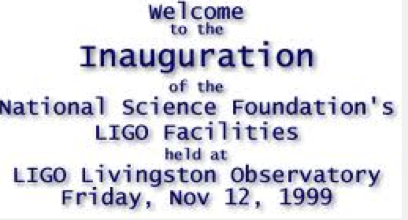

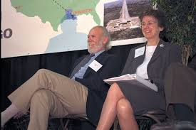
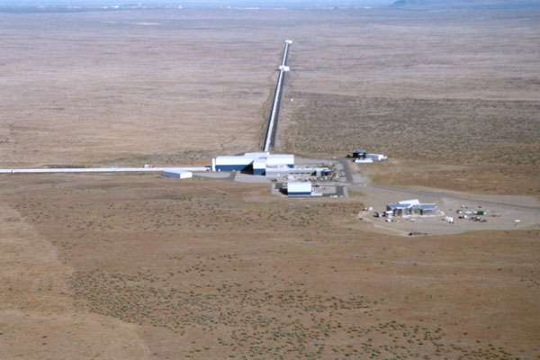
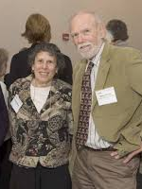
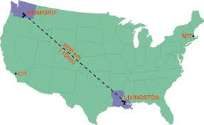
LIGO Observatories
LIGO Livingston, circa 1995
LIGO Hanford, WA
LIGO Livingston, LA

Slide 8
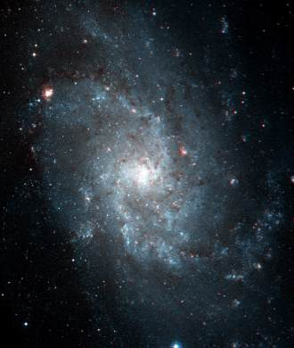
Where do gravitational waves come from?
From stars living in galaxies…

Slide 9
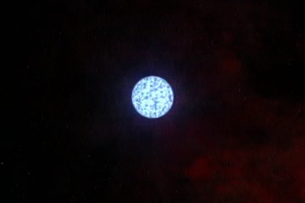
Where do gravitational waves come from?
From stars living in galaxies…
Supernova explosions
(that form a BH or a NS)
Credits: Animation: NASA/CXC/D.Berry & A.Hobart

Slide 10
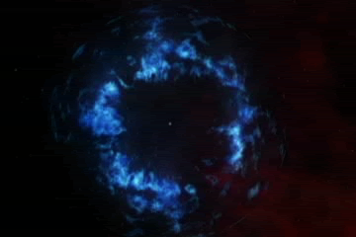
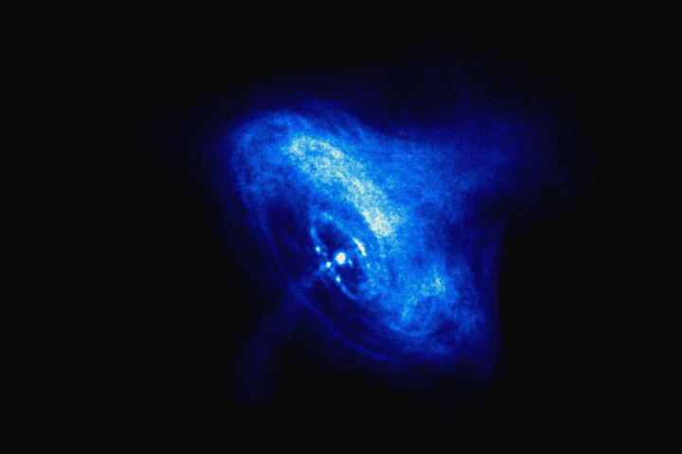
Where do gravitational waves come from?
From stars living in galaxies…
Rotating stars (pulsars)
Credit: NASA/CXC/ASU/J.Hester et al.

Slide 11

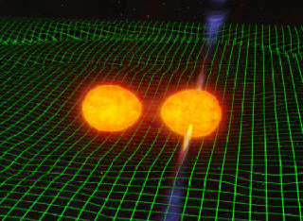
Where do gravitational waves come from?
From stars living in galaxies…
Supernova explosions
Rotating stars (pulsars)
Binary systems coalescing
into a black hole
Credit: John Rowe

Slide 12
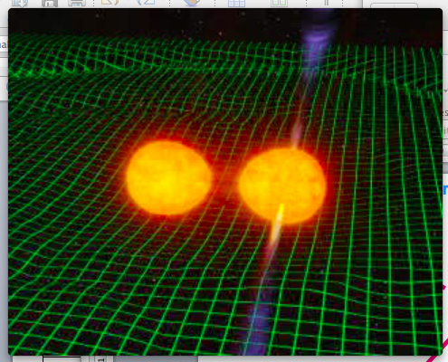
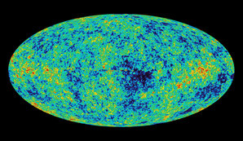
Where do gravitational waves come from?
From stars living in galaxies…
Supernova explosions
Rotating stars (pulsars)
..and from the beginning of the Universe!
Binary systems coalescing
into a black hole
Credit: NASA/WMAP

Slide 13
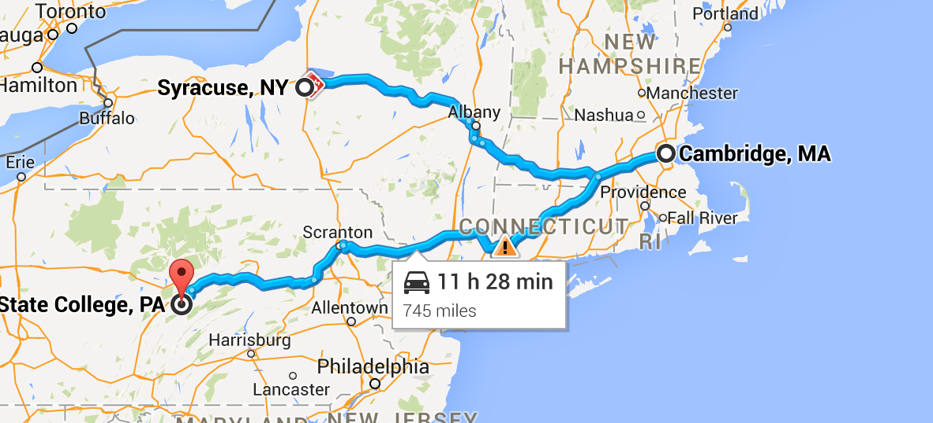

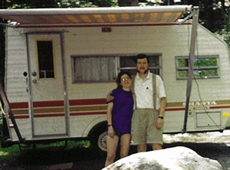
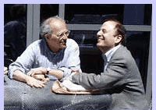
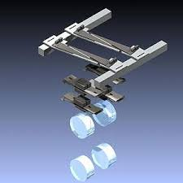
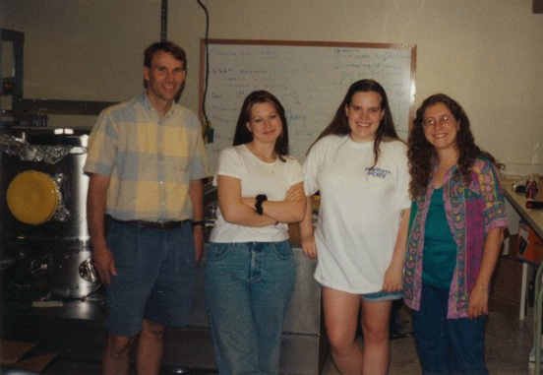
Moving around

Slide 14
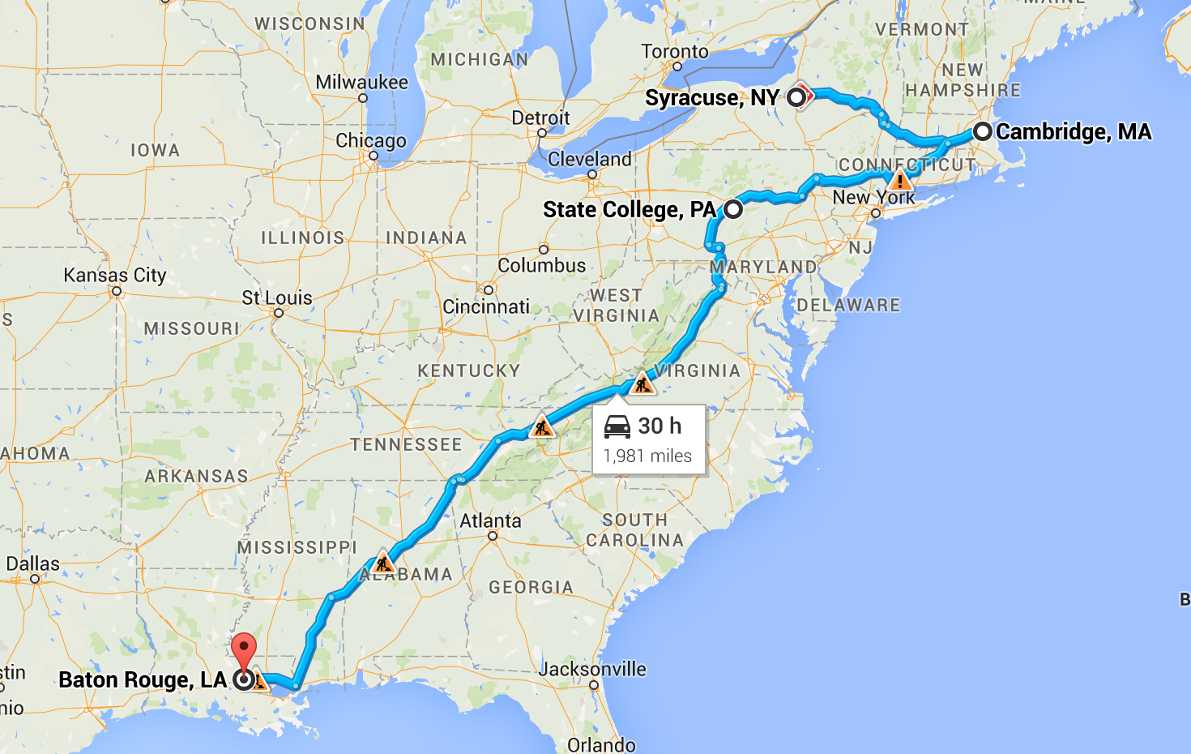
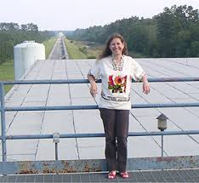

Our home since 2001

Slide 15
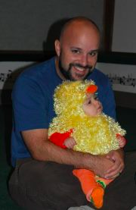
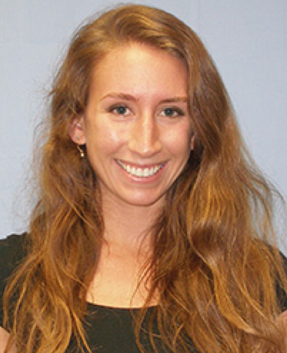
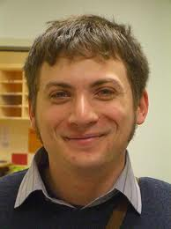
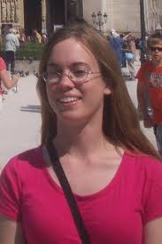

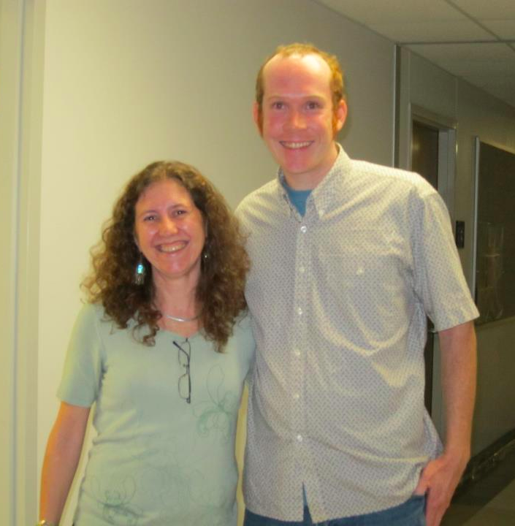

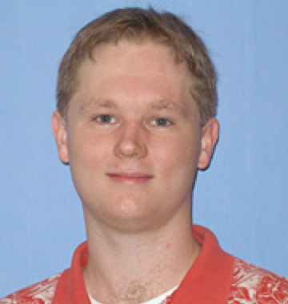
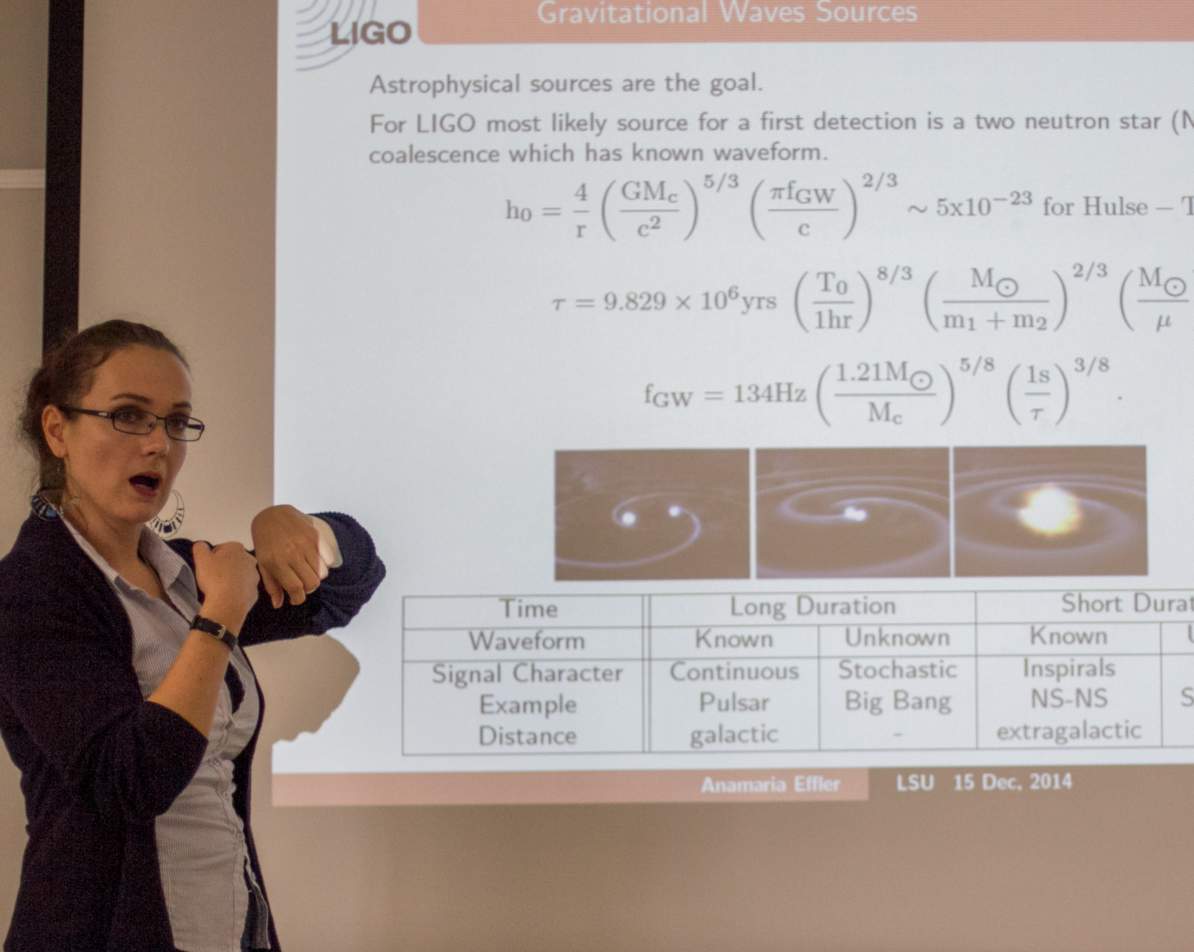
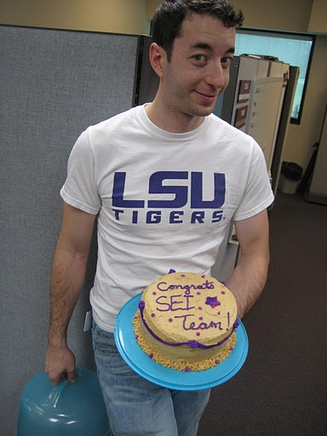


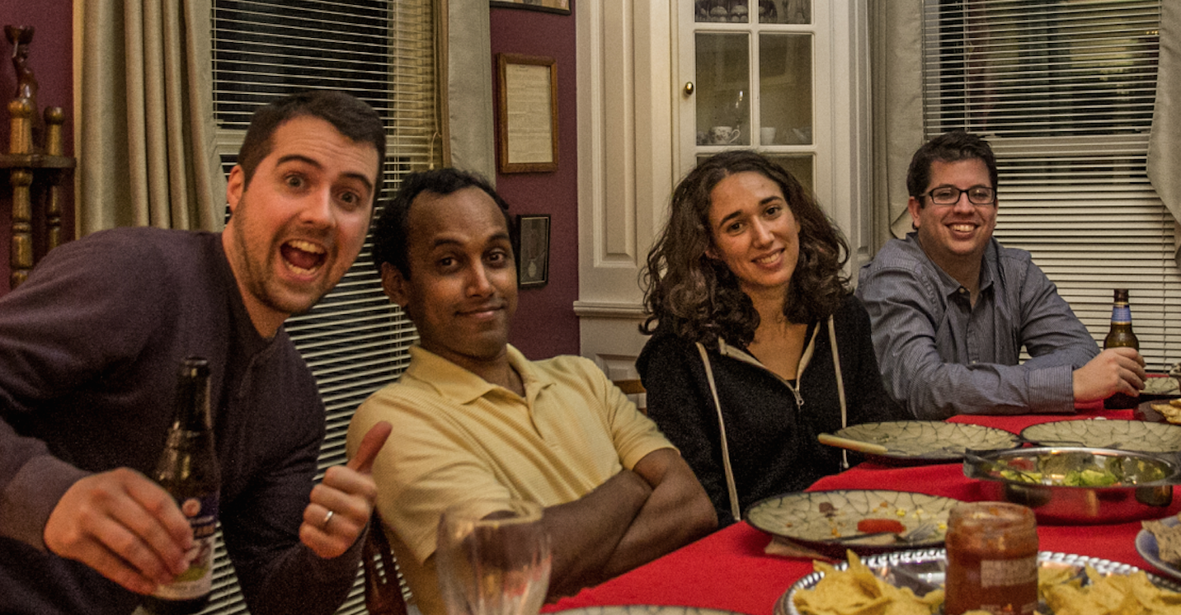
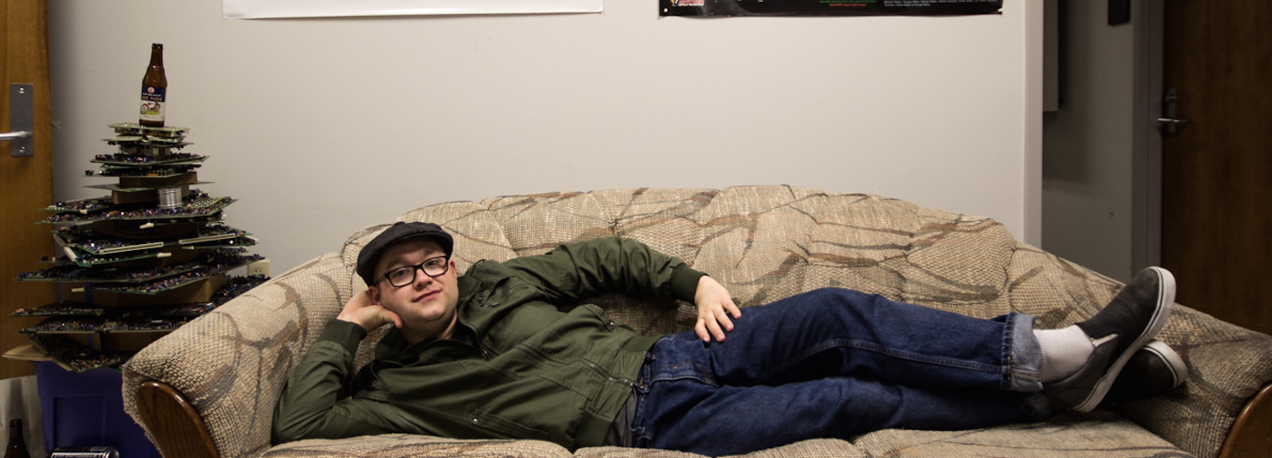
Students, postdocs, friends

Slide 16

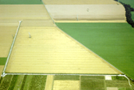


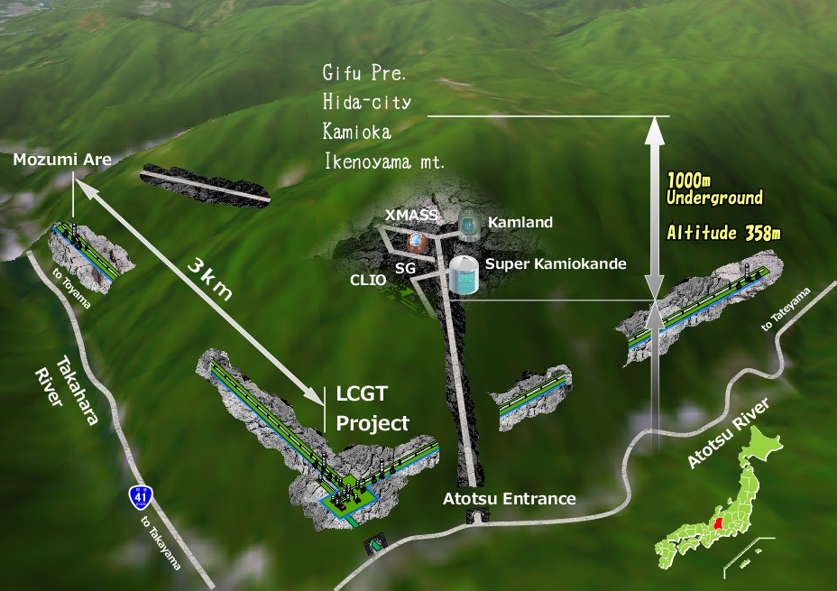

The GW Detector Network~2020
Advanced LIGO
Hanford
GEO600
Advanced
Virgo
KAGRA
Advanced LIGO
Livingston
LIGO-India
16

Slide 17
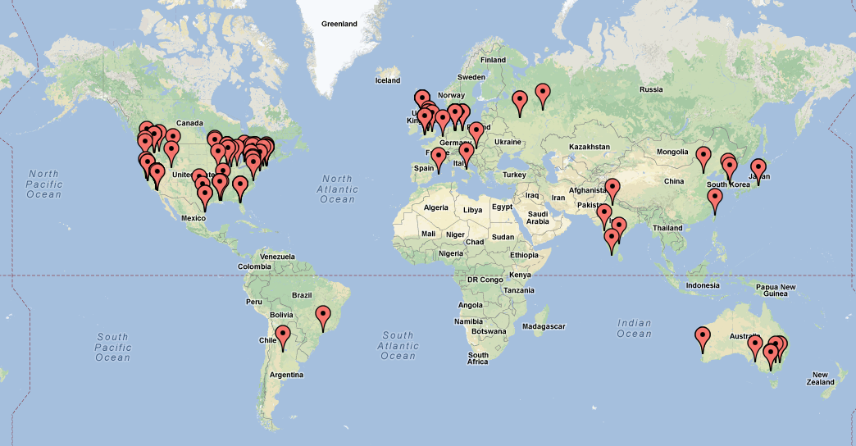
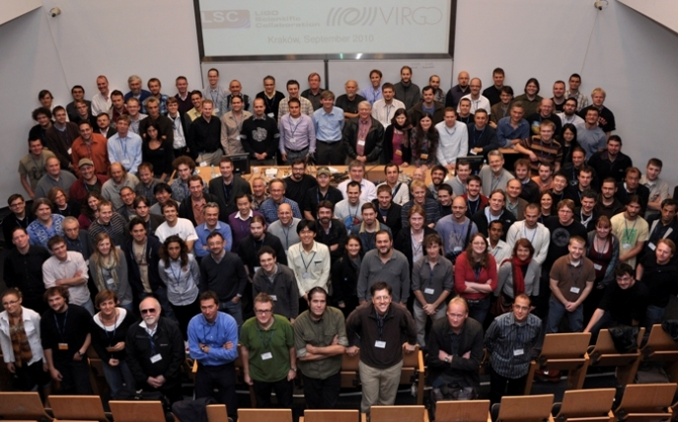
LIGO Scientific Collaboration www.ligo.org
900+ members, 85+ institutions, 16 countries
https://www.zeemaps.com/map?group=245330
roster.ligo.org

Slide 18






LIGO Detectors Technology
Strain (1/√Hz)
See K. Dooley’s
talk 3:45pm
LIGO-T1400316 (dcc.ligo.org).

Slide 19








LIGO Data Analysis
Crab pulsar (NASA, Chandra Observatory)
Strain (1/√Hz)
NASA, WMAP
?
LIGO-T1400054 (dcc.ligo.org).

Slide 20



Some interesting results 2005-2011
Astrophys. J. 681 (2008) 1419
GRB070201
atlasofthe universe.com
GW100916
Phys. Rev D85 (2012) 082002

Slide 21


What will Advanced LIGO see ?
Advanced LIGO
Neutron Star Binaries:
  Initial LIGO:
  Average BNS reach ~15 Mpc → rate ~1/50yrs
  Advanced LIGO: ~ 200 Mpc
  “Realistic rate” ~ 40/year (but can be 0.4 or 400)
  Other binary systems:
  NS-BH: 0.004/yr → 10/yr
  BH-BH: 0.007/yr→ 20/yr
Class. Quant. Grav. 27, 173001 (2010)
Notes:
P0900125-v8

Slide 22


Are we there yet?
Soon!!!
arXiv:1304.0670

Slide 23











Family, science, fun!

Slide 24

Life in Physics is Fun
And there’s a lot of gravitational waves excitement
coming to a theater near you!
To learn more about LIGO : www.ligo.org
To ask me (any!) question: gonzalez@lsu.edu

