Slide 1
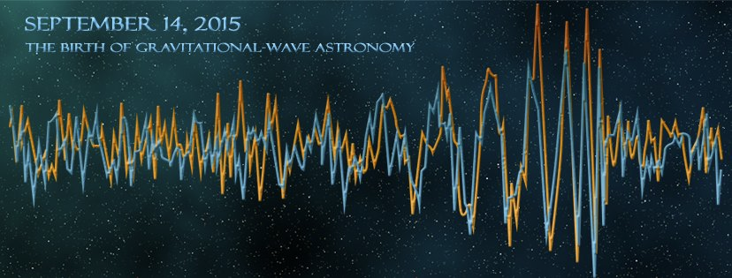
Observation of gravitational waves from a binary black hole system
Gabriela González
Louisiana State University
For the LIGO Scientific Collaboration and
the Virgo Collaboration
CIFAR meeting, Whistler, BC, Canada
March 31, 2016
LIGO Livingston Observatory,
Louisiana, USA

Slide 2
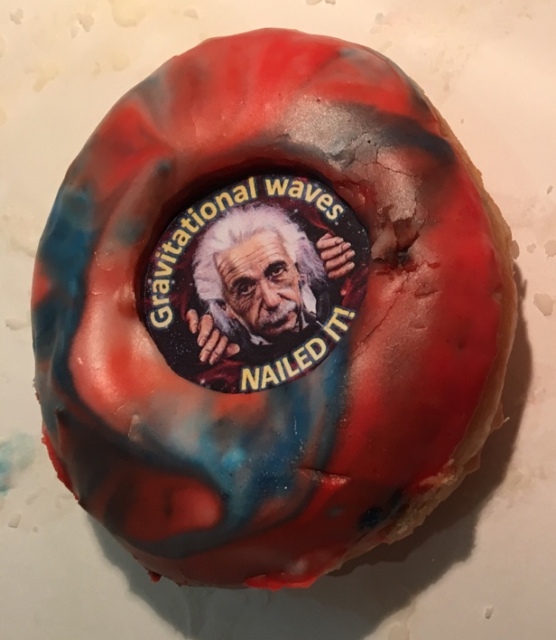
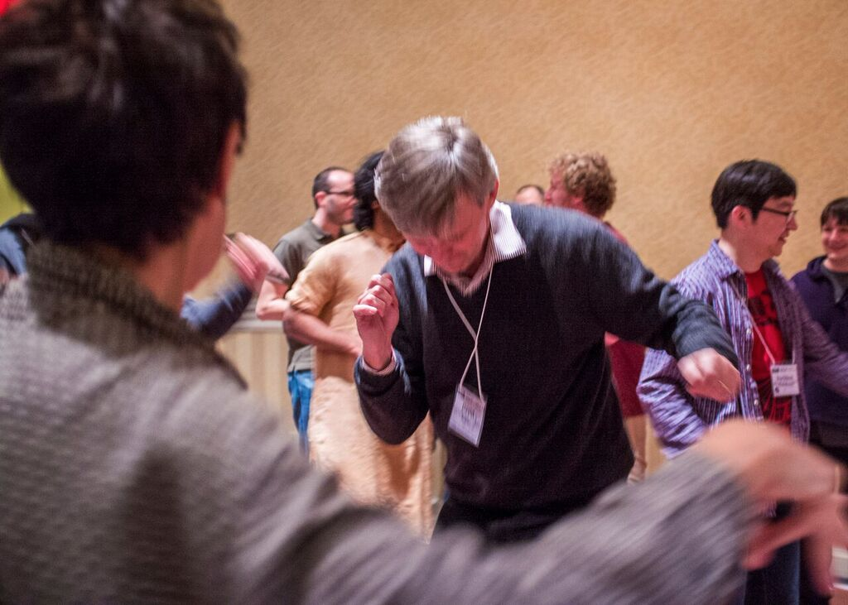
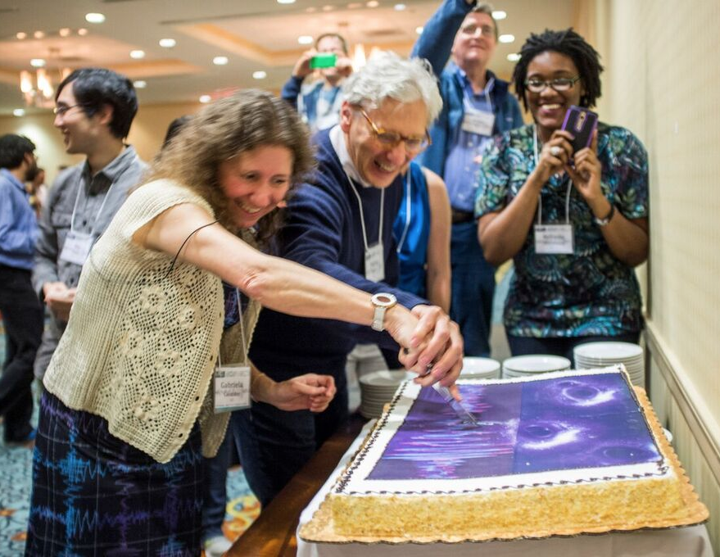
Recent celebrated news
Phys. Rev. Lett. 116, 061102 (2016)

Slide 3
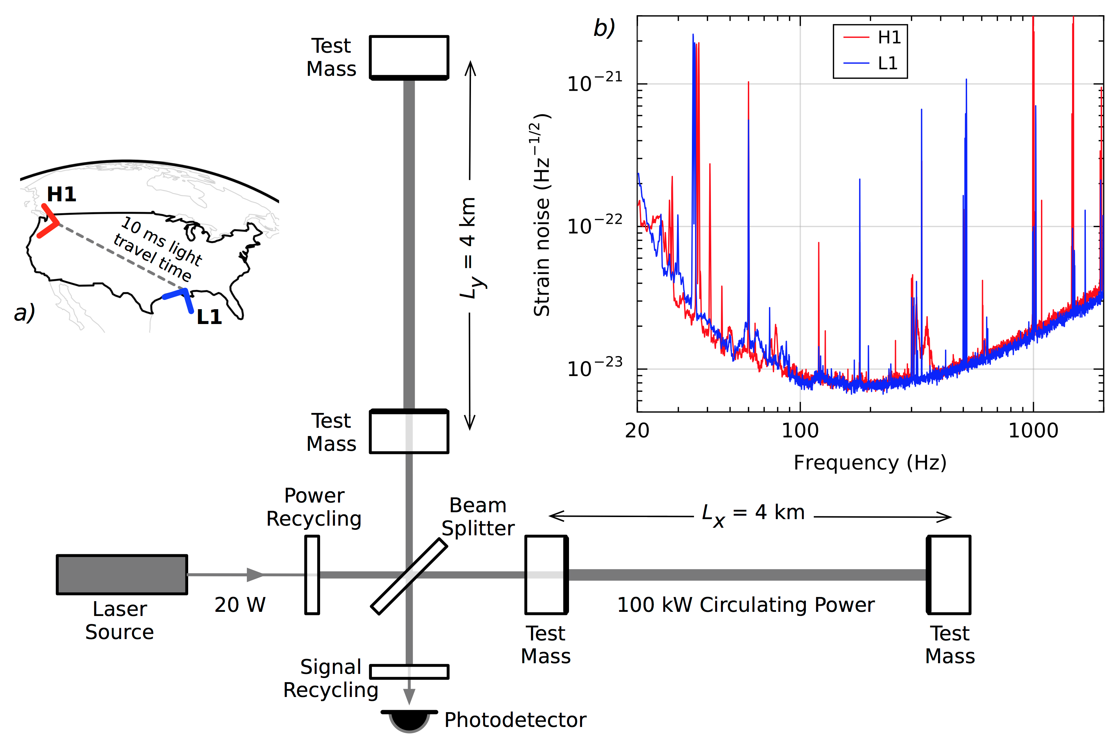
The LIGO detectors
Phys. Rev. Lett. 116, 061102 (2016)

Slide 4
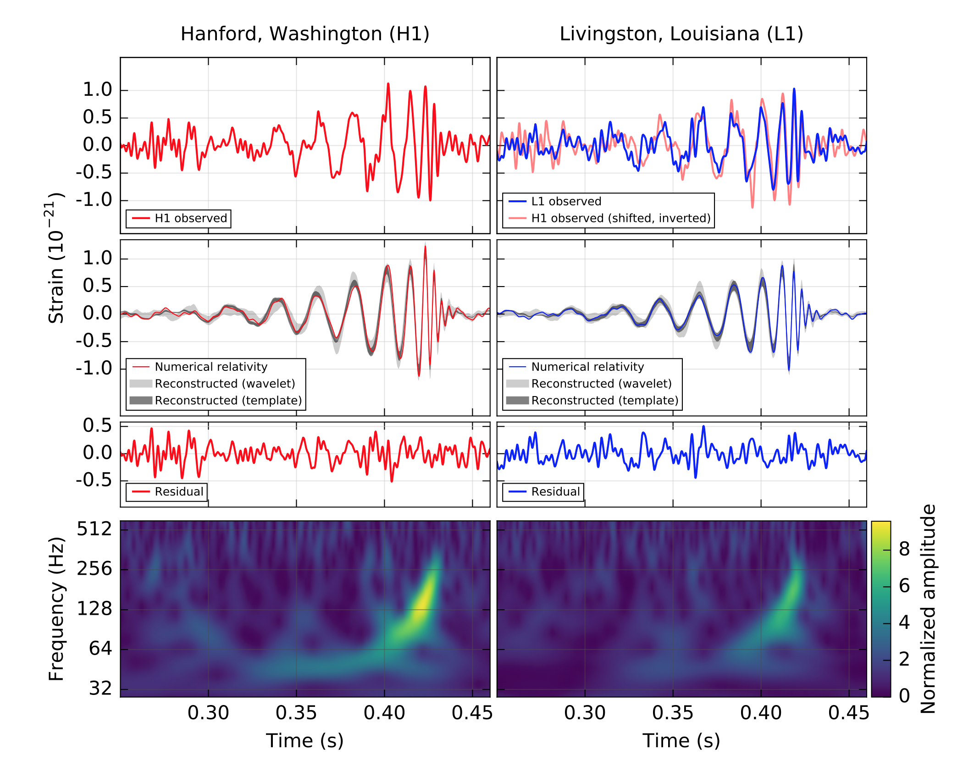
The detection
Phys. Rev. Lett. 116, 061102 (2016)

Slide 5
The detection
Phys. Rev. Lett. 116, 061102 (2016)

Slide 6
The detection
Phys. Rev. Lett. 116, 061102 (2016)

Slide 7
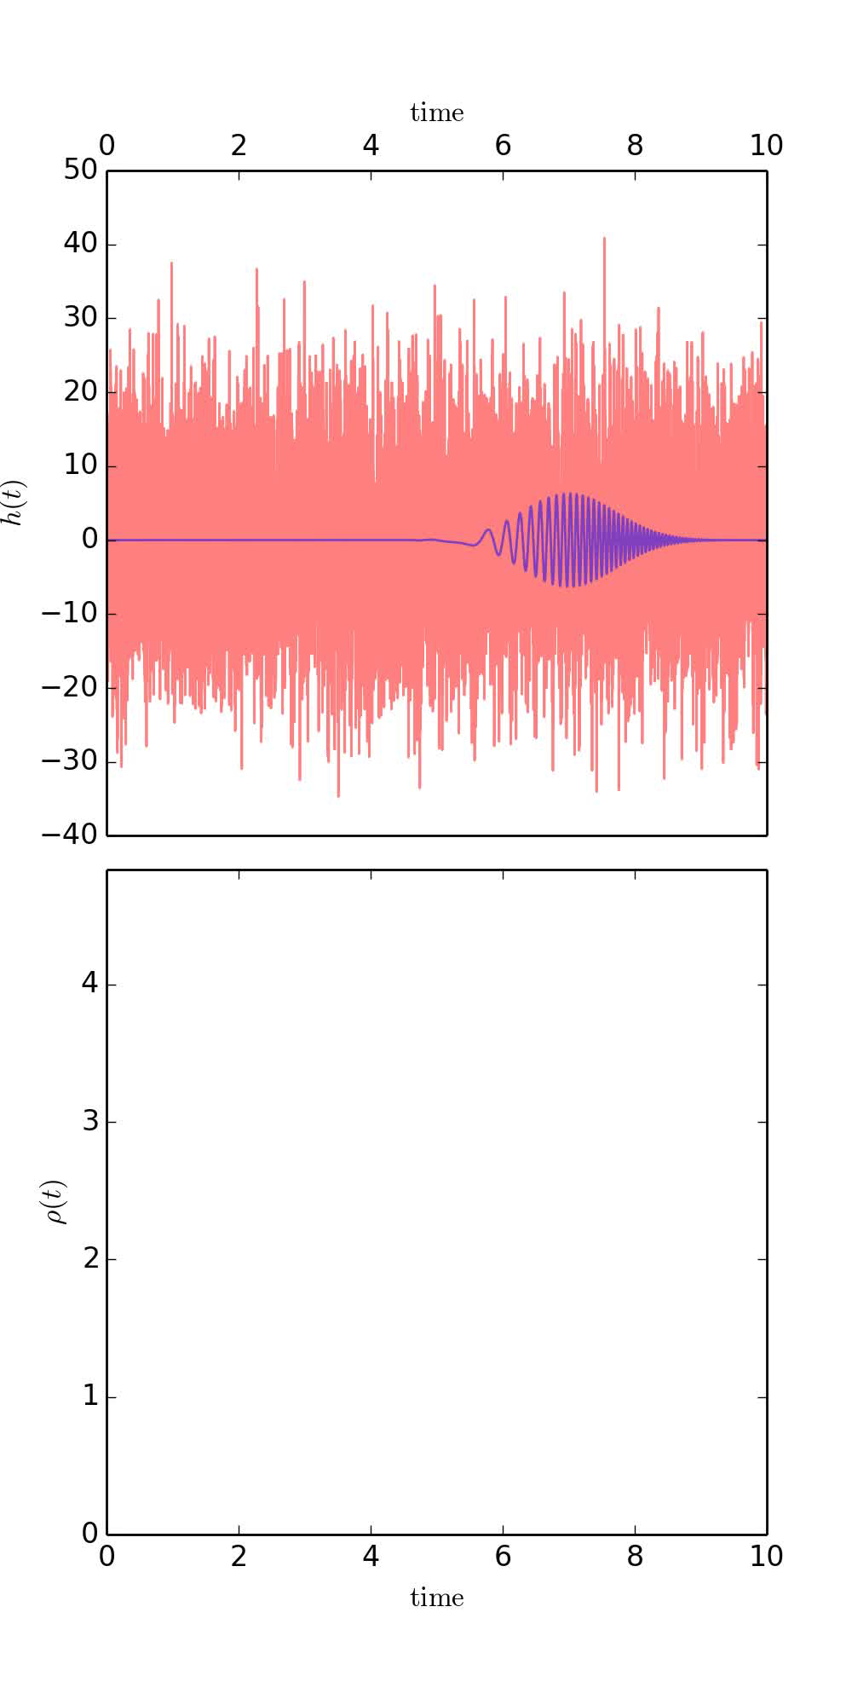
The statistics
Phys. Rev. Lett. 116, 061102 (2016)

Slide 8
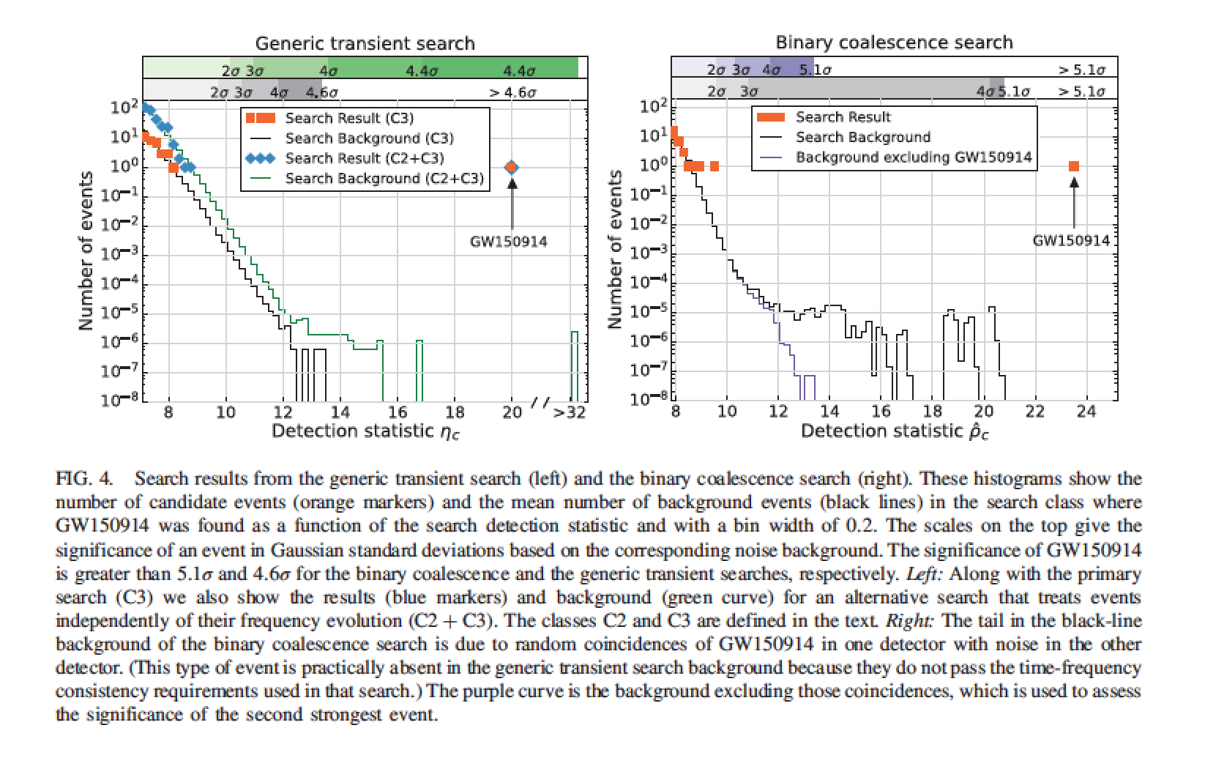
Even if we don’t look for inspirals, we find it…
Phys. Rev. Lett. 116, 061102 (2016)

Slide 9
Parameter estimation
arXiv:1602.03840

Slide 10
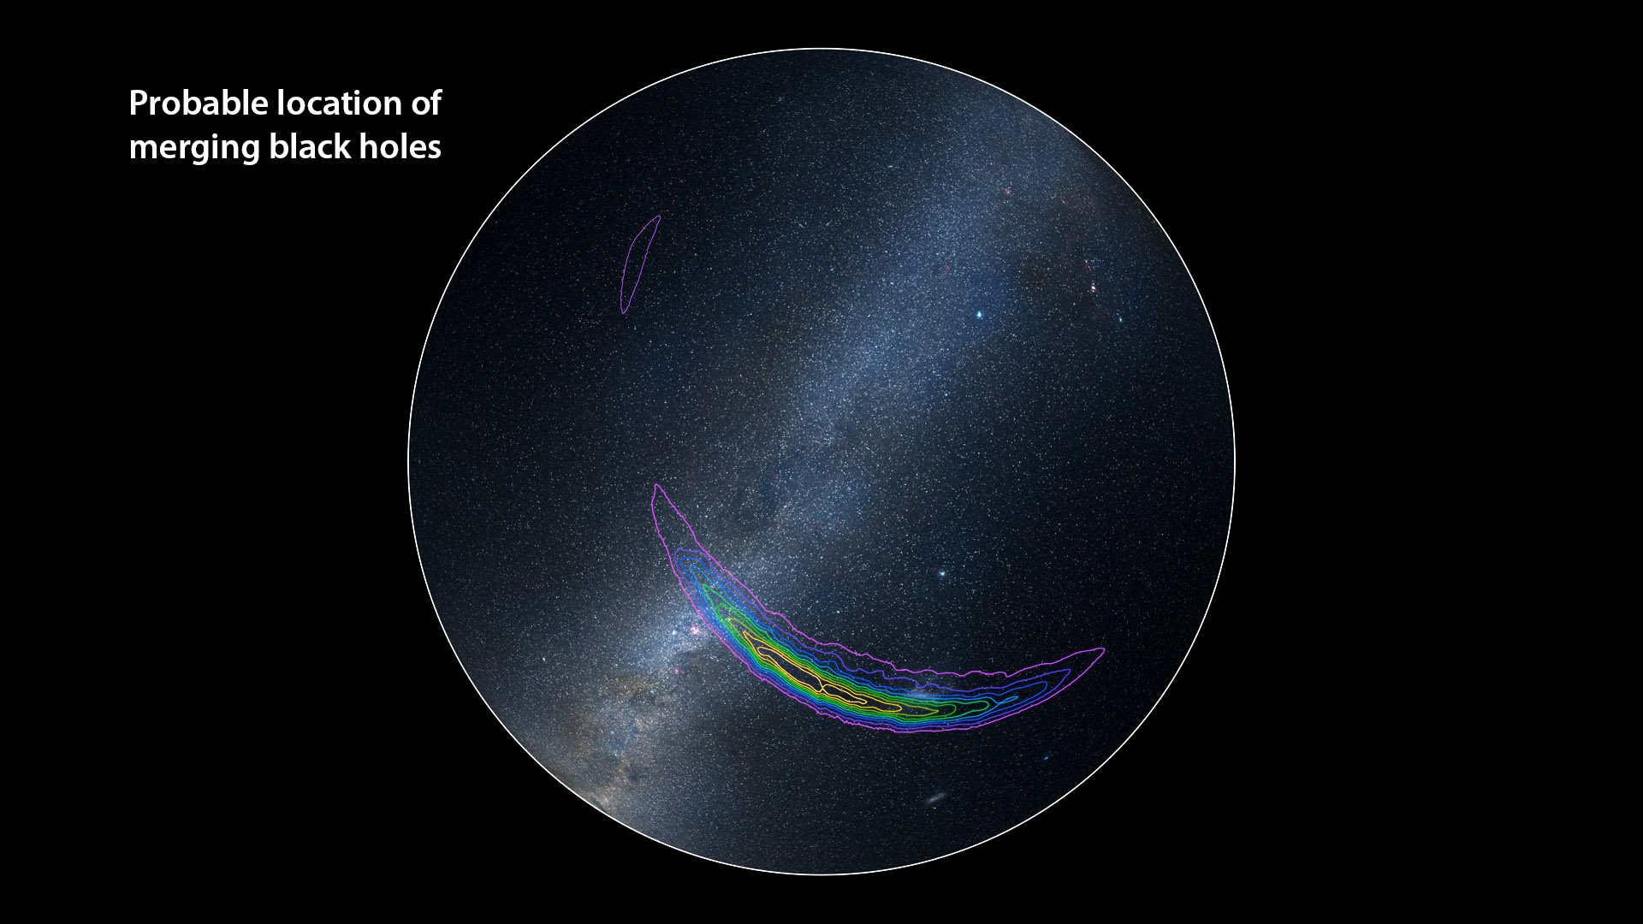

Slide 11
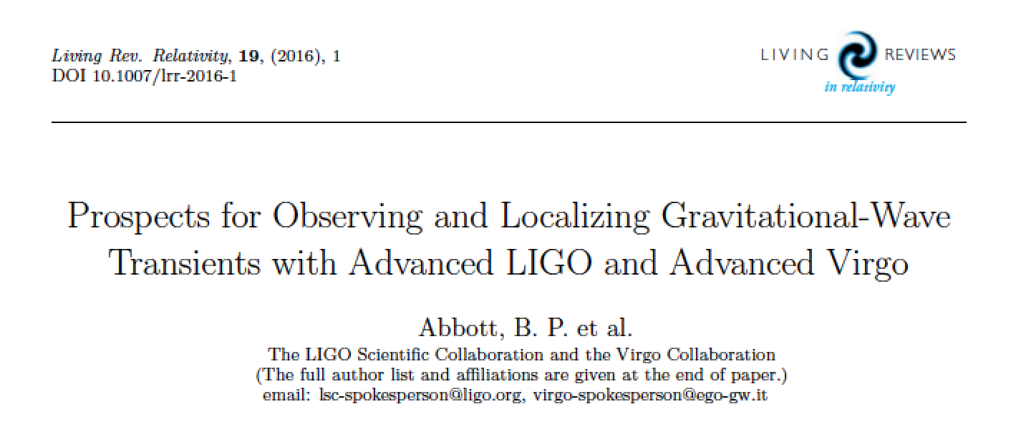
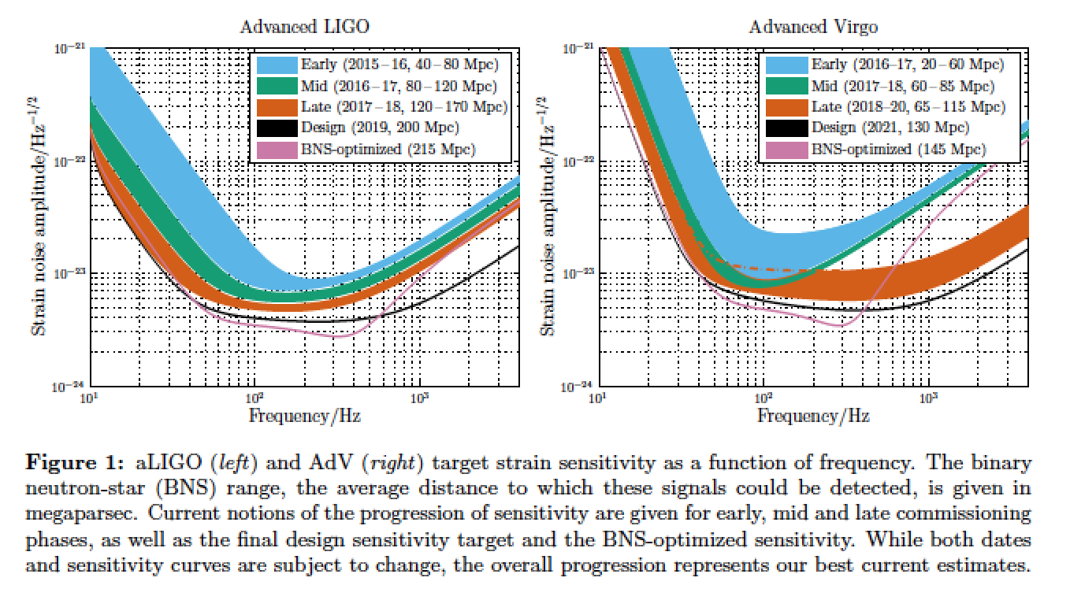
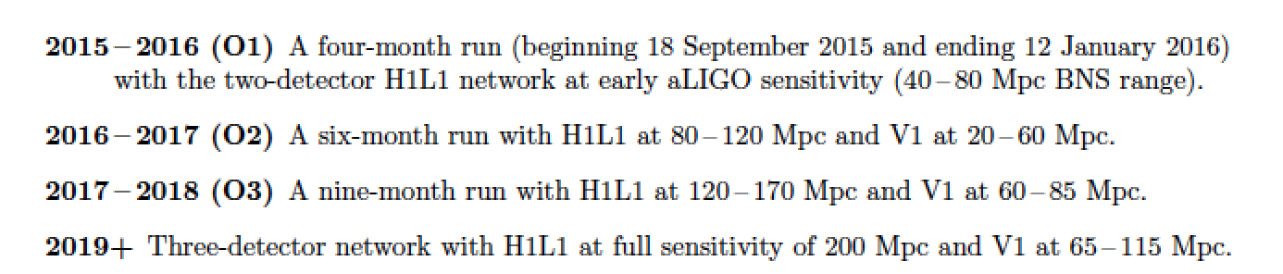

Slide 12
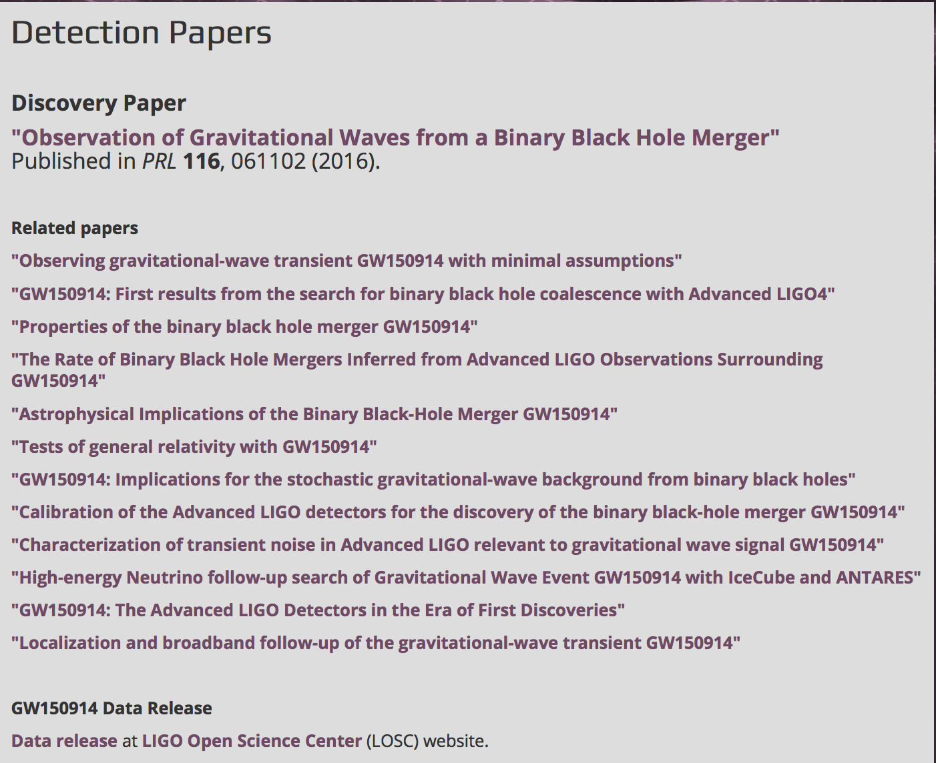
More references: papers.ligo.org

Slide 13
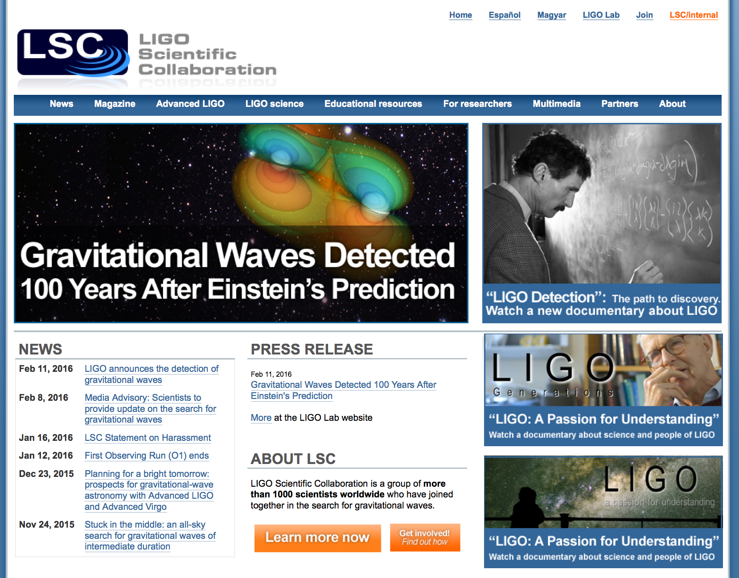
www.ligo.org

Slide 14
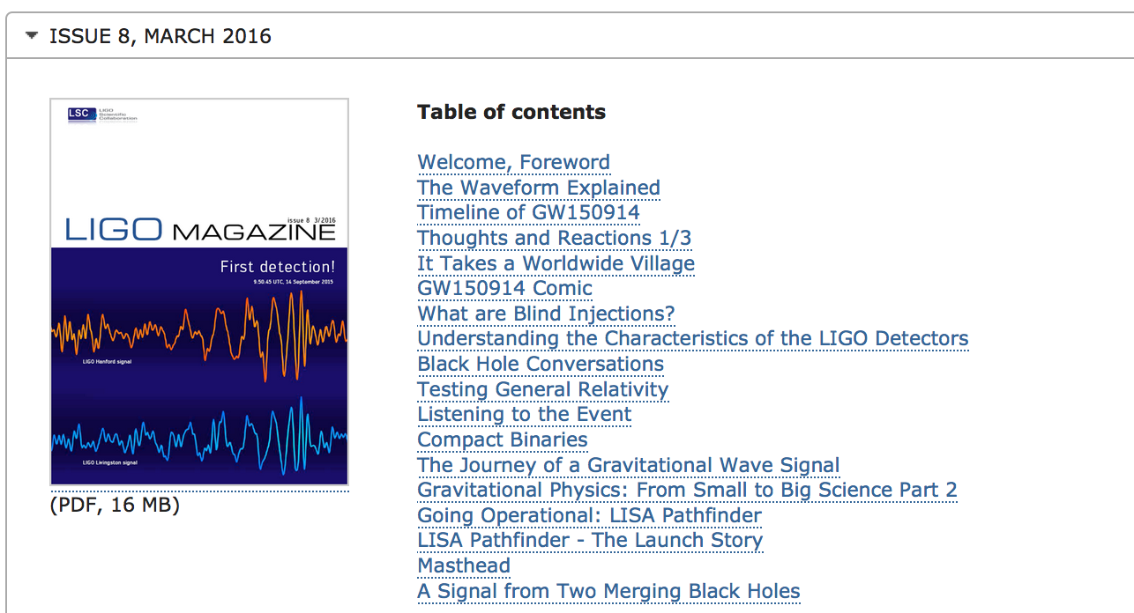
LIGO Magazine

Slide 15
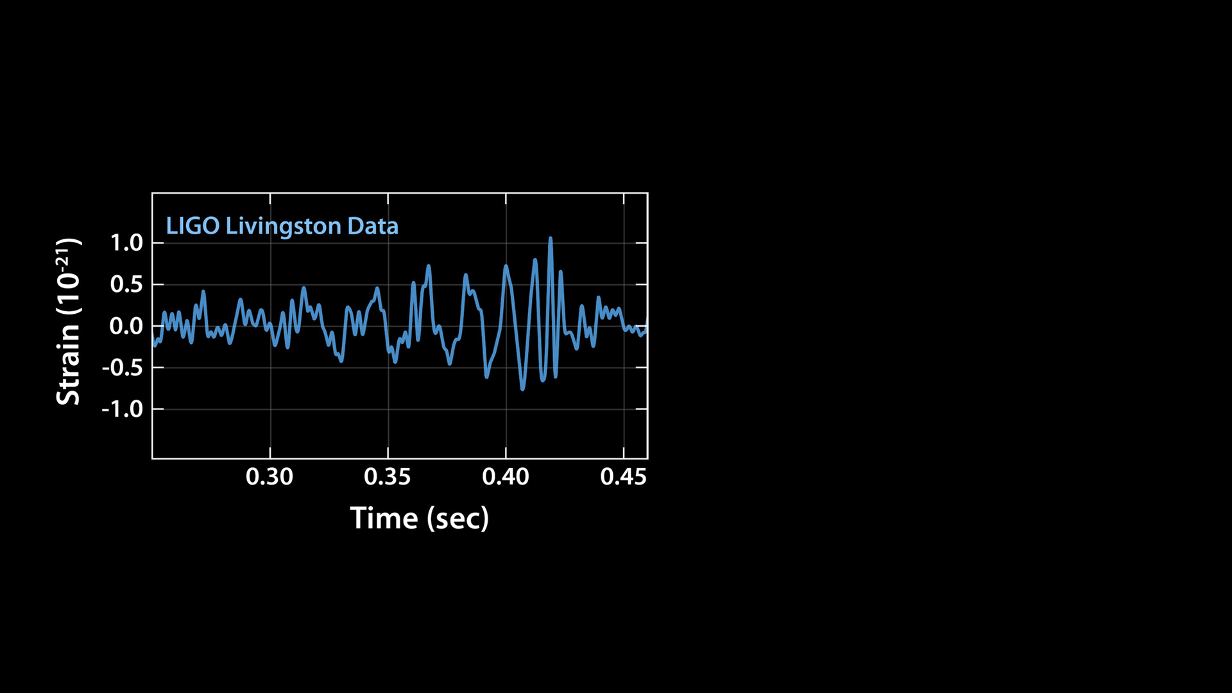
Notes:
The very hard work of this world-wide community paid off on September 14 last year, when strong signals were detected by LIGO detectors.
The signal first arrived to LIGO Livingston, at 4:51am, and showed a large amplitude signal that is ,larger than the background noise from the detector.

Slide 16
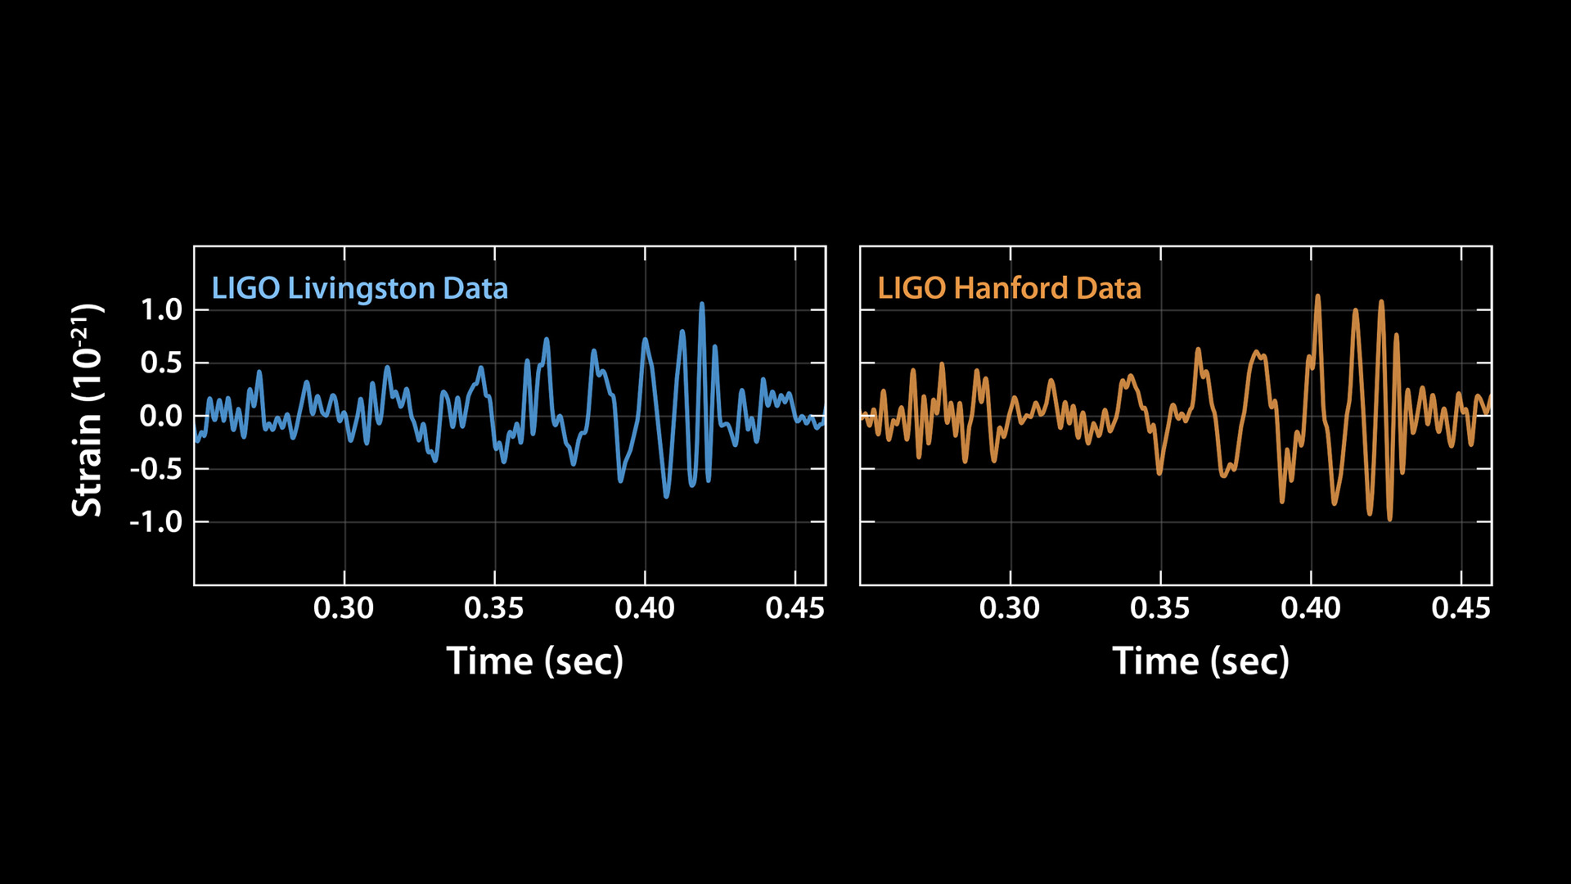
Notes:
We saw a very similar waveform in the LIGO Hanford detector, only 7 milliseconds later.
We see a few cycles increasing in amplitude and frequency, and the signal settles down back to the noise– all in a small fraction of a second.
The detected distortion of space time was very small, a part in 10^21. The distance changes we measured in LIGO's arms are 4 parts in a thousandth of a proton diameter: tiny!

Slide 17
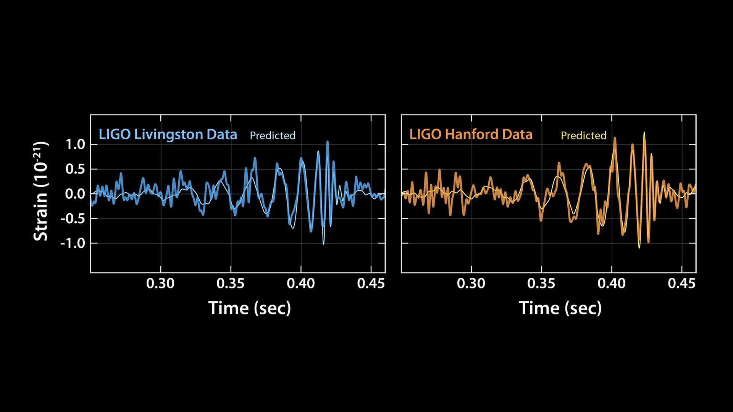
Notes:
The observed signals matched beautifully the predicted waveform for the motion of a pair of black holes and vibration of the resulting single black hole. From the frequency of the signals, we can tell the masses of each initial black hole and the mass of the final black LIGO has made the first-ever detection of two black holes merging into one, proving that binary black holes are more common in the universe than most scientists earlier thought.

Slide 18
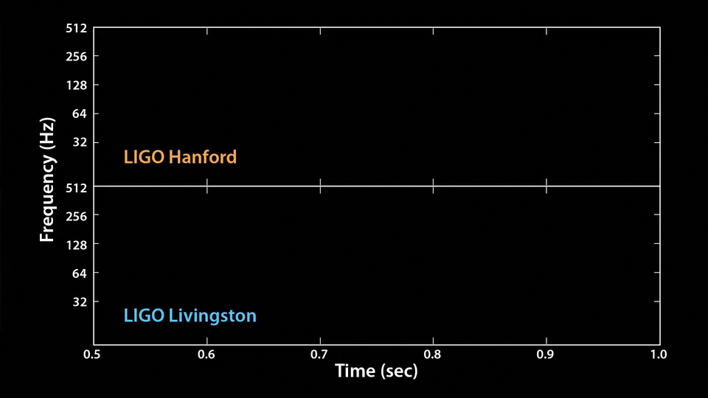
Notes:
We can also translate the signal into sound: listen carefully for the very short “thump” – that’s the tiny chirp of two black holes merging.

Slide 19
Notes:
The animation plays again, this time slower and with the frequencies shifted, so you can hear the signal better. This is the song and dance of two black holes colliding. It’s remarkable how much we can learn from this!

