Slide 1
Intro to Control Theory for LIGO People
G1600726-v3

Slide 2

Summary
Lecture 1: Introduction
  Part 1: Intro to controls
  Part 2: System modeling
Lecture 2: Basic Control Design
  Part 1: Feedforward
  Part 2: Feedback
  Part 3: Sensor Blending
Lecture 3: Digital Control

Slide 3
Background Assumptions
These lectures assume no prior knowledge of controls.
They do assume some prior exposure to
  Ordinary differential equations
  Fourier transform
  Laplace transform

Slide 4
Useful References
Digital Control of Dynamic Systems, 3rd Ed. Franklin, Powell, and Workman.
  Main focus is on the control of digitally sampled systems, but also has a good review of continuous control, system identification, optimal control, and nonlinear systems.
Modern Control Engineering, 5th Ed. Ogata
  Standard introductory text to control
Notes:
Most of what you need will be in the first one. The second does have some complimentary information, for example it talks more about continuous controls, and it talks about the math behind stability vs. instability.

Slide 5
Lecture 1
Introduction to Controls &
System Modeling

Slide 6
Lecture 1 - Part 1
Introduction to Controls

Slide 7
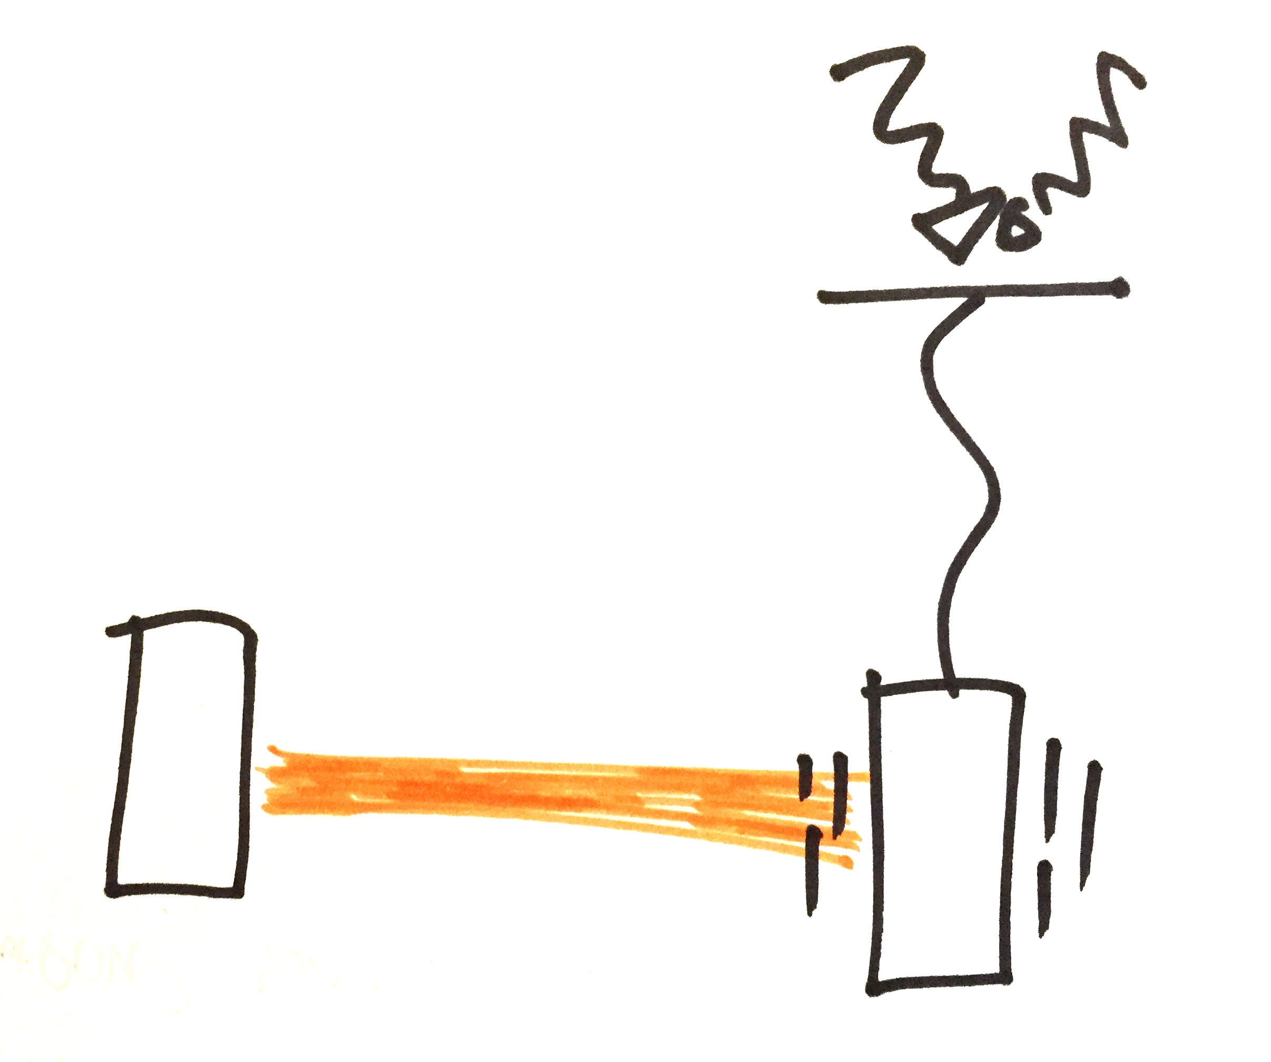
Why we need control
The ground moves and disturbs our mirrors.
We use control to keep the arm lengths at a constant 4 km +- 10⁻¹⁴ m
Fabry-Perot cavity
Ref G1600525
Notes:
We need control because we need our relative mirror displacements to be within 10^-14 m rms (and some angular tolerance), but the ground moves them more than this by many orders of magnitude, around 10^-6 m.

Slide 8
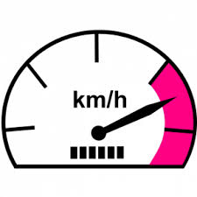

Example of a feedback loop
Cruise control
Current velocity
Desired velocity
Notes:
Cruise control in your car is a familiar example of a relatively simple feedback loop. You set your car to go at some particular velocity, but you’re currently going at some different velocity. The control is designed to adjust your velocity until it matches the desired velocity.

Slide 9
Feedback loop block diagram
Desired
velocity
Gas
flow
Current
velocity
Error
Gas flow actuator
Car
+
-
Velocity sensor
Current velocity
Desired velocity
Notes:
This is done with a feedback loop. There is a velocity sensor that measures how fast you are going. This signal is subtracted from the desired velocity to generate an error signal that you want to make small. There is also an actuator that gives the car gas. Naively, you could just take the velocity sensor and feed it back directly to the gas actuator, as shown here. That way, if you’re going too slow, the error signal is positive and the car gets more gas. If you’re going to fast, the error is negative and the car gets less gas.

Slide 10
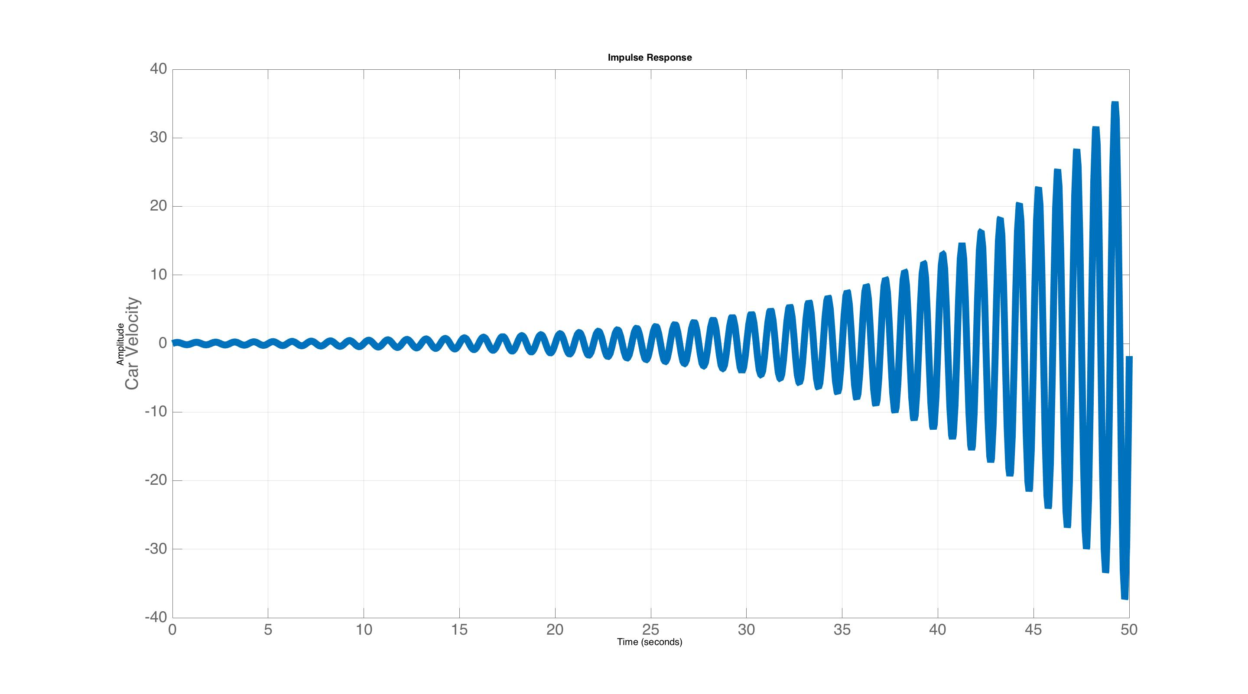
Feedback loop block diagram
Desired
velocity
Gas
flow
Current
velocity
Error
Gas flow actuator
Car
+
-
Velocity sensor
In general unstable!
Current velocity
Desired velocity
Notes:
However, whether or not this loop is stable depends entirely on the dynamic response of the car. It is quite likely that it will in fact be unstable. The plot in the bottom right corner is an example of an unstable response where the velocity oscillates and increases exponentially in amplitude.

Slide 11
Feedback loop block diagram
Desired
velocity
Current
velocity
Control
Gas flow actuator
Car
+
-
Velocity sensor
Stabilize with the addition of a control filter
Also gives you parameters to tune the response
Current velocity
Desired velocity
Notes:
To avoid these issues we always include a control filter in the loop. The control filter contributes its own dynamics to the loop, which compensate for the dynamics of the car, allowing the loop to be stable. Also, the controller gives you a place to tune the response so the loop isn’t just stable, but responds in a desirable way (avoids oscillations, offsets, etc).

Slide 12
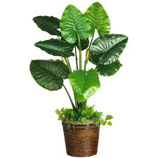
Basic system components
The ‘plant’
Desired
velocity
Current
velocity
Control
Gas flow actuator
Car
+
-
Actuator
Car
Velocity sensor
Plant (car) – object to be controlled
Sensor – measures the plant response
Controller – sets the loop dynamics to achieve the desired behavior
Actuator – drives the plant
Notes:
The basic components of a feedback loop are a controller, an actuator, a sensor, and the plant. The plant is the name for the thing you want to control.

Slide 13
Types of control
These will be defined on the next few slides.
Signal flow
  Feedback
  Feedforward
Computation
  Linear
  Nonlinear
Notes:
Control can take various forms. In can be either feedback, which we just saw, or feedforward. Both of these can then be linear or nonlinear.

Slide 14
Types of control
Signal flow
  Feedback
  Feedforward
Computation
  Linear
  Nonlinear
Nearly all our controls are linear.
Some exceptions include:
Acquiring cavity lock
ESD actuation (F α V²)
ISI blend filter switching
Notes:
We’re not going to go over nonlinear control. With a few exceptions, all our systems in LIGO or linear. We work very hard to make them that way. And even the systems we have that are nonlinear are typically controlled with linear control filters as well.
In the case of cavity locking, the signal only exists when you swing through a fringe. Traditionally, to acquire lock, we simply apply the control signal only when that signal exists. If the cavity velocity isn’t too high then this works pretty well. There is research out there to improve this by estimating what the signal is when we can see it, using a model of the cavity.
In the case of the electrostatic drive (ESD), which is the actuator applied directly to the test mass, the force is proportional to the square of the ESD voltage. To make this linear, we simply apply a square root to the control signal within the controller software, before sending it to the ESD.
In the case of blend switching, where we switch from one set of blend filters to the other. This is done with a very slow ramp. The slowness of the ramp ensures the loops is always quasi-linear.

Slide 15
Types of control – feedback
Feedback – Reacts to changes in the error after they occur.
Error
Desired
velocity
Current
velocity
Filter
Gas flow actuator
Car
+
-
Velocity sensor
Notes:
The key feature of feedback is that it reacts to changes in the error signal. Thus, the control would do nothing if the error signal was zero. So, by definition feedback can never drive the error signal to exactly zero (it can at single frequencies with infinite loop gain, but not it general). It can in theory make the error arbitrarily small as the loop gain gets arbitrarily large, but not zero.

Slide 16

Types of control – feedback
Feedback – Reacts to changes in the error after they occur. Could be unstable.
Hills
Error
Desired
velocity
Current
velocity
Control
Gas flow actuator
Car
+
-
Velocity sensor
Notes:
An example of something that will tend to increase the error size is when your car approaches a hill. The hill is a disturbance that tends to slow the car. The controller will only start to respond when it sees the error signal increase. It reacts after the error begins to change.
Another defining feature of feedback is that it can go unstable if the controller isn’t designed appropriately for the plant (or if something in the plant changes or breaks).

Slide 17
Types of control – feedforward
Feedforward – Predict the future and correct in advance. Theoretically always stable.
Hills
Hill sensor
Car model
Current
velocity
Gas flow actuator
Car
control subtracts out the
effect of the hill
-1
Notes:
Feedforward is in many respects the opposite to feedback. It tries to predict how the car (or plant) is going to respond, and corrects for it in advance. So, if the car had a sensor that saw the hill coming, and then a model of how the car would react, a feedforward controller could adjust the gas flow before the hill even had the chance to slow the car down. Mathematically, it subtracts the hill out of the loop, so it’s like it isn’t even there. To do this well, you need a good model of the plant, and a sensor that has good coherence to the plant’s response.
An example of this in LIGO, is the feedforward used by the ISIs. An inertial sensor is placed on the ground, which measures the ground’s displacement. The feedforward controller is a filter that models how the ISI will respond to this ground motion. This controller then sends a correction signal to the ISI actuators to cancel out any forces the ground imposes on the ISI, before the ISI has the chance to respond. The reason this works, without needing a sensor that can see the future, is because it takes the ISI some time to respond to the ground. So if you can apply the correction forces quickly enough, you can realize a useful feedforward controller. Clearly, any phase delays will degrade the performance.
An important feature of feedforward is that it is, in theory, always stable. Feedback is required for instability to happen, and there is no feedback here. In practice, instability can happen due to parasitic feedback paths. For example, when the actuators push the ISI, they also push on the ground. Since the ground is not infinitely rigid, the actuators move the ground a small amount. So ground sensor tells the ISI actuators what force to apply, which influences how the ground moves, which tells the ISI actuators what force to apply, etc…Thus, a feedback path.

Slide 18
Feedback with feedforward
- Complimentary limitations, so often we can get better performance using both together.
Hills
Hill sensor
Car model
Desired
velocity
Current
velocity
Control
-
Gas flow actuator
Car
+
+
-
Velocity sensor
Notes:
Feedback and feedforward have complimentary limitations. So in general you get the best performance by using both simultaneously. The idea being, you reduce the size of the disturbance as much as possible with feedforward, then suppress it further with feedback. So, if for example, you can reduce the disturbance by a factor of 10 with feedforward, and 100 with feedback, then with both you’ll get 1000.

Slide 19
Types of control - linear
Linear
  Output is a linear combination of the inputs
2 × gas
Car
2 × velocity
Notes:
A linear system has the property that its outputs are a linear combination of its inputs. So if you double the input, you double the output.

Slide 20
Types of control - linear
Linear
  Output is a linear combination of the inputs
a × gas + b × gas
Car
a × velocity + b × velocity
Notes:
Or more generally…

Slide 21
Types of control - linear
Linear
  Output is a linear combination of the inputs
  Linear systems have a very well defined and rigorous control theory
a × gas + b × gas
Car
a × velocity + b × velocity
Notes:
Linear systems are useful because there is a very well defines and rigorous theory to control them.

Slide 22
Types of control - linear
Linear
  Output is a linear combination of the inputs
  Linear systems have a very well defined and rigorous control theory
a × gas + b × gas
Car
a × velocity + b × velocity
* Also, the output frequency = the input frequency *
Notes:
Another important feature is that the output frequency is always the same as the input frequency. This is an extremely important property. We often see this fail when our systems develop large amplitude oscillations, because the interferometer behaves non-linearly at large amplitudes.

Slide 23
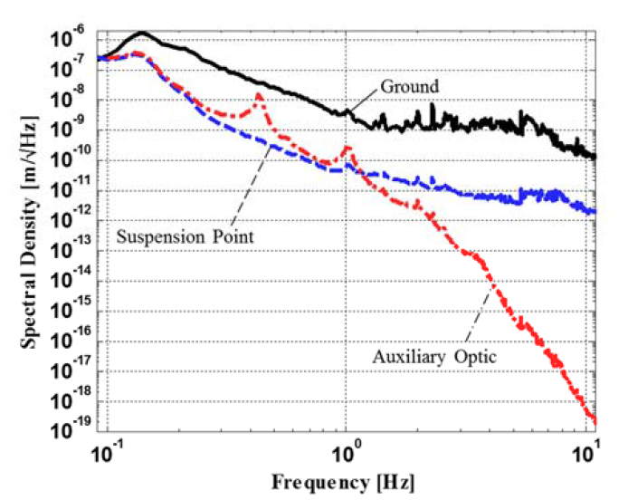
aLIGO Seismic Isolation Performance
Ground
Suspension Point
Test Mass
GW observations
> 10 Hz
P1600103
Linearity is the reason we need good seismic isolation below 10 Hz, even though we’re searching for GWs above 10 Hz. Large amplitude low frequency motion will have non-negligible 2nd order influences on the interferometer, causing upconversion to frequencies above 10 Hz. Mechanisms include nonlinear behavior of the cavity, scattered light, optic pitch and yaw.
Notes:
To stress this issue of large amplitude oscillations, this is why we work hard to control the seismic noise below 10 Hz, even though we’re observing gravitational waves only above 10 Hz. If we didn’t do this, we wouldn’t even be able to lock the interferometer. If we didn’t do it well, we might lock the interferometer, but the low frequency noise would upconvert above 10 Hz.

Slide 24
Types of control - computation
Nonlinear
  Output is some general function of the input
  No single theory for non-linear control
f(gas)
Car
h(gas)
Nonlinear system examples
Acquiring cavity lock – the sensor signal only exists intermittently
Rockets – the mass gets smaller as the propellant is consumed
Robotic arms – the moment of inertia depends on the arm’s position
Notes:
Nonlinear systems can be nonlinear in infinite ways. Their outputs can be any function of the input. Therefore there is no single theory to control them. We work hard to make sure our systems are linear to avoid the issues associated with nonlinear systems (upconversion, poorly defined control laws, etc).

Slide 25
Lecture 1 – Part 2
System Modeling
G1600726

Slide 26
Lecture 1 – Part 2
System Modeling
Recurring theme: more than 1 way to look at a system. All are equivalent, but each is useful in its own context.
G1600726

Slide 27
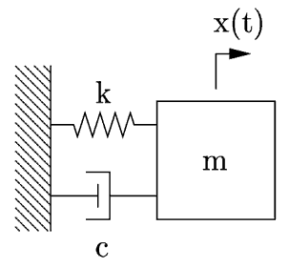
System Models
Example – mass spring system
Notes:
We’ll follow the example of a simple mass spring system (which turns out to be a half decent model for the HAM-ISI).

Slide 28
System Models
Equation of motion
k -> stiffness
c -> viscous damping
m -> mass
f -> external force
x -> mass position
Notes:
Here is it’s equation of motion.

Slide 29
System Models
Equation of motion
General solution
A₁ and A₂ are constants whose values depend on the initial conditions
x_{f} is a particular solution with the same form as f
σ±iω are the roots of the characteristic equation
  σ is the decay time constant
  ω is the natural frequency
Notes:
It has this general solution. The exponents of this solution are very important, as we’ll see in the remainder of this lecture.

Slide 30
System Models
Equation of motion
Time domain
State space model
Frequency domain
Transfer functions
k -> stiffness
c -> viscous damping
m -> mass
f -> external force
x -> mass position
Notes:
This system can be modeled in the time domain or the frequency domain.

Slide 31
System Models
Equation of motion
Time domain
State space model
Frequency domain
Transfer functions
k -> stiffness
c -> viscous damping
m -> mass
f -> external force
x -> mass position
Both formats are widely used, often at the same time.
Notes:
The time domain is done with the State Space format. The frequency domain uses transfer functions.

Slide 32
Models – time domain
Equation of motion
The state space form rewrites an N^{th} order differential equation as a system of N, 1st order differential equations.
k -> stiffness
c -> viscous damping
m -> mass
f -> external force
x -> mass position
Notes:
State space takes an Nth order differential equation and converts it to a system of N first order differential equations.

Slide 33
Models – time domain
Equation of motion
The state space form rewrites an N^{th} order differential equation as a system of N, 1st order differential equations.
System states:
displacement
k -> stiffness
c -> viscous damping
m -> mass
f -> external force
x -> mass position
velocity
* Mechanical systems have 2 states for every DOF: typically displacement & velocity
Notes:
This is done with a change of variables, defining the system ‘states’. There is no one correct choice for the state variables. A common choice for mechanical systems is to choose displacement as the first state, and velocity as the second.

Slide 34
Models – time domain
Equation of motion
The state space form rewrites an N^{th} order differential equation as a system of N, 1st order differential equations.
System states:
Matrix equation
k -> stiffness
c -> viscous damping
m -> mass
f -> external force
x -> mass position
* Mechanical systems have 2 states for every DOF: typically displacement & velocity
Notes:
The new resulting first order differential equations are grouped together into a single matrix equation.

Slide 35
Models – time domain
Equation of motion
The state space form rewrites an N^{th} order differential equation as a system of N, 1st order differential equations.
System states:
Matrix equation
k -> stiffness
c -> viscous damping
m -> mass
f -> external force
x -> mass position
* Mechanical systems have 2 states for every DOF: typically displacement & velocity
Notes:
This is what the matrices look like for this simple example.

Slide 36
Models – time domain
Equation of motion
A matrix: internal system dynamics
B matrix: external input
Notes:
The A matrix represents the dynamic behavior of the mass spring system. The B matrix describes the influence of the external input.

Slide 37
Models – time domain
Equation of motion
System dynamics
The complete state space form is given by the A, B, C, & D
matrices.
Sensing function
Ex. Displacement
sensor
A is the dynamic behavior matrix
B is the input matrix.
C is the output matrix
D directly connects the input to the output (if such a connection exists)
Notes:
There are also 2 output matrices, C and D, which can be thought of as a sensing function. If we have a displacement sensor on the mass, then the C and D are as follows. In most, but not all, cases the D matrix is zero. It is used in the case where your sensor also directly sees the input. An example of this would be if the input is ground displacement, and our displacement sensor measures the relative gap between the mass and the ground. In that case C = [1 0], as shown here, but D = -1, not 0.
All 4 matrices are required to complete the state space model.

Slide 38
Models – frequency domain
Equation of motion
Convert EOM to the frequency domain
with the Laplace transform.
Time derivative -> Laplace variable s
Laplace transform
Notes:
Frequency domain transfer functions are produced using the Laplace transform.

Slide 39
Models – frequency domain
Equation of motion
Convert EOM to the frequency domain
with the Laplace transform.
Time derivative -> Laplace variable s
Laplace transform
Force to displacement
transfer function
Notes:
You can then algebraically solve for the relation between the input f, and the output x.

Slide 40
Models – time & frequency domain comparison
Time domain (SS)
Frequency domain (TF)
Domain
Solution exponents
Poles of x/f -> roots of
eig(A)
# of rows of A, or the # of states
# of poles of x/f, or the order of the denominator’s polynomial
System order
Notes:
This table compares the properties of state space matrices to the frequency domain transfer functions. Note, the exponents to the equation of motion solution are given by the eigenvalues of the A matrix and the poles of the transfer function (or roots of its denominator). The order of the system is also the number of rows or columns of the matrix A (it is square), and the number of poles of the transfer function.

Slide 41
Models – time & frequency domain comparison
Time domain (SS)
Frequency domain (TF)
Domain
MIMO (multi-input, multi-output)
Has many states
Various matrix operations are useful for studying its properties
Some ‘modern’ controls techniques are defined in SS
Easy to numerically integrate
Examining the frequency content of the system’s behavior
Designing SISO (single-input, single output) control filters
When is each
more useful?
Example system: quadruple pendulum test mass suspension
The model is defined as a SS system, since it is MIMO and has many states.
The various controllers are designed by extracting TFs between individual inputs and outputs from the SS model.
Notes:
Each is useful in various contexts, as discussed here. Often, we define a model in state space form, and then examine its properties by looking at the transfer functions. This is done seamlessly in Matlab.

Slide 42
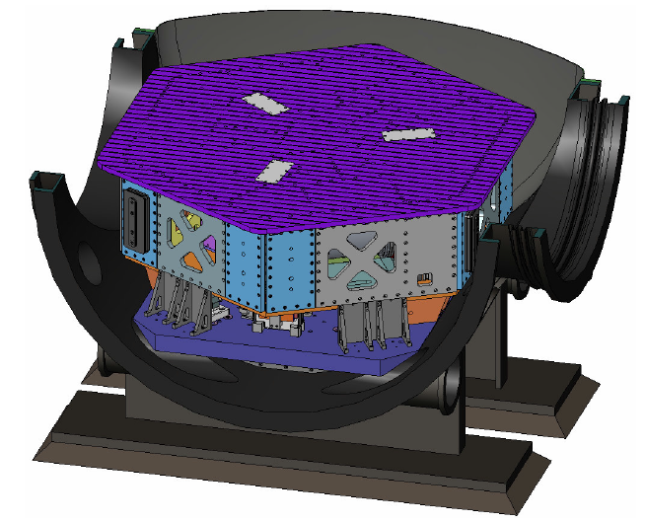
Example system – HAM ISI
G070156
Physical parameters from G070156
k -> 125770 N/m
m = 1900 kg
c -> 3000 N/(m/s) (guess)
State space model
Notes:
Let’s look at the example of the HAM-ISI. It’s physical parameters are given in G070156.

Slide 43
Example system – HAM ISI
State space model
A
B
C
D
Roots of the system
Matlab code for state space format:
HAMISI_SS = ss(A,B,C,D);
Notes:
Plugging in the parameters, we get these state space matrices. The matlab code eig function on the A matrix gives you the system poles. The ss function generates the state space system.

Slide 44
3 ways to characterize these models
Impulse response (or the similar step response)
Complex plane (zero-pole map)
* Bode plot of the transfer function
These are all equivalent, which we’ll see on the following slides.
* Bode plots are used more extensively than anything else, but all are useful
Notes:
There are 3 common ways to characterize these models, the impulse response, the complex plane, and bode plots. All are equivalent, but the bode plots are used the most. We’ll take a look at all 3 and see how they relate to each other.

Slide 45
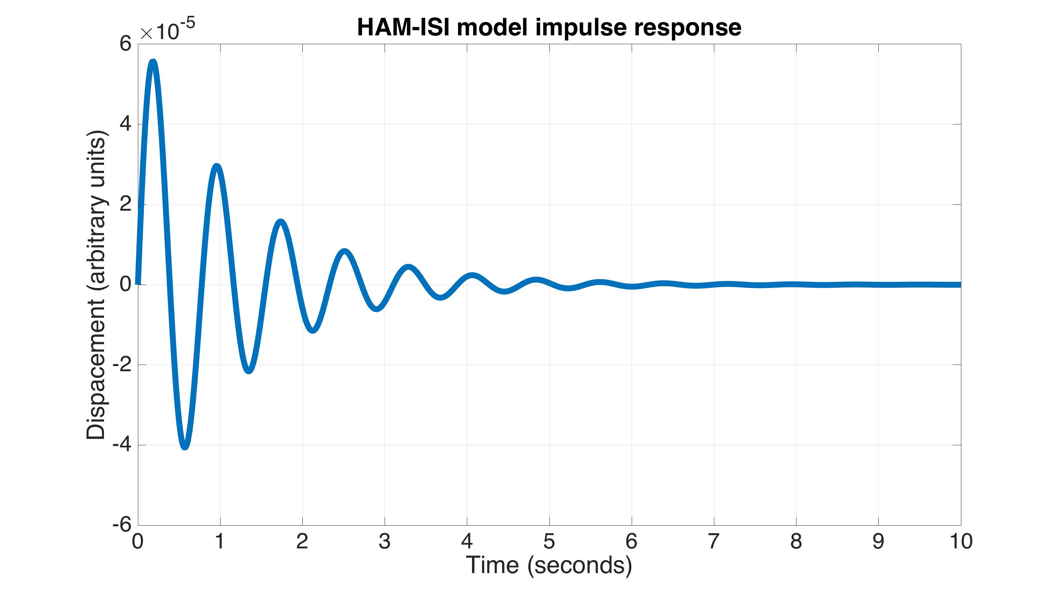
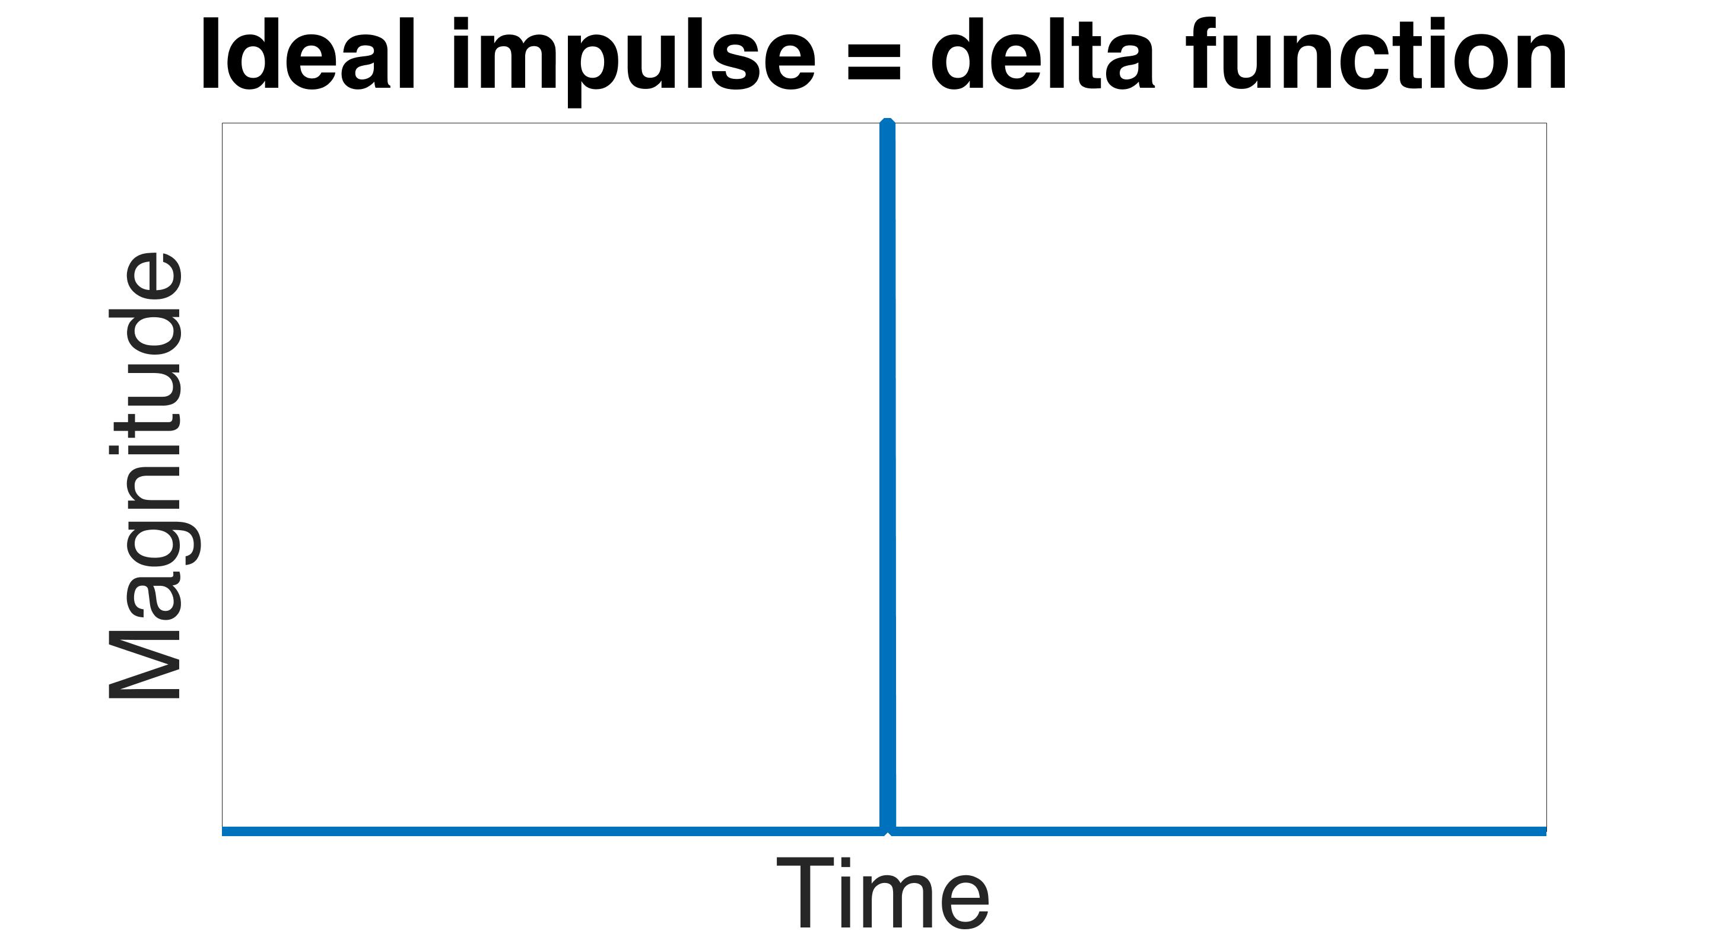
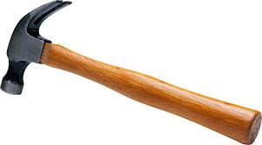
Example system – HAM ISI
One way to characterize the system is to plot the impulse response
Natural frequency = |eig(A)| = 8.14 rad/s = 1.29 Hz
Input force
Matlab code:
impulse(HAMISI_SS)
Notes:
The impulse response shows how the systems responds when you apply a delta function to the input, that is an input that is infinite in amplitude, but also infinitely short in time, so that the area of the curve equals 1. Matlab will generate these plots with the impulse function. The system oscillates at its natural frequency. This frequency is the absolute value of the system poles.

Slide 46
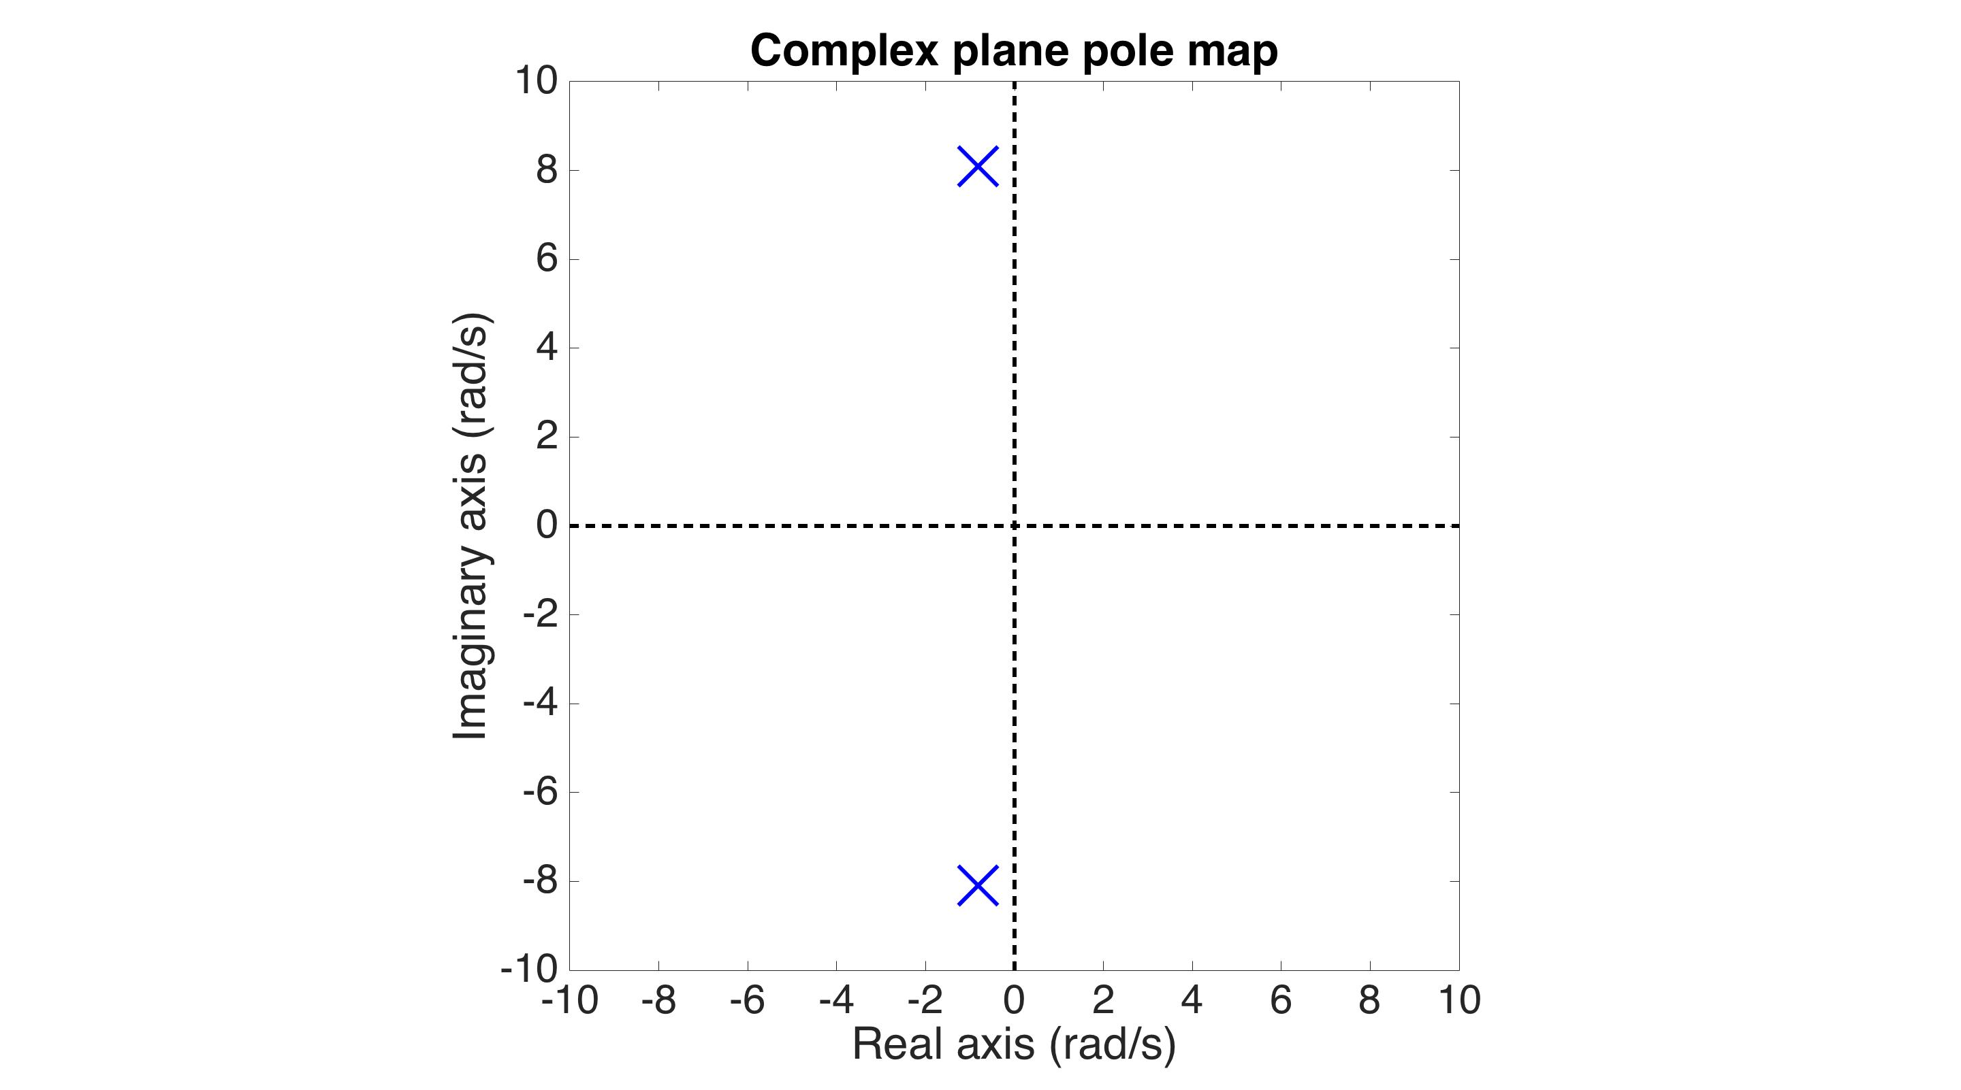
Example system – HAM ISI
Matlab code for a pole-zero map:
pzmap(HAMISI_SS)
Another way to characterize the system is to plot the eigenvalues (poles) in the complex plane
Conjugate pair
Notes:
The complex plane plots the system poles and zeros with respect to real and imaginary axes. The matlab function pzmap generates these plots. Note that complex poles and zeros are always conjugate pairs (for linear systems). Real valued poles and zeros do not need to come in pairs. In this example we just have poles, denoted by the X’s. Zeros would be denoted by O’s.

Slide 47
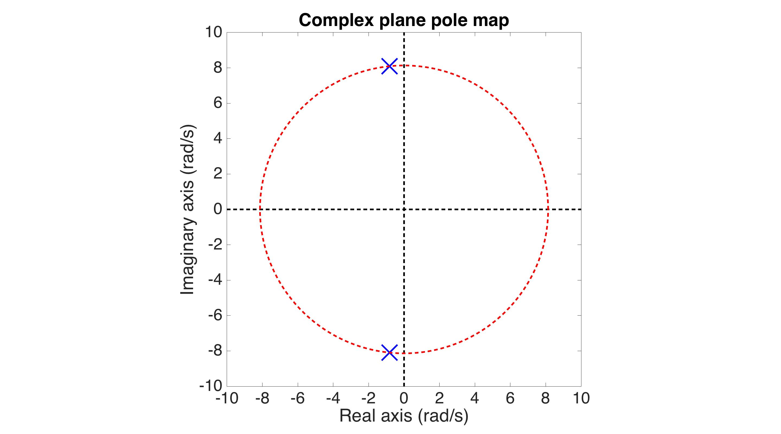
Example system – HAM ISI
Radius = natural frequency
Notes:
The radius of the circle these poles and zeros lie on tells you their frequency.

Slide 48
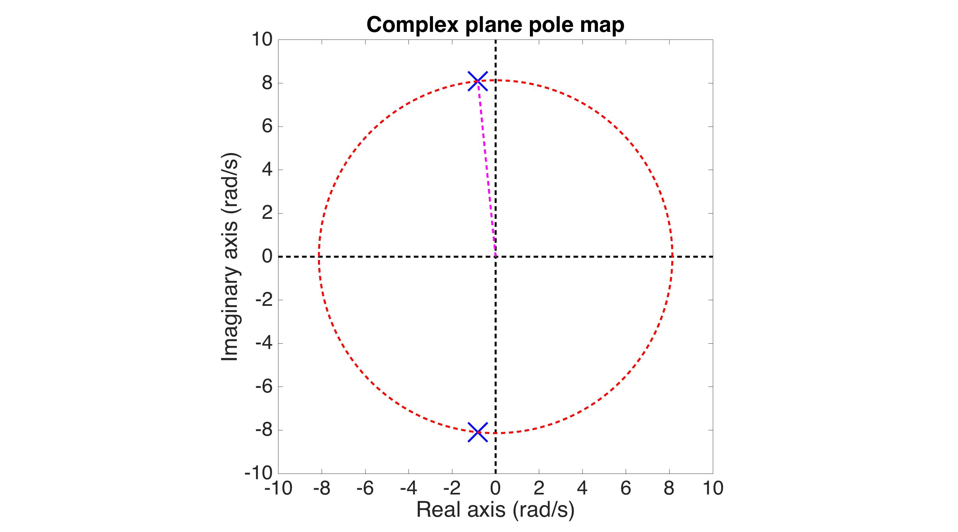
Example system – HAM ISI
Radius = natural frequency
sin(angle)= damping ratio
Q = 1/(2*damping ratio)
Notes:
The angle they make with the imaginary axis is the damping. Specifically, the damping ratio is the sine of the angle. The Quality factor is 1 / (2 * sin(angle) ).

Slide 49
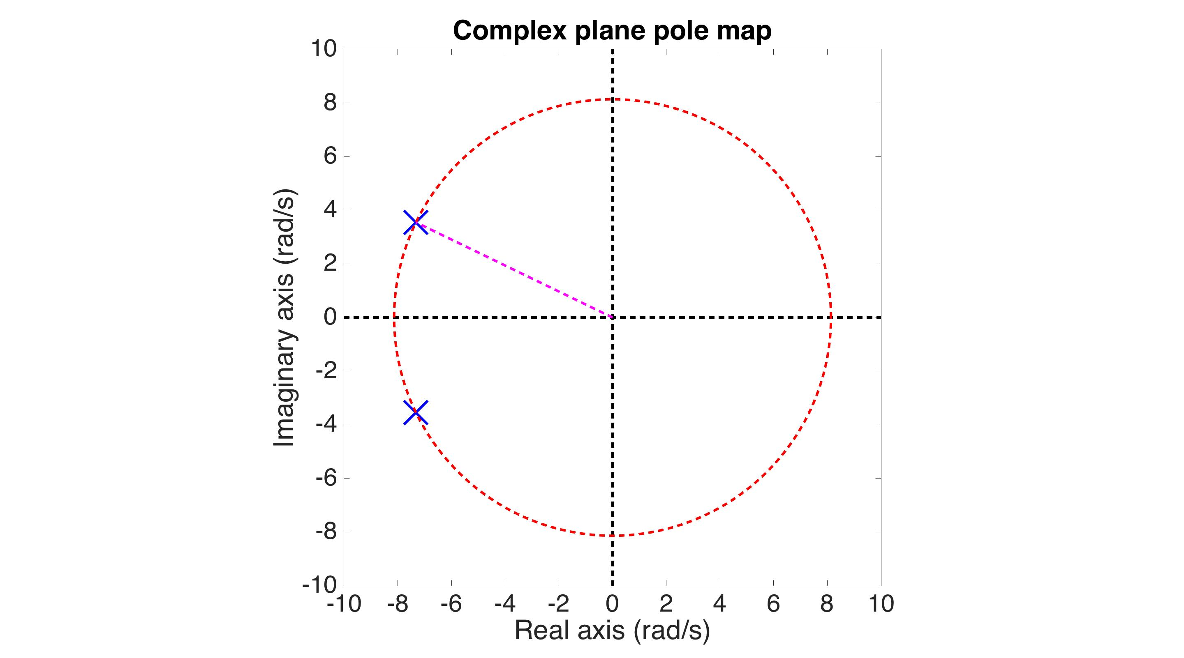
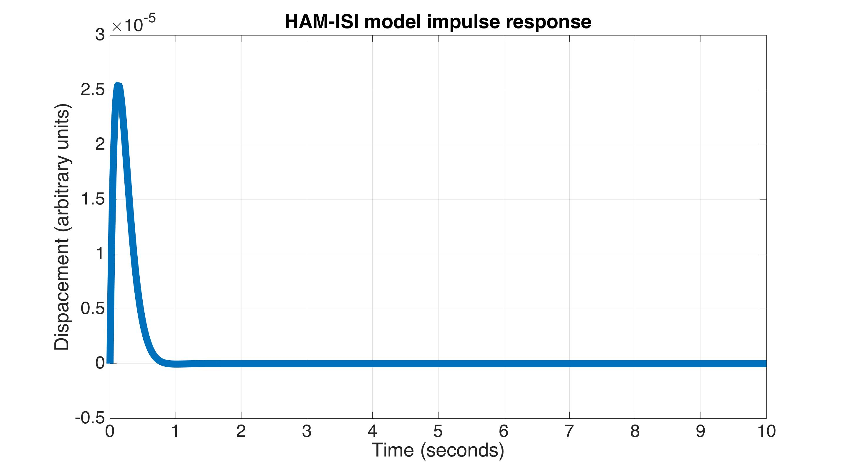
Example system – HAM ISI
Notes:
This is an example of the system with will damped poles.

Slide 50
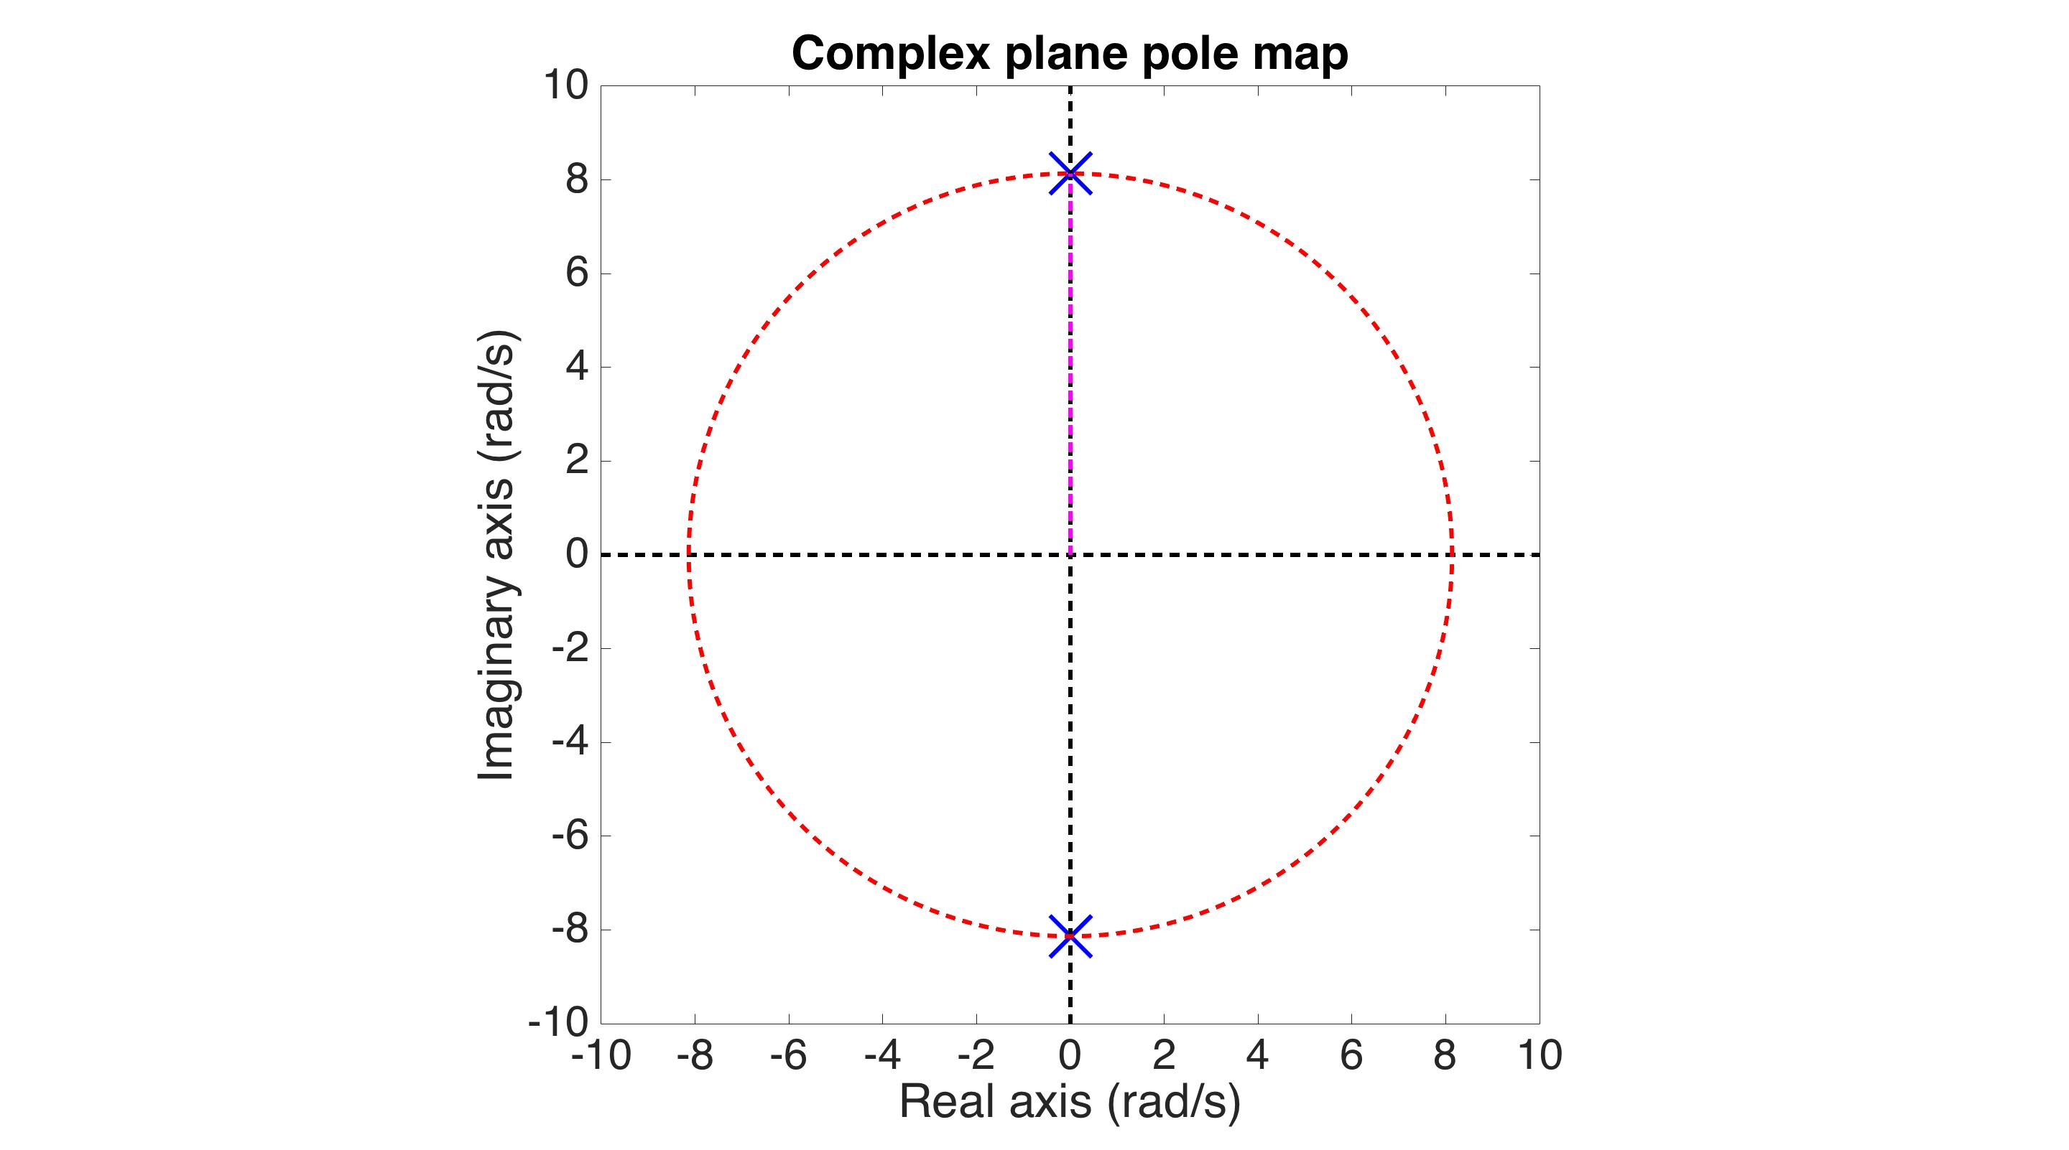
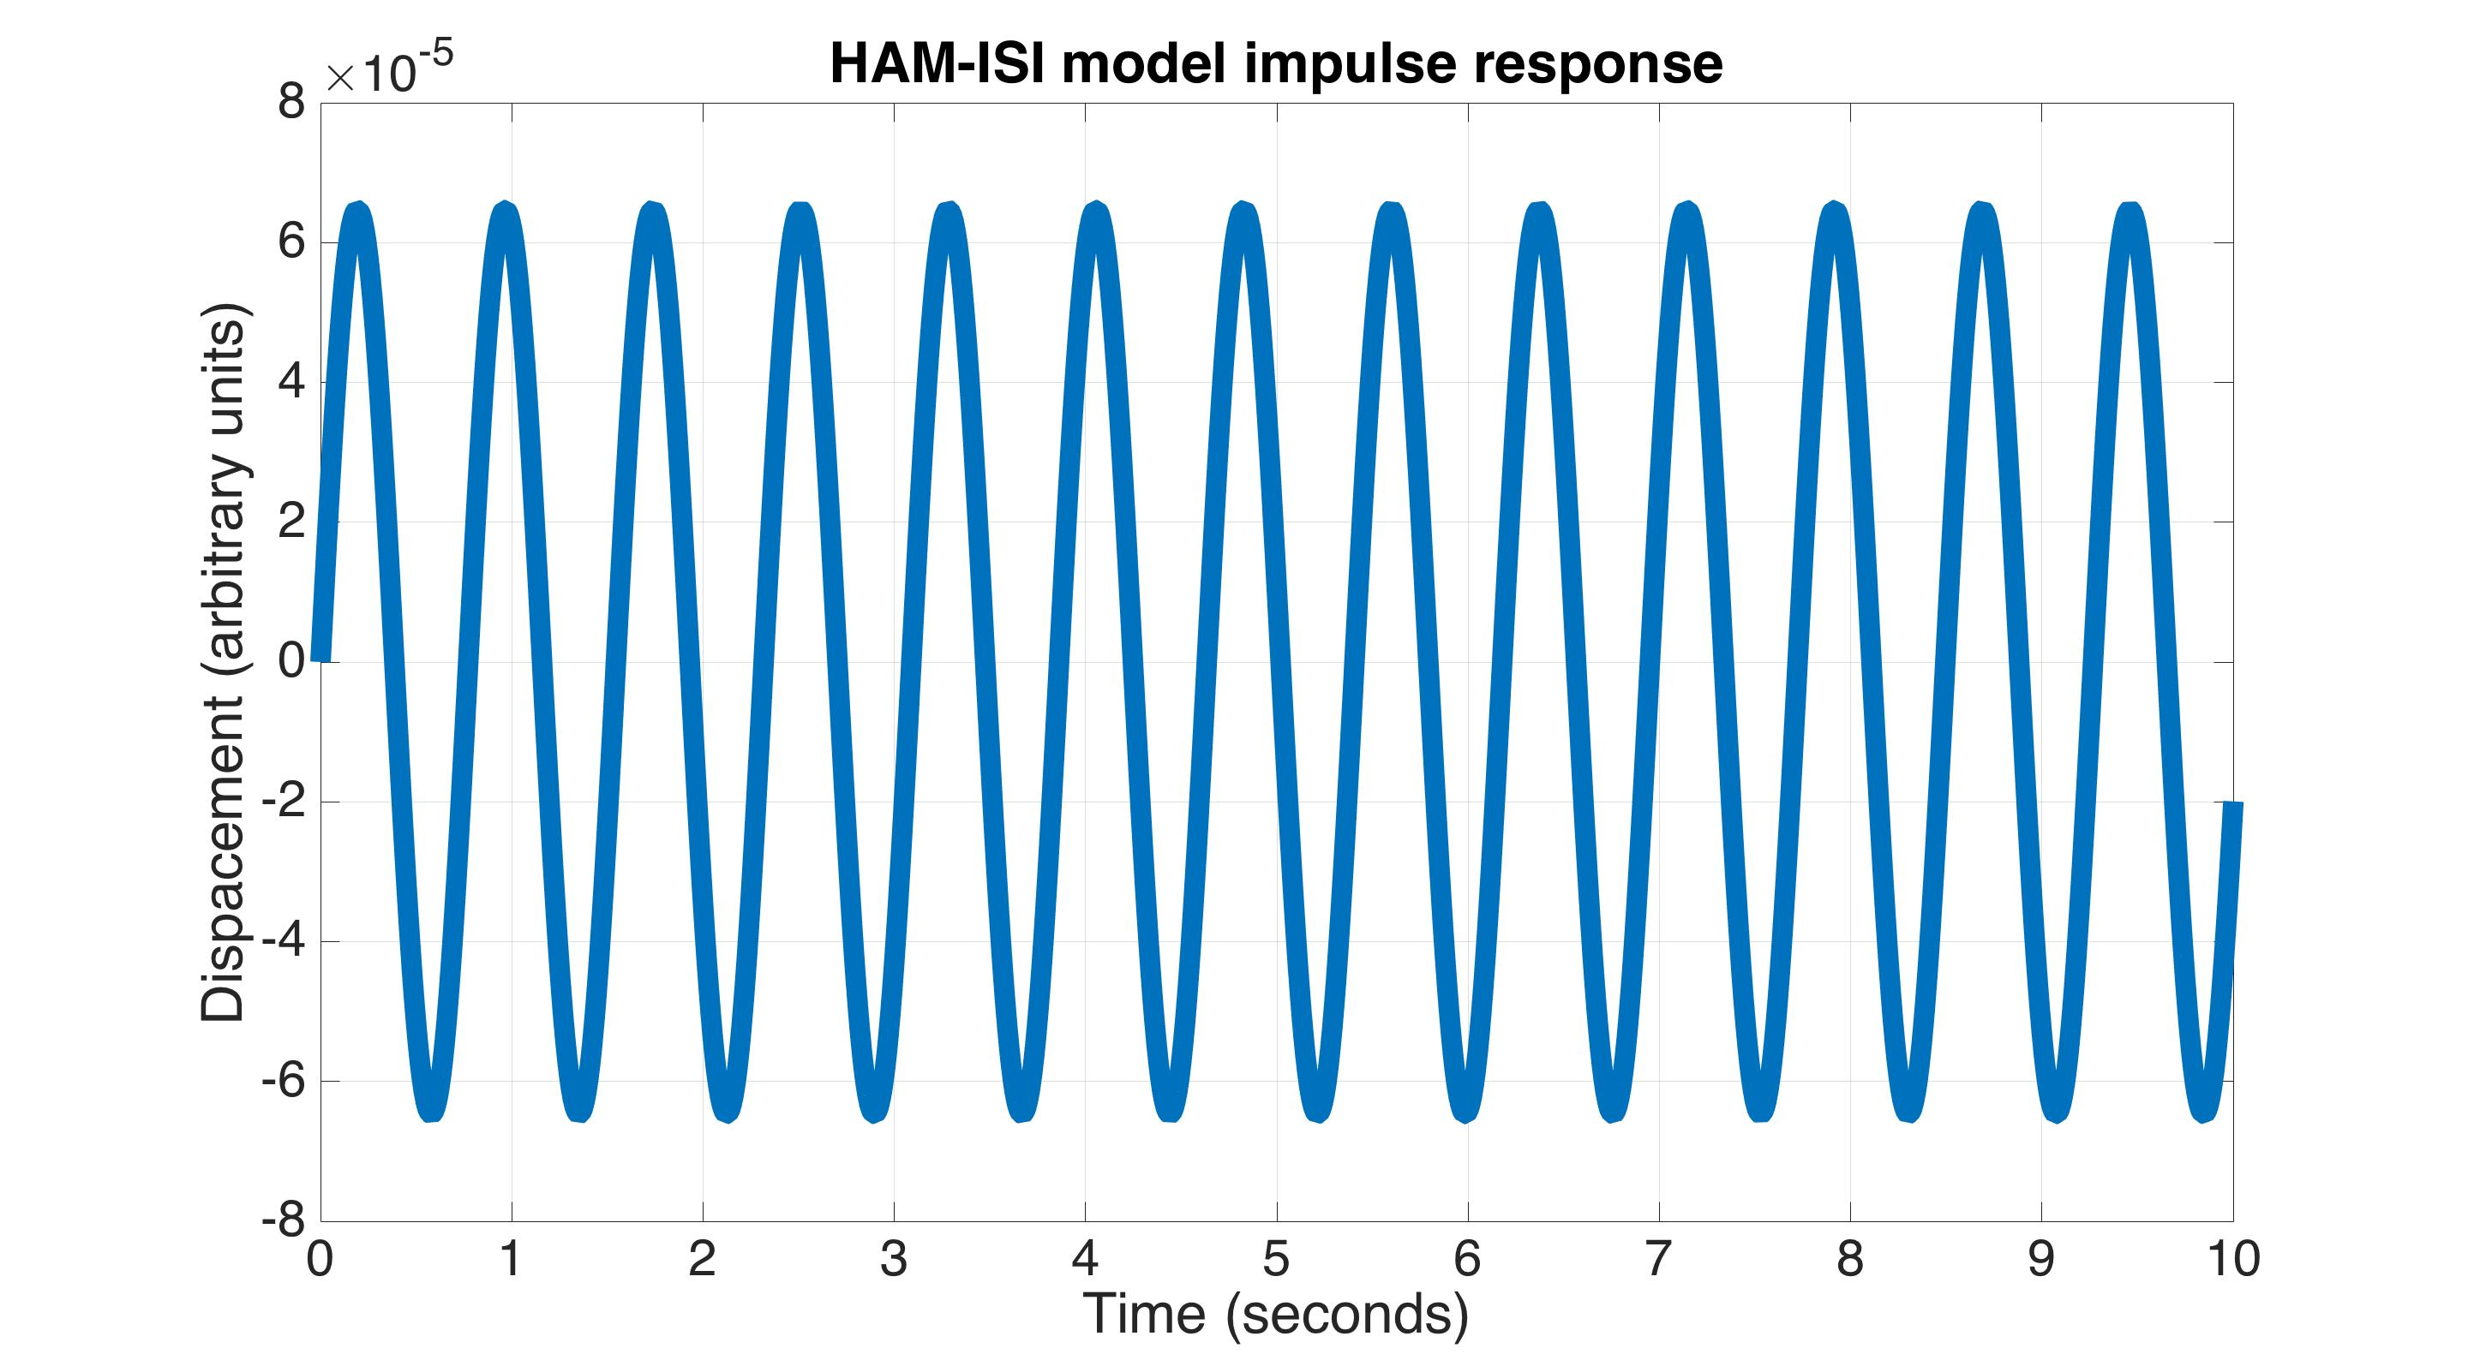
Example system – HAM ISI
Notes:
This is an example with zero damping.

Slide 51
Example system – HAM ISI
Matlab code for a pole-zero map:
pzmap(HAMISI_SS)
Radius = natural frequency
sin(angle)= damping ratio
Q = 1/(2*damping ratio)
Poles must be in the left half plane (LHP) for stability!
Notes:
For a system to be stable, all its poles must lie in the Left-Half-Plane (LHP).

Slide 52
Example system – HAM ISI
Yet another way to characterize the system is to plot the transfer function
This substitution converts the
Laplace transform to the Fourier transform
Poles of the system
Matlab code for transfer function format:
HAMISI_TF = tf(1,[1900,3000,125770]);
Notes:
The most typical way to look at a system is to plot the Bode plot of the transfer function. This is done by setting the Laplace variable s = 0 + i*omega, where omega is 2*pi*frequency. In general, s has both real and imaginary parts. For the bode plot however, we only need the imaginary part. Note, discarding the real part of s converts the Laplace transform to the Fourier transform. So, the bode plot is showing us the systems Fourier transform. There is a little bit more discussion on this in the backup slides for Lecture 1.

Slide 53
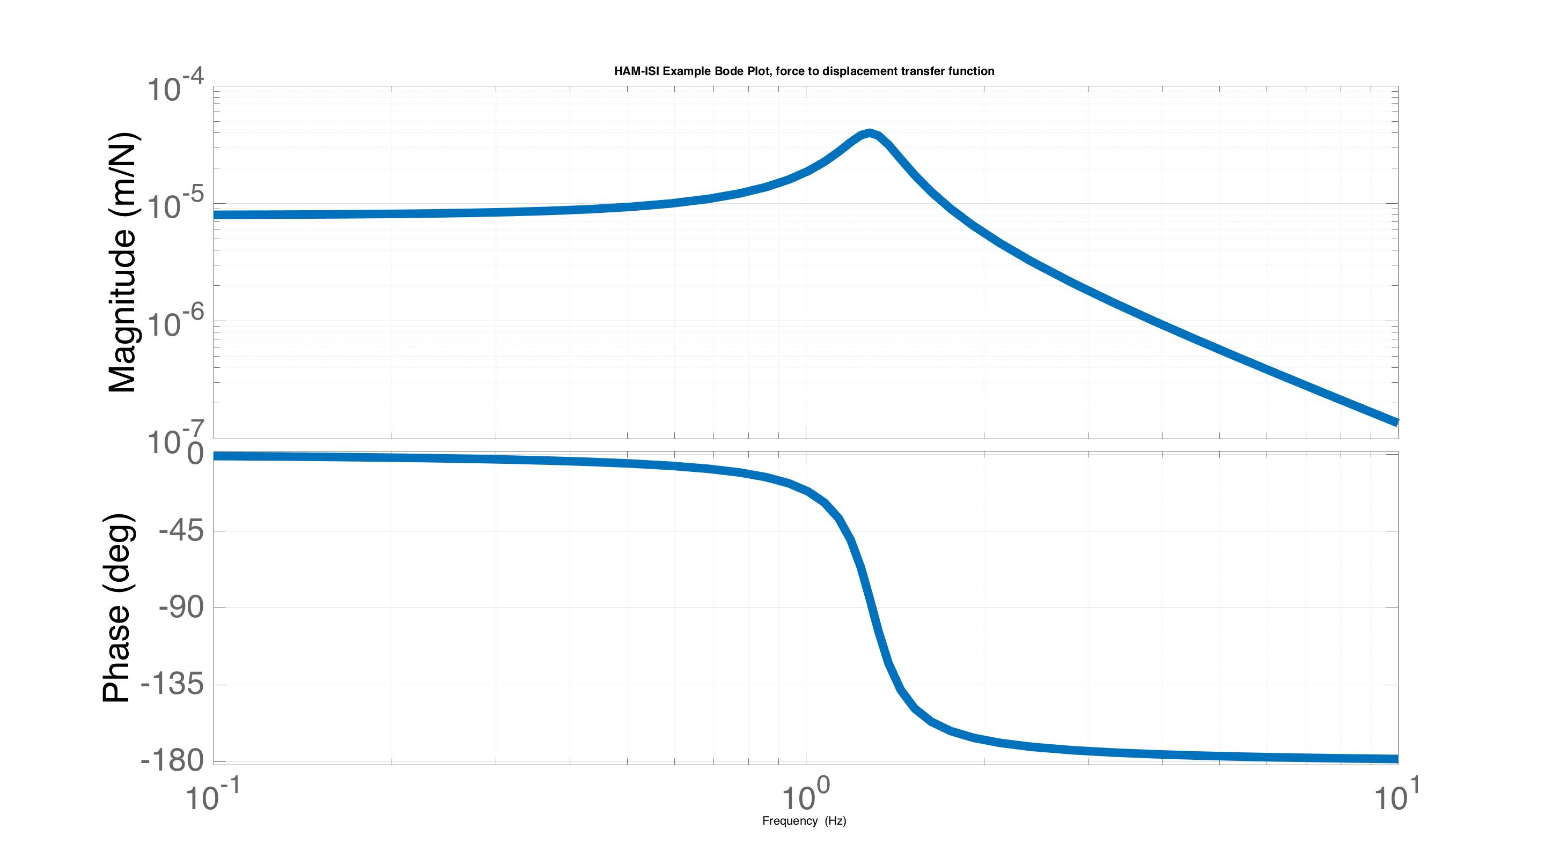
Example system – HAM ISI
Bode plot of the x/f transfer function
Frequency (Hz)
Notes:
Here is the Bode plot for our example. The plot shows the magnitude of the transfer function on top, and the phase below.

Slide 54
Pole map vs Bode plot
p₂
iω
iω
p₁
Frequency (Hz)
Notes:
The bode plot is equivalent to the pole-zero map in the complex plane. This can be seen by moving up the positive imaginary axis with s = i*omega. The magnitude of the bode plot results from the distances to the poles and zeros for a given frequency. The magnitude is inversely proportional to duistance for the poles, and proportional for zeros. You can see then how lightly damped poles produce large resonance features, because they are close to the imagniary axis, so the distance gets very small as you pass their frequency. The phase then comes from summing the angels to each pole and zero (with the proper signs).

Slide 55
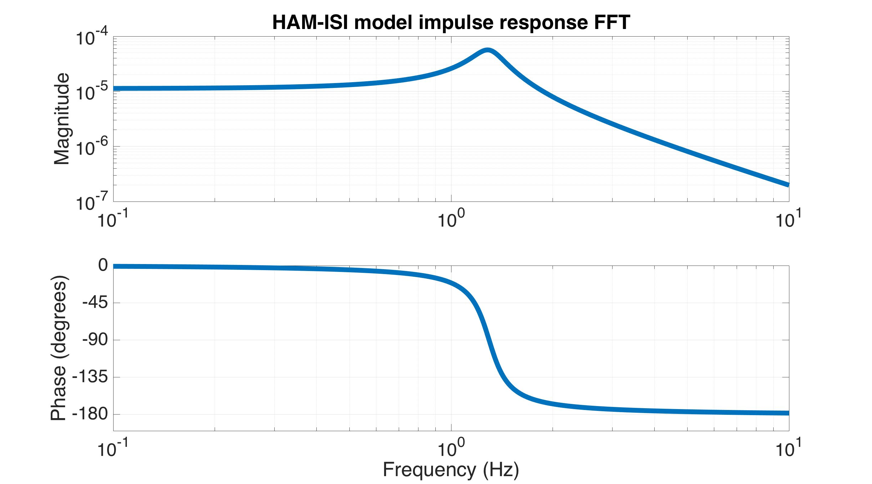
Impulse vs Bode plot
FFT of the
Impulse response
Impulse response
Notes:
The bode plot, it turns out, is exactly the Fourier transform of the impulse. Here I’ve simply taken the transform of the impulse you saw earlier, which reproduces the bode plot.

Slide 56
Impulse vs Bode plot
Impulse response
Transfer function
=
FFT
Time domain
Frequency domain
IFFT
Notes:
In fact, you can measure a transfer function by measuring its impulse response. This technique is often used to characterize the suspension cages.

Slide 57
Lecture 1 Summary
Control helps us achieve a desired behavior
  In general maintain desired setpoints
Control can be either feedback or feedforward
Nearly all our controlled systems are linear
System are modeled in both the time domain and frequency domain. Both domains are equivalent. Each is useful in its own context.

Slide 58
Lecture 1 – Backups
G1600726

Slide 59
Relationship between
Laplace and Fourier
Laplace becomes Fourier when the real part of s goes to zero
and the imagery part is frequency in units of rad/s
Why do we use Laplace for the transfer functions, but Fourier for the bode plots?
  As far as I know, this isn’t discussed much in controls classes. My hypothesis is that the Fourier transform is sufficient for reproducing time domain signals, since any time domain signal can be reproduced by an infinite sum of sine waves. However, the Fourier transform does not contain enough information to represent the dynamics of the system that produced that signal. Since poles and zeros in general have both real and imaginary parts, the Laplace transform, with the addition of the real part of s, is sufficiently general.

Slide 60
Cavity Signal
Pound-Drever-Hall (PDH) Signal for aLIGO
“Linear region”
PDH signal
The PDH signal for a 4 km aLIGO Fabry-Perot cavity with mirror power transmissions of 1.4% and 7.5 ppm. The cavity finesse is 445. The linear region between the dashed lines is 1 nm wide.
F = cavity finesse = 445
λ = laser wavelength = 1064 nm
C = arbitrary electronic scaling
Notes:
The PDH signal is only linear at the limit where the error signal, Delta-L, goes to zero. Deviations from this from the linear regime can cause upconversion in the interferometer. If the deviations are large enough, the cavity loses lock, because the slope (gain of the loop) changes dramatically in magnitude and sign.

Slide 61
Models – SS rel. disp. output
Equation of motion
System dynamics
Relative displacement sensor
Sensing function
Ex. Relative displacement
sensor
Note, to include the damping term, a different set of state variables is required. See T1400023.
Notes:
This shows the D matrix of a state space system when the output is given by a relative displacement sensor between the mass and the ground. Note, if the damping term is included between the ground and the mass velocity is no longer a useful state variable. See T1400023 for the proper choice of state variables in this case.

Slide 62
Lecture 2
Basic control design
- Part 1: Feedforward
- Part 2: Feedback
- Part 3: Sensor blending
G1600726

Slide 63
Example system – HAM ISI
G070156
Notes:
In this lecture, we’ll use the HAM-ISI as an illustrative example of control system design. The concepts applied to this system apply to many other systems as well.
We’ll model the HAM-ISI as a single degree of freedom (DOF) mass-spring-damper system. Here is the equation of motion we saw in Lecture 1, with the external force input.

Slide 64
Example system – HAM ISI
G070156
Goals:
Use f to reduce the influence of ground displacement, x_{g}, on the ISI
Don’t amplify the ISI motion with sensor noise
Notes:
More generally, there is also a ground motion input, which adds driving terms to the right side of the equation.
The goals here are to apply external forces, f, to minimize the influence of the ground displacements x_{g}, without amplifying the motion of the ISI with sensor noise.

Slide 65
Stage 1 of 1-stage of in-vacuum isolation table
(HAM-ISI)
Stage 0
Stage 0 to stage 1
+
+
-
+
Local & Cal
Actuation to stage 1
+
+
+
GS13
CPS
Cart & Cal
Cart & Cal
Stage 0 L4Cs
Damping
Cart & Cal
High pass
Feed-forward
Isolation
+
+
Low pass
Reference G1401207
Notes:
In the end, the control of the HAM-ISI we use to achieve these goals can be represented with a block diagram like this. The hope is that by the end of this lecture, we’ll understand each piece of this diagram.

Slide 66
Lecture 2 – Part 1
Feedforward
G1600726

Slide 67
Stage 1 of 1-stage of in-vacuum isolation table
(HAM-ISI)
Stage 0
Stage 0 to stage 1
+
+
-
+
Local & Cal
Actuation to stage 1
+
+
+
GS13
CPS
Cart & Cal
Cart & Cal
Stage 0 L4Cs
Damping
Cart & Cal
High pass
Feed-forward
Isolation
+
+
Low pass
Reference G1401207
Notes:
This is the feedforward part of this block diagram. There is a sensor that measures the ground motion, and a feedforward filter that drives the actuators to cancel this ground motion.
We won’t focus on the Cart & Cal matrix transformations here. For more information on these matrix transformations, see the Lecture 2 backup slides.

Slide 68
Feedfoward Control
G070156
Ideal feedforward controller
An inertial sensor on the ground measures x_{g}
The actuator applies the correcting force f before the ISI responds
  it’s like the ground never even moved
Performance is limited by how well the controller is tuned, and how much coherence there is between the ground sensor and the ISI sensor.
The feedforward controller does not depend on the feedback design
Notes:
With feedforward control, we simply try measure the ground motion, and cancel out its terms on the right side of the equation directly. This is limited by how good our sensor is, how much coherence it has with the ISI’s motion, and how good our model of the ISI is (e.g. how well we know k and c).
The feedforward control does not depend on the feedback design. This is because feedback reacts after the error has already begun to increase, while feedforward is proactive, acting before the error has a chance to change. Thus, feedforward acts before the feedback has a chance to respond. From the point of view of the feedback, the feedforward has done nothing more than reduce the amount of ground motion.

Slide 69
Feedfoward Control
In practice, the feedforward control is achieved with the following 4 steps:
Measure the TF between the ground and the ISI
Measure the TF between the actuator and the ISI
Calculate the ratio of step 1 to step 2
Fit a filter to this TF ratio. This is the feedforward control filter.
1)
Notes:
In practice, we don’t have perfect models of our systems. For example, we don’t know the calibrations of our sensors and actuators perfectly, in addition to not knowing k and c perfectly. So we base the feedforward control off measurements. The first step is to measure a transfer function between the sensor on the ground and the sensors on the ISI.

Slide 70
Feedfoward Control
In practice, the feedforward control is achieved with the following 4 steps:
Measure the TF between the ground and the ISI
Measure the TF between the actuator and the ISI
Calculate the ratio of step 1 to step 2
Fit a filter to this TF ratio. This is the feedforward control filter.
1)
2)
Notes:
The second step is to drive the actuators and measure the transfer function between the actuators and the sensors on the ISI.

Slide 71
Feedfoward Control
In practice, the feedforward control is achieved with the following 4 steps:
Measure the TF between the ground and the ISI
Measure the TF between the actuator and the ISI
Calculate the ratio of step 1 to step 2
Fit a filter to this TF ratio. This is the feedforward control filter.
1)
2)
3)
Notes:
The third step divides the first transfer function by the second. This gives us a transfer function in units of (actuator force) / (ground displacement). This describes the feedforward control we want to apply. Notice that it is the Laplace transform of the ideal feedforward law discussed a few slides ago. The 4th and final step is to fit a filter to this measurement, that matches in magnitude and phase. This filter is the feedforward controller we apply.
Any uncertainties in the sensor and actuator calibrations, and the ISI parameters, will be taken into account with these measurements.

Slide 72
Lecture 2 – Part 2
Feedback
G1600726

Slide 73
Stage 1 of 1-stage of in-vacuum isolation table
(HAM-ISI)
Stage 0
Stage 0 to stage 1
+
+
-
+
Local & Cal
Actuation to stage 1
+
+
+
GS13
CPS
Cart & Cal
Cart & Cal
Stage 0 L4Cs
Damping
Cart & Cal
High pass
Feed-forward
Isolation
+
+
Low pass
Reference G1401207
Notes:
These blocks represent the HAM-ISI feedback. Don’t be confused by the fact that there are two blocks here, Damping and Isolation. They have the same purpose, but are used in different states of the interferometer. Damping provides a small amount of isolation, but is very robust, and prevents the platform’s resonance frequencies from ringing up. Isolation is less robust, but provides very high performance isolation. Typically, when turning the interferometer on, we start with the damping feedback, and then engage the isolation feedback.

Slide 74
Stage 1 of 1-stage of in-vacuum isolation table
(HAM-ISI)
Stage 0 =
P_{g}: Stage 0 to stage 1
+
+
P_{a}: Actuation to stage 1
Sensor
-C: Isolation
Notes:
To see how feedback works, let’s remove all elements in the bock diagram except for the isolation path (recall, isolation an damping have the same basic roll, so let’s pick just one of them).

Slide 75
Stage 1 of 1-stage of in-vacuum isolation table
(HAM-ISI)
Stage 0 =
P_{g}: Stage 0 to stage 1
+
+
P_{a}: Actuation to stage 1
Sensor
+
Sensor noise
-C: Isolation
Notes:
Let’s add some sensor noise to this diagram, since it is important, but wasn’t included before.

Slide 76
Stage 1 of 1-stage of in-vacuum isolation table
(HAM-ISI)
Stage 0 =
P_{g}: Stage 0 to stage 1
+
+
P_{a}: Actuation to stage 1
Sensor
+
Sensor noise
-C: Isolation
Uncontrolled TF from ground to stage 1
Notes:
Let’s now write down the uncontrolled transfer function from ground displacement to platform displacement.

Slide 77
Stage 1 of 1-stage of in-vacuum isolation table
(HAM-ISI)
Stage 0 =
P_{g}: Stage 0 to stage 1
+
+
P_{a}: Actuation to stage 1
Sensor
+
Sensor noise
-C: Isolation
Close loop TF from ground to stage 1
(Ignoring the sensor response for now)
Notes:
Then, when we turn on the feedback loop, we just add one more term.

Slide 78
Stage 1 of 1-stage of in-vacuum isolation table
(HAM-ISI)
Stage 0 =
P_{g}: Stage 0 to stage 1
+
+
P_{a}: Actuation to stage 1
Sensor
+
Sensor noise
-C: Isolation
Close loop TF from ground to stage 1
(Ignoring the sensor response for now)
Notes:
We can then solve for platform displacement, x, as a function of ground displacement, x_{g}. This is the closed loop transfer function from the ground to the platform.

Slide 79
Stage 1 of 1-stage of in-vacuum isolation table
(HAM-ISI)
Stage 0 =
P_{g}: Stage 0 to stage 1
+
+
P_{a}: Actuation to stage 1
Sensor
+
Sensor noise
-C: Isolation
Close loop TF from sensor noise to stage 1
(Ignoring the sensor response for now)
Notes:
Similarly, we can find the closed loop transfer function from sensor noise, n, to platform displacement, x.

Slide 80
Stage 1 of 1-stage of in-vacuum isolation table
(HAM-ISI)
Stage 0 =
P_{g}: Stage 0 to stage 1
+
+
P_{a}: Actuation to stage 1
Sensor
+
Sensor noise
-C: Isolation
Close loop TF from sensor noise to stage 1
(Ignoring the sensor response for now)
All closed loop TFs in this loop
will have the same denominator
Notes:
Note, all closed loop transfer functions in this loop will have the same denominator, with the form 1 + something.

Slide 81
Stage 1 of 1-stage of in-vacuum isolation table
(HAM-ISI)
Stage 0 =
P_{g}: Stage 0 to stage 1
+
+
P_{a}: Actuation to stage 1
Sensor
+
Sensor noise
-C: Isolation
Close loop TF from sensor noise to stage 1
(Ignoring the sensor response for now)
Loop gain TF: important for studying stability
Notes:
That something is called the loop gain transfer function. It is a product of all the boxes in the closed loop. It is this loop gain transfer function that we analyze to study the loop’s stability. Just to clarify, this means we are analyzing the loop’s open loop characteristics to study its closed loop behavior.

Slide 82
Stage 1 of 1-stage of in-vacuum isolation table
(HAM-ISI)
Stage 0 =
P_{g}: Stage 0 to stage 1
+
+
P_{a}: Actuation to stage 1
GS13
Inertial sensor
+
Sensor noise
-C: Isolation
Close loop TF from sensor noise to stage 1
(Ignoring the sensor response for now)
Numerator: boxes between input and output
Loop gain TF: important for studying stability
Notes:
The numerator changes depending on which inputs and outputs you are examining. It will always turn out, that the numerator is just the product of the boxes between the input and output. In this case, we have the isolation block and P_{a} block between the sensor noise and the plant displacement. Therefore, it is very straightforward to find a closed loop transfer function just by inspecting the block diagram. No need to solve the algebraic equations each time.

Slide 83
Closed Loop TFs
Seismic noise transmission
Sensor noise transmission
Notes:
Let’s now compare the two closed loop transfer functions that we have: the seismic transmission, and sensor noise transmission.

Slide 84
Closed Loop TFs
When the loop gain is > 1, seismic noise is reduced, but the system tends to follow the sensor noise
Seismic noise transmission
Sensor noise transmission
Notes:
In the seismic case, when the loop gain is large, the seismic noise is reduced. However, in the sensor noise case, the transfer function approaches -1. Thus, the platform is driven to follow the sensor noise. This is fine at frequencies where the sensor noise is small; specifically less than how much the platform would respond to the seismic noise without control. However, at other frequencies where sensor noise is larger, big loop gains would cause the platform to move more than it would without control. So in general, we want to have large loop gains where seismic noise moves the platform a lot, and small loop gains everywhere else to minimize the influence of sensor noise. (sometimes suppressing seismic noise at low frequencies is important enough it is best to tolerate some sensor noise at high frequencies)

Slide 85
Closed Loop TFs
When the loop gain is > 1, seismic noise is reduced, but the system tends to follow the sensor noise
If the loop gain -> -1, the system goes unstable
Seismic noise transmission
Sensor noise transmission
Notes:
Note, that if the loop gain equals -1, the closed loop transfer function goes to infinity. Clearly, the -1 point must be meaningful for stability.

Slide 86
Closed Loop TFs
When the loop gain is > 1, seismic noise is reduced, but the system tends to follow the sensor noise
If the loop gain -> -1, the system goes unstable
To study stability, just look at the loop gain
Seismic noise transmission
Sensor noise transmission
Notes:
In practice, it is not just loop gain = -1, but how it approaches -1 that is important for stability. As mentioned before, we can study stability just by examining the properties of the loop gain, in particular its magnitude and phase (Bode plot).

Slide 87
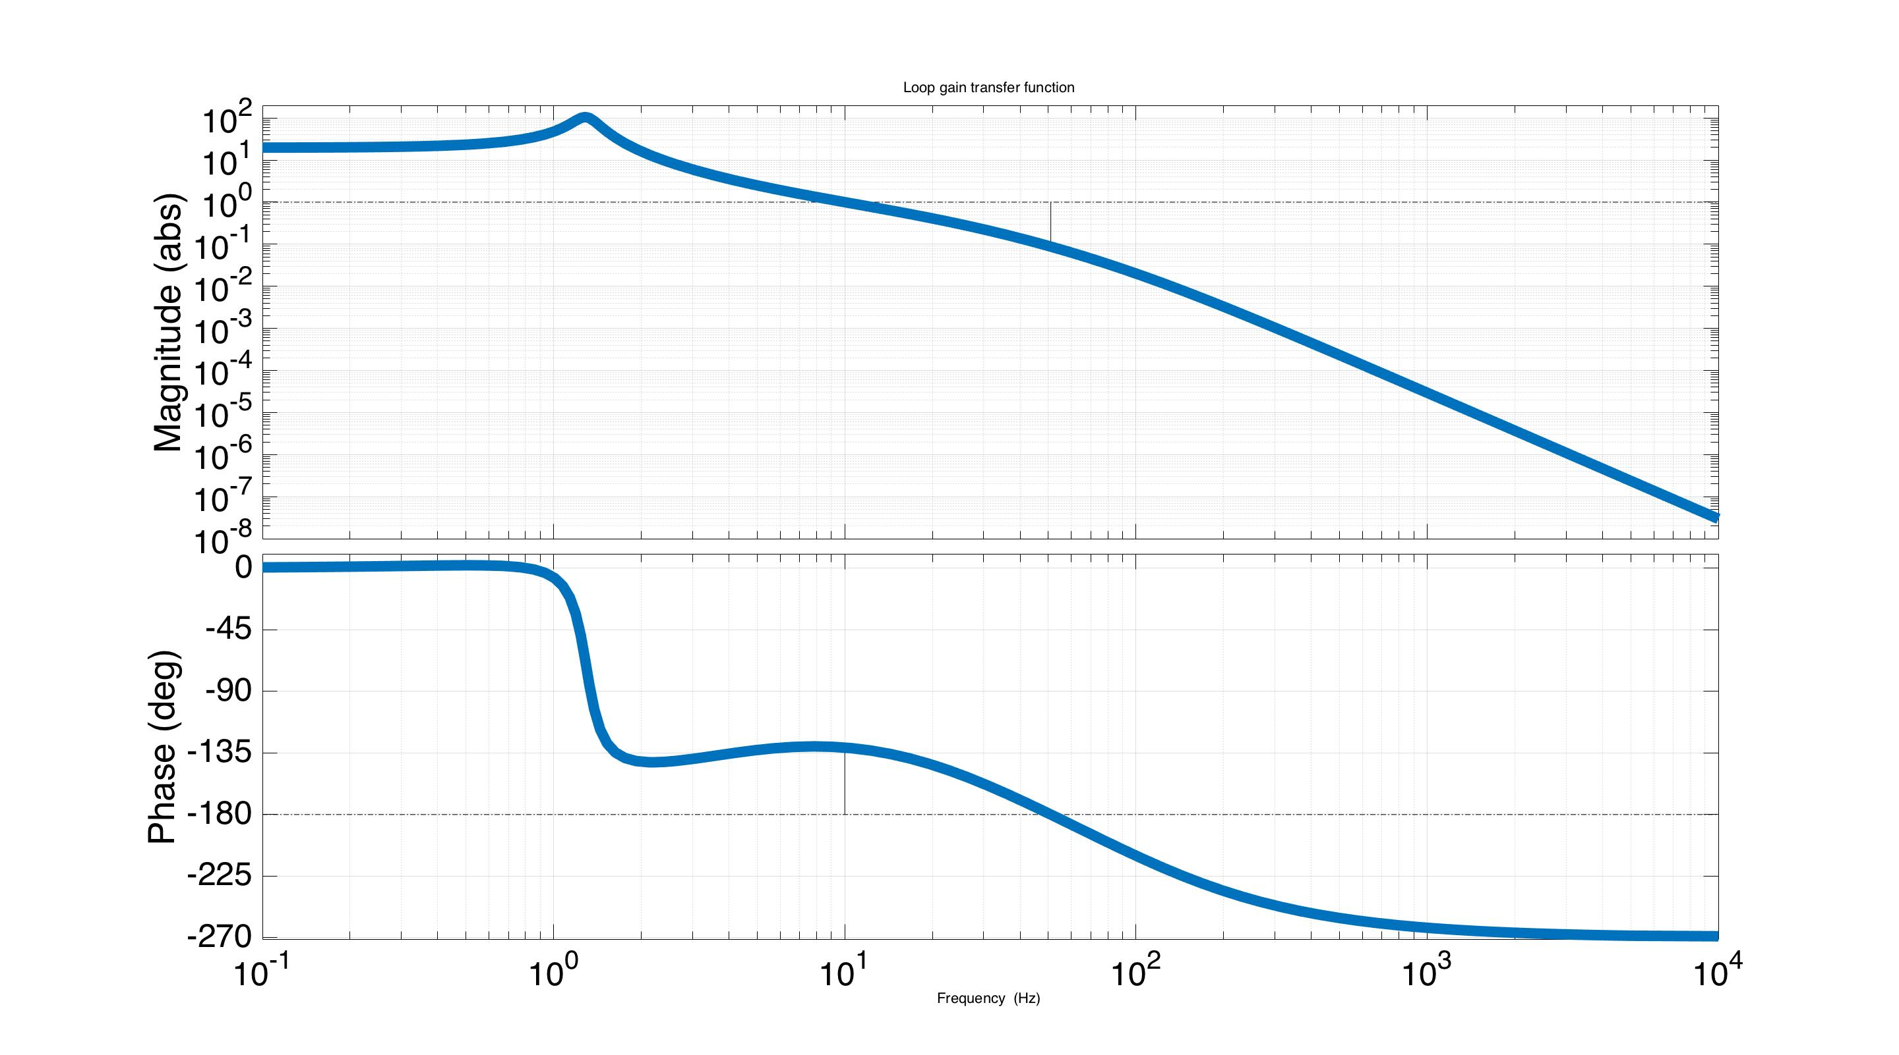
Ex. Loop Gain TF: P_{a}C
Matlab for control filter: C = zpk(-2*pi*3.33,-2*pi*[30;100],1.4e+10)
Notes:
Here is a Bode plot of an example loop gain for the HAM-ISI, using the HAM-ISI model from lecture 1, and the feedback filter C shown here.

Slide 88
Ex. Loop Gain TF: P_{a}C
Unity crossing
-180 crossing
Matlab for control filter: C = zpk(-2*pi*3.33,-2*pi*[30;100],1.4e+10)
Notes:
Let’s see how close it approaches to the -1 point. Note, -1 is equal to a magnitude of 1 and phase of +-180 degrees. Here, when the magnitude is 1, the phase is about -135. So where have a phase margin of 180-135 = 45 degrees. Then, when the phase reaches -180, the gain is about 0.1, so we have a gain margin of 1/0.1 = 10.

Slide 89
Ex. Loop Gain TF: P_{a}C
Unity crossing
-180 crossing
It never hits -1. Is it stable?
Matlab for control filter: C = zpk(-2*pi*3.33,-2*pi*[30;100],1.4e+10)
Notes:
So we’re 45 degrees away from -1 at one point, and an order of magnitude at the other. Is it stable?

Slide 90
Ex. Loop Gain TF: P_{a}C
Unity crossing
-180 crossing
It never hits -1. Is it stable? YES!!!
Matlab for control filter: C = zpk(-2*pi*3.33,-2*pi*[30;100],1.4e+10)
Notes:
Indeed, it is in this case.

Slide 91
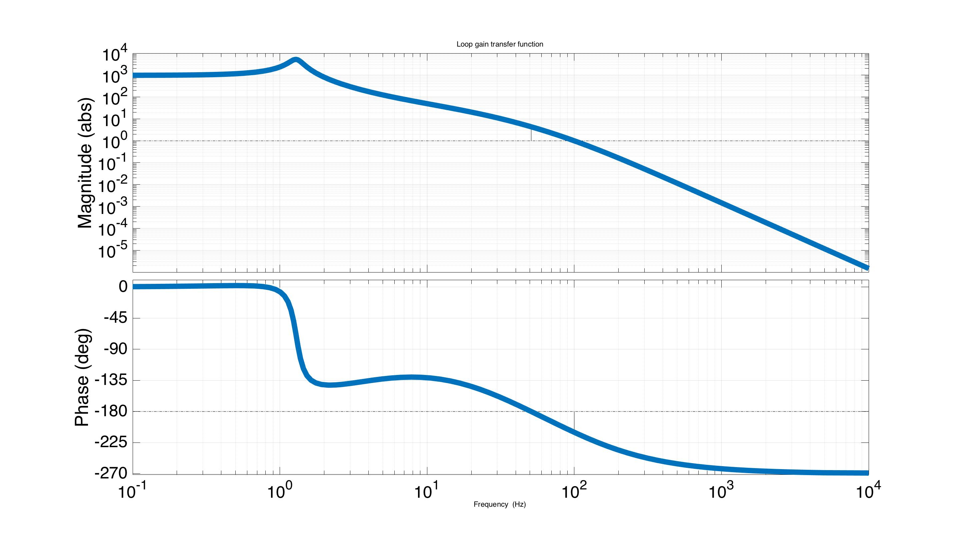
Ex. Loop Gain TF: 50*P_{a}C
-180 crossing
Unity crossing
It never hits -1. Is it stable?
Matlab for control filter: C = zpk(-2*pi*3.33,-2*pi*[30;100],7.0e+11)
Notes:
Let’s look at another example. Here we have exactly the same loop gain, except the magnitude is 50 times larger. When it crosses unity magnitude, the phase is about -220. So the phase margin is 180-220 = -40. When it crosses -180, the magnitude is about 10. So we have a gain margin of 1/10 = 0.1. As before, we never actually pass through -1. Is this loop stable?

Slide 92
Ex. Loop Gain TF: 50*P_{a}C
-180 crossing
Unity crossing
It never hits -1. Is it stable? NO!
Matlab for control filter: C = zpk(-2*pi*3.33,-2*pi*[30;100],7.0e+11)
Notes:
No, it isn’t. As mentioned before, how you approach -1 is just as important as avoiding it. In general you need positive phase margins, and gain margins that are greater than 1.
The mathematical proof for what makes a system stable or unstable is very abstract, and has to do with loop gain encirclements of the -1 point. Generally, you’ll see this proof in a controls class once, and then never see it again. If you’re interested in it, the Ogata text mentioned at the beginning of lecture 1 discusses this. In the end, it suffices to know what the resulting stability rules are.

Slide 93
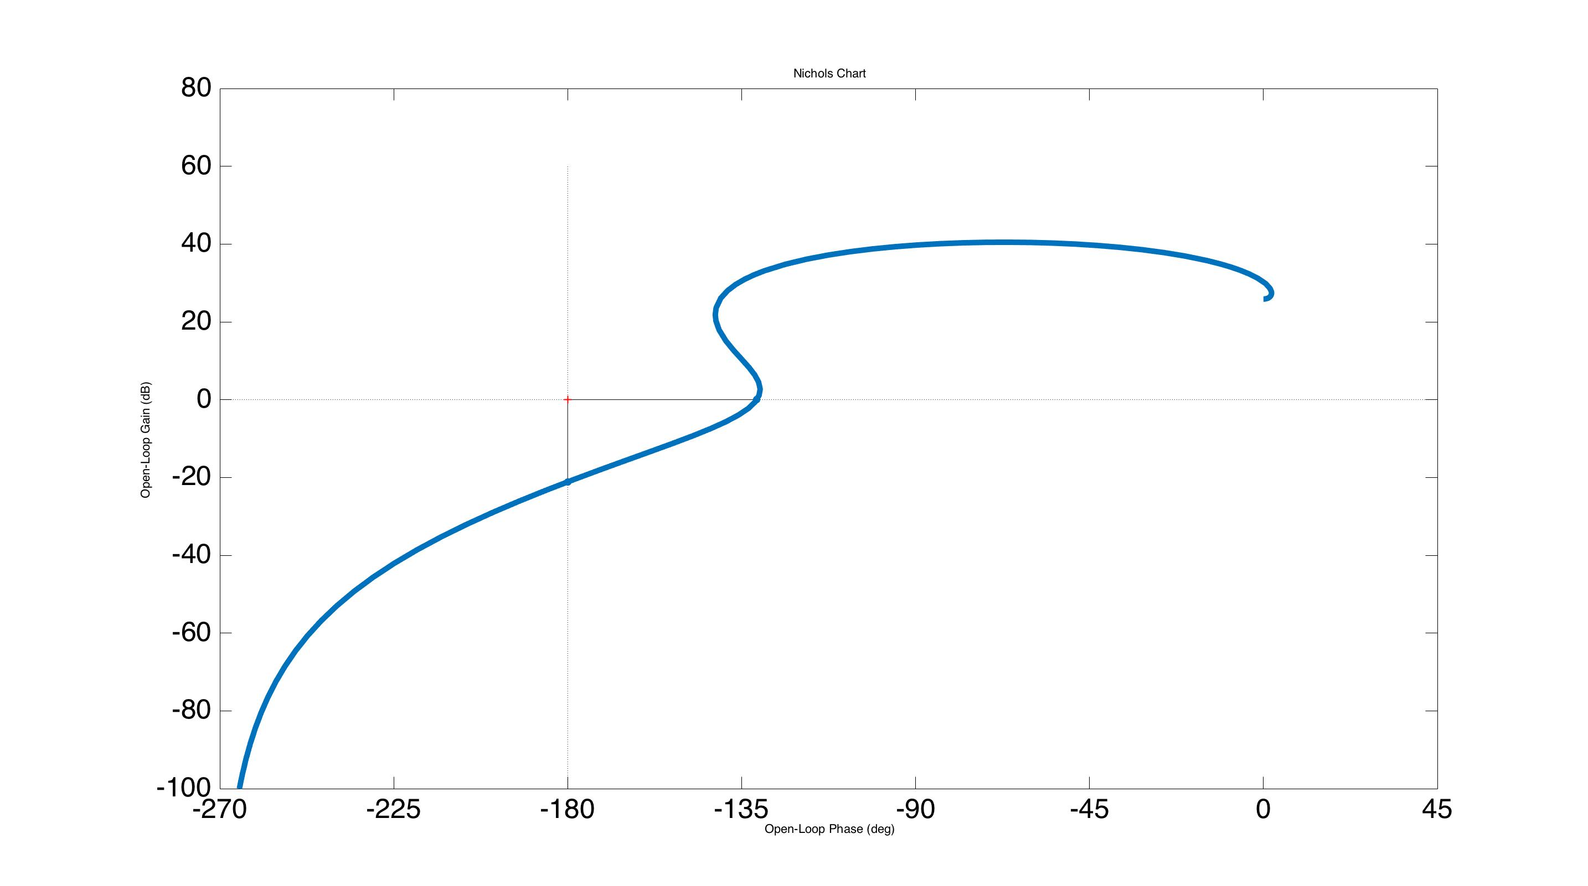
Loop Gain Nichols Plot: P_{a}C
Magnitude (dB)
Stable
Phase (degrees)
Matlab code: nichols(Pa*C),grid off
Notes:
These stability rules are, in my opinion, best represented by the Nichols plot of the loop gain. This Nichols plot is of the stable loop gain we just saw. It shows the same information as the bode plot, except here we have magnitude on the vertical axis (in dB units where 0 dB = 1) and phase on the horizontal. We don’t typically look at these plots when designing loops (perhaps we should). Typically we just look at the Bode plot and pick off phase and gain margins. However, stability is much more obvious in these Nichols plots than the Bode plots, so it is very useful to at least have these in mind when looking at the loop gain bode plots. The similar Nyquist plots are good too, and more traditional than these Nichols plots, however, Nichols plots are easier in my opinion because they are log spaced. In these Nichol’s plots a system is unstable if the -1 point is enclosed by the area under the curve. Here, it is not, so it is stable.
Note, if the uncontrolled plant has any unstable poles, the rules are subtly different. We’ll assume all our plants are naturally stable, so the rules discussed here apply.

Slide 94
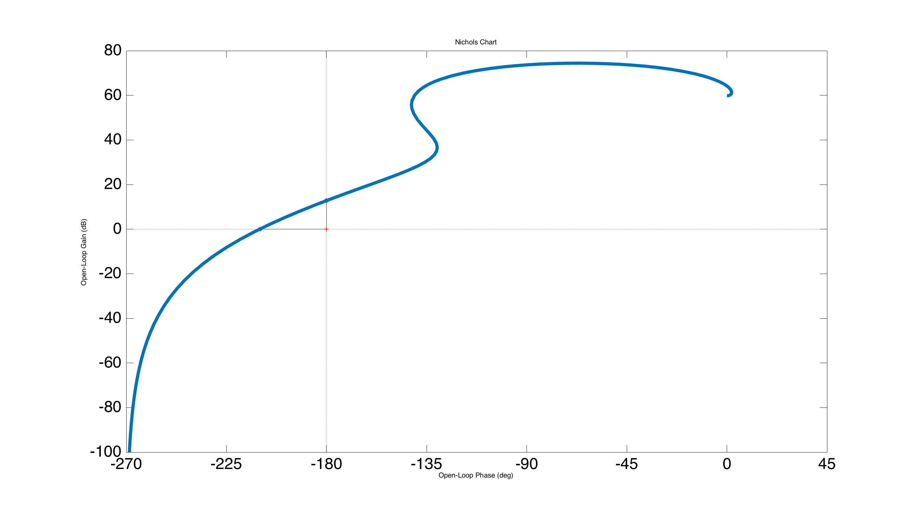
Loop Gain Nichols Plot: 50*P_{a}C
Magnitude (dB)
Unstable
Phase (degrees)
Matlab code: nichols(50*Pa*C),grid off
Notes:
Here is the Nichol’s plot with the unstable loop gain. See how the -1 point is now enclosed by the area under the curve.

Slide 95
Loop Gain Nichols Plot: 50*P_{a}C
Magnitude (dB)
Unstable
Rule of thumb: |phase| < 180 when crossing 1 (0 dB)
Phase (degrees)
Matlab code: nichols(50*Pa*C),grid off
Notes:
In general, you can keep a system stable simply by ensuring the loop gain phase is within +-180 degrees whenever the loop gain magnitude crosses unity.

Slide 96
Loop Gain Nichols Plot: 50*P_{a}C
* Derivation for this stability rule is mathematically abstract. See Ogata text book.
Magnitude (dB)
Unstable
Rule of thumb: |phase| < 180 when crossing 1 (0 dB)
Phase (degrees)
Matlab code: nichols(Pa*C),grid off
Notes:
As mentioned before, the derivation for these stability rules is mathematically abstract. See the Ogata text for details on the derivation.

Slide 97
Loop Gain TF: P_{a}C
Unity crossing
-180 crossing
Rule of thumb: |phase| < 180 when crossing 1
Matlab for control filter: C = zpk(-2*pi*3.33,-2*pi*[30;100],1.4e+10)
Notes:
We typically measure stability with phase and gain margin. So here is the stable loop gain again.

Slide 98
Loop Gain TF: P_{a}C
Gain margin
Unity crossing
-180 crossing
Phase margin
Rule of thumb: |phase| < 180 when crossing 1
Matlab for control filter: C = zpk(-2*pi*3.33,-2*pi*[30;100],1.4e+10)
Notes:
Stable phase margins are positive, where they are measured as the distance above the -180 degree line (and below the +180 degree line). Here it is about 45 degrees (180-135).
Stable gain margins are measured as the factor below unity whenever +-180 degrees is crossed. Here it is about 10, since the magnitude is 10 times below unity when crossing -180.

Slide 99
How to do control design
Multiple methods, but the most common is called ‘loop shaping’
Place poles and zeros until the loop gain is ‘shaped’ the way you like it
Causal filters require at least as many poles as zeros: n ≥ m. Non-causal filters respond with infinite magnitude and positive phase at infinite frequency, which they can only do if they have access to future data.
Notes:
In the next few slides, we follow an example of designing a feedback filter using the most common method, called loop shaping. Other design techniques exist, but this is by far the most common.
The technique involves placing poles and zeros in the feedback filter until the loop gain has the characteristics you desire.
Note, causal filters must have at least as many poles as zeros. If it is not causal, the filter can not be used in real-time, because it would require information from future data. Causality is not really in the scope of this lecture, but we’ll touch on it briefly on the next slide. There is also a backup slide in this lecture for it.

Slide 100
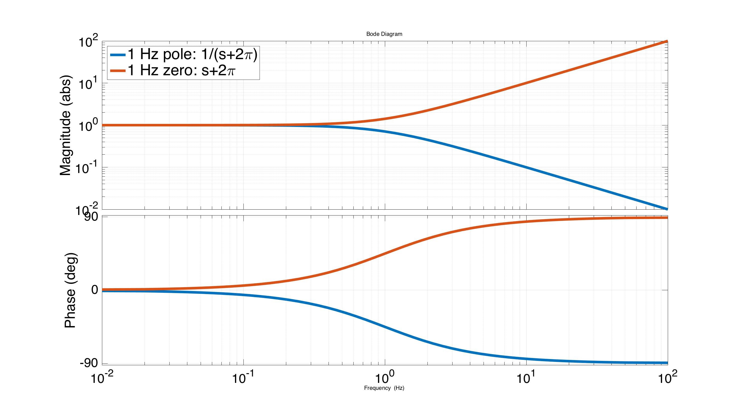
Control design: poles and zeros
LHP Poles: -90 deg phase, 1/f mag
LHP Zeros: +90 deg phase, f mag
Notes:
Before beginning the feedback design example, it is useful to look at a bode plot of a single zero, in red, and pole, in blue. Here both are set to 1 Hz. Note that the zero magnitude increases linearly with frequency, and the phase transitions to +90 degrees. The pole is the exact opposite. The magnitude is inversely proportional to frequency, and the phase goes to -90 degrees. (you can kind of think of the zeros and poles‘turning on’ as you move past them in frequency) For complex airs of poles and zeros, see the backup slides.
For the case of non-causal filters, we would have more zeros than poles, which means to magnitude would increase up to infinity at infinite frequency, with positive phase. This means the filter output would occur before the input. In realtime clearly this can’t happen. Non-realtime filters, for offline data processing, can have more zeros than poles.

Slide 101
Control design: poles and zeros
LHP Poles: -90 deg phase, 1/f mag
LHP Zeros: +90 deg phase, f mag
Note, don’t ever use these unless you have a really good reason:
RHP Poles: +90 deg phase, 1/f mag (unstable)
RHP Zeros: -90 deg phase, f mag (stable, but usually make feedback less stable)
Notes:
Note, these zero and pole properties are only valid for left half plane (LHP) poles and zeros. Right half plane (RHP) poles and zeros have the reverse phase characteristics (poles -> +90 phase, zeros -90 phase). It is best to avoid using either of these unless you have a really good reason. RHP poles are naturally unstable. RHP zeros are actually stable, however, they tend to make feedback less stable (because of their negative phase). RHP poles are zeros are not completely useless it turns out, but you should have a good reason for using them. For example, sometimes the only way to stabilize an unstable plant is to use RHP poles. This is a bit weird because it means you’re using an unstable controller to stabilize an unstable plant. In any case, nearly all our LIGO plants are stable (exceptions being some modes of the optics under high laser power, due to coupling to radiation pressure).

Slide 102
Control design: poles and zeros
Use poles at frequencies < ugf to get high magnitude at low frequency
Notes:
In general, the loop shaping design approach is to place poles at frequencies below the unity gain frequency (ugf) to get high low frequency gain.

Slide 103
Control design: poles and zeros
Use poles at frequencies < ugf to get high magnitude at low frequency
Use poles at frequencies > ugf to filter high frequency sensor noise
Notes:
And, to place them at at frequencies greater than the ugf to filter out sensor noise at high frequencies.

Slide 104
Control design: poles and zeros
Use poles at low frequency to get high magnitude before the ugf
Use poles at high frequency to filter sensor noise beyond the ugf
Use zeros to boost the phase above -180 at the unity crossing
Notes:
Then, the zeros are used primarily to boost the phase above -180 at the UGF so the loop is stable.

Slide 105
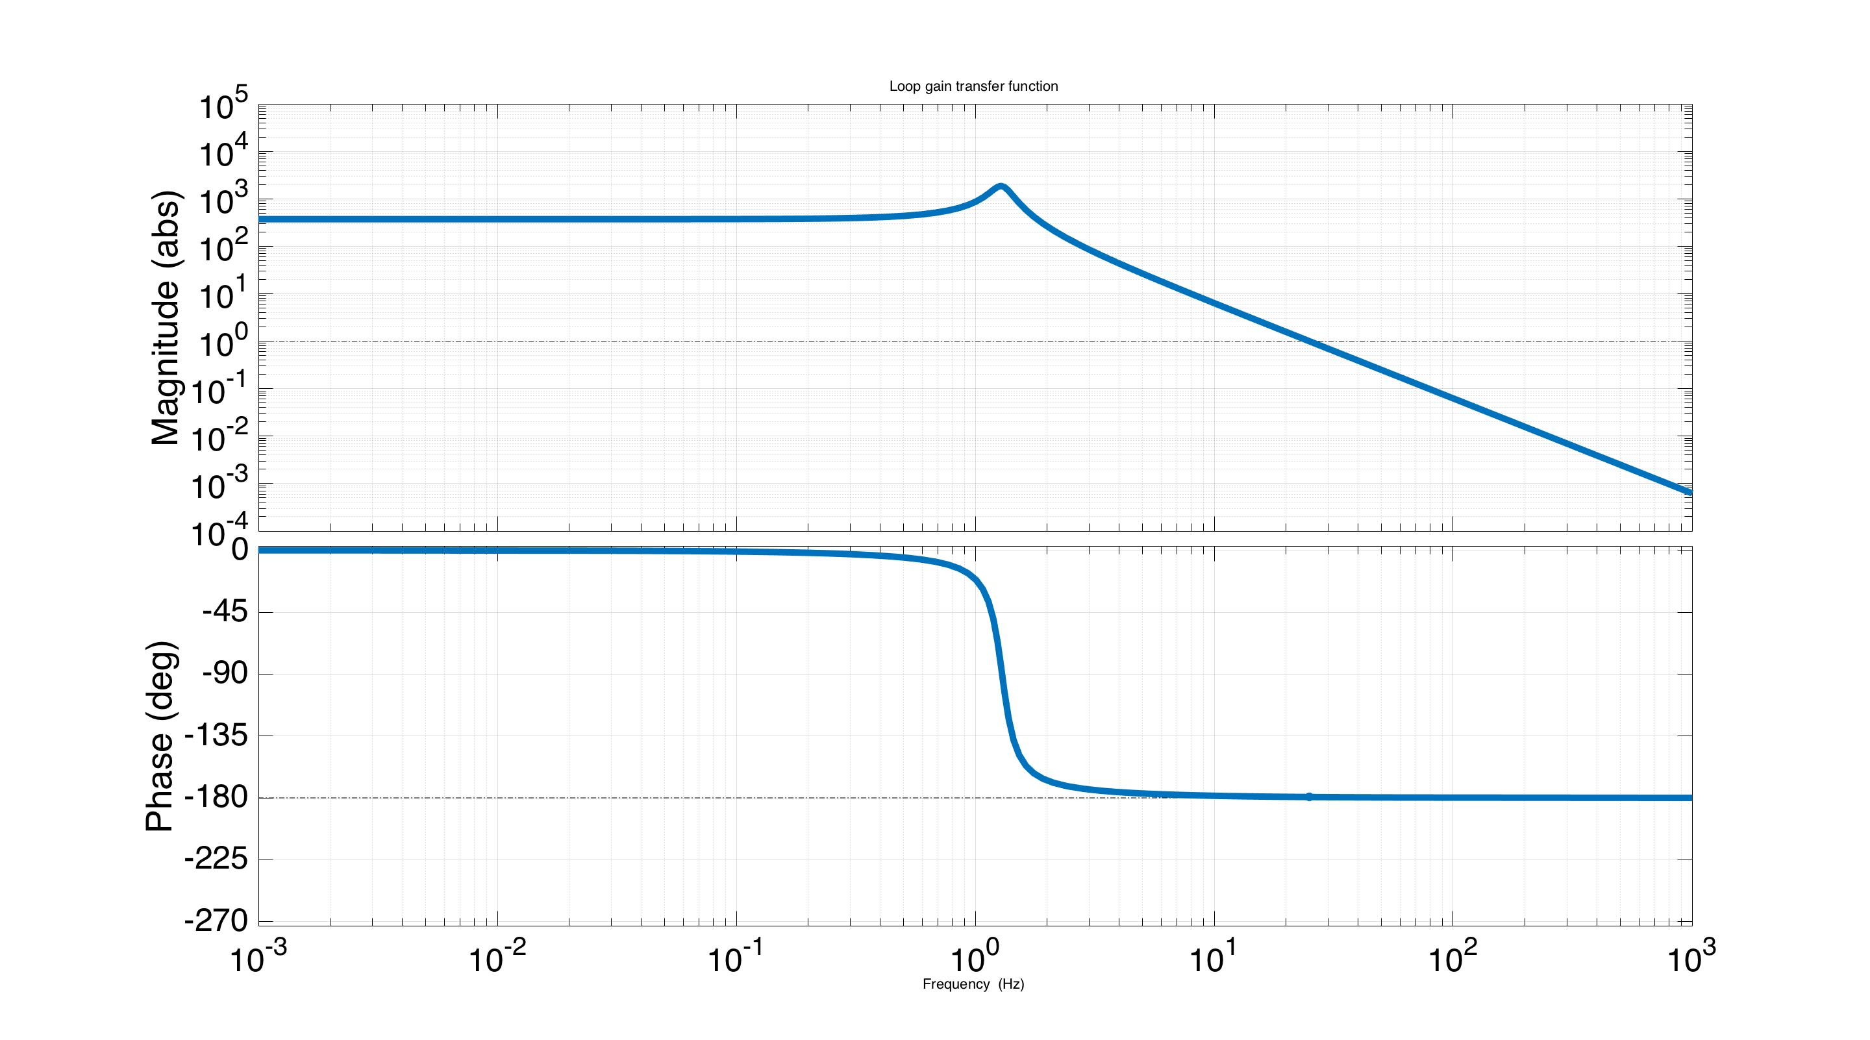
Control design: loop shaping
First, set unity gain frequency (ugf) to 25 Hz
Matlab for control filter: C = zpk([],[],4.7e7)
Notes:
So here is an example of a loop gain bode plot for the HAM-ISI. At this point the filter C is just a static gain value, chosen to set the ugf at 25 Hz. 25 Hz – 30 Hz is where the UGFs end up on the ISIs in practice, due to various limitations with going higher (primarily phase loss from sampling and continuous body vibrational modes).

Slide 106
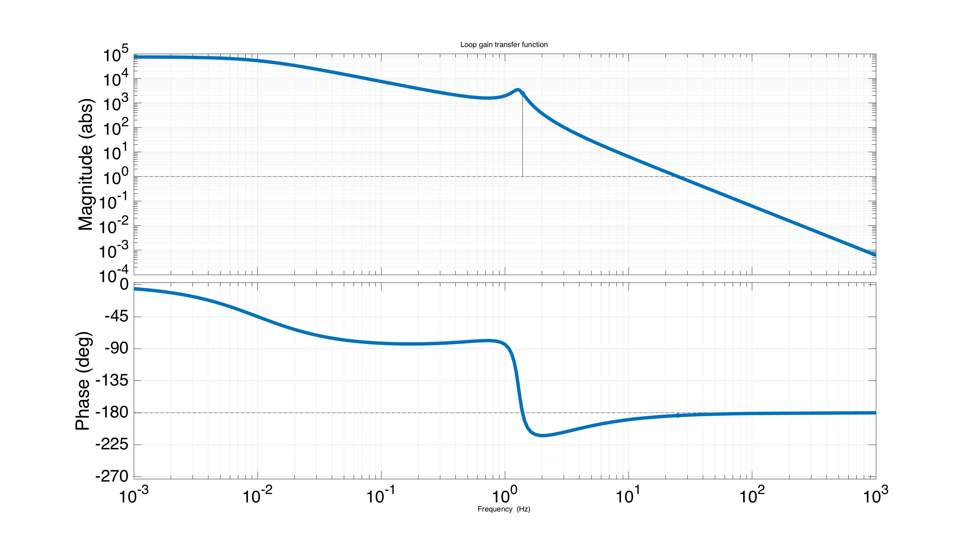
Control design: loop shaping
Boost the low freq gain with a 10 mHz pole & 2 Hz zero
Matlab for control filter: C = zpk(-2*pi*[2],-2*pi*[0.01],4.7e7)
Notes:
Then, we want to get more gain at low frequencies to reduce the influence of seismic noise where it is greatest. To do this, I have added a pole-zero pair, with the pole at 0.01 Hz and the zero at 2 Hz. We could do this without the zero, but the zero minimizes the phase loss at the UGF. However, the phase is still not quite stable at the UGF.

Slide 107
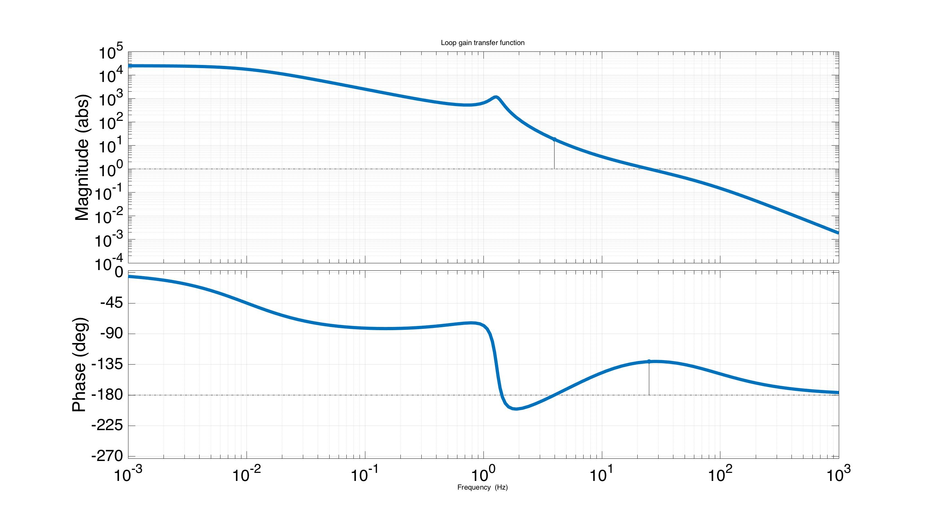
Control design: loop shaping
Stabilize with a zero-pole pair a factor of 3 below & above the 25 Hz ugf
Matlab for control filter: C = zpk(-2*pi*[2,25/3],-2*pi*[0.01,25*3],1.4e8)
Notes:
So we add another zero-pole pair, just to boost the phase around the UGF. These are centered around the UGF, with the zero a factor of 3 below, and the pole a factor of 3 above. Note, there is a compromise in doing this. If you flip between this slide and the previous one, you see that we have lost some low frequency gain. However, that gain does us no good if the system is unstable.

Slide 108
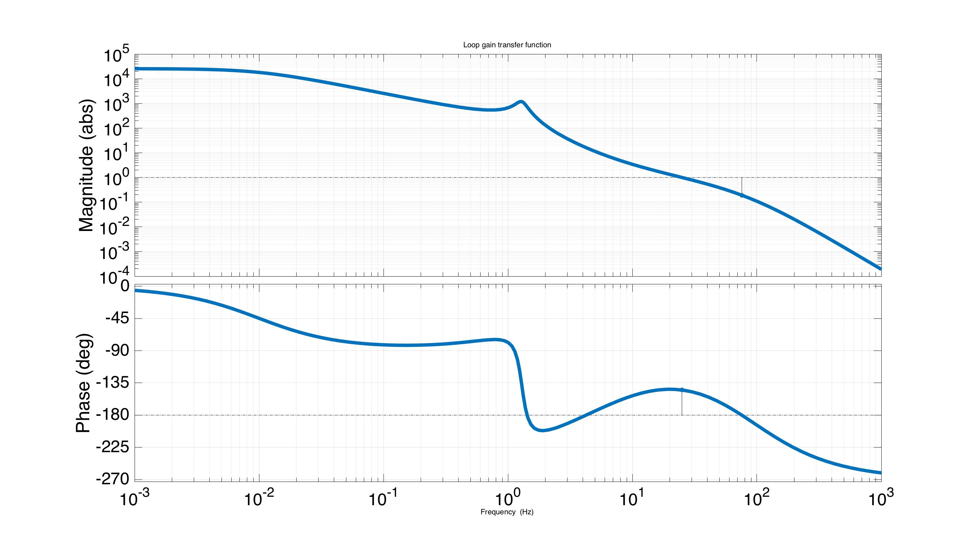
Control design: loop shaping
Give C more poles than zeros with a 100 Hz low pass pole
Matlab for control filter: C = zpk(-2*pi*[2,25/3],-2*pi*[0.01,25*3,100],9.1e10)
Notes:
Finally, we add a single pole at 100 Hz, just to filter away high frequency noise. In general it is good practice to ensure your filters have more poles than zeros, just so the response approaches zero at infinite frequency. This not only filters noise, but helps ensure the actuators don’t consume so much voltage that they saturate.

Slide 109
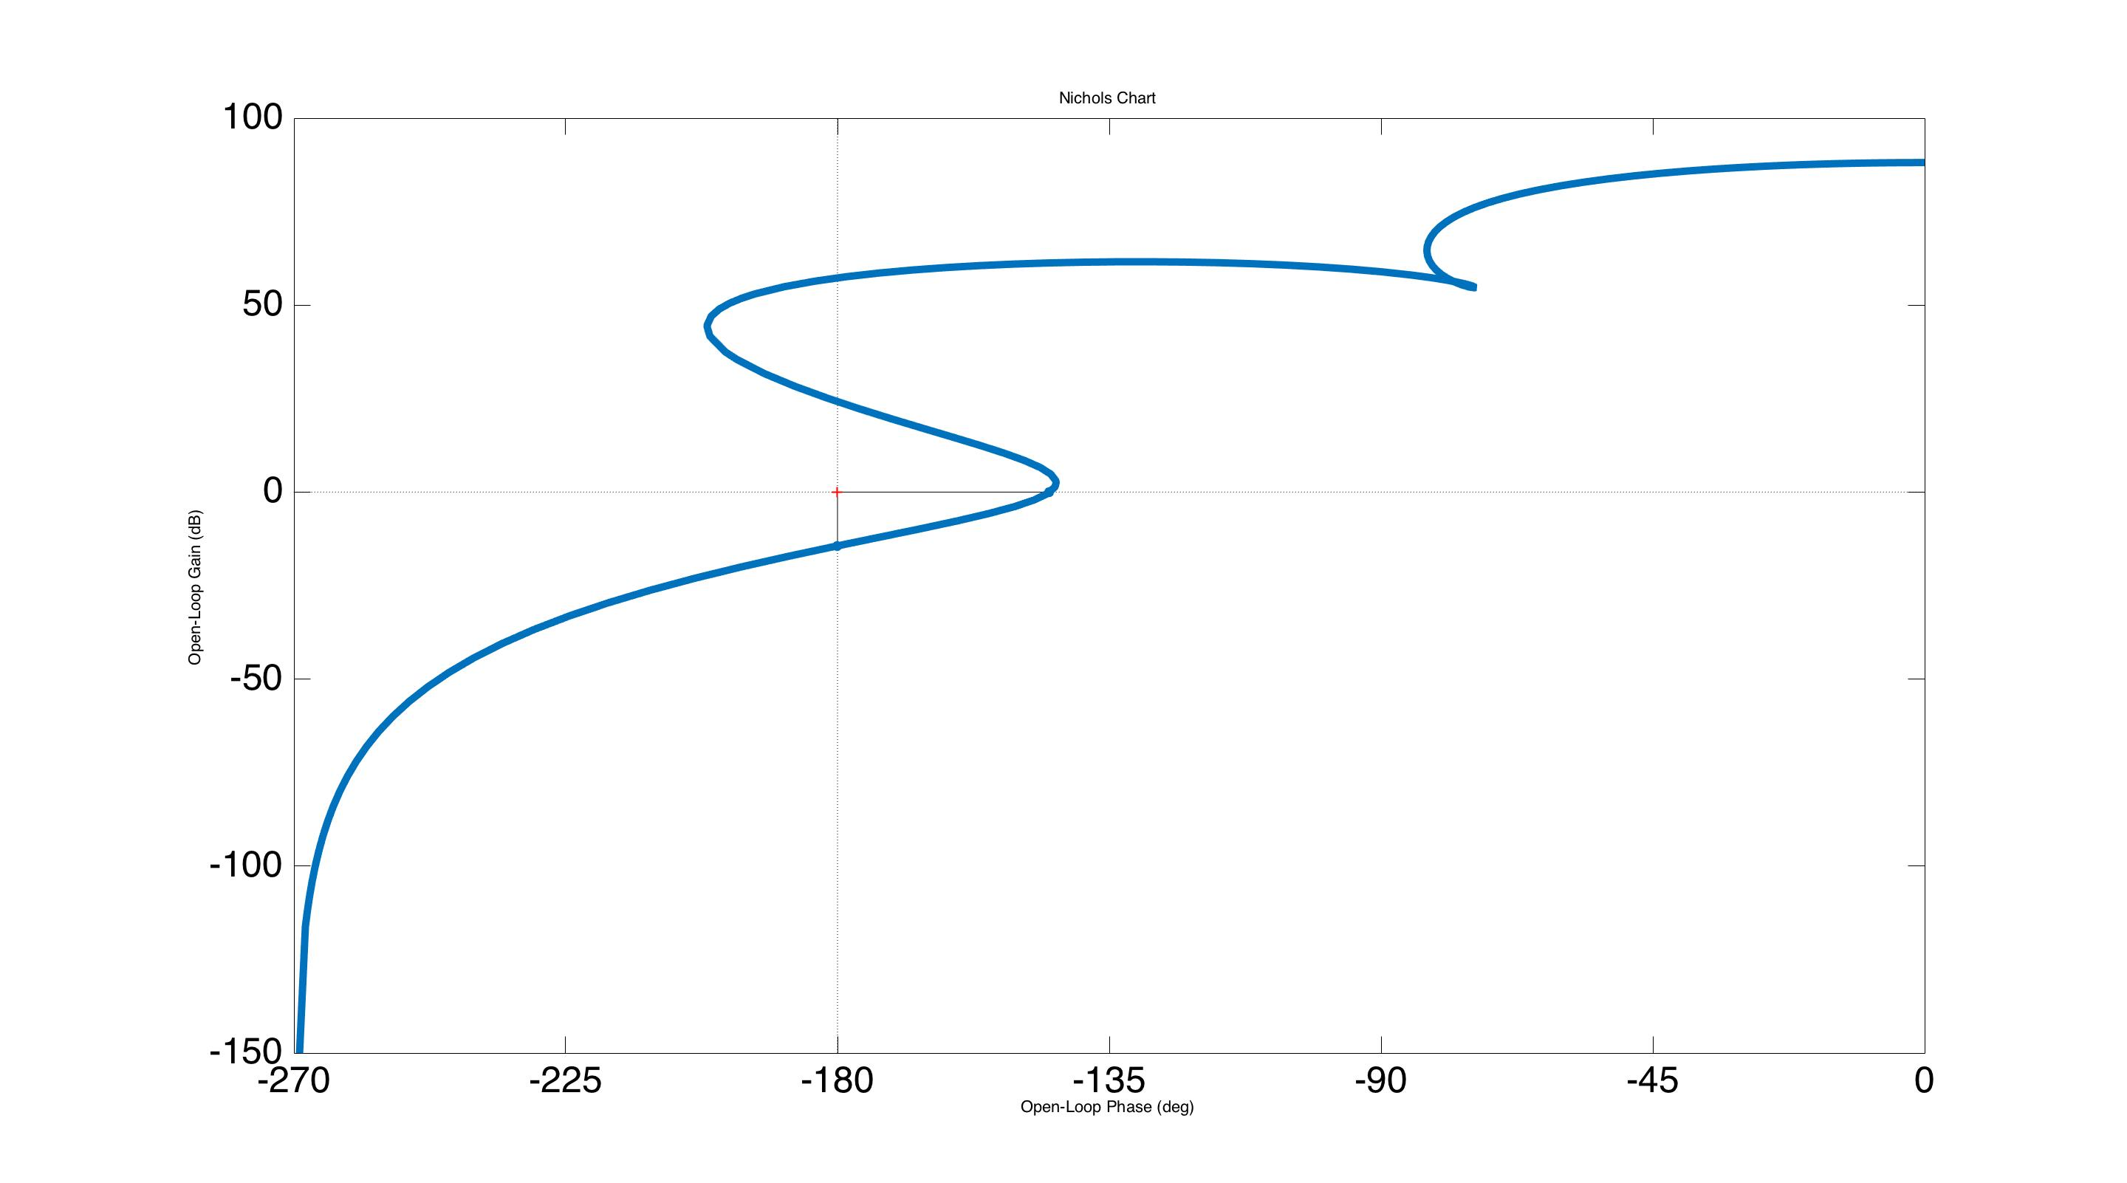
Control design: loop shaping
Nichols Plot
Magnitude (dB)
Phase (degrees)
Notes:
This is the Nichols plot of the resulting loop gain. The area under the curve does not include the -1 point, so it is stable.

Slide 110
Control design: loop shaping
Nichols Plot
Note, not unconditionally stable, meaning:
Both decreasing and increasing the gain causes instability
Magnitude (dB)
Phase (degrees)
Notes:
However, the -1 point is surrounded above and below by those lobes. This means that if we either increase or decrease the gain (curve moves up and down respectively) the system will go unstable. In this case we say the system is not unconditionally stable. An unconditionally stable system is one that is stable for all gains below a certain value. Non-unconditionanly stable systems are fine, we use them all the time, you just have to 1) be sure that the value of the gain is not going to change, and 2) be careful how you turn the feedback filter on.
You can’t just ramp the filter’s gain on like we usually do in this case. So you either have to turn it on all at once, or turn it on in pieces, where you start with an unconditionally stable piece, ramp its gain on, and then turn on the non-unconditionally stable piece.

Slide 111
Lecture 2 – Part 3
Sensor Blending
G1600726

Slide 112
Stage 1 of 1-stage of in-vacuum isolation table
(HAM-ISI)
Stage 0
Stage 0 to stage 1
+
+
-
+
Local & Cal
Actuation to stage 1
+
+
+
GS13
CPS
Cart & Cal
Cart & Cal
Stage 0 L4Cs
Damping
Cart & Cal
High pass
Feed-forward
Isolation
+
+
Low pass
Reference G1401207
Notes:
The final part of this loop is the sensor blending. The HAM-ISI uses a combination of relative capacitive displacement sensors (CPSs) and inertial sensors (the GS13 is a commercial geophone). These must be blended together into a single ‘super-sensor’ that we can send to the isolation feedback.

Slide 113
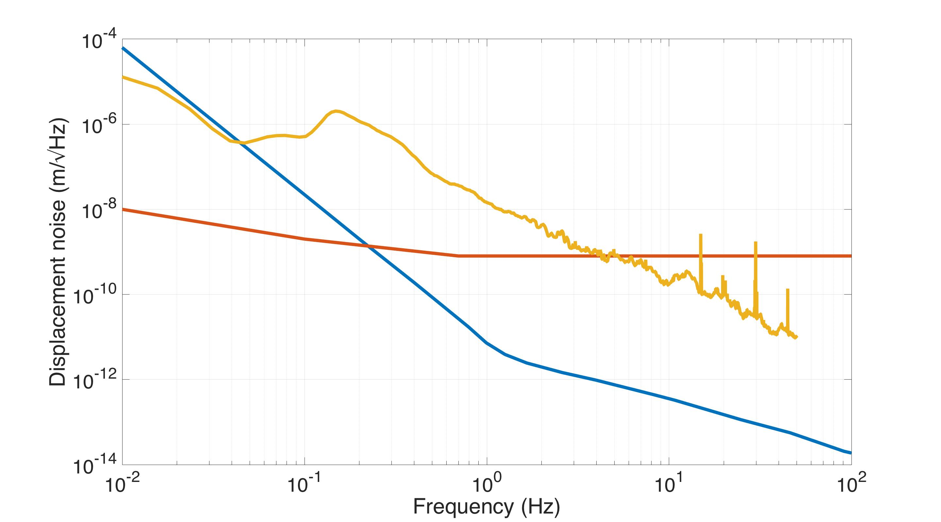
HAM ISI Sensor Noises
Ground – LLO Oct 2009 50th% (T1500224)
CPS displacement sensor
GS13 inertial sensor
Notes:
This plot illustrates why we need sensor blending. It shows the displacement noise of the CPSs and the GS13, compared to a typical ground motion spectrum. Note that at low frequencies the CPS noise is better, and at high frequencies the GS13 noise is better.

Slide 114
HAM ISI Sensor Noises
ideal blend frequency
Ground – LLO Oct 2009 50th% (T1500224)
CPS displacement sensor
GS13 inertial sensor
Notes:
We’re most interested in inertial isolation though, so the important crossover frequency is not where the sensor noises intersect, but where the inertial sensor noise intersects the ground motion. Here it is about 0.045 Hz. So we should use the displacement sensor below this, and the inertial sensor above. Thus the best ‘blend frequency’ is 0.045 Hz.
Note this ignores the issue of tilt-horizontal coupling all inertial sensors are subject to, which is not within the scope of this lecture. In general, horizontal inertial sensors are sensitive to being tilted. This sensitivity is proportional to g/w^2, where g is gravity and omega is 2*pi*frequency. So at low frequencies, tilt becomes a serious issue. This often limits how low we set the blend frequency (depending on the weather). For more information see P080073.

Slide 115
Blend filter design
Low pass the inertial sensor, high pass the displacement sensor
Low pass + high pass = 1
Notes:
To do the blending, we need to low pass the displacement sensor, and high pass the inertial sensor. Then we sum the two outputs to make a single sensor signal. Thus, to preserve units, the sum of the low pass and high pass must be 1 (assuming the two sensors are already calibrated to the same units). Strictly speaking, we don’t need to enforce the sum = 1, but not doing so would make the loop gain (and stability) dependent on the blending. We prefer to have the loop gain be the same for all blend configurations. With this sum = 1 requirement, the filters are said to be ‘complementary pairs’.

Slide 116
Blend filter design
Low pass the inertial sensor, high pass the displacement sensor
Low pass + high pass = 1
Simple approach
Make some low pass filter
Notes:
The simplest approach to designing blend filters with the sum = 1 constraint is to simply choose a low pass filter for the displacement sensor (or the high pass).

Slide 117
Blend filter design
Low pass the inertial sensor, high pass the displacement sensor
Low pass + high pass = 1
Simple approach
Make some low pass filter
Then, the high pass is simply
Notes:
Then the high pass for the inertial is just 1 – the low pass. (Or vice-versa).

Slide 118
Blend filter design
Low pass the inertial sensor, high pass the displacement sensor
Low pass + high pass = 1
Simple approach
Make some low pass filter
Then, the high pass is simply
This works, but hard to tune both simultaneously.
Notes:
This is fine, but then the high pass design completely depends on the low pass. We would prefer to have the freedom to design both independently.

Slide 119
Blend filter design
Low pass the inertial sensor, high pass the displacement sensor
Low pass + high pass = 1
Simple approach
Make some low pass filter
Then, the high pass is simply
This works, but hard to tune both simultaneously.
Try this instead:
Notes:
So instead, we take a different approach. We design the low pass and high pass we would like to have. These are called the ‘prototype’ filters. Then we normalize each by the sum of these prototypes. Therefore, the resulting low and high pass filters must be complementary pairs.

Slide 120
Blend filter design
But be careful!
Notes:
There is a price we pay for doing this though!

Slide 121
Blend filter design
But be careful!
This looks like a closed loop TF,
where the ‘loop gain’ is the ratio of the prototype filters.
Notes:
If you factor out one of the prototype filters from the denominator, you get a denominator with 1 + something.

Slide 122
Blend filter design
But be careful!
This looks like a closed loop TF,
where the ‘loop gain’ is the ratio of the prototype filters.
We must watch out for stability.
In practice, just keep the filters within 180 degrees of each other
when their magnitudes cross.
With this approach we’ve traded some stability for more design parameters
Notes:
This is kind of like when we have 1 + loopgain. Actually, it is exactly like that. And all the same stability rules apply. Thus, we must ensure that the two prototype filters are stable with each other. In practice, you just need to make sure their phases are within 180 degrees of each other when their phases cross.
So we have made a trade where we sacrifice some stability to generate more design parameters.

Slide 123
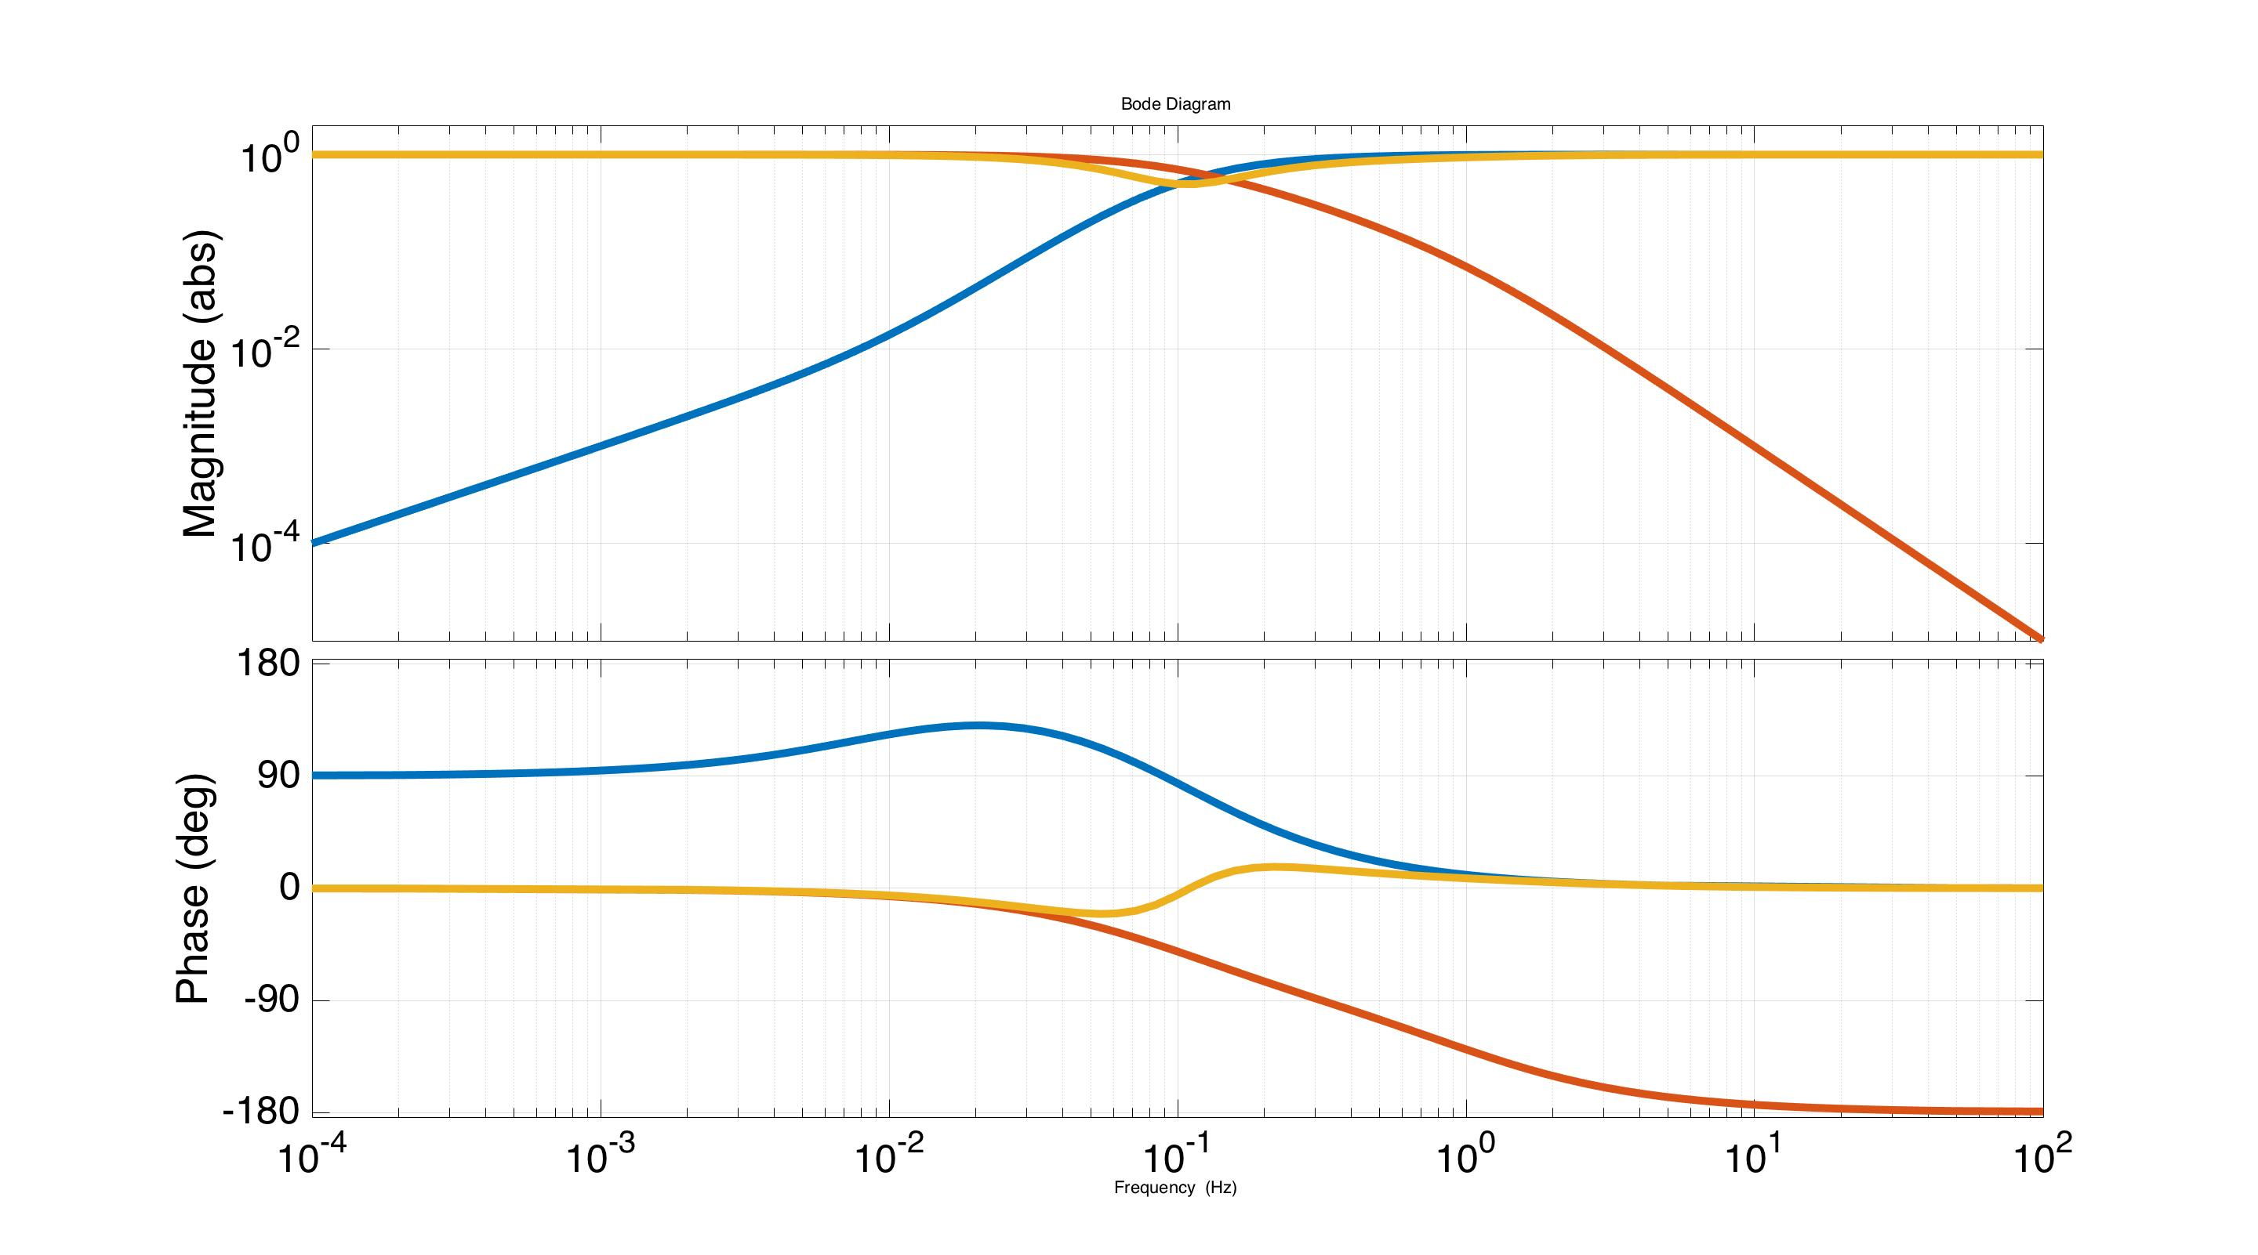
Prototype Blends
Filter sum
Inertial filter
Displacement filter
Frequency (Hz)
See Matlab code Blend_Example_Lecture2.m
Notes:
Here is an example of two prototype blend filters. See the example matlab code with this lecture.

Slide 124
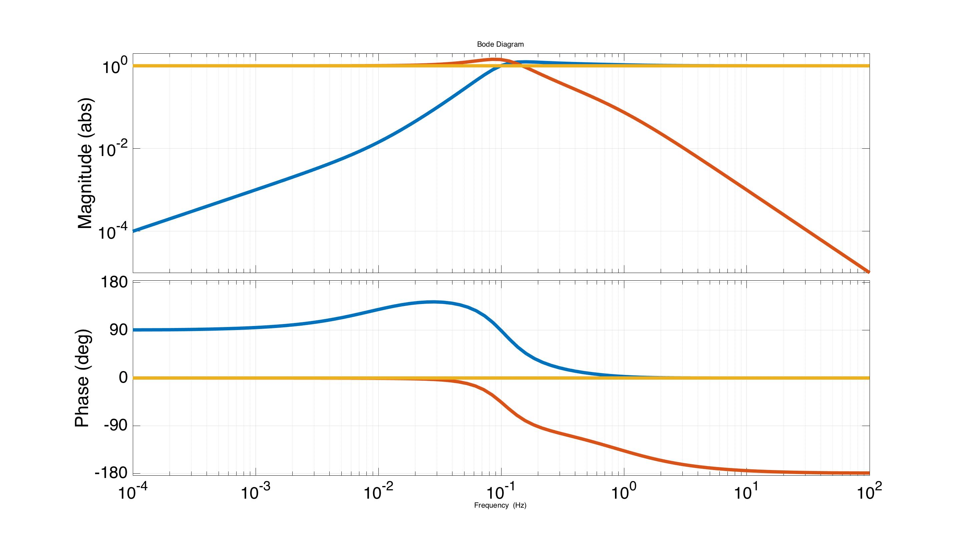
Implemented Blends
Filter sum
Inertial filter
Displacement filter
Frequency (Hz)
See Matlab code Blend_Example_Lecture2.m
Notes:
Then, when you do the normalization to make the complimentary pairs we actually implement, you get these filters.

Slide 125
Lecture 2 Summary
Seismic feedforward control depends only on the system’s connection to the ground.
For feedback stability the abs(phase) < 180 when the magnitude drops below 1
Sensor blending uses the displace sensor at low frequencies, the inertial sensor at high frequencies. Stability rules apply.
G1600726

Slide 126
Stage 1 of 1-stage of in-vacuum isolation table
(HAM-ISI)
Stage 0
Stage 0 to stage 1
+
+
-
+
Local & Cal
Actuation to stage 1
+
+
+
GS13
CPS
Cart & Cal
Cart & Cal
Stage 0 L4Cs
Damping
Cart & Cal
High pass
Feed-forward
Isolation
+
+
Low pass
Reference G1401207

Slide 127
Lecture 2 – Backups
G1600726

Slide 128
Matrix transformations
S₁
S₂
HAM ISI Stage 1
RY
Z
x
A₁
A₁
X
Ground
Sensing matrix
Actuation matrix
Notes:
This backup slide describes the matrix transformations that are shown in the example HAM-ISI control block diagram. Consider that we have 2 vertical sensors and 2 vertical actuators. We can combine the signals of the sensors to generate a Z sensor signal and an RY sensor signal. For Z, we simply take the average of the 2 (S1+S2)/2, which keeps the Z signal in the same units as the individual sensors (e.g. meters). For RY, we take the difference, normalized by the length between the sensors, so that we have units of rotation (e.g. radians). These transformations are grouped into a matrix, as shown here by the sensing matrix.
Similarly, we can combine the actuator signals to generate Z and RY actuator signals, as shown by the Actuation matrix. The actuation matrix is the transpose of the sensing matrix if La = Ls (or more generally, if the sensors and actuators are collocated).

Slide 129
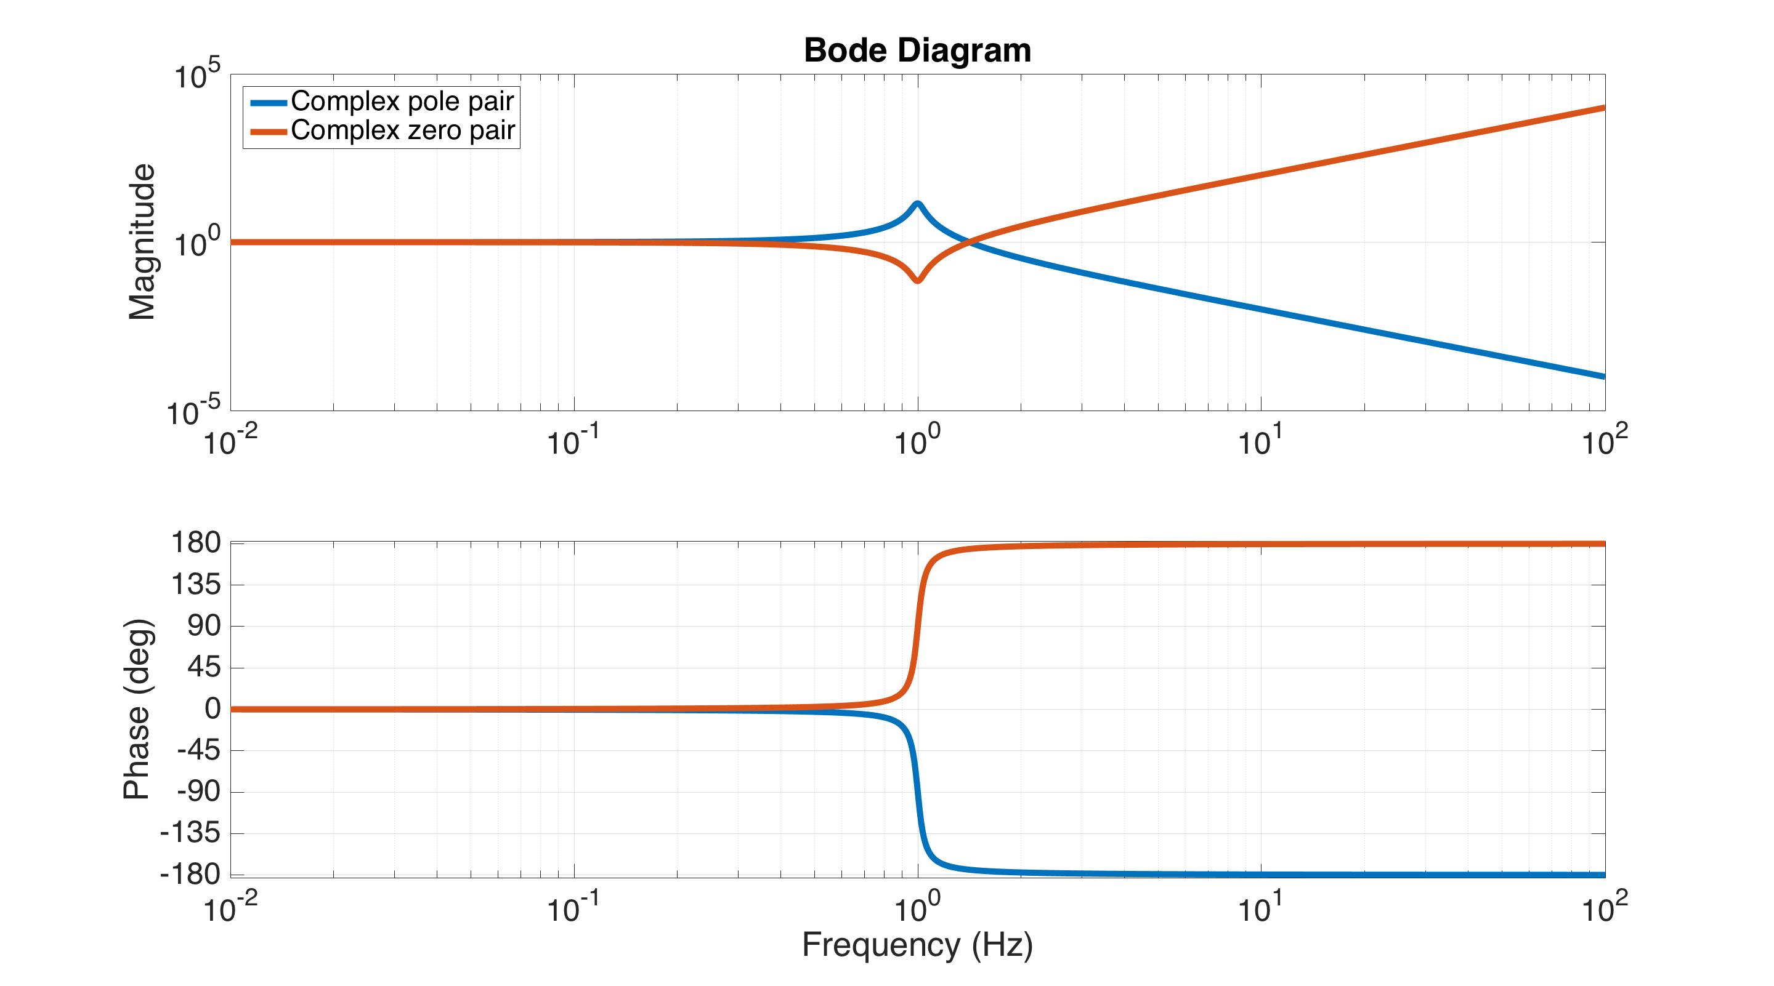
Complex pairs of poles and zeros
LHP Poles: -180 deg phase, 1/f² mag
LHP Zeros: +180 deg phase, f² mag
1 Hz complex pairs, 2 degrees off the imaginary axis.
Notes:
Complex pairs of poles and zeros are in many ways just like 2 repeated real poles and zeros. The main difference is that they have a damping term, which depends on the angle they make with the imaginary axis of the complex plane. In this case the angle is only 2 degrees, so the damping is small, where Quality factor = 1 / (2 * sin(angle) ). Lightly damped poles have a large resonance peak, and a short phase transition from 0 to -180 degrees. Lightly damped zeros have a large ‘notch’ feature, and a short phase transition from 0 to +180 degrees. For zero damping, the pole peak goes to infinite magnitude, and the zero notch goes to zero magnitude. The phase transition is instantaneous.

Slide 130
Extracting the GW signal
More detail in G1600412
C: Control
force
P: Suspension
S:
IFO
+
DARM
Noise
Gravitational wave
The GW exists in both signals. For large gains, DARM -> 0, while the force does not. However, the signal to noise is the same, so both are equally good.
Notes:
The arm cavity feedback control holds the arms at a fixed length. So how do we get the gravitational wave signal from the interferometer if the arm lengths aren’t allowed to change?
First, the feedback control doesn’t zero out the length fluctuations, it just makes them smaller. The length fluctuations are suppressed by 1+loopgain (if S = 1). So if we have a good model of the loop gain (which can be measured easily enough), we just multiply the measured photodiode signal (DARM) by 1+loopgain. You can think of this more physically as taking into account how much force the control is applying to minimize the length fluctuations. The loop also happens to suppress the cavity noise by the same amount as the gravitational wave, so the signal to noise ratio of the gravitational wave is unchanged by the feedback. We could also get the signal from any other place in the loop. For example, the gravitational wave signal also appears in the feedback force we apply with the actuators.

Slide 131
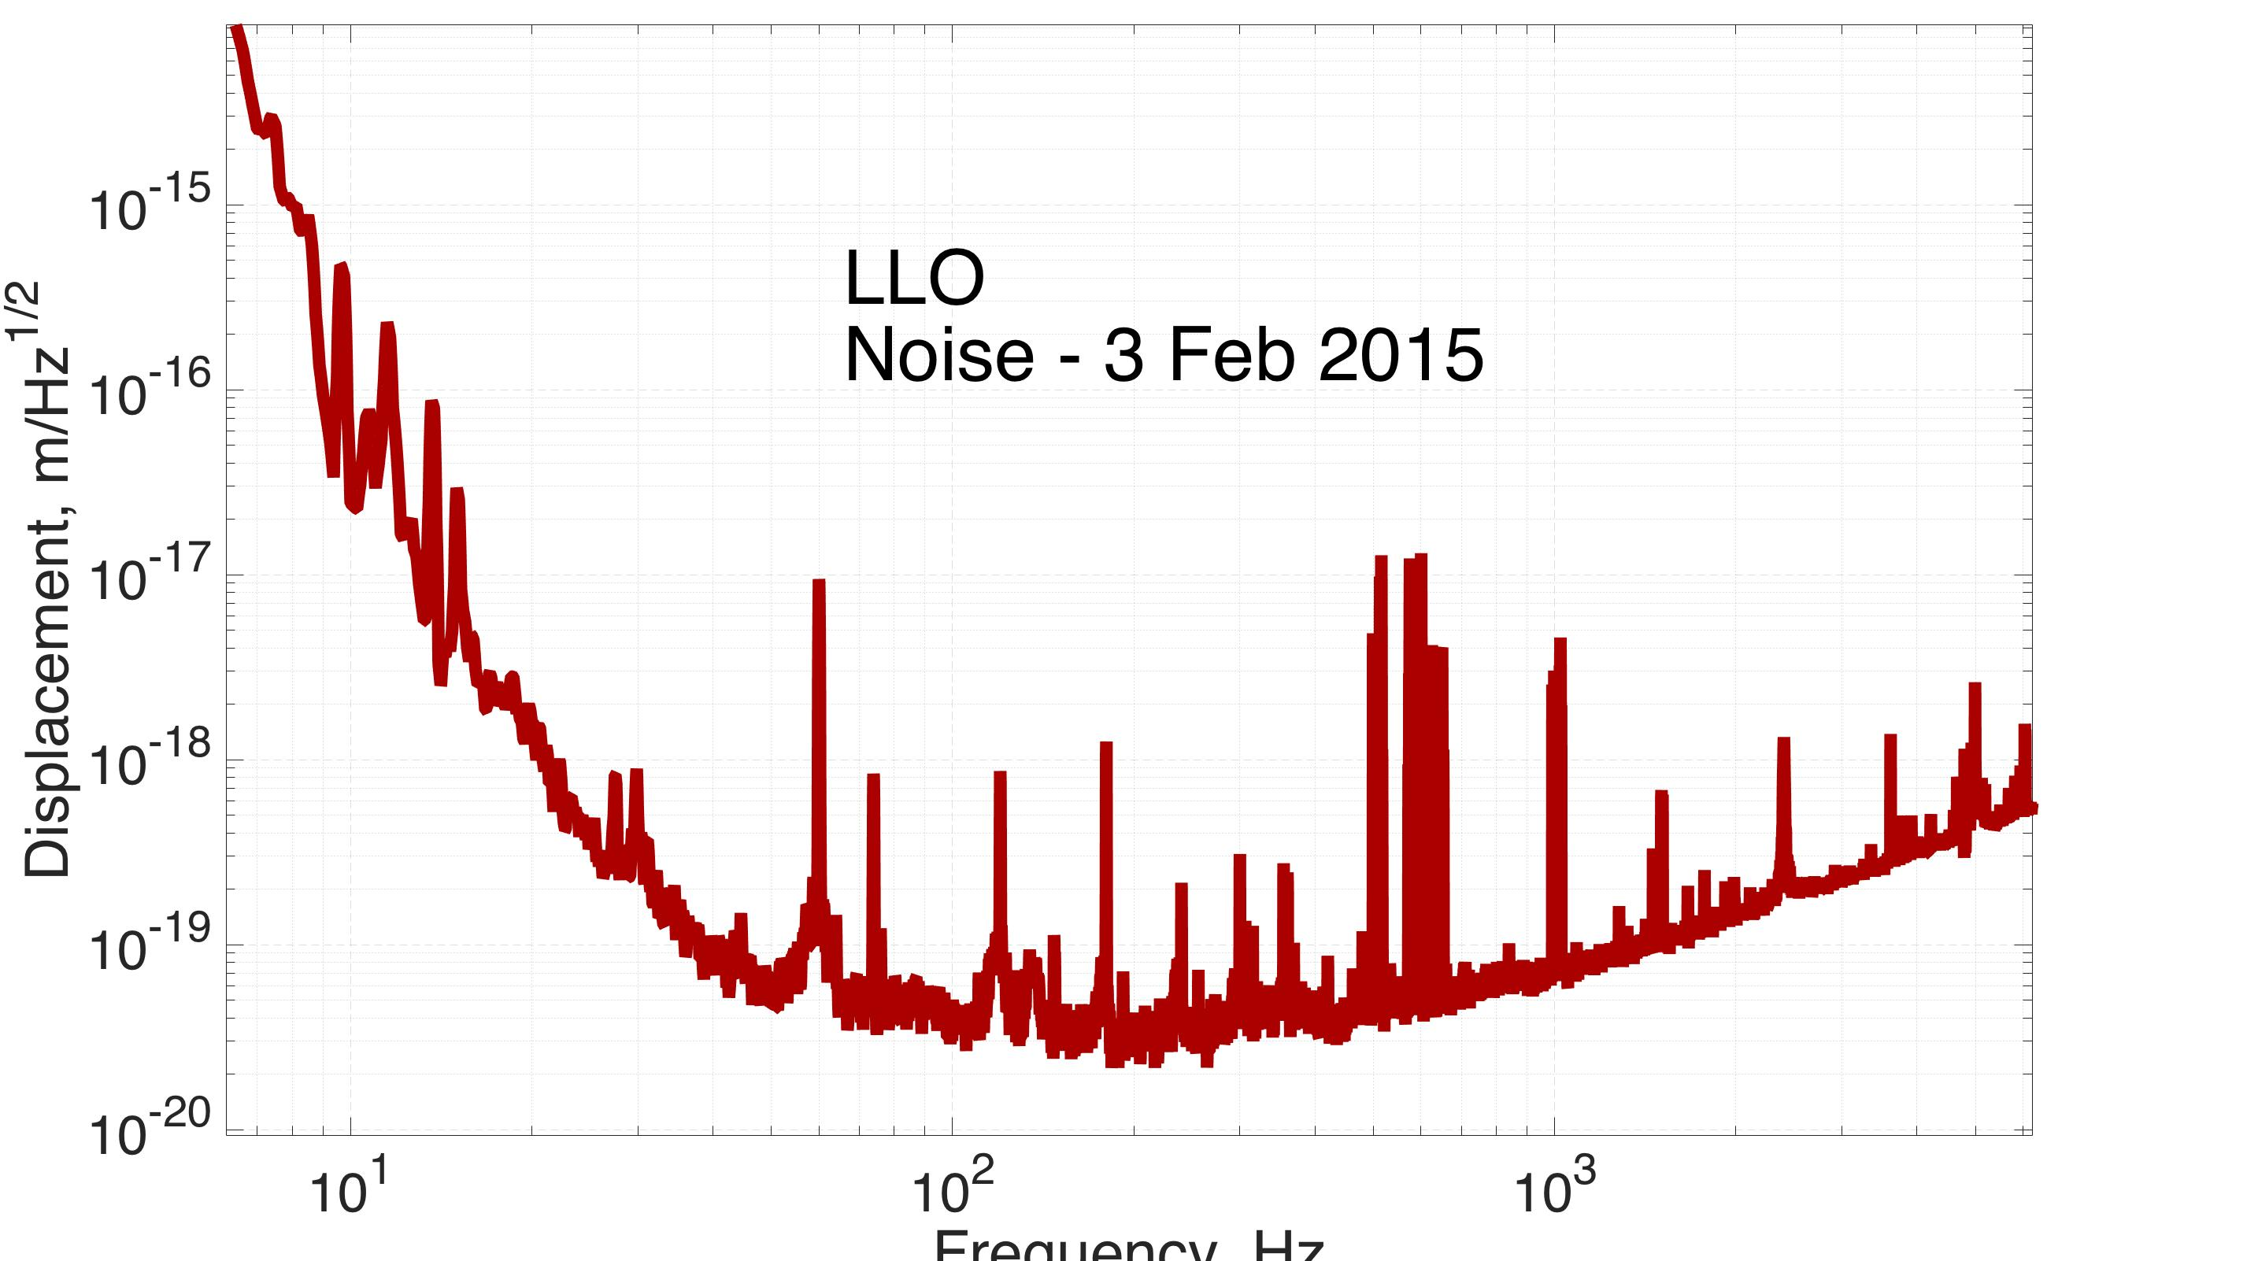
Extracting the GW signal
More detail in G1600412
C: Control
force
P: Suspension
S:
IFO
+
DARM
Noise
Gravitational wave
The GW exists in both signals. For large gains, DARM -> 0, while the force does not. However, the signal to noise is the same, so both are equally good.
Notes:
Here, the cavity noise is the same curve we see when we look at the aLIGO sensitivity plots.

Slide 132
Extracting the GW signal
More detail in G1600412
C: Control
force
P: Suspension
S:
IFO
+
DARM
Noise
Gravitational wave
If noise is small enough!
Hat indicates a system model
Notes:
If the gravitational wave is bigger than all other noise sources, than our measurement of it is the measured DARM signal times our model for the inverse of the closed loop transfer function. Here, the hats indicate models of the real system. It is the job of the aLIGO calibration group to ensure these models are good representations of what we have.

Slide 133
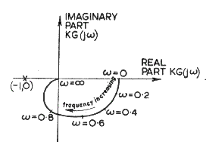
Nyquist plot
These plots are traditionally shown over Nichols plots,
but are harder to look at since they can’t be put in logspace.
Stability is achieved by not circling the -1 point
If a plant has unstable poles, then the rules change. See Ogata text.

Slide 134
Closed Loop TFs
S
S is called the ‘sensitivity’ TF and is common to all closed loop TFs in a loop

Slide 135
Another explanation for causality
Signal: x
t₋₂
t₋₁
t₀
time
A zero-pole pair (where the pole is at higher freq) is like a derivative approximation, where the pole determines the effective sampling time. Deleting the pole is the same as setting it to infinite frequency, which makes the time step = 0, which means we’d effectively be seeing the future by knowing the slope instantaneously.

Slide 136
Lecture 3
Digital Control
- Part 1: Sampling
- Part 2: User interface
- Part 3: Digital time &
frequency domain
G1600726

Slide 137
Lecture 3
Digital Control
- Part 1: Sampling
G1600726

Slide 138
Digital Feedback Signal Flow
Sensor
Anti-alias
ADC
Compens-ation Filter
Input Matrix Transformation
Measurement
Control and User Interface
Plant
Analog
Software
Actuation
Actuator
Anti-image
DAC
Compens-ation Filter
Output Matrix Transformation
Notes:
This is a typical block diagram for a feedback loop made with a digital control system. Note the symmetry of the diagram. The left is all analog components, the right software. The top is the sensing path, the bottom the actuation path.
Many of the blocks are what we have seen before, the plant, sensor, actuator, and controller. The compensation filters and matrix transformations are optional, and not unique to digital control systems. These are simply used to put signals into some desired units (e.g. meters) and coordinate system (e.g. x-y-z Cartesian coordinates). The main new thing here are the ADC and DAC, which move signals into and out of the computer; and the Anti-alias and Anti-image filters which smooth over the transitions through the ADC and DAC.

Slide 139
Sampling Hardware
ADC – Analog to Digital Converter. Samples the data and brings it into the computer.
Anti-Alias filter – filters noise close to and above the sampling frequency.
DAC – Digital to Analog Converter. Outputs the computer signals.
Anti-Image filter – filters harmonics close to and above the sampling frequency.
Notes:
The Anti-alias filter removes signals close to and above the sampling frequency, before the ADC brings the signals into the computer. The anti-image filter removes harmonics of the computer output before sending those signals to the actuators. We’ll see examples of this in the upcoming slides.

Slide 140
Optional Software Blocks
Compensation blocks – Can also be called ‘calibration’ blocks. These are optional, and are used to cancel out the analog frequency response of sensors and actuators and/or put them into meaningful units.
Matrix transformations – Also optional. Are used to put sensor and actuator signals into useful coordinate systems. For example, 2 vertical sensors next to each other can be combined to give you a vertical (Z) and a rotation (roll) signal.
Notes:
These blocks are optional, but make life easier.

Slide 141
Software Blocks
Control and user interface – Where the control filters and control logic goes. Also, the software that allows the user to interact with the control lives here.

Slide 142
Digital Feedback Signal Flow
Sensor
Anti-alias
ADC
Compens-ation Filter
Input Matrix Transformation
Measurement
Control and User Interface
Plant
Analog
Software
Actuation
Actuator
Anti-image
DAC
Compens-ation Filter
Output Matrix Transformation
Notes:
Let’s take a look next at what the Anti-alias filter does for us.

Slide 143
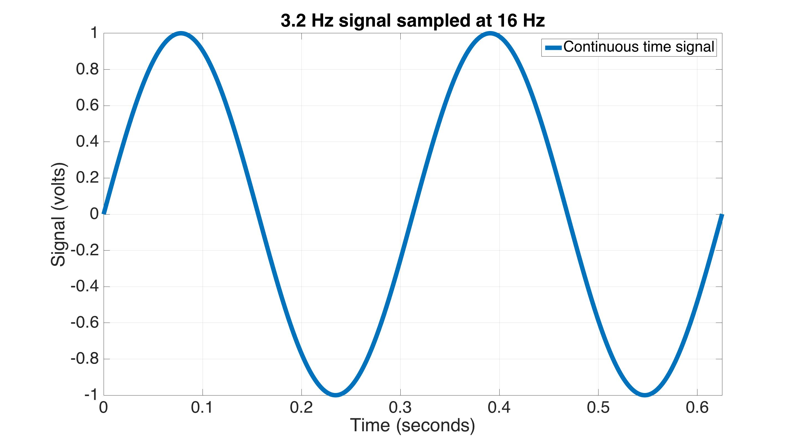
Aliasing – time domain
Notes:
Here is an example of a continuous sine wave, at 3.2 Hz.

Slide 144
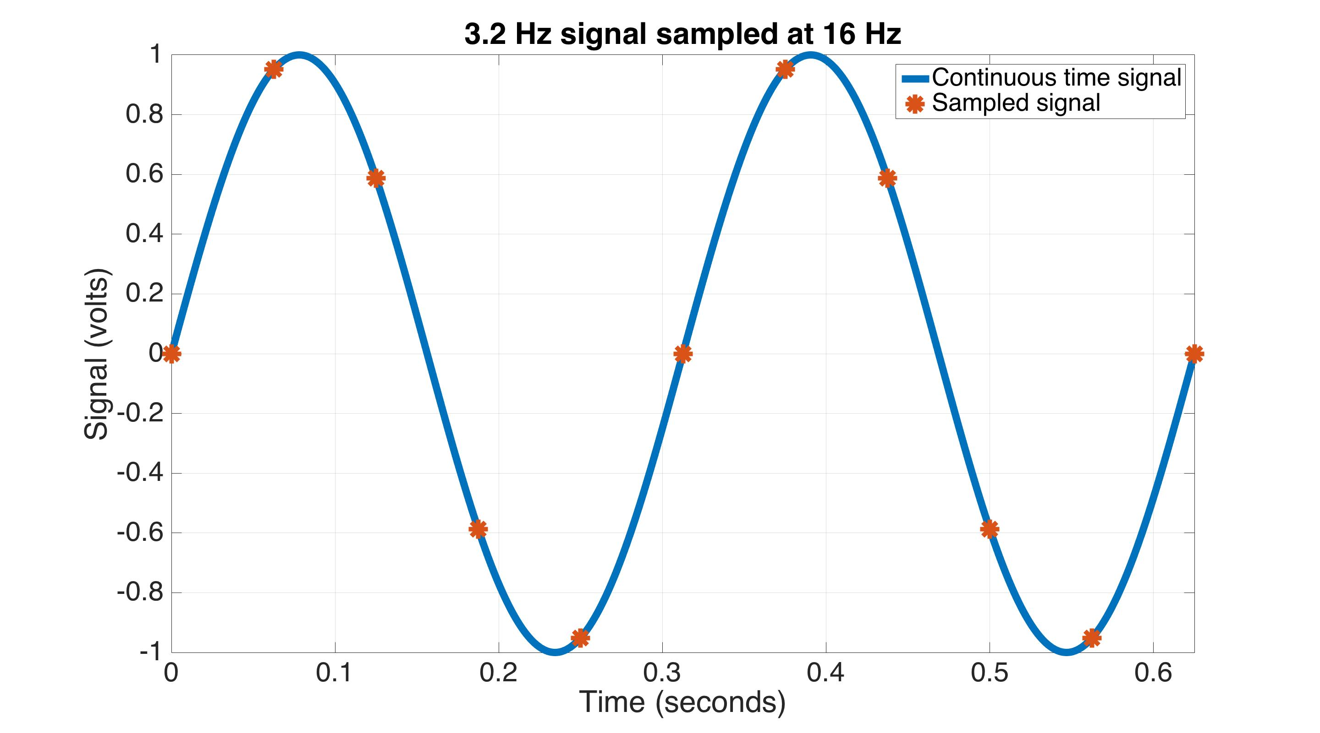
Aliasing – time domain
Notes:
We now sample this wave at 16 Hz with the ADC. The continuous wave passes cleanly through each of the sampled points.

Slide 145
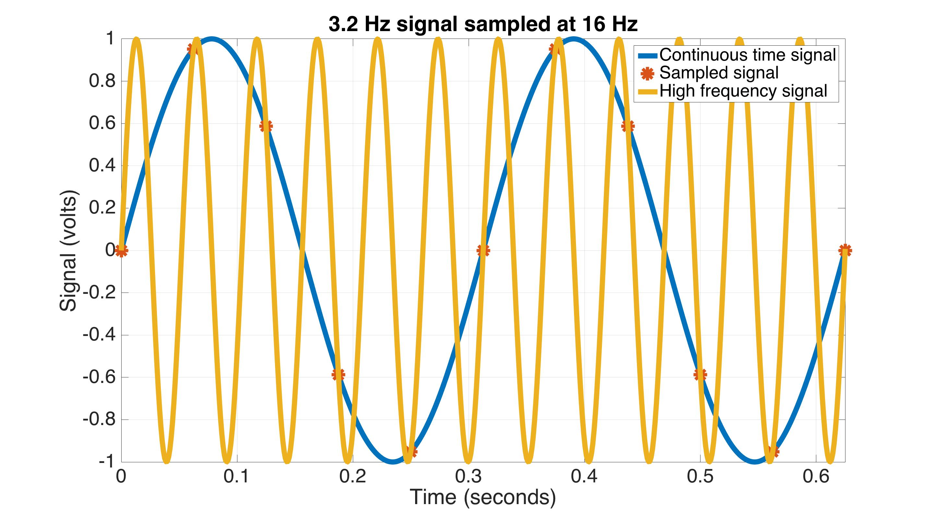
Aliasing – time domain
Notes:
But, we could also draw a higher frequency sine wave through these points. This yellow line is at 3.2+16=19.2 Hz. So, when we sample with the ADC, we don’t know which one we have. Thus, we make the assumption that our sampled points are passing through the lowest possible frequency sine wave.

Slide 146
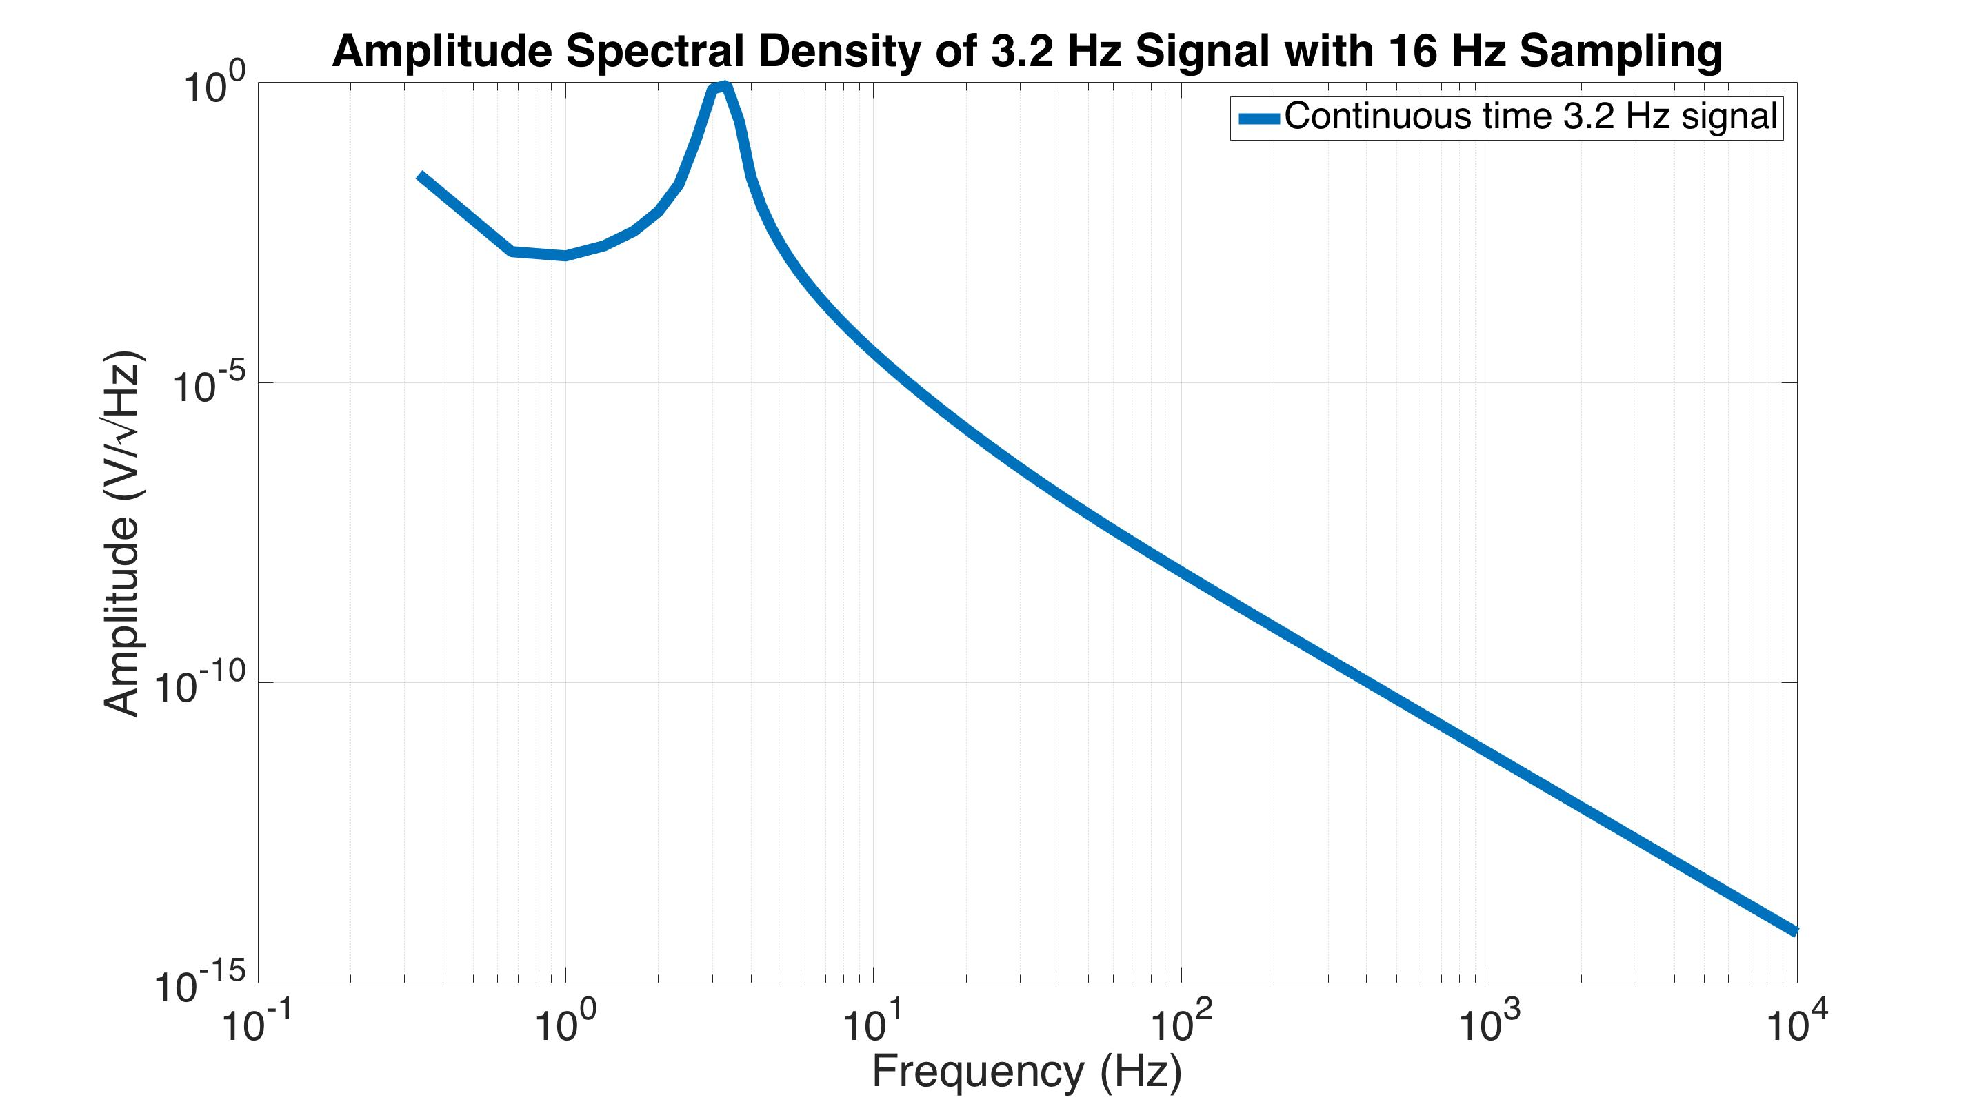
Aliasing – frequency domain
‘Continuous’ time data
Notes:
Moving from the time domain to the frequency domain, here is an amplitude spectral density (ASD) of the 3.2 Hz continuous wave.

Slide 147
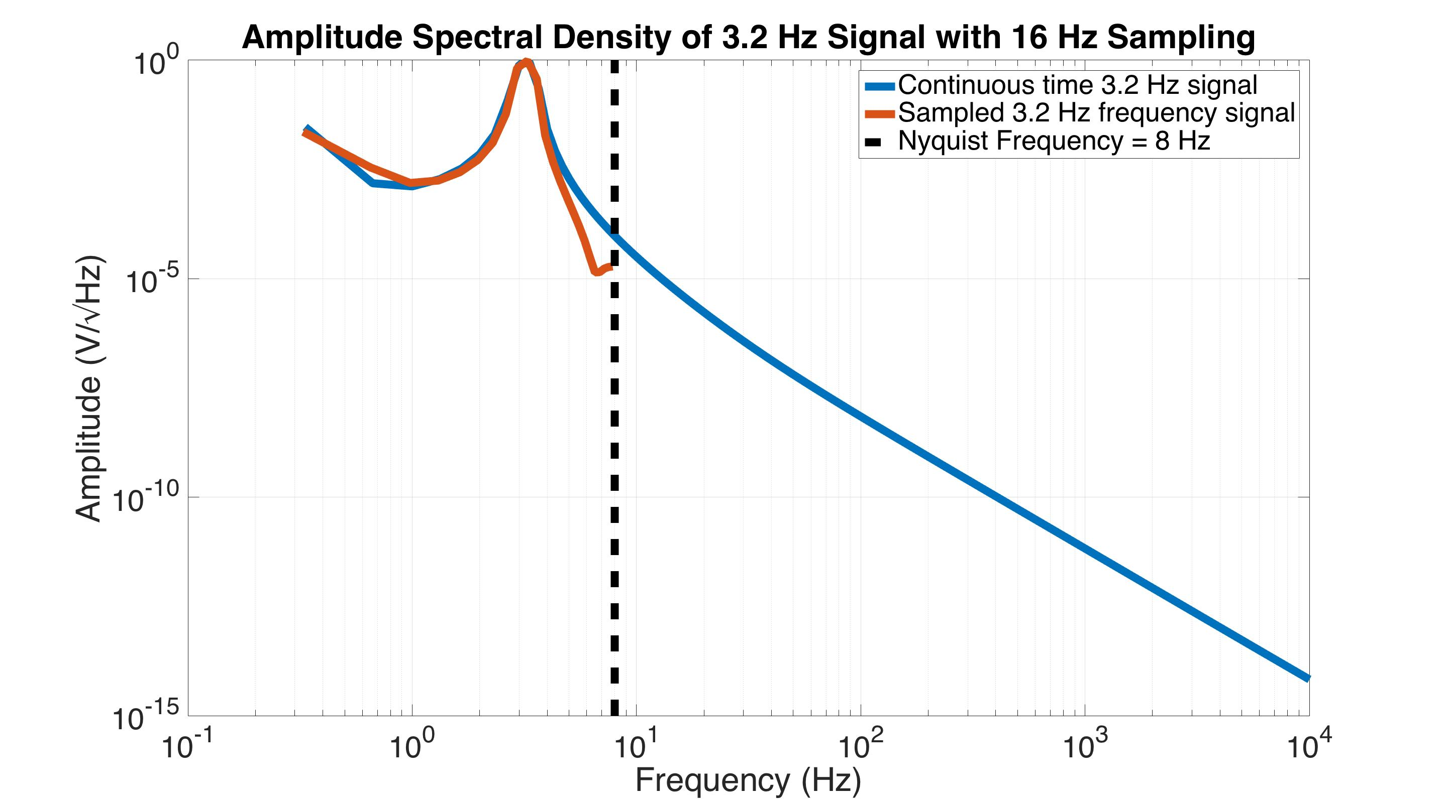
Aliasing – frequency domain
Sampled data
Nyquist frequency =
½ sampling frequency
‘Continuous’ time data
Notes:
Adding the ASD of the sampled data, we get the red curve (because we assume the sampled points represent the lowest possible frequency). I have also added the vertical dashed line at what is known as the Nyquist frequency. This is half the sampling frequency. It turns out that you can only recover signals that are < half the sampling frequency. Basically, the Nyquist sampling rule says that you need at least 2 samples per sine wave to recover that sine wave. This is why the red line stops at this vertical Nyquist frequency line, we can’t recover anything beyond it.

Slide 148
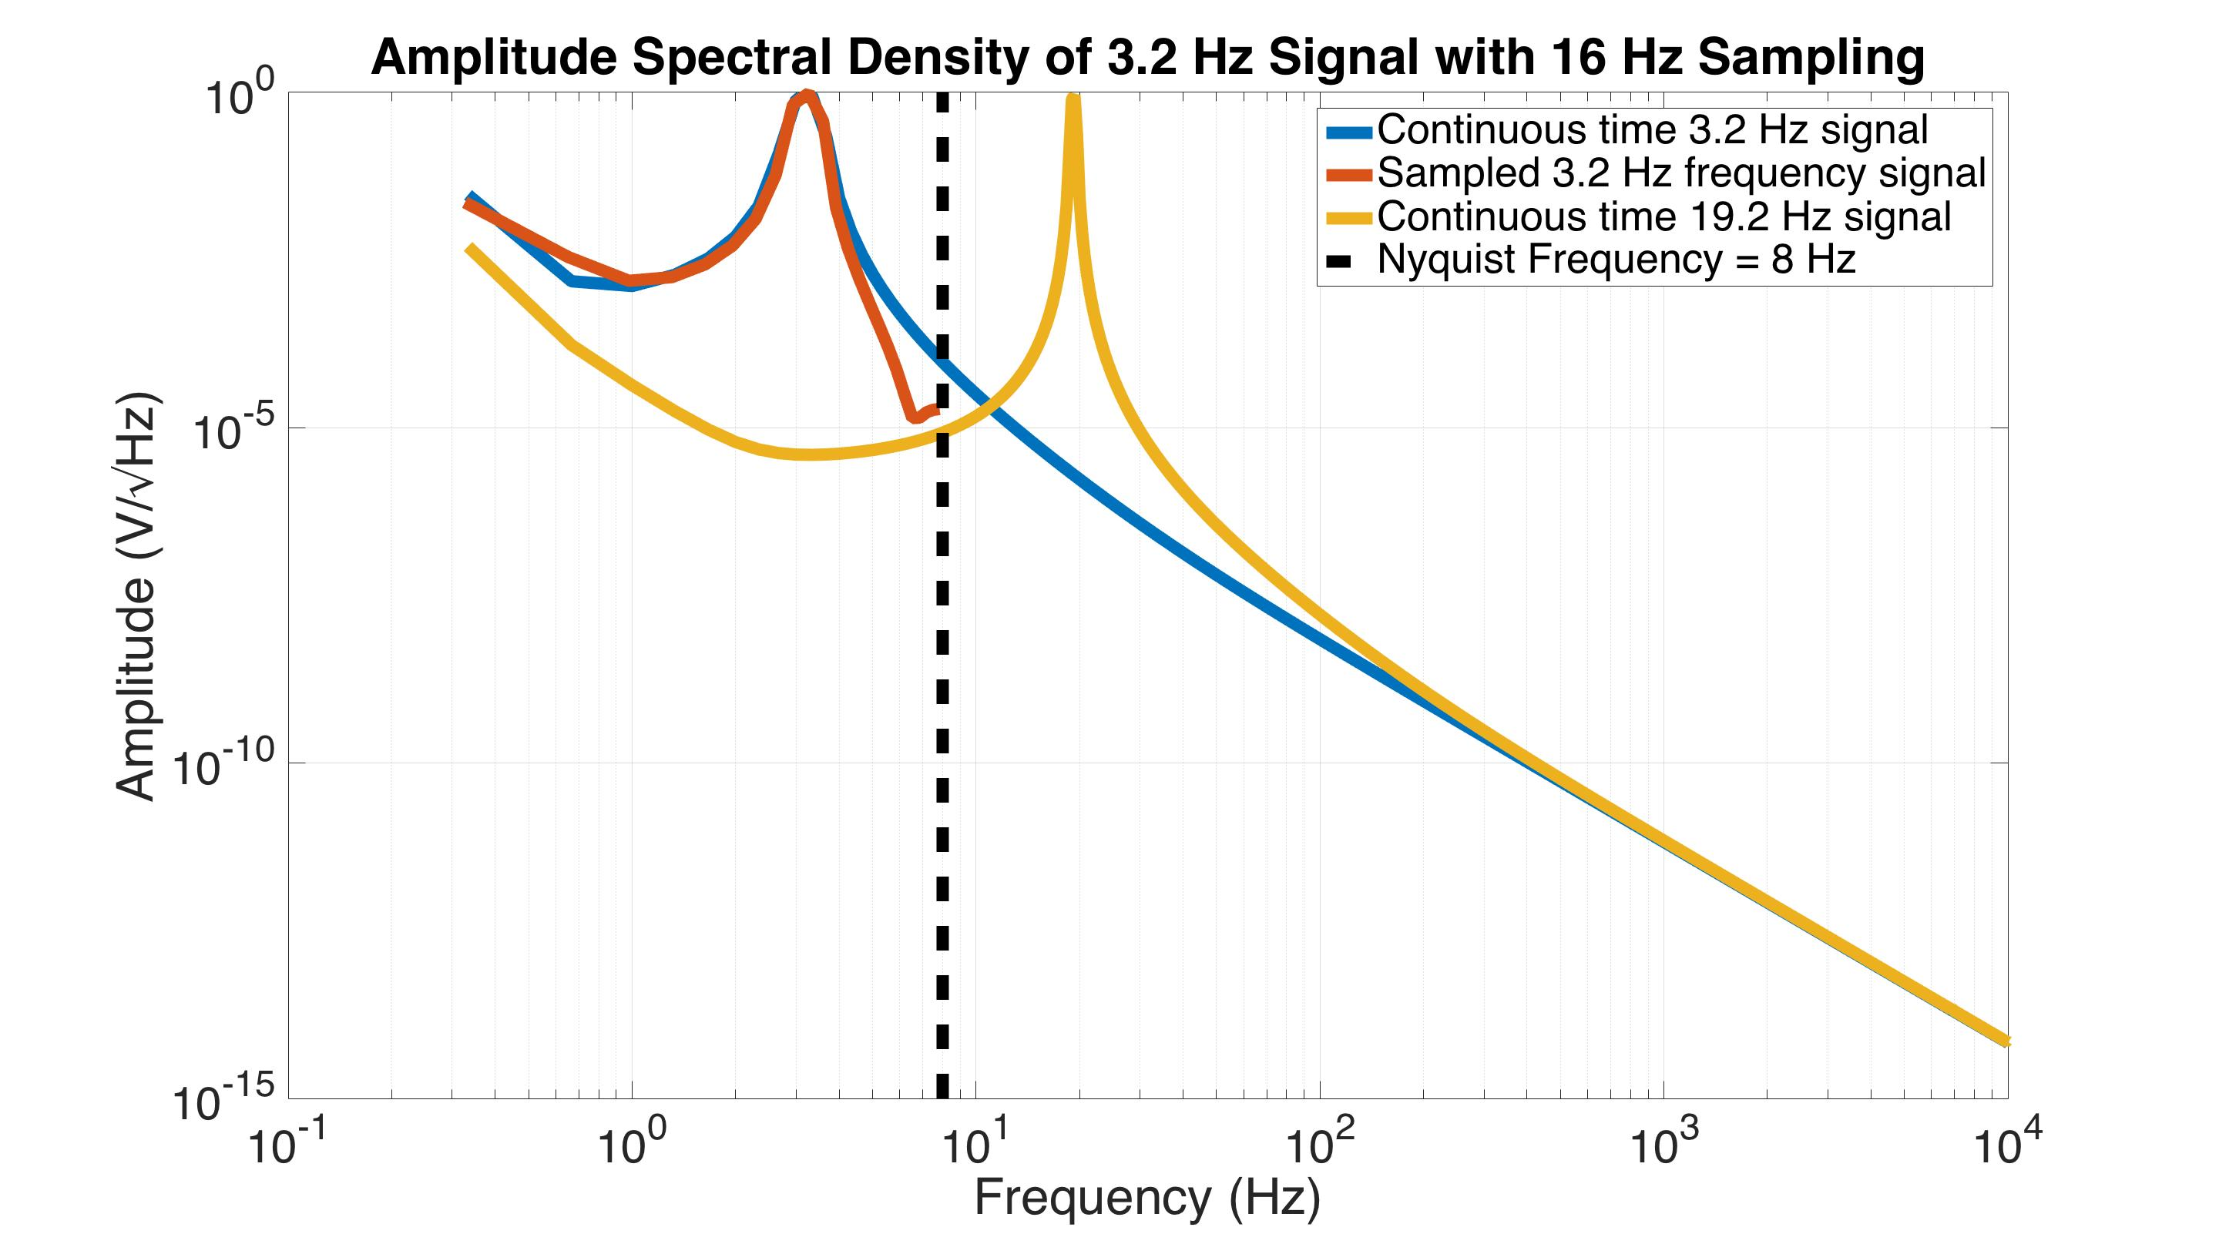
Aliasing – frequency domain
Sampled data
‘Continuous’ time high
frequency signal
Nyquist frequency =
½ sampling frequency
‘Continuous’ time data
Notes:
Now, let’s look at the ASD of the yellow line. It’s at 19.2 Hz.

Slide 149
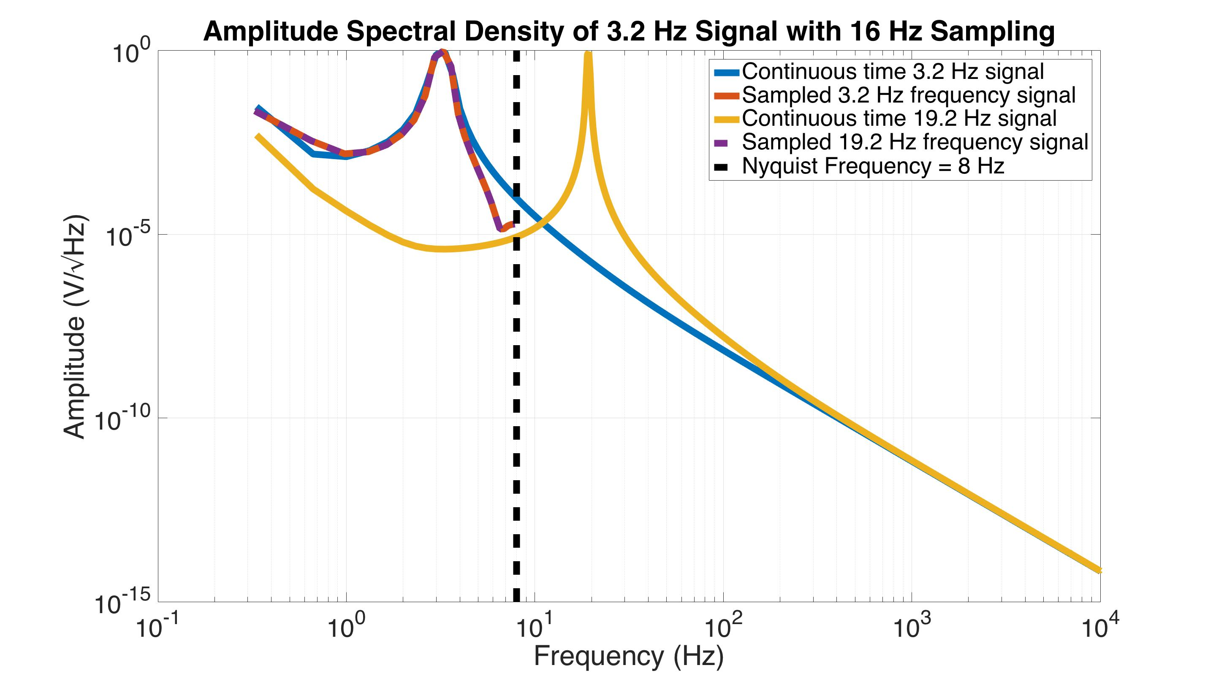
Aliasing – frequency domain
Sampled high
frequency data
Sampled data
‘Continuous’ time high
frequency signal
Nyquist frequency =
½ sampling frequency
‘Continuous’ time data
Notes:
If we were to sample that line, unsurprisingly our sampled ASD would look exactly like our sampled ASD for the 3.2 Hz wave, because we assume the samples represent the lowest possible frequency. This down-converting of signals from above the Nyquist to below is called ‘Aliasing’. The aliased frequency is found by subtracting the sampling frequency from the true frequency as many times as necessary until it is less than the Nyquist (and taking the absolute value if necessary). Aliased frequency = abs(true frequency – n*SamplingFrequency), where n is the integer required to make the aliased frequency less than the Nyquist.

Slide 150
Aliasing – frequency domain
Sampled data
‘Continuous’ time high
frequency signal
Nyquist frequency =
½ sampling frequency
‘Continuous’ time data
Analog low pass filter
Notes:
To avoid aliasing, we apply a low pass filter that cuts off any signals above the Nyquist. This way, when we assume our samples pass through signals below the Nyquist, our assumption is not a bad one.

Slide 151
Digital Feedback Signal Flow
Sensor
Anti-alias
ADC
Compens-ation Filter
Input Matrix Transformation
Measurement
Control and User Interface
Plant
Analog
Software
Actuation
Actuator
Anti-image
DAC
Compens-ation Filter
Output Matrix Transformation
Notes:
Next, let’s look at the anti-image filter. It turns out, this is very similar to the aliasing problem.

Slide 152
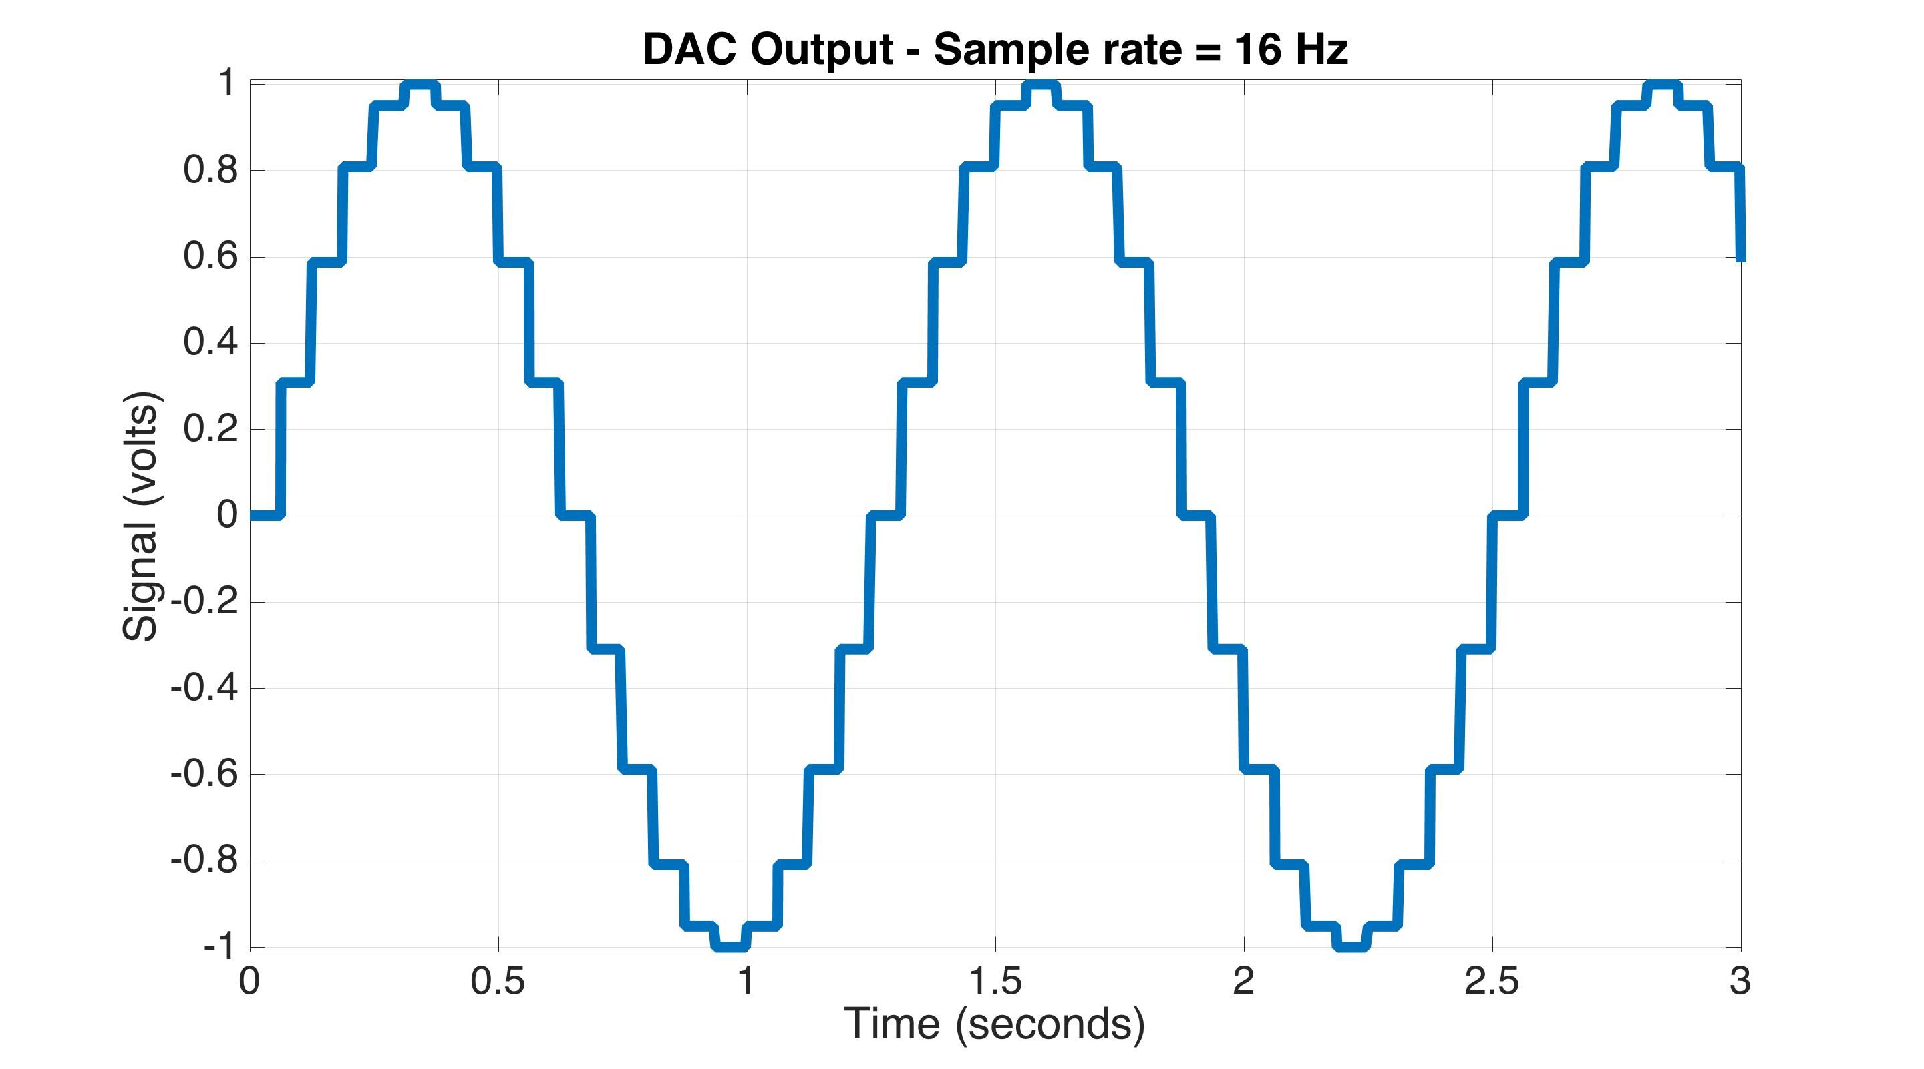
Anti-Image filtering
Raw DAC output, before AI filtering
0.8 Hz sampled sine wave
Notes:
Here is an example of a 0.8 Hz sine wave that the DAC puts out, with 16 Hz sampling. Note all the discrete steps. This happens because the DAC holds its value between samples (known as a zero-order-hold). The problem with these steps is that all those little corners generate higher order harmonics. If we take the ASD of this curve, we see..

Slide 153
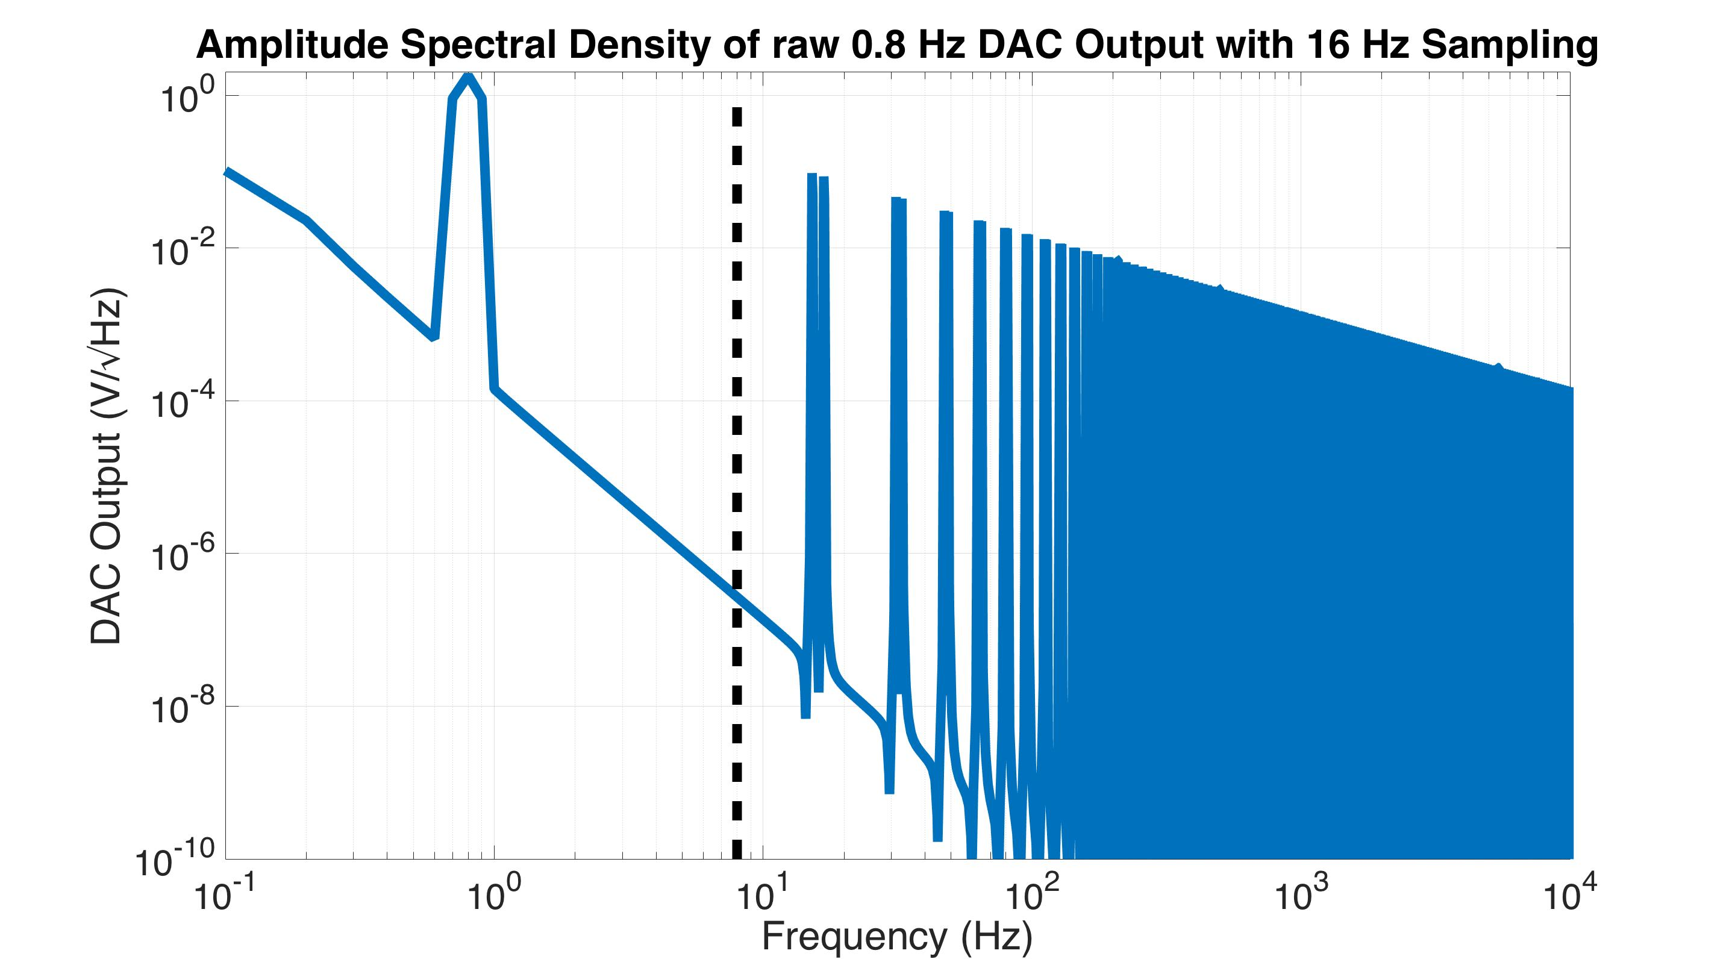
Anti-Image filtering
Raw DAC output, before AI filtering
Raw DAC spectrum
Nyquist Frequency
Notes:
…this. Note, we do get a nice peak the desired 0.8 Hz. However, we also get an infinite series of peaks at all the harmonics.

Slide 154
Anti-Image filtering
Raw DAC output, before AI filtering
Analog low pass filter
Raw DAC spectrum
Nyquist Frequency
Notes:
Like in the aliasing case, we apply a low pass filter to remove all those harmonics. This is called the anti-image filter.

Slide 155
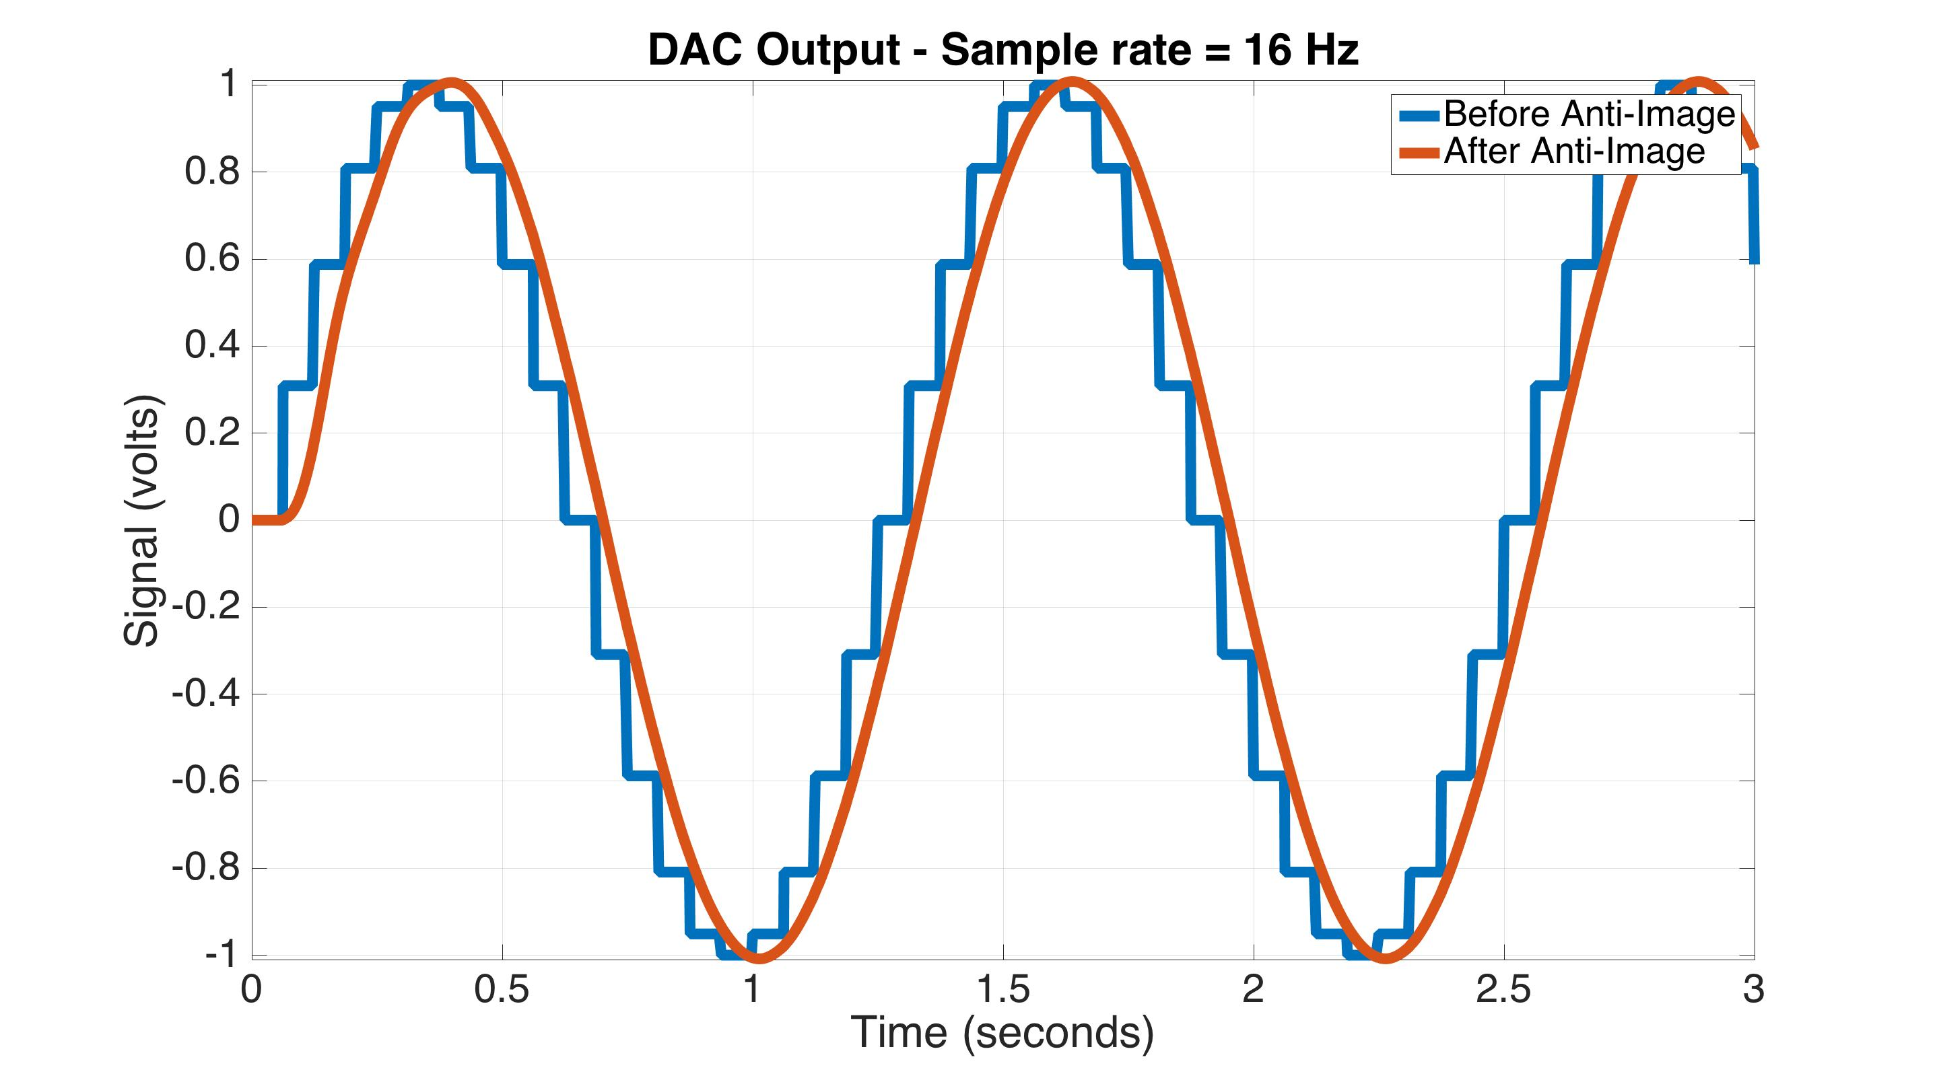
Anti-Image filtering
DAC output, after AI filtering
Notes:
After applying the anti-image filter, we now have a smooth 0.8 Hz sine wave. Note, there is a small phase delay, resulting from the phase loss of the anti-image filter.

Slide 156
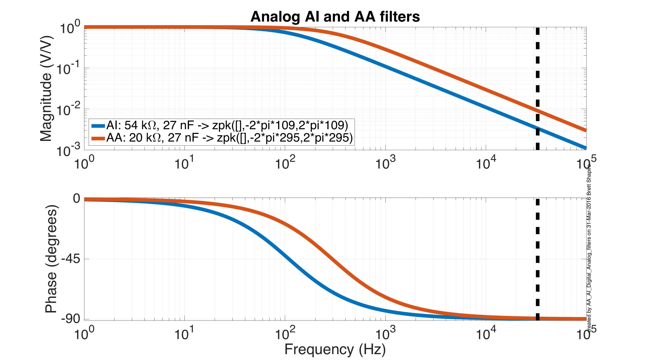
AA & AI filters from Stanford
65536 Hz sampling
Nyquist frequency
Notes:
Here are example anti-alias and anti-image filters from Stanford. The sample rate is about 65 kHz. Likely, there is no particular reason why the two filters aren’t the same. They just as well could be. Probably it is because our system is a prototype system and the components were installed at different times. These filters have just a single pole, at 109 Hz or 295 Hz. With only a single pole, the pole frequency must be much less than the sampling rate. See the backup slides describing how we improve on this with oversampling and the use of additional digital AA and AI filters.

Slide 157
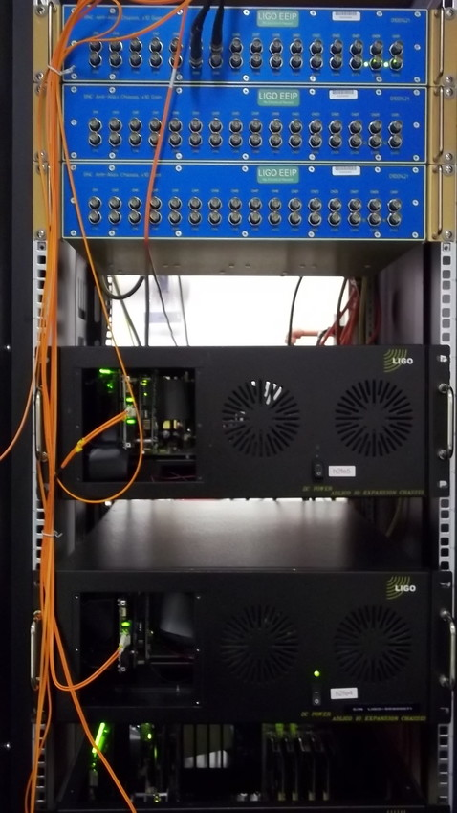
Electronics Hardware
AA and AI boards
Input/Output (I/O) Chassis
Has the DACs and ADCs
Notes:
Here is what some of these components look like at the sites, in their electronics rack.

Slide 158
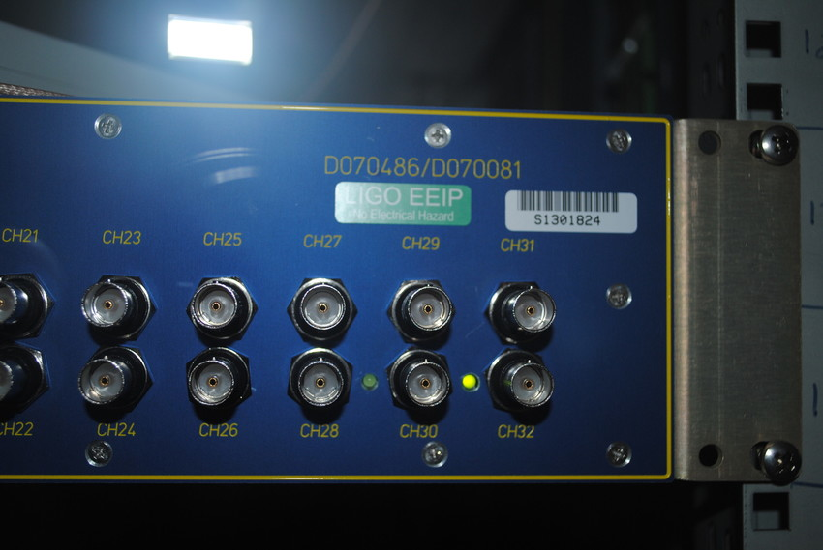
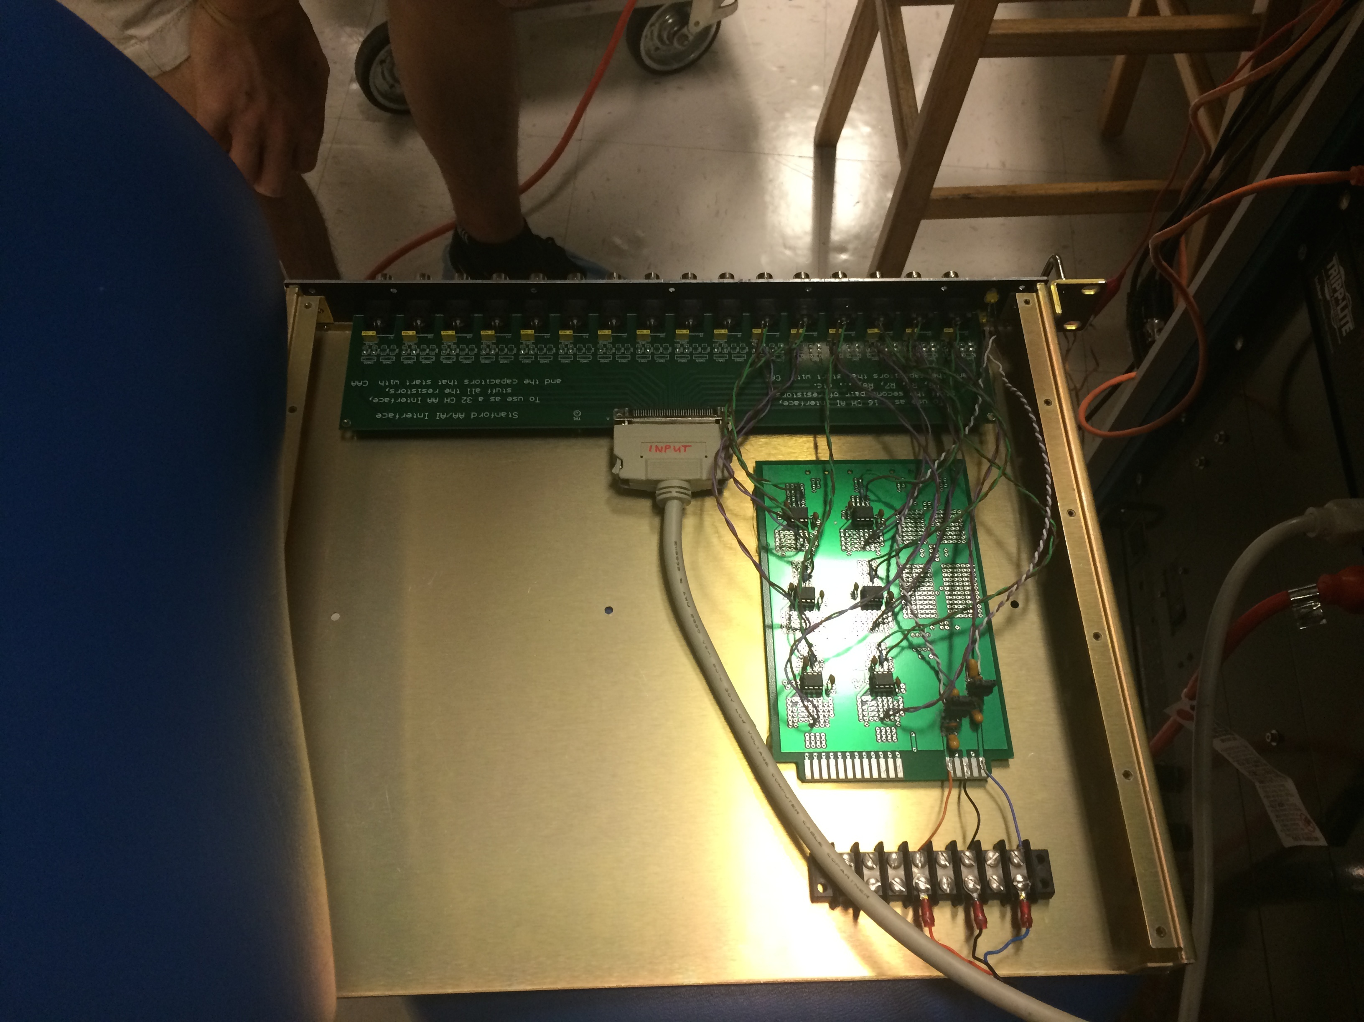
AA/AI boards
RC circuit:
pole frequency
capacitor
resistors
Notes:
If you look inside an AA or AI board, you’ll see some resistors and capacitors that give you a single pole low pass filter.

Slide 159
I/O Chassis
DAC and ADC cards
From T1000422
Notes:
If you look inside the IO chassis, you’ll see some ADC cards and DAC cards.

Slide 160

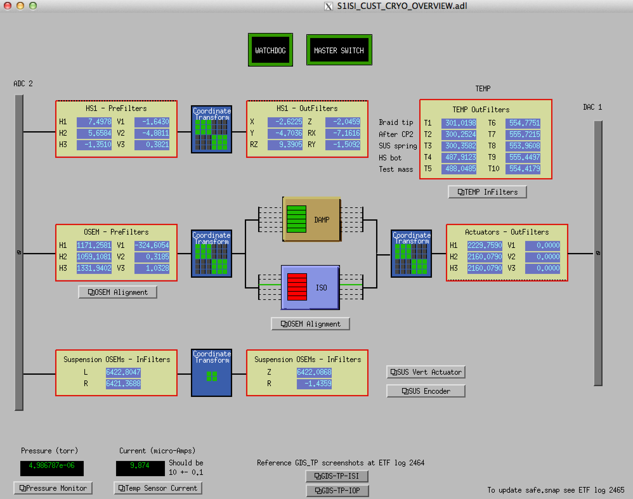

Computers
Front-end computer
Runs the real-time control system
Receives signals from ADC
Sends signals to DAC
Workstation
Runs the user interface
Notes:
For computing, there are two main types of computers. The front-end computer is the one that runs the controller, and receives signals from the ADC, and sends signals to the DAC. The workstation is the user interface, which has all the associated user interface software and diagnostic tools.

Slide 161
Lecture 3
Digital Control
- Part 2: User interface
G1600726

Slide 162
MEDM screens
Stanford cryo overview MEDM screen
Notes:
This is an example of the main user interface screens. These screens are custom made by the user. In this case, it is for the cryogenics platform at Stanford. The software is called MEDM. The signal flow follows the block diagram we saw earlier, with the ADC on the left, the DAC on the right. In between, the sensor signals go through some compensation filters and matrices. Depending on the sensor group, those signals are then sent through some control filters, then through some more matrices and compensation filters, before going to the DAC.

Slide 163
MEDM screens
Stanford cryo overview MEDM screen
Notes:
Each of these boxes you can click on to get more detail. Let’s take a look inside the OSEM prefilters (or compensation filters).

Slide 164

OSEM input filters screen
Notes:
Here you see a list of 6 filter modules, 1 for each of the 6 OSEMs.

Slide 165
offset
Filter input
gain
± saturation
limit
test excitation
Filter output
10 filter banks
Up to 20 poles & zeros each
Standard filter module
Notes:
Let’s focus on just one. This is the standard LIGO filter module medm screen, which is automatically generated for each realtime filter in the control system. Signals come in on the left, go through a selection of 10 possible filters banks, and then output on the right. You can also apply test excitations, offsets, gains, saturation limits, and flip various switches on and off. Here, since this is a compensation (or calibration) filter, the 2nd filter bank is engaged which converts the raw OSEM signal from units of counts to microns.

Slide 166
Stanford cryo overview MEDM screen
Notes:
Let’s now move along the signal path and look inside the OSEM sensor matrix transformation.

Slide 167

OSEM Sensor Input Matrix
Notes:
We see a 6 by 6 matrix, that converts the OSEM signals into an X, Y, Z coordinate from around the platform’s center of mass, from the original locations of the OSEMs. 3 of the OSEMs measure the horizontal displacement of the 3 corners of the platform; the other 3 measure the vertical motion of those 3 corners. For example, to get Z, or vertical motion of the center of mass, we simply take the average of the 3 verticals: (V1+V2+V3)/3.

Slide 168

foton – install filters
Notes:
To load filters into the filter banks of the filter module screen, we use an interface called foton.

Slide 169

foton – install filters
Notes:
There are various options for entering filters. A simple one is the ZPK option, which stands for zero, pole, and gain (the name zpk is consistent with matlab notation). With this zpk option, you simply type in the values for all the zeros and poles for each of the 10 possible filter banks. Each bank can hold up to 20 zeros and poles.

Slide 170

Notes:
Once you have created a filter, you can plot it to make sure it looks the way you expect. This particular example, is rather complicated. However, this is the beauty of digital controls, it is easy to make an arbitrary filter just by typing in the values. Analog filter like this would require a very complicated circuit, and be very difficult to modify.

Slide 171

offset
Filter input
gain
± saturation
limit
test excitation
Filter output
10 filter banks
Up to 20 poles & zeros each
Loading filter banks
Notes:
After the filter is loaded into foton, just hit the load coefficients button on the filter’s medm screen, and this updates the screen.

Slide 172

Realtime code designed in Matlab Simulink
Notes:
All the medm screens are just user interfaces for the realtime code running on the front-end computer. This front-end code is generated by simulink diagrams (through matlab), which define everything about the control system’s signal flow. It is here where you decide where the filters and matrices go. You can also setup any kind of logic or install C code to do what is infeasible in simulink alone.
Here we see the same basic signal flow again. The ADC is represented on the left, the DAC on the right. There is a CRYO block in the middle that contains all the real-time software for the stanford cryo platform.

Slide 173
Realtime code designed in Matlab Simulink
Simulink diagram compiled to C code
On real-time computer
Notes:
Once you have the simulink diagram the way you like it, you compile it to C code, which is what actually runs on the front-end computer.

Slide 174

Realtime code designed in Matlab Simulink
CRYO block
Notes:
If you look inside the CRYO block, you see many more sub-blocks. Each block we saw on the main MEDM screen has a corresponding block here.

Slide 175

Realtime code designed in Matlab Simulink
CRYO/OSEMINF block
Notes:
If you go into one of the sub-blocks, for example the OSEM sensor compensation filters, you’ll see a set of filter modules. Each of these filter modules has a corresponding medm filter module medm screen, which we saw earlier.

Slide 176
Making Measurements
Diagnostic Test Tools (DTT) - Measure TFs and ASDs, etc
Dataviewer – time data plots in real time
Notes:
For making measurements, 2 of the most common (though not only) software tools are DTT and Dataviewer.

Slide 177

DTT – make measurements
Notes:
DTT is capable of both passive and active (send excitations) measurements. Here is an example of a transfer function measured on the cryo platform by driving the actuators and observing the sensor signals.

Slide 178

Notes:
Excitations are sent by setting them up in the excitation tab. Here we are sending white noise, filtered by a 100 Hz low pass filter (2 poles at 100 Hz), to the excitation field of the CRYO_DAMP_Z filter module. This drives the actuators vertically up to 100 Hz.

Slide 179

Notes:
You can choose many, many channels to observe. Here the data is being collected up to 1000 Hz, with 0.05 Hz resolution (BW=frequency bin-width).

Slide 180

Dataviewer – realtime data
Notes:
Dataviewer is sort of like an oscilloscope, and is useful for watching the realtime, time domain signals.

Slide 181

Dataviewer – realtime data
Notes:
Here is an example of 2 signals being monitored in realtime with Dataviewer, with the settings shown on the previous slide.

Slide 182

Dataviewer – past data
Notes:
Dataviewer can also plot trends from past data.

Slide 183

Dataviewer – past data
Notes:
Here is the trend data plotted from the setting shown on the previous slide. It includes 1 day of data, with 1 minute trends. For each minute there are 3 data points displayed, the average in red, the max value in black, and the min value in green. You can do trends with 1 second resolution, 1 minute, 10 minute, and 1 hour. You can also look back at the raw data.

Slide 184
Lecture 3
Digital Control
- Part 3: Digital time &
frequency domain
G1600726
Notes:
This part of the lecture discusses digital control theory. All the control theory we spoke of up to now is for continuous linear systems. Strictly speaking, sampled digital systems are not linear, so the same control theory does not apply. In most cases, the sample rates we use are fast enough that linear control theory is a very good approximation, and may be used. Thus, in most cases you won’t need what is shown here. You may need it if you’re pushing your control close to the Nyquist frequency. In any case, it is good to be familiar with it because this represents what is actually going on in the realtime computer.

Slide 185
Filters: Continuous to Digital Conversion
Differential equation: continuous time
Approximation of derivative,
where k is the current sample
Approximation of EOM
Difference equation: digital
Notes:
Continuous time filters can be converted to digital time. This is done by taking a continuous time differential equation and converting it to a digital difference equation, the digital time analog for an equation of motion. To do this, you make a sample based approximation for the derivative.

Slide 186
Z-Transform
Analogous to the Laplace s-transform for continuous systems
d/dt -> s for continuous systems
k+1 -> z for digital systems
Notes:
To generate the frequency domain filter, we use the digital time analog for the Laplace transform, the z-transform. The Laplace transform does not apply because the system is no longer linear. The Laplace transform gives you an s for every derivate (1/s for integrals); the z-transform gives you a z for every future sample (z^-1 for past samples).

Slide 187
Z-Transform
Analogous to the Laplace s-transform for continuous systems
d/dt -> s for continuous systems
k+1 -> z for digital systems
Digital
Continuous
Difference equation
Differential equation
Notes:
Here is a table comparing digital time to continuous time. In digital, we have difference equations. In continuous, we have differential equations.

Slide 188
Z-Transform
Analogous to the Laplace s-transform for continuous systems
d/dt -> s for continuous systems
k+1 -> z for digital systems
Digital
Continuous
Difference equation
Differential equation
z-transform
s transform
Notes:
Digital has the z-transform for the frequency domain, continuous has the Laplace transform for the frequency domain.

Slide 189
Z-Transform
Analogous to the Laplace s-transform for continuous systems
d/dt -> s for continuous systems
k+1 -> z for digital systems
Digital
Continuous
Difference equation
Differential equation
z-transform
s transform
Transfer function
Transfer function
Notes:
Transfer functions have the z variable in the digital domain, and the s variable in the continuous domain.

Slide 190
Z-Transform
Digital
Continuous
Difference equation
Differential equation
z-transform
s transform
Transfer function
Transfer function
Frequency domain interpretation
Frequency domain interpretation
Notes:
Adding another row, while in the continuous domain, s relates to frequency by s=i*2*pi*frequency, in the digital domain, z = exp(i*2*pi*frequency/SamplingFrequency).

Slide 191
Z-Transform
Digital
Continuous
Difference equation
Differential equation
z-transform
s transform
Transfer function
Transfer function
Frequency domain interpretation
Frequency domain interpretation
where
Notes:
Note, that as the sampling frequency becomes very large, z starts to look more like s (normalized by the sampling frequency). In general, as the sampling frequency becomes large, the digital and continuous domains converge to the same solution (modulo some scale factors).

Slide 192


Complex plane pole-zero map
Digital
Continuous
a = 0.5 rad/s
dt = 0.1 s
Notes:
In the continuous domain, we have the complex plane, in the digital domain the complex unit circle. This slides shows the same low pass filter in its digital and continuous time equivalents.

Slide 193
Complex plane pole-zero map
Digital
Continuous
Stability:
Poles must in left half plane (LHP)!
Stability:
Poles must be inside unit circle!
a = 0.5 rad/s
dt = 0.1 s
Notes:
For stable continuous systems, poles must be in the left half plane (LHP). For digital systems, the poles must be inside the unit circle.

Slide 194

Complex plane pole-zero map
Digital
Continuous
a = 0.5 rad/s
dt = 0.01 s
Notes:
If we increase the sample rate, we see the digital pole moves closer to the z = 1 point. I have increased the sample rate a factor of 10 here.

Slide 195
Complex plane pole-zero map
Digital
Continuous
For small dt, the region around z=1 looks like the continuous time complex plane
a = 0.5 rad/s
dt = 0.01 s
Notes:
As the sample rate approaches infinite, it turns out that the region around z = 1 approximates the continuous time complex plane (modulo some scale factors). This visualizes why continuous control theory may be used when we have sufficiently high sample rates. In general, a rule of thumb for a sufficiently high sample rate is one that is 2 orders of magnitude higher than the frequency of your poles and zeros. Beyond that you have to start taking into account the phase loss from the AA and AI filters, as well as the phase loss from the sampling itself (there is a delay between each sample, resulting in a frequency dependent phase loss, see this lecture’s backup slides).

Slide 196
Matlab has various conversions from Laplace to Z
1
----------------------------
1900 s^2 + 3092 s + 1.258e05
Continuous time TF HAM_ISI =
Digital_filter = c2d(HAM_ISI,0.001,’ZOH’)
First order hold
2.63e-10 z + 2.629e-10
----------------------
z^2 - 1.998 z + 0.9984
0.001 = sample time (s)
Digital_filter = c2d(HAM_ISI,0.001,’tustin’)
1.315e-10 z^2 + 2.629e-10 z + 1.315e-10
---------------------------------------
z^2 - 1.998 z + 0.9984
Digital_filter = c2d(HAM_ISI,0.001,’matched’)
2.629e-10 z + 2.629e-10
-----------------------
z^2 - 1.998 z + 0.9984
Notes:
I showed a very simple conversion from continuous time to digital time when I introduced the difference equations (the simple derivative approximation). Matlab has a number of better conversions (in fact the one I showed is so naïve matlab doesn’t even list it as an option). These conversions are done in Matlab with the c2d command (continuous-to-digital). The command inputs are the continuous time system, the sample time (in seconds), and the type of conversion. The third input is optional, it defaults to ‘ZOH’ (zero-order-hold) if not included.

Slide 197

Digital TF Bode Plots
HAM-ISI force to displacement
nyquist
Frequency (Hz)
Notes:
Here are some bode plots of those c2d conversions, plotted against the continuous filter in blue. The red one is the naïve basic derivative approximation one I introduced with the difference equations (that matlab doesn’t even include).

Slide 198

Digital TF Bode Plots
HAM-ISI force to displacement
nyquist
Frequency (Hz)
Notes:
Here are some more bode plots of those c2d conversions, plotted against the continuous filter in blue.

Slide 199
Lecture 3 Summary
ADCs and DACs are used to sample signals and move them into and out of the computer.
Anti-alias and Anti-image filters smooth over the transitions through the ADC and DAC to remove unwanted high frequency content.
LIGO has various software tools for controlling and interfacing with realtime systems.
The z-transform is the digital equivalent to the Laplace s-transform (needed since sampling is nonlinear).

Slide 200
Lecture 3 – Backups
G1600726

Slide 201
Oversampled Signal Flow
Sensor
AA
ADC
Digital AA
Down-sampling
Compens-ation Filter
Matrix
Measurement
Control and User Interface
Plant
Decrease sample rate
Analog
Software
Increase sample rate
Actuation
Actuator
AI
DAC
Digital AI
Up-sampling
Compens-ation Filter
Matrix
Notes:
This is a more realistic representation of how the sampling actually occurs in LIGO systems. Because analog AA and AI filters are very simple (typically a single pole), there phase loss extends to very low frequencies. So what we do is we sample at a much higher frequency then what we actually need, so we can push the poles of the analog filters higher in frequency. This minimizes the phase loss at the frequencies we care about. At the sites, all systems are sampled at 65536 Hz, while the control systems run at 4096 Hz for the ISIs and 16384 Hz for the suspensions. The control systems need to run at the slower rate because they need sufficient time to do all the necessary computation in each clock cycle. To bridge the gap between the fast sampling of the ADC and slow sampling of the control system, we use digital AA and AI filters. Since these are digital, it is easy to make these with many poles and zeros in order to optimize their phase loss and filtering properties as much as possible. The next slide shows the digital AA and AI filter used for the ISIs.

Slide 202

Oversampled Signal Flow
The ADC and DAC sample at 65536 Hz, the controller samples at 4096 Hz
Nyquist frequency
Notes:
This is the digital AA and AI filter used for the ISIs (same filter for both). It bridges the gap between the 65536 Hz sampling of the ADC and DAC and the 4096 Hz sampling of the control system. This would require a relatively complex circuit design to realize with analog components.

Slide 203

Sampling Phase Loss
Nyquist Frequency
Notes:
Sampling causes a phase delay because you must wait for the next sample time before the control system updates. This phase, in degrees, is –360*frequency/(sample frequency); that is just the time between samples converted into phase for a given frequency. Note, you will have additional phase loss from both the anti-alias and anti-imaging filters.

Slide 204

ISO Block
Notes:
Example medm screen for an isolation block. Note the guardian states on the right.

Slide 205
General BackUps

Slide 206

Advanced LIGO
A single output chamber is complicated!
HAM5
Signal Recycling
(Mirror) 3
Output Faraday
Single Suspension
Signal Recycling
Mirror
Small Triple Suspension
Hydraulic Pre-Isolation
Lots of practical stuff removed for demonstration
Vacuum chamber
SUS sensors
EQ stops, Lockers

Slide 207




BSCs – core optics
hydraulic external pre-isolator (HEPI) (one stage of isolation)
active isolation platform (2 stages of isolation)
quadruple pendulum (four stages of isolation) with monolithic silica final stage

Slide 208

Hybrid Systems
Advanced LIGO - The Design
7 Stages of Isolation
  Hydraulic Preisolation
  Blade spring and wire flexures
  Monolithic Final Stage
6 DOF sensing on stages 1 – 4, 3 DOF on 5 – 6
  Inertial and displacement on stages 1-3
  Displacement only on stages 4 - 6
6 DOF DC - 1kHz actuation on Stages 1 – 4, 3 DOF on 5 - 7
(6+6+6+[3*6+4]) = 40 out of 42 Trans./Rot. resonant modes sensed and controlled
Many-control-loop system
  Sensor blending, Feed back, Feed forward, Sensor Correction, Heirarchical control
Versatile 800 kg payload
Stage 1 – 3 “Performance limited by sensor noise,” Stage 4 – 7 “Performance limited by direct transmission of platform motion”
2
3
1
4
4
5
5
6
6
7
7

Slide 209






Sensor Noise
Displacement Sensors
Inductive
aLIGO Pre-isolator Stage
Shadow Sensor
aLIGO SUS Top Stages
AEI 10m SUS Top Stages
Inductive
VIRGO / GEO / KAGRA SAS
Linear
Range
Shadow Sensor
aLIGO SUS Lower Stages
Capacitive
aLIGO Stage 1 ISIs
Interferometeric, U of Birmingham Prototype (As yet Non-UHV Comp.)
Capacitive
aLIGO Stage 2 ISIs

Slide 210





Sensor Noise
Inertial Sensors
aLIGO Stage 1 & 2 ISIs
aLIGO Pre-isolator Stage
aLIGO Stage 0 & 1 ISIs
AEI-SAS Vert. Witness
aLIGO Stage 1 ISIs
iVIRGO F0, F7
aLIGO Pre-isolator Stage
aVIRGO MultiSAS Horz. Witness
(Watt Linkage)
AEI-SAS Horz. Witness
(Watt Linkage)

Slide 211




SEI Sensors and Their Noise
“Low” Frequency
IPS
Kaman’s Inductive Position Sensors
Used On: HEPIs
Used For: ≤ 0.5 Hz Control, Static Alignment
Used ‘cause: Reasonable Noise, Long Range
CPS
MicroSense’s Capacitive Displacement Sensors
Used On: HAM-ISIs and BSC-ISIs
Used For: ≤ 0.5 Hz Control, Static Alignment
Used ‘cause: Good Noise, UHV compatible
DC
10 mHz
STS2
Strekheisen’s STS-2
Used On: HEPIs
Used For: 0.01 ≤ f ≤ 1Hz Control
Used ‘cause: Best in the ‘Biz below 1 Hz, Triaxial
T240
Nanometric’s Trillium 240
Used On: BSC-ISIs
Used For: 0.01 ≤ f ≤ 1Hz Control
Used ‘cause: Like STS-2s, Triaxial, no locking mechasim -> podded
GS13
GeoTech’s GS-13
Used On: HAM-ISIs and BSC-ISIs
Used For: ≥ 0.5 Hz Control
Used ‘cause: awesome noise above 1Hz,
no locking mechanism -> podded
1 Hz
L4C
Sercel’s L4-C
Used On: All Systems
Used For: ≥ 0.5 Hz Control
Used ’cause: Good Noise, Cheap,
no locking mechanism -> podded
800 Hz
“High” Frequency

Slide 212


Sensor size and noise
(Courtesy of Brian Lantz)
From G1400311

Slide 213



Optical Sensor ElectroMagnet (OSEM)
Birmingham OSEM (BOSEM)
Advanced LIGO OSEM (AOSEM)
- modified iLIGO OSEM
Magnet Types (M0900034)
BOSEM – 10 X 10 mm, NdFeB , SmCo
10 X 5 mm, NdFeB, SmCo
AOSEM – 2 X 3 mm, SmCo
    2 X 6 mm, SmCo
    2 X 0.5 mm, SmCo
BOSEM Schematic

Slide 214

HS1 Geophones
http://www.geospace.com/hs-1-industrial-geophone/

Slide 215

Geophone Schematic
Source: http://newsline.linearcollider.org/readmore_20070809_ftr1.html

