Slide 1
Photos from the Building 20 epoch
Photos from Dan Dewey, Jeff Livas, Steve Meyer, Peter Kramer, Mary Jane Doherty, David Shoemaker
17 March 2016
G1600667-v1

Slide 2
Building 20, Wing F

Slide 3
Anechoic chamber in Wing F (a good place for naps etc.)

Slide 5
Label on the best entrance door

Slide 6
A corridor in Building 20

Slide 7
When CMB was the focus

Slide 8
David’s first servo system

Slide 9
And: on to Gravitational Wave Detectors

Slide 10
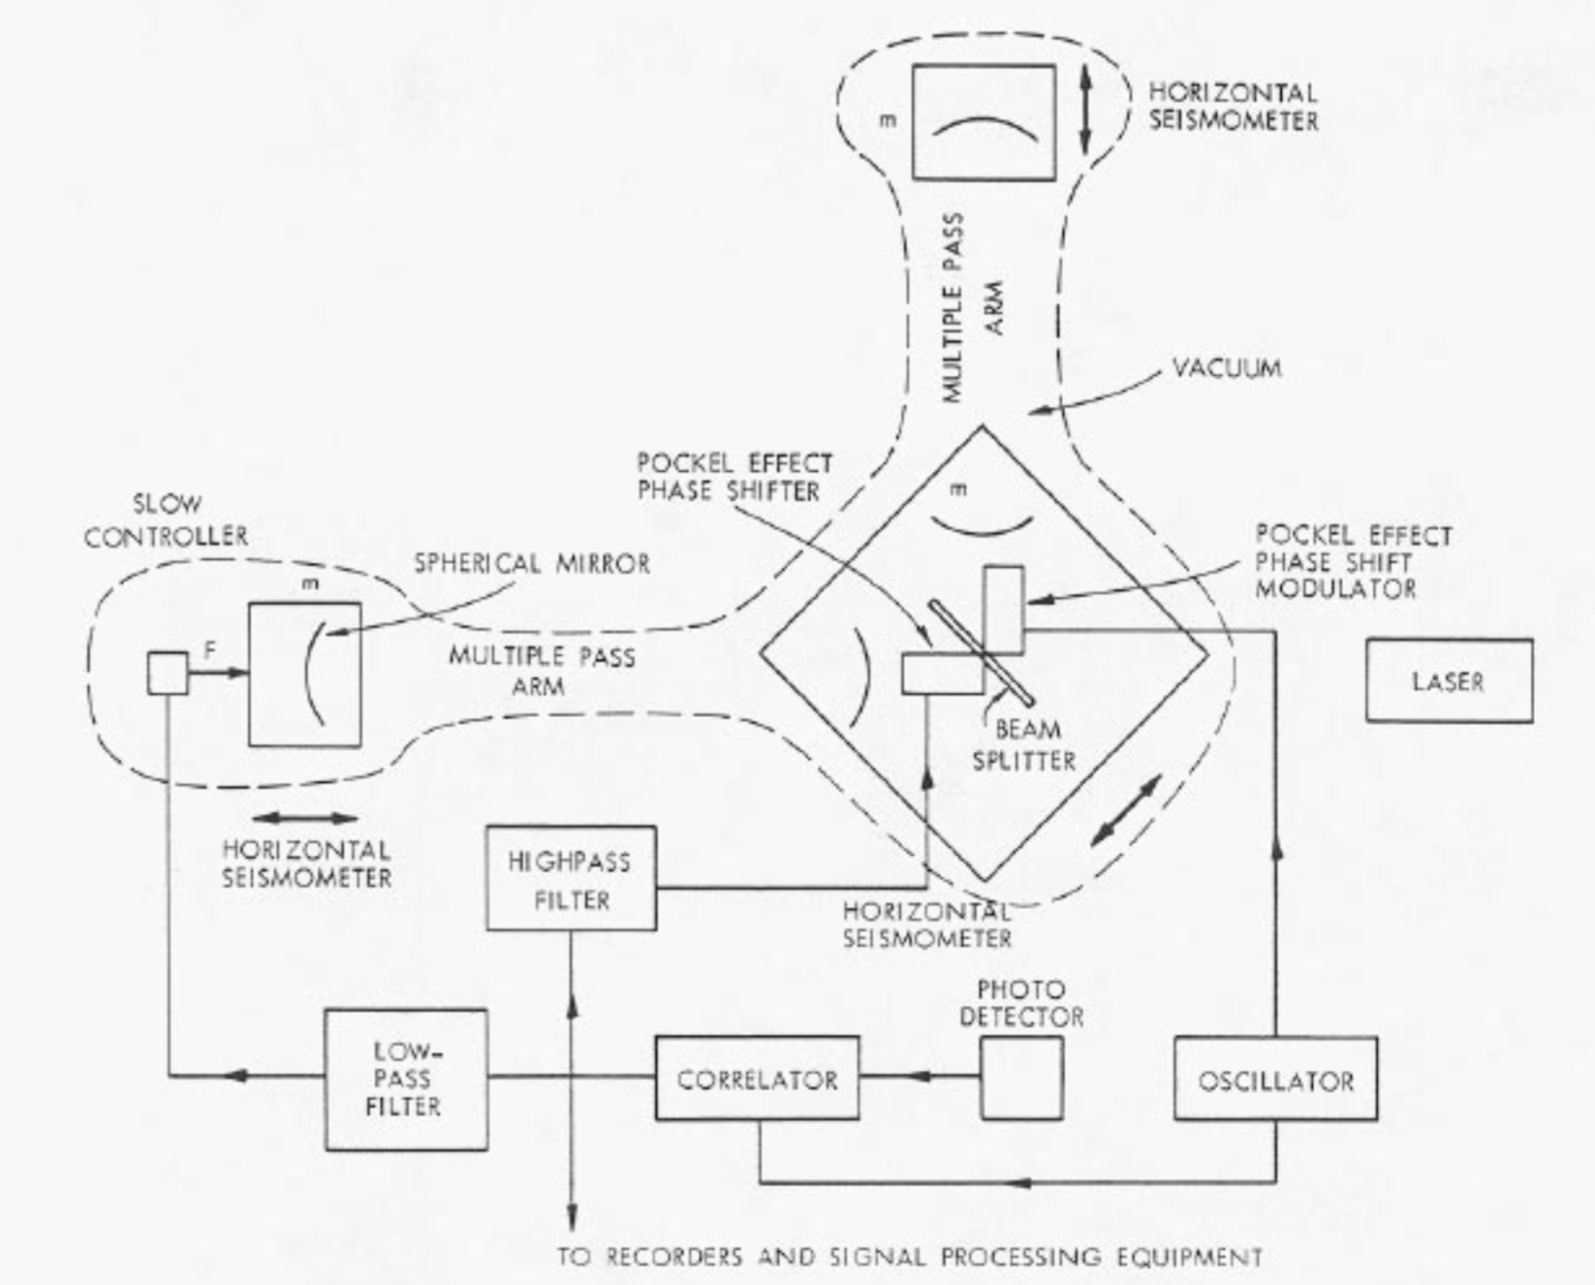
The Detailed Engineering Drawings

Slide 11
Peter Kramer assembling the vacuum system for the 1.5 meter prototype

Slide 12
General view of the 1.5 meter prototype

Slide 13
General view of the 1.5 meter prototype

Slide 14
Beamsplitter and input mirror block; end test mass/mirror

Slide 15
Herriot delay line on the ‘vertex block’, illuminated with Argon laser; rod suspension

Slide 16
‘Fuzzy’ photos are from Mary Jane Doherty

Slide 17
Jeff Livas; hole in upstairs floor to install pendulum suspension below

Slide 18
Rai and Jeff

Slide 19
Rai. Note pipe and tobacco at the ready.

Slide 20
RF phase modulator (in tube under dinosaur)

Slide 21
Peter Saulson and Rai

Slide 22
Jeff and Peter

Slide 23
Rai (pipe and beer) celebrating Lyman Page failing his exams

Slide 24
Test mass controller, servo control, and DAQ for 1.5 meter prototype

Slide 25
The Control Room Display

Slide 26
Single mode fiber, microscope objective

Slide 27
Single-mode fiber light delivery from laser to interferometer table (Jeff Livas, David Shoemaker, Dan Dewey)

Slide 28
The last gasp for the 1.5 meter: a data-taking weekend leading to a couple of PhD theses

Slide 29
Delivery of the ‘new’ vacuum system

Slide 30
Rai giving instructions to the riggers, a.k.a. grad students

Slide 31
Nelson Christensen and Peter Fritschel mixing glue

Slide 32
Michele Stephens and Peter Fritschel

Slide 33
Not Mike Zucker’s first, or last, vacuum system

Slide 34
Joe Giaime on saw, with Joe Kovalik and Nergis in the choir

