Slide 1
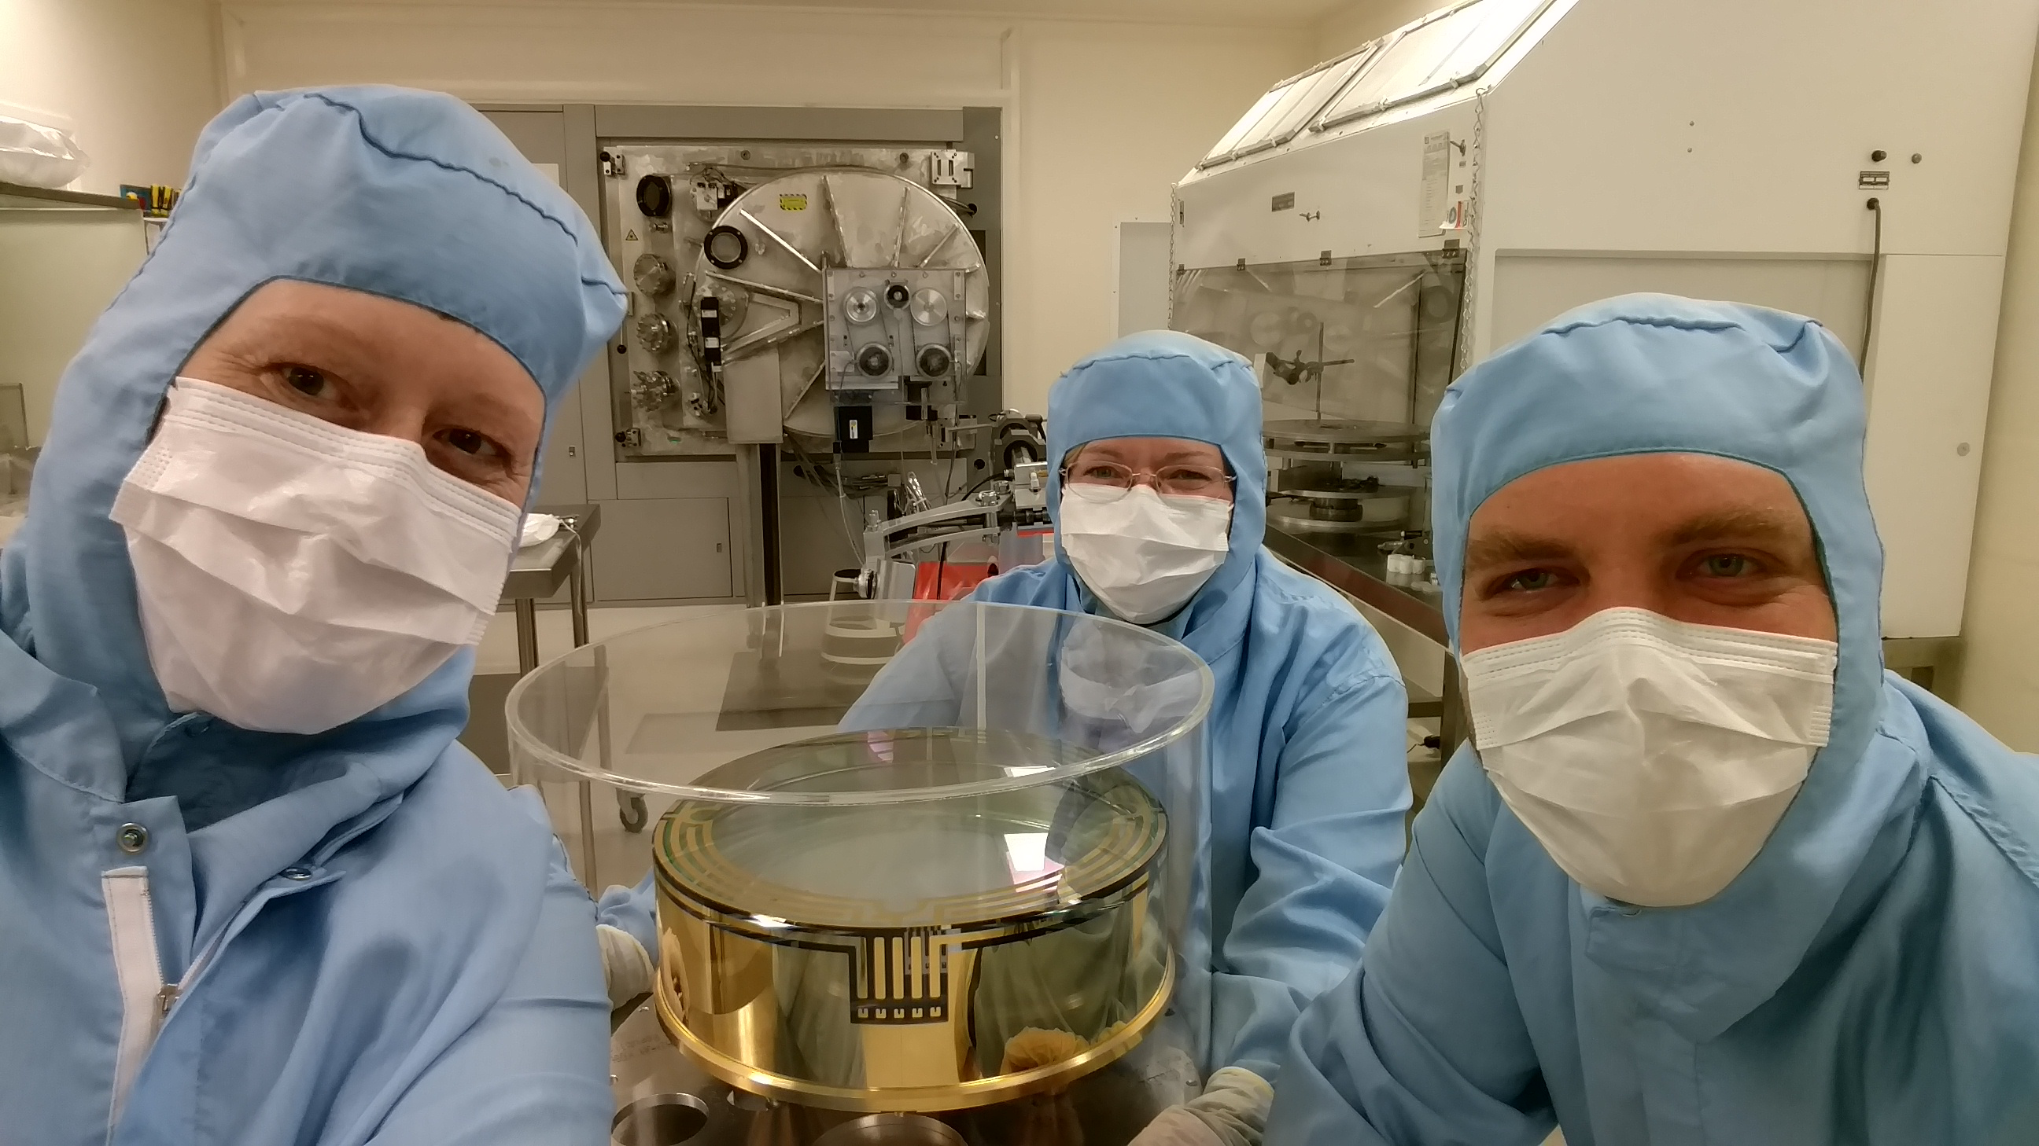
Inside LIGO
Betsy Weaver, GariLynn Billingsely and Travis Sadecki
2016 – 02 – 23 at CSIRO, Lindfield

Slide 2
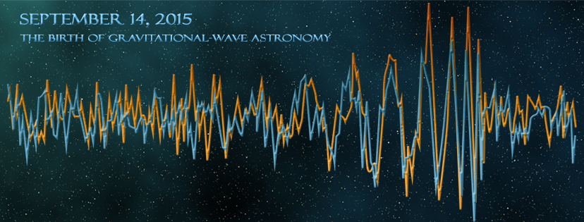
The Discovery
See also http://mediaassets.caltech.edu/gwave
Notes:
I manage the fabrication and test of the Core Optics,
I first came to CSIRO 20 years ago when working with
Betsy and Travis then figure out how to integrate those optics into the LIGO detectors.
We are here at CSIRO to assist in the coating of one of the LIGO optics.
There is a LOT of media available
summarize the detection briefly,
then go on to describe the hardware

Slide 3
Notes:
Both LIGO detectors. After analysis the LIGO, Virgo collaboration
“The first direct detection of gravitational waves and the first direct observation of a black hole binary.
After analysis we find:
2 BH, roughly 30 solar masses
S/N ratio 24
FAR <1 in 200K
– if you want more information on the astrophysics behind these signals

Slide 4
https://losc-dev.ligo.org/links/

Slide 5
Mirrors that float in space?

Slide 6
A close approximation of floating
active isolation platform (2 stages of isolation)
hydraulic external pre-isolator (HEPI) (one stage of isolation)
quadruple pendulum (four stages of isolation) with monolithic silica final stage
Notes:
Seven stages of isolation!
Betsy and Travis will go into the details of the mirror suspension
Still this is a noisy environment for the mirrors!
Let’s take a look at some noise sources.

Slide 7
Noise summary Coatings are key!
Limiting noise sources at 40 Hz:
Quantum noise
Shot Noise
Radiation Pressure
Coating Brownian noise

Slide 8
Core Optics
ERM 26 kg
ETM
Notes:
CSIRO coated 5 of the 7 types of Core Optics

Slide 9
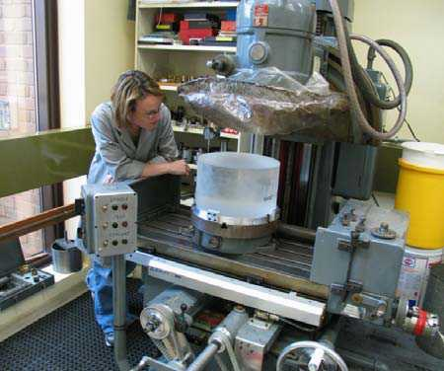
340 mm ⌀, 200 mm thick 40 Kg

Slide 10
What is a compensation plate

Slide 11
Arm Cavity Loss details: Results are within budget
Round Trip Cavity loss 2 surfaces (ppm) | Budget based on specs (ppm) | Actuals 2013 based on average of completed pieces (ppm)
Microroughness scatter (>1/mm) | 8 | 4.4; 2.2 Per mirror
Defects (Polish, Coating, Contamination) | 26 | 20; 10 per mirror includes polish and coating
Coating Absorption* | 1 | 0.7; 0.36 per mirror
Surface Figure Error & Diffraction | 24 | 16.2
ETM Transmission | 5 | 4.2
Total ( required < 75 ppm) | 64 | 45.5

Slide 12
Arm Cavity Loss Cartoon Hanford Y arm

Slide 13
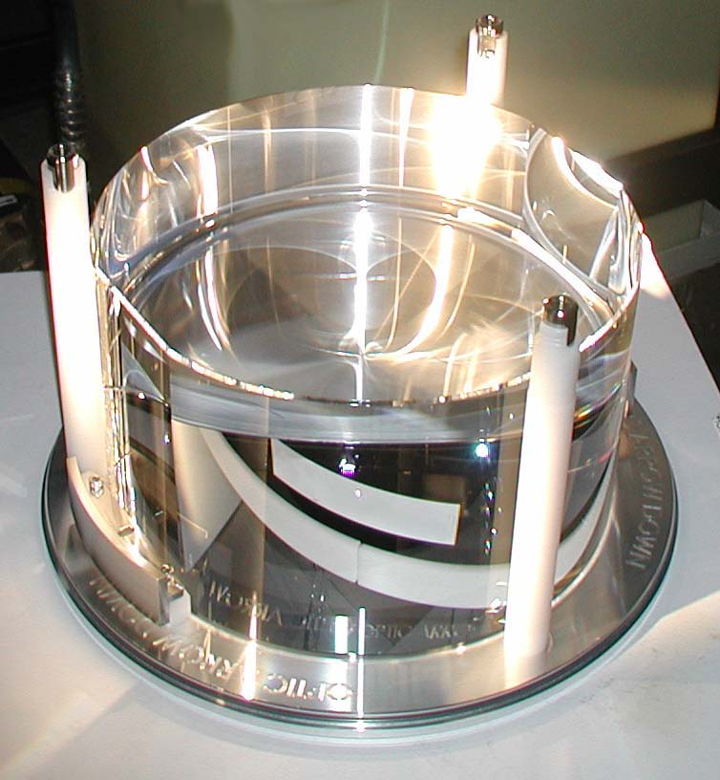
Design approach
Fused silica substrates
Low OH Fused silica used for in-cavity optics:
Beam Splitter
Compensation Plate
Input Test Mass
Two step polish:
Superpolish: ~1 Å microroughness, within 100nm of figure
Ion Beam Figuring: Corrects figure, maintains microroughness
Ion Beam sputtered coating
Coating performance at multiple wavelengths to support control system

Slide 14
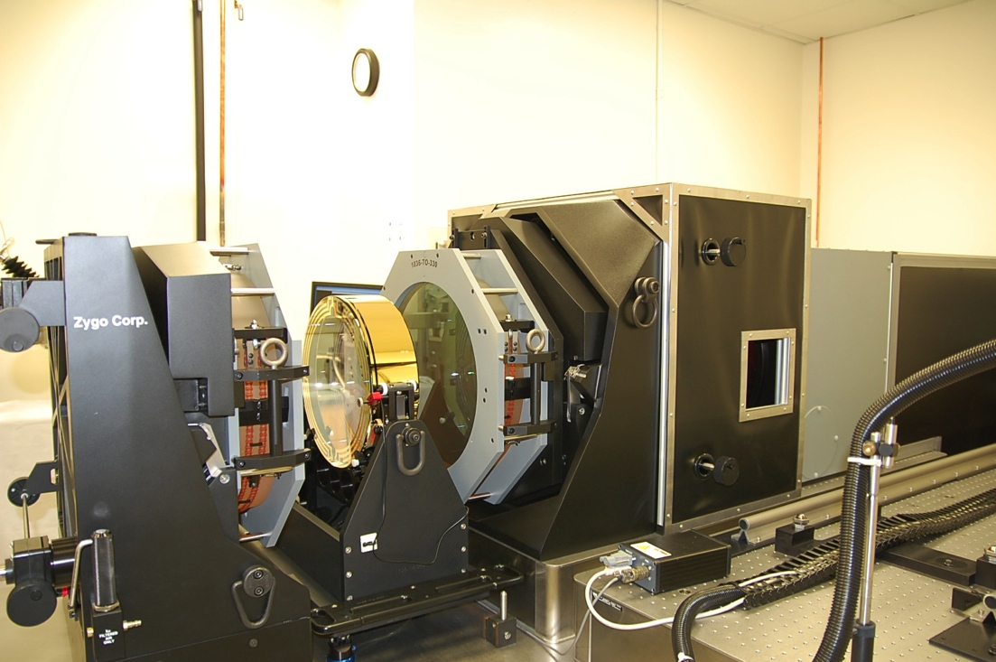
Metrology
Zygo full aperture interferometer installed at Caltech
The instrument and environment are quite stable, showing a uniform noise floor of 0.1 to 0.15 nm rms.
Polishing requirement is 0.3 nm rms
Vendor reports some surfaces at 0.08 nm rms
Good agreement with Polishing vendor measurements

Slide 15
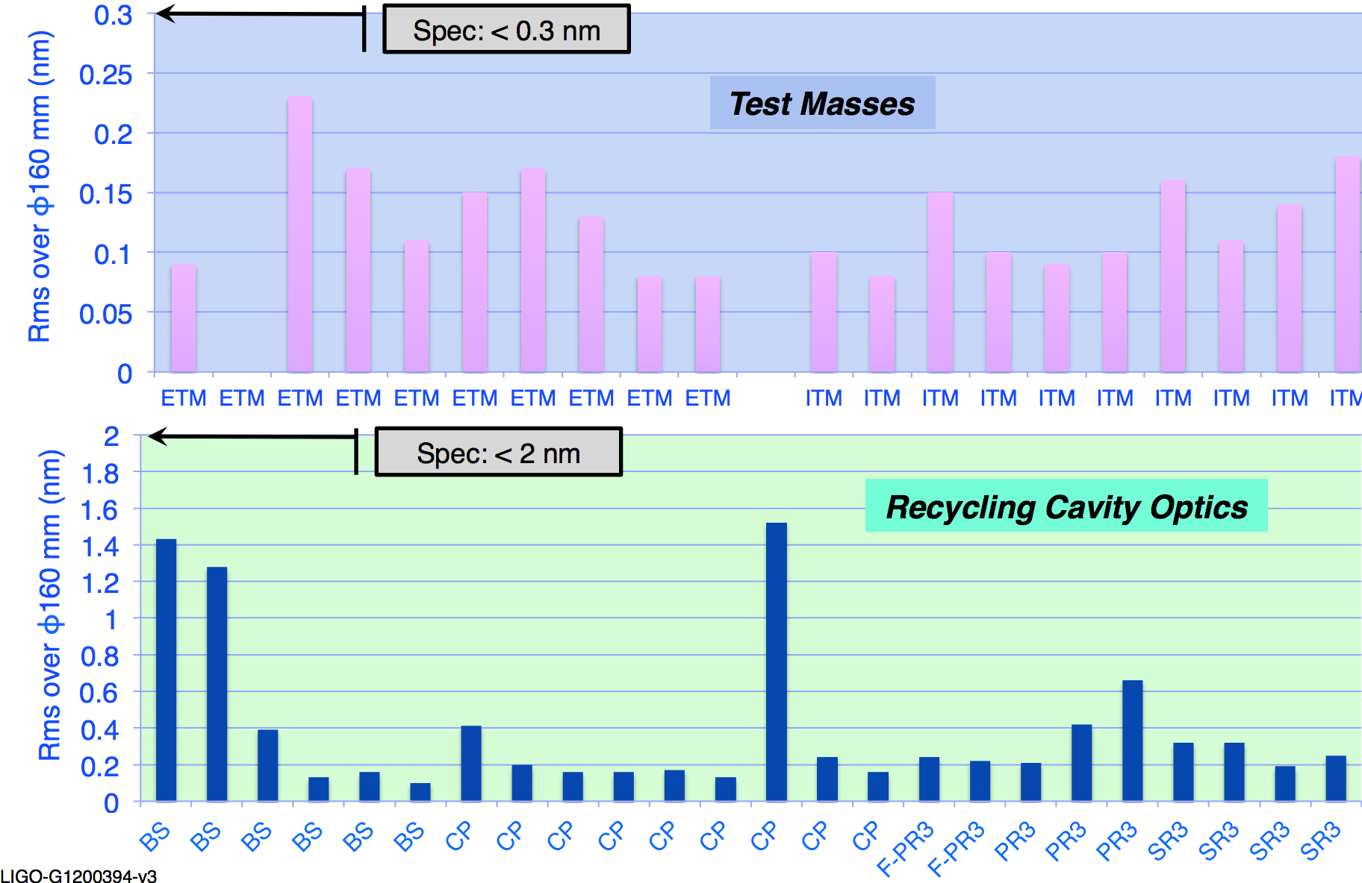
Figure, as polished Tilt, Power and Astigmatism removed

Slide 16
Figure, before and after coating measured on different instruments
Same diameter, same color scale
LIGO measurement after coating by CSIRO
9.8 nm PV 1.6 nm rms
Polisher (Zygo EPO) measurement
11.4 nm PV 1.7 nm rms

