Slide 1
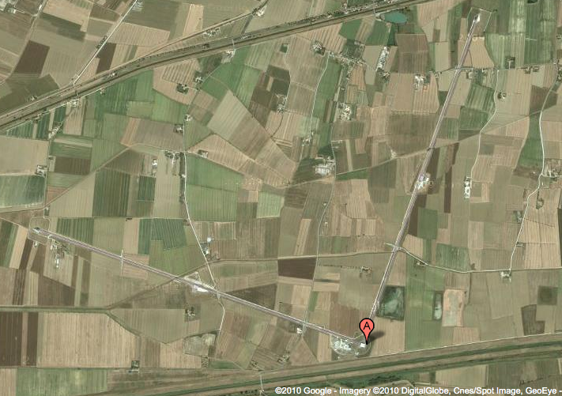
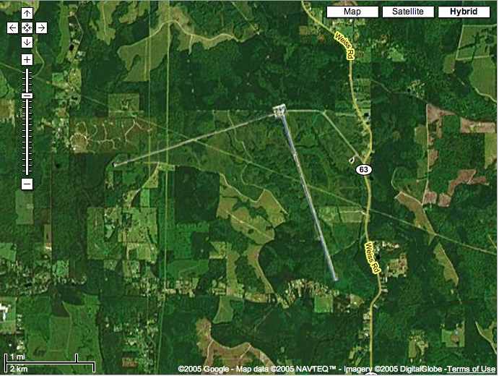
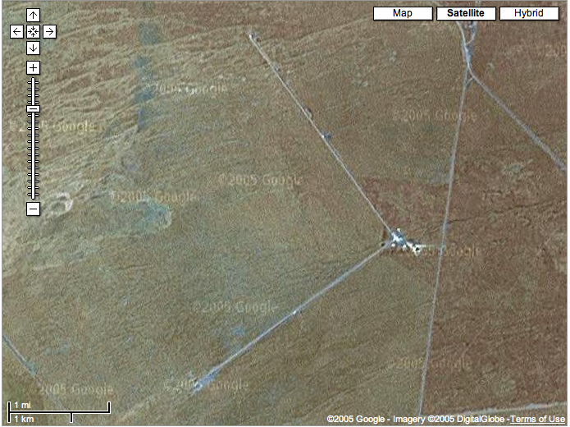
Searching for gravitational waves
Gabriela González
Louisiana State University
For the LIGO Scientific Collaboration and
the Virgo Collaboration
AAAS meeting, Washington DC, USA
Feb 12, 2016
Virgo detector, Cascina, Italy
LIGO Livingston Observatory,
Louisiana, USA
LIGO Hanford Observatory
Washington, USA

Slide 2
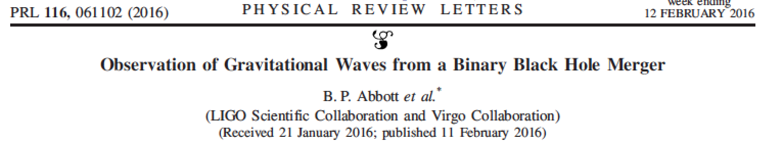

Slide 3
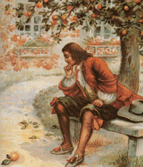
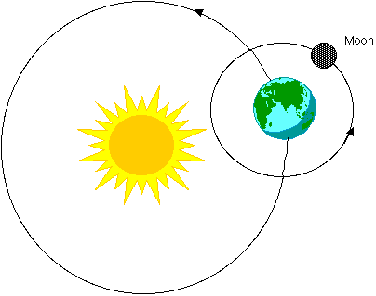
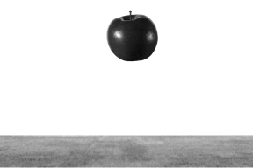
Newton’s gravity
“Newton’s law”: F = Gm₁m₂/r²
Explains why apples fall, why the planets move around the Sun,…

Slide 4
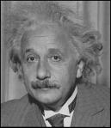
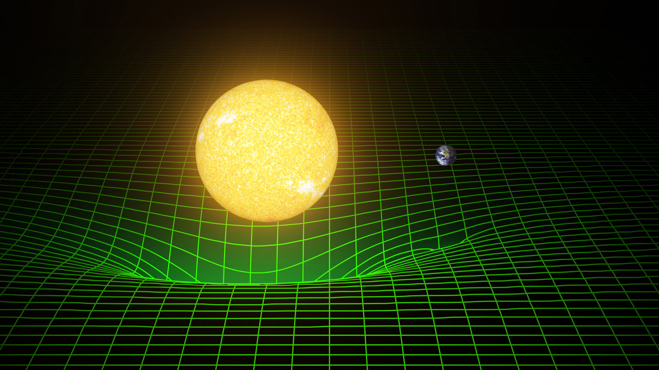
Einstein’s gravity

Slide 5
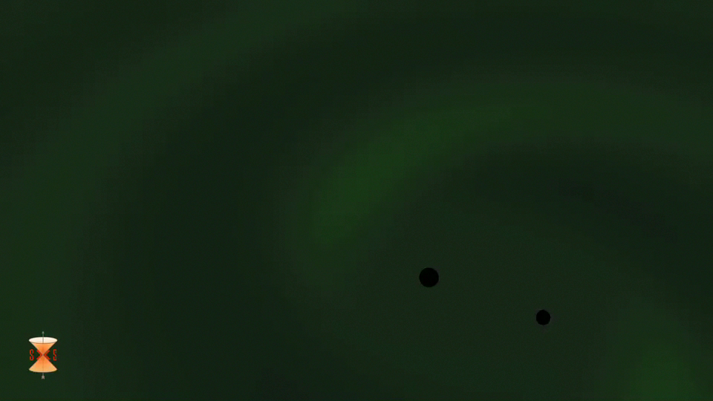
Einstein’s gravity

Slide 6
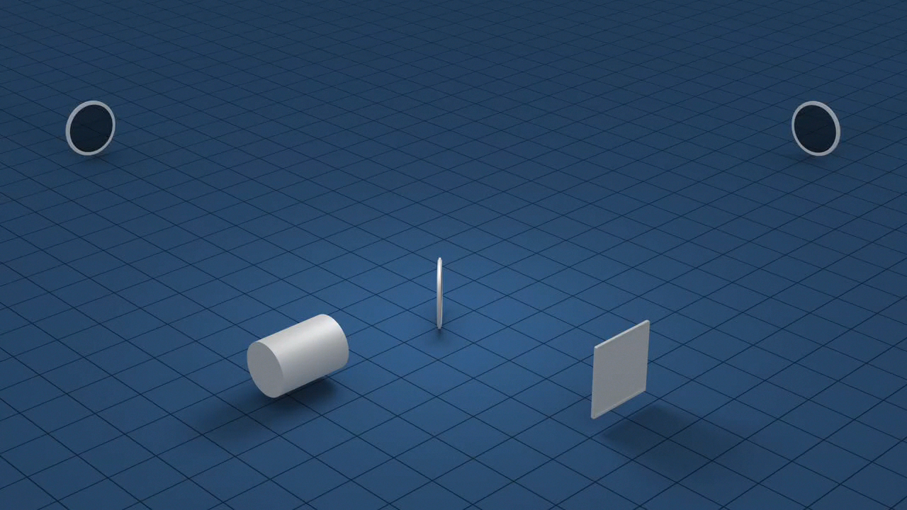

Slide 7
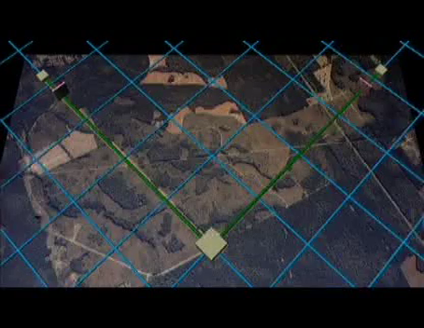


Slide 8
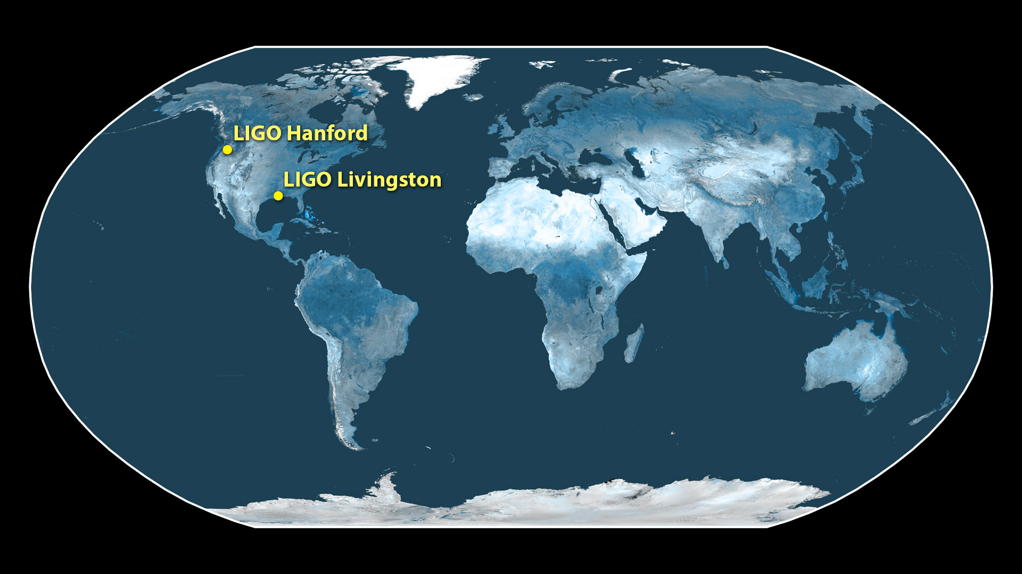
Notes:
LIGO built two detectors far from each other, in Livingston LA and Hanford, WA, in order to verify that detected signals come from space and not locally, on Earth.

Slide 9
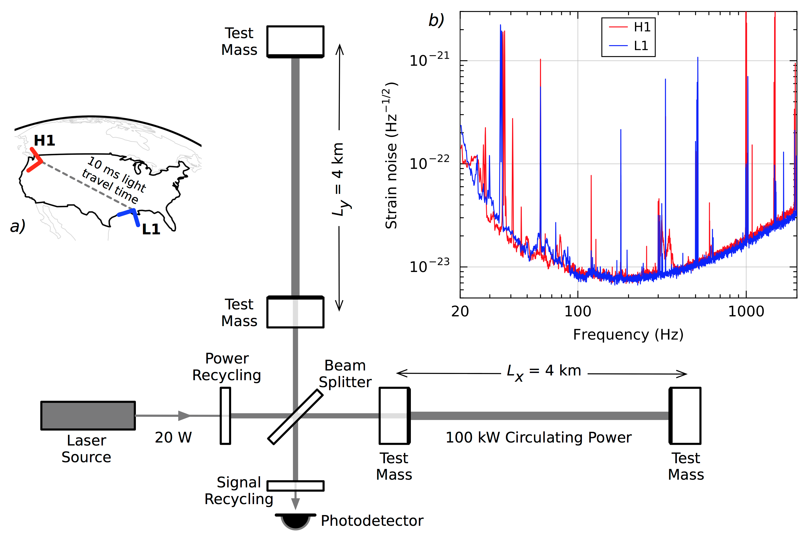

Slide 10
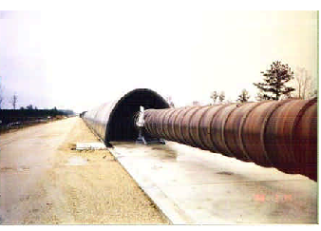
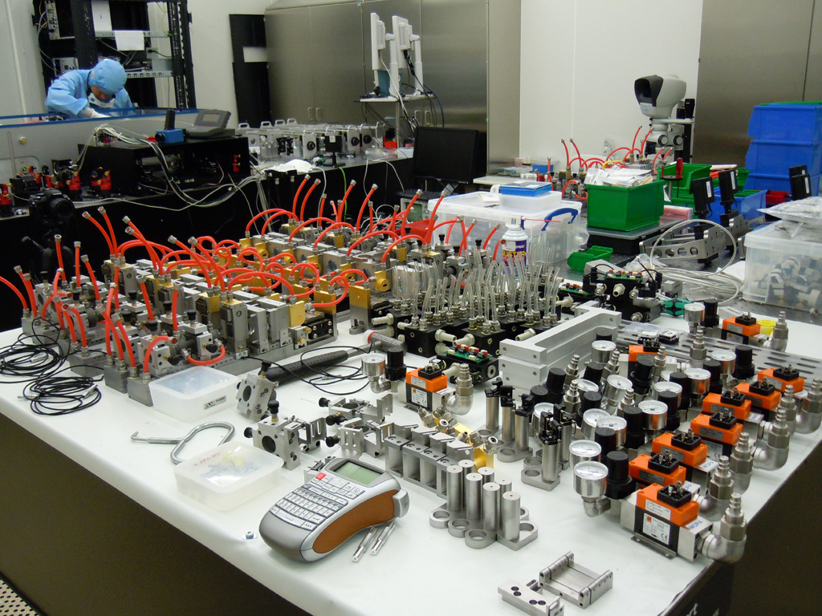
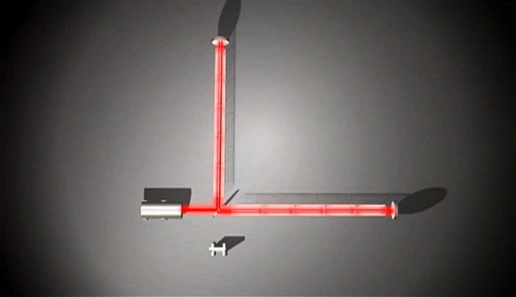
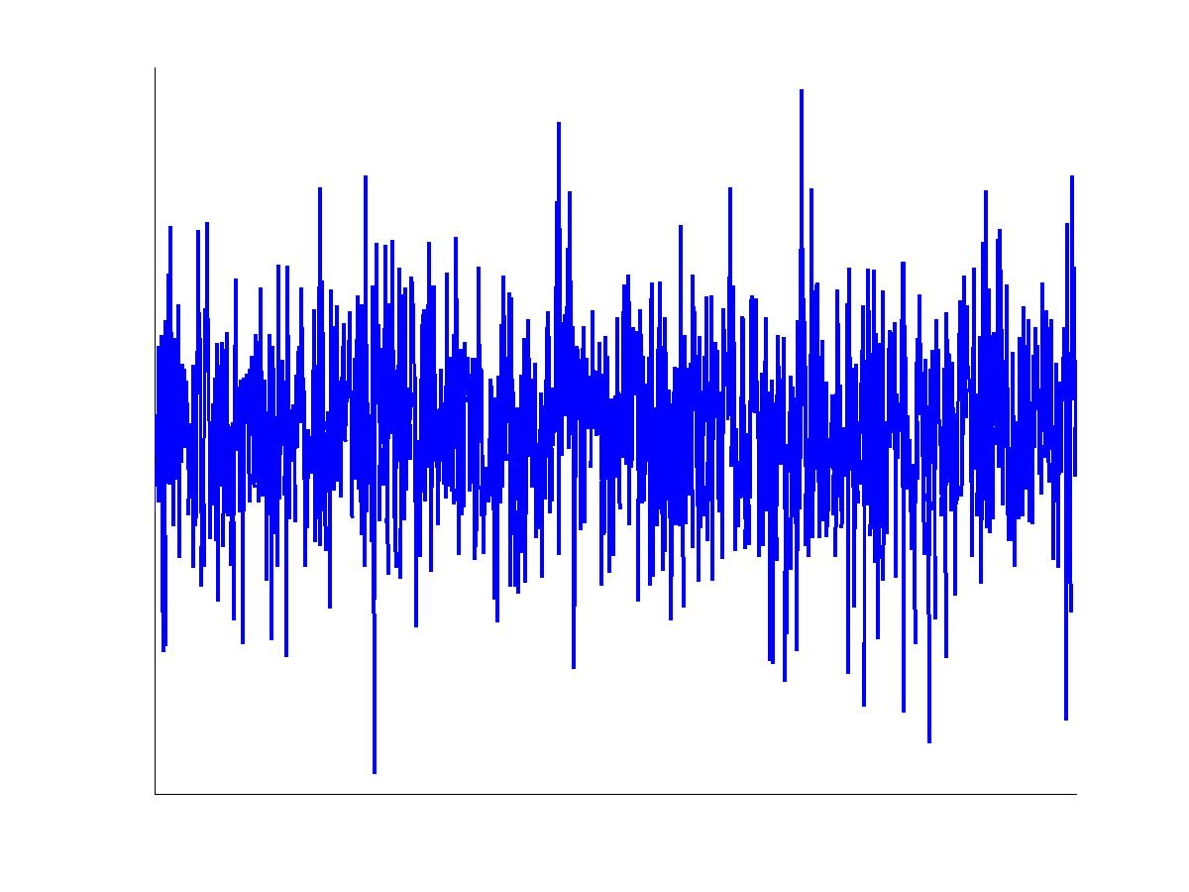
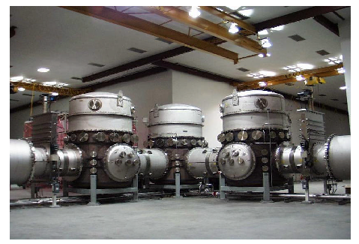

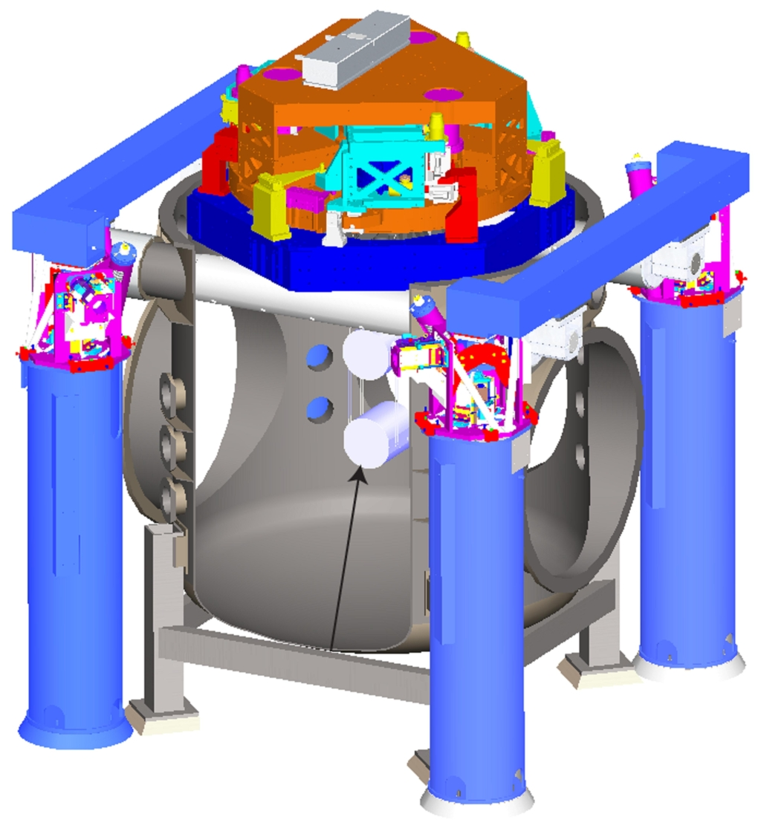
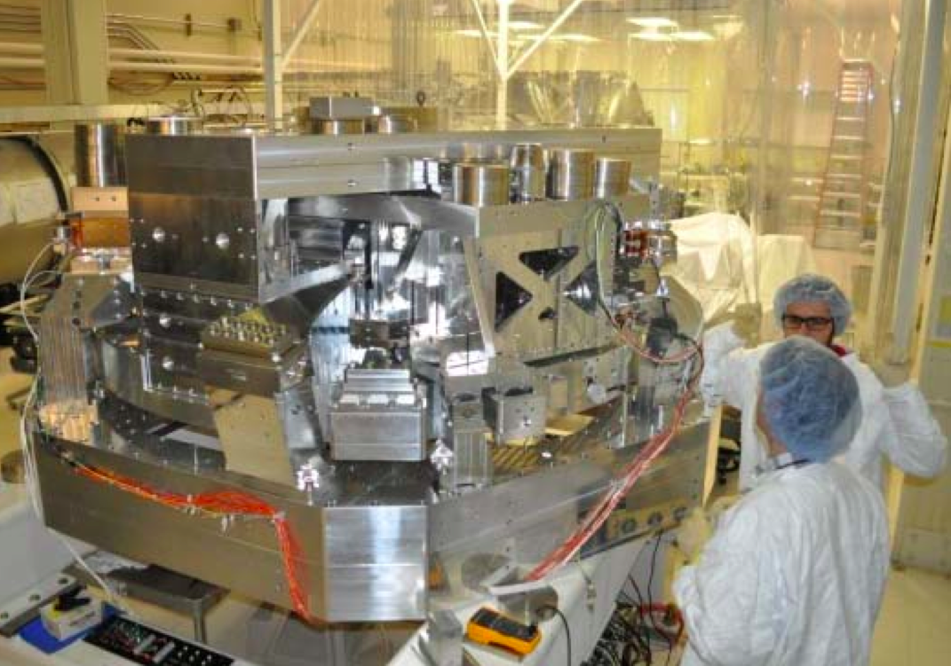
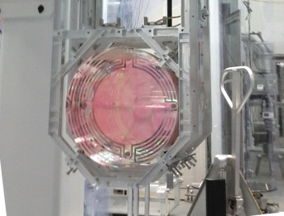
Advanced LIGO detectors

Slide 11
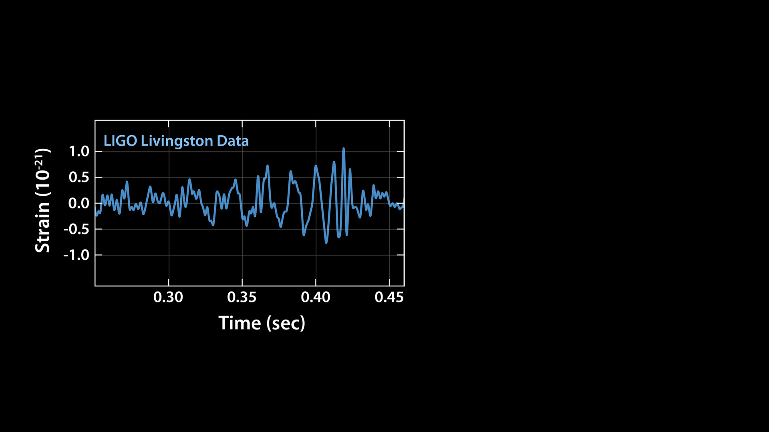
Notes:
The very hard work of this world-wide community paid off on September 14 last year, when strong signals were detected by LIGO detectors.
The signal first arrived to LIGO Livingston, at 4:51am, and showed a large amplitude signal that is ,larger than the background noise from the detector.

Slide 12
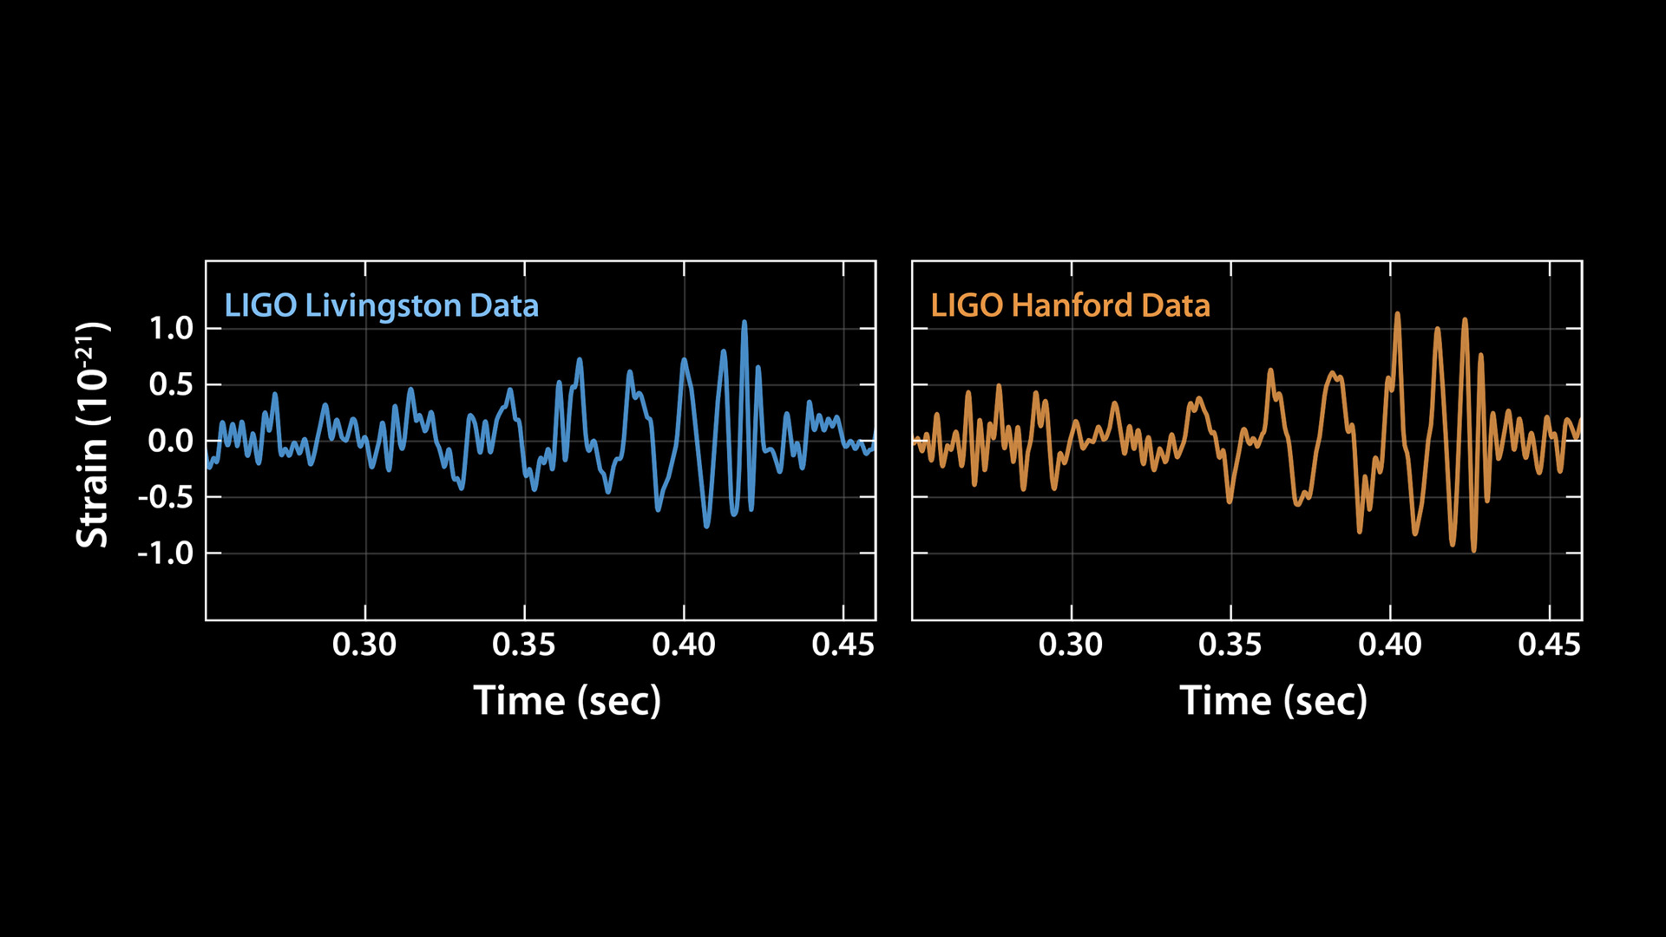
Notes:
We saw a very similar waveform in the LIGO Hanford detector, only 7 milliseconds later.
We see a few cycles increasing in amplitude and frequency, and the signal settles down back to the noise– all in a small fraction of a second.
The detected distortion of space time was very small, a part in 10^21. The distance changes we measured in LIGO's arms are 4 parts in a thousandth of a proton diameter: tiny!

Slide 13
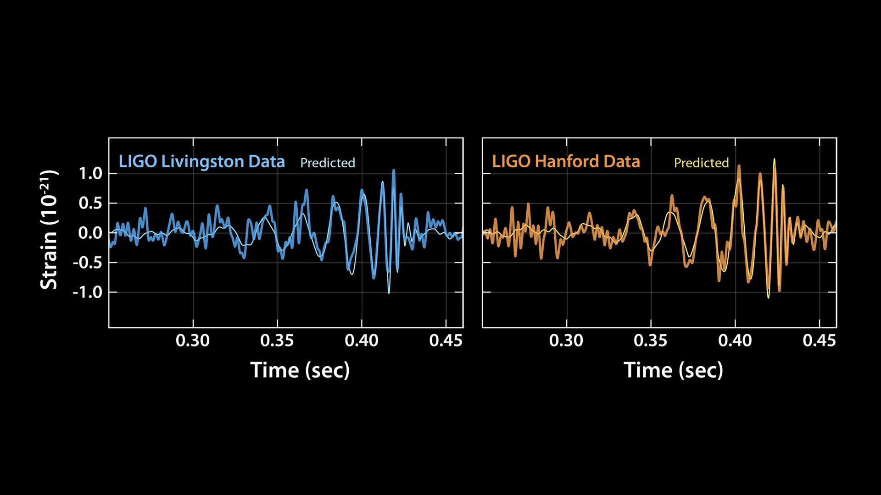
Notes:
The observed signals matched beautifully the predicted waveform for the motion of a pair of black holes and vibration of the resulting single black hole. From the frequency of the signals, we can tell the masses of each initial black hole and the mass of the final black LIGO has made the first-ever detection of two black holes merging into one, proving that binary black holes are more common in the universe than most scientists earlier thought.

Slide 14
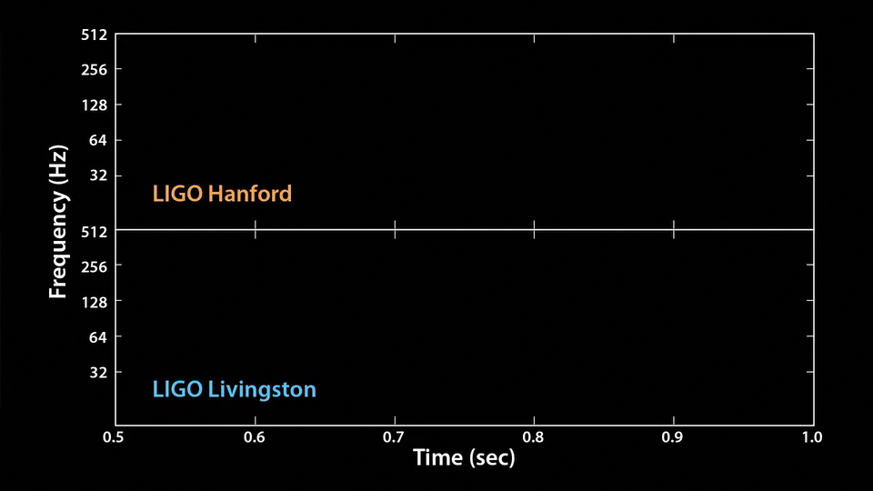
Notes:
We can also translate the signal into sound: listen carefully for the very short “thump” – that’s the tiny chirp of two black holes merging.

Slide 15
Notes:
The animation plays again, this time slower and with the frequencies shifted, so you can hear the signal better. This is the song and dance of two black holes colliding. It’s remarkable how much we can learn from this!

Slide 16
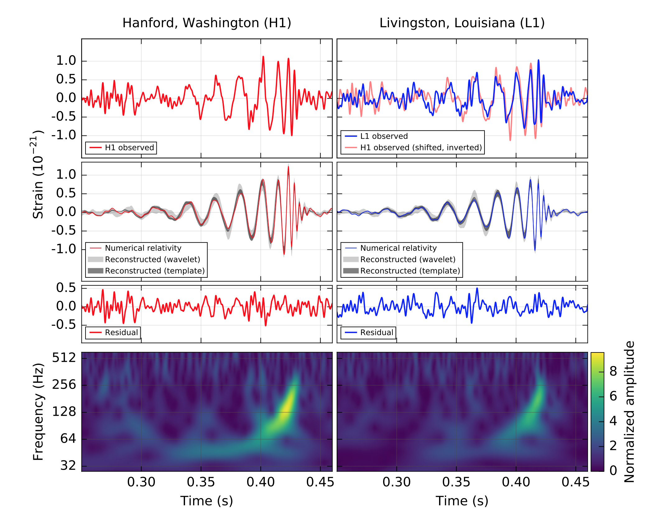

Slide 17
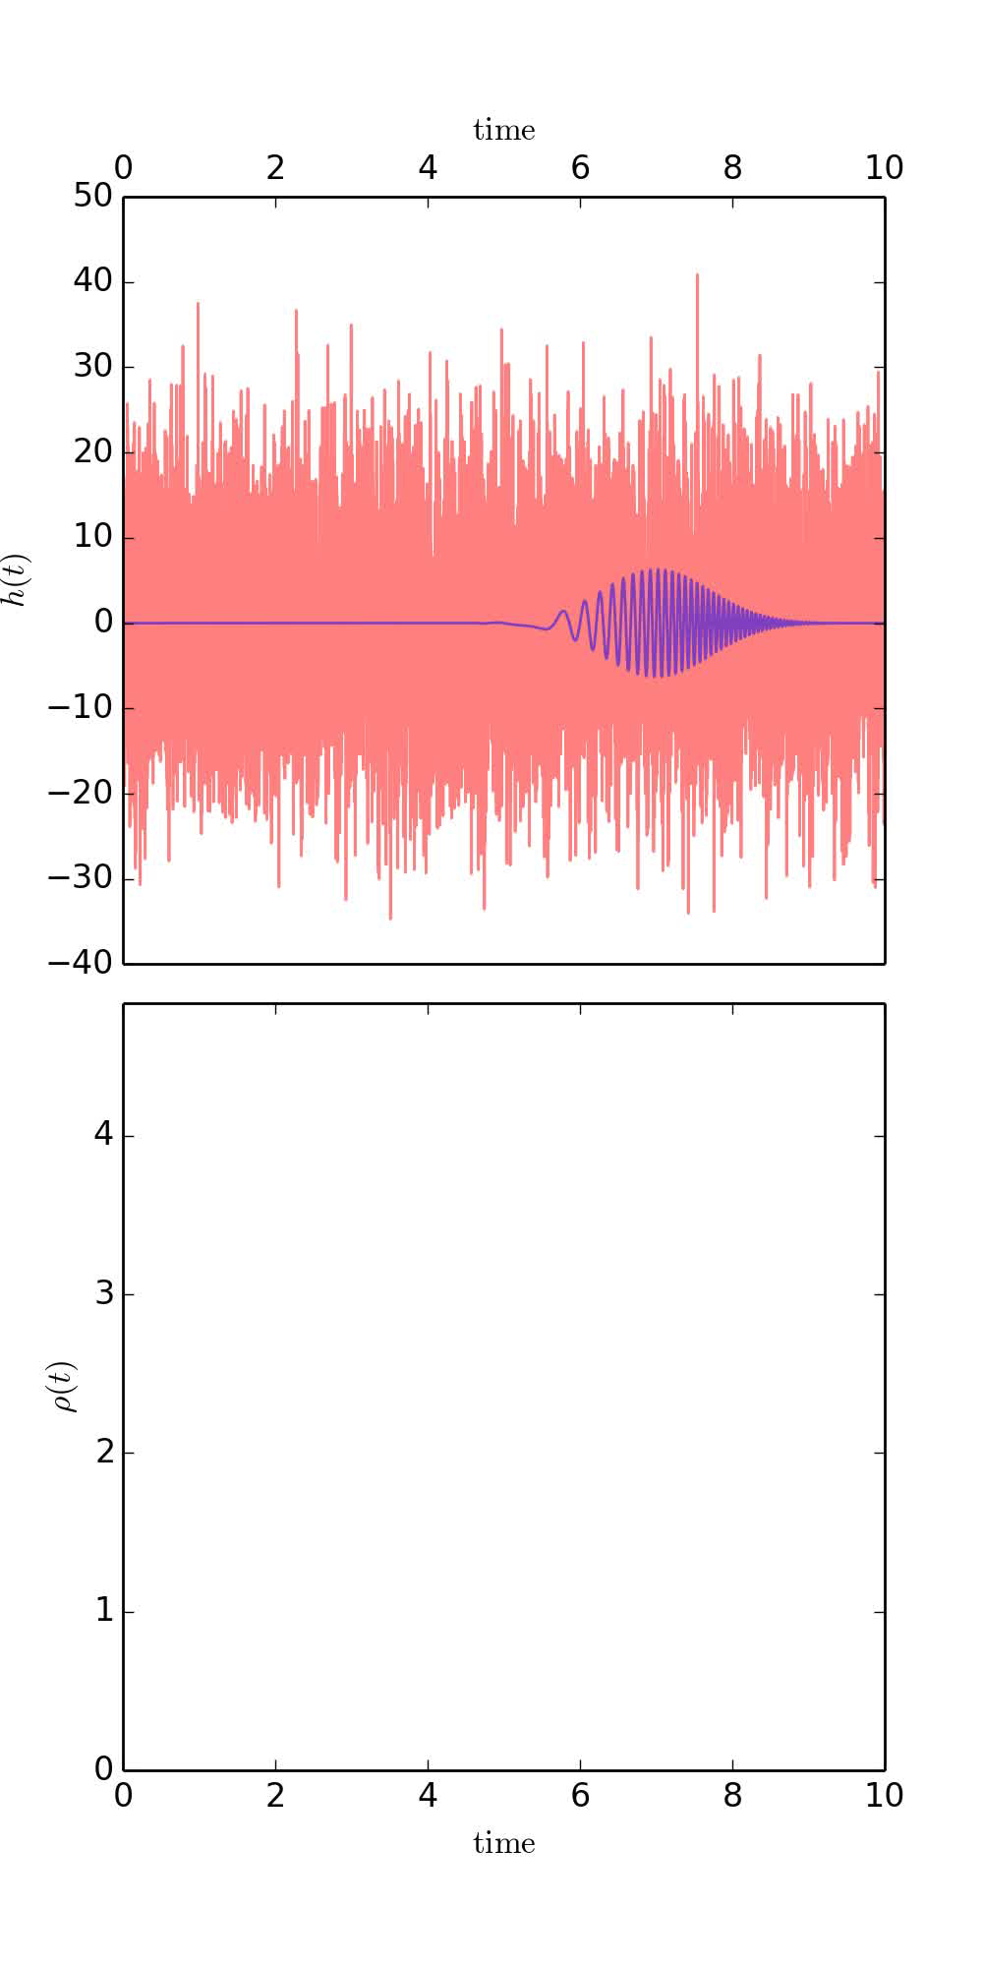

Slide 18
Parameter Estimation

Slide 19
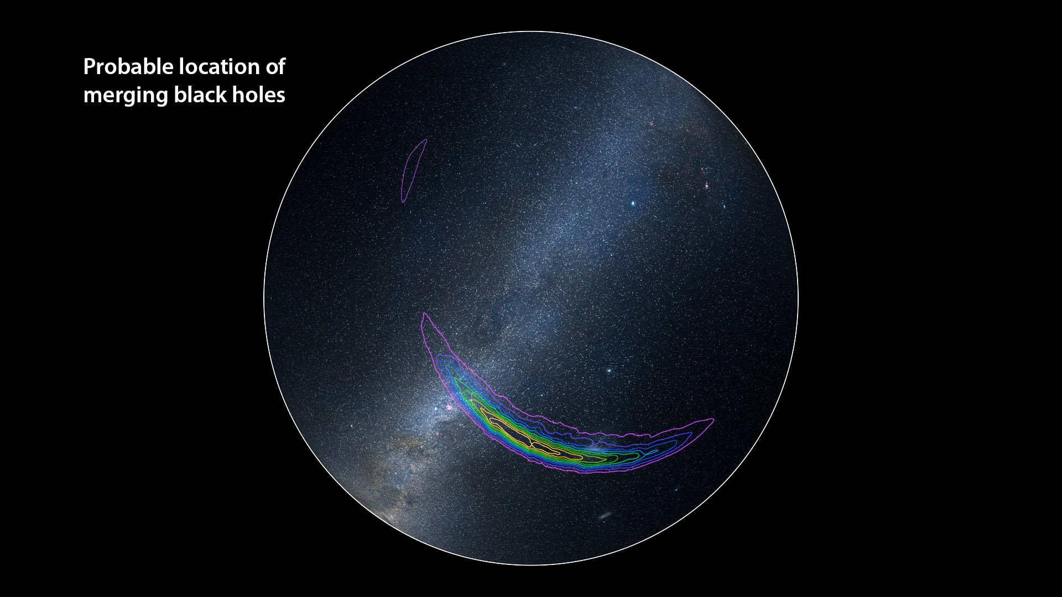

Slide 20
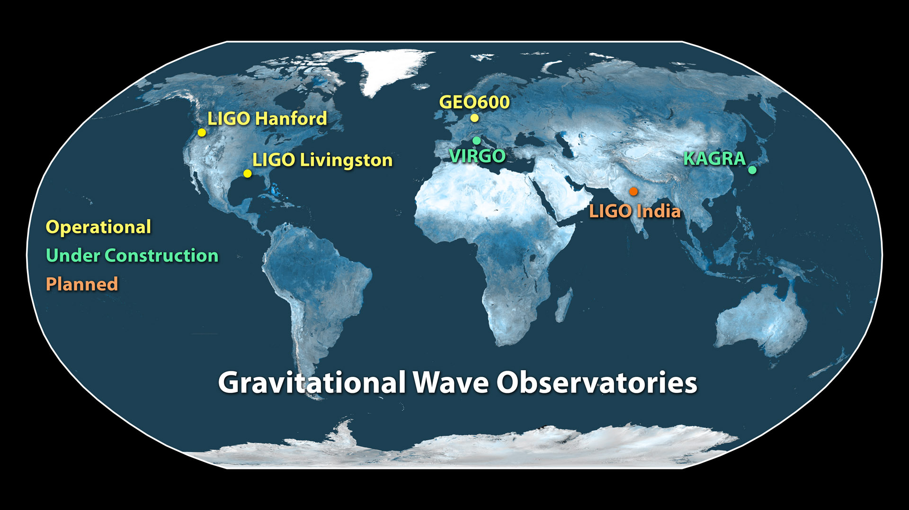
Notes:
Having three or more detectors will help us narrow down the location of the gravitational signals even more: You need at least two ears to know where a sound comes in a plane, but having more ears you can localize the source much better. We have more detectors in the near future: The Virgo detector will joining the gravitational wave network later this year – and we expect more detectors to join in Japan and perhaps India.
We have opened the era of gravitational wave astronomy, and expect to learn much astrophysics from the many detections to come. This is the end of a long quest, but more than that it’s the beginning of a new era. To quote one of our young scientists: we’ll never stop listening to gravitational waves now!
I have the honor to let now Rai Weiss, one of the founders of LIGO, tell you more about the history and technology involved in these amazing instruments.

Slide 21
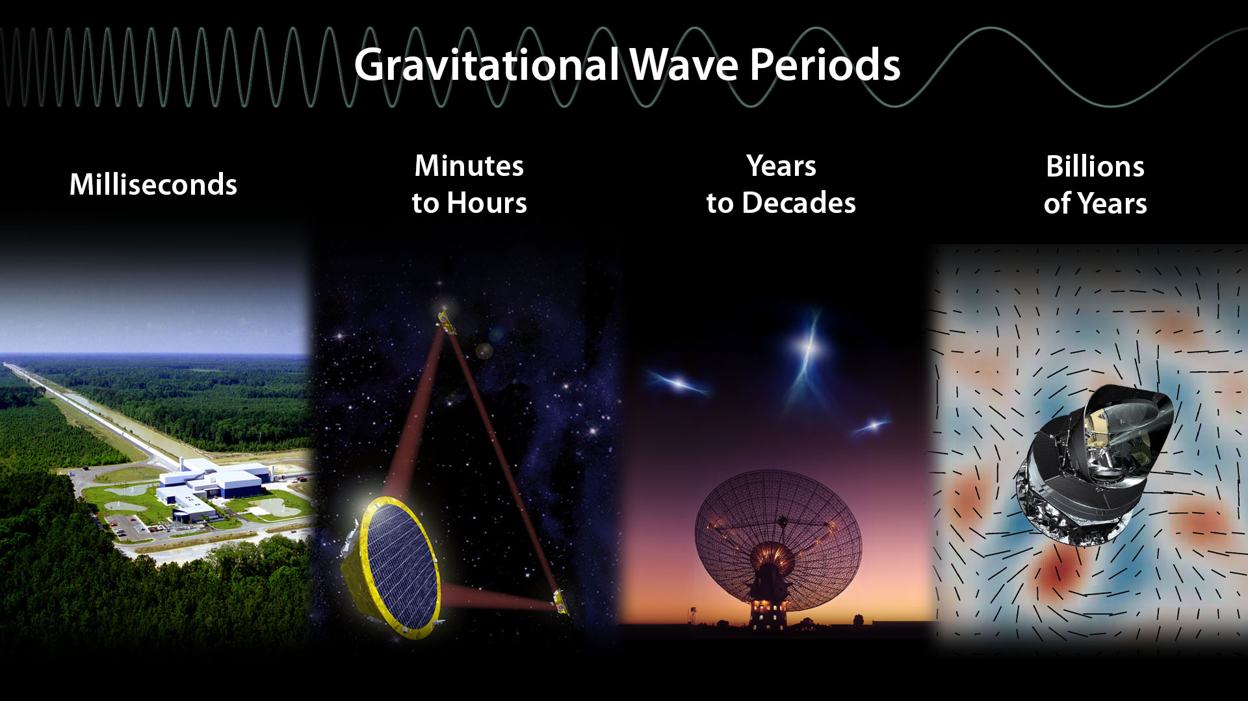

Slide 22
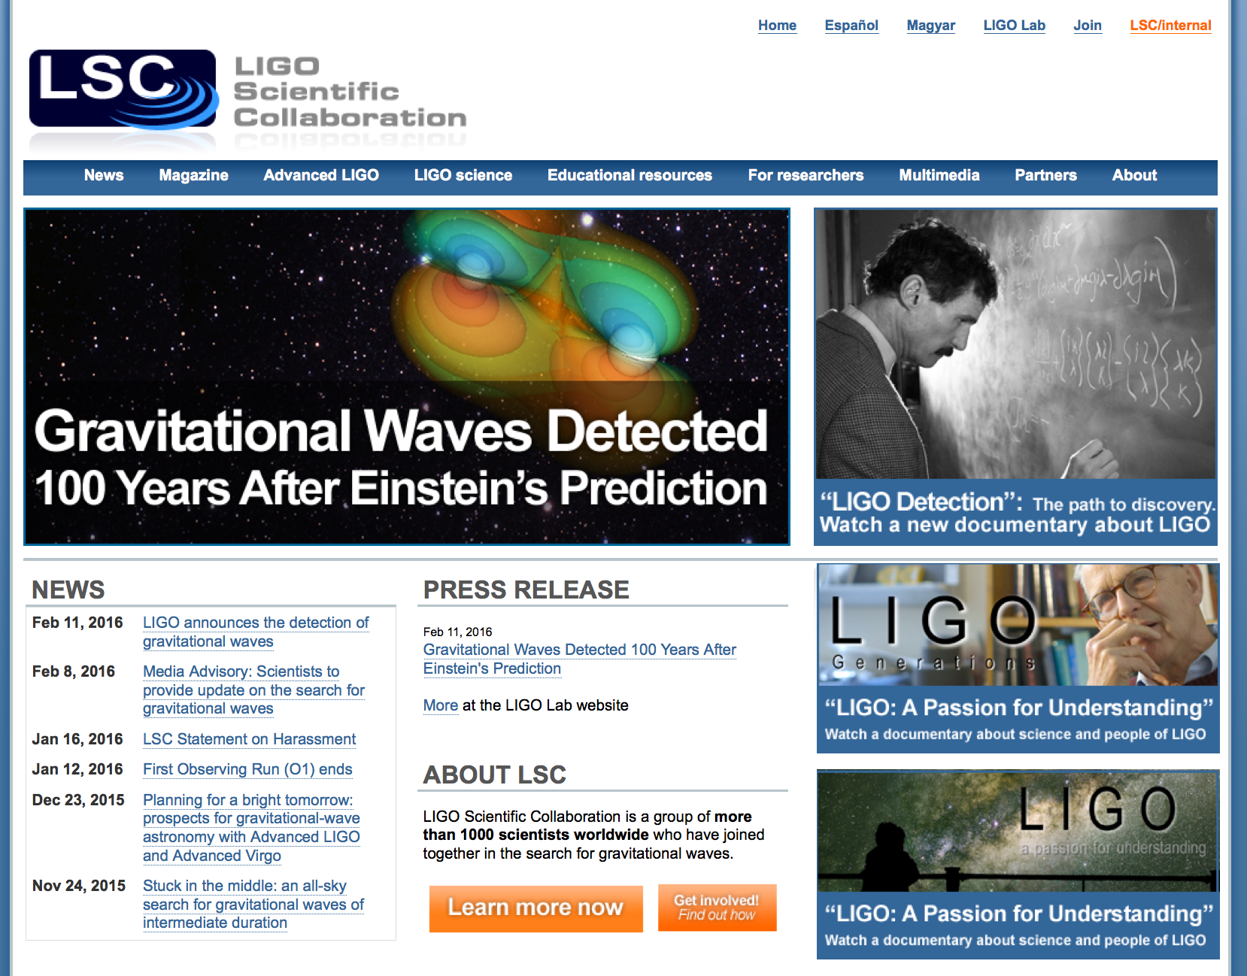
www.ligo.org

