Slide 1
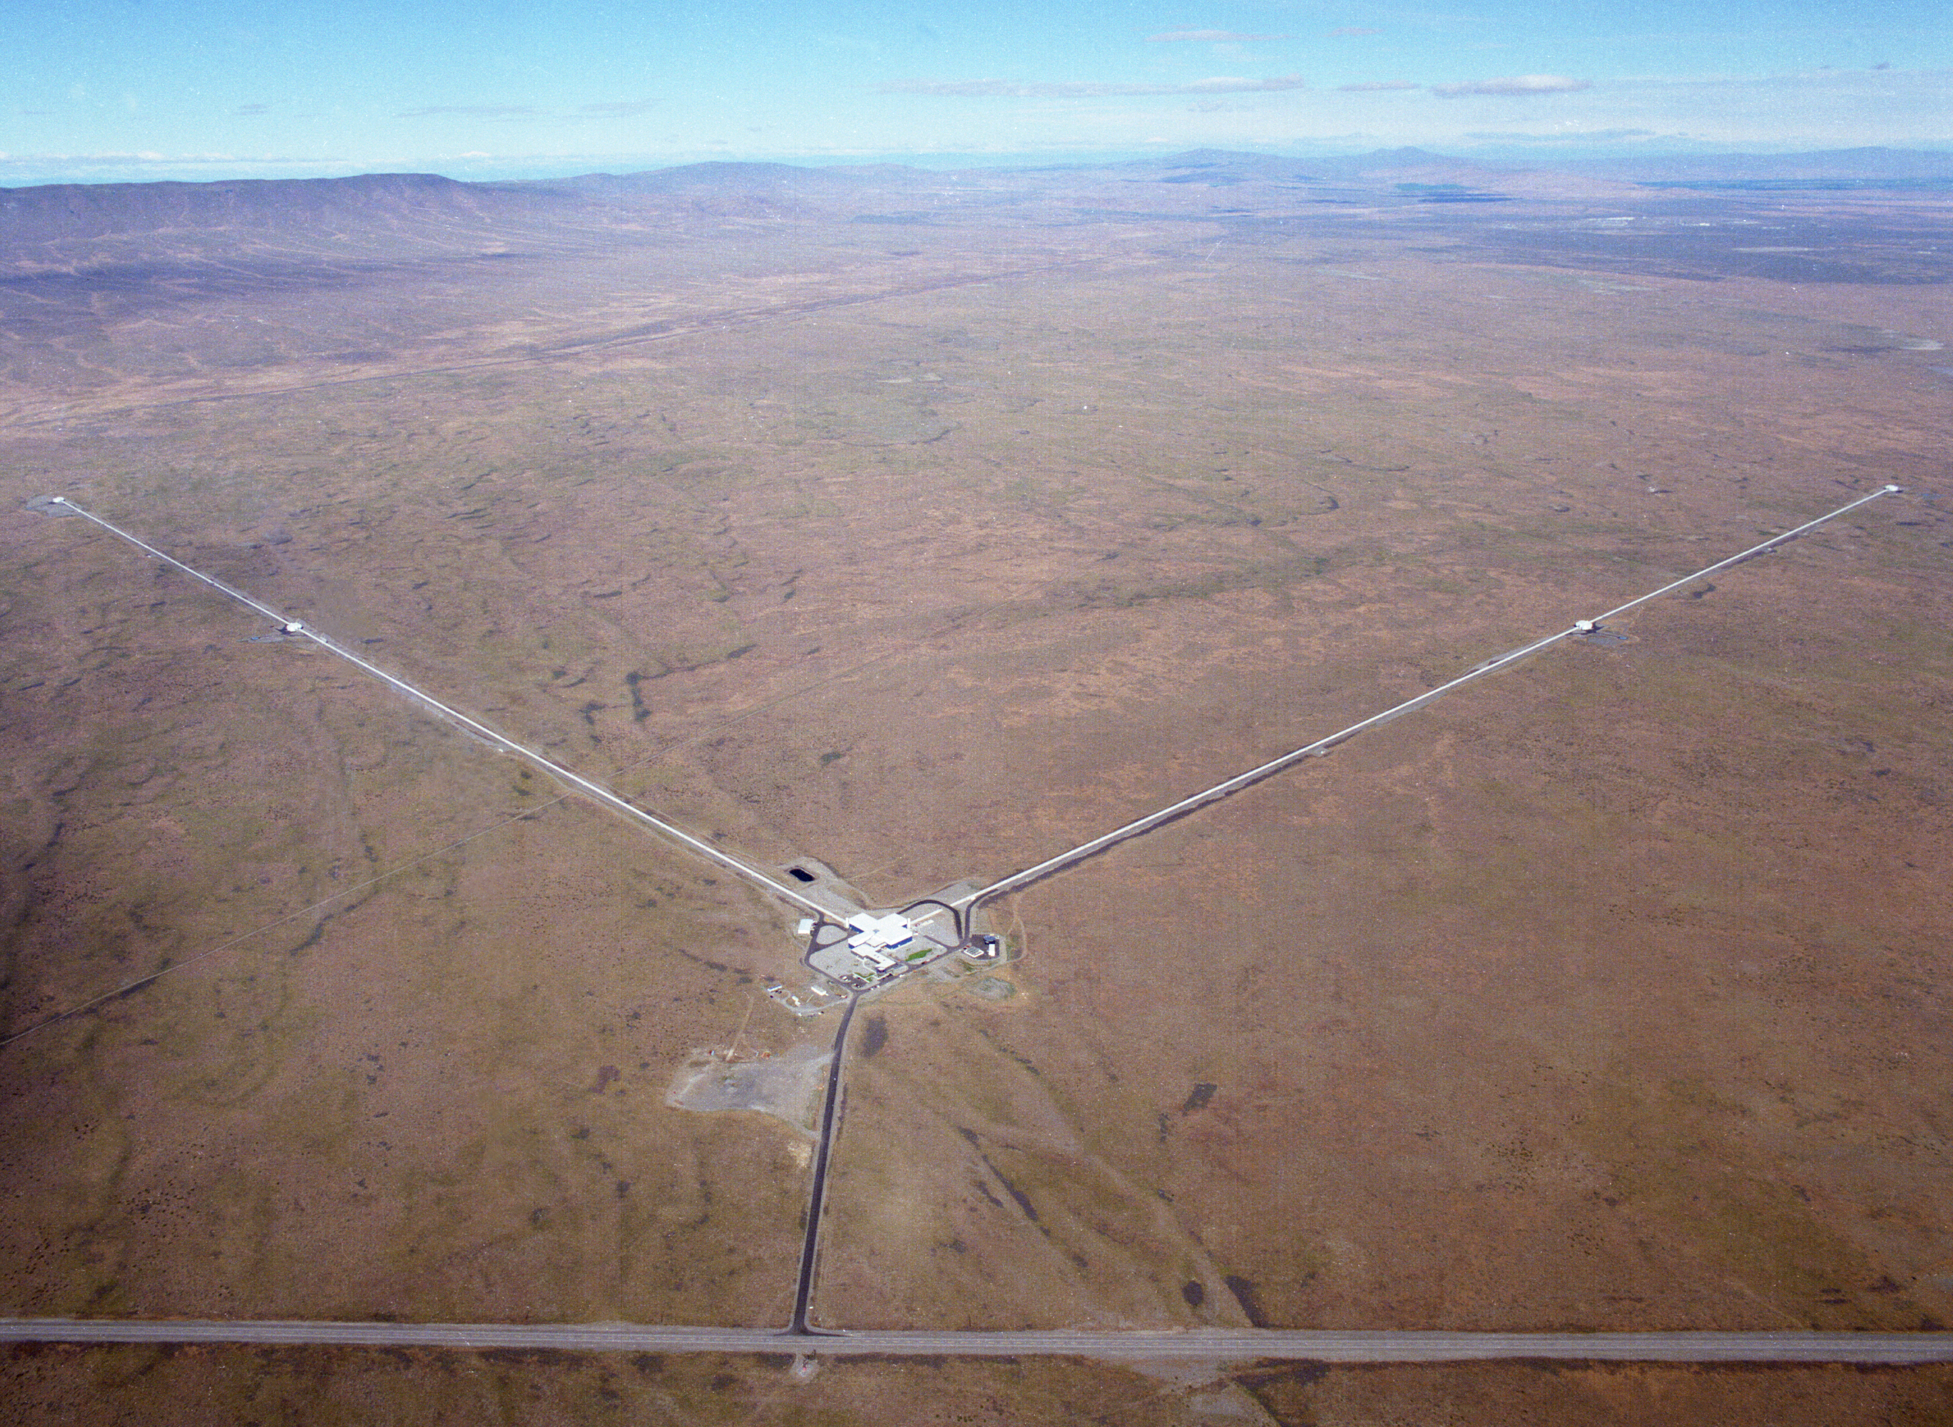
GW150914: Observation of Gravitational Waves from a Binary Black Hole Merger

Slide 2
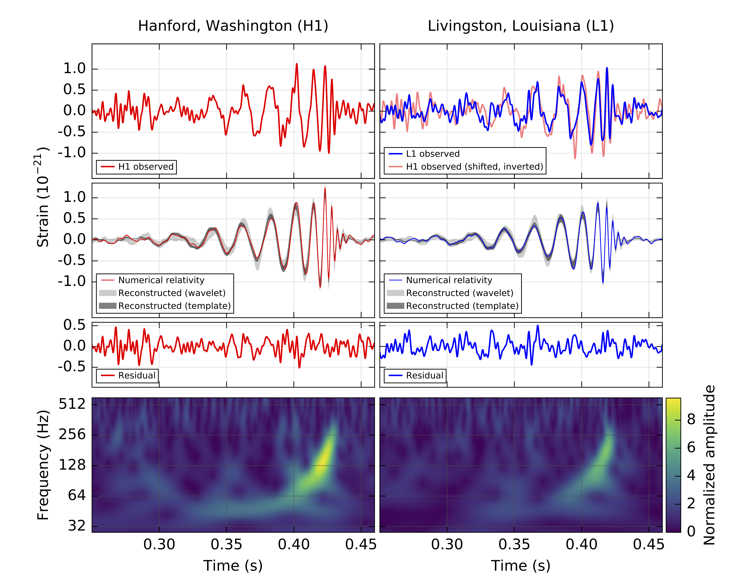
What was observed?

Slide 4
A signal from a binary black hole merger

Slide 5
A signal from a binary black hole merger

Slide 6
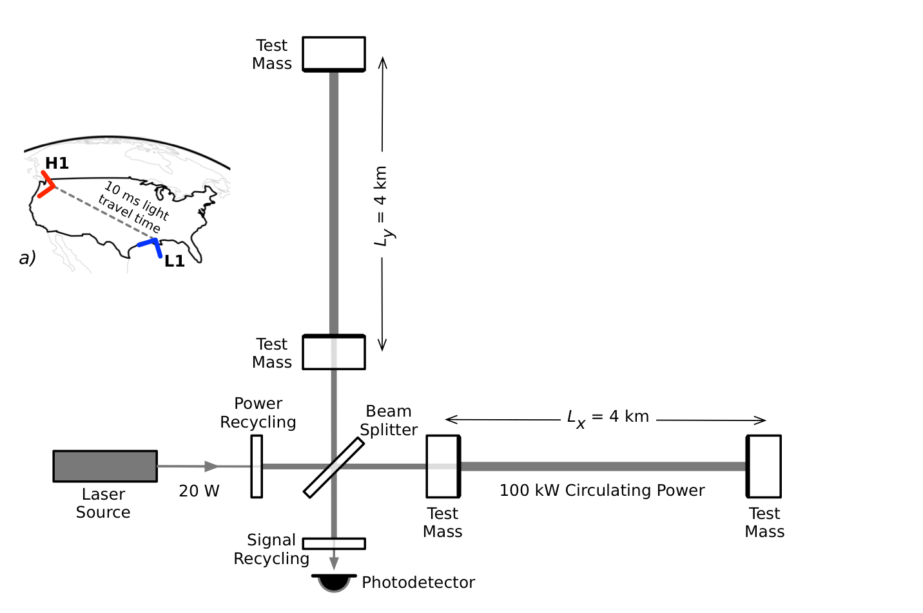
The detector works

Slide 7
First-ever tests of Einstein's theories under dynamical, extreme-gravity conditions
Notes:
7
7

Slide 8
Amazing Facts
about GW150914
3 times the mass of the sun (1 million times the mass of Earth) turned into energy vibrating the fabric of spacetime
Peak power more than 10,000,000,000,000,000,000,000,000,000,000,000,000,000 times the output of the Columbia Generating Station
Relative distance change same as changing distance to nearest star by width of human hair
Merger actually happened more than 1 billion years ago
In the volume that we can see systems like GW150914, there are more than
5 million galaxies

Slide 9
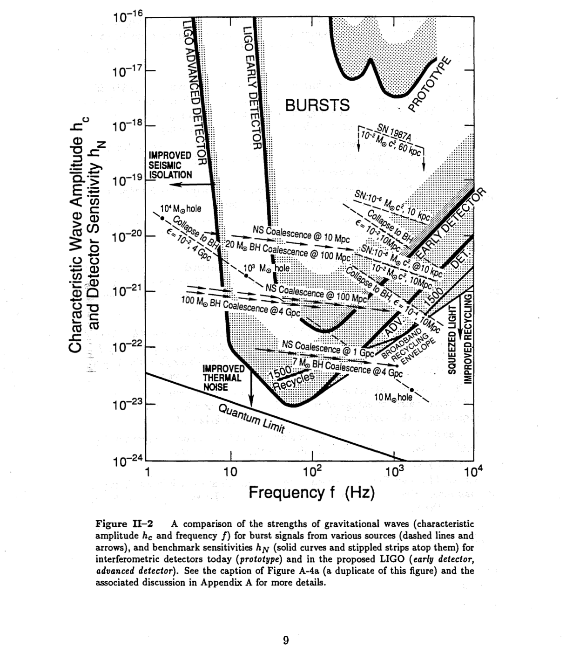
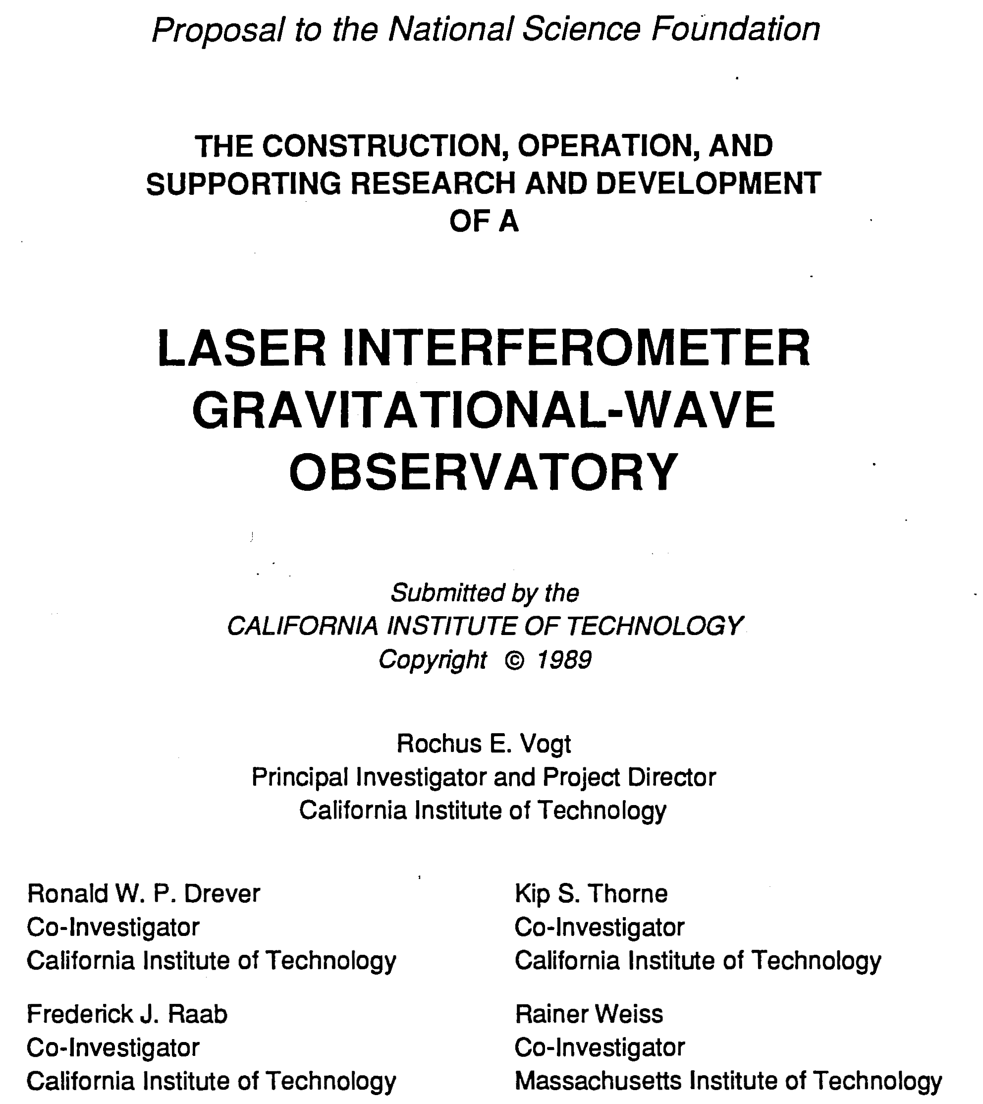
Original detection strategy succeeds!

Slide 10
A signal from a binary black hole merger

