Slide 1
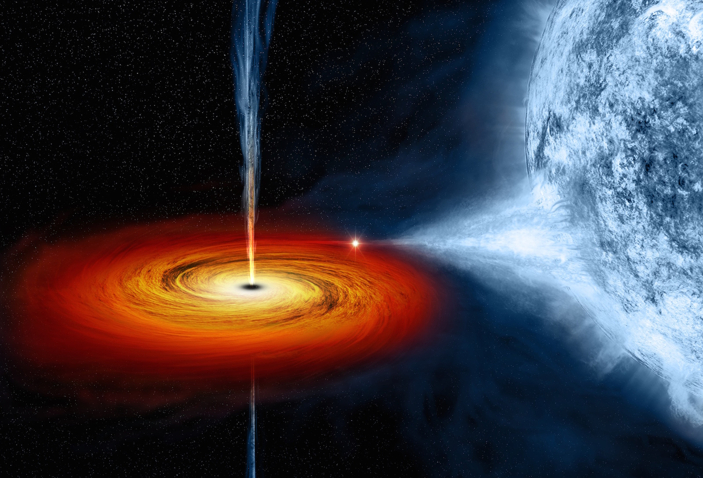
“Remember that time we decided to measure colliding super-dense stars with a laser, ripples in the fabric of space, tumbleweeds and an alligator?”
Aidan Brooks
Image credit: NASA/CXC/M.Weiss

Slide 2
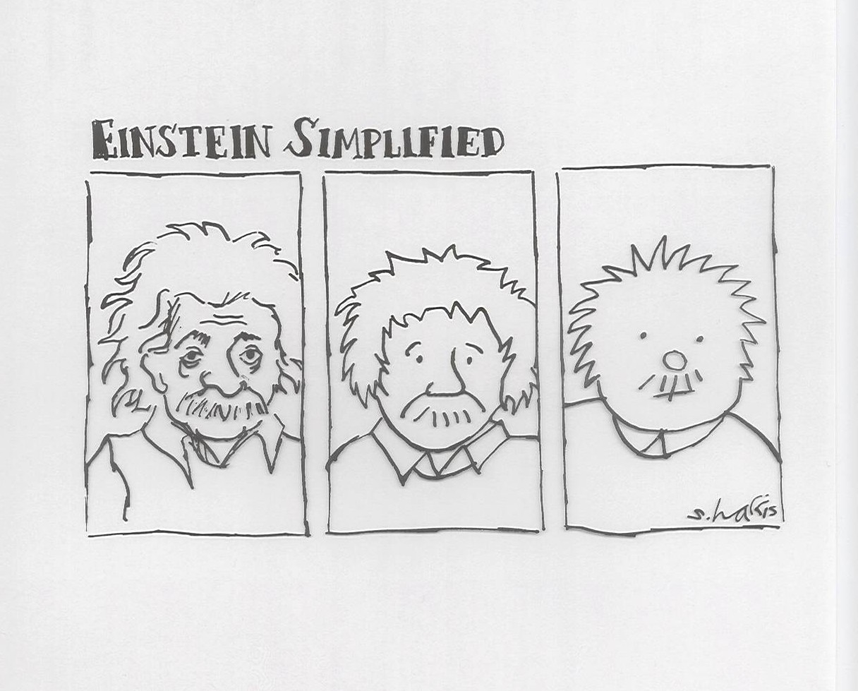
Einstein Simplified

Slide 3
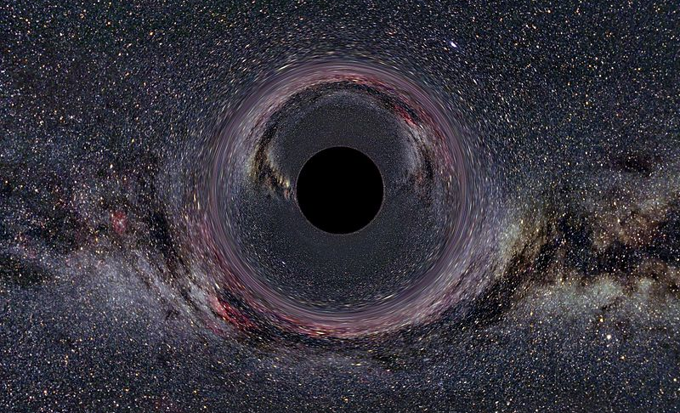

Our story begins 100 years ago …in 1915
Einstein’s General Theory of Relativity
Describes space-time and mass relationship
  “On the General Theory of Relativity”, Preussische Akademie der Wissenschaften, Sitzungsberichte, 1915 (part 2), 778–786, 799–801
Simulation of a black hole bending light around it.
Image credit: Ute Kraus, Physics education group Kraus, Universität Hildesheim

Slide 4
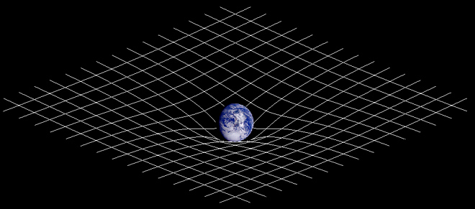
Space is a big rubber sheet

Slide 5
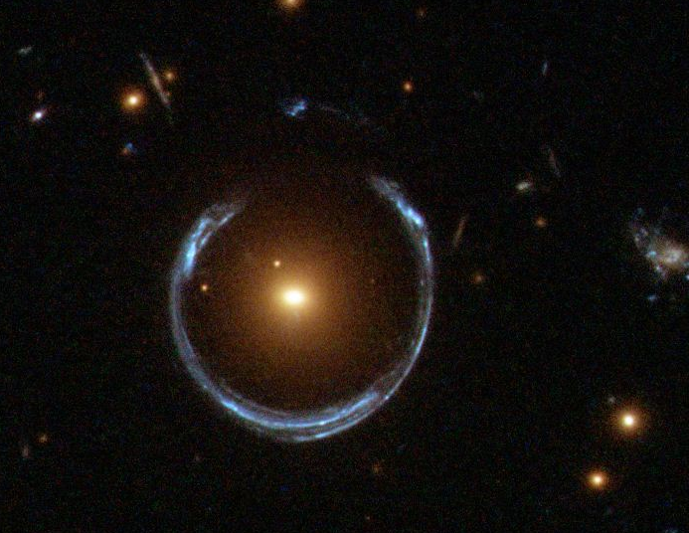
Gravitational lens: LRG 3-757
Side view
Light rays
Foreground galaxy
Far galaxy
Image Credit: ESA/Hubble http://apod.nasa.gov/apod/ap111221.html

Slide 6
Gravitational Waves are
Ripples in Space-Time
Edited and used with permission from NSF
Notes:
Einstein – Space Time like a fabric
What we call gravity is the warping of this fabric by a massive object!
Planet orbit a star when it is caught in this fabric.
Let Einstein to a prediction that when 2 large objects are colliding … produce waves in the fabric – GW!!!
Ripples in Space-Time.
We can show this in lab or pub with table top experiment – All we need is a couple of pool balls a bowling ball and a BIG sheet!!!

Slide 7
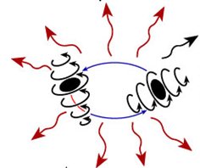
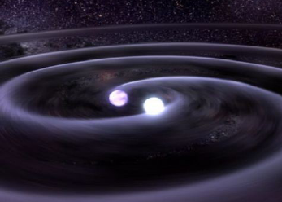
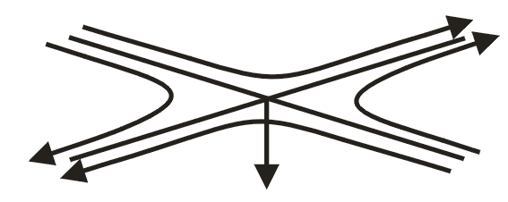
Gravitational Waves in detail
Gravitational waves are propagating dynamic fluctuations in the curvature of space-time (‘ripples’ in space-time)
Emissions from rapidly accelerating non-spherical mass distributions
  Practically, massive objects moving at speeds approaching the speed of light
  According to GR, GWs propagate at the speed of light
  Physically, GWs are strains
  GWs carry direct information about the dynamics of matter
Credit: T. Strohmayer and D. Berry

Slide 8
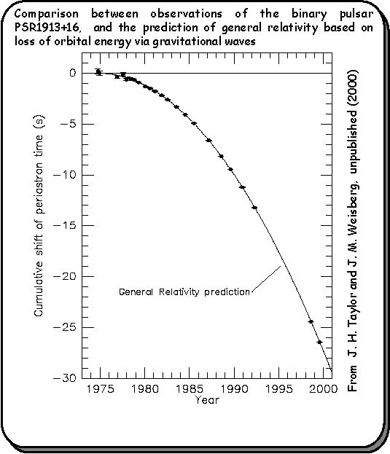
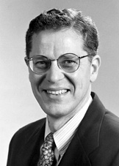
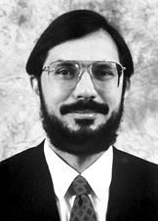
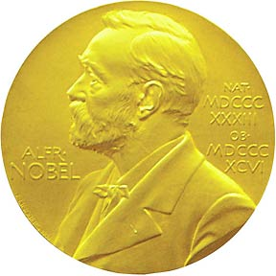
How do we know GWs exist?
PSR 1913+16
1993 Nobel Prize
In Physics
Joseph Taylor
Russell Hulse
•
17 / sec
•
~ 8 hr
Notes:
You might build a large scale gravitational wave interferometer on the basis of GR theory and known astrophysical sources, but personally, I’d want to be more convinced.
The proof, though indirect, comes from a series of pulsar timing experiments conducted by Joe Taylor and Russell Hulse over a 20 year time frame monitoring the orbital dynamics of PSR 1913+16
Describe the experiment and result in agreement with GR
Hulse and Taylor were awarded the Nobel prize for their work.
We’ll have to wait 300,000,000 years for these stars to merge…

Slide 9
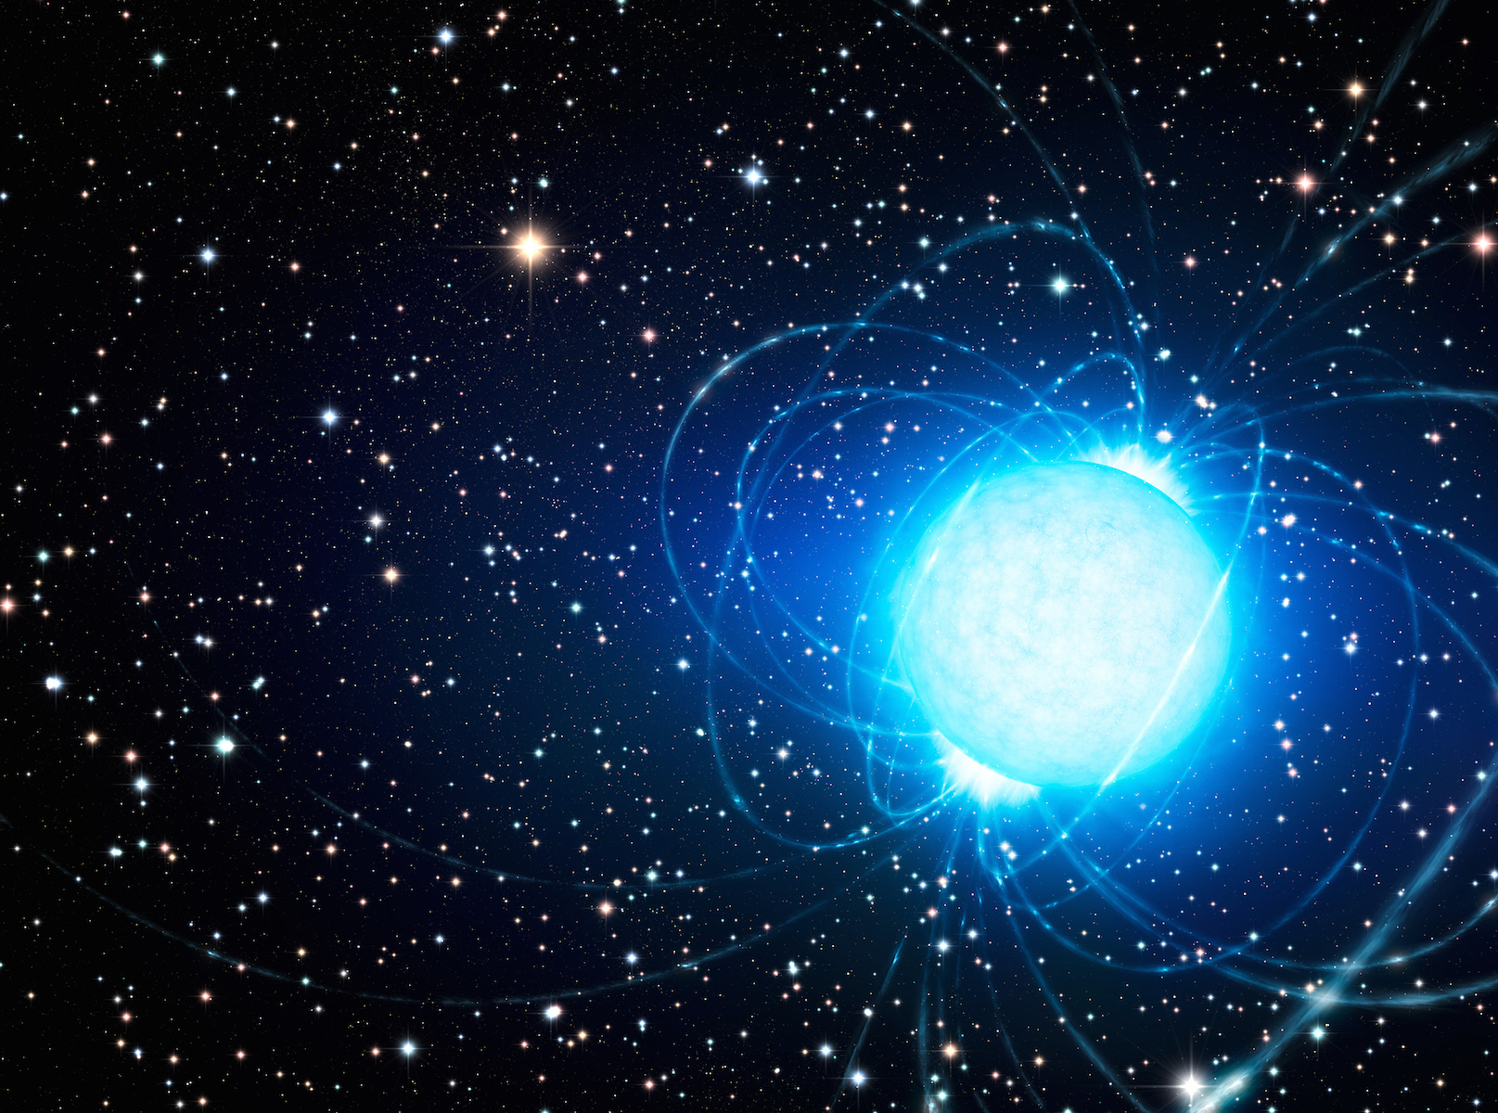
Neutron stars
Burnt-out star
20km in diameter
Mass of our sun
Fraction is like Mt. Everest
42,000 rpm!
Bends light
Insane surface gravity
GRB progenitor
Image Credit: ESO/L. Calçada, http://www.eso.org/public/usa/images/eso1415a/

Slide 10
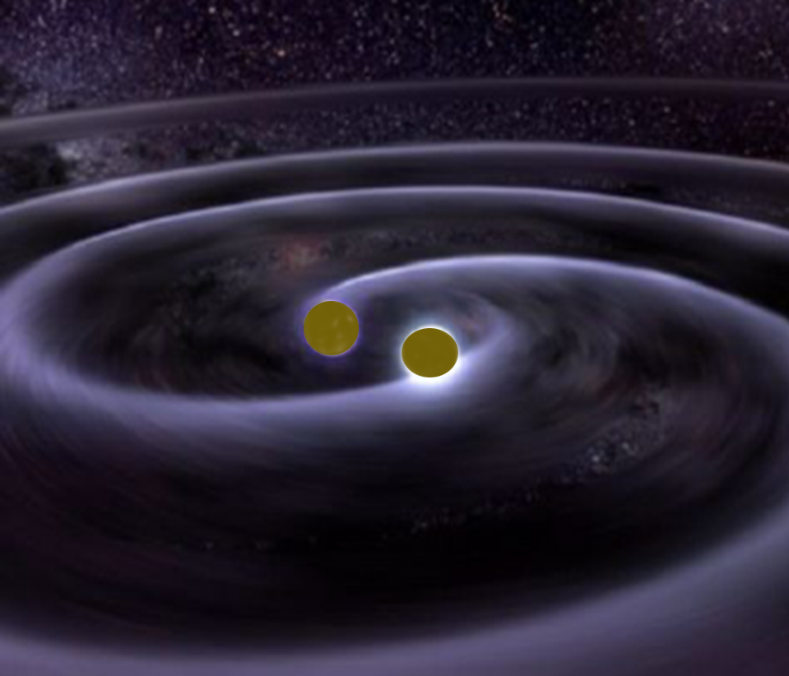
How to make a gravitational wave that might be detected
Case: A 1.4 solar mass binary pair
  M = 1.4 M
  R = 20 km
  f = 1000 Hz
  r = 200 Mpc
h ~ 5 x 10⁻²⁴
Credit: T. Strohmayer and D. Berry
Notes:
So let’s think more realistically.
Describe the parameters and motivate the astrophysics. Mention that the orbit is decaying as energy is radiated away, and the stars move toward a coalescence phase.
Of course, 1E-20
is still an awfully small number…
Describe the waveform (chirp, increasing amplitude) and make connection with ultrafast lasers and CPAs
Show spectrogram and comment on nonlinear chirp.

Slide 11
Simulating Dynamical Spacetime:
Binary Black Hole Merger
Caltech/Cornell SXS
Collaboration
http://www.black-holes.org
Credit: Mark Scheel
Caltech
Notes:
The upper movie shows in the upper half of the screen the orbits and the apparent horizons of the two holes, in the coordinate system used in the computation. The bottom half of the screen shows the spacetime geometry in the holes' orbital plane. The depth of the surface is proportional to the scalar curvature of space. (For the two-dimensional orbital plane the full spatial curvature is determined by the scalar curvature.) The colors encode the lapse function — the slowing of the rate of flow of time. The arrows show minus the shift — which can be thought of as the velocity of flow of space. The beginning of the inspiral is shown, and then the last several orbits, the merger of the two holes, and the vibrational ringdown.
The final hole does not look pefectly spherical because the computer code that created this movie chose spatial slices with a bit of crinkliness in them at the end. This simulation lasts for 16 inspiral orbits, followed by merger and ringdown, and it achieves a cumulative phase accuracy for the emitted gravitational waves of about 0.02 radians (out of roughly 200 radians, i.e. a fractional phase error of 1 part in 10,000).

Slide 12
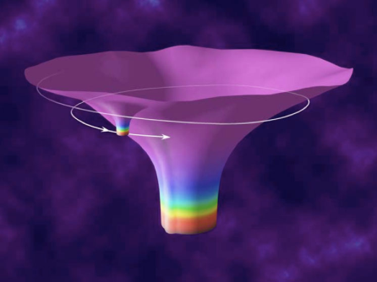

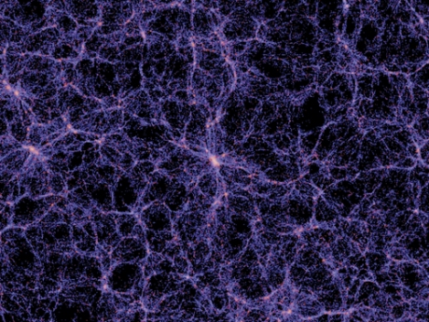
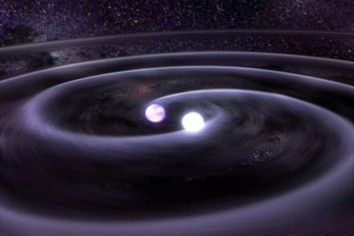

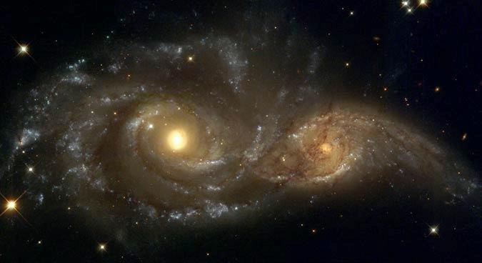

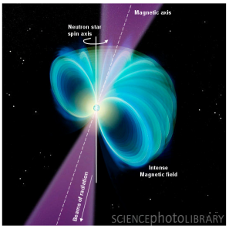
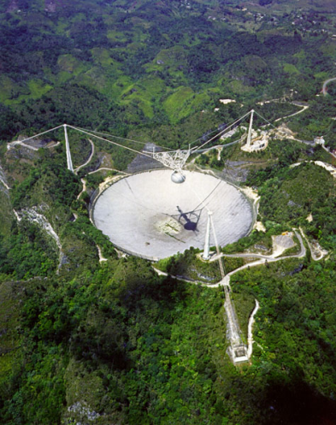
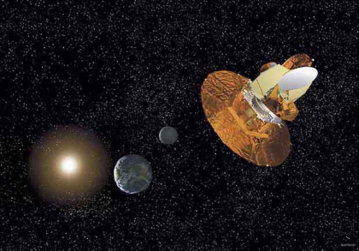

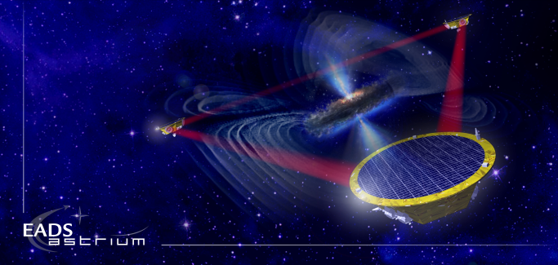
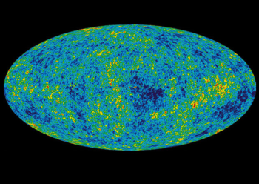
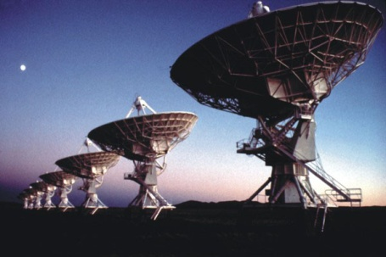
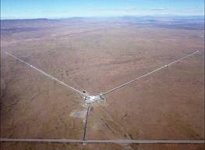
The Gravitational Wave Spectrum
Supernovae
Cosmic Strings
BH and NS
Binaries
Relic radiation
Extreme Mass Ratio
Inspirals
Supermassive BH Binaries
Binaries coalescences
Spinning NS
10⁻¹⁶ Hz
10⁻⁹ Hz
10⁻⁴ Hz
10⁰ Hz
10³ Hz
Inflation Probe
Pulsar timing
Space detectors
Ground interferometers
Laser Interferometer
Gravitational Wave
Observatory

Slide 13
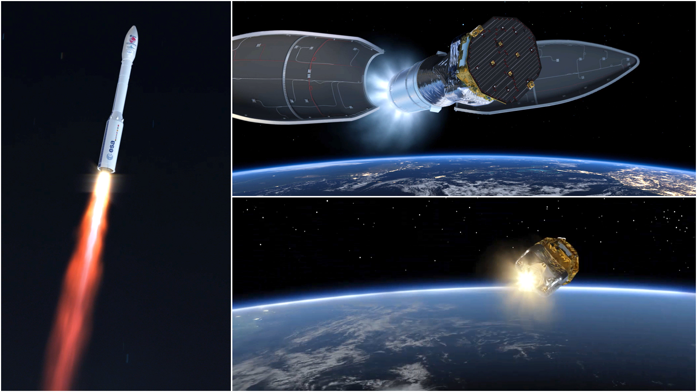
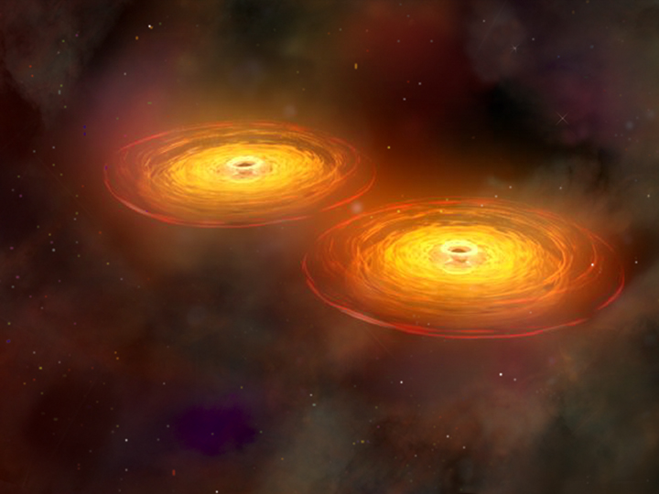

Binary black holes
Launched December 3, 2015

Slide 14
The Gravitational Wave Spectrum
Supernovae
Cosmic Strings
BH and NS
Binaries
Relic radiation
Extreme Mass Ratio
Inspirals
Supermassive BH Binaries
Binaries coalescences
Spinning NS
10⁻¹⁶ Hz
10⁻⁹ Hz
10⁻⁴ Hz
10⁰ Hz
10³ Hz
Inflation Probe
Pulsar timing
Space detectors
Ground interferometers
Laser Interferometer
Gravitational Wave
Observatory

Slide 15

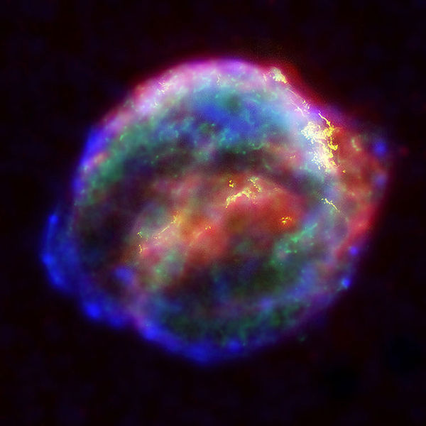

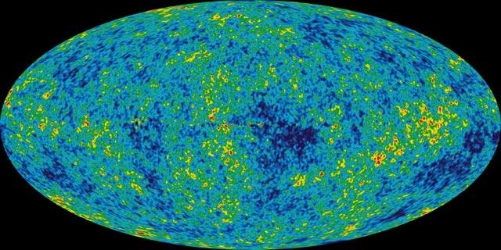
Ground-based
Astrophysical targets
for ground-based detectors
Coalescing Binary Systems
Neutron stars, low mass black holes, and NS/BS systems
‘Bursts’
galactic asymmetric core collapse supernovae
cosmic strings
???
Credit: AEI, CCT, LSU
Stochastic GWs
Incoherent background from primordial GWs or an ensemble of unphased sources
primordial GWs unlikely to detect, but can bound in the 10-10000 Hz range
Continuous Sources
Spinning neutron stars
probe crustal deformations, ‘EOS, quarki-ness’
NASA/WMAP Science Team
Casey Reed, Penn State
Notes:
Quickly walk through sources/characteristics

Slide 16
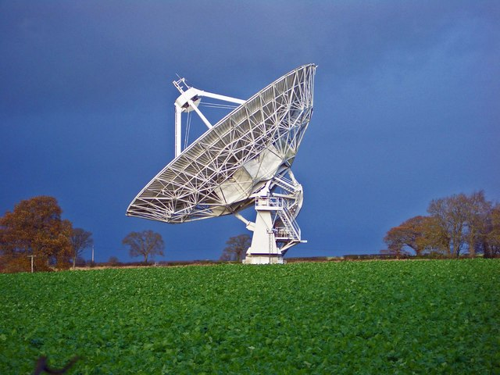
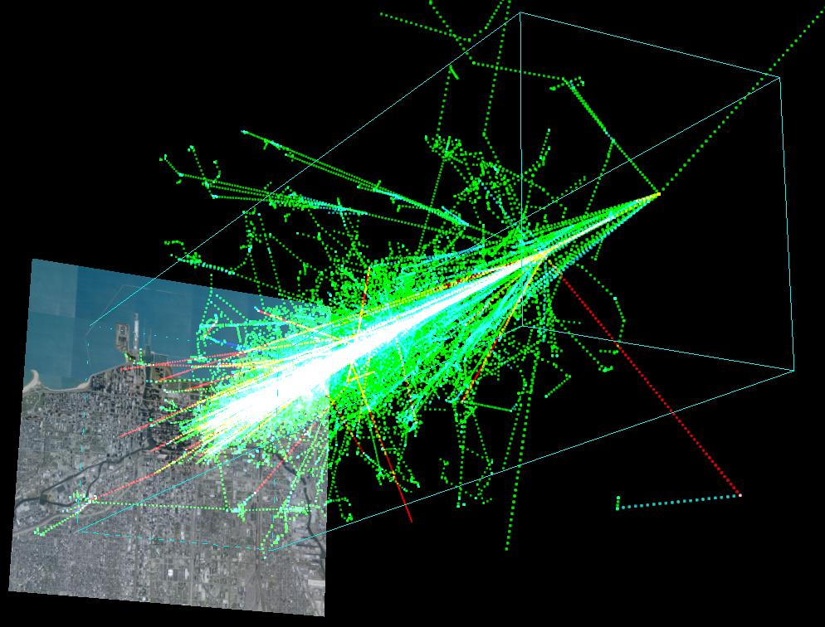
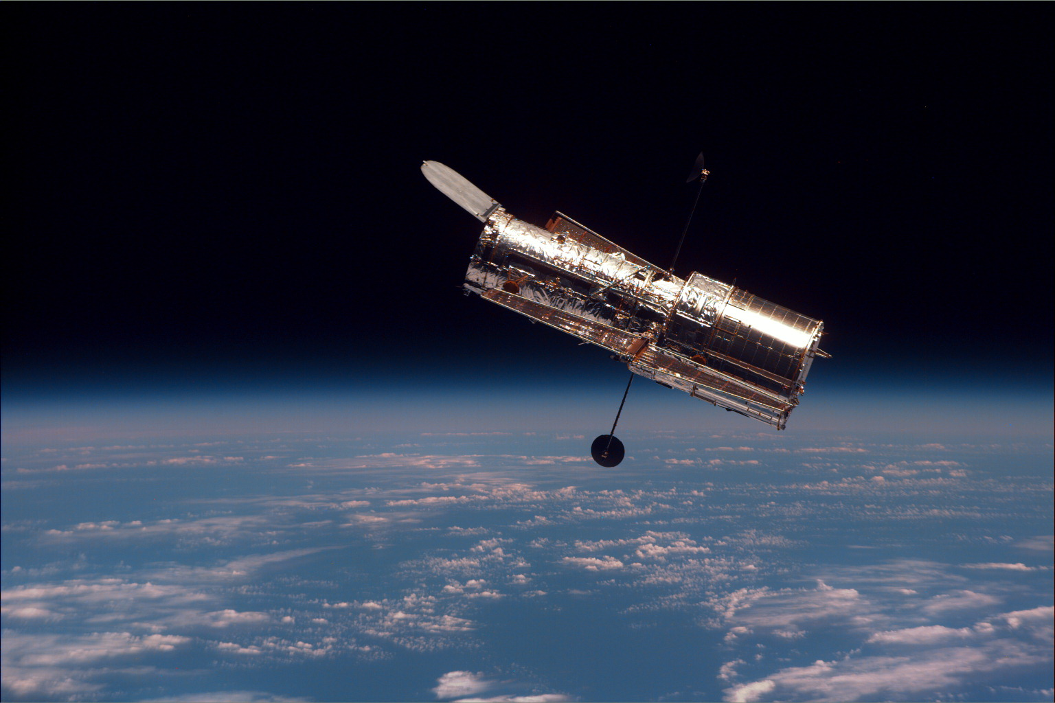
Observations of the Universe, so far …
Electromagnetic
Cosmic rays
Neutrinos
Gravitational waves are a radically different way to observe the Universe.
Image credit: Sergio Sciutto, Universidad Nacional de La Plata
Image credit: NASA

Slide 17
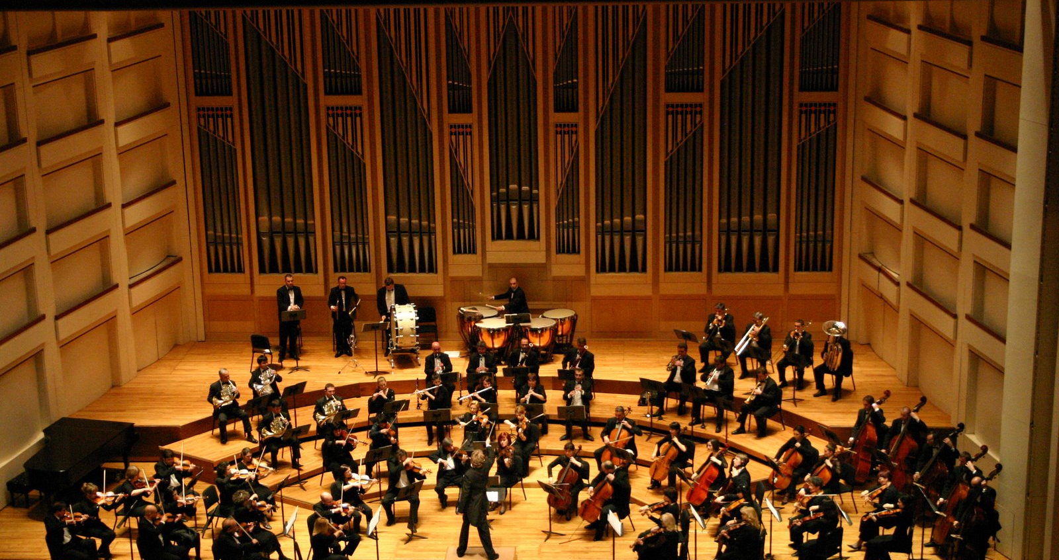


Slide 18
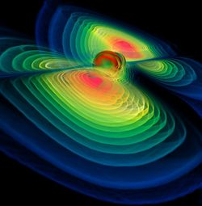
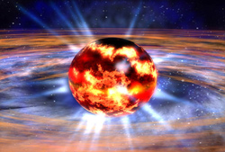
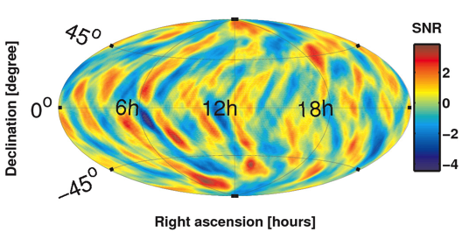
Some Questions Gravitational Waves May Answer
Black Hole Merger and Ringdown
Fundamental Physics
  Is General Relativity the correct theory of gravity?
  How does matter behave under extreme conditions?
  Are black holes truly bald?
Astrophysics, Astronomy, Cosmology
  Do compact binary mergers cause GRBs?
  What is the supernova mechanism in core-collapse of massive stars?
  How many low mass black holes are there in the universe?
  Do intermediate mass black holes exist?
  How bumpy are neutron stars?
  Is there a primordial gravitational-wave residue?
  Can binary inspirals be used as “standard sirens” to measure the local Hubble parameter?
Image credit: W. Benger
Neutron Star Formation
Image credit: NASA
GW Upper limit map
Credit: LIGO Scientific Collaboration

Slide 19
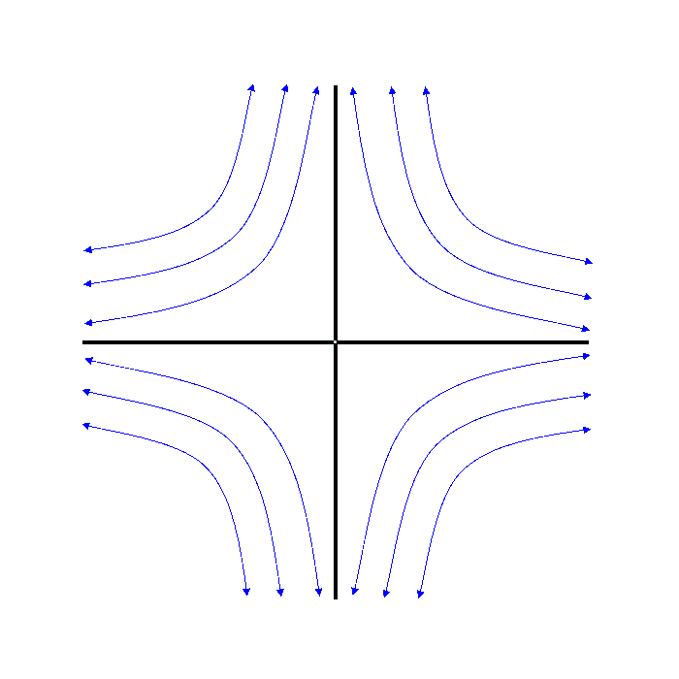
How do you build a device to detect ripples in the surface of space?
Illustration of a GW propagating into the board
Stretches in one direction, shrinks in the other
How would you measure this?
Has a quadrupolar moment

Slide 20
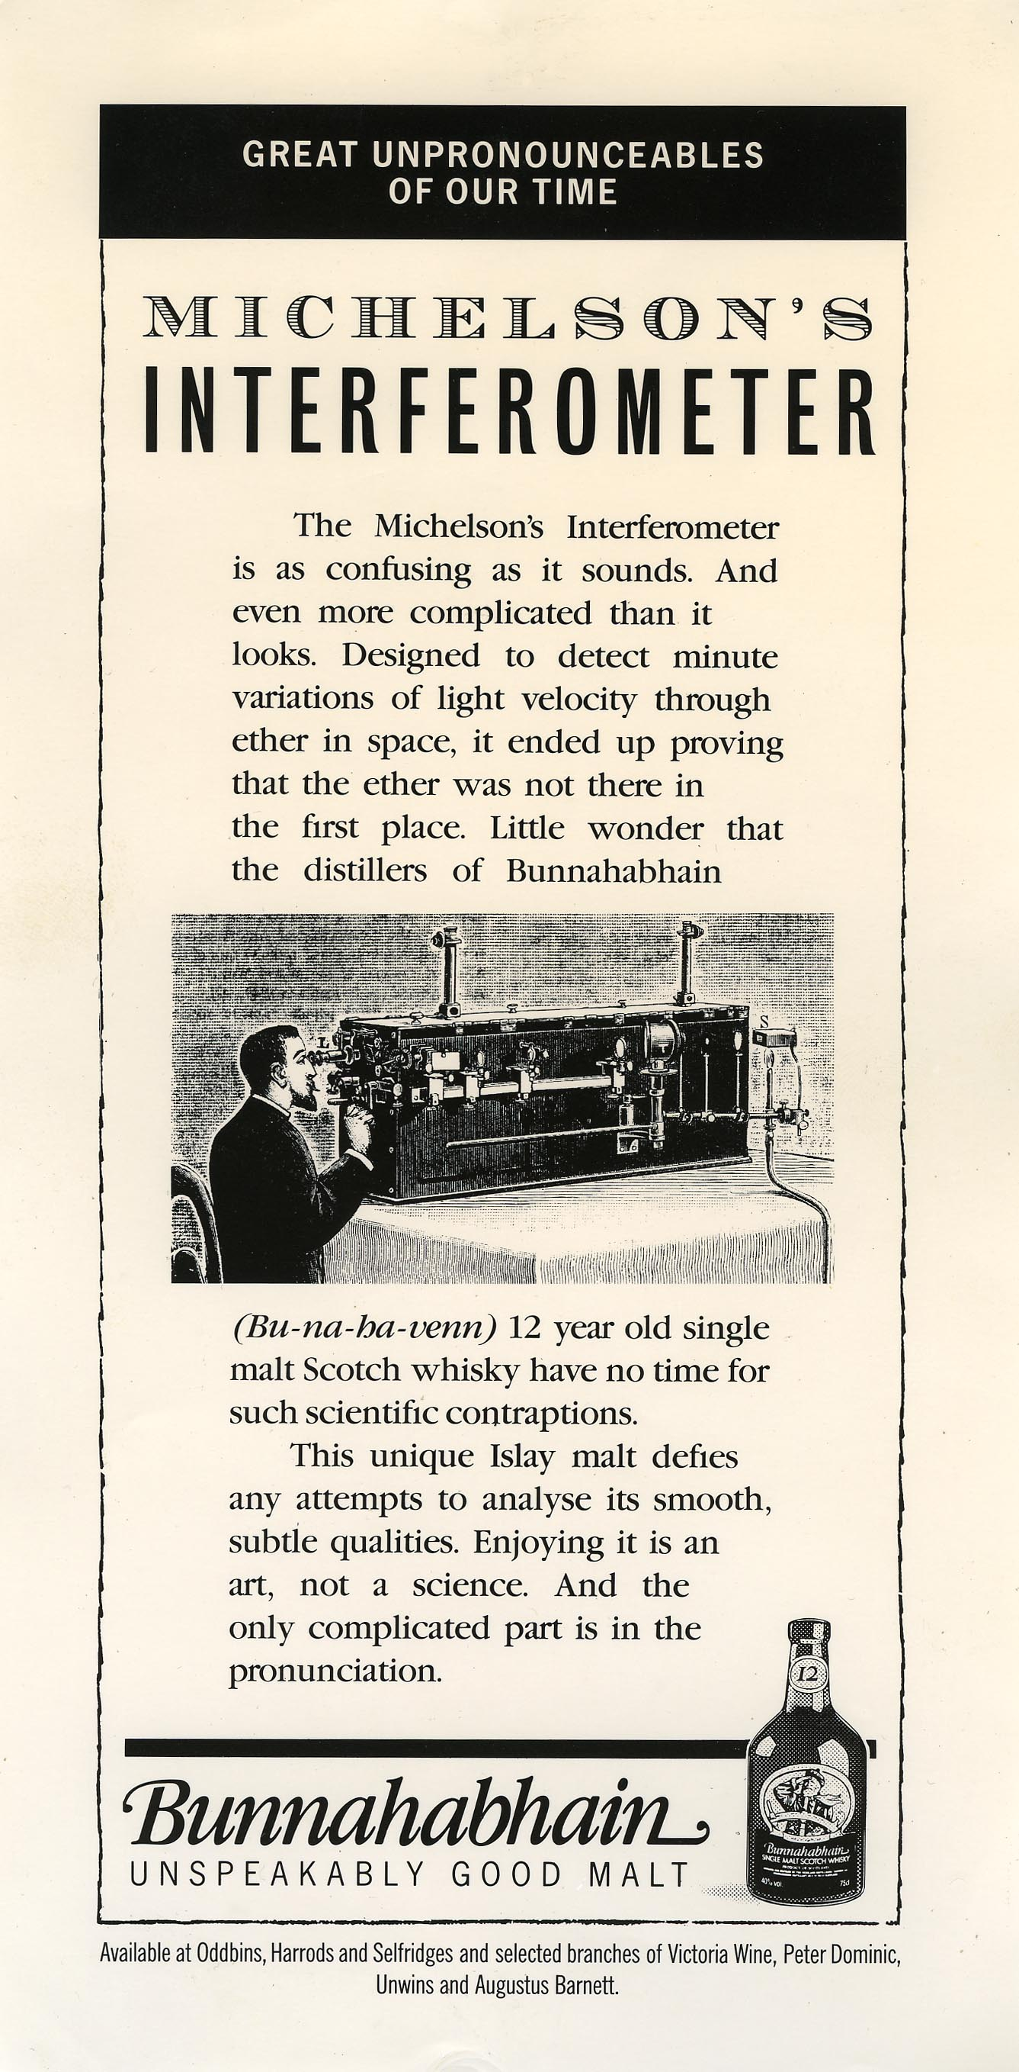
Notes:
Laser is split and sent down 2 arms (precisely the same length)
2 beams bounce off mirrors and recombine back at base (photodector) – lined up such that they cancel each other out
GW comes along and distorts space and the distance between the mirrors
One arm becomes longer and other shorter – then they switch!!
As distance changes so does alignment of beams – now light does make it to the detector. Measure intensity. Measure GW!!!
MEASURE INTENSITY!!! MEASURE GW!!!

Slide 21
Michelson Interferometer
Laser light: a ruler measuring tiny changes in arm length
Change in the phase of the light ➔ change in output power
Notes:
Laser is split and sent down 2 arms (precisely the same length)
2 beams bounce off mirrors and recombine back at base (photodector) – lined up such that they cancel each other out
GW comes along and distorts space and the distance between the mirrors
One arm becomes longer and other shorter – then they switch!!
As distance changes so does alignment of beams – now light does make it to the detector. Measure intensity. Measure GW!!!
MEASURE INTENSITY!!! MEASURE GW!!!

Slide 22
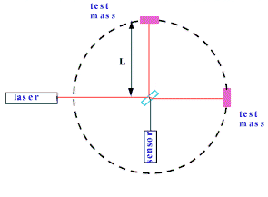
Gravitational Wave Transducer:
The Michelson Interferometer
ΔL = h × L
ΔL = h × L
ΔL = h × L
Longer arms ➔ bigger signal
Converts strain into a voltage on the sensor

Slide 23


The Laser Interferometer Gravitational Wave Observatory
LIGO
1997: Ground breaking on site and 4km arms
1997-2002: Initial LIGO construction and commissioning
2002: First science run
2006-2007: Science run at full sensitivity
2008: Enhanced LIGO
2010: Advanced LIGO construction

Slide 24

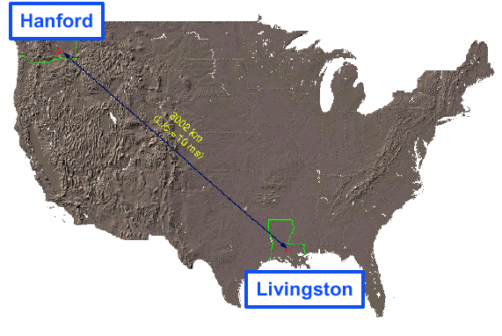
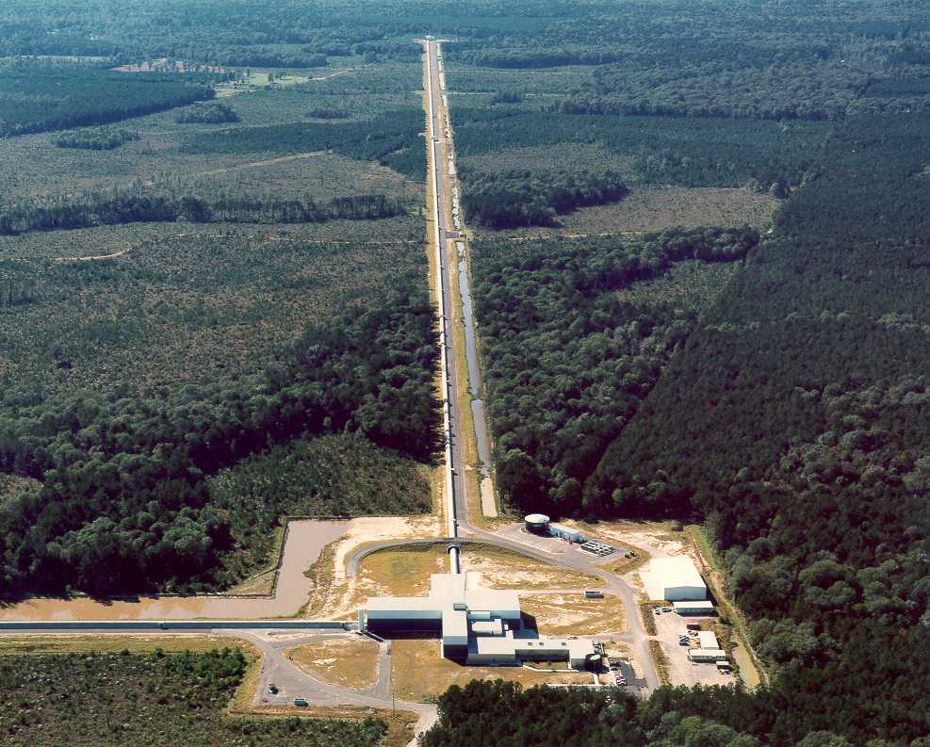
LIGO Laboratory
LIGO Hanford
LIGO Observatories are operated
by Caltech and MIT
MIT
Caltech
LIGO Livingston
Notes:
LIGO is actually two observatories.
Describe parameters
Emphasize that the arms are in ultra high vacuum. 8 km of steel 1.2 m dia beam tubes at each site
Separate observatories allow for coincidence detection – since the detectors see uncorrelated noise, only a true gravitational wave would appear on all the interferometers with the correct amplitude.
Emphasize that the LIGO Observatories were designed and are operated by Caltech and MIT

Slide 25
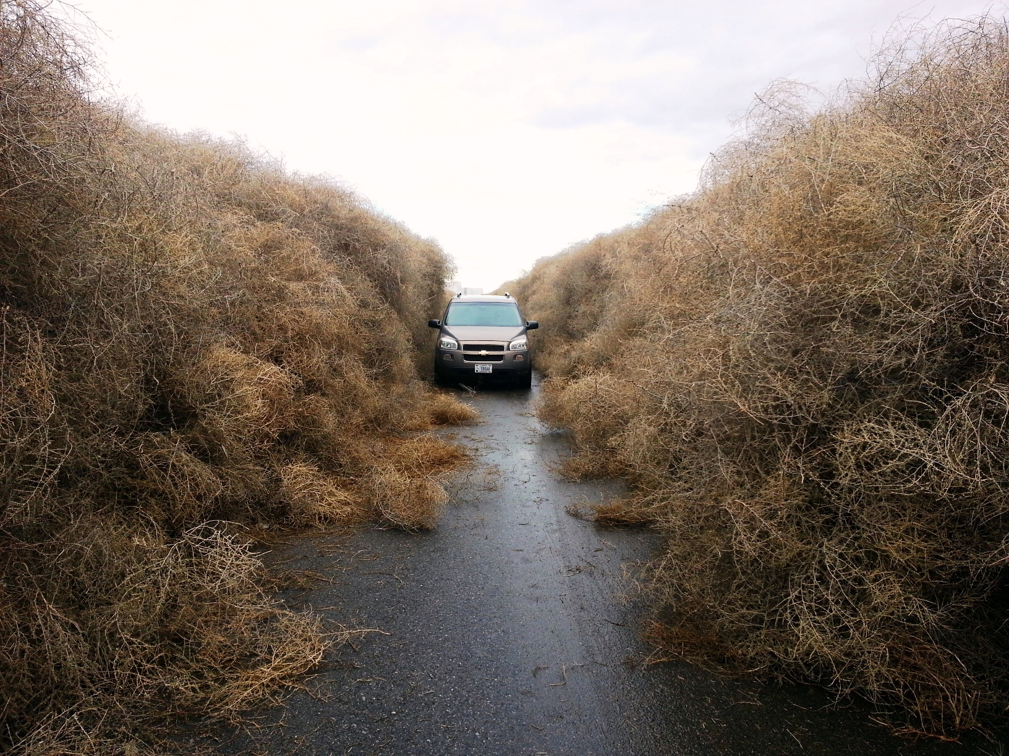
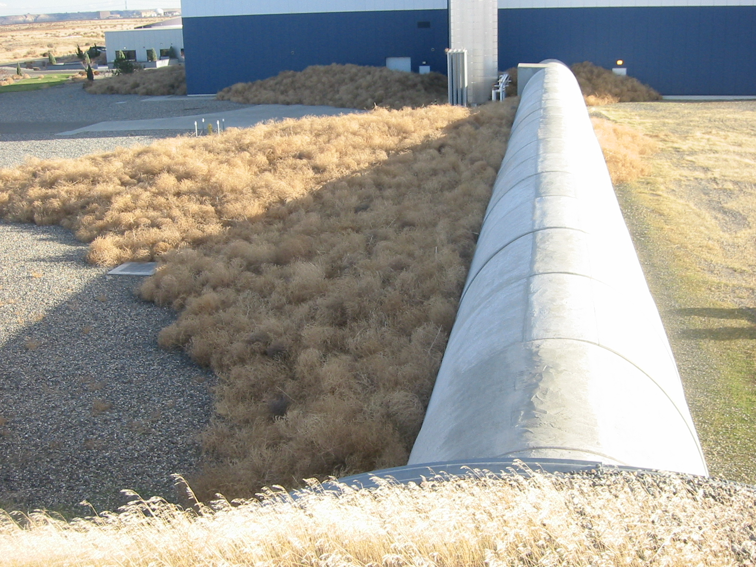
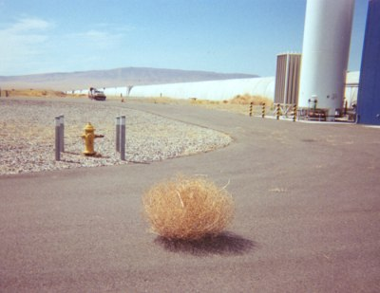
Environmental problems

Slide 26
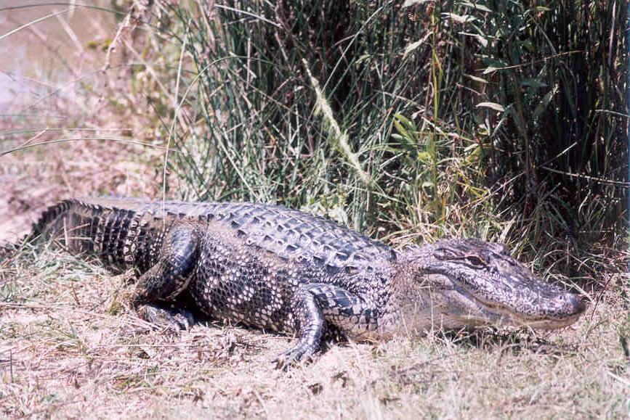
And Livingston?
Number Two
LIGO Livingston
Photo credit: Peter King

Slide 27
Laser Interferometer Gravitational Wave Observatory
Edited and used with permission from NSF
Notes:
LIGO = Laser Interferometer Gravitational Wave Observatory
Real World version of the Michelson Interferometer envisioned by Rai Weiss, MIT in the 1960’s
2 perpendicular arms 4 km long. One of the Largest Vacuums ever made. We have 2. the one shown here is in a swamp in Livingtson Louisiana between Baton Rouge and New Orleans..
200W Nd:YAG laser (CW) Laser beam travels down arms without distorting effect of air. Bounces back and forth between mirrors cushioned by isolation systems.
Large 40 kg mirrors with highly reflecting coatings are suspended from Four-stage pendulum suspension, last stage on 4 silica fibres
Sophisticated isolation systems using active electronics control
Even with all the attenuation of noise …

Slide 28
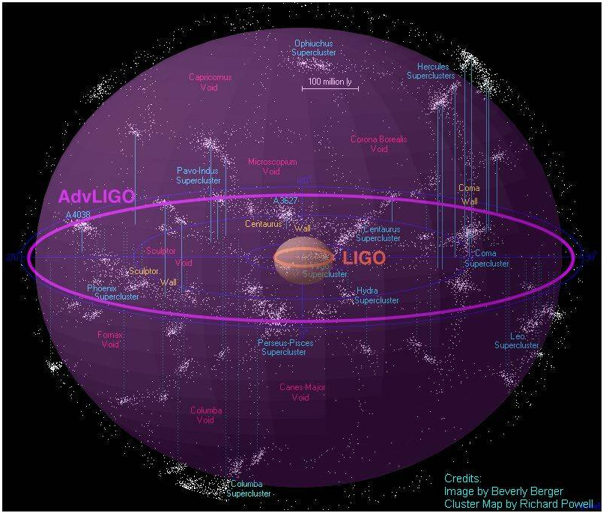
What can LIGO observe?
4km arms
Displacement: 10⁻²⁰ m
Strain: 5*10⁻²⁴
Expected rates:
  ~ 40 per year
  (NS-NS)
Range of 200 Mpc (~600 million light years, 6 septillion km)
Notes:
Wait Haven’t I heard LIGO before? YES
This is advanced LIGO. Bigger. Better and almost ready to detect!!!

Slide 29
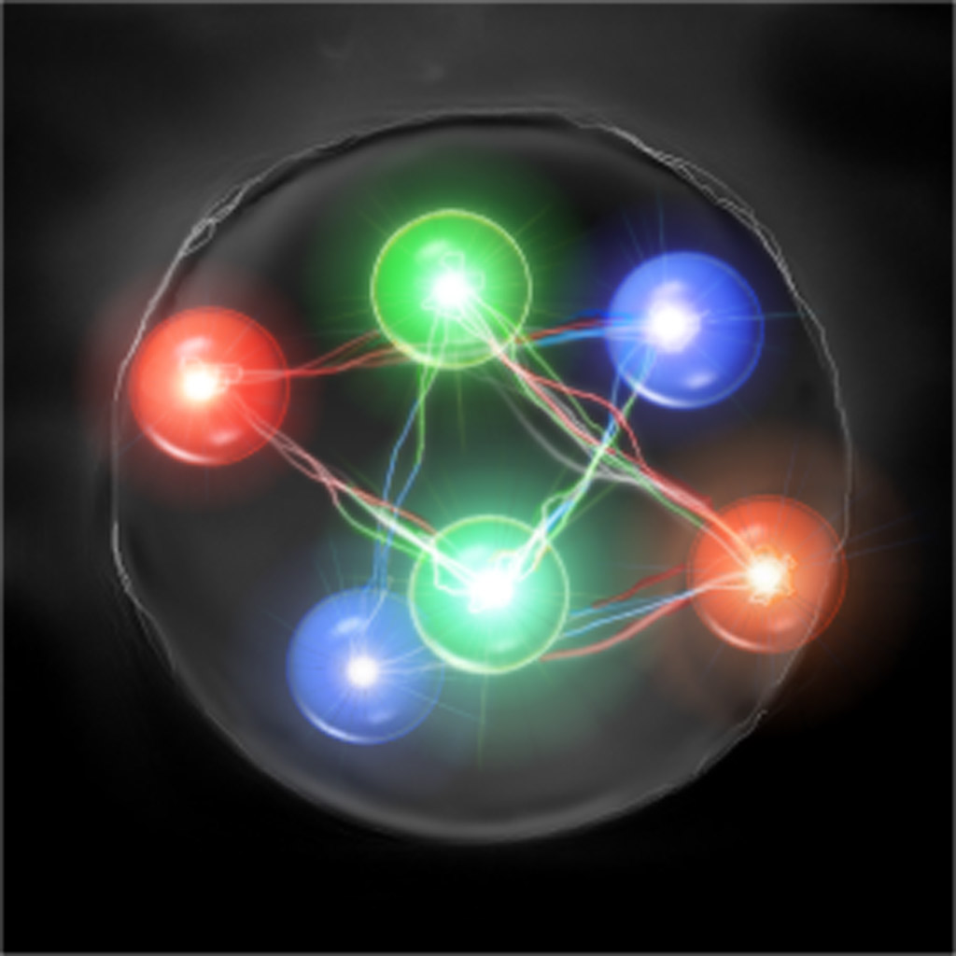
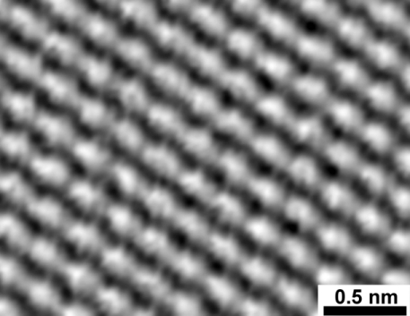
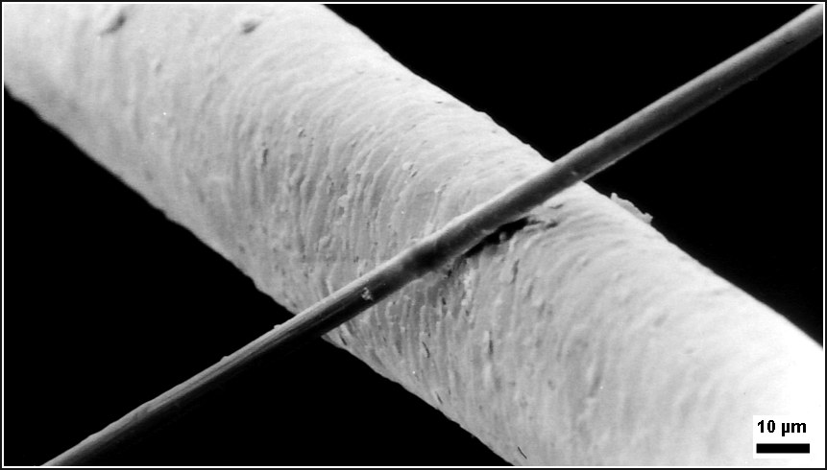
Wait! 10⁻²⁰ m at 100Hz?!!
Surely that’s not even a real distance?!
How small is that?
  100,000 times smaller than a proton
  10 billion times smaller than an atom
  1000 trillion times smaller than the width of a human hair

Slide 30
Is everything quiet enough to measure that?
Really, really loud noises get in the way!
  Ground motion is 10⁻¹² m
  Atomic motion is 10⁻¹⁰ m
  Quantum mechanical noise from light.
Trying to measure a motion 100 million times smaller??
Everything about the interferometer is designed to amplify the signal or reduce the noise
  High laser power,
  Big beams,
  Long interferometers
  Seismic isolation systems
Noise | Magnitude
Ground motion | 0.000000000001m
Atomic motion | 0.0000000001m
GW | 0.00000000000000000001m

Slide 31
Interferometric gravitational wave detector construction
1. Long arms (km-scale)
- amplifies signal
- creates big beams
4. Recycling mirrors
- amplifies signal
- reduces noise by increasing power
2. Resonant arm cavities
- multiple round-trips amplify signal
5. Input optics
- reduce technical noise sources
6. Suspend the optics
- dramatically reduces seismic noise
3. High power laser
- reduces quantum shot noise
Resonant arm cavities
200W
Laser
L = 4km
1 MegaWatt of stored power
Input optics
detector

Slide 32
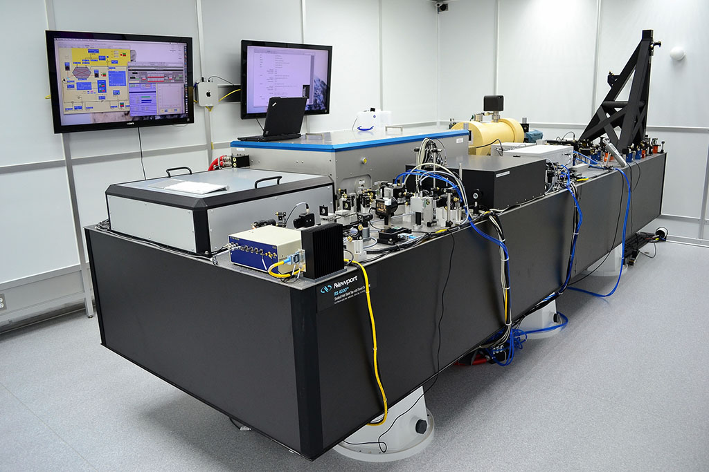


“Laser”
LIGO Tour

Slide 33



A closer look
Handle with care!
35W stage
Operational 35W stage
2W stage

Slide 34

High power stage
Fearless worker
Gain media
Water cooling

Slide 35



Into the Vacuum …

Slide 36


Bouncing off our beautiful
(and rather expensive) optics

Slide 37


The Flight of the Quadruple Suspension System

Slide 38



Suspensions isolate us from seismic motion (you and me)

Slide 39


The Flight of the Quad

Slide 40


The Flight of the Quad

Slide 41
Installation in action
Produced by Kai Staats, Over the Sun, LLC. Copyright LIGO Laboratory 2014.
Observation run ~ July 2015 with both instruments working at comparable sensitivity
Notes:
Install over 6 years etc …
(LHO & LLO) Both now under vacuum at all stations & installation complete.
(LHO) Expect to achieve full-lock end of Sept
(LLO) has now been locked for 7.5 hours (and counting)
(LLO) The max Binary Star range observed is 22Mpc

Slide 42

Controlling complexity
Controlling complexity

Slide 43

LIGO: now listening …

Slide 44



Why bother?
Technology leads to the unexpected
Image Credits:
Galileo Museum
NASA Ames/ W Stenzel
Carl D. Anderson (1905–1991)

Slide 45

This is pure discovery.
What will we discover next?
Credit: NASA / Dana Berry / SkyWorks Digital.

