Slide 1
aLIGO test masses, revisited
Scattering and loss by test mass
  Discrepancy between the measured arm loss, 50ppm/mirror, and the loss based on optics data, 25ppm/mirror
  Understand about the defects in coating
  Integrating sphere measurement with extension (Liyuan Zhang)
    Preliminary and proof of concept, but very interesting
    Small angle (θ≤1°) and large angle (θ≥1°) scattering
      Missing energy in the small angle scattering
      Defect size/distribution information
Excess PSD at λ_{spatial} < 3mm (system meeting)
  PSD of the coated mirror using the latest coating setup is larger than PSD using the original mask by more than 10 at λ_{s}=3mm~1/3mm
  Effect on the aLIGO performance when ETM is replaced
    Increase of arm loss and scattered light which hits beam tube baffles
    PRG and scattering noise

Slide 2
Reflection and propagation of field
Spherical wave from source point
far field
near field
* total power of far field =
total power of near field
* power distribution of far field =
interference of near fields
from various source points

Slide 3
Far field and mirror ASD wide smooth surface characterized by ASD
ASD:
λ_{S}→θ_{far field}:

Slide 4
Uncoated surface PSD not simple, pretty complex

Slide 5
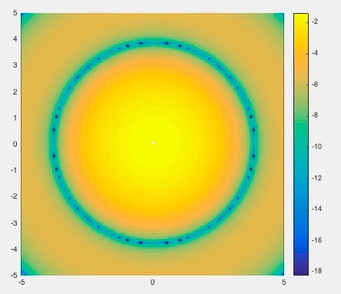
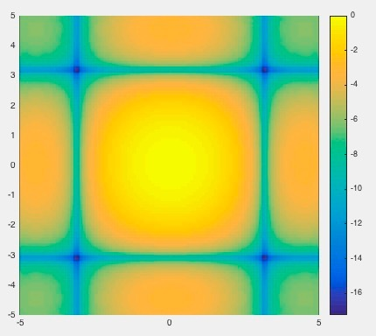
Far field and small size defects small defects cannot be characterized by PSD
reflected power = power density at defect ∙ defect size ∙ |A|²
circle with radius a
small
rectangle size of du x dv
k a θ =1 when
a = 1μm, θ=10°
or
a=10μm, θ=1°
Defect size looks different seen at different angle
log( power )
axis : k a θ = 0.1 a(μm) θ(degree)

Slide 6
interference and angle dependence of far field
Small defect
Periodic defect

Slide 7
Power distribution depends on the defect size
θ
Power fraction out
of an angle
Mie
Geometry
axis : k a θ = 0.1 a(μm) θ(degree)

Slide 8
Comparison of 1° vs 5° dead region

Slide 9
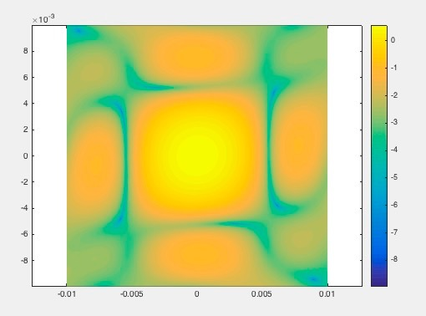
Clustered defects behave like a single defect
Power distribution generated by small defects in a square
Same distribution generated by

Slide 10
TIS measurement in small angle using integrating sphere by Liyuan Zhang
Scattering loss of mirrors
  Total loss in the arm cavity vs mirror data
  Understanding the defects in the coating
Integrating sphere covering θ≥1° predicts scattering loss / mirror ~ 10ppm
  Solid angle of the hole in θ≤1° is (π/180)²=3 x 10⁻⁴, so correction should be negligible.
If there are defects with size > 1μ, this may cause something unexpected
Integrating sphere + pickoff to measure TIS in the small angle region θ ≤ 1° in addition to large angle θ ≥ 1°

Slide 11
Setup for measuring
TIS(θ≤1°) and TIS(θ≥1°)

Slide 12
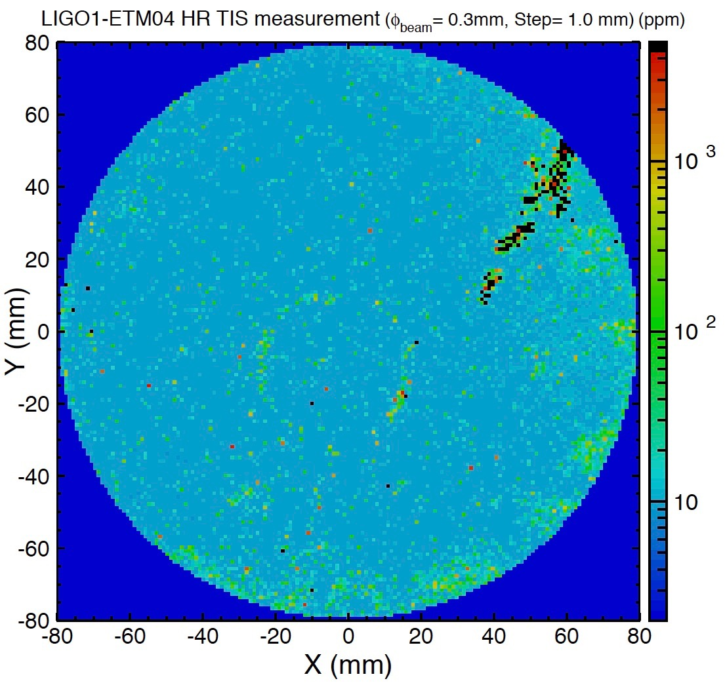
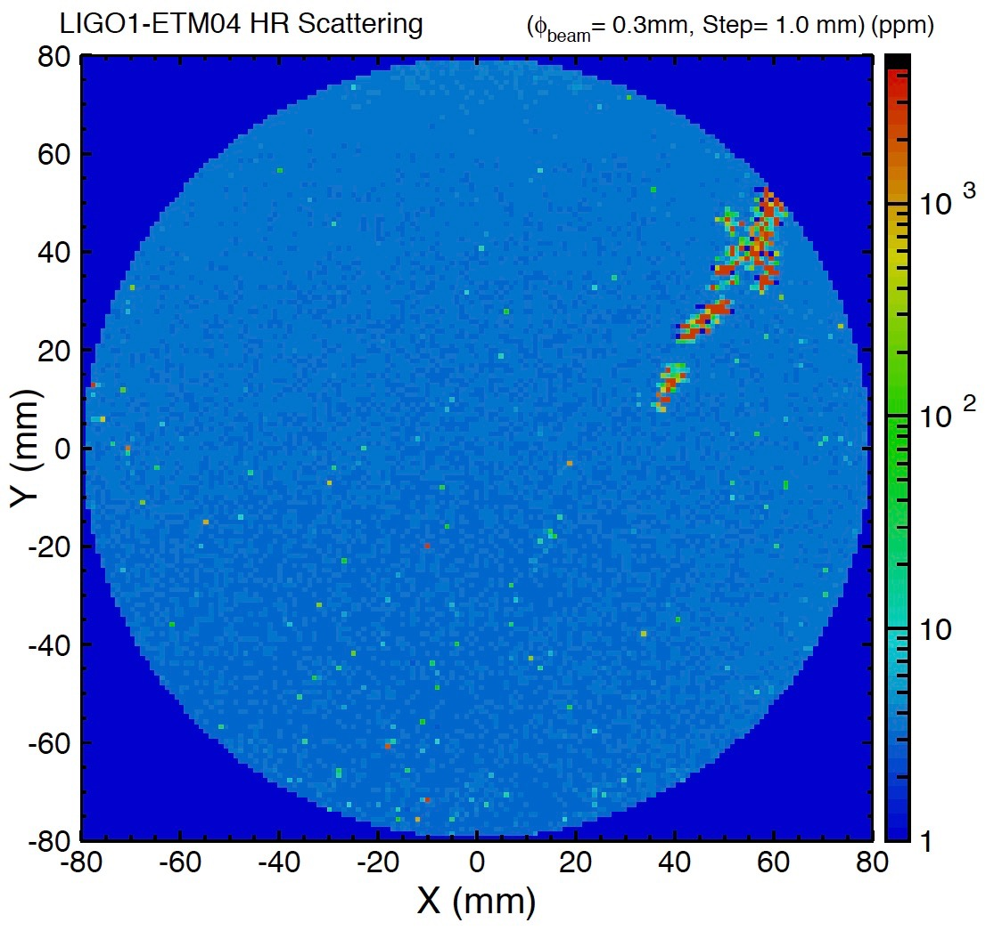
Very preliminary results mirror : initial LIGO ETM04
TIS (θ≥1°)
TIS (0.7°≤ θ≤1°)
scratch

Slide 13
TIS(θ≤1°) vs TIS(θ≥1°) very preliminary
Quadrants no scratch
Quadrant with scratch
brighter
(2) Scratch
Large defect on surface
(3) Large defect
(1) Isolated small defect or micro roughness
(4) Clustered small defects
Large TIS(θ≥1°), small TIS(θ≤1°)

Slide 14
Defect size and total loss assuming defect shape is circle
Defect size vs TIS(θ≥1°)
Total / TIS(θ≥1°) vs TIS(θ≥1°)

Slide 15
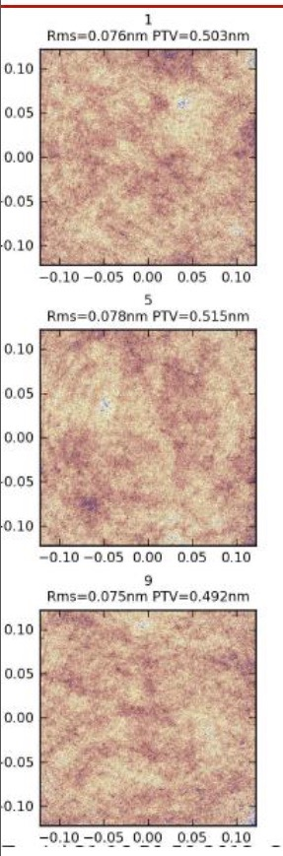
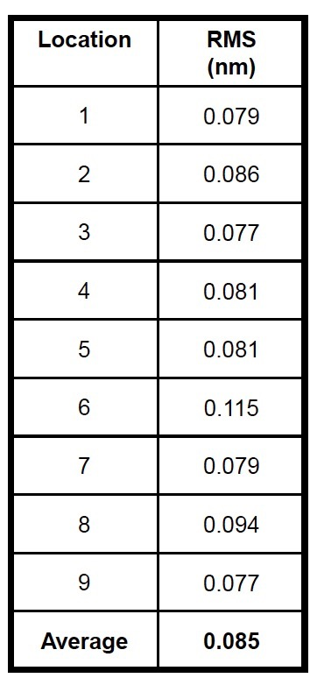
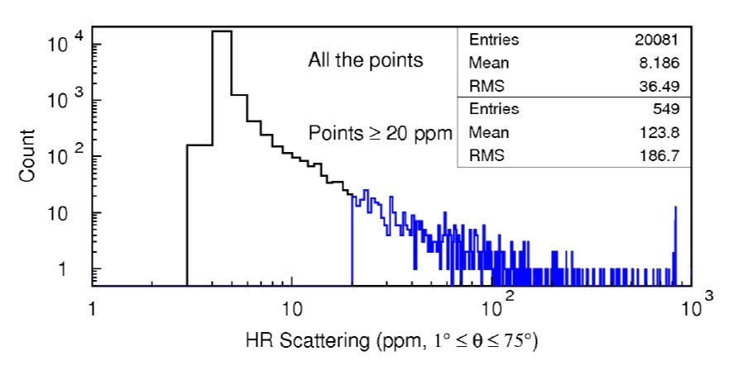
aLIGO ETM TIS(θ≥1°) low end of TIS(θ≥1°) by continuous roughness
ETM16 case
Zygo 50x PMM
rms → loss
Integrating sphere counts
Ratio of teak of measured TIS and
loss using uncoated surface RMS
of 10 aLIGO ETMs
Majority of the scattered data are by continuous roughness
peak

Slide 16
ETM PSDs with different coating
Does it cause any problems?
Reduction of spiral height
Same color,
same mask
Original mask
New mask
Increase of short wavelegth noise
Coating with jiggling

Slide 17
PSDs with and without coating
Original mask
New mask
Coating with jiggling
All uncoated surfaces
have similar PSD

Slide 18
Same high PSD in the central region as well

Slide 19
PSD(coated)/PSD(uncoated) > 10:
Is this increase real?
Three independent measurements of phasemaps of the coated ETM16 are consistent
  (1) Measured by LIGO Fizeau IFO without magnification
  (2) Measured by LIGO Fizeau IFO with x10 magnification
  (3) Measured by LMA Fizeau IFO without magnification
ETM16 PSDs
(1) LIGO x1
(3) LMA
(2) LIGO x10
Uncoated surface

Slide 20
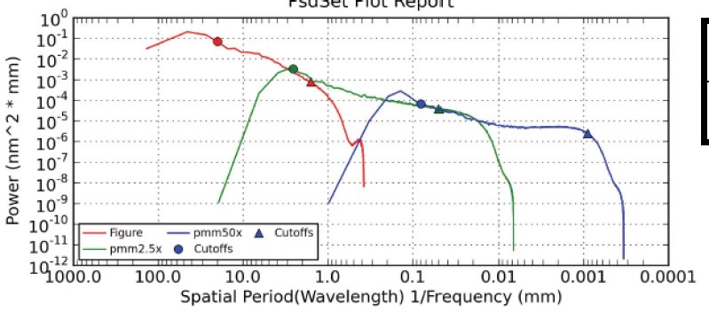
One complication we don’t/can’t handle/understand properly
Zygo PSDs by different devices
LIGO Fizeou IFO
Instrument transfer function
Low statistics
Poor efficiency
x1
@1mm 0.2
x10
@0.1mm 0.1

Slide 21
Change of rms and loss loss=1.3~2ppm @ λ_{s} =3~1/3mm
Coated ETM16 PSD by LIGO
 | Uncoated rms / loss | Coated rms / loss
(1) 3mm ~1mm | 0.03nm 0.1ppm | 0.08nm ~ 0.1nm 1.0ppm ~ 1.5ppm
(2)1mm~0.3mm | 0.02nm 0.06ppm | 0.06nm ~ 0.07nm 0.50ppm ~ 0.75ppm
(3)0.3mm~ 0.1mm | 0.02nm 0.08ppm | same as uncoated -assumed
(4)0.1mm~ 1μm | 0.076nm 0.83ppm | same as uncoated -assumed
Total loss λ_{s} < 3mm | 1.1ppm | 2.4ppm ~ 3.2ppm
Coated x1
(1)
(2)
(3)
Uncertainty due to
Interferometer transfer function
Uncoated
(measured by Zygo)
Coated x10
Uncoated ETM16 by Zygo
(4)

Slide 22
Scattering by periodic aberration vs point defects
Periodic aberration reflects to a fixed direction
point defects reflects uniformly ⇒ θ² ~ O(10⁻⁴)

Slide 23
Noise by sparial on ETM07 vs periodical aberration ~1mm on ETM16
L_{b}
r_{baff}
Scattering = 4.5ppm by spiral in a narrow region
by mirror = 1.5ppm by λ_{s} ~ 3~1/3mm in wide spread
Scattering
by baffle
= 0.02 for forward (spiral)
= 0.005 for backward (λ_{s} < 4mm)

Slide 24
Summary
Extended Integrating Sphere measurement
  Preliminary result – proof of concept
  Comparison of large angle TIS (θ≥1°) and small angle TIS(θ≦1°) provides information about the defect size and uncovered scattering
  Measurement of aLIGO test masses coated by LMA using better setup and detector.
Large PSD at short wavelength region
  Looks real, cause unknown
  PRG loss and back scattered noise by beam tube baffle, OK
  Any other issue by higher roughness in the short wavelength region which tends to scatter light to wider angle?

