Slide 1
O1 DARM Loop Design Comparisons and Critiques
J. Kissel, for the ISC and Calibration Teams

Slide 2
DARM Open Loop Gain TF (Big Picture)
Roughly the the same UGF
H1 needs more gain at low frequency
H1 has notched WAY more features
Good compromise on aggression of filtering

Slide 3
DARM OLGTF (UGF Zoom)
L1 UGF: 56.6 [Hz]
H1 UGF: 40.1 [Hz]
Good compromise on aggression of filtering
H1 Phase Margin: 42.2 [deg]
L1 UGF: 40.3 [Hz]

Slide 4
DARM Open Loop Gain TF
1 / (1+G)
L1 Max Suppression: 1.7
H1 Max Suppression: 1.5
Both have plenty of gain margin
H1 has a couple of orders of magnitude less suppression around the microseism

Slide 5
Actuator Strength Comparison

Slide 6
Actuator Strength Comparison
Small(-ish?) OOPS:
(L1 Forgot to include all possible harmonics in model)
Different ESD Bias Sign,
Different PUM COILOUTF convention → PUM and TST have different signs

Slide 7
Actuator Comparison (Hierarchy Filters)
Both sites have a mish-mash of “offloaded” vs. “distributed” hierarchy filters due to staggered design
L1 does more loop shaping in the DARM bank (because of all the notching done at H1)
Note the difference in HF cut-off filter for all stages…

Slide 8
The DARM Filter and Sensing Function
H1 boosts LF in the DARM bank
Digital gains (and a sign) are distributed differently on the sensing side,
so DARM filter gain and sign compensate, otherwise pretty similar…
actual optical gain: ~3 [mA/pm] at both sites
But because of the different design choices, with frequency response and gains all over the place, tough to get a feel for the loop shaping from just one filter or plot

Slide 9
L1 Actuator Authority (Big Picture)
“Strength” = from DRIVEALIGN OUT to Test Mass Displacement
“Authority” = from LOCK IN to Test
Mass Displacement
Authority re-mathed to show it as a Distributed system, so “cross-over” frequencies mean something
L1 does all their LF boosting in the actuator filters
Just a bit of light notching,
not too aggressive of a HF cut-off

Slide 10
L1 Actuator Authority (X-over Zoom)
UIM/PUM
Cross-over: (Ill-defined, but PUM is rolled off by) 0.45 [Hz]
Cross-over stability kinda risky here, but it’s hard!
PUM / TST
Cross-over: 15 [Hz]
Cross-over stability pretty good!

Slide 11
L1 Actuator Authority (HF Roll-off Zoom)
some icky wiggles
PUM is nicely rolled off above cross-over, but there’s still some phase interaction that causes some icky wiggles in the total TF of the “super actuator”

Slide 12
H1 Actuator Authority (Big Picture)
Shown to same scale as L1 on Slide 9
Don’t be alarmed: remember H1 does its boosting in the DARM bank (will show with DARM filter later)
Loooooot of high-frequency notching, plus a ridiculous cutoff filter
Interesting: UIM Bounce and Roll notches aren’t as aggressive…

Slide 13
H1 Actuator Authority (X-over Zoom)
Shown to different scale from L1 on Slide 10
UIM/PUM
Cross-over: (Ill-defined, but PUM is rolled off by) 0.45 [Hz]
Similarly risky cross-over here, but it’s hard!
PUM / TST
Cross-over: 30 [Hz]

Slide 14
H1 Actuator Authority (HF Roll-off Zoom)
YUCK.
PUM phase is still interacting with TST phase out to 300 Hz
Notches + HF Cut-off causes all sorts of nastiness.

Slide 15
Authority Including DARM Filter (scaled by optical gain)
Looks pretty DARM clean!

Slide 16
Authority Including DARM Filter (scaled by optical gain)
Even with DARM filter boost, there’s still lots more to go to get to L1’s level of boosting
Looks pretty DARM messy!

Slide 17
Conclusions
H1 DARM Loop needs some tune-up and clean-up
  More boosting at low-frequency
  Better / simpler distribution filters
  Less notching?
Frequency response is splayed out everywhere at both sites, evident that “design” was staggered and piecemeal
  Both sites should consider consolidating, for easier analysis of performance

Slide 18
Bonus Material:
Calibration Parameter
Time Dependence
Clues of “real” IFO parameters changing -- confirmation from alternative measurements

Slide 19
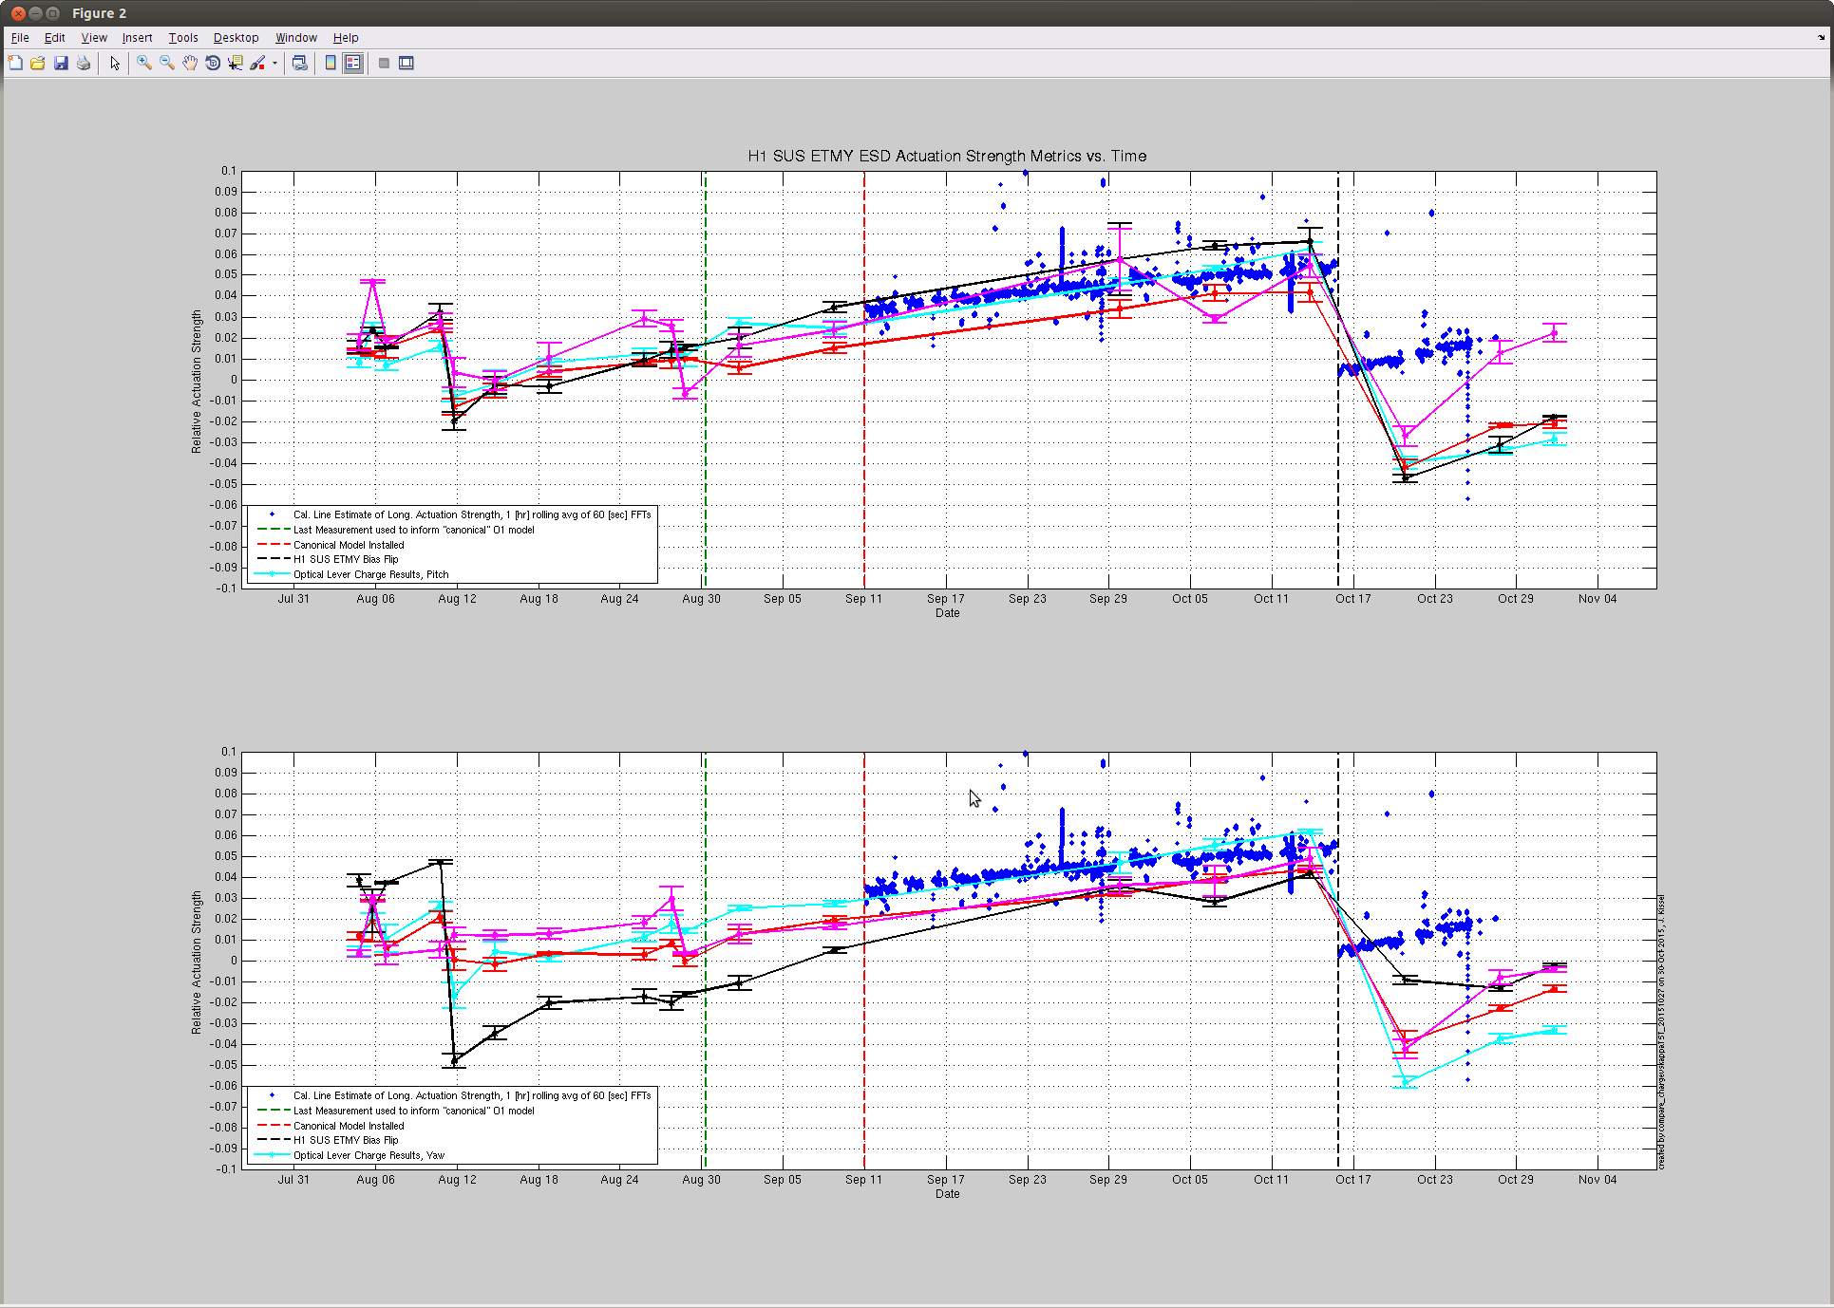
Comparison Between Relative ESD Actuation Strength
Tracked via Oplevs
Relative ESD Actuation Strength
Tracked via PCAL
LHO aLOG 22991
Aug
Sep
Oct
Nov
Time

Slide 20
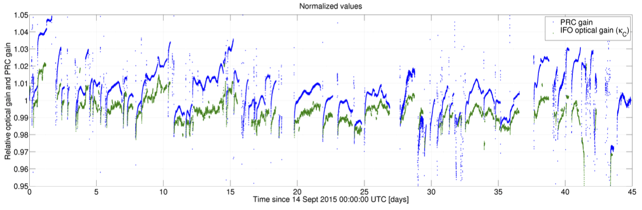
Comparison Between Relative Optical Gain Measurements
Arm Power (divided by PRM transmittion), normalized by the start of the lock stretch
Tracked via Arm Power
Tracked via PCAL
PCAL Estimation of the change in optical gain from 330 [Hz] PCAL lines
LHO aLOG 23147

