Slide 1
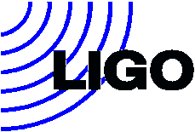
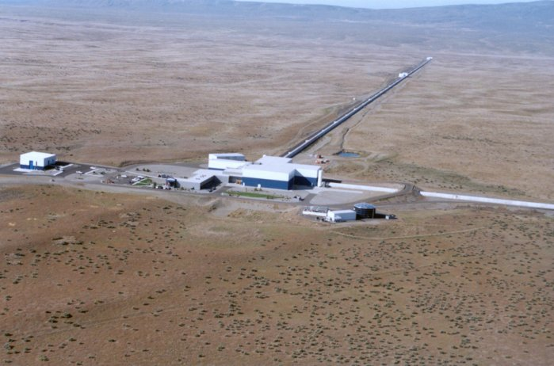
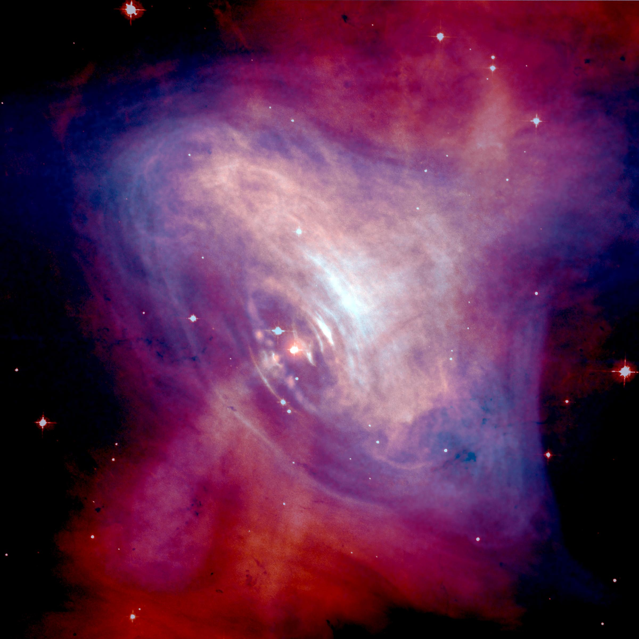
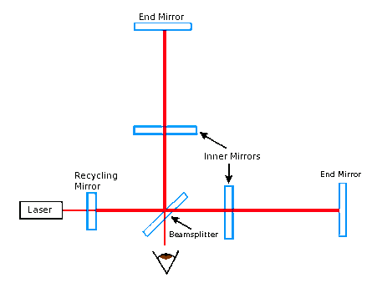
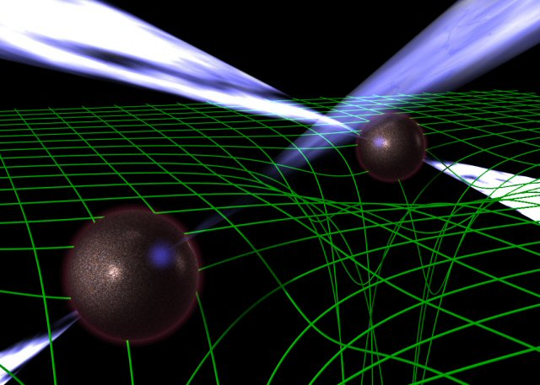
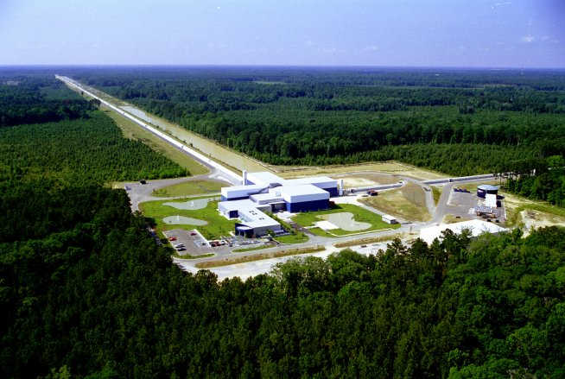
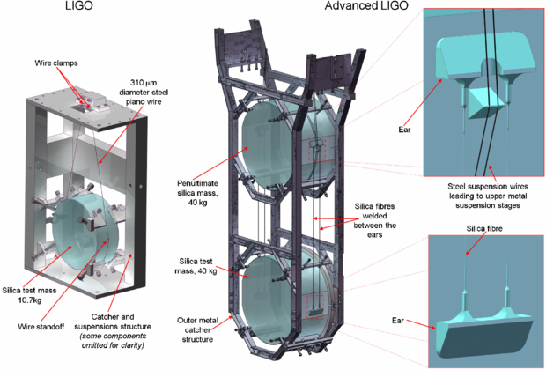
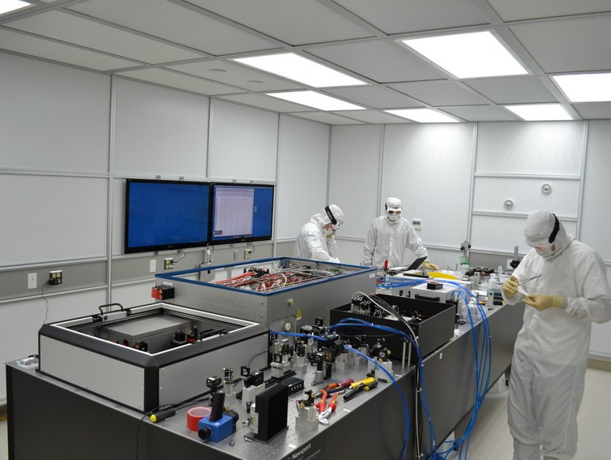
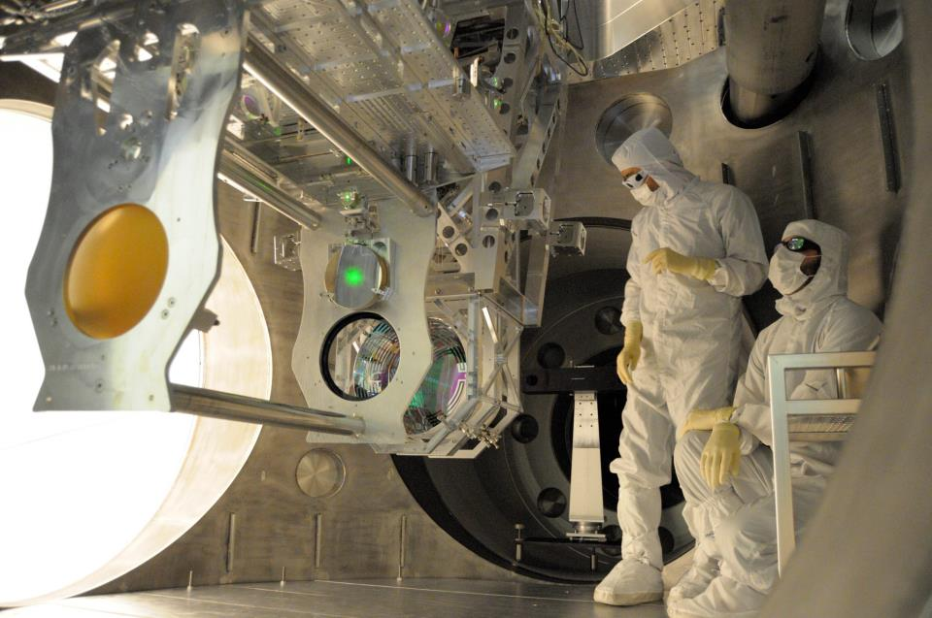
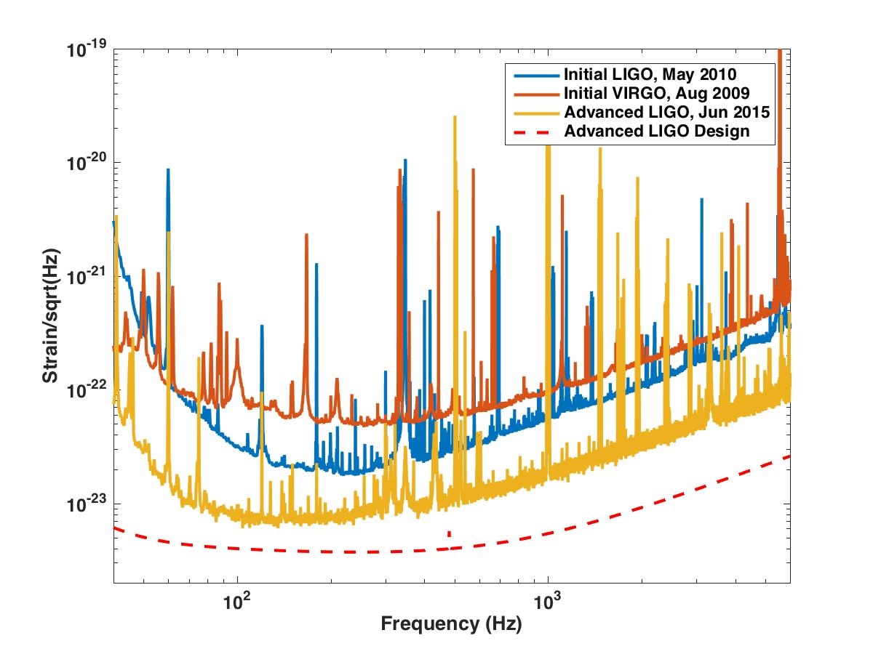
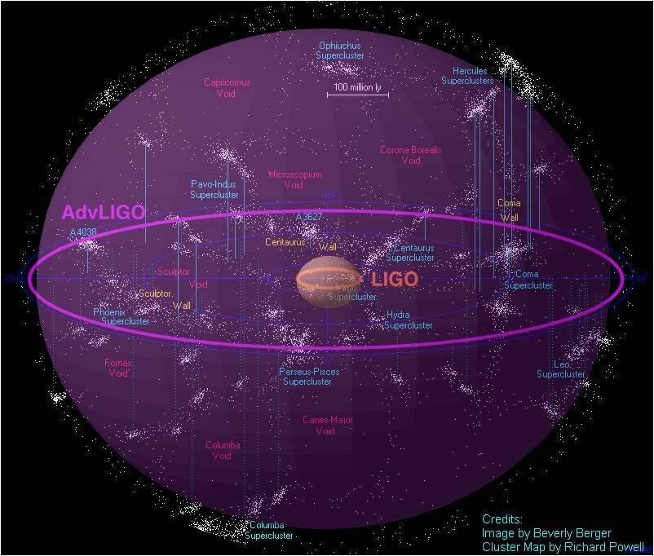
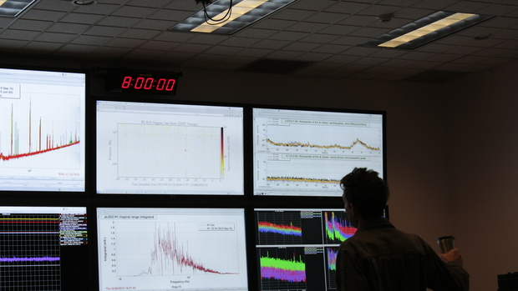
The Search for Gravitational Waves with Advanced LIGO
Tiffany Summerscales, Andrews University Dept. of Physics
What are gravitational waves?
Einstein’s theory of General Relativity predicts that mass curves the fabric of spacetime. John Wheeler summarized this prediction in the statement, “Mass tells spacetime how to curve and spacetime tells matter how to move.” Moving masses produce ripples in the fabric of spacetime that propagate outward at the speed of light. These ripples stretch and squeeze the space they pass through but are so weak by the time they reach earth that the largest ones would squeeze the planet by less than the diameter of a proton.
LIGO: the Laser Interferometer Gravitational-wave Observatory
Gravitational waves stretch and squeeze the space they pass through, changing the distances between
objects. Therefore, we need a way to measure distance changes very accurately. The LIGO (Laser
Interferometer Gravitational-wave Observatory) detectors were built to do just that [3]. Laser light is
sent down perpendicular 4 km long arms, reflected from end mirrors and then allowed to recombine
and interfere. Changes in the amount of interference indicates changes in the length of the arms.
Data from the LIGO detectors has been collected and analyzed, along with the data from other gravitational-wave detectors such as the Virgo detector in Italy, GEO600 in Germany, and TAMA in Japan. None of the analyses completed thus far has found a gravitational-wave signal. However, even not detecting gravitational waves has allowed LIGO scientists to make some important astrophysical discoveries.
LIGO Hanford Observatory in Hanford, WA (above) and
LIGO Livingston Observatory in Livingston, LA (below)
Images from [4]
One example of astrophysics coming from LIGO observations involves measuring the strength of pulsars’ outer crust. The stronger the crust, the more aspherical a pulsar can be and the stronger the gravitational waves it can emit. For both the Vela and Crab pulsars LIGO and Virgo have set the best upper limit on the gravitational wave amplitude and therefore give the most information about the structure of the pulsars [5, 6]
The image at right is from [7] and shows the center of the Crab nebula in X-ray (blue) and optical (red) light.
Above is an artist’s depiction of two pulsars orbiting around each other and producing gravitational waves. Pulsars are the remnants of dead stars whose powerful magnetic fields produce beams of radio waves that sweep around as the pulsar rotates. Such systems have been observed and seem to be losing energy to gravitational waves [1]. Image from [2].
Advanced LIGO
After gathering more than three years of data, the initial LIGO detectors were turned off and underwent major upgrades. The advanced detectors will have 10 times the sensitivity of the initial detectors over a broad range of frequencies, once they are fully tuned. A few of the changes made in the upgrades are described below.
Initial LIGO inner and end mirrors were 25 cm in diameter and weighed 10.7 kg. Advanced LIGO mirrors are 34 cm in diameter and weigh 40 kg. [3, 8] The image above was taken during the mirror alignment process.
A new laser system was installed and top laser power boosted from 4.5 W to 125 W [3, 8]. Image from [9].
The mirrors in both initial and advanced LIGO are hung as pendulums to help isolate them from vibrations and shaking. Additional stages in the advanced LIGO design provide extra isolation. Image from [10].
Advanced LIGO Turns On!
The advanced detectors started taking science data on September 18, 2015 at 8:00 am Pacific.
References
[1] Taylor, J. H. and Weisberg, J. M. “Further experimental tests of relativistic gravity using the binary pulsar PSR 1913 + 16”, Ap. J. 345, p434 (1989)
[2] http://www.jb.man.ac.uk/research/pulsar/doublepulsarcd/
[3] The LIGO Scientific Collaboration. “LIGO: The Laser Interferometer Gravitational-Wave Observatory”, Rept. Prog. Phys., 72, 076901 (2009) arXiv:0711.3041
[4] http://www.ligo.caltech.edu/~beckett/LIGO_Images
[5] The LIGO and Virgo Collaborations. “Gravitational waves from known pulsars: results from the initial detector era”, Ap. J. 785 (2014) 119 arXiv:1309.4027
[6] The LIGO and Virgo Collaborations, “Narrow-band search of continuous gravitational-wave signals from Crab and Vela pulsars in Virgo VSR4 data”, Phys. Rev. D, 91, 022004 (2015) arXiv:1412.0605
[7] NASA/CXC/ASU/J. Hester et al.
[8] The LIGO Scientific Collaboration. “Advanced LIGO”, Class. Quantum. Grav. 32 (2015) 074001, arXiv: 1411.4547
[9] https://www.advancedligo.mit.edu/
[10] Cumming, A. V. et. al. “Design and development of the advanced LIGO monolithic fused silica suspension”, Class. Quantum. Grav. 29 (2012) 035003
[11] https://ligo.caltech.edu/news/ligo20150918
[12] LIGO documents T1100338, G1500823, and T0900288. Available at dcc.ligo.org
[13] http://stuver.blogspot.com/2010/10/initial-ligo-is-dead-long-live-advanced.html
This poster has been given LIGO document number LIGO-G1501330
The start of the science run in the control room at the LIGO Hanford Observatory. Image from [11].
Sensitivity comparison between initial LIGO, initial Virgo and the Advanced LIGO detectors. The new detector is already far more sensitive and should continue to approach the design curve as the detectors are tuned. Data from [12].
The above diagram shows the volume of space for which Initial LIGO was able to measure gravitational waves produced by the inspiral of two neutron stars. Once the detectors reach design sensitivity, Advanced LIGO will be able to see far enough to make frequent detections. Image from [13].
Background picture by Swinburne Astronomy Productions

