Slide 1
How we know GW150914 was NOT an injection
Is GW150914 too perfect to be real?
(a collection of work and ideas of many, many people)

Slide 2
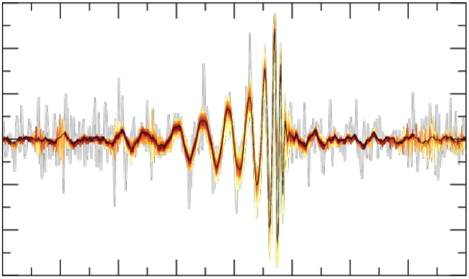
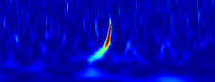
Introduction
GW150914 happened in the early hours of September 14, during ER8
The signal has a high SNR and appears to be a perfect binary black hole coalescence
Both the timing of the signal (during an ER, when software was still being tested) and the size and quality of the signal have raised questions about its veracity
Could GW150914 be a fake?
BayesWave
Omega

Slide 3
How are injections normally done?
Software Injections
  a signal is added to the strain channel (hoft) after it is recorded
  they do not appear in raw frames, or in any other channels
Hardware Injections
  an actuator is used to push on an end mirror in the interferometer to mimic a GW induced strain
  these injections appear in hoft and in many monitor channels
  “Hardware” is a misnomer – this is done via the digital system
Blind Injections
  a hardware injection which is done via an “off-limits” channel

Slide 4
GW150914 was NOT a “normal” injection
This was checked shortly after the event was discovered
No injection was made, and in fact we didn’t even know HOW to make hardware injections at the time of the event. (Inverse actuation filters for L1 had not been computed.)

Slide 5
What about “Rogue injections” ?
(injections that don’t follow the rules)
Frame Spoofing
  replace the original frames with fake frames that contain an event which was not there before
Double Blind Injections
  an injection into the interferometer control computer
    like a normal blind injection, but not recorded in “the envelope”
    or injected via some non-standard path (e.g., PCAL)
  Easter Egg Hacks – modifications of the digital system
Analog Hacks
  added hardware which changes the signals in analog before they are recorded
Note: All reference are on a slide at the end.

Slide 6
From strain to your computer
from G1400847 by Greg Mendell
How does data flow from the interferometer to the analysis pipelines?
Data from the observatories is quickly distributed, so if you want to fake it you must work at the source (or hack many, many complicated systems).
MIT
LHO
UWM
CIT
SYR
LLO
AEI
Virgo
Other Tier II or HPCs

Slide 7
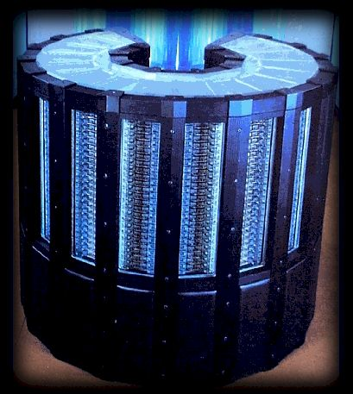

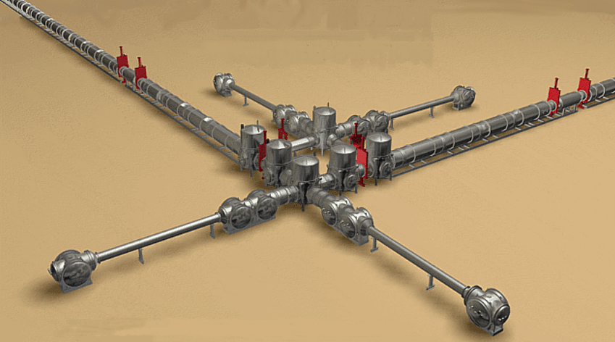
At the observatories
The gravitational wave is imprinted on the light in the interferometer
That imprint is converted into an analog signal on the photodetectors, which is then digitized and sent to the digital control system (CDS)
The digital control system passes this signal on for storage and distribution (LDAS)
Digital Controls
Data Storage
Interferometer

Slide 8
Frame Spoofing…
Wouldn’t it be easy to just replace the frames with ones that contain a signal after they are written to disk?
If someone did this before they were distributed, and they did it at both observatories, how would we ever know?
Digital Controls
Data Storage
Interferometer

Slide 9

Frame Spoofing!
Data Storage
Hacker!

Slide 10
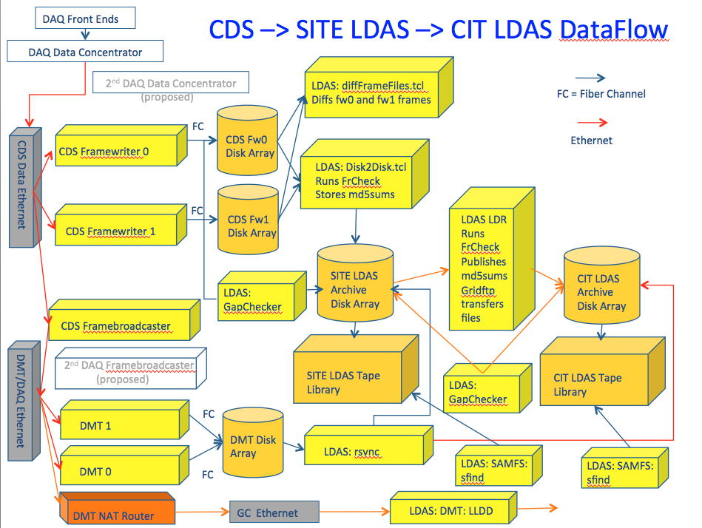
Frame Spoofing???
The data goes from CDS to 3 separate systems, 2 for redundant storage and 1 for distribution. Checksums are quickly generated, and data is cross checked.
Frame spoofing would have to be done simultaneously on multiple servers at LHO, LLO and CIT. All traces of activity, including remotely stored log files, would need to be erased.
Data Storage
G1400847
Hacker???

Slide 11
Frame Spoofing: a major operation due to security and redundancy.
Data Storage
Hacking LHO, LLO and CIT and replacing all redundant copies of the data is not impossible (what is?), but that is not the end of the story…
What exactly is “the data” that would need to be replaced?
Just the strain channel?
G1400847
Hacker???

Slide 12
Frame Spoofing: what would need to be spoofed?
Digital Control System (CDS)
Analog DARM
Strain (hoft)
Hacker!
DARM = Differential Arm ~ Strain

Slide 13
Frame Spoofing: what would need to be spoofed?
Digital Control System (CDS)
In each interferometer, 2 photodetector signals are digitized and passed through many filters and matrices. 30+ versions of DARM are stored at various points along the signal chain (each ).
ETMY L1
L1 DACs
L2 MONs
ETMY L2
L2 DACs
L3 MONs
PD A
ETMY IN
ETMY L3
L3 DACs
DARM
PD B
ETMX IN
ETMX L3
In order to reproduce all of these signals, a hacker would need to know CDS very well, and have access to recent configuration files and live parameter values.
DELTA L
hoft

Slide 14
No Frame Spoofing
This attack, while apparently simple, turns out to be a monumental feat (one might call it “impossible”)

Slide 15
Double Blind Injections…
Isn’t it possible that someone injected a signal into the digital control system (CDS) before it went to LDAS for storage?
We do this regularly… heck, it might have even happened by accident, right?
If it went in through the BLIND channel, but was not recorded in “the envelope” we would never know! Would we?
Digital Controls
Data Storage
Interferometer

Slide 16

Double Blind Injections
Digital Control System (CDS)
Analog DARM
Strain (hoft)
Injection!

Slide 17
Double Blind Injections
Digital Control System (CDS)
We record the GW signal as it comes in from the PDs, as it goes out to the actuators, and at many points in between. From the PD signals, we can can compute the signal we should see at each point in the chain.
ETMY L1
L1 DACs
L2 MONs
ETMY L2
L2 DACs
L3 MONs
PD A
ETMY IN
ETMY L3
L3 DACs
DARM
PD B
ETMX IN
ETMX L3
Injection!

Slide 18
Double Blind Injections: injections are clearly visible
Digital Control System (CDS)
When a signal is injected, it is clearly visible as a difference between the recorded signal (blue) and the signal expected given the input (orange).
PD A
PD B
Injection!

Slide 19
Double Blind Injections: no injection during GW150914
Digital Control System (CDS)
At the time of GW150914, the DARM signal propagates through the loop as expected.
Nothing is added at any point, which rules out all kinds of injections into DARM, including “blind” injections and front-end software bugs.
PD A
PD B
Note: Normal blind injections are recorded in the data, not just in the “envelope”, so ruling these out is trivial.

Slide 20

Double Blind Injections: what about injecting elsewhere?
Digital Control System (CDS)
Analog DARM
ETMY
PCAL
Injection!
PCAL = Photon Calibrator

Slide 21
Double Blind Injections: what about injecting elsewhere?
Digital Control System (CDS)
An injection into PCAL, or anywhere else that DARM is not normally found, results in a transient which is coincident with the event in DARM. This leaves a clear signature in the corresponding auxiliary channel.
Injections of this sort also pose a significant problem: the coupling to DARM must be known and inverted to produce an injection signal. No such inverse filter existed for PCAL until Oct 2.
October 8
PCAL
Injection

Slide 22
Double Blind Injections: what about injecting elsewhere?
Digital Control System (CDS)
PCAL and ALL other auxiliary channels have been checked repeatedly and exhaustively. No significant transient was found at the time of GW150914.
Essentially, this means that all signals which should contain the event (e.g., DARM) do so as expected, and all the signals which should NOT contain the event do not.
September 14
PCAL
No Injection

Slide 23
No Double Blind Injections
Injections are recorded in many ways, so there is no way for an accidental injection to be mistaken for a real signal
Blind injections are only blind by convention and are as easy to uncover as any other injection
The inverse filters needed to make injections were not in place on September 14
There is no sign of an injection around GW150914

Slide 24
Detailed Example: PCAL injection followed by frame spoofing
suggested by “AL”,
who will remain otherwise
nameless
PCAL is one of the easiest injection points to invert, and somewhat disconnected from the rest of the DARM loop, so it appears to be an easy target
If a PCAL injection is made, it will only appear in
  the digital excitation itself (EXC_SUM)
  the monitor diodes (TX and RX)
This “easy” hack requires
  generating a time-domain CBC waveform (easy for some)
  offline PCAL coupling inversion (easy for some)
  hacking a control machine, or physical access (easy for a few)
  defeating security to replace many redundant frames (hard)

Slide 25


Easter Egg Hacks
A large class of attacks involve the replacement of some part of the digital system with malicious code capable of performing an injection without leaving a record
This avoids the need to change the frames after they have been disseminated, reducing the scope of the hack
It would require:
  signal generation and actuator inversion, as usual
  CDS administrator privileges at both observatories
  in depth knowledge of CDS system
  removal of malicious code before the post-event inspection, or code hidden well enough to avoid detection

Slide 26
Analog Hacks
What if someone got to the interferometer analog electronics and added something there?
Couldn’t a signal be injected into one of the test-mass actuators after the monitor points?
This would probably just require a couple of iPod nanos and some clip leads!
Digital Controls
Data Storage
Interferometer

Slide 27

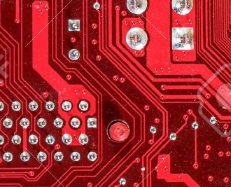

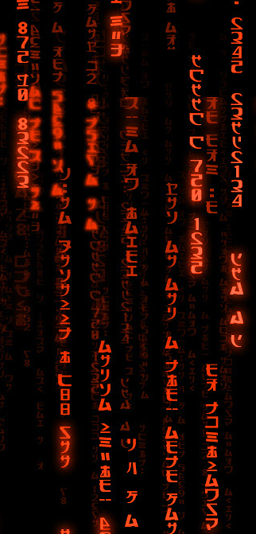
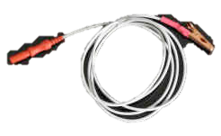
Analog Hacks
Interferometer

Slide 28
Analog Hacks
Interferometer
Analog Hack Requirements:
free access to VEAs at both sites
in-depth knowledge of the interferometer electronics (e.g., schematics)
sufficient understanding of electronics and/or mechanical systems to invert the DARM coupling
programmable injection devices with millisecond absolute timing resolution
production and filtering of time-domain CBC waveforms

Slide 29
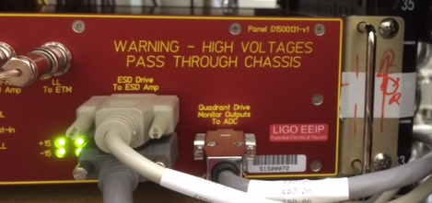
Analog Hacks
Interferometer
Analog Hack Concealment:
All electronics racks were inspected and photographed after the event. Nothing suspicious was found.
VEAs have card readers on the doors and entries are logged (better at H1 than L1). No unauthorized entries were made. PEM sensors can also be used to reveal activity.
Sensitive electronics will be inspected internally after the run, in the meantime they have been sealed.

Slide 30
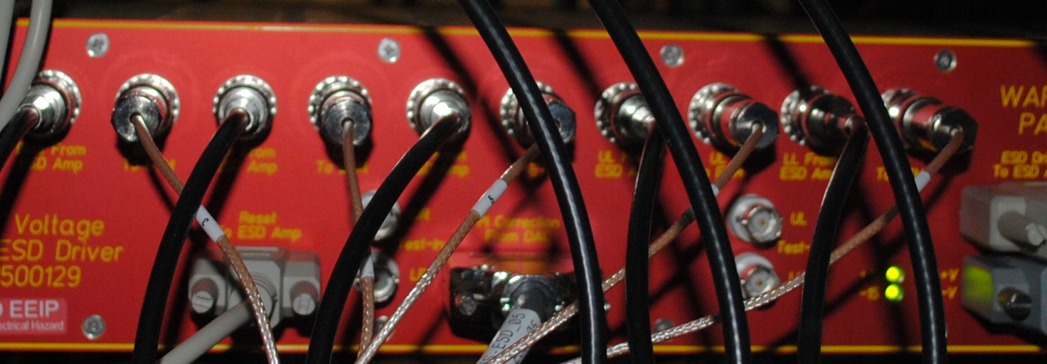
Detailed Example:
The Electrostatic Drive Test Inputs
The ESDs (which push on the interferometer test masses) have test inputs which could be used to inject a signal
  An injection at this point would escape our monitors (not obvious)
Here is how this “obvious” analog hack would go
  write an app for your favorite mobile audio device (e.g., iPod) which can output a pre-computed waveform with good timing accuracy
  produce desired CBC waveforms and filter them to invert the ESD response. (They are different between H1 and L1, with the differences noted only in the aLOG, but anyway…)
  travel to both sites, or recruit conspirators, to plant the injection devices (“iPods”). (There are very few people who travel to both sites and spend long hours in the VEAs.)

Slide 31
Detailed Example:
The Electrostatic Drive Test Inputs (2)
  place the iPods inside of the drivers
    If you just plug in to the front you get caught in the post-event inspection, and you can’t get in to remove the device without being caught since VEA entries are recorded.
    Since you are opening the boxes, you will need time when nothing is on to disconnect the ESD and remove it from the rack. A few hours of alone time in the VEA should do, but it will be hard to do this unnoticed (unless you work there).
  find an opportune time to remove the iPods
    The electronics have been photographed and sealed, so you will need to either do a very careful reconstruction or recruit more conspirators.
    At least a few more hours alone with the electronics will be required to leave an undisturbed looking scene
This is the EASIEST hack I can think of, and I don’t know anyone who could do it all.

Slide 32
No Analog Hacks
This kind of operation would require a multi-person inside job in order to
  cover both observatories
  have the full range of skills required
  avoid discovery

Slide 33
Conclusion
One might wonder why some think the “perfection” of GW150914 suggests that it is a fake. Which has a better track record, hardware injections or GR? If it didn’t match GR, wouldn’t we be more suspicious?
While several kinds of hacks seem plausible when first considered, careful investigation reveals many challenges
The LIGO data flows from the interferometers into a digital system with a great deal of redundancy
As the signal moves farther from the source both security and redundancy grow, making spoofing essentially impossible
Closer to the source the signal is protected by the natural complexity of hardware systems, as well as layers of physical security
Meticulous investigations have revealed no evidence of tampering
We can’t say that faking GW150914 was impossible, but we can say that faking it would have required an internal conspiracy of our most knowledgeable people

Slide 34
References
Frame spoofing
  see EVNT logs 11383, 11376 and 11325 (11196, 11198, 11376)
Double Blind Injections
  see T1500536 (DARM), T1500541 (CDS), T1500544 (ESD Mon)
  see EVNT logs 11253, 11288, 11267, and 11414 (11195, 11209, 11258, 11268, 11273, 11274, 11288, 11308, 11335, 11336)
  Easter Eggs, see 11260, 11266, 11318, 11329, 11330
Analog Hacks
  see T1500514 (IFO), L1500138 (Site), L1500139 (Inspection)
  access and inspection logs 11214, 11232, 11313, 11317, 11323, 11382, 11432

