Slide 1
aLIGO Design
Presentation at UF
October 5th, 2015
GM
Source Material:
T0900043
Optics Express, Vol 16(14), 10018 (2008)
Appl. Opt. 42(7) 2003, 1244-1256
Appl. Opt. 42(7) 2003, 1257-1268

Slide 2
Understanding aLIGO
Generation of signal field:
Phase modulation of cavity internal field
ITM
ETM
Carrier In
SB Out

Slide 3
Understanding aLIGO
ITM
ETM
Carrier In
SB Out
Signal (outside cavity):
Amplitude:
Max-Signal (ΩGW small): Impedance matched cavity

Slide 4
Understanding aLIGO
ITM
ETM
Carrier In
SB Out
State of the art cavity losses:
< 1ppm coating absorption
~5-10 ppm transmission
~50-100 ppm scatter across beam
TITM ~ 100ppm
Cavity with TITM ~ 100ppm:
Finesse = 3x10⁴
Line width (HWHM) ~ 1Hz
would average out all relevant GW signals

Slide 5
Advanced LIGO Design
ITM
ETM
Carrier In
SB Out
TITM is compromise between signal amplitude (gain) and detector band width
but also reduces carrier inside cavity

Slide 6
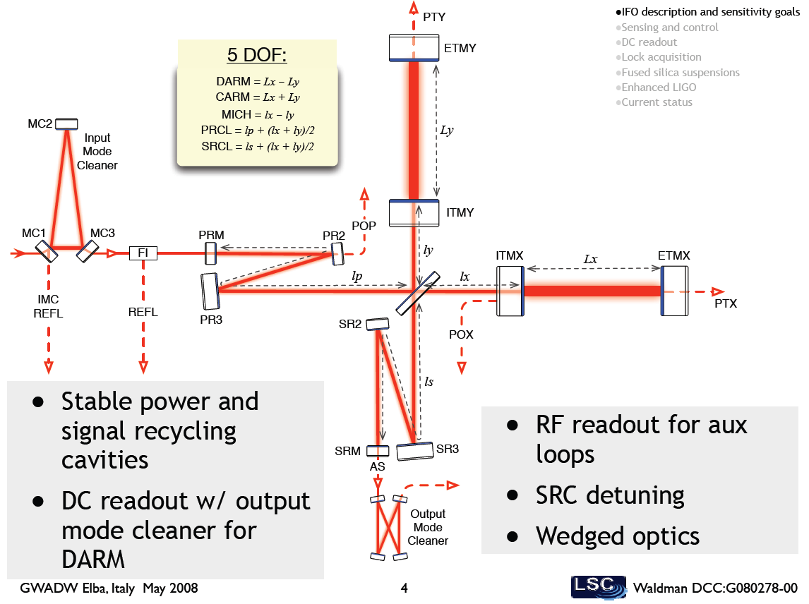
Advanced LIGO
Take advantage of
Michelson Interferometer
Quadrupole nature of GW
SB generated 180deg out of phase in both arms
Tune MI to dark
Carrier goes back to laser
all laser noise suppressed in dark port
Signal field goes to dark port
not affected by anything between BS and laser

Slide 7
Advanced LIGO
Take advantage of
Michelson Interferometer
Quadrupole nature of GW
SB generated 180deg out of phase in both arms
Tune MI to dark
Carrier goes back to laser
all laser noise suppressed in dark port
Signal field goes to dark port
not affected by anything between BS and laser
Allows power recycling. Best gain: Impedance matching
+ MI losses

Slide 8
Advanced LIGO
Lets put this together:
GW bandwidth sets TITM
Anticipated Losses determine TPR

Slide 9
Advanced LIGO
Signal Recycling:
Coherent amplification or
Coherent extraction
of signal field
IFO for signal ~ 3 mirror cavity
SR
ITM
ETM
ITM/SR: Compound mirror

Slide 10
Advanced LIGO
Signal Recycling:
Coherent amplification or
Coherent extraction
of signal field
IFO for signal ~ 3 mirror cavity
used to tailor frequency response of aLIGO
taking into account all known
noise sources
potential signals
locking issues

Slide 11
Advanced LIGO Design
Important mirror parameters:
Transmissivity
Mass = 40kg
as heavy as necessary
as light as possible
RPN ~ Suspension thermal
Limits useful mass
Radius of curvature
Increase beam size
reduce coating TN
limited by
diffraction losses to ~6cm
cavity stability
stability against thermal deformation

Slide 12
Advanced LIGO Design
Beam size on test masses:
Two options
large waist
small waist

Slide 13
Advanced LIGO Design
Beam size on test masses:
Two options
Large:
Smaller beam size at BS
ROCs difficult to measure ~ 52km
Small:
Stable against ROC increases due to heating
ROCs easier to measure ~ 2080m
More coating layers on ETM (increases thermal noise)
Diffraction larger issue at beam splitter:
Increase beam size at ETM to ~ 6.3cm
Decrease beam size at ITM to ~ 5.7cm
Final design: RETM = 2245m RITM = 1934m

Slide 14
Advanced LIGO Design
Recycling cavity design:
Two options
Simple, but barely stable:
R ~ 1400m
g = 1 - 20/4000 ~ 1 (nearly unstable)
higher order modes near resonant
bad for alignment sensing
very power dependent eigenmodes
bad experience in iLIGO
Folded recycling cavity
g selectable
HOMs non-resonant
nearly power independent eigenmodes

Slide 15
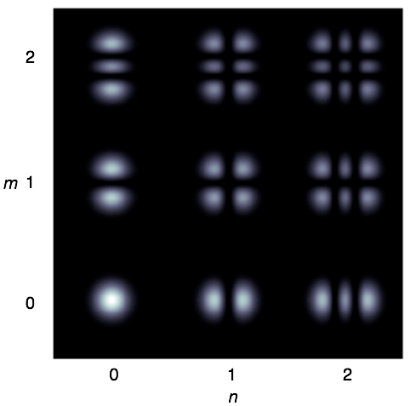
Higher-order HG modes
Spatial field distributions which reproduce after cavity roundtrip = spatial eigenmodes
Have different resonance frequencies (except for g~1)
Separable in x and y = HG-modes
P. Fulda Group Meeting 09/03/2015

Slide 16
Advanced LIGO Design
Recycling cavity design:
Two options
Folded recycling cavity
g selectable
HOMs non-resonant
nearly power independent eigenmodes
PR3 focuses ~6cm beam
waist after PR2
Stable mode between PR2 and PRM (sets Gouy phase)
MM very sensitive to PR2/PR3 distance/ROCs
SR-cavity similar

Slide 17
Advanced LIGO Design
Length sensing basics:
Paul will discuss in more detail
Important for design:
Each degree of freedom has to be sensed by some field
Requires resonant SBs inside recycling cavities
f1 for power recycling
f2 for signal recycling but has to pass through power recycling and MI

Slide 18
Advanced LIGO Design
Power Rec. cavity design:
Length~55m depends on Vacuum envelope
~16m between PRM/PR2
HAM2/3 distance
times 3
+ HAM3-ITM distance
incl. BS/ITM substrates
gives modulation frequencies:
0.5: because carrier is resonant in arm cavities

Slide 19
Advanced LIGO Design
Signal Rec. cavity design:
Length ~55m
SB has to pass through PR
Two ways:
Make MI bright for 2nd SB
Couple both cavities
rPR
rBS
rSR

Slide 20
Advanced LIGO: Design
Summary:
Transmission of ITM set by detector bandwidth
Power recycling gain set by losses in arm cavities and MI
Signal recycling mirror forms compound mirror with ITM to
tailor frequency response. Choices between:
High gain/low BW
low gain/high BW
ampl. displacement noise, only useful where shot noise limited
Stable recycling cavities to
contain spatial mode
reduce scatter into other spatial modes
Length sensing:
Need sidebands to probe recycling cavities

