Slide 1
PSL Presentation at UF
September 4th, 2015
GM
Source Material:
G1100452
Optics Express, Vol 20(10), 10617 (2012)
Dissertation presentation Jan Pöld (AEI, 2014)
G1100837 (PSL Training Session, incl. movies)

Slide 2
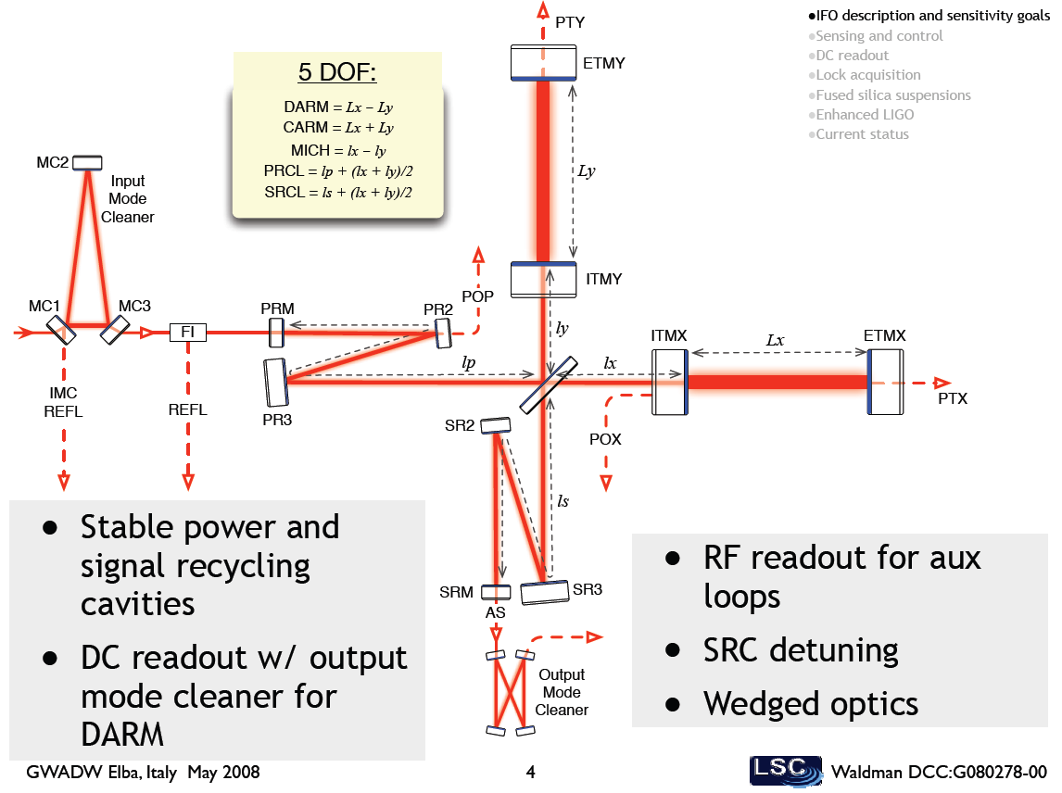
Advanced LIGO
Cavity-enhanced,
dual-recycled Michelson interferometer
200W
125W
Laser
EOM
~600kW

Slide 3
Advanced LIGO
4km long Cavities
Laser
EOM

Slide 4
Advanced LIGO
Short MI:
4 to 5m long
~4cm difference
Laser
EOM

Slide 5
Advanced LIGO
~55m power recycling cavity
~55m signal recycling cavity
Laser
EOM

Slide 6
Advanced LIGO
Why this design?
MI:
optimum geometry (∂l-meter)
equal arms = common mode rejection of noise
Cavities in arms
amplify phase shift
Trade-off between gain and BW
Power Recycling
builds up power
cleans up mode
Signal Recycling
builds up signal
Trade-off between gain and BW
Peak frequency tunable
(SR mirror position)
MI+Cav
∂l(f)
MI
MI+Cav+PR
MI+Cav+PR+SR
Log f

Slide 7
Advanced LIGO: Back on the envelope
Displacement Sensitivity: Shot Noise only
Power Recycling:
MI-Phase sensitivity:
Arm cavity gain:
In length and strain:
Low pass filter of cavity:

Slide 8
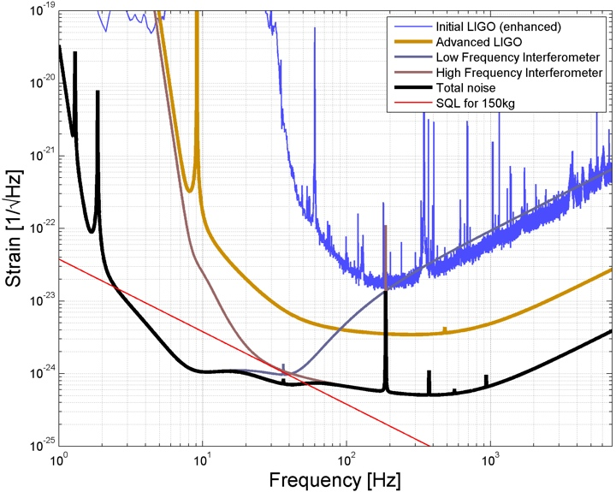
Advanced LIGO: Back on the envelope
Shot Noise

Slide 9
Advanced LIGO: Back on the envelope
Displacement Noise:
Seismic motion
Environmental vibrations
Thermal noise
Coating
Substrate
Suspension
Radiation Pressure Noise
Fundamental (Quantum)
Technical
Unbalanced Arms
Newtonian or Gravity gradient noise
Displacement
Noise

Slide 10
Advanced LIGO
Key systems:
PSL
IO
Core Optics
Suspensions
SEI
Main IFO
Mode matching
ISC, ASC
Output Optics
TCS
AOS
Photon calibrator
…
200W
125W
Laser
EOM
~600kW

Slide 11
PSL
PSL: Prestabilized Laser System
Designed, developed, tested, installed by
Albert Einstein Institute, Hannover, Germany
Development Lead: Benno Willke
PSL-Lead at project-level: Peter King
PSL-Officer at LLO: Matt Heintze

Slide 12
PSL
Requirements:
Stand alone Laser system
Stabilized system
Requirement flow down:
Top level:
125W TE00 injected into IFO spatial mode
< 5W in higher order modes as defined by IFO
Saturates detectors
Creates stray light

Slide 13
PSL
Requirements:
Stand alone Laser system
Stabilized system
Requirement flow down:
Top level:
125W TE00 injected into IFO spatial mode
Laser frequency noise relative to CARM
relative to CARM

Slide 14
PSL
Requirements:
Stand alone Laser system
Stabilized system
Requirement flow down:
Top level:
125W TEM00 injected into IFO spatial mode
Laser frequency noise relative to CARM
Laser Amplitude noise = Relative Intensity Noise (RIN)

Slide 15
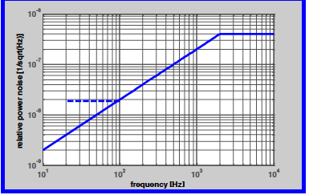
PSL
Requirements:
Stand alone Laser system
Stabilized system
Requirement flow down:
Top level:
125W TE00 injected into IFO spatial mode
Laser frequency noise relative to CARM
Laser Amplitude noise
measured at input of IFO at 125W input power

Slide 16
PSL
Requirements:
Stand alone Laser system
Stabilized system
Requirement flow down:
Top level:
125W TE00 injected into IFO spatial mode
Laser frequency noise relative to CARM
Laser Amplitude noise = Relative Intensity Noise (RIN)
Beam pointing = beam jitter
Maintain alignment into IFO (active or passive)

Slide 17
PSL
Requirements:
Stand alone Laser system
Stabilized system
Requirement flow down:
Top level
‘Propagate’ back through IO to PSL
IO filters Laser noise
reduces requirements of stand-alone laser
IFO and IO provide control signals to suppress laser noise
Requires appropriate actuators within PSL (and IO)

Slide 18
PSL
Requirements:
Stand alone Laser system
Power output: Deliver 165W TEM00 to IO
<5% of power in higher order modes

Slide 19
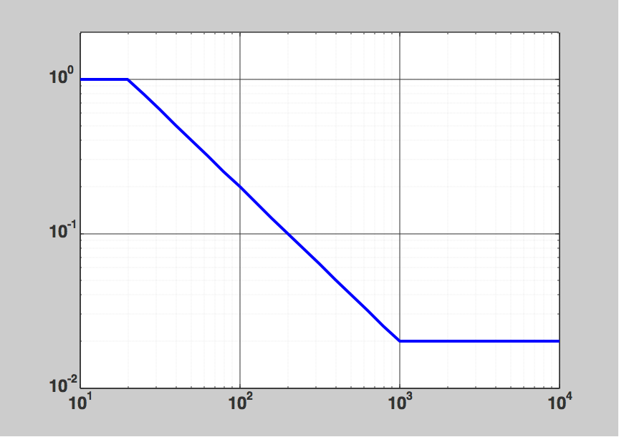
PSL
Requirements:
Stand alone Laser system
Power output: Deliver 165W TEM00 to IO
<5% of power in higher order modes
laser frequency noise

Slide 20
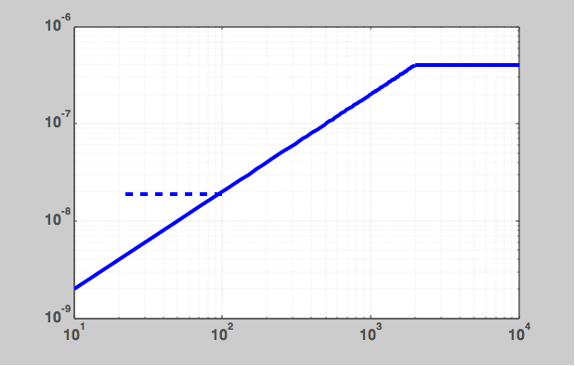
PSL
Requirements:
Stand alone Laser system
Power output: Deliver 165W TEM00 to IO
<5% of power in higher order modes
laser frequency noise
RIN
1st-Stage: PSL internal
2nd-Stage: Signal from IFO

Slide 21
PSL
Requirements:
Stand alone Laser system
Power output: Deliver 165W TEM00 to IO
<5% of power in higher order modes
laser frequency noise
RIN
Laser frequency drift: < 100kHz over 100s
Laser power drift: < 5% over 24h

Slide 22
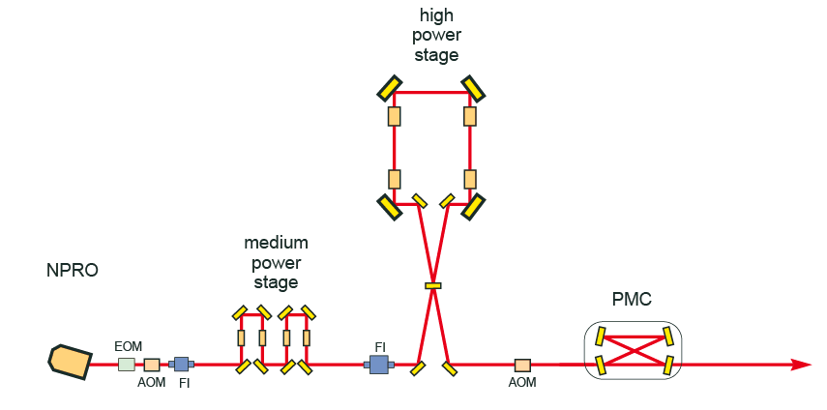
advanced LIGO laser - layout
eLIGO laser
2W
35W
180W
165W in TEM₀₀
4

Slide 23
advanced LIGO laser - layout
NPRO: Non-planar ring oscillator
Ultra-stable master (passive)
Laser crystal: Nd:YAG
Diode laser pumped (808nm)
~10kHz/rtHz @ 1Hz
Same lasers we have in lab!
808nm
eLIGO laser
2W
35W
180W
165W in TEM₀₀
4

Slide 24
advanced LIGO laser - layout
EOM:
Phase modulation
Phase correction
AOM:
Power stabilization
FI:
Suppress back reflection
808nm
eLIGO laser
2W
35W
180W
165W in TEM₀₀
4

Slide 25
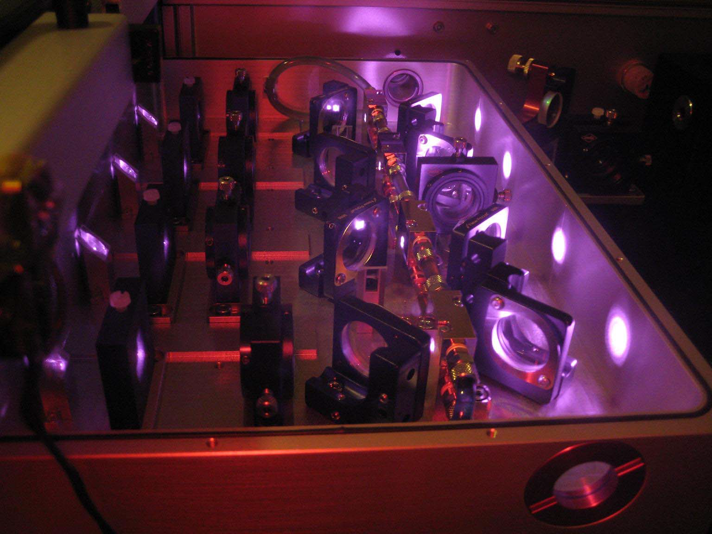
eLIGO laser
808nm
eLIGO laser
2W
35W
180W
165W in TEM₀₀
4

Slide 26
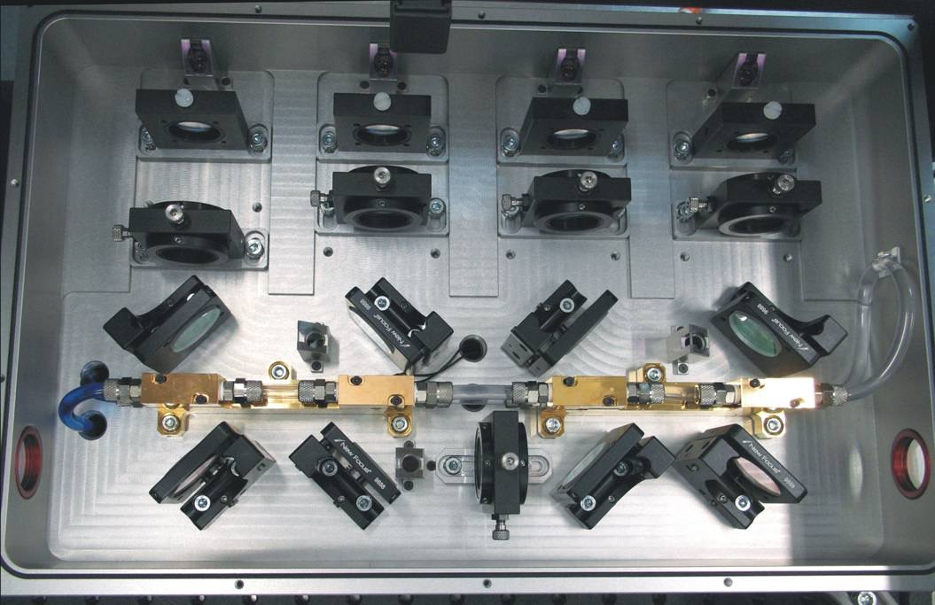
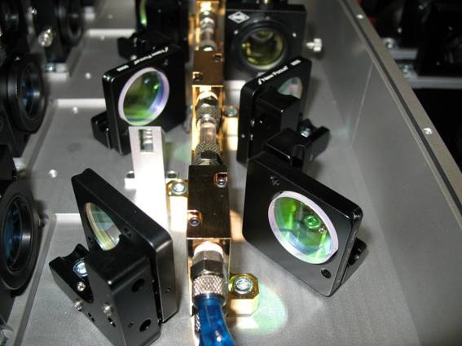
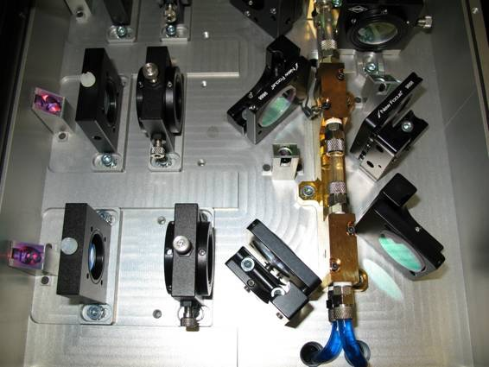
eLIGO Laser System
Amplifier
Pump
power
4 stage Nd:YVO₄
water cooled
fiber coupled pump diodes
pump power 4 x 32 W
seed power 1.7 W
output power 35 W
pump light pickups
laser pickups
temperature monitoring

Slide 27
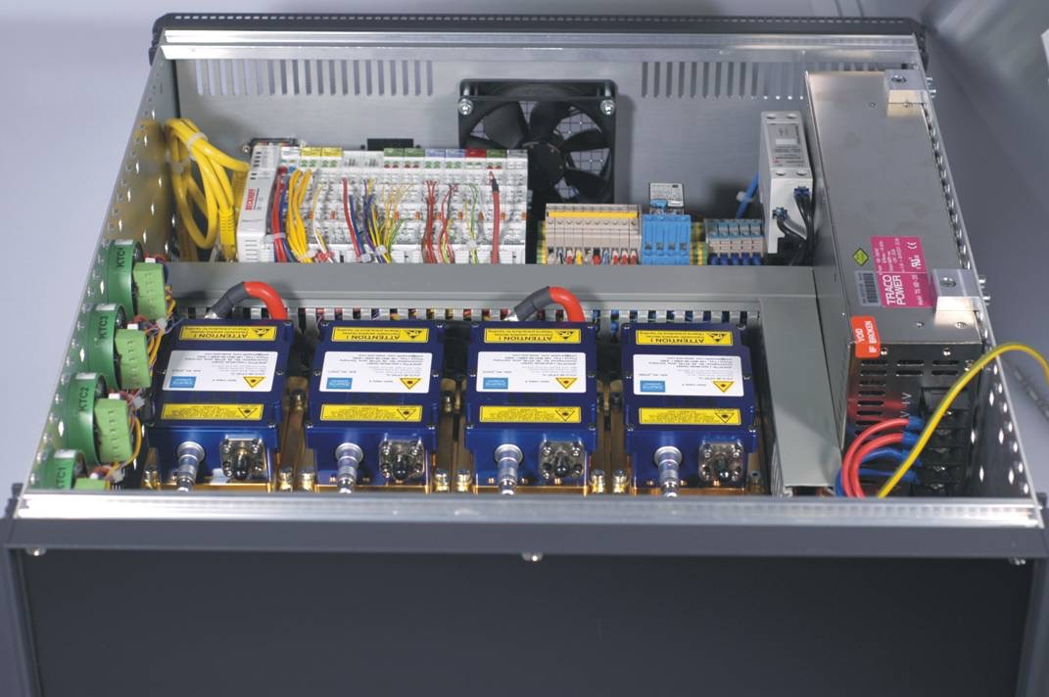
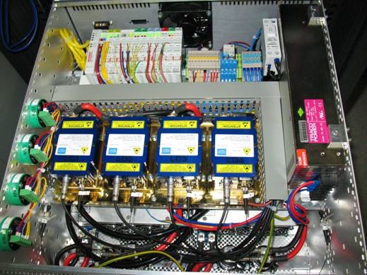
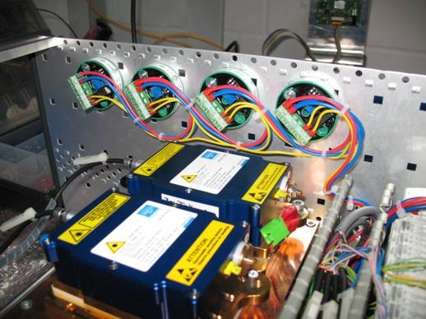
eLIGO Laser System
Diode Box
4 pump diodes
water cooled heat sink
temperature interlocks
diode power supplies
peltier driver boards with power supply
Beckhoff interface
Pump diodes
located in different room.
Fiber coupled

Slide 28
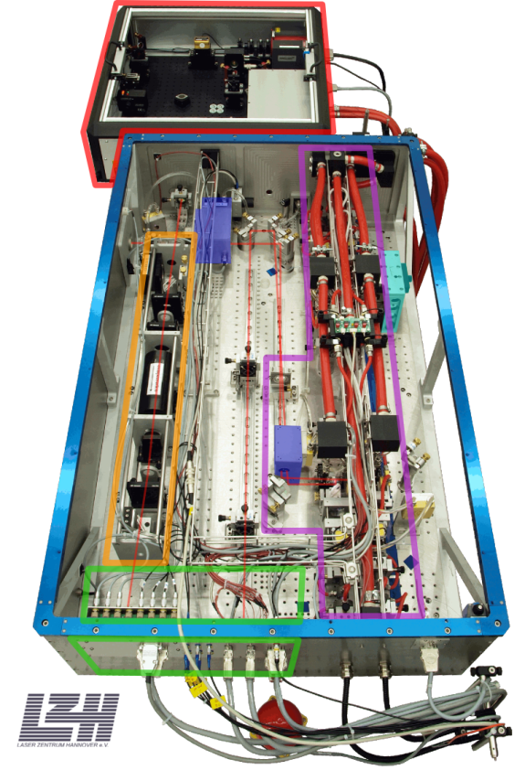
advanced LIGO laser - layout
EOM:
Phase modulation
Phase correction
AOM:
Power stabilization
FI:
Suppress back reflection
808nm
eLIGO laser
2W
35W
180W
165W in TEM₀₀
4

Slide 29
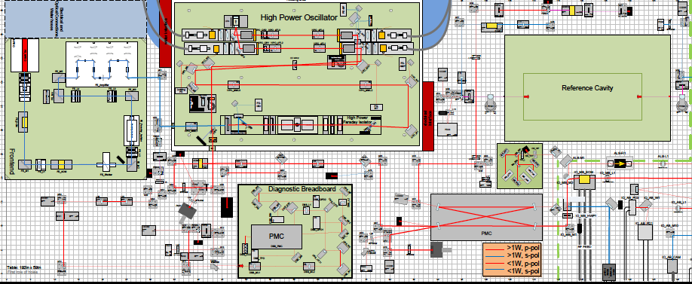
PSL

Slide 30
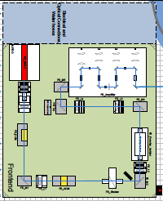
PSL
eLIGO Laser =
aLIGO front end
Nd:YVO4 crystals
pumped by 808nm diode lasers

Slide 31
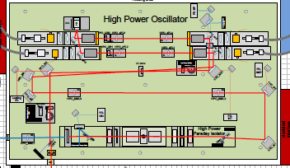
PSL
Injection locked ring laser, forced to emit on the injected laser frequency
laser frequency identical to master laser
Pumped by four ~200W diode laser arrays, fiber coupled

Slide 32
PSL
Ring laser:
‘Point’ design. Requires certain pump power to create thermal lens in Nd:YAG rods to stabilize laser resonator.
Water-cooled
Laser system can only operate at full power
Current low power operation (25W input at PRM) works w/o high power oscillator (slave laser)!

Slide 33
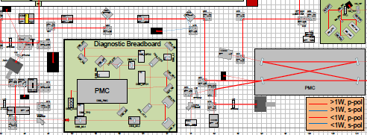
PSL
Auxiliary parts of PSL:
Diagnostic Breadboard (see Paul for details)
Pre-mode cleaner: Bow tie cavity to spatially filter laser field
1st Stage intensity stabilization system (ISS)
Sensor prior to Input Optics!!

Slide 34
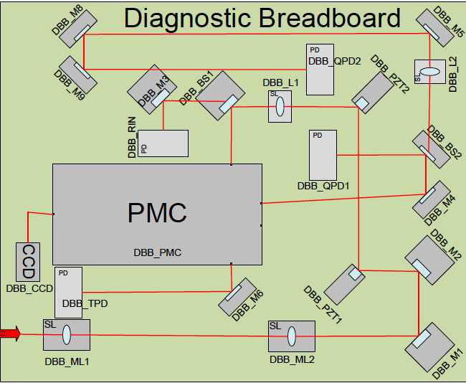
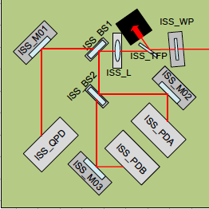
PSL
ISS:
PDA: Creates error signal
PDB: Out of loop signal
QPD to maintain alignment
PD sensitivity depends on position on active element
DBB:
Mode Analyzer Cavity
Power monitor
Pointing monitor (QPD1&2)
with respect to PMC

Slide 35
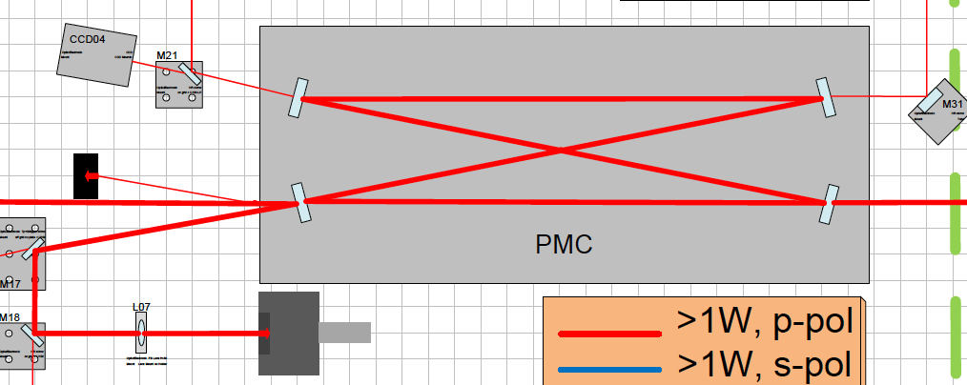
PSL
High power laser beam:
Fairly bad spatial mode quality (thermal distortions …)
incl. beam jitter
Pre-Mode Cleaner (PMC) filters spatial distortions
Locked to laser frequency via PDH signal
To Ref.Cav.
To ISS in PSL
To IO

Slide 36
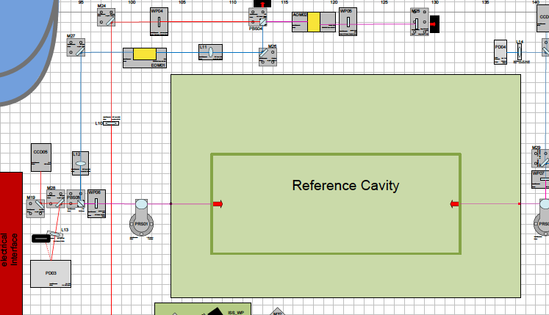
PSL
Reference Cavity:
Glass cavity in thermally isolated vacuum tank
1st Frequency stabilization system
Offset lock:
SB generated in AOM, locked to cavity
Sideband frequency tunable

Slide 37
PSL
Sensors external to PSL:
Frequency:
Input Mode Cleaner (IMC)
Common Arm Cavities (CARM)
Intensity:
2nd ISS uses signal in HAM2 after IO

Slide 38
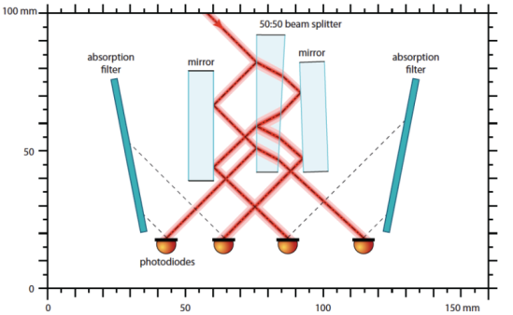
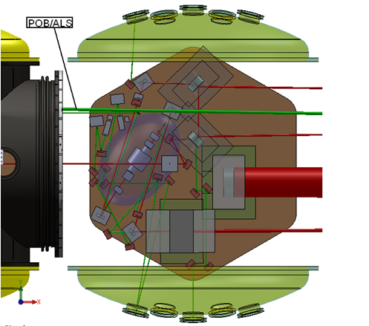
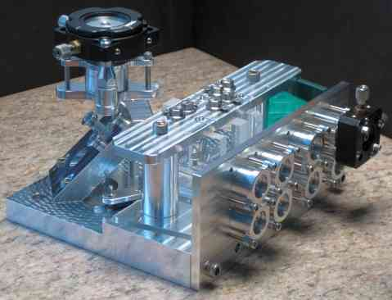
PSL
four photodiodes per detector
In-loop
Out of loop
each aligned to lowest pointing coupling
50mA photocurrent per photodiode
in dust-free environment with reduced pointing fluctuations
installed in HAM 2

Slide 39
PSL
Sensors external to PSL:
Frequency:
Input Mode Cleaner (IMC)
Common Arm Cavities (CARM)
Intensity:
2nd ISS uses signal in HAM2 after IO
General issues with PSL:
Beam pointing from PSL table (out of IO) might be higher than expected due
Acoustic noise and water flow shakes IO periscope
2nd ISS loop not yet 100% functional
Sees also stray light from IOT2R
Needed for high power operation only (not yet)
…

