Slide 1
Linear systems
LIGO-G1500817-v1
SURF 2015 lecture: Jun 24, 2015
Koji Arai – LIGO Laboratory / Caltech

Slide 2
What is a “system”?
A “system”
A physical instance that has internal DOFs (states)
Here we are interested in the response of the system
i.e. excitation -> response
Because...
- we can develop a better understanding of the system (i.e. modeling)
- it has a lot of applications
Particularly, we are interested in Linear Time Invariant (LTI) systems

Slide 3
Why do we need to learn about LTI systems?
Raw detector output ≠ GW waveforms
We need to consider:
- interferometer / sensor / actuator responses
- signal conditioning filters
- effect of feedback controls
Understanding the dynamics of various systems
- mechanics, electronics, thermodynamics, optics, ...
Designing feedback/feedforward control system
Signal processing: calibration / signal filtering

Slide 4
Example of systems
“Filters” and “Transducers”
If the input and output have:
a same unit, the system is categorized as a “filter”
- electrical filter (V->V, A->A),
- mechanical filter (m->m), optical filter (E->E),
- digital filter (number -> number)
different units, the system is categorized as a “transducer”
- force-to-displacement actuator (m/s^2->m),
- electro-magnetic actuator (V->m/s^2),
- displacement sensors (m->V)
- electrostatic transducer (C (charge) -> N/m^2 (sound))
- transimpedance amplifier (A->V), current driver (V->A)
- gravitational wave detector (“gravito-optic modulator”)

Slide 5
LTI: Linearity and Time Invariance
LTI systems fullfil the following two conditions
Linearity (super position)
Time invariance
H
  System Output
  y(t)
  System Input
  u(t)

Slide 6
Why LTI?
Why do we limit the discussion within LTI systems?
  They are simple,
  but still gives a lot of characteristics about them
  Nonlinear systems can be reduced to a linear system
  at a local region of the state space (cf. a pendulum)
  If change of the system states is slow,
  most of the LTI arguments are still applicable

Slide 7
Impulse response
Impulse response: A way to characterize the system H:
Constructing an arbitrary response:
(Convolution)

Slide 8
Frequency response
Arbitrary response:
What is the system response to a sinusoidal excitation?
Fourier Transform of h(t)
Fourier Transform of h(t)

Slide 9
Frequency response
Important consequences for LTI systems
  Sinusoidal excitation induces sinusoidal response
  at the same frequency
  The frequency response H(w) is, in fact,
  the fourier transform of the impulse response h(t)

Slide 10
Transfer functions
Impulse response:
Frequency response: (aka transfer function in freq domain)
Transfer function in Laplace domain
s is a natural extension of “frequency” in a complex plane
for most of the applications, we can just use

Slide 11
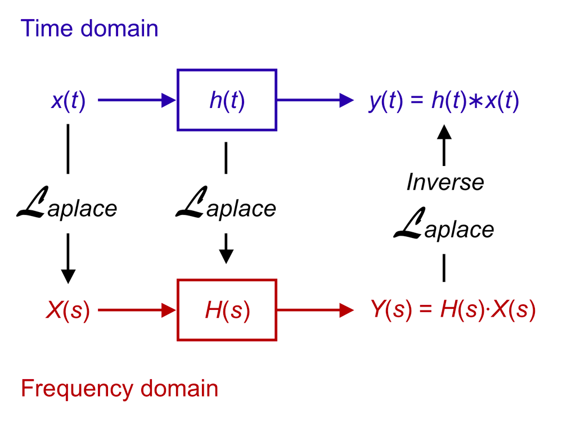
Time domain vs Laplace (or Fourier) domain
Impulse response
transfer function
http://en.wikipedia.org/wiki/Linear_system
http://en.wikipedia.org/wiki/LTI_system_theory

Slide 12
Deriving a transfer function from a t-domain Diff Eq.
In many cases, an LTI system can be described
by a linear ODE
It is easy to convert from an ODE to a transfer function
e.g. Forced oscillation of a damped oscillator
  Laplace Transform
  Fourier Transform

Slide 13
Transfer function of a mechanical system
e.g. Forced oscillation of a damped oscillator
  log-log
  log-lin
Bode diagram

Slide 14
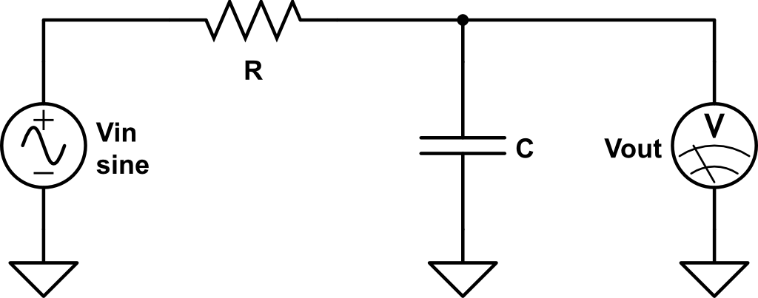
Transfer function of an electrical system
e.g. RC filter
cut-off freq
f = 1/(2*pi*R*C)
  log-log
  log-lin

Slide 15
Zeros, Poles, and Gain decomposition
The transfer function of a system with an ODEcan be expressed as:
The roots of the numerator are called as “zeros”
and the roots of the denominator are called as “poles”
Zeros (s_{zi}) and poles (s_{pi}) are
real numbers (single zeros/poles)
or pairs of complex conjugates (complex zeros/poles)
(fundamental theorem of algebra)

Slide 16
Linear systems and their stability
Poles rule the stability of the system!
H(s) can be rewritten as
(partial fraction decomposition)
Each term imposes exponential time impulse response
Therefore, if there is ANY pole with
the response of the system diverges

Slide 17
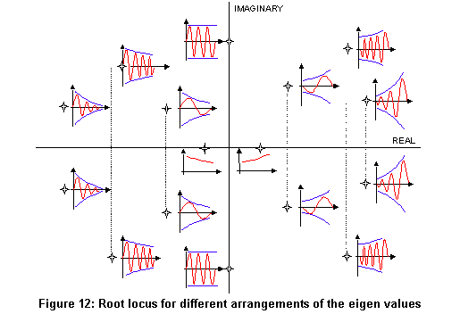
Linear systems and their stability
Poles rule the stability of the system!
Location of the pole (pair) and the impulse response
  Im(s)
  Unstable
  response
  Re(s)
http://nupet.daelt.ct.utfpr.edu.br/_ontomos/paginas/AMESim4.2.0/demo/Misc/la/SecondOrder/SecondOrder.htm

Slide 18
System identification
Modeling of the system: usually done in the freq. domain
  System Identification Tools: e.g. LISO, Vectfit

Slide 19
Zero, Pole, Gain representation
Building blocks (“zpk” representation)
  Single pole
  Single zero
  A pair of complex poles
  A pair of complex zeros
  Gain

Slide 20
Linear systems
Summary
  LTI systems
  Description of the LTI system:
  Impulse response <==> transfer function
  Zero, Pole, Gain representation of transfer functions
  Pole locations determine the stability of the system
  System identification

Slide 21
Zero, Pole, K representation
Relationship between pole/zero locations and w0&Q
To be compared with

Slide 22
Zero, Pole, K representation

