Slide 1
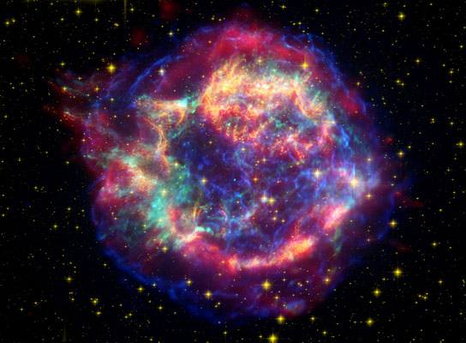
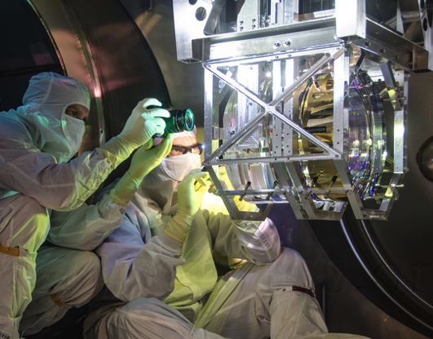

The impact of terrestrial noise on the detectability and reconstruction of gravitational wave signals produced by core-collapse supernovae
Photo: Michael Fyffe
Jess McIver PhD defense
May 21, 2015

Slide 2
Outline
Gravitational waves
Interferometric detectors
Core collapse supernovae
  Models
  Detectablity and waveform reconstruction
Terrestrial noise and its impact
Conclusions and future prospects
Notes:
-product of GR, first published in 1915 (100 years ago this year!)
- GWs solution to Einstein;s eqns

Slide 3
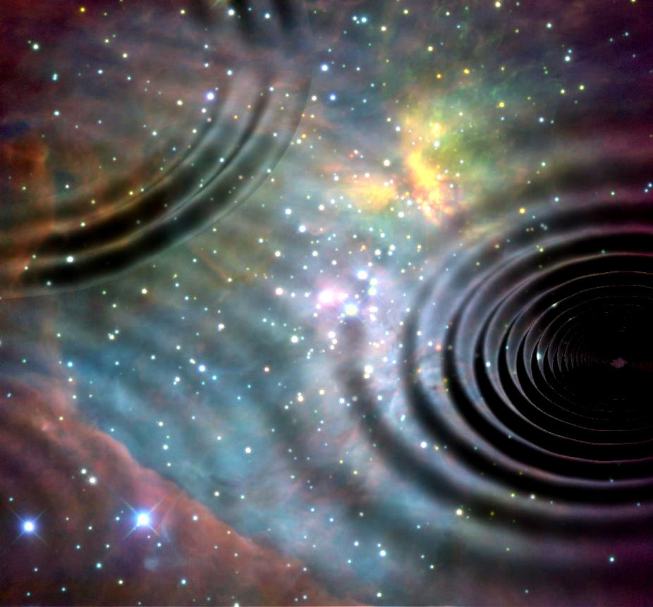
The centennial of General Relativity
The theory of General Relativity was first published by Albert Einstein in 1915
Predicts the emission of gravitational waves by accelerating mass:
ripples in the fabric of spacetime
Notes:
-product of GR, first published in 1915 (100 years ago this year!)
- GWs solution to Einstein;s eqns

Slide 4



Gravitational waves
Solution to Einstein’s field equations
Gravitational waves
  Propagate at speed of light
  Induce spacetime strain measured as:
Notes:
-product of GR, first published in 1915 (100 years ago this year!)
- GWs solution to Einstein;s eqns

Slide 5

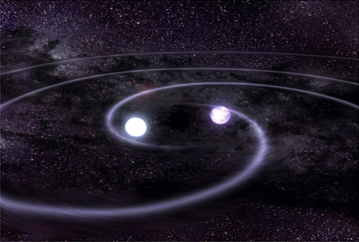
Gravitational wave emission
Produced by accelerating mass:
Weakly interacting
Binary black hole coalescence
h ~ 10⁻²¹ at 100Mpc for 10M
Core-collapse supernova
h ~ 10⁻²¹ at 10 kpc for rotating models
•
Notes:
Gravitational waves are IDEAL probe of astrophysical objects difficult to observe via EM
Takes very massive source accelerating extrememely quickly to have chance of producing detectable strain amplitude (10^18m change in length! Smaller than width of proton!)
Evidence for existence in binary pulsar observations – launched new field of astrophysics

Slide 6
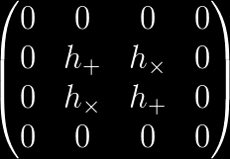

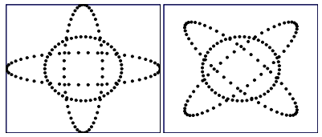
Gravitational wave manifestation
h(t) composed of cross and plus polarization
h₊
h_{x}
Notes:
Spacetime strain manifested as the change in length over length between two points
Movitates a detector that samples perpendicular directions

Slide 7
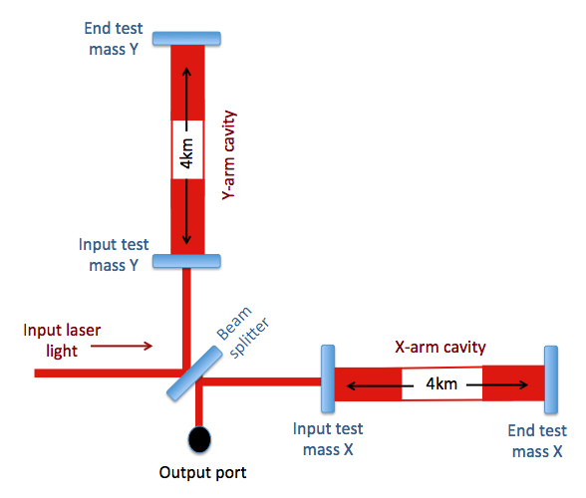
Observing GWs with interferometry
Notes:
Sense the spacetime strain through the phase difference between 2 perpendicular arms

Slide 8
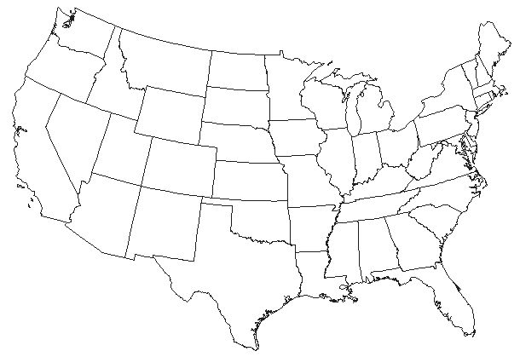

The LIGO detectors
4km
Hanford, WA
4km
Livingston, LA
Notes:
This is achieved by…. (aLIGO instrumentation)

Slide 9
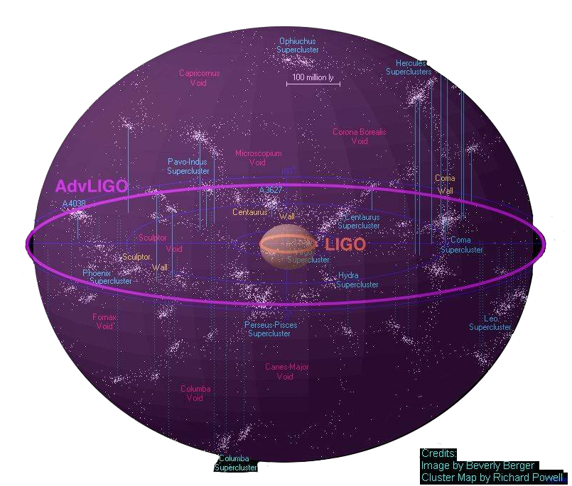

Slide 10
Sensitivity improvement
Better
Seismic
Isolation
Reduced
Brownian
Noise
Increased
Laser Power
and Signal Recycling
Notes:
This is achieved by…. (aLIGO instrumentation)

Slide 11
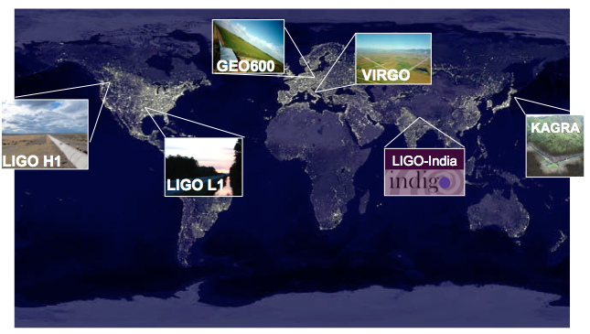
The global interferometer network
Notes:
LIGOS AND VIRGO used for study

Slide 12
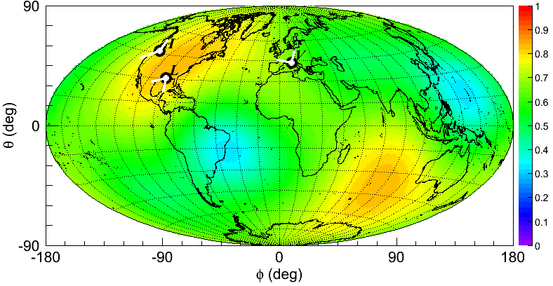
Network sensitivity
Notes:
The

Slide 13
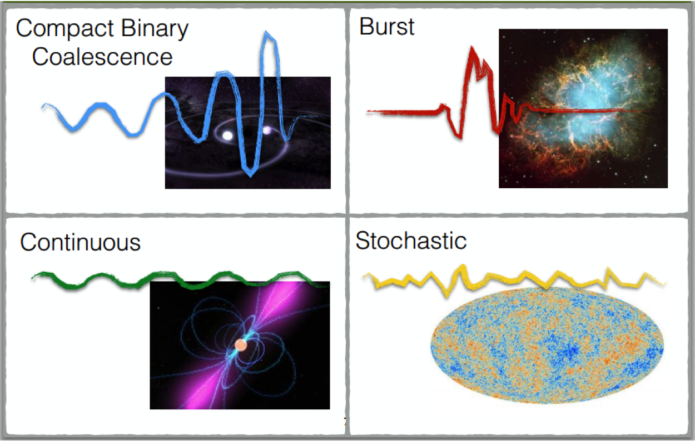
The gravitational wave sky
What sources will the Advanced detector network be sensitive to?

Slide 14
Core-collapse supernovae
The iron core of massive stars burns out and the degeneracy pressure can no longer support the star against gravity.
The gravitational core collapse releases an enormous amount of energy, 99% in the form of neutrinos of all flavors and forms a proto-neutron star.
Neutrinos observed during the 1987 supernova have confirmed this general model
However, calculations robustly conclude that the shock wave loses energy to interactions with the outer layers and stalls
Key question: what is the explosion mechanism?

Slide 15
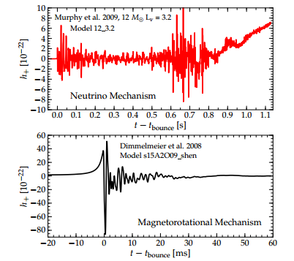
Explosion mechanism models
Neutrino-driven
Assumes a small fraction of the energy emitted in the form of neutrinos is absorbed by the shock
Magnetorotational
Differential rotation between the star core and outer layers induces magnetic field amplifications that cause jets of matter

Slide 16
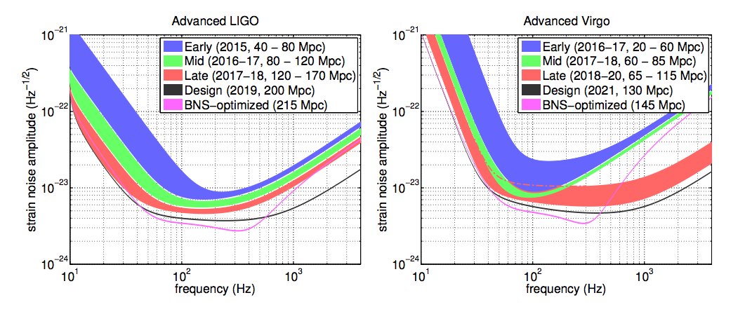
Study outline
Goal: Effective waveform reconstruction of gravitational wave signals will enable accurate interpretations of core-collapse supernovae (CCSN) physics
Waveforms injected into Gaussian noise colored with the expected Advanced LIGO and Advanced Virgo noise curves at design sensitivity
Injections recovered with burst waveform reconstruction algorithms
Notes:
Accurate waveform reconstruction is critical to extracting physics from gravitational wave signal for model selection, physical processes mapping, or other applications. Goal is to evaluate how well we can do this for aLIGO.
Included three waveform families, injected, analyzed with burst algorithms (paper summaries)

Slide 17
Included waveforms: Overview
The three considered waveform families:
Each simulated using different models.
1. Dimmelmeier
2D rotating core-collapse
Produce the simplest, shortest GW signature (‘wavelet-like’)
2. Yakunin
2D neutrino driven
Assumes star axis symmetry
No well-defined amplitude peak
3. Mueller
3D neutrino driven
Most realistic considered models
Longest, most complex produced waveforms
Notes:
Introduce nicknames
Go through GW features next

Slide 18
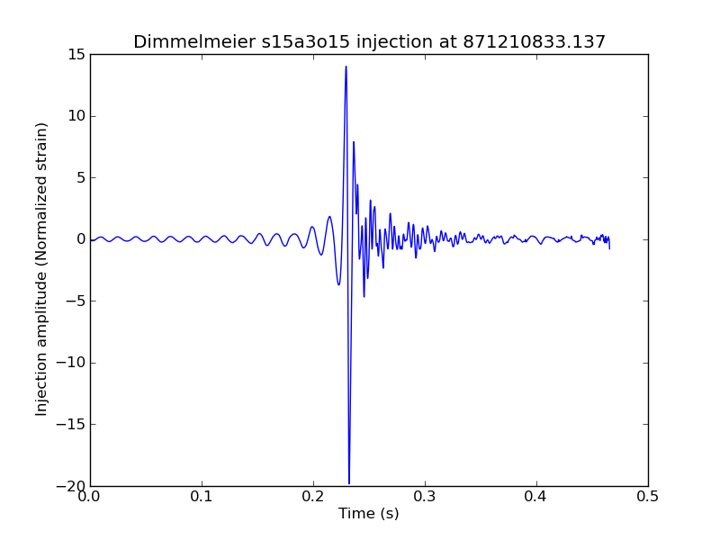
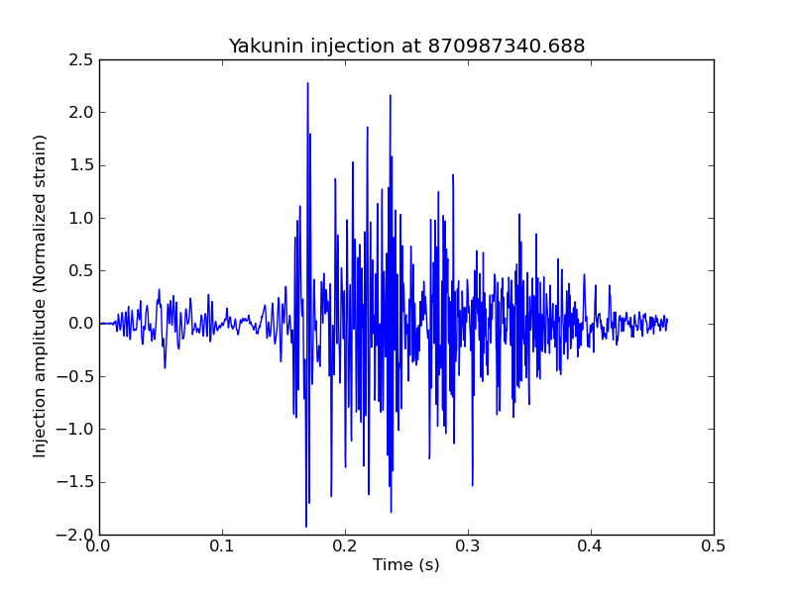
Included waveforms
Dimmelmeier
2D axisymmetric rotating core-collapse
3 Dimmelmeier models: different rotation rates and profiles imposed on a progenitor star
Yakunin
2D axisymmetric non-rotating neutrino driven
Strong signal due to standing accretion shock instabilities and non-radial accretion matter flows
Notes:
Hot bubble analogy
Time of core bounce is t=0

Slide 19
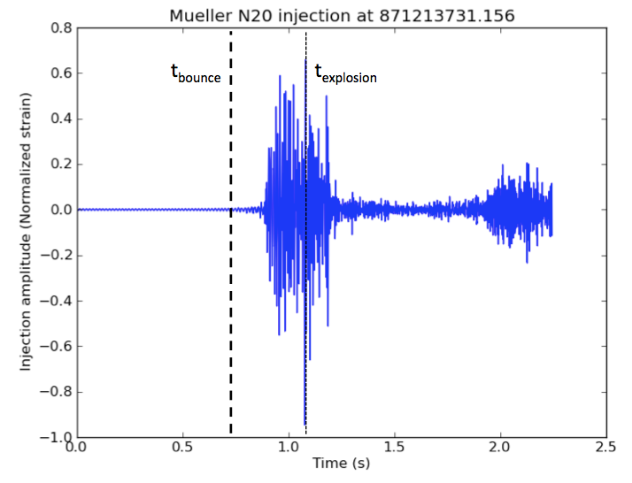
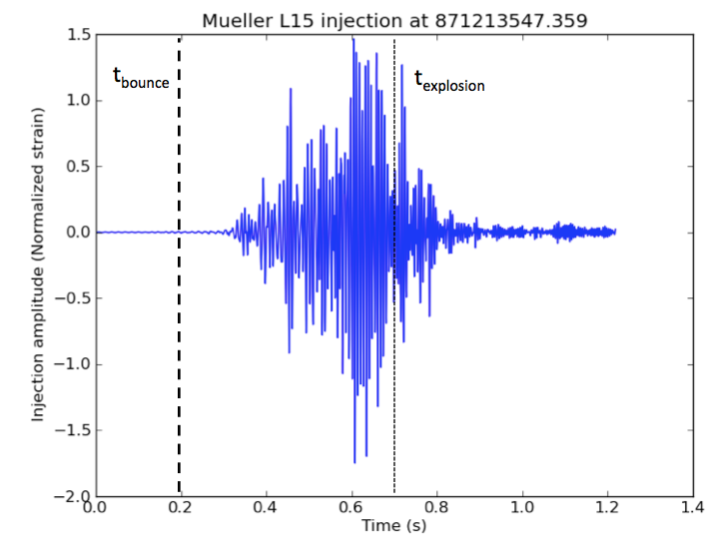
Included waveforms
Mueller
3D non-rotating neutrino-driven
3 different progenitor stars evolved using the same input physics, initial symmetry perturbation, and matter equation of state
Strong GW signal is due to non-radial matter flows produced by shock instability pre-explosion, and violent post-shock convection and PNS matter accretion post-explosion
Two of three progenitor stars observe a delayed burst of GW signal due to PNS convection.
Notes:
Accurate waveform reconstruction is critical to extracting physics from gravitational wave signal for model selection, physical processes mapping, or other applications. Goal is to evaluate how well we can do this for aLIGO.
Included three waveform families, injected, analyzed with burst algorithms (paper summaries)

Slide 20
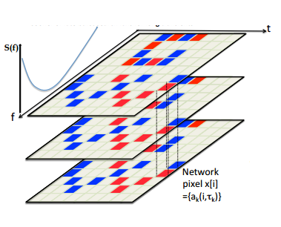
Targeted algorithms
cWB2G – the primary coherent burst all-sky search
Identifies burst candidate events by tiling the data in time and frequency via a wavelet transform
Extracts significant events using a coherent likelihood statistic maximized over all potential sky positions.
BayesWave – a Bayesian follow-up burst parameter estimation algorithm
Estimates a posterior distribution for a recovered waveform inferred from the data and network antenna pattern.
Reversible jump Markov-chain Monte Carlo algorithm explores a the application distribution of Morlet-Gabor wavelets and wavelet parameters to the signal fit
Notes:
Accurate waveform reconstruction is critical to extracting physics from gravitational wave signal for model selection, physical processes mapping, or other applications. Goal is to evaluate how well we can do this for aLIGO.
Included three waveform families, injected, analyzed with burst algorithms (paper summaries)

Slide 21
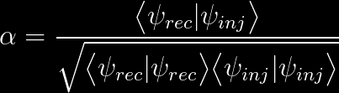
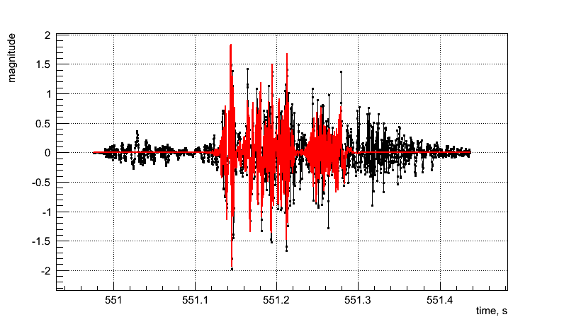

Figure of merit
Burst algorithm performance in reconstructing waveforms was judged by the noise-weighted normalized overlap:
Where:
  1 is perfect match, 0 is no match
Recovered
Injected
Notes:
Noise weighted inner product, normalized to unity for identical waveforms

Slide 22
Preliminary results in three parts:
1. Trends in detectability between different models
2. Trends for recovered overlap of different models by both algorithms
3. Trends for the recovered overlap by different algorithms of the same model
For these preliminary results, both cWB2G and BayesWave were run in configurations tuned for CCSN.
Notes:
(expecting much shorter duration, more wavelet-like signals like NS-NS binaries)
Most burst analysis algorithms are not tuned for complex signals expected for CCSN – a lot of work has already gone into tuning parameters to best resolve CCSN

Slide 23
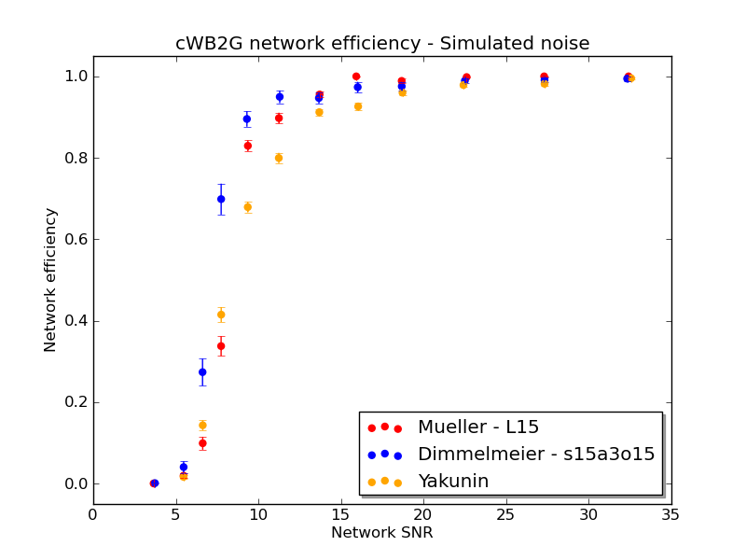
Detectability of the three included waveform families
Notes:
Fine structure of Dimmelmeiers
Introduce max overlap and overlap at SNR 12

Slide 24
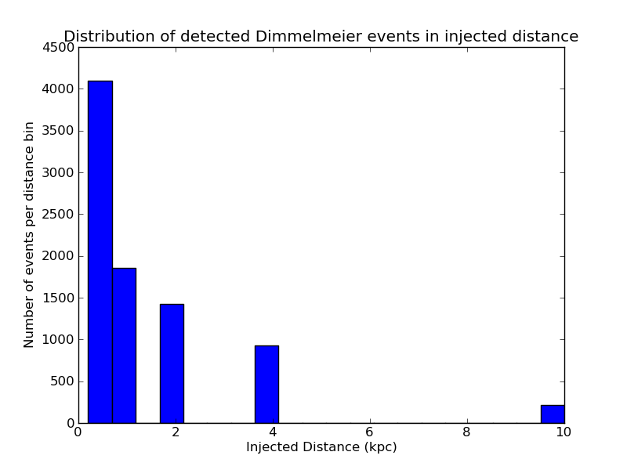
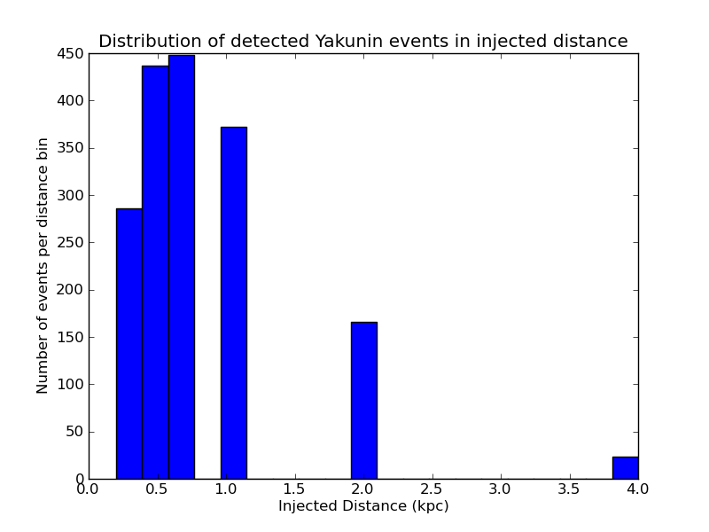
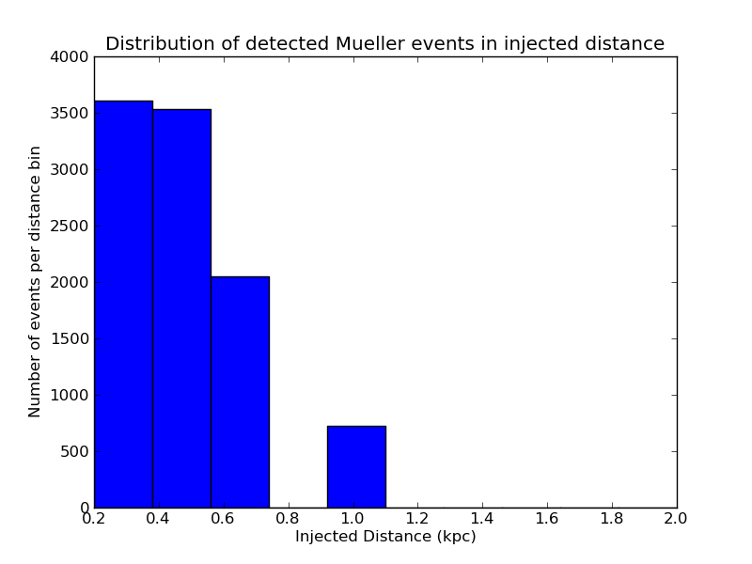
Detectability of the three included waveform families
Dimmelmeier
(2D rotating core-collapse)
Yakunin
(2D neutrino-driven)
10 kpc
4 kpc
Mueller
(3D neutrino-driven)
1 kpc!
Notes:
Fine structure of Dimmelmeiers
Introduce max overlap and overlap at SNR 12

Slide 25
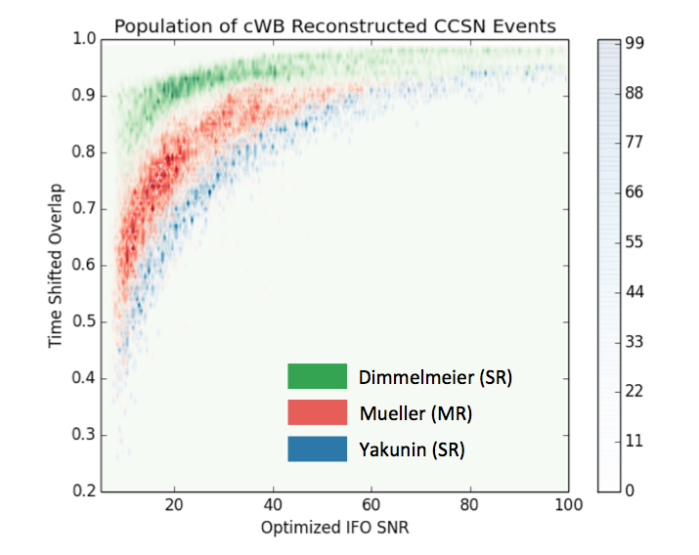
Reconstruction of the three included waveform families by cWB2G
Event signal-to-noise ratio in a single detector
Notes:
Fine structure of Dimmelmeiers
Introduce max overlap and overlap at SNR 12

Slide 26
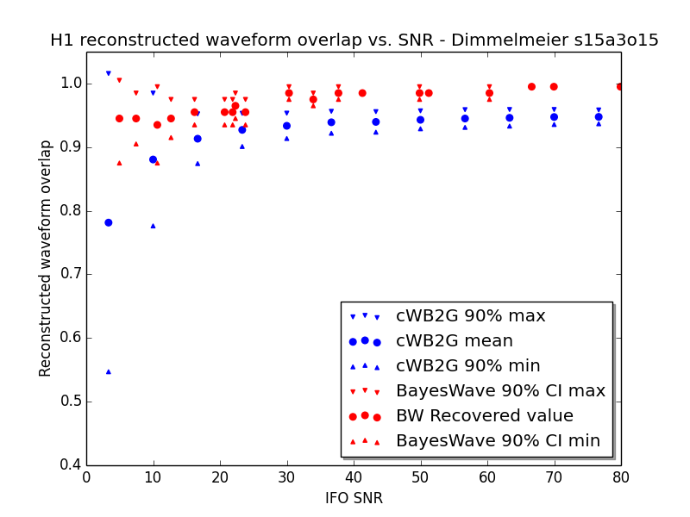
Dimmelmeier – rapidly rotating
Notes:
First of two particular examples comparing cWB2G and BayesWave

Slide 27
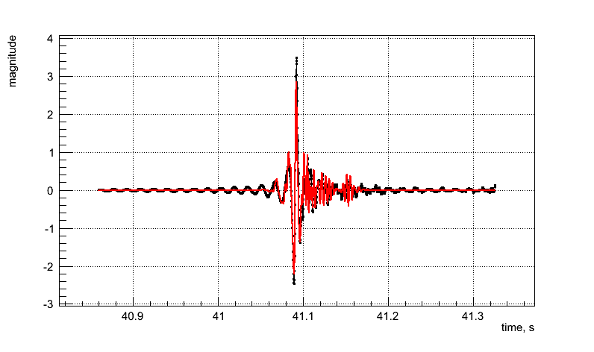
Dimmelmeier – rapidly rotating
Dimmelmeier s15a3o15 – L1
Pipeline | Max overlap | Overlap at SNR8
cWB2G | 95% | 86%
BayesWave | 99% | 94%
cWB2G s15a3o15 reconstruction
SNR 90
Recovered
Injected
0.2s

Slide 28
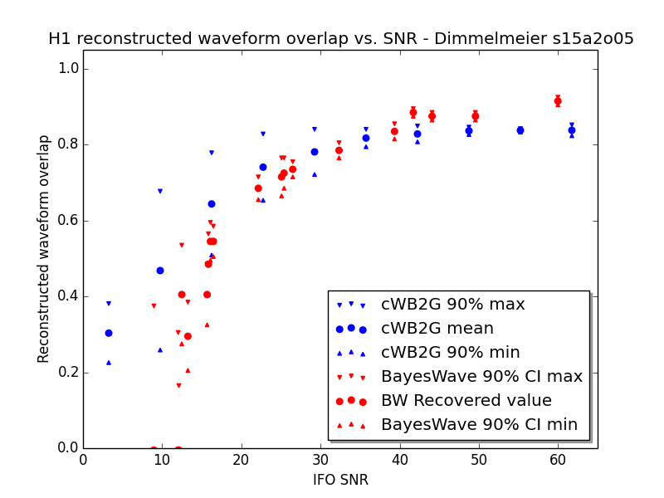
Yakunin
Yakunin

Slide 29
Yakunin
Yakunin – L1
Pipeline | Max overlap | Overlap at SNR8
cWB2G | 91% | 42%
BayesWave | 92% | 0%
cWB2G Yakunin reconstruction
SNR 30
Recovered
Injected
0.4s

Slide 30
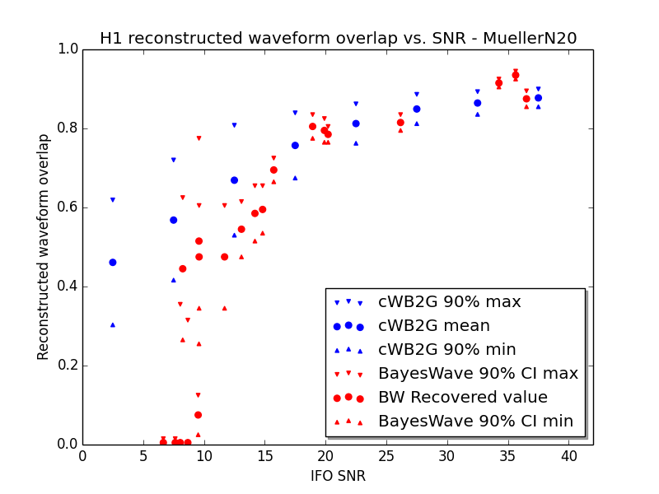
Mueller – N20
Notes:
Mueller –3D waveforms - most realistic

Slide 31
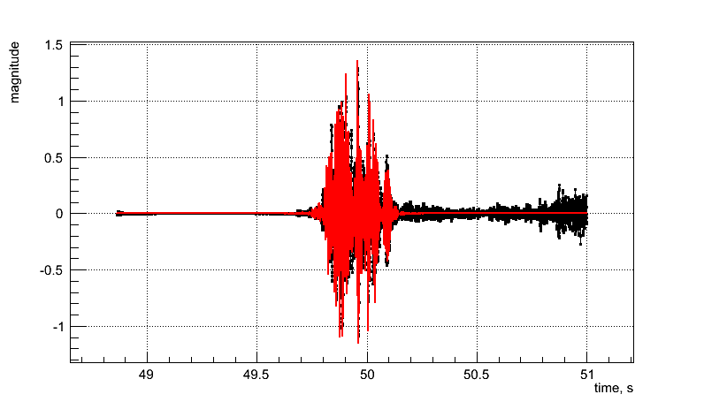
Mueller – N20
Mueller N20 – H1
Pipeline | Max overlap | Overlap at SNR8
cWB2G | 89% | 53%
BayesWave | 92% | 24%
cWB2G Mueller N20 reconstruction
SNR 40
Recovered
Injected
1.5s
Notes:
Mueller –3D waveforms - most realistic
Both algorithms struggle to resolve discrete bursts in time!!
(Associated with anisotropy in neutrino emission)

Slide 32
Summary:
CCSN in aLIGO/aVirgo Gaussian noise
For more realistic included waveforms in aLIGO/aVirgo noise the best average reconstruction (cWB2G) at realistic SNR (of ~8) is ~50-60% overlap.
BayesWave, with more wavelet placement flexibility, tends to achieve a lower overlap at an SNR of 8.
Both algorithms do not well reconstruct multiple bursts of energy distinct in time as one event.
A lot of potential for significant improvement with BayesWave developing CCSN priors.
Notes:
But made signficant progress tuning both of these pipelines to better resolve CCSN! Expect more progress before O1.
Multiple bursts contain interesting physics!!

Slide 33
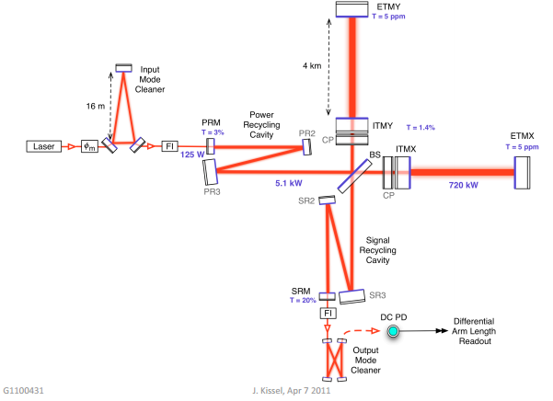
Terrestrial noise: a reality for
GW searches
Reality

Slide 34
The challenges of terrestrial noise
Many effects cannot be tested prior to large scale implementation
Often noise sources stem from the interaction of different subsystems and cavities
Optic alignment
Laser power
Noise!
Seismic
Optic quality
Thermal effects
Scattering

Slide 35
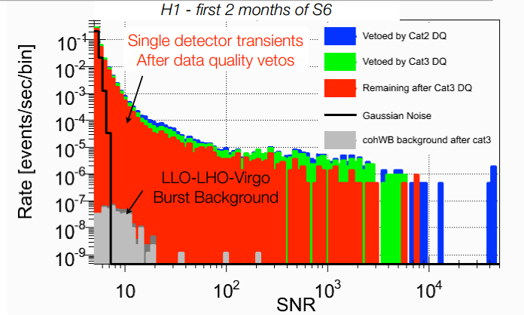
GW search pipelines are adversely affected by non-Gaussian data!
Long tails (outliers) in all-sky GW burst search background triggers greatly restrict achievable false alarm rate.
Non-Gaussian noise confuses parameter estimation for all transient searches.
Notes:
because of the loud tail, having a signal loud enough for detection is astrophysically unlikely.

Slide 36
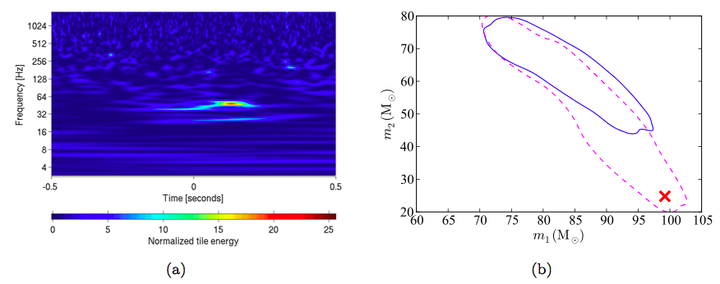
Example: NINJA2 search results
Actual injected masses
arvix 1401.0939
A normalized spectrogram of Hanford recolored noise only showing a transient event, or glitch, that happens to occur at the time of the injection.
Solid blue – the 95% credible region for mass estimation based on EOBNRv2 analysis using recolored noise.
Dashed pink – in Gaussian noise.
Notes:
NINJA2 notes

Slide 37
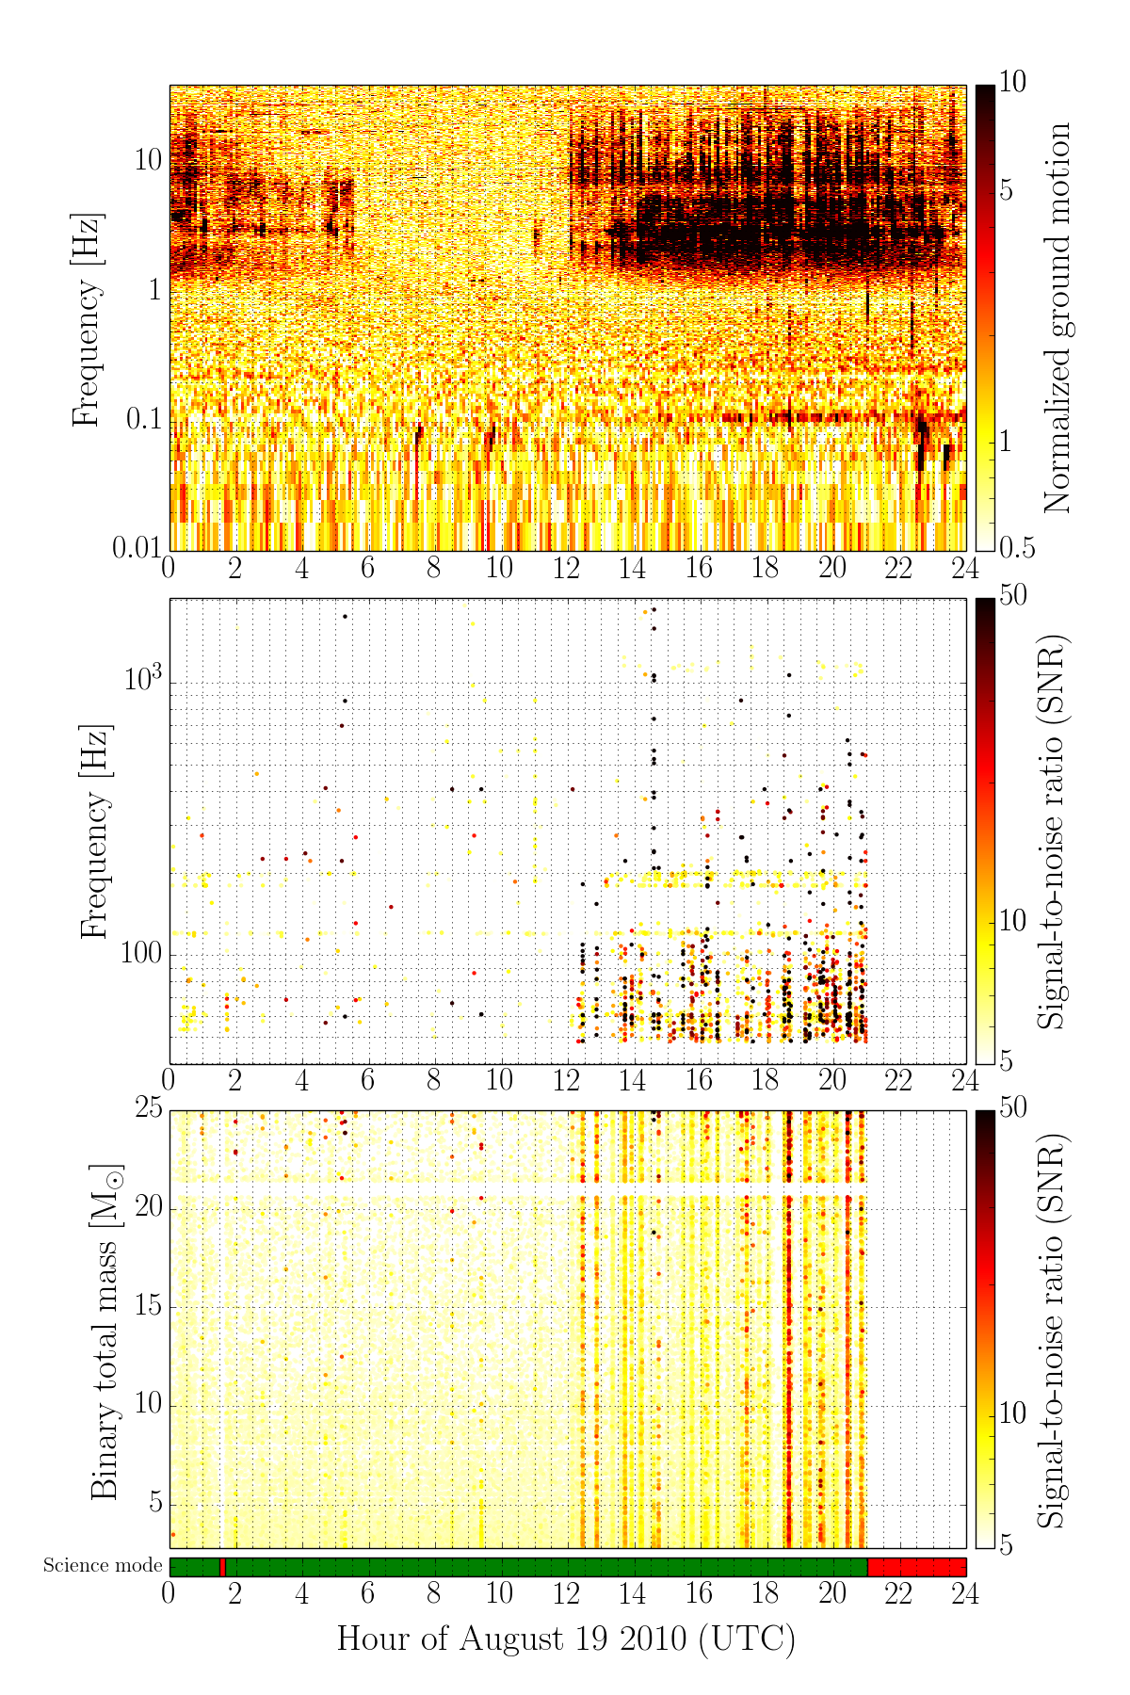
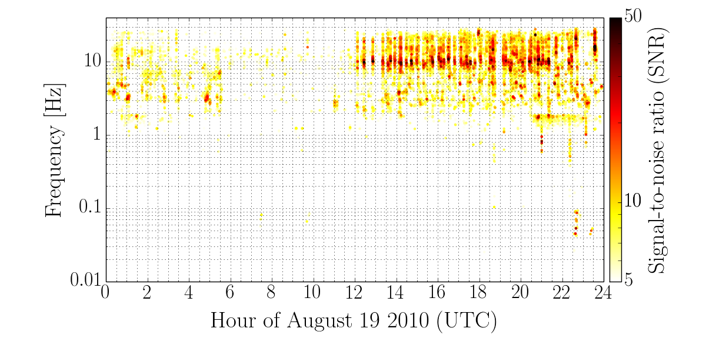
Data quality veto developed from application of burst analysis techniques (ETGs) was one of the most effective vetoes of S6:
Burst event SNR range | % events vetoed
SNR > 20 | 27%
SNR > 100 | 55%
SNR > 1000 | 85%
Notes:
Low freq transients identified by well-tuned singlo ifo burst pipeline. BEST EFFICIENCY VETO IN S6 – model for future instrumental detchar
Seismic transient as identified by low-freq Omega on ground motion monitors associated with ~70% of glitches

Slide 38
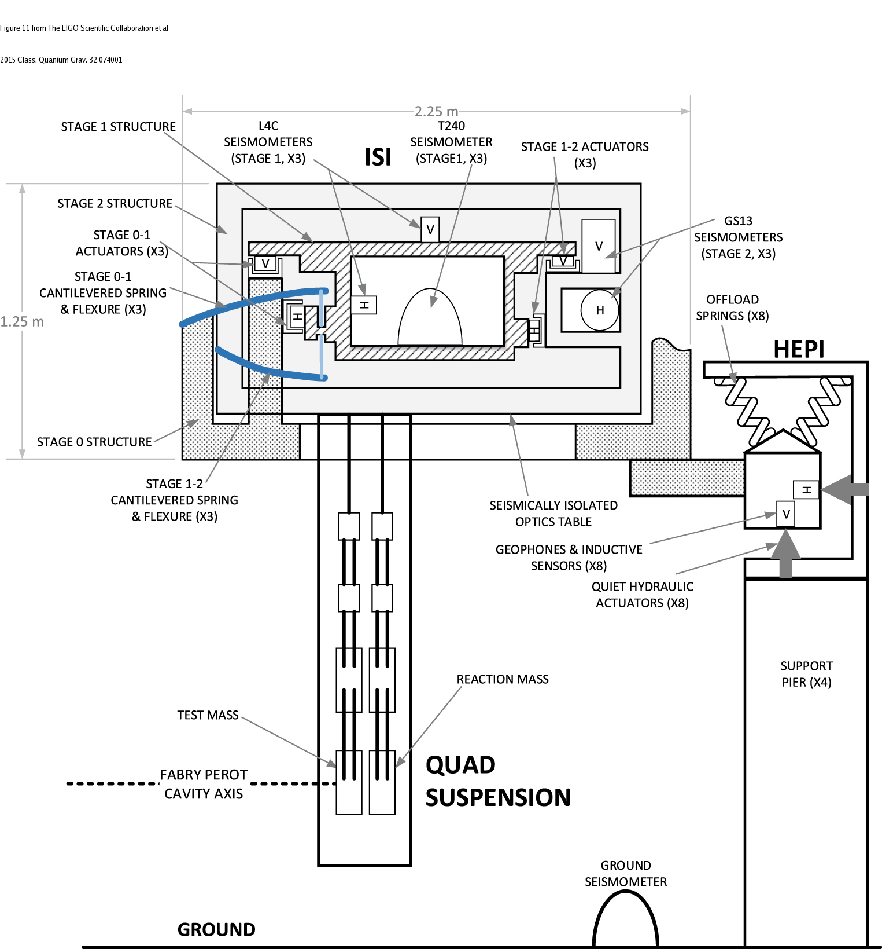
aLIGO seismic isolation instrumentation
BSC chamber and test mass
Stage motion is measured
Stage motion =
input motion +
driven motion
Isolation and damping filters interpret stage motion to apply a control force

Slide 39
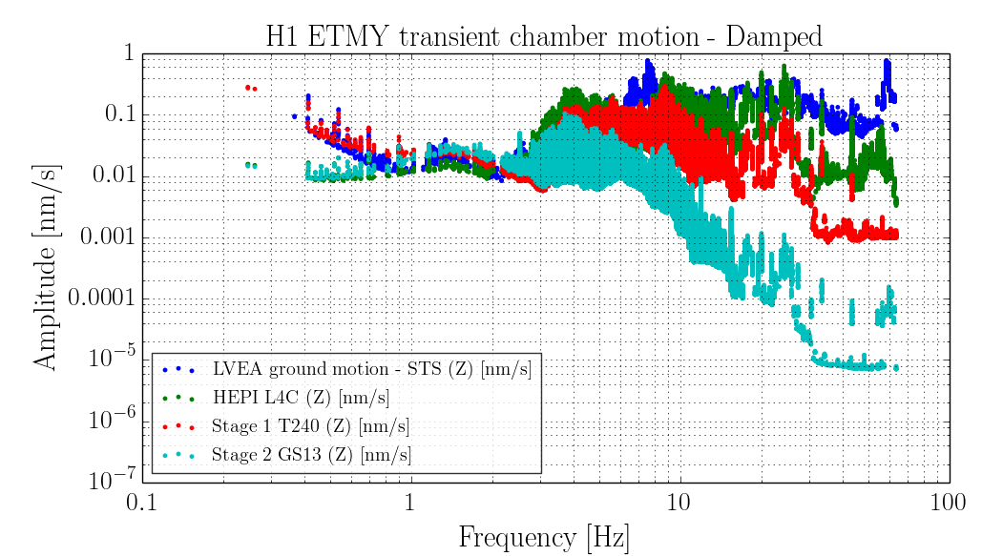
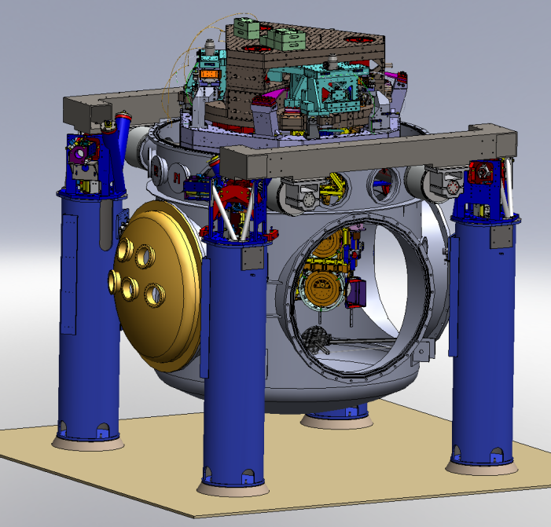
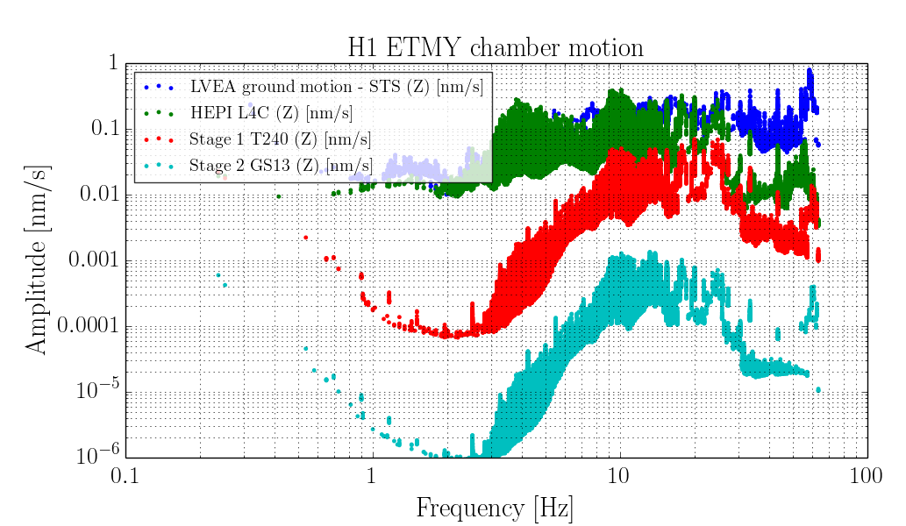
SEI transient propagation
H1 ETMY transient chamber motion – Fully isolated
Tracing the transient motion from the ground to the optic table in various states of isolation loop aggression.
More aggressive isolation mitigates transients well < ~15Hz
Notes:
Study focused on the core optic chambers, have 3 stages of active seismic isolation (4 passive). OPTIC TABLE
Many different isolation configurations were tested, least aggressive and most aggressive state shown

Slide 40
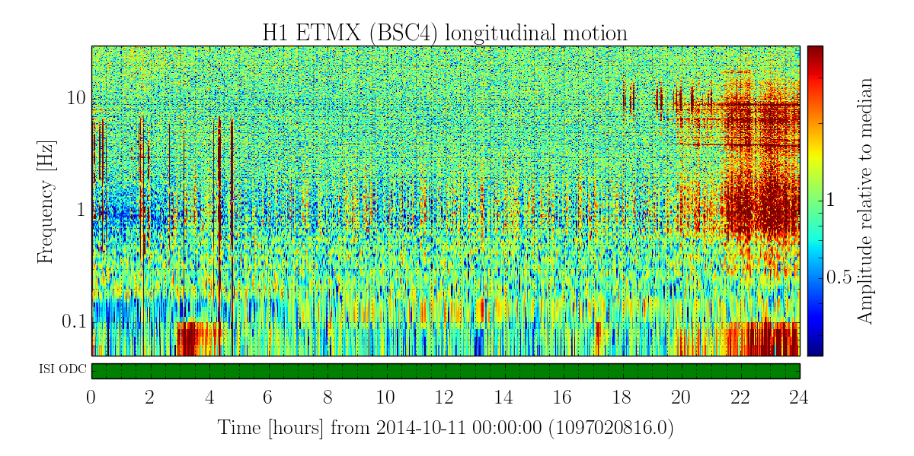
Windy vs. Quiet time transient SEI study at LHO
Most of the day, Oct 11, high microseism, low wind (~5MPH)
Notes:
Left isolation state constant at strongly isolated, and varied input ground motion

Slide 41
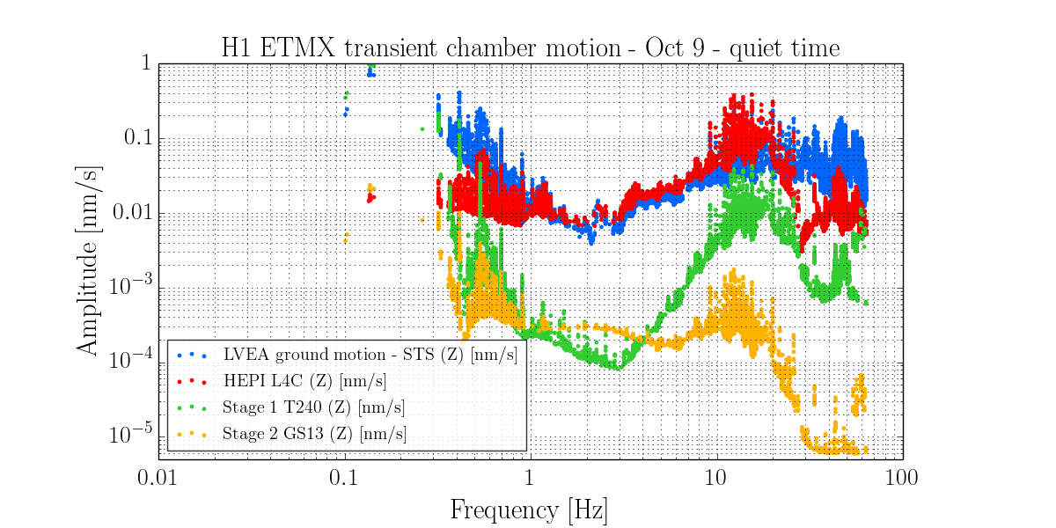
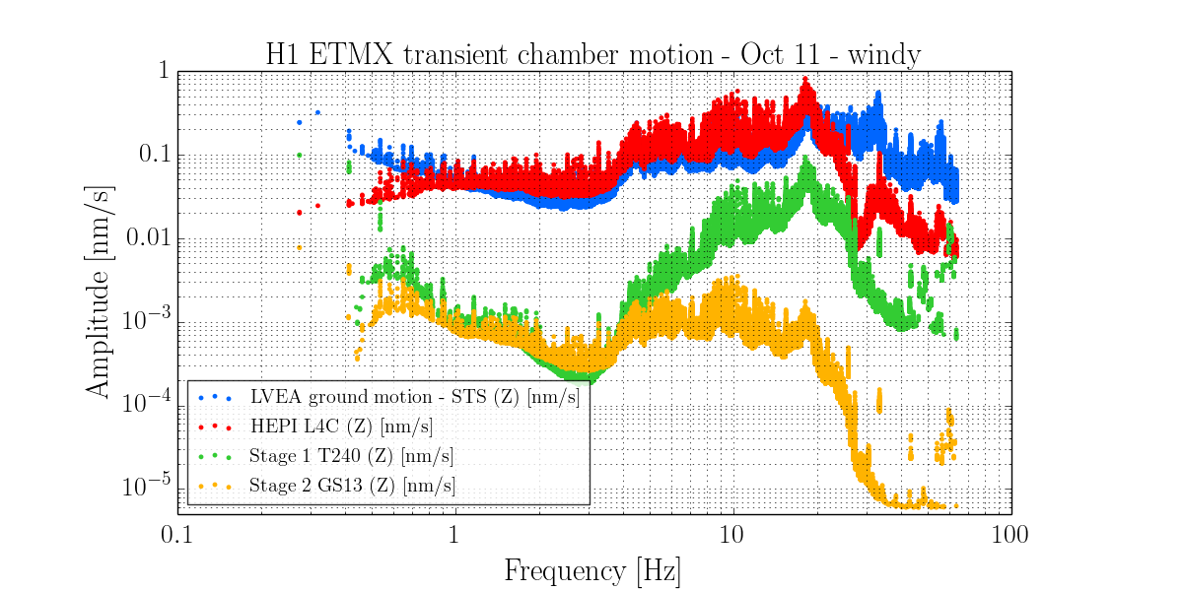
Windy vs. Quiet time transient SEI study at LHO
Most of the day, Oct 11, high microseism, low wind (~5MPH)
After~20:00 UTC, high wind (~30MPH)
Below are Omicron triggers of two hours of “quiet” time (left) and “windy” time (right). Each dot is a transient event. Transient motion amplitude is very elevated during high wind for events of freq < ~30Hz.
Note: these plots show ETMX local ground motion, not LVEA

Slide 42
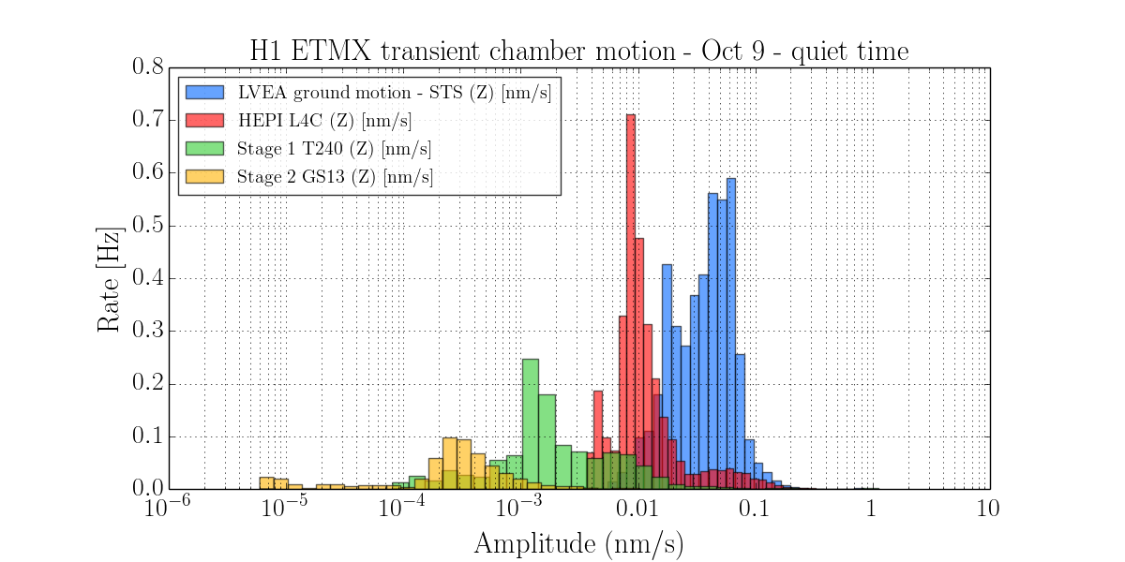
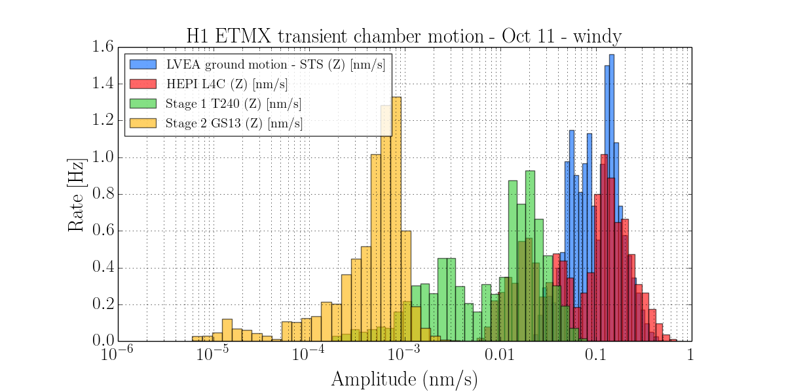
The rate of transient motion events also increases dramatically during windy time – by over a factor of 10 in optic table motion at end X.
Transient rate of 0.5Hz
Stage | Quiet* (# trigs) | Windy* (# trigs) | Factor increase
Ground motion | 30,755 | 116,601 | 3.8
HEPI (L4C) | 21,317 | 74,624 | 3.5
ISI ST1 (T240) | 7,791 | 57,948 | 7.4
ISI ST2 (GS13) | 3,924 | 49,562 | 12.6
* For a two hour period of relatively quiet or windy time
Isolated stages see a much greater increase in the rate of transients than ground motion during windy time.
Transient rate of 1Hz!!
Note: these plots show ETMX local ground motion, not LVEA

Slide 43
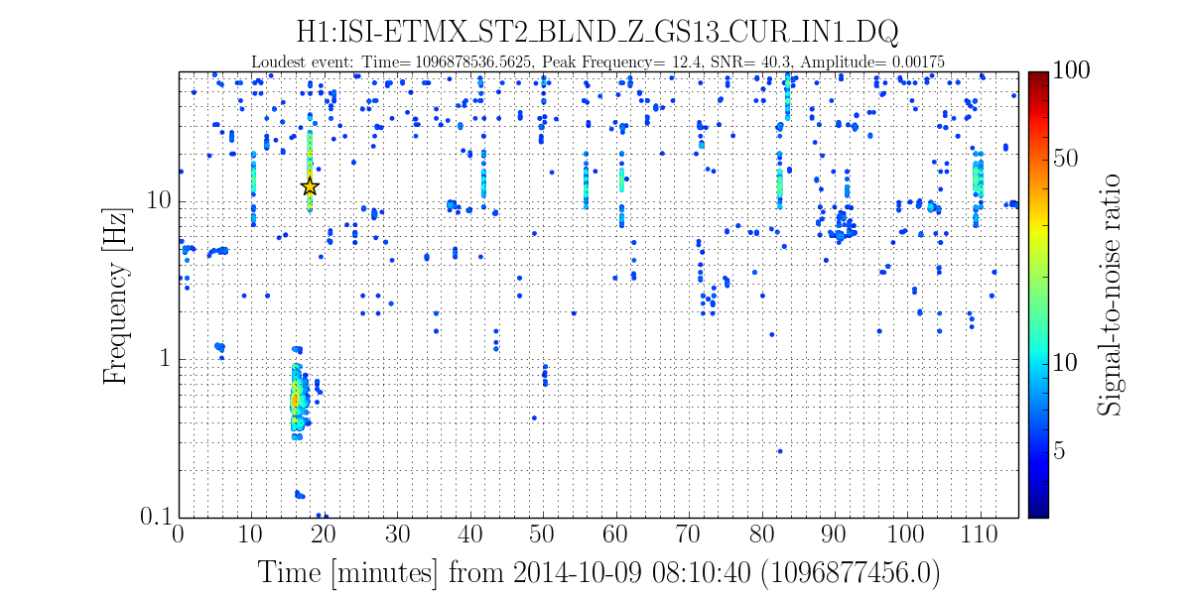
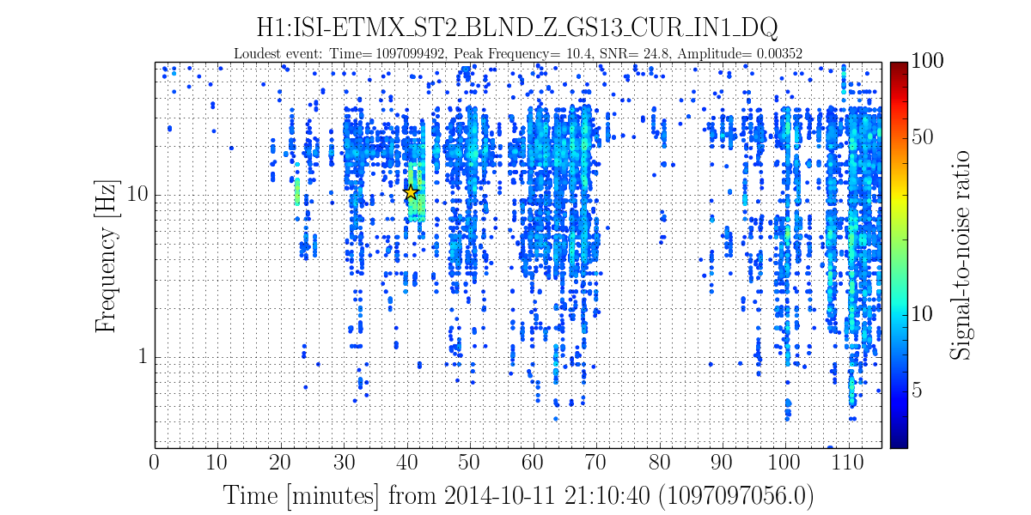
Conclusions for windy vs. quiet SEI transient study:
Ultimately, at the optic table the transient motion amplitude per event isn’t significantly increased above 10-15Hz, but the rate of transients is greatly increased
Oct 9 - Quiet
Oct 11 - Windy
Notes:
ITMY – rate much increased at high freq also

Slide 44
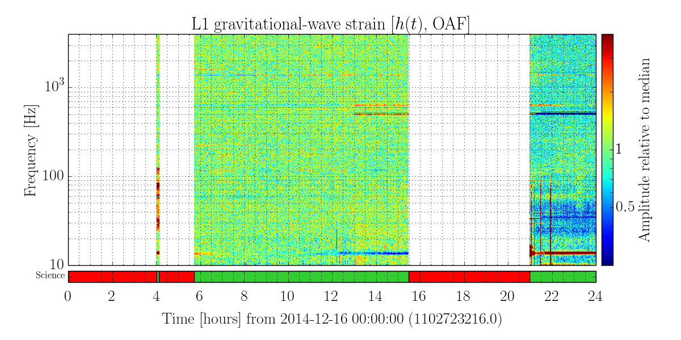
Livingston ER6 -Dec 16 lock
Notes:
Moving onto Livingston – results WITH DARM

Slide 45
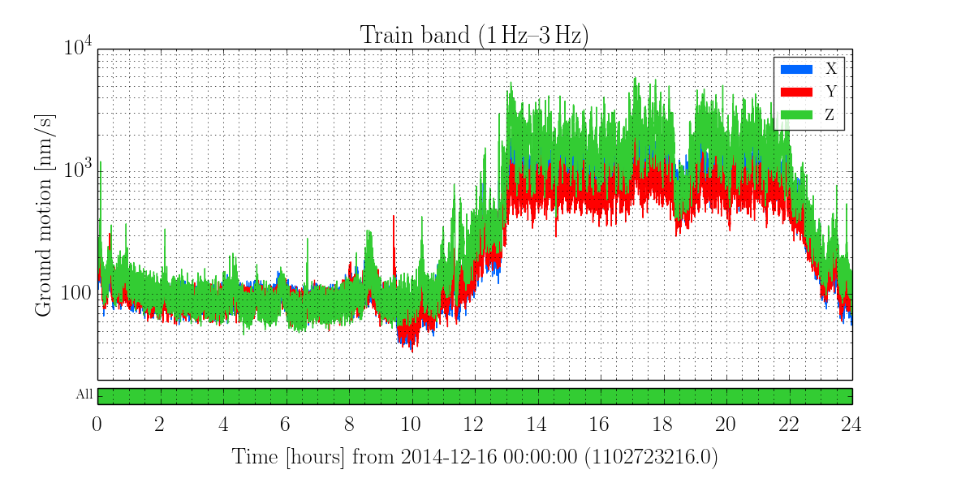
Violin modes caused high trigger rate in inspiral and burst searches

Slide 46
‘Seismically quiet’ time
‘Logging’ time

Slide 47
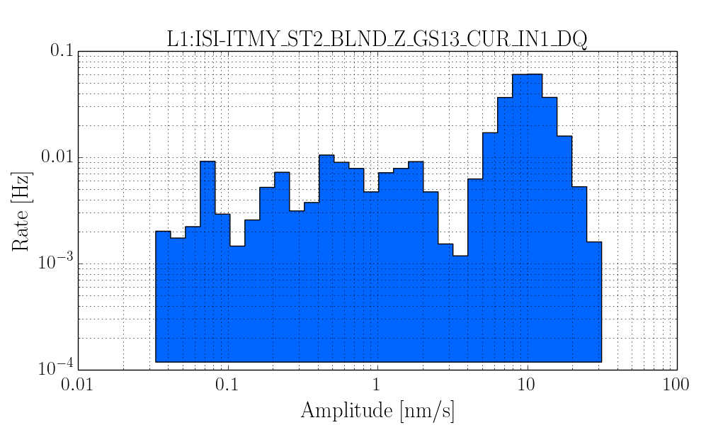



Seismically quiet part of lock
Logging stretch of lock

Slide 48
Summary:
Terrestrial noise and its impact on generic burst searches
In previous science runs, seismic noise was a major contributor to glitch pollution of transient GW searches.
Advanced LIGO seismic isolation instrumentation does mitigate seismic noise, drastically reducing average motion and increasing observation time.
However, elevated ground motion is still shown to affect DARM by increasing the glitch rate.
Efforts are underway to tune the instrumentation configuration and control loop settings to better mitigate this.
ETGs are a critical tool in this effort.
Notes:
But made signficant progress tuning both of these pipelines to better resolve CCSN! Expect more progress before O1.
Multiple bursts contain interesting physics!!

Slide 49


CCSN recovery in realistic noise
Representative results for the same set of waveforms injected into real non-Gaussian data from a prior science run, re-colored to aLIGO design sensitivity
Noise | Max overlap | Overlap at SNR8
Gaussian | 89% | 53%
Recolored | 83% | 38%
Transient noise pollution

Slide 50



Example outlier event
L1 reconstruction stats: single ifo SNR 17.5, overlap 30%
Reconstructed time series
Reconstructed spectral density
Discrete power burst not present in waveform
Injected
Reconstructed
Overestimation of power from 80-200 Hz, consistent with L1 noise
S5 L1 h(t) (not re-colored)
Example event (SNR 17, overlap 30%) with excess power from 80-200Hz and a distinct glitch at ~150Hz in L1.

Slide 51
Future prospects
This work identified two major areas that need improvement:
Burst waveform reconstruction algorithms
Transient noise mitigation
Major efforts in progress ahead of O1 and O2 to address these:
cWB2G and BayesWave tuning and guided development
ETG performance testing, tuning, and improvement
Noise mitigation studies and instrument tuning informed by the data quality needs of the transient GW searches
2010
2011
2012
2013
2014
2015
2016
S6
Hanford aLIGO installation, testing, commissioning
aLIGO observing run
Now
S6
Livingston aLIGO installation, testing, commissioning
aLIGO observing run

Slide 52

Acknowledgements
My advisor:
Laura Cadonati
My committee:
Ben Brau
David Kastor
Alex Pope
My thesis readers:
Laura Nuttall
Josh Smith
James Clark
Sarah Gossan
Florent Robinet
Laura Cadonati
Contributors:
Josh Smith
James Clark
Duncan Macleod
Jeff Kissel
Sarah Gossan
Florent Robinet
Claudia Lazzaro
Jonah Kanner
Tyson Littenberg
Chris Pankow
John Zweizig
Joey Key
Daniele Triferio
Amber Stuver
LIGO supporters:
Laura Nuttall
Andy Lundgren
TJ Massinger
Ryan Fisher
Marissa Walker
Thomas Abbott
Brian Lantz
Fabrice Matichard
Rich Mittleman
Dan Hoak
Gaby Gonzalez
Joe Giaime
Peter Saulson
Hugh Radkins
Celine Ramet
Sebastien Biscans
Arnaud Pele
Matt Heintze
Janeen Romie
Team thesis:
Alex Lombardi
Preema Pais
Brendan Gavin
Szu-Chia Chen
Sarah Zuraw
Kalina Nedkova
Elizabeth Drellich
Cathy Walker
Jane Knapp and the UMass physics staff
Family and friends
Tom ..

Slide 53

Next up:

Slide 54
Extra slides

Slide 55

Core-collapse supernovae
Relative timing of astronomy messengers
A gravitational wave burst lasting less than 3 seconds
An electromagnetic signature occurring minutes – days later
A burst of neutrinos lasting 50-300 ms
. . .
Time
The time of core bounce

Slide 56

Dimmelmeier –slowly rotating

Slide 57

Dimmelmeier –slowly rotating
Dimmelmeier s15a2o05 – L1
Pipeline | Max overlap | Overlap at SNR8
cWB2G | 98% | 71%
BayesWave | 99% | 79%
cWB2G s15a2o05 reconstruction
SNR 70
0.2s

Slide 58

Mueller – L15

Slide 59

Mueller – L15
Mueller L15 – H1
Pipeline | Max overlap | Overlap at SNR8
cWB2G | 92% | 61%
BayesWave | 97% | 66%
cWB2G Mueller L15 reconstruction
SNR 70
1.0s

Slide 60
Timeline: the lead up to the first observing run
2010
2011
2012
2013
2014
2015
2016
S6
Hanford aLIGO installation, testing, commissioning
aLIGO observing run
S6
Livingston aLIGO installation, testing, commissioning
aLIGO observing run
2014
2015
Hanford Installation
Vertex
Arms
Full ifo
Acceptance and sens. improve.
O1
Now
Livingston Full interferometer
Acceptance and sensitivity improvement
O1

Slide 61

Event Trigger Generators
Single-interferometer burst algorithms that identify excess power events well-localized in time and assign a characteristic event time, frequency, and measure of loudness signal-to-noise ratio (SNR)
ETGs tile the data in time and frequency, generally with multiple difference aspect ratios.
The data is projected onto some basis that provides an adequate potential match for a target signal.
Notes:
Noise weighted inner product, normalized to unity for identical waveforms

Slide 62


The ETG Omicron
Omicron uses a sine-Gaussian basis which provides low mis-match between burst-like signals and the basis functions.
Omicron identifies burst events very well – especially at higher SNR
Notes:
Noise weighted inner product, normalized to unity for identical waveforms

Slide 63




Notes:
Identified needed improvement for trigger clustering!

Slide 64



Loud WNBs missed by Omicron
Tend to be higher frequency than ExcessPower loud missed WNBs
Tend to be more long duration, narrow bandwidth than ExcessPower missed WNB events
Efficiency may be significantly improved by accounting for injection duration in matching

Slide 65

Timing resolution
Standard deviation of ETG time difference
ETG | SG (s) | WNB (s)
Omicron | 3.4e-4 | 9.8e-3
Excess Power | 0.014 | 0.056
DMT Omega | 5.4e-4 | 6.2e-3
BayesWave | 0.055 | 0.045
PCAT | 7.9e-4 | 0.010
All ETGs have better timing resolution for SGs (with the exception of BayesWave, which has some timing offset for SGs)
The Greeks (Omicron, Omega) have comparable timing resolution – the best for both SGs and WNBs

Slide 66


Frequency resolution - I
Standard deviation of frequency difference
Summary
All ETGs have more accurate frequency resolution for SGs (BayesWave has some skew for both)
The Greeks (Omicron, Omega) again have the best resolution for both SG and WNB frequency
ETG | SG (Hz) | WNB (Hz)
Omicron | 82 | 152
Excess Power | 196 | 544
DMT Omega | 93 | 150
BayesWave | 48 | 115
PCAT | 142 | 121
There are some noticeable tiling artifacts for Omicron and DMT Omega SG freq resolution
Omicron SG freq diff vs. freq
DMT Omega SG freq diff vs. freq

Slide 67



Frequency resolution - II
ExcessPowerAll freq diff vs. freq
ExcessPower has a strong artifact in frequency resolution for WNBs and SGs
BayesWave has a skew toward overestimating frequency at lower freq (and underestimating at high freq)
PCAT seems to have no noticeable artifacts for WNBs or SGs
PCAT SG freq diff vs. freq
BayesWave2000Hz SG freq diff vs. freq

Slide 68



Missed injections
Omicron
Excess Power
White noise bursts
Missed loud WNB injections
Sine Gaussians

Slide 69
Advanced LIGO instrumentation
Notes:
Addition of SRC, PRC (formerly PRM), higher laser power, better optics coatings.
Seismic isolation improvement will discuss later

Slide 70

Advanced LIGO seismic isolation instrumentation
Notes:
Addition of SRC, PRC (formerly PRM), higher laser power, better optics coatings.
Seismic isolation improvement will discuss later

