Slide 1

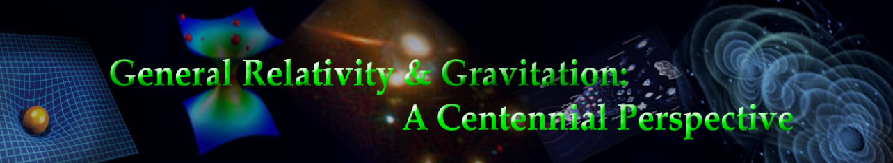
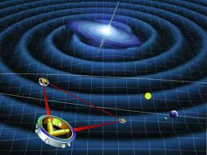
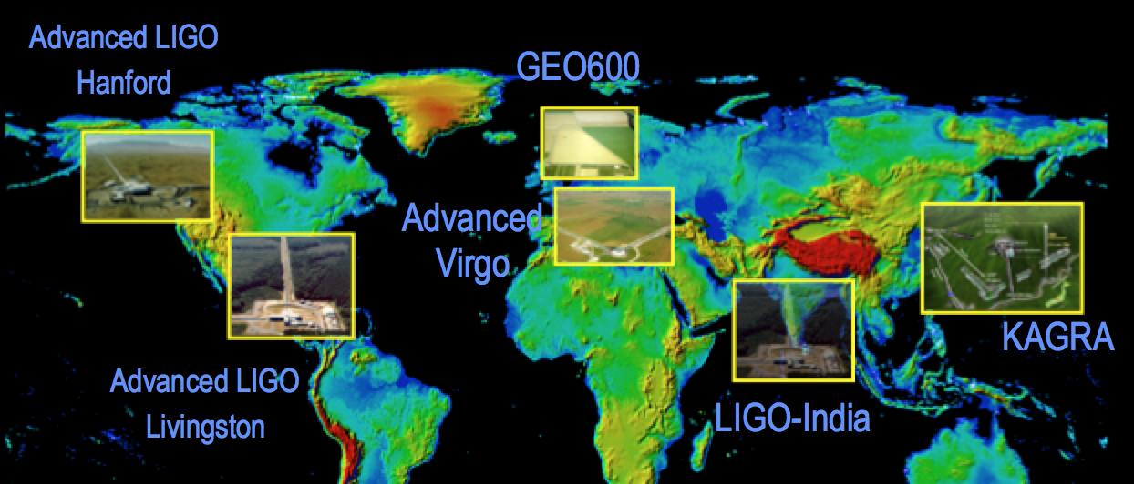
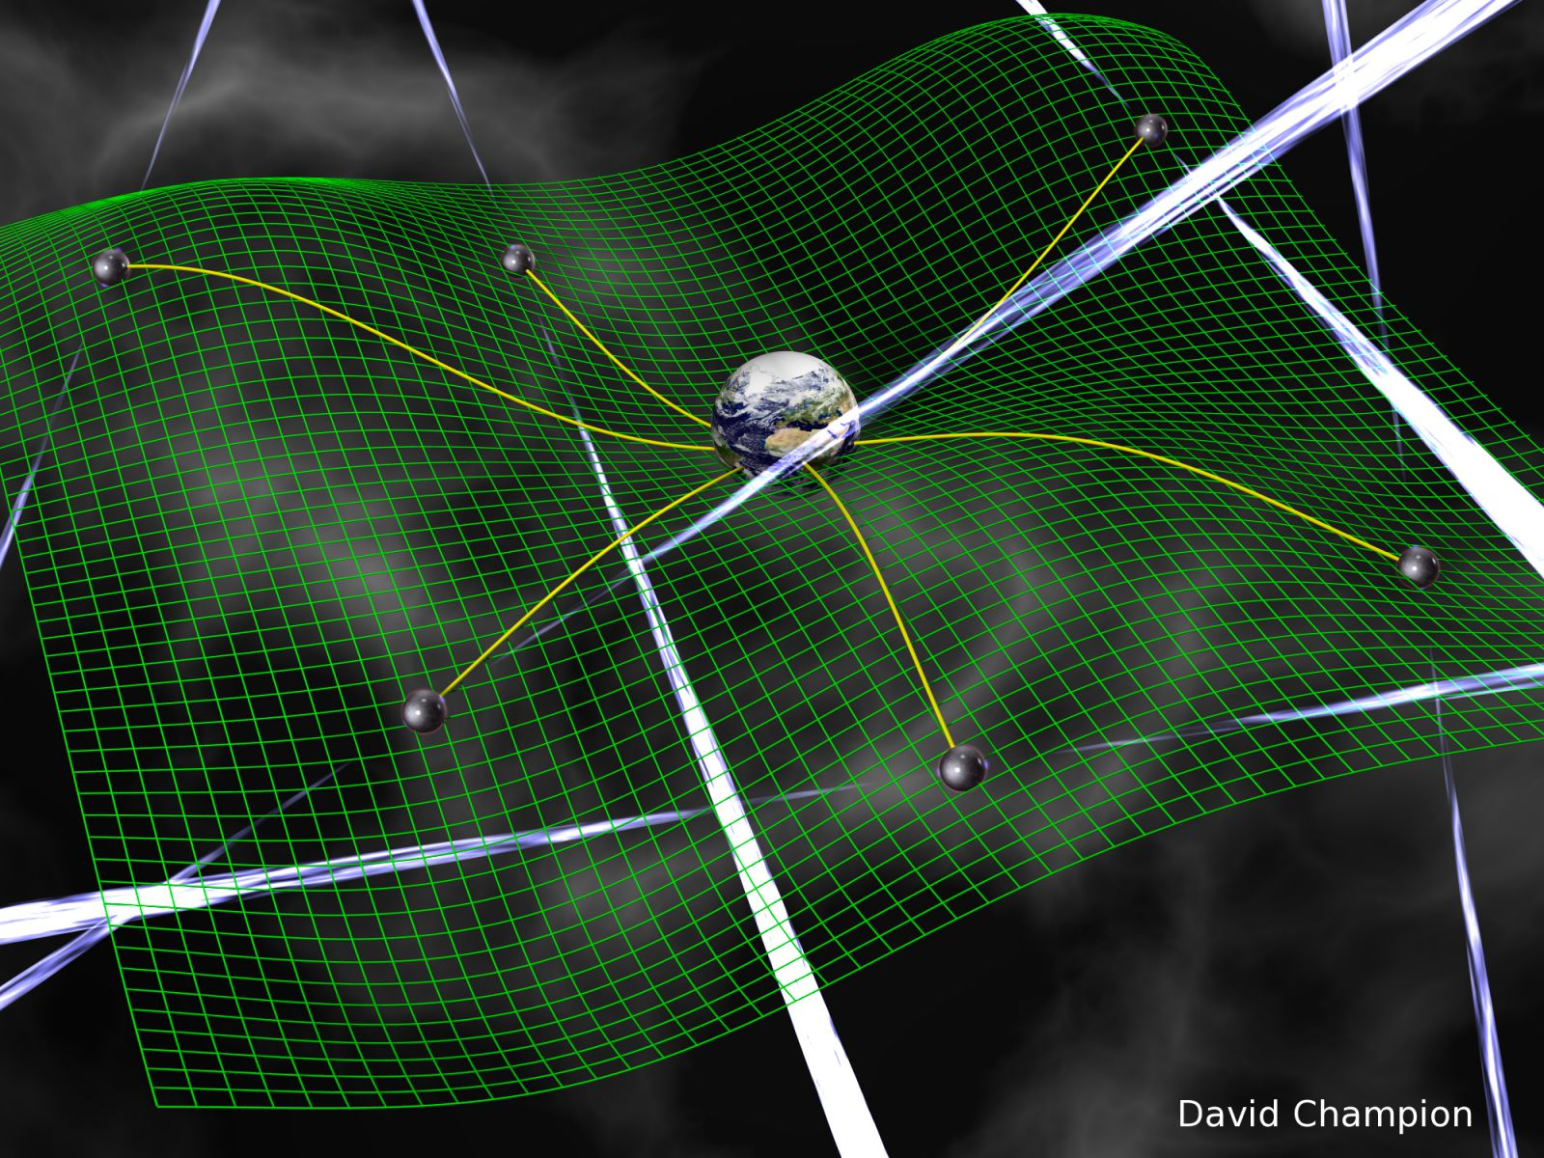
Detecting Gravitational Waves
Gabriela González
Louisiana State University
General Relativity Centennial Conference
Penn State, June 12 2015

Slide 2


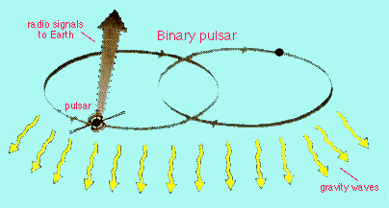


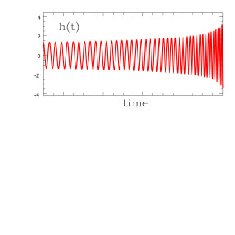

Gravitational waves
Gravitational waves are quadrupolar distortions of distances between freely falling masses. They are produced by time-varying mass quadrupoles.
A NS-NS coalescence in the Virgo cluster has h ~ 10⁻²¹ near Earth:
changes the distance between the Sun and the Earth by ~ one atomic diameter, and
changes 1km distance by ~10⁻¹⁸ m
Notes:
2
1AU x 1e-21 = 149 598 000 000 meters x 1e-21 = 1.5e11m x 1e-21 = 1.5 e-10 m = 3 Bohr radius
1 Bohr radius = 0.5 e-10 m
1km x 1e-21 = 1.5 e-10 m = 3 Bohr radius
1 Bohr radius = 0.5 e-10 m

Slide 3
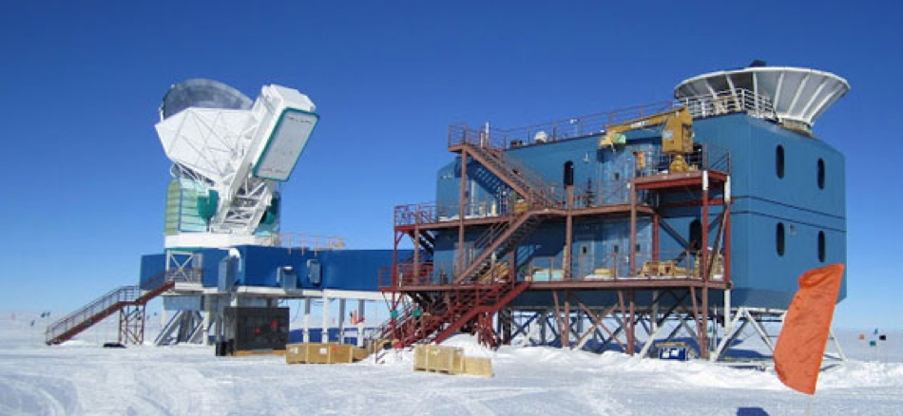
GW landscape
Many sources, many frequencies, many detectors, many collaborations
Credit: Nanograv/Bicep2

Slide 4
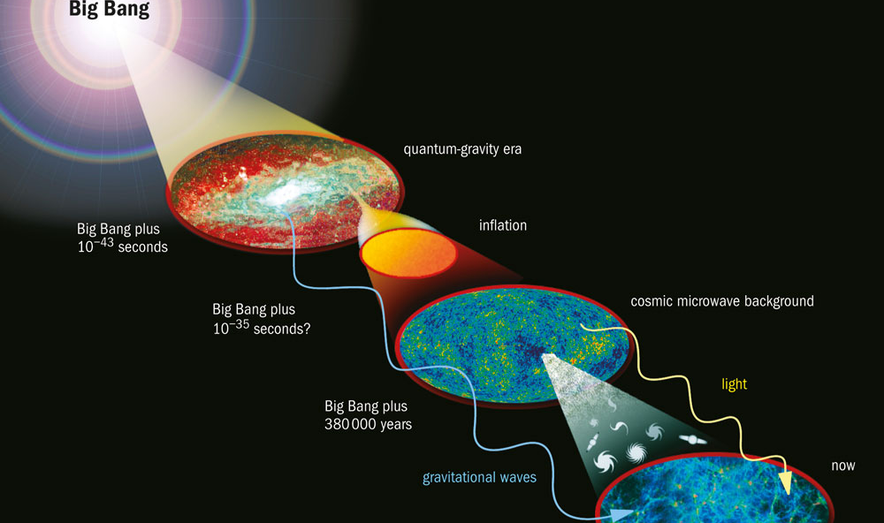
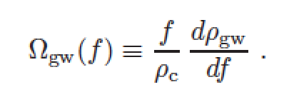
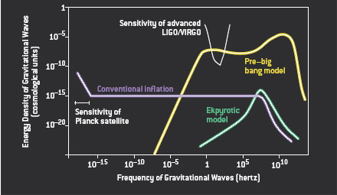
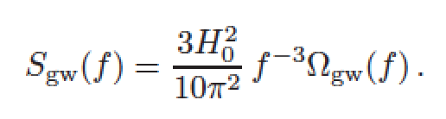
Primordial GWs
Credit image: NASA
Veneziano, Scientific American, 2004, 290, p54-65

Slide 5
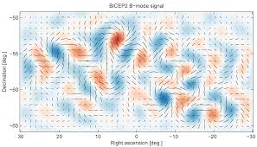
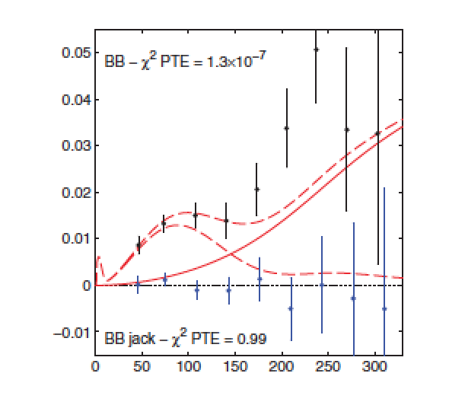
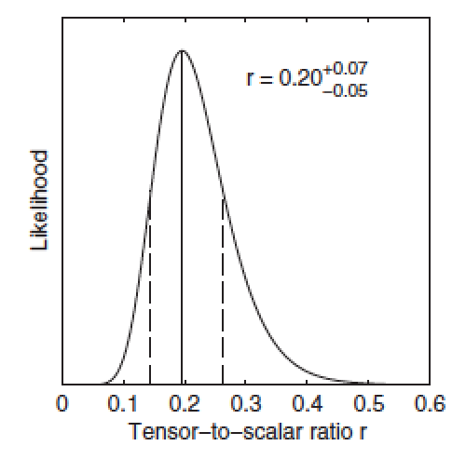
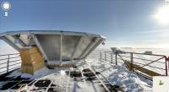
Primordial GWs
ΛCDM+lensing
GW r = 0.2
Bicep2, Keck, South Pole
PRL 112, 241101 (2014)

Slide 6
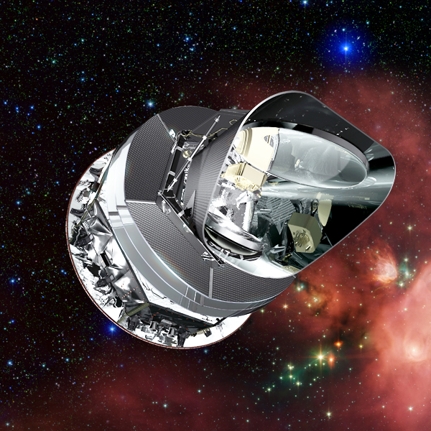
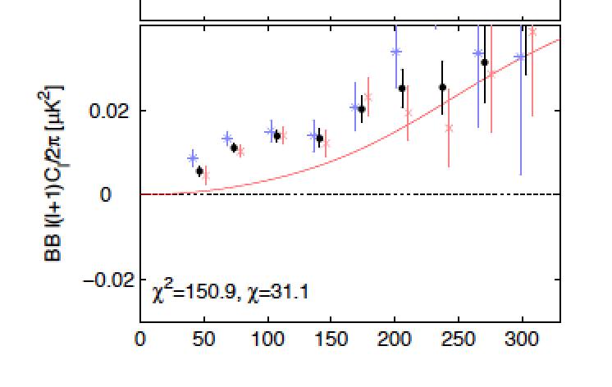
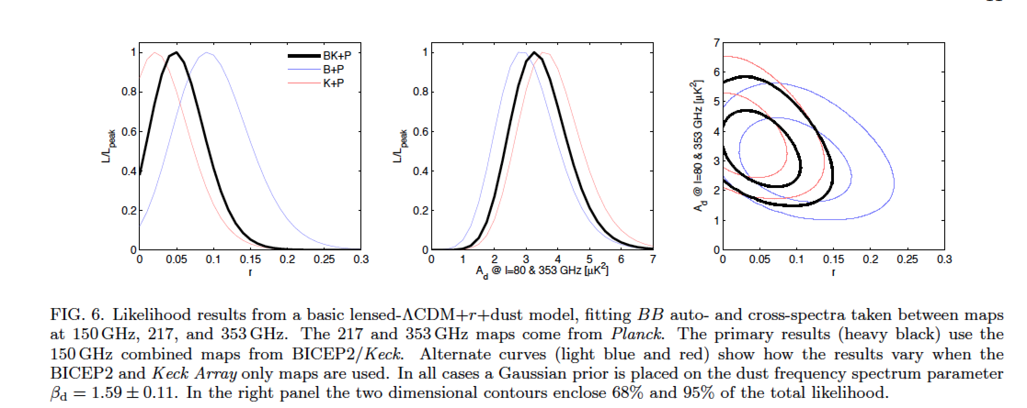
Primordial GWs
Bicep2, Keck, South Pole
Planck Satellite
P. A. R. Ade et al. (BICEP2/Keck and Planck Collaborations)
Phys. Rev. Lett. 114, 101301

Slide 7
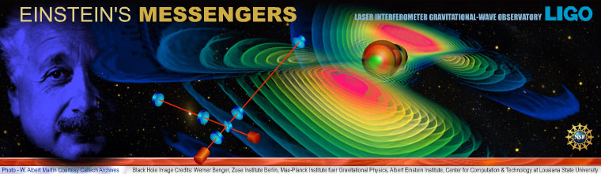
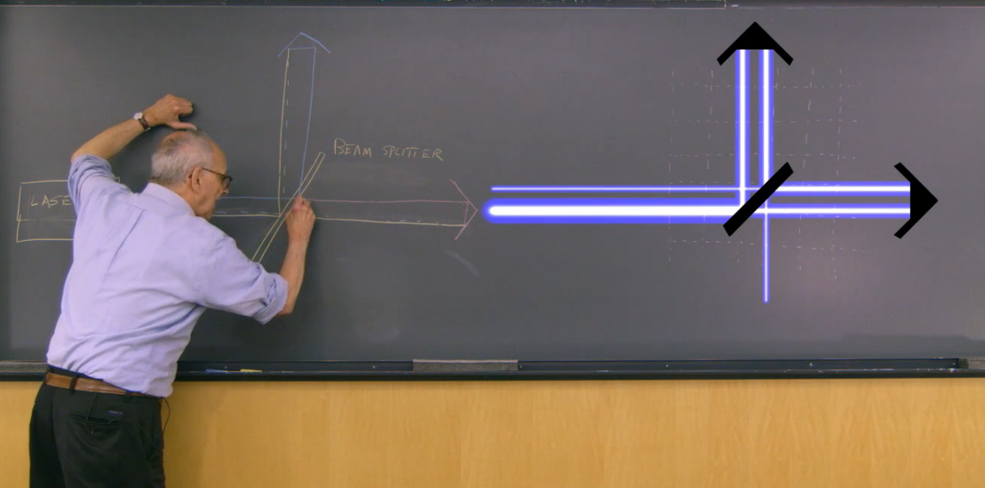
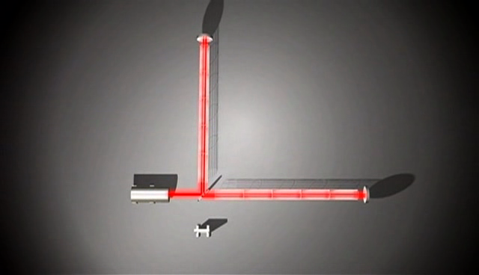
GW detection with an interferometer
“LIGO generations”
http://www.kaistaats.com/film/ligo-generations/
Einstein’s messengers,
National Science Foundation video
http://www.einsteinsmessengers.org/

Slide 8
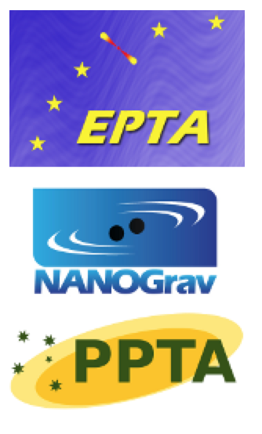
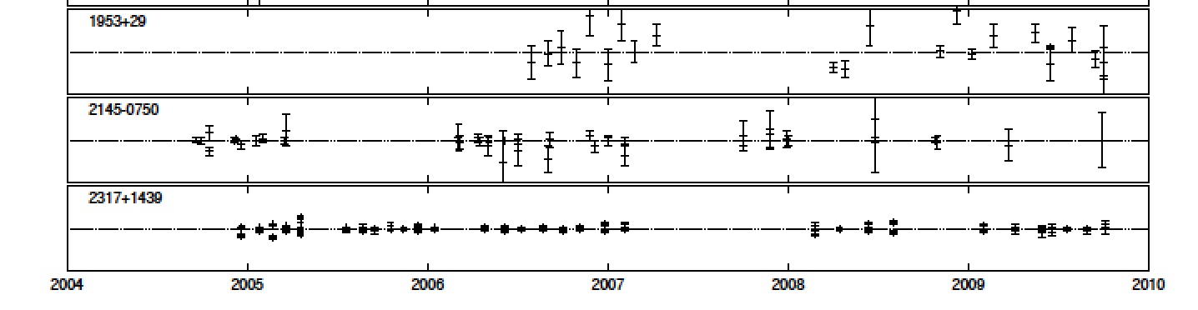
Pulsar timing
Measuring changes in phase of pulsar radio beams on Earth, we have a “galactic scale interferometer” measuring gravitational waves with periods of several years (nHz frequencies): mergers of super-massive black holes (galaxies!). They are limited by noise in the time of arrival of radio beams, number of pulsars and integration time.
10 μs

Slide 9
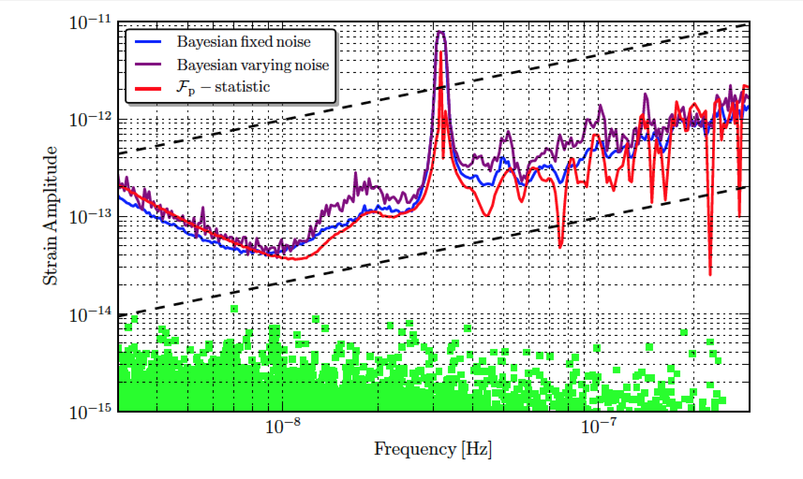
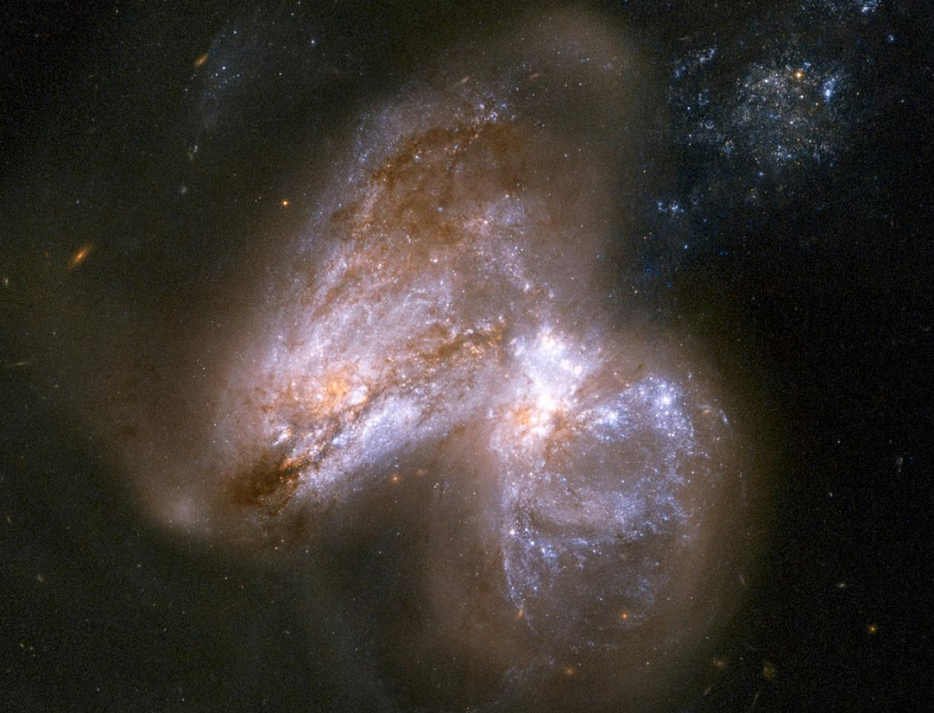
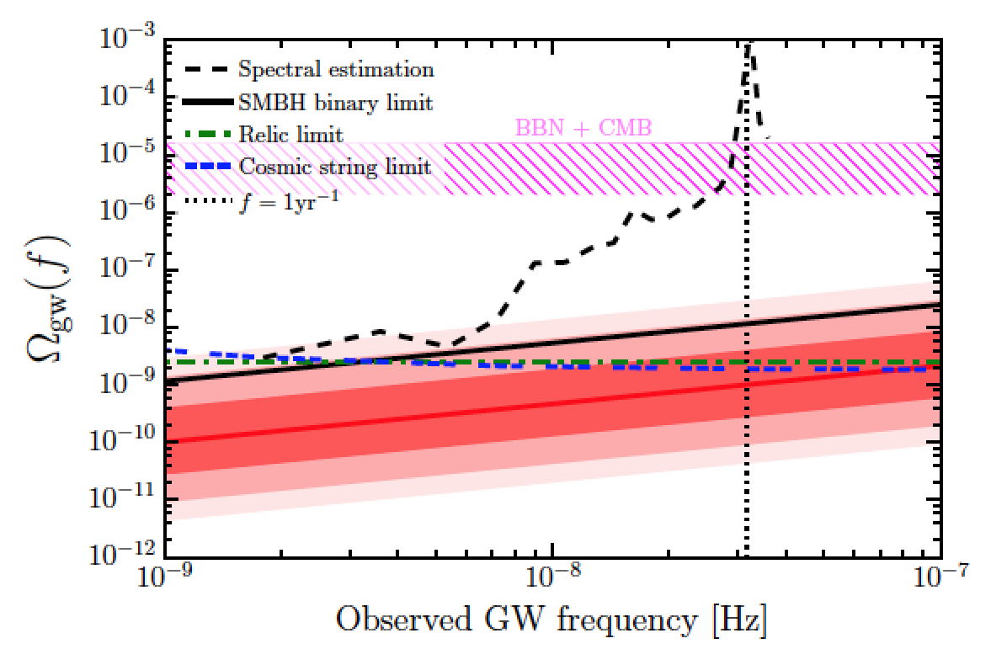
Pulsar timing results
NASA/JPL-Caltech/GSFC
SMBBH
Z. Arzoumanian et al (NANOGrav collaboration), 2014 Astrophys. J. 794 141
SMBBH
Lentati et al, (EPTA collaboration), arXiv:1504.03692

Slide 10
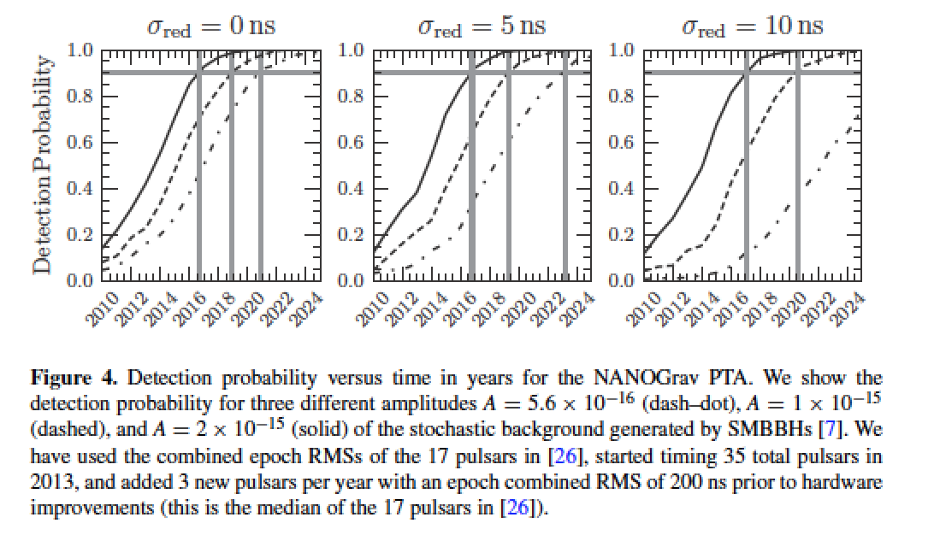
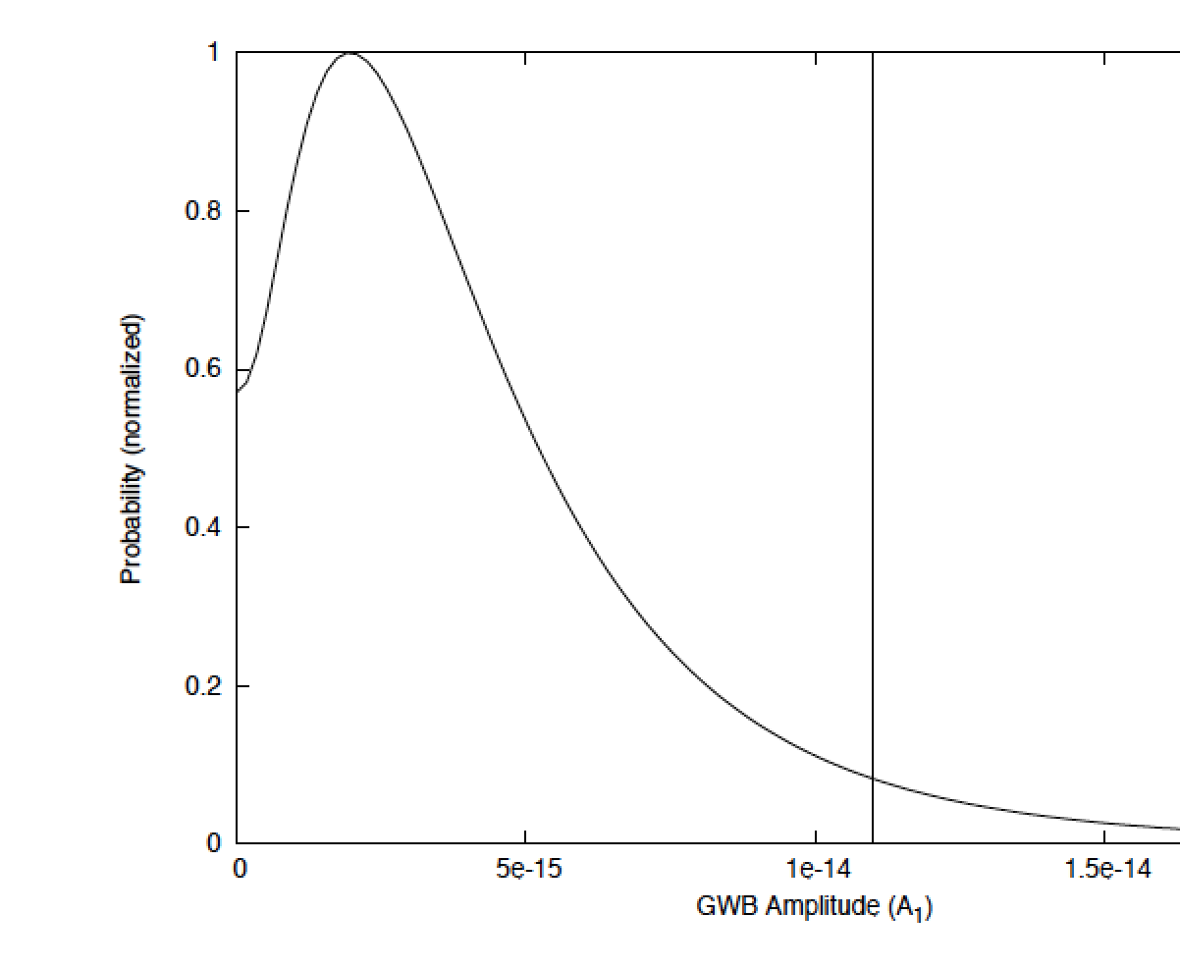
GW PTA detections are coming soon
Siemens et al., Class. Quantum Grav. 30 (2013) 224015
Demorest et al. (NANOggrav), ApJ 762, 94(1/2013)

Slide 11
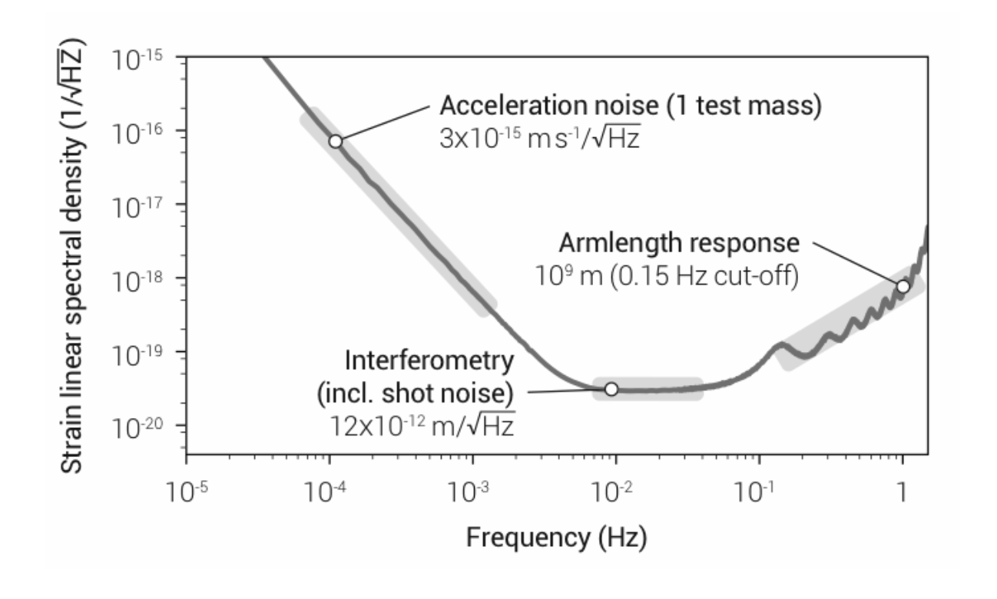
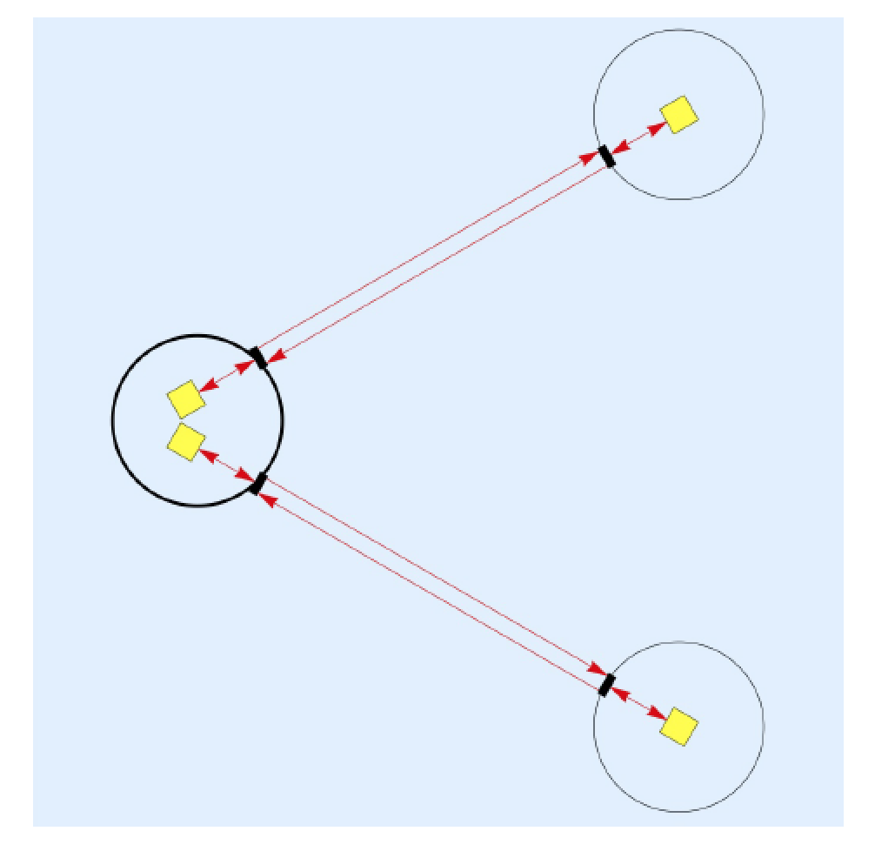
Space-based detector: (e)LISA
eLISA white paper
eLISA: ESA large L3 mission, launch date 2034,
Mission design call 2022 (or 2016?)

Slide 12
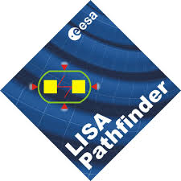
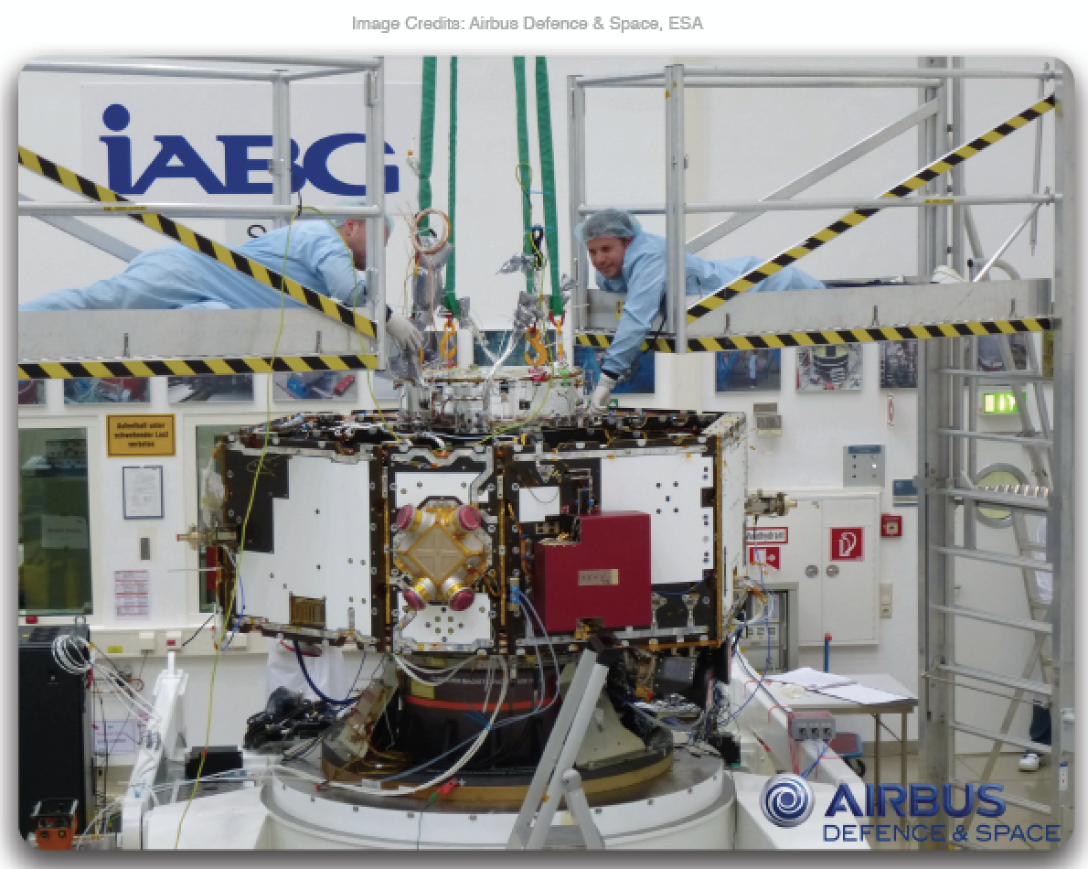
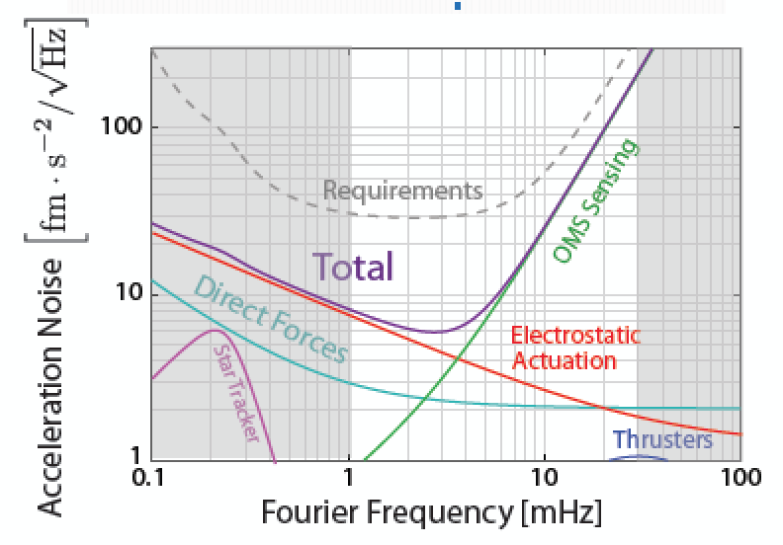
LISA Pathfinder
Launch date October 2015!

Slide 13
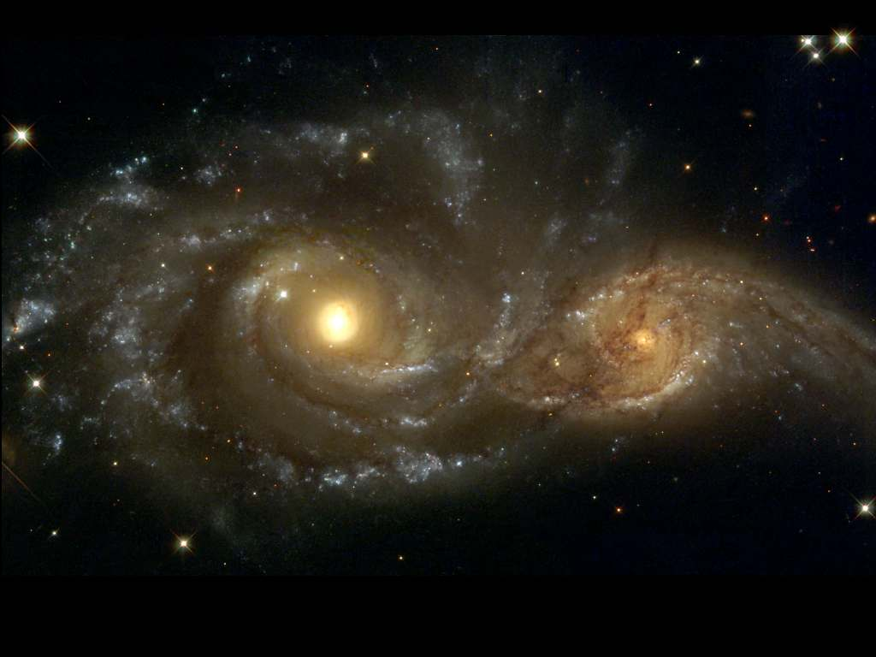
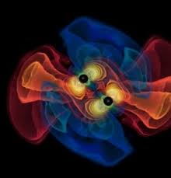
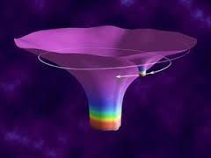
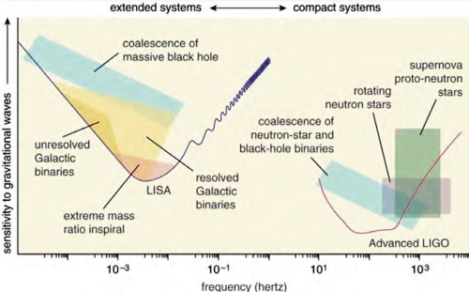
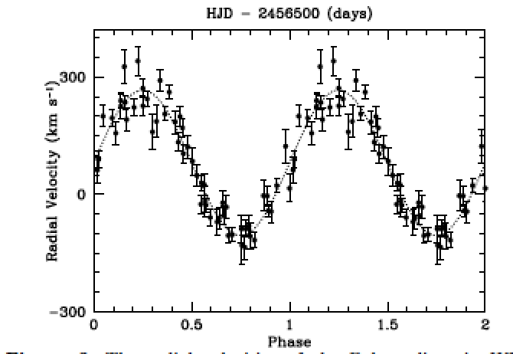
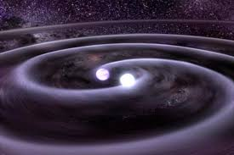
LISA Science

Slide 14
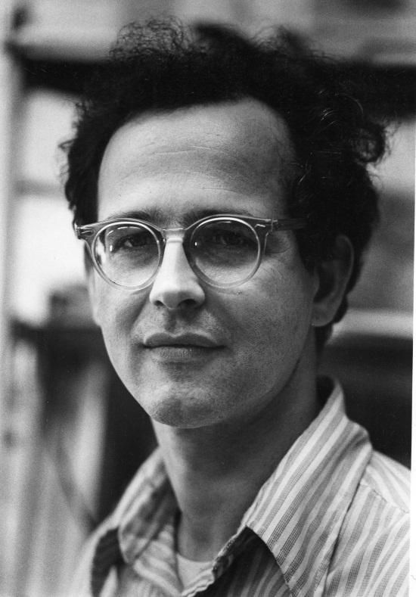
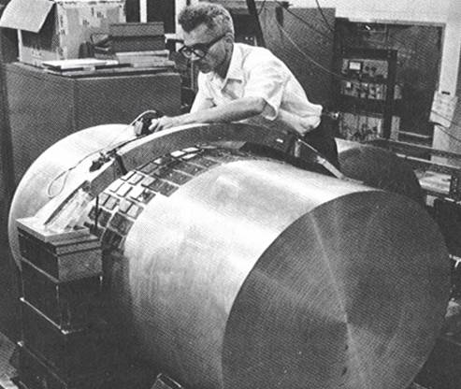
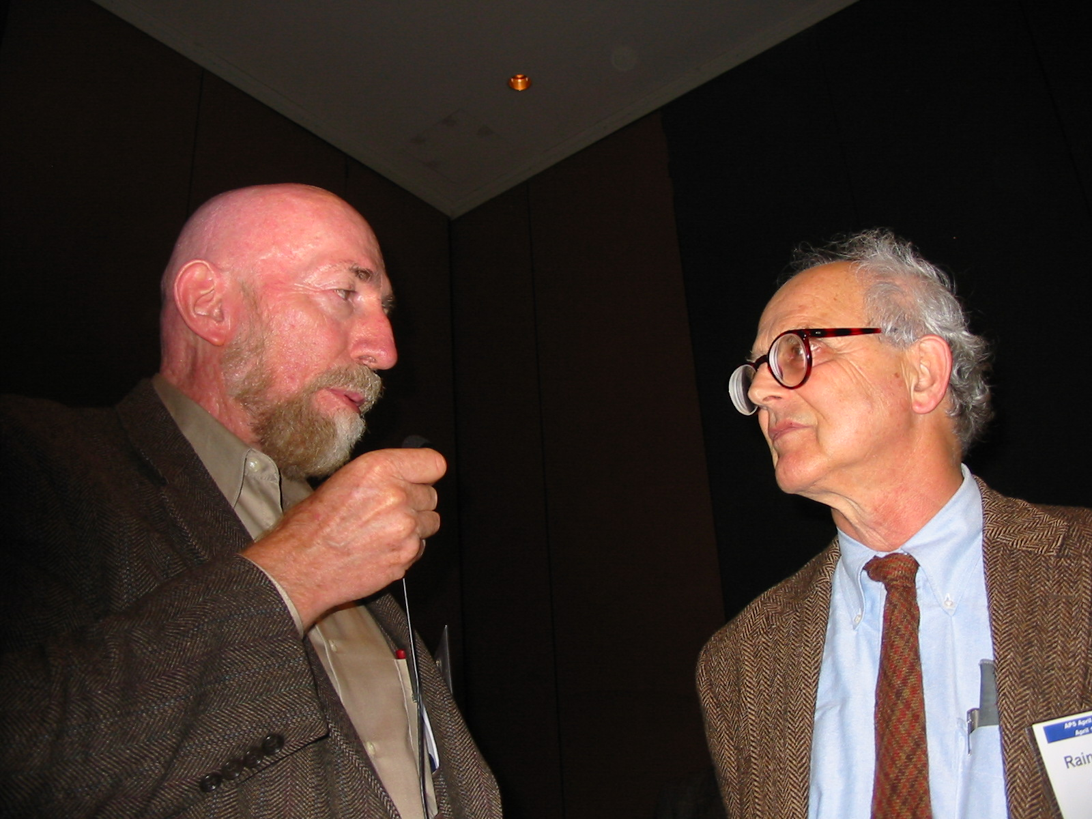
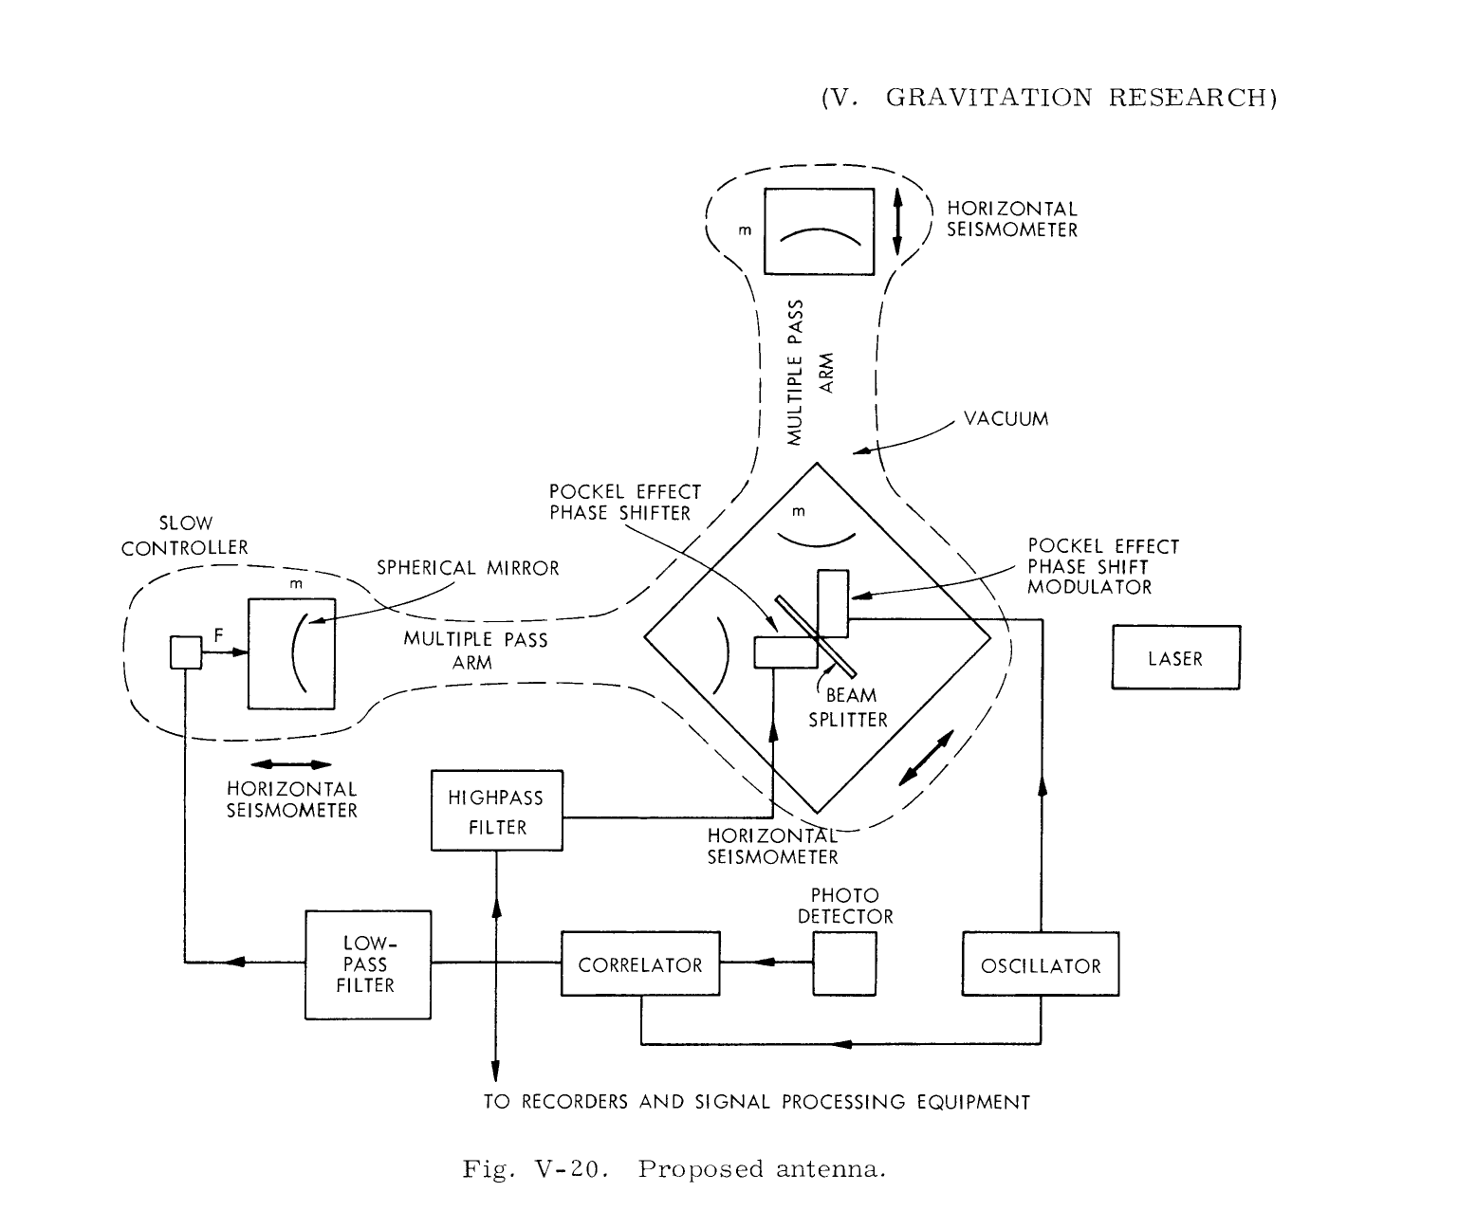
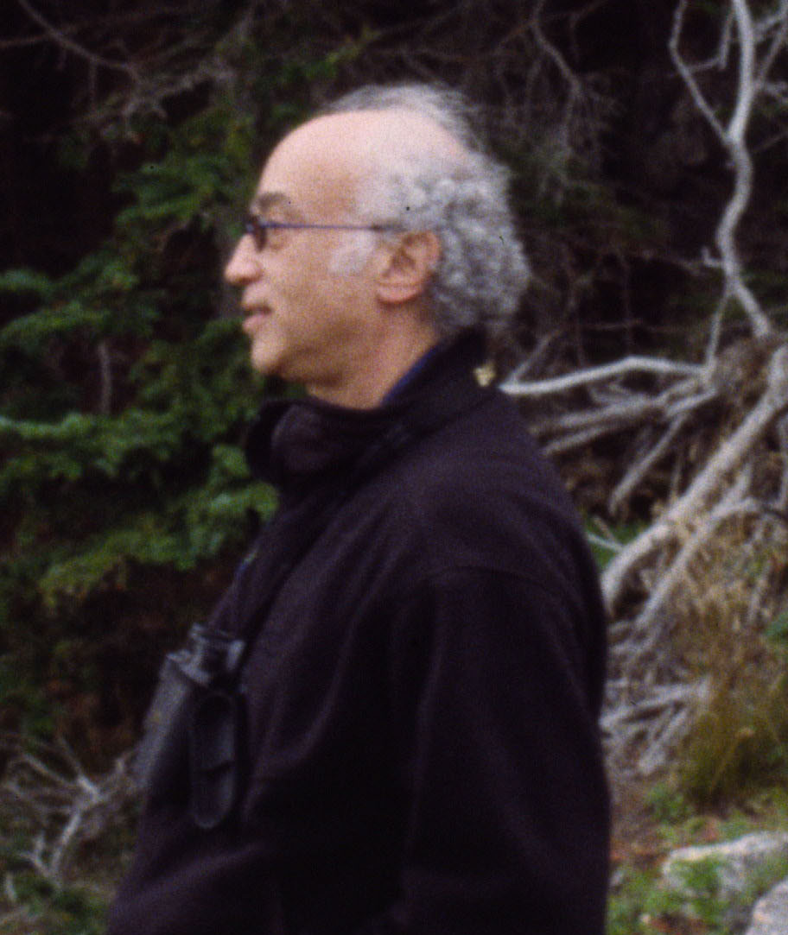
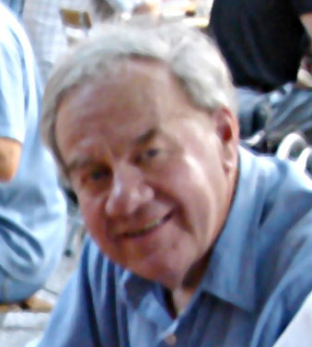
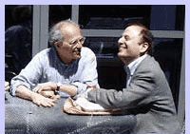
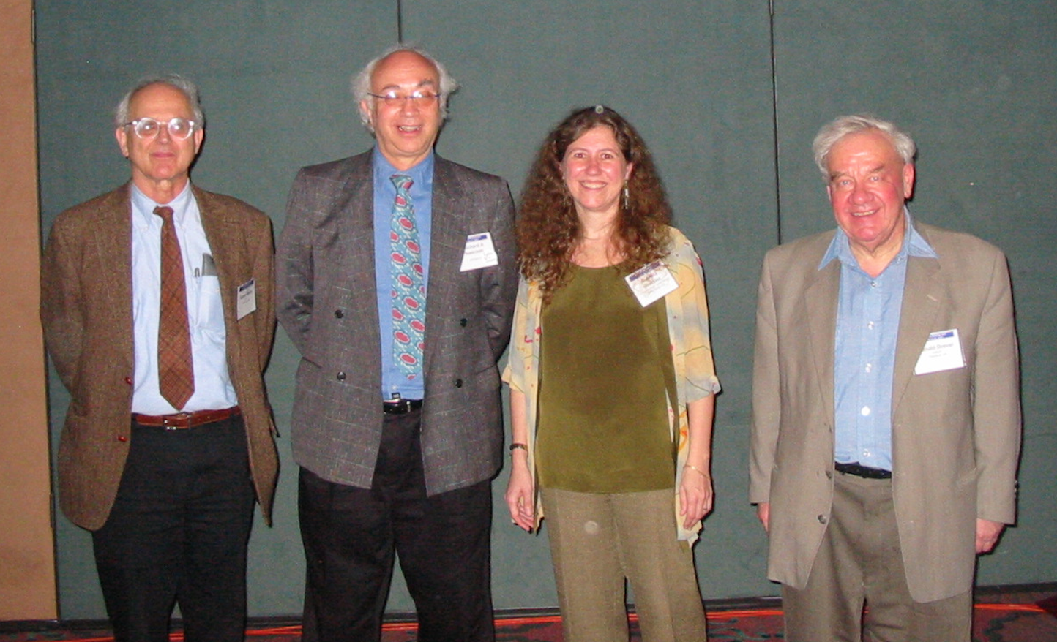

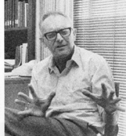
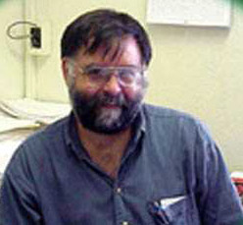
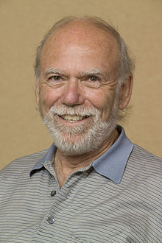

Very incomplete history of LIGO GW detectors

Slide 15





LIGO Scientific Collaboration
900+ members, 80+ institutions, 16 countries
LIGO today
MIT
LIGO Livingston
Caltech
Notes:
LIGO is actually two observatories.
Describe parameters
Emphasize that the arms are in ultra high vacuum. 8 km of steel 1.2 m dia beam tubes at each site
Separate observatories allow for coincidence detection – since the detectors see uncorrelated noise, only a true gravitational wave would appear on all the interferometers with the correct amplitude.
Emphasize that the LIGO Observatories were designed and are operated by Caltech and MIT

Slide 16




Ground Based Detectors: 2005-2010
LIGO Hanford
GEO600
Virgo
LIGO Livingston
16

Slide 17










LIGO GW Searches 2005-2010
Crab pulsar (NASA, Chandra Observatory)
Strain (1/√Hz)
NASA, WMAP
LIGO-T1400054
?
www.ligo.org

Slide 18


LIGO-Virgo detectors 2005-2010
Astrophys. J. 681 (2008) 1419
GRB070201

Slide 19


Some interesting results 2005-2011
Upper limits on GW emissions from Crab and Vela pulsars
Astrophys. J. 737 (2011) 93
Astrophys. J. 722 (2010) 1504

Slide 20

Some interesting results 2005-2011
Upper limit on GW stochastic background
Nature 460 (2009) 990

Slide 21

Some interesting results 2005-2011
False alarm rate ~1/7000 yrs!
GW100916
Phys. Rev D85 (2012) 082002

Slide 22

Exciting experimental results too
Quantum-enhanced sensitivity!

Slide 23

The future is here! Advanced LIGO
Advanced LIGO
~10 times better than initial LIGO
First observing run starting this year (!!)
with increasing sensitivity to follow.

Slide 24


Dual recycled Fabry-Perot Michelson interferometer

Slide 25





Advanced LIGO in Pictures
Pre-stabilized Laser
Active Seismic Isolation
‘Test Mass’ Mirror
Output Mode Cleaner
‘TransMon’ Telescope

Slide 26

Current Spectra
Preliminary
Notes:
Current ~60 Mpc BNS inspiral range spectra compared to the sensitivity goals.

Slide 27

Engineering Run
Stable and reliable locking of both detectors in a configuration that could be plausible during observation runs
Best effort for similar sensitivities
Several hours of coincidence data taking (May 26th – June 15th)
Sufficient automation
Hardware injections, blind injections implementation, and testing
Includes some maintenance
Best GW data collected
*20% Unct.
Preliminary

Slide 28


arXiv:1304.0670
Already here!

Slide 29


Predictions
arXiv:1304.0670 (based on Class. Quantum Grav. 27 (2010) 173001)

Slide 30


How many coalescences to expect?
Gamma Ray Bursts
If beaming factor is ~ 70 (θ ~10º), [??]
source rate is ~1/Mpc³/Myr,
similar to inferred from DNS in the galaxy (!).
DOI: 10.1146/annurev-astro-081913-035926
arXiv:1311.2603

Slide 31

The GW Detector Network~2020
Advanced LIGO
Hanford
GEO600
Advanced
Virgo
KAGRA
Advanced LIGO
Livingston
LIGO-India
31

Slide 32

More detectors = better localization

Slide 33





Multi-messenger astronomy with Advanced GW Detectors
After the first four published GW events, LSC and Virgo will promptly release public triggers to be followed up.
To initiate the multi-messenger from the very beginning, LSC and Virgo opened a call to sign agreements for the identification of EM counterparts to GW triggers in Advanced detectors starting in 2015.
We have signed more than 70 agreements with groups from 19 countries, with about 150 instruments covering the full EM spectrum,
from radio to high-energy gamma-rays.

Slide 34




GW ground-based detectors: the future (perspective session)
https://dcc.ligo.org/LIGO-T1400316/public
Einstein Telescope
http://www.et-gw.eu/

Slide 35

Gravitational waves are coming!

