Slide 1
Squeezing for Advanced LIGO
L. Barsotti
LIGO Laboratory – MIT
G1500734
Enhanced Interferometers Session --- May 18, 2015

Slide 2
Lessons learned from GEO and LIGO
Losses are very unforgiving: they come in many forms, some of them are very hard to fix:
OPO cavity, Faradays, mode mismatch, OMC throughput, photodiode quantum efficiency, misalignments, …
When coupling a squeezed light source to an interferometer, the ``usual” nasty noise couplings show up: lock error point, ``phase noise” back scattered noise, …
You needs some cleverness in your control scheme
GW
Signal
Dwyer et al., Optics Express, Vol. 21, Issue 16, pp. 19047-19060 (2013)
Grote et al., Phys. Rev. Lett. 110, 181101 (2013)
Chua et al., Class. Quantum Grav. 31 035017 (2014)
Dooley et al., Optics Express Vol. 23, Issue 7, pp. 8235-8245 (2015)
Schreiber et al., LIGO-P1500056 (2015)

Slide 3
Squeezing R&D program
Study filter cavity performance and demonstrate frequency dependent squeezing in the audio-frequency region
Incorporate lessons learned from GEO/LIGO in a squeezed light source targeted for aLIGO
Couple squeezing + filter cavity in a design compatible with an early upgrade to aLIGO

Slide 4
Squeezing R&D program
Study filter cavity performance and demonstrate frequency dependent squeezing in the audio-frequency region
Incorporate lessons learned from GEO/LIGO in a squeezed light source targeted for aLIGO
Couple squeezing + filter cavity in a design compatible with an early upgrade to aLIGO

Slide 5
Study of filter cavity performance
Direct measurements of losses in a high finesse cavity :
* Isogai et. al. Optics Express 21 (2013)
* Optical scatter of quantum noise filter cavity optics
(J. Smith’s group @ Fullerton, http://arxiv.org/pdf/1411.5403v1.pdf)
→ Experimental results (~10 ppm round trip losses for 1-3mm beam size) compatible with a “short” filter cavity for Advanced LIGO
Development of model to describe filter cavity noise mechanisms, including loss and mode mismatch P. Kwee, J. Miller, et al. Phys. Rev. D 90, 062006
A “short” filter cavity allows squeezing injection without degrading low frequency sensitivity (“not harm”)
(see Tomoki’s talk tomorrow)

Slide 6
Demonstration of frequency dependent squeezing with a 2m filter cavity @ MIT (2015)
Paper circulated to the LSC: P1500062
Extrapolation for aLIGO
16m filter cavity: factor of 2 reduction in shot noise (6dB), 25% reduction in radiation pressure noise (2 dB)
(see Tomoki’s talk tomorrow)

Slide 7
Frequency Dependent Squeezing
(“short” filter cavity)
High frequency improvement, + 25% BNS-BNS range (200 vs 250 Mpc)
Enables further improvement through coating thermal noise reduction

Slide 8
Squeezing R&D program
Study filter cavity performance and demonstrate frequency dependent squeezing in the audio-frequency region
Incorporate lessons learned from GEO/LIGO in a squeezed light source targeted for aLIGO
Couple squeezing + filter cavity in a design compatible with an early upgrade to aLIGO

Slide 9
Conceptual design of a new squeezed light source for Advanced LIGO
OPO typically sits on an in-air table, no seismic isolation, no acoustic enclosure
Advantages of seismic and acoustic isolation: reduce OPO cavity length noise (thus phase noise), mitigate impact from back scattering, less stringent requirements on alignment stability, OPO can be used as “quiet reference cavity” for the pump laser
Let’s move the OPO into the vacuum envelope on seismic isolated tables
E. Oelker et al., Optics Express, Vol. 22, Issue 17, pp. 21106-21121 (2014)

Slide 10
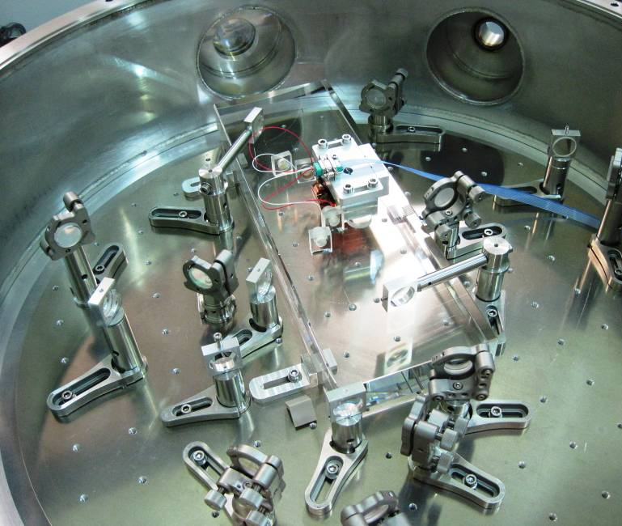
A new squeezed light source (ANU/MIT)
  First monolithic Optical Parametric Oscillator built at ANU
  Same optical characteristics as OPO used in H1 Squeezing test (bow-tie, doubly resonant)
ANU OPO cavity
More than 8 dB of squeezing measured
in-vacuum (see Georgia Mansell’s talk at the last LVC: G1500364)
➔ Observation that dual resonance condition shifts air/in-vacuum (dispersion problem: air refractive index change with wavelength)

Slide 11
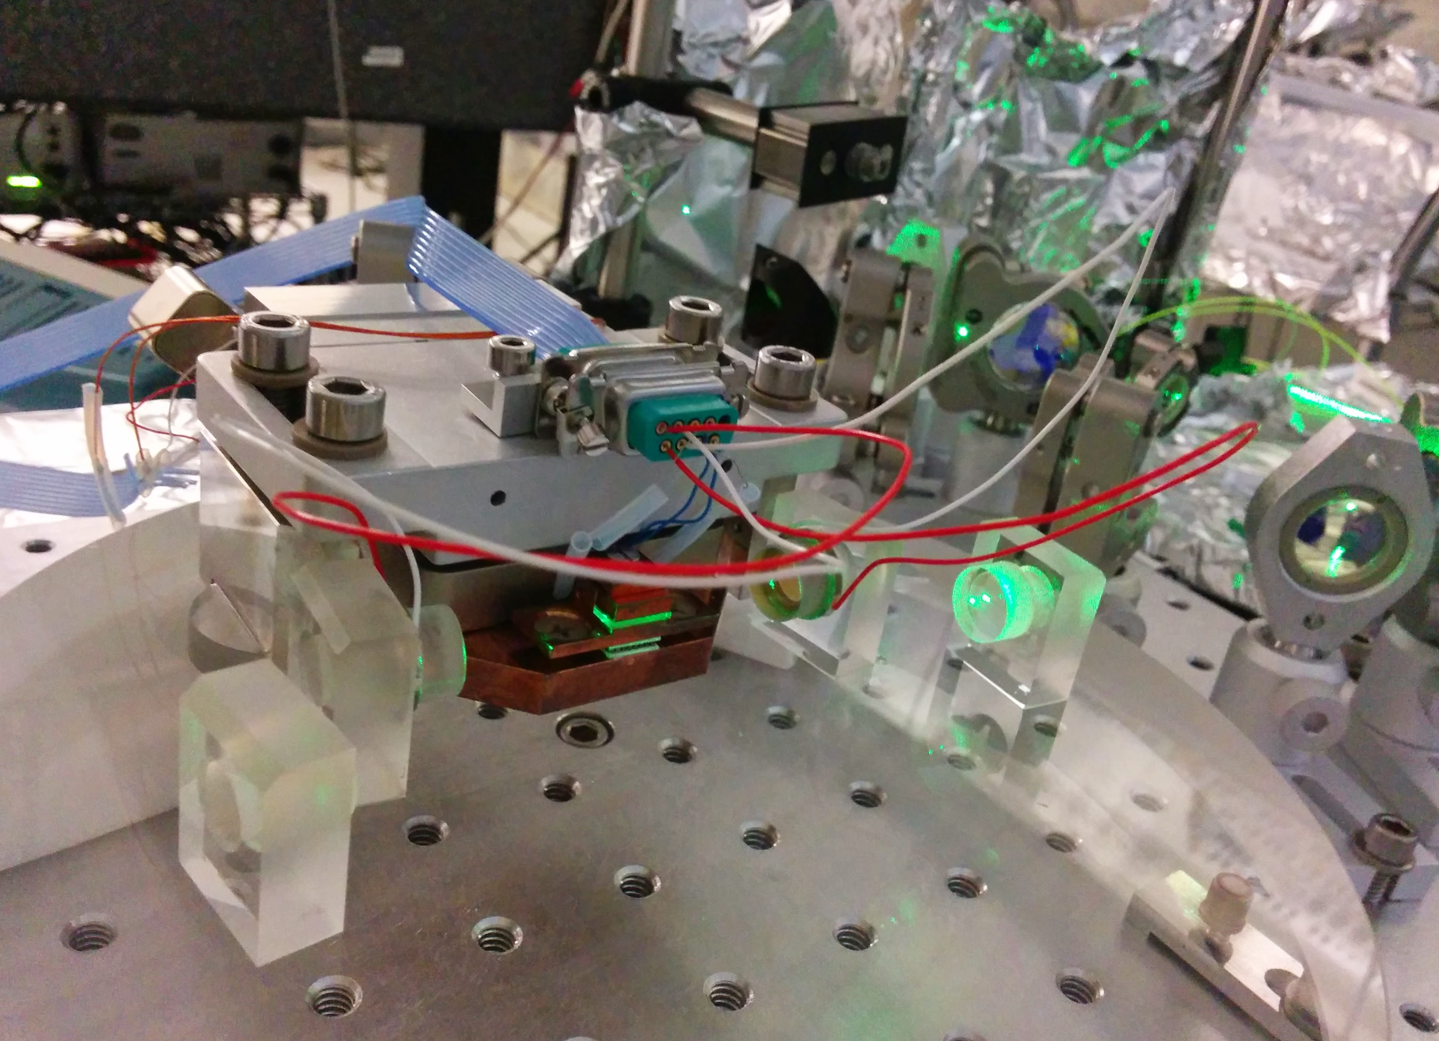
A new squeezed light source (ANU/MIT)
New OPO just built at MIT, incorporating lessons learned from first ANU prototype (in particular, remotely controllable translation stage for the OPO crystal to compensate dispersion problem)
Option of fiber coupling light to the OPO under investigation
New control scheme and noise budget analysis in progress
Results from table top experiment at MIT expected by the end of the summer
Investigations on-going in parallel at ANU
New OPO cavity @ MIT Picture Credit: Georgia Mansell

Slide 12
Squeezing R&D program
Study filter cavity performance and demonstrate frequency dependent squeezing in the audio-frequency region
Incorporate lessons learned from GEO/LIGO in a squeezed light source targeted for aLIGO
Couple squeezing + filter cavity in a design compatible with an early upgrade to aLIGO

Slide 13
Still a
“Conceptual Design”
Basic idea for implementation in aLIGO, include the option for a filter cavity

Slide 14
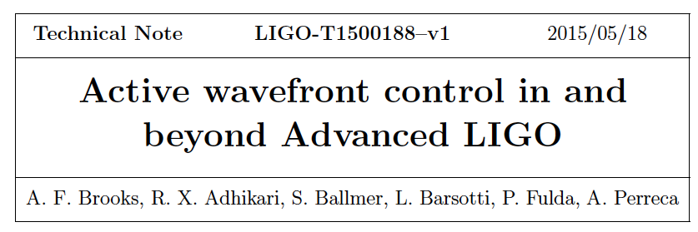
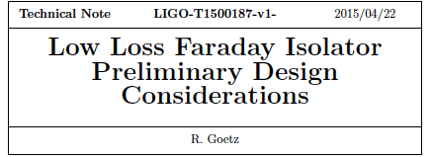
One of the greatest challenge: reduce optical loss
Easier said than done
On-going LSC “low loss” effort T1400715
https://wiki.ligo.org/AIC/LowLoss
(GEO’s talk earlier, Kate/Emil’s talk tomorrow)

Slide 15
Plausible Scenario for Squeezing in aLIGO
Modest squeezing performance with aLIGO not yet at full power (maybe post O2 (2017?), maybe without filter cavity)
Incorporate filter cavity and low loss readout (maybe post O3 (2018?))
➔ No decision yet, detector performance & network observing runs set the schedule

Slide 16

The Global Perspective
Possible Upgrade to Advanced LIGO

Slide 17
The Global Perspective
I made this plan almost 2 years ago…still plausible!
Thanks to the hard work of all the people/institutions involved!

Slide 18
The Message
Squeezing R&D progressing well:
  First demonstration of audio-band frequency dependent squeezing successful, no surprises
  ANU/MIT effort on new squeezed light source on-going
  LSC effort to attack loss
We believe this is the way to go…proposal for a full scale squeezing injection system at MIT in the near future
Effort will ramp up soon to converge on preliminary design for aLIGO
Plan for actual implementation in aLIGO being developed (plausible scenario: post-O2), detector performance & network observing runs set the schedule
More in the Topologies & Squeezing workshop..

Slide 19
Summary of Squeezing Options
Option | Benefit & Cost | Readiness
Frequency Independent Squeezing | x2 improvement at HF, worse low frequency $1M / IFO | system development
Frequency Dependent Squeezing (short cavity) | x2 improvement at HF, preserve low frequency add $500k / IFO | system development
Frequency Dependent Squeezing (long cavity) | x2 improvement at HF, improvement at low frequency too add $1M / IFO (TBC) | technology development

Slide 20
Extra Slides

Slide 21
Readiness level / cost for Squeezing
Frequency independent
  Already applied in large scale interferometers
  Nature Physics 7, 962 (2011), Nature Photonics 7, 613–619 (2013)
  Mature technology: system development phase
  High frequency improvement, risk mitigation for high power operation in aLIGO
  Tentative cost estimate: $1M per interferometer
Frequency dependent (“short cavity”)
  Recent demonstration with table top experiment (P1500062)
  Mature technology: system development phase
  +25% improvement in BNS-BNS range (~250 Mpc)
  Greater benefit when combined with reduced coating thermal noise (see Stefan’s talk, and Phys. Rev. D 91, 062005)
  Tentative estimate: additional $0.5M per interferometer
Frequency dependent (“long cavity”)
  Particular beneficial for low frequency sources, when combined with other noise improvements
  Technology development phase; more costly

Slide 22
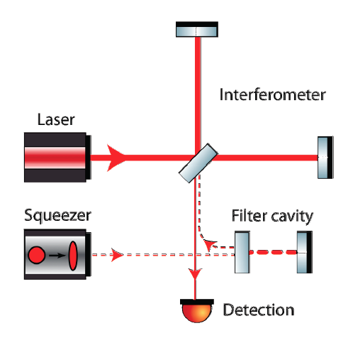
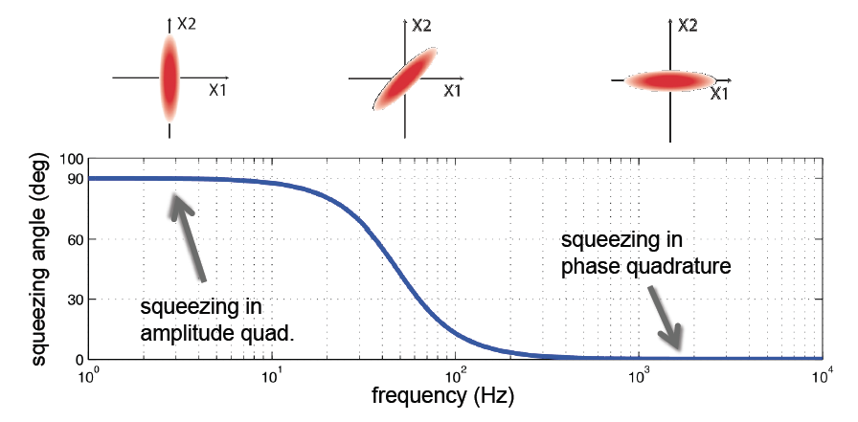
Frequency Dependent Squeezing - I
GW Signal
RADIATION PRESSURE
NOISE
~30Hz
~30Hz
Quantum Noise
SHOT NOISE
High finesse detuned “filter cavity” which rotates the squeezing angle as function of frequency

Slide 23
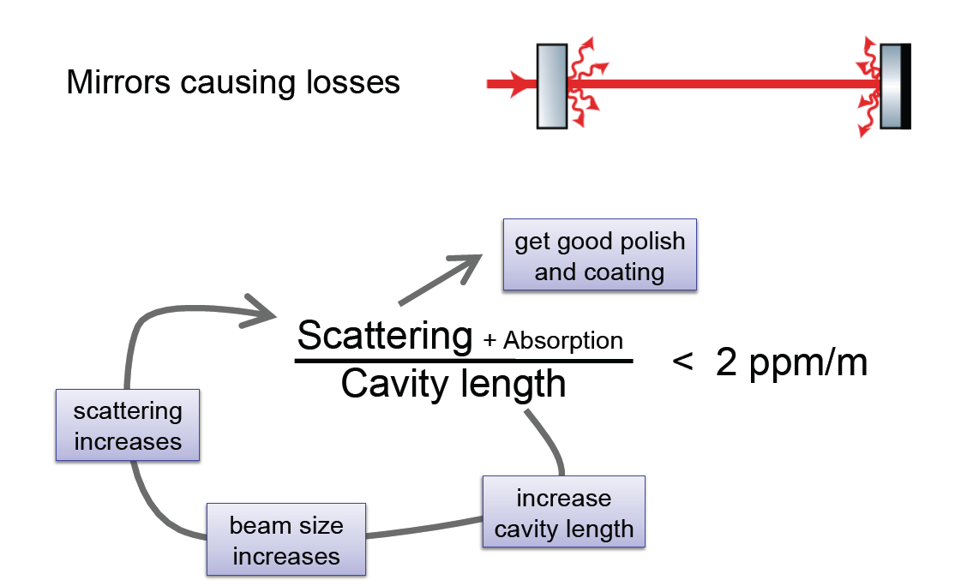
Long vs Short filter cavity
(Nothing comes cheap)
Advanced LIGO needs a a filter cavity with 50 Hz bandwidth
Losses in a filter cavity deteriorate, if too high, make the filter cavity useless…
Per-round-trip loss depends on the beam spot size
(big beam size → higher scatter losses), which depends on L
1 ppm/m

Slide 24
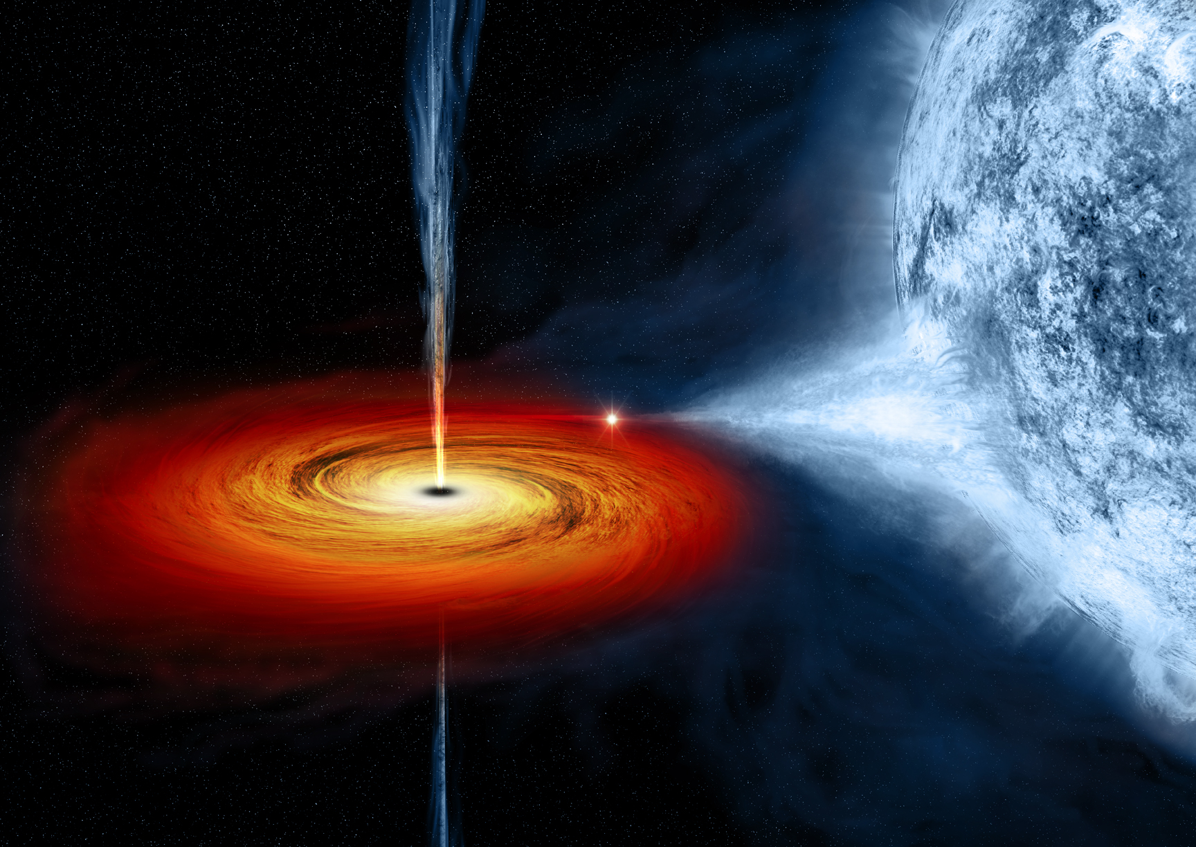
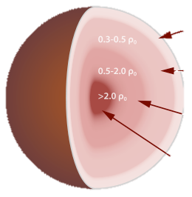
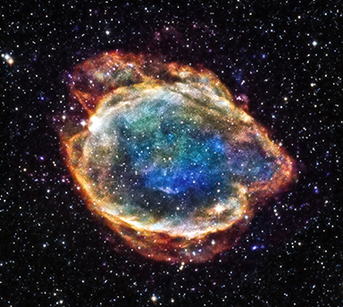
Focus on High Frequency Sources
NS EOS
LMXB
SN
Parameter estimation of compact binary systems:
Phys. Rev. D 91, 044032
L. Barsotti, LIGO Laboratory - MIT

Slide 25
Limiting noise: quantum noise

Slide 26
Quantum shot noise limits the high frequency sensitivity
RADIATION PRESSURE
NOISE
P = stored power
m = mirror mass
SHOT NOISE
RADIATION PRESSURE NOISE: Back-action noise caused by random motion of optics due to fluctuations of the number of impinging photons
Additional displacement noise
SHOT NOISE: Photon counting noise due to fluctuations of the number of photon detected at the interferometer output → Limitation of the precision to measure arm displacement:

Slide 27
Reducing losses is critical for achieving 6 - 10 dB
(x 2-3 shot noise reduction)
LIGO
GEO
We need less than 20% total losses
aLIGO readout now has ~30%(w/o squeezing)
GW
Signal

Slide 28
Frequency Independent Squeezing
SHOT NOISE
gets better by a factor of 2
RADIATION PRESSURE NOISE
gets worse
➔ High frequency improvement, no benefit in BNS-BNS range

Slide 29
Frequency Dependent Squeezing
(“short” filter cavity)
High frequency improvement, + 25% BNS-BNS range (200 vs 250 Mpc)
Enables further improvement through coating thermal noise reduction

Slide 30
Frequency Dependent Squeezing
(“long”, or low loss, filter cavity)
More challenging than “short cavity”; particularly beneficial for targeting low/mid frequency sources, especially when combined with other improvements

Slide 31
Signal Recycling Detuning
In principle, ability to target high frequency sources without squeezing
Less hardware investment with respect to squeezing, but challenge from the controllability of the interferometer
Given the same loss in the interferometer, benefit at high frequency is comparable to frequency dependent squeezing in a narrow band, worse elsewhere
Signal recycling detuning not particular beneficial for high frequency sources
Interesting cases for low-mid frequencies regions, especially when combined with frequency independent squeezing

Slide 32
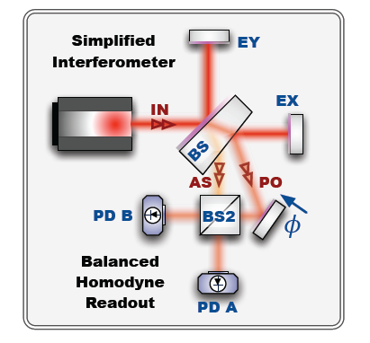
Balanced Homodyne Detection
Standard technique in table top squeezing experiments
It has advantages compared to DC readout when applied to large scale interferometers
Main advantage: remove static carrier field at the anti-symmetric port
Optics Express Vol. 22, Issue 4, pp. 4224-4234 (2014)

Slide 33
Balanced Homodyne Detection
L1 current high frequency noise budget
Optics Express Vol. 22, Issue 4, pp. 4224-4234 (2014)
Credit: Denis Martynov

Slide 34
LOSS
Faraday Isolators: need to be < 1% loss per pass
➔ aLIGO output faraday now adds 4% loss per pass
OMC loss: ideally less than 1%
➔ study done by Koji Arai @ Caltech
aLIGO OMC loss from 3% – 7%, it strongly depends on beam spot position on the optics
Mode matching: target is 1%-2%
➔ the sad reality is that mode matching is hard (best ever LIGO mode matching to the OMC: 5% loss, L1 eLIGO)
Photodiode quantum efficiency = 99% ??
➔ Hartmut Grote’s wisdom:
“only 1 batch of diodes have ever been
measured with only 1% loss @ 1064”

Slide 35
Signal Recycling Detuning with frequency independent squeezing

Slide 36
Signal Recycling Detuning with frequency independent squeezing, low loss

