Slide 1
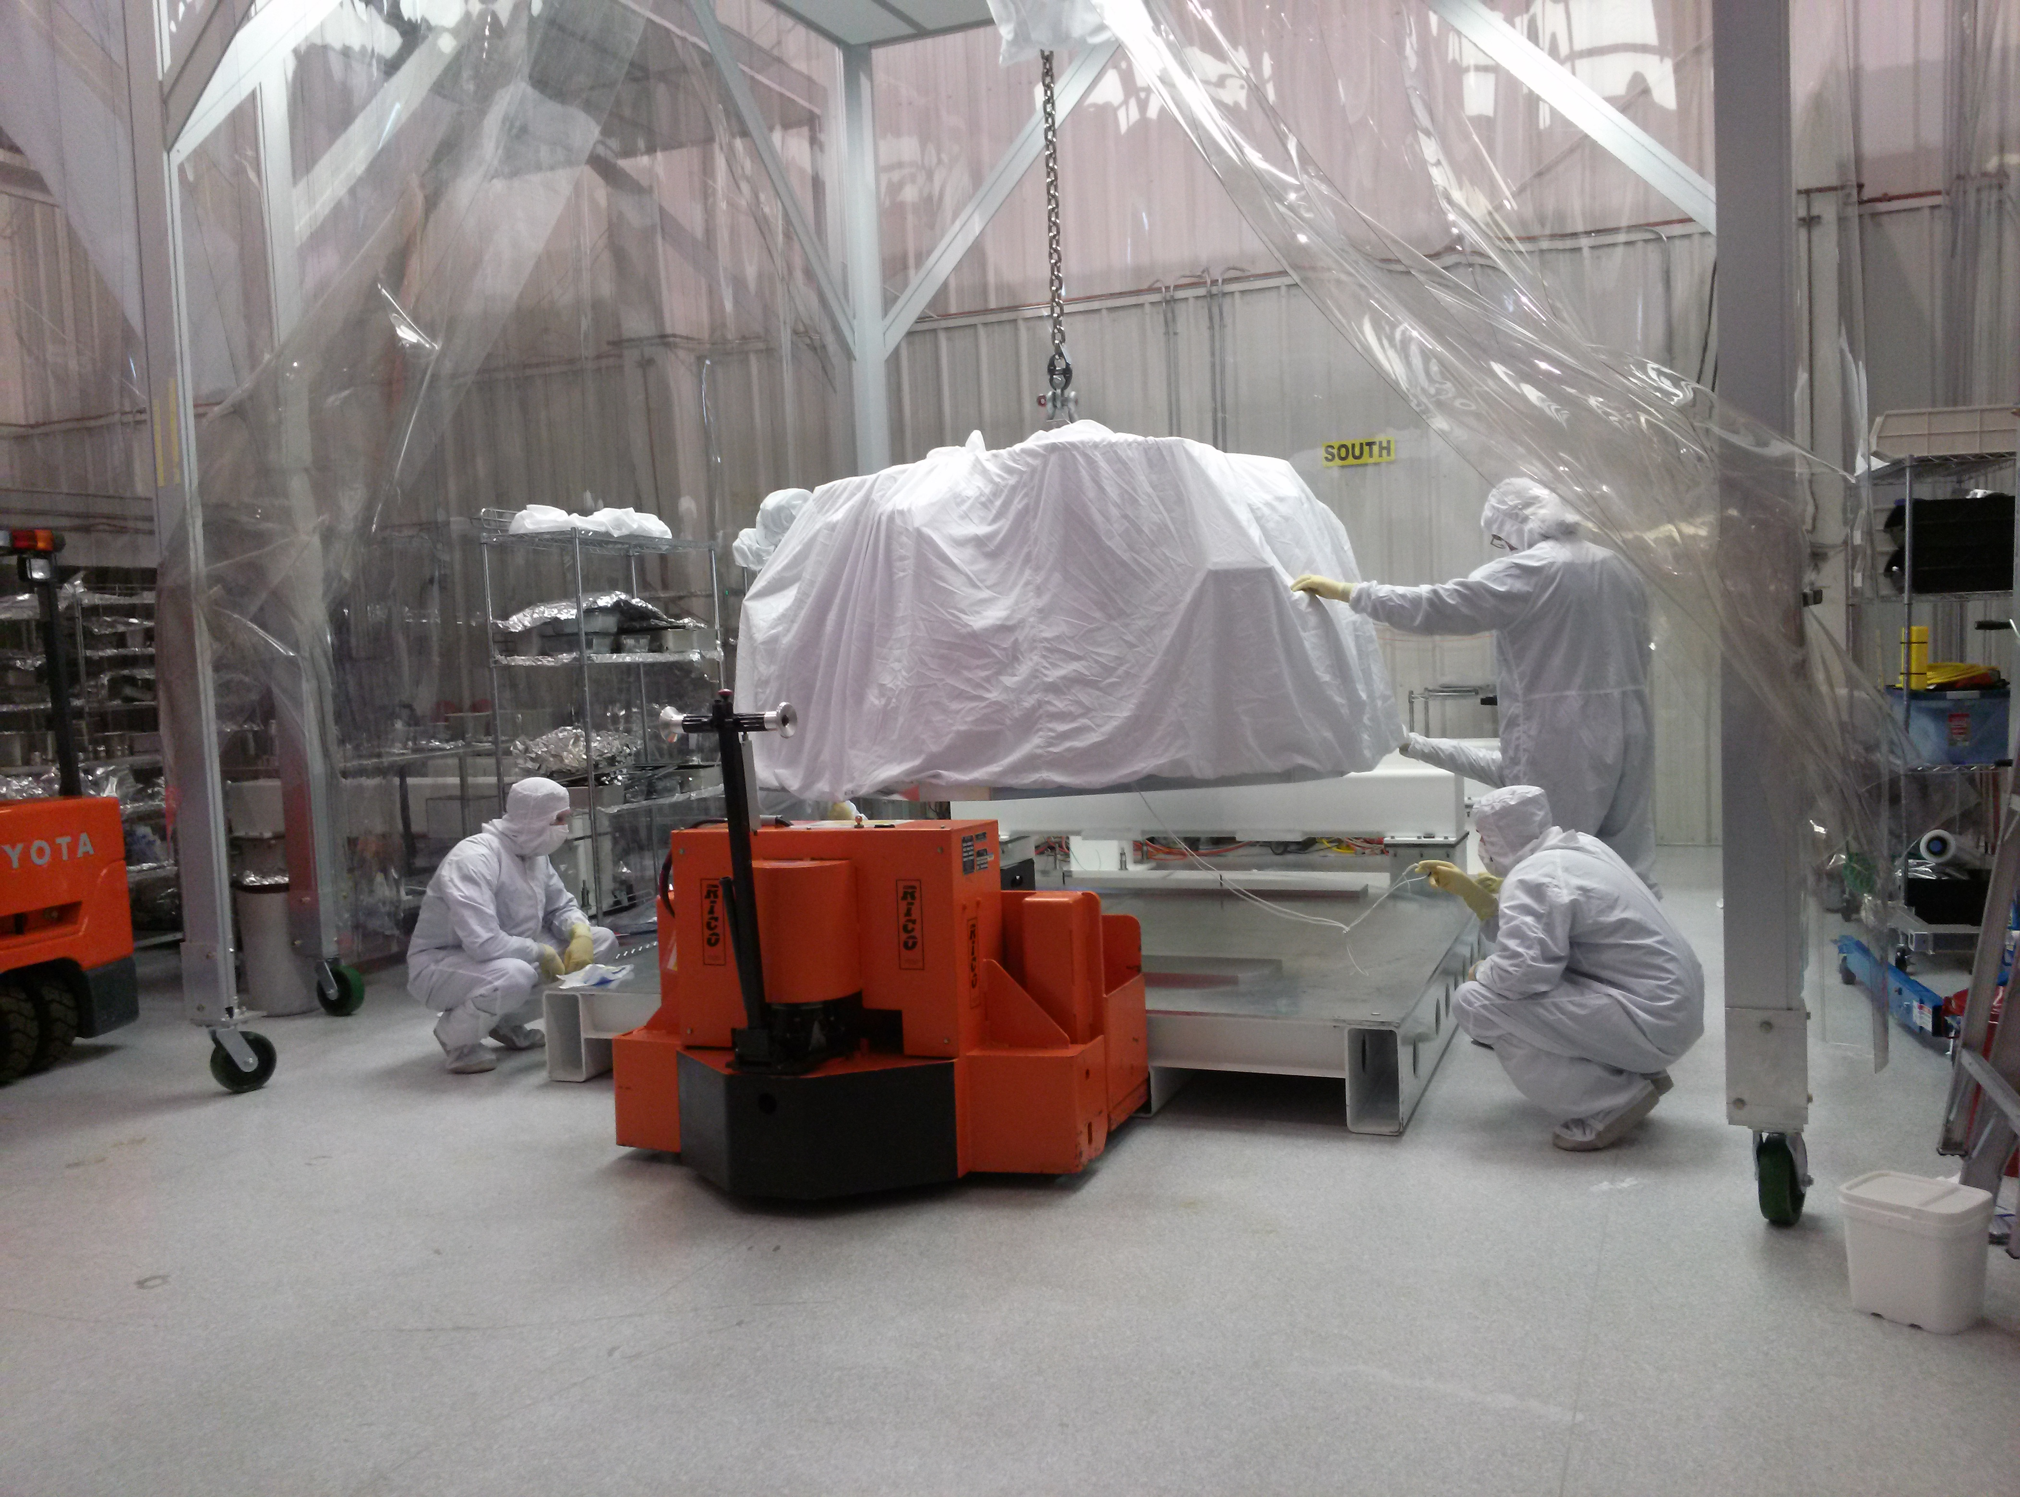
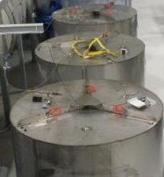
Technical Progress: Third Interferometer aka 3IFO
By Jodi Fauver
NSF Review 16-18 June 2015 @ LLO
LIGO-G1500720
Notes:
Left: Final 3IFO ISI being transferred to storage container.
Center: Storage container being moved to long-term storage location.
Right: Series of loaded storage containers in place near nitrogen piping.

Slide 2
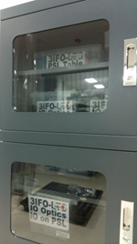
Overview
Organization and Management
Physical location
Documentation
Monitoring
Eyes on
Probes and sensors
Safeguarding and Securing
Physical control
Administrative control
LIGO-G1500720

Slide 3
Organization of 3IFO: Storage Venues
Venues arranged according to general storage condition requirements
LIGO-E1300001: Long Term Storage Plan for the Components of the Third Advanced LIGO Interferometer
Temperature range: 72F +/- 3.5F
Maintained through building HVAC
Humidity range: 20-70% relative humidity (RH)
Cleanliness: Either “clean” or “dirty” space
“Clean”-required for storage of in-vacuum (Class A or Class B) items
“Dirty”-acceptable for the storage of “in-air” and “in-the crate” items
Assignment of 3IFO Storage venue is further refined using each sub-system’s specific humidity control requirements
For example:
LIGO-T1200527: Suspension (SUS) Long Term Storage for the 3rd aLIGO Interferometer
LIGO-G1500720
Notes:
“Clean” and “dirty” are defined in E1300001.

Slide 4
Organization of 3IFO: Storage Venues Spaces and Storage Conditions
“Clean” Storage Spaces
Laser-Vacuum Equipment Area (LVEA)
Items stored in
Custom containers under dry nitrogen purge
Bins/Walled pallets
With desiccant (WD)
Without desiccant (WOD)
Air
“Dirty” Storage Spaces
H2 Electronics Building
Items stored in plastics bags with desiccant
Mechanical Room
Items stored in air
Mid-Stations
Items stored in
Bins/Crates/Walled Pallets
With desiccant (WD)
Without desiccant (WOD)
Air
Vacuum Prep Warehouse (VPW)
Items stored in
Bins/Walled pallets
Without desiccant
“Dry Boxes”
LIGO-G1500720

Slide 5
LVEA: Custom Containers with Dry Nitrogen Purge Internal Seismic Isolation Units
LIGO-G1500720
Notes:
HAM1 is an iLIGO passive stack that is not is a storage container. It does not any components that require nitrogen purge. There are five aLIGO HAM ISIs and five BSC ISIs, each in individual storage containers.

Slide 6
LVEA: Custom Containers with Dry Nitrogen Purge Core Optic and Baffle Suspensions
LIGO-G1500720
Notes:
The cluster consists of the beamsplitter and four (4) quad lower structures, each in individual storage containers. There are three (3) modified storage containers dedicated to suspensions and other sensitive components. Container 1 houses seven (7) HAM Small Triple and two (2) HAM Large Triple Suspensions in addition to the Output Mode Cleaner and the Output Faraday Isolator weldments. Container 2 encloses four (4) quad upper structures, two (2) TMS telescopes and two (2) Elliptical Baffle suspensions. Container 3 includes two (2) TMS weldments, four (4) quad sleeves and four (4) ACB suspensions

Slide 7
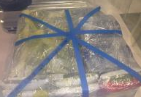
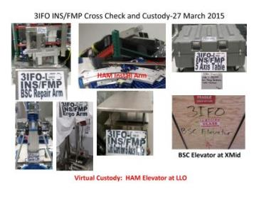
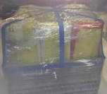
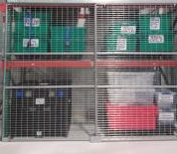
LVEA: In-Air or Bins/Walled Pallets With (WD) or Without (WOD) Desiccant
Stray Light Control (SLC) aka Baffles
Installation (INS) Tooling
Stored “In-Air”
WD
WD
XXXXXX
WD
Thermal Compensation System (TCS)
WD
WD
XX
WOD
WD
WD
XX
WD
WD
SUS Install and cabling kits
LIGO-G1500720
Notes:
The flat-packed baffle parts are stored in two large walled pallets near the Beer Garden. The remaining baffle hardware and fasteners are stored in various sealed bins in “The Cage”.
Installation Tooling is labeled (but not containerized) and stored on an eleven (11) foot tall platform. All items are secured to the platform
The TCS has a dedicated shelf that contains two (2) pallets full of bins with the CO₂ lasers housed on the shelf above. Other TCS components are stored in a nitrogen-purged desiccant cabinet in the LVEA.
Suspension-related install tooling, cabling and miscellaneous items occupy various walled pallets and bins on two and a half shelves of the pallet rack in the West Bay of the LVEA.

Slide 8
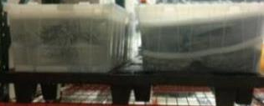
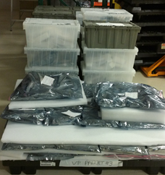
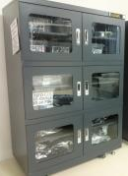
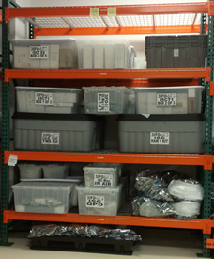
VPW: In Bins/Walled Pallets Without (WOD) Desiccant or in Dry Boxes
Interferometer Sensing and Control (ISC)
Commercial viewports Custom viewport glass Testing fixtures
Various subsystems
Dry boxes for humidity control and security
LIGO-G1500720
Notes:
ISC bins occupy three (3) rack shelves in the VPW: each “layer” is at least two (2) bins deep.
There are also four (4) pallets of commercial viewports, custom viewport glass and testing fixtures in the VPW.
Small-ish items that require very low humidity or are deemed to need an extra measure of security are stored in lockable “dry boxes” housed in the VPW. Examples of items requiring low humidity are crystals, maraging steel blades in tip-tilt suspensions, and the OMC glass bench.

Slide 9
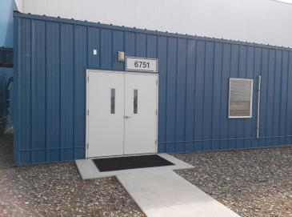
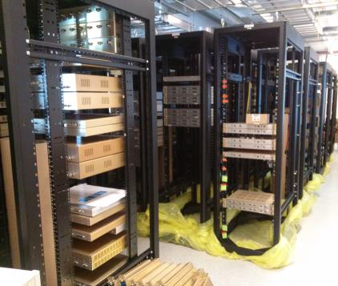
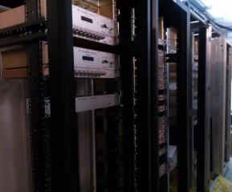
H2 Electronics Building Sealed Plastic Bags with Desiccant
Various subsystems
SEI-Eight (8) racks
SUS-Ten (10) racks
ISC-Thirteen (13) racks
LIGO-G1500720

Slide 10
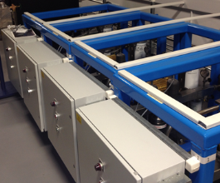
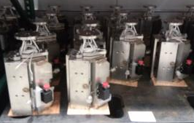
Mechanical Room In-Air
SEI HEPI Actuators and Pump Carts
LIGO-G1500720
Notes:
The actuators are not containerized because they must be flushed on a regular basis to maintain viability. Pump Carts are stored on the mezzanine.

Slide 11
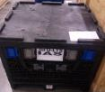
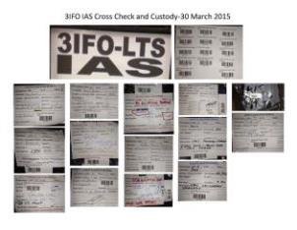
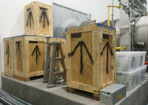
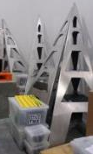
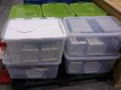
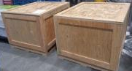
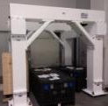
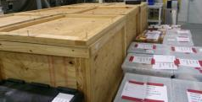
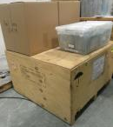
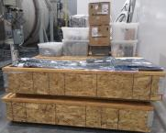
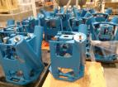
Mid-Station X: In-Air or Bins/Crates/Walled Pallets With (WD) or Without (WOD) Desiccant
Initial Alignment System
Optical Levers
Photon Calibration
Seismic Isolation (SEI)
LIGO-G1500720
Notes:
IAS is contained in one (1) walled pallet.
Most OpLev pylons are in their original wooden shipping crates. The uncrated pylons are stored on pallets for ease of movement. OpLev “guts” occupy a walled pallet and various bins near the related pylon.
Large PCal items are stored in wooden crates and smaller items are in cardboard boxes or bins.
Some seismic HEPI housings are stored in their original wooden shipping crates: others are stored in air on pallets. The balance are stored in place in the LVEA around HAM7/8/9/10. Conflats, feedthroughs and masses are stored in walled pallets. Cables, capacitive position sensor electronics, fasteners and miscellaneous are stored in bins.

Slide 12
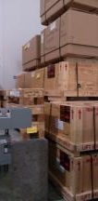
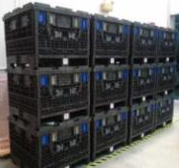
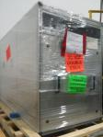
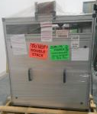
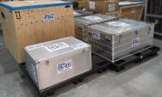
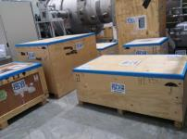
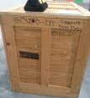
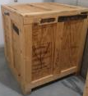
Mid-Station Y: In-Air or Bins/Crates/Walled Pallets With (WD) or Without (WOD) Desiccant
Electronics Cables
ISC and TCS Optical Tables
Input Optics (IO) Hardware
Pre-Stabilized Laser (PSL)
Viewport Hardware
LIGO-G1500720
Notes:
There are twelve (12) walled pallets for the cables to service thirty-one (31) electronics racks for SEI, SUS and ISC.
New optical tables and enclosures for TCS and ISC are in their original wooden-cardboard packaging.
Opto-mechanical hardware for IO is stored in various bins and the periscopes are stored in air on pallets. (*Note: optics/crystals are in the VPW.)
Viewport guards, including plexi-glass,are in original cardboard packaging and then consolidated to wooden crates for security and ease of movement. Fasteners, O-rings and gaskets are in bins: some of bins are inside crates.
The majority of PSL is in the original wooden shipping crates that came for Hanover. Cables have been consolidated to two (2) metal cases. There is a similar metal case for miscellaneous items. (*Note: optics/crystals are in the VPW.) The US-provided ISS PD array is in four (4) containers: two (2) wooden crates and two (2) cardboard boxes.

Slide 13
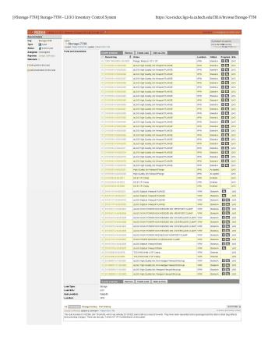
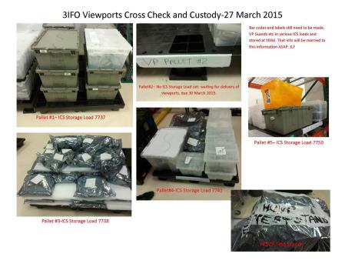
Organization and Management of 3IFO: Documentation
aLIGO Inventory Control System (ICS)
Provides the history of in-vacuum parts/assemblies
Storage Loads
Packing lists for kits
LIGO-G1500720

Slide 14
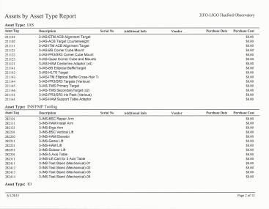
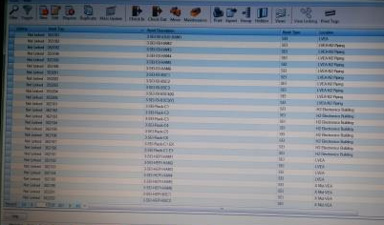
Organization and Management of 3IFO: Documentation continued
Long-Term Storage (LTS) Asset Management System (LAM)
Check-out/check-in capability
Barcodes for inspections and audits
BOM/Packing List for Out-Bound Shipment
LIGO-G1500720
NSF June 2015 Review

Slide 15
Monitoring of 3IFO: Eyes On
Weekly visits by LTS Manager: usually on maintenance day
Visits to major storage areas: brief general checklist
Are all expected bins and pallets in place?
Is there any evidence of tampering?
Special conditions =Special questions
LVEA
Qualitative check on nitrogen purge
Containers cool?
Does it sound like gas is flowing?
VPW
Dry boxes present and locked?
Check out system for borrowing mid-station key
No un-fettered access

Slide 16
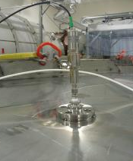
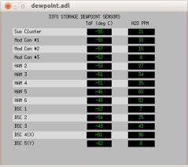
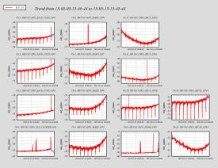
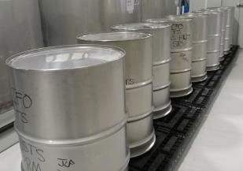
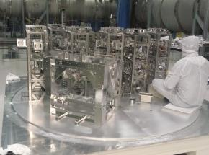
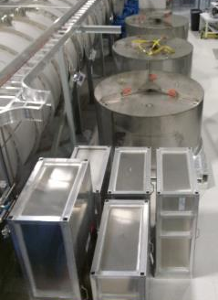
Monitoring of 3IFO: Probes and Sensors Nitrogen Purge
Large assemblies transferred from temporary to LTS containers
Containers have attached probes. Probe information is monitored in the control room on the Facility Management screens.
LIGO-G1500720
Empty temporary HAM Triple Suspension storage containers (9 units)
HAM Triple Suspensions being secured to a modified HAM ISI Storage Container
Modified HAM ISI Storage Containers (round) and Suspension Storage Containers (rectangle) in LVEA ready to attach to nitrogen piping

Slide 17
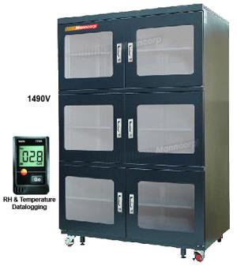
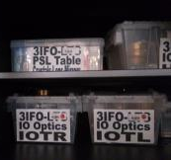
Monitoring of 3IFO: Probes and Sensors Relative Humidity
A number of LTS items require humidity control
Crystals
Tip tilts
Traditional solution: Desiccant cabinets
Require desiccant replacement
Technology of choice: Dry boxes
Four (4) dehumidifying motors per unit
Housed in the Clean and Bake facility (VPW) so that motor noise does not impact interferometer performance
Logging sensor within the unit
Very stable performance so far
0% relative humidity (RH) most of the time
Spikes in RH when door has been opened
Return to 0% RH within half an hour
LIGO-G1500720

Slide 18
Safeguarding and Securing 3IFO: Physical and Administrative Controls
Physical controls
Limited access
Special locks on mid-stations
Gatekeepers
Locked pallet rack
Key card access (Summer 2015)
Locked/Sealed containers
Tamper evident containers
Administrative control
Established procedure for removing items from storage
Specifies loan terms
Requires System Engineer and LTS Manager approval
LIGO-G1500720

Slide 19
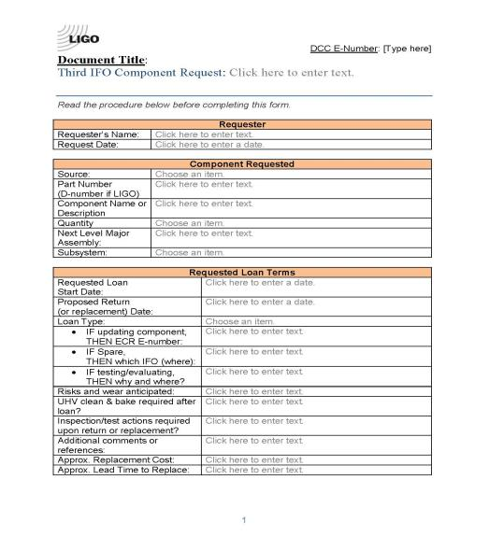
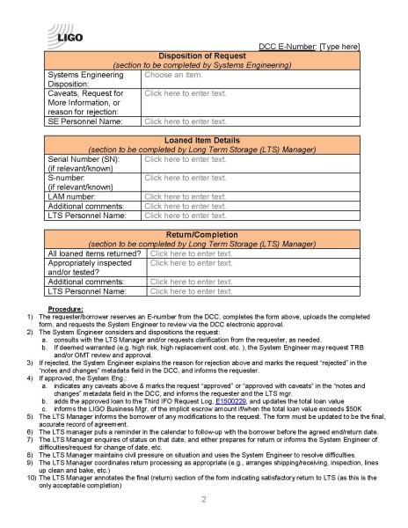
Safeguarding and Securing 3IFO: Administrative Control-Request Form

Slide 20
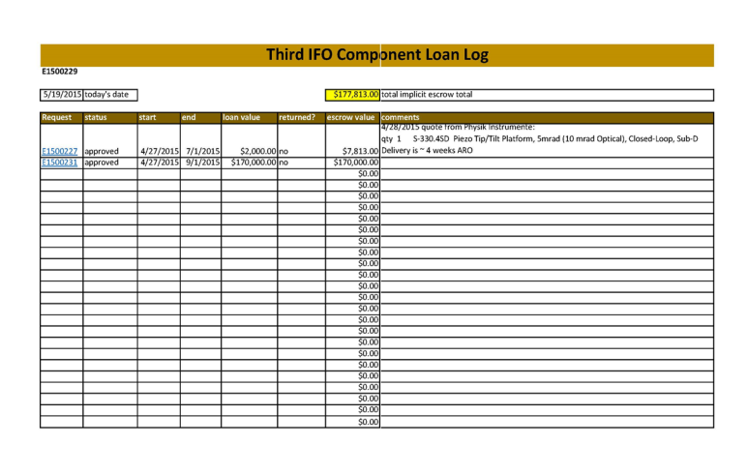
Safeguarding and Securing 3IFO: Administrative Control-3IFO Loan Log
LIGO-G1500720

