Slide 1
Status of LIGO
June 22, 2015
Daniel Sigg LIGO Hanford Observatory
(on behalf of the LIGO Scientific Collaboration)

Slide 2
Highlights
Robust Locking Achieved
Livingston Observatory: First lock on May 27, 2014
Hanford Observatory: First lock on February 7, 2015
Sensitivity of initial detectors surpassed quickly
Current inspiral range: 50 to 70 Mpc
ER7 completed
40 hours of coincident data
Preparing for O1: September to December
Issues:
High Q Resonances and Uncontrolled DOFs
ESD Charging Issues
Parametric Instabilities

Slide 3
Progress

Slide 4
Preliminary

Slide 5
L1 Noise Model
Scattered light noise

Slide 6
Locking
Full Lock
Switching to Nominal Sensors &
Adjusting operating point
DRMI 3f
Intensity Power [W]
Arm Length Stabilization
Refl.
Power [W]
Refl.
Locking
Time [s]

Slide 7
7th Engineering Run
May 16 to June 14, 2015
First coincidence data between L1 and H1
Test of the analysis pipeline
H1 110 hours, L1 74 hours, 42 hours of coincidence (as of June 11)
Successfully completed
Calibrated strain readout
Sufficient automation to be controllable by operators
Hardware injections Blind Injections Implementation and Testing
Approximately 7 days of data taking

Slide 8
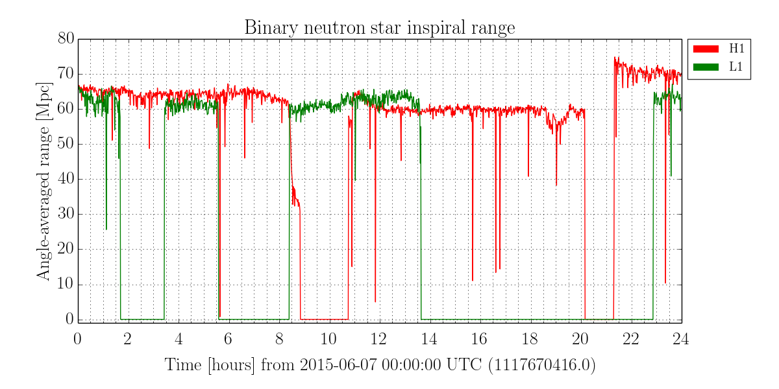
Binary Neutron Star Range (SNR 8, 1.4M☉, sky average)

Slide 9
ER7 Segments (24 hours)

Slide 10
Parametric Instabilities
Evans et al., Phys. Rev. Lett. 114, 161102 (2015)

Slide 11
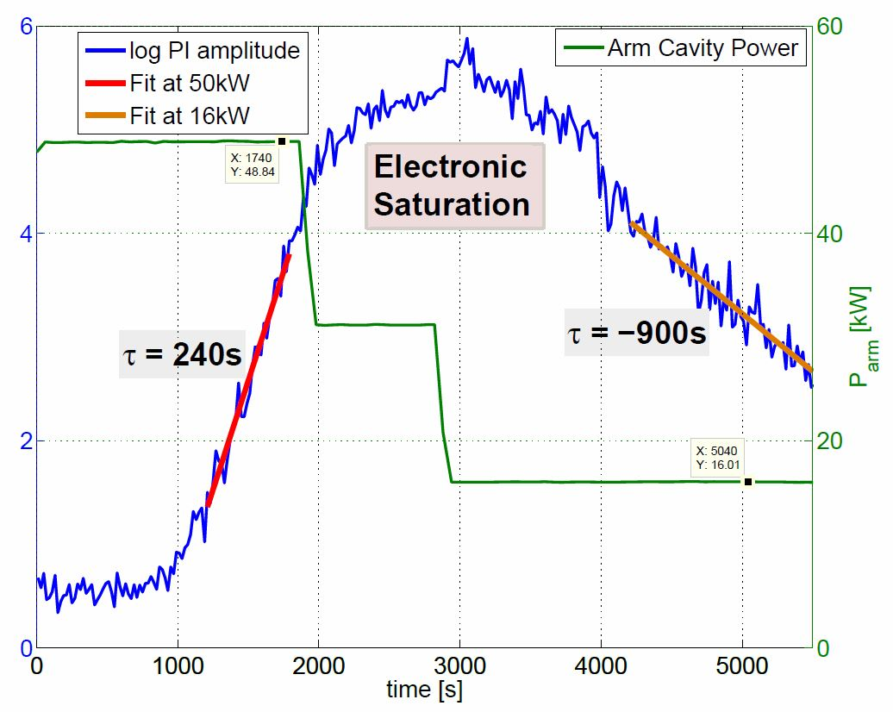
Parametric Instabilities (3)
Mechanical Optical

Slide 12
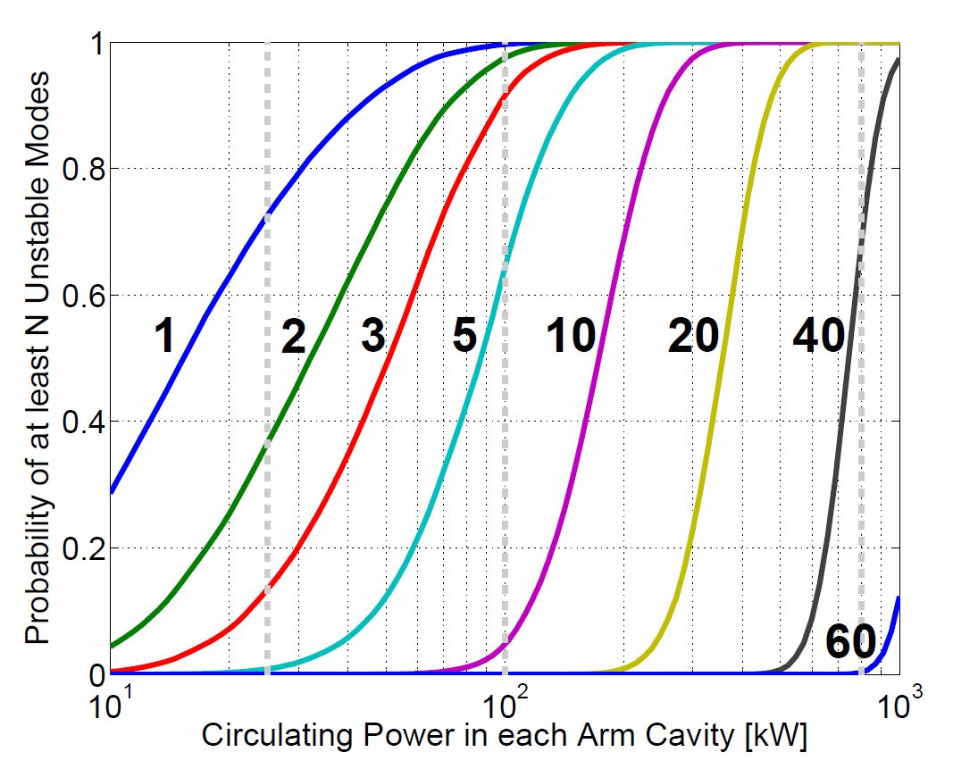
Parametric Instabilities (2)
Number of Unstable Modes Depends on ROC
Thermal control of ROC can work for small N

Slide 13
High Power Operations
With 25W input power
No significant thermal loading
Parametric instabilities mitigated with ETM ring heater
Angular instabilities under control
At higher powers
Hartmann wavefront sensors to map ITMs
Ring heaters for ITMs and ETMs
CO₂ laser heating for ITM compensation plates
Active damping control for parametric instabilities
Testing a passive mode damper (shunted piezo-electric transducer)
Angular instabilities require more control bandwidth (induces noise)

Slide 14
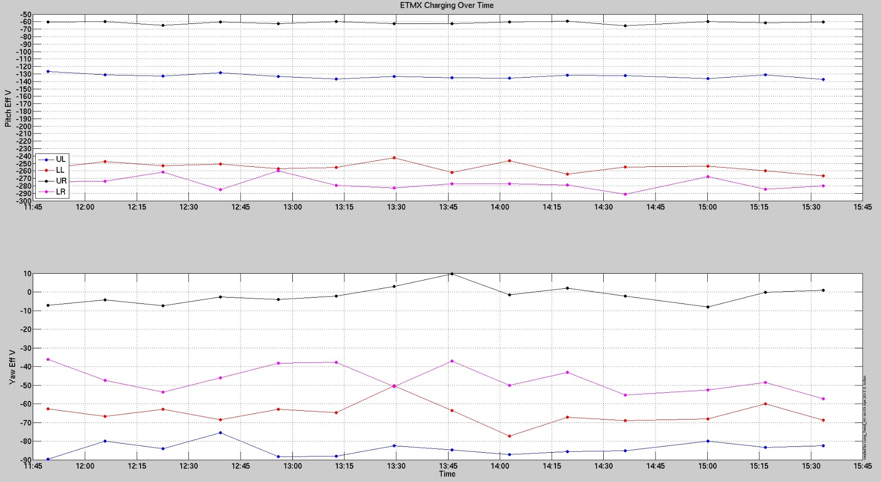
Electro Static Drive
100V
Discharging
300V
Ion Pumps
60V
130V
300V
4 hours
0V
50V
90V

Slide 15
Electro Static Drive (2)
Why so much charge? Can be 100s of Volts
First contact leaves a charge behind
Charge variation appears to be caused by ultraviolet light emitted by ion pumps mounted at the test mass chambers (recharging)
Additional Noise and Uncertainty
Field lines must terminate somewhere (e.g. ring heater)
Drive strength depends on charge, adds a linear term
Charge is not uniform and varying
In-vacuum ion injecting did not fix the problem
Hard to reach the back surface
In-air, in-situ neutralization procedure
Test mass stays discharged (without an ion pump)

Slide 16
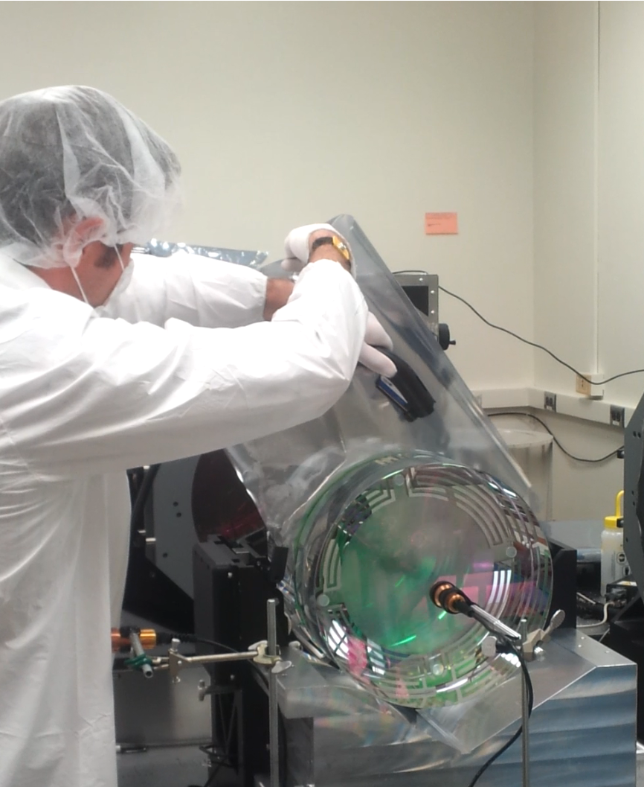
Test Mass Discharging

Slide 17
Summary
Sensitivity of initial detectors surpassed quickly
Robust locking achieved
Parametric instabilities are real; need to be dealt with
Test mass charge is a problem
Discharging effort underway
Looking forward to the first observing run
What’s left?
High power operations: thermal control, PI, alignment instability
Low frequency noise hunting & controls optimization
Make the seismic system work during bad weather
Damping of high Q modes

Slide 18
