Slide 1
aLIGO CDS Pros and Cons
GWADW Conference
May 20, 2015
R. Bork
LIGO-G1500693-v1
2015 May 20

Slide 2
CDS Architectural Overview

Slide 3
Pros of CDS System
Modular, common design, hardware and software
Scalable
Standalone, ‘DAQ in the Box’
Fully distributed system with inclusion of real-time networks
Hardware makes use of commercially available and supported equipment as much as possible
Beckhoff industrial controls for ‘slow’ control systems
Standard server class computers and PCIe I/O system
Software leverages off of iLIGO developments and software available from other sources, such as EPICS tools.
Set of common software tools for use by controls engineers and scientists to develop control algorithms
Real-time Code Generator (RCG) and Guardian

Slide 4
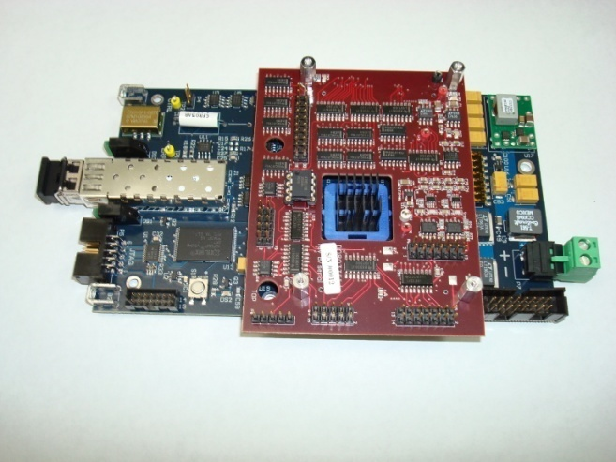
Timing Distribution System (TDS)
Pros
Central distribution point
Auto length correction
GPS time (seconds)
Used to synchronize both CDS I/O and various RF sources
Modular and expandable
Cons
Would like to have a PCIe version of the timing slave units
Turn clocks on/off on initialization and read time w/o need for extra cards
IRIG-B Timing Fanout
Provides accurate time information to computers.
Timing Slave provides accurate clocks
At 65536Hz to ADC/DAC modules.

Slide 5
CDS I/O Chassis
Pros:
Standard design
Allows I/O to be separated from the computer and remotely located with electronics
Cons
DC power supplies noisy
Being replaced
Contains fans
Conductively cooled versions of PCIe cards now available
Requires special electrical to fiber to electrical (EFE) links, ordered to length
Expensive and custom
New systems now available with simple fiber pair and length up to 10km
PCIe Uplink
I/O Timing Bus
Timing Slave
Fiber Link to Computer
17 Slot PCIe Bus

Slide 6
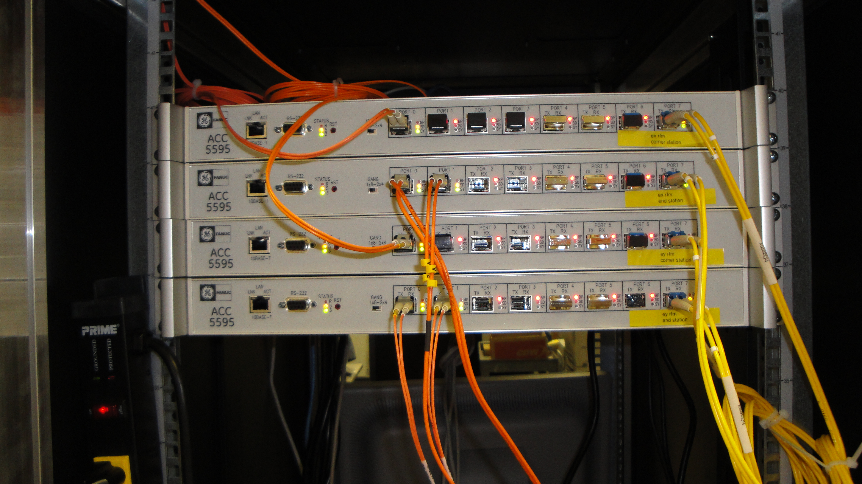
CDS Computing and Networking Equipment
Pros:
All equipment is Commercial Off-The-Shelf (COTS)
Computers can be readily replaced with later technologies, as needed
Standard Ethernet used for DAQ and supervisory control
Real-time networks highly deterministic
Cons:
RFM network used between end/corner stations has slower than desired I/O read/write times.
Standard Real-time Control / DAQ Computer
Reflective Memory Real-time Network
PCIe Real-time Network

Slide 7
CDS Software
Pros
Designed as common tool set with standard interfaces
DAQ software
Stand-alone to fully distributed
Network Data Server (NDS1 and NDS2)
Client libraries to support C/C++, python and Matlab
Many Diagnostic tools
DTT, awgstream, Dataviewer, etc.
Remote Data Access
Via NDS2 and MEDM web access
Real-time Code Generator (RCG)
Custom patch to GPL Linux to provide real-time capabilities
Saved >$200K/year in licensing fees

Slide 8
RCG Example Quad Suspension (Top Level)

Slide 9
Quad Suspension Control Model (Level 2, Partial View)

Slide 10
CDS Standard Filter Module With Diagnostics
AWG Input
DAQ System

Slide 11
Built-in Support for New Features
RCG accepts user provided C code modules (Fast/Sync)
Code must run within the real-time code time constraints
Can be turned into RCG supported parts
NDS / EPICS channel access client software to access control settings and diagnostics information. (Slow/Asynchronous)
Support for C/C++, Python, Matlab
Scheduled control (Slow to Fast/Synchronous)
User task running on a real-time computer
Could be expanded to run on a separate computer via a real-time data link

Slide 12
RCG Cons
Asynchronous communications between supervisory (EPICS) layer and real-time applications.
Not found to be a particular problem to date, but various synchronization schemes are being explored, as time permits.
Exposes a lot of control settings, adding to overall complexity from the operations perspective.
Over 100,000 settings in aLIGO
Added SDF to monitor channels which should not change on a regular basis
No built-in ‘control intelligence’ provided
Can we add some standard adaptive filtering algorithms?

Slide 13
Overall Assessment
Not without growing pains, but hardware/software systems seem reliable and robust.
Early deployment a big plus
Users could become accustomed to the tools early
Controls developed for early stand-alone SUS/SEI prototyping and test systems could be applied directly in the final aLIGO control system.
CDS software developers were provided with plenty of feedback on problems, new feature requests at an early stage.
Ready for O1

