Slide 1
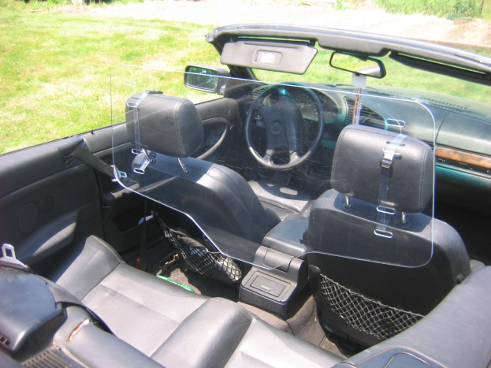
Making LIGO wind-resistant
Krishna Venkateswara
Borrowing from J. Kissel, B. Lantz, L. Barsotti, S. Dwyer, R. Schofield, D. Talukder, G. Vajente, M. Vidrio, B. Shapiro, J. Warner
for the SEI, PEM and ISC teams
05/20/2015
LIGO-G1500684-v1

Slide 2
Contents
Introduction: Wind-speed data
Effects of wind on ground motion
Effects of wind on the interferometer
Path forward

Slide 3
It sure is windy at Hanford!
8 year study shows that wind is above 20 [mph] for 15% of the year
(LHO aLOG 12996)
Wind Speed [mph]
>4.5 >13.4 >22.4 >31.3 >40.3 >49.2 > 58.2
M. Vidrio
>8.9 >17.9 >26.8 >35.8 >44.7 >53.7 >62.6

Slide 4
Wind speed variation - monthly
M. Vidrio

Slide 5
Wind speed variation - daily
M. Vidrio

Slide 6
Impact of Wind on Ground Motion

Slide 7
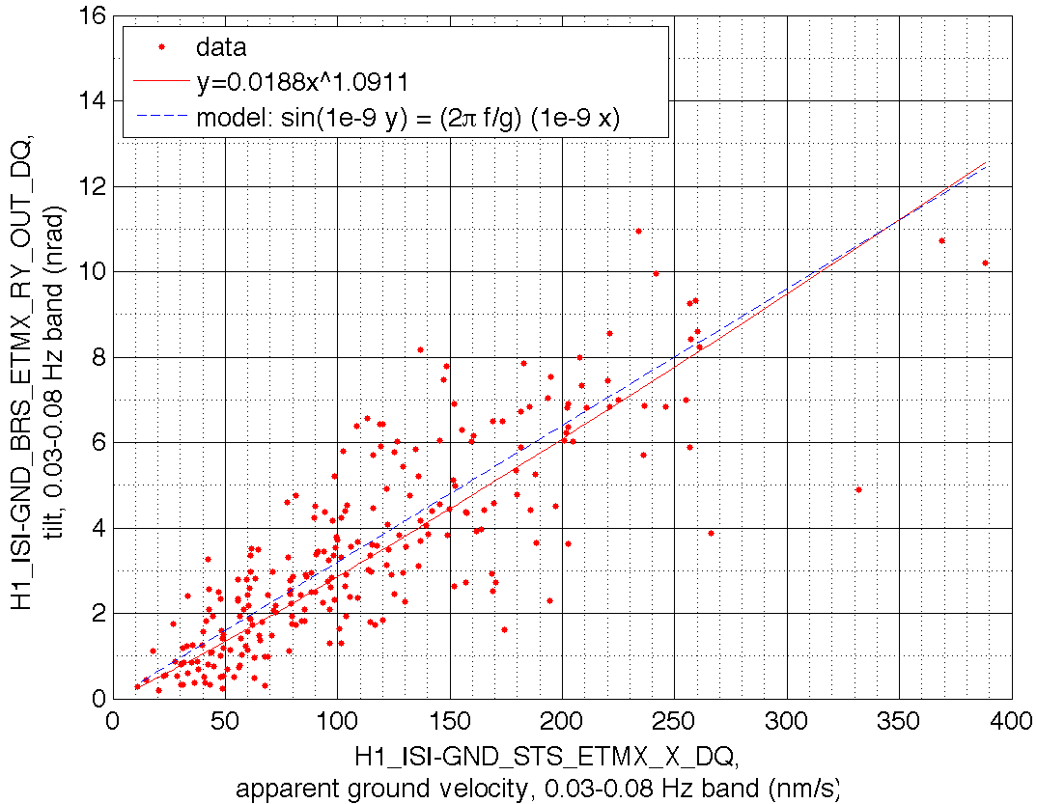
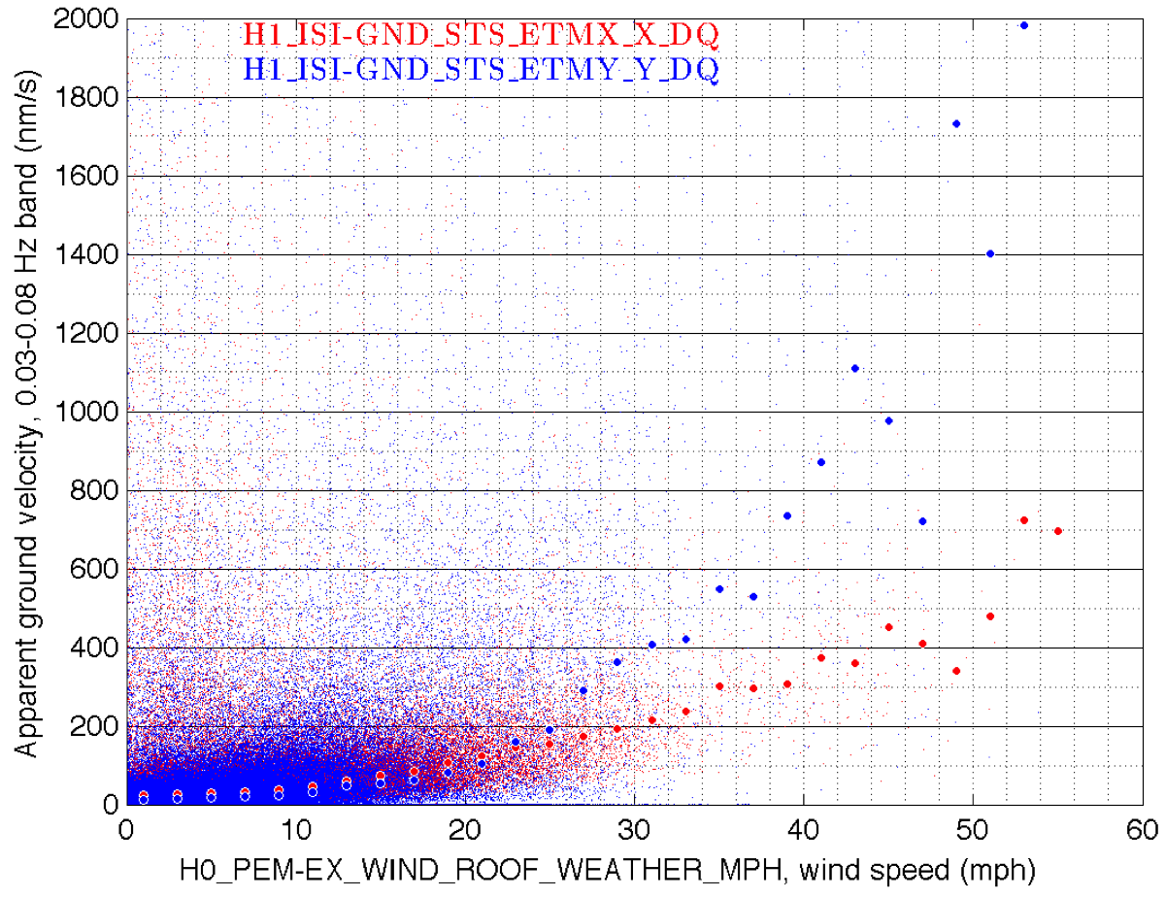
Effect on Ground Motion
4-month study (performed with data from late 2014), EY Y experiences more tilt than at EX X (LHO aLOG 17574), likely because prevailing winds are along the Y direction.
Data for one wind storm
Data over whole 4 months
BRS comparison with GND T240 at EX shows assuming 30 to 80 [mHz] band is “all” tilt in a GND inertial sensor is a safe assumption
Median points show clear factor of 2-3 more tilt from > 30 [mph] winds in EY than at EX
D. Talukder

Slide 8
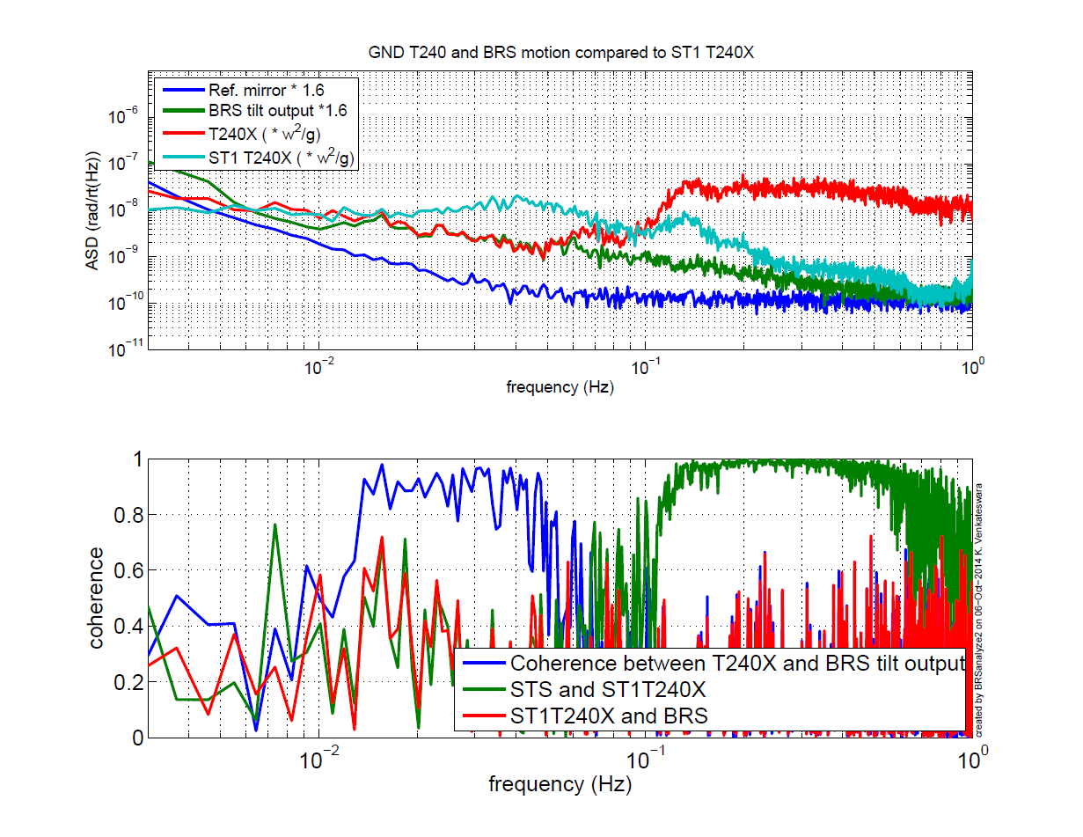
Ground tilt during 0-5 mph winds
Requirement
Ref: LHO 14322

Slide 9
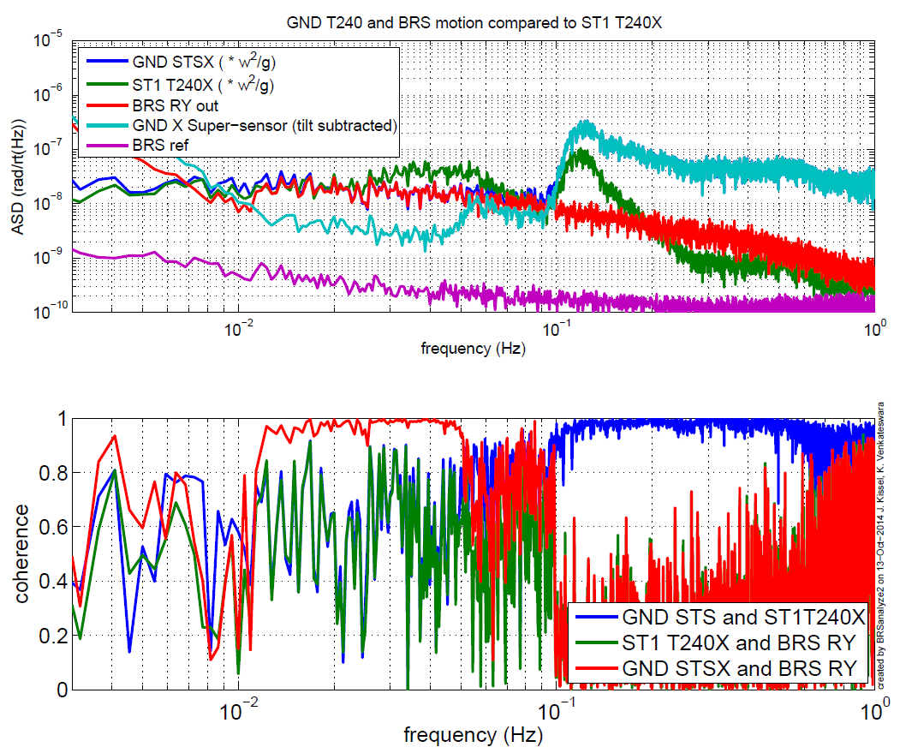
Ground tilt during 20-30 mph winds
Ref: LHO 14422

Slide 10
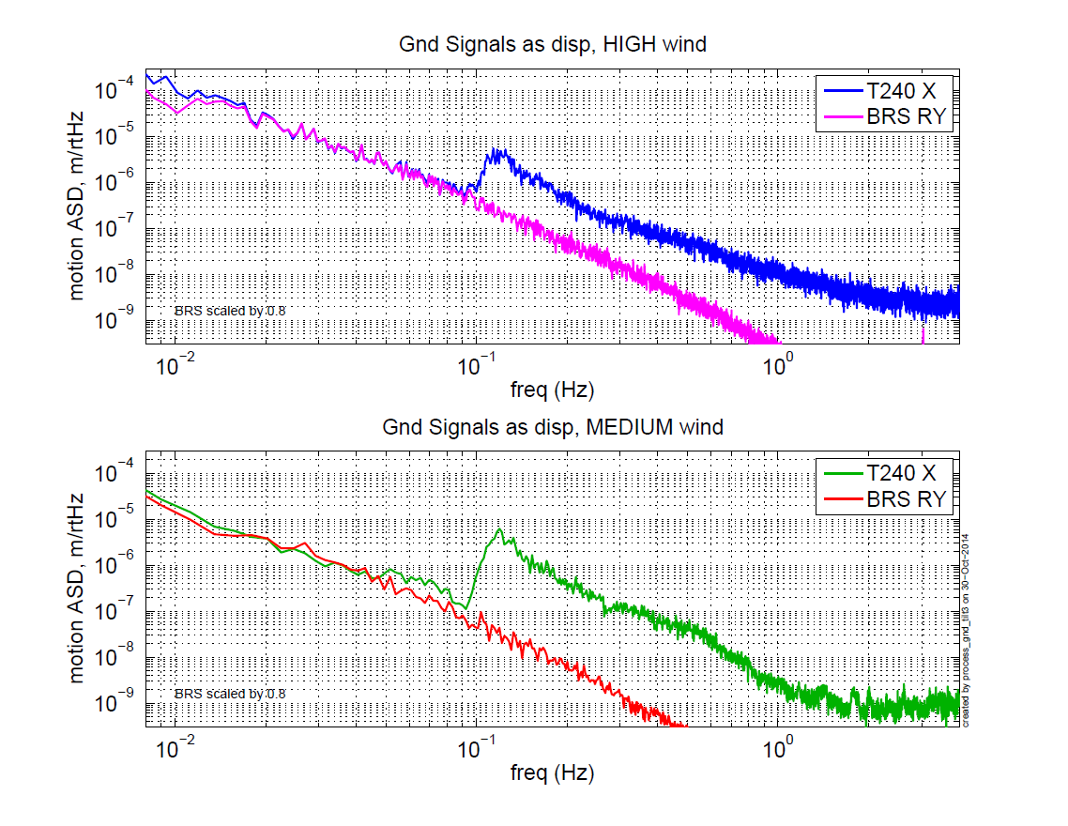
Ground tilt during 20-30 mph winds
Ref: SEI 602, thanks to B. Lantz!

Slide 11
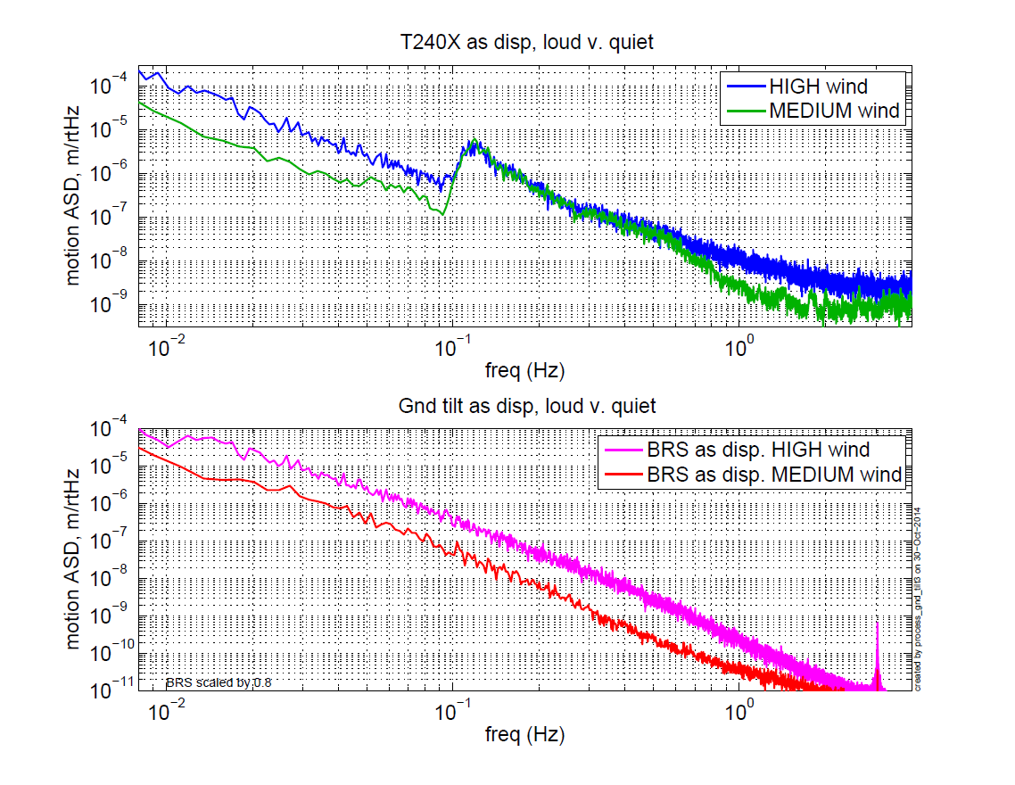
Ground tilt during 20-30 mph winds
Ref: SEI 602, thanks to B. Lantz!

Slide 12
Tilt to translation TF
Ref: SEI 602, thanks to B. Lantz!

Slide 13
Impact of Wind on Interferometer

Slide 14
Ref: LHO 15146
Platform Motion

Slide 15
Ref: LHO 15146
Platform Motion
Net Stage 1 Inertial Motion (45 mHz blend)
Tilt re-injection
Blends: Trade-off between isolation at f>0.1 Hz and re-injection at f< 0.1 Hz

Slide 16
Wind Substantially Impacts the Observatory and the Detector
Wind above even 5 [mph] has an impact on the sensitivity (LHO aLOG 17446)
Wind surpasses 5 [mph]
Range becomes visibly correlated with wind
S. Dwyer

Slide 17
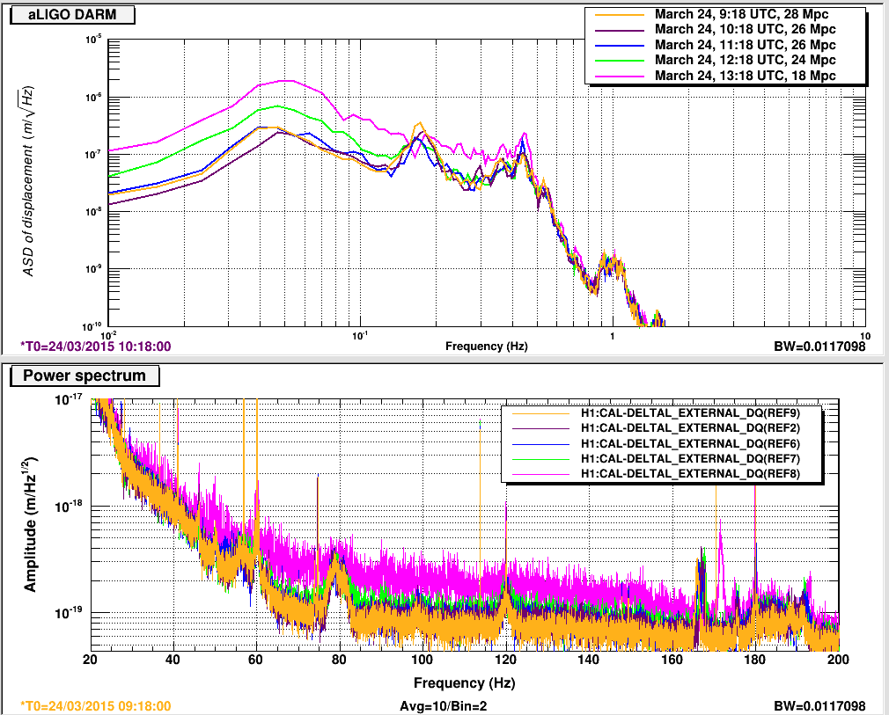
Wind Substantially Impacts the Observatory and the Detector
Comparison of hourly progression of ASDs at low frequency shows how low frequency motion up-converts into the bucket.
(LHO aLOGs 17460)
Note: Calibration a below
1 [Hz] is inaccurate.
ASD is too good by ~10 at 0.1 [Hz], and by ~100 at 0.02 [Hz] (see LHO aLOG 17708)
“1e-6” [m]
“1e-7” [m]
“1e-8” [m]
0.1 [Hz]
1 [Hz]
1e-17
1e-18
1e-19
L. Barsotti

Slide 18
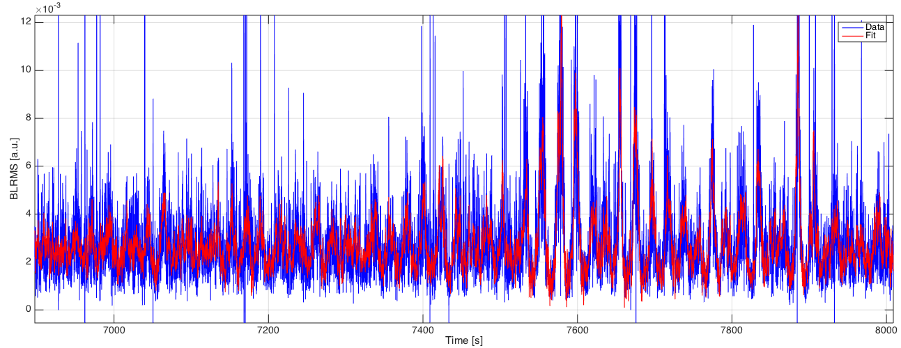
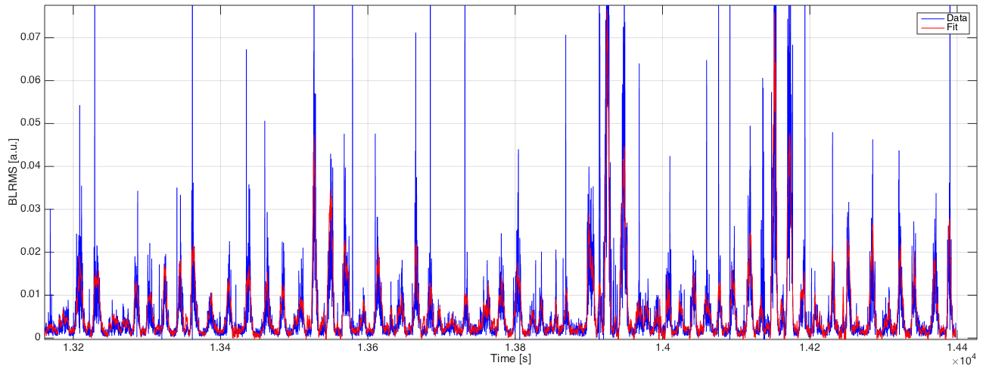
Wind Substantially Impacts the Observatory and the Detector
Wind greatly affects the alignment, and therfore the stationarity of the performance (LHO aLOG 17461)
0.012
Low Wind Conditions
0.010
0.010
0.008
0.006
0.004
BLRMS Time Series
Portion of BLRMS
Time Series that’s predicted by coherent TF with WFS
0.002
100-200 [Hz] Band-limited RMS of DARM
[Uncalibrated Arbitrary Units]
0.07
High Wind Conditions
0.06
0.05
0.04
0.03
0.02
0.010
0.01
~ 30 [min]
G. Vajente

Slide 19
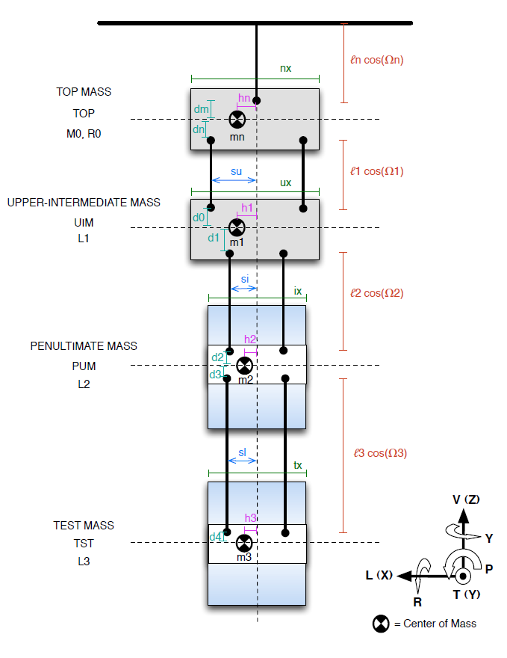
Mechanism of Increased Alignment Fluctuation?
Was mainly in ‘Yaw’
(LHO aLOG 17461)
Longitudinal to Yaw?
Transverse to Yaw?
Others?
See Anamaria’s talk yesterday: G1500676
B. Shapiro

Slide 20
Path forward

Slide 21
Simulate Wind?
We have reasonable idea of what wind does to the ISI – it increases Longitudinal, Transverse motion ~ 100s of nanometers
Pitch, Roll ~ few nanoradians
Perform tests by injecting these motions on BSC-ISIs (or on HEPI?), individually, and see how DARM/lock acquisition is affected. This gives an idea of which coupling is the most important.
Additionally, perform tests by switching between 45 and 90 mHz blends (during low wind-speeds) and see how DARM is affected. This gives an idea of how much seismic isolation is needed below 0.5 Hz.

Slide 22
Use Tiltmeters to improve ISI?
The ISI can perform better with BRSs in medium wind, 10-20 [mph]
(LHO aLOG 17729)
Order of magnitude less RMS motion
Sacrifice only 2-3 here
Windy Config
Same at QUAD Resonances and above
Nominal Config
J. Kissel

Slide 23
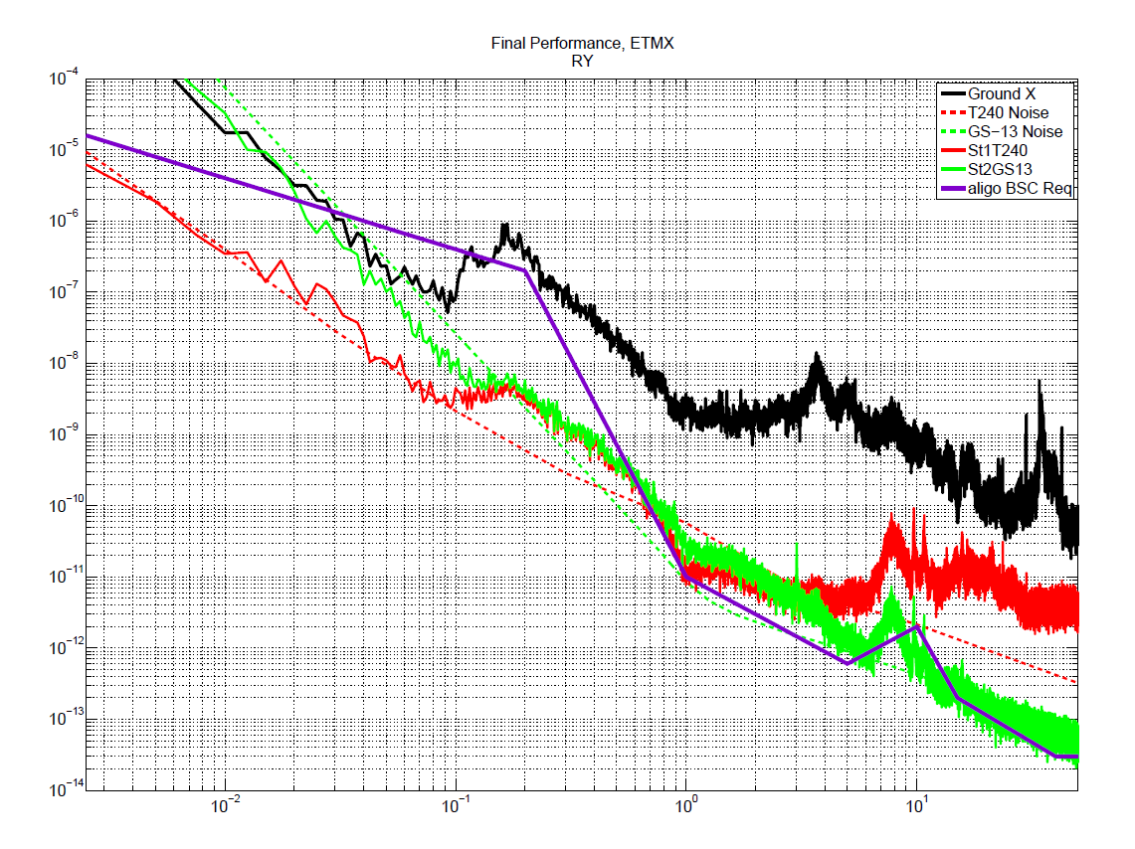
Put a tiltmeter on the ISI?
Angle ASD (rad/rt(Hz))
Present BRS read out noise
Compact BRS?
Ref: LHO 17197
Frequency (Hz)

Slide 24
Thank you!

Slide 25
Backup slides

Slide 26
Wind speed impact
Beaufort Scale* | Wind Speed | Land conditions
2 | 3.4–7.4 mph | Wind felt on exposed skin. Leaves rustle. Wind vanes begin to move.
4 | 12.2–17.9 mph | Dust and loose paper raised. Small branches begin to move.
6 | 24.1–31 mph | Large branches in motion. Whistling heard in overhead wires. Umbrella use becomes difficult. Empty plastic bins tip over.
8 | 38.4–46.3 mph | Some twigs broken from trees. Cars veer on road. Progress on foot is seriously impeded.
10 | 54.8–63.6 mph | Trees are broken off or uprooted, structural damage likely.
>73 mph is considered a Hurricane!
*The Beaufort scale is an empirical measure that relates wind speed to observed conditions at sea or on land. - Wikipedia

Slide 27
Effect on Ground Motion
Also in LHO aLOG 17574: Different wind storms can have differing effects at each end station, likely due to wind direction
D. Talukder

Slide 28
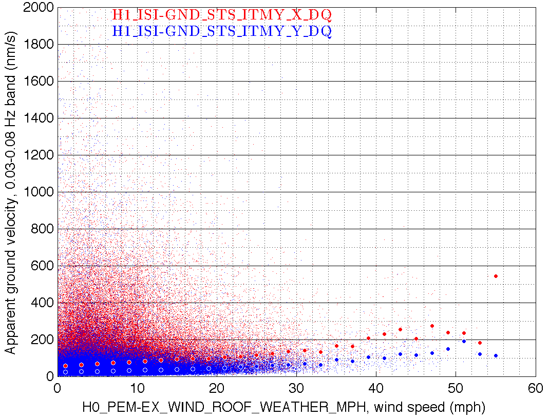
Effect on Ground Motion
Also in LHO aLOG 17574: Corner Station doesn’t tilt as much in the wind. (but this sensor was known to have problems, so is not very reliable. see LHO aLOG 18422)
End Stations
Corner Station
D. Talukder

