Slide 1
State observers and Kalman filtering
High performance vibration isolation systems
Prof.dr. J.F.J. van den Brand
GWADW, May 19, 2015
jo@nikhef.nl

Slide 2
Multi-stage attenuation systems
Bench low frequency control
Mark Beker
Paper, see:
http://www.nikhef.nl/pub/services/biblio
/theses_pdf/thesis_M_G_Beker.pdf
Vertical DOF

Slide 3
LISA
Least squares
Minimizes the sum of squares of the errors
Has no “knowledge” of the system
Wiener filter
x[n] = s[n] + w[n] -> “estimate s[n] so as to minimize the error”
Stationary processes – The statistical properties of the inputs don’t change in t
Causal, length grows, (generally) non-recursive
For discrete samples reduces to least squares solution
Kalman filter
Wiener vs Kalman filtering
! ["]
2
1
3 4 5
"
!ˆ[5]
http://www.ws.binghamton.edu/fowler/fowler%20personal%20page/EE522_ﬁles/EECE%205
Generalization for Wiener filter to non-stationary processes – The signal is
characterized by a dynamical model
Recursive – don’t need to re-evaluate all data at each step
Uses prior knowledge of the system
System is described by state vector x (unobservable)
State can be estimated based on ẍ previous data z and model
Requires a dynamic (state space) model

Slide 4
Finite element models used to identify all modes
of the system
1.6 Hz
Eric Hennes
4
IP leg modes
Where needed passive eddy current dampers can be used to lower Q-factor of higher order resonances

Slide 5
Finite element model: Higher order modes
84 Hz
252 Hz
Non-rigid leg modes
Higher order GAS modes
357 Hz
340 Hz

Slide 6
Simulated performance
Vertical transfer function

Slide 7
Simulated performance
Horizontal transfer function
Vertical to horizontal coupling will dominate performance above 10 Hz

Slide 8
Simulated performance
Horizontal to tilt coupling

Slide 9
LISA
Optimal control: state observer
State space model
Imperative to have an accurate model
FEA
Detailed description of the system
Tune model to measured transfer functions

Slide 10
Advanced Virgo
Questions?

Slide 11
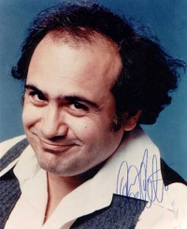
System identification with bayes theorem and non gaussian distributions
We will take each single bit of information
G. Cella
If it does not cost too much!

Slide 12
Three basic rules
Law of total probability
Bayes’ theorem
The product of two (multivariate) gaussian distributions is proportional to a (multivariate) gaussian distributions:

Slide 13
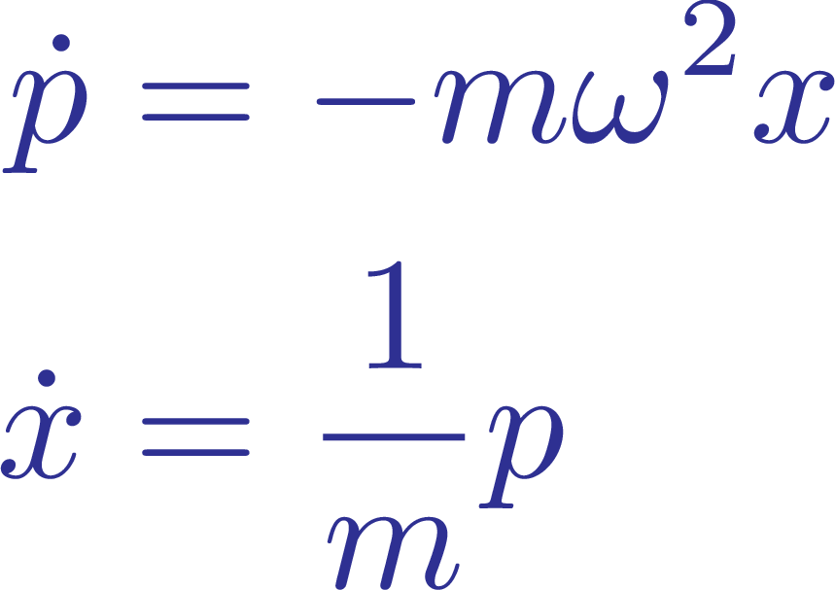
A simple example: a suspension (pendulum) with uncertain length
Description in the phase space:
We measure the state (position and velocity). Maybe with some measurement error.
We enlarge the space, adding the unknown parameter
We model our ignorance with a joint probability distribution
We assume we have a good model…
…which can be used to calculate the time evolution (RULE 1 at work)

Slide 14
A simple example: a suspension (pendulum) with uncertain length
Description in the phase space:
We measure the state (position and velocity). Maybe with some measurement error.
We enlarge the space, adding the unknown parameter
We model our ignorance with a joint probability distribution
We assume we have a good model…
…which can be used to calculate the time evolution (RULE 1 at work)

Slide 15
A simple example: a suspension (pendulum) with uncertain length
Description in the phase space:
We measure the state (position and velocity). Maybe with some measurement error.
We enlarge the space, adding the unknown parameter
We model our ignorance with a joint probability distribution
We assume we have a good model…
…which can be used to calculate the time evolution (RULE 1 at work)

Slide 16
A simple example: a suspension (pendulum) with uncertain length
Description in the phase space:
We measure the state (position and velocity). Maybe with some measurement error.
We enlarge the space, adding the unknown parameter
We model our ignorance with a joint probability distribution
We assume we have a good model…
…which can be used to calculate the time evolution (RULE 1 at work)

Slide 17
A simple example: a suspension (pendulum) with uncertain length
Description in the phase space:
We measure the state (position and velocity). Maybe with some measurement error.
We enlarge the space, adding the unknown parameter
We model our ignorance with a joint probability distribution
We assume we have a good model…
…which can be used to calculate the time evolution (RULE 1 at work)

Slide 18
A simple example: a suspension (pendulum) with uncertain length
This is no more a gaussian distribution (in general). How to parameterize it?
Each horizontal line is a gaussian distribution
Gaussian misture can be a good representation:
Now, we measure the position and the velocity again, and we use RULE 2 and RULE 3

Slide 19
A simple example: a suspension (pendulum) with uncertain length
This is no more a gaussian distribution (in general). How to parameterize it?
Each horizontal line is a gaussian distribution
Gaussian misture can be a good representation:
Now, we measure the position and the velocity again, and we use RULE 2 and RULE 3

Slide 20
This could have several applications
Tracking the Pound Drever signal
Identify optical parameters
Improve locking
Systems with nonlinear dynamics
Radiation pressure
Adjusting noise models:
Selection strategy needed
Elements with low weight must be removed
Gaussian misture not necessarily a good representation in all cases

Slide 21
Suspension Parameter Estimation for State Space Models Brett Shapiro GWADW – 19 May 2015

Slide 22
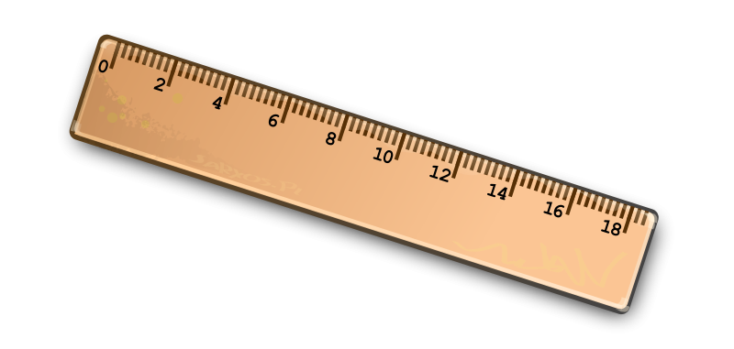
State space from physical values
Energy methods convert
parameters to matrices
Gradient of potential energy
Gradient of kinetic energy
See T020205
MATLAB
Inertia
Stiffness
Length
Notes:
The state space models are parameterized by the physical values, such as mass, stiffness, and length. A Mathematica script solves the state space matrices in terms of these parameters using energy the gradients of the suspension kinetic and potential energy.
Since most of our analysis tools are in actually in MATLAB, that solution is then exported to MATLAB, along a with a parameter file listing listing all the parameter values. Finally, a script in MATLAB produces the actual state space model.

Slide 23
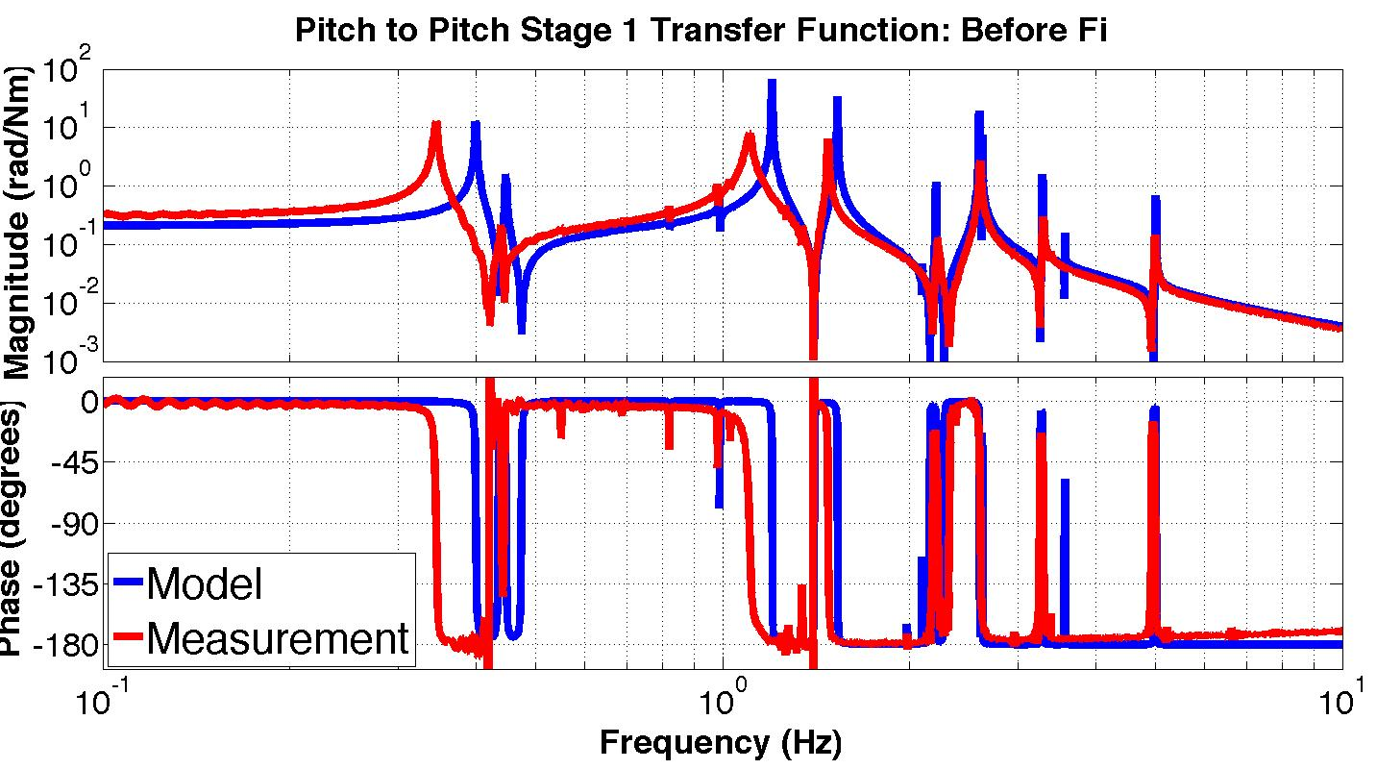
Parameter Estimation Algorithm
J = Jacobian matrix of error gradients wrt parameters
e = % error between modeled and measured resonant frequencies
p = parameter value (mass, stiffness, length, etc)
Mismatch between model and measurement
Notes:
Once the state space model is in MATLAB, we still have to fit the parameter values to the measured data. Critical to this fitting algorithm is the Jacobian matrix. This matrix is just a list of the gradients of the model error with respect to the model parameters like mass and stiffness. As before the errors are given by the resonant frequencies.
The gradients are calculated numerical, simply by moving each parameter a small amount and measuring how much the error changes.

Slide 24
Parameter Estimation Algorithm
J = Jacobian matrix of error gradients wrt parameters
e = % error between modeled and measured resonant frequencies
p = parameter value (mass, stiffness, length, etc)
Gauss-Newton algorithm – an modification of Newton’s method (2nd order)
Update the parameter list, p, with step size α
Update the descent direction d with the psuedo-inverse of J.
References: T1000458 and “Selection of Important Parameters Using Uncertainty and Sensitivity Analysis”, Shapiro et al.
Notes:
Once we have the Jacobian, we can apply a fitting algorithm. The suspensions use a Gauss-Newton algorithm, which is an approximation of Newton’s method.
In this method, the descent direction is given by the psuedoinverse of the Jacobian matrix. For reference, gradient descent would be the same except it would use the transpose.

Slide 25
Before Parameter Estimation
Notes:
So using this algorithm, we can adjust update the model that so it goes from one a mismatch like this…

Slide 26
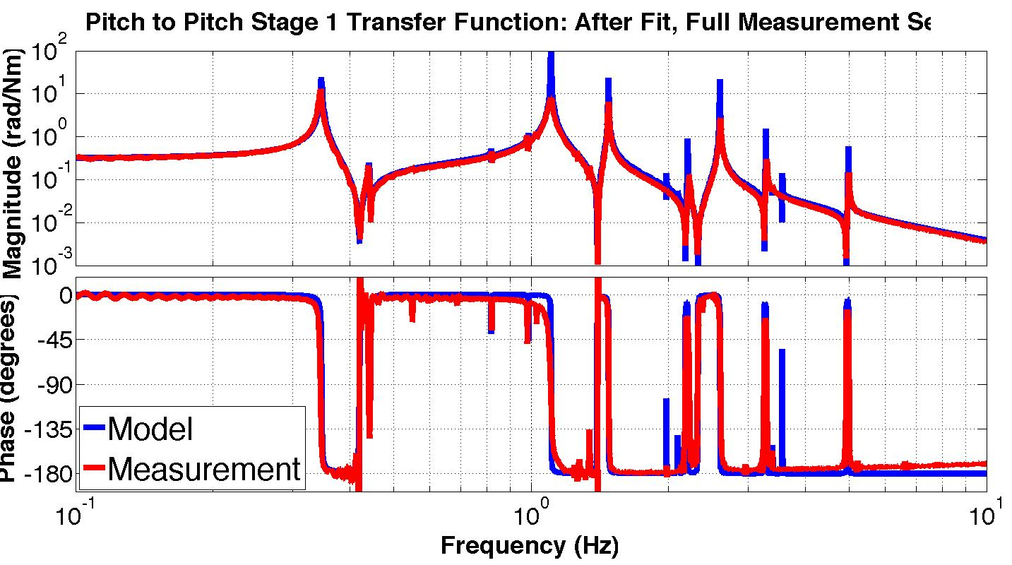
After Parameter Estimation
Notes:
To one like this.

